Slide 1
EUMETSAT NEWS
Marianne König
marianne.koenig@eumetsat.int
www.eumetsat.int

Slide 2
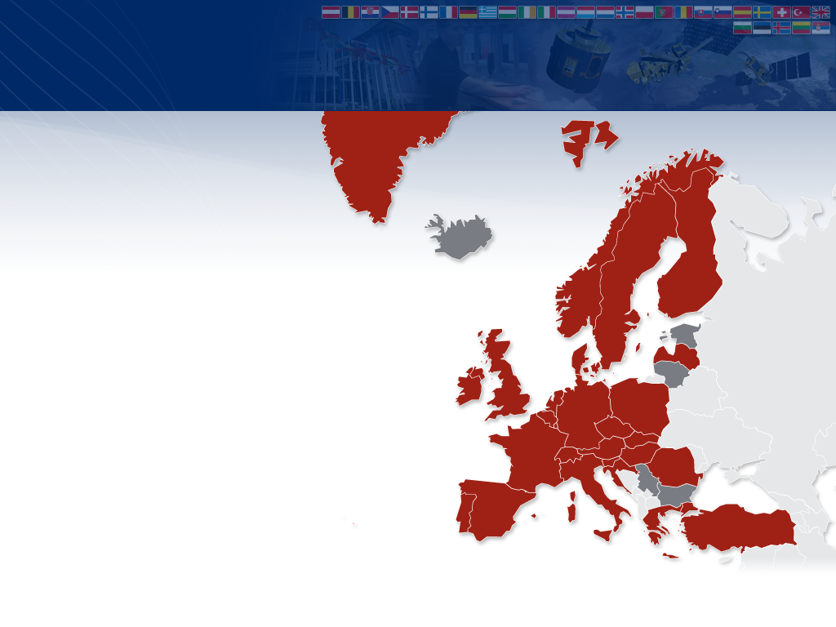


26 Member States & 5 Cooperating States *
Member States
AUSTRIA
BELGIUM
CROATIA
CZECH REPUBLIC
DENMARK
FINLAND
FRANCE
GERMANY
GREECE
HUNGARY
IRELAND
ITALY
LATVIA
LUXEMBOURG
NETHERLANDS
NORWAY
POLAND
PORTUGAL
ROMANIA*
SLOVAK REPUBLIC
SLOVENIA
SPAIN
SWEDEN
SWITZERLAND
TURKEY
UNITED KINGDOM
Cooperating States
* Pending full ratification
BULGARIA
ESTONIA
ICELAND
LITHUANIA
SERBIA
Slide: 2
MUG 2010

Slide 3
EUMETSAT Space Segment
30
…
00
01
02
03
04
05
06
07
08
09
10
11
12
13
14
15
16
17
18
19
20
21
22
23
24
25
26
27
28
29
METEOSAT FIRST GENERATION
METEOSAT-6
METEOSAT-7
METEOSAT SECOND GENERATION
METEOSAT-8
METEOSAT-9
METEOSAT-10
METEOSAT-11
METEOSAT THIRD GENERATION
EUMETSAT POLAR SYSTEM
METOP-A
METOP-B
METOP-C
POST-EPS
OCEAN SURFACE TOPOGRAPHY MISSION
JASON-2
JASON-3
JASON FOLLOW-ON
THIRD PARTY PROGRAMMES
GMES SENTINEL-3A/B
GMES SENTINEL-4
GMES SENTINEL-5

Slide 4
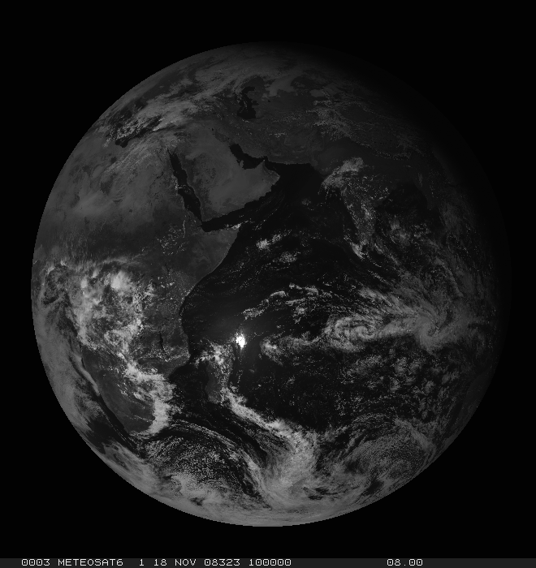
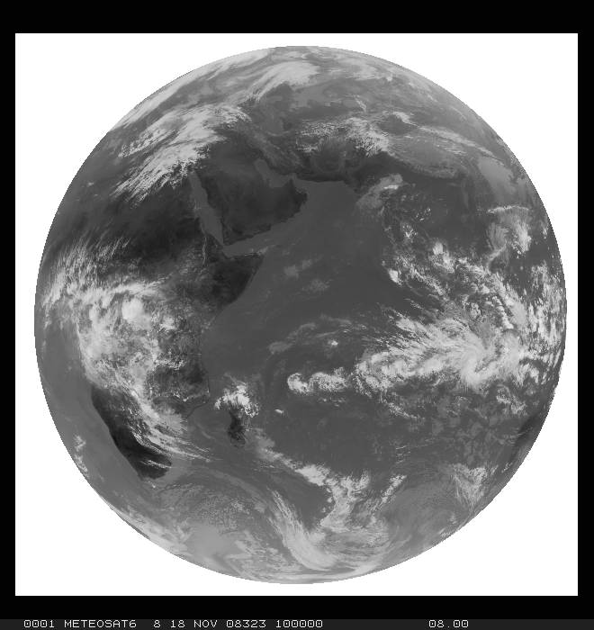
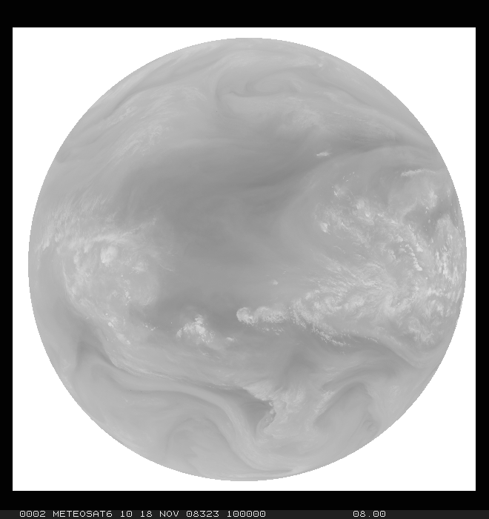
Meteosat First Generation
Operational imager mission over the Indian Ocean since 1998
3-channel radiometer (VIS, IR, WV), image repeat cycle 30 minutes

Slide 5
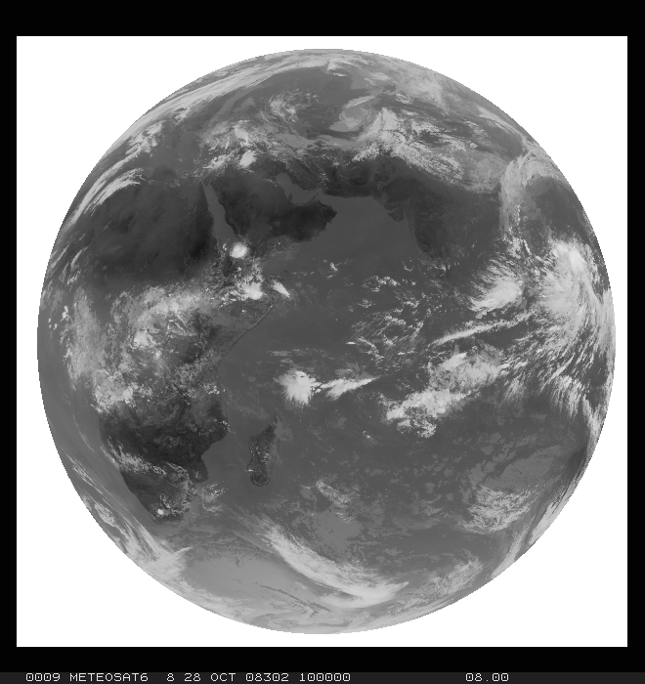


Meteosat-6: An Interesting Case
Radiometric Anomaly needs correction through cross-calibration with e.g. MSG

Slide 6
MSG – Operational Service since 2004
Meteosat-8: stand-by satellite, over 10 E, currently in "rapid scan" mode
Meteosat-9: operational satellite, over 0 deg
Some MSG facts:
12-channel radiometer ("SEVIRI")
15 minute repeat cycle for full disk scans
3 km pixel sampling distance, 1 km for HRV
Main instrument is SEVIRI (spinning enhanced visible and infrared imager)
Series of 4 MSG satellites – MSG-3 launch in 2012, MSG-4 in 2014

Slide 7
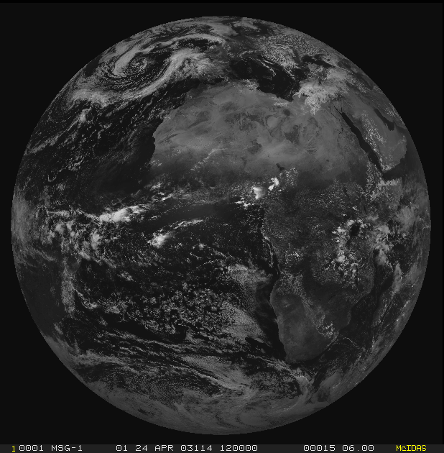
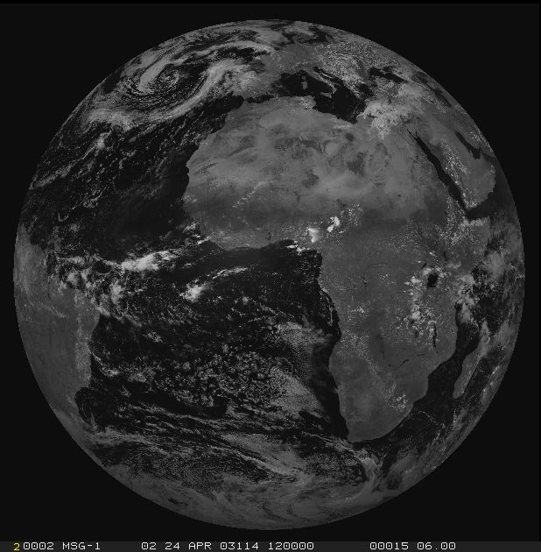
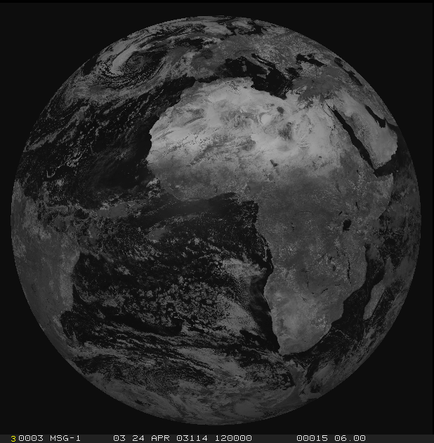
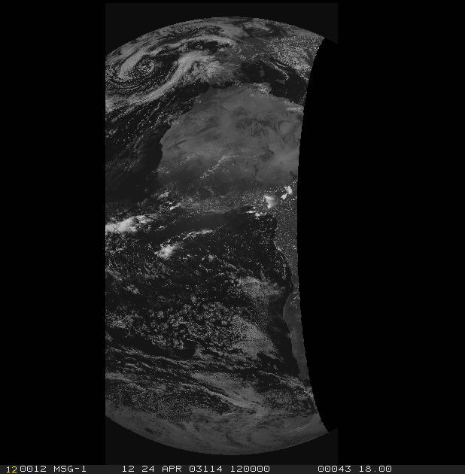
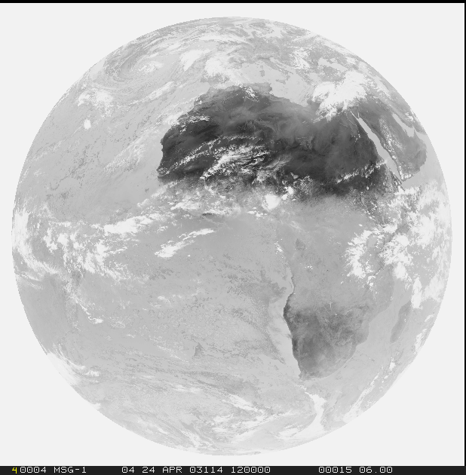
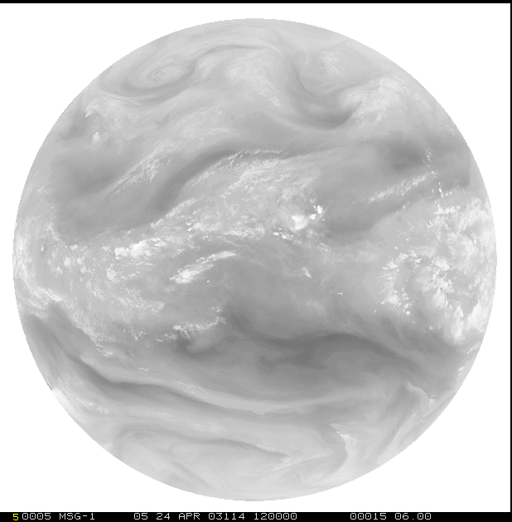
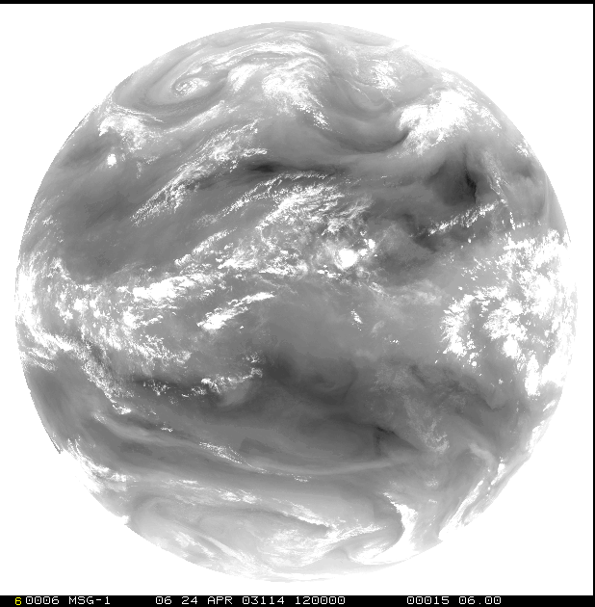
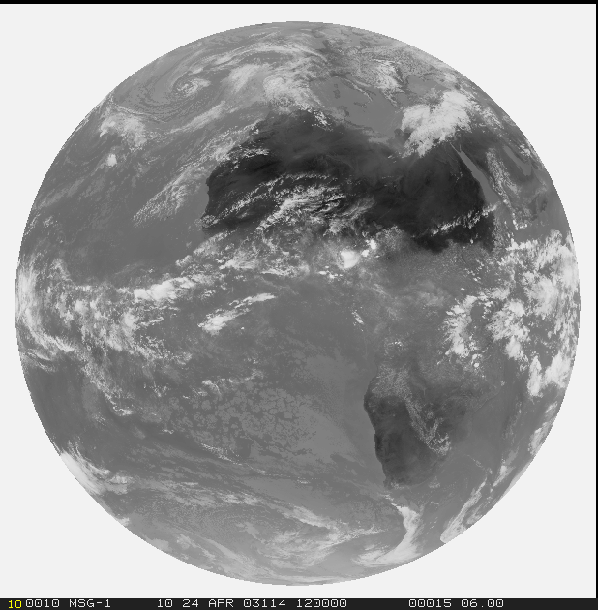
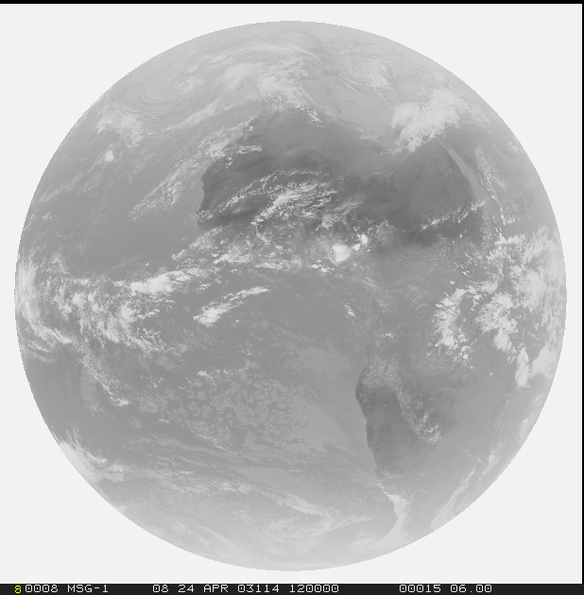
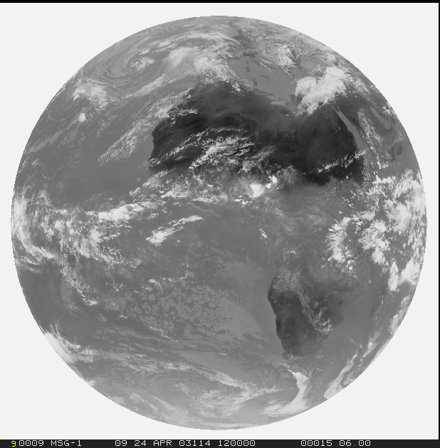
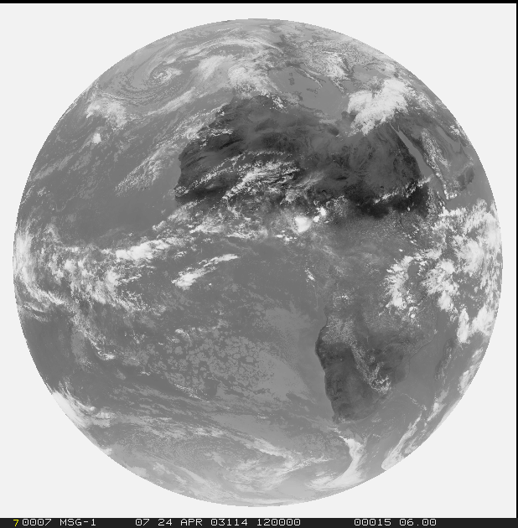
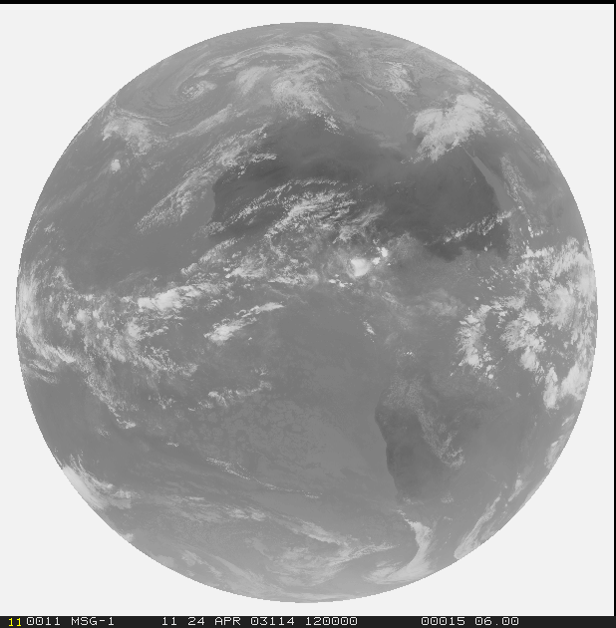
SEVIRI Overview
1
2
3
12
4
5
6
7
8
9
10
11

Slide 8
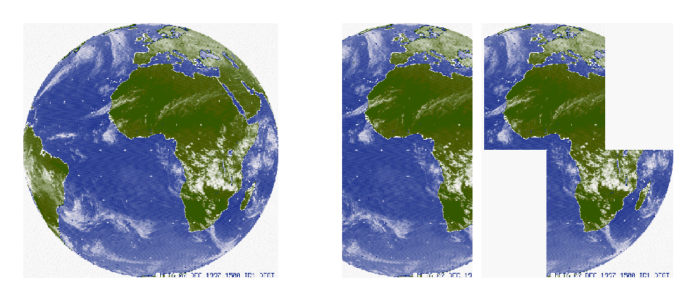
HRV: A Special Case
High data rate allows only transmission of half a scan line. Two blocks of "half lines" can be selected.
(current setup)

Slide 9
HRV Coregistration with other Channels
Full disk:
3712 Lines
3712 Elements per line
HRV:
3712 * 3 = 11136 Lines
(3712 * 3) / 2 = 5568 Elements

Slide 10
HRV Coregistration with other Channels
But:
Alignment of the two grids:
HRV 1 km
Other 3km channels,
“intuitive”
Full disk:
3712 Lines
3712 Elements per line
HRV:
3712 * 3 = 11136 Lines
(3712 * 3) / 2 = 5568 Elements
Other 3km channels,
“true”
SE Image Corner
First pixel in first row in SE corner:
Center of HRV Pixel (1,1) coincides with center of 3km-Pixel (1,1)

Slide 11
HRV Coregistration with other Channels
NW Corner – McIdas (1,1):
HRV 1 km
Other 3km channels,
“intuitive”
Full disk:
3712 Lines
3712 Elements per line
HRV:
3712 * 3 = 11136 Lines
(3712 * 3) / 2 = 5568 Elements
Other 3km channels,
“true”
For the NW corner (mcidas (1,1) ):
First 3km-Pixel coincides with HRV Pixel (3,3)

Slide 12
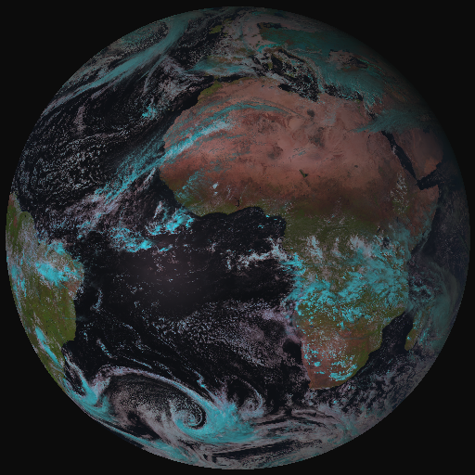
Meteosat-8: Rapid Scanning Service
Repeat Cycle 5 min
Position 9.5 E
HRV window in orange

Slide 13
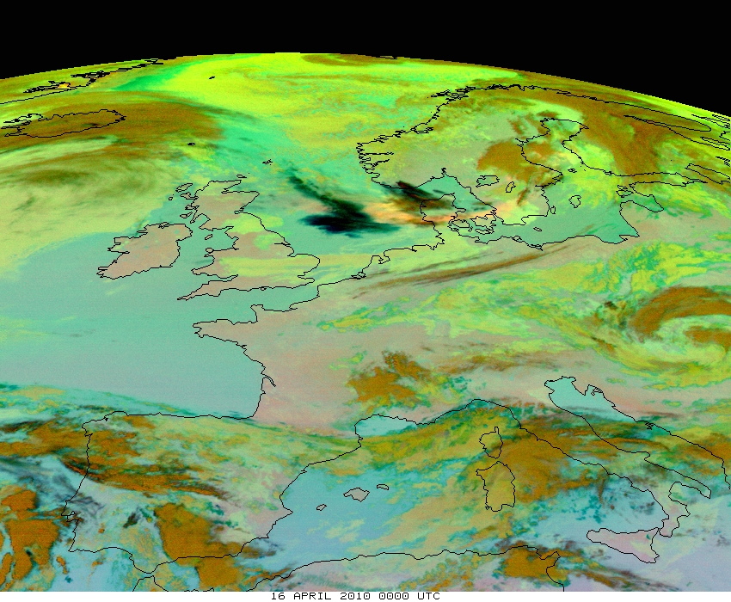
MSG Benefits
Long list of NWP and Nowcasting applications
Hot topic in 2010: Volcanic Ash from Eyjafjalla eruption

Slide 14

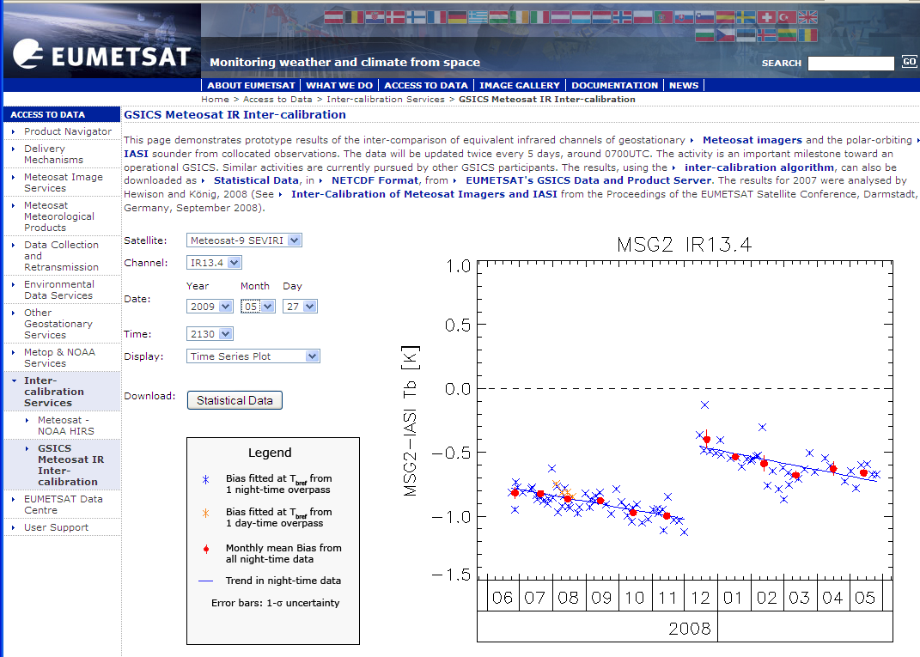
MSG Calibration: GSICS
One GSICS Product:
Daily cross-calibration to IASI
http://www.eumetsat.int/Home/Main/AboutEUMETSAT/InternationalRelations/CGMS/SP_1226312587804

Slide 15
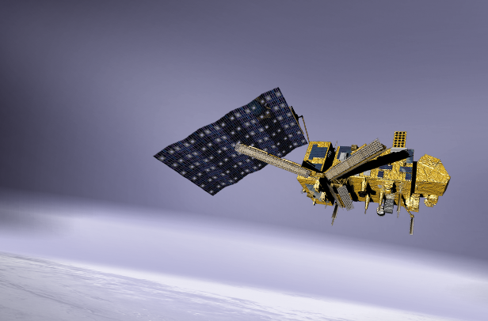
European Polar System EPS
Metop-A is Europe’s first operational polar orbiting weather satellite, in orbit since 2006. Metop-B will be launched on 02 April 2012.
09:30 ECT descending node
Suite of instruments for imaging and sounding capabilities, active radar:
AVHRR, AMSU, MHS, IASI, GOME, GRAS, ASCAT

Slide 16
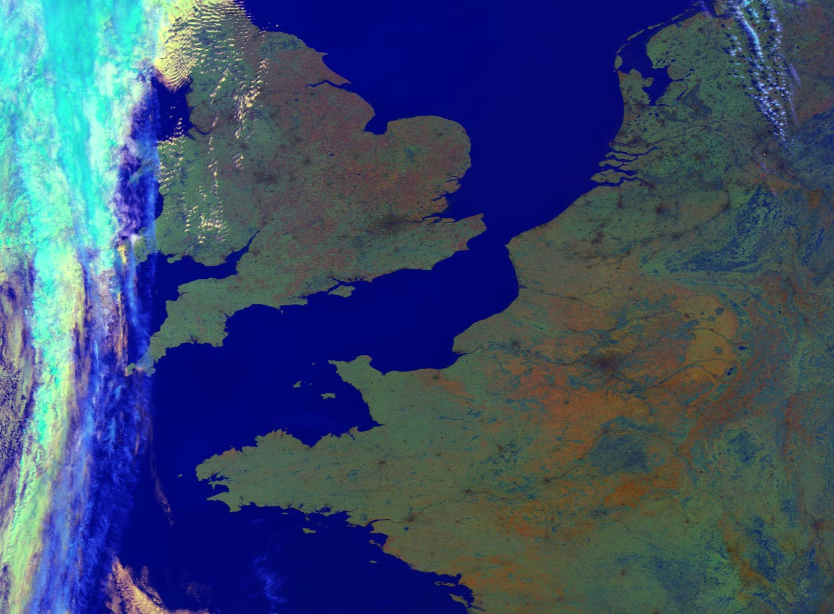
AVHRR on Metop: Global 1km Resolution

Slide 17
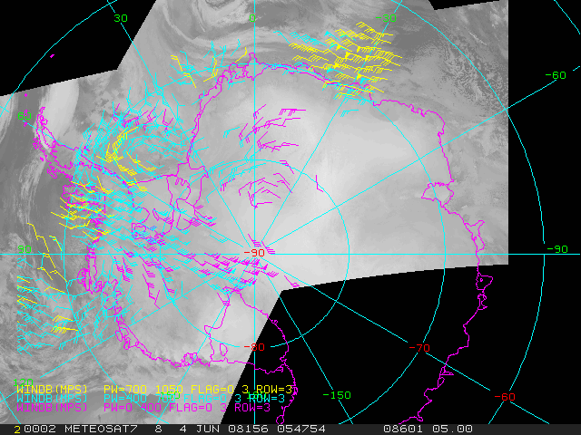
Polar Winds from AVHRR

Slide 18
GOME: Sensitivity Loss since Launch
Wavelength: 240 – 780 nm in ~4000 channels
Time since Launch
40 – 100% Throughput

Slide 19
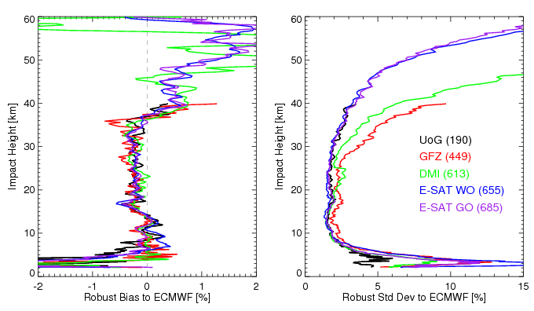
GRAS – Radiooccultation Instrument
Ongoing:
Update of processing software to wave optics:
Wave Optics open possibility to retrieve profiles down to ~2 km height

Slide 20
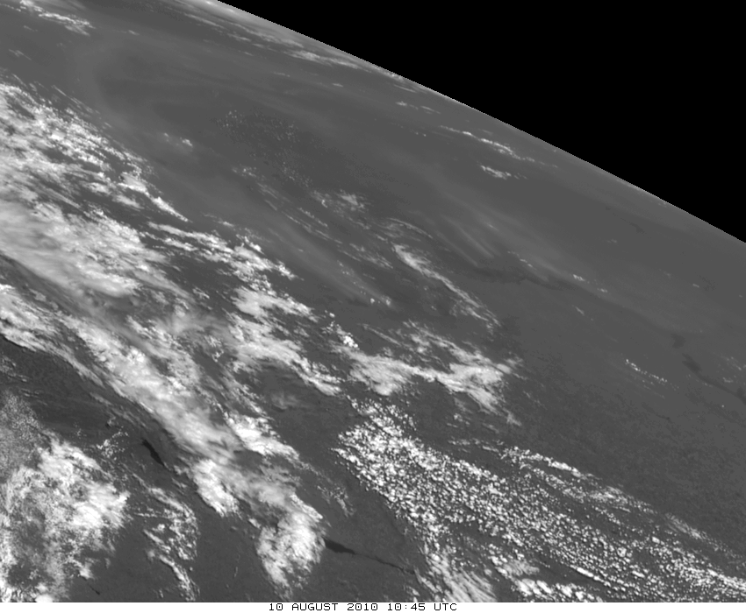
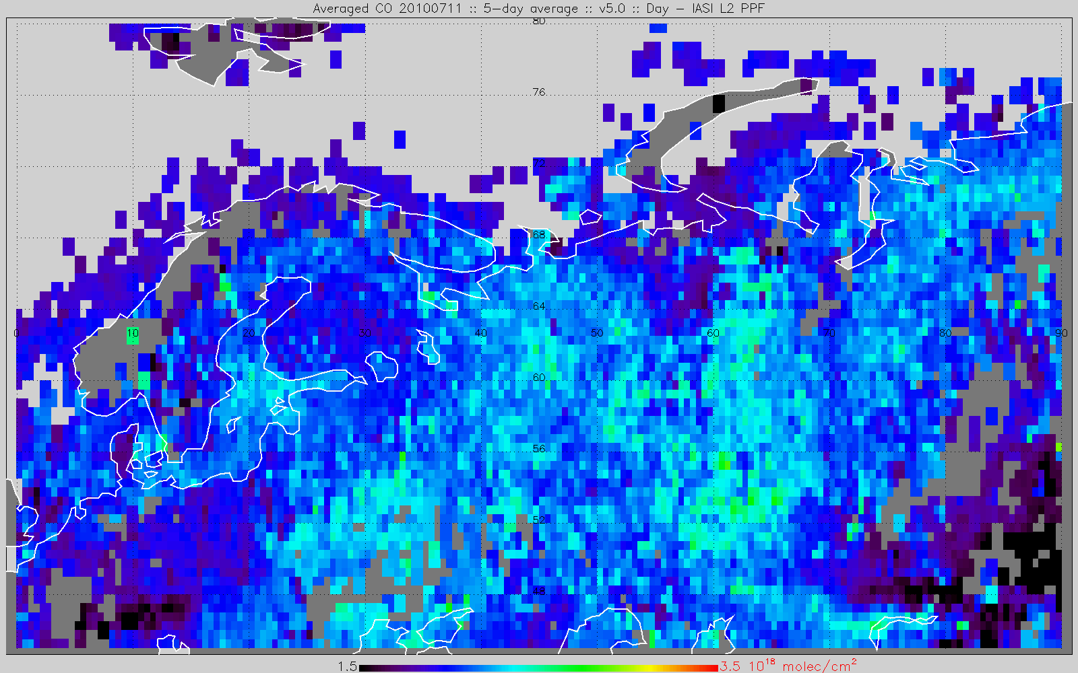
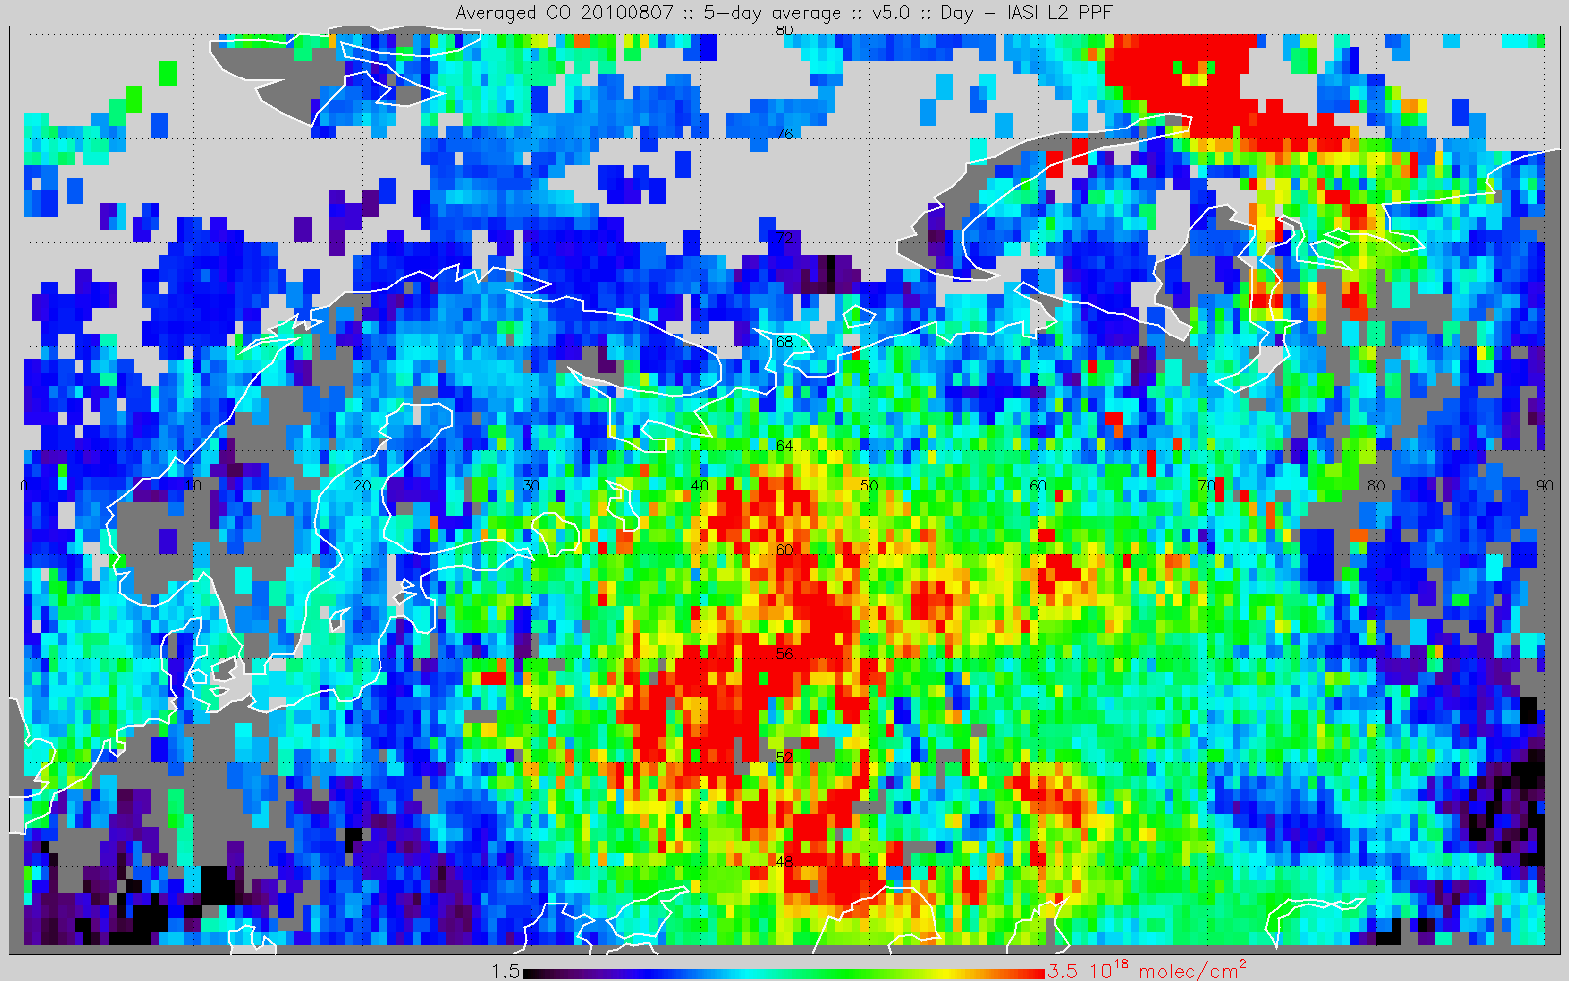
IASI: CO Retrievals – Russian Fires in 2010

Slide 21
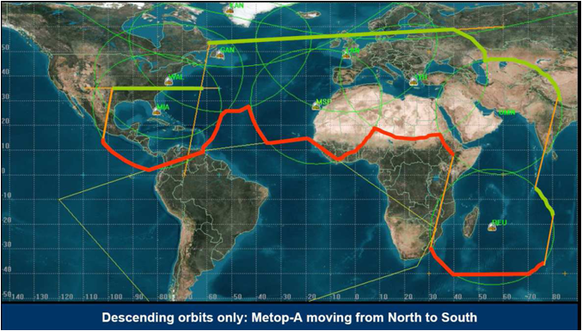
Metop HRPT Zones

Slide 22
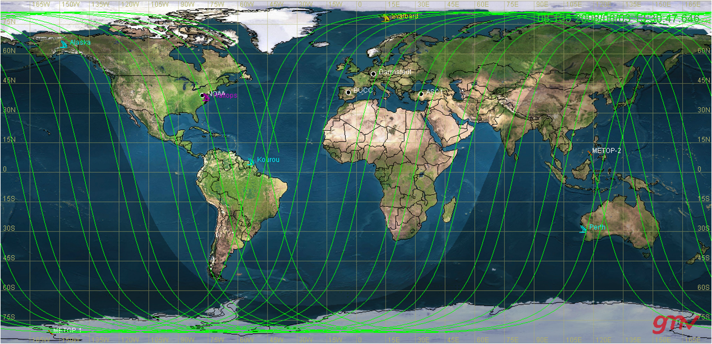
Metop-B: 48 min Separation to Metop-A

Slide 23
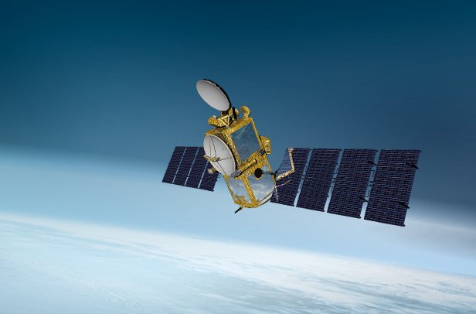
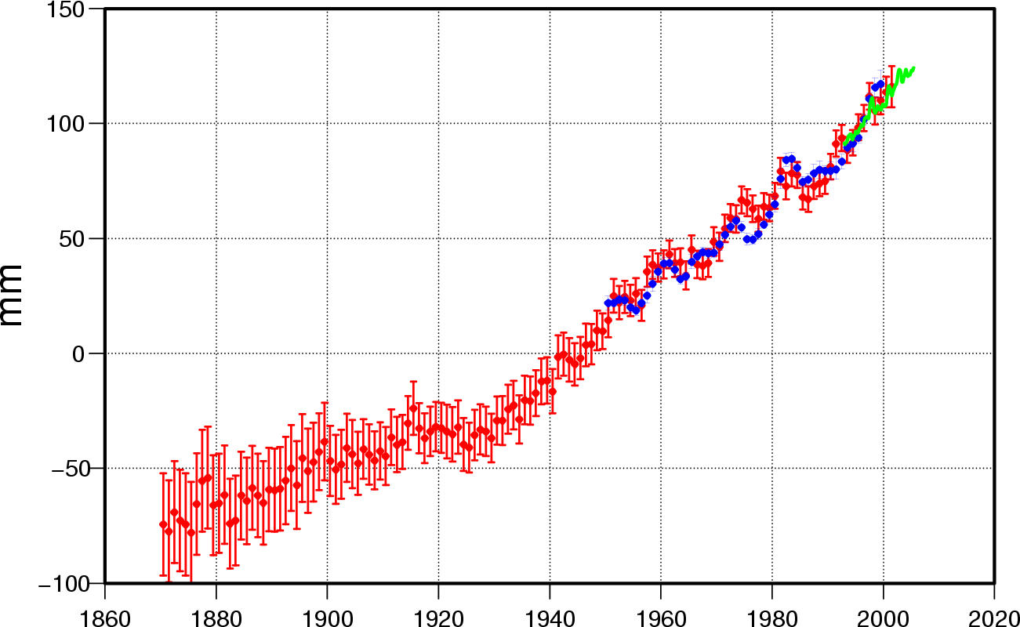
JASON-2: EUMETSAT – NASA – NOAA - CNES
Launched in 2008
Main payload: ocean surface altimeter
To be continued through JASON-3 (2011-2013) and Sentinel-3 beyond 2013
Satellite radar
Water gauge measurements

Slide 24
Future: Meteosat Third Generation
Twin Satellite Configuration, 3-axis stabilised platforms:
MTG-I: Imager Satellite carrying the FCI instrument (Flexible Combined Imager), the Lighning Imager (LI) and the Data Collection and SAR packages
MTG-S: Sounder Satellite carrying the hyper-spectral infrared sounder IRS and a UVN instrument for GMES (Sentinel-4)
Final operational configuration:
2 imaging satellites for full disk and regional scans
1 sounder satellite
Full programme: 4 MTG-I and 2 MTG-S satellites

Slide 25
MTG-I: Imager
Launch of first MTG-I anticipated for 2016,
second MTG-I in ~2022
(I3 in 2025, I4 in 2029)
16 channels, spatial resolution between 0.5 and 2 km
Coverage Repeat cycle Full Disk Coverage 18ºx18º 10 min
Local Area Cov. 1/4 FD 10/4 min

Slide 26
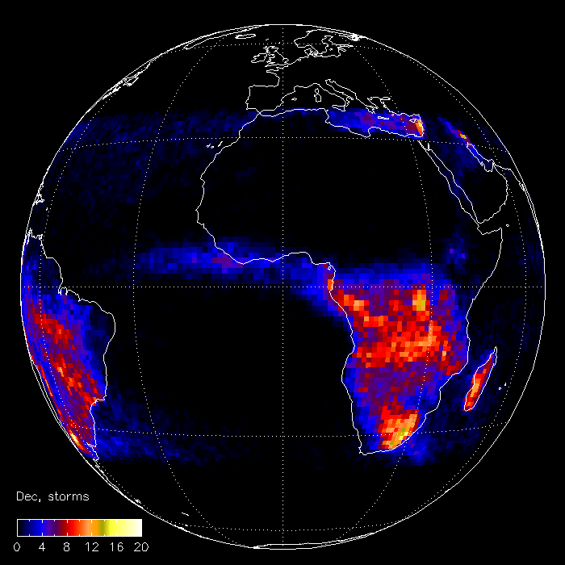
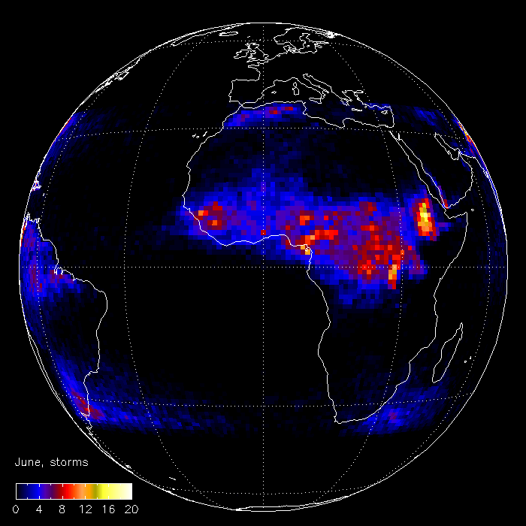
MTG-I Lightning Instrument
LIS - December
LIS - June
Provision of continuous lightning information (IC + GC) from the 0deg position

Slide 27
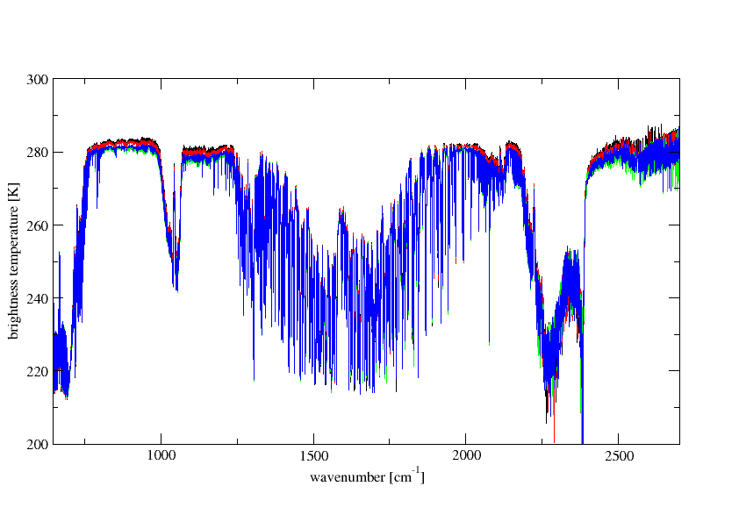
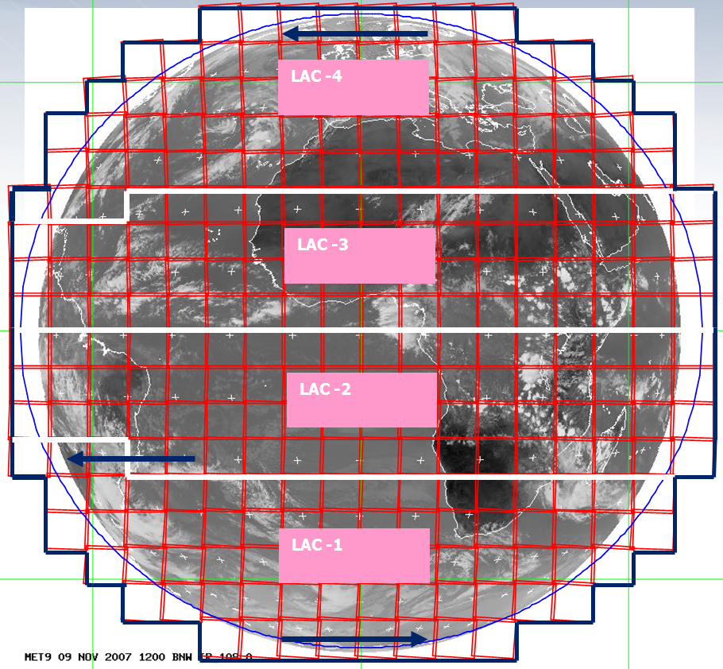
MTG-S
IRS: 700-1210 cm⁻¹,
and 1600-2175 cm⁻¹ @0.625 cm⁻¹ resolution
Spatial resolution at nadir: 4km

Slide 28
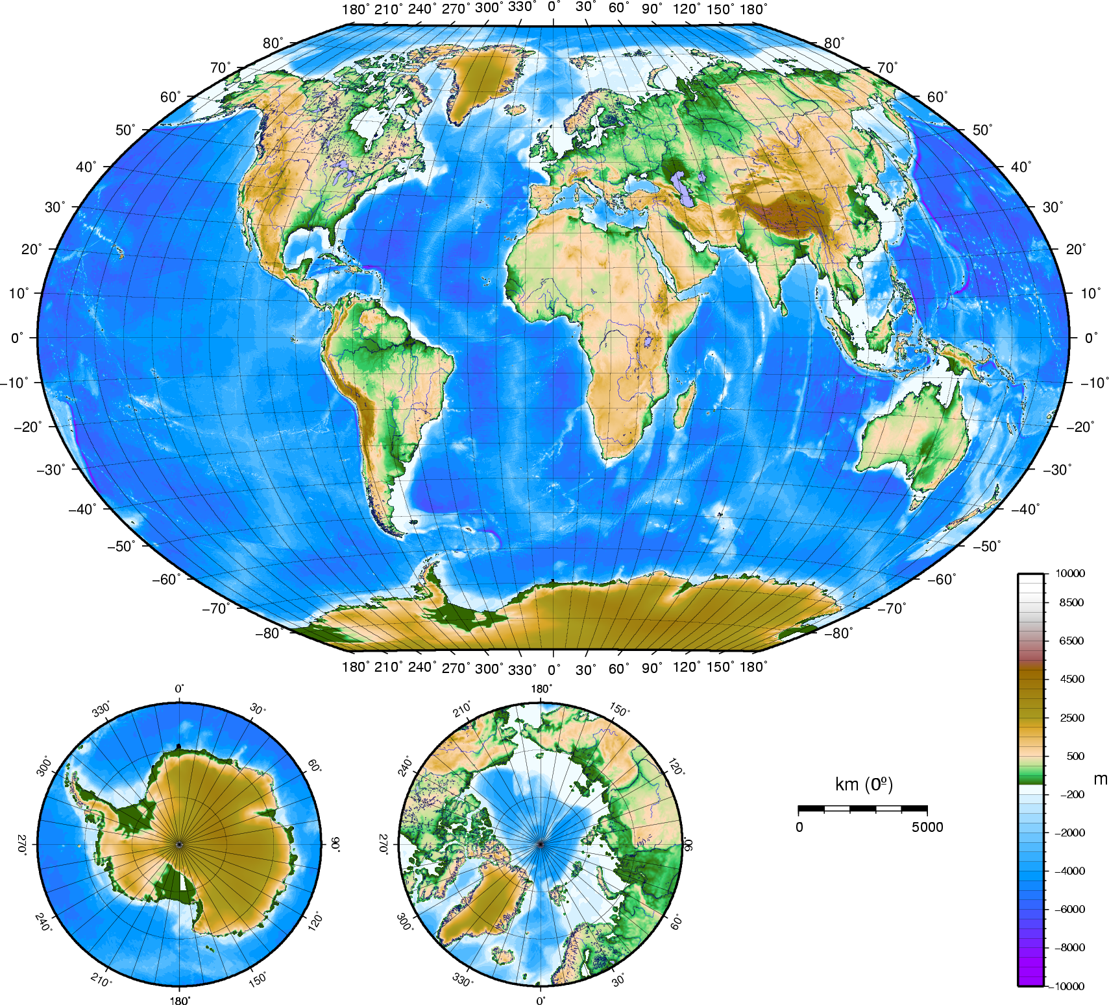
MTG-S UVN Sounder
The GMES Sentinel-4 (S4) sounding mission is achieved through the Ultraviolet, Visible & Near-infrared (UVN) Instrument accommodated on the MTG-S satellites
  covering Europe every hour
  taking measurements in three spectral bands (UV: 305 - 400 nm; VIS: 400 - 500 nm, NIR: 750 - 775 nm)
  with a resolution around 8km.
The primary data products are O3, NO2, SO2, HCHO and aerosol optical depth.

Slide 29
Very much Future: Post-EPS or EPS-SG
JPS Notional Assignments |  | Orbit, Operator, Satellites, Instruments
 |  | 05:30 (LTDN) | 09:30 (LTDN) | 13:30 (LTAN)
 |  | DoD | EUMETSAT | NOAA
Instrument Type | Provider | DWSS | EPS-SG Satellites | JPSS-1/2/3+
Visible/Infrared Imager | NOAA | VIIRS(TBC) |  | VIIRS
 | EUMETSAT |  | METimage
Low Light Imager | NOAA |  | LLI
Infrared Sounder | NOAA |  |  | JPSS-1/2: CrIS
 | EUMETSAT |  | IASI-NG | JPSS-3+: IASI-NG
Microwave Sounder | NOAA | MW Sensor | ATMS | ATMS
 | EUMETSAT |  | MWS (option)
Microwave Imager | NOAA | MW Sensor |  | GCOM AMSR-2 Data
 | EUMETSAT |  | MWI (Cloud/Precipitation)
Scatterometer | NOAA | Possibly in dedicated constellation
 | EUMETSAT |  | SCA
Atmospheric Chemistry | EUMETSAT |  | GMES Sentinel-5
 | NOAA |  |  | OMPS N&L
Aerosol | EUMETSAT |  | 3MI
 | NOAA
Radio Occultation | NOAA | Pursuing dedicated constellation (COSMIC f/o)
 | EUMETSAT |  | RO
Space Environment | NOAA | SEM-N(TBC) | SEM-N(TBC) | SEM-N(TBC)
Earth Radiation | NOAA |  | CERES f/o | CERES f/o
Solar Irradiance | NOAA |  |  | TSIS (may be on a small sat)
Data Collection | NOAA |  |  | ARGOS-4 (may be on a small sat)
 | EUMETSAT |  | ARGOS-4
Search and Rescue | NOAA |  | S&R | S&R (may be on a small sat)
EPS-SG is part of Joint Polar System with US
Phase-A studies will start in 2010/2011
Concept studies for METimage and IASI-NG in progress
Launch need >2020, possibly multi-satellite constellation

Slide 30
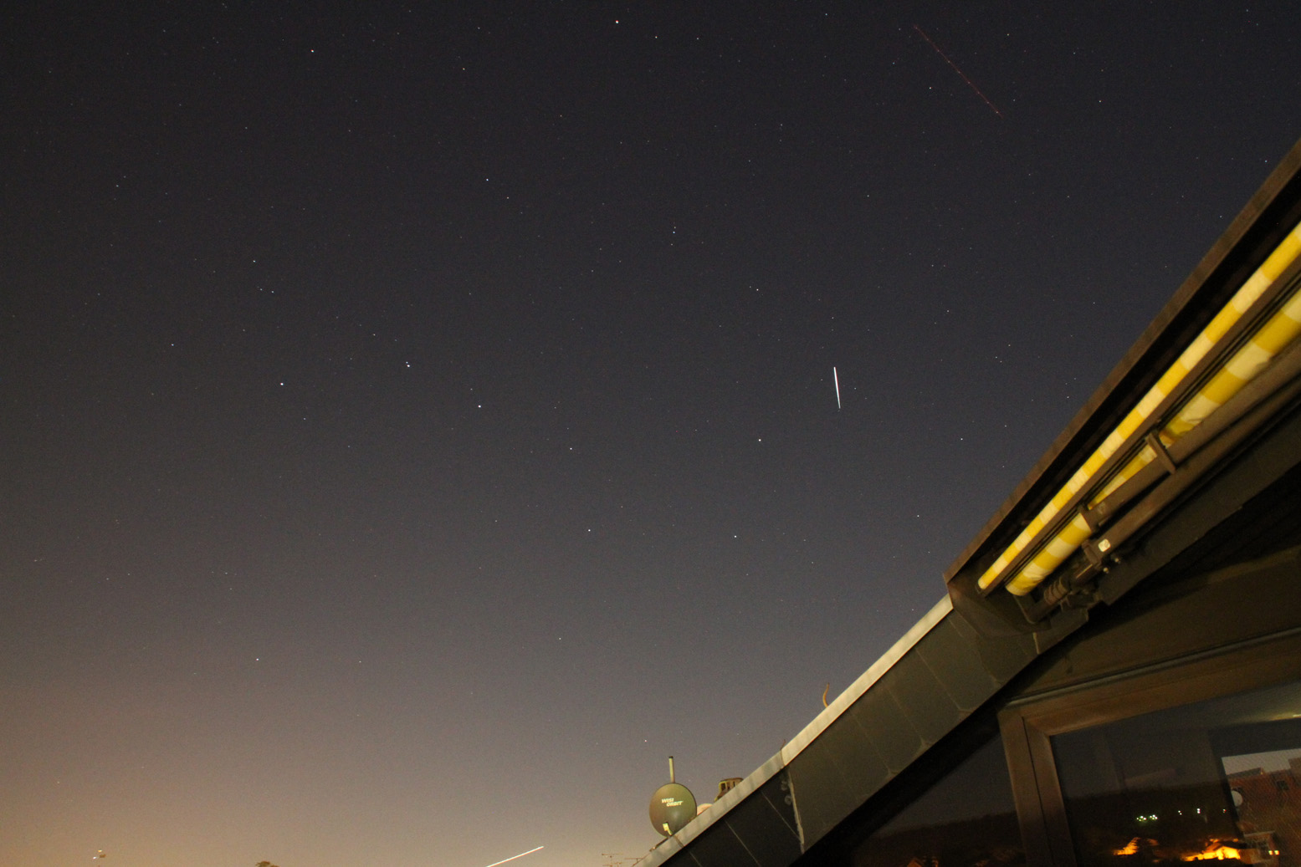
Bright Future for Weather Satellites
And they are bright on the sky:
Photo copyright Dieter Klaes
Metop-A Flare: photographed on 18 Sept 2010 in Darmstadt, 10sec shutter speed
flare = sunlight reflection on ASCAT antenna

