Slide 1
Scripting McIDAS-X in a Python environment
Kevin Hallock
SSEC Datacenter Programmer
September 10, 2013
2013 McIDAS Users Group Meeting

Slide 2
What problems are we trying to solve?
Running a mcenv instance within a bash script requires redirection of stdin (i.e. "<< 'EOF'")
Parsing text in bash can be clumsy, requires piping commands together to extract useful information.
Manipulating dates in bash is messy, code can often depend on having a particular version of GNU date installed, for example.

Slide 3
What is Python?
Python is a general-purpose interpreted programming language that supports multiple programming paradigms, including both object-oriented and procedural programming.
Python is very flexible and can be used to write anything from simple scripts to an entire application with a fully graphical interface.
Because of the flexibility it provides, Python has been one of the most popular programming languages over the past 10 years.

Slide 4
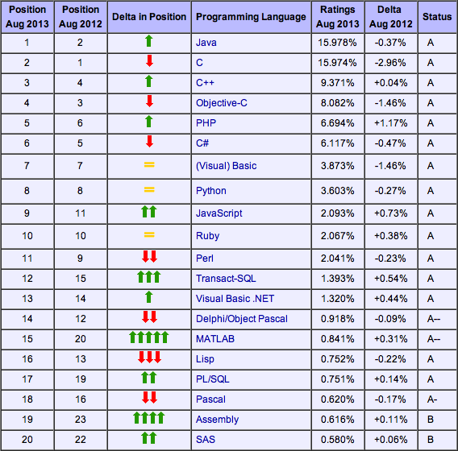
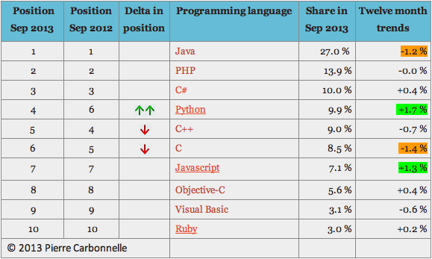
What makes Python a good alternative?
https://sites.google.com/site/pydatalog/pypl/PyPL-PopularitY-of-Programming-Language
http://www.tiobe.com/index.php/content/paperinfo/tpci/index.html
Where is bash?

Slide 5
What makes Python a good alternative?
Existing Python modules such as NumPy and SciPy offer advanced mathematical/scientific analytical tools comparable to MATLAB or R.
As implied by the name, Python modules are modular, allowing a user to import whichever modules they deem necessary for their project.
Because of the nature of Python modules, code implementing the McIDAS-X module can easily be added to an existing project; similarly, any McIDAS-X Python script can be extended to use other modules.

Slide 6
What makes Python a good alternative?
Python is multi-platform

Slide 7
How our solution works
The Python 'subprocess' module is used to spawn an instance of the mcenv shell in the backround
mcenv shell commands are passed to the mcenv session using pseudo-native python functions, as in the following examples:
bash:
imglist.k DATA/SET FORM=ALL
python:
mcenv.imglist("DATA/SET FORM=ALL")
In this case, the imglist method is not explicitly defined, but rather is interpreted such that the example bash command is run in the mcenv sub-shell.

Slide 8
bash example
#!/bin/bash
PATH=/home/mcidas/bin:$PATH
MCPATH=$HOME/mcidas/data:/home/mcidas/data
export PATH MCPATH
mcenv << 'EOF'
logon.k ABC 1234
dataloc.k ADD GROUP SERVER.DOMAIN
imglist.k GROUP/DESCRIPTOR TIME=12:00
EOF

Slide 9
Python example
#!/usr/bin/env python
import mcidasx
import os
os.environ['PATH'] = "%s:%s" % ('/home/mcidas/bin', os.environ['PATH'])
os.environ['MCPATH'] = '%s/mcidas/data:~mcidas/data' % os.environ['HOME']
m = mcidasx.mcidas.mcenv()
m.logon('ABC 1234')
m.dataloc('ADD GROUP SERVER.DOMAIN')
m.imglist('GROUP/DESCRIPTOR TIME=12:00')
Setting environment variables could be further abstracted into the module import step in order to simplify code.

Slide 10
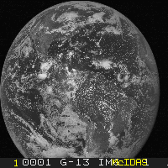
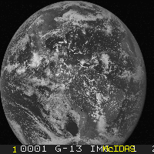
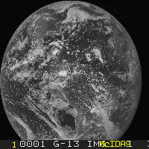
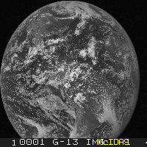
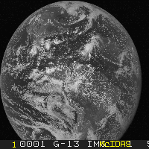
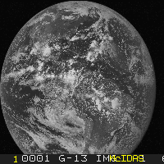
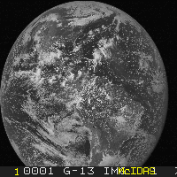
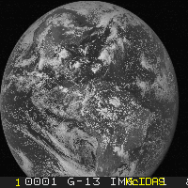
GOES East Full Disk over a range of days
#!/usr/bin/env python
import mcidasx
import os
Import sys
from datetime import datetime
from mcidasx.utilities import date_range
mcidas_home = '/home/mcidas'
os.environ['PATH'] = "%s:%s" % (mcidas_home + '/bin', os.environ['PATH'])
os.environ['MCPATH'] = '%s/mcidas/data:%s/data' % (os.environ['HOME'], mcidas_home)
def main(start_date, end_date):
mcenv = mcidasx.mcidas.mcenv(frame_size='900x1200')
mcenv.logon("ABC 1234")
mcenv.dataloc("ADD AGOES13 GEOARC.SSEC.WISC.EDU")
for day in date_range(start_date, end_date):
d = day.strftime('%Y%j')
mcenv.imgdisp("AGOES13/FD MAG=-10 -20 BAND=1 DAY=%s TIME=17:45" % d)
mcenv.frmsave("1 test-%s.jpg" % d)
if __name__ == "__main__":
start_date = datetime.strptime(sys.argv[1], '%Y-%m-%d')
end_date = datetime.strptime(sys.argv[2], '%Y-%m-%d')
main(start_date, end_date)
Notes:
Get 8-10 images, stack them on this page

Slide 11
Relevant python modules
NumPy
SciPy
netCDF4
GDAL
matplotlib
PyTables
pandas

Slide 12
How can users install the McIDAS-X python module?
Care was taken to ensure that the McIDAS-X python module could be installed and imported just like any other python module.
ftp://ftp.ssec.wisc.edu/pub/mug/mug_meeting/2013/python/mcidasx-python.tar.gz
Decompress the archive, and run 'python setup.py install --user' in the new directory (or use a Python tool such as pip or easy_install to install the .tar.gz directly).
Now, within python, add the command 'import mcidasx', and all of the functionality of this module should be available.

Slide 13
Future work
Additional modules which offer more direct access to underlying McIDAS-X commands
For example, the imglist command could return a Python object with callable methods and accessible attributes, rather than returning a multi-line string (which needs to be manually parsed to be useful).
Additional specialized/specific utility functions
Perhaps functions that generate commonly used McIDAS time/date formats
Although we are giving this "McIDAS-X/Python" presentation at the MUG meeting, this project is not currently funded by MUG.
Funded by another project at SSEC where the use of Python was necessary
Disclaimer – This project was initially designed as a proof-of-concept, and as such has not been thoroughly tested for every McIDAS-X command.
Notes:
Disclaimer – everything should work, no reason to believe it shouldn’t… we just don’t support it yet

Slide 14
Questions?

