Slide 1
McIDAS-XCD Replacement
Kevin Baggett
September 9, 2013

Slide 2
Rewrite Team
Kevin Baggett, Dan Forrest, Kevin Hallock, Jay Heinzelman, Dave Parker, Roseann Spangler, Becky Schaffer, Jerrold Robaidek

Slide 3
McIDAS XCD
McIDAS X
Conventional Data
Decoder
McIDAS-XCD files, decodes and indexes the NOAAPORT data stream into formats
that can be served by McIDAS-X ADDE servers.
Output formats include McIDAS MD files, Text files, GRID files, grib1 and
grib2 files, NEXRAD files, and BUFR files.

Slide 4
NOAAPORT Data
The NOAAPORT broadcast system provides a one-way broadcast communication of NOAA environmental data and information in near-real time to NOAA and external users. This broadcast service is implemented by a commercial provider of satellite communications utilizing C-band.

Slide 5
NOAAPORT Channels
The following 2 NOAAPORT channels supply data to be decoded by McIDAS-XCD:
NCEP/NWSTG Channel (NWS Telecommunications Gateway)
model output from the National Centers for Environmental Prediction (NCEP)
observations, forecasts, watches and warnings from NWS Forecast Offices
WSR-88D radar products
most observational data over North America
NCEP/NWSTG2 Channel
supplements the NWSTG channel

Slide 6
NOAAPORT Data flow into SSEC
Users generally get NOAAPORT data in two ways:
Directly from DOMSAT (101°W)
Over the Internet via LDM

Slide 7
Why replace XCD?
Installation is difficult
Upgrades are difficult
System is overly complex, large learning curve for operators, and very large learning curve for new programmer
System was written for a mainframe then ported to UNIX
A powerful system is needed to run XCD, otherwise data can be lost
A data format change can mean bad data, and a fix can be difficult to implement, and is only effective for future data

Slide 8
Goals
Replace 4 parts of XCD filing and decoding:
GRIB (prototype done)
NEXRAD (prototype done)
Text (prototype nearing completion)
MD serving (prototype nearing completion)
Utilize LDM direct filing
Create simple interface to pqact.conf and ldmd.conf to select and edit data to be filed
Reduce or eliminate compiled code
Remove legacy mainframe complexity
Utilize simple open-source database, SQLite
Match or exceed current filing and serving performance on existing hardware

Slide 9
GRIB Data
LDM files GRIB messages to a temporary directory
A GRIB daemon watches for directories, and moves it to a temporary directory name
Another daemon watches for temporary directories and extracts information and files metadata in to an SQLite DB
One SQLite database per model per day
See 2012 McIDAS-XCD presentation for details

Slide 10
NEXRAD Data
LDM files NEXRAD files into a directory structure similar to existing XCD Decoder
Data served by NEXRAD server
See 2012 McIDAS-XCD presentation for details

Slide 11
Text Data
LDM files data directly to disk
A script running as a daemon watches for new data and files data into a daily *.XCD file as data comes in
New -XCD:
A concatenation of the text from the LDM stream with no stripping out of start of text, carriage return, line feed, end of text characters
Current -XCD:
Starts with the date of the file (in binary) and a total 80-byte header
Padding (spaces) in the file - to make 80 character lines
Start of text character 0x01 and end of text character 0x03 are included, and also 80-character padded. Carriage returns/line feeds stripped out
Script extracts metadata to put into SQLite DB
Text server accesses SQLite DB to find data and return information to client

Slide 12
Point Data
No MD files created, but structure created on the fly by the server
PTLIST, PTDISP and PTCOPY get metadata from the SQLite database, then extract data from the *.XCD file created by the text filer
Daily Station Database table included in same SQLite database file as the Daily Text Metadata table
Station Database is retained for archived data

Slide 13
BUFR Data (Binary Universal FoRmat)
Filed directly using LDM
No operational McIDAS-X server exists, only a prototype server
Individual files can be loaded into McIDAS-V if they follow the standard BUFR tables

Slide 14
LDM pqact.cfg configuration assistant
Allows user to select Models, stations, parameters, etc
Web interface
Cut and paste to pqact.cfg

Slide 15
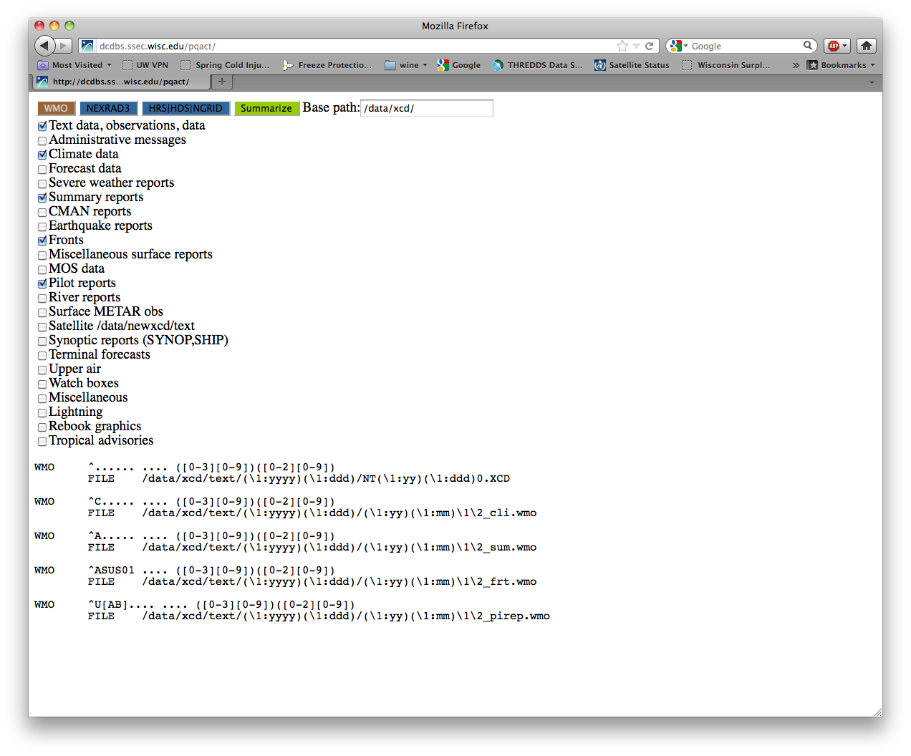
pqact assistant

Slide 16
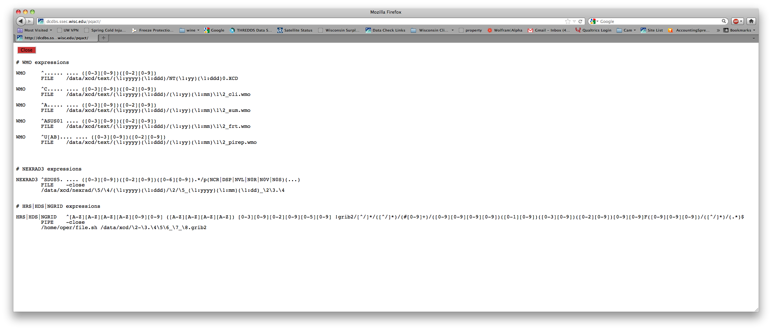
pqact assistant

Slide 17
Local Data
A couple -XCD sites have local feeds of data
We have contacted those sites for test data
So far, they believe there are not any -XCD dependencies
If there is local data that do depend on –XCD, we will add that into the existing framework

Slide 18
Reprocessing Data
Script with a filename argument
Script automatically determines data type (e.g. text, GRIB)
Files data appropriately and updates SQLite DB

Slide 19
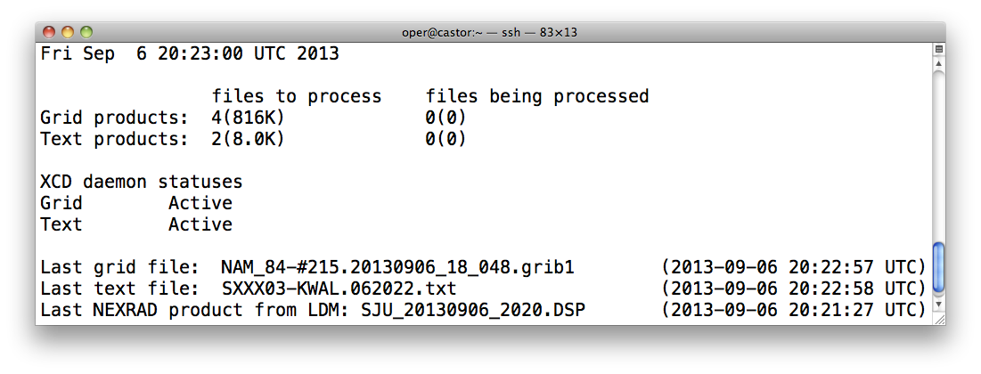
Monitoring

Slide 20
Performance (TEXT)
TEXT lists
WXTLIST (no parameters)
Current -XCD: fastest=.50 s slowest=1.75 s
New -XCD : fastest=.014 s slowest=.078 s
WXTLIST WMO=SA
Current -XCD : fastest=.015 s slowest=2.379 s
New -XCD : fastest= .880 s slowest= .900 s

Slide 21
Performance (SFCRPT)
SFCRPT
SFCRPT KGRB 9 (Current –XCD)
Fastest : ~.014s
Slowest : ~.983 s
SFCRPT KGRB 9 DAT=RTPTLITE/SFCHOURLY(New –XCD)
Fastest : ~.015s
Slowest : ~.036 s

Slide 22
Performance (PTLIST)
PTLIST
PTLIST RTPTSRC/SFCHOURLY SEL=‘DAY 2013246; TIME 12; ID KMSN’
Current –XCD: fastest=.021 s slowest=.037 s
New –XCD: fastest=.024 s slowest=.148 s
Remove ID: PTLIST RTPTLITE/SFCHOURLY SEL=‘DAY 2013246; TIME 12’
New –XCD slows to : ~1.23 s
Remove ID and Time: PTLIST RTPTLITE/SFCHOURLY SEL=‘DAY 2013246’
New –XCD slows to : ~6.48 s

Slide 23
Performance (GRID)
GRID lists
RTGRIB2/GFS-USLC2 DAY=2013246 TIME=6:00 PAR=U NUM=10
Current -XCD : ~.031 s
New -XCD : ~.040 s
GRID display
RTGRIB2/GFS-USLC2 DAY=2013246 TIME=6:00 PAR=U FHOUR=12 LEV=500
Current -XCD: ~.122 s
New -XCD : ~.125 s
GRID copy
RTGRIDS/NAM-USLC2 G/G.5700 DAY=2013246 TIME=0:00 PAR=T FHOUR=9 LEV=500
Current -XCD: ~.074 s
New -XCD: ~.078 s

Slide 24
Current Issues
Dependency on existing compiled –XCD code for GRIB metadata decoding has not been eliminated
Testing of the system with many multiple users has not been attempted thus far
SQLite database queries and organization need to be optimized
PTCOPY reveals MD file limitations (e.g. SFCHOURLY – 1 normal, 2 specials) when NOAAPORT datastream has more data available, including duplicates

Slide 25
Current Issues (continued)
Existing text datasets do not always follow format rules, leading to some data not being decoded
Better handling of data searches across multiple days

Slide 26
Schedule
Prototype working – bugs and performance being addressed
Code sharing of individual pieces
Bash scripts
Server/decoding software
SQLite table construction and queries
System Testing
Monitoring
Packaging
Beta release in 2014

Slide 27
End

