Slide 1
McIDAS-X Software Development and Demonstration
Dave Santek and Jay Heinzelman
16 November 2016

Slide 2
Overview
McIDAS-X 2015.2, 2016.1, 2016.2
McIDAS-XCD 2015.2, 2016.2
Software development and plans for 2017 and beyond…

Slide 3
Imagery
GOES-R ABI
ABI ADDE servers released
Level 1B
Level 2+ products
Navigation routines support satellite and sun angles through NAVCALC

Slide 4
Imagery
Himawari
HimawariCast ADDE server (WARC)
Himawari AHI data reshaped as MTSAT and broadcast by JMA in HRIT format
Updates for Himawari data (WARI)
Correct time for Japan and Target sectors
SIZE=SAME with MAG= specification
Displays partial images

Slide 5
Imagery
Meteosat
Updates to ADDE servers for Meteosat-11
MSG Level 1.5 support (MSGS)
First release of ADDE server for native format of current Meteosat data broadcast by EUMETSAT

Slide 6
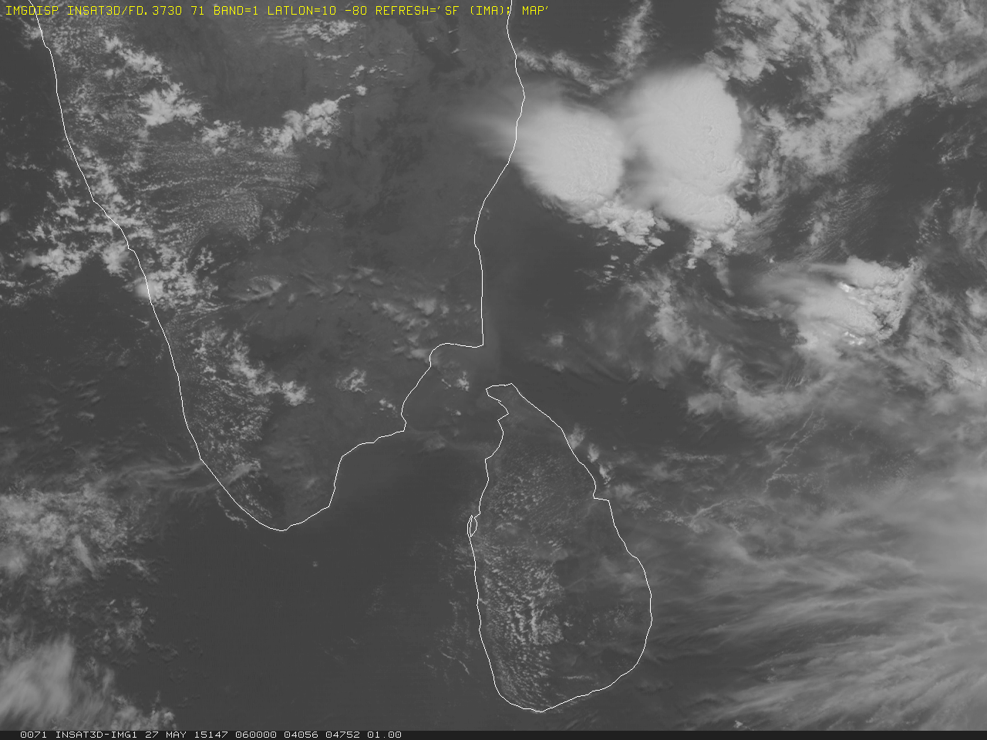
Imagery
India
Kalpana (KPH5) ADDE server released
Updates for calibration for INSAT-3D Imager and Sounder ADDE servers

Slide 7
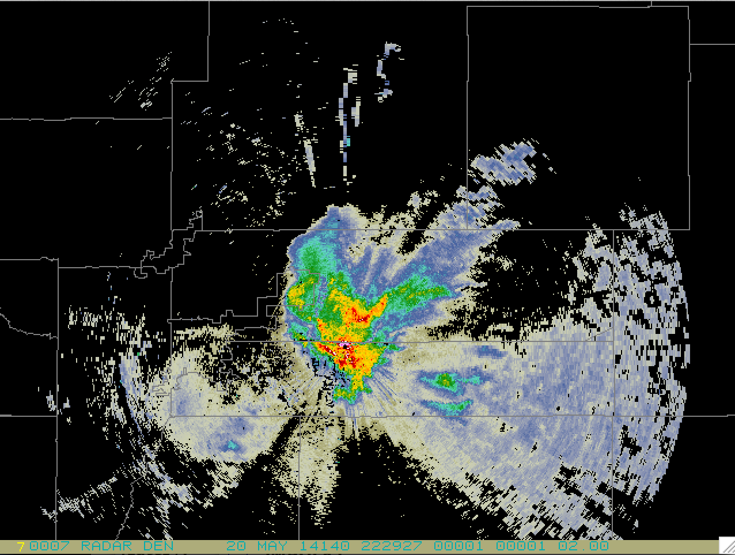
Imagery
TDWR radar products
256-level Base Reflectivity
16-level Base Velocity
8-level Base Spectrum Width
16-level long range Base Reflectivity

Slide 8
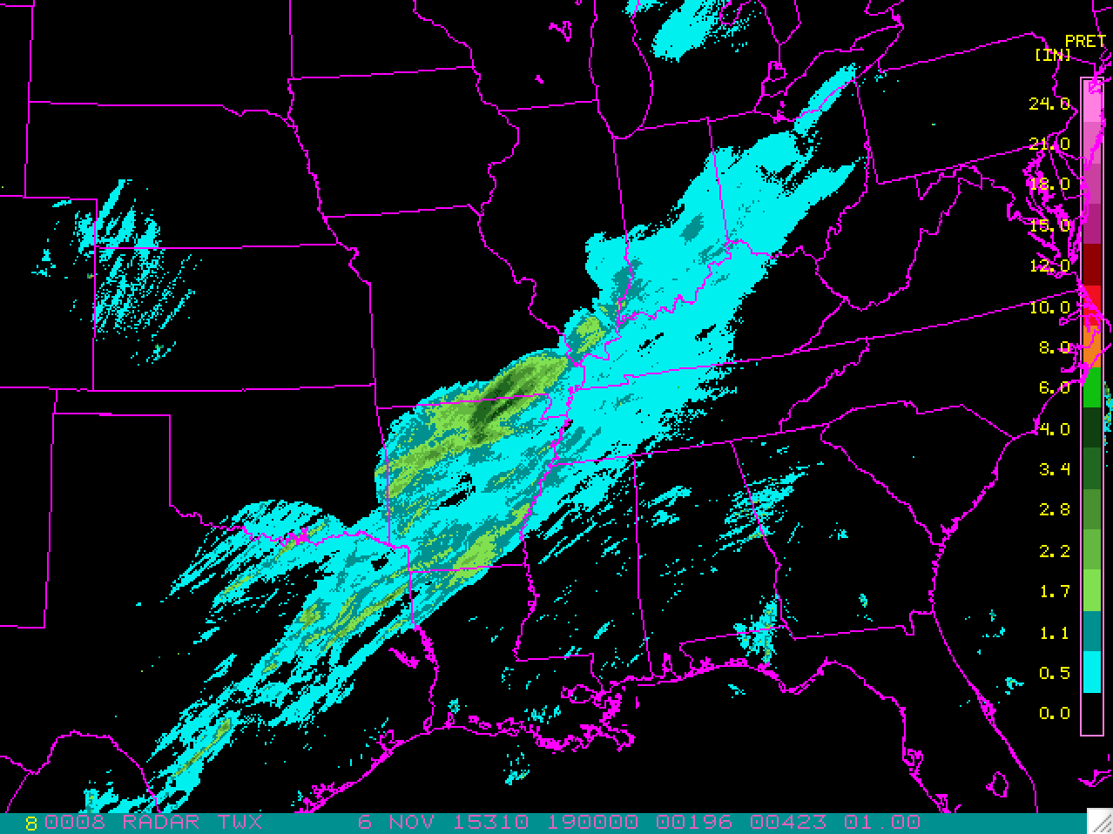
Imagery
NEXRAD Level III
GINI server updated for NEXRAD Level III composite imagery

Slide 9
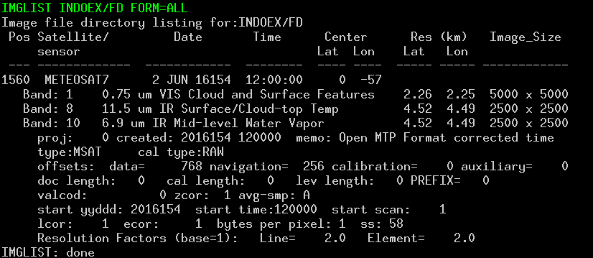
Imagery
Meteosat-7
MSAT and OMTP ADDE servers

Slide 10
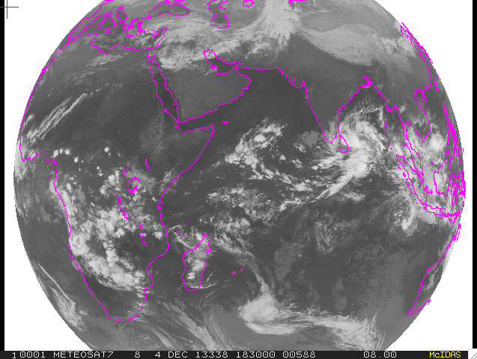
FSD (LRIT) server update
MET7

Slide 11
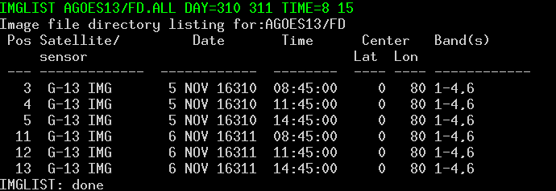
Imagery
Multi-day requests GOES archive
IMGLIST can span days for GOES archive requests

Slide 12
Imagery
IMGPROBE: Scan line time available for COMS and Himawari
Time are approximate; rectified images
IMGCOPY SIZE=SAME MAG= -N
Example: 2500x2500 image MAG=-5 results in 500x500 image

Slide 13
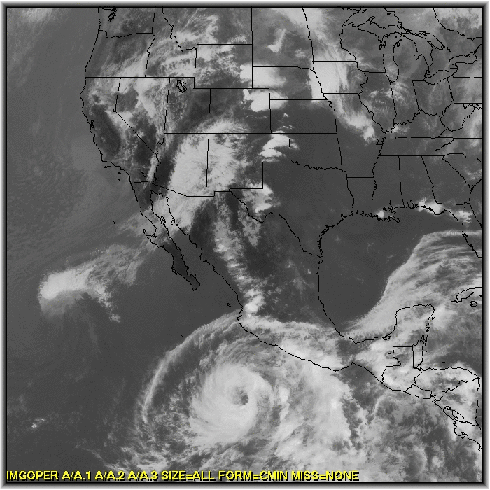
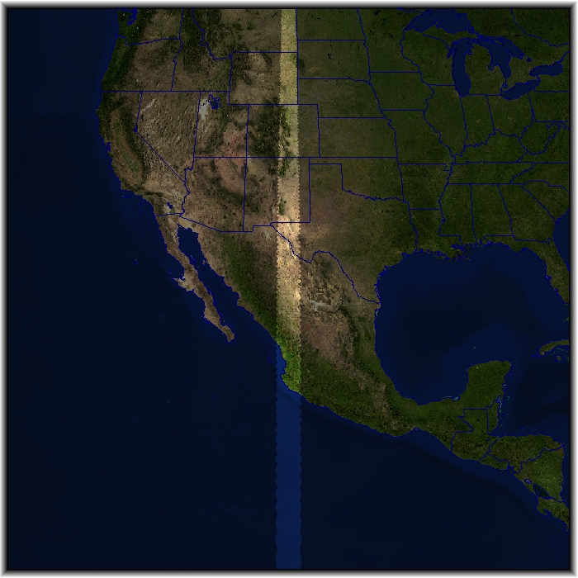
SATCOMP (-XRD)
Customize overlap region
– reduces parallax errors
Accurate Cloud Coverage
GOES-West/East
5km Parallax Overlap

Slide 14
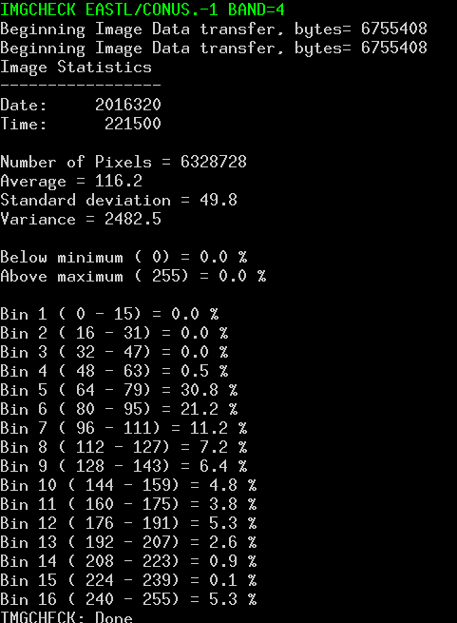
Imagery (XRD)
IMGCHECK
Statistics on entire image (1-byte BRIT values)
Average, standard deviation, variance, histogram

Slide 15
Grids
New models support
Updates for HRR, GFS, NDF, PSS
GRIB2 tables updated for RAP, NWPS, WPC, MOS, NAEF, NBGR
Recognize MOS GRIB2 files from Storm Prediction Center

Slide 16
Grids
Updates
PUNIT keyword
Preferred Unit when mixed mb and hPa
CONTOUR.DEF
Handle grids correctly with units of Pa
Native units
More Pa and hPa checking

Slide 17
Point
Cloud cover
Use of cloud cover symbols with PTDISP and SFCPLOT:
Symbols using parameters CIGC, CC1, CC2 with FORMAT=SYMB
Default for station location
Open circle for no clouds reported

Slide 18
Point
Upper Air
Correction to upper air calculations
When LFC is below the LCL, it is made equal to LCL
Precipitable water (PW) calculation from SFC to 300 hPa (previously it was 500 hPa)
Update to all upper air commands to use all significant level data

Slide 19
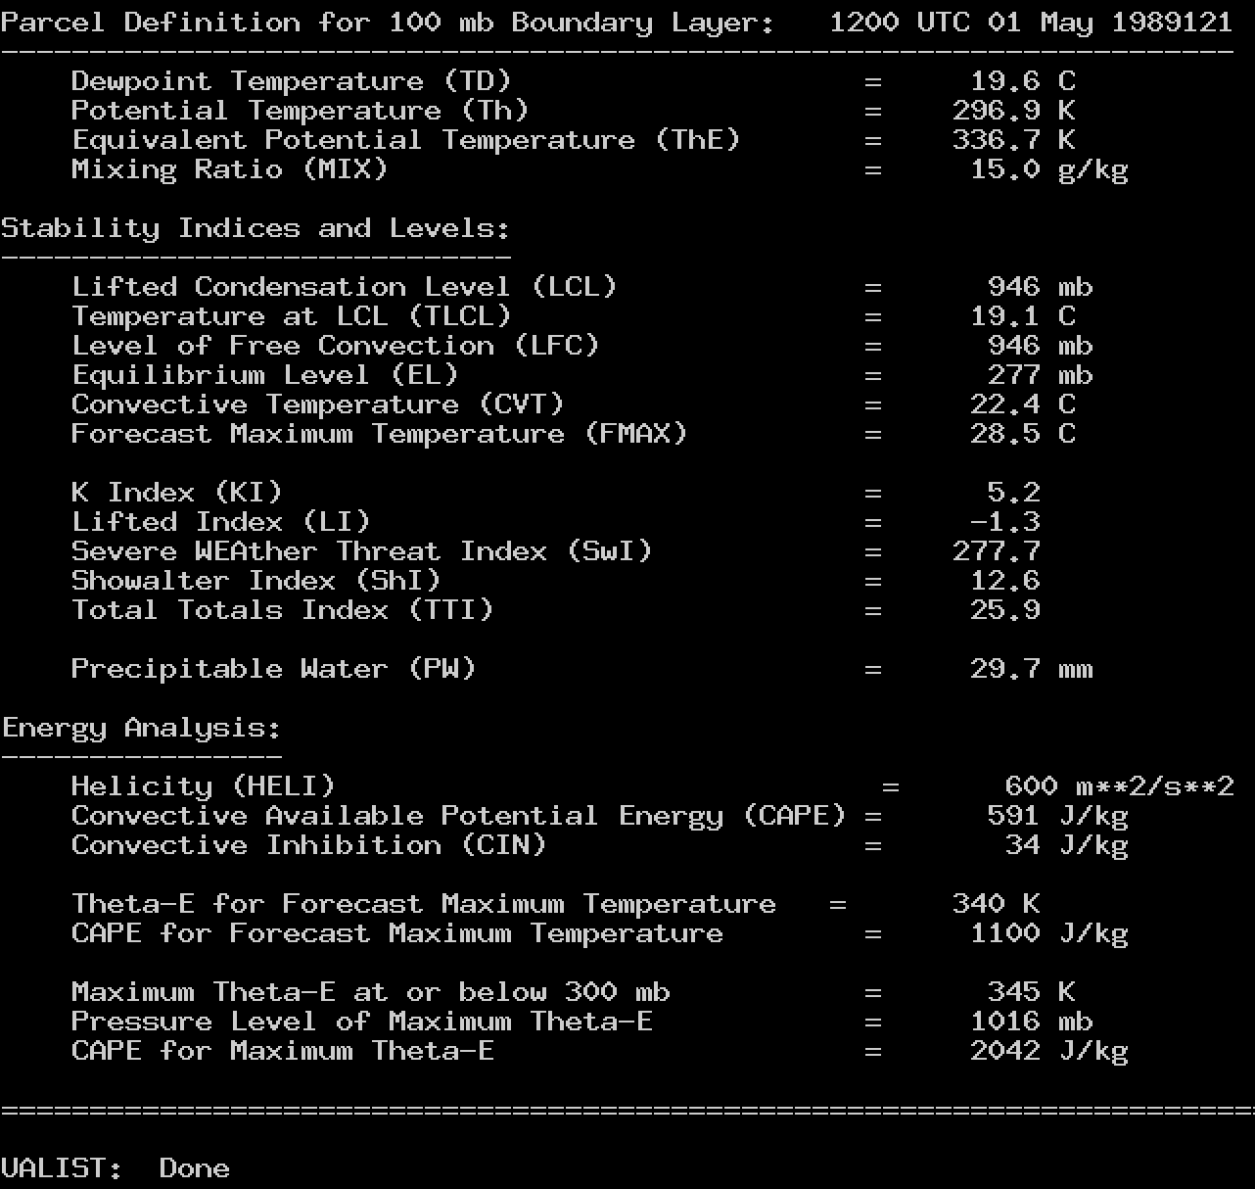
LFC/LCL, Precipitable water calculation adjustments for UA* commands

Slide 20
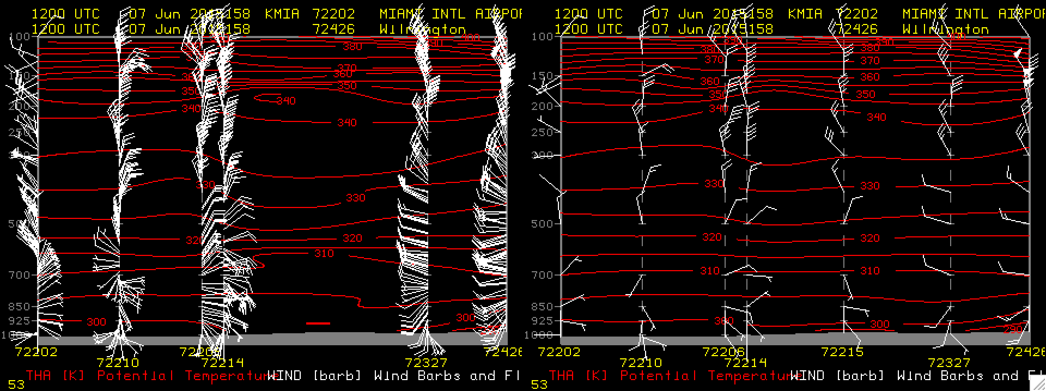
UACROSS with more than 100 levels
UACROSS KMIA KGRB SIG=YES PARAM=THA WINDB
New -XCD
Current -XCD

Slide 21
Point
Updates
Correctly interpret missing grid points with math calculations and contouring
DAY= keyword added to RAOBPLOT, RAOBCON, SFCPLOT, SFCCON to access archive server

Slide 22
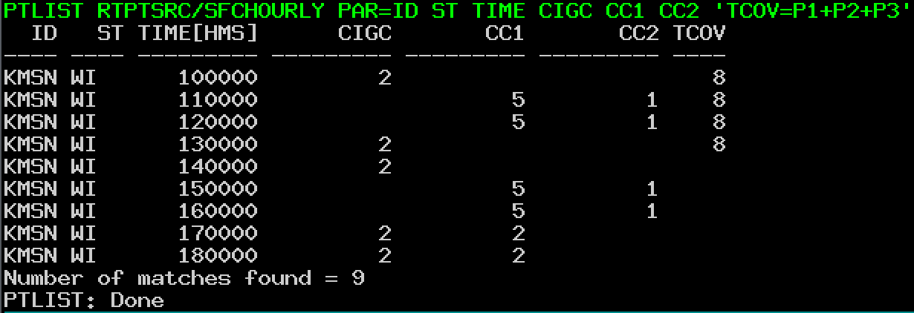
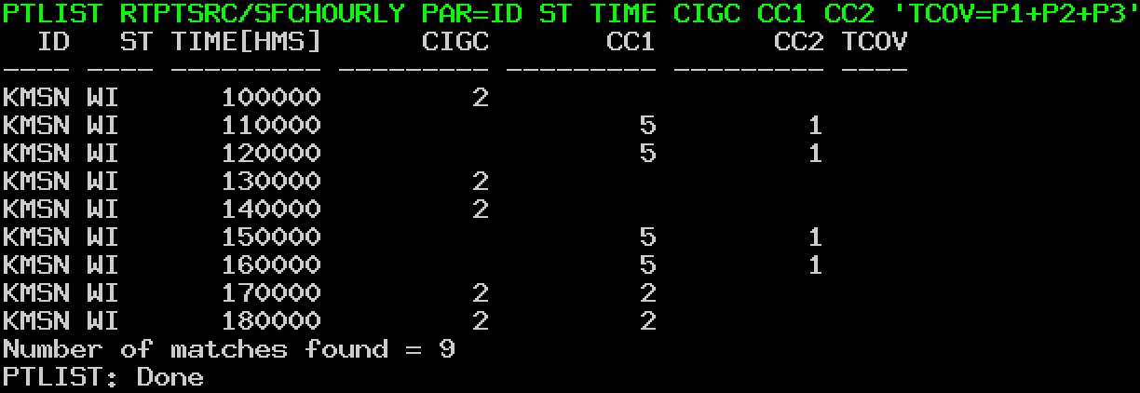
PTLIST computed parameters
with missing values

Slide 23
Miscellaneous
WWDISP/WWLIST: Blizzard Watch enabled
FRMLABEL/ZA: DESC placeholder added to list band description of an image

Slide 24
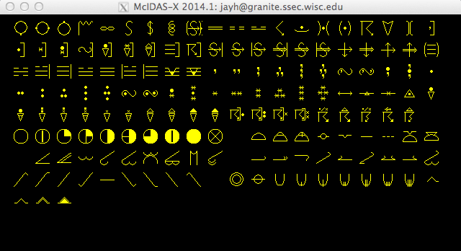
WXSYMB (-XRD)

Slide 25
Miscellaneous
GZIP/GUNZIP included for ADDE
Updated AWIPS servers for north pole projection
Update to maps and station database (NOAA sources)
Increased maximum number of points for PTCON to 10,000,000

Slide 26
Miscellaneous
Improved handling of large grids
Added display swath width to NAVDISP for Fengyun and Metop satellites

Slide 27
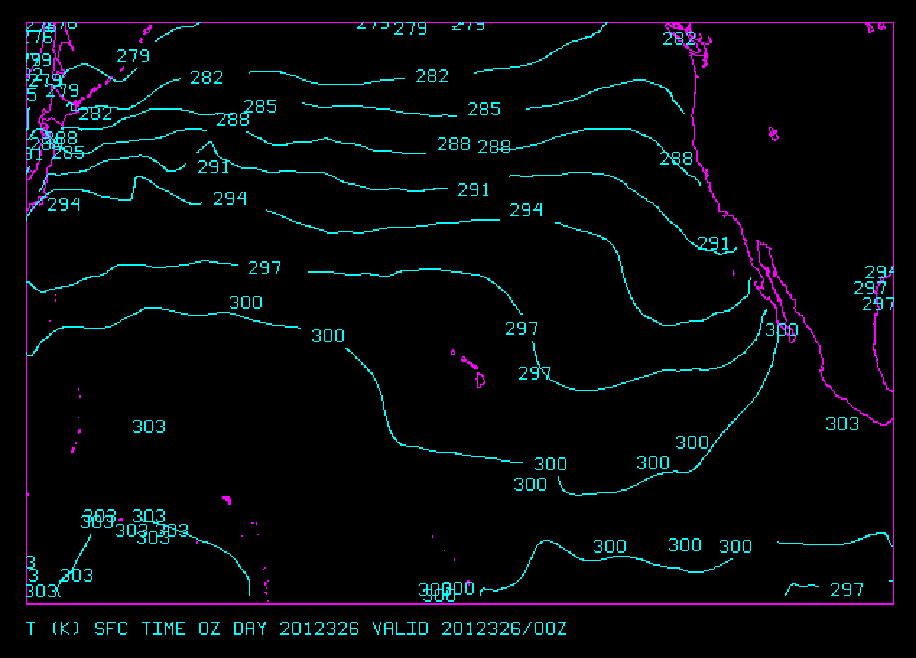
Access to large grids
Change in g2clib code vs. Using –ulimit

Slide 28
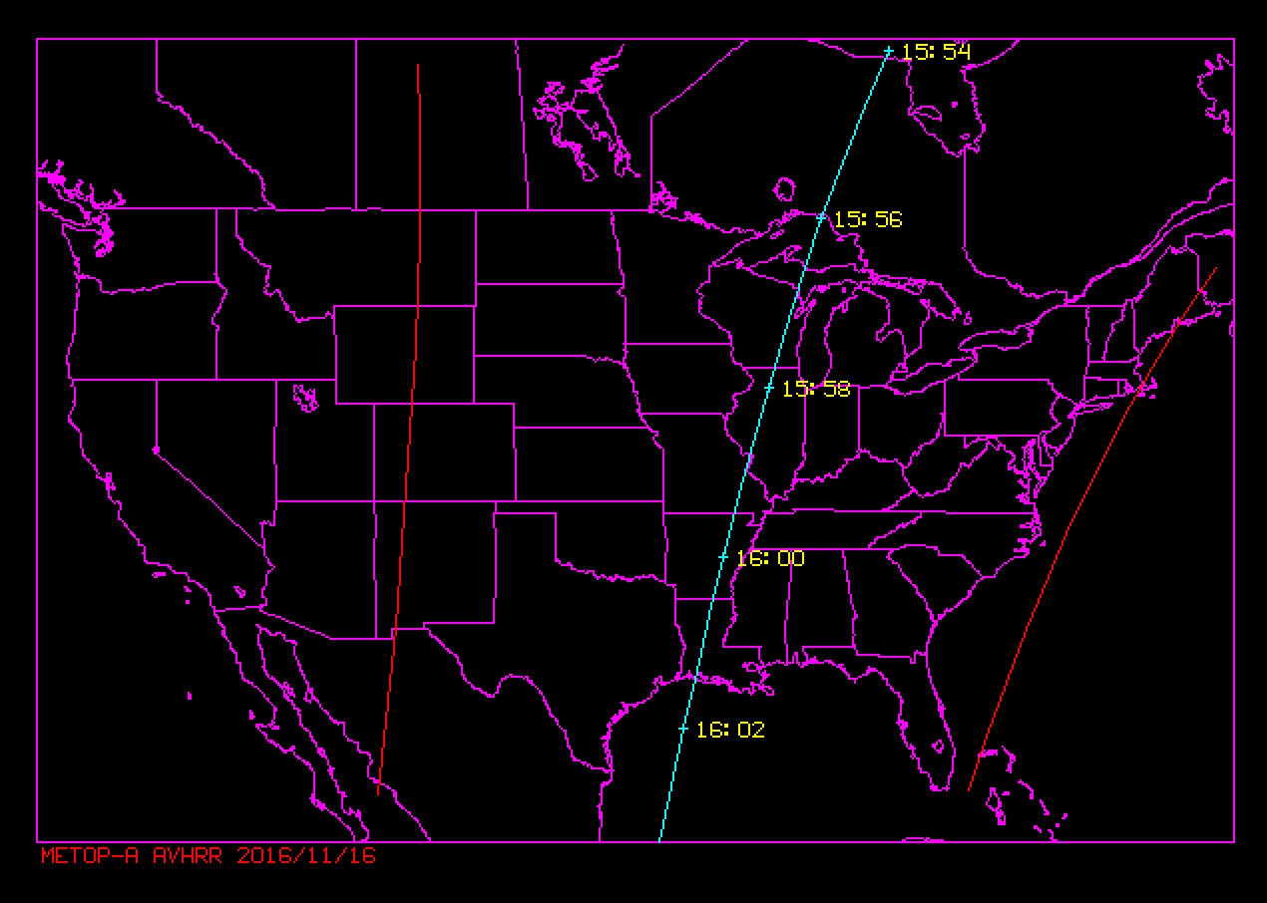
NAVDISP of Metop AVHRR

Slide 29
…..and beyond
VIIRS ADDE Server to –XRD planned
Limited functionality
Multi-band transfers for GOES-R ABI
Increase maximum image size beyond 4096 elements (graphics limitation)
Next generation ADDE servers

Slide 30
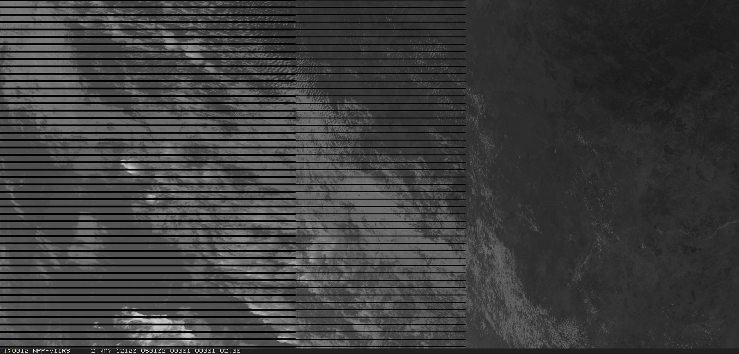
VIIRS ADDE Server
Left half of VIIRS granule with bowtie deletion

