Slide 1







Implementation of IMAPP/IDEA-I over the Po Valley region, northern Italy, for air quality monitoring and forecasting
CSPP/IMAPP
Users’ Group Meeting
Madison, Wisconsin (USA)
21-24 May 2013
Arvani⁽¹⁾ B., Pierce⁽²⁾ R. B.,
Teggi⁽¹⁾ S., Bigi⁽¹⁾ A., Ghermandi⁽¹⁾ G.
(1) University of Modena and Reggio Emilia, Italy
(2) NOAA/NESDIS Advanced Satellite Products Branch, Madison, Wisconsin USA
Notes:
“Good afternoon at everyone! I am Barbara Arvani, I am a PhD student from the University of Modena in Italy.
Today I am going to present the implementation of IMAPP/IDEA-I over the Po valley region, in the northern Italy (where I live), for an air quality assessment and forecast.”

Slide 2
Outline
Po Valley Domain: area of interest
IMAPP IDEA-International Application
PM₁₀ – AOD Correlation: ground stations over Po Valley
Aerosol vertical distribution: analysis of PBL information
PM₁₀ – AOD Correlation improvement: use of PBL information over the Po Valley
Conclusion
Outgoing and Future work
CSPP/IMAPP Users' Group Meeting 2013
Notes:
“In particular, we will see more in detail the Po Valley domain, the area of our interest and we have considered for our study.
Then the application of IMAPP IDEA-I over the Po Valley.
The core of my presentation will be to show you the PM10 – AOD (Aerosol Optical Depth) correlation analysis that we conducted over the Po Valley. We will start by considering just the PM10-AOD correlation; then we will introduce the aerosol vertical distribution – in particular we will consider the Planetary Boundary Layer information and we will see how the use of these kind of information will improve the PM10 – AOD correlation over the Po valley domain.
The last part of the presentation will be reserved to the conclusion and future work!”

Slide 3
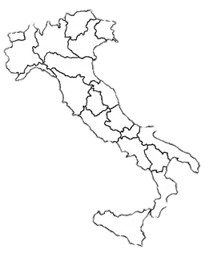
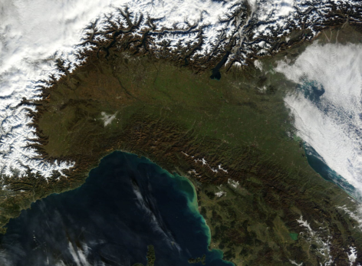
Po Valley
Specific geographic domain of interest
The largest industrial, trading and agricultural area with a high population density
MI
Area with the most severe air pollution problems in the country
TO
40° - 50° N
5° - 15° E
Alpine chain acts as a barrier to winds blowing from Northern Europe and the Mediterranean,
favoring the stagnation of pollutants
Notes:
“The Po valley is the specific geographic domain of interest, that we considered for our study. The reason of this choice is the Po Valley is the largest industrial, trading and agricultural area, with a very high population density - in particular the two cities of Milan and Turin are the two main cities in the area - . As result, this area is the area with the most severe air pollution problems in the country, with SEVERE DESEASE PROBLEMS! The presence of Alpine chain in the north of the valley and in the south west, favoring the stations of pollutants because acts as a barrier to winds blowing from the Nord of Europe and the Mediterranean sea.”

Slide 4
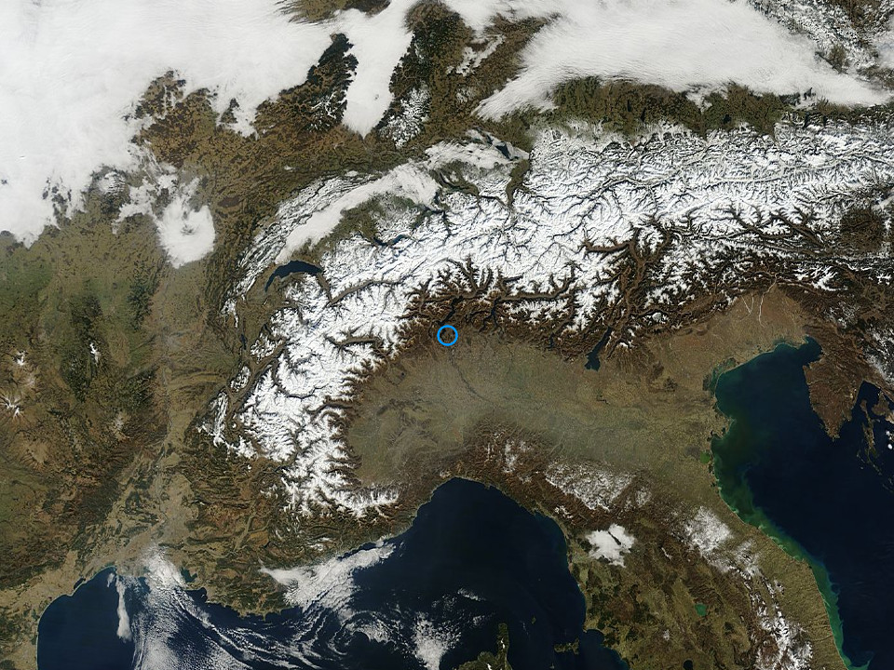
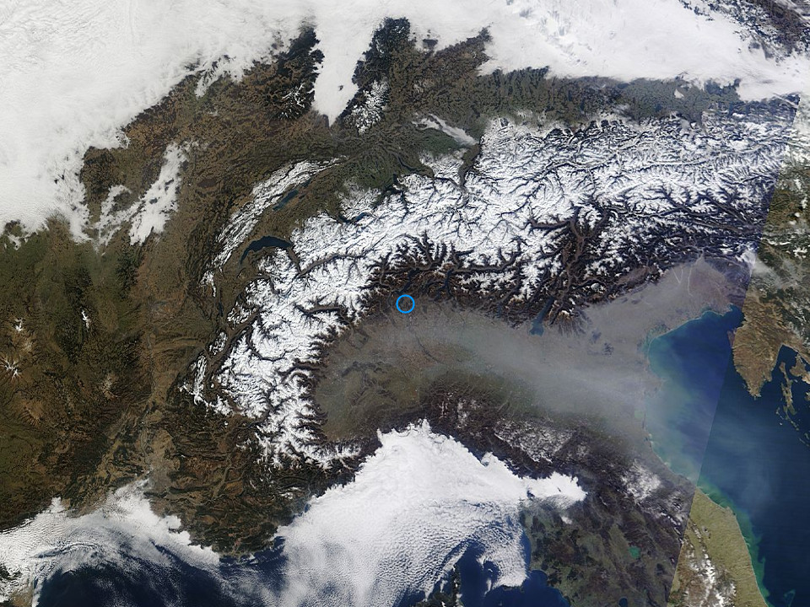
Po Valley IDEA-International Application (I)
March 1, 2012
March 2, 2012
Pollution
AERONET_Ispra.2012061.terra.1km
AERONET_Ispra.2012062.terra.1km
MODENA
CSPP/IMAPP Users' Group Meeting 2013
Notes:
“Last year I have the opportunity to spend a period like Visiting scholar at CIMSS, after my master degree in physics.
During that period I was interested on Air quality assessment. Due to this my interest and my future study plans, we decided to install IDEA-I at University of Modena, my homeland university, to study the polluted area of Po valley and start my PhD period of study.
In this slide, a day as example is shown: March 2, 2012. It has been considered this day an example of a very polluted day. The visible image from Terra at 1 km shows a polluted area on East side of the valley and this image is compared with the day before, where no pollution appear.”

Slide 5
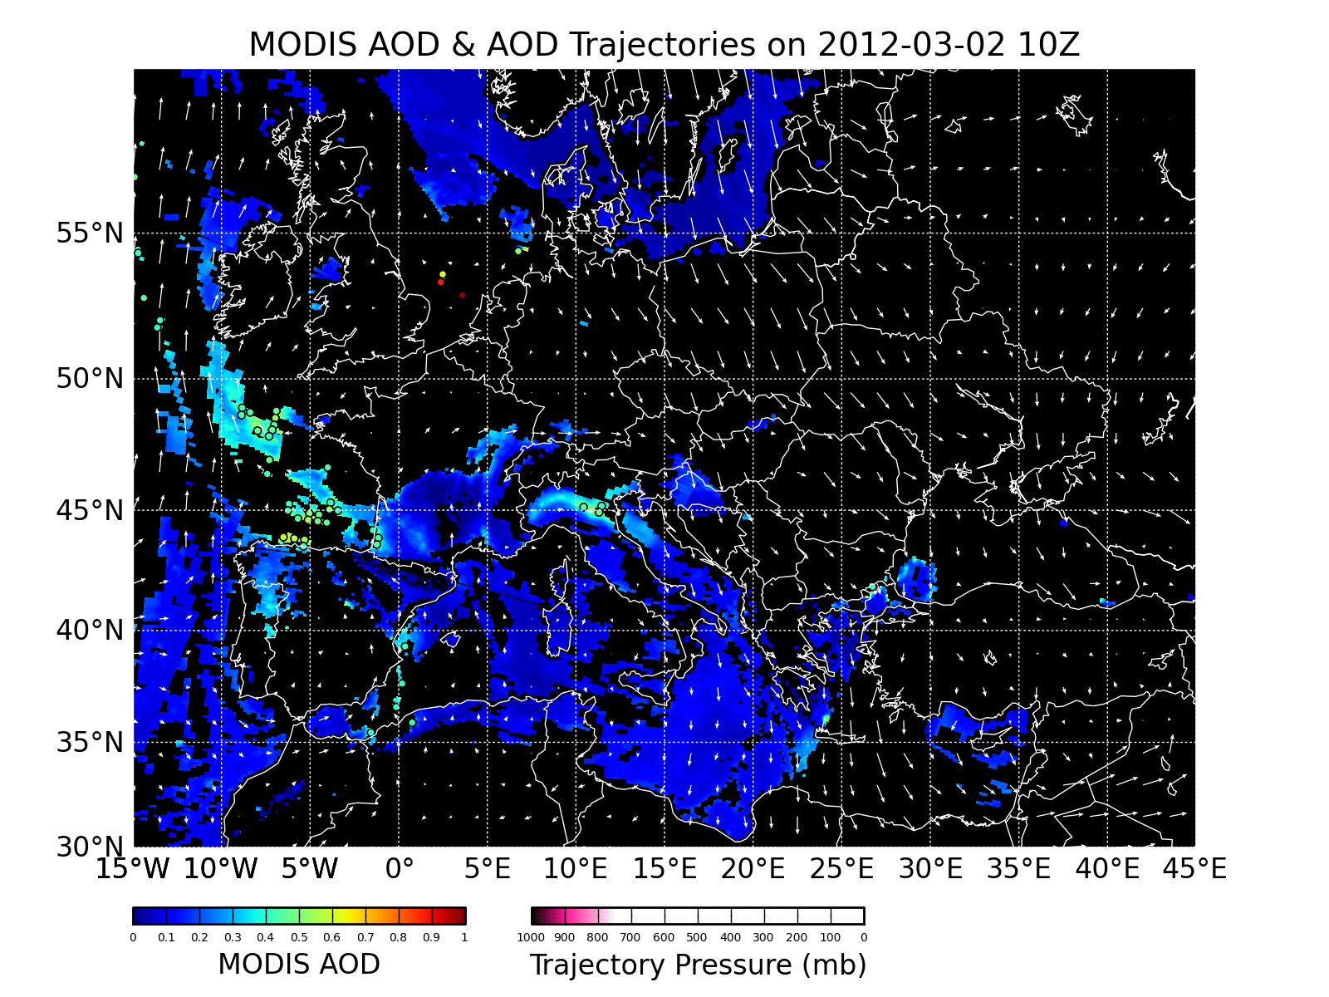
Po Valley IDEA-International Application (II)
The use of Terra or Aqua MODIS AOD (Aerosol Optical Depth) products – available daily –
by IDEA-I permits
real-time air quality forecasts
VENTING OF AEROSOL TO SOUTH-EAST
HOW DOES MODIS AOD COMPARE TO SURFACE PM₁₀ IN THE PO VALLEY?
↑ PM_{10 OR} ↑ PM₁₀
↑ AOD ↓ AOD
BACKGROUND BASEMAP:
daily Terra MODIS AOD product (MOD04)
USED TO INITIALIZE TRAJECTORIES
WHICH SHOW WHERE THE AEROSOL WILL MOVE IN THE NEXT 48 HRS.
CSPP/IMAPP Users' Group Meeting 2013
Notes:
“The polluted air quality condition of March 2, 2012 has been investigated with an IDEA-International run, that shown high values of AOD on the east side.
So, just a couple of information about IDEA-I:
The use of Terra or Aqua MODSI Aerosol Optical Depth products, that are available every day, by IDEA-I permits a real time air quality forecasts.
If we pay attention at the image, the background basemap is represented by the daily terra MODIS AOD product MOD04. It is used INITIALIZE TRAJECTORIES WHICH SHOW WHERE THE AEROSOL WILL MOVE IN THE NEXT 48 HRS.
Again, by considering as example the day March 2, 2012, the aerosol trajectories show venting of aerosol to south-east.
The application of IMAPP IDEA-I over the Po Valley domain has been, and at this moment is, the first step of investigation on the existing PM10 – AOD correlation.”

Slide 6
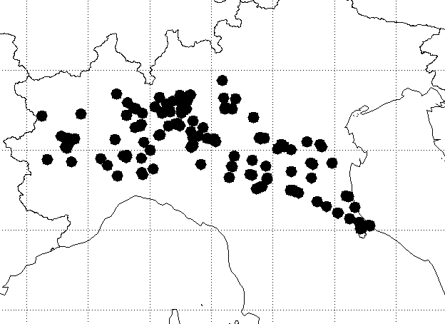
Po Valley Surface PM₁₀ Network
Specific geographic domain of interest
DISTRIBUTION OF
126 AIR QUALITY GROUND MONITORING STATIONS OF ARPA NETWORK FOR PM₁₀ MEASUREMENTS
40° - 50° N
MODIS (Terra) AOD DATA AT 0.55 μm WITH
10x10 km² OF SPATIAL RESOLUTION
5° - 15° E
Notes:
“ Now, we are ready to move our attention to the PM10-AOD analysis more in details. For our analysis we have used a distribution of 126 air quality ground monitoring stations of ARPA network(that is the Italian regional Agency for Environmental Protection) where we downloaded the Particulate Matter (in particular and for the moment the PM10), figure on the left.
About the Aerosol Optical Depth data, we have considered MODIS Terra AOD data at 0.55 um with a spatial resolution of 10 km square.”

Slide 7
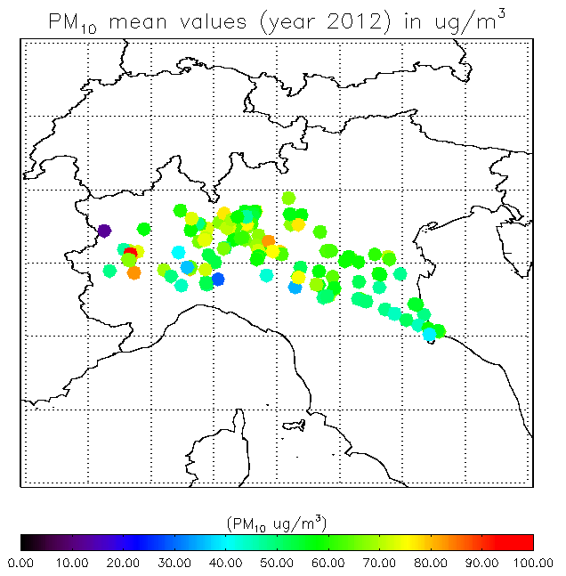
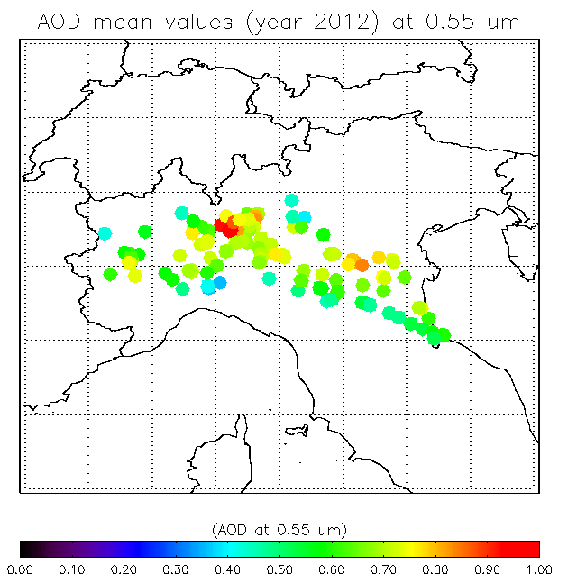
Po Valley Surface PM₁₀ vs AOD
HIGHER VALUES OF MEAN AOD DO NOT APPEAR TO CORRESPOND TO HIGHER SURFACE PM₁₀
CSPP/IMAPP Users' Group Meeting 2013
Notes:
“ the spatial distribution of PM10 mean values – calculated over the whole year of 2012, per each ARPA site – is compared with the spatial distribution of MODIS AOD mean values.
The comparison of the two spatial distribution seem to show that higher values of mean AOD do not appear to correspond to higher values of surface PM10.”

Slide 8
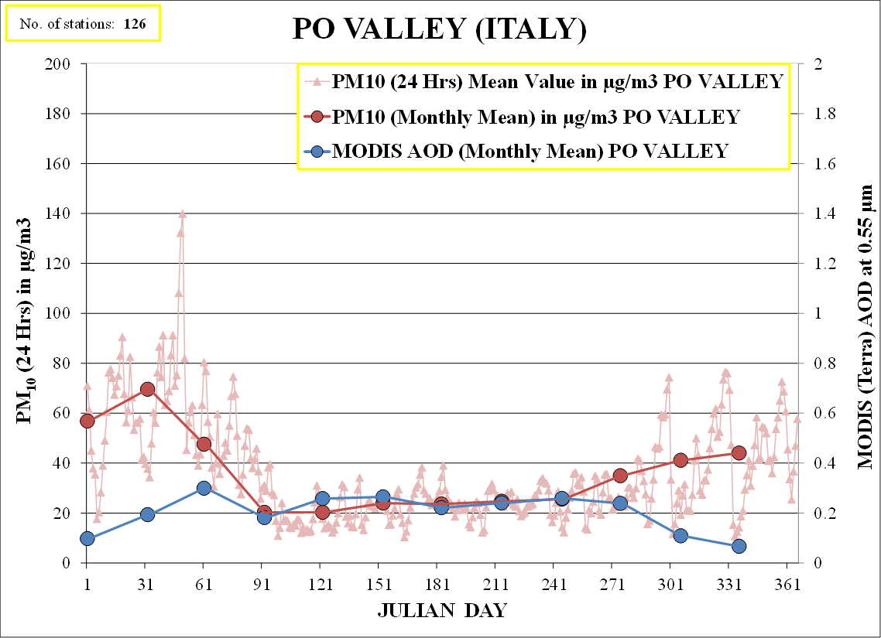
PM₁₀ – AOD Correlation (I)
TRENDS NOT COMPARABLE FOR THE FALL/WINTER SEASONS
YEAR 2012
Variation in PM₁₀ mass concentration (μgm⁻³) and MODIS AOD at 0.55 μm over Po valley during 2012
56.8
22.6
0.22
0.10
APR
SEP
CSPP/IMAPP Users' Group Meeting 2013
Notes:
“ this seems to be confirmed also if we consider a seasonal analysis.
One year (2012) of data has been considered.
The seasonal trends are not comparable if the fall and the winter seasons are considered, instead of a much better comparison if we look at the summer period. “

Slide 9
PM₁₀ – AOD Correlation (II)
CORRELATION
MAY BE IMPROVED BY CONSIDERING:
METEOROLOGICAL DATA
VERTICAL DISTRIBUTION OF AEROSOL
CSPP/IMAPP Users' Group Meeting 2013
Notes:
“ As suggested by the literature, the PM10 – AOD correlation may be improved. This could be due by considering meteorological data information or vertical distribution of aerosol.
As first step, we have concentrated our attention on vertical distribution of aerosol; we have introduced information of Planetary Boundary Layer over the Po Valley.”

Slide 10
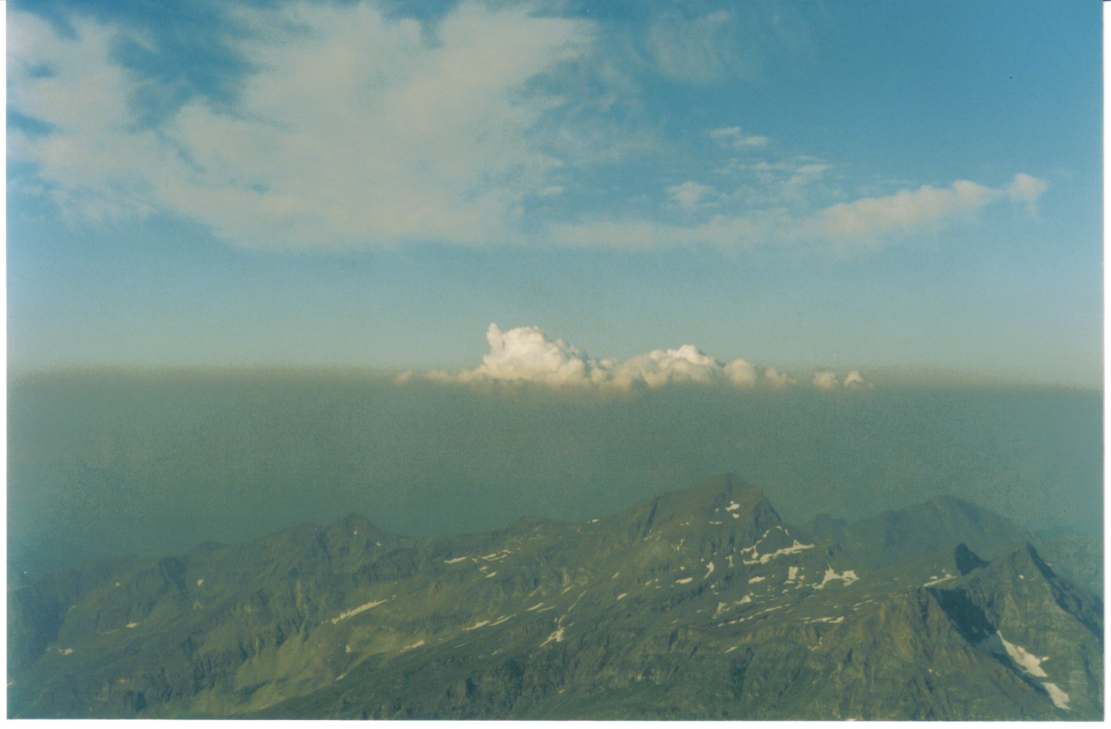

Aerosol vertical distribution:
PBL Information
Planetary Boundary Layer
the lowest part of the atmosphere, directly influenced by its contact with the Earth’s surface.
Aerosol Optical Depth (AOD) from Remote Sensing measurements
A
O
D
AEROSOL CONFINED AND MIXED HOMOGENEOUSLY WITHIN BOUNDARY LAYER
A
O
D
THE VALUES OF AOD NORMALIZED BY PBL HEIGHT (ZPBL) MAY BE REGARDED AS MEAN PBL EXTINCTION (km⁻¹)
Height
PBL Height
Extinction coefficient
CSPP/IMAPP Users' Group Meeting 2013
Notes:
“If we consider the Aerosol Optical Depth from Remote Sensing measurements we intend an INTEGRAL FORM OF AEROSOL COEFFICIENT EXTINCTION, FROM THE SURFACE TO THE TOP OF THE ATMOSPHERE, as well shown in figure of this slide.
The Planetary Boundary Layer is the lowest part of the atmosphere, directly influenced by its contact with the Earth’s surface.
We introduce the Planetary Boundary information over the Po Valley to improve the poor PM10 – AOD correlation analyzed before.
So, under the hypothesis that the aerosols are confined and mixed homogeneously within boundary layer, under this hypothesis we can say that the AOD values normalized by PBL height may be considered as the mean PBL extinction in km minus 1. “

Slide 11
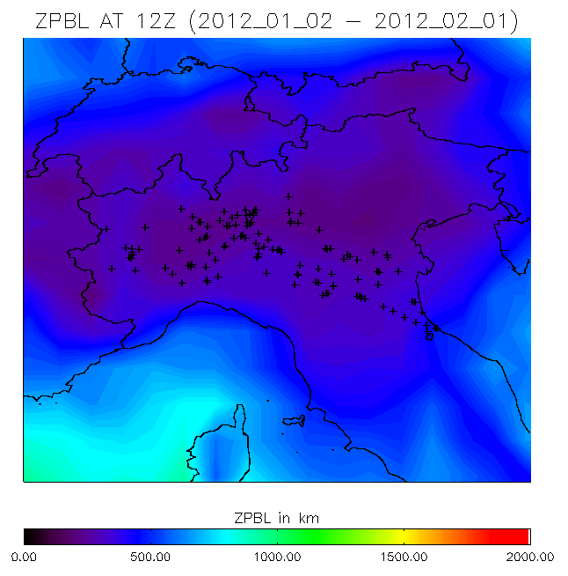
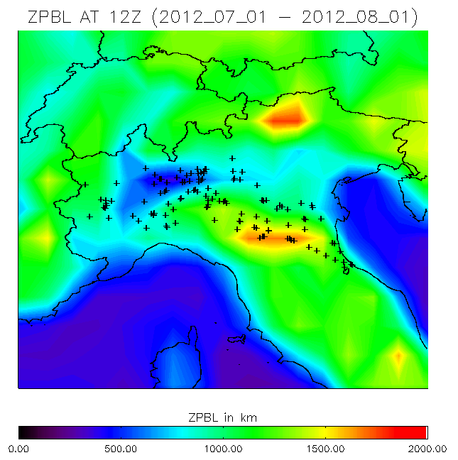
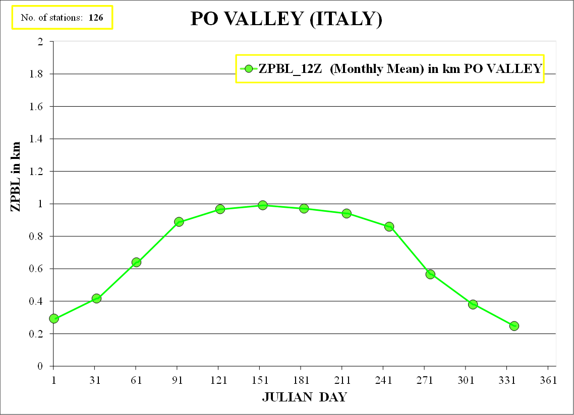
PM₁₀ – AOD Improvement:
use of PBL Information (I)
YEAR 2012
PBL values from GFS grib2 files are used, over Po valley during 2012
0.97
0.30
APR
CSPP/IMAPP Users' Group Meeting 2013
SEP
Notes:
“ As I have said before, we introduce the Planetary Boundary Layer information over the Po Valley to improve the PM10-AOD correlation.
As first step, we have used PBL values from GFS grib2 files and the whole 2012 year has been considered.
If we consider the seasonal trend over the Po valley, we have low values during the winter – in particular 0.3 km in January – and high values during the summer – in particular 0.97 km in August.

Slide 12
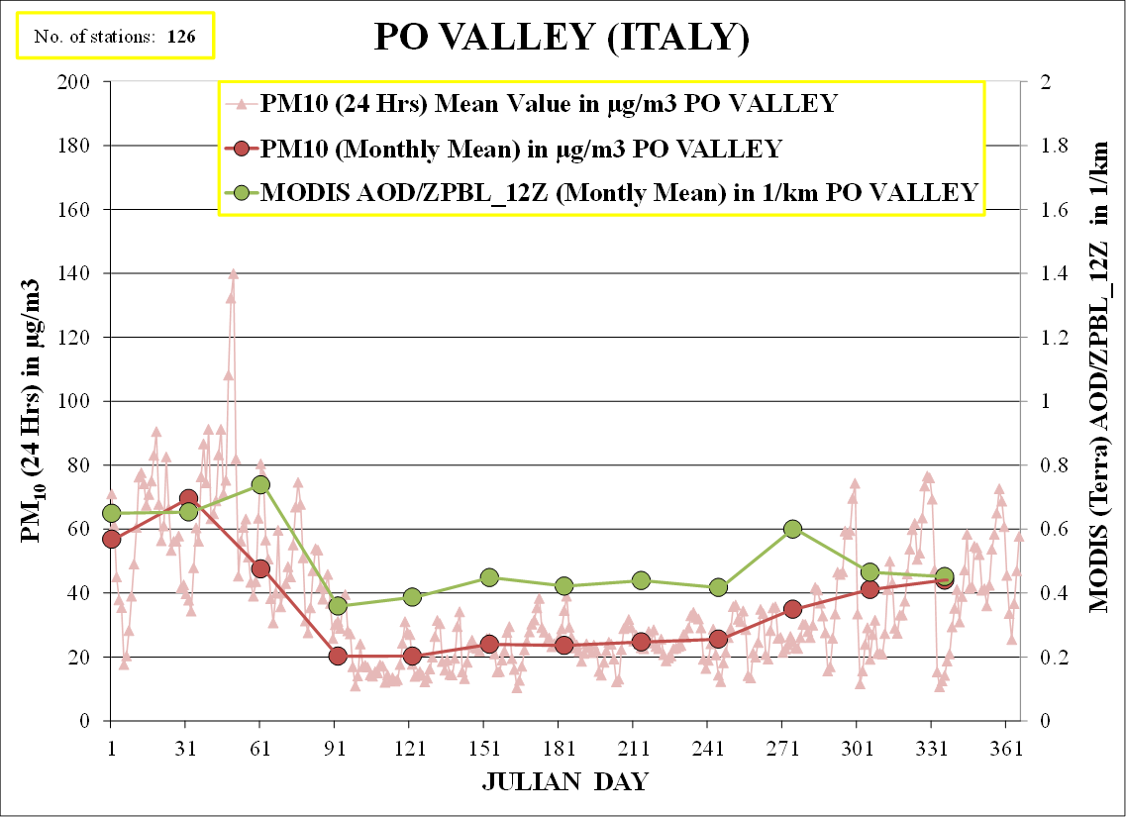
The majority of aerosol abundance resides in the PBL
The thickness of PBL has direct impacts on the correlation between AOD and PM
PM₁₀ – AOD Improvement (II)
TRENDS MORE COMPARABLE FOR THE FALL/WINTER SEASONS
YEAR 2012
Variation in PM₁₀ mass concentration (μgm⁻³) and normalized MODIS AOD at 0.55 μm by ZPBL over Po valley during 2012
0.65
0.42
56.8
22.6
APR
SEP
CSPP/IMAPP Users' Group Meeting 2013
Notes:
“ The ZPBL trend has a direct impact on the PM10- MODIS AOD correlation.
If we analysis the seasonal trend, we can notice a much stronger correlation. In particular, if we consider the winter and the fall period the trends appear much more comparable than before. “

Slide 13
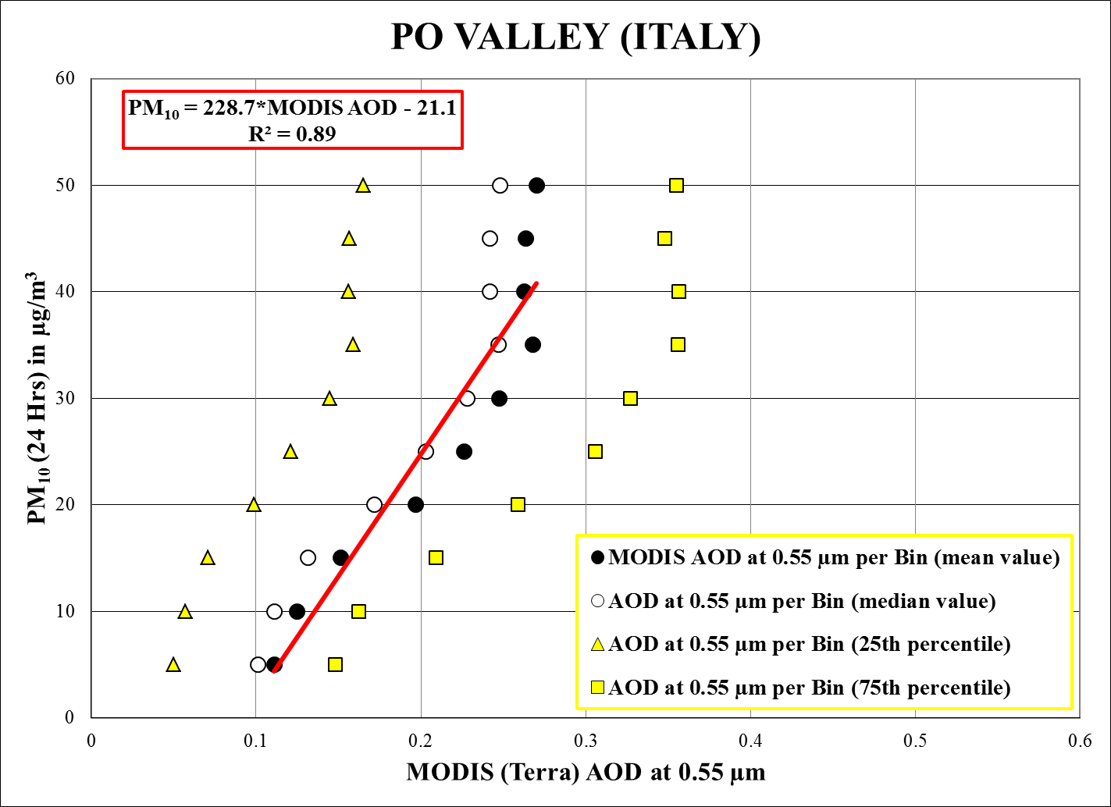
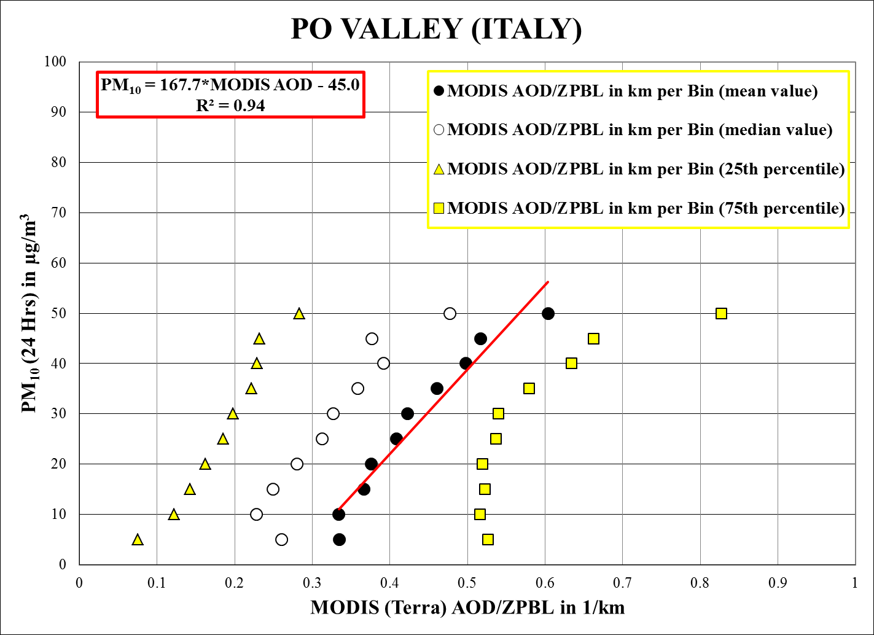
PM₁₀ – AOD Correlation (II)
LINEAR REGRESSION EQUATION DERIVED BY DIVIDING PM₁₀ (24 Hrs) INTO 10 BINS OF 5 μgm⁻³ INTERVALS
(Gupta et al., 2006)
THE CORRELATION
PM - AOD/ZPBL
IS HIGHER THAN THE
PM – AOD CORRELATION
CSPP/IMAPP Users' Group Meeting 2013
Notes:
“ So, the seasonal analysis has suggested an improvement if MODIS AOD normalized ZPBL is considered. This result is confirmed also if we analysis a statistic result.
The scatter plot between MODIS AOD data at 0.55 um and PM10 shows a good correlation, that it improves from the PM-AOD correlation with an R square of 0.89, to the PM-AOD/ZPBL correlation with an R square of 0.94.
The linear regression equation has been derived by dividing the PM10 values into 10 bins of 5 ug/m3 intervals. The corresponding AOD value is the mean into each intervals, as suggested by Gupta paper of 2006.”

Slide 14
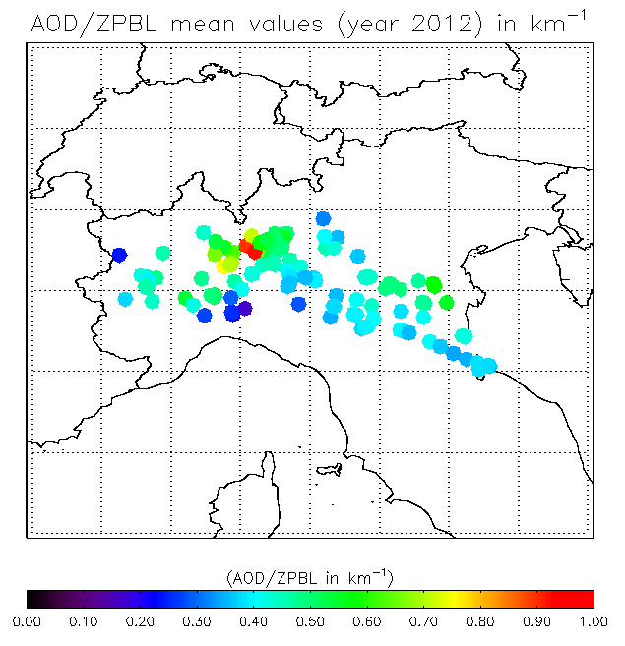
Po Valley Surface PM₁₀ vs AOD/ZPBL
VALUES OF MEAN AOD/ZPBL MATCH MEAN PM BETTER ON THE EASTERN SIDE OF THE PO VALLEY
CSPP/IMAPP Users' Group Meeting 2013
Notes:
“ and we close the analysis with the first result that I showed: the spatial distribution of the PM10 mean values over each ARPA site consider.
In this case, this result is compared with the AOD mean values normalized by the Planetary Boundary Layer height.
More comparable result are located in the east side of the valley (square on the right).
If we consider the square on the left, the high value of AOD normalized ZPBL is found, that it is not match with the PM10 mean value distribution.“

Slide 15
Conclusion
IMAPP IDEA-I aerosol forecasts heightens the comprehension of air quality within the Po Valley
MODIS AOD and AOD/ZPBL has been
co-located ground-based PM₁₀ concentration
measurements at 126 stations over the Po Valley
The correlation between PM₁₀ and AOD/ZPBL (R²=0.94) is found to be superior to the correlation between AOD and PM₁₀ (R²=0.89) within the Po Valley
CSPP/IMAPP Users' Group Meeting 2013

Slide 16
Outgoing and Future Work
Validation of GFS PBL analyses with CALIPSO measurements
Improvement of spatial resolution of MODIS AOD by using 1km MAIAC retrieval (Lyapustin, A. et al., 2011)
CSPP/IMAPP Users' Group Meeting 2013
Notes:
“

