Slide 1
Moore, Oklahoma, Tornado Summary
Event Date: May 20, 2013
Jordan Gerth and Scott Bachmeier
Cooperative Institute for Meteorological Satellite Studies, University of Wisconsin at Madison

Slide 2
Fronts at 1 PM CDT, May 20, 2013

Slide 4
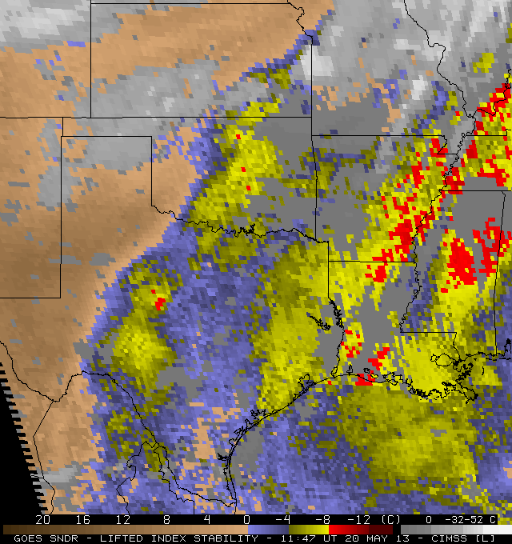
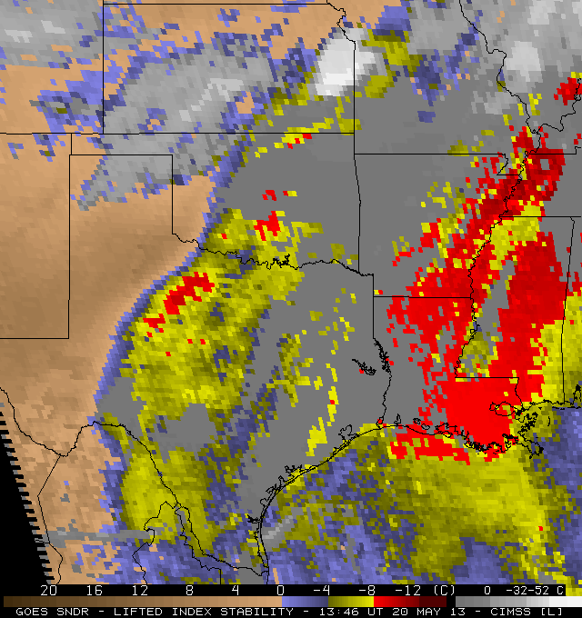
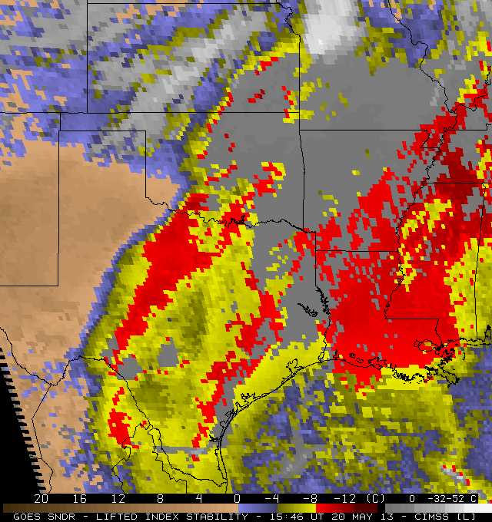
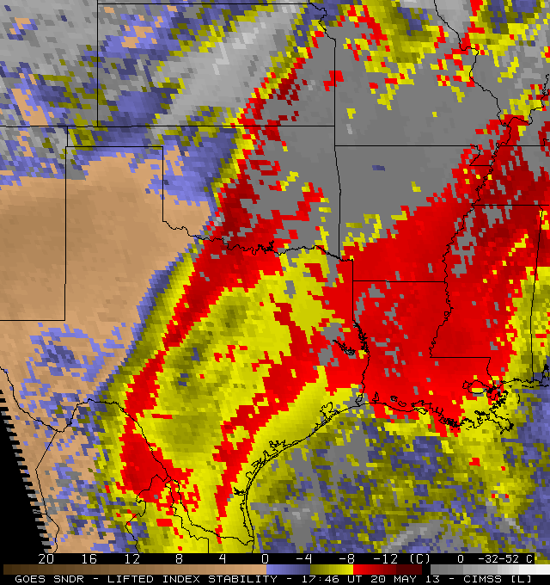
7 AM CDT (12 UTC)
9 AM CDT (14 UTC)
11 AM CDT (16 UTC)
1 PM CDT (18 UTC)
Image Credit: Gary S. Wade

Slide 5
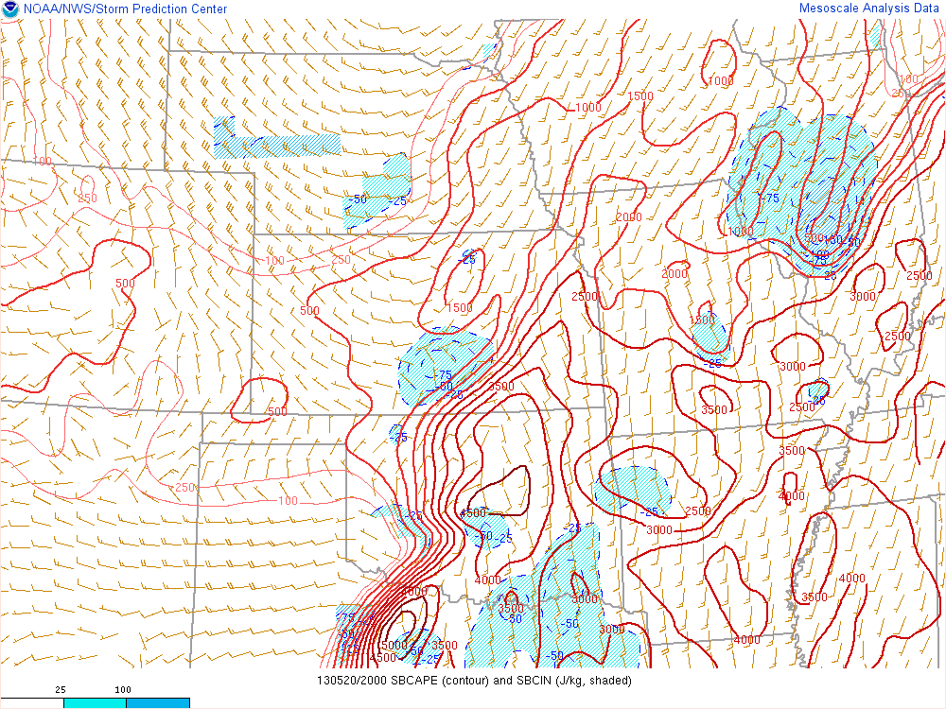

Slide 6
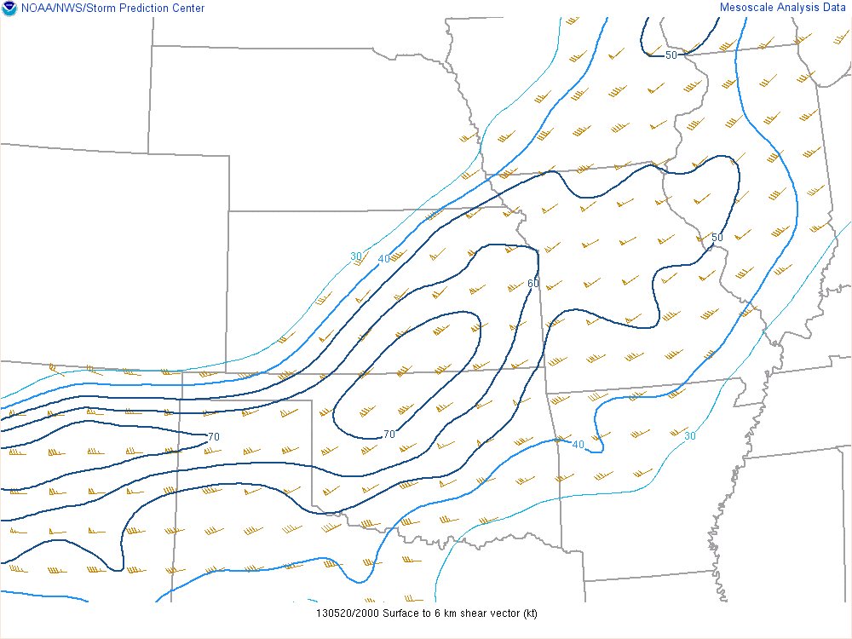

Slide 7
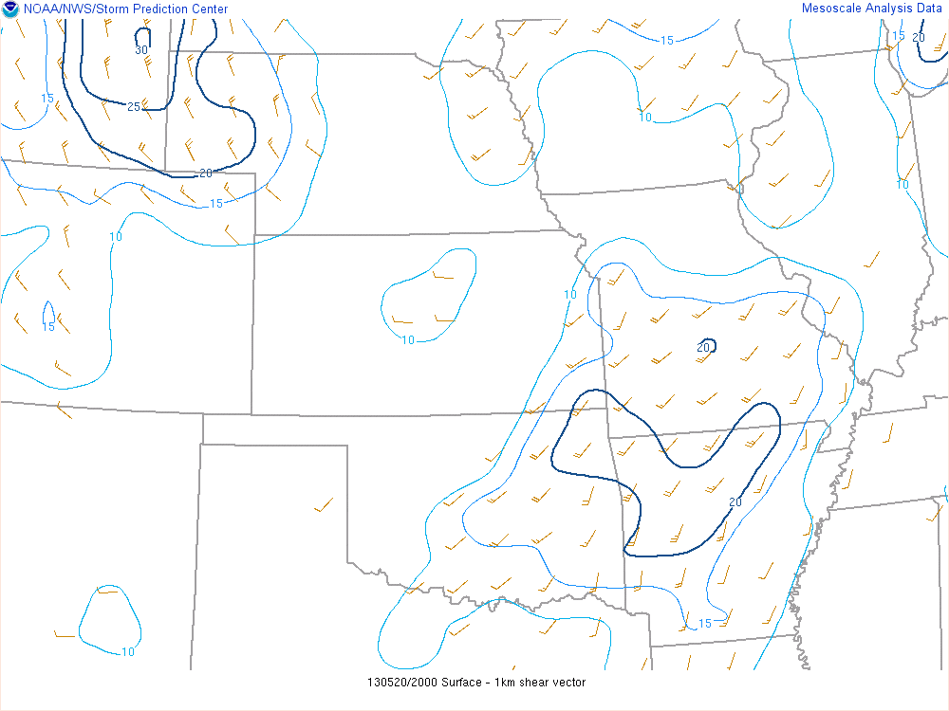

Slide 8
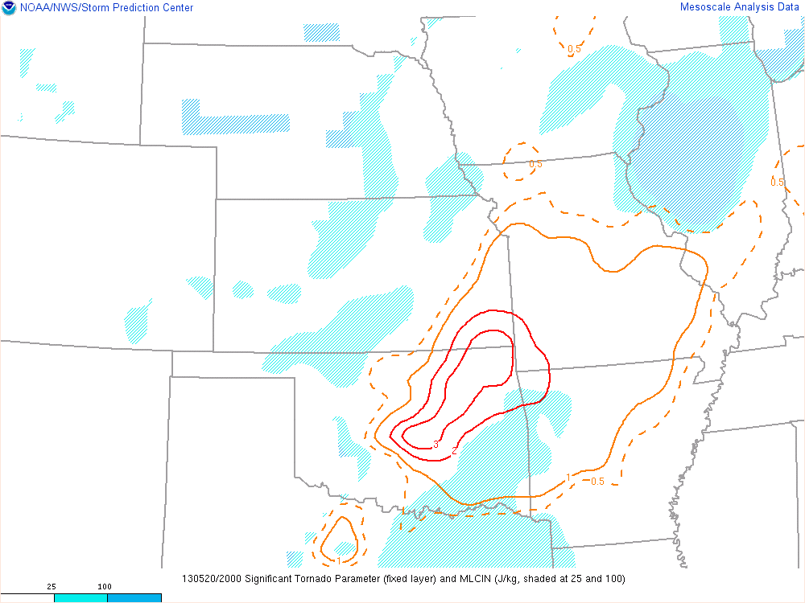

Slide 9
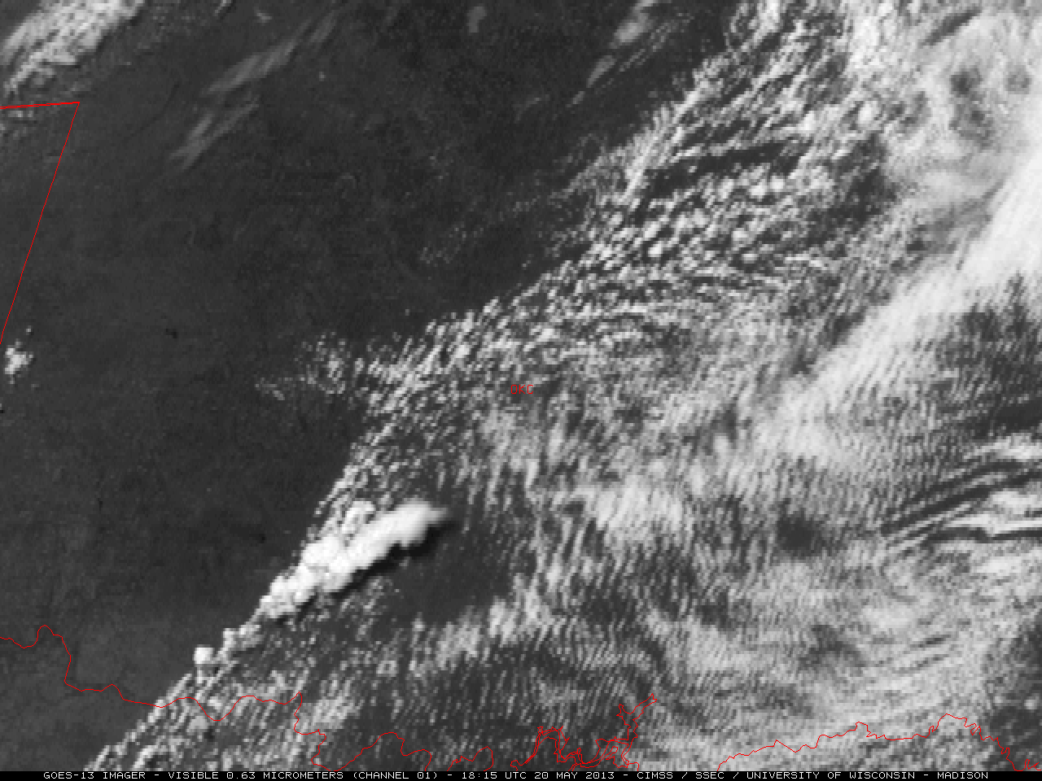

Slide 10
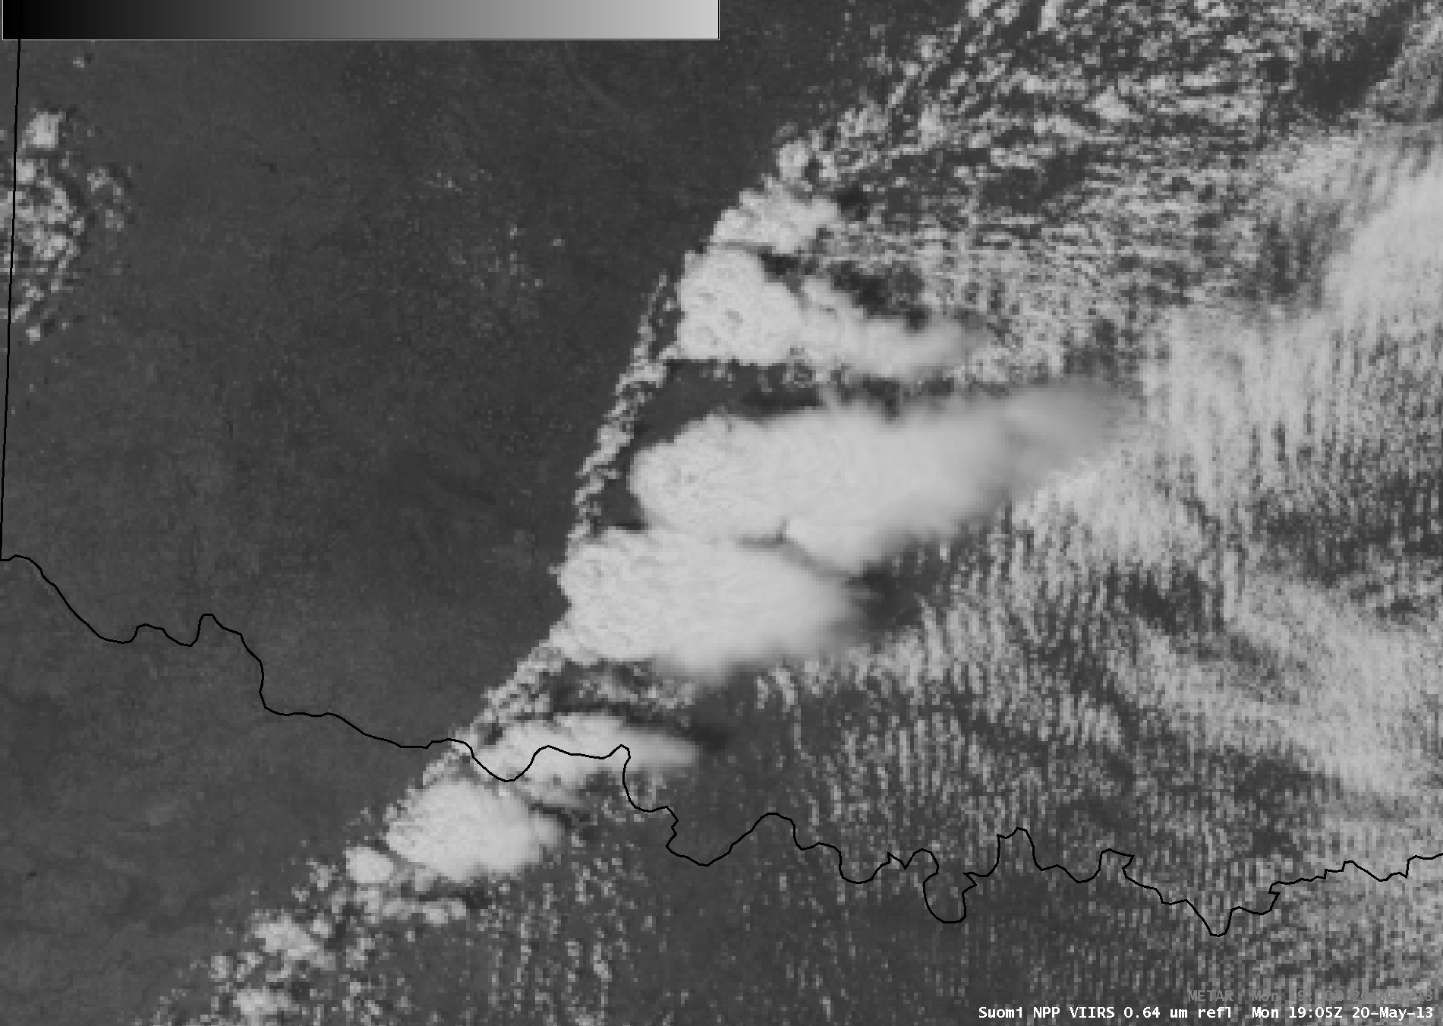

Slide 11
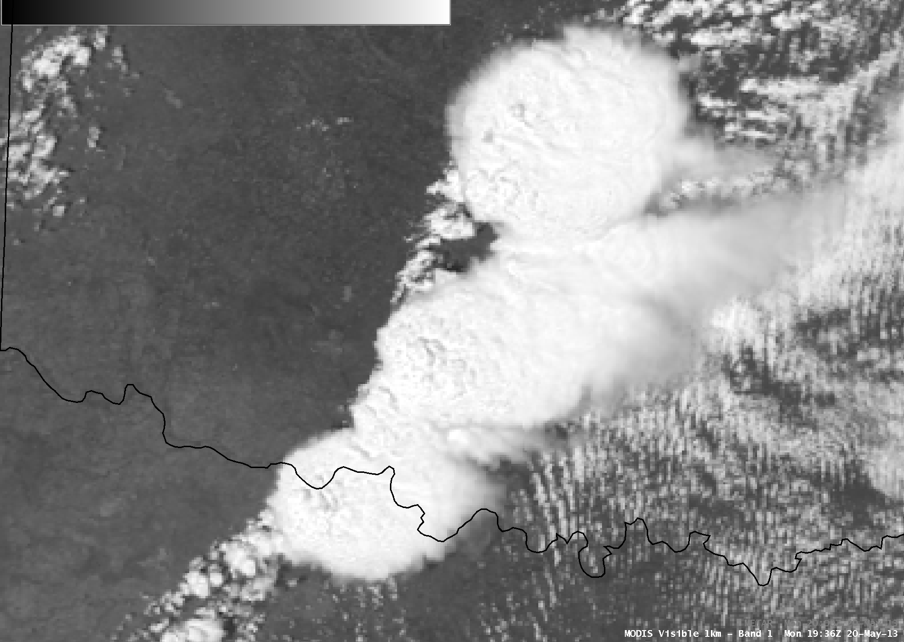

Slide 12
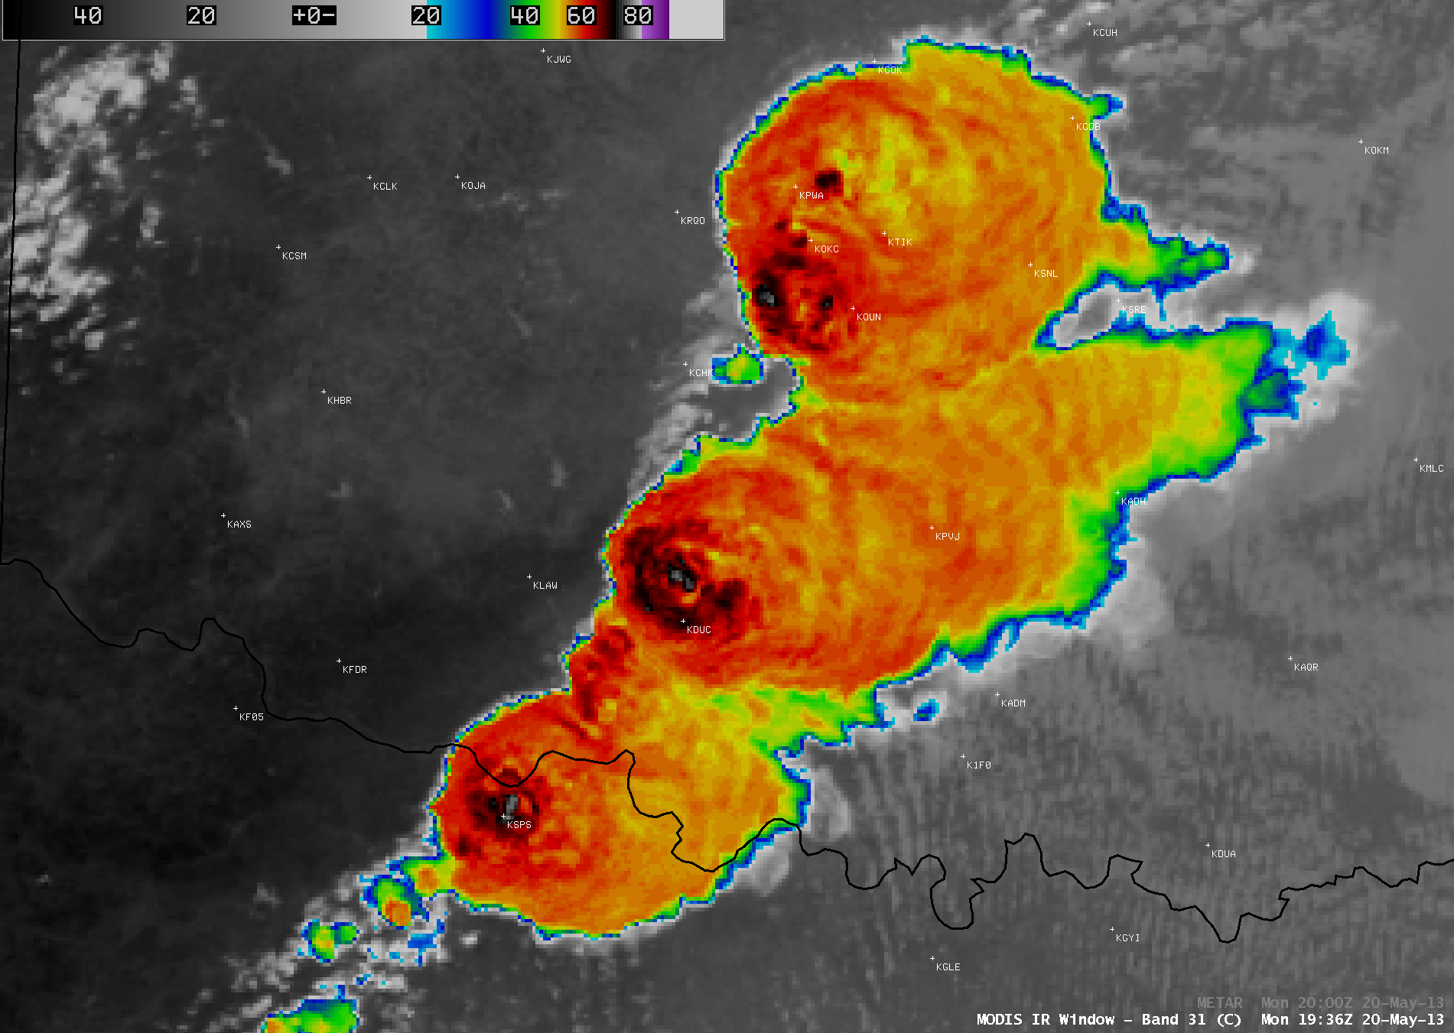

Slide 13
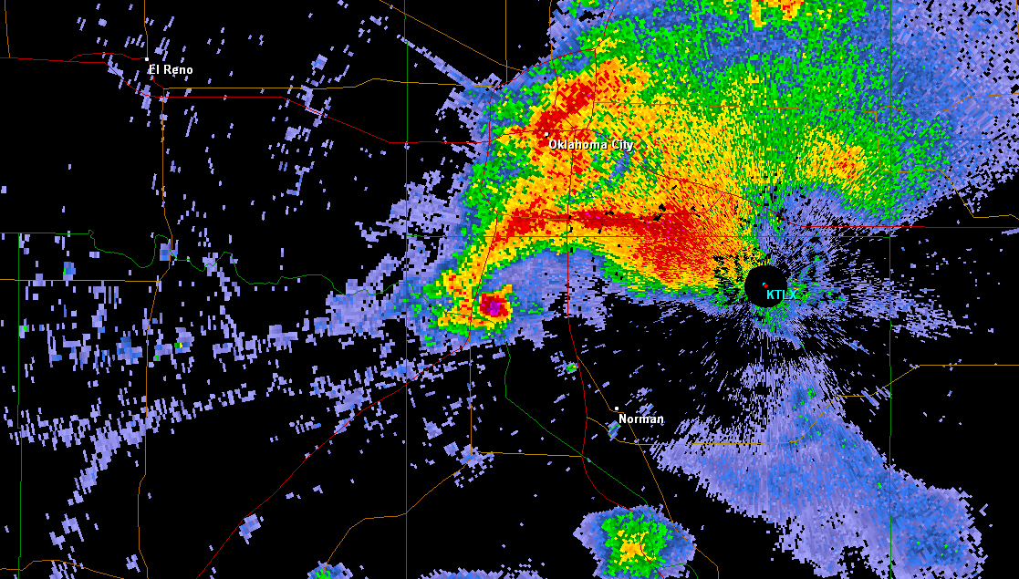
20:08 UTC (3:08 PM CDT) May 20, 2013

Slide 14
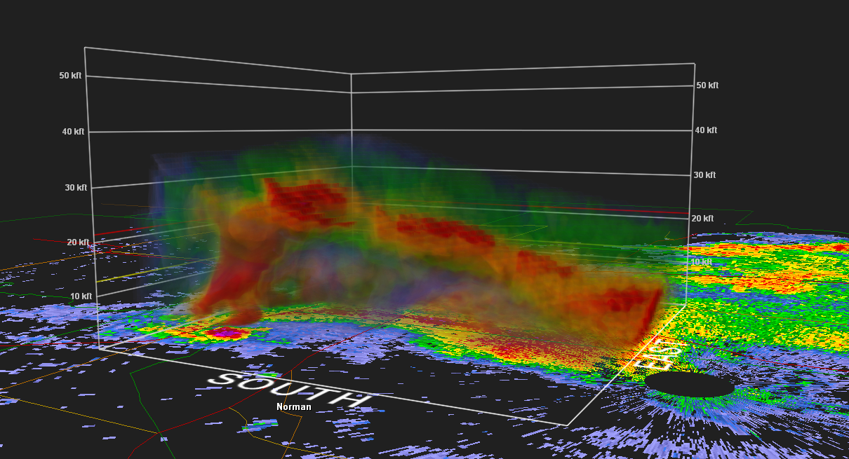
20:08 UTC (3:08 PM CDT) May 20, 2013

Slide 15
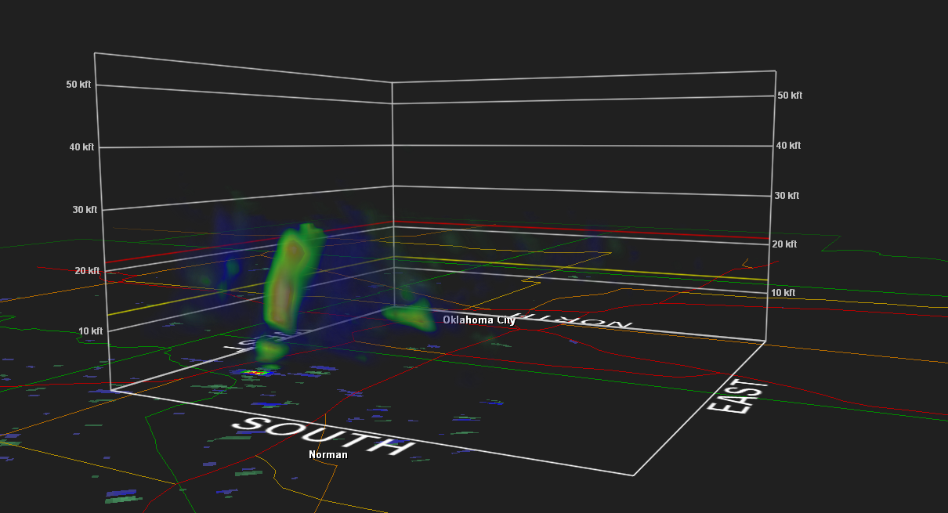
20:08 UTC (3:08 PM CDT) May 20, 2013

Slide 16
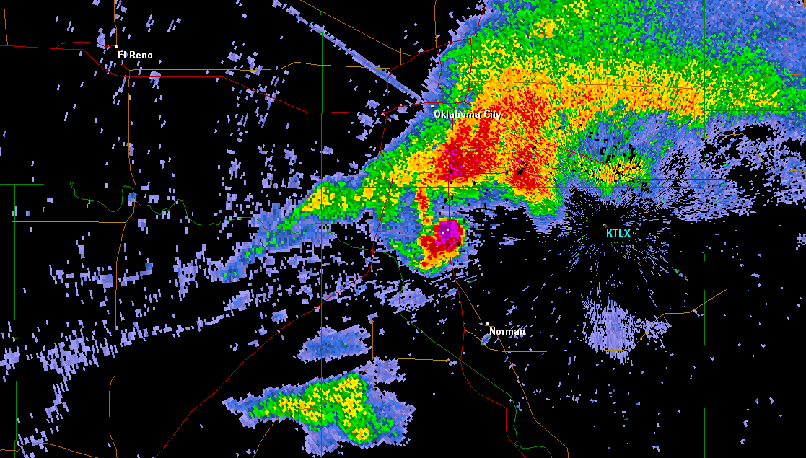
20:21 UTC (3:21 PM CDT) May 20, 2013

Slide 17
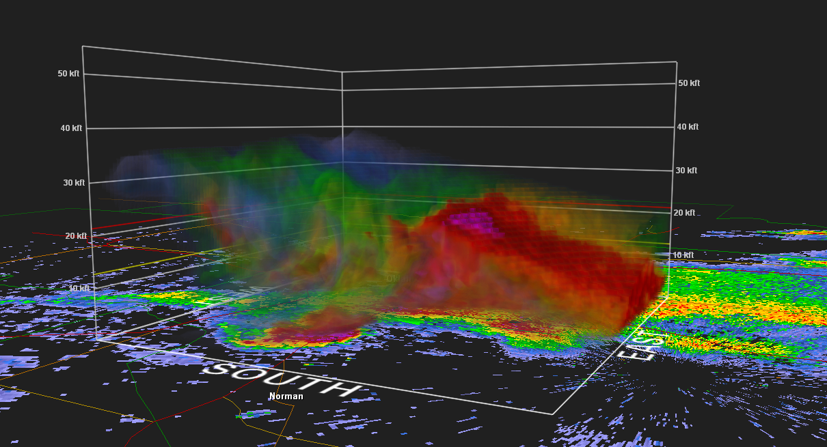
20:21 UTC (3:21 PM CDT) May 20, 2013

Slide 18
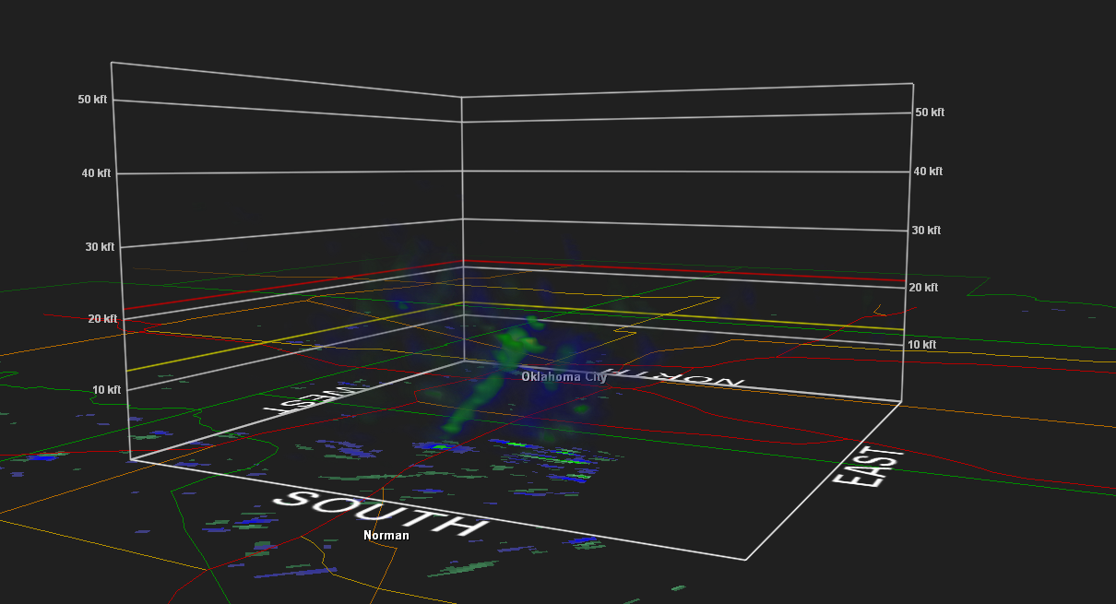
20:21 UTC (3:21 PM CDT) May 20, 2013

Slide 19
EF-4 Tornado: Winds 166+ MPH
Image Credit: National Weather Service, Norman, OK

Slide 20
VIIRS Day/Night Band (Post-Event)
Image Credit: William Straka

