Slide 1
Supporting Alaska Region National Weather Service Volcanic Ash Advisory Center and Weather Forecast Offices with IMAPP Processing
Justin Sieglaff¹
Michael Pavolonis²
Corey Calvert¹
Jordan Gerth¹
1 – UW-CIMSS
2 – NOAA/NESDIS/STAR

Slide 2
Outline
Data processing flow/history
GOES-R/JPSS Proving Ground (PG) Product Descriptions and Examples
Feedback from Operations to Research
Looking to the future

Slide 3
Processing Flow
Level 0 MODIS data is served on FTP server for pulling from UW-CIMSS
GOES-R/JPSS Products are converted to NWS AWIPS format and injected into LDM for distribution back to Alaska
Data are distributed to Anchorage, Fairbanks, and Juneau NWS WFOs and NWS Alaska Region HQ
MODIS data is received by
direct broadcast antenna at UAF-GINA
IMAPP software retrieves and processes MODIS data. GEOCAT software processes GOES-R/JPSS algorithms as a call from IMAPP.
Data latency: Processing at UW-CIMSS is complete 10-40 minutes after MODIS date/time stamp. Most of the latency is from data transfer—and it varies. Total latency is 30-60 minutes by the time data reaches NWS work stations.
Volume: 11-20 successfully geo-located Terra and Aqua granules per day.
UAF-GINA processing began Fall 2010; since have added direct broadcast antennas from University of Wisconsin, US Park Service in Utah and plan on adding Hawaii antenna later in 2013.
Notes:
Use DBVM ‘user option’ to process algorithms in our own processing software—GEOCAT.
Include thoughts about processing in AK—obstacles funding and research is ongoing—frequent upgrades.

Slide 4
GOES-R and JPSS Proving Ground
Demonstrate new products/algorithms to National Weather Service forecasters
Ensure Day 1 Readiness
Provide iterative feedback to improve products
Alaska region is focused on two GOES-R/JPSS product suites
Volcanic Ash Detection and Physical Retrievals
Fog / Low Stratus Detection
Notes:
Note opportunity for end users to have input during algorithm developmental stage

Slide 5
Volcanic Ash Detection and Physical Retrievals
Automated ash cloud detection—Bayesian Model utilizes spectral and spatial quantities to mimic trained human analyst
Retrieve physical properties of ash clouds
Ash cloud-top height
Column ash mass loading
Ash particle effective radius
Ash detection and physical retrievals are input into automated ash alert system being developed by NOAA/UW-CIMSS

Slide 6
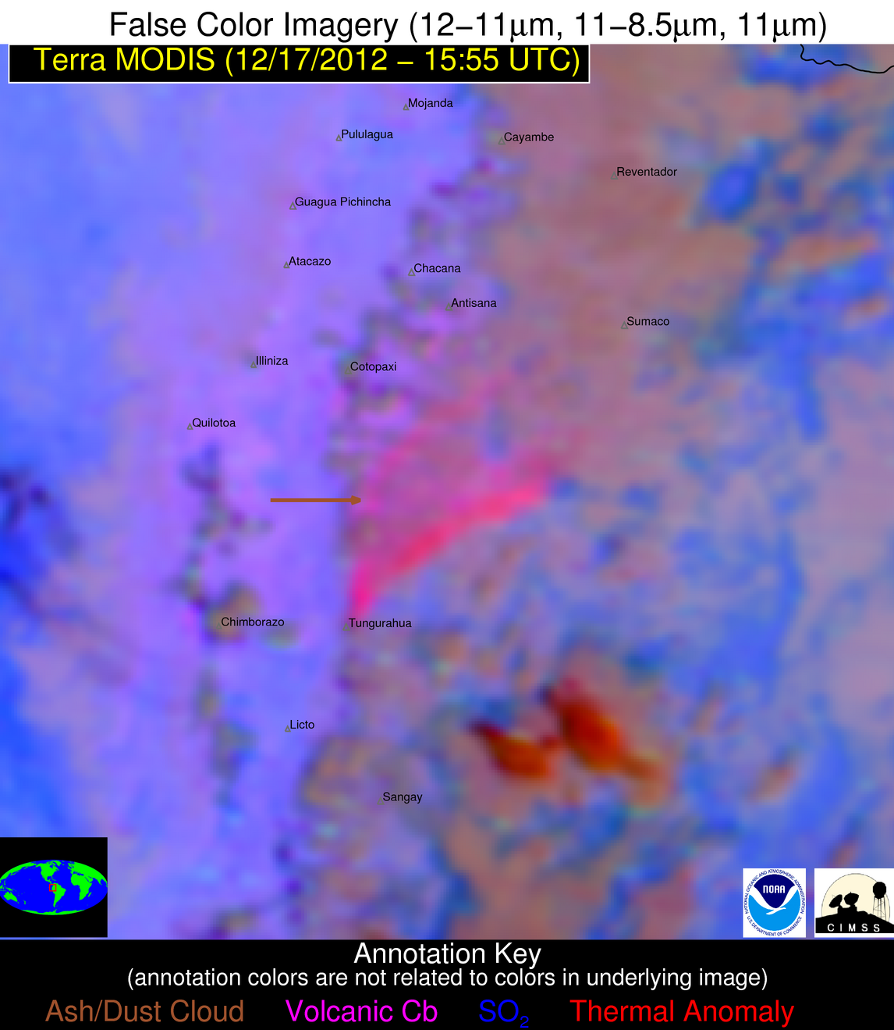
A manual analysis of this image suggests the horizontal boundary depicted in white

Slide 7
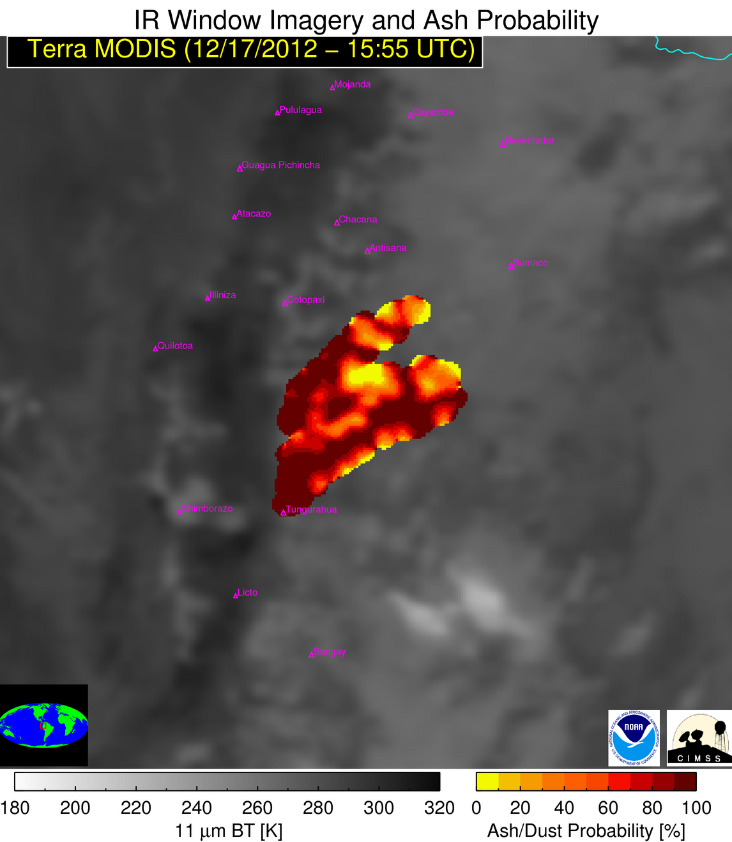
The horizontal extent of the ash cloud determined by GOES-R/JPSS automated computer algorithm agrees very well with the bounds derived from manual analysis of multi-spectral imagery
While a very well trained human will most often slightly out-perform the computer algorithm, the automated detection results are accurate enough to be used to issue alerts when an ash cloud is found (and eventually initialize dispersion models)

Slide 8
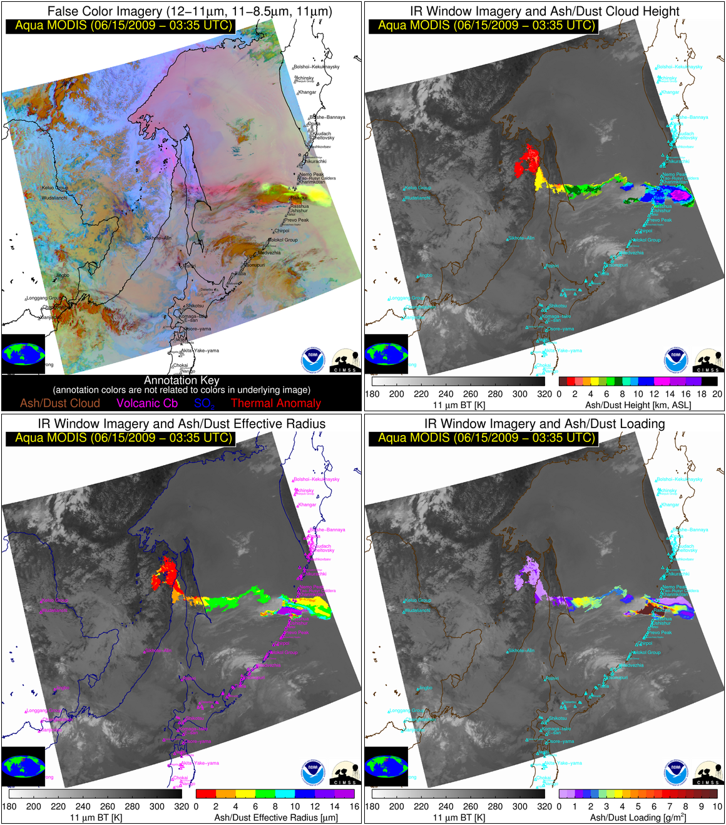
An optimal estimation approach is used to retrieve the ash cloud temperature, 11 μm emissivity, and β(12/11 μm)
The ash cloud height can be estimated from the cloud temperature using an atmospheric profile and the mass loading and effective particle radius can be estimated from the 11 μm emissivity and β(12/11 μm)
A negative split-window BTD need not be present. See Pavolonis et al. (2013) for details.
The retrieval solution is determined from a weighted combination of the difference between the measurements and forward model and the first guess
Notes:
Ruang

Slide 9
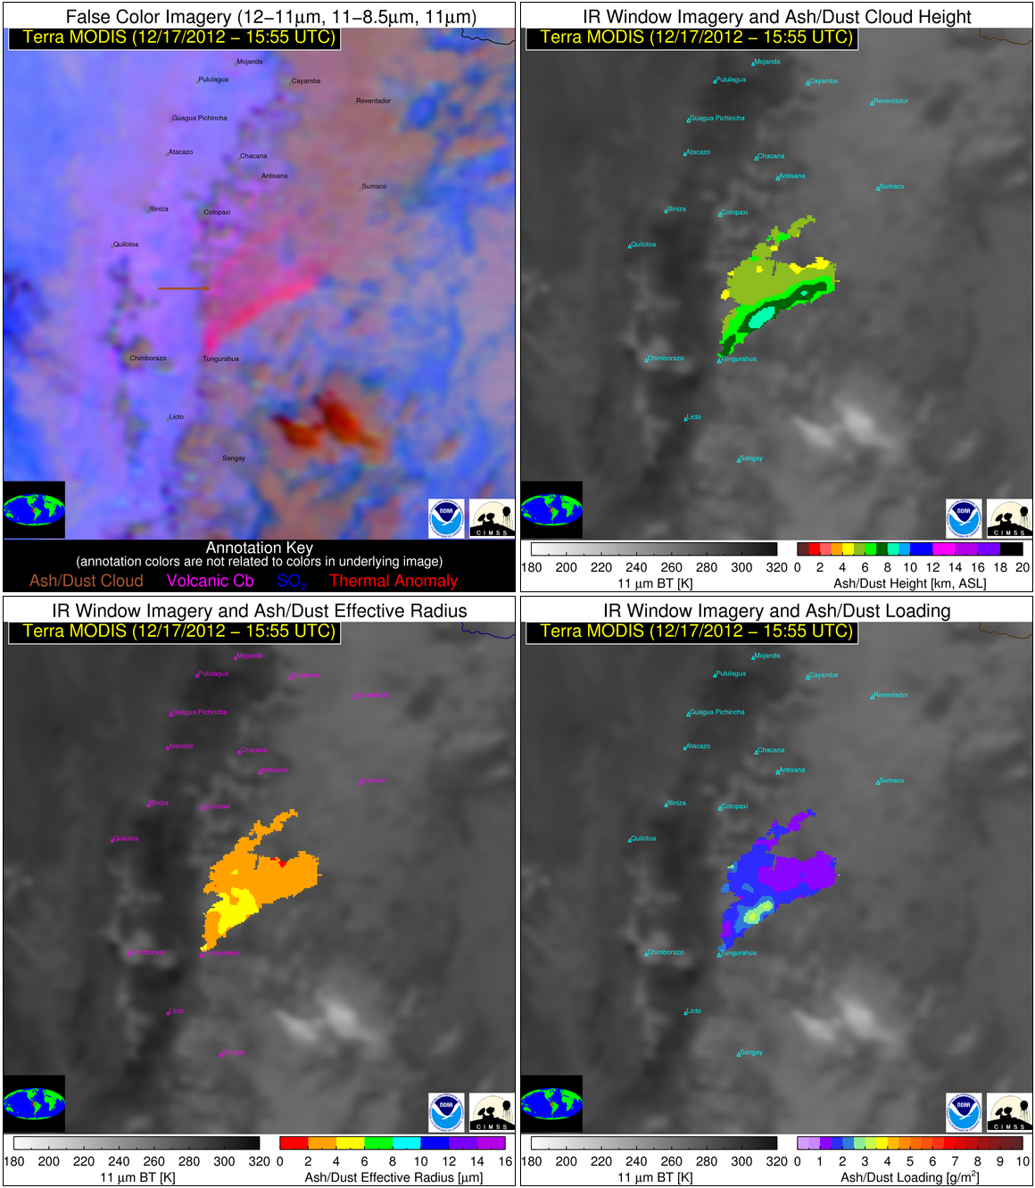
Example of physically derived quantities include ash cloud-top height (upper right), ash effective radius (lower left), and column mass loading (lower right).
Physical retrievals utilize multi-spectral optimal estimation approach using 11, 12, and 13.3 µm channels

Slide 10
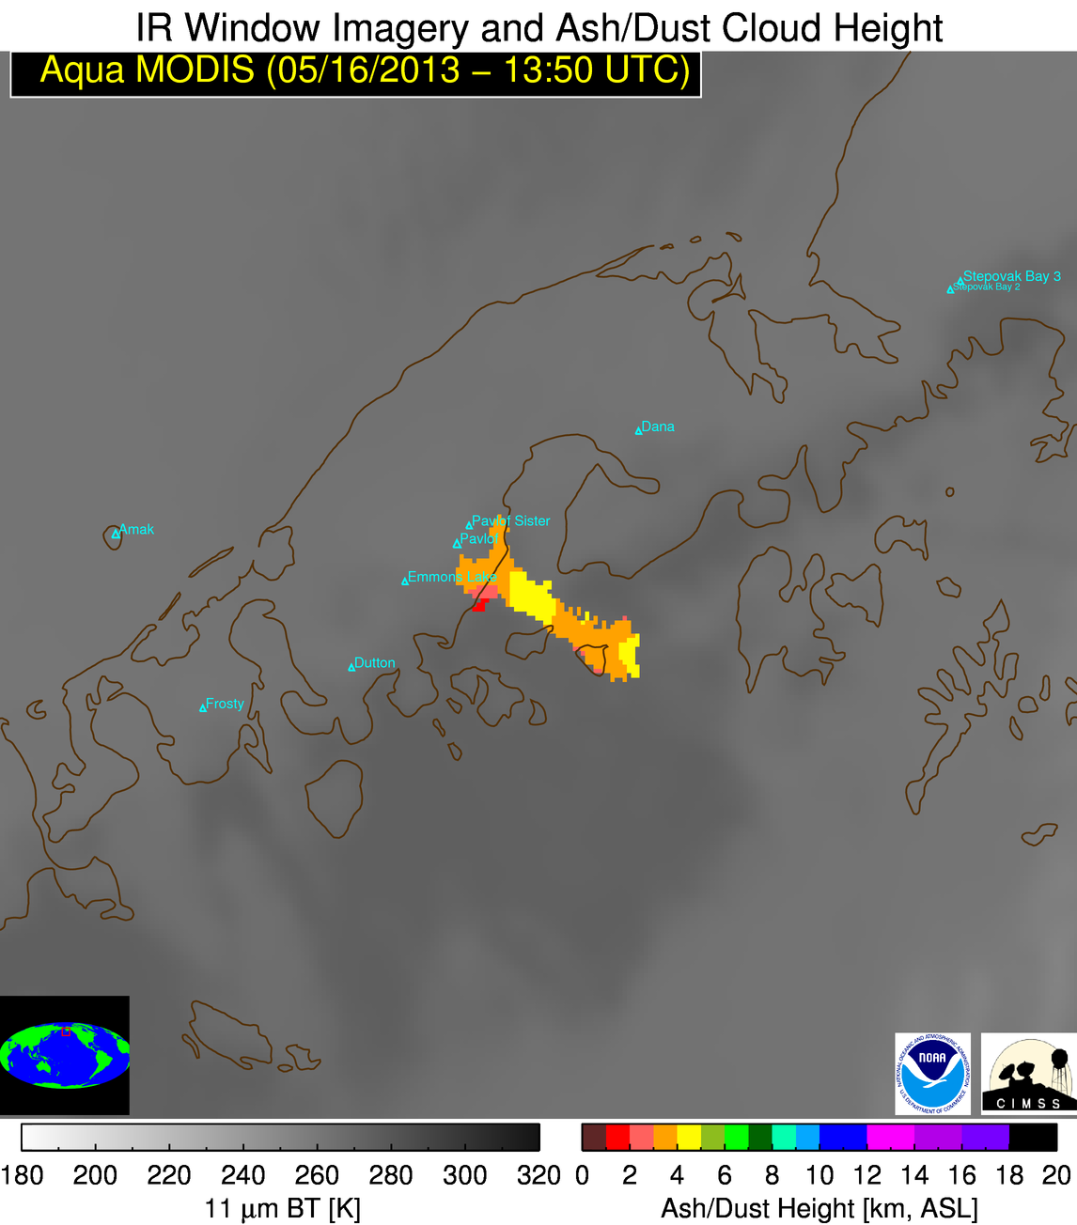
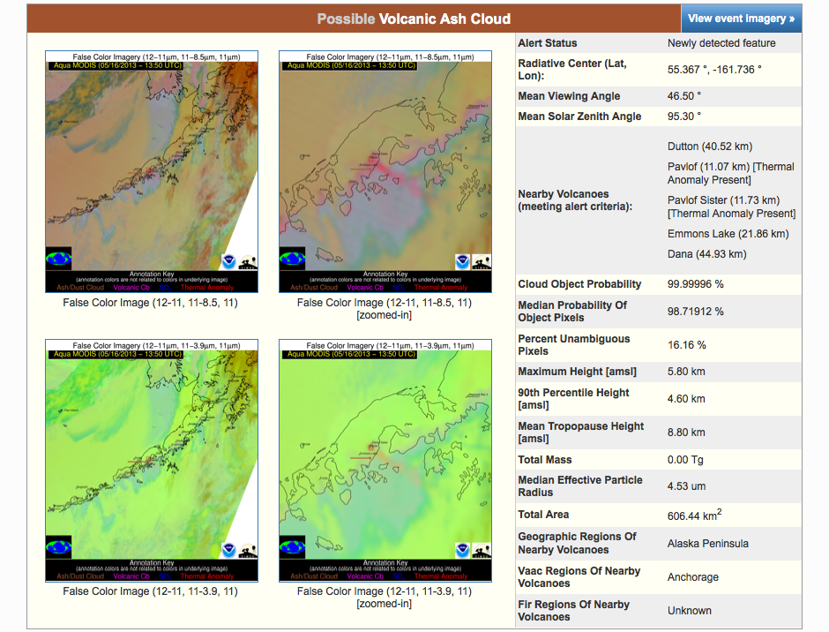
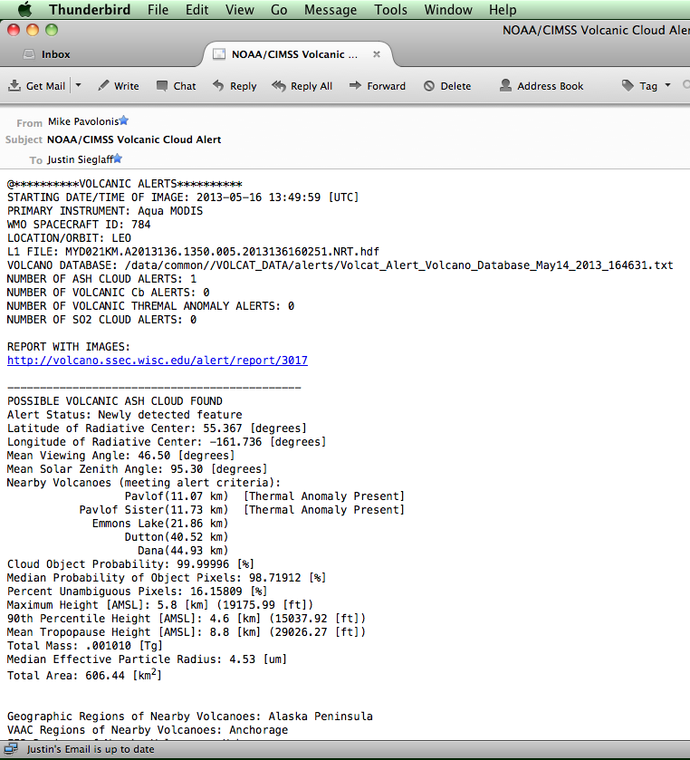
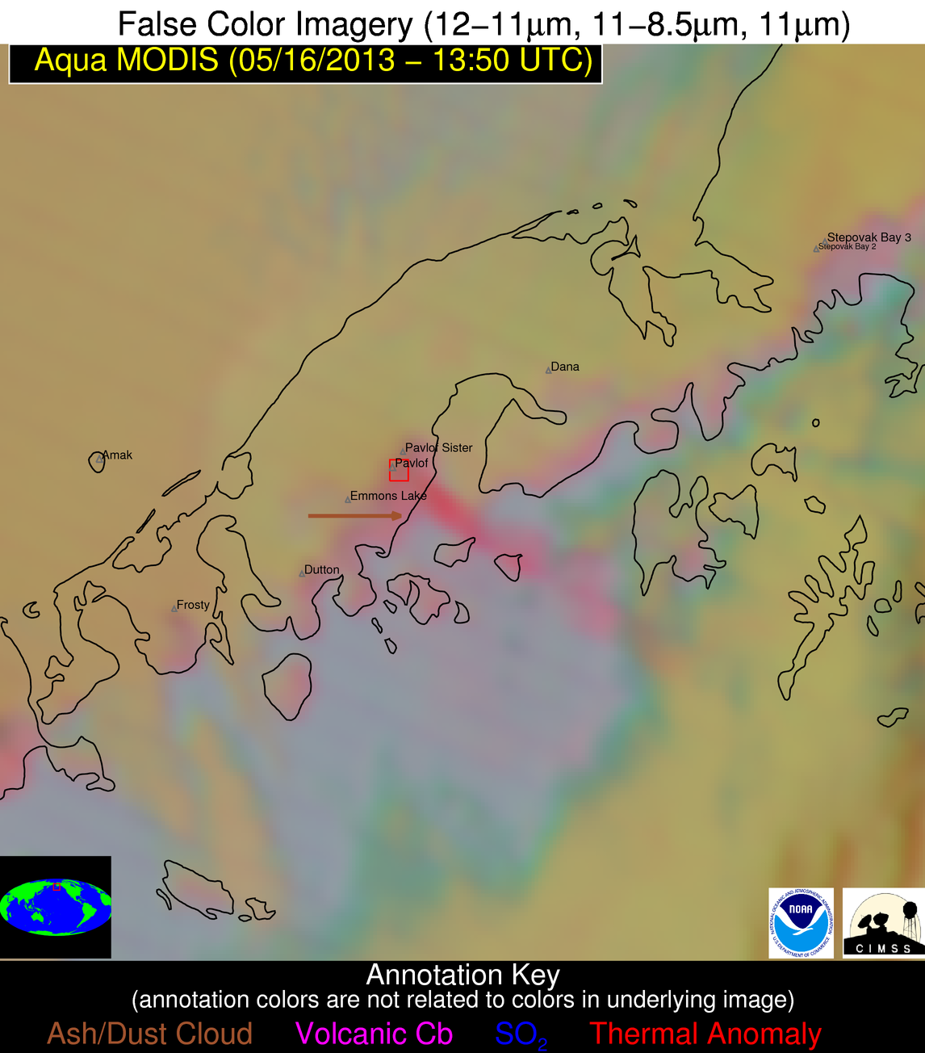
Automated Alert Example from Pavlof Volcano Eruption 16 May 2013

Slide 11
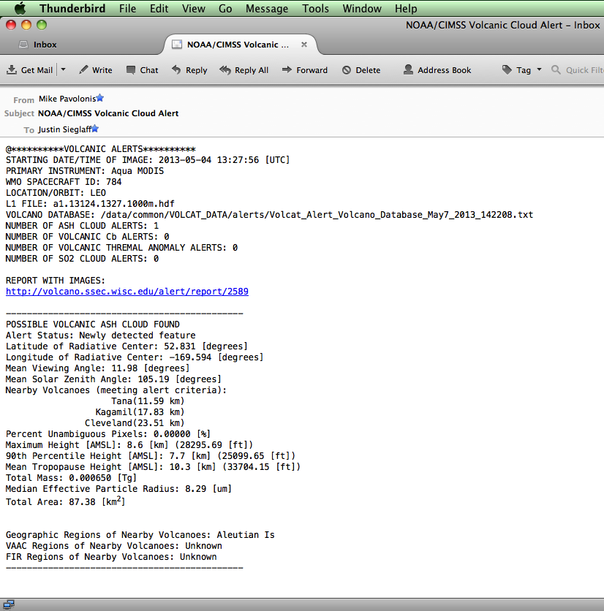
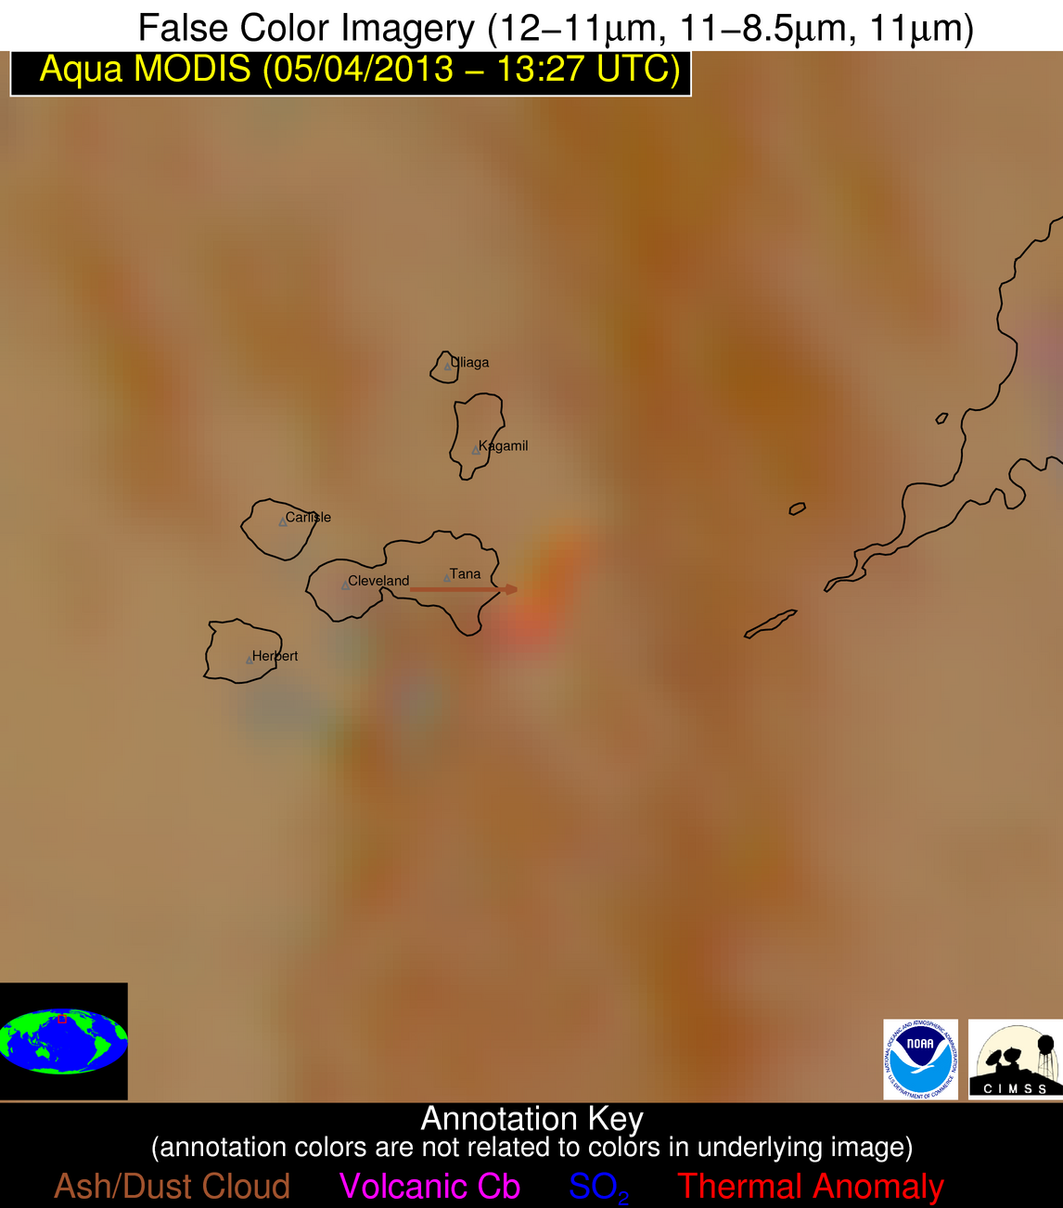
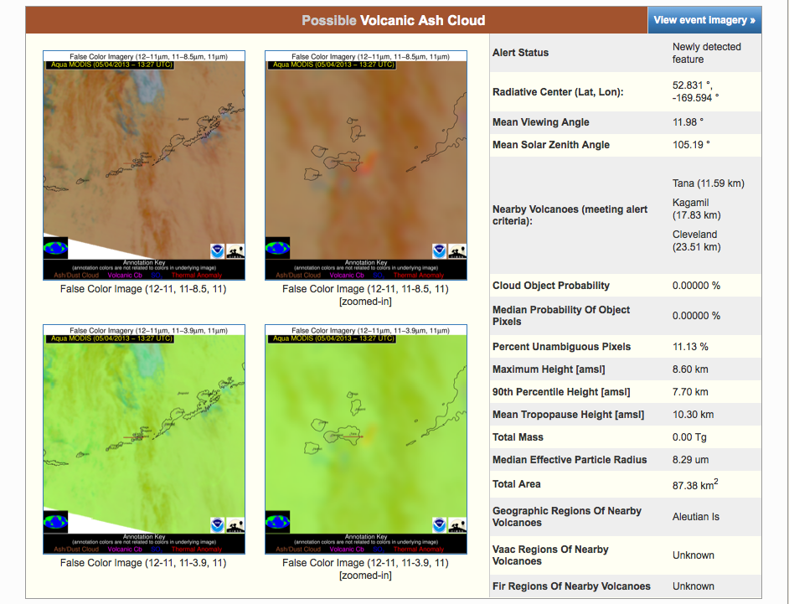
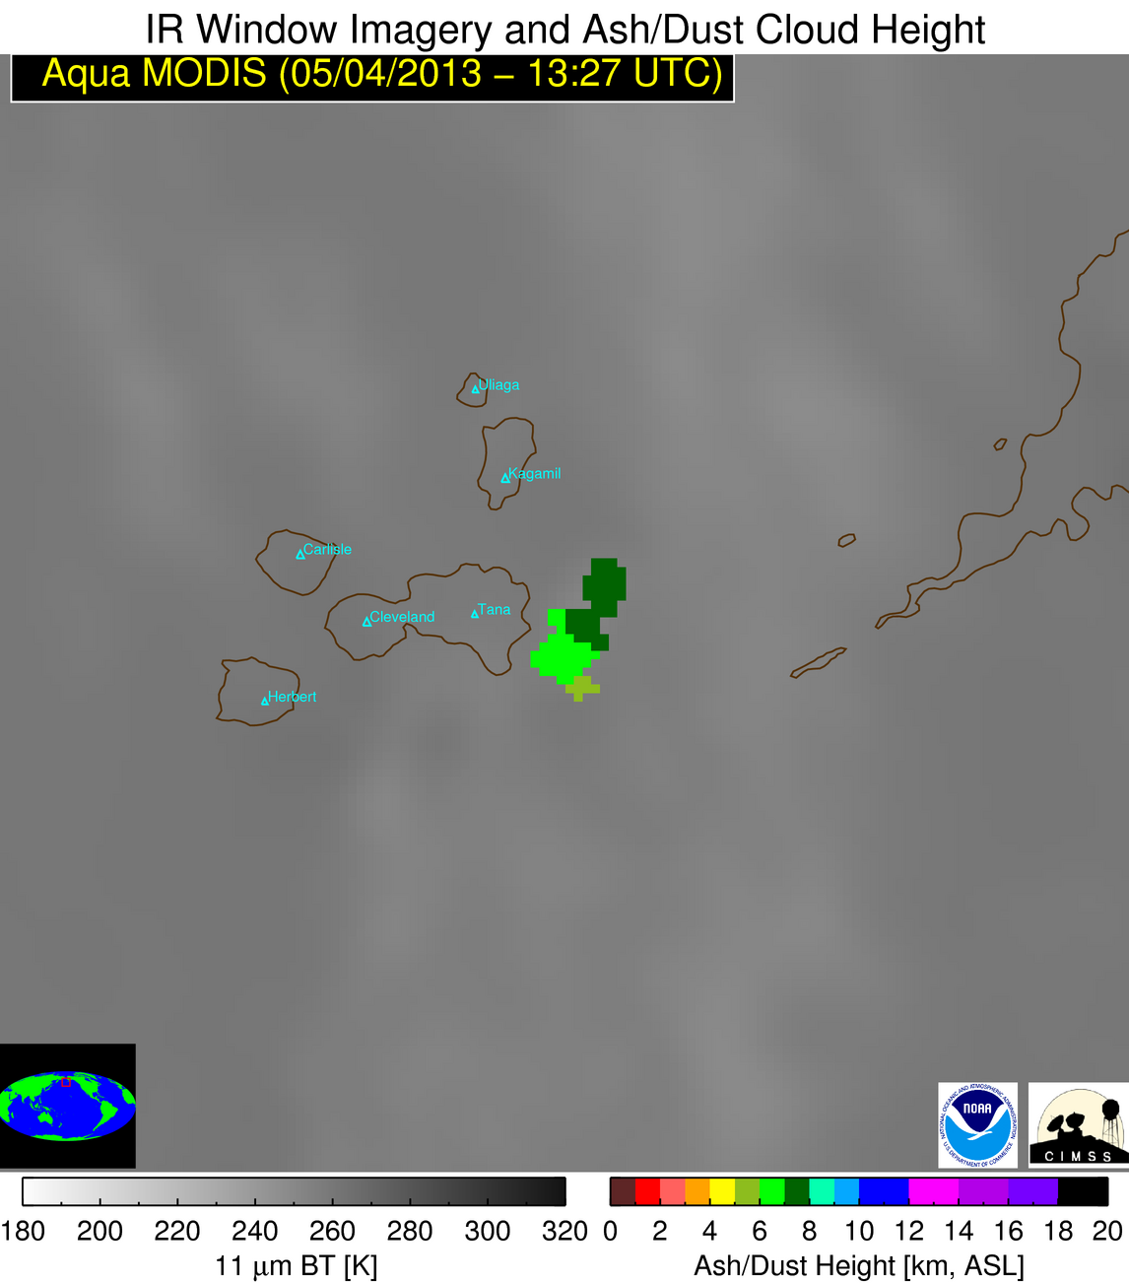
Automated Alert Example from Cleveland Volcano Eruption 4 May 2013

Slide 12
Fog and Low Stratus
Automated, probabilistic approach combines satellite observations/derived products (cloud-top phase, brightness temperature differences, etc.) and numerical weather prediction model data to determine probability of various aviation flight rules (IFR, LIFR, MVFR)
Additionally cloud thickness (cloud top height- cloud base height) is also computed
Notes:
Area of Alaska (663,330 sq miles) is equivalent to MT, WY, ID, WA, OR, AND CA. 3 Alaska WFOs vs 22 WFOs serving those states. Satellite data is critical due to expanse and relative sparseness of surface observations.

Slide 13
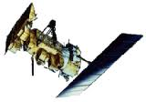
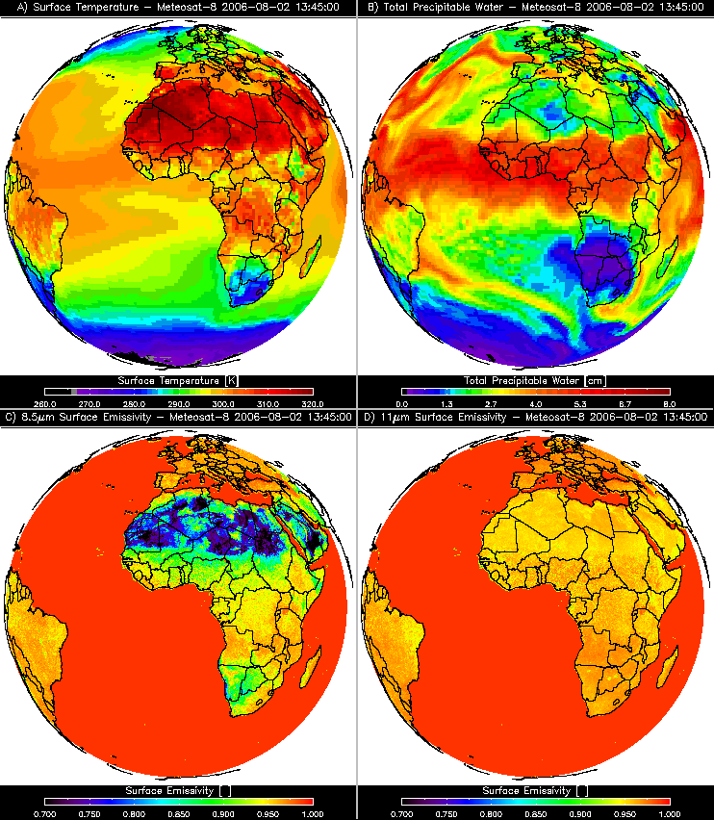
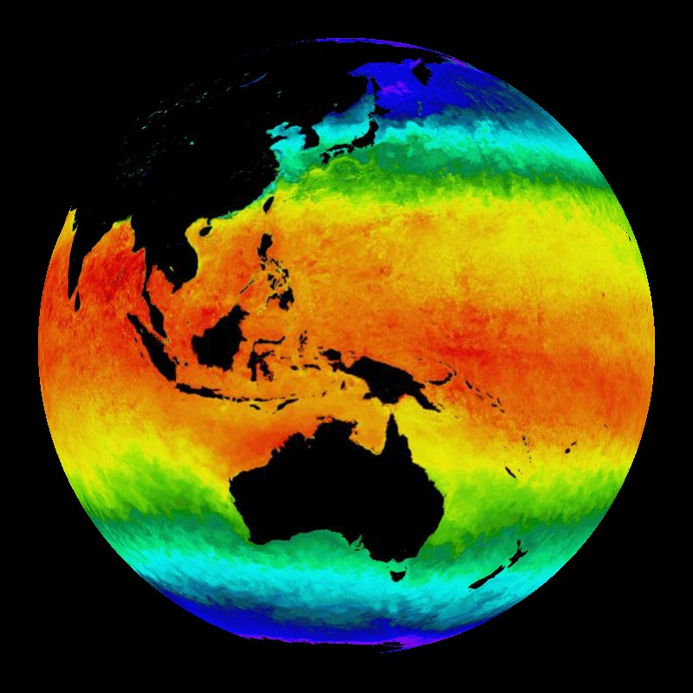
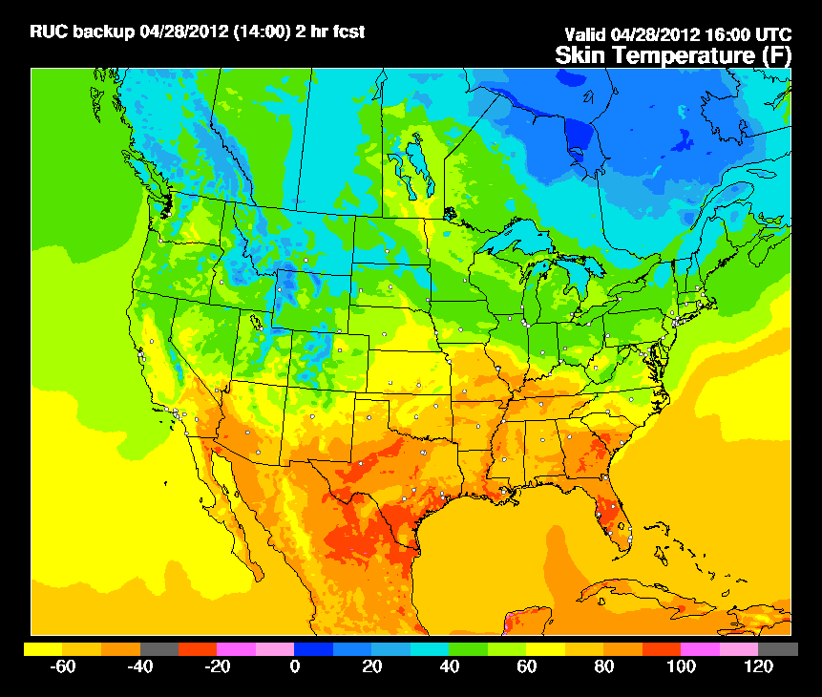
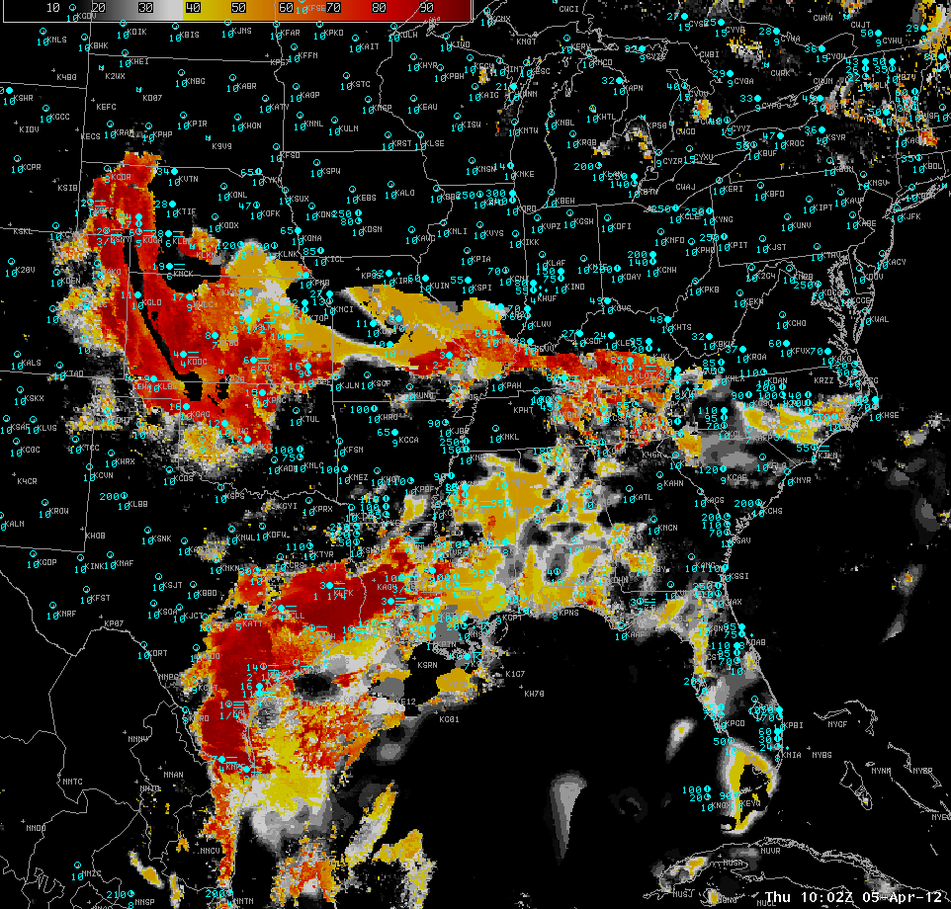
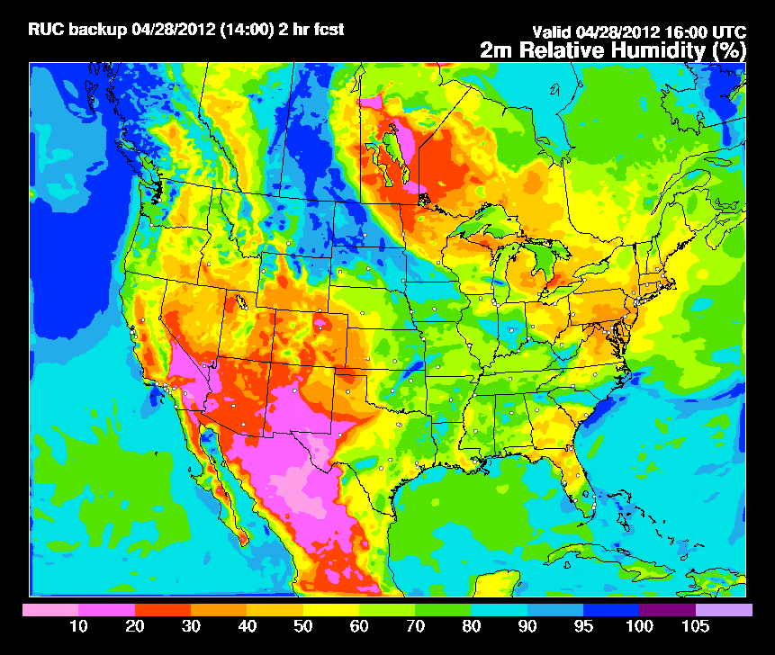
Fused Fog/Low Cloud Detection Approach
Satellite Data
Static Ancillary Data
Daily SST Data
NWP
+
+
+
-Minimum channel requirement: 0.65, 3.9, 6.7/7.3, 11, and 12/13.3 μm
-Previous image for temporal continuity (GEO only)
-Cloud Phase
-Surface Temperature
-Profiles of T and q
-RUC/RAP (2-3 hr forecast) or GFS (12 hr forecast)
-DEM
-Surface Type
-Surface Emissivity
0.25 degree OISST
Clear Sky RTM
IFR and LIFR Probability
NWP RH Profiles
Naïve Bayesian Model
Total run time: 2 - 3 minutes
-RUC/RAP (2-3 hr forecast) or GFS (12 hr forecast)
***IMPORTANT: Other sources of relevant data (e.g. sfc obs) influence results through the model fields
Notes:
13

Slide 14
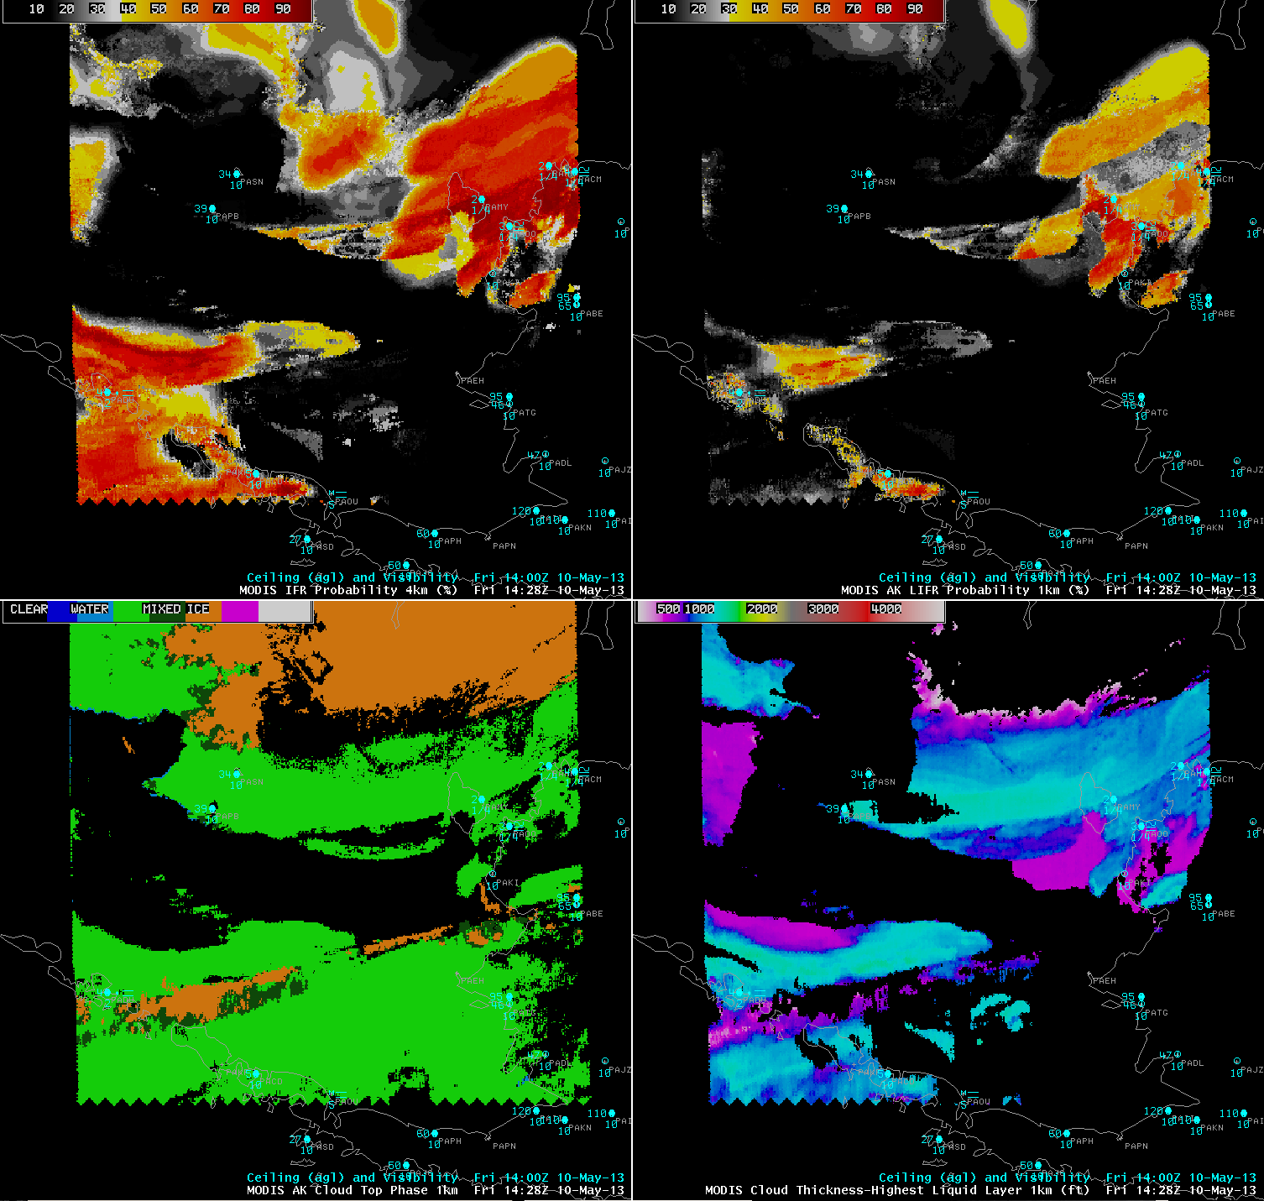
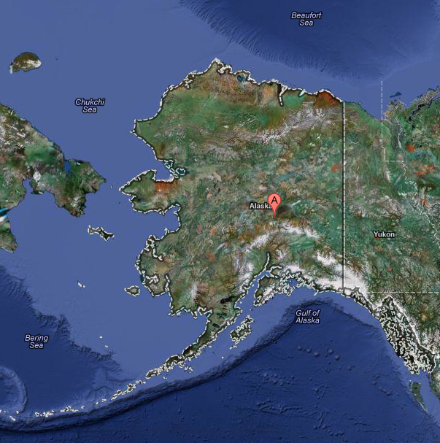
GOES-R Fog/Low Stratus (FLS) Products
The GOES-R FLS algorithm calculates the probability that IFR/LIFR conditions are present for a given satellite pixel and estimates the thickness of the cloud layer (cloud top – cloud base)
MODIS data is important over Alaska because its 1 km spatial resolution provides much more detail than the larger GOES footprint (>4 km) at high latitudes
The higher spatial resolution from MODIS makes identifying small-scale FLS possible where
GOES-R IFR probability [%]
(MODIS)
GOES-R LIFR probability [%]
(MODIS)
GOES is most useful identifying large-scale events
GOES-R IFR probability [%]
(GOES)
GOES-R cloud thickness [ft]
(MODIS)

Slide 15
Feedback Improves Algorithms
Feedback from Anchorage VAAC identified unexpected ‘holes’ in volcanic ash detection and retrievals for explosive volcanic eruptions where the ash cloud was dominated by ice particles—this was addressed and these holes are now filled (next slides)
Alaska region FLS feedback suggested the GOES display color palate wasn’t ideal for Alaska given very cold backgrounds (GOES instrument noise)—so a Alaska specific FLS color display was developed—MODIS does not have this problem

Slide 16
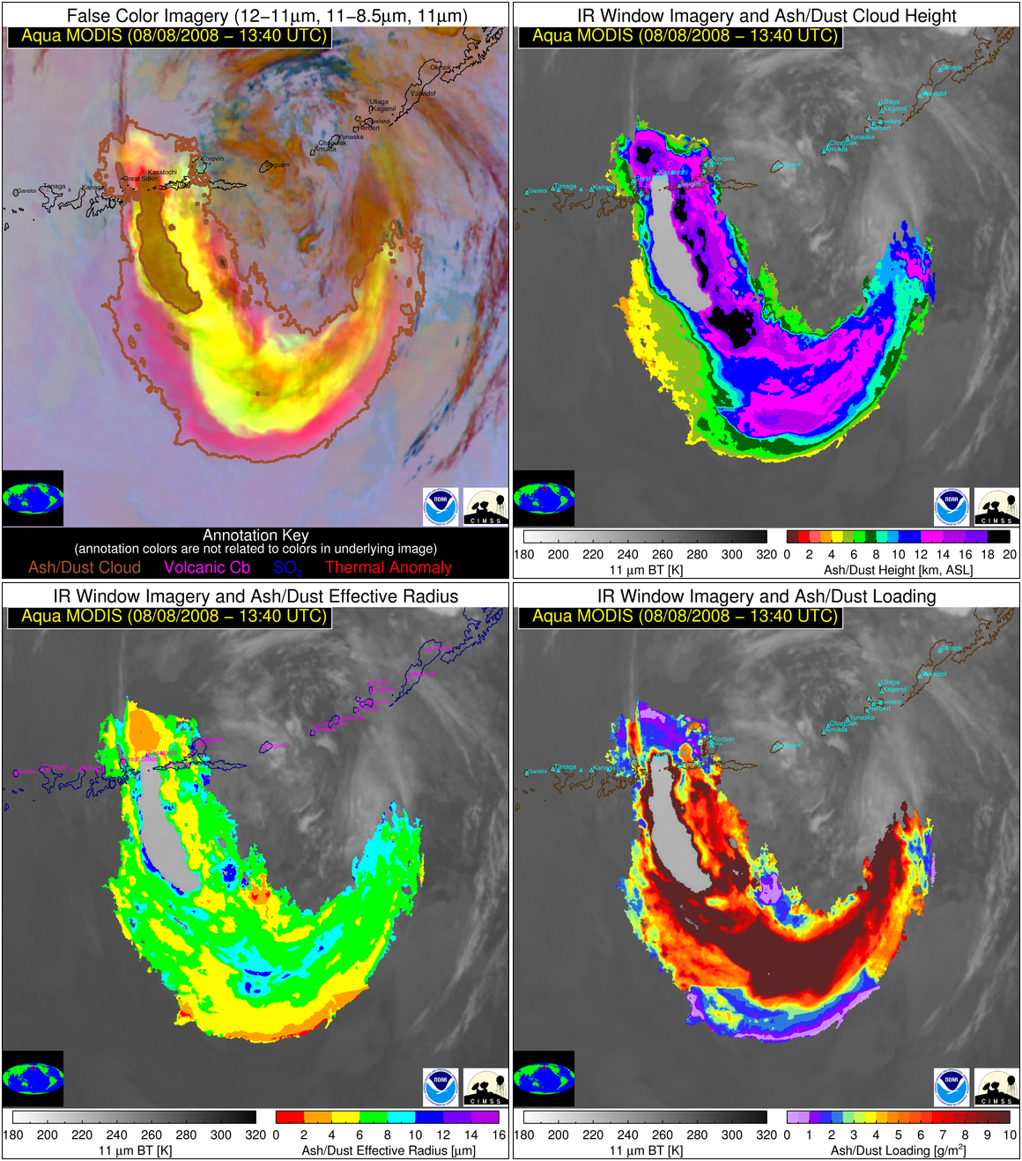
Kasatochi Volcano
Kasatochi Volcano
August 8, 2008 (13:40 UTC): Kasatochi volcanic cloud
Aleutian Islands
Aleutian Islands
The optically thick center of the Kasatochi cloud contains ice particles in addition to volcanic ash and thus it cannot be distinguished from meteorological clouds and the ash cloud properties are not estimated.
Ash + Ice
Ash + Ice
Kasatochi Volcano
Kasatochi Volcano
Aleutian Islands
Aleutian Islands
Ash + Ice
Ash + Ice

Slide 17
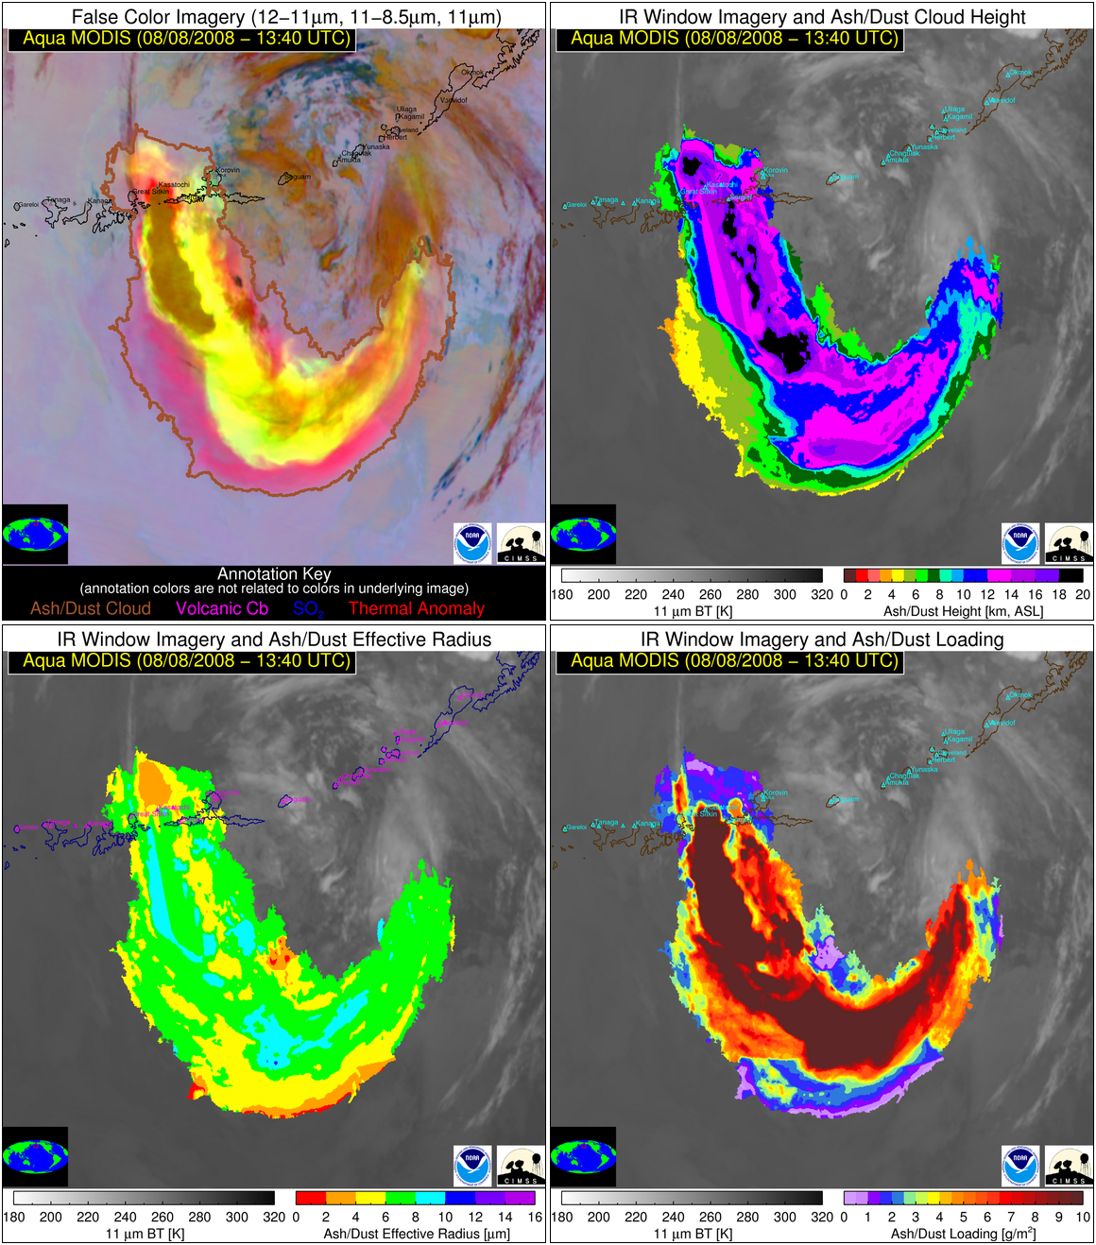
Kasatochi Volcano
Kasatochi Volcano
August 8, 2008 (13:40 UTC): Kasatochi volcanic cloud
Aleutian Islands
Aleutian Islands
Artificial holes in volcanic clouds are automatically identified and a Cressman interpolation scheme is used to fill them.
Ash + Ice
Ash + Ice
Kasatochi Volcano
Kasatochi Volcano
Aleutian Islands
Aleutian Islands
Ash + Ice
Ash + Ice

Slide 18
Future Plans
Add Suomi NPP VIIRS to processing stream
Volcanic Ash Detection and Retrieval Suite
Fog / Low Stratus Suite
Higher infrared resolution (750 m) of Suomi NPP VIIRS will benefit:
Detecting spatially small volcanic eruptions
Small scale terrain-induced ceiling/visibility aviation hazards
Increased data frequency
Especially with Gilmore Creek DB antenna since Suomi NPP VIIRS has priority over MODIS Aqua
Begin processing Hawaii DB antenna feed late 2013
Notes:
Note ash and FLS product suites are coded in such a way that they can easily run on new sensors with sufficient spectral channels

Slide 19
Questions?
Thank you!
Contact:
Justin Sieglaff (justin.sieglaff@ssec.wisc.edu)
Mike Pavolonis (michael.pavolonis@noaa.gov)
Corey Calvert (corey.calvert@ssec.wisc.edu)
Jordan Gerth (jordan.gerth@ssec.wisc.edu)

Slide 20
References
Pavolonis, M., A. Heidinger, and J. Sieglaff, 2013: Automated retrievals of volcanic ash and dust cloud properties from upwelling infrared measurements, J. Geophysical Research, 118(3), 1436-1458.
Pavolonis, M. J., 2010: Advances in extracting cloud composition information from spaceborne infrared radiances: A robust alternative to brightness temperatures Part I: Theory, J. Applied Meteorol. And Climatology, 49(9), 1992-2012.
Pavolonis, M. J., W.F. Feltz, A.K. Heidinger, G. Gallina, 2006: A daytime complement to the reverse absorption technique for improved automated detection of volcanic ash. J. Oceanic and Atmos. Tech., 23, 1422-1444.

