Slide 1
50 Years of Meteorological Satellite Experiments – The NASA Perspective
Franco Einaudi
November 2, 2009

Slide 2
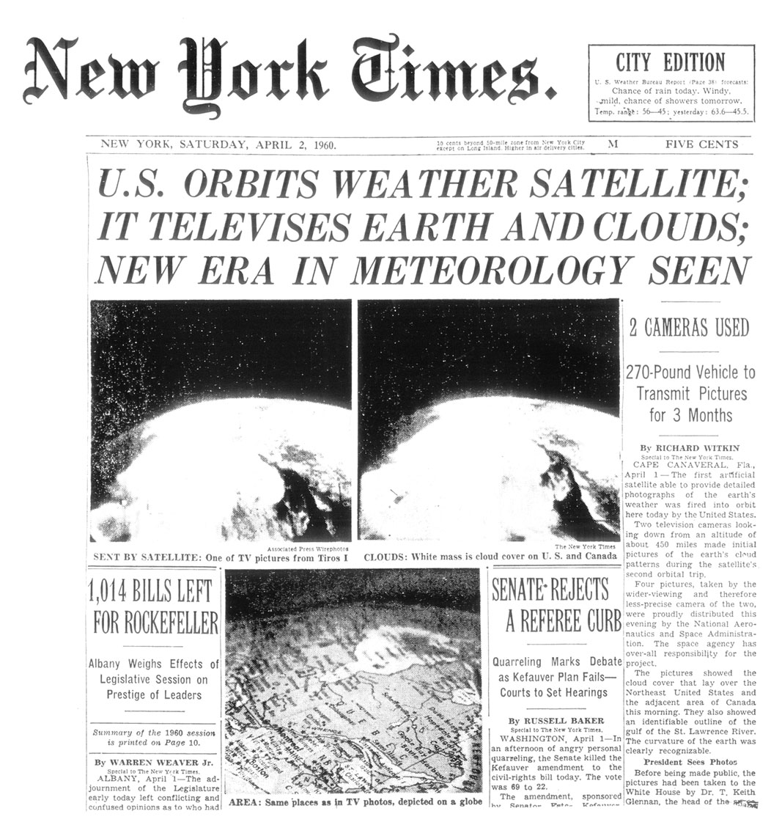
A Proud History
TIROS I
Launched
April 1, 1960
The first picture from space. Here is where NASA began its mission of observing the Earth’s weather.
Notes:
Launched on April 1, 1960
TIROS - Television InfraRed Observation Satellites
This is the first picture from space. Here is where NASA began its mission of observing the Earth’s weather.
The primary objective of the TIROS program was to demonstrate the feasibility and capability of observing the Earth's cloud cover and weather patterns from space. Although the program was experimental, this first spaceborne system demonstrated the capability to acquire information which meteorologists could use immediately in an operational setting.
TIROS IX launched in January 1965 was the first series of polar orbiting weather satellites

Slide 3
50 Year Ago…
On April first 1960 the USA launched its first meteorological satellite, TIROS 1.
Its importance did not go unnoticed to the operational community and to the scientific community.
The event was also of profound political importance.
President Kennedy in an address at the UN in 1961 called on the countries of the world to exploit this new tool jointly.
The battle for resources:
Scientists recognized the need for a major research effort for an effective use of these new observations.
They recognized that a battle for resources was inevitable
They also recognized the important role that our science can play and the responsibility we have to provide reliable information to the policy makers
Notes:
Launched on April 1, 1960
TIROS - Television InfraRed Observation Satellites
This is the first picture from space. Here is where NASA began its mission of observing the Earth’s weather.
The primary objective of the TIROS program was to demonstrate the feasibility and capability of observing the Earth's cloud cover and weather patterns from space. Although the program was experimental, this first spaceborne system demonstrated the capability to acquire information which meteorologists could use immediately in an operational setting.
TIROS IX launched in January 1965 was the first series of polar orbiting weather satellites

Slide 4
Half a Century Later…
Battle for resources is on-going.
Our responsibility to provide reliable information to policy makers remains.
We have a stronger realization of the potential global economic impact of our science.
In general, we have an even stronger realization that our problems and challenges are global.
The role of satellites is to provide the global view of the Earth System.
Notes:
Launched on April 1, 1960
TIROS - Television InfraRed Observation Satellites
This is the first picture from space. Here is where NASA began its mission of observing the Earth’s weather.
The primary objective of the TIROS program was to demonstrate the feasibility and capability of observing the Earth's cloud cover and weather patterns from space. Although the program was experimental, this first spaceborne system demonstrated the capability to acquire information which meteorologists could use immediately in an operational setting.
TIROS IX launched in January 1965 was the first series of polar orbiting weather satellites

Slide 5
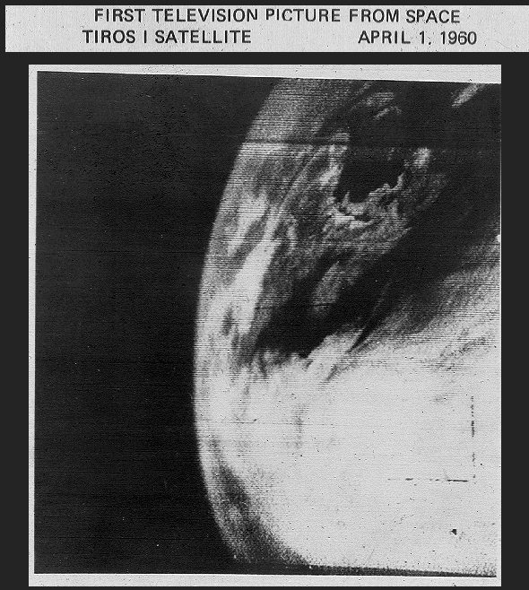
Images from TIROS 1, the First Successful Weather Satellite
TIROS = Television and Infrared Observation Satellite

Slide 6
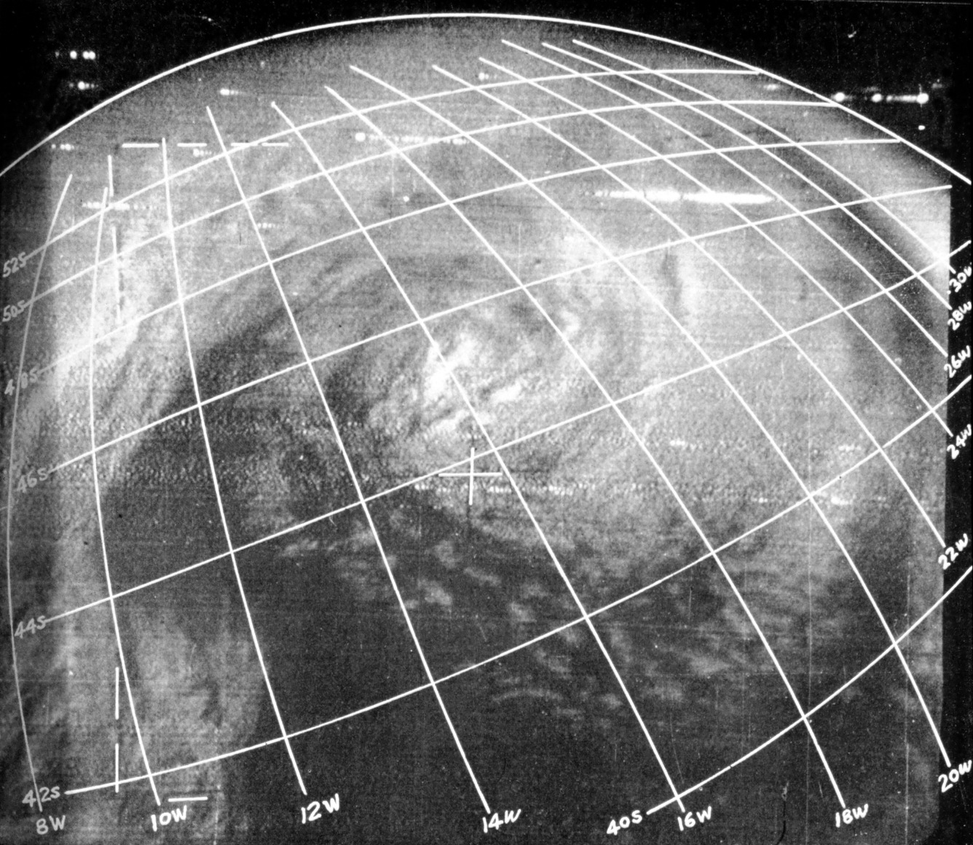
Images from TIROS 1, the First Successful Weather Satellite
TIROS 1 image of a mid-latitude cyclone, July 1961
TIROS = Television and Infrared Observation Satellite

Slide 7
MODIS true-color
Hurricane Rick
off of Baja CA
18 Oct 2009
Notes:
Google Earth projection

Slide 8
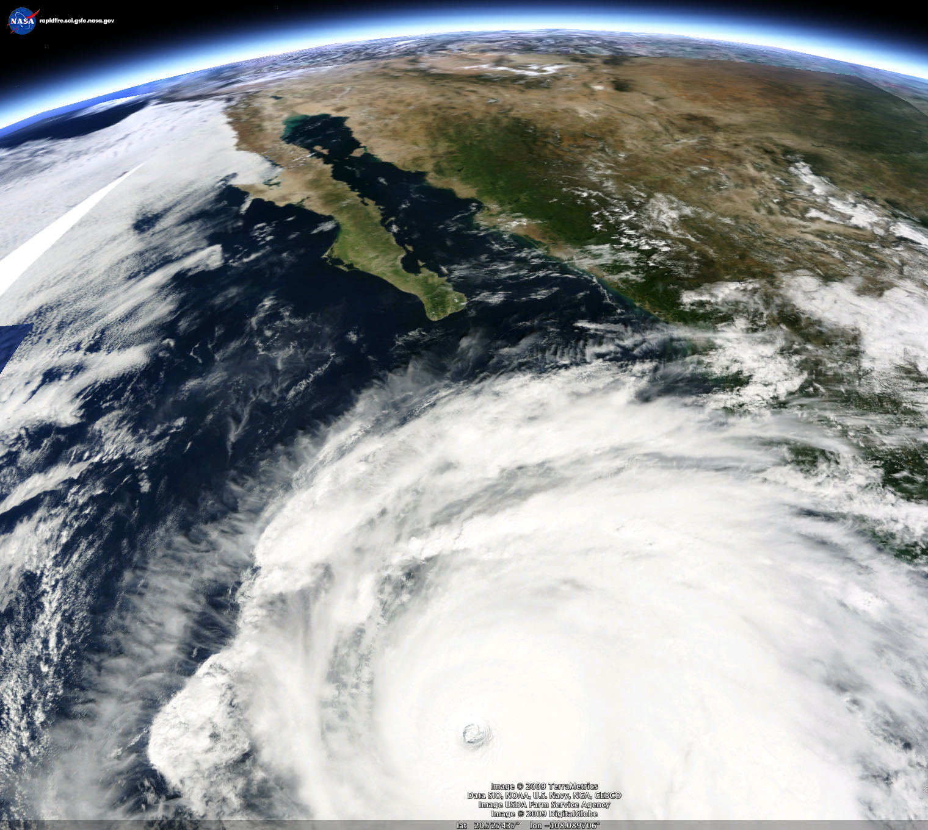
MODIS true-color
Hurricane Rick
off of Baja CA
18 Oct 2009
Notes:
Google Earth projection

Slide 9
Human induced changes are small: performance requirements are large
CO₂
Precision: 1ppmv
Duration: 2-3 years
Total O₃
Trend: 1% per decade
Duration: Continuous
Ice Sheets and Sea Ice
Ice Sheets Elevation: 1 cm/year on the scale of 100km
Sea ice thickness: 20 cm
Duration: 3-5 years

Slide 10
Global Climate Change Observing System (GCOS) Reference Upper Air Network (GRUAN)

Slide 11
Earth’s Energy Balance
Ways the energy balance of the planet can change:
Changes the incoming solar radiation
Changes in the orbit parameters
Changes in the solar input
Changes in the fraction of solar radiation that is reflected
Cloud cover
Aerosols
Land cover
Changes in long-wave energy radiated back to space
Greenhouse gases concentration

Slide 12
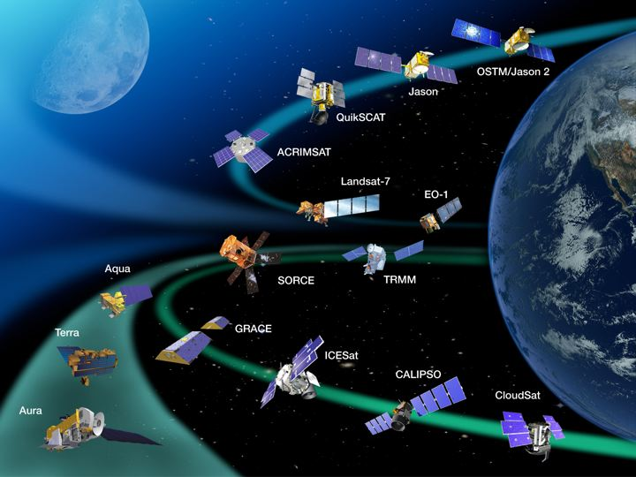
NASA Operating Research Missions
1st time in Senior Review
New mission

Slide 13
Missions in Development
Mission Name | Launch Date | Mission Description
Aquarius | May 2010 | To collect sea surface salinity (SSS) data over the global oceans
Glory | Oct. 2010 | Aerosols measurements; Total Solar Irradiance
Landsat Data Continuity Mission (LDCM) | Dec. 2012 | To provide continuity for land use/land cover change
Global Precipitation Measurement (GPM) | July 2013 | Global Water Cycle precipitation measurements
NPOESS Preparatory Project (NPP) | 2013 | To provide continuity in measurements between EOS and NPOESS programs and pre-operational risk reduction
Geostationary Operational Environmental Satellites (GOES) |  | To provide a constant vigil for the atmospheric “triggers” for severe weather conditions
Polar Operational Environmental Satellites (POES) |  | To provide measurement of various parameters for operational use

Slide 14
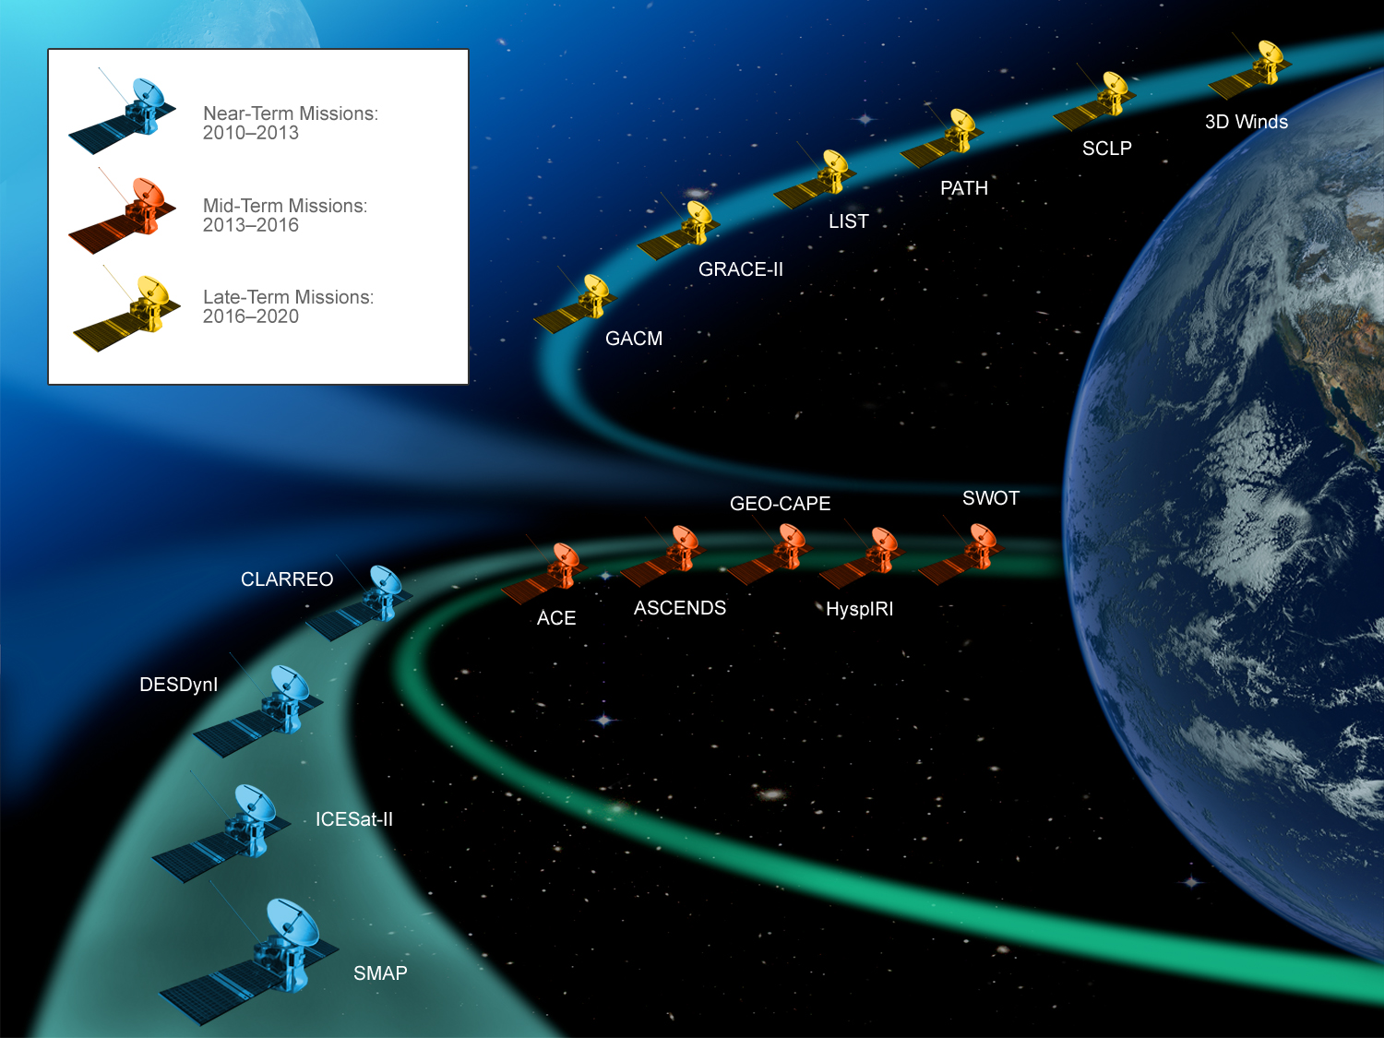
Decadal Survey Missions Next Generation
Plus: Venture Class

Slide 15
Near-term Decadal Survey Missions (2010-2013)
Mission Name | Mission Description | Concept Instruments
ICESat-II | Ice sheet height changes for climate change diagnosis | Laser altimeter
SMAP | SMAP soil moisture and freeze/thaw for weather and water cycle processes | L-band radar L-band radiometer
DESDynI | Surface and ice sheet deformation for understanding natural hazards and climate; vegetation structure for ecosystem health | L-band InSAR Laser altimeter
CLARREO (NASA portion) | Solar radiation; spectrally resolved forcing and response of the climate system | Absolute, spectrally resolved interferometer

Slide 16
Mid-term Decadal Survey Missions (2013-2016)
Mission Name | Mission Description | Concept Instruments
ACE | Aerosol and cloud profiles for climate and water cycle; ocean color for open ocean biogeochemistry | Backscatter lidar Multiangle polarimeter Doppler radar
ASCENDS | Day/night, all-latitude, all-season CO₂ column integrals for climate emissions | Multifrequency laser
GEOCAPE | Atmospheric gas columns for air quality forecasts; ocean color for coastal ecosystem health and climate emissions | Hyperspectral spectrometer
HyspIRI | Land surface composition for agriculture and mineral characterization; vegetation types for ecosystem health | Hyperspectral spectrometer
SWOT | Ocean, lake, and river water levels for ocean and inland water dynamics | Ka-band wide swath radar C-band radar

Slide 17
Long-term Decadal Survey Missions (2016-2020)
Mission Name | Mission Description | Concept Instruments
3D-Winds (Demo) | Tropospheric winds for weather forecasting and pollution transport | Doppler lidar
GRACE-II | High temporal resolution gravity fields for tracking large scale water movement | Microwave or laser ranging system
LIST | Land surface topography for landslide hazards and water runoff | Laser altimeter
GACM | Ozone and related gases for intercontinental air quality and stratospheric ozone layer prediction | UV spectrometer IR spectrometer Microwave limb sounder
SCLP | Snow accumulation for fresh water availability | Ku and X-band radars K and Ka-band radiometers
PATH | High frequency, all-weather temperature and humidity soundings for weather and forecasting and SST | MW array spectrometer

