Slide 1


NOAA Satellite Update and McIDAS at ESPC
Brian Hughes
User Services Team Lead
Satellite Products and Services Division
NOAA/NESDIS Office of Satellite Products and Operations
2010 McIDAS Users’ Group Meeting, Madison, WI
Notes:
1

Slide 2
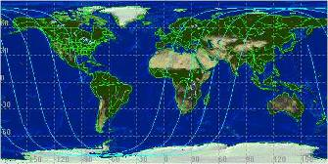
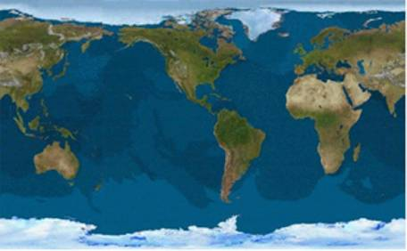
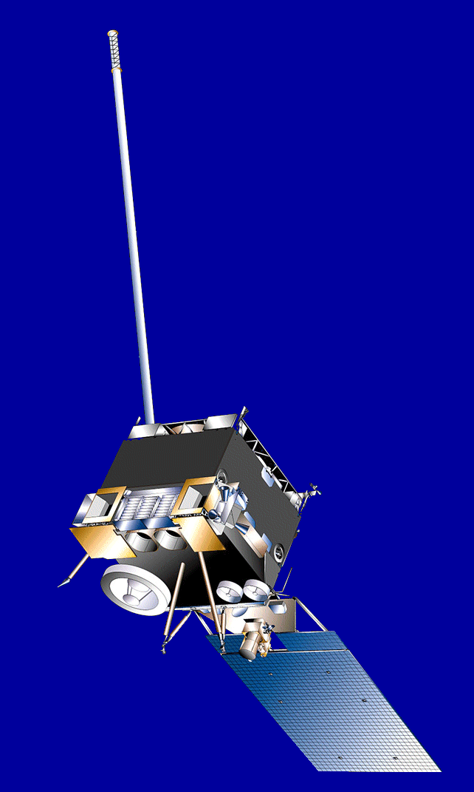
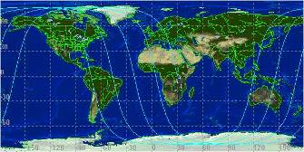
NOAA Satellite Program Overview
2 p.m. Orbit
GOES-11
135° West
GOES-13
75° West
GOES-12
60° West
GOES-14
@ 105°W
GOES-15
@ 90°W
10 a.m. Orbit
Two polar operational satellites; one in morning and one in afternoon orbit
Launch upon failure of imager or sounder
Continuity of operations since early 1960s
Since May 2007, NOAA using EUMETSAT satellite operationally for mid-morning orbit through NOAA/EUMETSAT partnership
Two operational geostationary satellites
On-orbit spare
GOES-13 became GOES-East on 4/14/10
Continuity of operations since 1974
DOC/NOAA is the U.S. civil operational environmental satellite agency
Note: Satellites are labeled with letters on the ground and changed to numbers on orbit

Slide 3
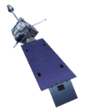
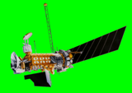

Operations Overview
Geostationary Operational Environmental Satellites (GOES)
  Provide continuous monitoring of North and South America, and Atlantic and Eastern Pacific Oceans
  Primary source of data for short term forecasting, especially of severe weather such as tropical storms
Polar-orbiting Operational Environmental Satellites (POES)
  Provides world-wide coverage every 12 hours
  Directly broadcasts data to users worldwide
  Primary source of data for longer term weather prediction, global environmental monitoring, and long-term predictions
Defense Meteorological Satellite Program (DMSP)
  Department of Defense satellite operated by NOAA
  Provides world-wide coverage every 12 hours
  Directly broadcasts data to Department of Defense users
Ocean Surface Topography Mission (OTSM) Jason-2
  Joint NOAA, NASA, CNES, EUMETSAT effort
  provides sea surface heights for determining ocean circulation, climate change and sea-level rise
Non-NOAA Data (NASA, Foreign Governments)

Slide 4
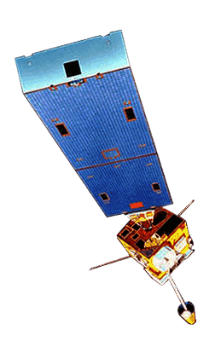
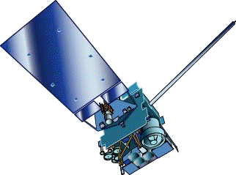
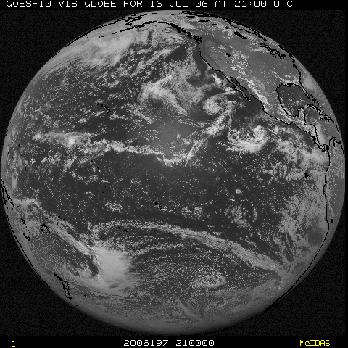
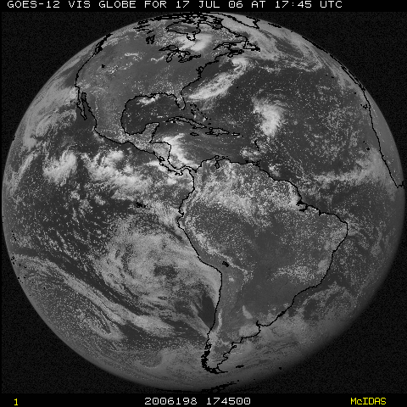
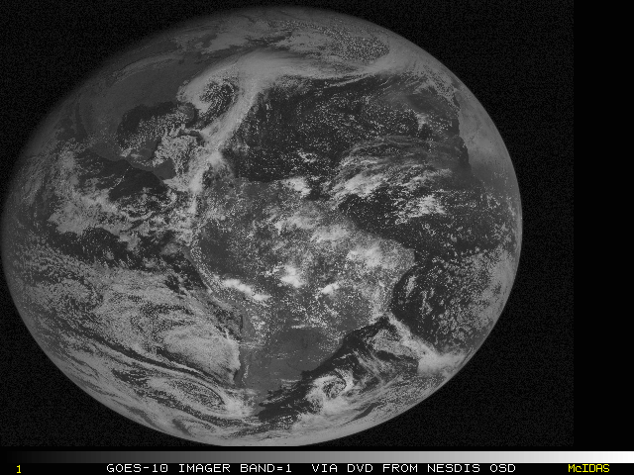
Current GOES Configuration
GOES-11
(135W)
GOES-13
(75W)
Operational
Operational
Very healthy GOES constellation.
GOES-14
(105W)
In-orbit
Back-up
GOES-15
(90W)
Testing
GOES-12
(60W)
South America
On 11/1/10, GOES-15 will takeover SEM and XRS ops
4

Slide 5
Operational GOES Updates

Slide 6
GOES I/M to N/P
GOES-8 to -12
GOES-13 to -15
First series using 3-axis gyro stabilization
GOES-11 finishing out GOES-West mission
  Last to have the 12 μm imager band until GOES-R (volcanic ash)
GOES-12 recently moved to 60°W for South America
New spacecraft bus allowing better navigation and radiometric accuracy
Operates through eclipse
Narrower WV band and increased resolution in 13.3 μm (-14, -15)
Modified GVAR format (-14, -15)

Slide 7

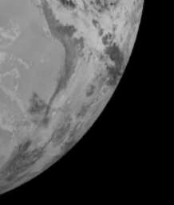
GOES-13 Schedules and Eclipse
GOES-13 operates with a slightly modified schedule:
  GOES-East housekeeping moved from 1834Z to 1534Z
Eclipse and “Stray Light Zone” (SLZ) Ops:
  GOES-13 currently performing Partial Frame scans (imager) when the Sun is within 6 degrees.
  NOAA/NASA and ITT working on an algorithm that would “clean” stray light from imagery:
    Currently testing products such as Fire, CSBT, and other products that depend on band 2
7

Slide 8
Current POES Configuration
Two polar operational satellites; one in morning and one in afternoon orbit
Continuity of operations since early 1960s
Since May 2007, NOAA using EUMETSAT satellite operationally for mid-morning orbit through NOAA/EUMETSAT partnership
2 p.m. Orbit
10 a.m. Orbit
Satellite | Metop-A | NOAA-15 | NOAA-16 | NOAA-17 | NOAA-18 | NOAA-19
Launch Date | Oct 2006 | May 1998 | Sept 2000 | June 2002 | May 2005 | Feb 2009
Operational Date | May 2007 | Dec 1998 | Mar 2001 | Oct 2002 | Aug 2005 | June 2009
Status | AM primary | AM secondary | PM secondary | AM backup | PM secondary | PM Primary
http://www.oso.noaa.gov/poesstatus/
http://www.wmo.int/pages/prog/sat/GOSleo.html#CurrentLEO
Valid as of June, 2009
Notes:
Satellite METOP-A NOAA-11 NOAA-12 NOAA-14 NOAA-15 NOAA-16 NOAA-17 NOAA-18 NOAA-19
Ascending Node* 2130 2302 1723 2155 1655 1712 2143 1339 1400

Slide 9
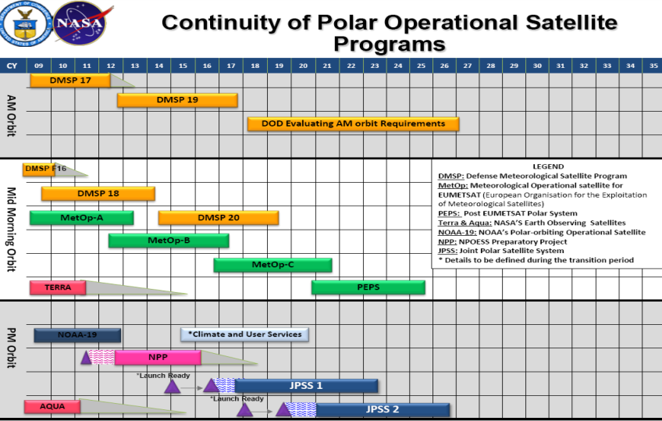
Operational POES Updates

Slide 10
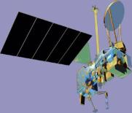
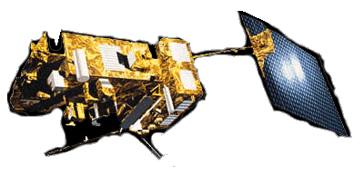


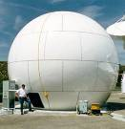




Geostationary Satellites
Polar Orbiting Satellites
NOAA-15, 16, 17, 18, 19
Metop-A
NASA Terra, Aqua
DoD DMSP
MTSAT-2 (DOMSAT)
MSG (DOMAST via Wallops)
Meteosat-7 (landline)
GOES-11, 12, 13, 14, 15
“Raw” Data
Various Ways
Polar Acquisition Stations for POES, MetOp, EOS
Wallops, VA
Fairbanks, AK
Gilmore Creek, AK
Svalbard
Honolulu, HI
Miami, FL
Australia
Monterey, CA
NASA DAACs
NOAA Satellite Operations Facility, Suitland, MD
Processed data, products, and services
Partners and Customers
Public

Slide 11

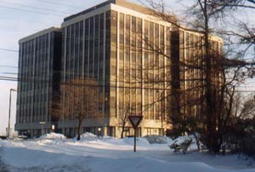
Office of Satellite and Product Operations (OSPO)
Office of Satellite and Product Operations (OSPO): Merges the functions of the Office of Satellite Operations (OSO) and Office of Satellite Data Processing and Distribution (OSDPD) as of October 10, 2010. The core functions of OSPO include:
Control of NOAA’s Satellite Constellations
Management of the Enterprise of the Ground Systems for Command and Control, Data Ingest, Product Generation and Distribution (Environmental Satellite Processing and Distribution System – ESPDS) and Critical Infrastructure Protection (CIP)
Operational support of NOAA’s satellite products and services, including interactive products and SARSAT
Joint command of NOAA’s Ice Center
Management of integration of NPP, JPSS, and GOES-R future systems

Slide 12
Office of Satellite and Product Operations (OSPO)
Director
E/SPO
Kathy Kelly
Admin Officer
Linda Brown
Corporate
Services
E/SPOx1
Keith Amburgey
Assistant Director CAPT Mark Moran
Deputy Director
E/SPO
Ajay Mehta
Special Projects Selina Nauman
MOD
E/SPO2
Ron Mahmot
Wallops CDA
E/SPO2
Doug Crawford
Fairbanks CDA
E/SPO3
Larry Ledlow (acting)
NOAA Ice Center
E/SPO4
Sharolyn Young
SPSD
E/SPO5
Dave Benner
Deputy: Linda Stathoplos
Operations (E/SPO21)
Al McMath
Deputy: Tom Renkevens
Operations (E/SPO11)
Steve Schaffer
Satellite Products (E/SPO51)
Ricky Irving
Support
(E/SPO22)
Stephen Howard
Acronyms
CDA – Command and Data Acquisition
MOD – Mission Operations Division
SPSD – Satellite Products and Services Division
Support (E/SPO12)
Mike Settles
Satellite Analysis (E/SPO52)
Davida Streett
Systems Engineering (E/SPO23)
Bob Clark
Systems (E/SPO13)
Alva Barnette
Direct Services (E/SPO53)
Chris O’Connors
Engineering (E/SPO14)
Cindy Hampton
IT Services (E/SPO15)
Andre Hammond

Slide 13
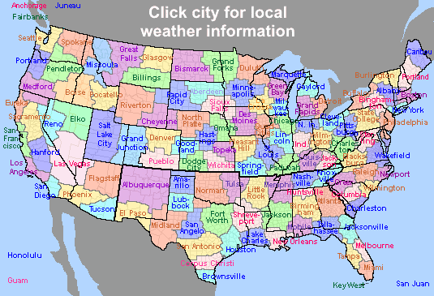
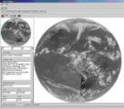
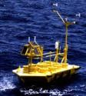


Direct Service Operations
Emergency Managers Weather Information Network (EMWIN):
NOAA satellites relay critical information to users across the country.
  http://www.weather.gov/emwin/index.htm
Low Resolution Image Transmission (LRIT):
NOAA satellites are used to relay satellite and weather products to users in remote locations, that do not have landlines or internet connections.
  http://www.noaasis.noaa.gov/LRIT/
Data Collection:
NOAA satellites are used to collect and relay scientific data from around the globe.
  http://www.noaasis.noaa.gov/DCS/ http://www.noaasis.noaa.gov/ARGOS/
Search and Rescue:
NOAA satellites are used to relay distress alerts from aviators, mariners and land-based users.
  http://www.sarsat.noaa.gov/
Geonetcast Americas
Data from NOAA for diverse societal benefits including agriculture, energy, health, climate, weather, disaster mitigation, biodiversity, water resources, and ecosystems.
  http://www.geonetcastamericas.noaa.gov/index.html
Notes:
OSDPD also manages NOAA’s Satellite Services including Search and Rescue, Data Collection, Low Rate Information Transmission, and data/product rebroadcast including GVAR, HRPT/APT, and GeoNETCAST. We partner with NWS to provide data and products through the Emergency Managers’ Weather Information Network.

Slide 14
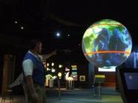
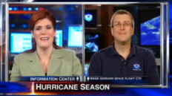
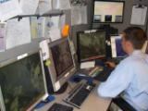
User Services*
The Satellite Products and Services Division serves as the primary interface with the user community of environmental satellite data and products:
Provides realtime notifications to users and stakeholders of any type of activity affecting product ingest, processing or distribution
Maintains “One Stop Shop” Help Desk responsible for the monitoring of many operational OSDPD products and services.
Serves as the conduit of information between users and the Product Area Leads (PALs).
Enhances the knowledge transfer between OSDPD and stakeholders.
Actively engaging users, stakeholders, potential customers, and the public.
Soliciting feedback from existing users on our performance
Continually assessing user requirements.
Briefing users on the process to set up new or enhances satellite products and services
Exploring the use of Web 2.0 technologies such as YouTube and Twitter: www.twitter.com/noaa_osdpd

Slide 15
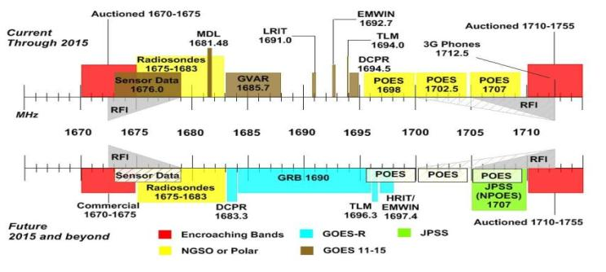
FCC Radio Spectrum Notice
FCC released Public Notice 10-123 on 6/4/10
  Covers the use of spectrum in the 1675 – 1710 MHz range
  Affects NWS radiosondes and GOES/POES downlinks
    GVAR
    HRPT
    EMWIN, LRIT, DCS
    http://fjallfoss.fcc.gov/ecfs/proceeding/view?z=ryjse&name=10-123
15

Slide 16

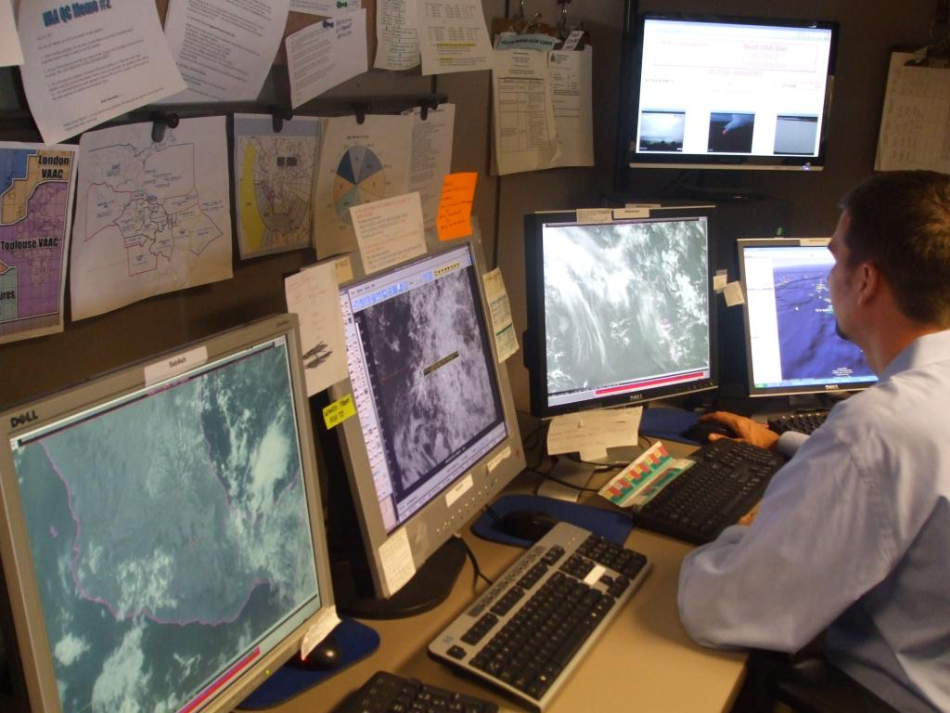
McIDAS at ESPC
Over 20 SDIs at NSOF and Wallops OBF:
  GOES-East, West, spare (-15)
  MTSAT
  GOES Ingest and NOAAPORT Interface (GINI)
Over 20 High Performance Workstations in Satellite Analysis Branch:
  -X for realtime analysis, product generation, and QA/QC
  RHEL 5 Linux on Intel x86
  Many “home grown” programs in Fortran, .PGM, BATCH
ESPC Product Generation/Distribution:
  IBM P6 Series with Linux Partitions
  Migration from Intel to IBM completed in 2008 (byte flipping)
  GINI running on SGI IRIX

Slide 17
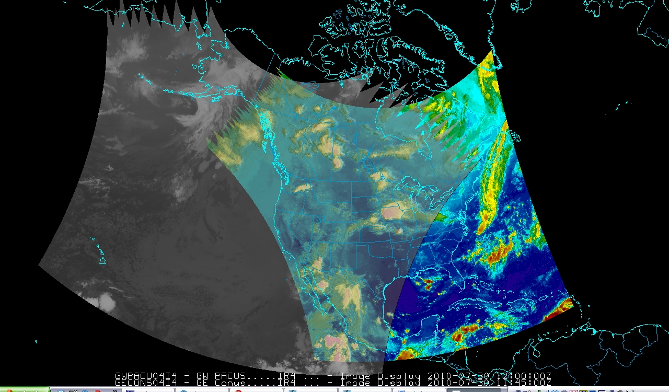
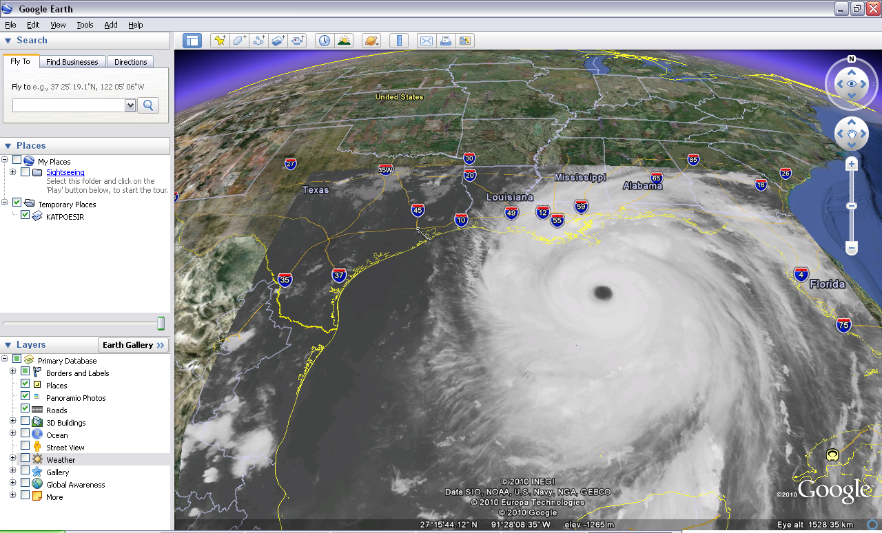
McIDAS at ESPC
Advantages of McIDAS at ESPC:
The ADDE protocol allows for many users accessing single systems with one port (112)
Common legacy (and future?) formats for satellite remote sensing data (GOES and POES) and ancillary information for research and ops
Simple and quick visualization and UI customization (McIDAS-V makes remapping, overlays, sampling, other tasks much easier!)
Platform independence of McIDAS-V
17

Slide 18
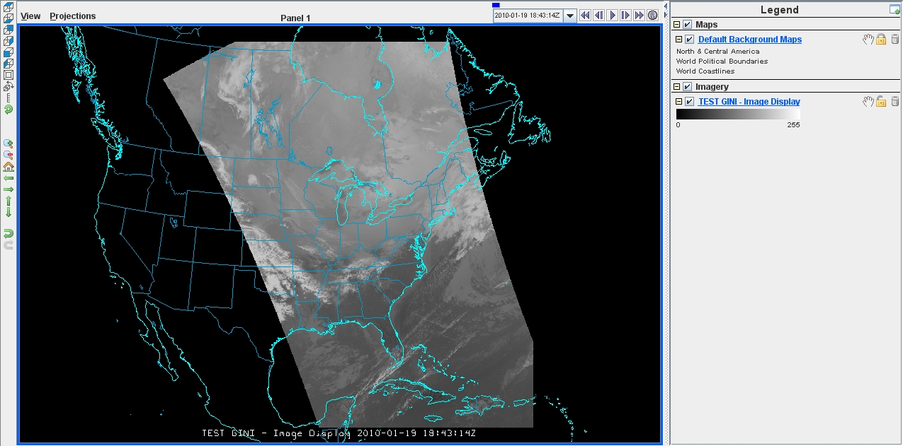
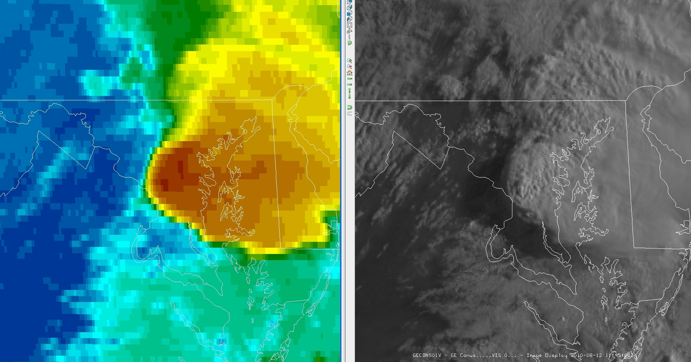
McIDAS at ESPC
Challenges at ESPC:
Maintaining efficient access to servers for operations
“Version-itis” between systems (GINI still running v.2005!)
Additional customer requirements for advanced formats (GIS, KMZ)
McIDAS-V Testing and Evaluation:
  Performance
  Functionality and carry over of –X commands used for years
  Migration of software from –X to –V

Slide 19
2011 NOAA Satellite Direct Readout Conference
The focus of the conference will be on current GOES and POES data access, distribution, and preparing users for the upcoming changes to NOAA satellite programs. We will present users with information on APT, HRPT, GVAR, ARGOS DCS, GOES DCS, LRIT, EMWIN, GEONETCast Americas and other NOAA systems. We will also review the upcoming GOES-R and Joint Polar Satellite System (JPSS) Programs.
April 4-8, 2011
Hilton Miami Airport Hotel, Miami, FL
directreadout.noaa.gov
“Real-time Access for Real-time Applications”

Slide 20
Backup Slides

Slide 21
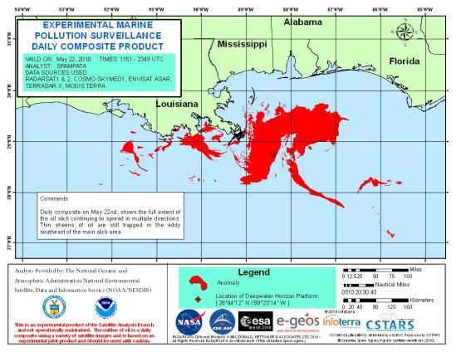
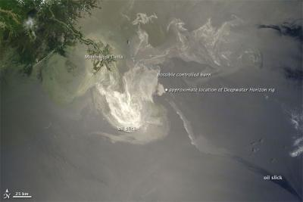
Experimental Marine Pollution Surveillance Report
New Users of SAB Oil Location Products
  Many new additional NOAA users especially in NOS, NESDIS and ICC
  United States Geological Survey (USGS)
  Pentagon
  National Geospatial-Intelligence Agency (NGA)
  Dept of the Interior headquarters (info source for briefings of the Secretary of the Interior)
  Department of Homeland Security
SAB product depicting oil spill location for May 22. MODIS, ENVISAT and RADARSAT imagery used.
http://www.ssd.noaa.gov/PS/MPS/deepwater.html

Slide 22
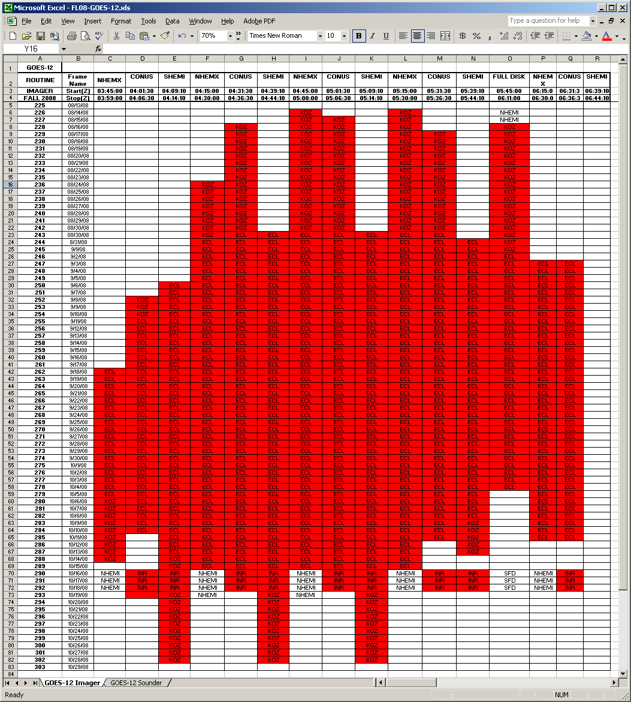
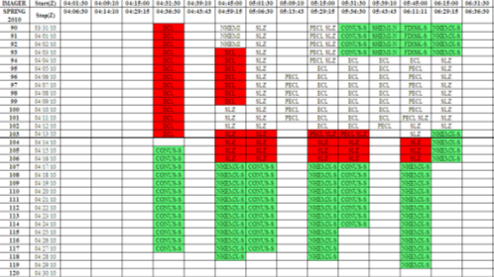
Differences in Imager cancellations:
GOES-12 and GOES-13
KOZ plus Eclipse cancellations (GOES-12 @ 75°W, KOZ @ 6° Sun)
Actual Spring 2010 cancellations on GOES-13 for KOZ only, including partial frame scans (in green)

Slide 23
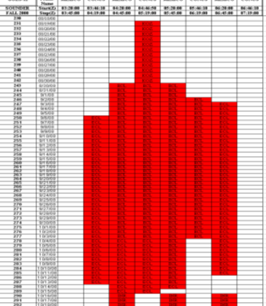
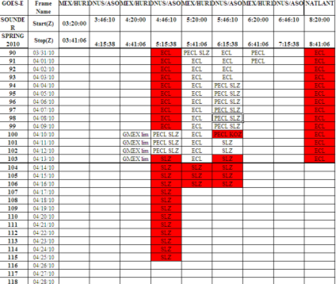
Differences in Sounder cancellations: GOES-12 and GOES-13
KOZ plus Eclipse cancellations (GOES-12 @ 75°W, KOZ @ 6° Sun)
Actual Spring 2010 cancellations on GOES-13 for KOZ only

Slide 24
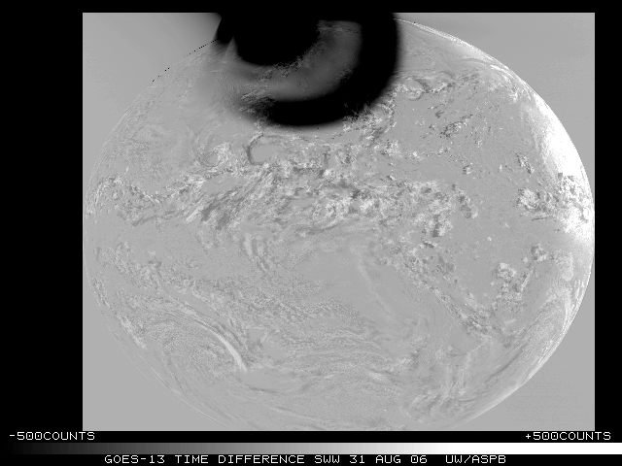
GOES-13 Schedules and Eclipse
Why not scan away from contaminated data?

Slide 25
GOES Current Series Plans - Summary
GOES-11 as GOES-West until late 2011
GOES-12 serving over South America
GOES-14 tested and set as spare at 105°W with XRS in operation
GOES-15 (launched 3/4/10) at 90°W to undergo Science Testing beginning August 7, 2010.
GOES-R scheduled for launch n.e.t. October 2015.

Slide 26
Research to Operations
User Request: Users can identify a need for new or improved observations or products.
Mature Science Development: Scientists can identify maturing scientific development or algorithm thought to provide significant user benefit.
NOAA Program/NESDIS Project Manager Directed Project: NOAA/NESDIS program or project managers can provide requirements to develop new or improved products. These acquisition managers formulate plans to acquire the new products
An integrated product team (IPT) will be formed to coordinate the development process, and submitted to the Satellite Products and Services Review Board for funding.

Slide 27
Office of Satellite Products and Operations (OSPO)
Kathy Kelly, Director
Ajay Mehta, Deputy
Administrative Officer
Assistant Director
Special Projects
Corporate Services Manager
Mission Operations Division
Ron Mahmot
Satellite Products and Services Division
David Benner
Wallops Island CDA
Doug Crawford
NOAA Ice Center
(Navy, NOAA, USCG)
Fairbanks CDA
Operations
IT Services
Satellite Products
Systems Support
Support
Satellite Analysis
Engineering
Systems
Direct Services
Engineering
Satellite and Product Operations
Orange indicates GOES-R participation
Control

Slide 28
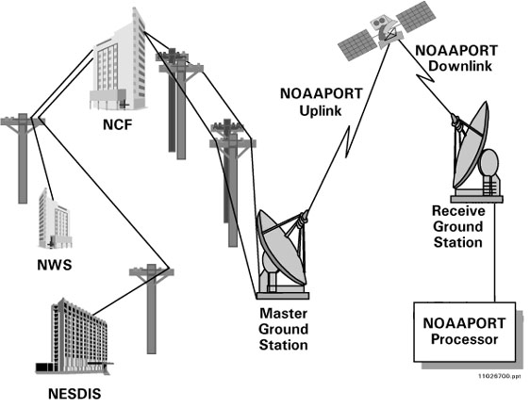
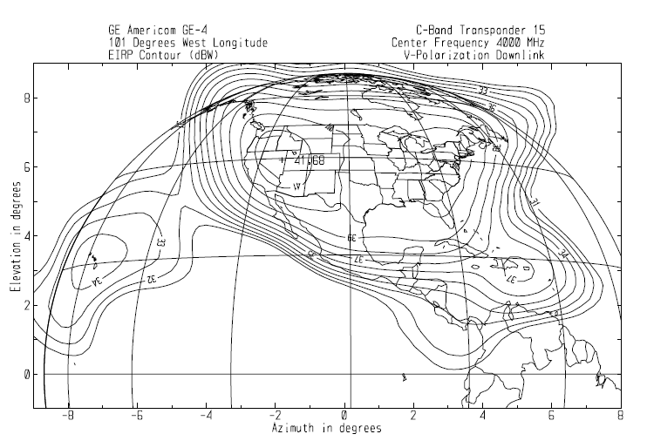

Product PD Operations - AWIPS
NOAAPORT Distribution
http://www.weather.gov/noaaport/html/noaaport.shtml
Main User – NWS / AWIPS
Satellite Broadcast Network (SBN)
  Provides broadcast and reliable multicast data transmission to field sites.
    Transmitted data includes: Centrally collected radar data, GOES imagery, NCEP model data, field observations, and watches and warnings
  DVB-S
    Single channel solution.
    Linearly scalable up to 43 Mbps
Satellite Data on NOAAPORT limited to remapped CONUS and AK, HI, PR with subset of sounder bands

Slide 29
“Snapshot” of SSD Users
Major Users:
  NWS National Centers for Environmental Prediction (NCEP): HPC, OPC, TPC, SPC, NCO, AWC, EMC, CPC, SWPC
    N-AWIPS, AWIPS, Direct Broadcast, sFTP, Internet, ADDE
  NWS Weather Forecast Offices and River Forecast Centers
    AWIPS and Internet
  National Ocean Service (NOS), National Marine Fisheries Service (NMFS)
    Internet and sFTP
  DoD, DoI, DoT, USDA, EPA, NASA, FEMA, NTSB, USGS
    Shared Processing (DAPE), Internet, sFTP, Direct Broadcast, NOAAPORT, ADDE
  International: EUMETSAT, ECMWF, UKMET
    Direct Broadcast, Internet, ADDE

Slide 30
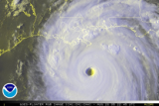
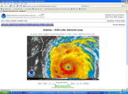
“Snapshot” of SSD Users
Major Users:
  Private Industry: WSI, WSC, Meteorologix, Accu-Weather, Unisys, Baron, IPS Meteostar, airlines (Domestic and Int’l, and Cargo)
    Direct Broadcast, NOAAPORT, Internet, ADDE
  Universities and Cooperative Institutes
    Direct Broadcast, NOAAPORT, Internet, ADDE
  International Meteorological Services: Central and South America, New Zealand, France; Research institutions, Volcanic Ash Advisory Centers. Media and Private Users
    Direct Broadcast, NOAAPORT, GeoNetCast
  General Public
    Internet, ADDE
    Public demand for GOES imagery during a land falling hurricane can account for as much as 300 million “hits” per week, and over 10 Tb of data served!

Slide 31
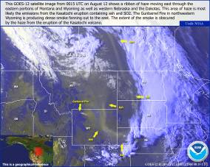
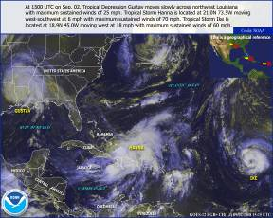
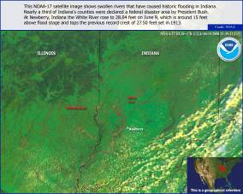
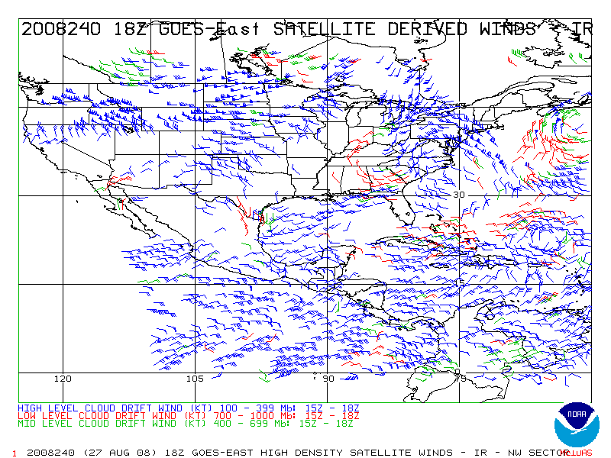
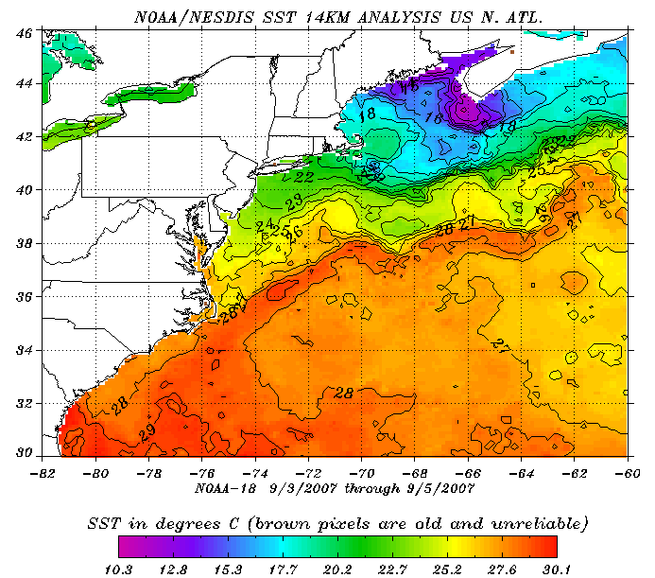
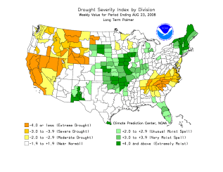
Satellite Data Products http://www.osdpd.noaa.gov/
Volcanic Ash & Fires
Hurricanes
Midwest Floods
Wind Speed/Direction
Sea Surface Temperature
Drought Monitoring
31
Notes:
Weather sentinel
Hurricanes
Severe storms
Flash floods
Input to weather models, forecasts and warnings
Fire and smoke products for air quality monitoring and forecasting and fire fighting
Sea surface temperature monitoring for fisheries and climate
Winds for aviation
Solar imagery for communication satellites, utility companies, and astronaut safety
Environmental data collection–buoys, rain gauges…
Search and Rescue
GOES data shared within the western hemisphere

Slide 32
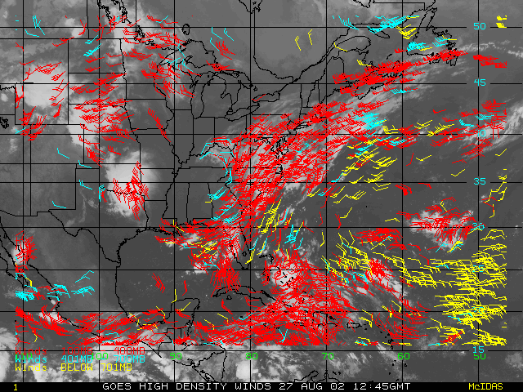
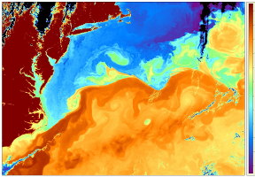
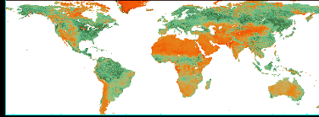
Diverse Products and Services
Atmospheric Products are the most common generated by satellites. Sensors on board Geostationary and Polar Orbiting satellites measure electromagnetic radiation emitted by the atmosphere at many levels. Complex algorithms can turn these measurements into meteorological variables used by forecasters to predict weather.
Ocean Products are a staple of remote sensing platforms since the dawn of satellites, in vast ocean areas where in-situ measurements are few and far between. Satellites are used to measure many variables such as temperature, winds, waves, surface currents, and ocean color. These products are used by meteorologists and biologists, as well as commercial fishing fleets.
Land Products are very important to numerical weather models, and have benefit in climate applications. In recent years, advanced sensors from both NOAA and NASA assist forestry managers to determine vegetation stress in relation to droughts and wildfire dangers.

Slide 33
Product Operations
“RAW” Imagery Data
GOES-13
GOES-11
MTSAT-2
NOAA-15
NOAA-16
NOAA-17
NOAA-18
NOAA-19
Metop-A
Meteosat-9
Meteosat-7
Other NASA
“Ancillary” Data Input
RADAR Data Profiler Data
Model Data RAOB/Radiosonde Data
Forecast Data Ship Reports
Surface Data Pilot Reports
Upper Air Data Buoy Reports
Applications (subset)
Global Geostationary Satellite Imagery
Tropical Cyclone Analysis
Volcanic Ash Detection and Tracking
Fire Monitoring and Analysis
Flash Flood Analysis
Satellite Imagery for AWIPS
Winds
ASOS Satellite Cloud Project
Sounding-Derived Products
Snow Cover
Special Events Imagery
Products (sampling)
GOES-13, GOES-11, MTSAT-2, Met-9. and Met-7 Remaps
GOES-13 and GOES-11 High Density Winds
GOES-13 and GOES-11 ASOS SCP
GOES-13 and GOES-11 DPI
GOES-13 and GOES-11 Soundings
GOES-13 and GOES-11 IFFA
GOES-13 and GOES-11 Product Archive (NCDC)
NOAA-15, 16, 17, 18, 19 Derived SNOW-IMS
GINI: AWIPS Predefined Digitally Remapped Sector Products
SSM/I WINDS, Rain Rate, Total Precipitation Water, Snow
POES Passes and Composites
SSM/I Composites
GOES SST
For more product/application information, see the Satellite Product End to End Doc (SPEEDS) at: http://www.ngdc.noaa.gov/speeds/
ESPC
Processing

Slide 34
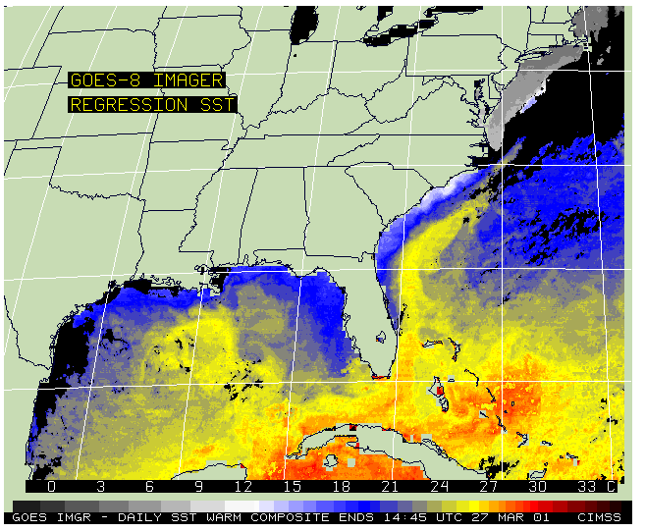






Satellite Products and the Benefit to Society
Satellites measure radiant energy
Algorithms use satellite data to create products
Environmental products distributed to users
Using these products to construct a “picture” of the environment. These datasets are input into complex computer model simulations of the atmosphere
Using satellite data and models together, forecasters can accurately predict environmental conditions
Users input products into computer model simulations of the atmosphere
Putting all the data together, scientists can better warn the public of pending disasters

Slide 35




ESPC Product Distribution
GOES Ingest and NOAAPort Interface (GINI)
NOAAPort/AWIPS
NWS
IBM SATEPSDIST Servers
(ADDE and FTP)
NWS/NCEP
DOD
STAR
SAB
Universities
Private Industry
ESPC Processing
Data Distribution Server (DDS)
NWS/NCEP/EMC
ECMWF
UKMET
STAR
DOD
Dell Blade Servers (Linux)
NWS/NCEP
DOD
STAR
SAB
Universities
Private Industry
SAB Analysis
Notes:
In order to serve our stakeholders, customers, international partners, and the public, we manage a data center capable of processing and serving Terabytes of raw and processed data every day.

Slide 36




User Services
Maintaining information portals to enhance the flow of information between OSDPD/SSD and users:
  Updated web page with FAQ, contacts, and archive of all notifications
  E-mail lists, GTS bulletins, Twitter, RSS feeds (Twitter: @noaa_osdpd )
  Acquiring Help Desk/CRM Tools with user “portals” for instant access to information
  Integrating web based information delivery pages with existing SOCC status charts
  Involved in the development and deployment of the Satellite Product End to End Documentation System (SPEEDS)
www.osdpd.noaa.gov
www.oso.noaa.gov

Slide 37



Smoke and Fire Detection
GOES and POES imagery, products, and analyses support State and Federal firefighting programs by detecting and tracking areas of smoke, and detecting and monitoring large wildfires.
Analysis of smoke and fire, performed 2x/day, sent to field centers and input into local weather models to forecast AQ.

Slide 38




Southern California Wildfires
Infrared and visible sensors on board Geostationary and low Earth orbiting satellites can detect heat signatures such as fires, and show the aerial extent of smoke from those fires. Smoke locations are derived from the measurements, then sent to the National Weather Service as input into regional and local Air Quality models.

Slide 39





OSPO/NIC Sea Ice Products www.natice.noaa.gov
PRODUCTS
Ice Charts for Northern and Southern Hemispheres
Sea Ice Forecast and Outlooks
Daily Ice Concentration
Iceberg Tracking
Special Support for Government Ships
Among known CUSTOMERS
National Weather Service – Alaska Region
NOAA Pacific Marine Environmental Laboratory
North American Ice Service (NAIS)
US SUBFOR
Arctic Submarine Lab
US Coast Guard District Office 17
Arctic Research Consortium of the United States (ARCUS)
US Mineral Management Service
Private Companies
University and Research Groups
Foreign Governments
USCGC HEALY conducts operations in the Chukchi

Slide 40




OSPO/NIC Snow and Ice Product (IMS)
NOAA / National Weather Service Support
ASSIMILATED IN MOST NWP MODELS WORLD WIDE
Primary Customers
  NOAA NWS NCEP Environmental Modeling Center (EMC)
  Climate Prediction Center (CPC)
Known Secondary Customers
  US Army, US Air Force, US Navy, Dept of State, USDA, NOAA SSD, NOAA NWS field offices, US DoT, Environment Canada, EMCWF, UK Met, Numerous Universities, Weather Channel, CNN, AccuWeather, private companies, and many general public users.

Slide 41




ESPC Access to Data and Products
GINI (GOES Ingest and NOAAPORT Interface)
  McIDAS powered remapped satellite data distributed to NWS for display on AWIPS
  Derived products (i.e. GOES/POES Sounding Products) generated external to GINI distributed via GINI
  Available from NWS Broadcast and via McIDAS from select Unidata sites
ReBroadcast Services: GeoNETCAST, NOAAPORT
  GVAR, LRIT, EMWIN, DCS, SARSAT
  HRPT, VHF, APT, ARGOS
Internet Distribution (Web, FTP, ADDE)
  www.osdpd.noaa.gov (links to GIS, JPG, KMZ files)
  Satepsanone.nesdis.noaa.gov (HTTP and FTP) – download binary files (AREA)
  ADDE: PUB on satepsanone.nesdis.noaa.gov – public McIDAS
Notes:
This slide breaks down the publicly available methods for users to obtain data and products. NOAAPORT is a NWS system, and covers CONUS and near CONUS users only, but is free to use. GeoNETCAST delivers select data and products to North and South American users, and is the American component to the GEOSS broadcast. The internet is rapidly becoming one of the primary methods for distributing data and products, through web portals, the Abstract Data Distribution Environment (ADDE), and FTP. We offer many types of files (image, text, BUFR, GIS, KML, AREA) for a diverse set of users. SSD imagery of tropical storms and hurricanes are one of the most accessed Federal Government sites when the public is threatened by tropical weather (in 2005 after Katrina, we served over 300 million “hits” and over 10 Tb of data through our website in one week).

Slide 42



ESPC Access to Data and Products
SATEPSDISTx (1-7) – McIDAS ADDE Based – Registration Required
  Serves real time and remapped imagery from GOES, POES, MTSAT, Meteosat-9/7, NASA/EOS
  Serves Derived products from GOES, POES, DMSP, TRMM
  Serves Model and InSitu (observations, forecasts) Data
DDS – Registration Required
  AIX server delivers primarily polar products for use in polar derived product and for assimilation into NWP
  Level 1b and various Level 2 products (BUFR, Text)
DAPE (SPP)
  Data exchange of Air Force, Navy, NESDIS, NWS
    Largely derived products such as from SSM/I, GOES Winds
Notes:
These distribution methods are available to critical users and stakeholders who need fully supported, dedicated systems in order to fulfill their mission. Users register themselves with OSDPD and are vetted through a process to determine the appropriate level of access. Support is guaranteed with 24x7 on call system admins and programmers, and systems have multiple, redundant backups.

Slide 43
Satellite Products on AWIPS/NOAAPORT
GOES Products
Cloud and Moisture Imagery (visible, IR, water vapor, 3.9 μm, select sounder bands) over CONUS, North America, Northern Hemisphere
Sounder Derived Imagery (TPW, LI, Skin-T, CTP, ECA) over CONUS
Sounder Profiles (hourly)
Low Cloud Base
Satellite Precipitation Estimates (auto and manual)
Derived winds from visible, IR, Water Vapor, 3.9 μm
POES Products
Blended TPW and % of Normal (POES, GOES, GPS)
Microwave Rain Rate from AMSU and SSMIS
POES Sounder Profiles
ASCAT Scatterometer Winds
Future Products
POES Visible and Infrared from AVHRR
Blended Rain Rate (POES, GOES)
MODIS Derived Products (currently available as part of GOES-R PG)

