Slide 1
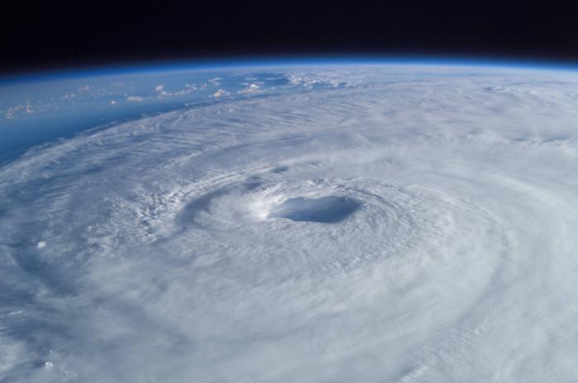
McIDAS at the National Hurricane Center
McIDAS Users' Group (MUG) Meeting
Madison, Wisconsin (October 25-26, 2010)
Christopher Sisko
National Hurricane Center (NOAA/NWS)

Slide 2
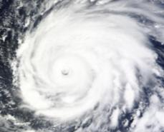
Presentation Outline
Our mission and vision statements
Area of Responsibility (AOR)
Satellite data usage at NHC
Our operational framework (McIDAS)
Specialized Projects
Future Direction
Questions / Comments
Hurricane Igor on Sep 14, 2010

Slide 3
Our Mission / Vision Statements
Mission Statement (What We Do):
To save lives, mitigate property loss, and improve economic efficiency by issuing the best watches, warnings, forecasts and analyses of hazardous tropical weather, and by increasing understanding of these hazards through global outreach.
Vision Statement (What We Hope to Achieve):
To be America's calm, clear and trusted voice in the eye of the storm, and, with our partners, enable communities
to be safe from tropical weather threats.

Slide 4
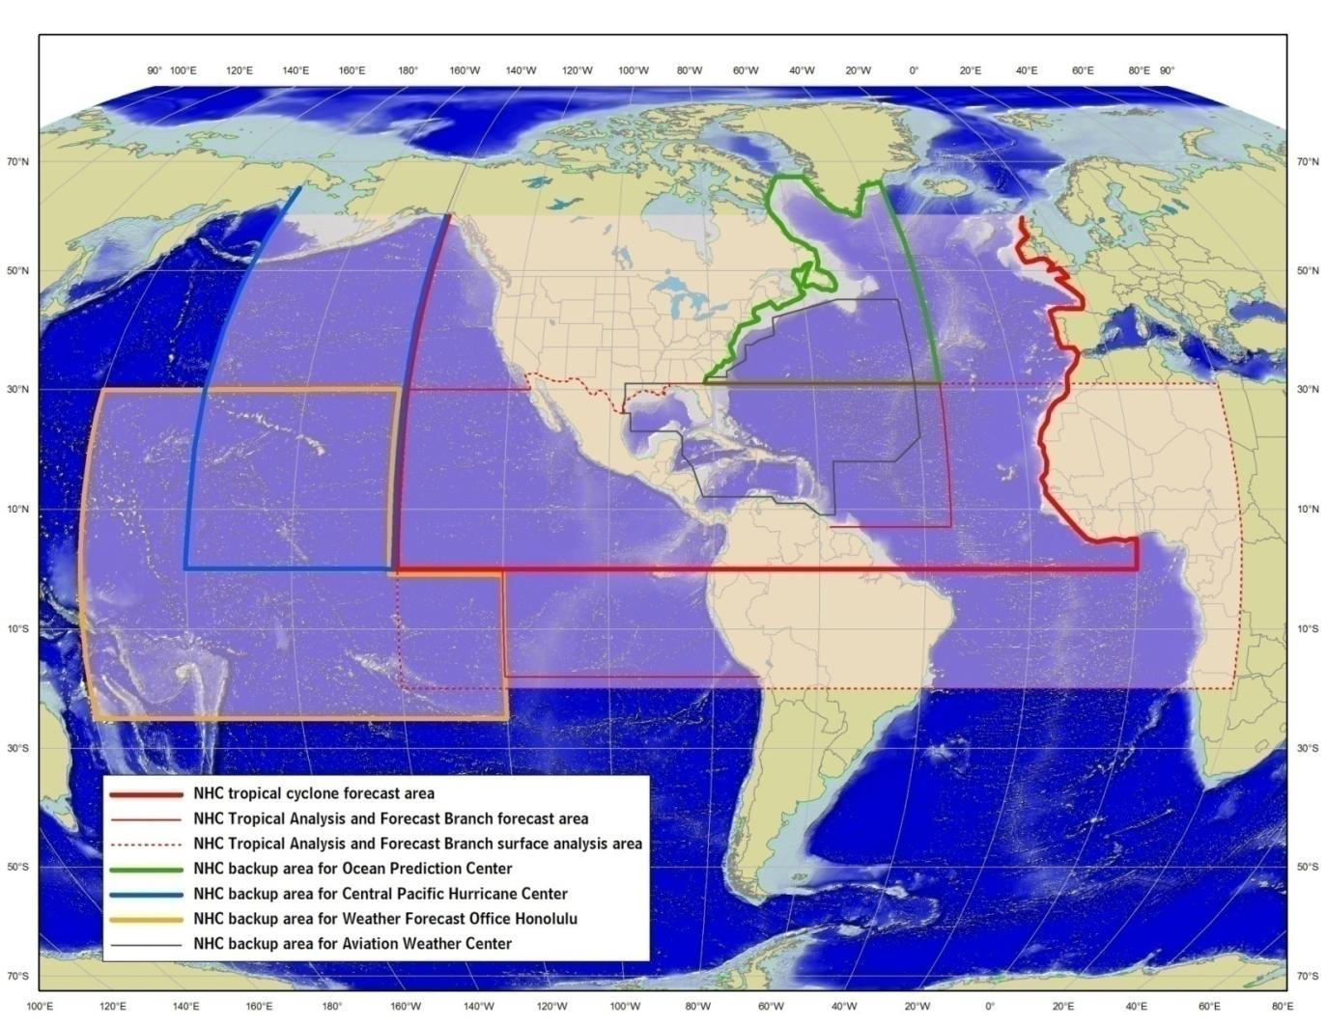
NHC’s Area of Responsibility (AOR)

Slide 5
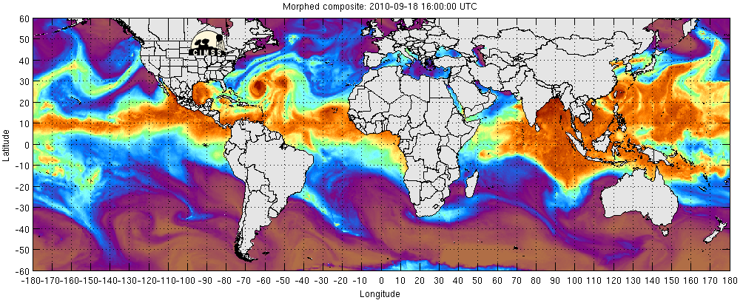
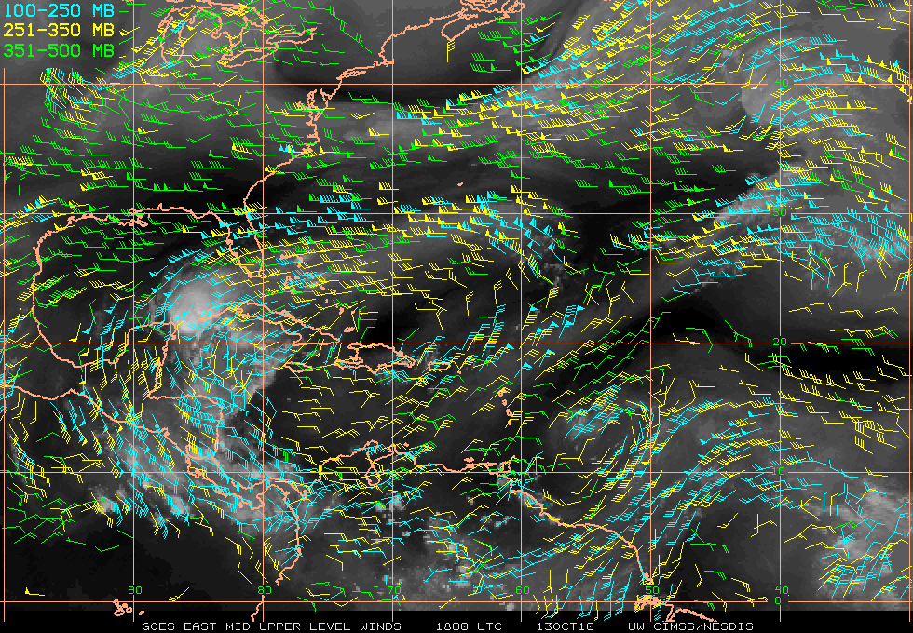
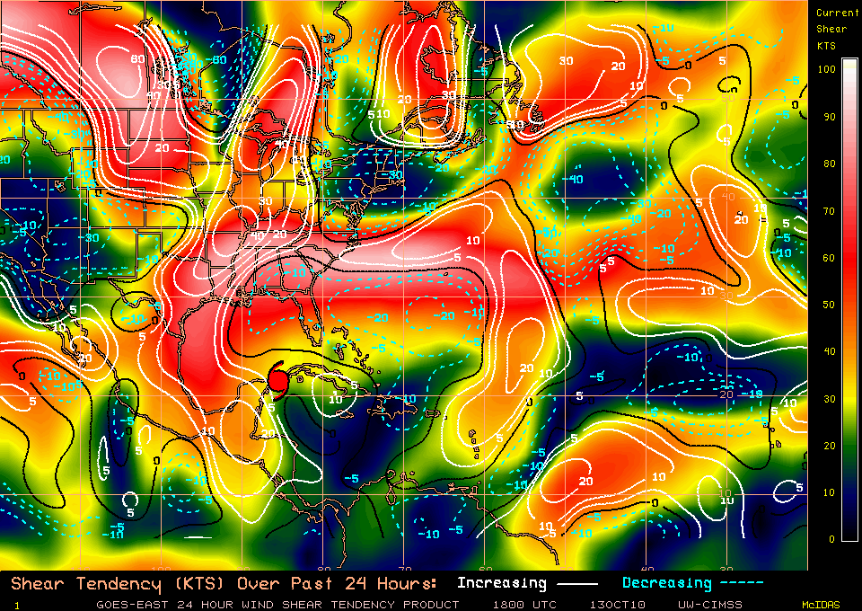
Satellite Use at NHC
Tropical Cyclone monitoring and analysis
Dvorak technique
Determine synoptic scale patterns
  Satellite winds, TPW, wind shear, etc
Storm scale patterns
  microwave analysis and intensity based algorithms
Intensity predictor and other model based algorithms
  Rapid intensification indicator, eyewall replacement cycle, annular hurricane detection, etc.

Slide 6
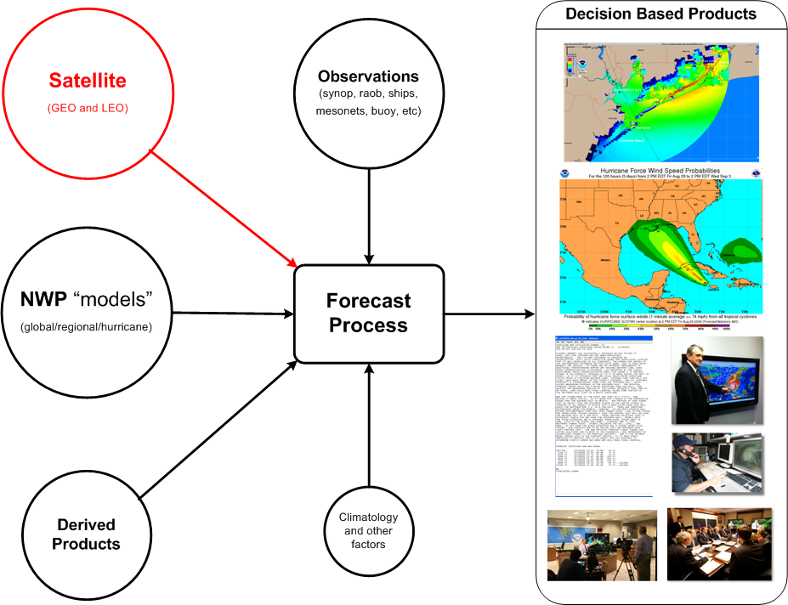
Satellite Use at NHC

Slide 7
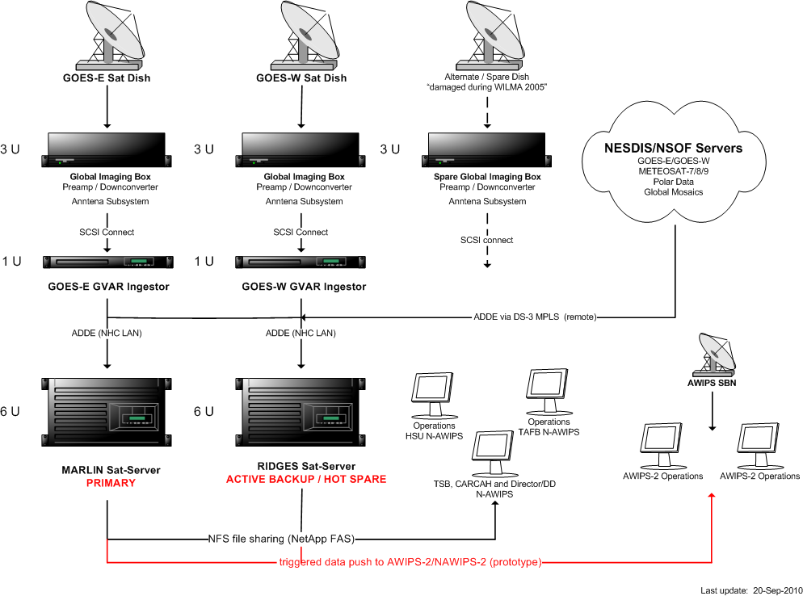
Our Mission

Slide 8
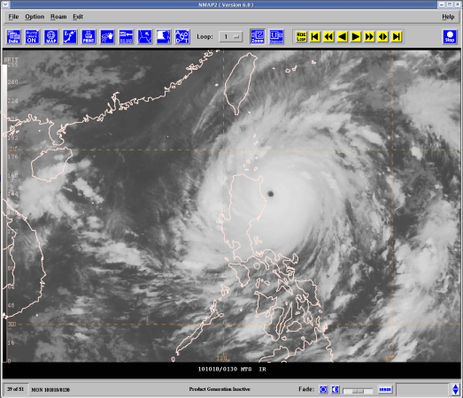
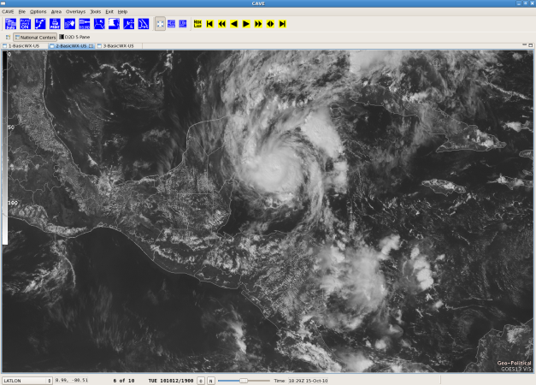
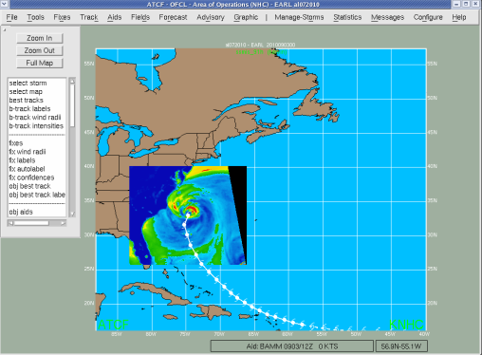
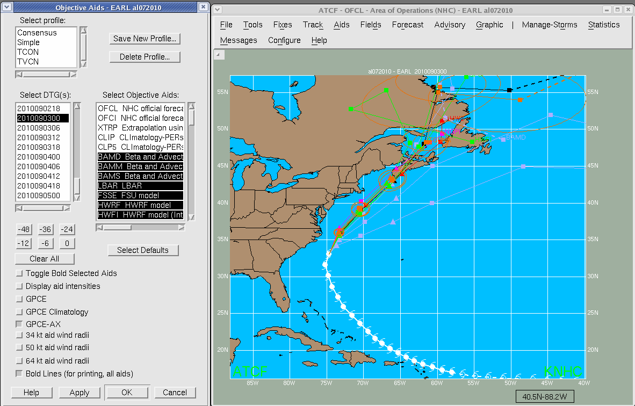
  NHC’s Forecast Display Systems
NAWIPS Display (current system)
AWIPS-2/NAWIPS-2 Display
(future system – SOA framework)
ATCF Display (satellite overlays)
ATCF Display (models)

Slide 9
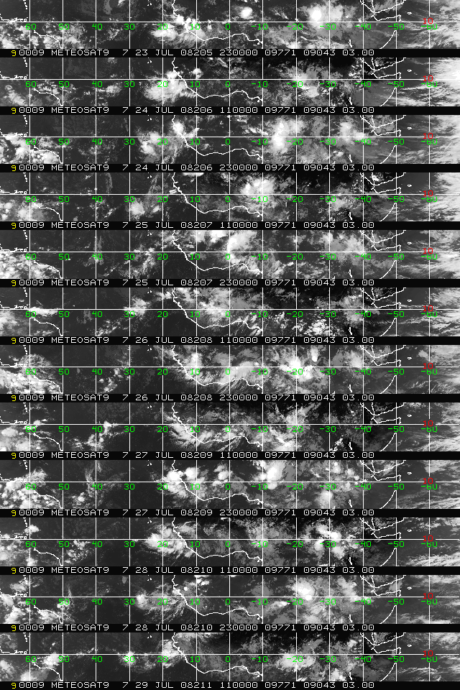
A Hovmöller chart shows the foot print of a weather system moving from west Africa to the Eastern Caribbean
The initial tropical wave passed west Africa around
0000 UTC Jul 24, 2008

Slide 10
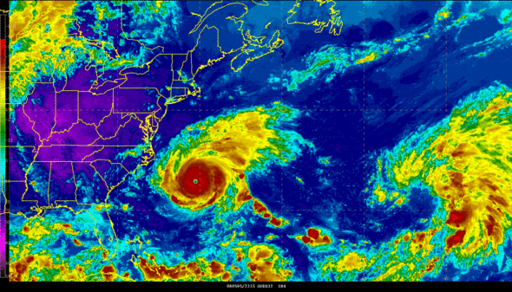
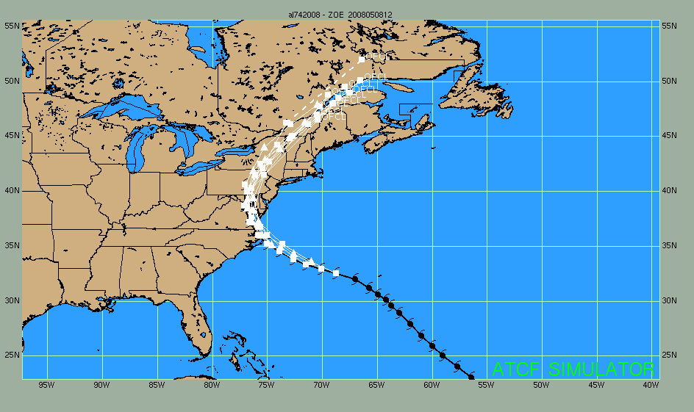
Special Purpose Satellite Imagery
Hurricane Zoe (2008) used to test continuity of operations and response for Federal Agencies during a simulated major emergency event – Hurricane Ivan (2004) re-navigated imagery.
Emergency management response training (Federal, State and/or Local)
Outreach and preparedness activities
Media (documentaries or science related segments)
Situational awareness (mostly for communities rarely impacted by tropical cyclones).

Slide 11
McIDAS Users' Group (MUG) Meeting
Madison, Wisconsin (October 25-26, 2010)
Future Direction
Expect McIDAS to perform NHC’s operational satellite background processing for AWIPS-2.
Continue to leverage McIDAS for specialized projects – emergency management exercises, case studies, outreach efforts, etc.
“McIDAS will continue to play a crucial role in NHC’s operational framework.”

Slide 12
McIDAS Users' Group (MUG) Meeting
Madison, Wisconsin (October 25-26, 2010)
Questions or Comments?
Thank You

