Slide 1
Advanced Image Compositing Techniques
David Santek, Rick Kohrs, Nick Bearson,
Matthew Lazarra
McIDAS Users’ Group Meeting
26 October 2010

Slide 2
Outline
Project overview
IMGPARM
COMP_ALLBAND
Current results

Slide 3
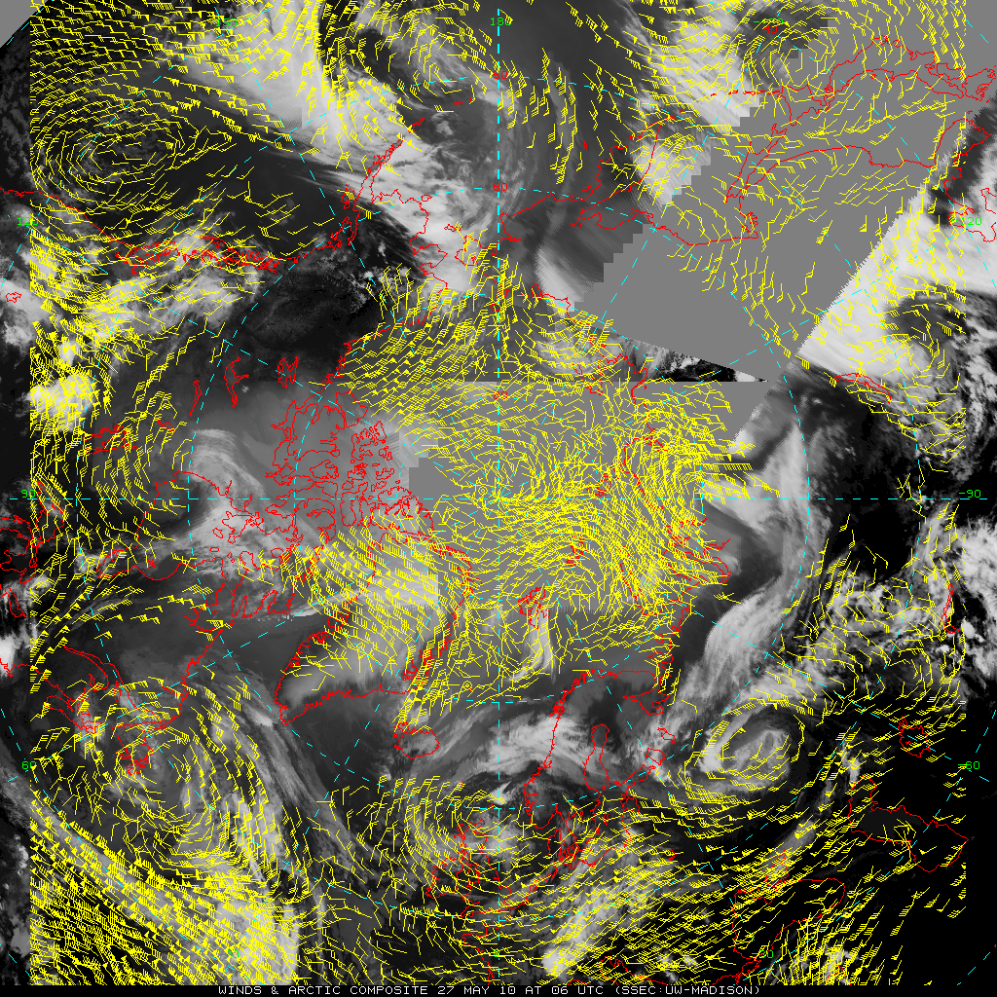
Project Overview
Combine data from polar and geostationary satellites to track clouds in high latitudes
Geostationary satellites are good up to 50º-60º latitude
Polar orbiting satellites are good poleward of 70º latitude
This technique is designed to ‘fill the gap’

Slide 4
Project Issues
Accounting for inter-satellite calibration differences
Correcting for parallax in viewing the cloud tracers from different satellites and instruments
Using the pixel time within the composite that corresponds to the viewing by each satellites when computing cloud velocity

Slide 5
IMGPARM: Create multi-band files
Band | Description
1 | Grayscale values (brightness temperature)
2 | Time difference from nominal time (sec)
3 | Distance from satellite subpoint (km)
4 | Pixel area (km²)
5 | McIDAS Satellite Sensor number (SS)
6 | Wavelength
7 | Parallax distance (km*10)
8 | Parallax direction (degrees)

Slide 6
COMP_ALLBAND
All IMGPARM files are remapped with REMAP2 into a common projection
COMP_ALLBAND then combines many IMGPARM files into a single file
Choose highest resolution pixel
Ensure pixels are in time range
Retain all IMGPARM bands

Slide 7
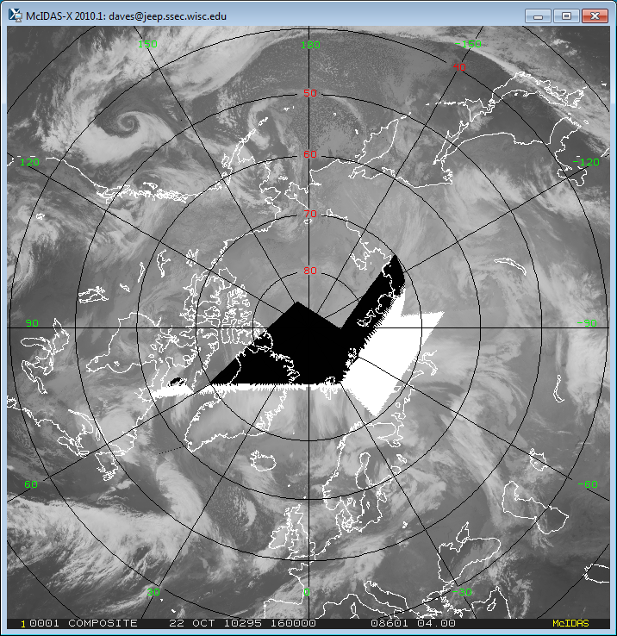
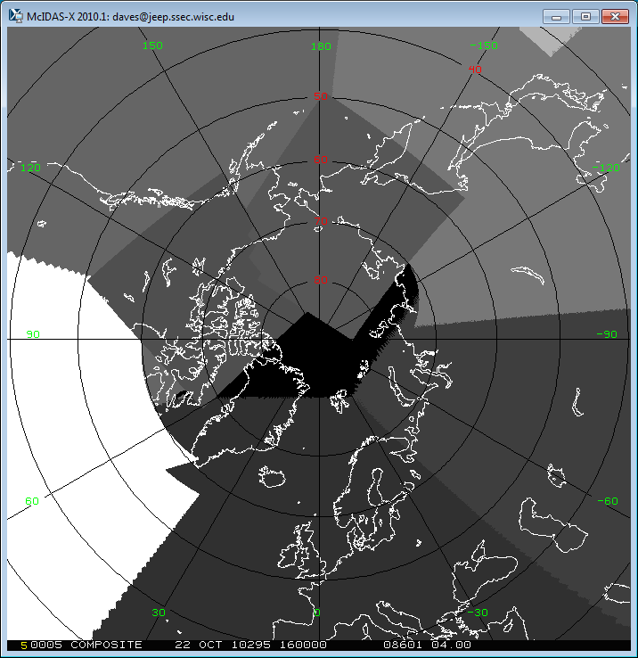
Example composite
Satellite ID number
Infrared composite
Notes:
This is work in progress.

Slide 8
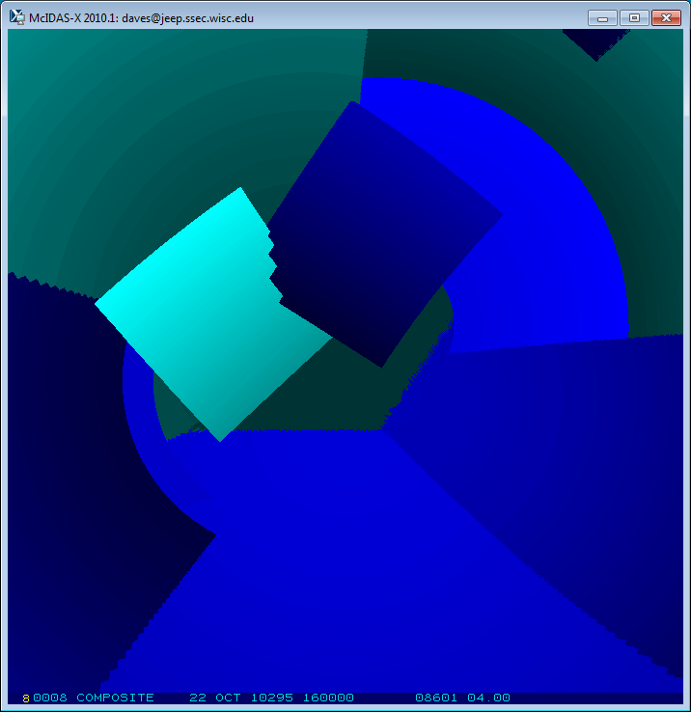
Pixel Time (Difference from a nominal time)
Blue: 0 to 15 minutes before nominal time
Green: 0 to 15 minutes after nominal time

Slide 9
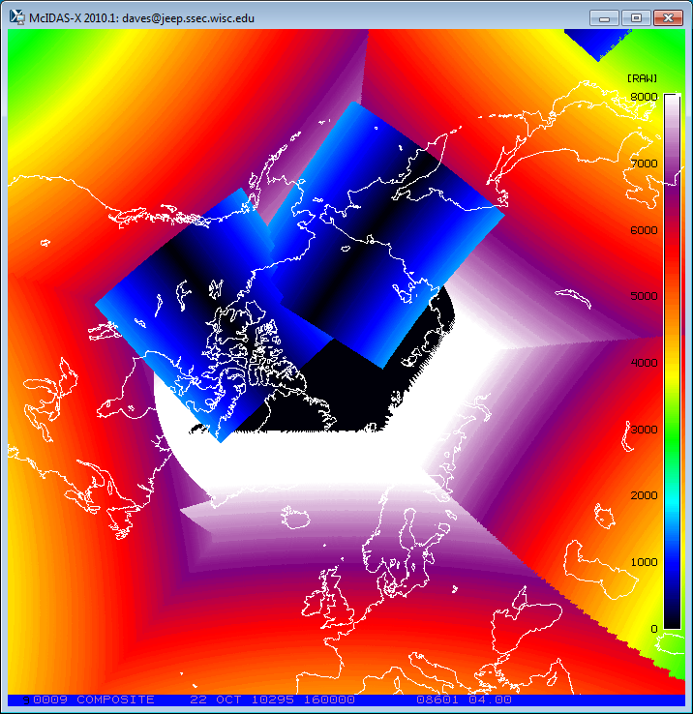
Pixel Distance (km) from Subpoint

Slide 10
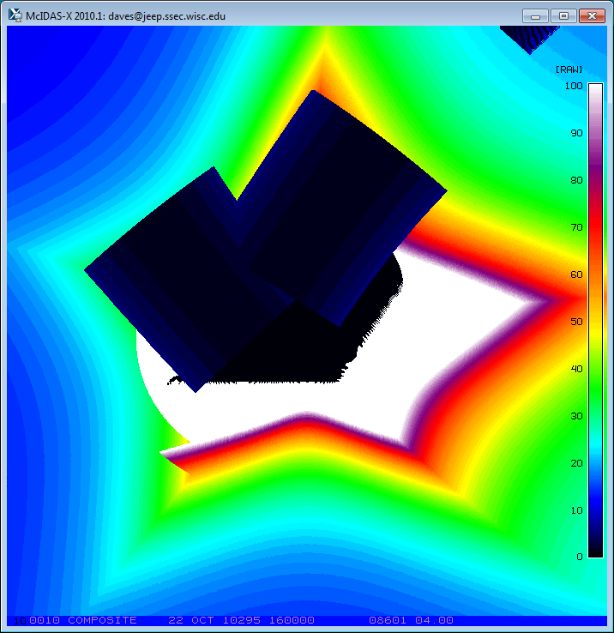
Pixel Area (km²)

Slide 11
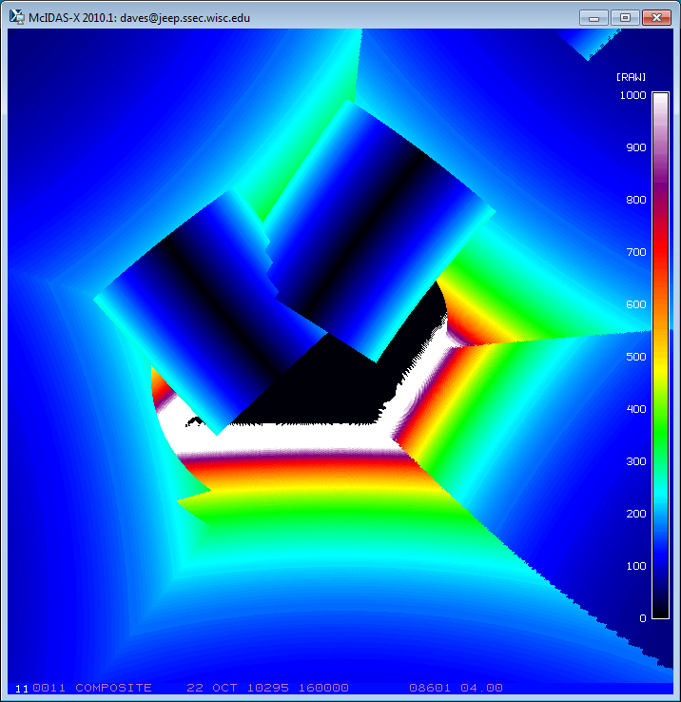
Parallax Distance (km)

Slide 12
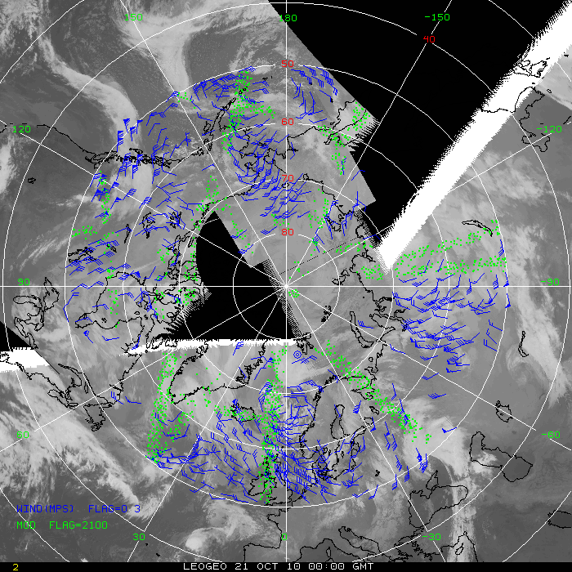
Satellite-derived winds
Triplets of ½ hourly composites
Composite building delayed by 3 hours
Wind flags (blue) at all levels
Potential targets (green) not tracked due to overlapping satellite data
Arctic for 21 October 2010

Slide 13
Summary
IMGPARM, REMAP2, COMP_ALLBAND process:
3-hour delay before running process
Up to 60 input files every 15 minutes
Each polar region takes about 3 minutes
ADDE dataset (images and winds)
DATALOC ADD LEOGEO LEOGEO.SSEC.WISC.EDU
Composite with winds overlayed (LEO-GEO):
http://stratus.ssec.wisc.edu/products/rtpolarwinds/
IMGPARM and COMP_ALLBAND will be in McIDAS-XRD

