Slide 1
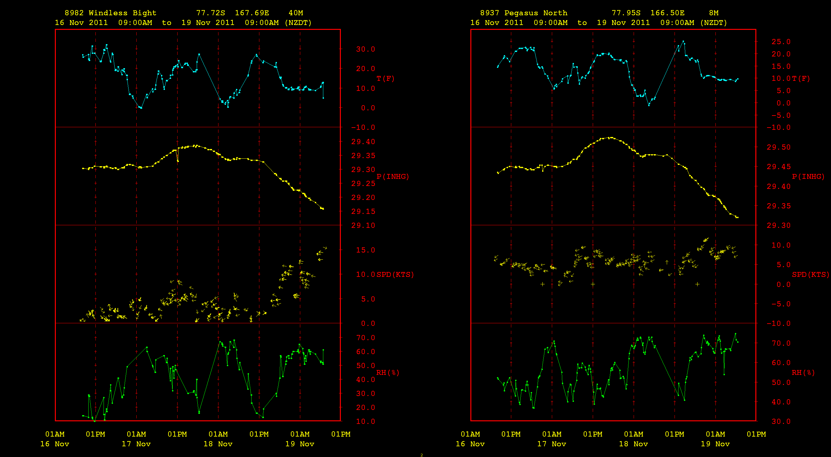
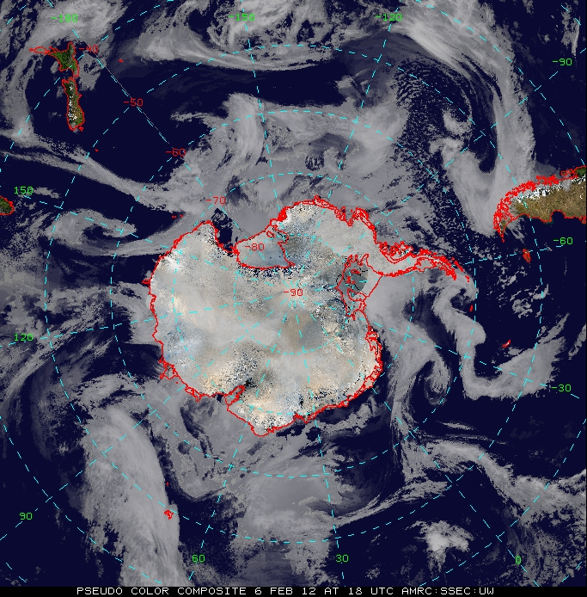
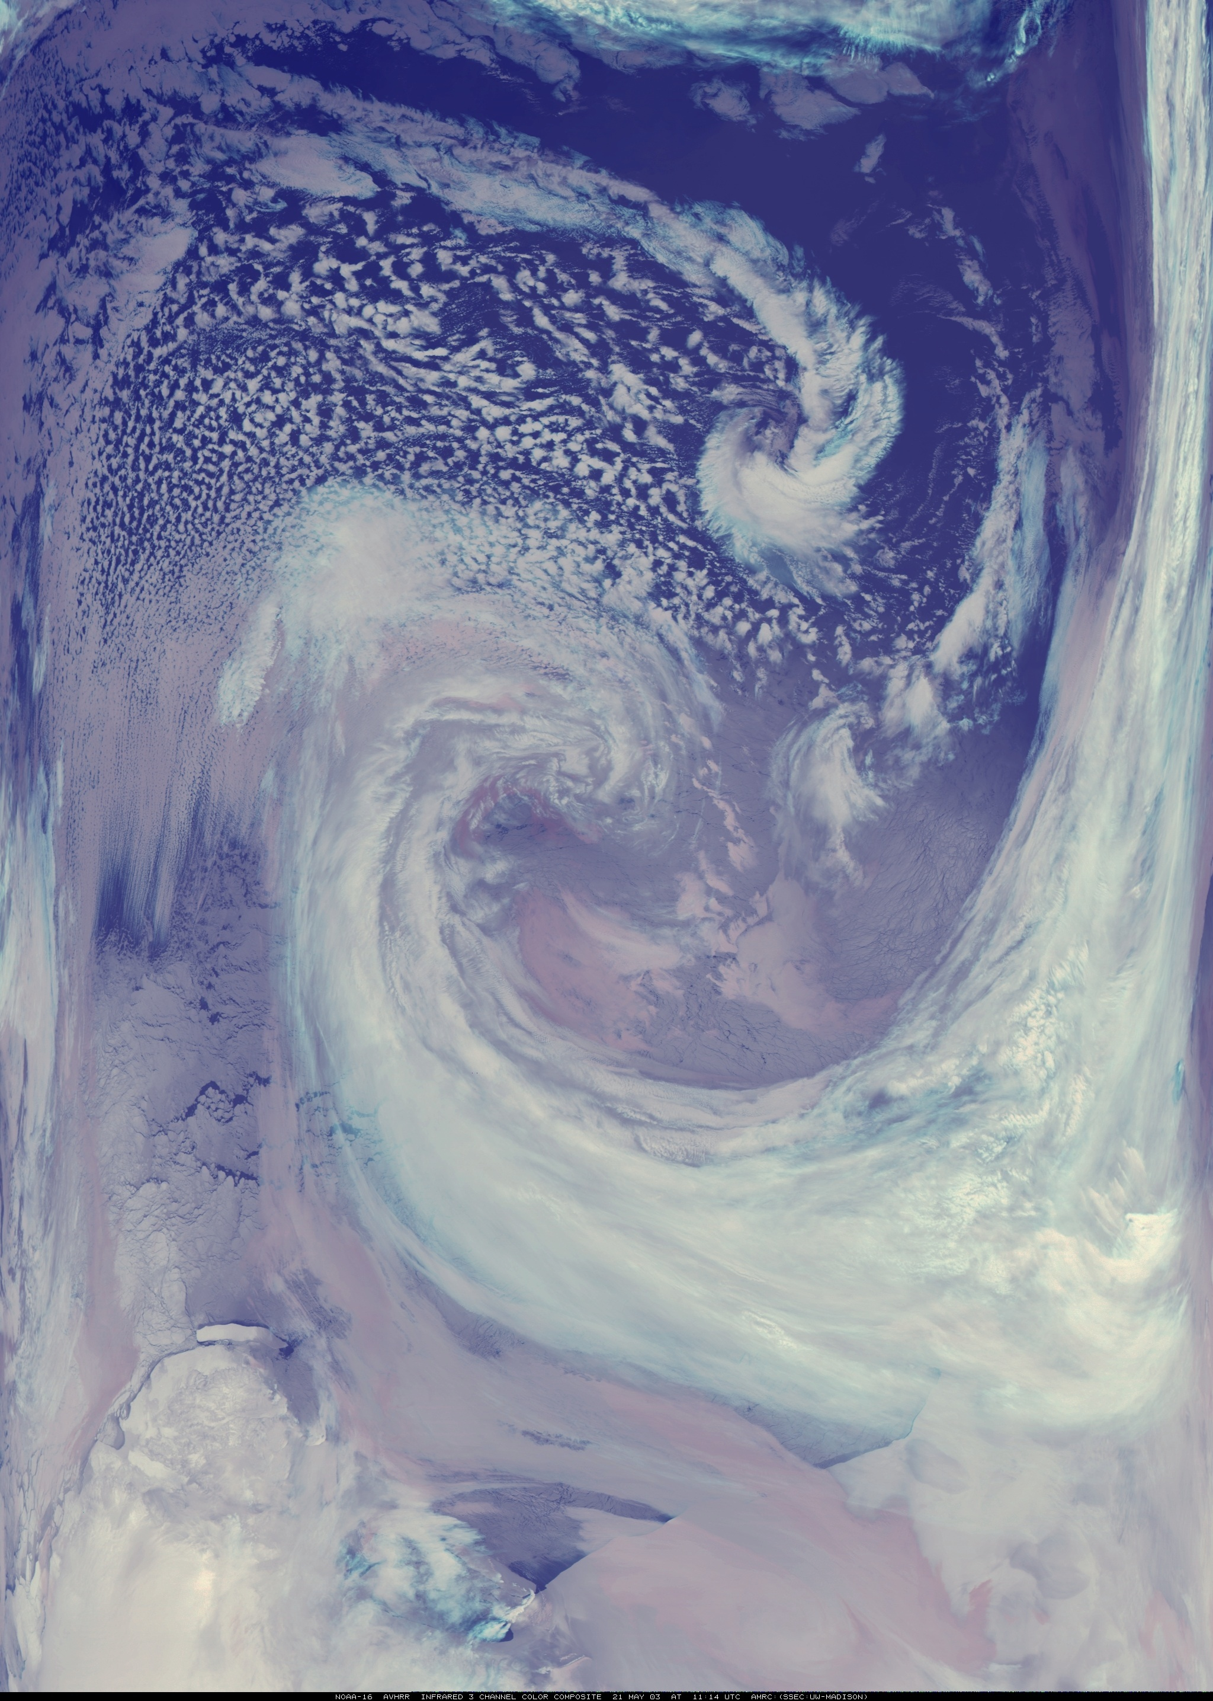
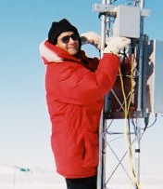
McIDAS at the AMRC
Dr. Matthew A. Lazzara
AMRC - SSEC
UW-Madison

Slide 2
In memory of: Dr. Neil Adams 1961-2012
Regional Manager Antarctic Meteorological Section
Tasmania/Antarctica Region
Bureau of Meteorology
Australia

Slide 3
Outline
Antarctic Meteorological Research Center
Grantee of the Office of Polar Programs
National Science Foundation
United States Antarctic Program
About the AMRC
Who we are, what we do, the US Antarctic Program
AMRC and McIDAS
How we observe Antarctic Weather:
Automatic Weather Stations…Records, applications…
Satellite Composite Imagery…History, examples…
Samples of McIDAS Use…
Servers and Services…
The other tools we use: McIDAS-V, RAMADDA, etc…
(Sprinkle of photos from the “ice”)

Slide 4
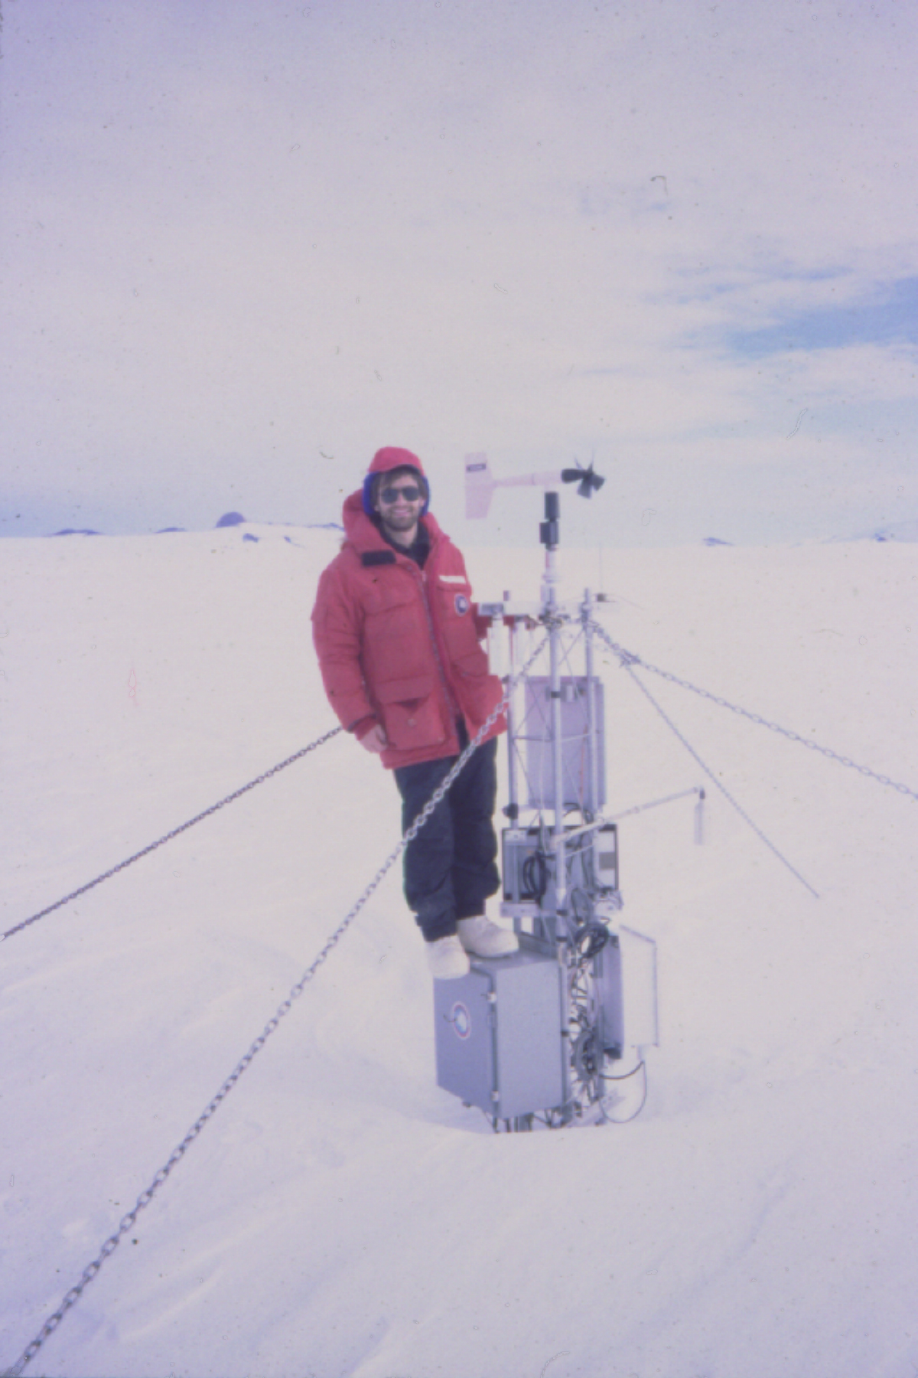
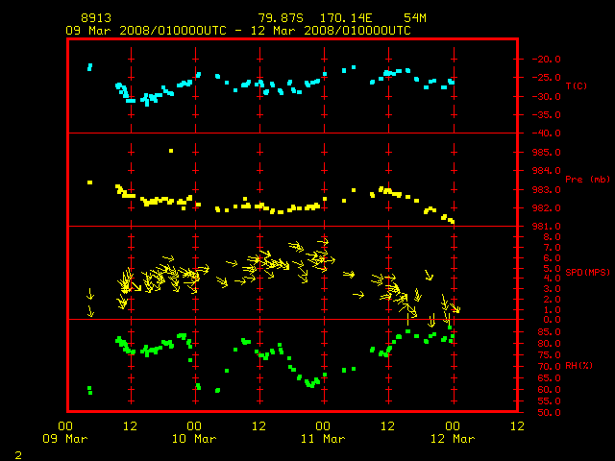
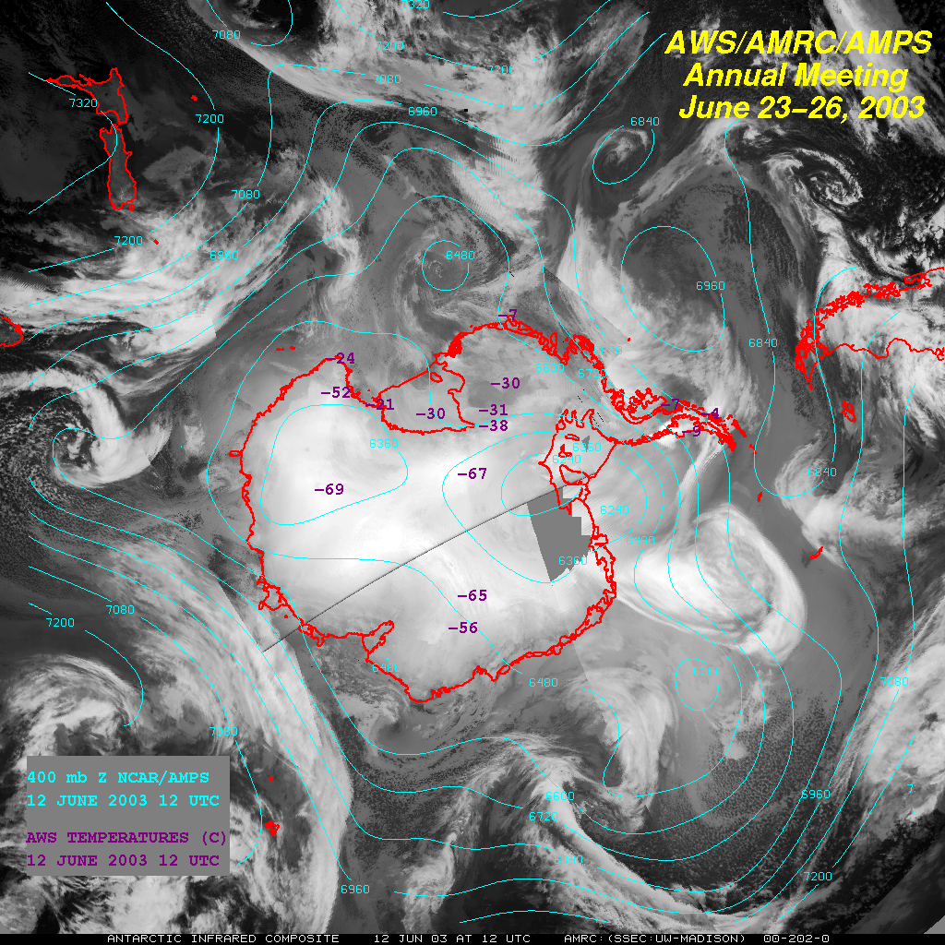
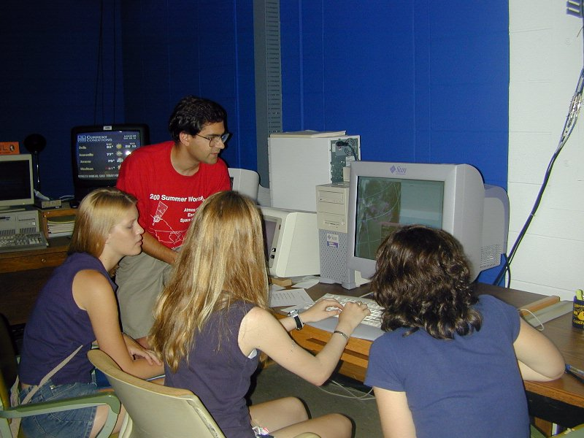
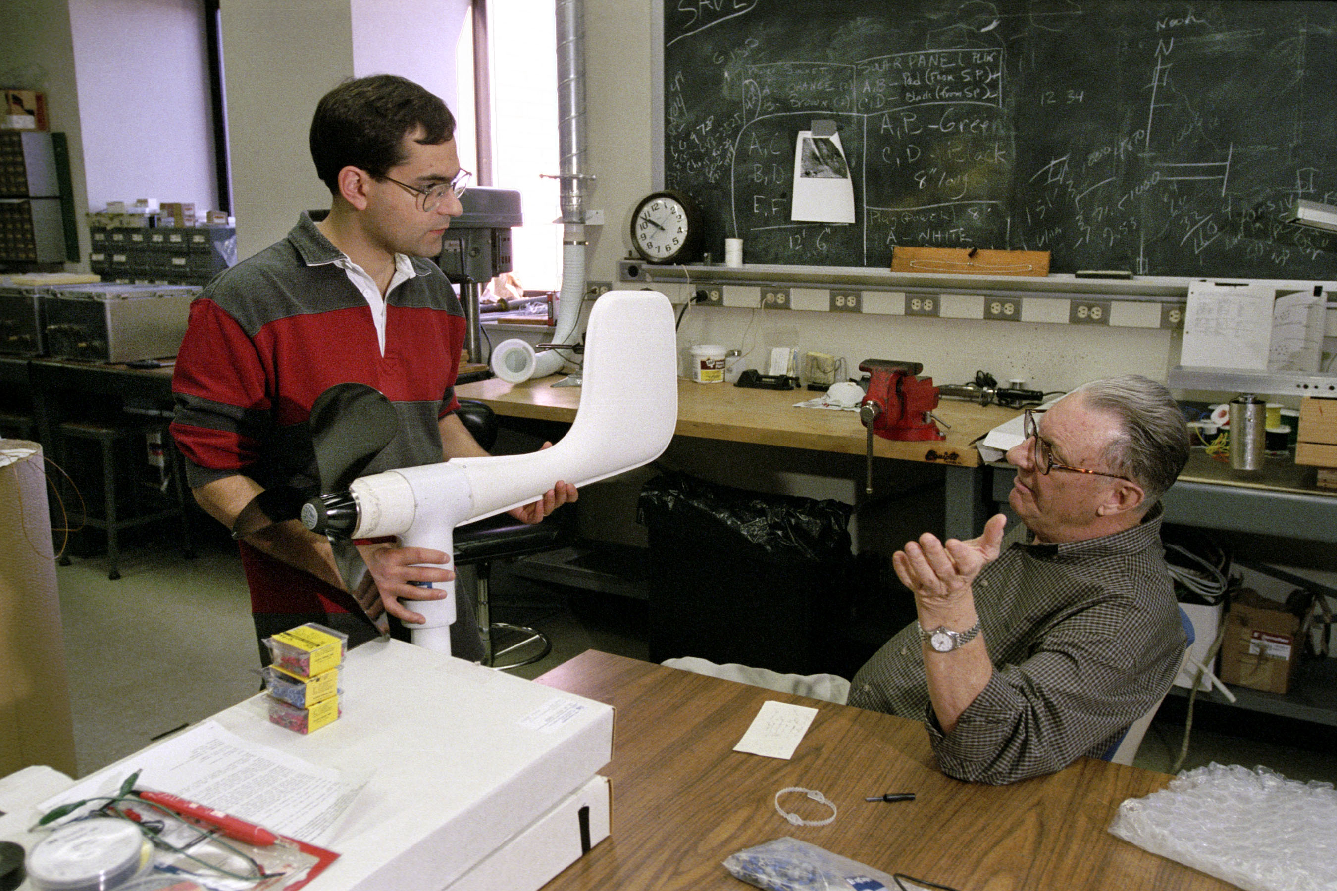
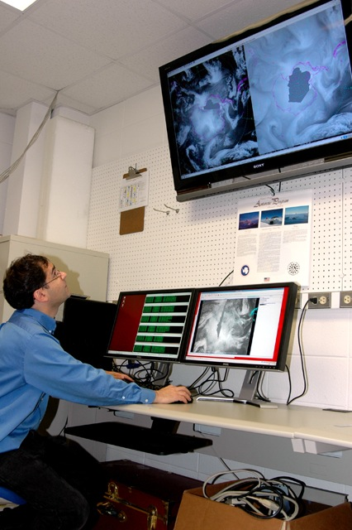
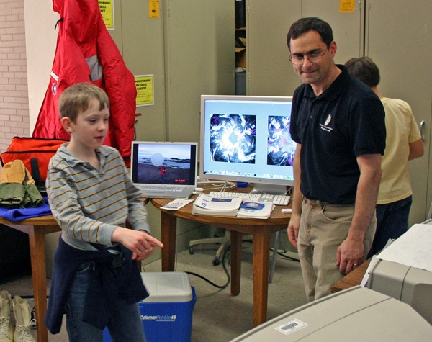
What we do….
Weather Stations
Service
Satellites
Teaching
Research
Outreach

Slide 5
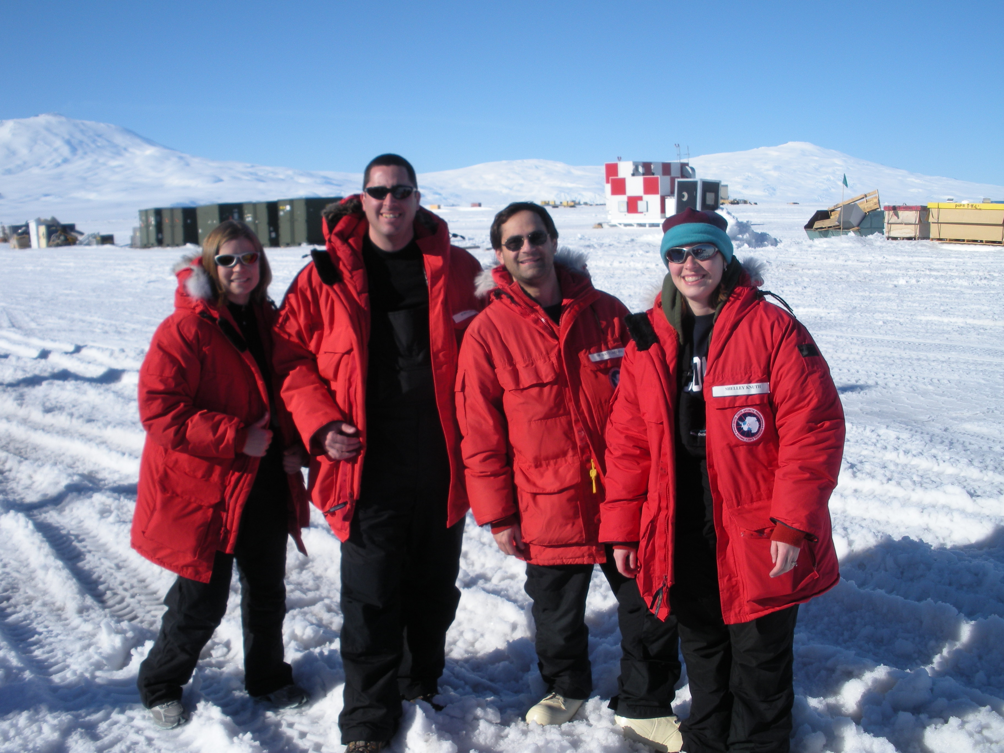
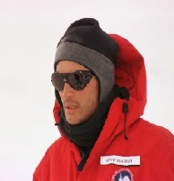
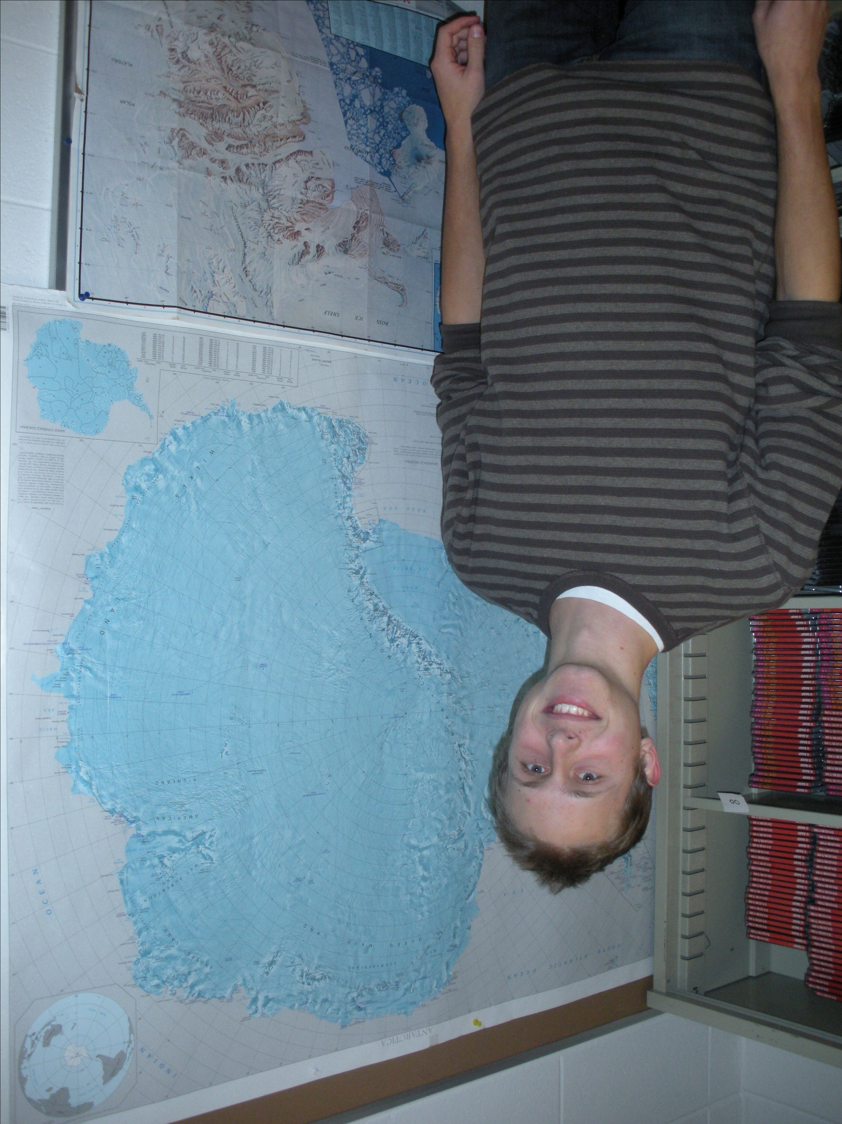
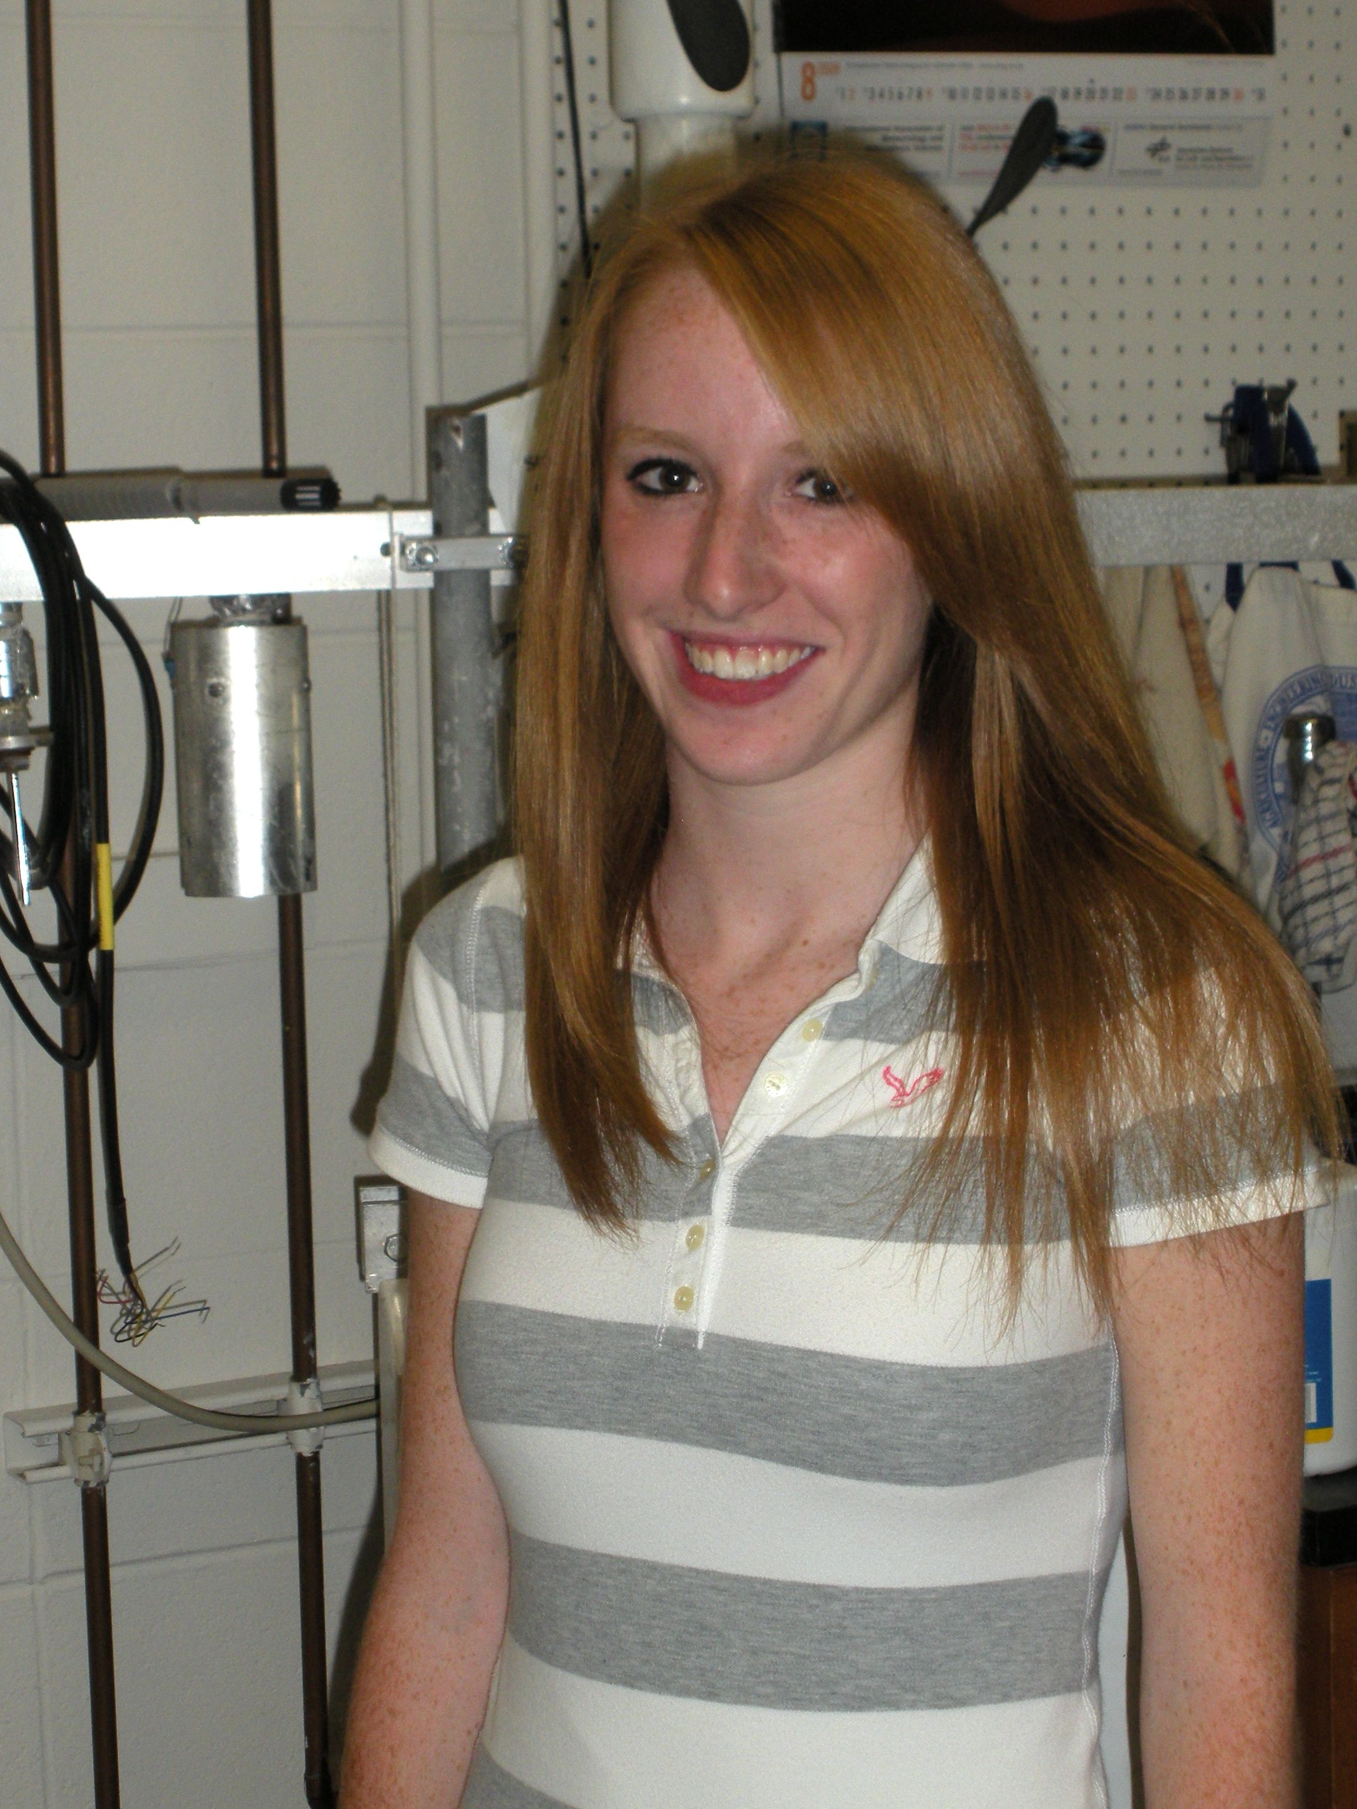
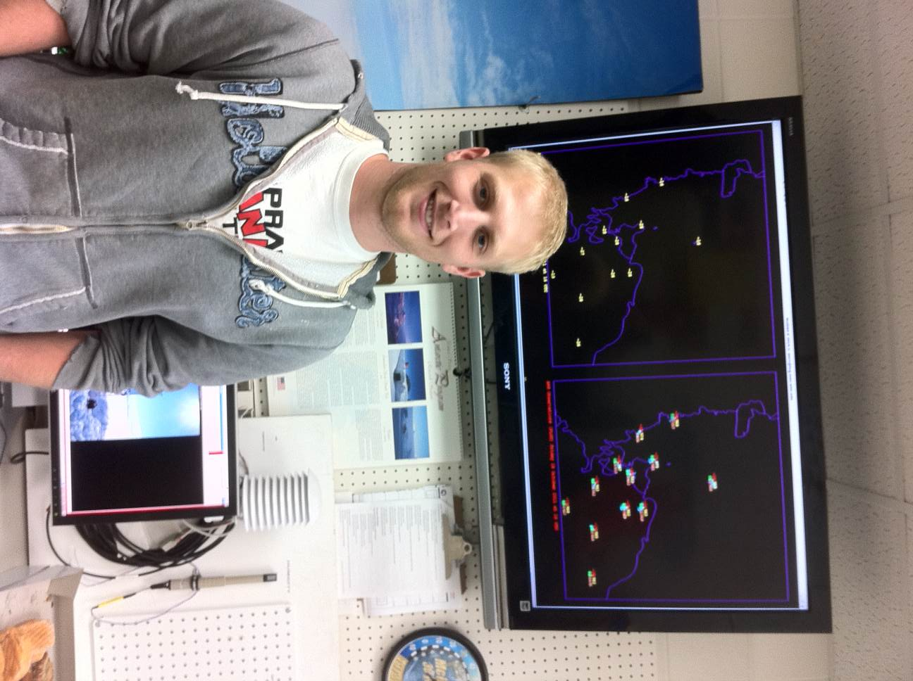
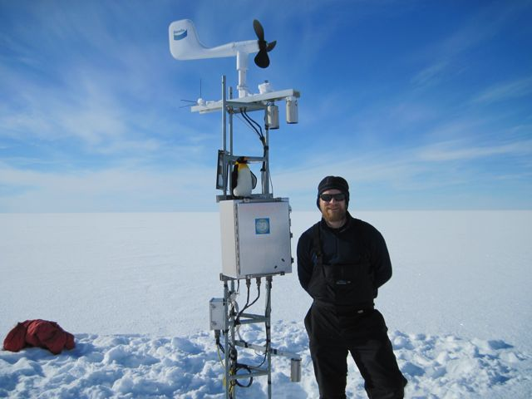
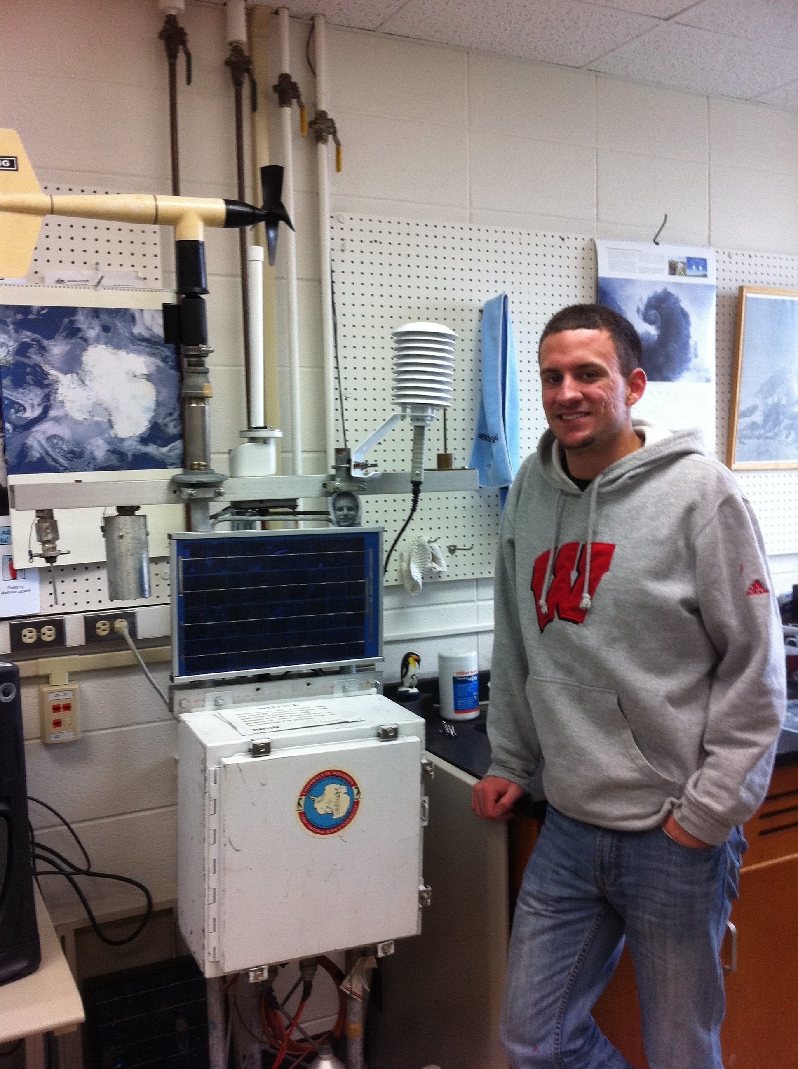
Who we are…
Dr. Matthew Lazzara
George Weidner
Melissa Richards, Dr. John Cassano,
Dr. Matthew Lazzara, Shelley Knuth
Linda Keller
Jonathan Thom
Joey Snarski
Dave
Mikolajczyk
Scott Trevorrow
Elena Willmot
Nick Weber
Lee Welhouse

Slide 6
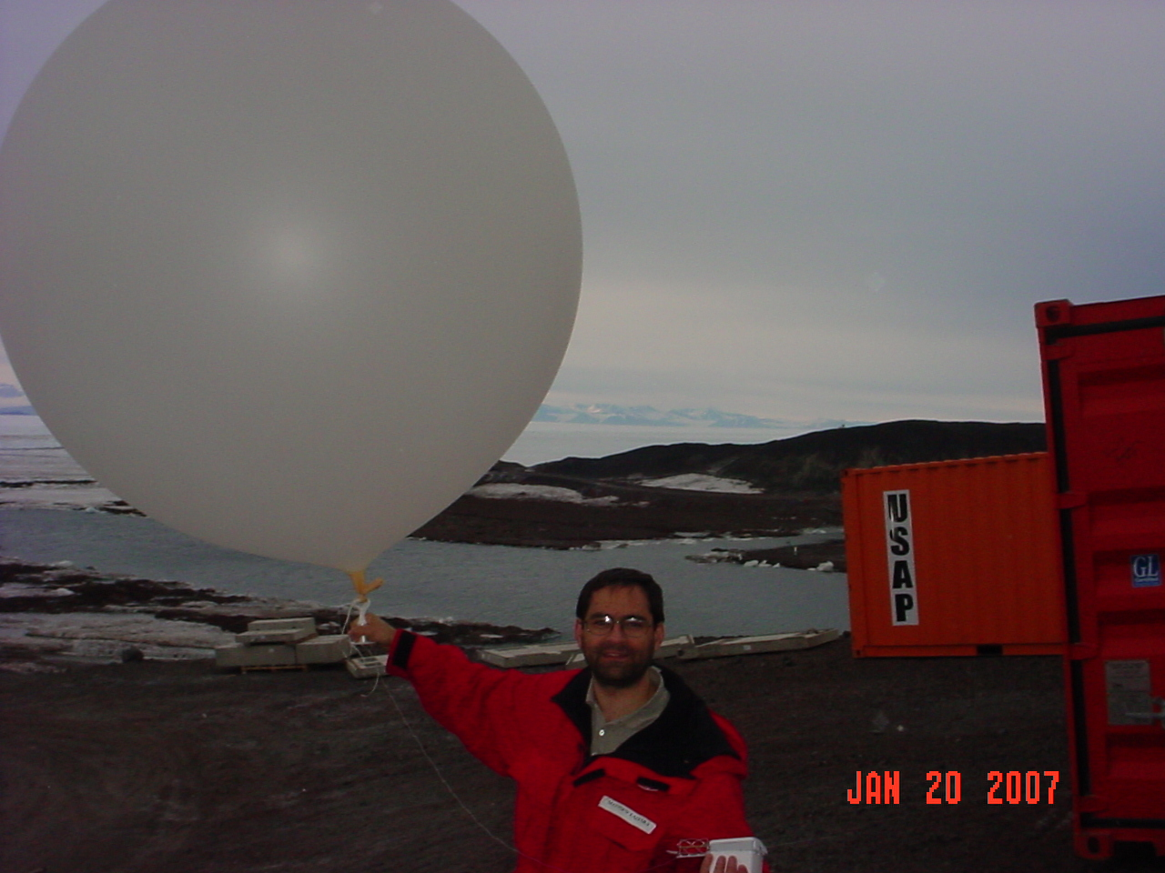
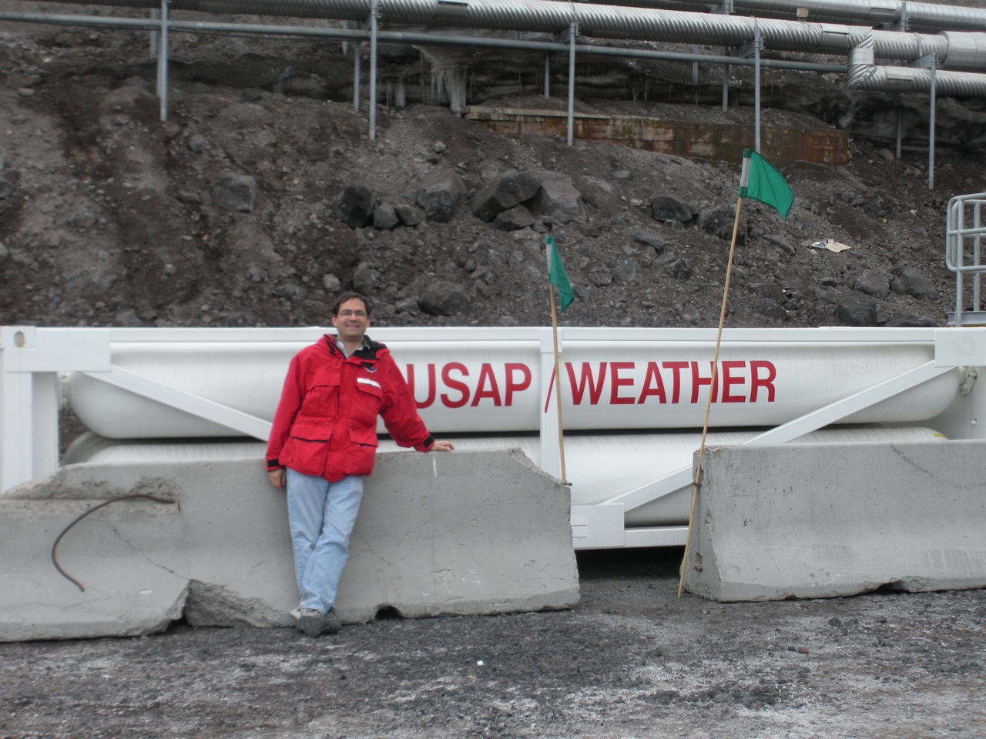
Antarctic Meteorology How do we observe the weather?
Staffed Surface Observations
Radiosonde/Weather Balloons
Ships & Buoys
Aircraft
Automatic Weather Stations
Weather Satellite Studies
Polar Orbiting
Via Satellite Composites

Slide 7
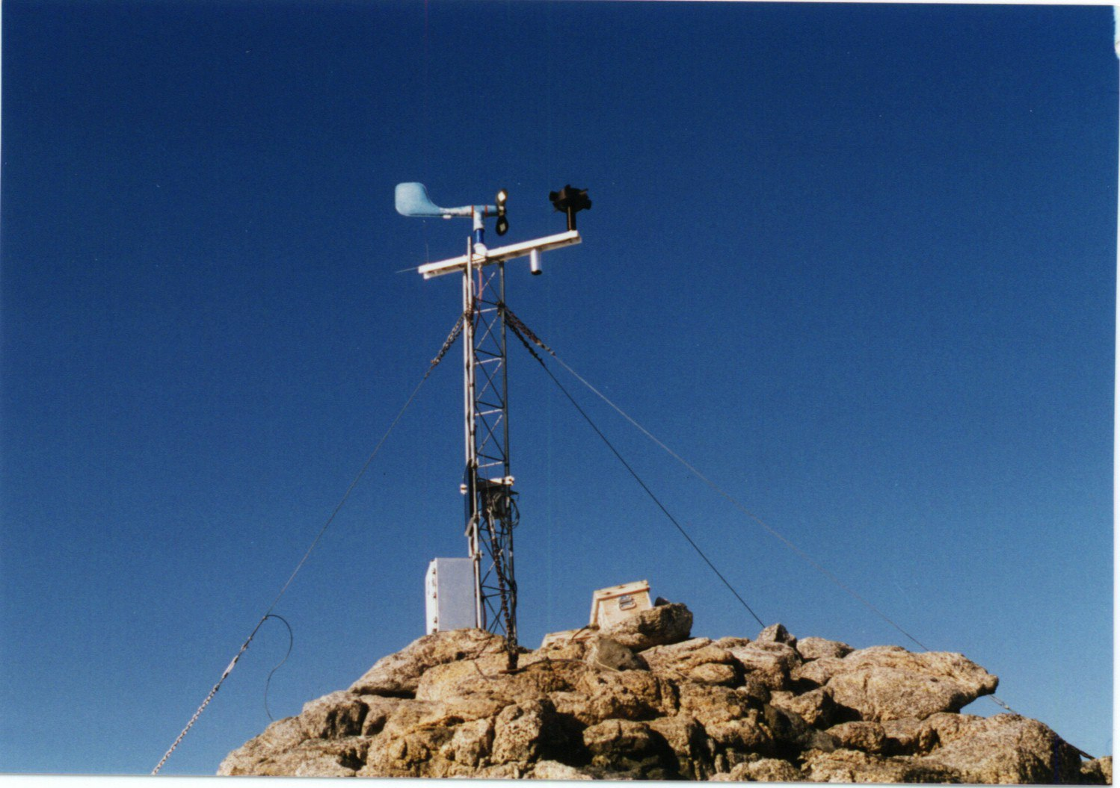
Wisconsin Automatic Weather Station (AWS)
* Able to send data
via satellite
*1300 Watt-Hours power used all year long (power used to run a 60 watt light
bulb for ~22 days!)
* Small memory
storage needs: Original
AWS uses 256 bytes
(Today ~16 kilobytes)
---------------------------
Built for extreme cold
Port Martin AWS 1994

Slide 8
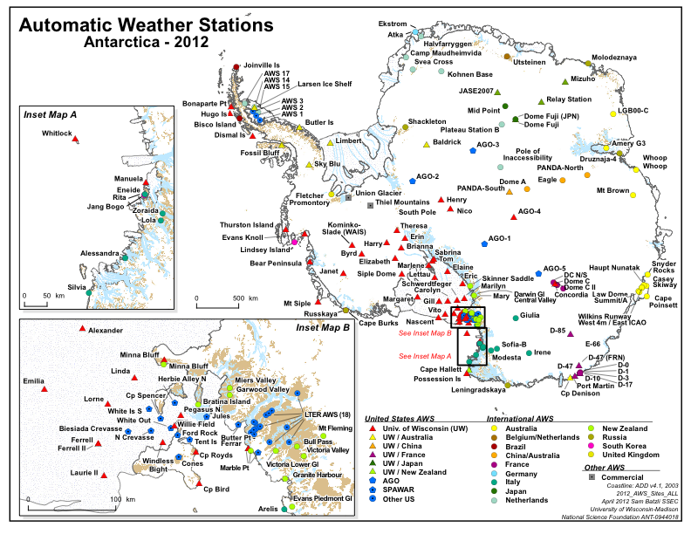
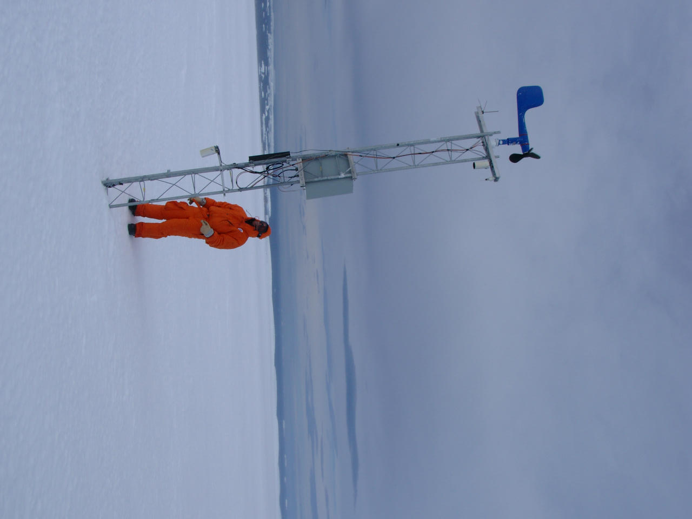
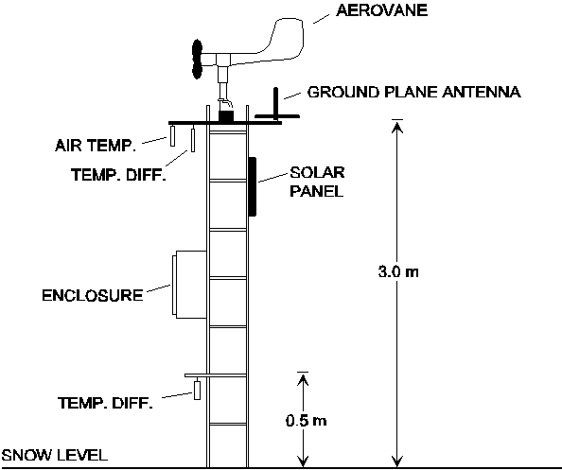
D-10 AWS

Slide 9
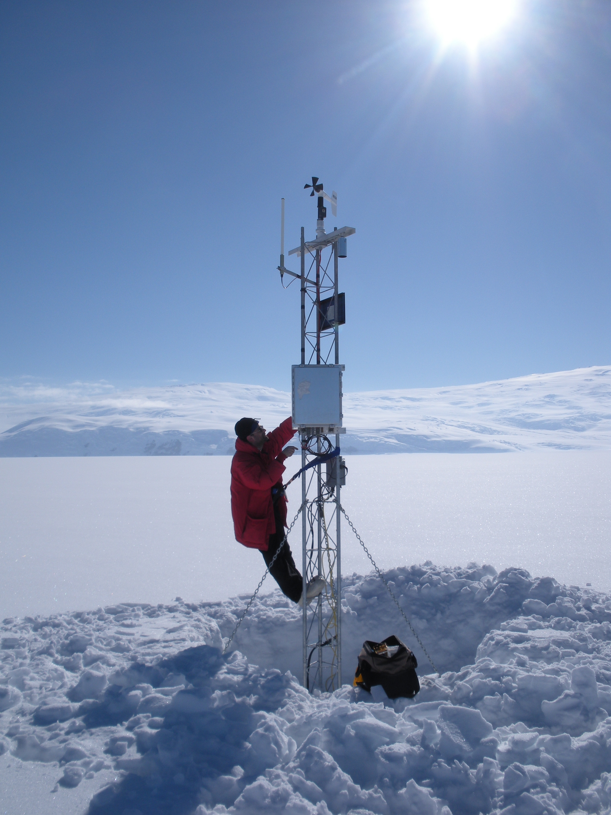
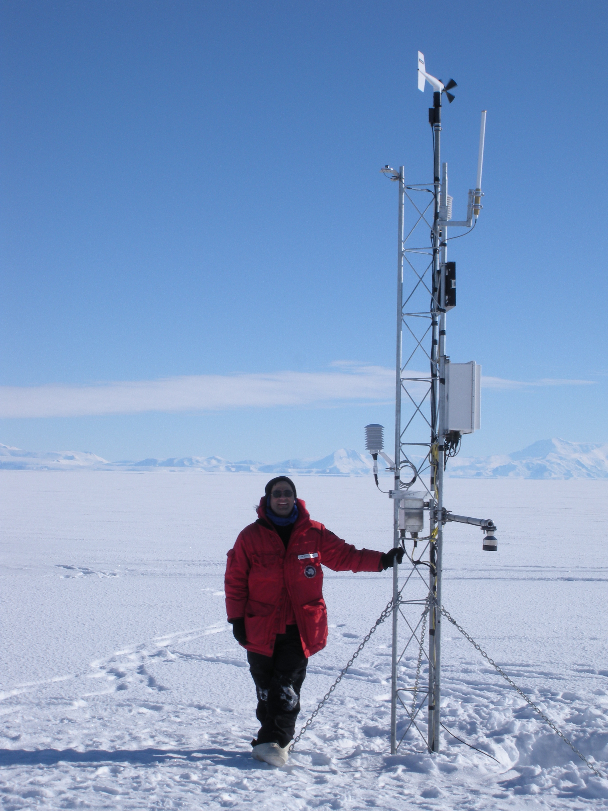

Slide 10
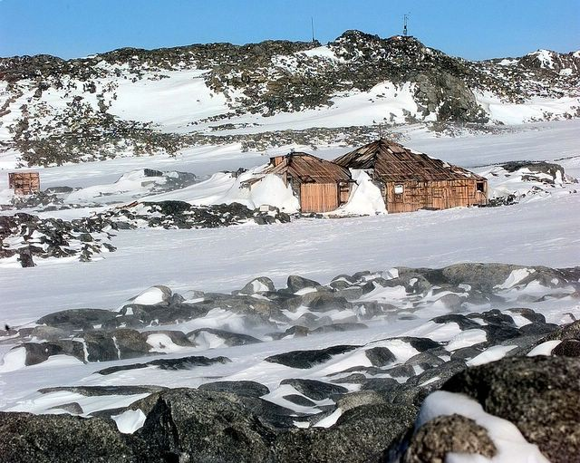
Wisconsin
AWS!
Windiest Place in Antarctica: Cape Denison
40 to 60 miles per hour average monthly winds
Greater than 122 miles per hour actual wind speeds
Mawson’s Hut Foundation

Slide 11
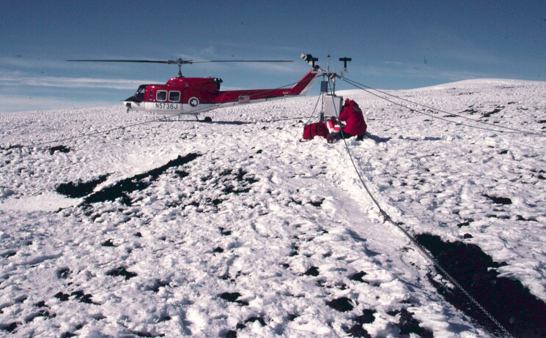
Wisconsin AWS Record Antarctic Maximum Wind Speed:
137 miles per hour (61.3 meters per second) at Minna Bluff on July 10, 2001

Slide 12
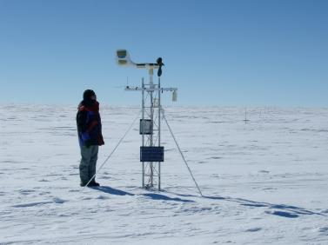
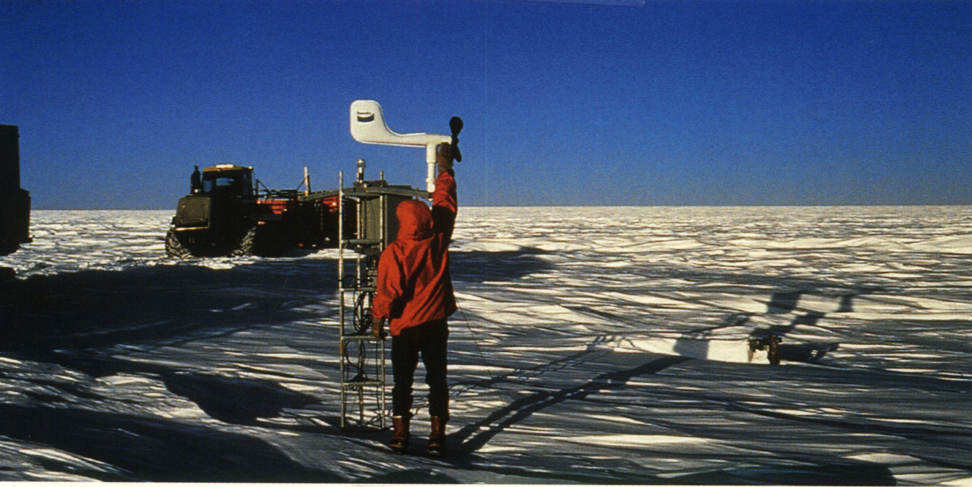
Wisconsin AWS
Antarctic Record Low Temperature:
-120.3 F (-84.6 C)
Dome C
August 26, 1982
IPEV
IPEV

Slide 13
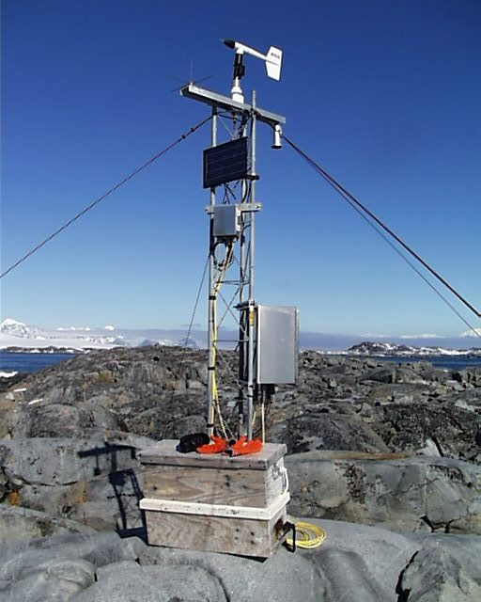
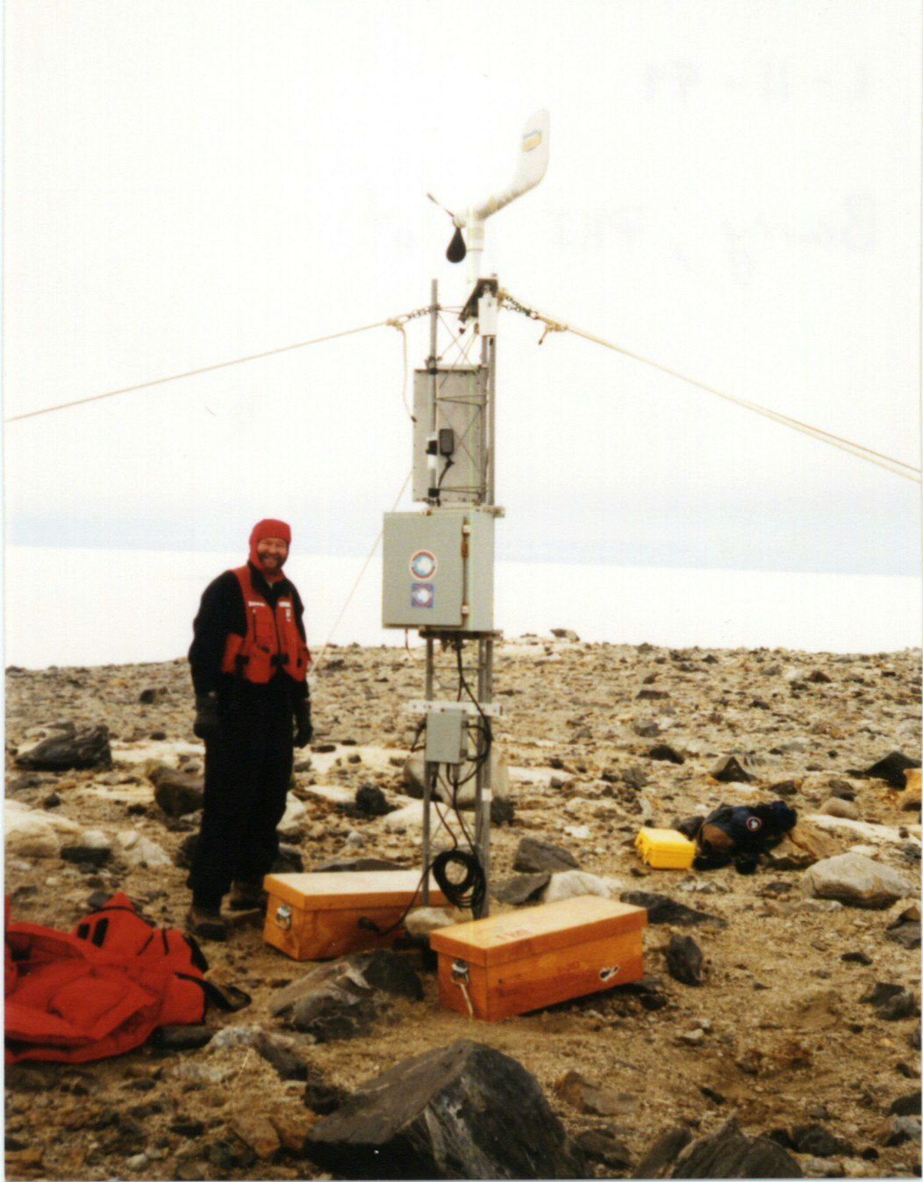
Wisconsin AWS
Record High*
Temperature
Bonaparte Point AWS
51 F (10.6 C)
Dec 6, 1992 18:50 UTC
*1991-2001 quality control years
otherwise
Marble Point AWS
44.8 F (7.1 C)
Dec 29, 2001
21:10 UTC

Slide 14
AWS Applications
Past:
Barrier and Katabatic wind studies
Mesoscale circulations
Sensible and latent heat flux studies
Southern Ocean GLOBEC
Long Term Ecological Research
Weather forecasting
Research on Ocean-Atmosphere Variability and Ecosystem Response in the Ross Sea
West Antarctic Ice Sheet Initiative and International Trans-Antarctic Scientific Expedition
Iceberg studies
And more….
Current:
Long term climatology
Antarctic ENSO studies
Precipitation/snow accumulation studies
Ross Ice Shelf Air Stream (RAS) near surface wind field
Boundary Layer Studies
Weather forecasting
And more…

Slide 15
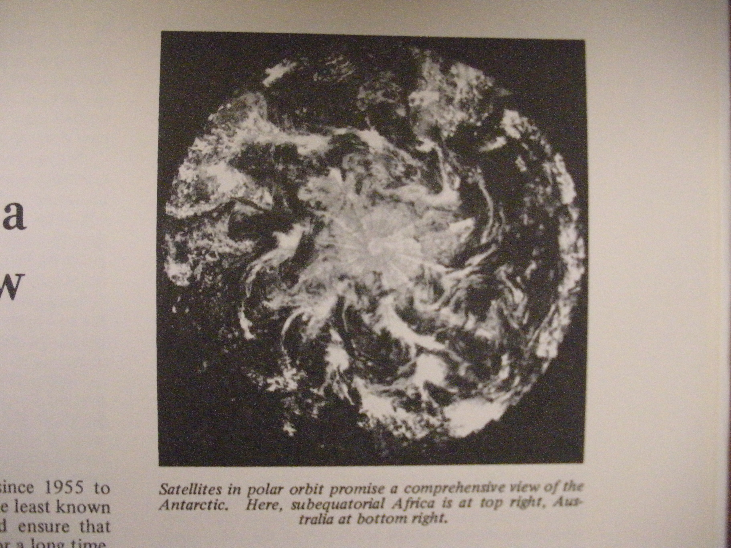

Slide 16
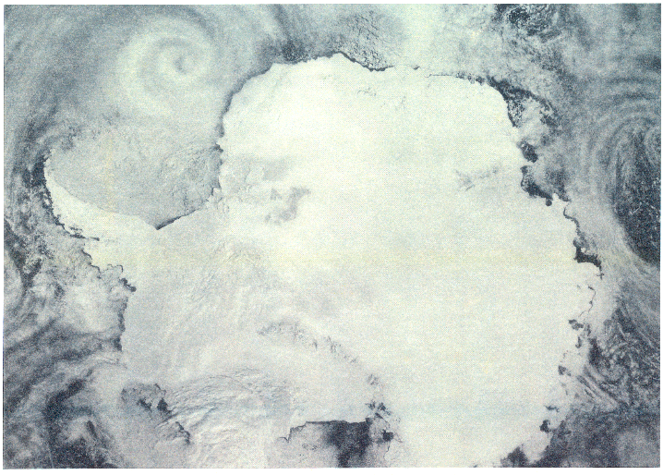
Dr. Charles R. Stearns visits Colorado in 1987/88 sees this Composite!
Inspiration for real-time a composite for:
Forecasting
Research
Education
Larger context of USAP meteorology program
Produced from USAF DMSP
film transparencies archived
for NOAA/NESDIS at the
University of Colorado,
CIRES/National Snow and
Ice Data Center
© 1986 Cooperative Institute for Research in Environmental Sciences (CIRES)

Slide 17
Go BiPolar!

Slide 19
Visible Composites… …thanks to Rick Kohrs!

Slide 20
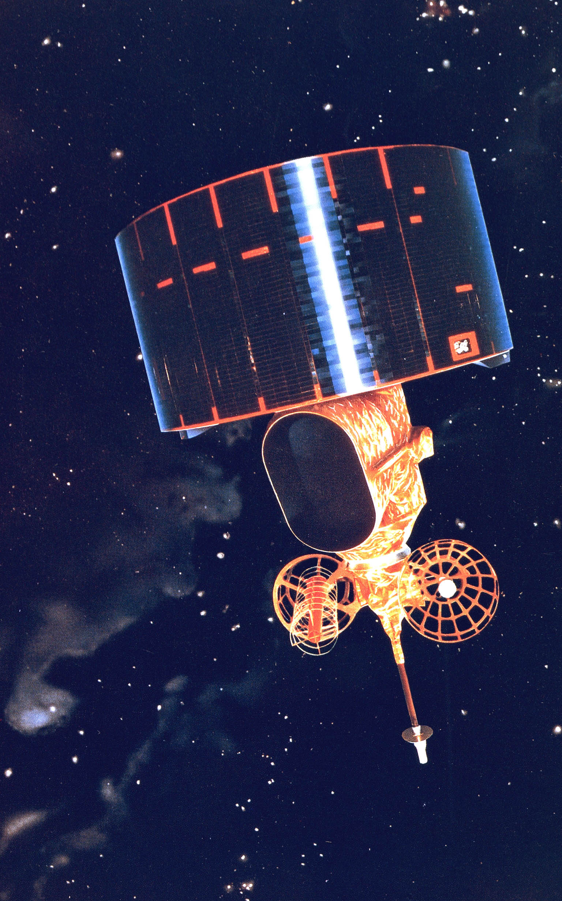
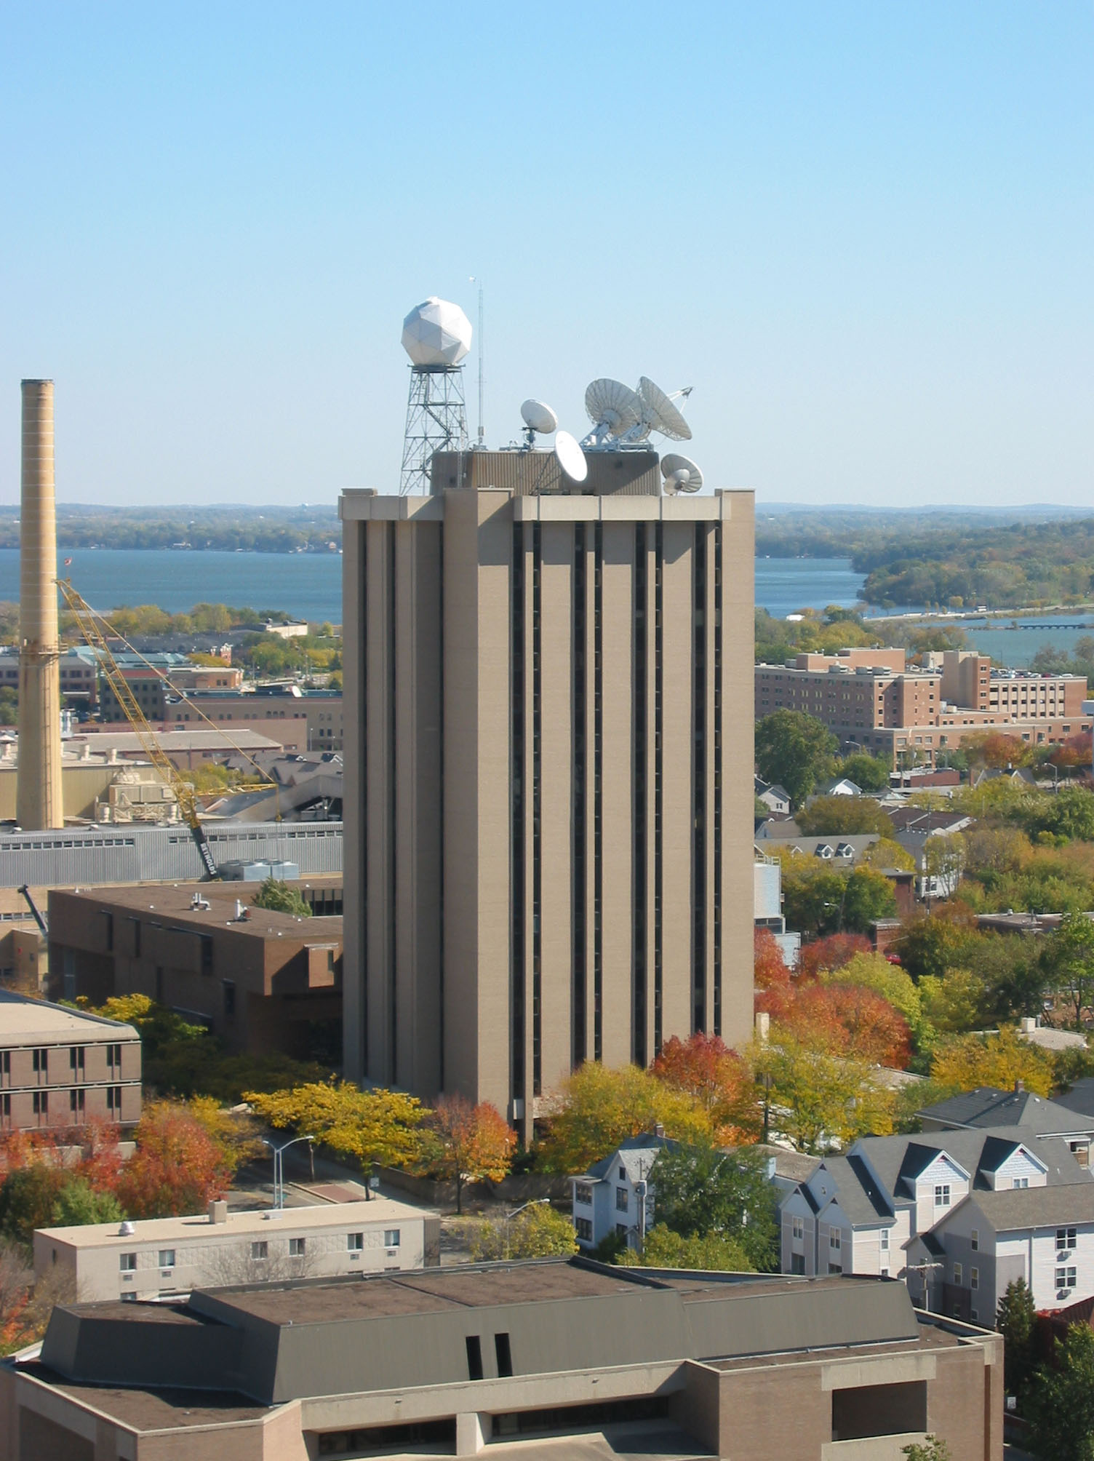
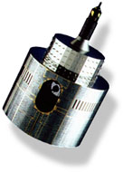
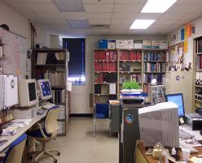
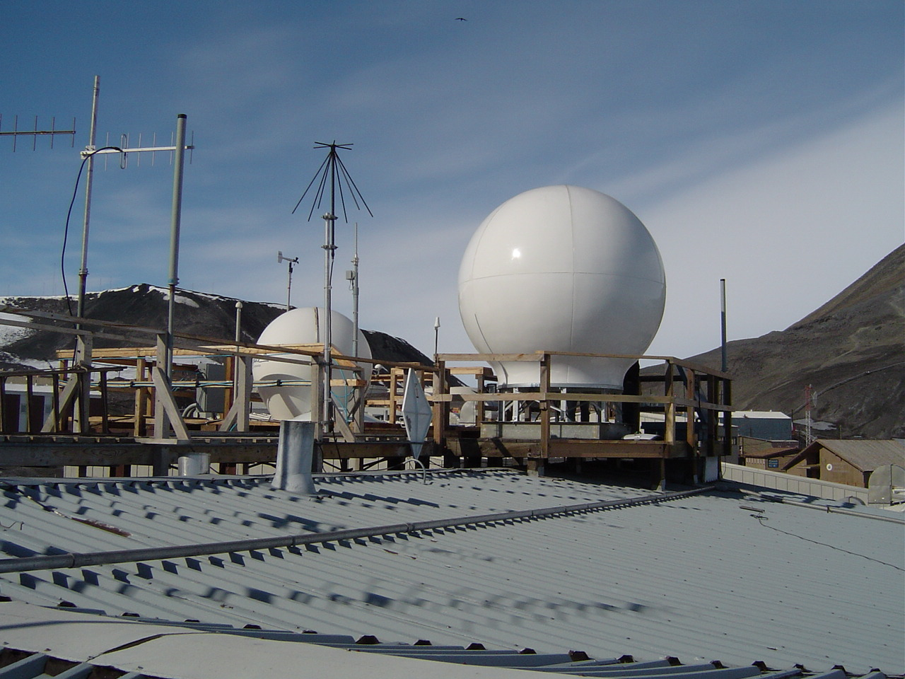
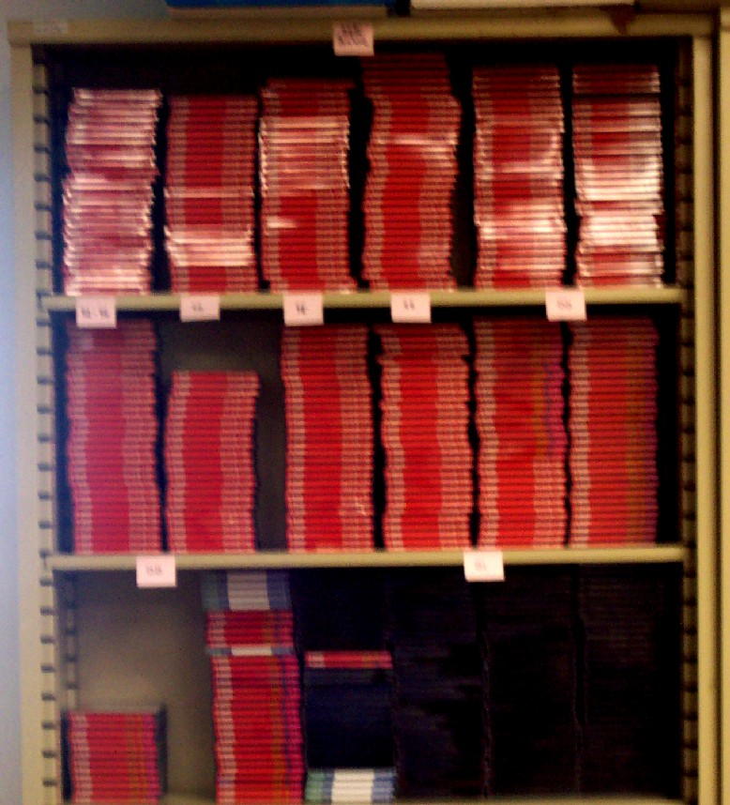
GOES (3)
Real-time Distribution
U.Wisconsin/SSEC
FY-2C,D,E,F
Satellite
Data
Flow
Aqua/Terra NASA/NOAA
Kalpana-1
Meteosat (2)
NOAA
GAC/LAC
AMRC
MTSAT
NOAA
HRPT
Aqua/Terra DB
(McMurdo only)
DMSP
RTD
McMurdo & Palmer Station - SDI
Archive

Slide 21
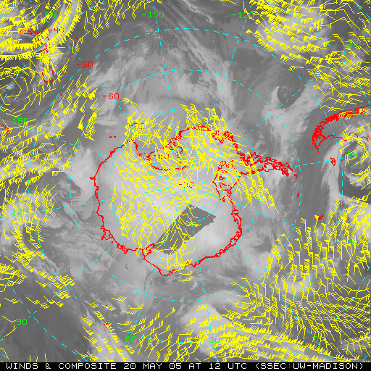
Atmospheric Motion Vectors

Slide 23
With LEO/GEOAMV – Global Coverage!
IMGPARAM contributed to this effort!!!

Slide 24
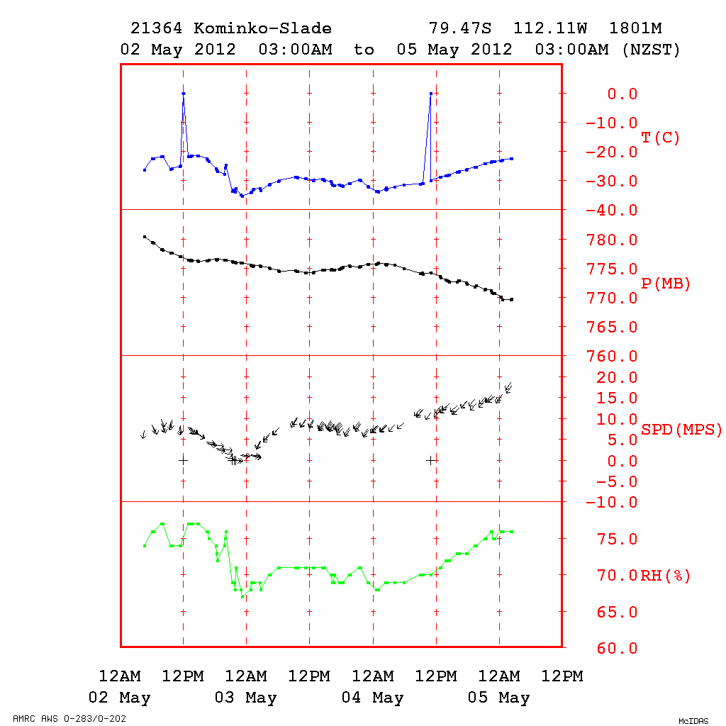
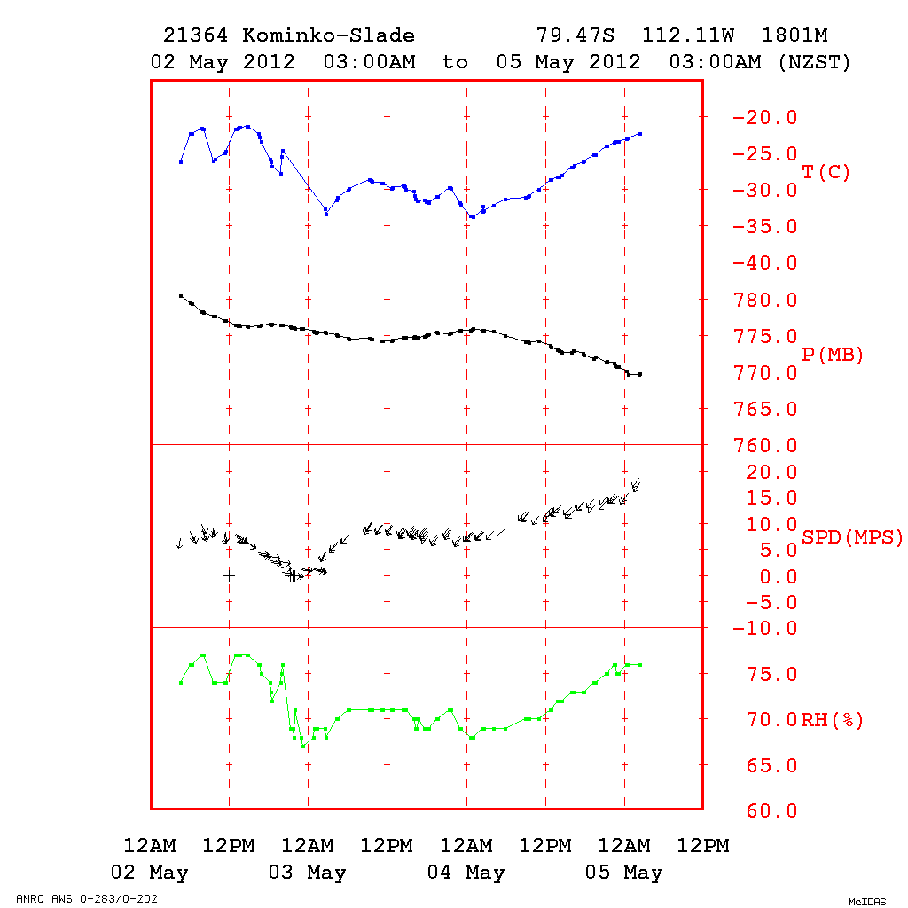
AWS Meteorogram….
…Thanks to Russ Dengel
AWSMG Command…
…with DELTA= “filtering”

Slide 25
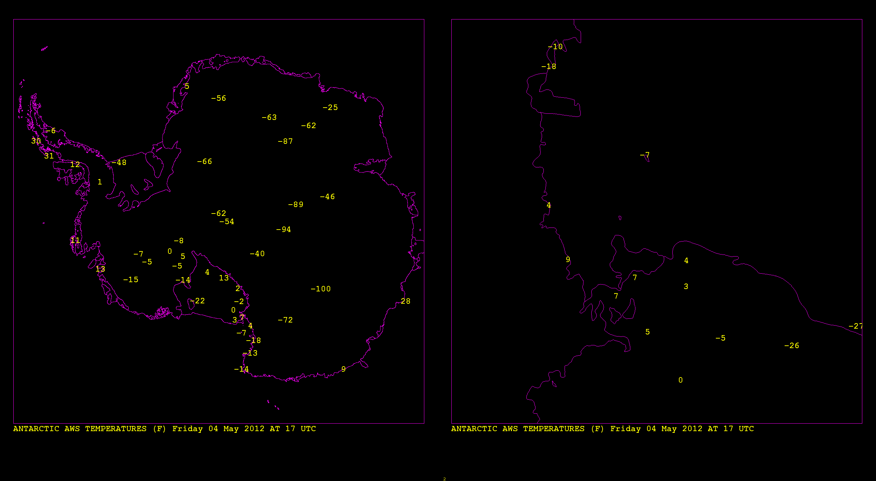
AWS Observations – SDI * DCS * ARGOS

Slide 26
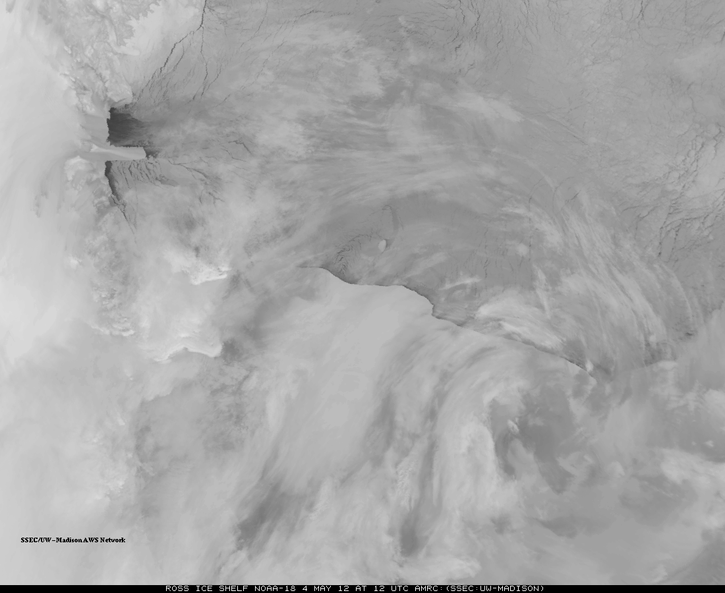
Tracking Icebergs…via LEO command:

Slide 27
Additional Examples of AMRC Special McIDAS-X usage….
AWSLOC AWS text listings from AWS decode calibration file (works with *new* AWSMG)
MAKE_AWIP (with server) to generate Arctic Composite for AWIPS I
TXT2MDA – SDI decoded AWS observations into McIDAS MD file format
…and others for support in composite work…

Slide 28
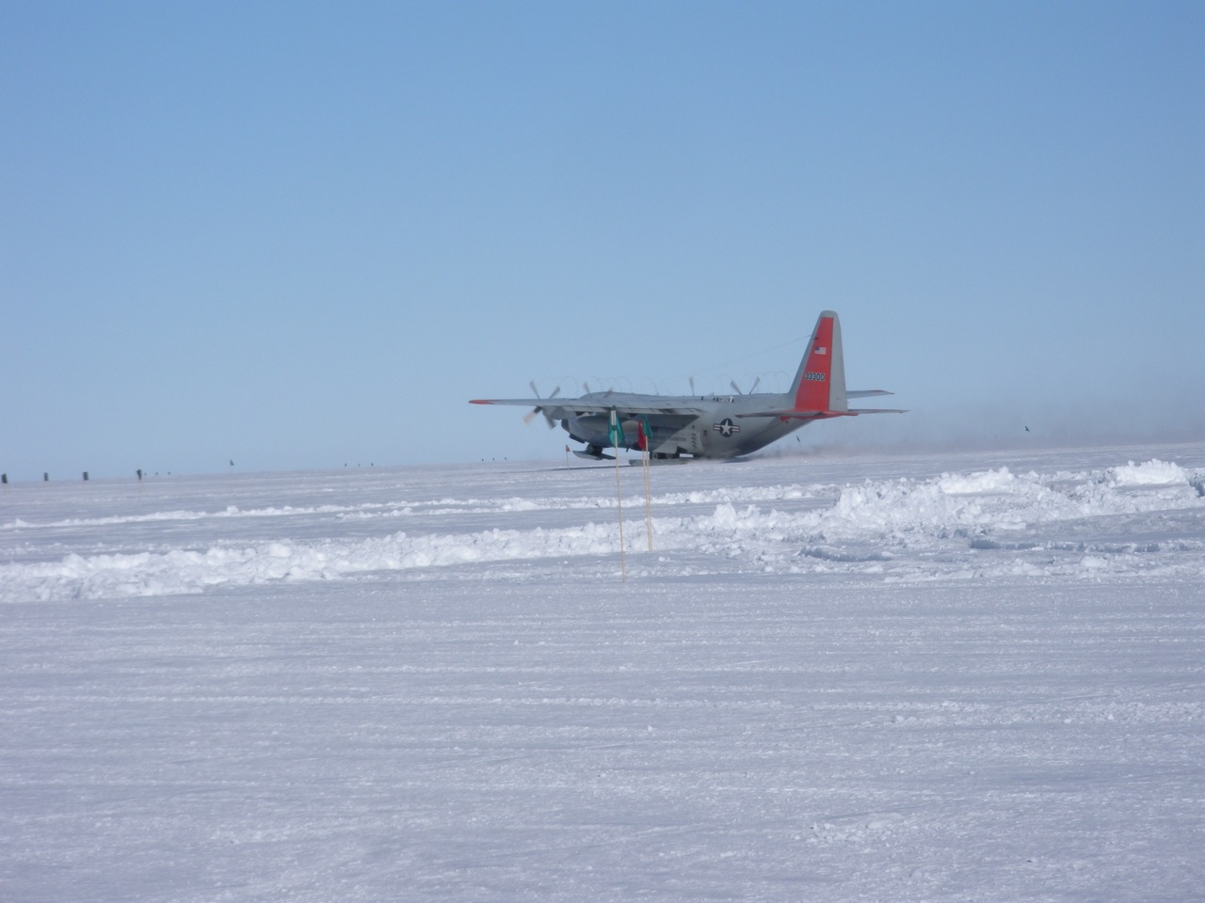
Servers, Services…
ADDE Servers:
DATALOC ADD AWS AWS.SSEC.WISC.EDU (Primary – realtime)
DATALOC ADD AMRC AMRC.SSEC.WISC.EDU (Backup – realtime)
DATALOC ADD ARCHIVE AWS.SSEC.WISC.EDU
Web: http://amrc.ssec.wisc.edu
FTP: ftp://amrc.ssec.wisc.edu ftp://aws.ssec.wisc.edu
RSYNC Service: amrc.ssec.wisc.edu, aws.ssec.wisc.edu
LDM: Antarctic-IDD: aws.ssec.wisc.edu, amrc.ssec.wisc.edu, &
fog.ssec.wisc.edu
RAMADDA: https://amrc.ssec.wisc.edu/repository

Slide 29
Time-ordering Reanalysis with Antarctic Composites: McIDAS-V … thanks to Jay Heinzelman + others

Slide 30
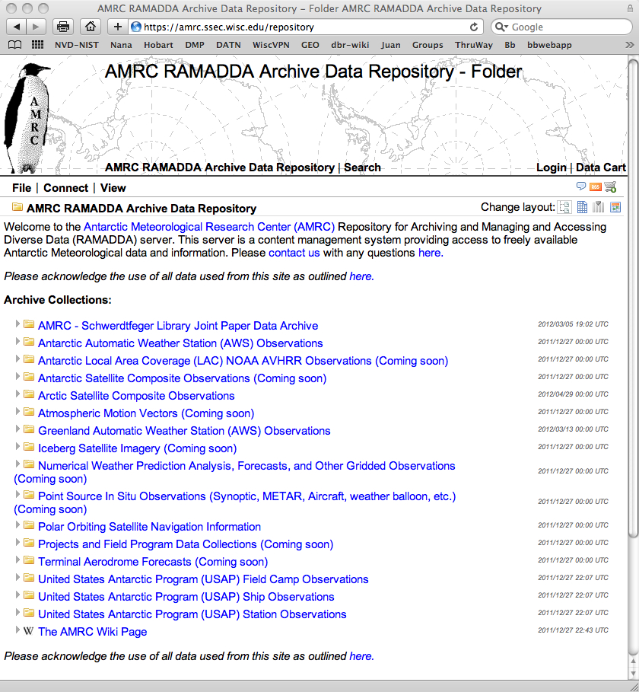
AMRC’s RAMADDA (Thank you Unidata)

Slide 31
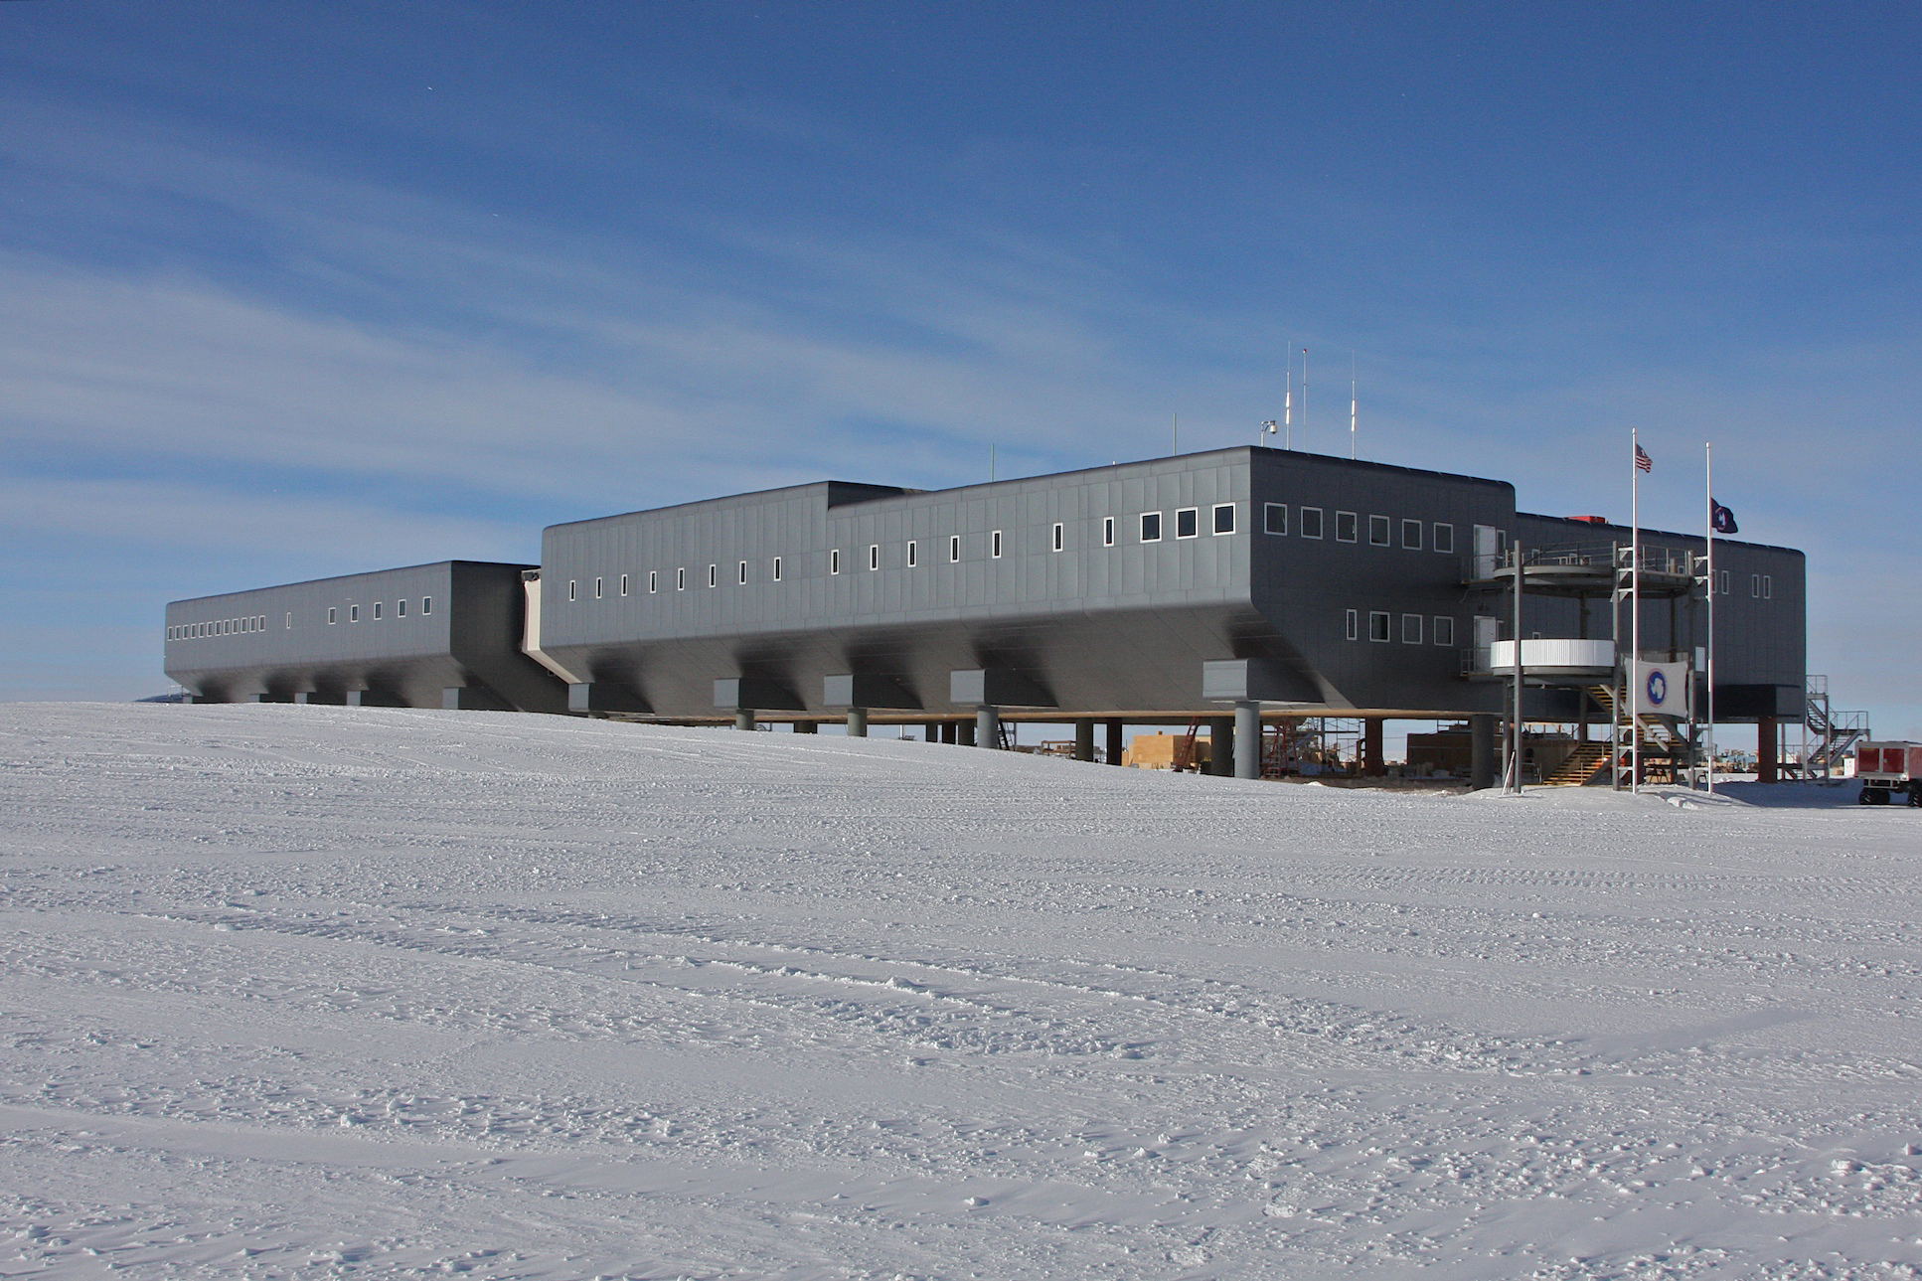
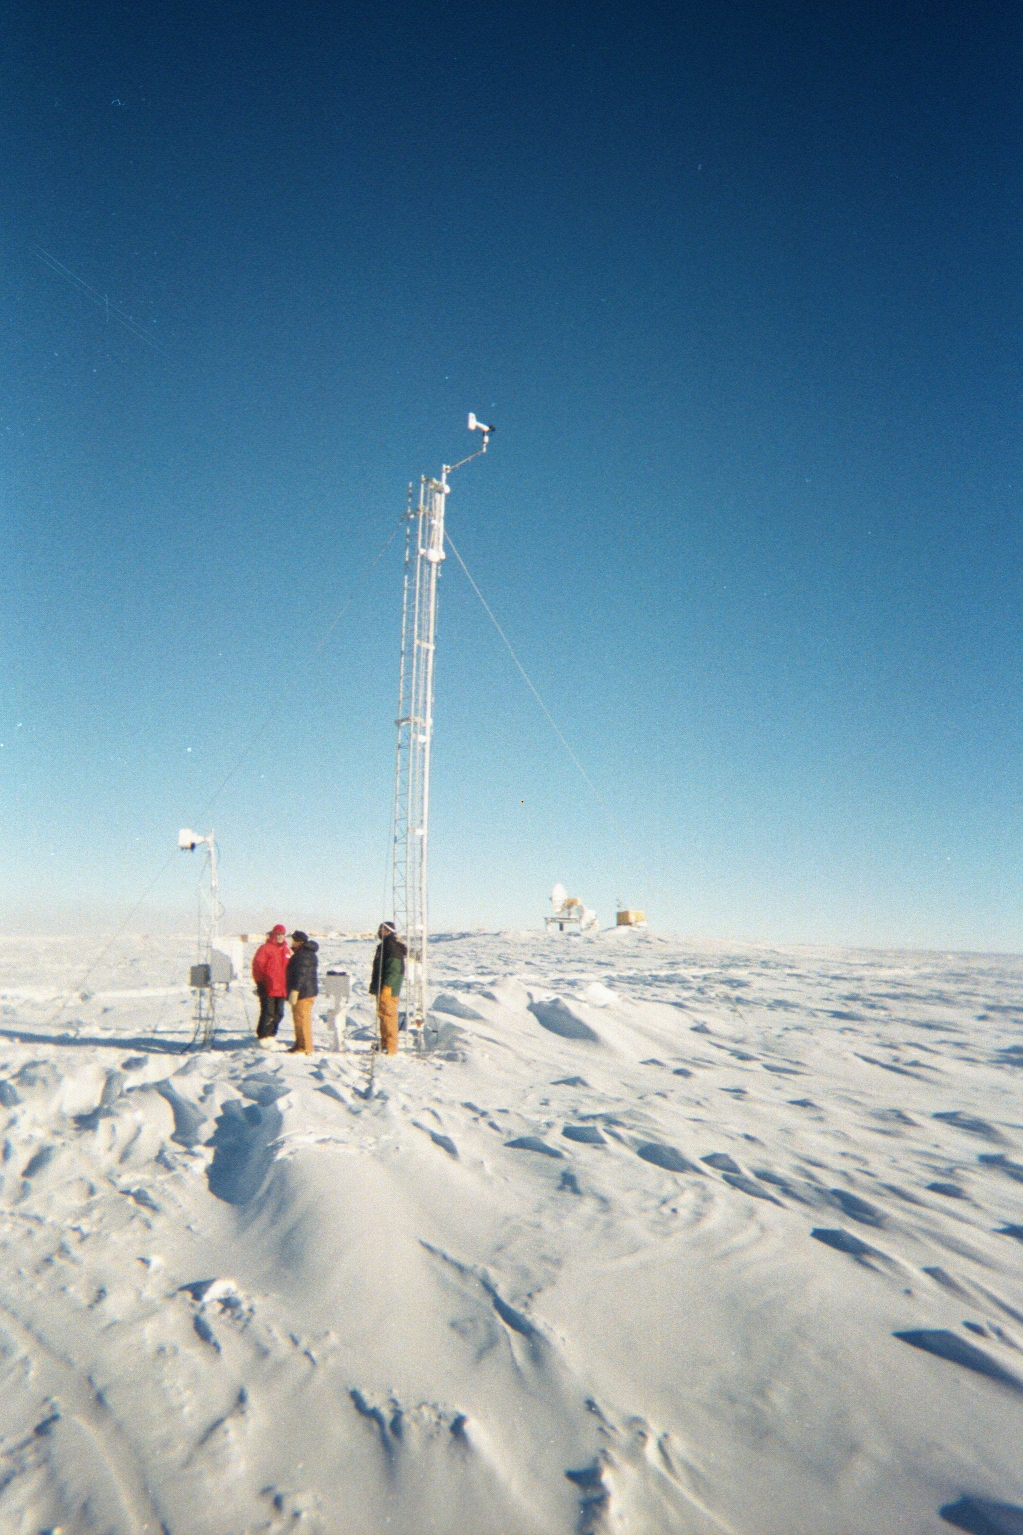
South Pole Climatology Project: MatLab
“Coreless” Winter!
NSF
Average Temperatures Jan - Dec
Lazzara et al. 2012
No significant change…
Significant decrease!
Temperatures:1956-2010
Wind Speed:1956-2010

Slide 32
AWS Quality Control: IDL
Seefeldt and Keller, 2006

Slide 33
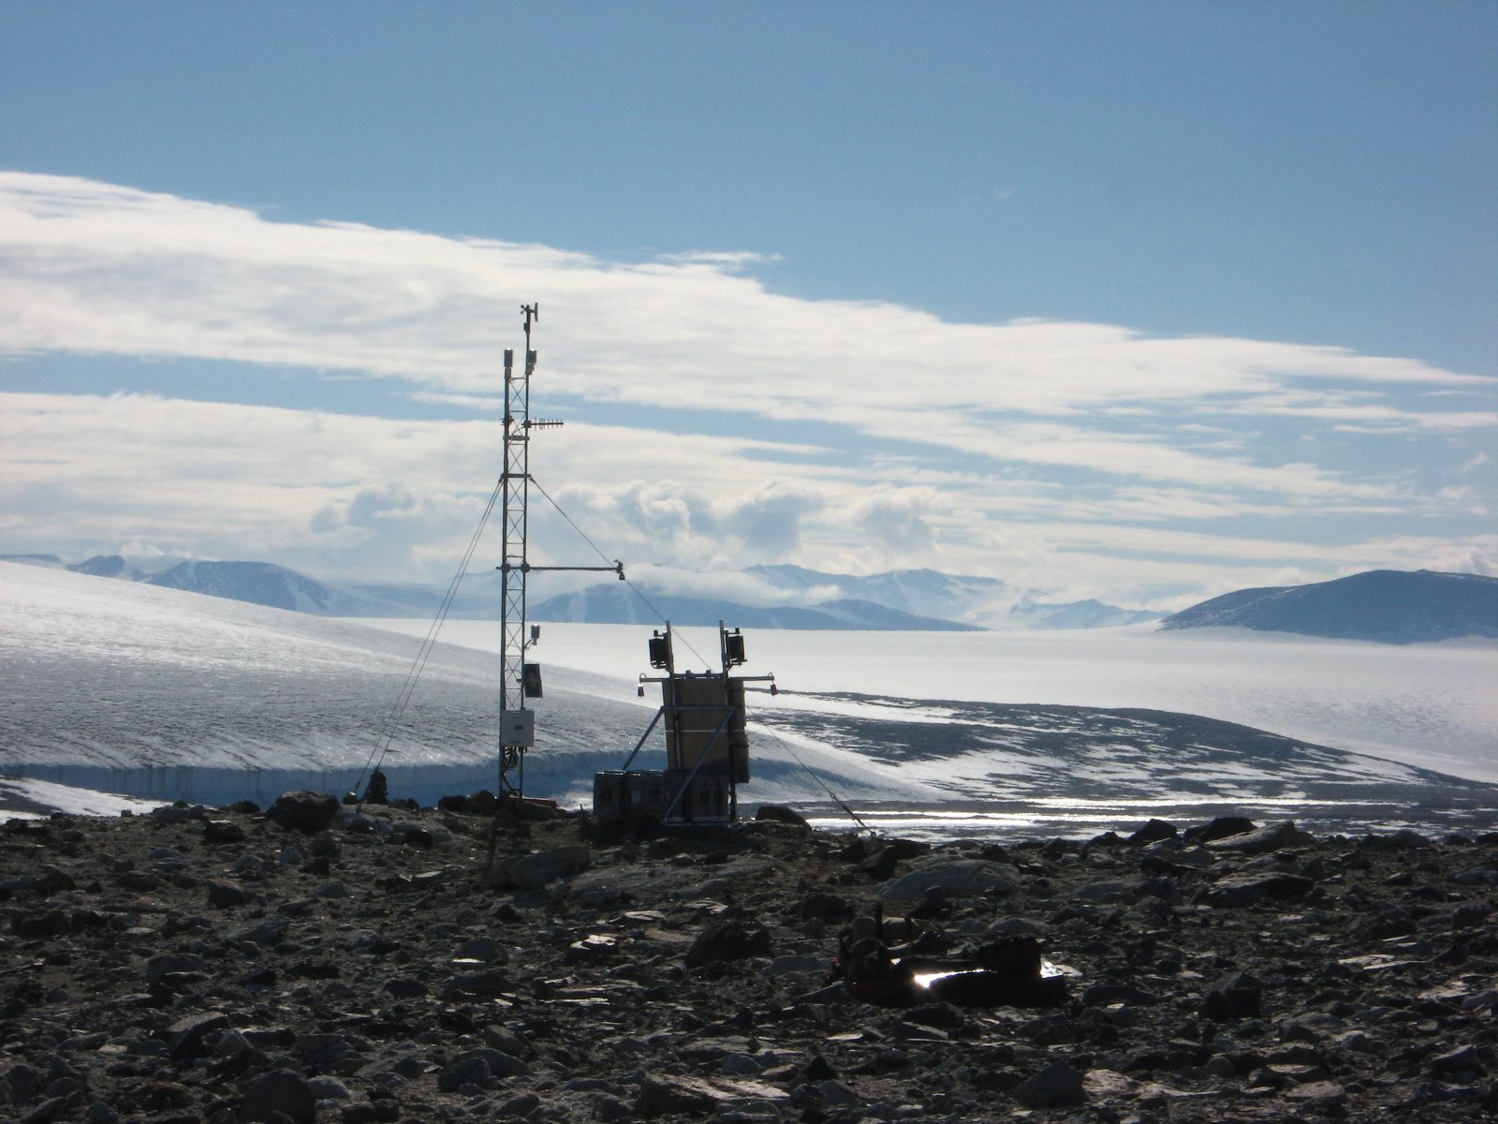
Thank you! Questions?
Marble Point AWS Ozone Site – photo courtesy of Lars Kalnajs, CU
Thanks to NSF OPP Grants #ANT-0838834, #ANT-0944018, & #ANT-1043478

