Slide 1
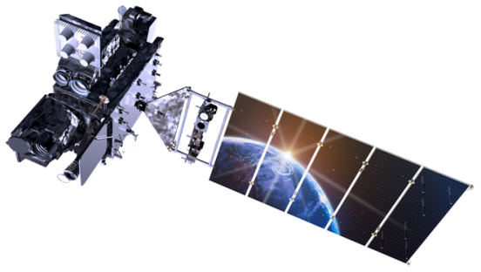

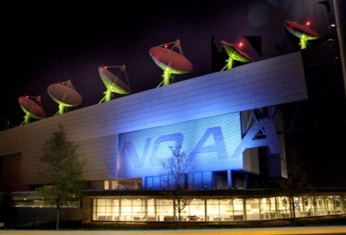
NOAA Satellite Update and McIDAS at ESPC
Matthew Seybold
Satellite User Services Coordinator
NESDIS Operations (OSPO)
2012 McIDAS Users Group Meeting – Madison, WI
May 7-8, 2012
Notes:
Coordinate with users on anomaly impacts, operational transitions, future continuity planning.
Personally, I presently use McIDAS primarily as an ad hoc diagnostic tool for interrogating availability and timeliness off ESPC PG & PD, so feel free to quiz me on McIDAS, but may defer questions to Bonnie, Russ, Jess, Tony, & Gregg.

Slide 2
Talk Collaborators
Natalia Donoho – User Services Co-Coordinator
Thomas Renkevens – SPSD Deputy Division Chief
Tim Schmit – NESDIS/StAR GOES Senior Scientist
Jessica Staude – SSAI GOES & McIDAS Guru
Bonnie Morgan – GOES Product Area Lead
Mark Ruminski – SAB Fire Team Lead & All Desks
Gregg Gallina – SAB COOP Team Lead & All Desks
Tony Salemi – SAB Ash, Fire, Oil, Tropical Desks
Russ Lancaster – SSAI Senior Systems Analyst
I needed and received a lot of help!

Slide 3
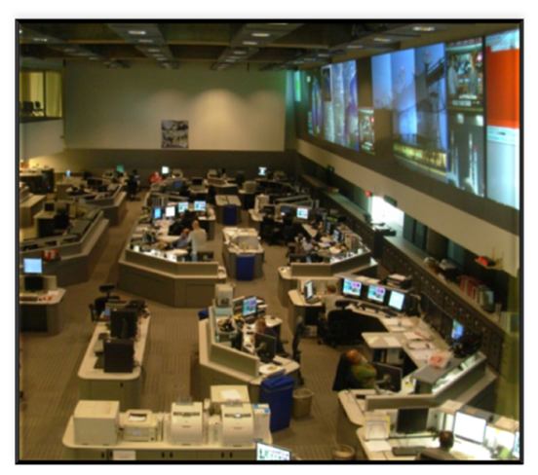
Talk Outline
OSPO Overview
Operational Satellite Status
  GOES, POES, NPP, Non-NOAA
Future GEO Plans
  Meteosat, Himawari
Future LEO Plans
  METOP-B, Suzuki
Anomalies, Outages, and Retirements
  Envisat Failure
  GOES-7 De-Orbit
  Missing GOES-15 scans in AWIPS
  GOES-15 Imager Calibration
  GOES-15 Yaw Flip Maneuver
Maneuvers, Eclipse, Stray Light, Schedules
McIDAS in ESPC
New and Enhanced Products & Services
Data Access Policy & CRM
Command & Control & NSOF

Slide 4
NESDIS Office of Satellite and Product Operations
(OSPO)
Director
Kathy Kelly
Admin Officer
Linda Brown
Corporate
Services
Keith Amburgey
Special Projects Selina Nauman
Deputy Director
Mark Moran (a)
MOD
Ron Mahmot
Wallops CDA
Doug Crawford
Fairbanks CDA
Larry Ledlow
National Ice Center
Sharolyn Young
SPSD
Dave Benner
Deputy: Linda Stathoplos
Deputy: Tom Renkevens
Operations
Al McMath
Acronyms
CDA – Command and Data Acquisition
MOD – Mission Operations Division
SPSD – Satellite Products and Services Division
Satellite Products
Ricky Irving
Operations
Joe Perez (acting)
Support
Stephen Howard
Support
Mike Settles
Satellite Analysis
Davida Streett
Systems Engineering
Bob Clark
Systems
Alva Barnette
SPSD User Services Co-Coordinators
Direct Services
Chris O’Connors
Matthew Seybold
Work: (301)763-8051 x106
Cell: (202) 557-4997
Matthew.Seybold@noaa.gov
Natalia Donoho
Work: (301)763-8051 x134
Cell: (202) 604-0734
Natalia.Donoho@noaa.gov
Engineering
Cindy Hampton
IT Services
Andre Hammond
Notes:
OSPO is a NESDIS line office along with OSD, STaR, GOES-R, JPSS, Climate Offices, and Staff Offices
MOD – includes Command & Control at NSOF, satellite engineering, and systems support
The CDA (Command and Data Acquisition) sites are at Wallops, VA and Fairbanks, AL.
The National Ice Center is a joint Navy, NOAA, and Coast Guard office that resides at NSOF.
SPSD is home to all of the R2O algorithm transition work in Ricky Irving’s Products Branch, Interpretive Analysis in Davida Street’s SAB, Chris O’Connors’ Direct Services, and User Services is on staff level.
Natalia and I have taken over the user services roles from Tom Renkevens and Brian Hughes.

Slide 5

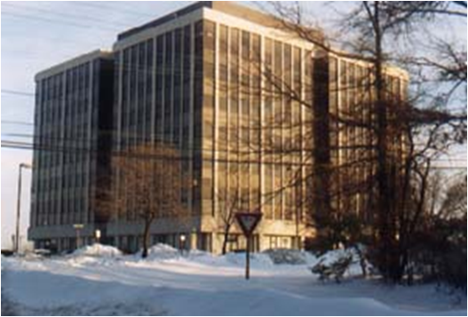
NESDIS Office of Satellite and Product Operations
(OSPO)
Operates the Nation’s 17 environmental satellites
  4 Geostationary (GOES) by NOAA
  5 Polar-Orbiting (POES) by NOAA
  6 Defense Meteorological Satellite Program (DMSP) operated by NOAA
  1 OSTM Jason-2 (Ocean Surface Topography Mission) Joint NOAA, NASA, CNES, EUMETSAT effort
  1 Suomi National Polar-orbiting Partnership (NPP) by NOAA & NASA
Locations at four facilities housing 700 people
  NOAA Satellite Operations Facility (NSOF) in Suitland, MD - $5B facility operating $5B of satellites
  World Weather Building (WWB) in Camp Springs, MD
  Command and Data Acquisition Stations at Fairbanks, AK and Wallops, VA
NSOF
WWB

Slide 6
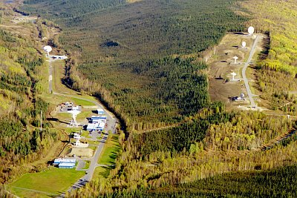
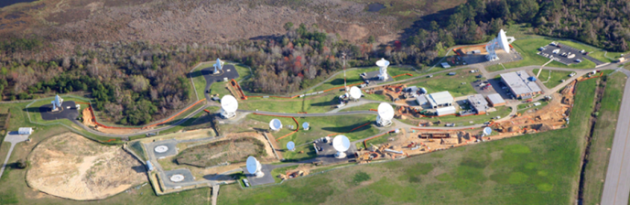
NESDIS Office of Satellite and Product Operations
(OSPO)
Key Roles
  Ground System Command & Control, Ingest, Generation, and Distribution
  Pre-Launch and Post-Launch Testing
  Operational Testing, Validation, and Verification
  User Readiness for Broadcast Services and Product Delivery
  Long-Term Continuity of Products and Services
Interpret products and manage services including GVAR, LRIT, SARSAT, EMWIN, DCS, Argos, Geonetcast
Issue critical environmental data and imagery used for tracking and predicting
  Hurricanes, Tornadoes, Floods
  Wild Fire, Ash Plumes, Vegetation
  Ocean Color, Sea Surface Temperature
Fairbanks CDA
Wallops CDA

Slide 7
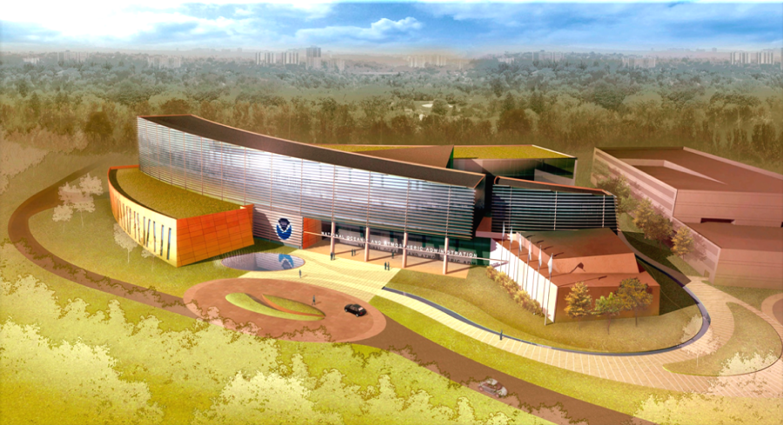
NOAA Center for Weather and Climate Prediction
(NCWCP) in College Park, Maryland
Home to NWS / NCEP (NCO, EMC, HPC); NWS / ARL; NESDIS / STaR & OSPO
Public access photo log: http://www.ncep.noaa.gov/news/ncwcp/

Slide 8
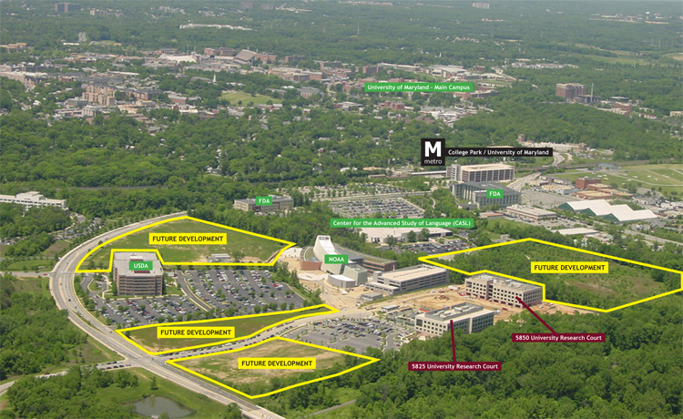
NOAA Center for Weather and Climate Prediction
(NCWCP) in College Park, Maryland
Notes:
Proximity to College Park and small College Park airport
Other M-Campus residents include USGS, NSA, and STaR has additional staff in co-located office buildings
Washington D.C. Green Line metro stop

Slide 9

NCWCP in College Park, Maryland
Notes:
Art feature – cabled water spout drain to green space – water garden

Slide 10

NCWCP in College Park, Maryland
Notes:
Open, glass walls, railings, natural light

Slide 11






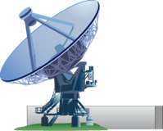
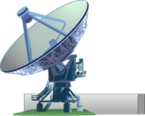
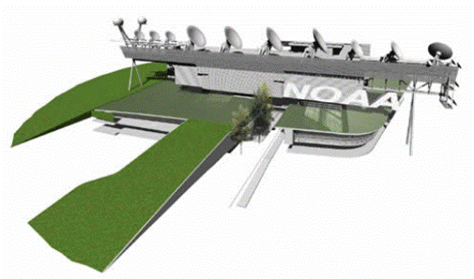


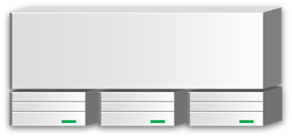





Satellite Information Flow
METOP-A (AM)
GOES 15 (West)
GOES 13 (East)
Non-NOAA
Ancillary observations & model data.
GINI (GOES Ingest and
NOAAPORT Interface for
AWIPS)
Satepsdist (ADDE & ftp)
DDS (Data Dist. Server)
Dell Blade Servers (Linux)
POES NOAA 19 (PM)
Fairbanks Ground
Station - POES
Wallops Ground
Station - GOES
Satellite Operations Control Center
Environmental Satellite Processing Center
Command and Control
Process and Distribute
Polar Acquisition Stations for POES, MetOp, EOS
Wallops, VA
Fairbanks, AK
Gilmore Creek, AK
Svalbard
Honolulu, HI
Miami, FL
Australia
Monterey, CA
NASA DAACs
Data
Products
Archive and Access
(CLASS)
Users
Notes:
11

Slide 12
GOES Data Delivery Summary
Broadcast Services – GVAR, LRIT
Various Websites
GINI / NOAAPORT – for AWIPS display
DDS – mostly polar data and products, some GOES derived products
SATEPSDIST
  Geostationary satellite data is ingested on a Satellite Data Ingestor (SDI), converted to McIDAS format and placed on a server. This data can then be transferred to the various workstations via McIDAS ADDE software
  Data NSOF Server ADDE Name
  Derived Products SATEPSDIST1e DPD
  GOES-E SATEPSDIST2e GER
  GOES-W SATEPSDIST3e GWR
  Polar SATEPSDIST4e PLR
  Model data SATEPSDIST5 MOD
  Global Mosaic 5 Sat. Comp. SATEPSDIST6 MOS
  MSG/MET SATEPSDIST6e MSG / MET
  FY-2D from SSEC SATEPSDIST7 FY2D
  MTSAT SATEPSDIST7e MTS
  Select requested data SATEPSANONE PUB
  Surface/Ship Buoy/RAOBs FOS2 FOS (Family of Services)
Notes:
Per Bonnie added MOD, MOS, FY2D, FOS
Per Tom added PUB

Slide 13
Sample of GINI and AWIPS Products
Created and distributed through GINI
  Imagery
  Sounder “images”
Created outside of GINI, but distributed through GINI
  Five satellite composite files (VIS, IR, WV)
  Sounder Derived Products (TPW, LI, CTP, ECA, Skin-T)
  Imager Derived Products (LCB)
  Polar (POES and DMSP) microwave derived products (TPW, Rain Rate, blended TPW)
  SSM/I AMSU Blended RR products
Created outside of GINI, distributed outside of GINI, but appearing within AWIPS
  Precipitation Autoestimator (PG on satepsdist1, PD from DDS to AWIPS)
  GOES BUFR and POES BUFR Soundings
  High Density Winds
  ASCAT
  Text Messages: SPENES, VAA, Tropical Bulletins, Help Desk messages
  ASOS Satellite Cloud Products

Slide 14
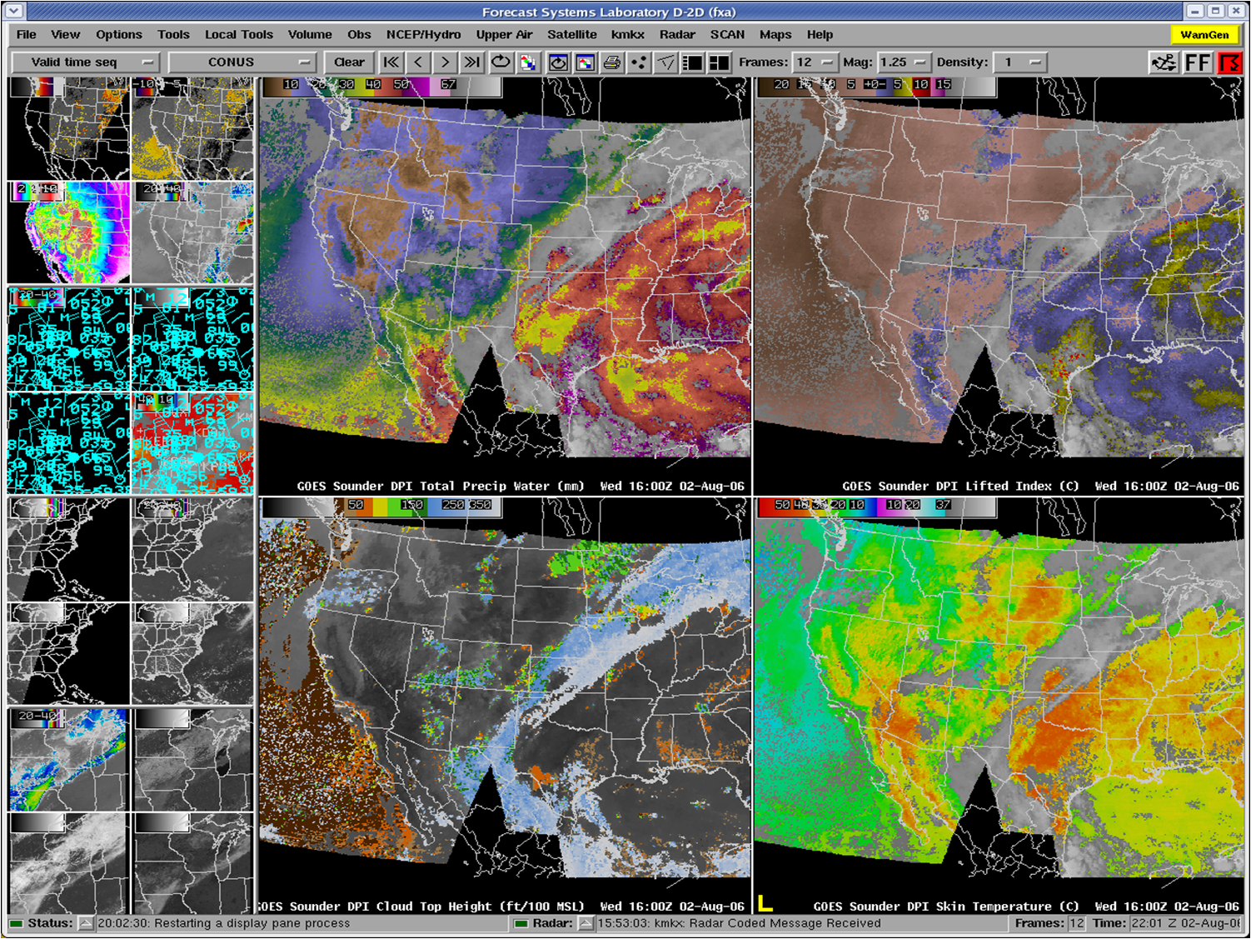
Total Precipitable Water SuperN.PW.1A
Lifted Index SuperN.LI.1A
Cloud-Top Height SuperN.CTP.1A
Surface Skin Temperature SuperN.SKT.1A
Not shown…
Effective Cloud Amount SuperN.ECA.1A

Slide 15
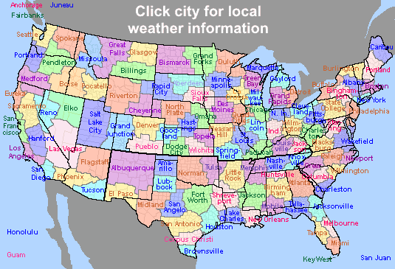
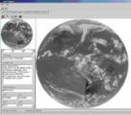
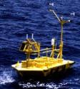
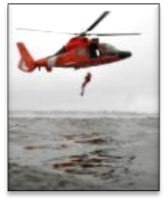

Direct Service Operations
Emergency Managers Weather Information Network (EMWIN):
NOAA satellites relay critical information to users across the country.
  http://www.weather.gov/emwin/index.htm
Low Resolution Image Transmission (LRIT):
NOAA satellites are used to relay satellite and weather products to users in remote
locations, that do not have landlines or internet connections.
  http://www.noaasis.noaa.gov/LRIT/
Data Collection:
NOAA satellites are used to collect and relay scientific data from around the globe.
  http://www.noaasis.noaa.gov/DCS/ http://www.noaasis.noaa.gov/ARGOS/
Search and Rescue:
NOAA satellites are used to relay distress alerts from aviators, mariners and
land-based users
  http://www.sarsat.noaa.gov/
Geonetcast Americas:
Data from NOAA for diverse societal benefits - agriculture, energy, health, climate,
weather, disaster mitigation, biodiversity, water resources, and ecosystems.
  http://www.geonetcastamericas.noaa.gov/index.html
Notes:
OSDPD also manages NOAA’s Satellite Services including Search and Rescue, Data Collection, Low Rate Information Transmission, and data/product rebroadcast including GVAR, HRPT/APT, and GeoNETCAST. We partner with NWS to provide data and products through the Emergency Managers’ Weather Information Network.

Slide 16
Operational Satellite Status

Slide 17
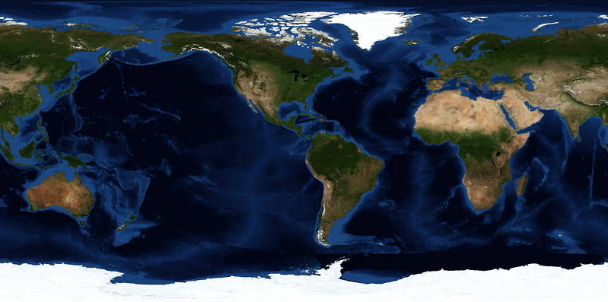
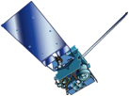
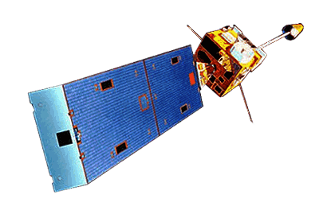
GOES Constellation
GOES-15
135° West
GOES-14
105°W
GOES-13
75° West
GOES-12
60° West
  Primary source of data for short term forecasting, especially of severe weather such as tropical storms
Continuity of Operations since 1974
GOES 13/14/15 improvements over GOES 10/11/12
  Spring and fall eclipse outages are avoided by larger onboard batteries
  Improved navigation and radiometrics

Slide 18
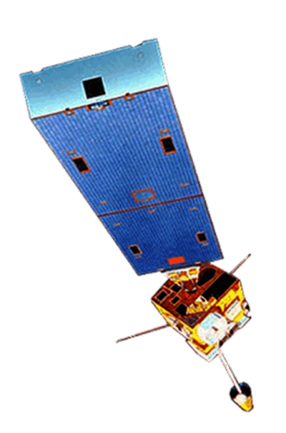
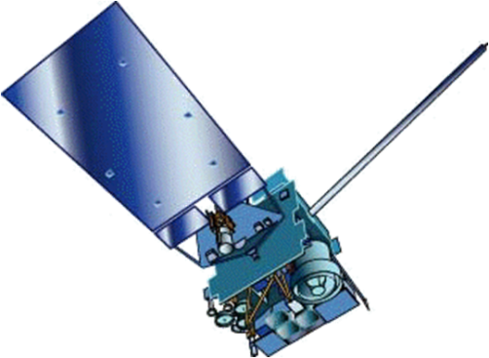
…just in case…
GOES-West Transition
  In December, 2011 GOES-15 replaced GOES-11 at GOES-West
  GOES-11 was decommissioned to a higher “retirement” orbit
  GOES-15 sounder requires a yaw flip twice per year, creating 30 additional hours of unstable data
  GVAR format (version 3) for GOES-15 and GOES-14 is different from earlier GOES satellites
    The data for the 8th detector has been added to block 0
    Instrument Factory Coefficients are located in Block 11
    Instrument Nadir and Detector Offsets located in Block 11 but are also located in Block 0
    Detector Offsets located in block 0, words 7933 to 8028
    Instrument Nadir located in block 0, words 8033 to 8038

Slide 19
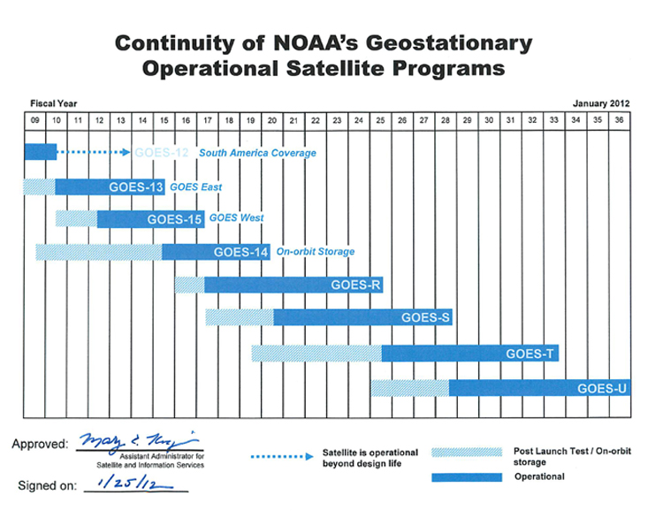
GOES Flyout Schedule
http://www.nesdis.noaa.gov/FlyoutSchedules.html http://www.goes-r.gov

Slide 20
GOES Status (May 1, 2012) http://www.oso.noaa.gov/goesstatus
Payload Instrument | GOES-12 (S. America) Launch: Jul 01 Activation: Apr 03 | GOES-13 (East) Launch: May 06 Activation: Apr 10 | GOES-14 (Storage) Launch: Jun 09 Activation: | GOES-15 (West ) Launch: Mar 10 Activation: Dec 11
Imager | Y(1) | G | G | G
Sounder | Y (2) | G | G | Y (11)
Energetic Particle Sensor (EPS) | Y (3) | G | G | G
Magnetometers | G | G | G | G
High Energy Proton and Alpha Detector (HEPAD) | G | G | G | G
X-Ray Sensor (XRS) | Y (4) | R (8) | G | G
Solar X-Ray Imager (SXI) | R (5) | Y (9) | G | S/C (12)
Spacecraft Subsystems
Telemetry, Command & Control | G | G | G | G
Attitude and Orbit Control | S/C (14) | G | G | G
Inclination Control | R (6) | G | G | G
Propulsion | Y (7) | S/C (10) | G | G
Mechanisms | G | G | G | G
Electrical Power | G | G | G | G
Thermal Control | G | G | G | G
Communications Payloads | G | G | G | S/C (13)
Key
Operational
Spacecraft issues but no user impacts
Operational with limitations
Non-operational
G
S/C
Y
R
Notes:
1

Slide 21
GOES Status (May 1, 2012) http://www.oso.noaa.gov/goesstatus
Payload Instrument | GOES-12 (S. America) Launch: Jul 01 Activation: Apr 03 | GOES-13 (East) Launch: May 06 Activation: Apr 10 | GOES-14 (Storage) Launch: Jun 09 Activation: | GOES-15 (West ) Launch: Mar 10 Activation: Dec 11
Imager | Y(1) | G | G | G
Sounder | Y (2) | G | G | Y (11)
Energetic Particle Sensor (EPS) | Y (3) | G | G | G
Magnetometers | G | G | G | G
High Energy Proton and Alpha Detector (HEPAD) | G | G | G | G
X-Ray Sensor (XRS) | Y (4) | R (8) | G | G
Solar X-Ray Imager (SXI) | R (5) | Y (9) | G | S/C (12)
Spacecraft Subsystems
Telemetry, Command & Control | G | G | G | G
Attitude and Orbit Control | S/C (14) | G | G | G
Inclination Control | R (6) | G | G | G
Propulsion | Y (7) | S/C (10) | G | G
Mechanisms | G | G | G | G
Electrical Power | G | G | G | G
Thermal Control | G | G | G | G
Communications Payloads | G | G | G | S/C (13)
GOES-12 Imager Cycle Slip Occurs periodically. 2 to 3 images are corrupted or lost for each cycle slip. OSPO Developed a pseudo-telemetry to detect the anomaly for quick correction response.
Key
Operational
Spacecraft issues but no user impacts
Operational with limitations
Non-operational
GOES-15 Sounder temperature control blanket is raised. Yaw flip at Equinox to keep Sun angle below cooler plane. Data outage and degraded products during each yaw flip maneuver and 28 hours of INR recovery period.
G
S/C
GOES-12 X-ray Imager has failed. No recovery possible.
GOES-13 X-Ray Sensor Failed. No x-ray space measurements being collected.
Y
GOES-12 Inclination Control is non-operational. No fuel remains for inclination control maneuvers. Code was loaded to mitigate image motion at slightly inclined orbit. XGOHI (eXtended GOES High Inclination.) Users should expect a 4 minute delay from the time actually imaged. As with the past GOES-10, users should also expect if there is a frame break during an image that the rest of the image will be lost. Without XGOHI, the growing satellite inclination would continue to cause loops with an ever increasing "wobble".
R
Notes:
1

Slide 22
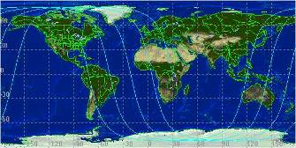
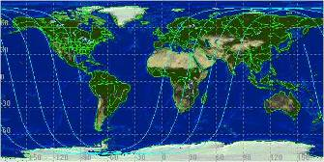
POES Constellation
10 am Orbit (Metop-A)
2 pm Orbit (NOAA-19)
Two polar operational satellites; one in morning and one in afternoon orbit. Each orbit is 102 minutes
Since May 2007, NOAA using EUMETSAT satellite operationally for mid-morning orbit through NOAA/EUMETSAT partnership
Each satellite provides world-wide coverage every 12 hours (6-hour global sampling for the pair)
Directly broadcasts data to users worldwide
Continuity of operations since early 1960s
N
Fairbanks,
Alaska
Wallops,
Virginia
Data Acquisition Sites
530 Mi
Equator
Orbit Path
S
Primary source of data for longer term weather prediction, global environmental monitoring, and long-term predictions

Slide 23
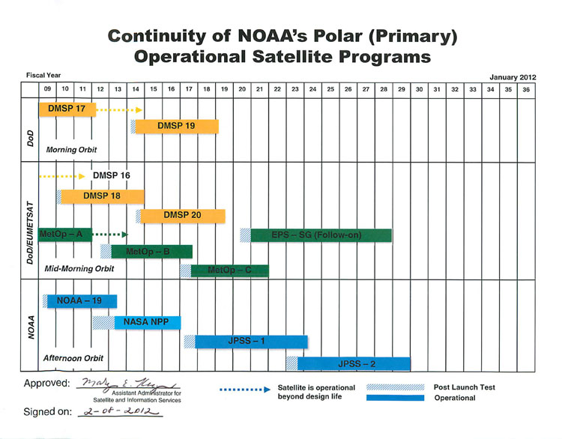
POES Flyout Schedule
Two more DMSP (19,20) in future. DWSS canceled (Defense Weather Satellite System)
METOP-B Launch in July, 2012
NPP Launch Oct., 2011; Ops Apr., 2013
However, NCEP plans to use some ATMS radiance data in ops GFS in June, 2012

Slide 24
Operational | G
Spacecraft Issue but no User Impact | S/C
Operational with Limitation | Y
Non-Operational | R
Not Applicable | N/A
POES Status (May 1, 2012)
http://www.oso.noaa.gov/poesstatus/index.asp
Spacecraft Subsystems | METOP-A | NOAA-19 | NOAA-18 | NOAA-17 | NOAA-16 | NOAA-15
Launch Date | Oct 2006 | Feb 2009 | May 2005 | Jun 2002 | Sep 2000 | May 1998
Operational Date | May 2007 | Jun 2009 | Aug 2005 | Oct 2002 | Mar 2001 | Dec 1998
Mission Data Category | Primary (AM) | Primary (PM) | Secondary (PM) | Secondary (AM) | Secondary (PM) | Secondary (AM)
Payload Instruments
AVHRR | G | G | G | R (11) | Y(13) | Y(20)
HIRS | G | G | Y (3) | G | Y(14) | R (6)
AMSU-A1 | Y(26) | G | G | R (4) | Y(15) | Y(21)
AMSU-A2 | G | G | G | G | G
AMSU-B | N/A | N/A | N/A | Y (9) | G | R (12)
MHS | G | Y (8) | G | N/A | N/A | N/A
SEM | G | G | G | G | G | G
SBUV | N/A | S/C (9) | G | G | Y(16) | N/A
Spacecraft Subsystems
Telemetry, Command & Control | G | G | G | G | G | G
ADACS | G | G | Y (7) | G | Y(17) | Y(10)
EPS | G | G | G | Y(25) | G | G
Thermal Control | G | G | G | G | G | Y(22)
Communications | Y (1) | G | G | S/C (5) | G | Y(23)
APT/LRPT | R (2) | G | G | G | R(18) | G
SAR | G | G | G | G | Y(19) | Y(24)
Notes:
1

Slide 25
Operational | G
Spacecraft Issue but no User Impact | S/C
Operational with Limitation | Y
Non-Operational | R
Not Applicable | N/A
POES Status (May 1, 2012)
http://www.oso.noaa.gov/poesstatus/index.asp
Spacecraft Subsystems | METOP-A | NOAA-19 | NOAA-18 | NOAA-17 | NOAA-16 | NOAA-15
Launch Date | Oct 2006 | Feb 2009 | May 2005 | Jun 2002 | Sep 2000 | May 1998
Operational Date | May 2007 | Jun 2009 | Aug 2005 | Oct 2002 | Mar 2001 | Dec 1998
Mission Data Category | Primary (AM) | Primary (PM) | Secondary (PM) | Secondary (AM) | Secondary (PM) | Secondary (AM)
Payload Instruments
AVHRR | G | G | G | R (11) | Y(13) | Y(20)
HIRS | G | G | Y (3) | G | Y(14) | R (6)
AMSU-A1 | Y(26) | G | G | R (4) | Y(15) | Y(21)
AMSU-A2 | G | G | G | G | G
AMSU-B | N/A | N/A | N/A | Y (9) | G | R (12)
MHS | G | Y (8) | G | N/A | N/A | N/A
SEM | G | G | G | G | G | G
SBUV | N/A | S/C (9) | G | G | Y(16) | N/A
Spacecraft Subsystems
Telemetry, Command & Control | G | G | G | G | G | G
ADACS | G | G | Y (7) | G | Y(17) | Y(10)
EPS | G | G | G | Y(25) | G | G
Thermal Control | G | G | G | G | G | Y(22)
Communications | Y (1) | G | G | S/C (5) | G | Y(23)
APT/LRPT | R (2) | G | G | G | R(18) | G
SAR | G | G | G | G | Y(19) | Y(24)
AVHRR Scan Motor Failed
AMSU –A1 Scan Motor Failed
N15 still available to users
HIRS Filter Wheel Stalled, N17 & METOP-A still available to users
HIRS Longwave channel noise
AMSU-B Antenna Scan Motor Failed, METOP-A MHS still availalble to users
Transmitter off, no LRPT
APT 1 & 2 Failed, N19 still available to users
Notes:
1

Slide 26
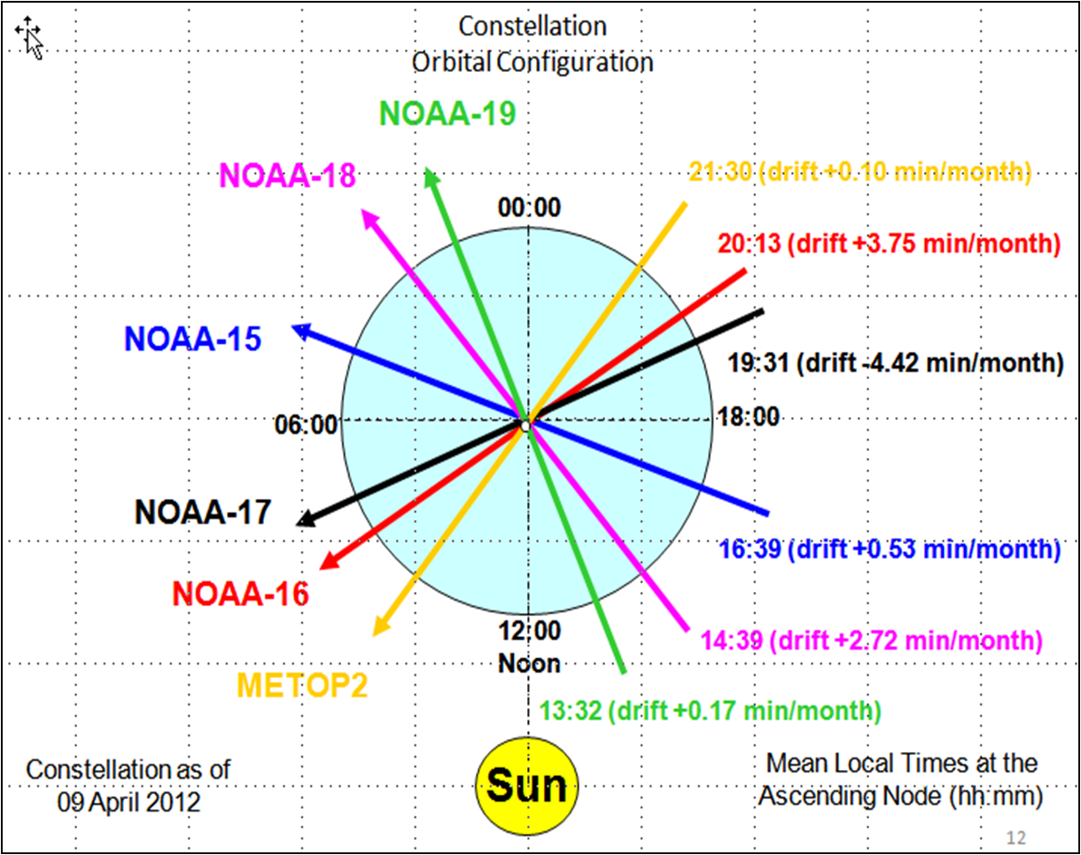
Slide credit: Renee Smith-Dearring

Slide 27

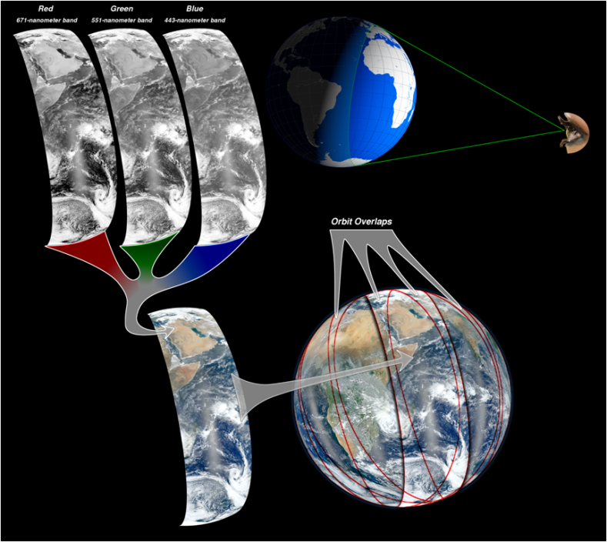

Suomi NPP
(National Polar-orbiting Partnership)
Launched in October, 2011
What is the NPP Blue Marble?
6 composite RGB swaths in an 8 hour period (not full disk)
NPP, 2012
Apollo-17, 1972
Images Credit: NASA

Slide 28
Suomi NPP
Instrument Status - May 6, 2012
VIIRS: In Nominal operations mode, full science data production
CrIS: In Nominal operations mode --- Full science data production --- On-orbit performance evaluation shows CrIS is meeting its top level performance requirements
ATMS: In Nominal operations mode (Scan profile 1)
OMPS: In Nominal operations mode (Operate), Full science data production
CERES: In Nominal operations mode (Cross track), Full science data production
  Instrument performance supports product accuracy requirements
  Earth Radiation Budget Climate Analysis Research System (ERBCARS) is fully operational
  Solar presence sensor anomaly occurred on orbit 2280 (April 6) during lunar calibration scan and resulted in no science data for nine orbits

Slide 29
Suomi NPP - Mission Status
The number of NPP Data Access requests from OSPO is growing
Testing with primary customers is well underway with the NDE group at NSOF testing with NCEP, AFWA, NAVO, FNMOC, EUMETSAT, and others
NCEP will ingest ATMS to the GFS in June, 2012
The plan for data access requests and delivery to customers is still being finalized between NESDIS/OSD and NESDIS/OSPO
OSD will provide 8 x 5 (and best effort) monitoring
Hand over from OSD to OSPO is slated for _________
Resources:
Common Data Format Control (CDFC) book of NPP products being delivered to NDE: http://jointmission.gsfc.nasa.gov/science/documents.html
FY11 Project Acquisition Plan: http://projects.osd.noaa.gov/NDE/ pub-docs/NDE_FY2011_Project_Acquisition_Plan.pdf
Project Summary: http://projects.osd.noaa.gov/NDE/pub-docs/NDE_Concept_of_Operations-v4.pdf

Slide 30
Non-NOAA Federal Satellite Data acquired by NOAA
Satellite | Source | Primary Product Areas
EOS Aqua | NASA | Imagery, Fire/Smoke, Hurricane, Aerosols, Precipitation, Oil Spill Monitoring, Ocean Color, Winds
EOS Terra (With loss of ENVISAT, looking to augment Ocean Color Product with Terra) | NASA | Imagery, Fire/Smoke, Hurricane, Aerosols, Precipitation, Oil Spill Monitoring, Winds
EOS Aura | NASA | SO2, Volcanic Ash
TRMM | NASA | Precipitation
DMSP | DoD | Precipitation, Winds, Hurricane Intensity, Imagery
Coriolis / Windsat | DoD / NRL | Winds
Landsat | USGS | Oil Spill Monitoring
The systems are leveraged through agreements which require no direct exchange of funds between NOAA and the inter-agency partner.
Notes:
The systems are leveraged through agreements which require no direct exchange of funds between NOAA and the inter-agency or international partner, except for Radarsat-2. Radarsat-2 is a public-private venture. NOAA pays for or leverages other Federal agency acquisitions of data from this system.
EOS – Earth Observing System
DMSP – Defense Meteorological Satellite Program
TRMM – Tropical Rainfall Measurement Mission
DoD – Department of Defense
NRL – Naval Research Laboratory
USGS – U.S. Geological Survey

Slide 31
Non-NOAA International Satellite Data acquired by NOAA
Satellite | Source | Primary Product Areas
Meteosat-7 | EUMETSAT | Imagery, Tropical Cyclones, Precipitation, Snow & Ice
Meteosat-9 (Meteosat-8 is backup) | EUMETSAT | Imagery, Tropical Cyclones, Precipitation, Snow & Ice, Sea Surface Temperature, Fire
Metop-A | EUMETSAT | Imagery, Tropical Cyclones, Precipitation, Winds, Snow & Ice, Volcanic Ash, Sea Surface Temperature, Fire
MTSAT-2 (MTSAT-1R is backup) | JMA (Japan) | Imagery, Tropical Cyclones, Precipitation, Winds, Snow & Ice, Volcanic Ash, Sea Surface Temperature, Fire
FY-2D | CMA (China) | Imagery, Tropical Cyclone (Limited usage – mainly at night over Indian Ocean)
Jason-2 | NOAA & CNES | Sea Surface Heights
Envisat (Failed on April 9, 2012) | ESA | Snow and Ice, Ocean Color, Oil
Notes:
The systems are leveraged through agreements which require no direct exchange of funds between NOAA and the inter-agency or international partner, except for Radarsat-2. Radarsat-2 is a public-private venture. NOAA pays for or leverages other Federal agency acquisitions of data from this system.
EUMETSAT - European Organisation for the Exploitation of Meteorological Satellites
JMA – Japan Meteorological Agency
CMA – China Meteorological Agency
CNES – French Space Agency
ESA – European Space Agency
ISRO - Indian Space Research Organization
CSA – Canadian Space Agency
NPSO - National SPace Organization (Taiwan)

Slide 32
Non-NOAA International Satellite Data acquired by NOAA
Satellite | Source | Primary Product Areas
COSMIC | NSPO Taiwan | Soundings (Radio Occultation)
Oceansat | ISRO (India)
Radarsat-1, Radarsat-2* | CSA (Canada) | Snow and Ice, Oil
TerraSAR-X | German Aerospace Center DLR / EADS Astrium | Oil Spill Monitoring
SPOT | CNES (France) | Oil Spill Monitoring
Worldview | Digital Globe (Commercial) | Oil Spill Monitoring
The systems are leveraged through agreements which require no direct exchange of funds between NOAA and the international partner, except for Radarsat-2.
*Radarsat-2 is a public-private venture. NOAA pays for or leverages other Federal agency acquisitions of data from this system.
Notes:
The systems are leveraged through agreements which require no direct exchange of funds between NOAA and the inter-agency or international partner, except for Radarsat-2. Radarsat-2 is a public-private venture. NOAA pays for or leverages other Federal agency acquisitions of data from this system.
EUMETSAT - European Organisation for the Exploitation of Meteorological Satellites
JMA – Japan Meteorological Agency
CMA – China Meteorological Agency
CNES – French Space Agency
ESA – European Space Agency
ISRO - Indian Space Research Organization
CSA – Canadian Space Agency
NPSO - National SPace Organization (Taiwan)

Slide 33
Future GEO & LEO Plans

Slide 34
  Prepare for GOES-R transition to GOES Rebroadcast (GRB)
  (Replaces GVAR and will be tested during PLT)
 | GVAR | GOES Rebroadcast (GRB)
Full Disk Image | 30 minutes | 5 minutes (Mode 4)
 |  | 15 min (Mode 3)
Other modes | Rapid Scan, Super Rapid Scan | 3000 km x 5000 km CONUS: 5 min
 |  | 1000 km x 1000 km Mesoscale: 30 sec
Polarization | None | Dual circular polarized
Receive Center Frequency | 1685.7 MHz (L-band) | 1686.6 MHz (L-band)
Data Rate | 2.11 Mbps | ~30 Mbps
Antenna Coverage | Earth coverage to 5° | Earth coverage to 5°
Data Sources | Imager and Sounder | ABI (16 bands), GLM, SEISS, EXIS, SUVI, MAG
Space Weather | Non | ~2 Mbps
Lightning Data | None | ~0.5 Mbps
NWS plans to use NHC as primary downlink and PD point to other prediction centers.
Slide Credit: Vanessa Griffin, GOES-R GS

Slide 35
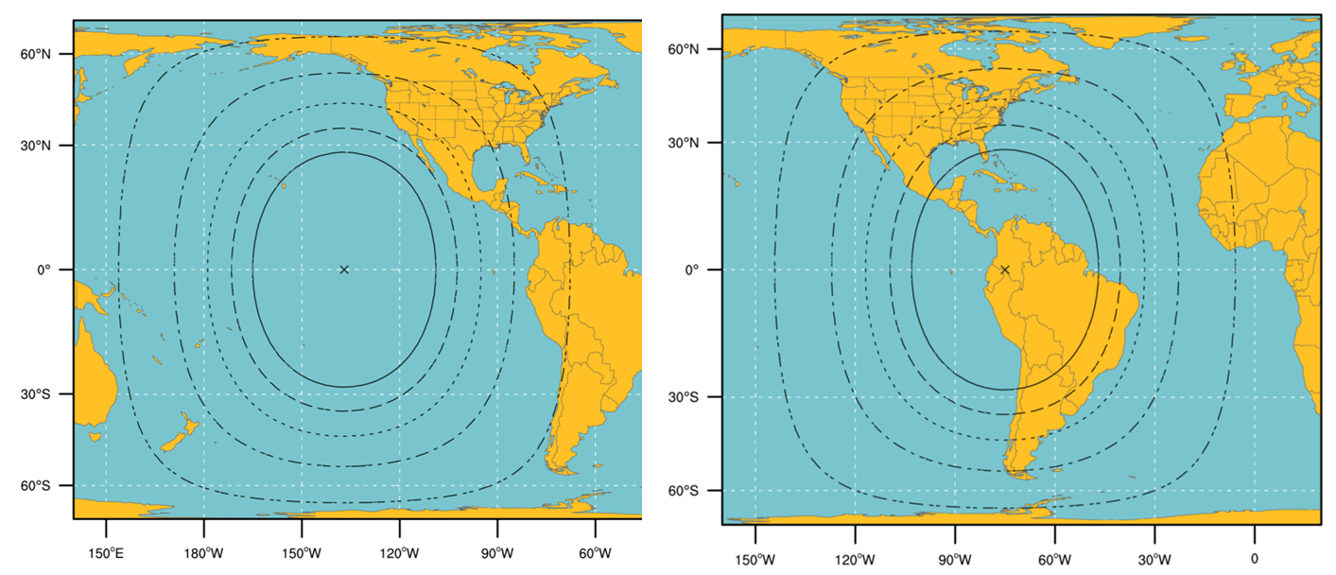
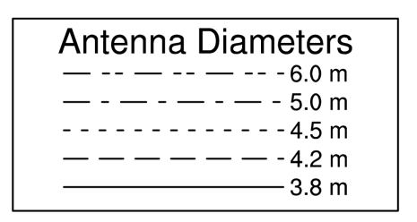
GRB Ground Antenna Sizes
NOTES:
Calculations based on available data as of May 2011
Each antenna size is usable within the indicated contour
Rain attenuations included are:
1.3/1.6/2.0/2.2/2.5 dB (3.8 to 6 m)
4. An operating margin of 2.5 dB is included as the dual polarization isolation is likely to vary within each antenna size area
Slide Credit: Vanessa Griffin, GOES-R GS

Slide 36
GRB Downlink Characteristics
Input Center Frequency: 1690.0 MHz
Content (specified for each of two polarization channels: LHCP, RHCP)
  L1b data, QC data and metadata: ABI, SUVI, EXIS, SEISS, MAG
  L2 data, QC data, metadata: GLM
  GRB Information Packets
Data rate
  31 Mbps maximum data rate
  15.5 Mbps instantaneous maximum for each polarization channel
  Down link margin: 2.5 db
Compression - Lossless compression required
  JPEG2000 and SZIP are candidates that are being considered/studies
Format
  Inner Frame Format: CCSDS Space Packet
  Outer Frame Format: DVB-S2
Coding
  BCH + LDPC (2/3) for 8-PSK and LDPC (9/10) for QPSK
Modem Required C/No (dB-Hz): 78.6
Maximum Demodulator Required Eb/No (dB) for 1x10⁻¹⁰ BER: 4.8 dB/Hz
Minimum Antenna System G/T (dB/K) : 15.2
These specs should be considered preliminary and will be finalized in 2012
Slide Credit: Vanessa Griffin, GOES-R GS

Slide 37
GRB Simulators
Purpose
  On-site testing of user ingest and data handling systems, aka GRB field terminal sites
  Simulates GRB downlink functionality by generating Consultative Committee for Space Data Systems (CCSDS) formatted GRB output data based on user-defined scenarios, test patterns, and proxy data files.
  Available in 2013
Key Capabilities and Features
  Transportable
    Fully self contained
    Configurable hardware units
  Outputs simulated GRB
  “Off-line Mode” to create and setup configurations and scenarios
    Also, create test patterns and input proxy data
  “On-line Mode” to continuously output GRB data stream at IF or baseband levels
    Includes monitoring and logging of events
Slide Credit: Vanessa Griffin, GOES-R GS

Slide 38
Future GEO Plans – METEOSAT-10 (MSG-3)
Launches in June 19, 2012
From French Guiana
Operational Transition Plans in progress at EUMETSAT
Heard unofficially and without timelines…
  -10 will go to 0°
  -9 will go to 5° East in backup status
  -8 will go to Indian Ocean
  -7 will go ?

Slide 39
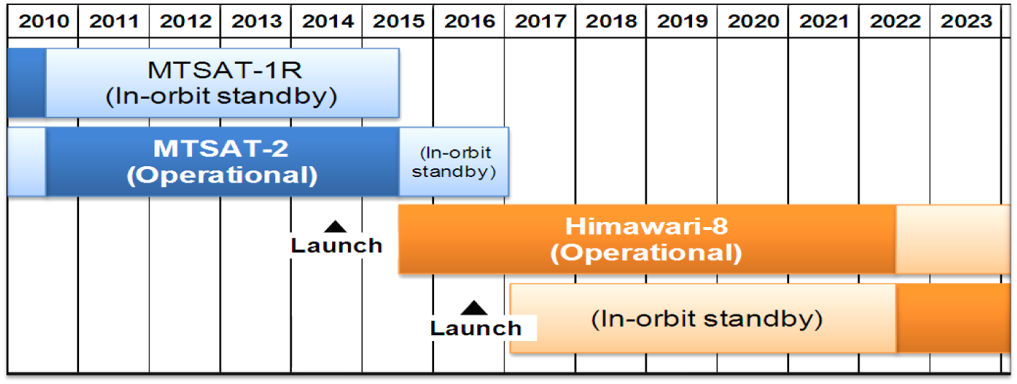
Future GEO Plans – Himawari-8/9
(sunflower)
There is no L-band on these satellites. There is dialogue with JMA and COPC partners on if/how to get data back to the U.S.
JMA plans to launch Himawari-8 in 2014 and begin its operation in 2015
The launch of Himawari-9 for in-orbit standby is also scheduled in 2016
Himawari-8/9 will be in operation around 140 degrees East covering the East Asia and the Western Pacific

Slide 40
Future GEO Plans
At this point, NESDIS is not pursuing COMS (Korea) or Elektro-L (Russia) GEO data

Slide 41
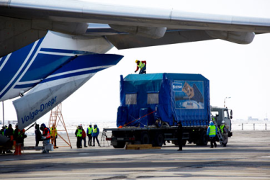

Future LEO Plans – METOP-B
Launch in July 2012 (already on site, but postponed from May to ensure safe liftoff drop zones for launch components)
From Baikonur, Kazakhstan
50 minutes behind METOP-A (morning)
More…
  ASCAT – Winds
  IASI, AMSU-A, HIRS/4 – Soundings
  AVHRR – Fires
  GOME-2 – Ozone
  MHS – Cyclones
  Searth & Rescue
  SEM – Space Obs
NOAA will continue to receive Metop-A as Metop-B completes checkout and is expected to get Metop-A data indefinitely, on a best effort basis from EUMETSAT, in conjunction with operational Metop-B.
Once Metop-B is declared operational, 1/2 orbit dumps, a minimum of 9 dumps/day are expected to be received from the Antarctic Data Acquisition (ADA) site in McMurdo. Metop-A will not be available via ADA after that time.

Slide 42
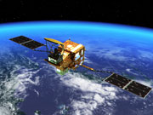
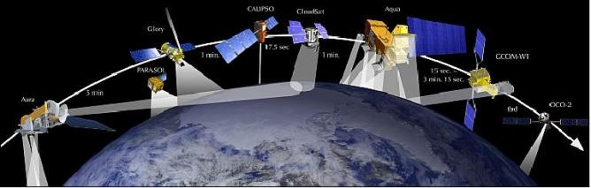
Future LEO Plans – “Shizuku”
(water droplet)
GCOM-W1 (Global Change Observation Mission – Water 1st) - JAXA
Launch by Sept, 2012
Joins afternoon “A-Train”
AMSR2
Focus is water observations
It is a successor to Aqua and is part of the GEOSS (Global Earth Observation System of Systems)
http://www.jaxa.jp/countdown/f21/index_e.html
Notes:
JAXA - Japan Aerospace Exploration Agency

Slide 43
Anomalies, Outages, Retirements

Slide 44
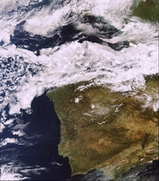
Satellite Anomalies - Envisat
April 12, 2012: After 10 years of service, Envisat has stopped sending data to Earth
ESA still trying to re-establish communications
Remains in stable orbit
Applications:
  snow and ice cover analysis
  ocean color
MERIS image before loss of contact.
Photo courtesy: ESA
Notes:
12 April 2012
After 10 years of service, Envisat has stopped sending data to Earth. ESA’s mission control is working to re-establish contact with the satellite.
Although this landmark mission has been in orbit twice as long as it was designed for, ESA hopes to keep the satellite in service until the launch of the successor Sentinel missions. The first sign that there was a problem came on 8 April when contact with the satellite was unexpectedly lost, preventing the reception of any data as it passed over the Kiruna ground station in Sweden.

Slide 45
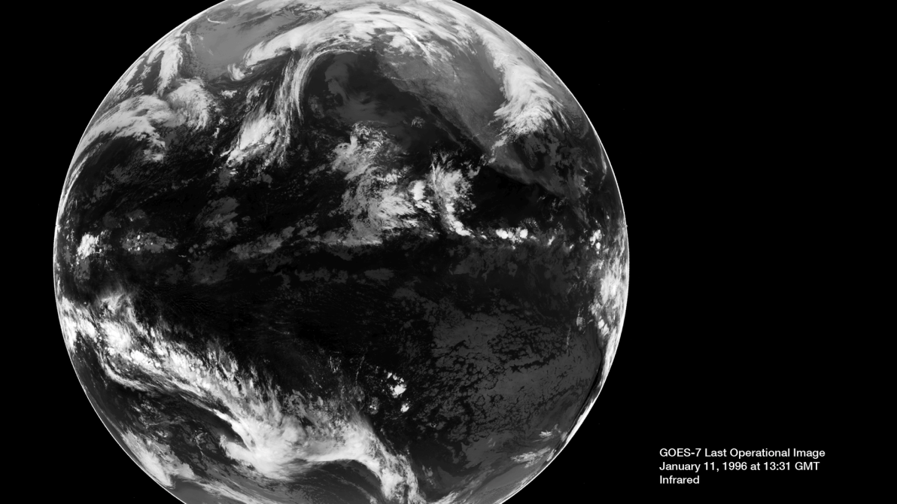
Aloha GOES-7!
GOES-7 is the only satellite in the history of NOAA’s geostationary program to serve both as the GOES-East and GOES-West spacecraft in the course of normal operations
In 1999, NOAA leased GOES-7 to the Pan-Pacific Education and Communication Experiments by Satellite (PEACESAT) program, which used the satellite to provide critical communications for the Pacific islands
On April 12, GOES-7 was de-orbited and “retired” from service

Slide 46
Missing GOES-15 CONUS 4km WV in AWIPS
Discovered by SSEC’s Jordan Gerth and others… Thanks!
Interestingly, GOES-15 4km WV imagery for CONUS scale (only) was not in AWIPS
  CONUS was available at 8km
  4km was available at regional scale
AWIPS addressed this oversight February 7, 2012
Appreciated by Andy Edman - NWS Western Region Scientific Services Division Chief

Slide 47
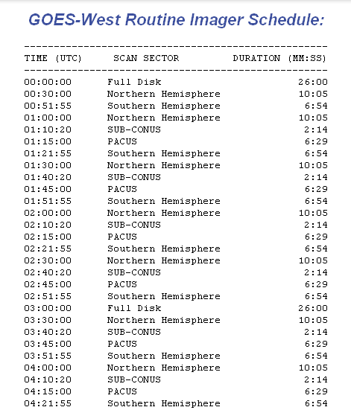
Missing GOES-15 CONUS Scans in AWIPS-I
“Every Image Loops”
Discovered by SSEC’s Scott Bachmeier and Jordan Gerth… Thanks!
Due to logic in the AWIPS-I configuration files, scans at 15 and 45 after the hour do not appear in the "every
image" loop on the CONUS scale
The bug in the code logic is not going to be fixed since AWIPS-II is coming on line
GOES-West Routine Imager Schedule: http://www.ospo.noaa.gov/Operations/GOES/west/imager-routine.html

Slide 48
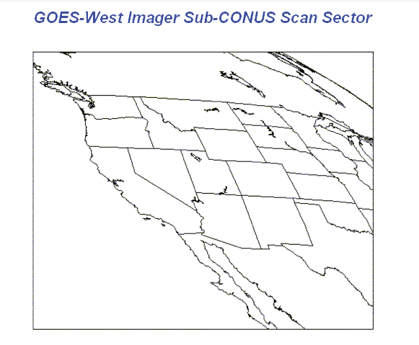
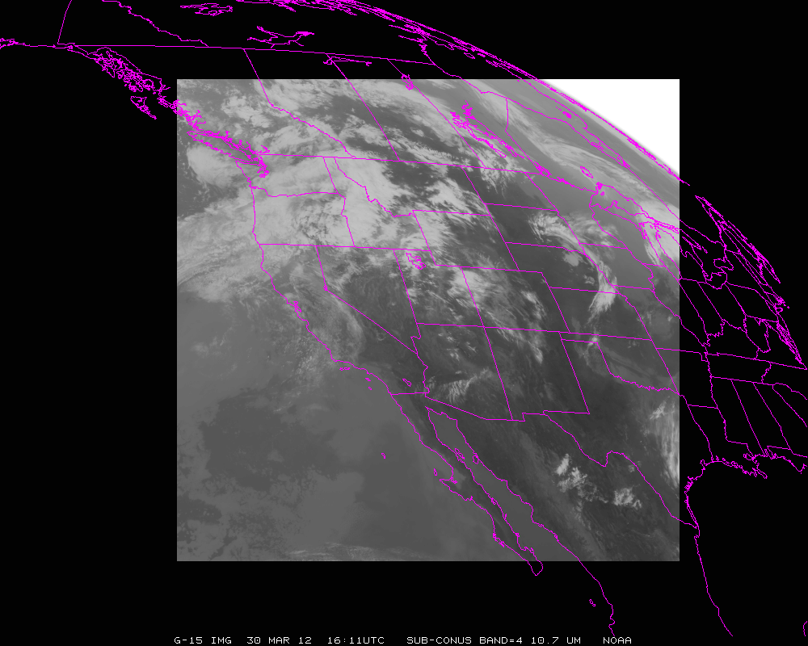
Missing GOES-15 CONUS Scans in AWIPS-I
“Every Image Loops”
Subsequent discussions about expanding the subconus region to capture more of the NWS western region’s upstream weather have been tabled for now, due to lack of resources.
GOES-West Routine Imager Schedule: http://www.ospo.noaa.gov/Operations/GOES/west/imager-routine.html

Slide 49
Recent Major Outages
Dec 29, 2011 EMC SAN Outage
  21 hours, 40 minutes; backlogged data processed
  6 Disk Failures on EMC SAN caused failed data distribution through DDS, Polar Dev, Satepsdev9...
  While replicating to each spare disk, another would fail causing corrupted tracks to be recorded
  Root Cause: bug in EMC SAN software
Jan 1, 2012 EMC SAN Outage
  8 hours
  Derived products outage, mostly GOES
  Root Cause: EMC technician replaced drives without setting up correct synchronization

Slide 50
Recent Major Outages
Jan 21-22, 2012 Bad IMC Load to GOES-15 [ORB]
  6 hour outage, Period: 2230Z (Jan 21) – 0415Z (Jan 22)
  Impact: Pitch in attitude and 25km image offset and Attitude Error
  Products Impacted: Volcano and Fire products
  Image Motion Compensation (IMC) is used on board for bus pointing and image navigation
  Root Cause: GOES-15 bad IMC (Integrated Memory Controller) Load
GOES Imagery Dropouts – Wallops facility remains susceptible to thunderstorm activity
Recent (April, 2012) ESPC notifications regarding missing GOES 13/15 images and causes of “RFI”, “BER”, “GOES-R Construction”
  An uplink antenna at Wallops has identified hardware shortfalls that are being addressed

Slide 51
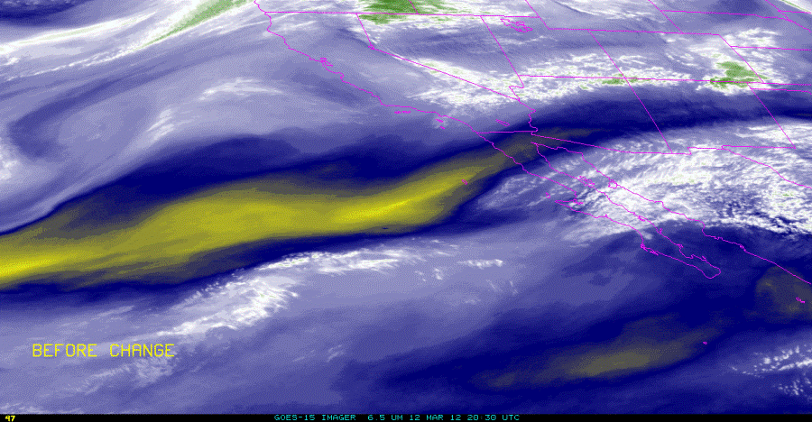
GOES-15 Imager Calibration Anomaly [ORB] http://cimss.ssec.wisc.edu/goes/blog/archives/9995
CIMSS Satellite Blog
The Sensor Processing Subsystem (SPS) for GOES-15 (operational as GOES-West) was changed at 20:45 UTC on March 12, 2012.
This change that should have been transparent to the users introduced an error to the calibrated data that was especially apparent in the Imager Water Vapor Channel (Channel 3). Watch the 5% cool brightness temperatures.
ESPC distributed 5 days worth of erroneous band 3 (WV) data due to this calibration mistake. It situation was not completely remedied until March 17th.

Slide 52
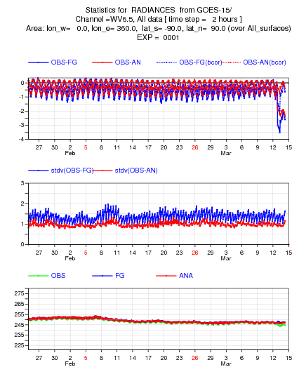
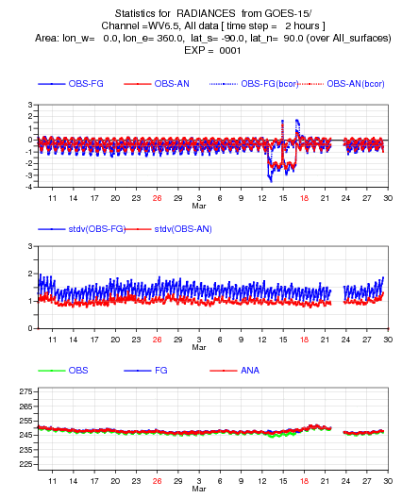
GOES-15 Imager Calibration Anomaly [ORB]
(monitored by ECMWF)
Beginning of the anomaly
Encompassing the anomaly

Slide 53
GOES-15 outage in March 21-23, 2012 [ORB]
Event: GOES15 failed to sun acquisition mode during a momentum dump following the yaw-flip maneuver (fault trip #1) and again during recovery, detecting a low state of charge (fault trip #2)
Date/Time of Events:
    2048z, Wednesday, March 21 (Day 81) -Fault trip #1
    1006z, Thursday, March22 (Day 82) – Fault trip #2
    2017z, Friday, March 23 (Day 83) – return to normal data operations
Impact: Spacecraft (s/c) went from earth point mode to sun acquisition mode due to two different faults. Loss of all GOES15 data for almost 48 hours
Major Cause:
Fault Trip #1 - Orbital and Attitude Tracking System (OATS) error in calculation of ECI-to-Body direction cosine matrix.
Fault Trip #2 – Error in the STOL Proc ZWEBCMCHGRAT, thus the s/c was not commanded to “High Charge” while going through eclipse.
Notes:
During March 21, 2012 20:45z GOES-15 House Keeping period the s/c momentum wheels did not unload as expected and eventually a fault trip occurred causing an autonomous entry into Sun Acquisition mode. The s/c attitude and all subsystems appear nominal. Engineers have arrived in the control center and are reviewing telemetry. Recovery will begin once Engineers confirm why the fault trip occurred. The root cause is unknown at this time. As a reminder no images are taken in Sun Acq mode. The ops team is updating the GOES-13 schedules in order provide full disk imaging coverage.

Slide 54
GOES-15 outage in March 21-23, 2012 [ORB]
Contributing Factors:
Antenna swap during the momentum dump slowed the recognition of the problem.
GOES 15 did not get a full check-out during Post Launch Testing (PLT). It was never put into storage mode and a storage mode database was never created. The STOL Proc error might have been prevented and the recovery process would have been quicker with the storage data base.
Note
This momentum dump just happened to be near the 24 hour mark since the yaw-flip maneuver which might have been the reason the OATS solution was incorrect. This was the 11th yaw flip maneuver of the NOP series, the 7th for GOES 15, but the first at its new location at 135’ west longitude. Thus, it was the first time the maneuver occurred at the same time of day as the momentum dump during the housekeeping period. This needs further research to find the actual source of the error (Action Item #1, below).
Notes:
During March 21, 2012 20:45z GOES-15 House Keeping period the s/c momentum wheels did not unload as expected and eventually a fault trip occurred causing an autonomous entry into Sun Acquisition mode. The s/c attitude and all subsystems appear nominal. Engineers have arrived in the control center and are reviewing telemetry. Recovery will begin once Engineers confirm why the fault trip occurred. The root cause is unknown at this time. As a reminder no images are taken in Sun Acq mode. The ops team is updating the GOES-13 schedules in order provide full disk imaging coverage.

Slide 55
March Anomaly Communications [ORB]
Shortfalls identified in the prior two March Anomalies resulted in a separate Help Desk & User Services ORB
The ESPC notifications, User Services Outreach, and Procedures for email contingencies were investigated and actions were taken to remedy shortfalls

Slide 56
GOES Maneuvers, Eclipse Season, SLZs, and Schedules

Slide 57
GOES Maneuvers and Schedules
Successful orbital keeping maneuvers this year
  GOES-13 E/W on May 1, 2012 (15-30 minute impact)
  GOES-12 E/W on April 11, 2012 (12 hour impact)
  GOES-15 E/W on April 10, 2012 (15-30 minute impact)
  GOES-13 E/W on March 6, 2012 (15-30 minute impact)
  GOES-13 N/S on February 21, 2012 (~2 hour impact for N/S)
  GOES-12 E/W on January 25-26, 2012 (12 hour impact)
  GOES-15 E/W on January 25, 2012 (15-30 minute impact)
The Spring eclipse schedule (1/31-4/28) has passed, but the Fall eclipse schedule with shifted frames, keep out zones, and stray light recovery periods will be distributed & posted August, 2012
  http://www.ospo.noaa.gov/Operations/GOES/eclipse.html
Notes:
GOES Fall 2011 Eclipse and Keep Out Zone/Stray Light Exclusion Schedules
As one satellite is in eclipse, keep-out-zone, or shifted > frame, the other satellite is in full disk zone to provide broader > geographic coverage over the area of the other satellite when data are > not available.
The left panel is the GINI output (pulled from the publicly available Unidata server at UCAR). At 8:45 (after the 8:45 GOES-11 PACUS comes in), the GINI is switched into "alternate" mode so that the missing 9:00 FD is replaced by a 9:15 GOES-13 image (look at the clouds just off of Vancouver). Since today is only one image in eclipse for GOES-11, the GINI is switched back to get the regular 9:30 GOES-11 image. The right panel is the GOES-11 Northern Hemi images from SATEPSANON (we do not host the GOES-11 PACUS on ANON) (BTW all this is done in McIDAS-V using pre-loaded Unidata servers hosting GINI output and our SATEPSANON ADDE server since my VPN back into SATEPSDIST is still not working)

Slide 58
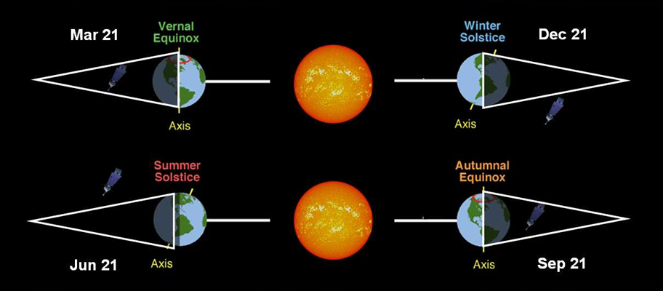
GOES Eclipse Season
GOES solar panels are blocked from sunlight up to 72 minutes/day
  Insufficient power for instruments on GOES-12 causes prolonged frame outages
  Cannot image for up to 3 hours during daily eclipse on GOES-12
Midwest thunderstorms occur during Vernal Equinox
Hurricane season occurs during Autumnal Equinox
GOES-12, as well as GOES 13/14/15 are susceptible to stray light intrusion as the satellite passes in and out of the eclipse
http://www.ssd.noaa.gov/PS/SATS/eclipse.html
Notes:
GOES-South America actually has prolonged frame outages due to insufficient power for instruments during eclipse, when the Earth places a shadow over the satellites.
All GOES are susceptible sunlight intrusion during SLZs as the satellite passes in and out of the eclipse.

Slide 59
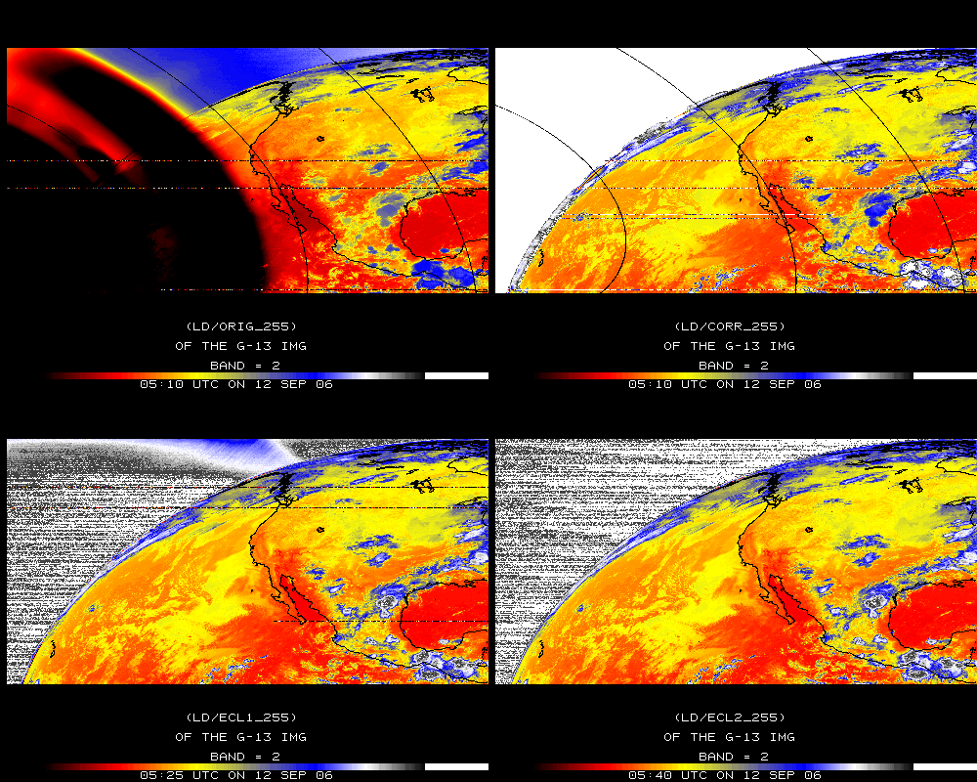
Stray Light Correction (SLC)
GOES-13/14/15 imagers and sounders are capable of scanning the sun without health and safety issues
However, imaging within 6 degrees must be canceled or replaced due to intolerable sun intrusion
The annual loss is equivalent to 6 days of imaging
ITT Exelis has characterized the effect of the sun intrusion and developed a correction algorithm to claim >95% of lost images
SLC is Operational on GOES-13 as of Feb 22, 2012
Algorithm promotion to GOES-15 is planned for the Fall of 2012
Slide Credit: Hyre Bysal & Tim Schmit, NESDIS
Notes:
STRAYO/ALL on dcarchive-new.ssec.wisc.edu Original image with out stray light correction
STRAYN/ALL on dcarchive-new.ssec.wisc.edu Corrected image
ftp://satepsanone.nesdis.noaa.gov/ppp/dhan/GOES_STRAY_LIGHT_TEST_DATA/
ftp://satepsanone.nesdis.noaa.gov/ppp/dhan/areadata
ftp://dcarchive-new.ssec.wisc.edu/data2/oper/straylight/areas/

Slide 60
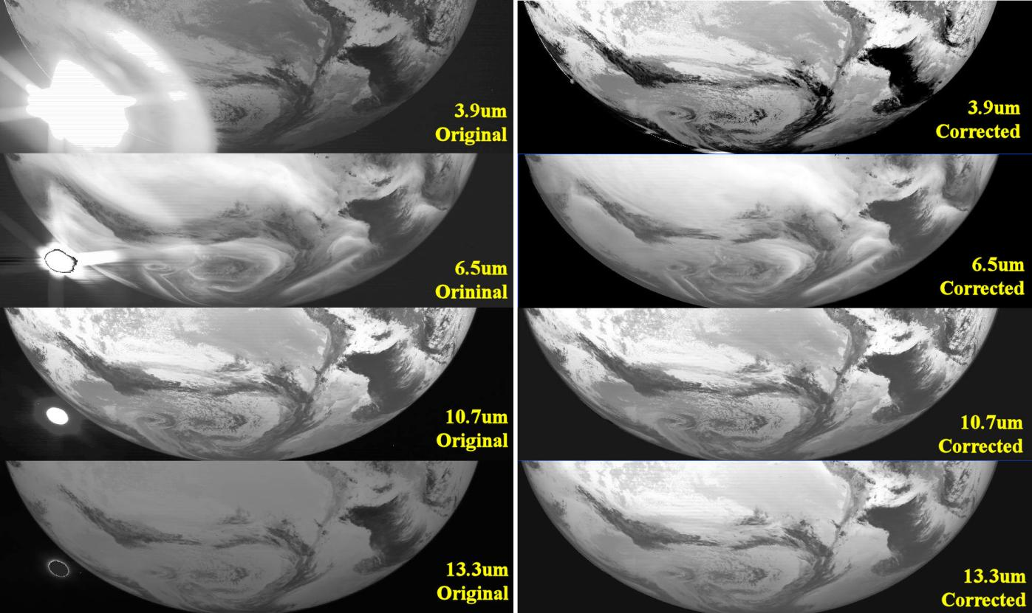

SLC: Results for all channels corrected 1º from Sun
Mostly affects imager band 2 (4 micrometer), but all bands can be affected
Slide Credit: Tim Schmit, NESDIS
Notes:
Correction works as close as 1 degree from Sun

Slide 61
SLC: Spring Eclipse (GOES-13 Imager)
Net Scan Time gained (hours per season):
Scan Sector | Eclipse | StrayLightCorr | Both
CONUS | 5.8 | 5.4 | 11.2
SHEMI | 5.5 | 5.5 | 11.0
NHEMX | 15.2 | 21.2 | 36.4
FD | 0.0 | 16.0 | 16.0
TOTAL | 26.4 | 48.2 | 74.6
Number of Frames Saved (per season):
Scan Sector | Eclipse | StrayLightCorr | Both
CONUS | 69 | 65 | 134
SHEMI | 73 | 73 | 146
NHEMX | 65 | 91 | 156
FD | 0 | 37 | 37
TOTAL | 207 | 266 | 473
Slide Credit: Tim Schmit, NESDIS
Notes:
SLC = Stray Light Correction.
Eclipse = more images due to better batteries on SC.

Slide 62
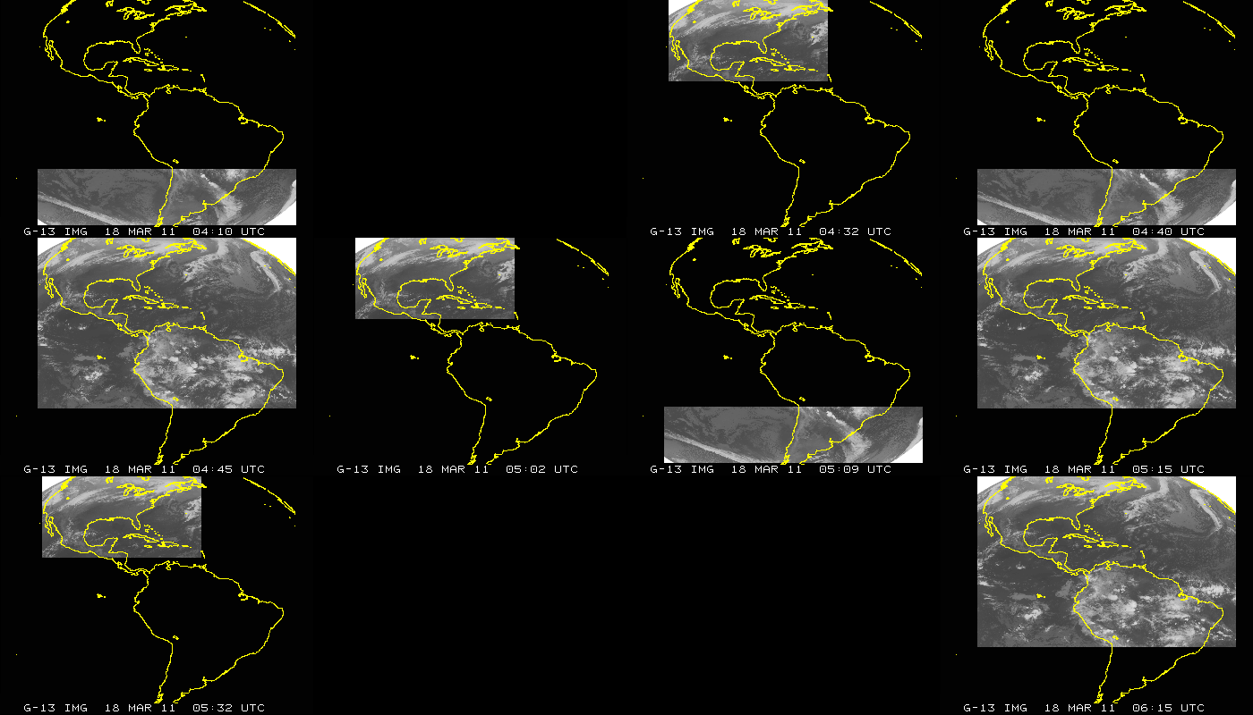
GOES-13 (East) Imager Coverage during Eclipse w/o SLC
JD=077; March 17, 2011 (04:10 to 06:15 UTC); GOES-13 Imager
Several frames canceled during Eclipse Period
Slide Credit: CIMSS & Tim Schmit, NESDIS

Slide 63
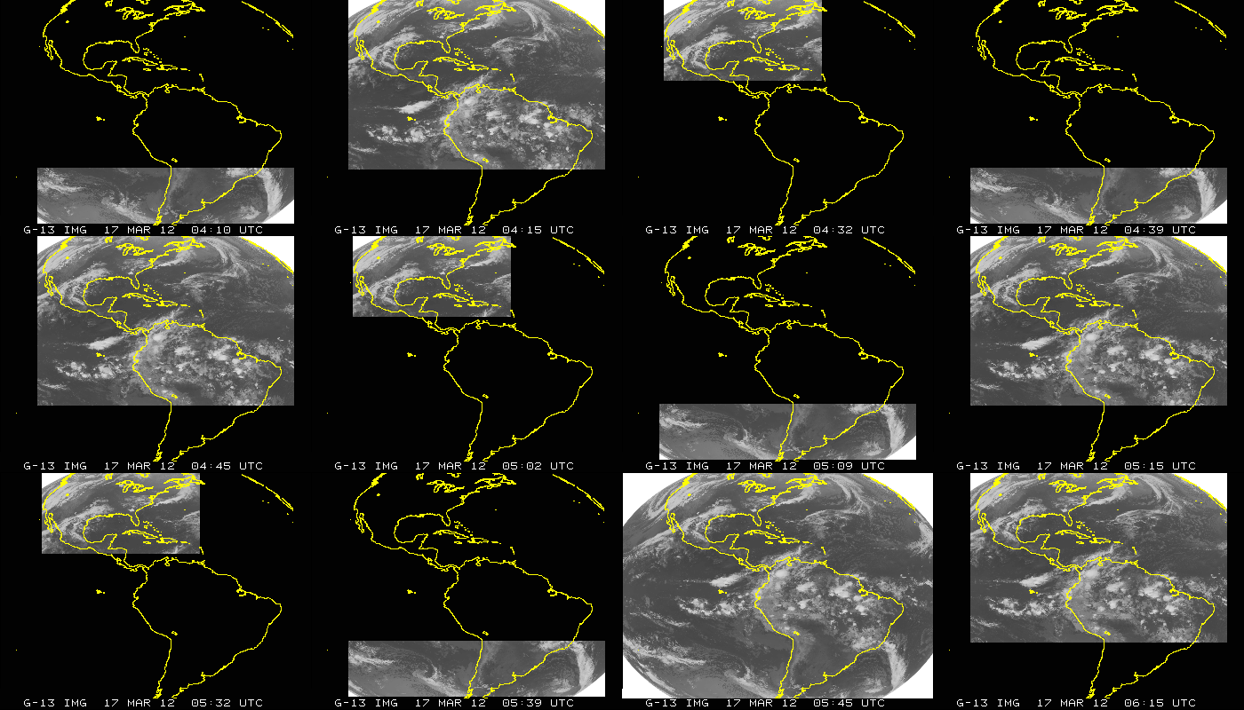
GOES-13 (East) Imager Coverage during Eclipse w/ SLC
JD=077; March 18, 2012 (04:10 to 06:15 UTC); GOES-13 Imager
SLC saves those frames that were previously canceled.
Slide Credit: CIMSS & Tim Schmit, NESDIS

Slide 64
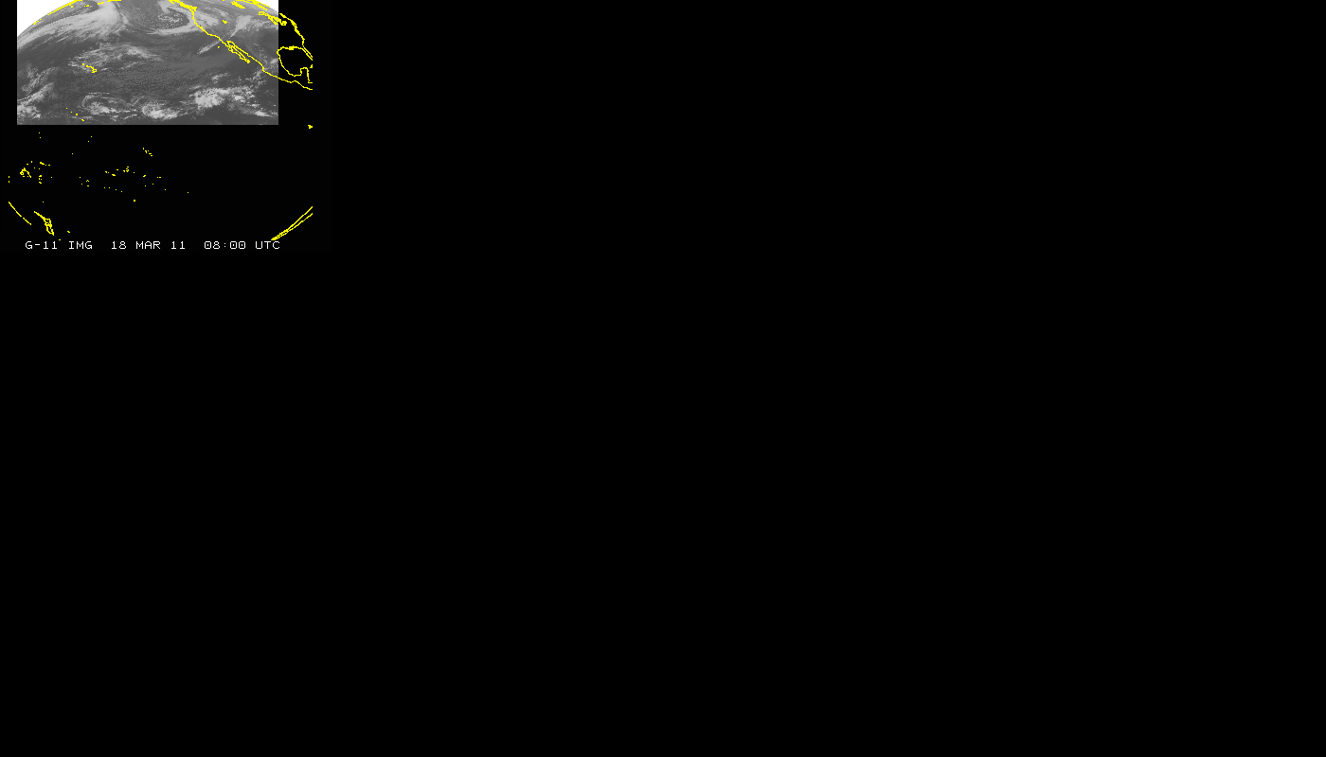
GOES-11 (West) Imager Coverage during Eclipse
JD=077; March 18, 2011 (08:00 to 10:11 UTC); GOES-11 Imager
GOES-11 had to shut off entirely during Eclipse Period
Slide Credit: CIMSS & Tim Schmit, NESDIS

Slide 65
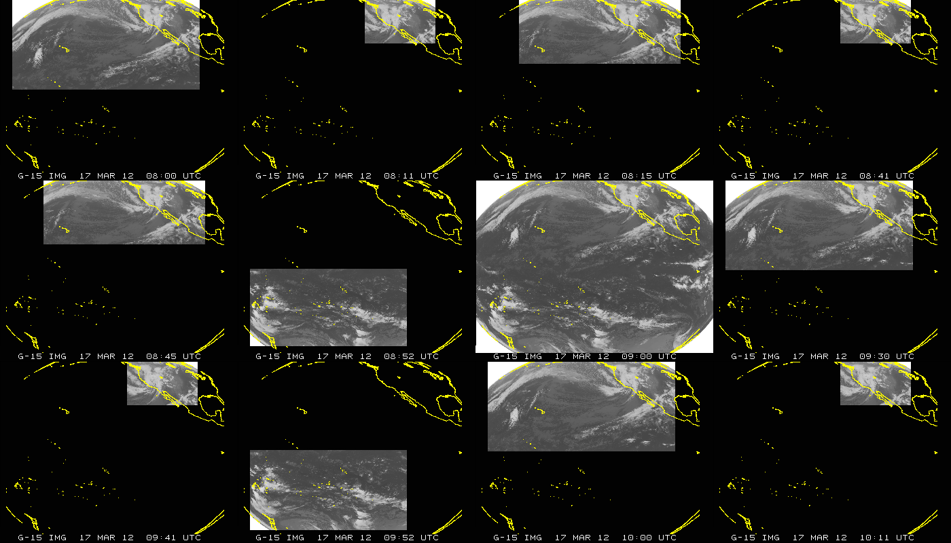
GOES-15 (West) Imager Coverage during Eclipse w/ SLC
JD=077; March 17, 2012 (08:00 to 10:11 UTC); GOES-15 Imager
SLC saves those frames that were previously canceled.
Slide Credit: CIMSS & Tim Schmit, NESDIS

Slide 66
SLC: Info in the GVAR stream
Stray Light correction status bits are sent out over GVAR (GOES VARiable data transmission format) and are now part of the McIDAS area line prefix
  Enabled, performed relative position of the sun, etc.
An example of the type of output of Stray Light Correction information found in the GVAR stream, in the area line prefix for the GOES-13 Imager data is shown below. This provides a summary of how each image is modified depending on the time of year (i.e. relative declination of the sun and GOES platform).
  Directory information (sensor #, image ccyyddd, image hhmmss): 180, 2012068, 54500
  SLCE (# lines w/SLC enabled) = 2705
  SLCD (# lines w/SLC disabled) = 0
  SLCP (# lines w/SLC performed) = 2705
  SLCNP (# lines w/SLC not performed) = 0
  SLC_FRST (1st ln w/SLC performed) = 1
  SLC_LST (last ln w/SLC performed) = 2705
  SUNE (# lines w/sun on e/side earth) = 2705
  SUNW (# lines w/sun on w/side earth) = 0
  SUNN (# lines w/sun on n/side earth) = 0
  SUNS (# lines w/sun on s/side earth) = 2705
  2705 nonzero values were found for parameter: min_sun_angle
  Smallest sun angle value = 5 found at line # 1419
  Largest sun angle value = 15 found at line # 1
Slide Credit: Hyre Bysal & Tim Schmit, NESDIS

Slide 67
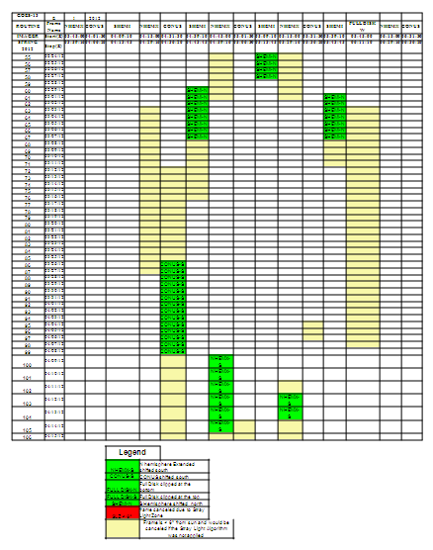

GOES-East
Eclipse Schedule / Frames
Imager
Sounder
Green - Shifted or Clipped
Red - Canceled due to SL
Yellow - Recovered by SL algorithm
Red - Canceled due to KOZ
Orange - Canceled due to SL
  http://www.ospo.noaa.gov/Operations/GOES/eclipse.html

Slide 68


GOES-West
Eclipse Schedule / Frames
Imager
Sounder
Red - Canceled due to KOZ
Orange - Canceled due to SL
Tan - Off-Earth striping frames
Green - Shifted or Clipped
Red - Canceled due to SL
  http://www.ospo.noaa.gov/Operations/GOES/eclipse.html

Slide 69


GOES-South America
Eclipse Schedule / Frames
Imager
Sounder
Red - Canceled due to KOZ
ECL – Canceled due to Eclipse
Green – Replaced due to KOZ
ECL – Canceled due to Eclipse
  http://www.ospo.noaa.gov/Operations/GOES/eclipse.html

Slide 70

DMSP Half Orbit data from the Antarctica
Data Acquisition (ADA) Station at McMurdo
Operational Processing and Delivery began June 10, 2011 for Metop-A
DMSP F-17 & F-18 became operational in February, 2012
McMurdo Station – Ross Island
77.5°S (similar in Latitude to Svalbard)
166.6°E (below Australia/New Zealand)
Reference for Map: Capt Gaber, Defense Weather Systems Directorate
http://directreadout.noaa.gov/miami11/docs/5.9_Gaber_DWSD.pptx
Reference for Image: http://www.eumetsat.int/Home/Main/News/Features/807695?l=en
Notes:
Metop-A and NOAA-19 are primary morning and afternoon satellites, respectively
The current MetOp series has three identical satellites. Launched in 2006, MetOp-A is Europe's first polar-orbiting mission dedicated to operational meteorology, and will be followed by MetOp-B in 2012 and MetOp-C in 2016.
Antarctic Data Acquisition (ADA) :
Metop mission data downlink to be supported by NASA/NSF 10m antenna at McMurdo Sound (77°S)
MGS support will only be utilised for X-band, although antenna is S-band capable (may be used for auto-track)
Mission data to be sent by combined satellite/land link to Darmstadt via Australia
Phases :Demonstration Feb 2011 to Feb 2014(average of 9 passes/day)OperationalFeb 2014 onwards(all passes of operational satellite)
Support to be focused on prime Metop, with option to support backup Metop
Metop mission data : raw data transfer to NOAA nearer to sensing time than presentLevel-1 product timeliness to improve from max. 135 to 65 mins (sensing time to product dissemination), current avg= 115
In order to improve the timeliness of Metop-A data, EUMETSAT will soon be downloading data using the McMurdo Antarctic Data Acquisition (ADA) station for several orbits a day. When this happens, instead of downloading full orbits from Svalbard, they will be downloading half orbits at Svalbard and half orbits at McMurdo. This change may go operational in May or June, exact date TBD. Here are some pertinent considerations: Orbital data and products will be distributed in more than 14 or 15 files a day. The McMurdo filenames will end in .MM instead of .SV. There may be some duplicate data or time jumps in the data, or between orbital segments.
NCEP testing for McMurdo half orbit data
EUMETSAT and the US National Oceanic and Atmospheric Administration (NOAA) successfully completed the first acquisition of data from EUMETSAT's Metop-A satellite at McMurdo Station, Antarctica, on 19 January 2011. [Track] [Images]
NOAA, together with the US National Aeronautic and Space Administration (NASA) and the US National Science Foundation (NSF), have teamed up to provide a new data acquisition and transfer capability for EUMETSAT's Metop series of polar-orbiting environmental satellites at NSF's McMurdo Station, Antarctica.
McMurdo Station serves the logistics hub for the US Antarctic Program. NSF manages the US Antarctic Program, though which it coordinates all US science, and the logistical support for that science, on the Southernmost Continent and aboard research vessels operating in the Southern Ocean.

Slide 71

DMSP ADA Benefit to Users
There are 14 DMSP orbit ingests at McMurdo per day per satellite
DMSP ADA provides ~ 30 minutes of improved latency for the first half orbit
Second half of orbit does not benefit (like Metop-A) due to the DMSP CDAs at Fairbanks, Wallops, Suitland (compared to the single other Metop-A CDA at Svalbard)
Impacts these files: EDR/TDR/SDR/UPP (unifed pre-process) data (ESPC names “TDUP”))
SVL CDA – Svalbard Command & Data Acquisition
ADA – Antarctica Data Acquisition
Notes:
Improved timeliness increases the impact of satellite data in global atmospheric models and thus provide significant benefits to global operational weather forecasting and disaster monitoring.

Slide 72
McIDAS at ESPC

Slide 73



McIDAS at ESPC
Over 50 applications in ESPC use McIDAS, McIDAS libraries, input files (AREA), or serve McIDAS files (AREA) via ADDE
ADT, ABBA, CSBT, HMS, others…

Slide 74
McIDAS at ESPC
Windsat is in McIDAS area on ESPC polar server for brightness temperature
Heavily using the local GINI server in McIDAS format for validation checks (image previews) prior to sending test data to NWS AWIPS
McIDAS was relied upon for the GOES-11 to GOES-15 conversion to AWIPS
Cons – Lack of AIX support (GOES-East, GOES-West, TCFP, MTCSWA are all on AIX servers)
ESPC is working on moving the GINI’s from SGI IRIX to Linux

Slide 75


McIDAS at ESPC
Over 20 SDIs at NSOF and Wallops OBF:
  GOES-East, West, spare (-15)
  MTSAT
  GOES Ingest and NOAAPORT Interface (GINI)
Over 20 High Performance Workstations in
Satellite Analysis Branch:
  -X for realtime analysis, product generation, and QA/QC
  RHEL 5 Linux on Intel x86
  Many “home grown” programs in Fortran, .PGM, BATCH
ESPC Product Generation/Distribution:
  IBM P6 Series with Linux Partitions
  Migration from Intel to IBM completed in 2008 (byte flipping)
  GINI running on SGI IRIX

Slide 76


McIDAS Advantages at ESPC
The ADDE protocol allows for many users accessing single systems with one port (112)
Common legacy (and future?) formats for satellite remote sensing data (GOES and POES) and ancillary information for research and operations
Notes:
Background processing is extremely critical to our mission.

Slide 77
McIDAS Advantages in SAB
Ability to have quick, efficient load of 900+ frames is essential. The ability to load (display) imagery literally as it is coming in to the servers. This is important when every minute counts for products that are fast developing - like volcanic eruptions and flash floods and to some extent fires. This cannot be done with NAWIPS or HMS. In fact, depending on the area of concern up to 20 minutes is lost waiting for imagery to show up on these other systems vs McIDAS.
SAB Analysts have great familiarity with McIDAS
Since the NWS is the primary user of many SAB products (e.g. volcanic ash and heavy precipitation), there are benefits for SAB to conduct PG on the NWS platform, NAWIPS for communication, firewall, and security reasons
Analysts find this to be a hindrance because McIDAS allows for greater manipulation, interrogation, and imagery generation than NAWIPS or HMS (Fires & Smoke)

Slide 78


McIDAS Challenges at ESPC
Maintaining efficient access to servers for operations
Additional customer requirements for advanced data formats (GIS, KMZ)… writing own local code for NPP VIIRS, Windsat, others to convert them to AREA files as there are no local servers
Learning Curve with commands
Color Tables – only 8 bit – problem with upcoming GOES-R

Slide 79



NPP VIIRS EDR Imager-Band Conversion from NetCDF to McIDAS
(provided by Jerry Guo)
Imagery Resolution
Band for EDR:
NPP/EDRI1
NPP/EDRI2
NPP/EDRI3
NPP/EDRI4
NPP/EDRI5
If you would like, may add
Moderate Resolution
Band for EDR:
NPP/EDRM1ST
NPP/EDRM2ND
NPP/EDRM3RD
NPP/EDRM4TH
NPP/EDRM5TH
NPP/EDRM6TH
Day Night Band for EDR:
NPP/NCC
Moderate Resolution
Band for SDR:
NPP/SDRM2
NPP/SDRM3
NPP/SDRM5
NPP/SDRM6
NPP/SDRM8
NPP/SDRM11
NPP/SDRM12
NPP/SDRM13
NPP/SDRM7
NPP/SDRM10
Band 1
Spectral Range
0.402-0.422 um
Band 4
Spectral Range
0.545-0.565 um
Band 5
Spectral Range
0.662-0.682 um

Slide 80
New or Enhanced
Products & Services

Slide 81


SPSRB Requests
(Satellite Products & Services Review Board)
Several new requests since last quarterly meeting – Gridded Clouds (format, res), Elektro-L radiances for fire/aerosols, NPP Vegetation
All new development projects require a user request from a federal agency.
https://requesttracker.osd.noaa.gov/admin_login.asp
http://projects.osd.noaa.gov/spsrb
Notes:
For details on the entire SPSRB process, please refer to the SPSRB white paper which is available on the SPSRB web page (left panel).
Includes Development…
User Requests
Technical Assessments
Formation of Integrated Product Teams
Also includes Divestiture and Retirement of products and services being phased out.

Slide 82

Space Weather Data Plot
In addition to the 3-day and 14-day space environment plots, a new time series of 108 days has been add for both GOES-13 and GOES-15 satellites
Promoted April, 2012
Image courtesy of NESDIS/NGDC
http://satdat.ngdc.noaa.gov/sem/goes/data/new_plots/latest/goes15/g15_summary_latest108days.pdf
Notes:
The 108 day plot covers four solar rotations and includes cosmic ray data from Moscow that can show when solar energetic particles have enough energy to reach ground level. The, so called, Forbush decreases in cosmic ray intensity are indicative of galactic shielding caused by large solar Coronal Mass Ejection (CME) events. This unique product will be used by GOES customers to examine event relationships over time. An example of the new 108-day plot for the GOES-15 satellite is available at http://satdat.ngdc.noaa.gov/sem/goes/data/new_plots/latest/goes15/g15_summary_latest108days.pdf.

Slide 83
Blended TPW
(Total Precipitable Water)
Blended TPW replaced the MIRS AMSU TPW from N18, N19 and Metop-A with those from the MSPPS over ocean, while still keeping MIRS TPW over land.
Improved spatial and temporal continuity for the blended TPW products , especially over west pacific ocean.
The changes were implemented into operation on March 26 , 2012

Slide 84

Global Hydro-Estimator (GHE)
Instantaneous rain rate, 1 hour, 3 hour, 6 hour, 24 hour and also multi-day precipitation accumulation
Available in GRIB, McIDAS and netCDF4 formats through DDS and ADDE servers
Can be accessed through NAWIPS, but no requirement for AWIPS
The operational promotion occurred on April 30, 2012
0300 utc -1200 utc March 16, 2009
0300 utc - 1200 utc March 16, 2009
Notes:
Operational Readiness Review (ORR) for the Global Hydro-Estimator Satellite Rainfall Estimates (GHE): The Operational Readiness Review for the GHE was held on April 6, 2012. The ORR reviewed the system and products readiness for transition into operations, including system and products requirements and their allocations, the operational readiness for product generation, dissemination and monitoring, and also the software and documentation status in meeting the operational standards. The ORR was led by the OSPO/SPB GHE project lead, and the reviewers included NESDIS satellite product manager, Mission Operation Division (MOD) Deputy Manager, Precipitation Products Oversight Panel (PREPOP) co-chairs, SPB chief, precipitation Products Area Lead (PAL), Satellite Products Branch (SPB) QA lead, Users, System, IT security and Distribution leads, the GHE IPT team and other colleagues. The review team is working on an ORR report, which will include all review comments, and identified actions and risks. The ORR report will be presented to the GHE team when it is ready, and all identified actions shall be properly addressed before the GHE can be officially declared operational.

Slide 85
Promotion Readiness Activities
ESPC systems freeze is months removed and promotion activities are hot!
Green Vegetation Fraction (GVF) data continuity and upgrades for NPP/VIIRS (GVF) Critical Design Review (CDR) held April 3rd
  The GVF system will produce a Weekly Green Vegetation Fraction (GVF) global (4km) and regional (1km) map using VIIRS Surface Reflectance, Cloud Mask, and Geolocation
Infrared Atmospheric Sounding Interferometer (IASI) Phase 2 Software Code Review held April 4th
  Overall the IASI code meets the SPSRB software coding standards, the review team highlighted several issues that need to be resolved before proceeding to operational transition.
Microwave Integrated Retrieval System (MiRS) NPP/ATMS Integration into NDE System Readiness Review (SRR) held April 19th
  The review included open risks and actions, system requirements, system integration of MiRS into the NPOESS Data Exploitation (NDE) environment and system readiness (incl. system test, readiness for users and maintenance/operations).

Slide 86
Data Access Policy, CRM,
Upcoming Conferences, Feedback

Slide 87

Data Access & Distribution Policy
Contact: NESDIS.data.access@noaa.gov
To consistently vet user requests for near real-time satellite data and products based on organizational affiliation or type of application
To effectively manage data distribution resources to ensure effective system performance
To be in compliance with policy, procedures and required interconnection agreements with NIST/DOC IT security regulations
To factor ESPC IT system planning and future distribution resource availability and capacity needs into data access decisions
www.ospo.noaa.gov

Slide 88
Data Access & Distribution Policy
Contact: NESDIS.data.access@noaa.gov
DDS Re-Validation is nearly complete
  User list was validated and finalized
  New DDS is set up with test data available
  DDS Adminstrator, Donna McNamara, has asked all DDS users to confirm their connectivity to the new DDS
  Users who need early access to Metop-B data after the May 23 launch will be set to get that data only from the New DDS
  The new DDS will be operational in June or later. The exact date will be provided when it is known.
  The count of accounts to be removed on the new DDS - 24! That's 17%.
Satepsdist Re-Validation exercise will be conducted this summer
www.ospo.noaa.gov

Slide 89
Customer Relationship Management
(CRM) Database
The Goal is for improved management of
  Product Monitoring Procedures
  Trouble Tickets
  Notifications
  Tracking of Interactions with Users
Data Load Status
  Complete
    Satellites
    Instruments
    Applications
    End Products
    Servers
  In Progress
    Organizations and Contacts
    User / End Product Linkage
Training for Help Desk and PALs
  Complete – Incident Tracking
  Next – Queries & Notifications
Web Portal (Future)
  User Help Ticket Submission
  User Contact Information and Reaffirmation
Organizations
&
Contacts
Incidents
(Help Tickets)
End Products
Applications
Notifications
Servers
Reporting
Instruments
Satellites

Slide 90
CRM - Application Usage
An Application is the image or science software running in ESPC that ingests satellite data & generates End Products
168 Applications produced for All Users
93 Applications used by 37 NWS centers / offices / branches
55% of available Applications are used by NWS
37% of Applications used by NWS use GOES (Any combination of GOES-12/13/15 including Blended Applications with NOAA and/or Non-NOAA POES)
Notes:
55% = 93/168
45% = 100%-55%
37% = 35/93
56% = 52/93
56% of Applications used by NWS use POES (Any combination of NOAA-15/16/17/18/19/Metop-A including Blended Applications with NOAA and/or Non-NOAA GOES)
ASCAT
Aerosols & Smoke
Snow & Ice Mapping System
ATOVS
Winds GOES/AVHRR
AWIPS SDPI
Blended SST
AMSU-McIDAS
ADT, eTRaP
CSBT
Remapped Imagery
GINI
IASI
HMS
Jason-2
Level 1b & 1b*
SSMI / SSMIS
Ozone

Slide 91
CRM - End Product Usage
An End Product is generated by an Application and may vary by satellite, instrument, region, format, resolution, etc.
30,560 End Products produced for All Users
  Those are unique End Product-to-User records.
  Some of the records include multiple satellites and sensors, some do not. It depends on how the product is typically characterized by the Product Area Lead (PAL) and users.
6,050 End Products used by 37 NWS centers / offices / branches
21% of available End Products are used by NWS
79% of available End Products are produced for use by Non-NWS users
Notes:
21% = 6,050 / 30,560
79% = 100% - 21%

Slide 92
Upcoming Conferences
EUMETSAT Meteorological Satellite Conference
  September 3-7, 2012
  Sopot, Poland
  http://www.eumetsat.int/Home/Main/News/Conferences_and_Events/810062?l=en
SeaSpace International Remote Sensing Conference
  October 21-24, 2012
  San Diego, CA
  http://www.seaspace.com/?mid=conference
  NOAA Satellite Conference !!! …see next slide

Slide 93


Attention Users!
If you go to DRO, this is for you!
If you go to GUC or Polar Year, this is for you!
If you care about GOES-R or JPSS, this is for you!

Slide 94
Looking for Feedback – Let’s Talk!
The focus of NOAA Satellite Operations
  Availability
  Timeliness
  Quality
On a scale of 1 to 10, how would you rate the quality of our relationship (or service, or a specific product) during the FY12?
What would it take to make our operations a 10?

Slide 95



Contact Information
24/7 Help Desk | ESPCOperations@noaa.gov
User Services | SPSD.UserServices@noaa.gov
Data Access | NESDIS.Data.Access@noaa.gov
Webmaster | SSDWebmaster@noaa.gov
Web | www.ospo.noaa.gov
 | www.facebook.com/NOAANESDIS
 | www.twitter.com/usnoaagov_ospo

Slide 96

Office of Satellite and Product Operations
(OSPO) Video
http://www.nnvl.noaa.gov/MediaDetail2.php?MediaID=1008&MediaTypeID=3&ResourceID=104489
or
http://www.youtube.com/watch?v=TWSua5ysuag

