Slide 1
ESPC’s Spider II Program
Opening the Box on Capability and Use

Slide 2
What is SPider?
Satellite Product Information Distribution EnviRonment
Expands on concepts of Core Mcidas commands concepts
ADDE, DATALOC, DSSERVE, PT/GRD/IMGLIST, PT/GRD/IMGDISP, PT/GRD/IMGCOPY, SKL, etc.
Consists of two programs: Spider Server (SPS) and Spider Client (SPC)

Slide 3
Pros and Cons
Benefits:
Automatic loading without duplication of images
Reduces task loading of server/workstations
Numerous pings to server but fewer downloads
Run from command line environment (typically SKL) on all platforms
Leads to distribution system effectiveness
Timely, based on user needed requirements (set to any refresh rate)
Weaknesses:
“Addictive” Nature
Become too reliant on the program working
Leads to lack of CORE Mcidas knowledge for users
Produces text output into active text window; can be annoying
Doesn’t work as well with full swath polar images

Slide 4
Two Types of SPider
Spider Client (SPC)
Spider Server (SPS)
User
Resides on Workstation
Keeps Request File of user defined loop(s) specifications and polls it against the Server Availability File
Pulls “area” files from server and loads it into predetermined frame
Host
Resides on Server
Integrated into “Area generator” that creates products on the server
Keeps and up to date Availability List of these products
SPS
SPC

Slide 5
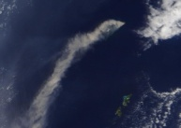
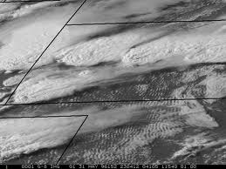
SPC CYcle
“Handshake” w/SPS
Spider Server Database:
Dataset Last Image
GER/GENHEM 18:15Z
GER/GECONS 18:32Z
GER/GESHEM 18:22Z
GWR/GWPACU 18:15Z
MTS/MTGLOB 18:32Z
MTS/VOLASH 18:32Z
Do you have anything NEW for me?
Yes! Here are your Requested files.
SPS
SPC
GER/GECONS 37N 100W last= 18:15z
MTS/VOLASH
16.5N 145E
Last= 17:32z

Slide 6
SPS Commands
Install - Initializes server’s database & creates Availability File
Create - Provides the initial parameters of hosted dataset(s) on a server
Set - Updates the parameters when needed of dataset(s)
Invoke - Compares and updates corresponding information in the Availability File when there is a match. Typically, command is embedded at the end of a product generation script to notify Availability File of the new image/file.
List - Provides list of each instance in Availability File
Suspend - Changes status of entry to suspend
Release - Changes status of entry to active

Slide 7
SPS Create/Set
Provides the initial (create) or changes to (set) parameters of hosted dataset(s) on a particular server
RANGE - Beginning and ending file range
MACH - Machine name
GROUP - Name of the ADDE group (for organization purposes, part of the dataset name)
NAME - ADDE name or descriptor (other portion of dataset name)
SOURCE - Name of the satellite or data/product origin
SATE - Set to same as SOURCE (for backward campatibility)
RES - Image Resolution
SCAN - Amount of Scan lines for the particular AREA file
EOF - End of File Flag for an AREA file
STATUS - State of the loop; Active or Suspended
FNAME - File name of TEXT type document
FPATH - Path for the files in the dataset

Slide 8
SPS LIST Example – “Availability File”
Variables Listed
STA: Status
BAREA & EAREA: Begin/End Areas on Server
CAREA: Current Area to be created
DATE & TIME: a bit obvious
SCAN: # of lines on image
EOF: End of File Flag
RES: Resolution
‘0’ denotes Magnification
GRP & ADDE: Dataset entry names called by SPC Cycle request
***** Server Records Listing: Record 1 -- 120 ***********************
------------------------------------------------------------------------------------------------------------
# STA BAREA EAREA CAREA DATE TIME SCAN EOF RES SRC GRP ADDE
------------------------------------------------------------------------------------------------------------
4 A 5000 5049 5006 2012121 123000 100 0 0 RDA DPD 1KMBREF
11 A 100 123 110 2012101 142000 100 0 1 DPD GA-SDPI-CTPX
12 A 200 223 210 2012101 142000 100 0 1 DPD GA-SDPI-LIX
13 A 300 323 310 2012101 142000 100 0 1 DPD GA-SDPI-PWX
14 A 400 423 410 2012101 142000 100 0 1 DPD GA-SDPI-SKX
15 A 150 173 158 2012101 144600 100 0 1 DPD GE-SDPI-CTPX
16 A 250 273 258 2012101 144600 100 0 1 DPD GE-SDPI-LIX
17 A 350 373 369 2012101 144600 100 0 1 DPD GE-SDPI-PWX
18 A 450 473 459 2012101 144600 100 0 1 DPD GE-SDPI-SKX
19 A 500 523 522 2012101 140100 100 0 1 DPD GW-SDPI-CTPX
20 A 600 623 620 2012101 140100 100 0 1 DPD GW-SDPI-LIX
21 A 700 723 704 2012101 140100 100 0 1 DPD GW-SDPI-PWX
22 A 800 823 806 2012101 140100 100 0 1 DPD GW-SDPI-SKX
23 A 550 573 569 2012101 142400 100 0 1 DPD GP-SDPI-CTPX
24 A 650 673 654 2012101 142400 100 0 1 DPD GP-SDPI-LIX
25 A 750 773 754 2012101 142400 100 0 1 DPD GP-SDPI-PWX
26 A 850 873 854 2012101 142400 100 0 1 DPD GP-SDPI-SKX
27 A 9100 9123 9109 2012101 140000 100 0 1 DPD SDPI-PWX
28 A 9200 9223 9216 2012101 140000 100 0 1 DPD SDPI-LIX
29 A 9300 9323 9320 2012101 140000 100 0 1 DPD SDPI-SKX
30 A 9400 9423 9415 2012101 140000 100 0 1 DPD SDPI-CTPX

Slide 9
SPC Commands One instance or less useful ones
Install/Uninstall – Initializes/Removes client’s database
Data – Provides an image listing for the particular loop on the server
Delete – Deletes the requested loop from the client file
Stop – Halts the looping process (so does Alt-L)
Background – places Spider into the background
Off – pull Spider back out of the background
PrintLog – Prints the log of Spider processes
Transfer – Grabs Availability File from the servers
Version – Identifies the current Spider version running
Verbose – shows or changes client output levels (suppresses, output errors only or output all messages)

Slide 10
“Most Useful” SPC Commands
Create – With input variables, creates loop record to load
CreateServer – Allows client to add server details to server list. This allows the client during the CYCLE command to search the Availability files on each server
Cycle – Allows the client to grab the availability list from each server. If a new file is available, Spider will automatically load the image into the predetermined frame
List – Allows user to view request partial detail of loop record
ListServer – Lists the available servers for data retrieval
Load – Force loads the most recent imagery into the loop’s frames. This can be one or all frames within the loop depending on user’s input
Loop - Displays and begins looping the user defined loop number
Report – Provides a detailed text listing of specified loop’s entered parameters. Excellent for tracking errors
Reset – Allows client to force the loop record to reset and cycle on the next cycle instance
Set – Allows client to change any parameter for a created loop

Slide 11
SPC Create/Set
VARIABLES
TYPE (Area, Grid, Point or Text)
STATUS (Active or Suspend)
DOM or OPP (Sets the Dominant or Opposite Loop, to coordinate loading of concurrent images)
RES or MAG (Sets the Resolution or Magnification of the image [can set either, not both])
GROUP (ADDE Group name)
NAME (ADDE Descriptor name)
BAND
LAT
LON
FRAME (Range of frames to use)
INC (Sets an increment of when to request a new image to load)
DWELL (sets looping parameters used by the McIdas CORE DR command)
EU (Sets Enhancement Table to use)
SU (Sets Stretch Table to use)
LBG (Loop Bound Graphic Frame #)
MAP – Y/N (Sets Map if loop is Area)
GRAY - Y/N (Shows EU color bar at bottom of the image loop)
WORK (data range allocated on the system)
PER (Minimum scan line % to read new image)
Once an instance (ie loop) is created:
SPC LIST → Quick reference table of set variables
SPC REPORT → view all variables in a detailed report
SPC SET → Change any variable listed

Slide 12
SPC LIST Example
********************************************************************
***** Client Records Listing: Records: 1 -- 100 *****************************
====================================================================
SET X DATASET ... RS B LAT LON INC BW EW BFR EFR SU DOM OPP
-----------------------------------------------------------------------------------------------------------------
1 A GER/GENHEM04I4 0 4 11.3 85.6 15 0 0 11 20 11
2 A GER/GENHEM04I2 0 2 11.3 85.6 15 0 0 31 40
3 A GER/GENHEM04I4 0 4 4.2 76.0 15 0 0 51 60 13
4 A GER/GENHEM04I2 0 2 4.2 76.0 15 0 0 71 80
5 A GER/GENHEM04I4 0 4 -0.2 78.5 15 0 0 91 100 15
6 A GER/GENHEM04I2 0 2 -0.2 78.5 15 0 0 111 120
7 A GER/GENHEM04I4 1 4 -0.5 90.7 15 0 0 131 140 17
8 A GER/GENHEM04I2 0 2 -0.5 91.5 15 0 0 151 160
9 A GER/GENHEM04I4 0 4 17.0 63.0 15 0 0 171 180 19
10 A GER/GENHEM04I2 0 2 17.0 63.0 5 0 0 191 200
11 A GER/GENHEM01V 0 1 11.3 85.6 15 0 0 395 404 1
12 A DPD/NHVOLCIR 0 2 11.3 85.6 15 0 0 415 424
13 A GER/GENHEM01V 0 1 4.2 76.0 15 0 0 435 444 3
14 A DPD/NHVOLCIR 0 2 4.2 76.0 15 0 0 455 464
15 A GER/GENHEM01V 0 1 -0.2 78.5 15 0 0 475 484 5
16 A DPD/NHVOLCIR 0 2 -0.2 78.5 15 0 0 495 504
17 A GER/GENHEM01V 1 1 -0.5 90.7 15 0 0 515 524 7
18 A DPD/NHVOLCIR 0 2 -0.5 91.5 15 0 0 535 544
19 A GER/GENHEM01V 0 1 17.0 63.0 1 0 0 555 564 9
20 A DPD/NHVOLCIR 0 2 17.0 63.0 15 0 0 575 584
Variables Listed
Dataset: Group/Name
RS: Resolution
‘0’ denotes Magnification
B: Band
LAT & LON: a bit obvious
BW & EW: Beginning and End Workload
BFR & EFR: Frames in loop
SU: Stretch Utility used
DOM & OPP: Lists the Dominant or Opposite Loop for entry

Slide 13
Uses @ SAB
Automatic loading loops (static or floaters) and when combined with “TE” Hotkeys
SAB McIdas Workstations can use over 100 loops and 950+ frames! Using F1-F12 keys (Alt, Shift and Cntl)
Provides dynamic domain sizes and locations
Saves Time:
Analysts do not have to spend time loading imagery
Can “view from afar” on active areas to allow multi-tasking
Provide background satellite health/situ. awareness
See drop-outs or outages of imagery/products

Slide 14
Combining SPC and String (TU) Capabilities
TU REST SABFLASH
Change String | SYNTHETIC SATELLITE | SYNTHETIC SATELLITE | SYNTHETIC SATELLITE |  | SYNTHETIC SATELLITE | SYNTHETIC SATELLITE | SYNTHETIC SATELLITE |  |  |  | Convective Initiation |  | Graphics
Table | IMAGERY | IMAGERY | IMAGERY | CTRL | IMAGERY | IMAGERY | IMAGERY |  | CTRL |  | CI.BAT |  | Sendnow.tr
 | (NAM) | (Atlantic NAM) | (Pacific NAM) |  | (GFS) | (Atlantic GFS) | (Pacific GFS)
TRMM | Microwave Comp | AMSU Rain Rate | AMSU Rain Rate |  | AMSU Rain Rate | SSMI/S Rain Rate | SSMI/S Rain Rate | SSMI/S Wind |  | SSMI/S Wind
Rain Rate | Rain Rate Loop | West Coast | SPC Loop | SHIFT | Gulf/East Coast | West Coast | Gulf/East Coast | Loop | SHIFT | Loop | SST
 |  |  | Loop 124 |  |  |  |  | West Coast |  | Gulf/East Coast
 | Microwave Comp. | AMSU PW | AMSU PW |  | AMSU PW | SSMI/S PW | SSMI/S PW | AMSU 89 GHz |  | AMSU 89 GHz
NAT'L RADAR | PW Loop | West Coast | SPC Loop | ALT | Gulf/East Coast | West Coast | Gulf/East Coast | Loop | ALT | Loop | MIMIC TPW LOOP | WATCH | BLWUPTR X 4
Loop 111 |  |  | Loop 114 |  |  |  |  | West Coast |  | Gulf/East Coast
Hydro-Est | Hydro-Est | Hydro-Est | Hydro-Est |  | Hydro-Est | Hydro-Est | Hydro-Est | Hydro-Est |  | Hydro-Est
Instantaneous | 1-Hour Loop | 3-Hour Loop | 6-Hour Loop |  | Daily Totals Loop | 2-Day Totals | 3-Day Totals | 5-Day Totals |  | 7-Day Totals | Hydro-Estimate | Auto-Estimate | ODD
Loop 101 | Loop 102 | Loop 103 | Loop 104 |  | Loop 105 | Loop 106 | Loop 107 | Loop 108 |  | Loop 109 | U.S./PR/HI | U.S./PR/HI
F1 | F2 | F3 | F4 |  | F5 | F6 | F7 | F8 |  | F9 | F10 | F11 | F12
TU REST SABFLOOD
Change String | PLR/GPS Bl. TPW | PLR Blended | GOES Comp Sounder LI |  | GOES Comp Sounder CAPE | GOES Comp Showwalter | GOES Comp Sounder LFC | GOES Comp 850 Rel. Hum |  | GOES Comp Trop. Temp | GOES Cloud Top Pressure | GOES-W | GOES-E
Table | Anom. On Opp. | Rain Rate | PW on Opp. | CTRL | Sounder CINH Opp. | K-Index Opp. | Sounder LCL Opp. | 850-500 Lapse Rate Opp. | CTRL | Equil. Level Temp Opp. | Sfc Skin Temp Opp. | Chan 2/VIS | Chan 2/VIS
 | Loop 32/82 | Loop 33 | Loop 34/84 |  | Loop 35/85 | Loop 36/86 | Loop 37/87 | Loop 38/88 |  | Loop 39/89 | Loop 40/90 | Loop 44/94 | Loop 48/98
West U.S. 12 HR | East U.S. 12 HR | GOES-W IR/VIS | GOES-E IR/VIS |  | GOES-E IR/VIS | GOES-W WV | GOES-E WV | GOES-E WV |  | GOES-W WV | GOES-E WV | LES | LES
GOES-W IR/VIS | GOES-W IR//VIS | Western U.S. | Central U.S. | SHIFT | Eastern U.S. | West U.S. | Central U.S. | Atlantic Ocean | SHIFT | Full Disk | Full Disk | Superior/Michigan | Ontario/Erie
Loop 21/71 | Loop 22/72 | Loop 23/73 | Loop 24/74 |  | Loop 25/75 | Loop 26 | Loop 27 | Loop 28 |  | Loop 29 | Loop 30 | Loop 43/93 | Loop 47/97
GOES-W Synoptic | GOES-W IR/VIS | GOES-W IR/VIS | GOES-W IR/VIS |  | GOES-W IR/VIS | GOES-E IR/VIS | GOES-E IR/VIS | GOES-E IR/VIS |  | GOES-E IR/VIS | GOES-E IR/VIS | GOES-E IR/VIS | GOES-E Synoptic
IR/VIS | Hawaii | Pacific NW | Coastal CA | ALT | Southwest | N. Plains | S. Plains | Southeast/FL | ALT | Ohio Valley/Great Lakes | New England | Puerto Rico | IR/VIS
Loop 11/61 | Loop 12/62 | Loop 13/63 | Loop 14/64 |  | Loop 15/65 | Loop 16/66 | Loop 17/67 | Loop 18/68 |  | Loop 19/69 | Loop 20/70 | Loop 42/92 | Loop 46/96
GOES-W IR/VIS | GOES-W IR/VIS | GOES-W IR/VIS | GOES-W IR/VIS |  | GOES-E IR/VIS | GOES-E IR/VIS | GOES-E IR/VIS | GOES-E IR/VIS |  | GOES-E IR/VIS | GOES-E IR/VIS | TROPICAL FLOATER 1 | TROPICAL FLOATER 2
Floater 1 | Floater 2 | Floater 3 | Floater 4 |  | Floater 5 | Floater 6 | Floater 7 | Floater 8 |  | Floater 9 | Floater 10 | IR/VIS | IR/VIS
Loop 1/51 | Loop 2/52 | Loop 3/53 | Loop 4/54 |  | Loop 5/55 | Loop 6/56 | Loop 7/57 | Loop 8/58 |  | Loop 9/59 | Loop 10/60 | Loop 41/91 | Loop 45/95
F1 | F2 | F3 | F4 |  | F5 | F6 | F7 | F8 |  | F9 | F10 | F11 | F12
Sab Precipitation Workstation Hotkeys
980 Frames, 101 SPC loops, strings, macros, pgms & Batch commands

Slide 15
Additional Uses
Serves SPSD online web loops
GOES geostationary global, regional, WFO sectors
Volcanic Ash
Sounder products
Directly linked by NHC for tropical loops
Etc
NCEP uses SPC (Client) to generate imagery sectors for use within NAWIPS

Slide 16
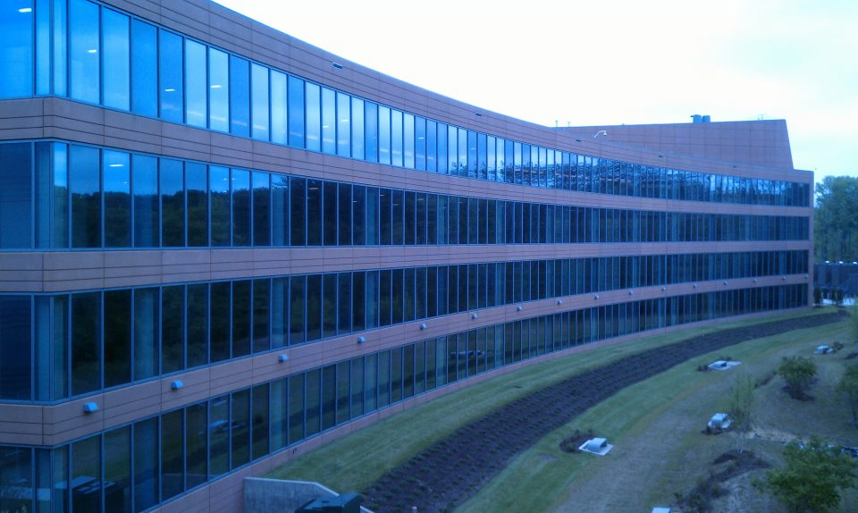
Questions?
North side of NCWCP
SAB - Operations
Gregory M. Gallina - greg.gallina@noaa.gov
Satellite Analysis Branch (SAB) – NOAA/NESDIS/OSPO/SPSD
www.ssd.noaa.gov or www.ospo.noaa.gov
WWB (thru Sept. 1) NCWCP
5200 Auth Rd Rm 401 5830 University Research Ct. - 4050
Camp Springs MD, 20746 College Park, MD 20740
301-763-8444 (office) 301-683-1400 (office)
301-683-1409 (personal)

