Slide 1
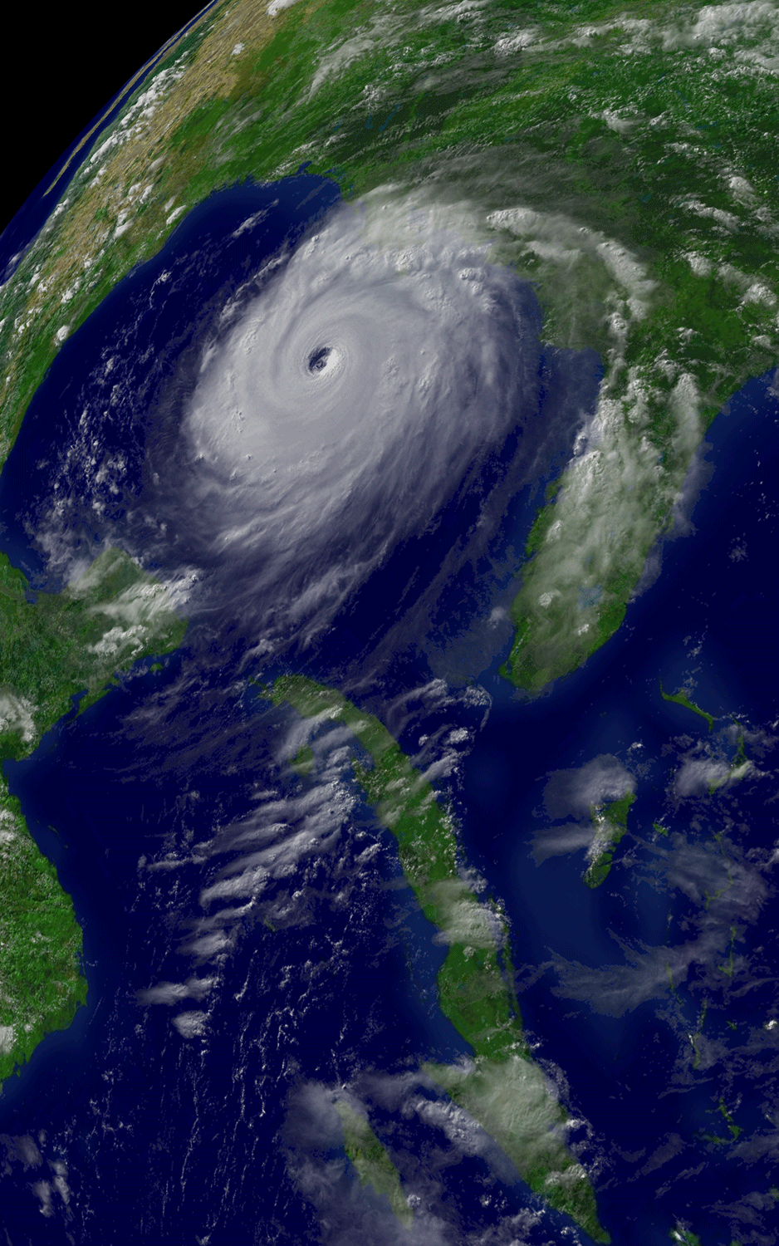
Advanced Graphics Using McIDAS-X and -V
Dan Pisut
NOAA Environmental Visualization Lab
Dan.Pisut@noaa.gov
Hurricane Katrina; August 29, 2005 at 1545z
McIDAS-X and Boeing/Autometric Edge

Slide 2
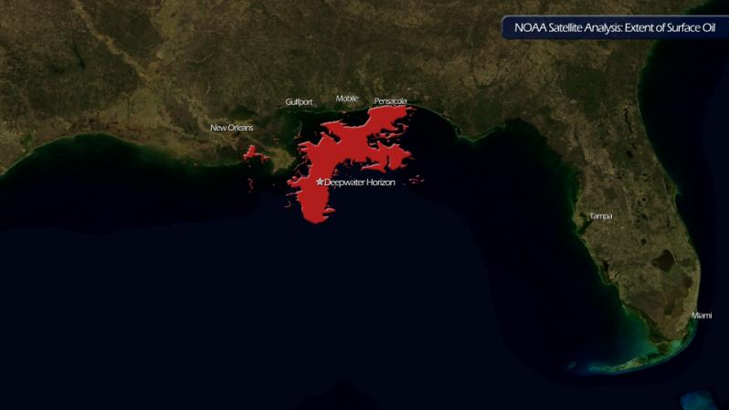
Top 10 Reasons to Love McIDAS
Shapefiles
Any netCDF
Custom analysis
Real-time access
Consolidated access
Flexibility
Free
Time saver
Resolution
Batch processing

Slide 3
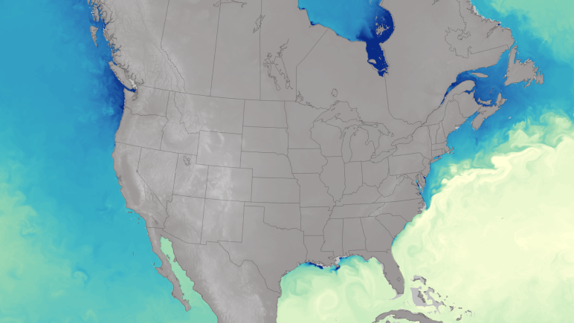
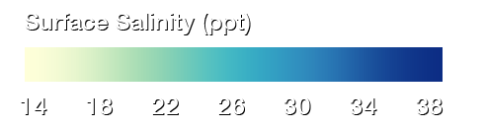
Top 10 Reasons to Love McIDAS
Shapefiles
Any netCDF
Custom analysis
Real-time access
Consolidated access
Flexibility
Free
Time saver
Resolution
Batch processing

Slide 4
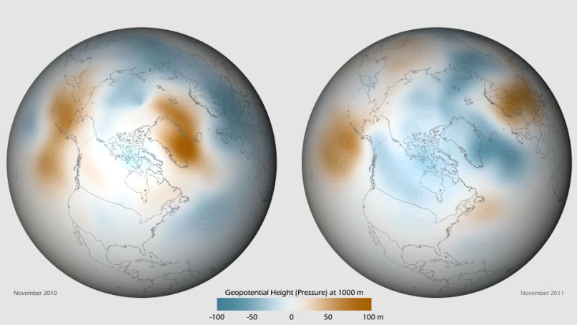
Top 10 Reasons to Love McIDAS
Shapefiles
Any netCDF
Custom analysis
Real-time access
Consolidated access
Flexibility
Free
Time saver
Resolution
Batch processing

Slide 5
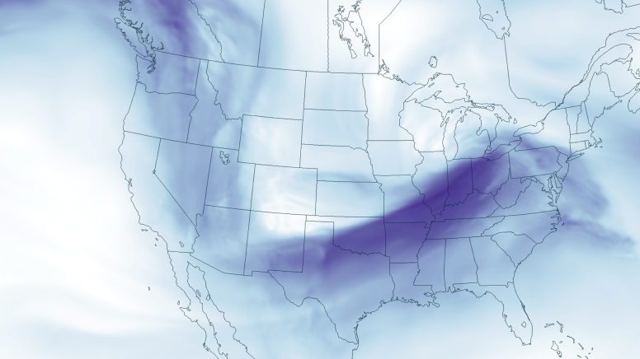
Top 10 Reasons to Love McIDAS
Shapefiles
Any netCDF
Custom analysis
Real-time access
Consolidated access
Flexibility
Free
Time saver
Resolution
Batch processing

Slide 6
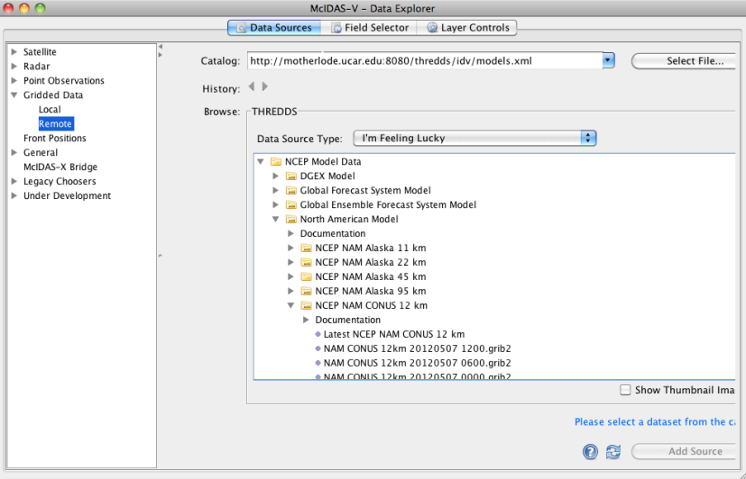
Top 10 Reasons to Love McIDAS
Shapefiles
Any netCDF
Custom analysis
Real-time access
Consolidated access
Flexibility
Free
Time saver
Resolution
Batch processing

Slide 7
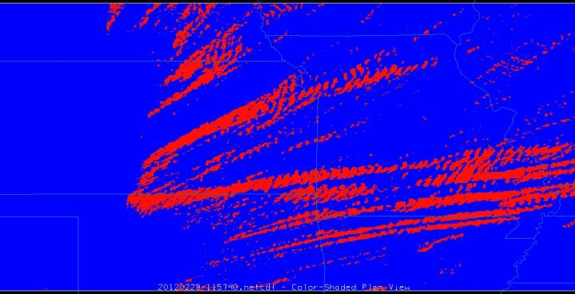
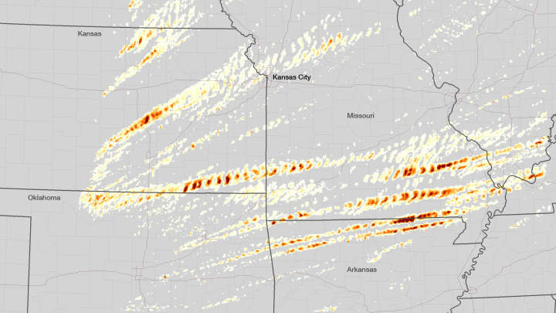
Top 10 Reasons to Love McIDAS
Shapefiles
Any netCDF
Custom analysis
Real-time access
Consolidated access
Flexibility
Free
Time saver
Resolution
Batch processing

Slide 8

Top 10 Reasons to Love McIDAS
Shapefiles
Any netCDF
Custom analysis
Real-time access
Consolidated access
Flexibility
Free
Time saver
Resolution
Batch processing

Slide 9
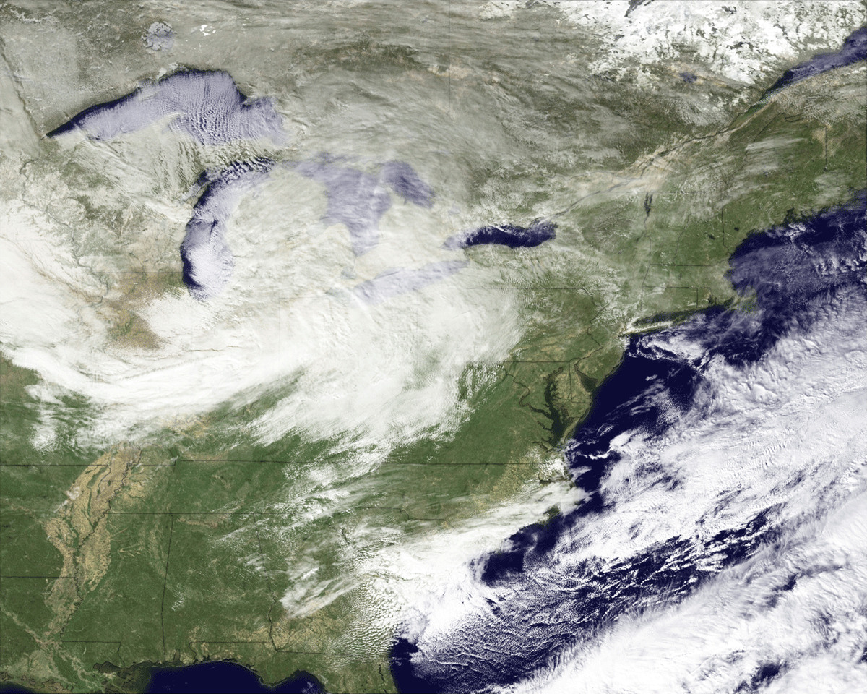
Top 10 Reasons to Love McIDAS
Shapefiles
Any netCDF
Custom analysis
Real-time access
Consolidated access
Flexibility
Free
Time saver
Resolution
Batch processing

Slide 10
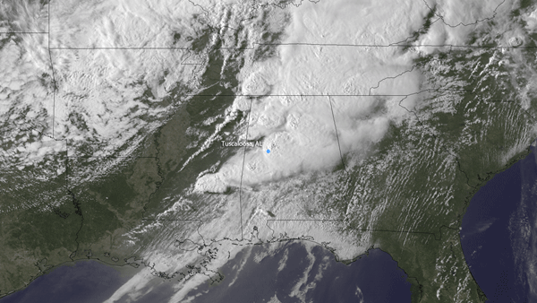
Top 10 Reasons to Love McIDAS
Shapefiles
Any netCDF
Custom analysis
Real-time access
Consolidated access
Flexibility
Free
Time saver
Resolution: 10,000 x 10,000 pixels? Yes please!
Batch processing

Slide 11
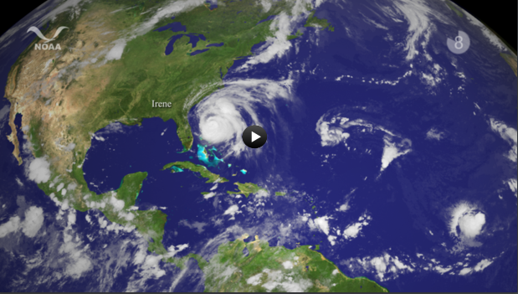
Top 10 Reasons to Love McIDAS
Shapefiles
Any netCDF
Custom analysis
Real-time access
Consolidated access
Flexibility
Free
Time saver
Resolution
Batch processing
Notes:
<iframe width="560" height="315" src="http://www.youtube.com/embed/fX7Q-0QuID4" frameborder="0" allowfullscreen></iframe>

Slide 12


Slide 13
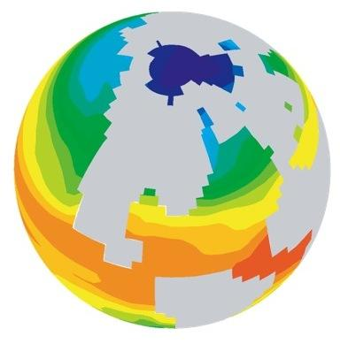
Simple
The Evolution of Visualization

Slide 14
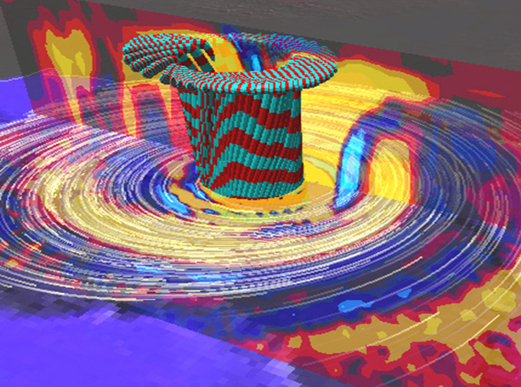
Simple Complex
The Evolution of Visualization

Slide 15
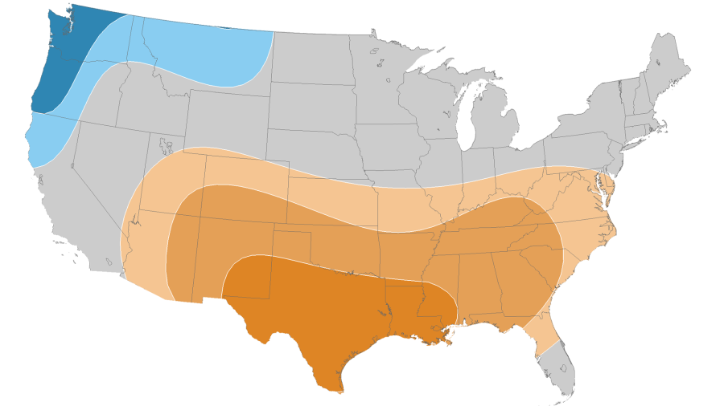
Simple Complex Simple
The Evolution of Visualization

Slide 16
Rules of Color in Visualization
Hue
Saturation
Brightness

Slide 17
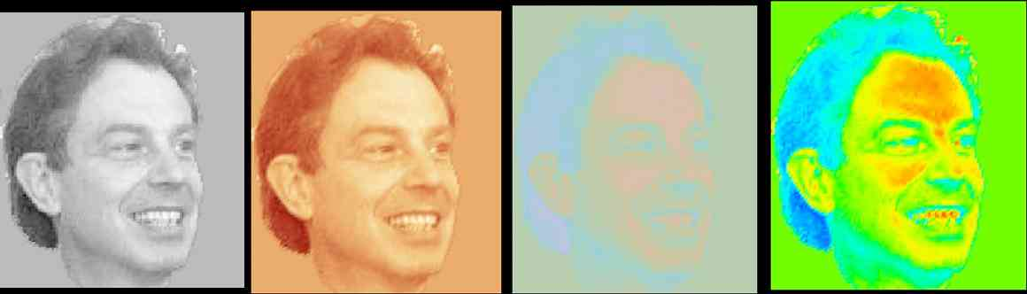
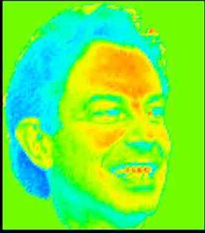
Most people don’t see things the same way as scientists
Rogowitz, Bernice and Alan Kalvin, "The 'Which Blair Project:" A Quick Visual Method For Evaluating Color Maps,” Proceedings. IEEE Visualization Conference, San Diego, CA, October 21-26, pp. 183-188, 2001

Slide 18
Can you see similar patterns in grayscale and color?
The Litmus Test

Slide 19
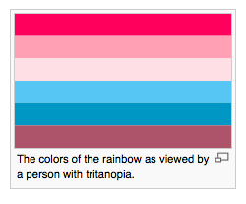
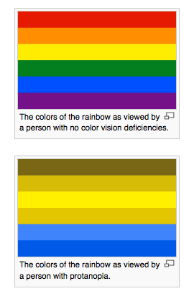
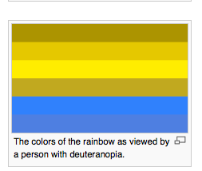
http://en.wikipedia.org/wiki/Color_blindness#Design_implications_of_color_blindness

Slide 20
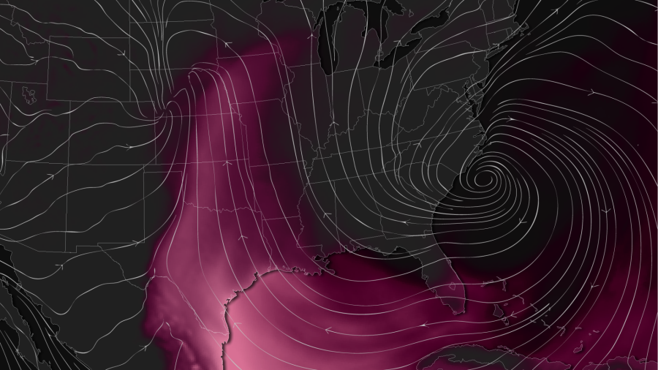
Uses NAM CAPE product and wind barbs
Visualizing the conditions setting up for major tornado outbreaks

Slide 21
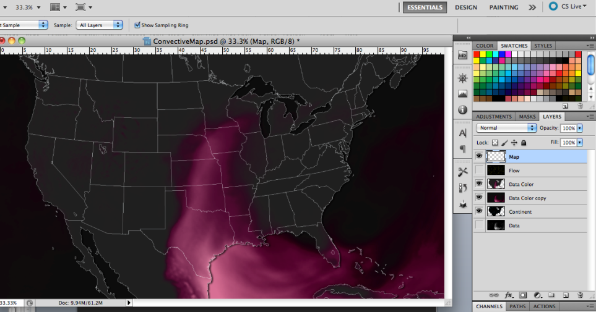

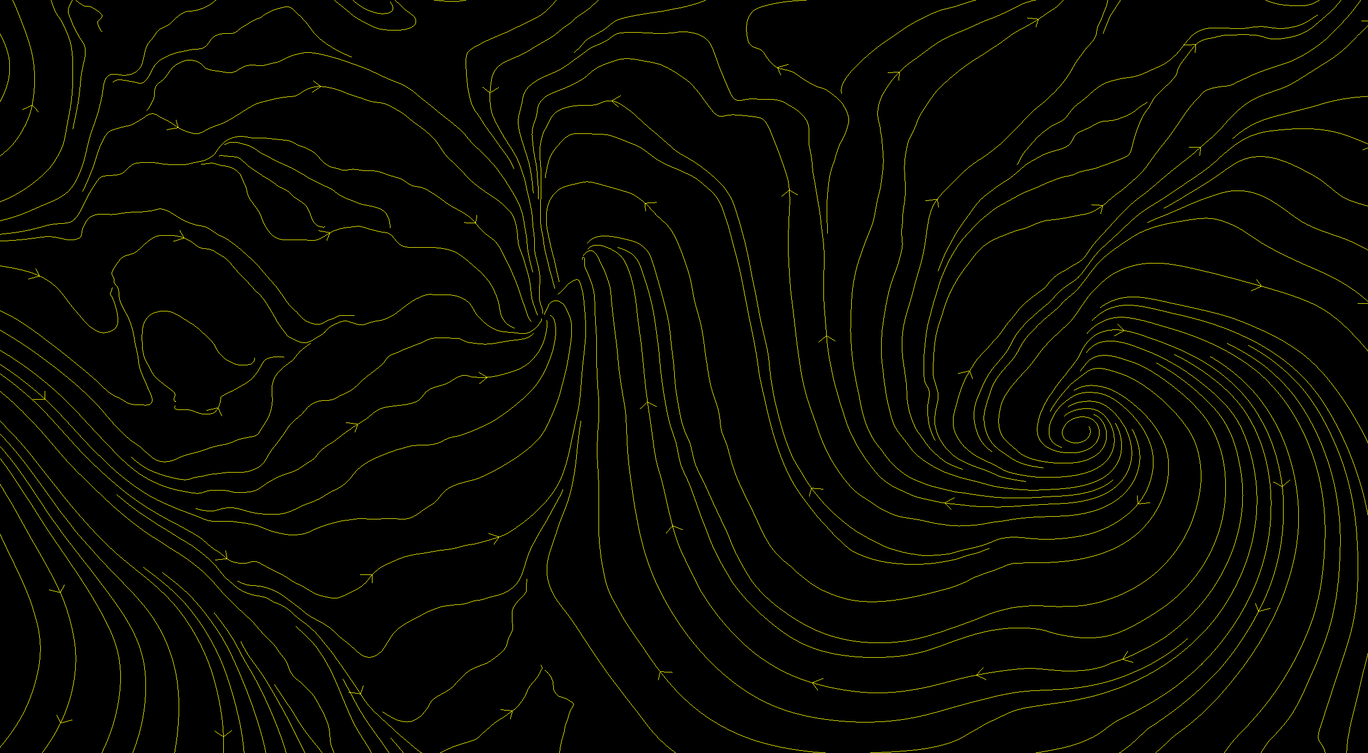

Output multiple map outlines data layers separately
Layering the displays

Slide 22
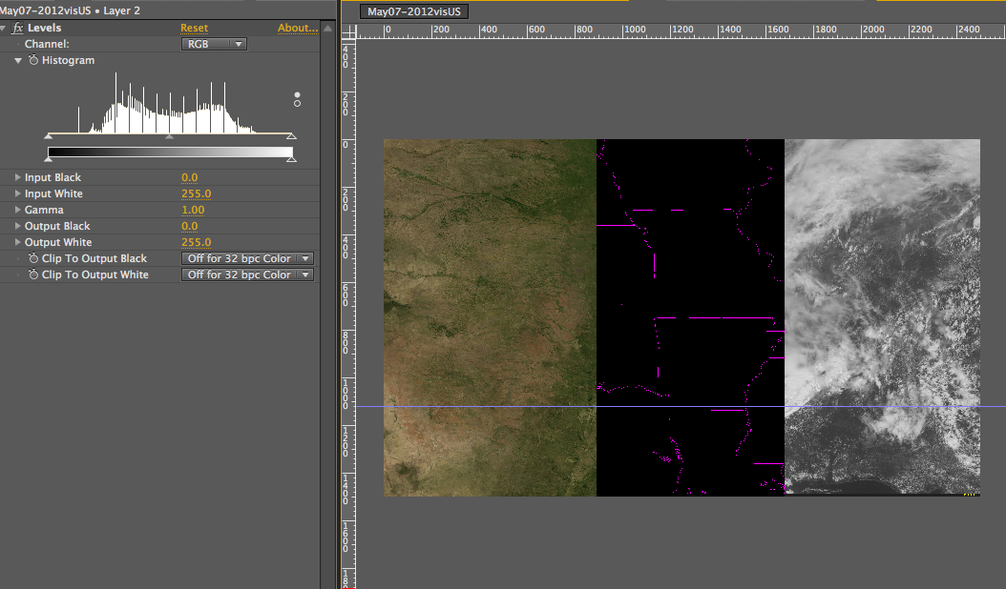
Same concept, different data
Layering the displays

Slide 23
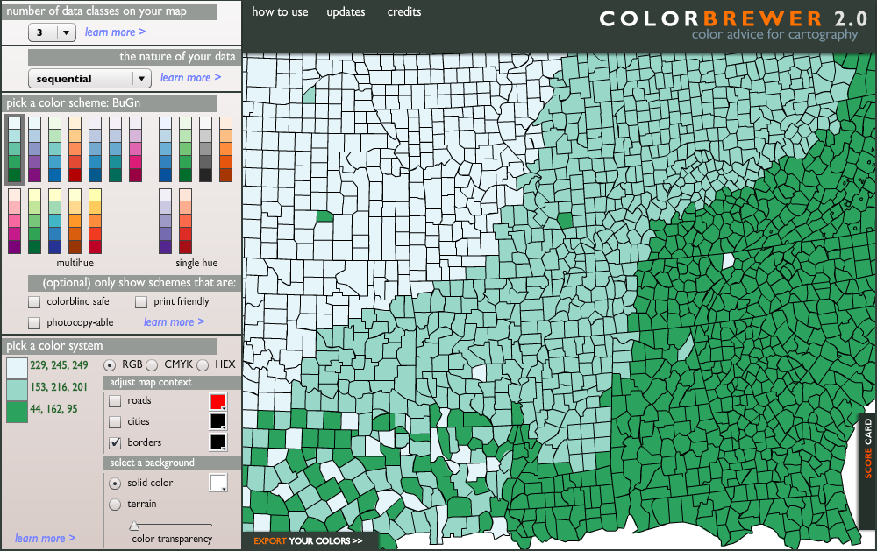
Colorbrewer2.org
Plan or test your color treatments

Slide 24
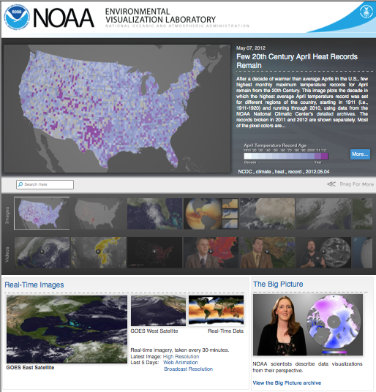

Questions?
Dan Pisut
Dan.Pisut@noaa.gov
www.nnvl.noaa.gov

