Slide 1
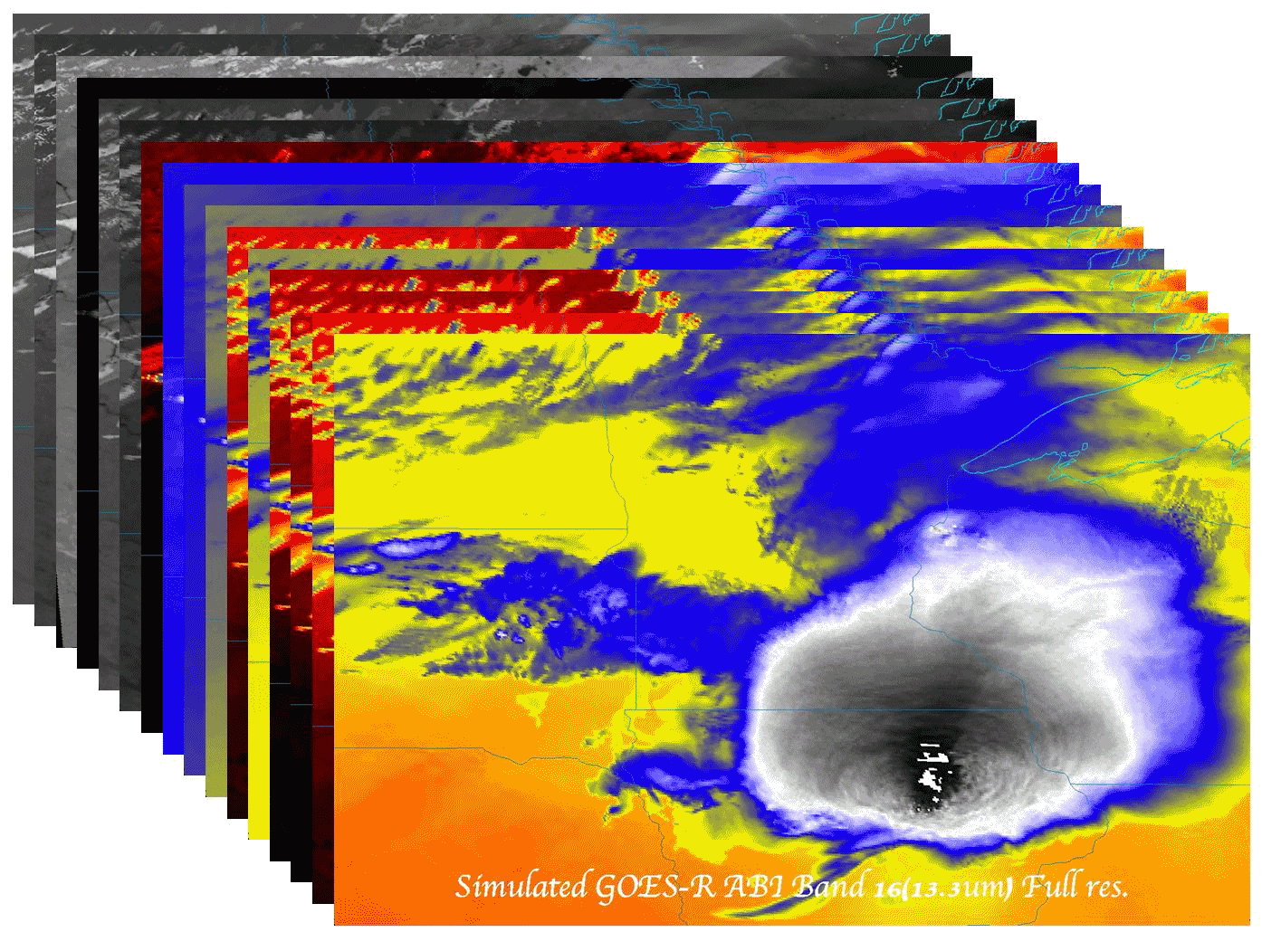
The GOES-R series and the Advanced Baseline Imager (ABI)
Timothy J. Schmit (tim.j.schmit@noaa.gov)
NOAA/NESDIS/Satellite Applications and Research
Advanced Satellite Products Branch (ASPB)
Madison, WI
MUG Meeting
Madison, WI
8 May 2012
UW-Madison

Slide 2
Thanks to…
The GOES-R imagery team (Kaba Bah, Mat Gunshor, Joleen Feltz, etc.).
William Straka, Jun Li, Scott Bachmeier, Steve Ackerman, Bob Aune, Don Hillger, Paul Menzel, Steve Ackerman, Tony Schreiner, Jason Otkin, Justin Sieglaff, Jim Jung, Elaine Prins, Shobha Kondragunta, Brad Pierce, Joleen Feltz, Wayne Feltz, Jean Phillips, Gary Wade, Don Hillger, Jinlong Li, Jing Zheng, Allen Huang, Bob Rabin, the SSEC data center, Mike Pavolonis, Jaime Daniels, ASPB, STAR, NESDIS, NSSL, MUG, Steve Weygandt, Haidao Lee, Mark DeMaria, and many others!
GOES-R Program Office (Steve Goodman, Jim Gurka, etc.), NASA, ITT Industries, other industry partners, etc.
You.

Slide 3
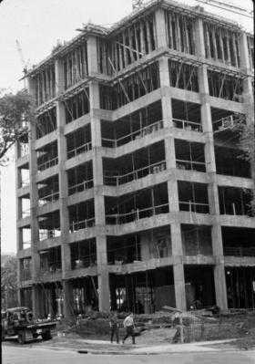
Outline
ABI (Advanced Baseline Imager)
Temporal
Spatial
Spectral
Products
Summary
More information
Questions

Slide 4
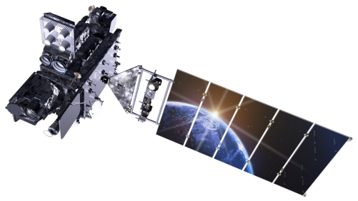
Outline
ABI (Advanced Baseline Imager)
Temporal
Spatial
Spectral
Products
Summary
More information
Questions
Lockheed Martin

Slide 5
GOES-R Overview
Advanced Baseline Imager (ABI)
No dedicated Sounder
Geostationary Lightning Mapper (GLM)
Space Weather
Space Environmental In-Situ Suite (SEISS)
Solar Ultra Violet Imager (SUVI)
Extreme Ultra Violet/X-Ray Irradiance Sensor (EXIS)
Magnetometer
Communications
GOES Rebroadcast (GRB)
Low Rate Information Transmissions (LRIT)
Emergency Managers Weather Information Network (EMWIN)
Search and Rescue (SAR)
Data Collection System (DCS)
Notes:
Advanced Baseline Imager (ABI) Earth-viewing
Geostationary Lightning Mapper (GLM) Earth-viewing
Solar Ultra-Violet Imager (SUVI) Sun-viewing
EUVS and XRS Irradiance Sensors (EXIS) Sun-viewing
Space Environment In-Situ Suite (SEISS) Space-viewing
Magnetometer (MAG) Space-viewing

Slide 6
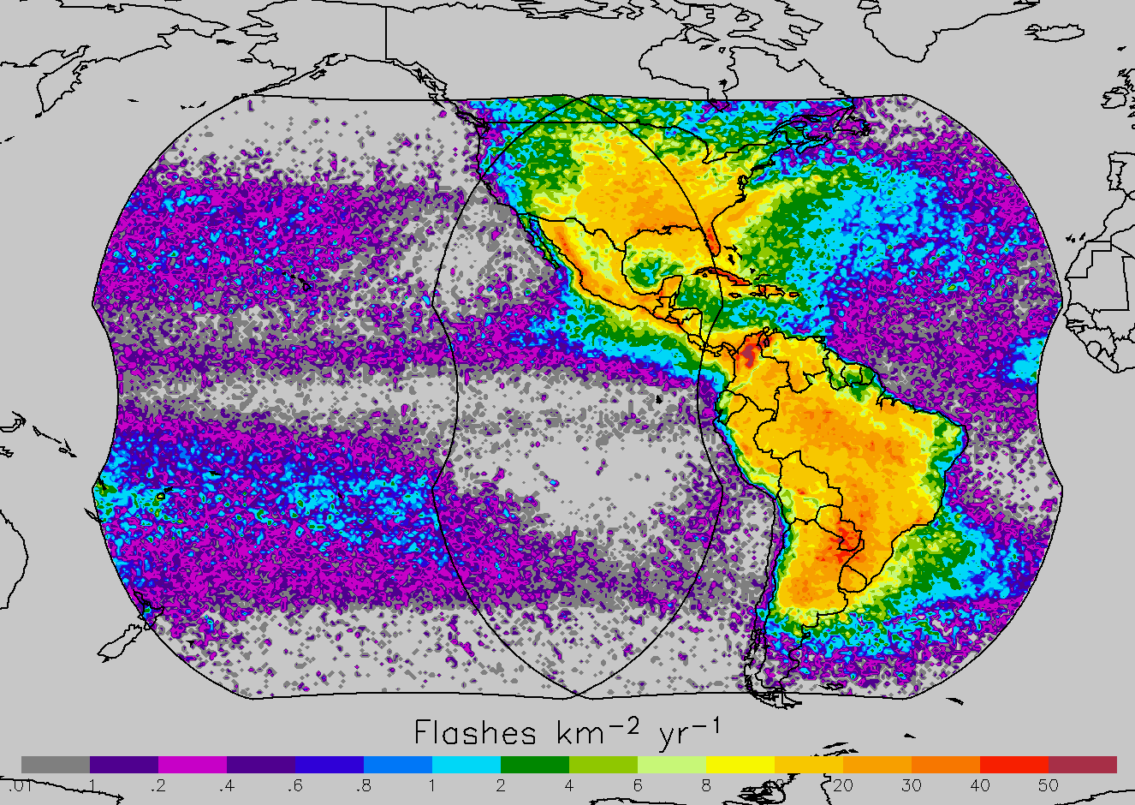
Decadal lightning data
GOES- East, West coverage
Steve Goodman

Slide 7
GOES-S (East?): Operational 2020

Slide 8
The Advanced Baseline Imager:
ABI Current
Spectral Coverage
16 bands 5 bands
Spatial resolution
0.64 μm Visible 0.5 km Approx. 1 km
Other Visible/near-IR 1.0 km n/a
Bands (>2 μm) 2 km Approx. 4 km
Spatial coverage
Full disk 4 per hour Scheduled (3 hrly)
CONUS 12 per hour ~4 per hour
Mesoscale Every 30 sec n/a
Visible (reflective bands)
On-orbit calibration Yes No

Slide 9
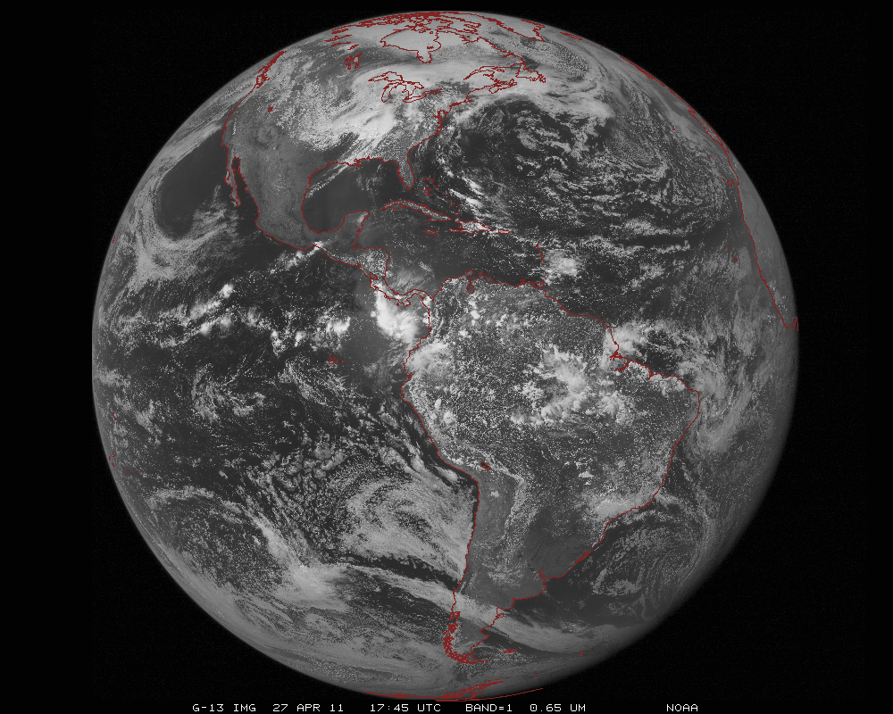
ABI scans about 5 times faster
than the current GOES imager
There are two anticipated scan modes for the ABI:
- Full disk images every 15 minutes + 5 min CONUS images + mesoscale.
or - Full disk every 5 minutes.

Slide 10
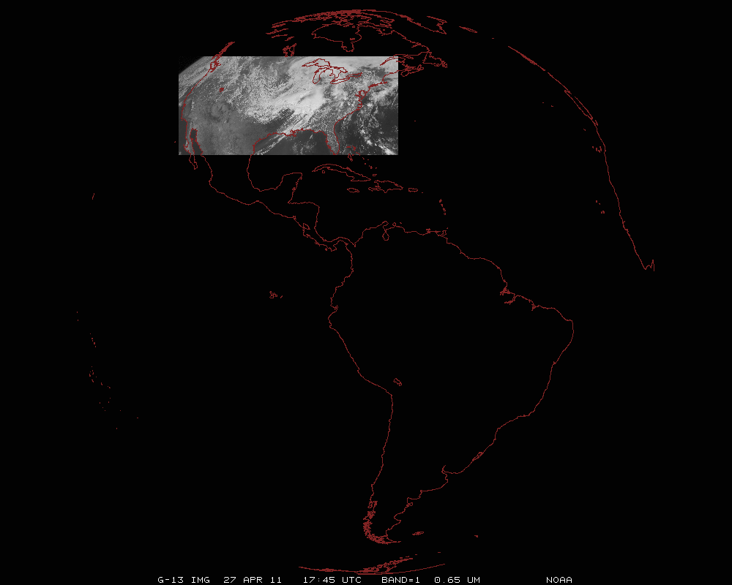
ABI can offer Continental US images every 5 minutes for routine monitoring of a wide range of events (storms, dust, clouds, fires, winds, etc).
This is every 15 or 30 minutes with the current GOES in routine mode.
Notes:
Approx. size of CONUS

Slide 11
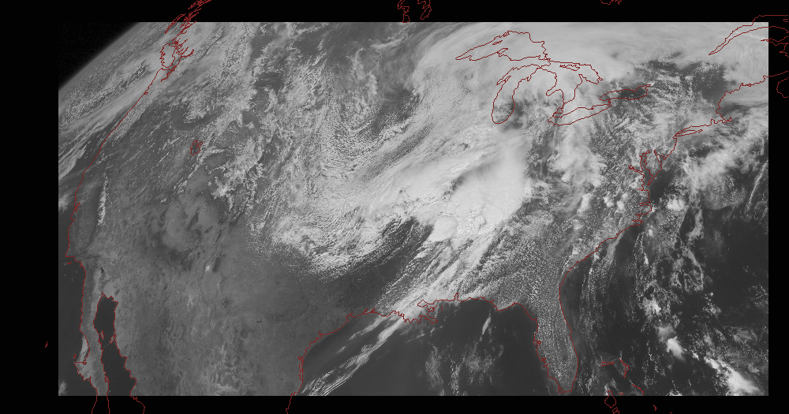
Notes:
Approx. size of CONUS

Slide 12
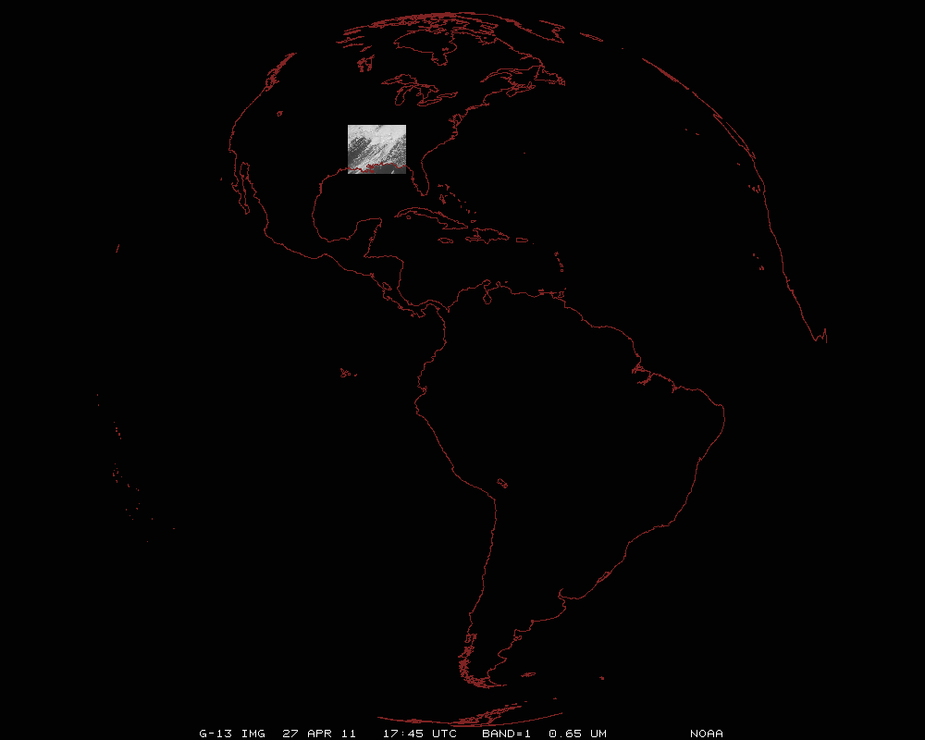
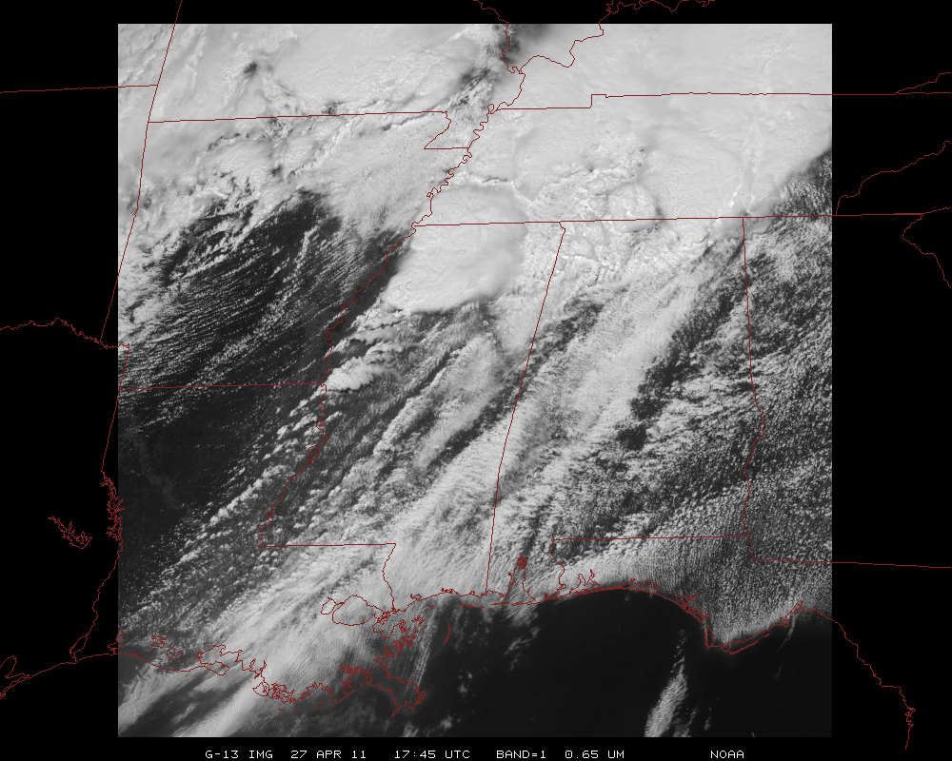
Mesoscale images every 30 seconds for rapidly changing phenomena
(thunderstorms, hurricanes, fires, etc). Or two regions every 60 seconds.
Notes:
Approx. size of meso-scale showing “Franklin”.

Slide 13
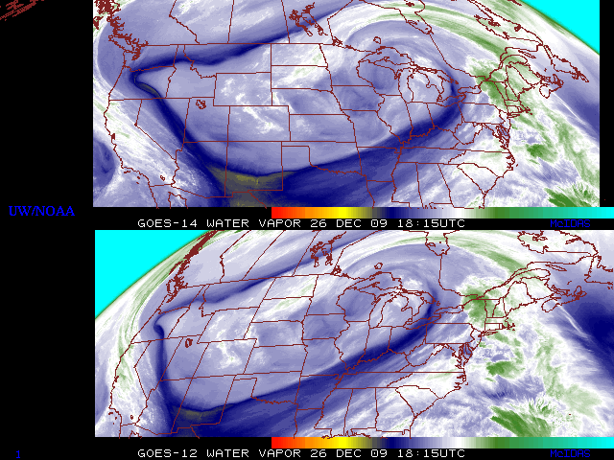
GOES-14: Sample “5-min” imagery
GOES-14
GOES-12
“Water vapor” data from the GOES-14 NOAA Science Test, lead by Hillger and Schmit
Notes:
Note the comma head is forming in the dry slot as a vort max swings around. This is not obvious from the 15 min.

Slide 14
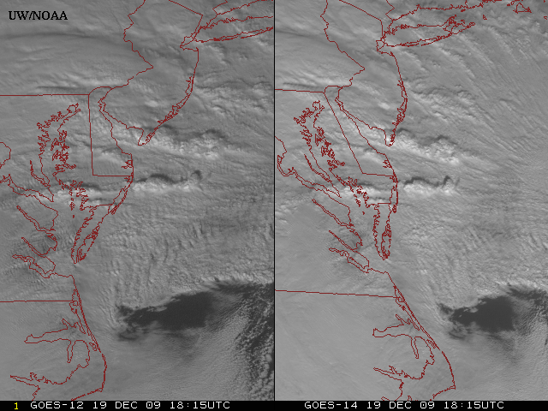
GOES-14: Sample “1-min” imagery
GOES-12
GOES-14
- Visible data from the GOES-14 NOAA Science Test, lead by Hillger and Schmit
- Can these type loops validate meso-scale models?
Notes:
Note the number of different levels of motion you can see (the cyclonic low level circulation over the ocean through the breaks in the higher clouds)... and you can't distinguish those on the GOES-12 loop.

Slide 15
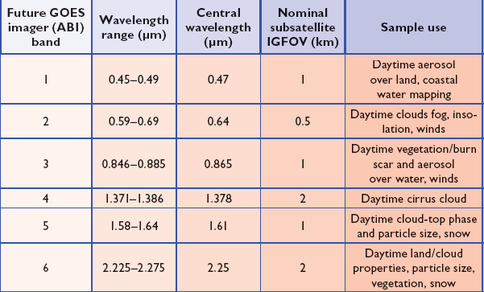
ABI Visible/Near-IR Bands
Schmit et al, 2005
Notes:
Schmit, T. J., M. M. Gunshor, W. P. Menzel, J. J. Gurka, J. Li, and A. S. Bachmeier, 2005: Introducing the next-generation Advanced Baseline Imager on GOES-R. Bull. Amer. Meteor. Soc., 86, 1079-1096.

Slide 16
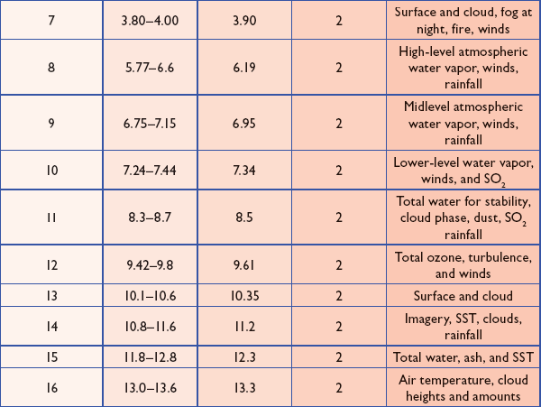
ABI IR Bands
Schmit et al, 2005
Notes:
Schmit, T. J., M. M. Gunshor, W. P. Menzel, J. J. Gurka, J. Li, and A. S. Bachmeier, 2005: Introducing the next-generation Advanced Baseline Imager on GOES-R. Bull. Amer. Meteor. Soc., 86, 1079-1096.

Slide 17
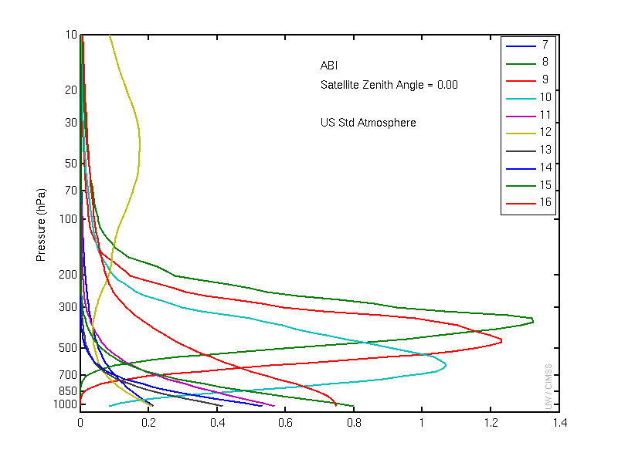
ABI IR Weighting Functions
Clear-sky

Slide 18
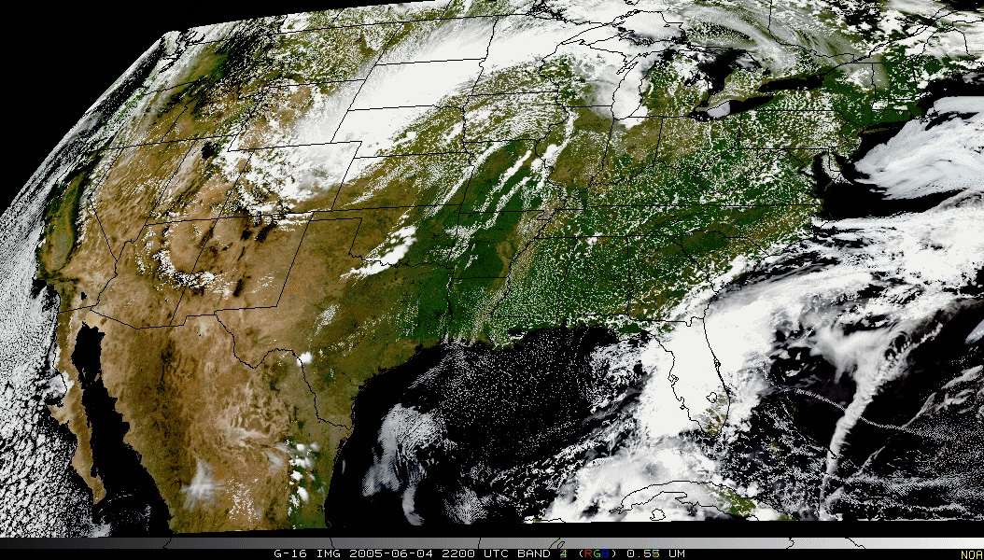
Outline
ABI (Advanced Baseline Imager)
Temporal
Spatial
Spectral
Products
Summary
More information
Questions

Slide 19
GOES-R Products
Baseline Products
Future Capabilities
Advanced Baseline Imager (ABI)
Aerosol Detection (Including Smoke and Dust) Aerosol Optical Depth (AOD) Clear Sky Masks Cloud and Moisture Imagery Cloud Optical Depth Cloud Particle Size Distribution Cloud Top Height Cloud Top Phase Cloud Top Pressure Cloud Top Temperature Derived Motion Winds Derived Stability Indices Downward Shortwave Radiation: Surface Fire/Hot Spot Characterization Hurricane Intensity Estimation Land Surface Temperature (Skin) Legacy Vertical Moisture Profile Legacy Vertical Temperature Profile Radiances Rainfall Rate/QPE Reflected Shortwave Radiation: TOA Sea Surface Temperature (Skin) Snow Cover Total Precipitable Water Volcanic Ash: Detection and Height
Geostationary Lightning Mapper (GLM)
Lightning Detection: Events, Groups & Flashes
Space Environment In-Situ Suite (SEISS)
Energetic Heavy Ions Magnetospheric Electrons & Protons: Low Energy Magnetospheric Electrons: Med & High Energy Magnetospheric Protons: Med & High Energy Solar and Galactic Protons
Magnetometer (MAG)
Geomagnetic Field
Extreme Ultraviolet and X-ray Irradiance Suite (EXIS)
Solar Flux: EUV Solar Flux: X-ray Irradiance
Solar Ultraviolet Imager (SUVI)
Solar EUV Imagery
Advanced Baseline Imager (ABI)
Absorbed Shortwave Radiation: Surface Aerosol Particle Size Aircraft Icing Threat Cloud Ice Water Path Cloud Layers/Heights Cloud Liquid Water Cloud Type Convective Initiation Currents Currents: Offshore Downward Longwave Radiation: Surface Enhanced “V”/Overshooting Top Detection Flood/Standing Water Ice Cover Low Cloud and Fog Ozone Total Probability of Rainfall Rainfall Potential Sea and Lake Ice: Age Sea and Lake Ice: Concentration Sea and Lake Ice: Motion Snow Depth (Over Plains) SO₂ Detection Surface Albedo Surface Emissivity Tropopause Folding Turbulence Prediction Upward Longwave Radiation: Surface Upward Longwave Radiation: TOA Vegetation Fraction: Green Vegetation Index Visibility

Slide 20
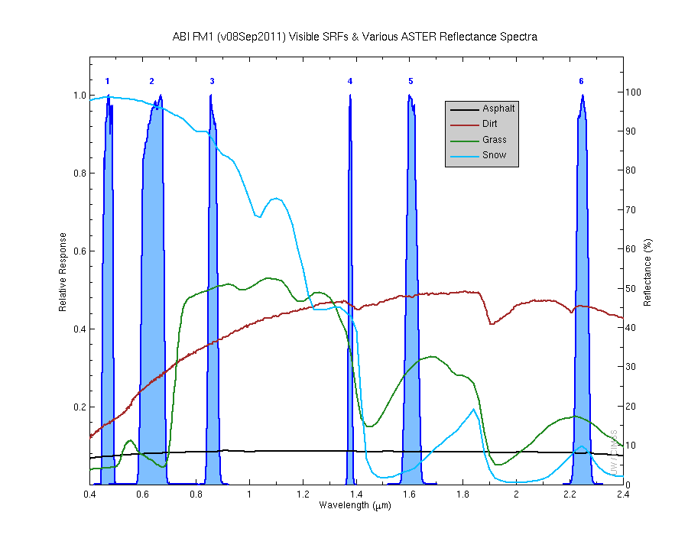
Visible and near-IR channels on the ABI
Aerosols, Insolation
Clouds, Snow
Vegetation, Imagery
Cloud mask, Suspended matter
Snow, Phase
Cloud Particle size
Sample use only, many other uses
The ABI visible and near-IR bands have many uses.
Notes:
Schmit, T. J., M. M. Gunshor, W. P. Menzel, J. J. Gurka, J. Li, and A. S. Bachmeier, 2005: Introducing the next-generation Advanced Baseline Imager on GOES-R. Bull. Amer. Meteor. Soc., 86, 1079-1096.

Slide 21
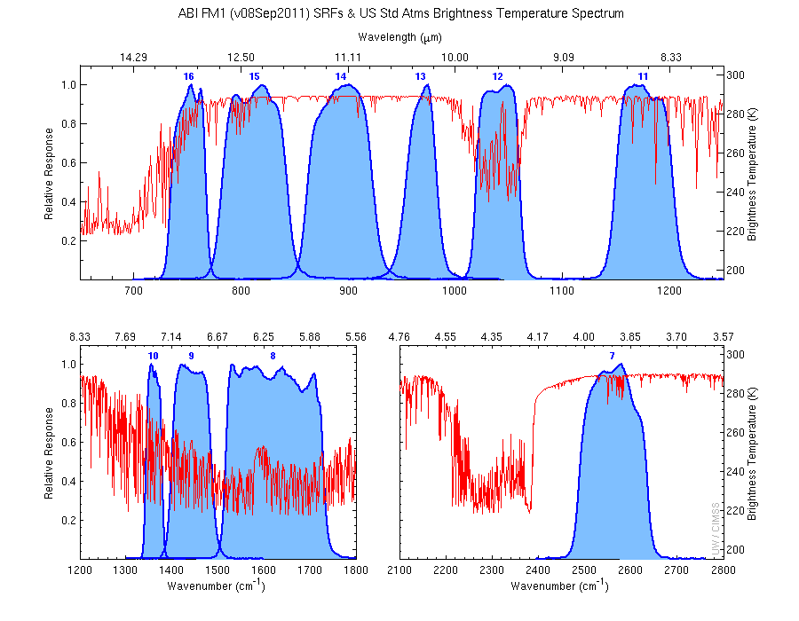
The IR channels on the ABI
Clouds, Stability Indices
SST, Fires, Radiances
Ozone, Downward Radiation
Rainfall, Aerosol
Hurricane, Imagery
Cloud Phase, SST
Sample use only, many other uses
SO2, Radiances
Winds, WV profiling
TPW, Rainfall rate
Fires, Fog
ABI has many more bands than the current operational GOES imagers.
Notes:
Schmit, T. J., M. M. Gunshor, W. P. Menzel, J. J. Gurka, J. Li, and A. S. Bachmeier, 2005: Introducing the next-generation Advanced Baseline Imager on GOES-R. Bull. Amer. Meteor. Soc., 86, 1079-1096.

Slide 22
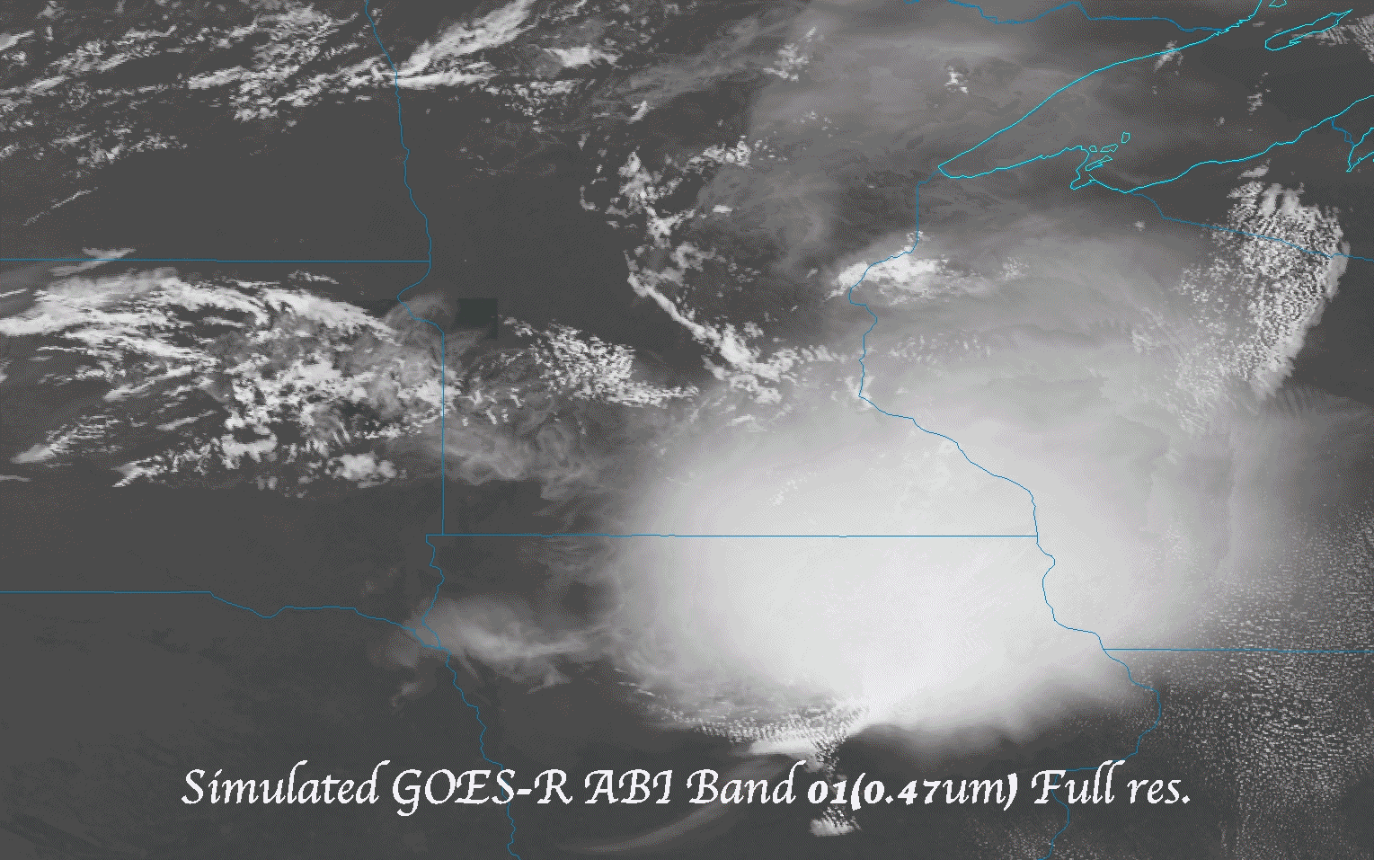
Meso-scale (all bands)
Meso-scale (animated gif of the 16 ABI bands)

Slide 23
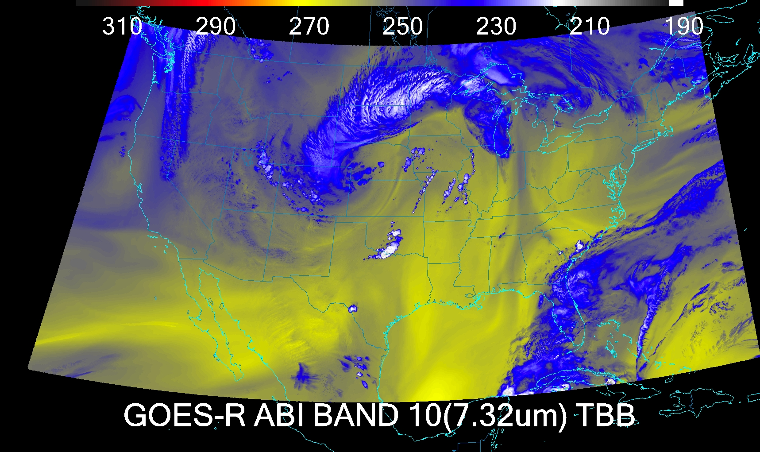
CONUS
CONUS

Slide 24
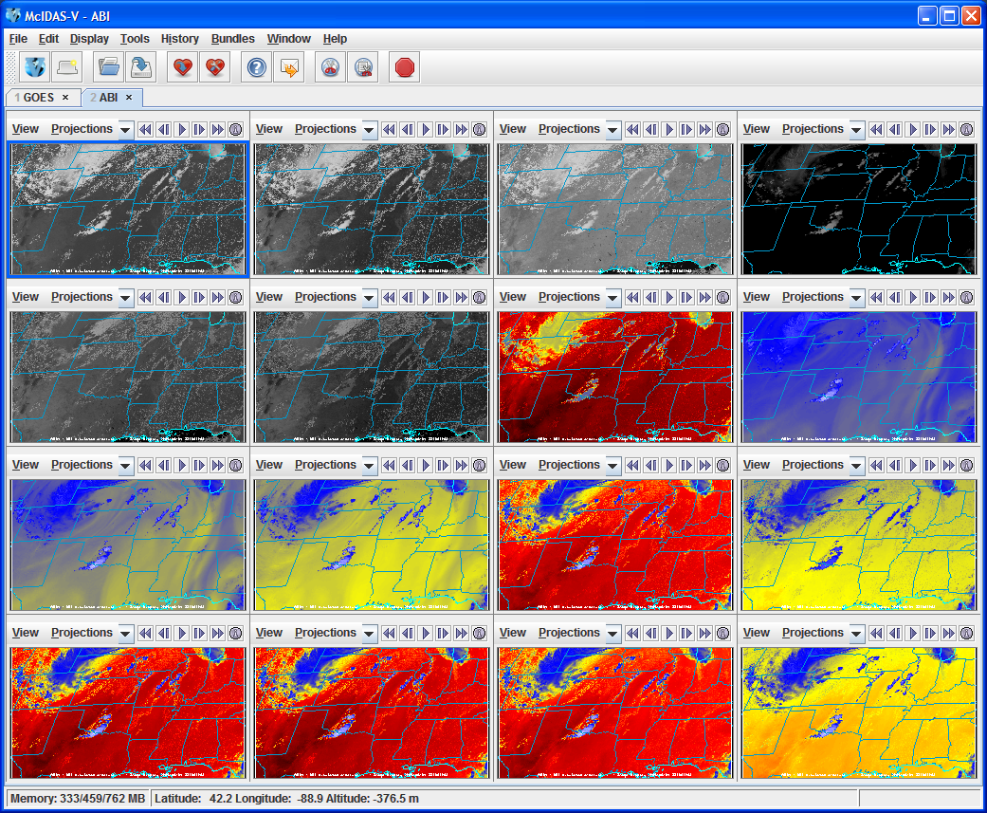
Example CMIP Output ABI bands in McIDAS-V

Slide 25
Full Disk
Simulated ABI Full Disk image
Generated with McIDAS-V
Via a script
Using McIDAS areas
All bands are shown

Slide 26
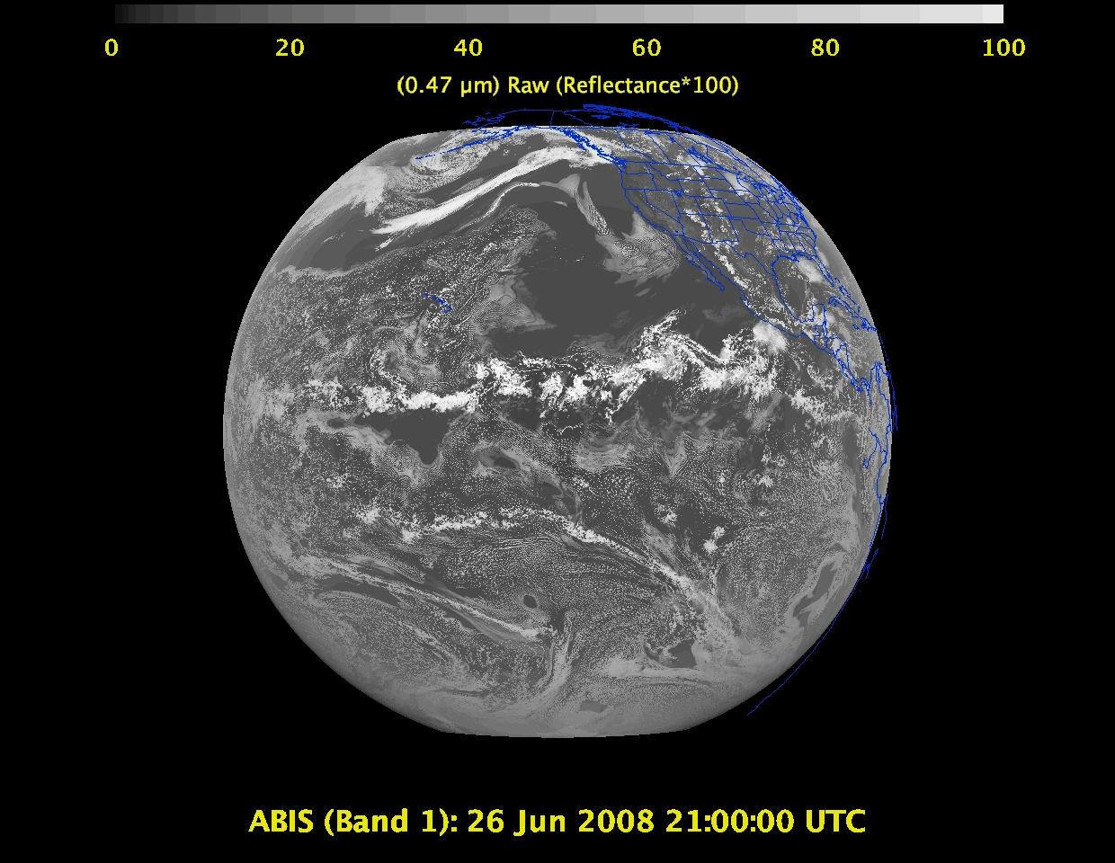
Daytime “Blue” band – aerosols, solar insolation, snow cover

Slide 27
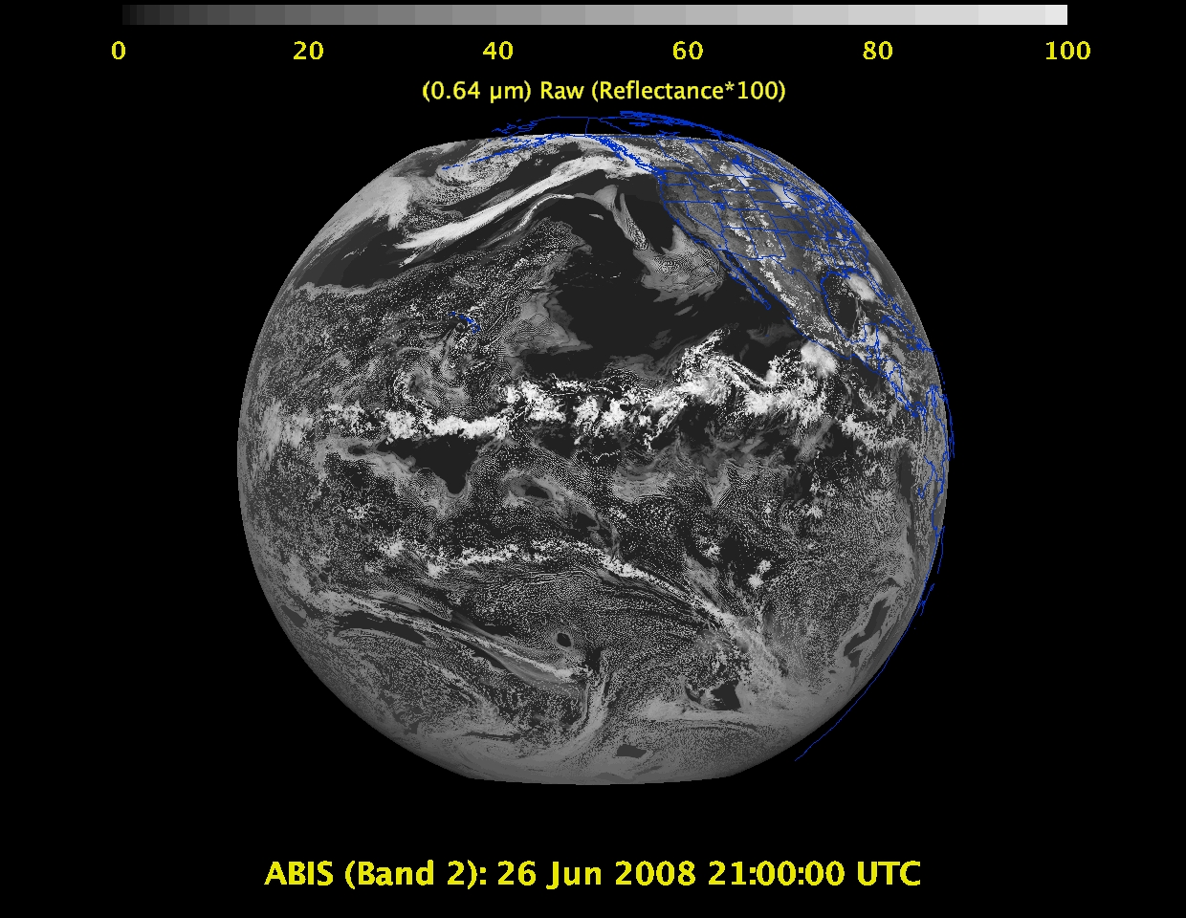
Daytime “Red” band – clouds, cloud-mask, optical depth, winds, etc.

Slide 28
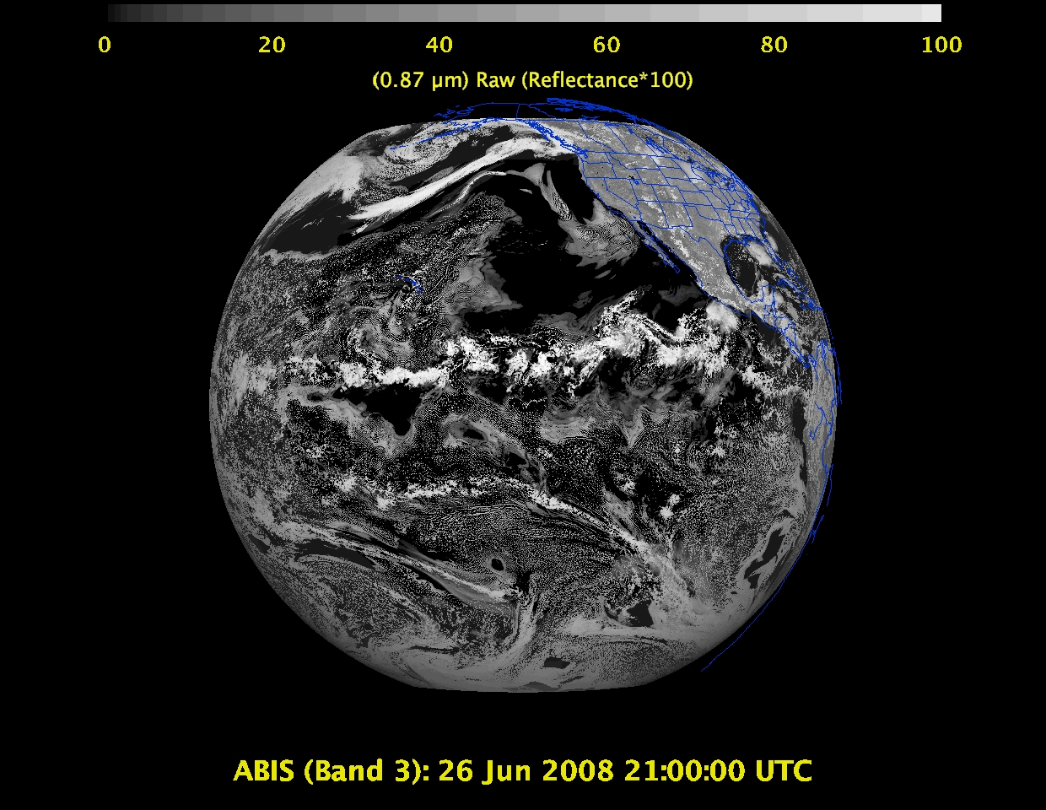
Daytime “Veggie” band – NDVI, solar insolation, snow cover

Slide 29
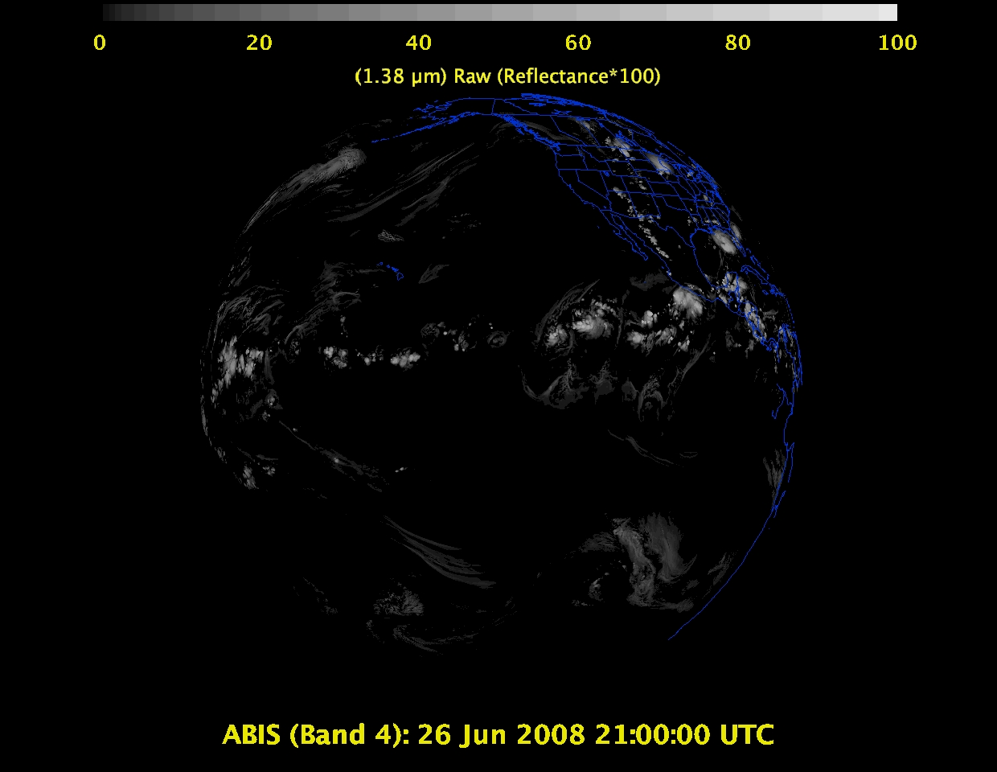
1 Daytime “Cirrus” band – cloud mask, aerosol detection

Slide 30
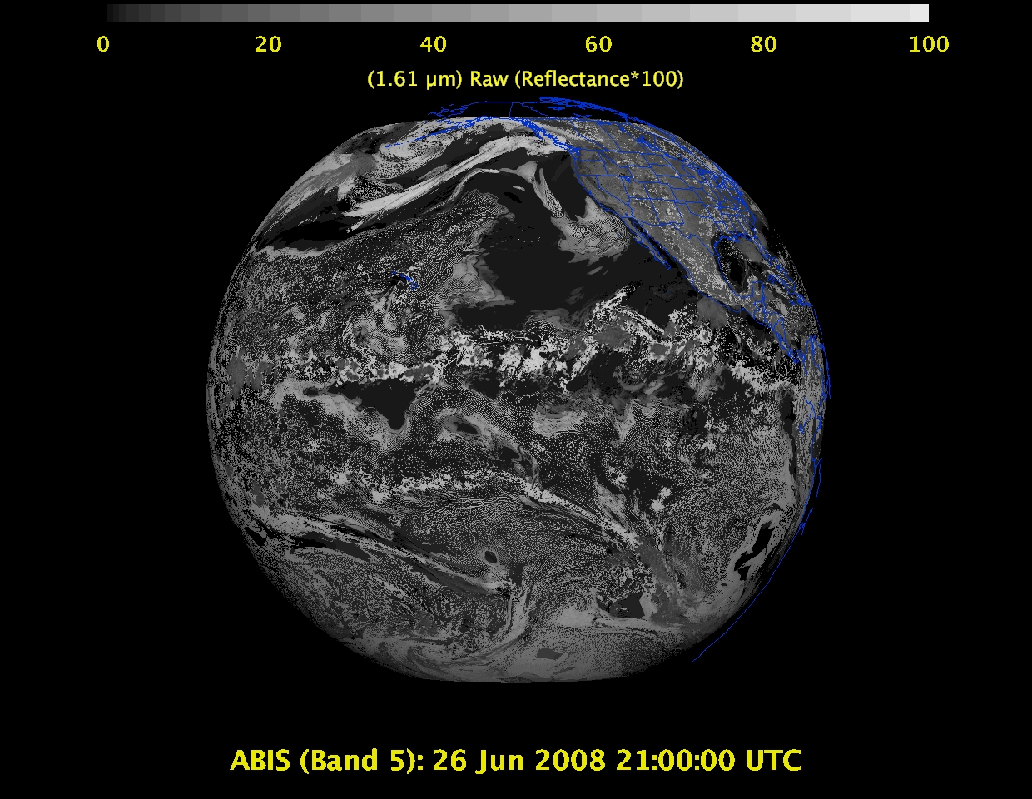
Daytime “Snow” band – snow cover, cloud mask, etc.

Slide 31
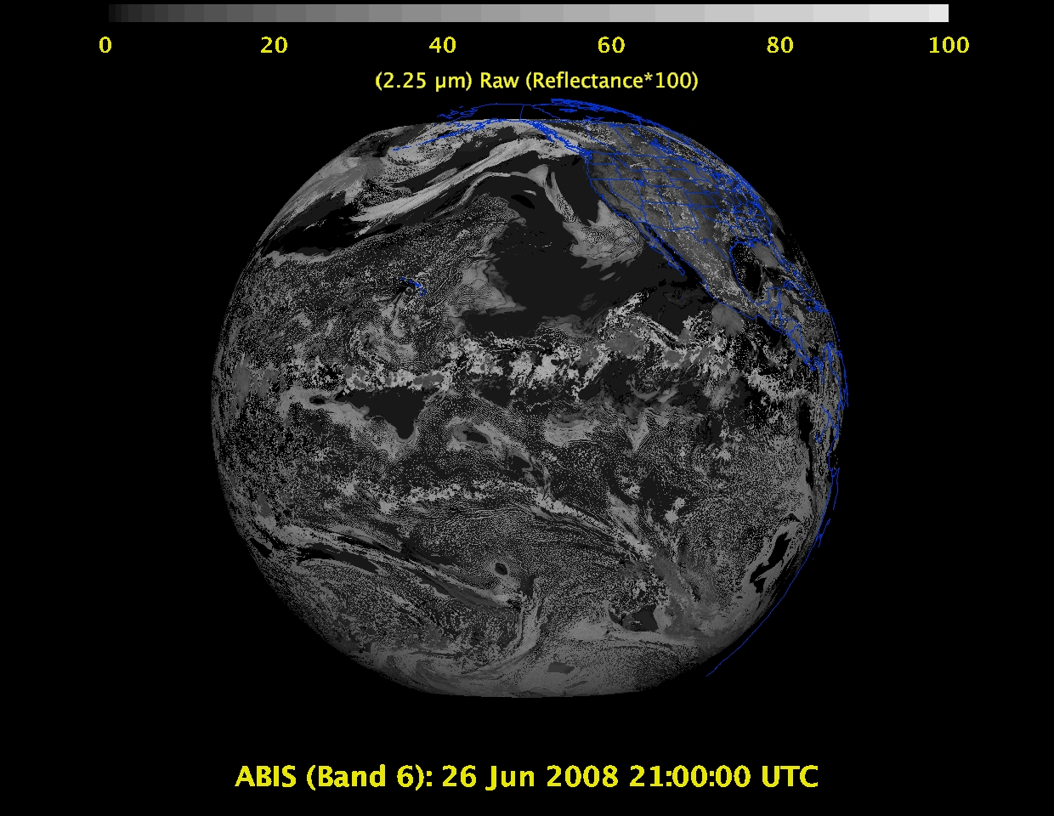
Daytime “Cloud-top phase” band – cloud particle size, snow cover

Slide 32
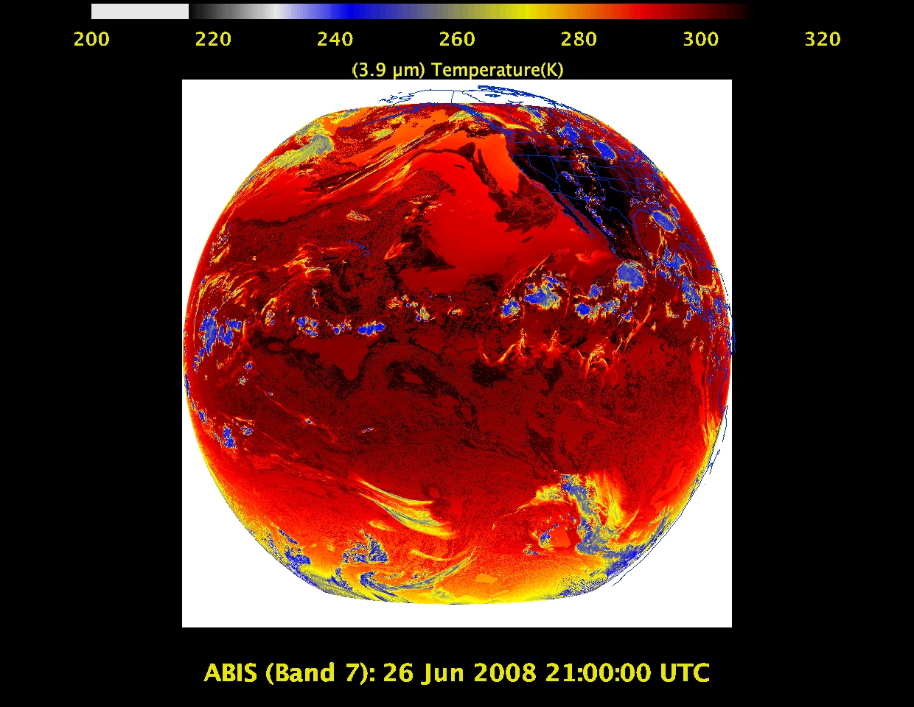
Shortwave IR window band - fog, fires, winds, SST, etc.

Slide 33
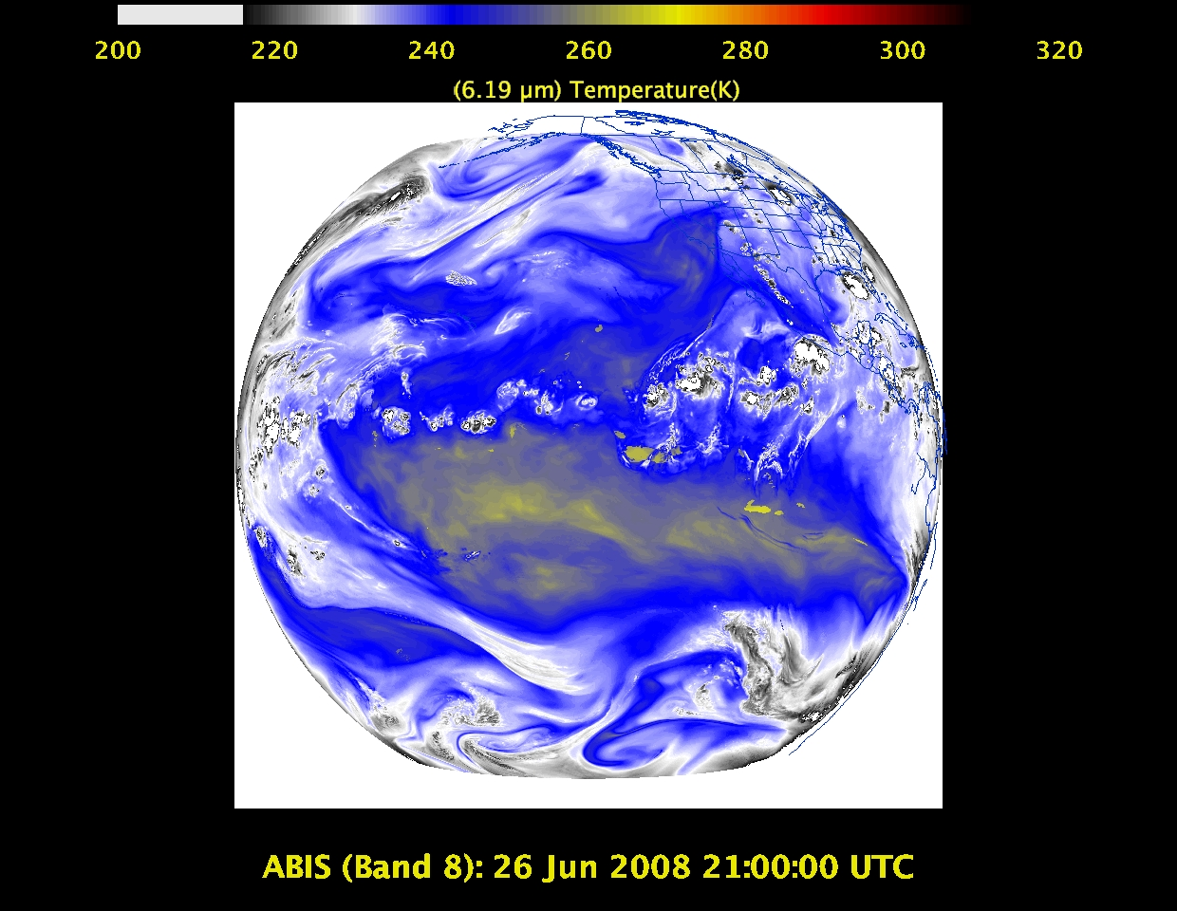
Upper-level tropospheric water vapor band – moisture, flow, winds

Slide 34
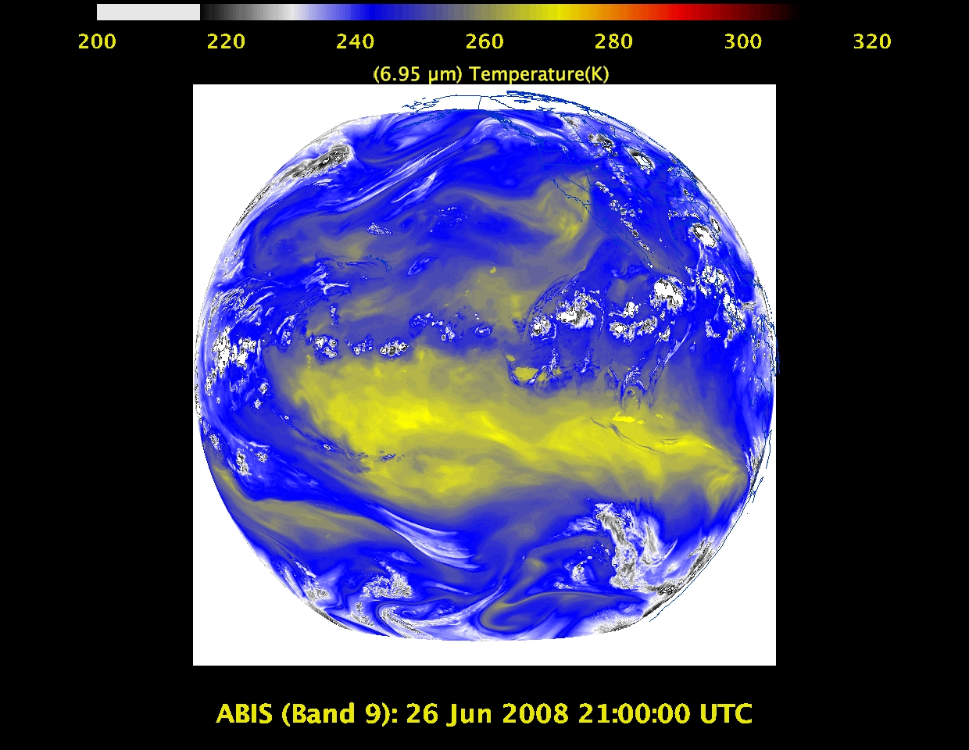
Upper/mid-level tropospheric water vapor band – moisture, flow, winds

Slide 35
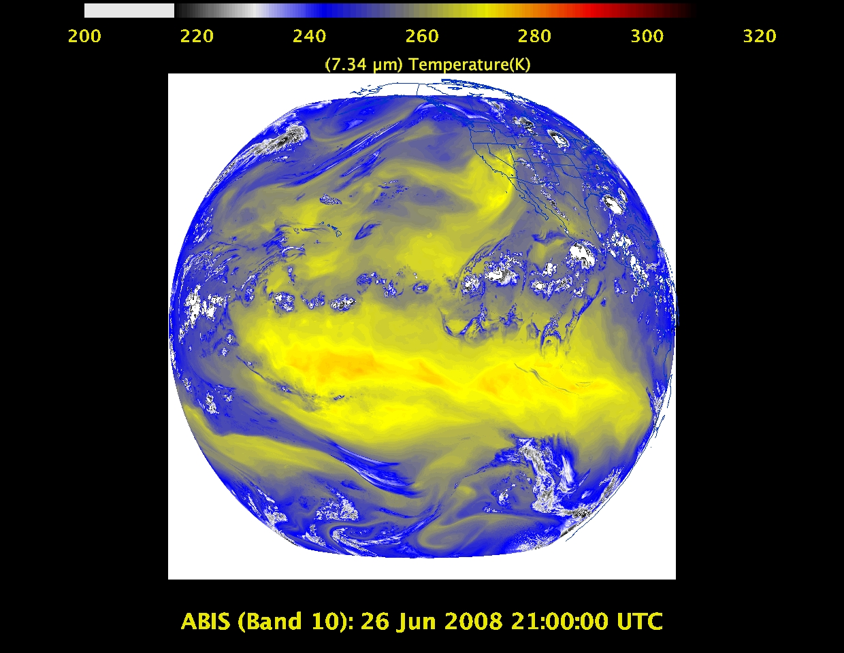
Lower mid-level tropospheric water vapor band– moisture, flow, winds

Slide 36
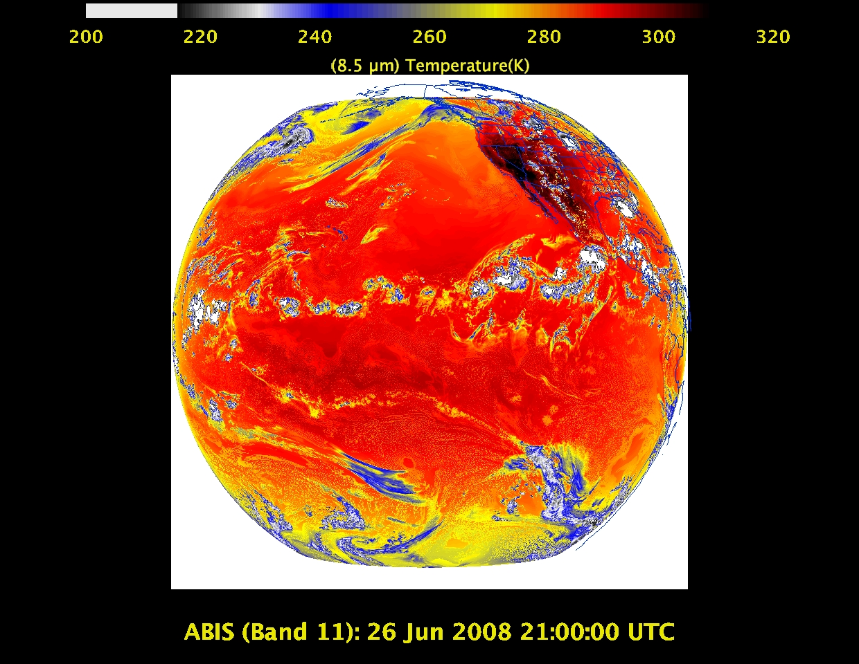
“Cloud-top phase” band – SO₂, dust, SST, stability indices, etc.

Slide 37
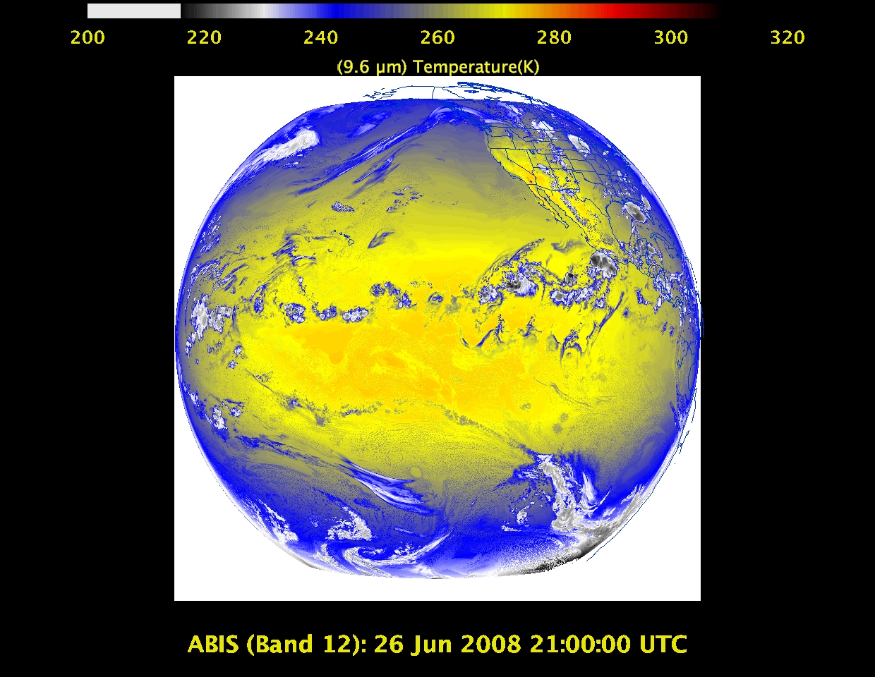
“Ozone” band

Slide 38
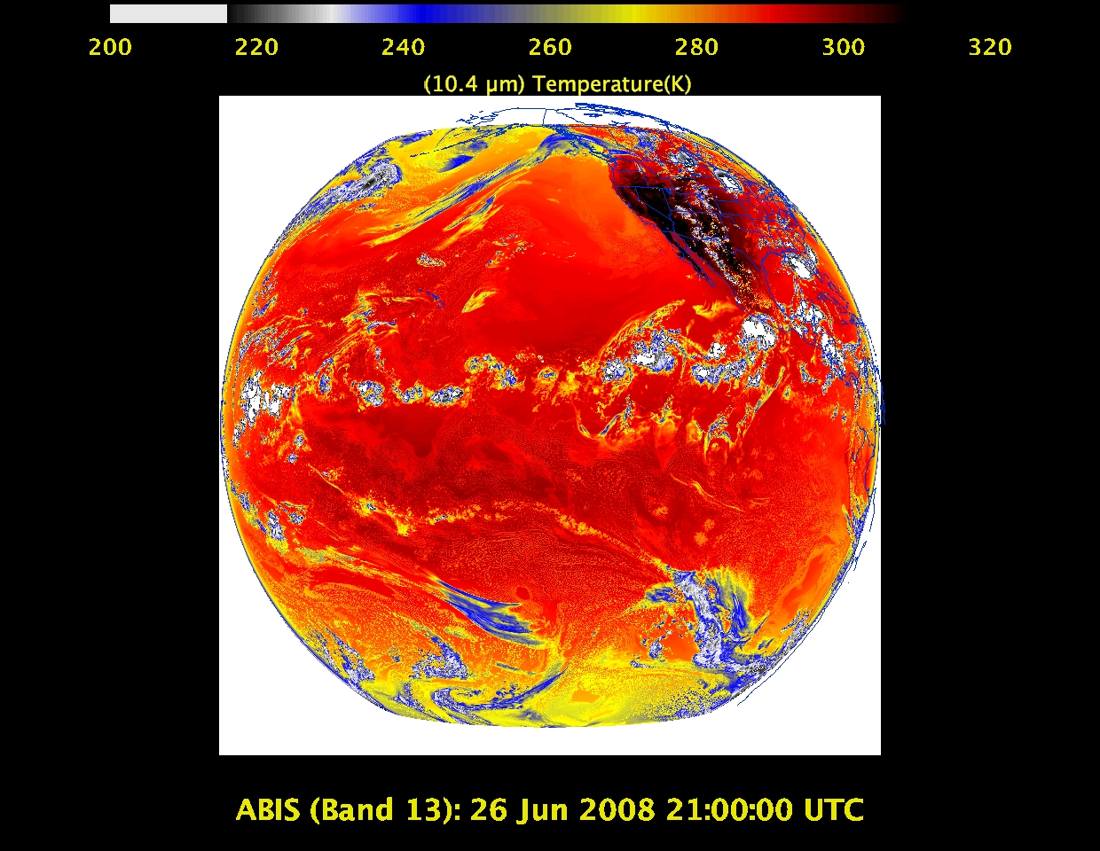
“Clean” IR longwave window band – imagery, TPW, etc.

Slide 39
IR longwave window band – many cloud parameters, SST, snow cover

Slide 40
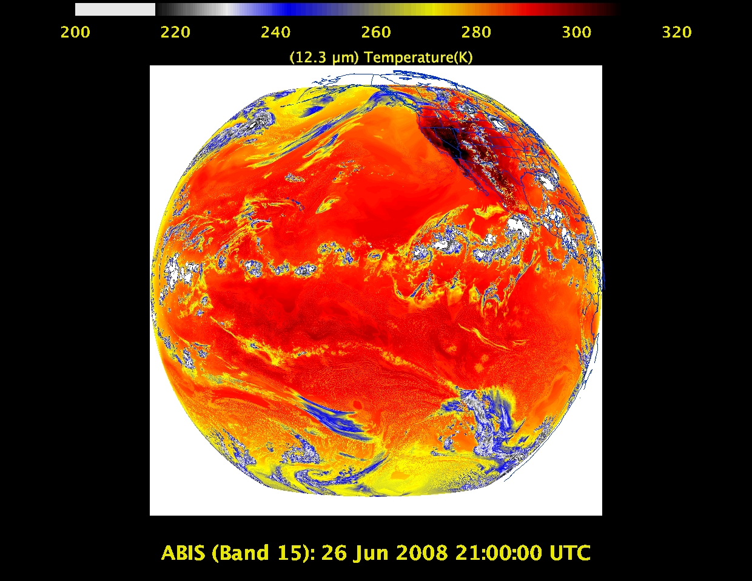
“Dirty” IR longwave window band – many cloud parameters, TPW

Slide 41
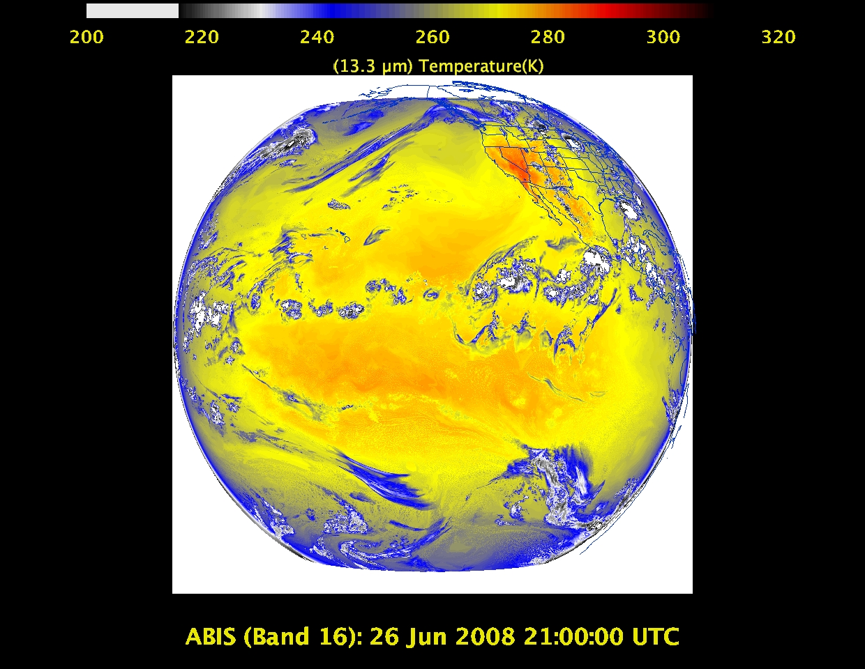
“CO2” longwave IR band – cloud height/pressure, stability indices

Slide 42
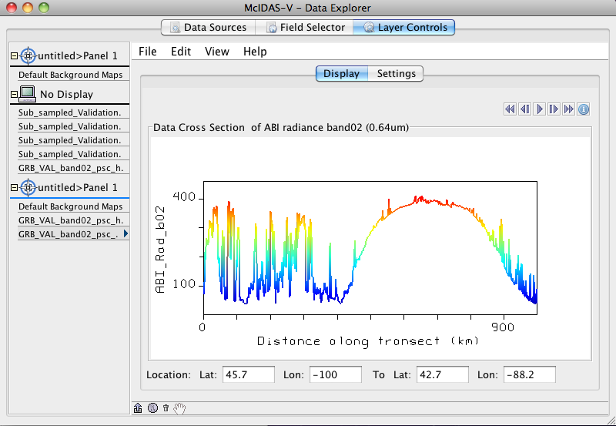
Transect (Mcidas-V)

Slide 43
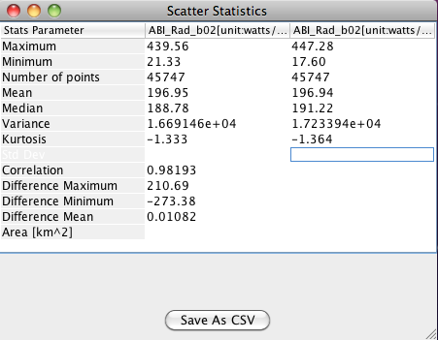
Interactive Scatter plot and Statistics

Slide 44
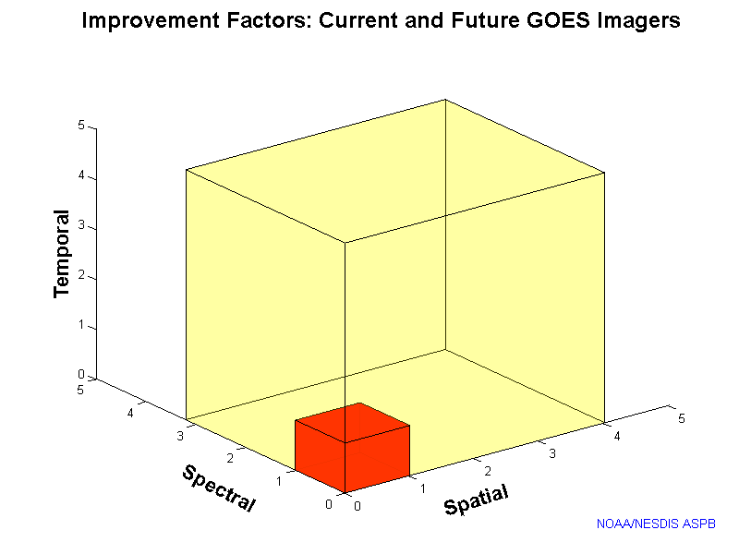
Outline
ABI (Advanced Baseline Imager)
Temporal
Spatial
Spectral
Products
Summary
More information
Questions

Slide 45
Approximate spectral and spatial resolutions of US GOES Imagers
~ Band Center (um) | GOES-6/7 | GOES-8/11 | GOES-12/N | GOES-O/P | GOES-R+
0.47
0.64
0.86
1.6
1.38
2.2
3.9
6.2
6.5/6.7/7 | 14km
7.3
8.5
9.7
10.35
11.2
12.3
13.3
Visible
Near-IR
Box size represents pixel size
8
4
2
“MSI mode”
Infrared
Notes:
0.40 inches = 4km; 0.80 inches = 8km
MSI is Multi-Spectral Imaging Mode (dashed boxes)
This does not show other improvements: SNR, MTF, bit-depth, navigation, coverage rates, etc.

Slide 46
Summary
The ABI on GOES-R will improve over the current instrument, including improved image navigation and registration and radiometer performance (colder patch temperatures, etc).
These improvements will greatly assist a host of data assimilation, NWP applications, and other applications.
Still need the vertical resolution of high-spectral, high-temporal observations!

Slide 47
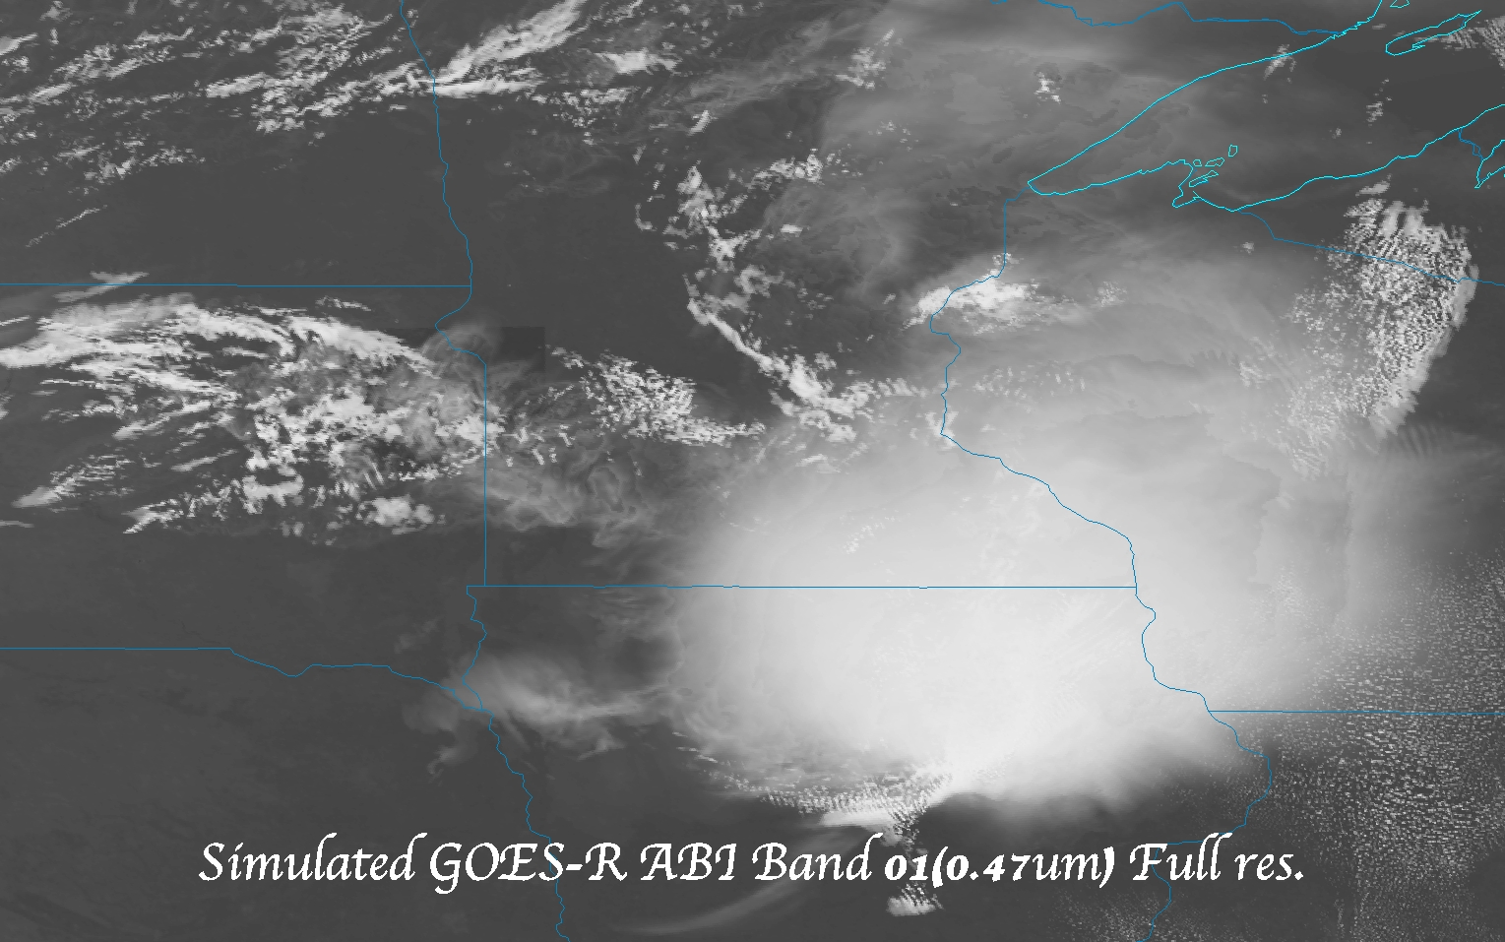
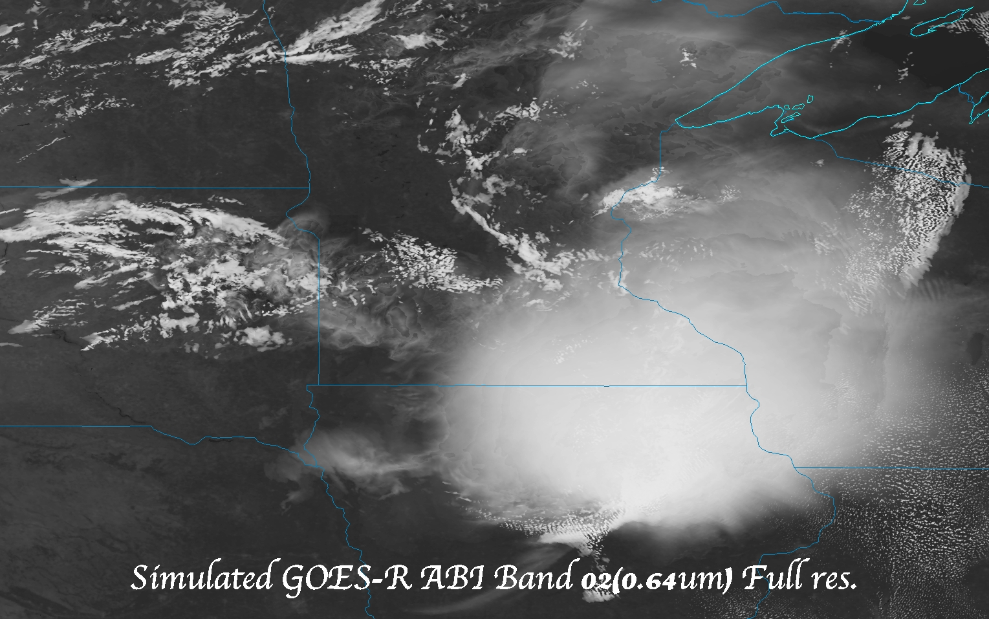
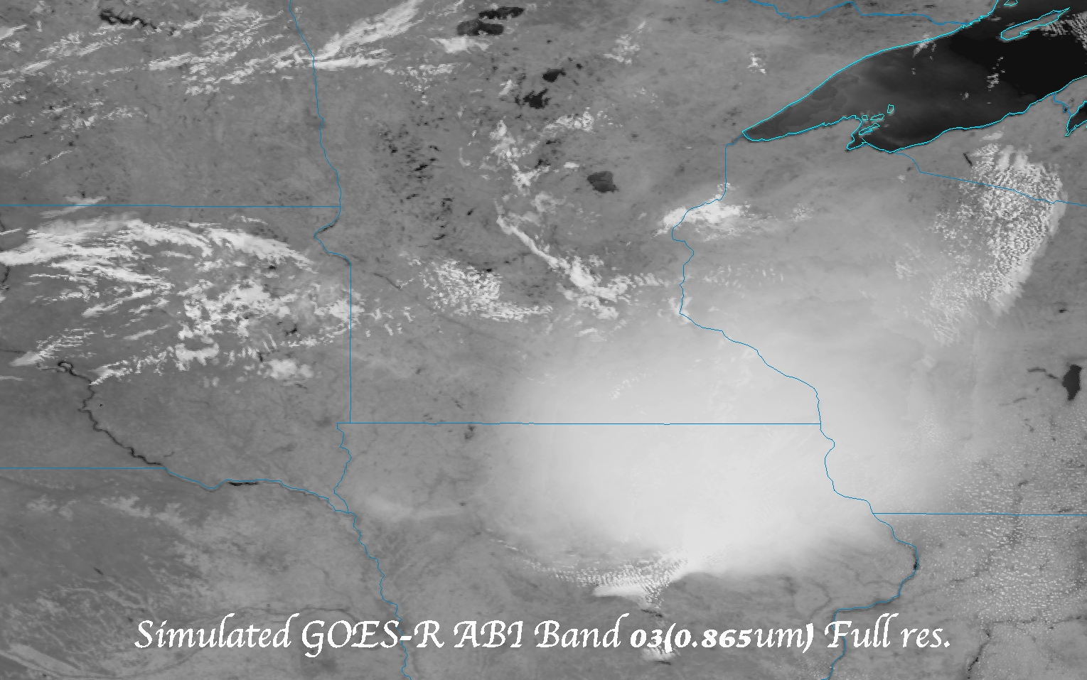
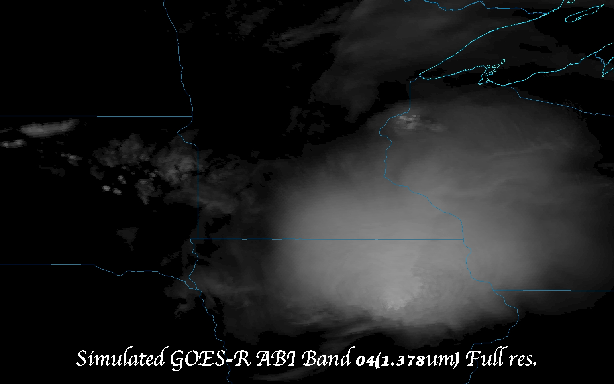
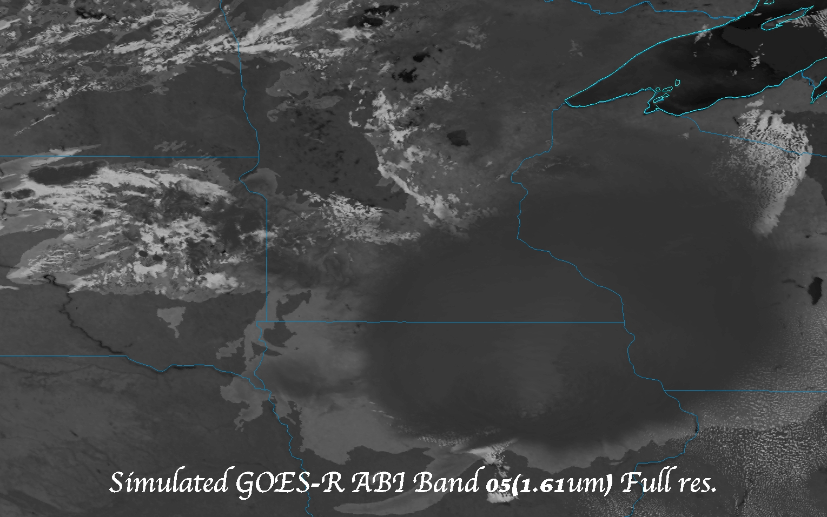
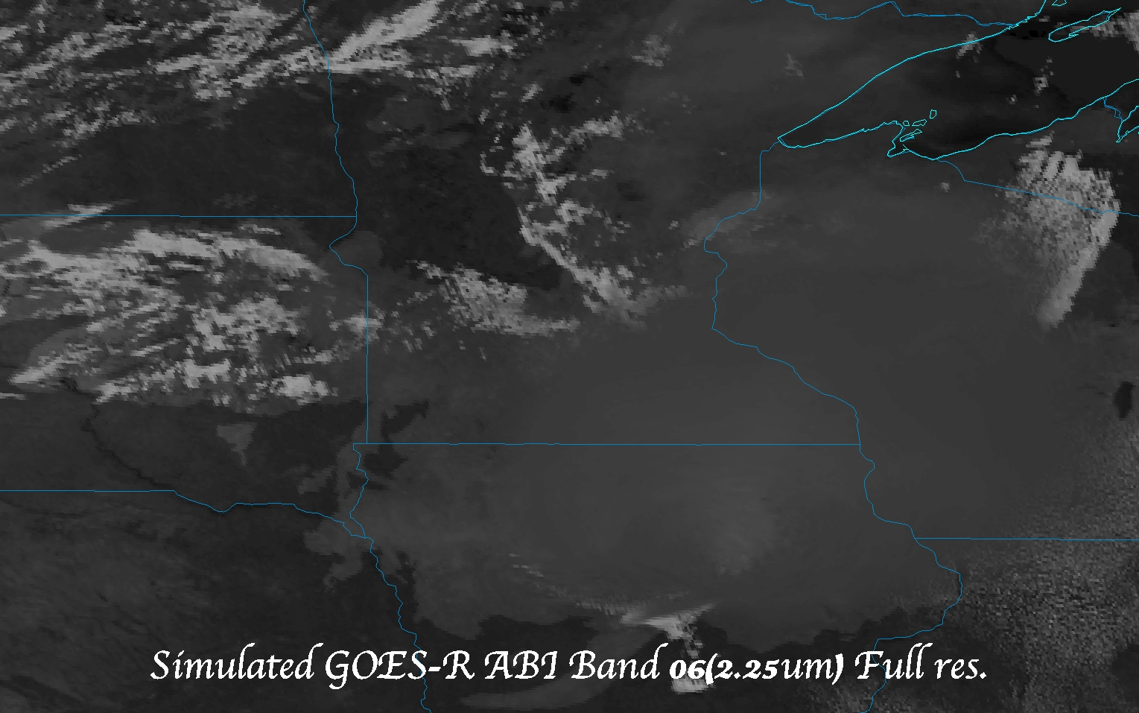
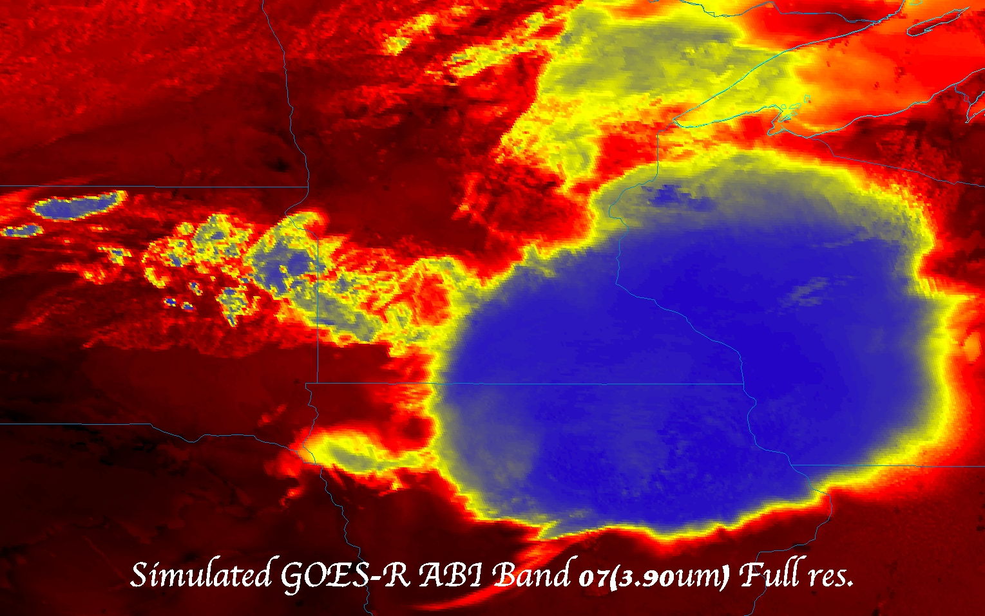
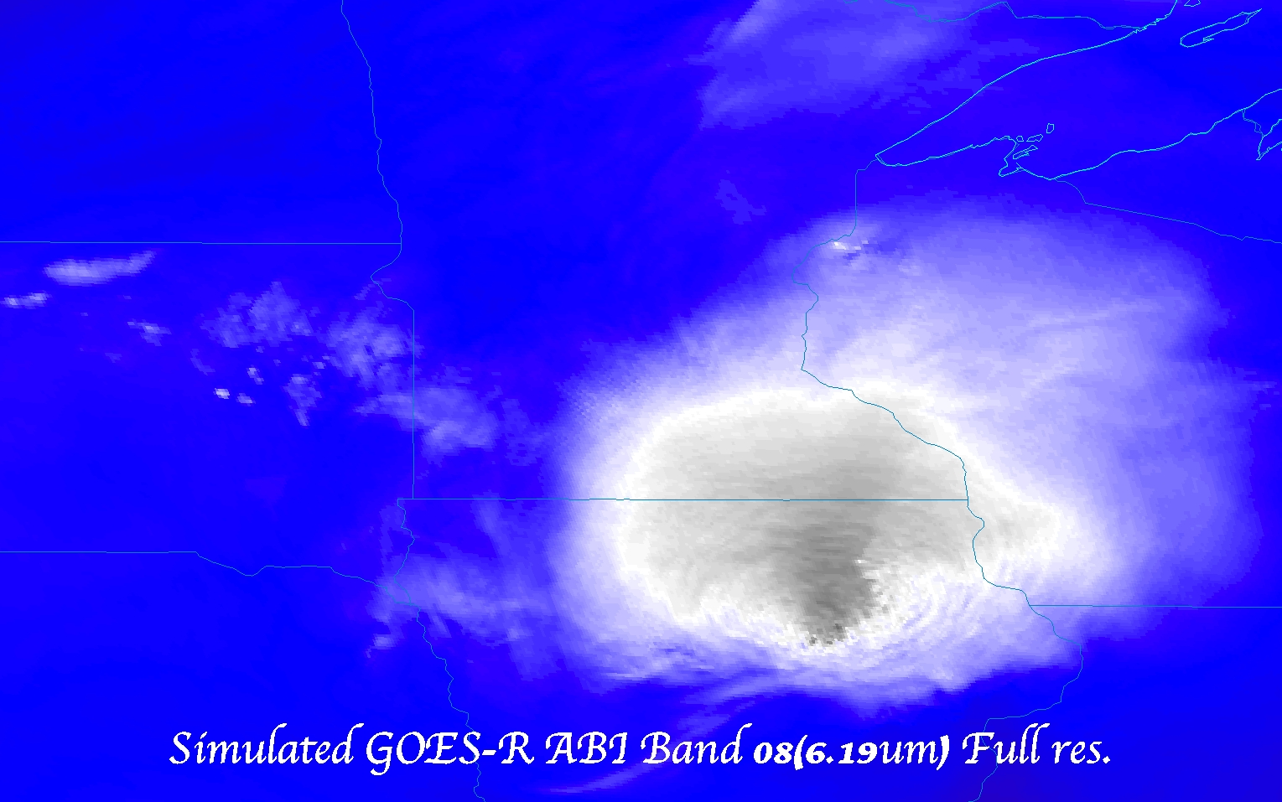
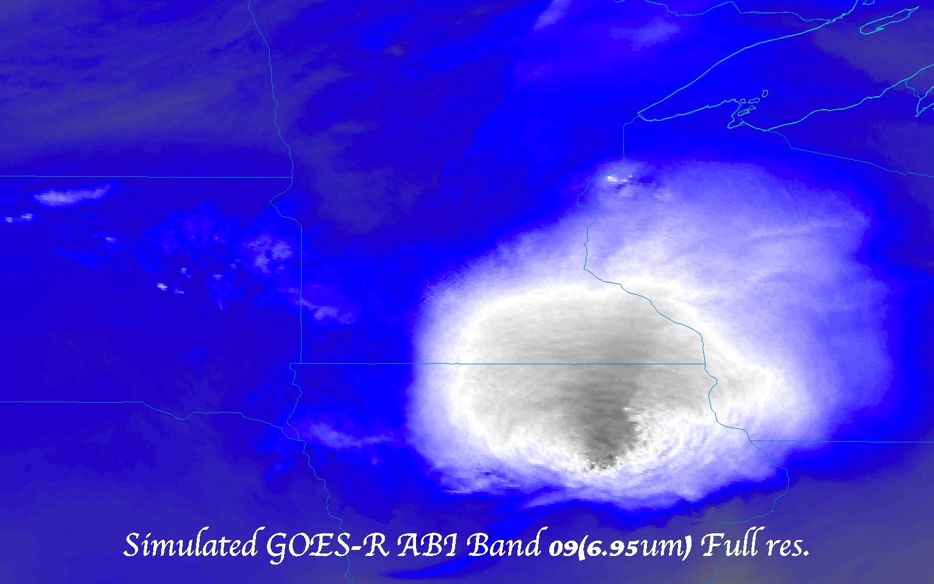
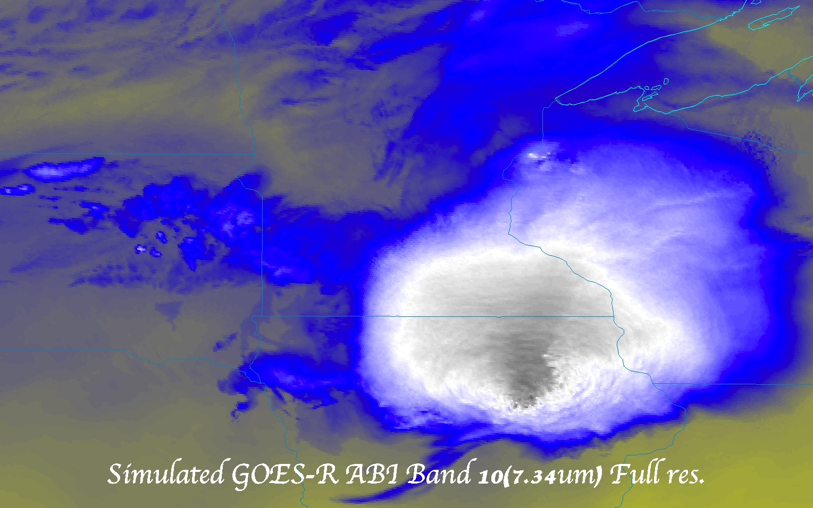
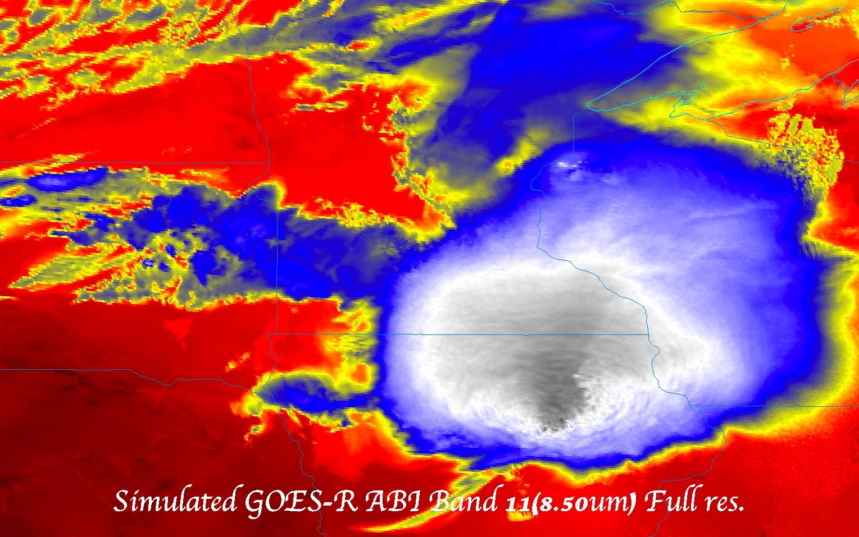
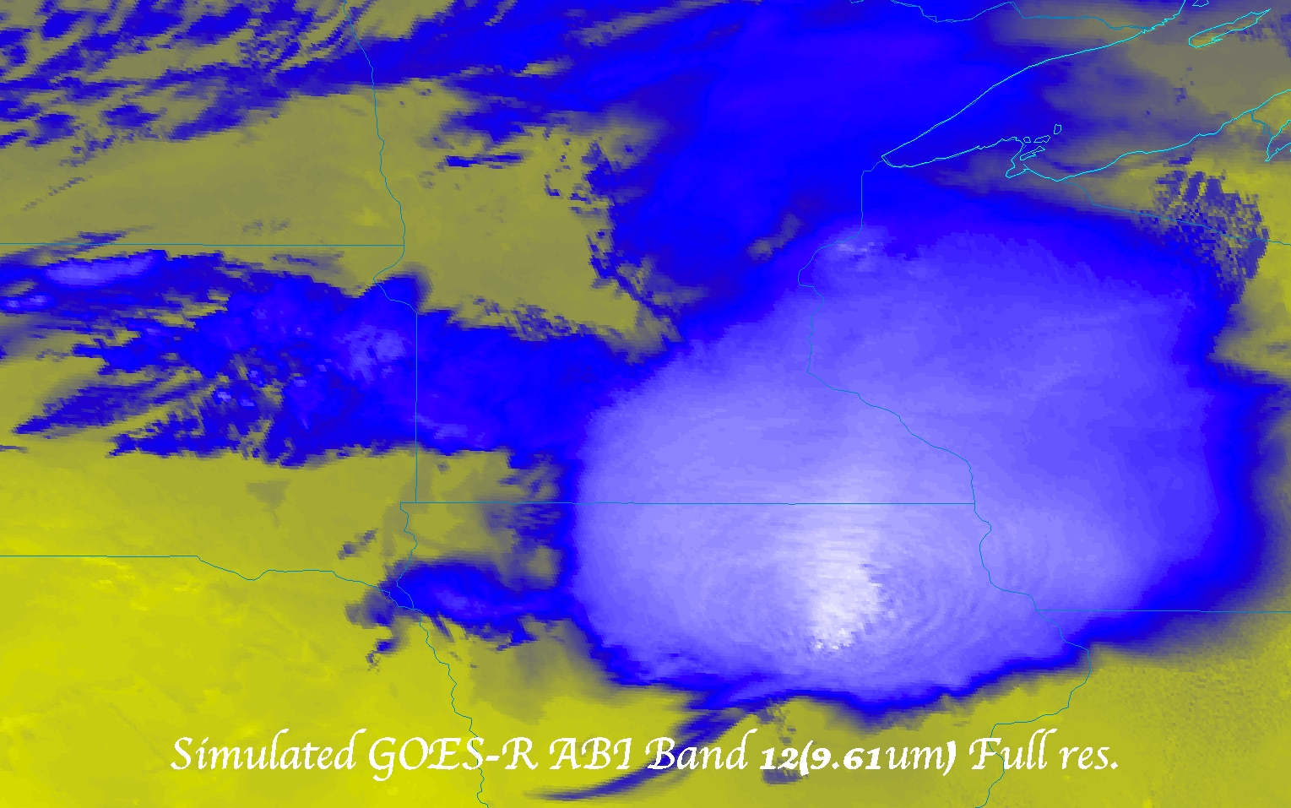

Slide 48
More information
GOES-R:
http://www.goes-r.gov
http://www.meted.ucar.edu/index.htm
http://cimss.ssec.wisc.edu/goes_r/proving-ground.html
GOES and NASA:
http://goespoes.gsfc.nasa.gov/goes/index.html
http://goes.gsfc.nasa.gov/text/goes.databookn.html
UW/SSEC/CIMSS/ASPB:
http://cimss.ssec.wisc.edu/goes_r/proving-ground/nssl_abi/nssl_abi_rt.html
http://cimss.ssec.wisc.edu/goes_r/awg/proxy/nwp/
http://cimss.ssec.wisc.edu/goes/abi/
http://cimss.ssec.wisc.edu/goes/abi/wf
http://cimss.ssec.wisc.edu/goes/blog/
http://www.ssec.wisc.edu/data/geo/
AMS BAMS Article on the ABI (Aug. 2005)

Slide 49
Acknowledgements
The authors would like to thank the entire GOES-R team (especially the GOES-R Program Office); within the government, industry and academia.
The views, opinions, and findings contained in this presentation are those of the author and should not be construed as an official National Oceanic and Atmospheric Administration or U.S. Government position, policy, or decision.
What do these notes have to do with the ABI?
49

Slide 50
Progress!

