Slide 1
University of Wisconsin SSEC Data Center
May 7, 2012

Slide 2
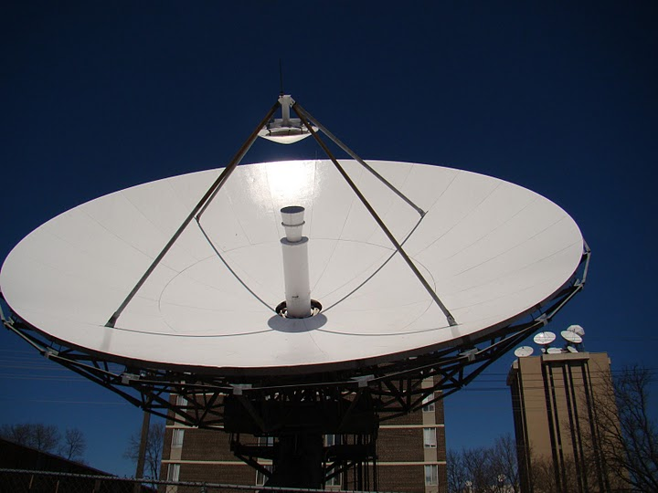
SSEC Data Center
The SSEC Data Center mission is to create and maintain the facilities, human expertise and technology necessary to provide SSEC scientists and collaborators with the highest quality geophysical data in a timely fashion and to provide real-time data access, archive and retrieval services as necessary to support SSEC’s scientific programs.
The Data Center is treated as a project and is expected to breakeven.
The Data Center is supported through data services. ALL users pay for services, both internal to SSEC and the outside community.

Slide 3
SSEC Data Center - Activities
Assist Satellite Operations Control Center and other agencies in satellite checkout and troubleshooting of related problems
Support to field experiments
Special archiving
Extended staffing, either on-call or on-site
Provide large dataset backups for users
Read, write, and copy tapes
Provide specialized archives of user data
Provide Help Desk support to users of the SSEC SDI, and assist in the generation of SDI user documentation
Assist McIDAS User Services team with McIDAS testing for system upgrades
Provide archive data to in-house and external users
Top level provider of GOES data to the Unidata UNIWISC IDD feed, and hosts Unidata server for IDD relaying and GOES ADDE serving

Slide 4
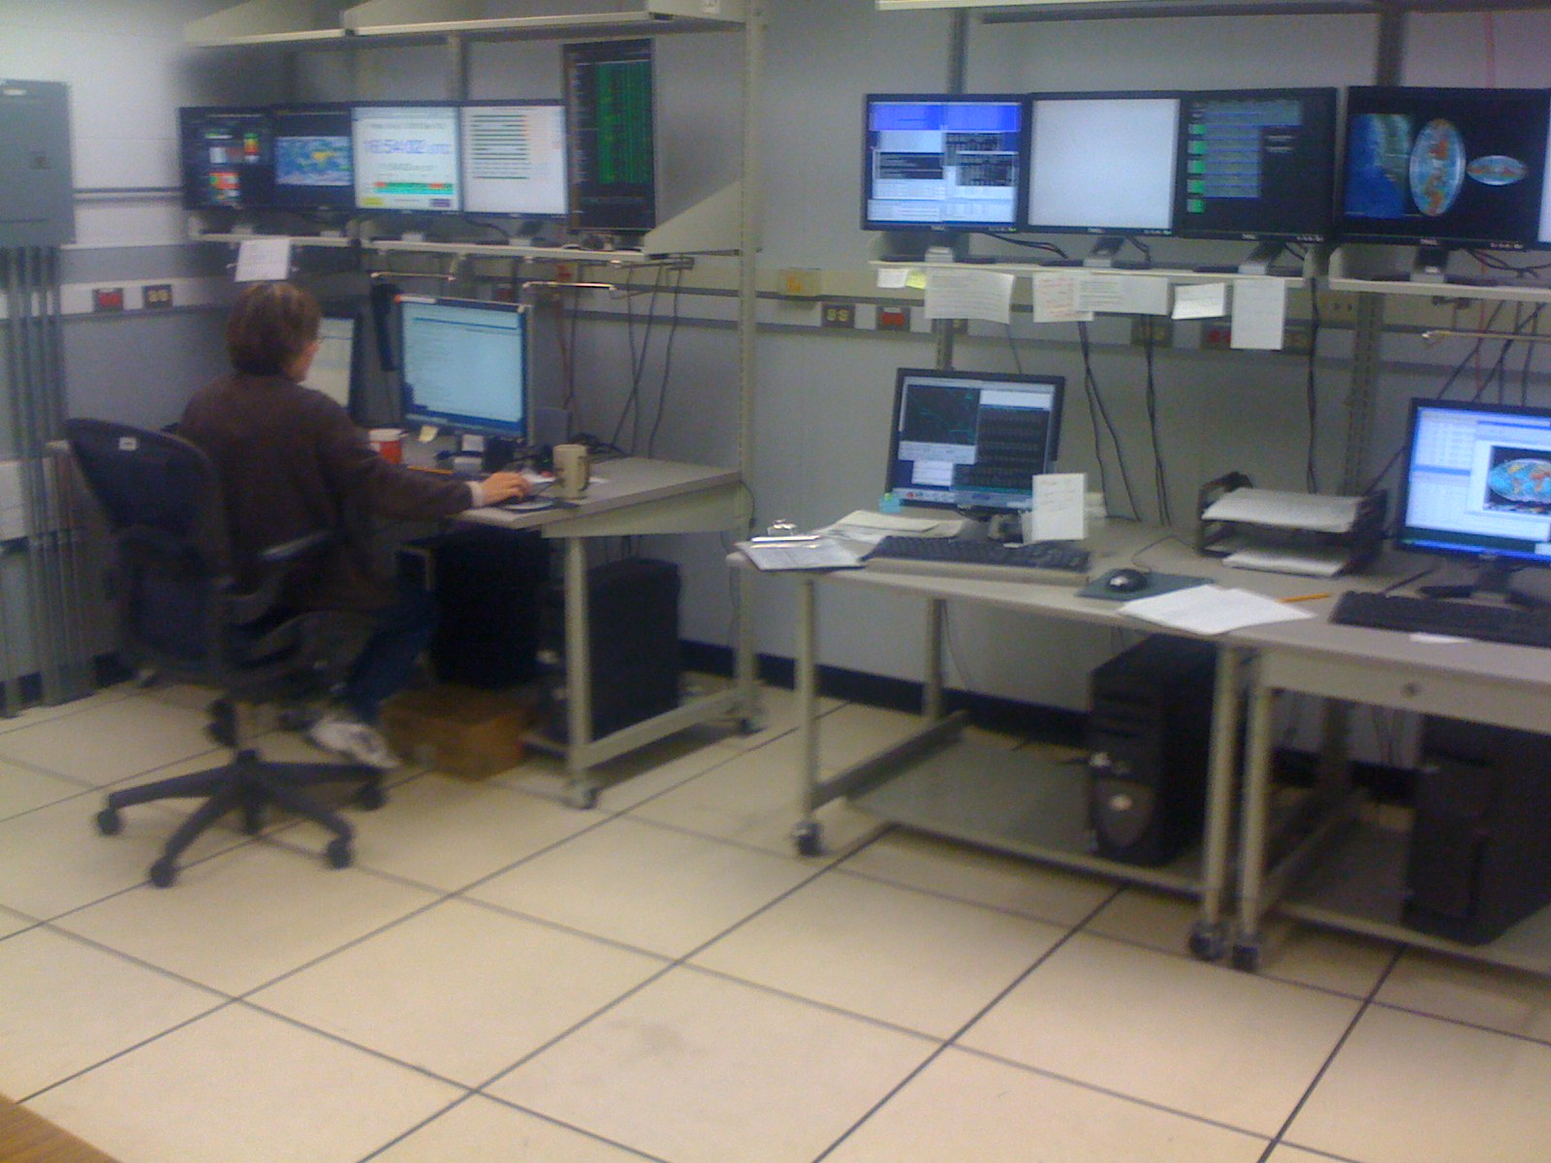
SSEC Data Center - Staff
Staffed M-F , 7:30 AM - 11:00 pm Central time.
3 FTE ~100% time
Archivist & Computer Operator (1st shift)
Computer Operator (1st shift)
Computer Operator (2nd shift)
5 FTE ~portions of their time
Program Manager
System Programmer
Data Base Programmer
Research Specialist (PM assistant)
Antenna/Communication technician
1 Student programmer
1 Student archive assistant

Slide 5
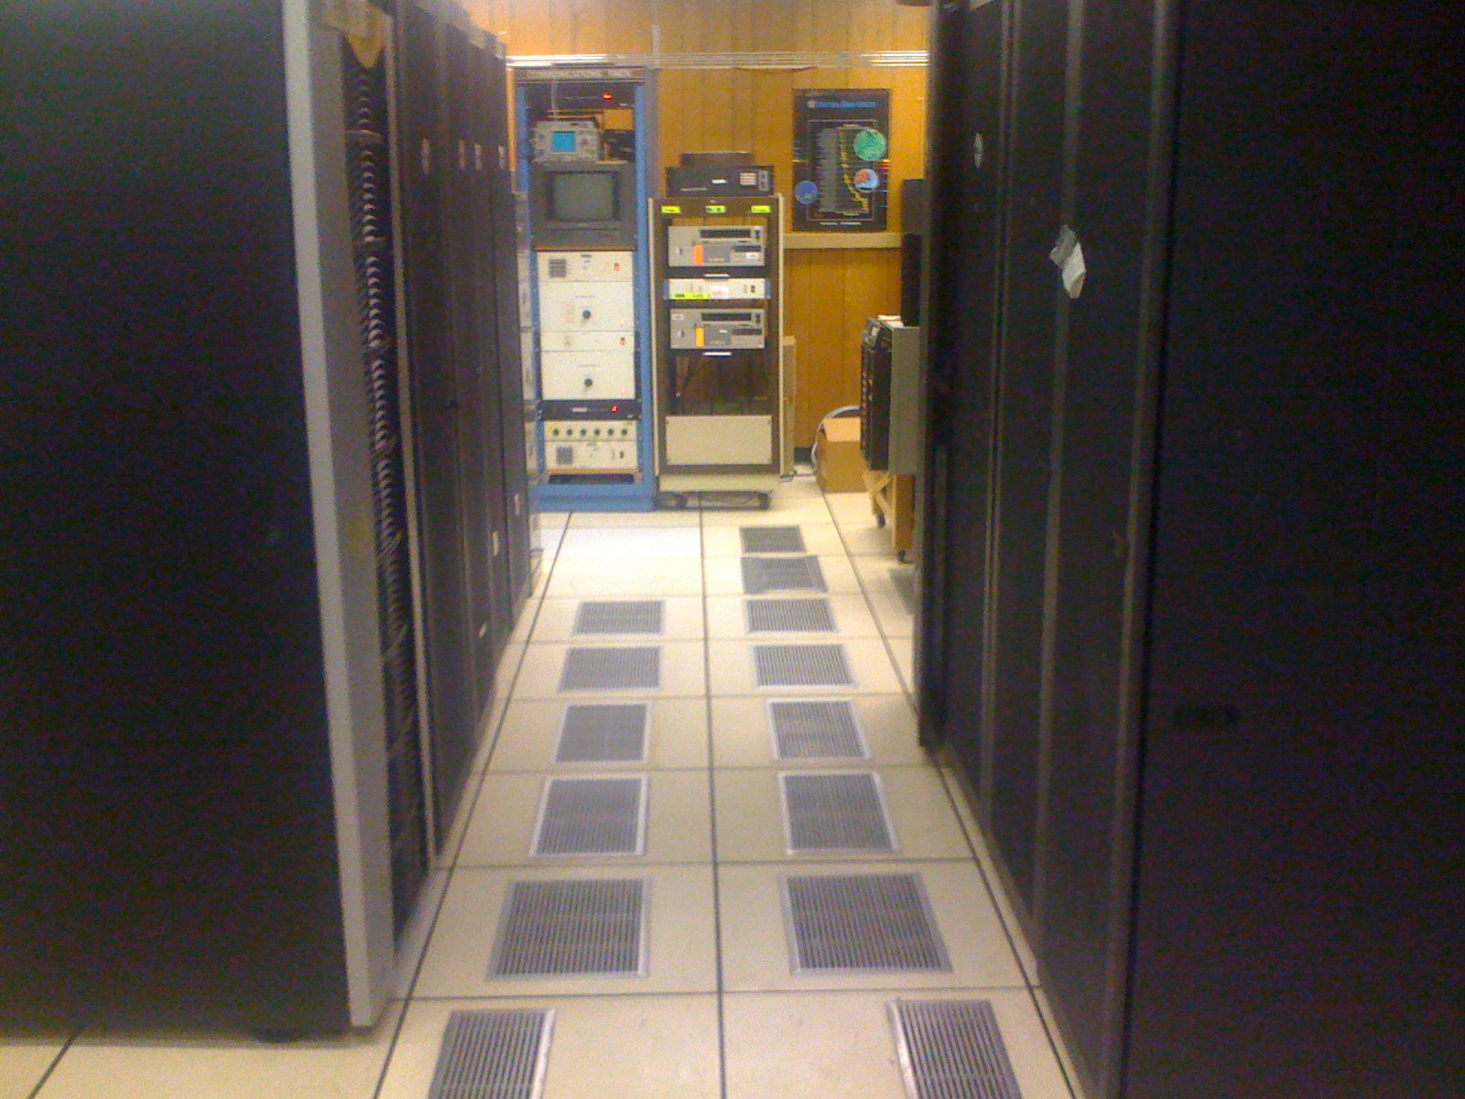
Data Center Facilities
Over 2100 ft.
Currently the Data Center has 39 racks representing over 1600 rack units of space.
Data Center staff monitors 60+ servers and over 1.2 PB of disk. The entire room’s disk storage exceed 2 PBs.
The entire room is on three 72 KW UPSs, of which, about 150 KW are in use. Non UPS power usage is ~20 KW.
Cooling provided by campus chilled water and outside air in the winter. Racks on North end of the room are cooled by 12 in row APC coolers.
Gigabit network (also 100 MB admin network, 40 Gigabit infiniband).

Slide 6
Facilities layout
Early 2012
Peate System
Shared Systems
Legacy Ingestors
Real-time Processing
Data Center Control Room
In row Cooling Water Distribution
Geostationary Archive System
GOES AWG System
Badger Cluster
Satellite Comm Rack
And SDI-104 ingestors
GB Network switches

Slide 7
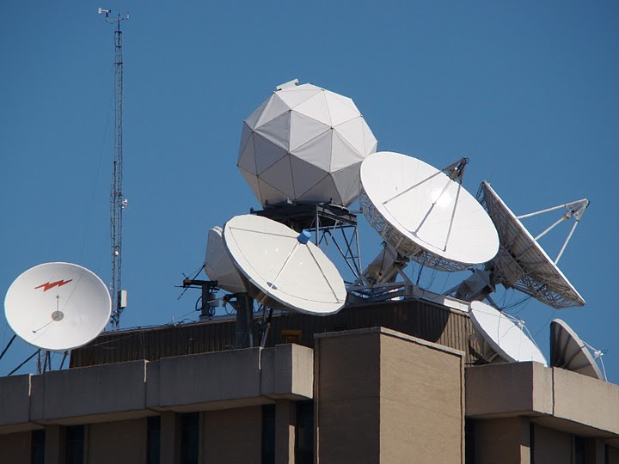
Data Center Antennas
C-Band
11 meter (87° West - POES Wallops Relay, MSG)
7.3 meter (101° West – POES Fairbanks Relay, MTSAT, Noaaport)
6.3 meter heated backup (101° West – POES Fairbanks Relay, MTSAT, Noaaport)
L-Band
7.3 meter (75° West –GOES-East Primary)
4.6 meter (135° West –GOES-West Primary)
4.5 meter (60° West –GOES-SA auto tracking)
4.5 meter (105° West –GOES-test/spare)
3.7 meter (offline spare)
X-Band
4.4 meter (Tracking – EOS)
X/L Band
2.4 meter (Tracking – Suomi NPP, EOS,metop, FY1 and FY3)

Slide 8
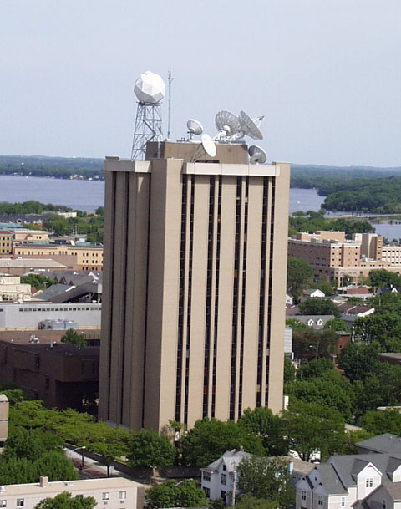
SSEC Data Center Incoming Data February 2012
170+ GB/day
via Satellite
(C-band. L-band, X-band)
GOES satellites ~96 GB/day
International Geo Satellites ~47 GB/day
NOAA Polar ~27 GB/day
Miscellaneous Polar and Non satellite ~85 GB/day
MODIS polar from NASA archive ~150 GB/day
NPP (VIIRS CrIS ATMS) ~700 GB/day
935+ GB/day
via Internet
(ftp, LDM, ADDE, http)

Slide 9
SSEC Data Center Outgoing Data
Four primary methods of Data delivery
ADDE
HTTP
FTP
LDM (Unidata local data manager)
HTTP
ADDE
LDM
FTP

Slide 10
Outgoing Data February 2012
On average over 1 million ADDE transactions per day
Over 1 TB data distributed per day

Slide 11
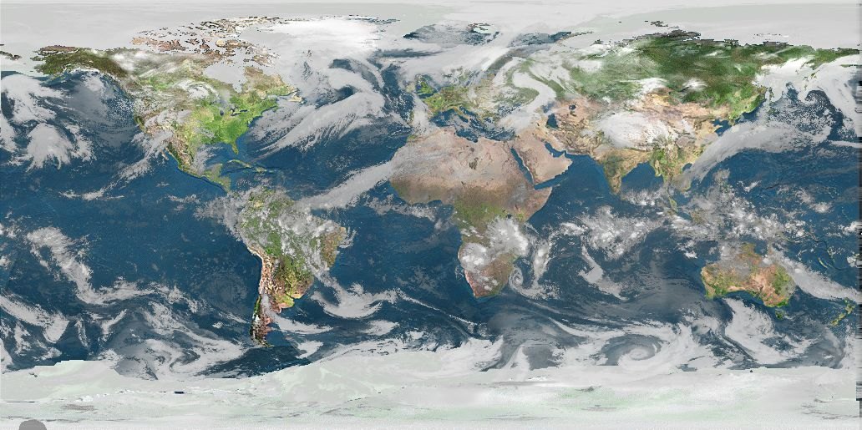
Geostationary Satellites
GOES East/West/ S. America
FY-2
MTSAT
Kalpana
Meteosat (access restricted)
Real-time Data
The SSEC Data Center receives data from 9 different geostationary satellites and 10 different polar orbiting satellites. Most data are available in near real-time via ADDE. Other methods of data access are available upon request.
Polar Satellites
NOAA AVHRR
NPP
METOP
EOS (AQUA/TERRA)
FY1,FY3
NOAAPORT/Conventional Data
Model Output (GFS, RAP, etc)
NEXRAD
NWS Text output

Slide 12
Current Real-Time Satellite Data availability (ADDE and/or ftp)
Geostationary
US |  |  | Eumetsat |  |  | Japan |  |  |  | India |  |  |  | China
Dataset | Delay |  | Dataset |  | Delay | Dataset |  | Delay |  | Dataset |  | Delay |  | Dataset |  | Delay
GOES-15 (WEST) GOES-13 (EAST) GOES-12 (SA) | < 5 min |  | Meteosat-9 (Prime) Meteosat-7 (IODC) |  | <15 min | MTSAT-2 |  | <5 min |  | Kalpana1 |  | .75 – 2+ hours |  | FY-2D FY-2E |  | 15-30 min
Polar
NOAA POES (Wallops and Gilmore Creek DOMSAT Relays, and DDS) |  |  |  | EOS |  |  |  |  | Suomi NPP |  |  |  | Other
Dataset |  | Delay |  | Dataset |  |  | Delay |  | Dataset |  |  |  | Dataset |  | Delay
NOAA-15 NOAA-16 NOAA-18 NOAA-19 |  | GAC 1.5 hours – 6+hours HRPT <20 minutes |  | AQUA TERRA |  |  | <30 min |  | VIIRS CRIS ATM |  | <30 min |  | METOP FY1, FY3 |  | 1.5 hours – 6+hours < 10 minutes after pass

Slide 13
Archive Data
Over 685 TBs online.
Geostationary Satellites
SMS-1&2 (1978-1981)
GOES-1 through GOES-7 (1978-1996)
GOES-8 through GOES-15 (1994-Present) (East, West and South America)
International Geo Satellites
GMS/MTSAT (1998-Present)
Meteosat/Meteosat IODC (1998-Present)
FY2 (2004-Present)
Kalpana (2005-Present)
NOAAPORT/Conventional Data
Model Output (1996-Present)*
Insitu Point Observations (1976-Present)
*available via ADDE and THREDDS

Slide 14
Recent Data Center Changes

Slide 15
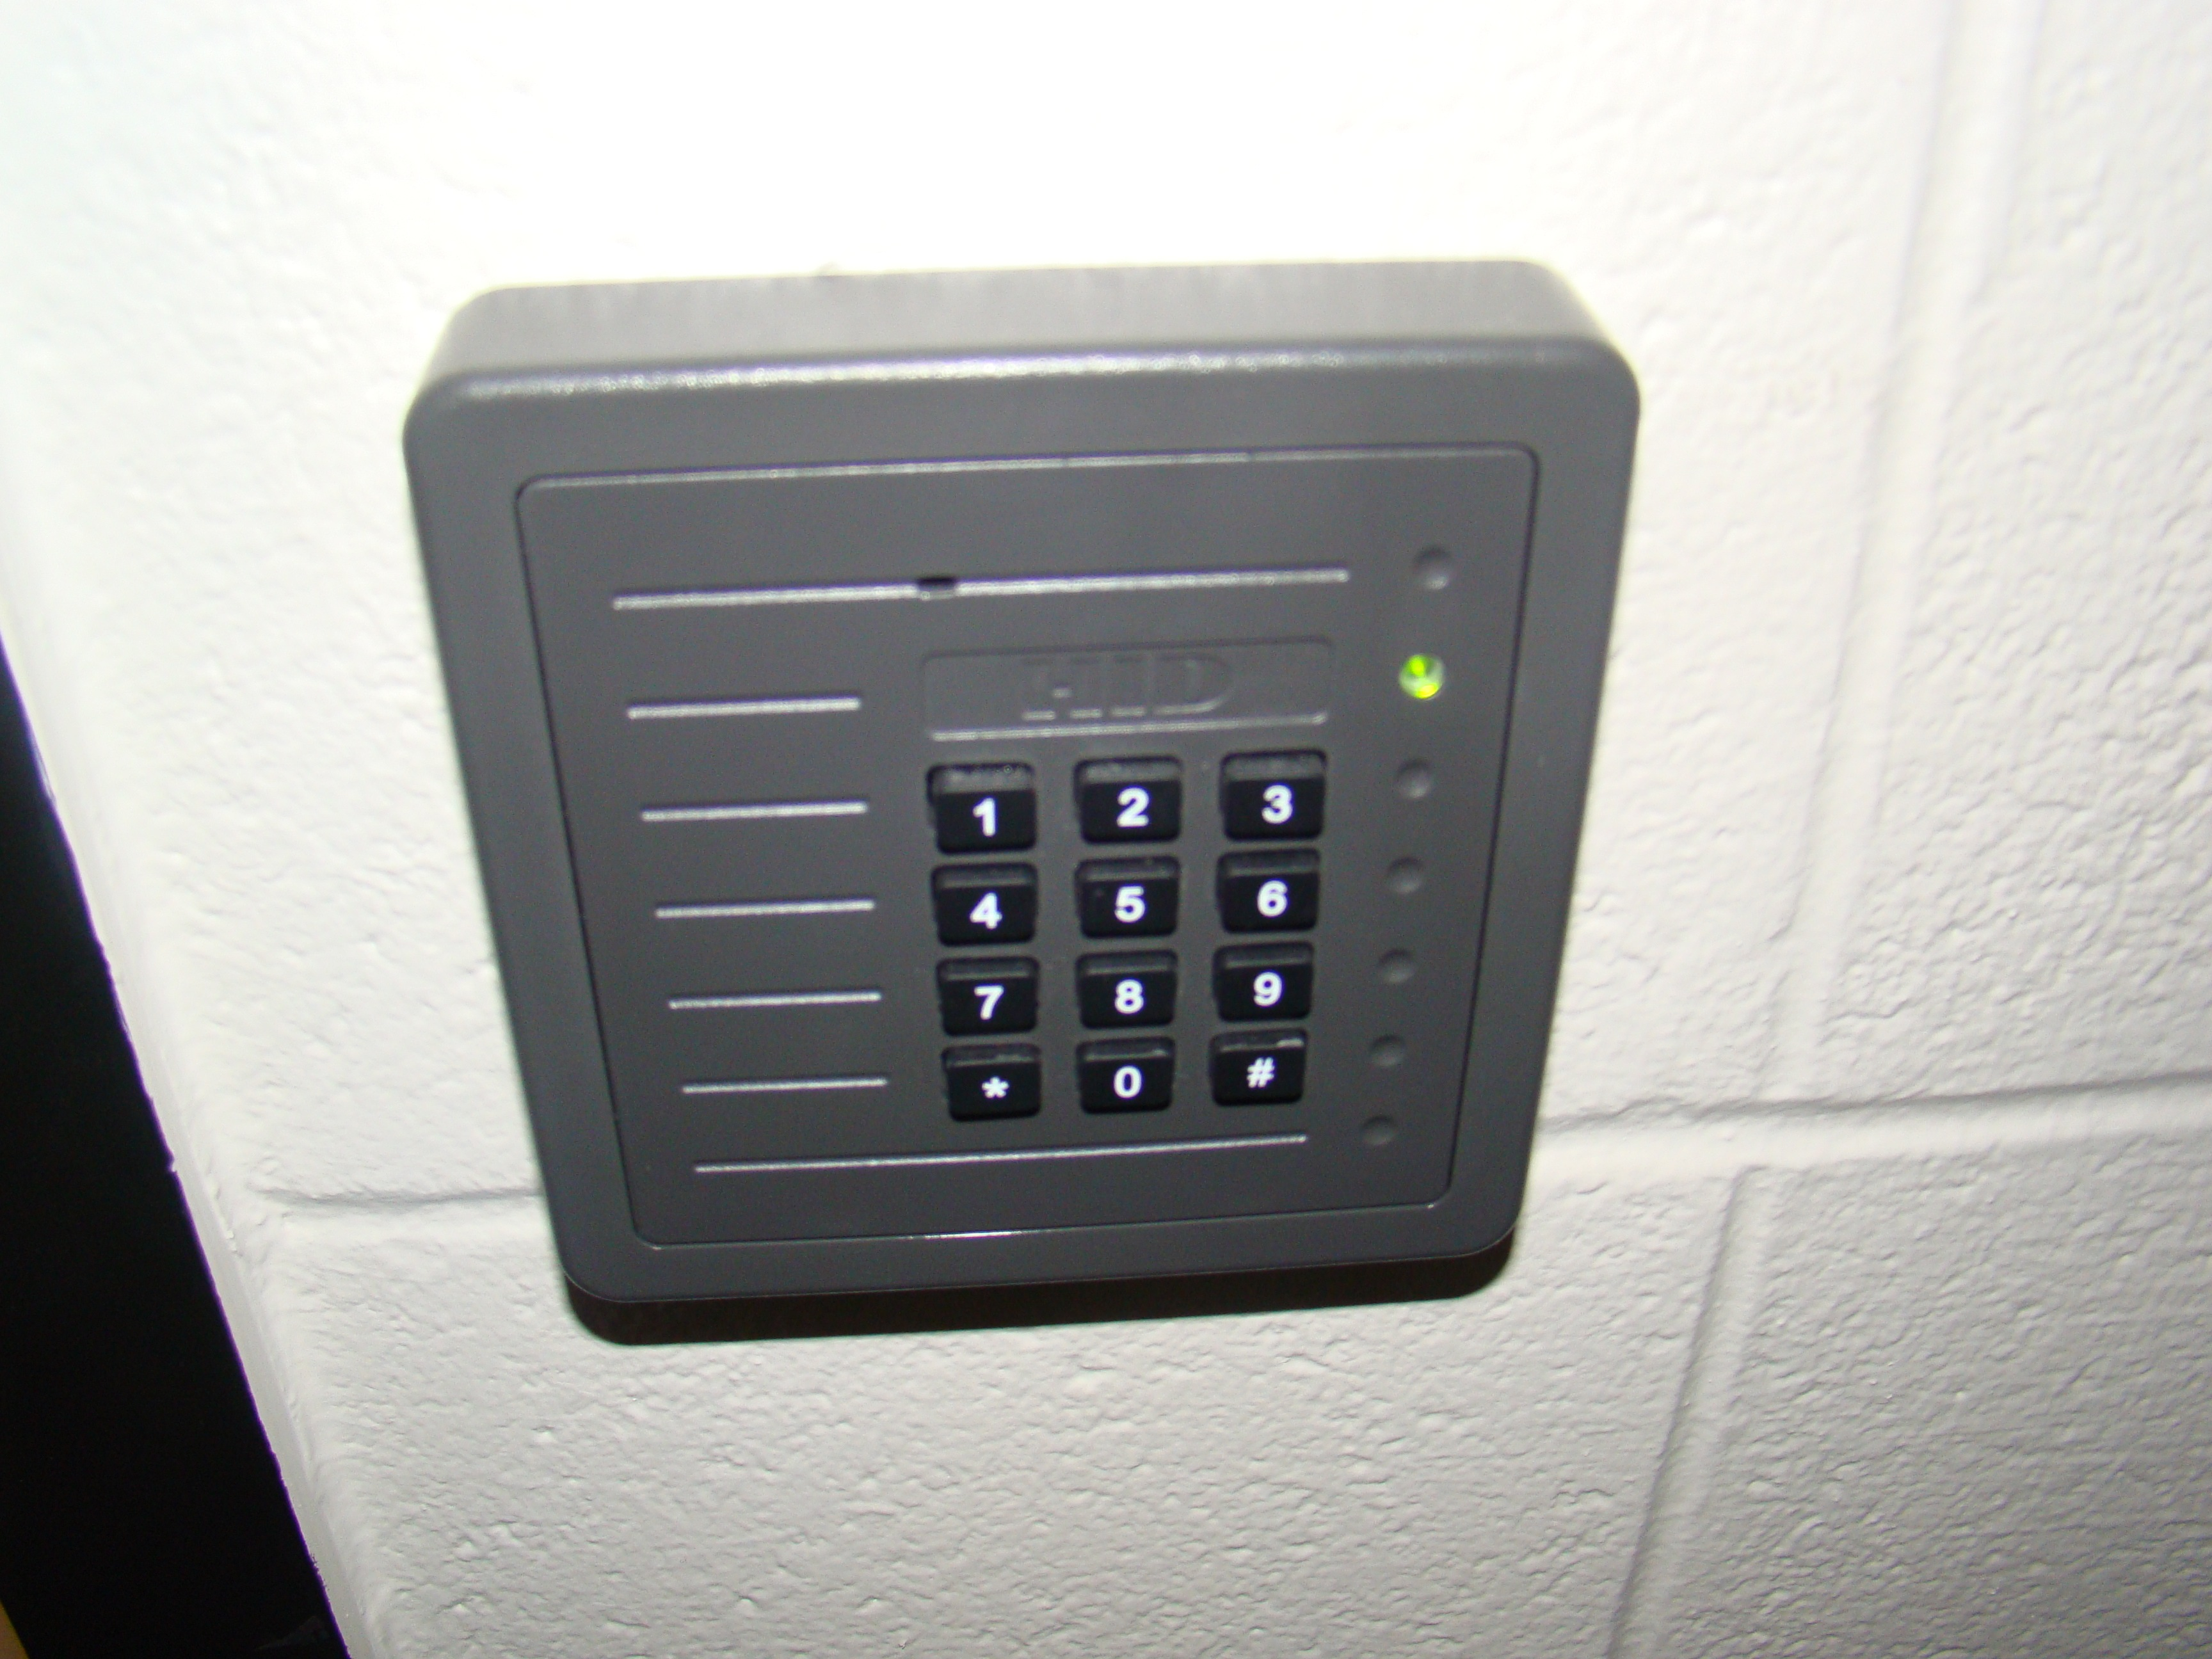
Increased Computer Room Security

Slide 16
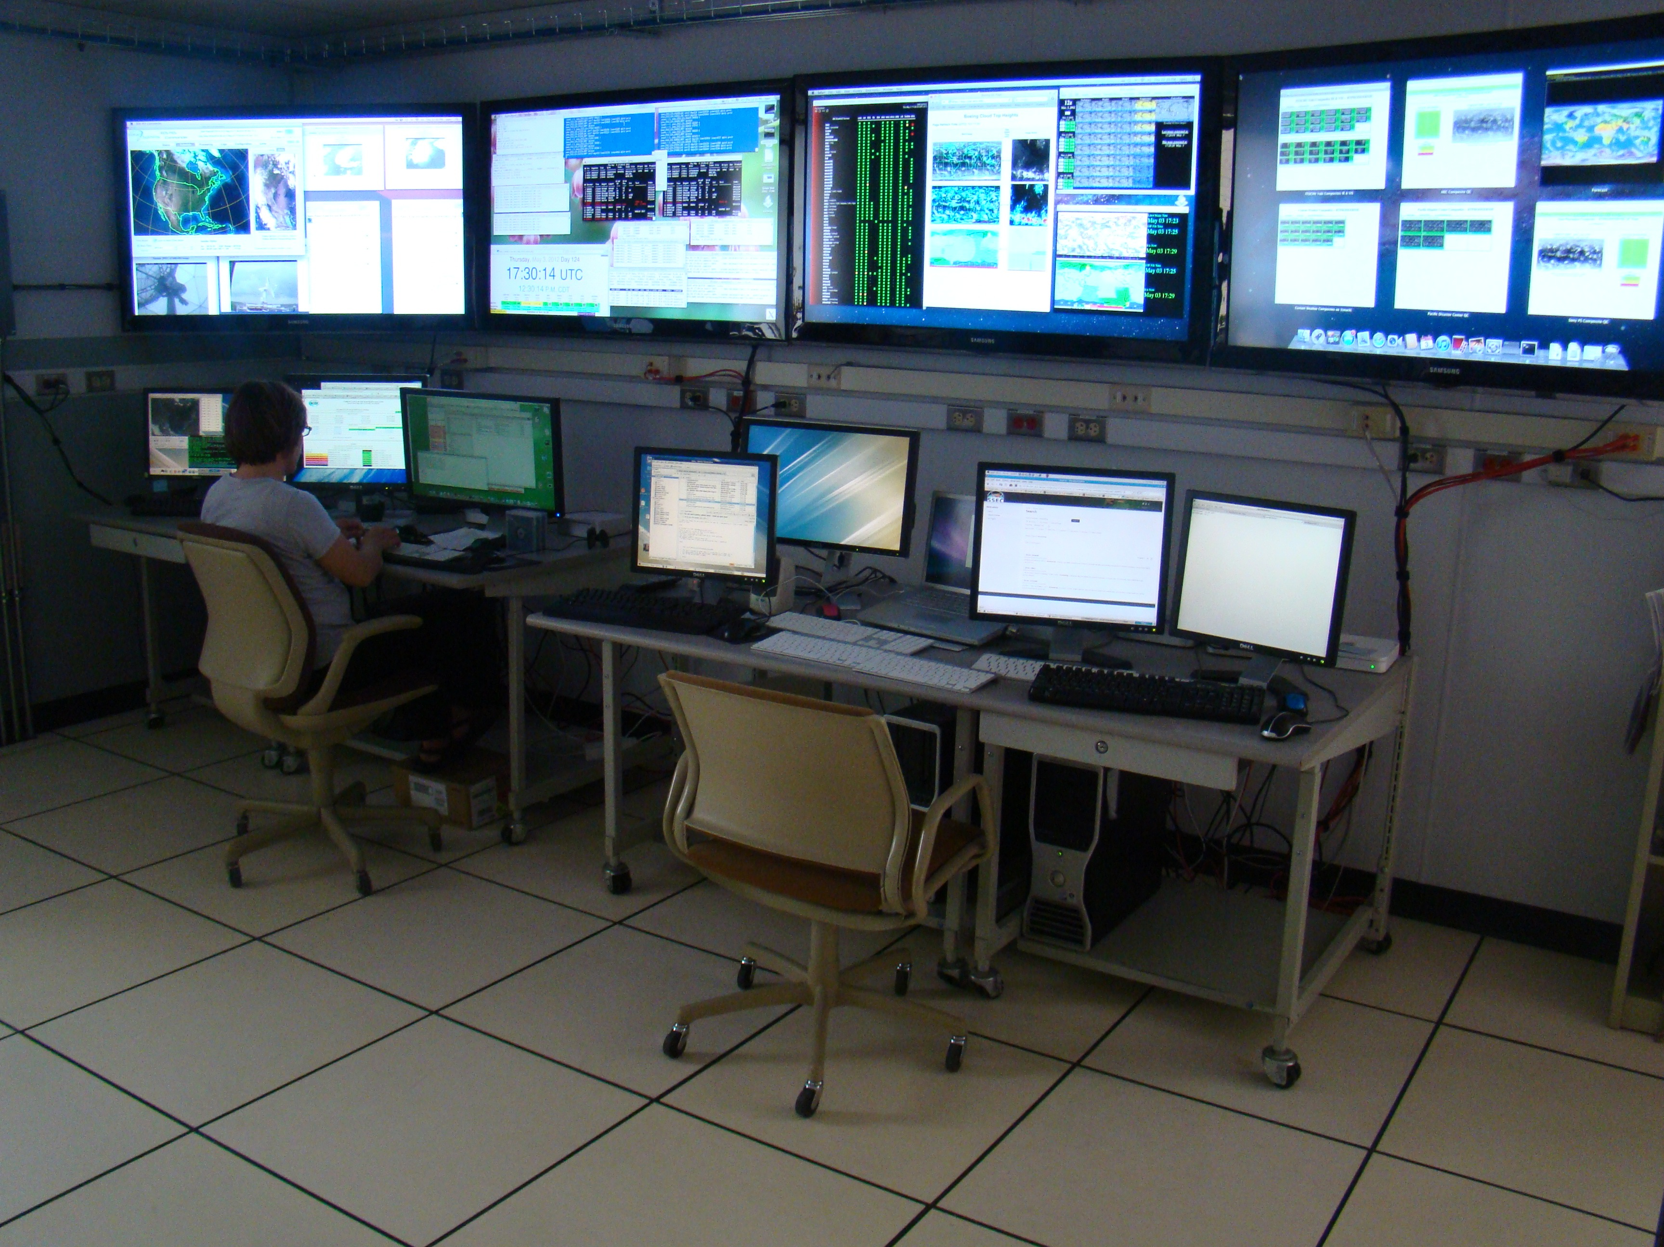
Update to Control room

Slide 17
New Programmer
Kevin Hallock
Data Center Support
New Archive metadata Database and Inventory interface
XCD replacement

Slide 18
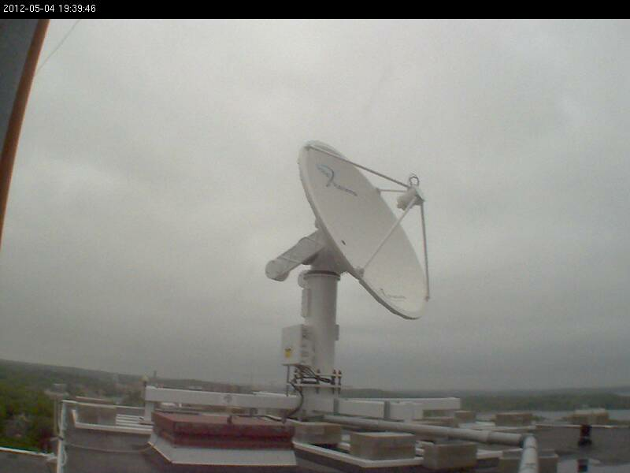
New Dual X/L Band antenna

Slide 19
S4 Supercomputing Cluster
Funded by the National Oceanic and Atmospheric Administration (NOAA), S4 is used by NOAA and UW researchers to run data assimilation experiments with the goal of improving the NOAA operational weather models used to generate weather forecasts for the United States.
The system was designed, installed, and is maintained by the UW SSEC Technical Computing Group.

Slide 20
S4 Hardware
Largest High Performance Compute Cluster at UW Madison
Total compute: 3072 cores, 8TB memory
Total storage: 456 TB
40 Gigabit/s Infiniband Network Interconnect

Slide 21
Current Data Center Projects

Slide 22
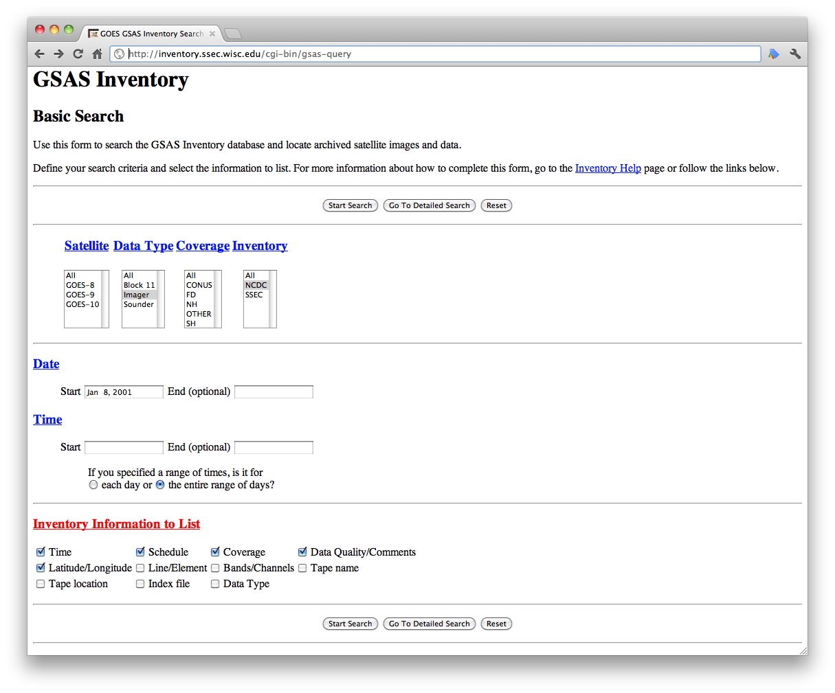
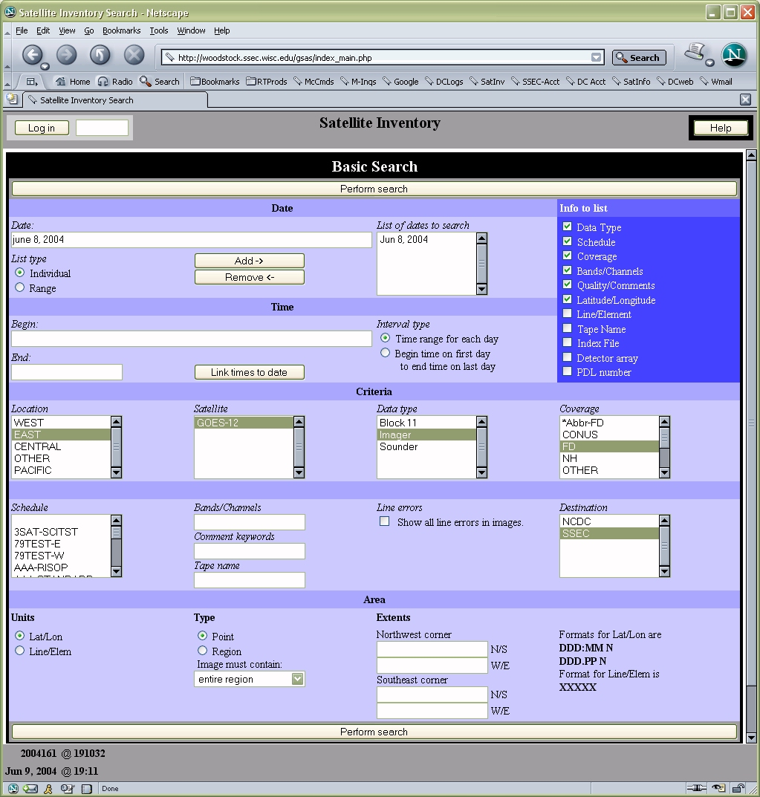
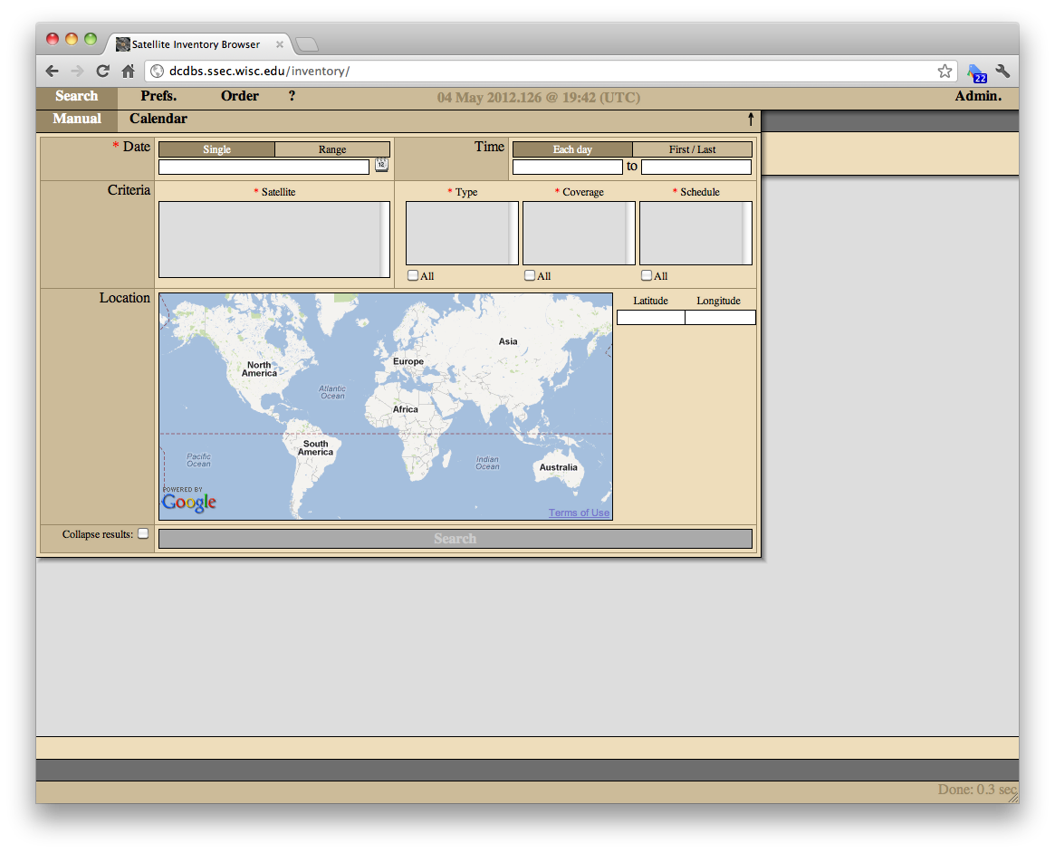
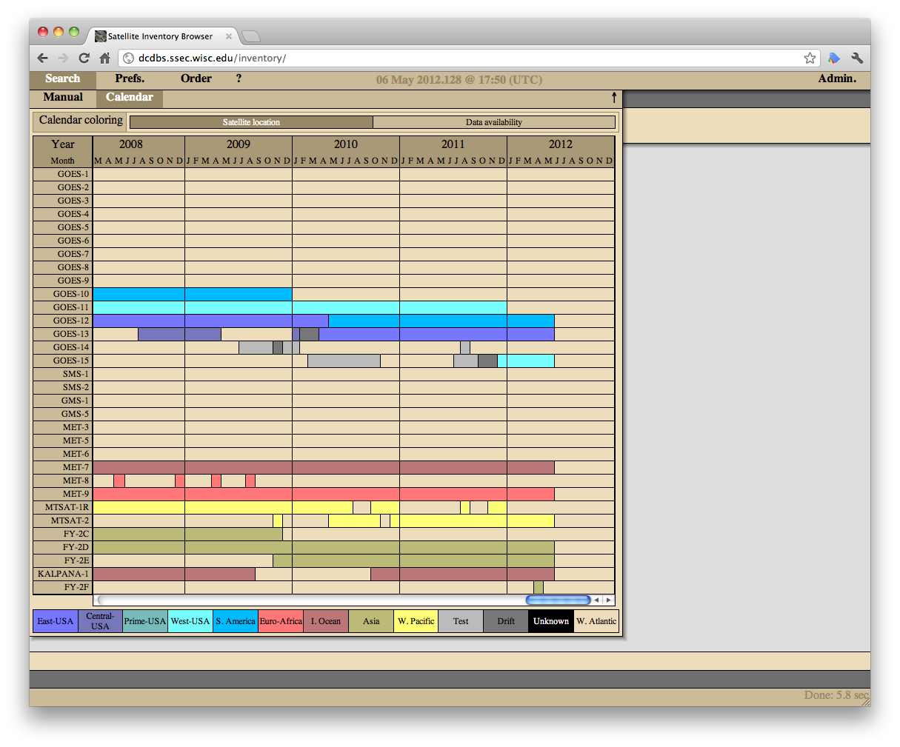
Satellite Data Archive Inventory Interface rewrite
(1996-2003)
(2003-2007)
(2007-Present)

Slide 23
Satellite Data Archive Inventory Interface rewrite
Allow more flexibility for searching
GUI and command line search capabilities, well documented API
Database will be accessible from McIDAS-V and McIDAS-X
Able to output McIDAS-X scripts and McIDAS-V Jython scripts
Output DIF (Directory Interchange Format)
Incorporating ISO 19115 and accepted best practices for meta data storage
Web interface heavily utilizes HTML5
Surveys going out soon

Slide 24
Early GOES Archive - Data Interrogation and Reconciliation
Dan Forrest, Janean Hill, Nancy Troxel-Hoehn, Dee Wade, Kevin Hallock, Russ Dengel, Jerrold Robaidek (and many others)

Slide 25
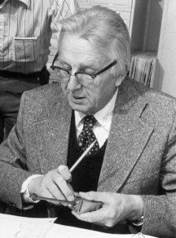
GOES Archive History
Mid-1970s: SSEC began recording data to U-matic tape
1978: SSEC started keeping the data
1979: SSEC became the official archive of GOES data (ended in 2004)
Dr. Vern Suomi

Slide 26
Early GOES
May 17, 1974 (SMS-1) – Jan 11, 1996 (GOES-7)
SMS-1, SMS-2, GOES-1 through GOES-7
Three Modes
MODE-A
MODE-AA
MODE-AAA

Slide 27
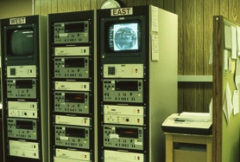
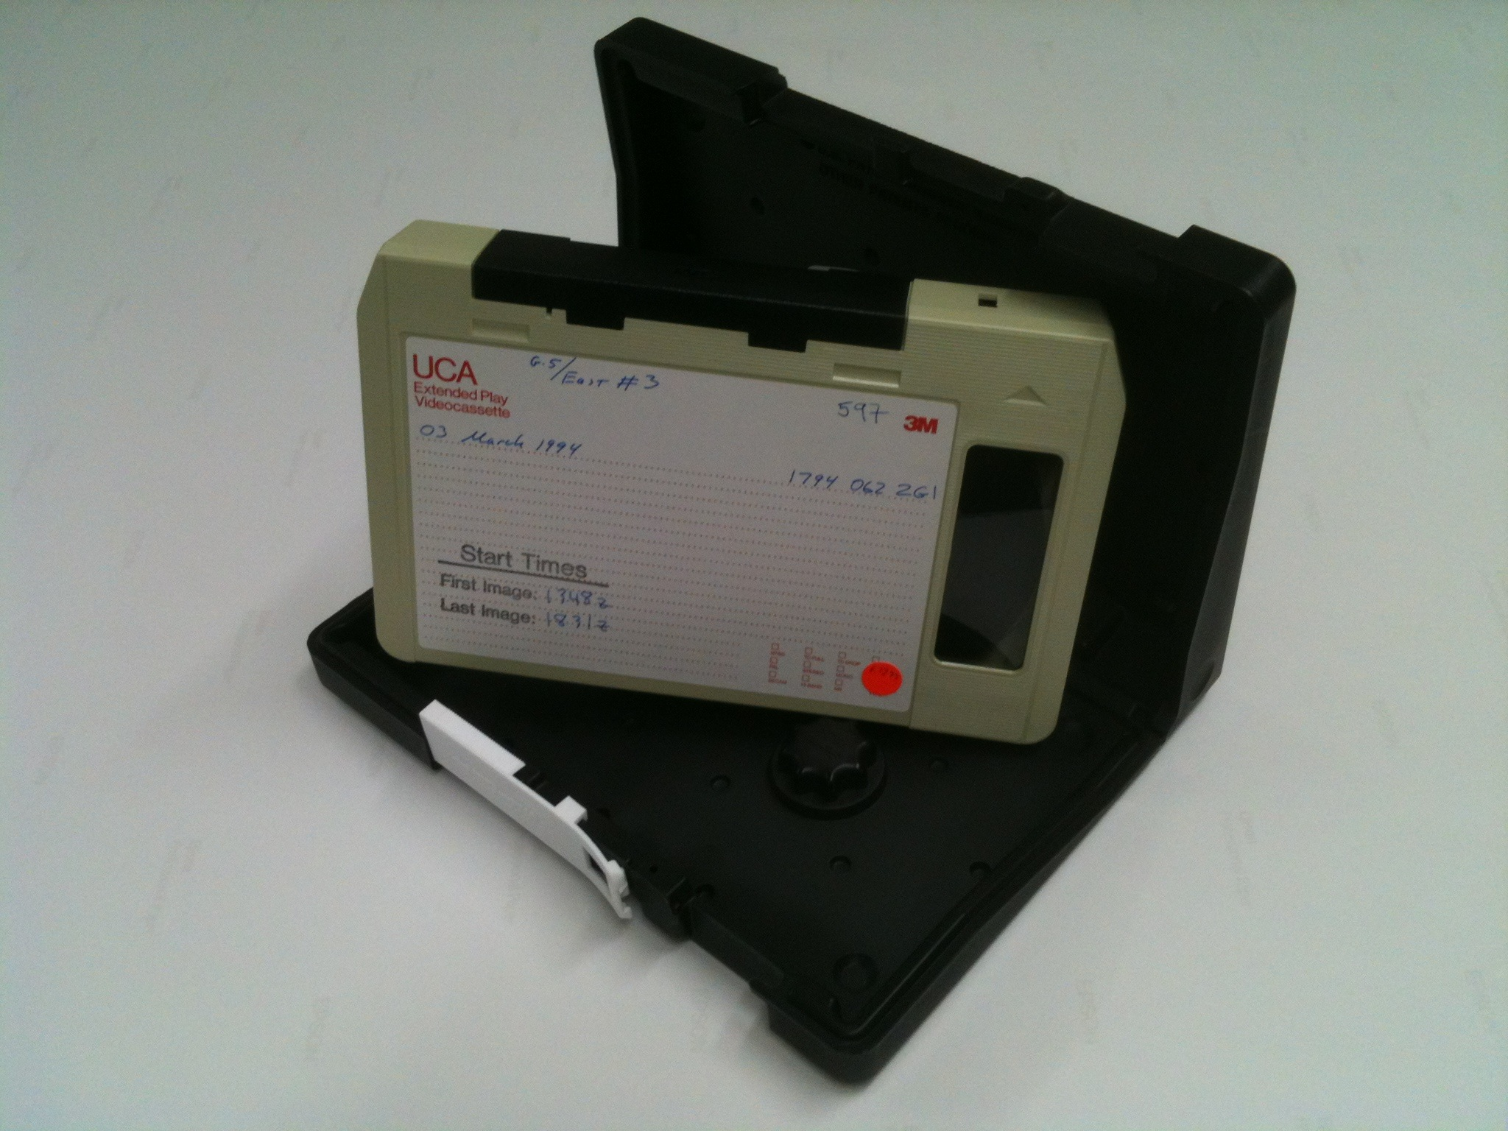
Archive recording 1978-1997
U-matic Recorder Archive Hardware (1989)
U-matic
8 hours of data per tape 1,095 tapes per year
(1978-1997)

Slide 28
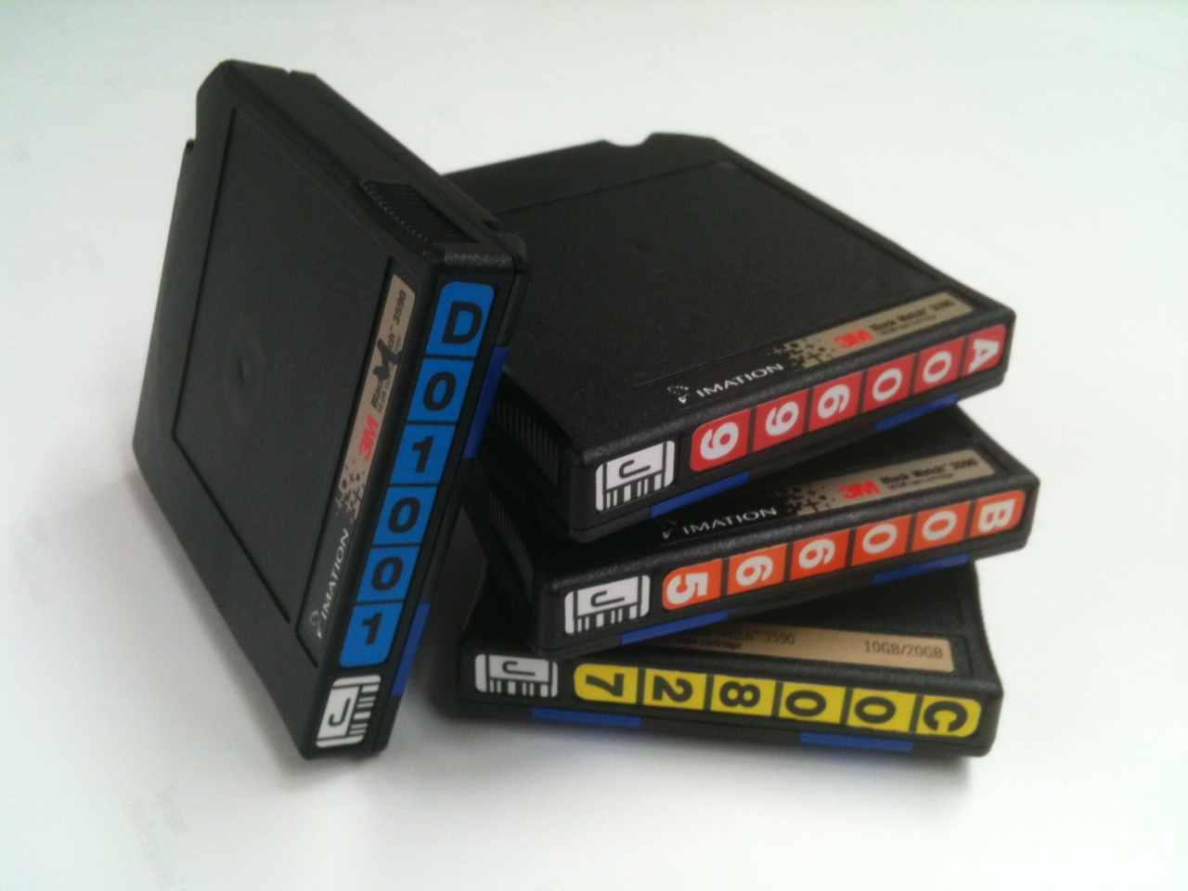
1997: Switched to 3590
IBM 3590
~2 days of data per tape 182 tapes per year
(1997-2005)

Slide 29
Data Rescue
1990s: U-matic tapes were deteriorating
1997: Data rescue project began
Reingest all data from (Early GOES)1978 to 1996 and first few years of GVAR (1994-1997) and put on 3590 tape.
One copy sent to NCDC in Asheville, NC; one copy kept at SSEC

Slide 30
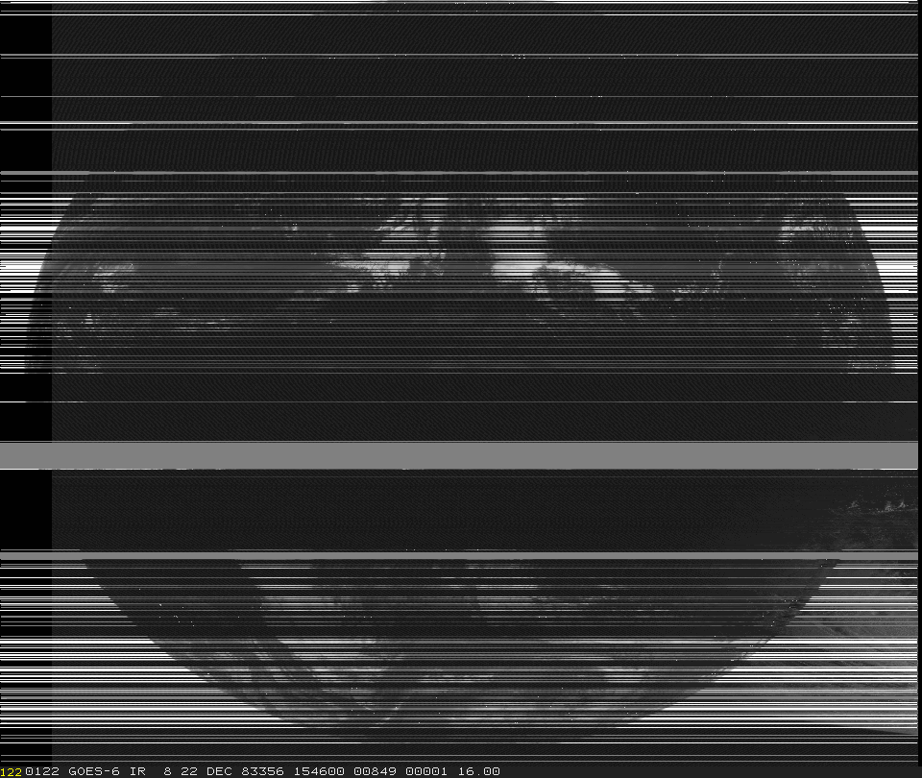
Data Rescue project completed in 2005
All data copied to 3590 tapes
Copy of all tapes sent to NCDC
Known issues
Multiple copies of some images (sometimes more than 8 copies)
Significant errors and data dropouts
tape degradation
recording problems
noise in the original signal

Slide 31
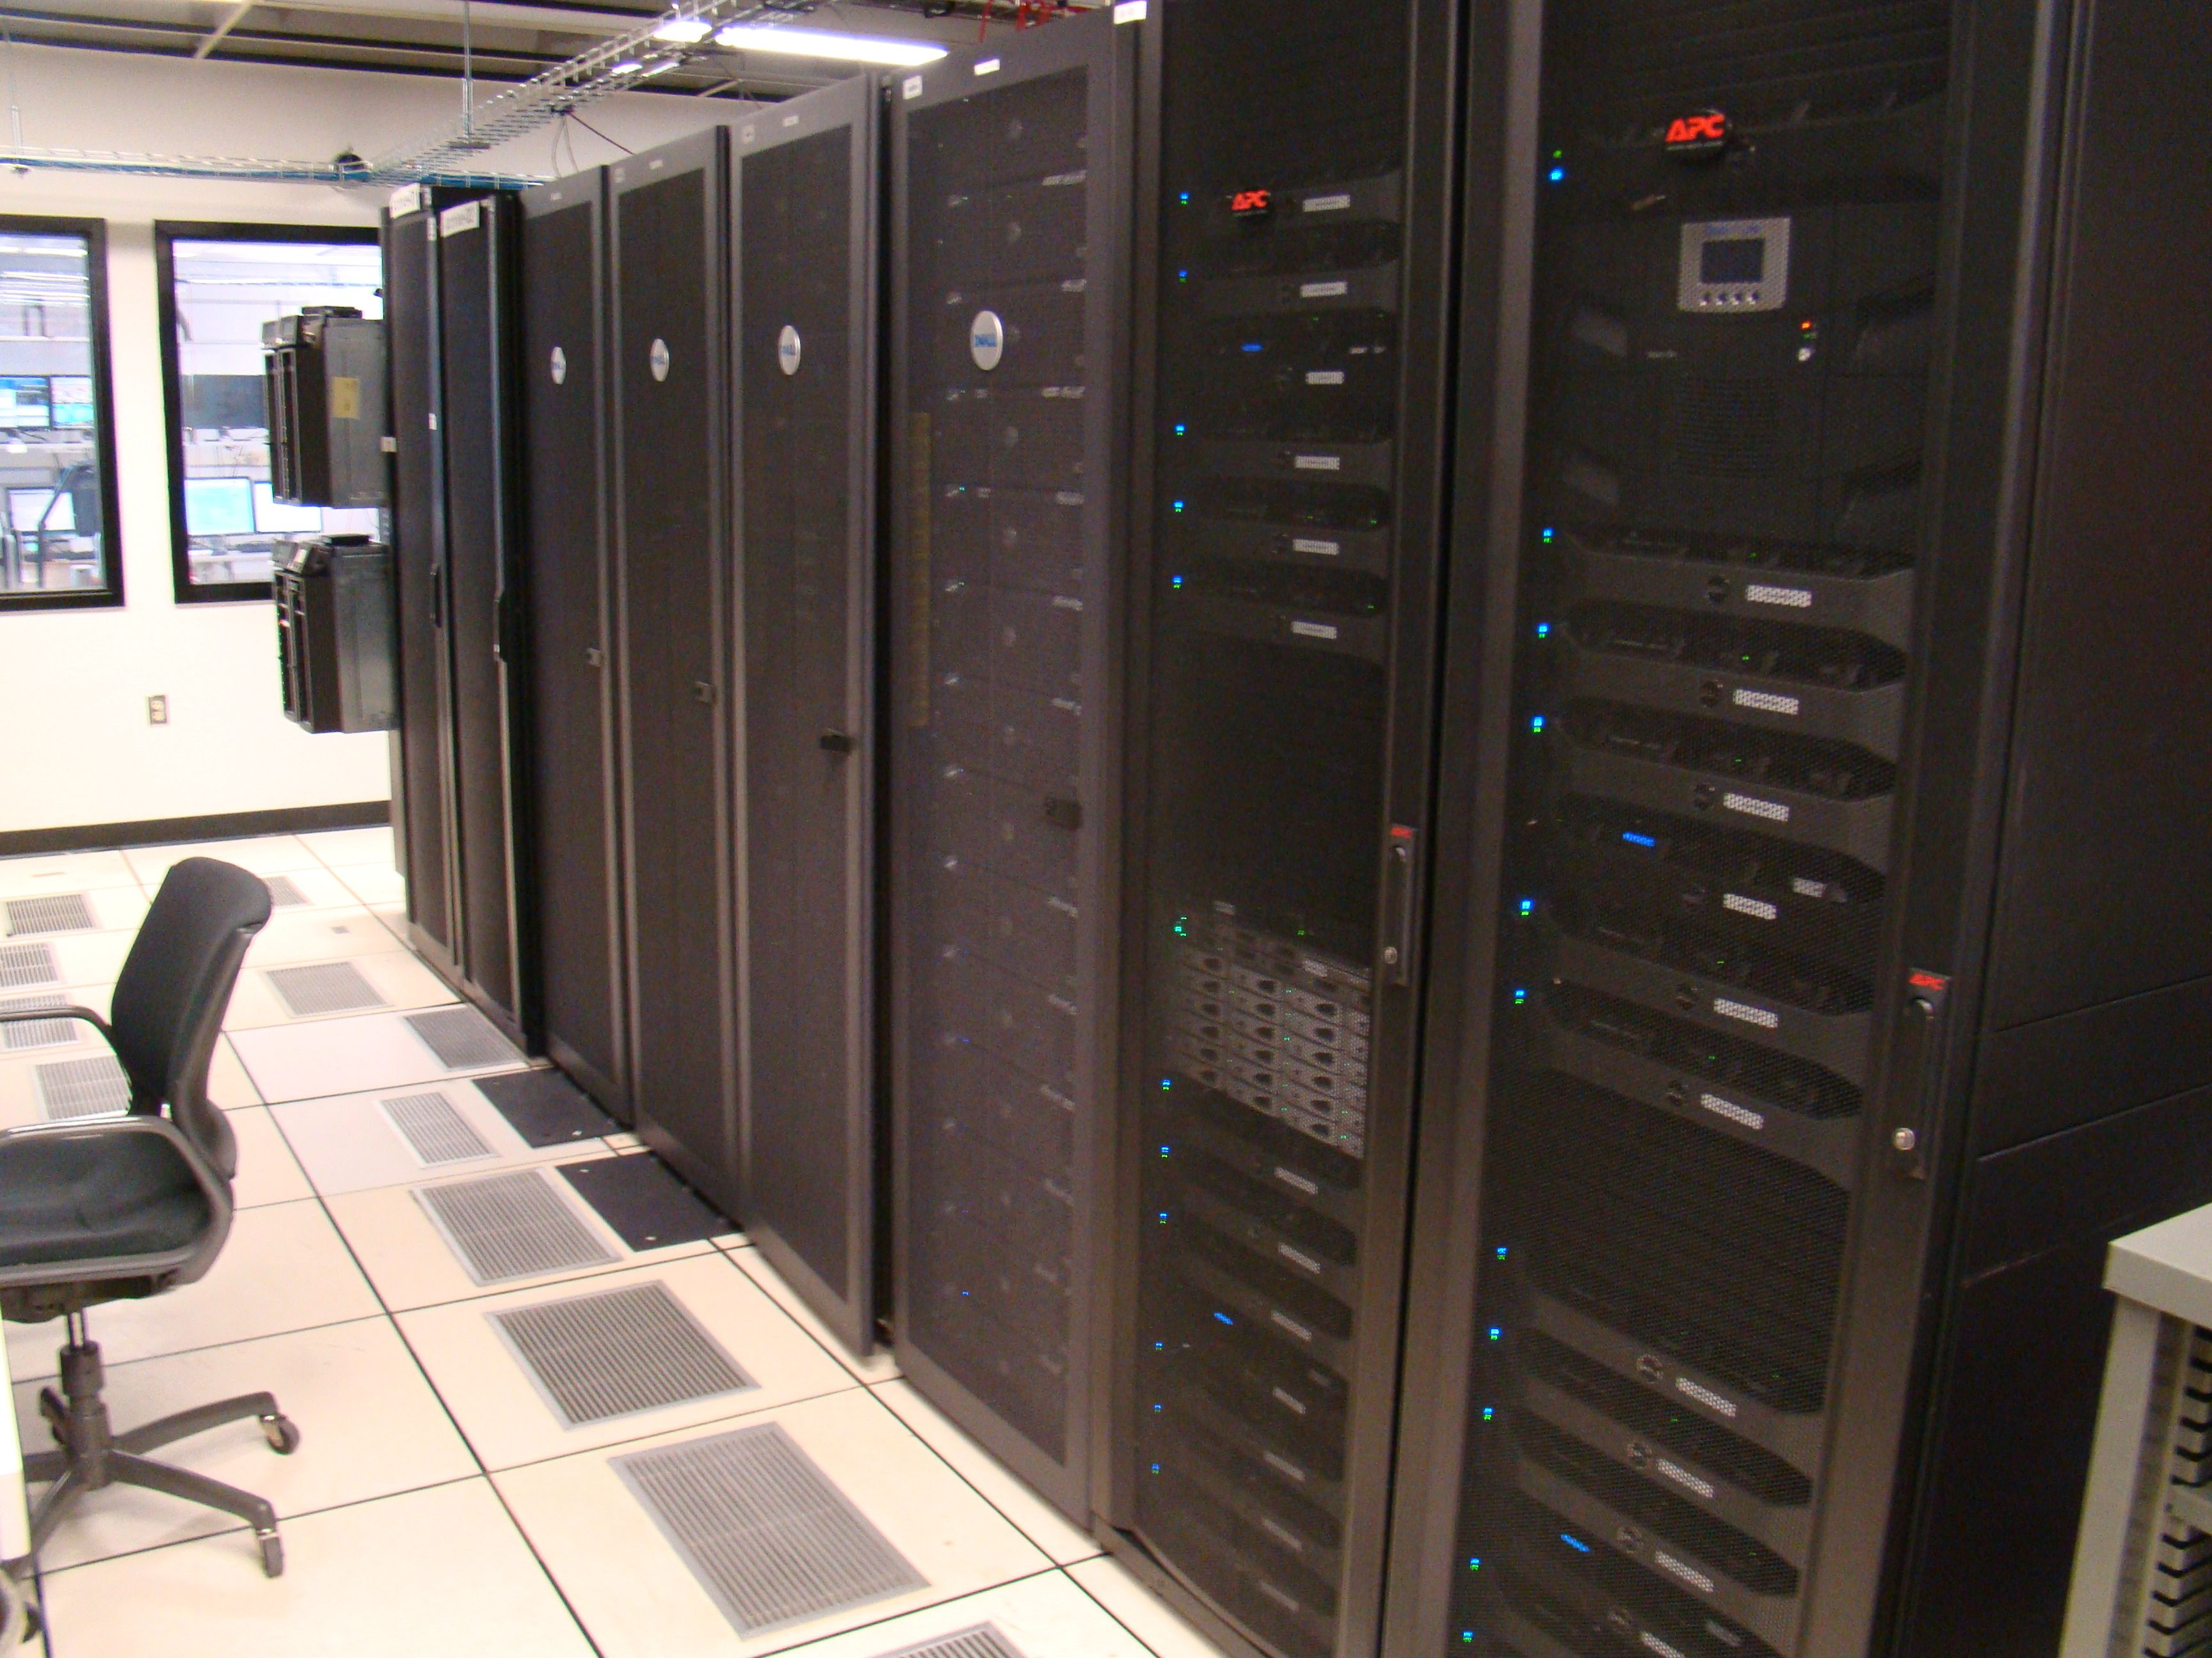
On-line archive (2005) ( a little side track)
61 TB of disk (RAID-5) enough space for 6 years of GOES-East and West.
All new GOES data archived on-line (Sep 2005)
Backed up to lto-2
Data service to users, went 27 minutes to pull an IR full disk from U-matic – 15 seconds via ADDE, no operator needed!
Wow!

Slide 32
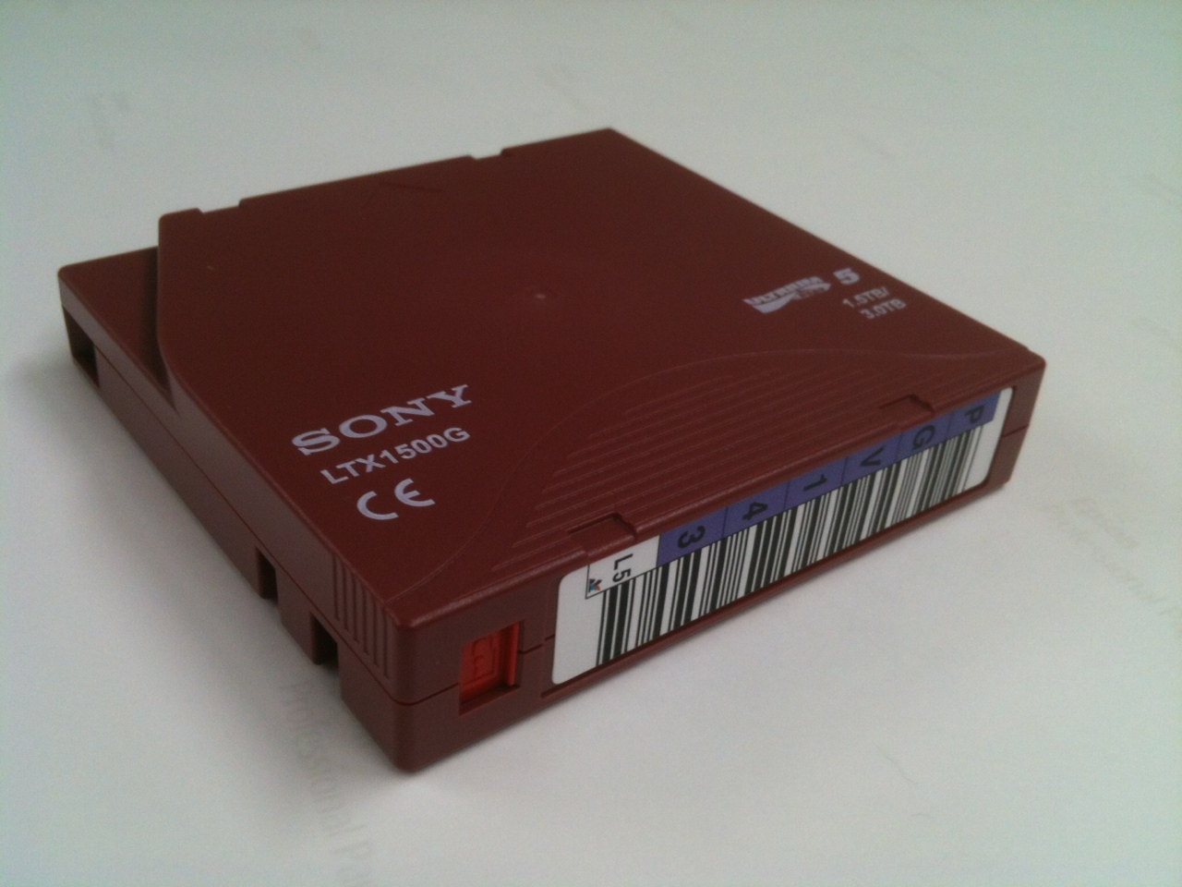
GOES Archive Storage Media History
U-matic
8 hours of data per tape 1,095 tapes per year
(1978-1997)
IBM 3590
~2 days of data per tape 182 tapes per year
(1997-2005)
All data now on-line.
Early GOES data: 1978 to 1996 >100 TB.
All other data: 1994 to present almost
600 TB.
(2005 - Present day)
LTO-5
~135 days of data per tape less than 3 tapes per year
(2010-Present day)

Slide 33
Entire GVAR and International GEO Archive put online (2008)
Large request by a private company (late 2007)
User was first sent to NCDC, came back to SSEC
Funded expansion of the system at SSEC for archiving Geostationary Satellite Data online.

Slide 34
All GOES data online 2009
By mid 2009 all GOES data from rescue was put on line.
Data had many issues:
Noisy
Multiple images
Missing images
Plan was to merge multiple images
Replay some U-matic tapes, if needed to fix noisy data or look for missing data

Slide 35
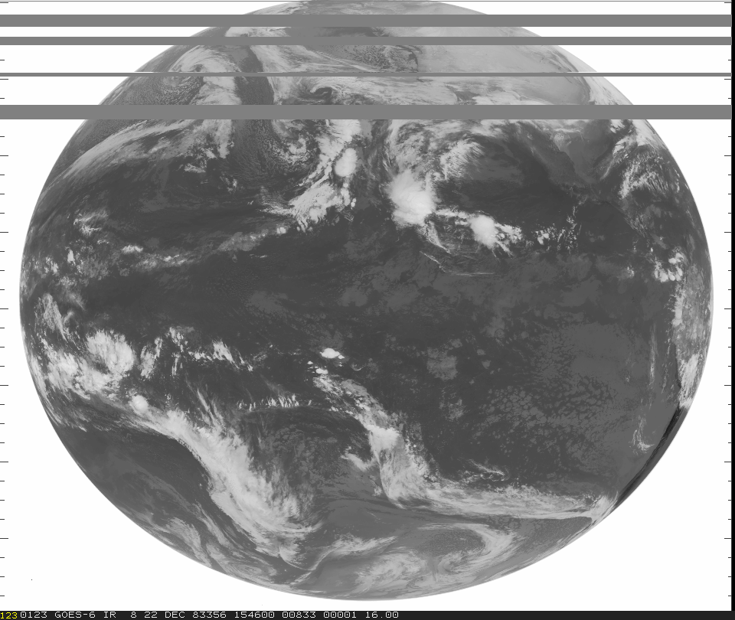
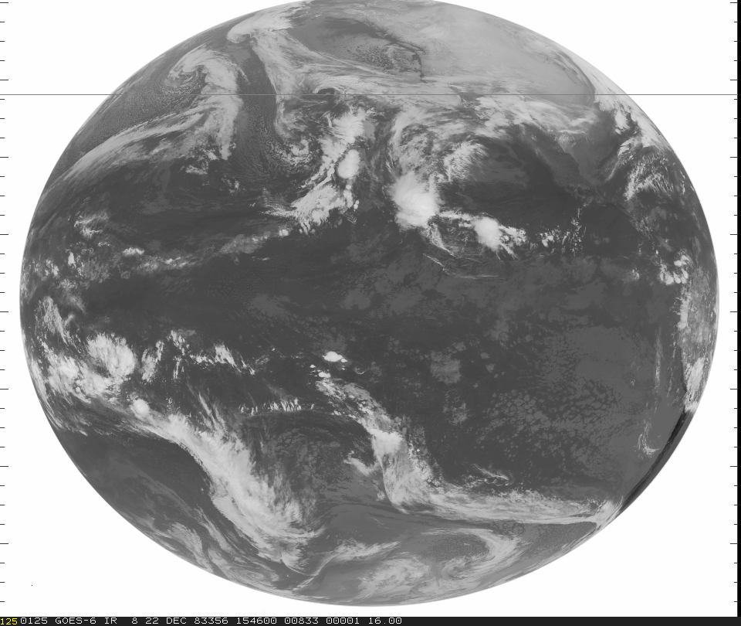
Processing Plan
Objectively merge redundant data
Get rid of multiple images and merge into a “best” image.

Slide 36
Types of Correctable Errors Encountered in Mode-A data
Lines deleted/added: Caused by multiple/bad sync or ground station send errors, sometimes resulted in multiple images in one index.
Bit slip: Bits inserted between sync and type blocks and/or data, probably from when U-matic was first recorded, or may have happened during playback.
Fixed type: IR (0) or VIS (1-8) incorrect, sometimes due to bit slip or multiple/bad sync.
Fixed line number: Line number was changed, caused by bit error.
Framing Error: IR data block size was incorrect.

Slide 37
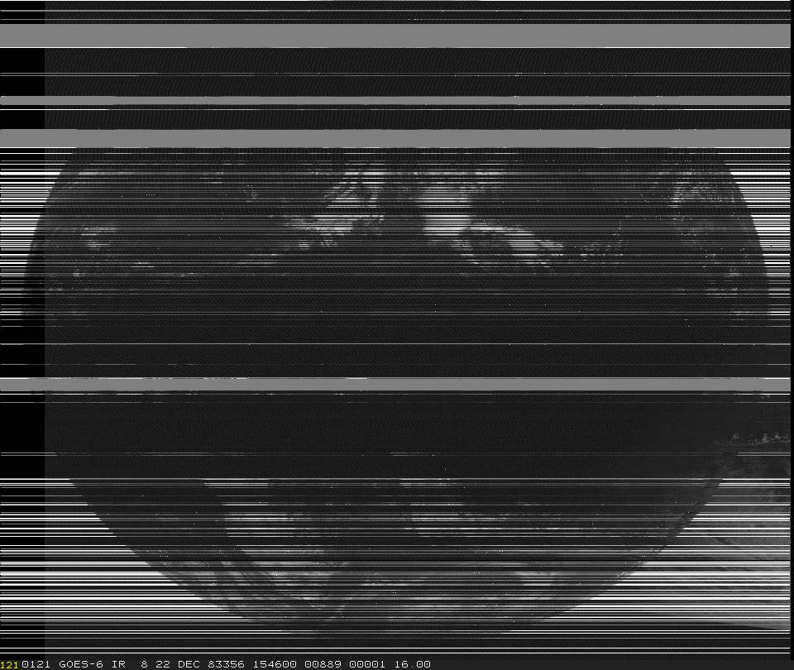
Interrogation and Reconciliation Process
Correct Ingest/signal transmit errors
Merge redundant data
NO data are changed, averaged or otherwise manipulated. All data are uncovered by correcting errors made by earlier software deficiencies.

Slide 38
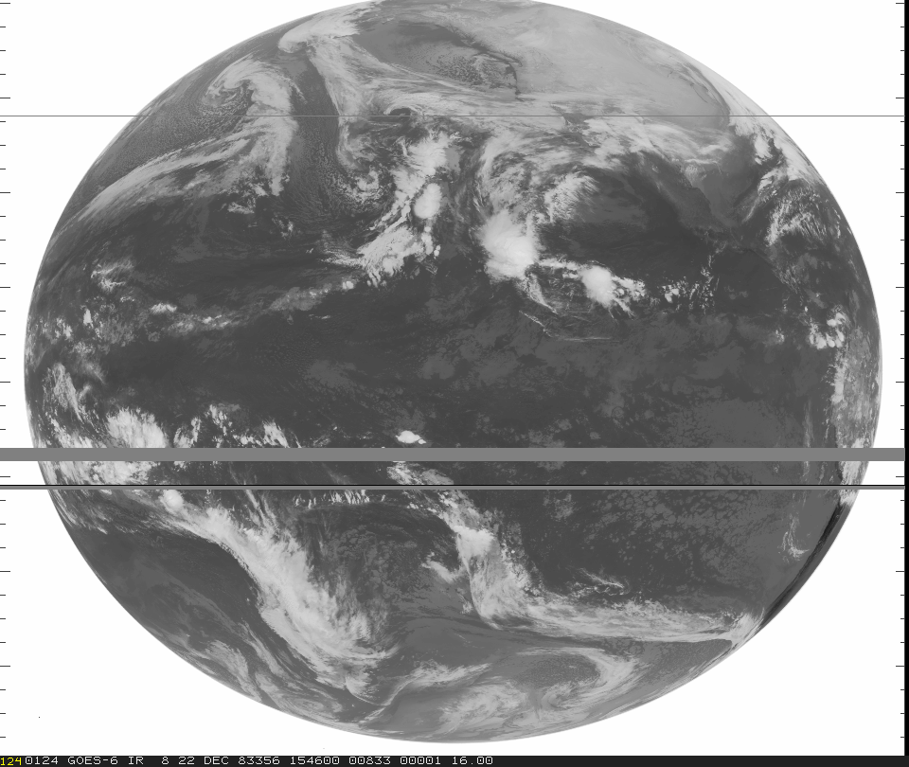
Processing Results
GOES-6 Dec 22, 1983 15:46 UTC
Original playback from U-matic tape
2nd attempt playback from U-matic tape
Processed
Processed

Slide 39
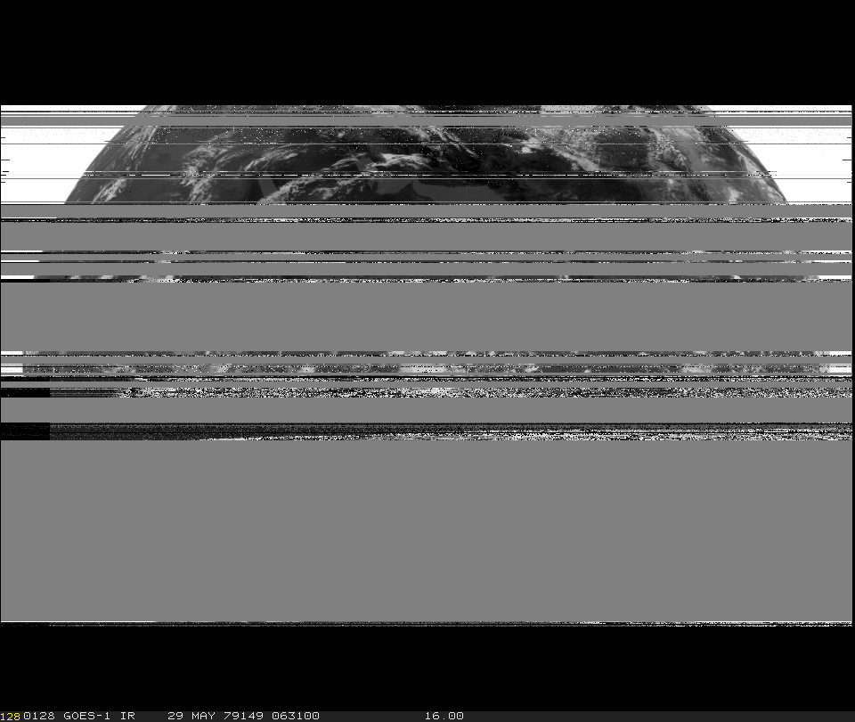
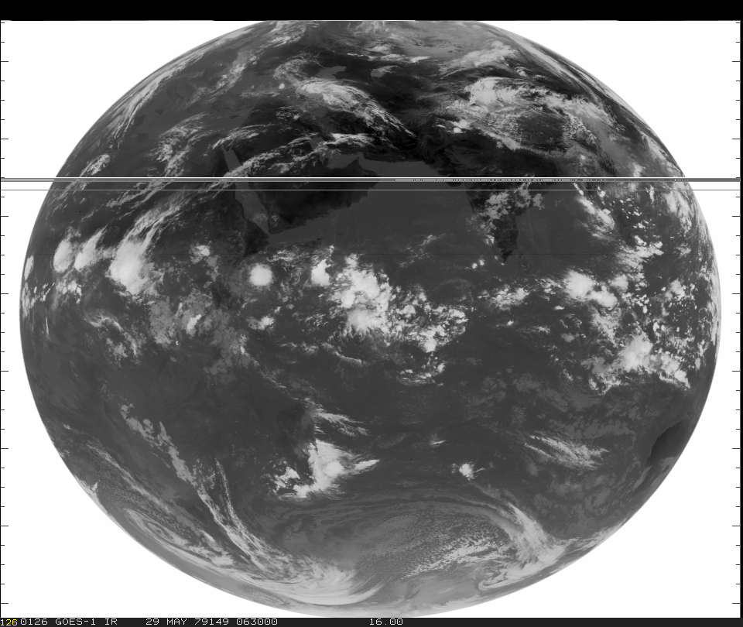
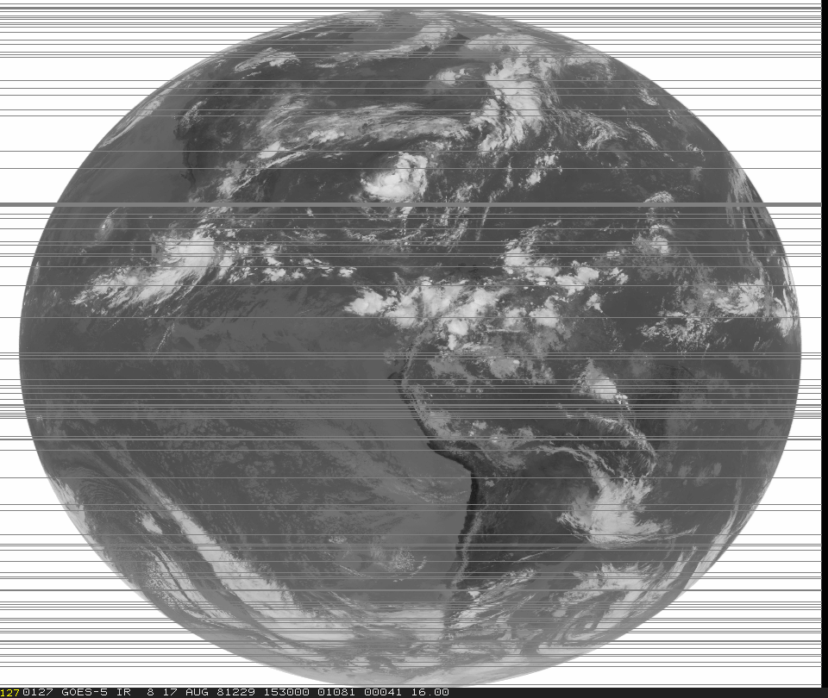
Processing results
GOES-1 May 29, 1979 06:30 UTC
GOES-5 Aug 17, 1981 15:30 UTC
Original playback from U-matic Tape
Original Playback from U-matic Tape
Processed
Processed

Slide 40
Processing Statistics
There are over 717,000 images archived from the operational GOES satellites during the period 1978 to 1996.
All Mode-A data (over 306,470 images) have now been processed.

Slide 41
Processing Statistics
~2,800 Mode-A images thought to be completely lost were recovered
~8,100 images had corrections to at least 95% of their image lines
~25,500 images had framing errors corrected that affected every visible scan in an image
Totals above represent nearly 2 full years of data!

Slide 42
Archive work in progress
Complete MODE-A work
Complete MODE-AA and MODE-AAA
Improve ADDE Server Performance
Update metadata database interface

Slide 43
End

