Slide 1
McIDAS Advisory Committee (MAC) Sponsored: Group Discussion
Joleen Feltz* and Kristopher Bedka⁺
McIDAS Advisory Committee Co-Chairs
*Cooperative Institute for Meteorological Satellite Studies
⁺Science Systems and Applications, Inc. @ NASA Langley Research Center

Slide 2
McIDAS Advisory Committee
Membership 2011-2012:
Kristopher Bedka, Co-Chair (SSAI @ NASA LaRC)
Jessica Braun (SSAI @ NOAA/ESPC)
Joleen Feltz, Co-Chair (CIMSS)
Greg Gallina(NOAA/ESPC)
Mat Gunshor (CIMSS)
Don Hillger (CIRA)
Matt Lazzara (AMRC: Former Chair)
Jim Nelson (CIMSS)
HP Roesli (EUMETSAT)
Dave Watson (CIRA)
Tom Yoksas (Unidata: Former Chair)
Non-voting member: Becky Schaffer (SSEC)

Slide 3
The MAC Needs Your Input!
Provide input on/discuss issues as they arise
Two way street: SSEC <==> MAC
Address questions or concerns for any of McIDAS or Datacenter products: -V, -X, -XCD, SDI, ADDE
MAC is your advocate! If your site does not have a representative, consider becoming a member of the MAC
If your MUG site is not represented, contact co-chairs: joleen.feltz@ssec.wisc.edu or kristopher.m.bedka@nasa.gov

Slide 4
Some Recent Topics Discussed Within MAC
McIDAS-V performance, scripting, and usage on a remote machine
Publication quality graphics in McIDAS-V
How will Mc-V support specialized Mc-X capabilities?
CDM updates to accommodate new grib naming conventions
SPIDER and other tools built on the scheduler

Slide 5
Scripting
Direction influenced by scientist working within the GOES-R Imagery and Visualization project
Loading hdf and ADDE files
Building the McIDAS window and displaying layers
Adding maps, setting projection, applying color tables and color bars
Statistics and formulas
Text files from probes, statistics and other data analysis features.
What scripting tools/capabilities would be useful for your organization? What doesn’t Mc-X do that you would like to do in Mc-V?

Slide 6
Publication Quality Graphics
Publication quality graphics means different things to different people, and there may be different requirements for various journals vs. powerpoint presentations
MAC members were asked to provide examples of graphics they perceive to be “publication quality”
Primary theme of submissions was a desire for “user control”
User-selectable font type, size, weight
Adjustable tick mark intervals, axis range, axis/colorbar labels, and titles
Lat/lon labels and grid lines
Pressure (or other parameter, i.e. wavenumber) as a vertical coordinate
Image size in width x height in inches or number of pixels
Adjustable dots per inch
Questions: What are the highest “priorities” and what should the dividing line be between Mc-V and matlab/IDL?

Slide 7
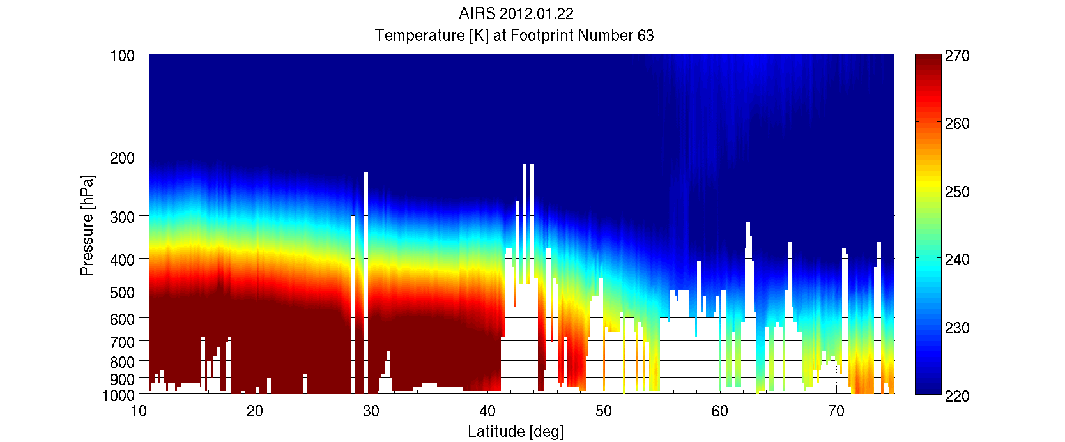
Cross Section of Temperature by Pressure Level (MATLAB, Dr. Elisabeth Weisz, UW-CIMSS)
Publication Quality Graphics
Cross-Section with y-axis of properly scaled (pressure as height is desired for 3D surfaces as well.)
Grid within cross-section for easier determination of feature locations
Color bar location can be plotted with cross-section
Crisp colors and clean fonts

Slide 8
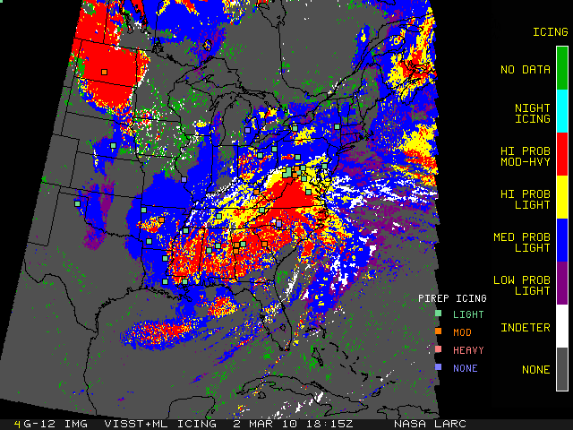
Publication Quality Graphics
Non-Numeric Colorbar Labels (McIDAS-X, Doug Spangenberg, NASA LaRC)
2-D image data overlaid with point dataset created in McIDAS-X
Customized colorbar has user-selected, non-numeric labels
Point data legend also included within the plot

Slide 9
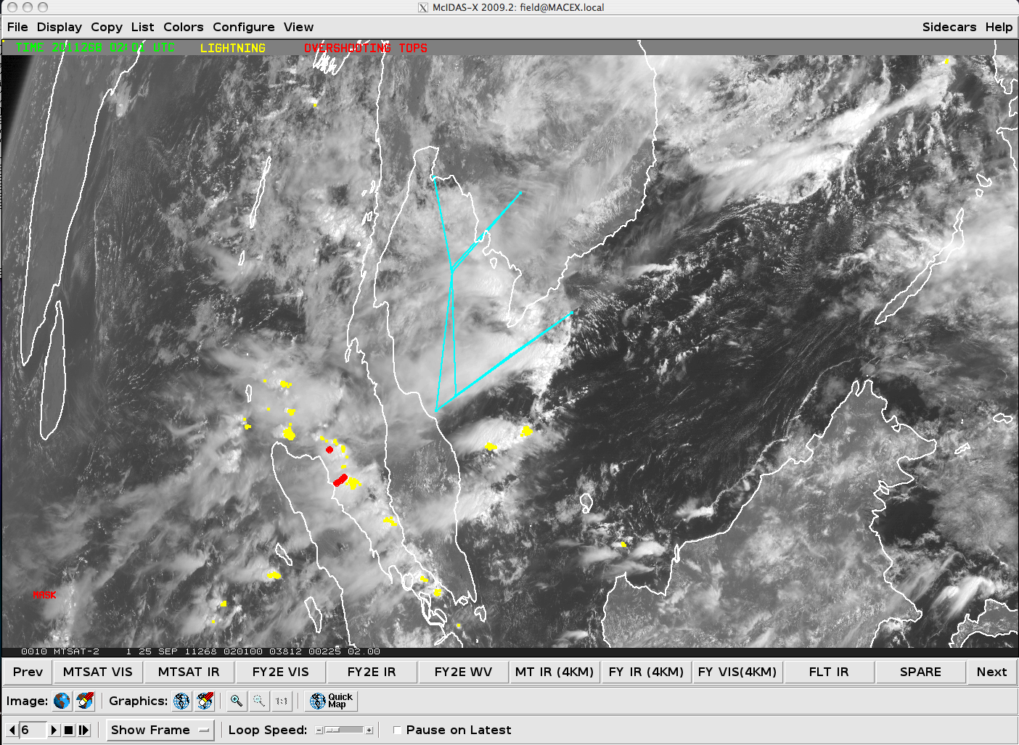
How Will Mc-V Support Specialized Mc-X Capabilities?
Mc-X GUI frequently used by NASA LaRC to provide on-site flight planning support at field experiments
Real time geostationary image loops ingested via Mc-X scheduler and attached to GUI buttons
Objective point-based datasets such as severe thunderstorm and lightning detection displayed via BATCH files
Real time aircraft positions for multiple aircraft acquired from web page and overlaid via virtual graphic
Display system must be reliable and cannot crash or lag when aircraft are enroute

Slide 10
Common Data Model (CDM) Update
GRIB naming convention changes will affect the loading of GRIB data in old IDV and McIDAS-V bundles
UNIDATA is working to minimize impact to users by updating the CDM and addressing concerns raised by the user community

Slide 11
Discussion
What features are regularly used in McIDAS-X and how will these be supported in McIDAS-V?
What is currently problematic in Mc-X or Mc-V?
Necessary but currently unavailable features?
Expectations?
Other comments, questions or suggestions?

