Slide 1
McIDAS-XCD Replacement
Jerrold Robaidek
May 7, 2012

Slide 2
Rewrite Team
Kevin Baggett, Kevin Hallock, Dave Parker, Roseann Spangler, Becky Schaffer, Jerrold Robaidek

Slide 3
McIDAS XCD
McIDAS X
Conventional Data
Decoder
McIDAS-XCD files, decodes and indexes the NOAAPORT data stream into formats
that can be served by McIDAS-X ADDE servers.
Output formats include McIDAS MD files, Text files, GRID files, grib1 and
grib2 files, NEXRAD files, and BUFR files.

Slide 4
NOAAPORT Data
The NOAAPORT broadcast system provides a one-way broadcast communication of NOAA environmental data and information in near-real time to NOAA and external users. This broadcast service is implemented by a commercial provider of satellite communications utilizing C-band.

Slide 5
NOAAPORT Channels
GOES Channel
GOES-East visible, infrared, and water vapor for the Eastern Conterminous United States (CONUS), Puerto Rico, supernational composites, and Northern Hemisphere (NH) composites
GOES-West. visible, infrared, water vapor for CONUS, Alaska, and Hawaii; supernational composites, and NH composites
*NCEP/NWSTG Channel (NWS Telecommunications Gateway)
model output from the National Centers for Environmental Prediction (NCEP)
observations, forecasts, watches and warnings produced by NWS Forecast Offices
WSR-88D radar products
most observational data over North America
*NCEP/NWSTG2 Channel
supplements the NWSTG channel
Non-GOES Imagery/DCP Data Channel
GOES DCP data
GMS/GOES-West/GOES-East/METEOSAT-7/METOSAT-9 composites for visible, IR, and water vapor products (every 3 hours)
OCONUS grids

Slide 6
NOAAPORT Data flow into SSEC
Users generally get NOAAPORT data in two Ways:
Directly from DOMSAT (101°W)
Over the Internet via LDM

Slide 7
Why replace XCD?
Installation is difficult
Upgrades are difficult
System is overly complex, large learning curve for operators, and very large learning curve for new programmer
System was written for a mainframe then ported to UNIX
A powerful system is needed to run XCD, otherwise data can be lost
A data format change can mean bad data, and a fix can be difficult to implement, and is only effective for future data

Slide 8
Survey Highlights
Survey was sent out during the last Quarter of 2010
26 responses (not all current users of XCD)
Feed types decoded:
33% used for CONDUIT feed
100% used for NOAAPORT
Local data?
All used XCD with LDM
Built in monitoring not used?

Slide 9
Goals
Replace 4 parts of XCD filing and decoding:
GRIB (prototype done)
NEXRAD (prototype done)
Text (in process)
MD serving (in process)
Utilize LDM direct filing
Create simple interface to pqact.conf and ldmd.conf to select and edit data to be filed
Reduce or eliminate compiled code
Remove legacy mainframe complexity
Utilize simple open-source database, SQLite
No more GRIDXXXX files created by XCD
Match or exceed current filing and serving performance on existing hardware

Slide 10
GRIB details
LDM files GRIB files to a temporary directory
A GRIB daemon watches for directories, and moves it to a temporary directory name
Another daemon watches for temporary directories and extracts information and files metadata in to an SQLite DB; One SQLite DB per model per day

Slide 11
GRIB processing
GRIB messages arrive on LDM
!grib/ncep/NAM_84/#215/201204251800/F003/VGRD/90-60 mb above gnd/
!grib/ncep/NAM_84/#212/201204251800/F009/RH/925 mb/
!grib2/ncep/NAM_84/#218/201204251800F009/UREL/525 hPa PRES
!grib2/ncep/NAM_84/#218/201204251800F009/AVOR/250 hPa PRES
!grib2/ncep/NAM_84/#218/201204251800F009/RELH/500 hPa PRES
LDM directly files GRIB message to disk
…
FILE -close /data/xcd/incoming_grib.tmp/\2-\3.\4\5\6_\7_\8.grib1
…
FILE -close /data/xcd/incoming_grib.tmp/\2-\3.\4\5\6_\7_\8.grib2
/data/xcd/incoming_grib.tmp/
NAM_84-#215.20120425_18_003.grib1
NAM_84-#212.20120425_18_009.grib1
NAM_84-#218.20120425_18_009.grib2
Daemon xcdgribdir.sh moves temporary directory to processing directory
/data/xcd/incoming_grib.process/2012117_220304
NAM_84-#215.20120425_18_003.grib1
NAM_84-#212.20120425_18_009.grib1
NAM_84-#218.20120425_18_009.grib2
Daemon xcdgribprocess.sh runs rt_gribdblite.k on all gribfiles in the temporary directory, extracts metadata to put into the SQL Lite database and moves the data to the final directory.
/data/xcd/database/2012117/2012117_grib2NAM_84.sqlite
/data/xcd/database/2012117/2012117_grib1NAM_84.sqlite
/data/xcd/grib/
NAM_84-#215.20120425_18_003.grib1
NAM_84-#212.20120425_18_009.grib1
NAM_84-#218.20120425_18_009.grib2

Slide 12
GRIB processing
GRIB messages arrive on LDM
!grib/ncep/NAM_84/#215/201204251800/F003/VGRD/90-60 mb above gnd/
!grib/ncep/NAM_84/#212/201204251800/F009/RH/925 mb/
!grib2/ncep/NAM_84/#218/201204251800F009/UREL/525 hPa PRES
!grib2/ncep/NAM_84/#218/201204251800F009/AVOR/250 hPa PRES
!grib2/ncep/NAM_84/#218/201204251800F009/RELH/500 hPa PRES
LDM directly files GRIB message to disk
…
FILE -close /data/xcd/incoming_grib.tmp/\2-\3.\4\5\6_\7_\8.grib1
…
FILE -close /data/xcd/incoming_grib.tmp/\2-\3.\4\5\6_\7_\8.grib2
/data/xcd/incoming_grib.tmp/
NAM_84-#215.20120425_18_003.grib1
NAM_84-#212.20120425_18_009.grib1
NAM_84-#218.20120425_18_009.grib2
Daemon xcdgribdir.sh moves temporary directory to processing directory
/data/xcd/incoming_grib.process/2012117_220304
NAM_84-#215.20120425_18_003.grib1
NAM_84-#212.20120425_18_009.grib1
NAM_84-#218.20120425_18_009.grib2
Daemon xcdgribprocess.sh runs rt_gribdblite.k on all gribfiles in the temporary directory, extracts metadata to put into the SQL Lite database and moves the data to the final directory.
/data/xcd/database/2012117/2012117_grib2NAM_84.sqlite
/data/xcd/database/2012117/2012117_grib1NAM_84.sqlite
/data/xcd/grib/
NAM_84-#215.20120425_18_003.grib1
NAM_84-#212.20120425_18_009.grib1
NAM_84-#218.20120425_18_009.grib2

Slide 13
NEXRAD Details
LDM files NEXRAD files into a directory structure similar to existing XCD Decoder
Data served by NEXRAD server

Slide 14
NEXRAD to Disk
NEXRAD via LDM
.....
NEXRAD3 15995913 SDUS86 KOTX 261535 /pN0COTX !nids/
NEXRAD3 15995914 SDUS86 KOTX 261535 /pN0HOTX !nids/
NEXRAD3 15995915 SDUS55 KTWC 261528 /pDPAEMX
NEXRAD3 15995916 SDUS24 KMAF 261529 /pN2SMAF
NEXRAD3 15995917 SDUS74 KTSA 261534 /pTV2TUL !nids/
....
(pqact.cfg)
NEXRAD3 ^SDUS.. .... ([0-3][0-9])([0-2][0-9])([0-6][0-9]).*/p(...)(...)
FILE -close /data/xcd/nexrad/\5/\4/\5_(\1:yyyy)(\1:mm)\1_\2\3.\4
/data/xcd/nexrad/OTX/N0C/OTX_20120426_1535.N0C
/data/xcd/nexrad/OTX/N0H/OTX_20120426_1535.N0H
/data/xcd/nexrad/EMX/DPA/EMX_20120426_1528.DPA
/data/xcd/nexrad/MAF/N2S/MAF_20120426_1529.N2S
/data/xcd/nexrad/TUL/TV2/TUL_20120426_1534.TV2

Slide 15
Text
LDM files data directly to disk
A script running as a daemon watches for new data and files data into a daily *.XCD file as data comes in
New -XCD:
A concatenation of the text from the LDM stream
No stripping out of start of text, carriage returns, line feeds, end of text
Current -XCD:
Starts with the date of the file (in binary) and a total 80-byte header
Padding (spaces) in the file - to make 80 character lines - carriage returns and line feeds have been stripped out
Start of text character 0x01 and end of text character 0x03 are included, and also are 80-character padded
Script extracts metadata to put into SQLite DB
Text server accesses SQLite DB to find data and return information to server

Slide 16
Text processing
text messages
IDS|DDPLUS 16144267 FLUS42 KFFC 261659 /pHWOFFC
IDS|DDPLUS 16144301 SIAA01 KARS 261600 RRB
IDS|DDPLUS 16144298 SRBZ40 KWAL 261659
IDS|DDPLUS 16144426 SRUS55 KTWC 261659 /pRR2TWC
LDM directly files text message to disk
…
PPS|DDS|IDS (^......) ([A-Z][A-Z][A-Z][A-Z]) (......)( |)(...|)( /|)(p......|)
FILE -close /data/xcd/incoming_text/\1-\2.\3\7.txt
/data/xcd/incoming_text/
FLUS42-KFFC.261659pHWOFFC.txt
SIAA01-KARS.261600.txt
SRBZ40-KWAL.261659.txt
SRUS55-KTWC.261659pRR2TWC.txt
Daemon xcdtextdir.sh moves temporary directory to processing directory
/data/xcd/incoming_text.process/2012117_180304
FLUS42-KFFC.261659pHWOFFC.txt
SIAA01-KARS.261600.txt
SRBZ40-KWAL.261659.txt
SRUS55-KTWC.261659pRR2TWC.txt
Daemon xcdtextprocess.sh runs on all files in the temporary directory, extracts meta data to put in the SQL Lite database and moves the data to the final directory.
/data/xcd/textdatabase/2012117/2012117.sqlite
/data/xcd/text/NT2012117.XCD

Slide 17
MD
Uses the *.XCD file created by the text filer
No MD files created (current plan)
PTLIST and PTDISP serves from *.XCD file
PTCOPY serves from *.XCD file
Daily Station Database
Station Database is retained for archived data

Slide 18
MD data ADDE serving (PTLIST & PTDISP)
ADDE request
Returns decoded data
SAODEC
RABDEC
SYNDEC
SHPDEC
GFSMOS
PIRDEC
TERDEC
NewPointServer
/data/xcd/textdatabase/2012117/2012117.sqlite
/data/xcd/text/NT2012117.XCD

Slide 19
MD data ADDE serving (PTCOPY)
ADDE request
Returns MD file structure
SAODEC
RABDEC
SYNDEC
SHPDEC
GFSMOS
PIRDEC
TERDEC
SCHEMAS
NewMDFileServer
/data/xcd/textdatabase/2012117/2012117.sqlite
/data/xcd/text/NT2012117.XCD

Slide 20
BUFR (Binary Universal FoRmat)
Filed directly using LDM
No operational server exists, only a prototype server

Slide 21
LDM pqact.cfg configuration assistant
Allows user to select Models, stations, parameters, etc
Web interface
Cut and paste to pqact.cfg

Slide 22
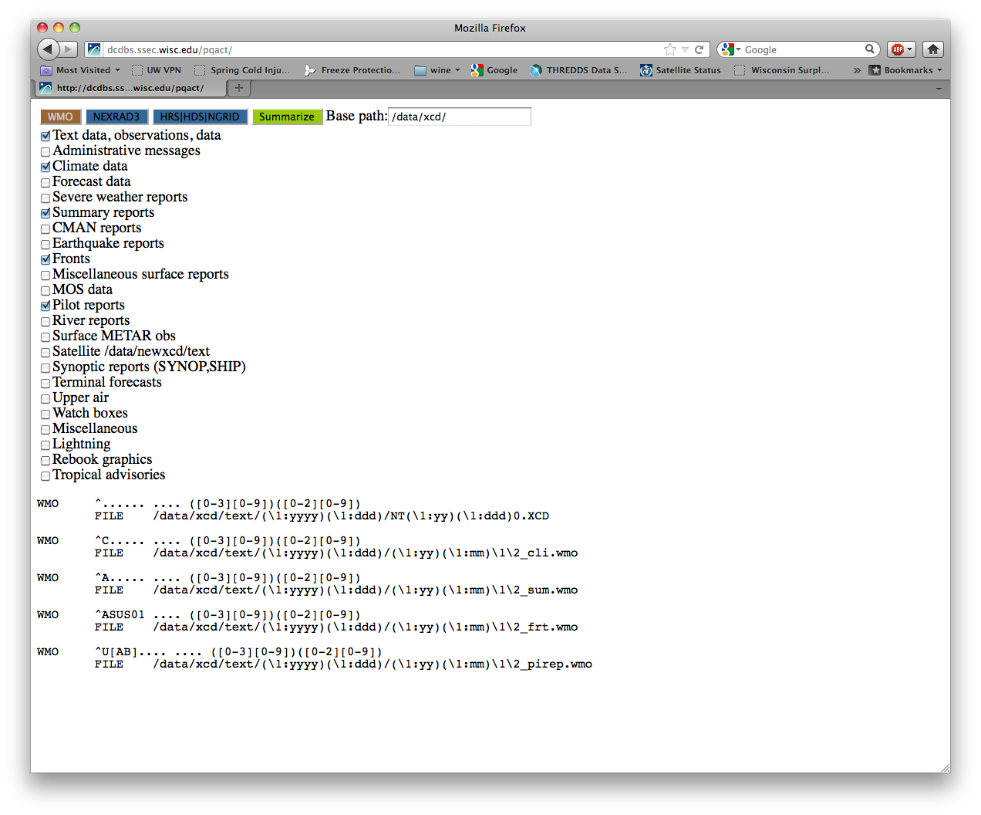
pqact assistant

Slide 23
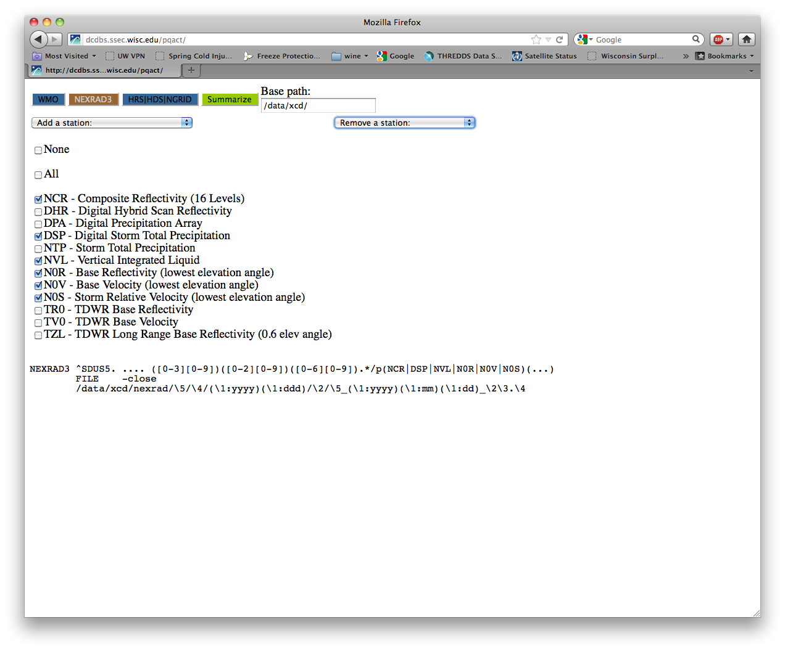
pqact assistant

Slide 24
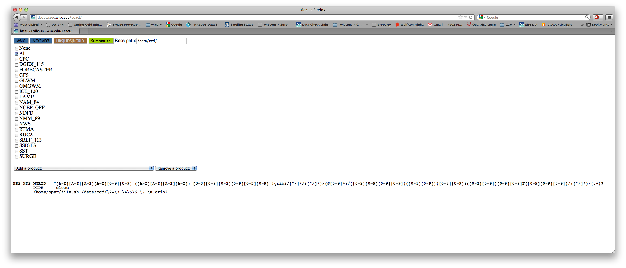
pqact assistant

Slide 25
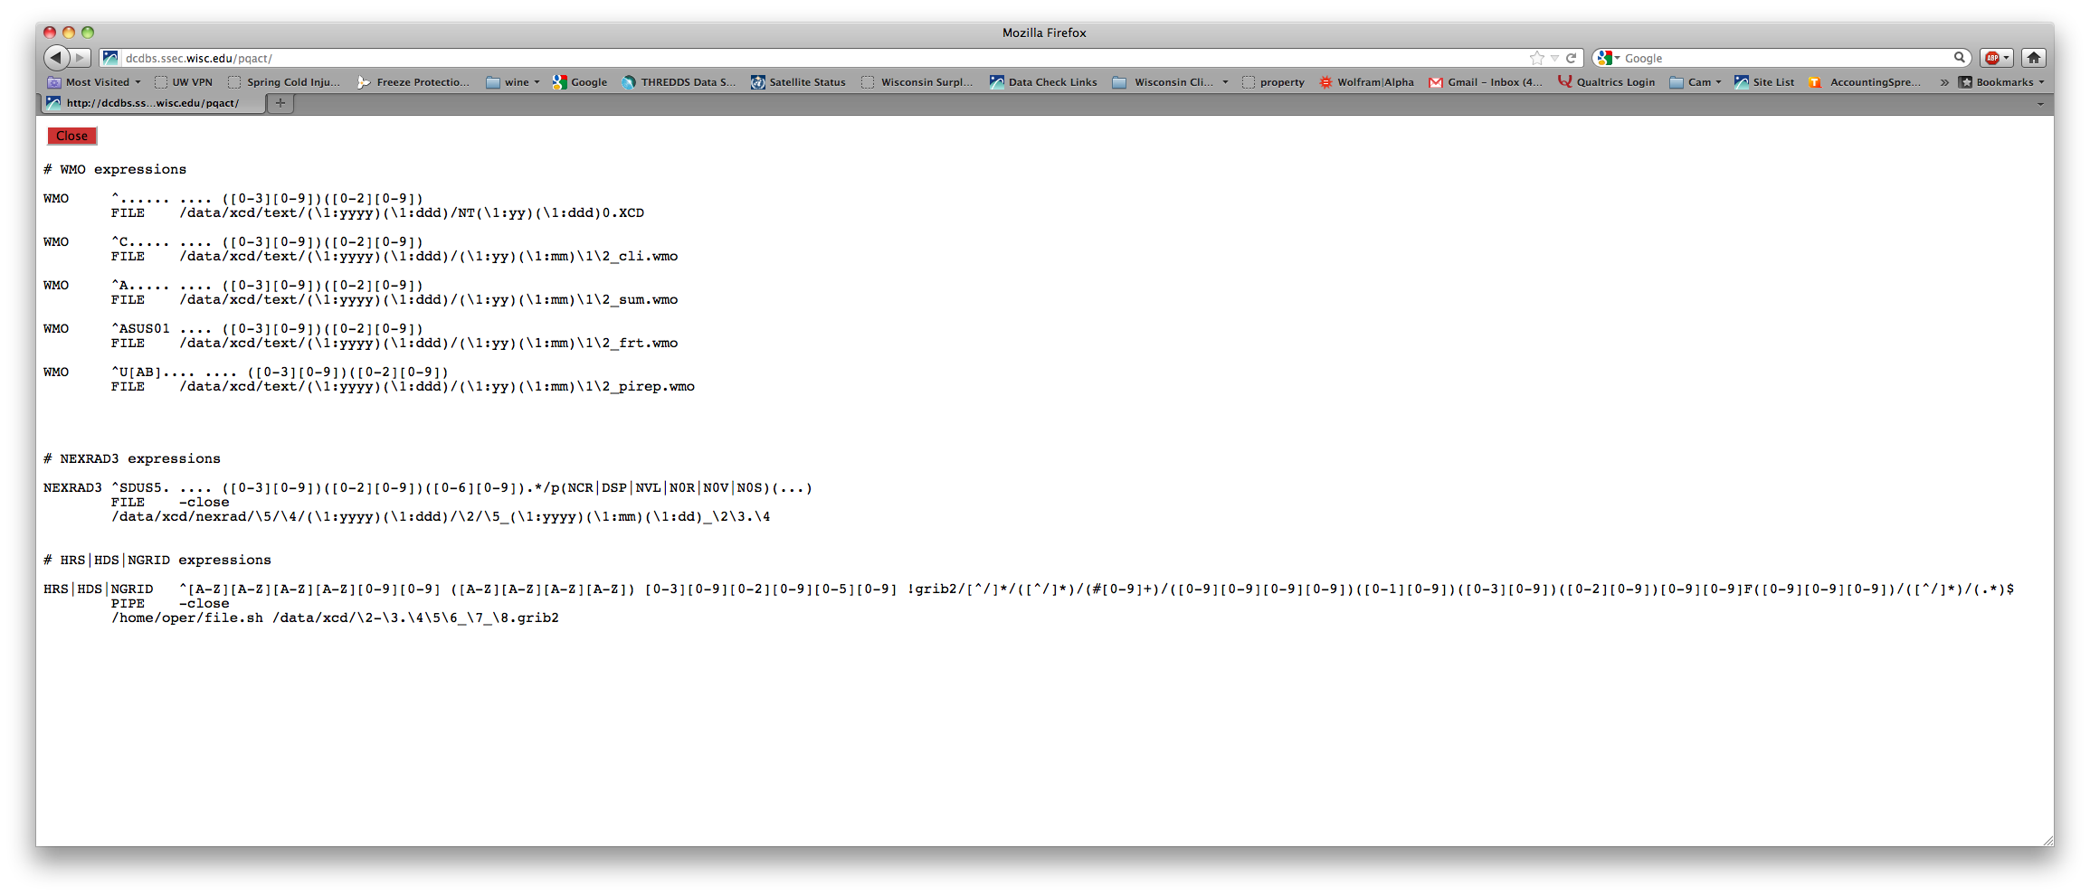
pqact assistant

Slide 26
Local feeds
Several sites have local feeds
We will be contacting those sites in the future for test data

Slide 27
Reprocessing Data
Script with a filename argument
Script automatically determines data type (e.g. text, GRIB)
Files data appropriately and updates SQLite DB

Slide 28
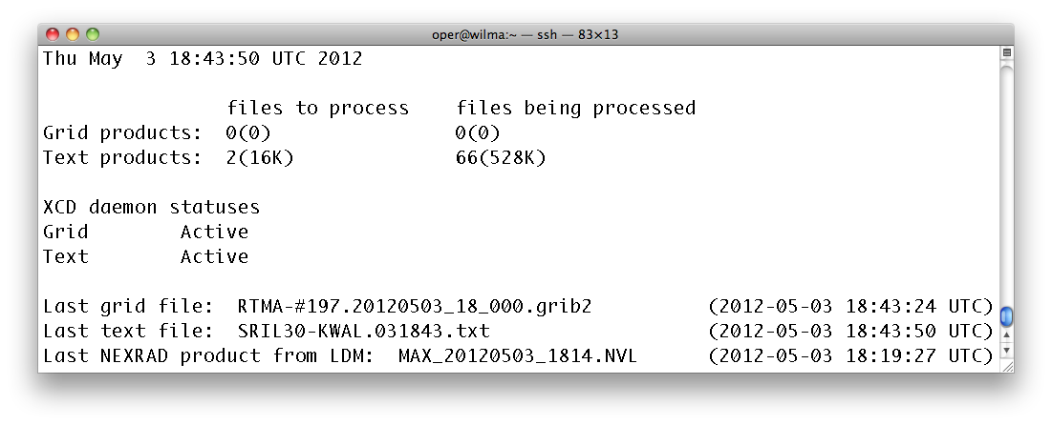
Monitoring

Slide 29
Performance (TEXT)
TEXT lists (no parameters)
WXTLIST
Current XCD: fastest=.158 s slowest=1.584 s
New XCD : fastest=1.544 s slowest=2.453 s
TEXT lists
WXTLIST WMO=SA
Current XCD : fastest=.024 s slowest=.556 s
New XCD : fastest=.026 s slowest=.612 s

Slide 30
Performance (SFCRPT)
SFCRPT
SFCRPT KGRB 9
Current XCD : ~.040s
New XCD : ~.640 s

Slide 31
Performance (GRID)
GRID lists
RTGRIB2/GFS-USLC2 DAY=2012124 TIME=6:00 PAR=U NUM=10
Current XCD : .064 s
New XCD : .052 s
GRID display
RTGRIB2/GFS-USLC2 DAY=2012124 TIME=6:00 PAR=U FHOUR=12 LEV=500
Current XCD: .868 s
New XCD : .414 s
GRID copy
RTGRIDS/NAM-USLC2 G/G.5700 DAY=2012124 TIME=0:00 PAR=T FHOUR=9 LEV=500
Current XCD: .451 s
New XCD: .205 s

Slide 32
Schedule
Prototype this summer
Released 2013

Slide 33
End

