Slide 1
Using McIDAS-V to visualize and validate real time simulated WRF-CHEM data sets for GOES-R ABI bands and products.
Kaba Bah
(CIMSS/UW-Madison)
Timothy J. Schmit, Mat Gunshor, Brad Pierce,
Tom Greenwald, Joleen Feltz, Marek Rogel, Allen Lenzen, Todd Schaack, Jim Nelson.
Annual MUG Meeting
Madison, WI
Sept- 09-11- 2013

Slide 2
Content
Introduction
Visualize
Analyze
Validate/ Deep-dive
Summary

Slide 3
Introduction.
McIDAS-V is a powerful and versatile visualization and data analysis software.
It is Java based, open source and freely available.
WRF-Chem is the Weather Research and Forecasting (WRF) model coupled with Chemistry.
Simulates the emission, transport, mixing, and chemical transformation of trace gases with the meteorology.

Slide 4
Visualiztion

Slide 5
Visualiztion

Slide 6
Full disk simulation of ABI band14 (11.2um) and displayed in McIDAS-V for the June-26-2008 storm outbreak at 21:00UTC.

Slide 7
Visualization

Slide 8
Visualiztion

Slide 9
Visualiztion
Simultaneously (16 bands)
Full disk (Big picture)
Mesoscale (Focus)
Loops (over time)

Slide 10
Analyze

Slide 11
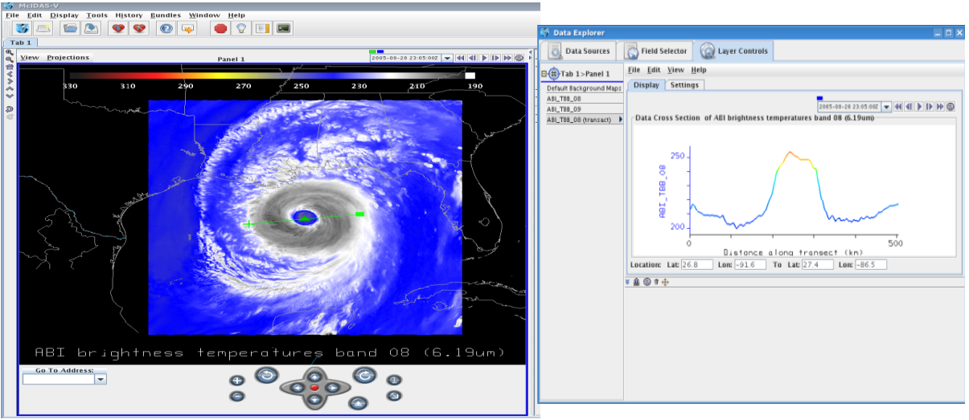
Analyze
Transact

Slide 12
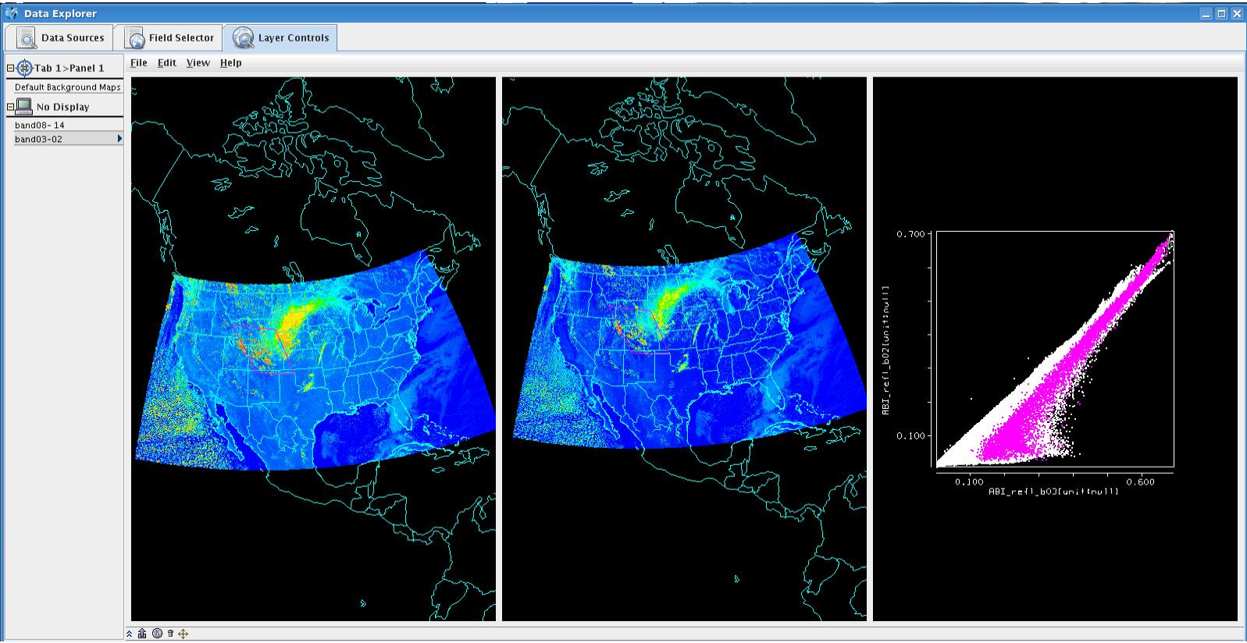
Scatter analysis

Slide 13
Scripting for other displays

Slide 14
Analyze: Tell a story
Once upon a time:
There was a GOES East and GOES West.
Both had only one water vapor band.
We could see what had happened after it rains.
It was exiting.
Then we heard, GOES-R was coming
With thee water vapor bands and 30 times better.
We will see what is happening when it rains.
Hmm.., Wait a minute, where was all this rain before?
Now what are we going do if something happens?

Slide 15
Analyze: Tell a story

Slide 16
ABI- weighting functions
The weighting functions were calculated using simulated spectral response functions based on proposed ABI bandwidths.
http://www.epssi.mtu.edu/seminar/i1520-0477-86-8-1079.pdf

Slide 17
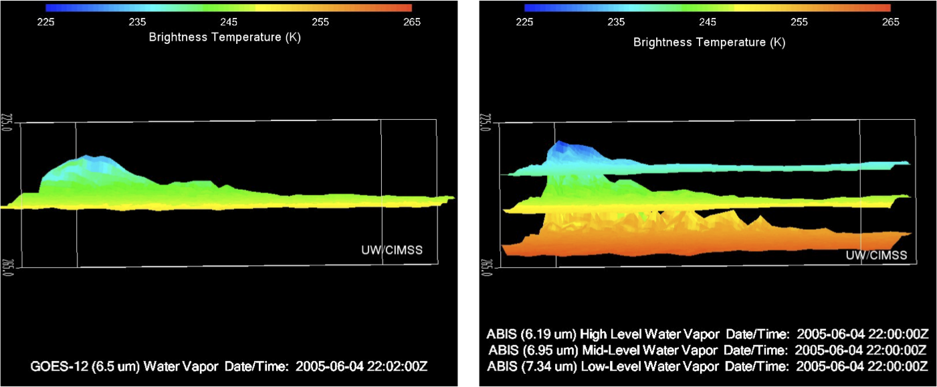
Analyze 1

Slide 18
Puzzle: 5 Analyze: 75W vs 89.5W
http://weatherstories.ssec.wisc.edu/work/suomi.html

Slide 21
Sat. Sub point: 75W vs 89.5W

Slide 22
Analyze
Data Transacts
Scatter plots
Google maps
Tell a story
Solve a puzzle

Slide 23
Validation and deep diving

Slide 24
Sub-sampling vs Averaging

Slide 25
Sub-sampling vs Averaging

Slide 26
Sanity check/Navigation

Slide 27
AIRS DPI in AWIPS
TO DO LIST.
Remapping data for AWIPS.
Stitch files together for each pass.
Setup and test new files in McIDAS-V.
Setup and test new files in AWIPS.

Slide 28
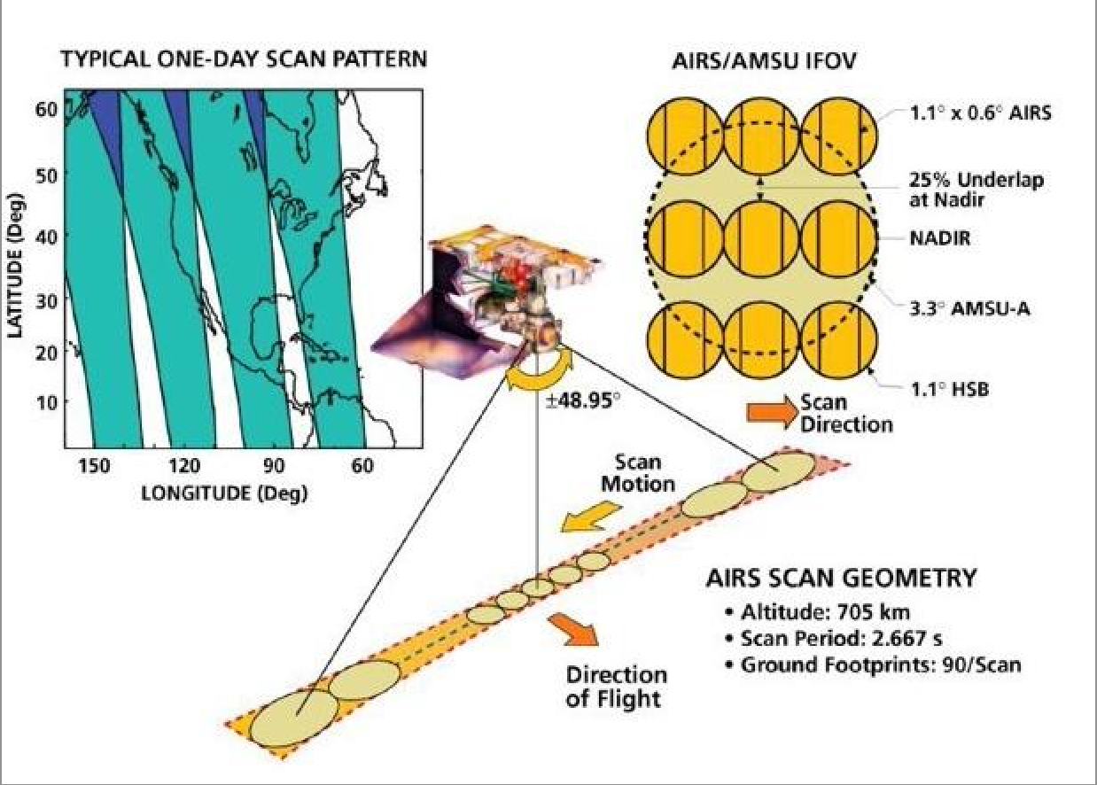
The Atmospheric Infrared Sounder (AIRS) is a cross-track rotary scanning sensor with a ± 49.5 degrees (from nadir) ground coverage
http://www.star.nesdis.noaa.gov/smcd/spb/LANDEM/website/instr_AIRS.php

Slide 29
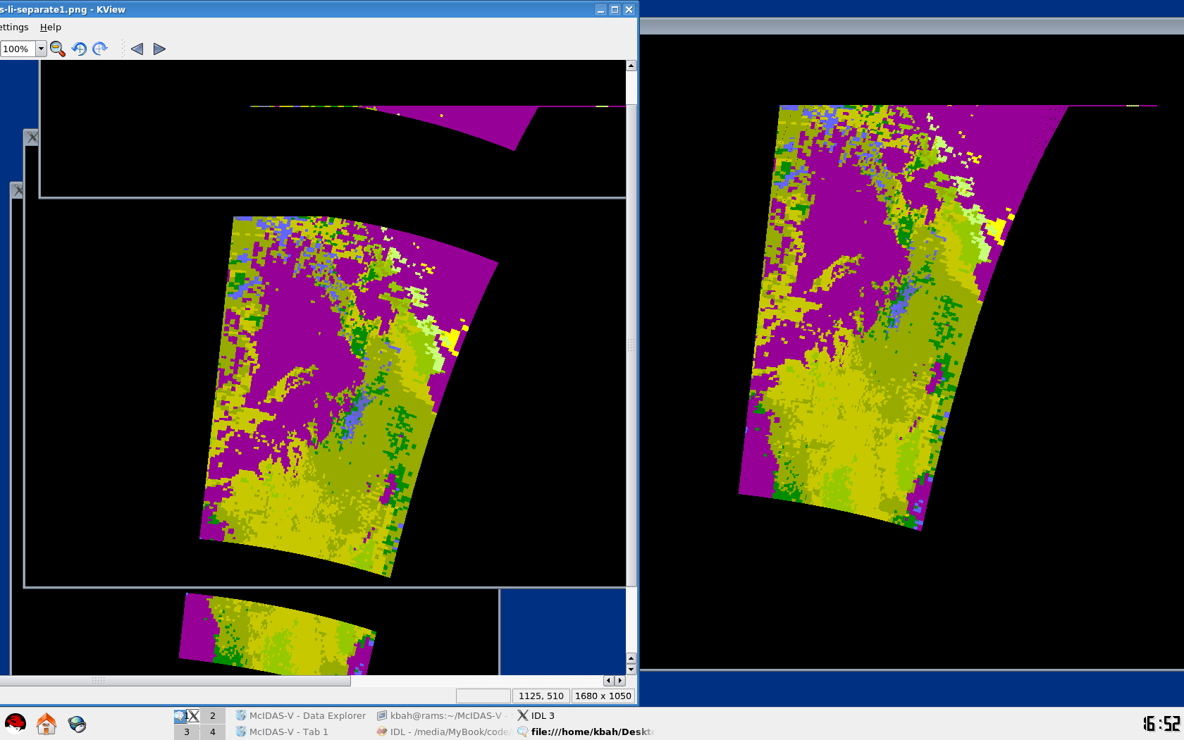
Sanity check/Navigation GOAL:Stitch AIRS files together for each pass
Before and after

Slide 30
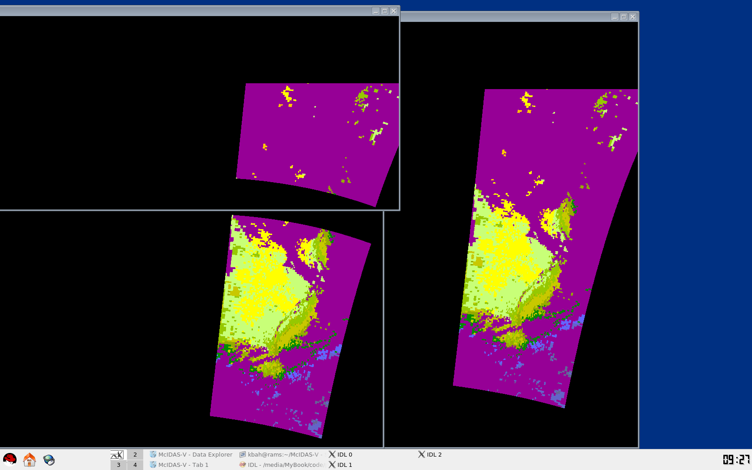
Stitching files together for each pass
Before and after stitching files. Test 02

Slide 31
Setup and test new stitched files in McIDAS-V

Slide 32
Setup and test new stitched files in AWIPS

Slide 33
Detector Analysis
HERE WE DIVE.

Slide 34
Detector Analysis

Slide 35
CONUS Simulation
CONUS Simulation for 4 June 2005
Noise free from NWP
Remapped to ABI Fixed Grid Format (FGF), nominally 2km
CONUS sector is 2500 by 1500 pixels
3,750,000 total pixels
3,661,932 of these are on the Earth
Deviation simulated by adding 0.135K @300K noise to the 12.3um band image for every 100th line.
Products besides Imagery are generated using first all noise-free data and comparing to those generated with all bands noise-free data except band 15 (12.3um) with striping

Slide 36
12.3um Band 15 Simulation
Notes:
CONUS GRB file is 2500x1500 pixels
Radiances are displayed.

Slide 37
12.3um Band 15 Simulation with Striping
Notes:
CONUS GRB file is 2500x1500 pixels
Striping was added every 100 lines starting with line 50. Striping is random noise generated based on 0.135K @300K. This means the noise across a striped line is distributed normally with a mean of 0 and std=0.135K@300K in radiance space.

Slide 38
12.3um Band 15 Simulation with Striping
Difference Image
Notes:
CONUS GRB file is 2500x1500 pixels
Striping was added every 100 lines starting with line 50.
There are 150 stripes across this image but you can’t see them because we’re not zoomed in enough.

Slide 39
12.3um Band 15 Simulation with Striping
Difference Image
Notes:
Zoomed in over Mississippi Delta area.

Slide 40
12.3um Band 15 Simulation

Slide 41
12.3um Band 15 Simulation with Striping

Slide 42
Imagery Analysis
Based on image generation and viewing, it is thought that:
The band 15 Imagery product is not affected significantly
Users would not notice visible striping in the imagery without clean data for comparison
A “smart” remapper could effectively mitigate this
It is not worth affecting the other detector arrays for a problem this insignificant for one detector.
Bottom line: Investigate a smarter resampler, but this particular issue is not a “show stopper”

Slide 43
Diving deep
Sampling vs Averaging
AIRS DPI navigation
Detector Analysis

Slide 44
Summary
Very interactive.
Has something to offer for most.
Easy to install easy to use
Free, Free, free
Now go get it.!!

Slide 45
END

Slide 46
QUESTIONS ??

