Slide 1


The Challenge of VIIRS Imagery in McIDAS-X: How McIDAS Experience Helps
Don Hillger
Don.Hillger@noaa.gov
StAR Lead
VIIRS EDR Imagery and Visualization Team
NOAA/NESDIS/StAR/RAMMB
Fort Collins CO
MUG Meeting, Madison WI, 9-12 September 2013

Slide 2
VIIRS Bands and Bandwidths
VIIRS Band | Central Wavelength (μm) | Bandwidth (μm) | Wavelength Range (μm) | Band Explanation | Spatial Resolution (m) @ nadir
M1 | 0.412 | 0.02 | 0.402 - 0.422 | Visible / Reflective | 750 m
M2 | 0.445 | 0.018 | 0.436 - 0.454
M3 | 0.488 | 0.02 | 0.478 - 0.488
M4 | 0.555 | 0.02 | 0.545 - 0.565
M5 (B) | 0.672 | 0.02 | 0.662 - 0.682
M6 | 0.746 | 0.015 | 0.739 - 0.754 | Near IR
M7 (G) | 0.865 | 0.039 | 0.846 - 0.885
M8 | 1.240 | 0.020 | 1.23 - 1.25 | Shortwave IR
M9 | 1.378 | 0.015 | 1.371 - 1.386
M10 (R) | 1.61 | 0.06 | 1.58 - 1.64
M11 | 2.25 | 0.05 | 2.23 - 2.28
M12 | 3.7 | 0.18 | 3.61 - 3.79 | Medium-wave IR
M13 | 4.05 | 0.155 | 3.97 - 4.13
M14 | 8.55 | 0.3 | 8.4 - 8.7 | Longwave IR
M15 | 10.763 | 1.0 | 10.26 - 11.26
M16 | 12.013 | 0.95 | 11.54 - 12.49
DNB | 0.4 | 0.5 - 0.9 | Visible | Visible / Reflective | 750 m across full scan
I1 (B) | 0.64 | 0.08 | 0.6 - 0.68 | Visible / Reflective | 375 m
I2 (G) | 0.865 | 0.039 | 0.85 - 0.88 | Near IR
I3 (R) | 1.61 | 0.06 | 1.58 - 1.64 | Shortwave IR
I4 | 3.74 | 0.38 | 3.55 - 3.93 | Medium-wave IR
I5 | 11.45 | 1.9 | 10.5 - 12.4 | Longwave IR
Notes:
M-bands highlighted in pale yellow are available as EDRs, in addition to SDRs.
True-color component bands are highlighted in red, green, and blue.
Natural-color component bands are noted with R, G, and B.

Slide 3
NPP/JPSS data sources
GRAVITE¹ (Suitland, 7-hour delay)
NOAA CLASS² (Asheville, 7-hour delay) – not actively used
Atmosphere PEATE³ (Wisconsin, 7-hour delay)
  ADDE server for McIDAS-X
  FTP and HTML
Direct Readout (Wisconsin, minimal delay, but provides data only over North America, when the satellite is with sight of Madison)
AFWA IDPS⁴ (Omaha, near real-time)
¹Government Resource for Algorithm Verification, Independent Test, and Evaluation
²Comprehensive Large Array-data Stewardship System
³Product Evaluation and Algorithm Test Elements
⁴Air Force Weather Agency Interface Data Processing Segment

Slide 4
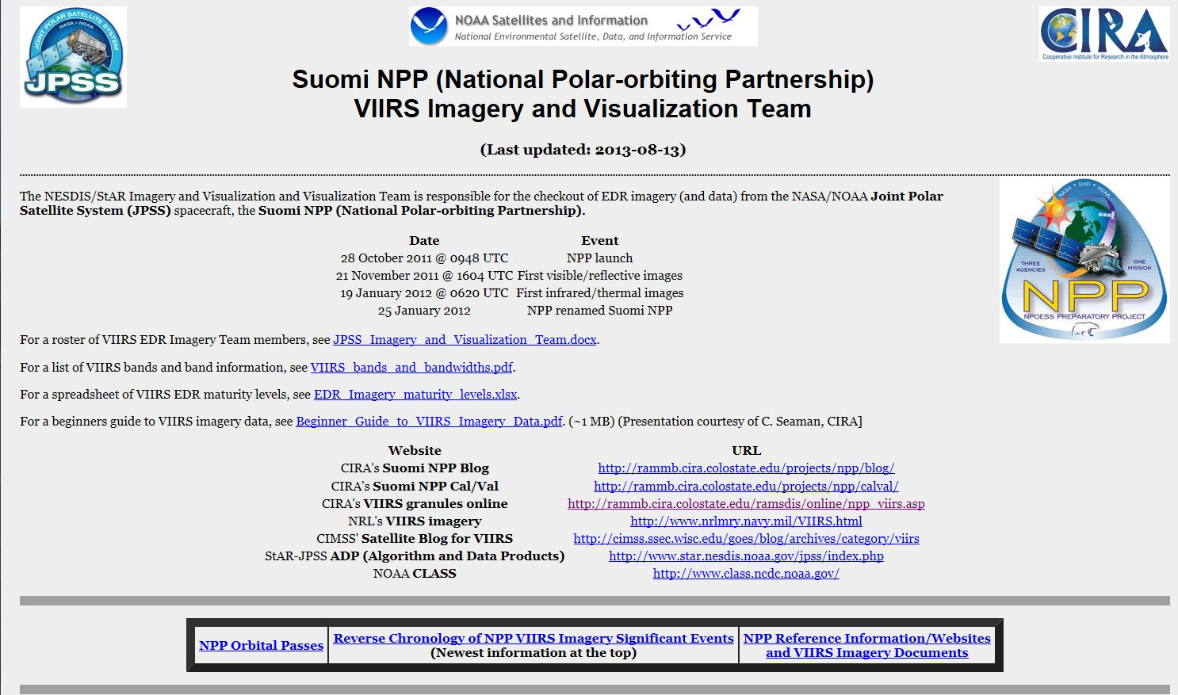
  Suomi NPP Imagery and Visualization Team web page http://rammb.cira.colostate.edu/projects/npp/

Slide 5
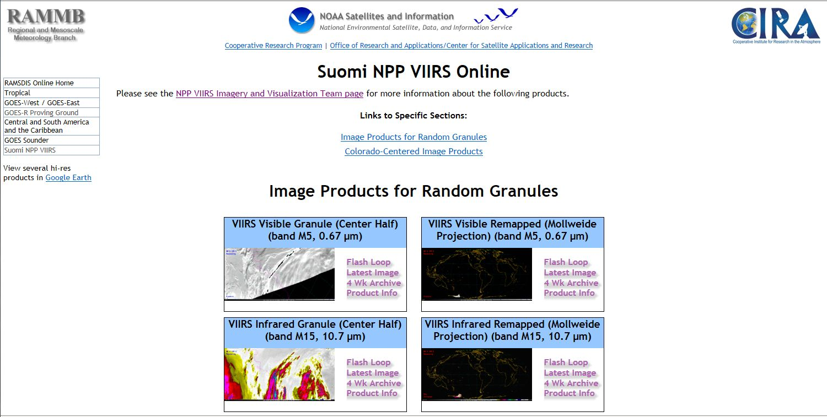
  Suomi NPP VIIRS Online http://rammb.cira.colostate.edu/ramsdis/online/npp_viirs.asp

Slide 6
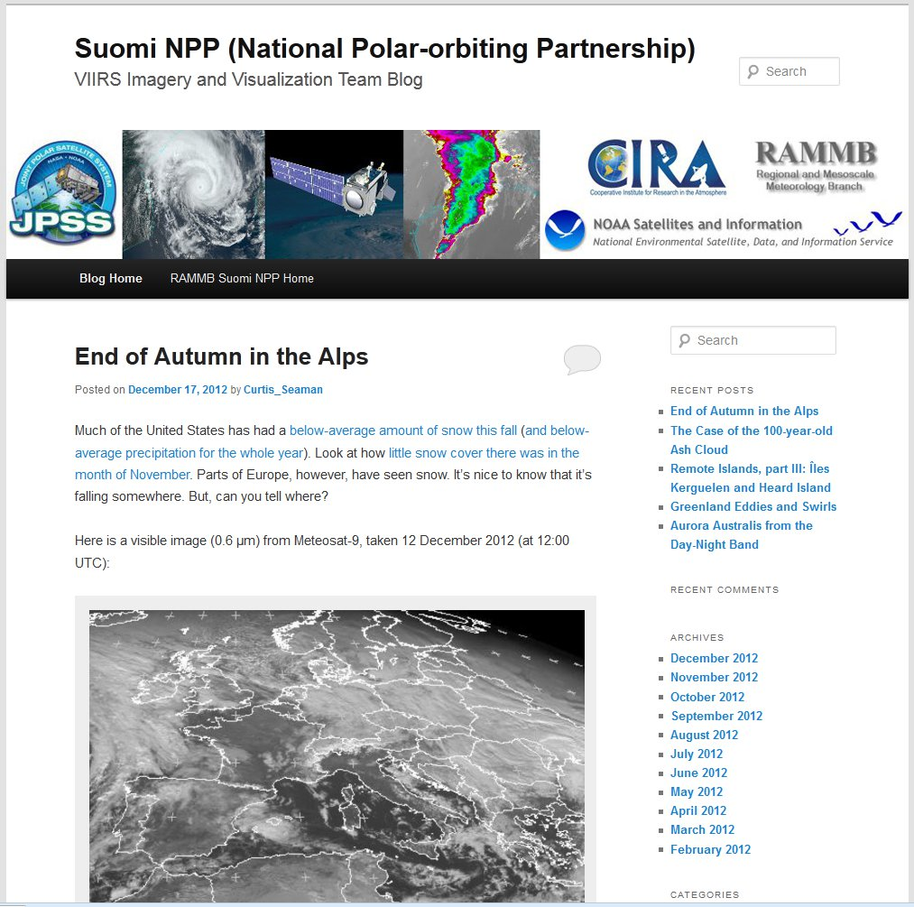
JPSS/Suomi NPP VIIRS Imagery Blog
http://rammb.cira.colostate.edu/projects/npp/blog/
Blog maintained at CIRA to highlight capabilities of VIIRS instrument.
Designed to provide education/outreach of VIIRS imagery applications.
Blog covers wide range of topics: tropical cyclones, severe weather, fire detection, auroras, volcanic eruptions, flooding, snow and ice detection, DNB applications, RGB composites and other interesting high-resolution imagery from VIIRS

Slide 7
Beginner’s Guide to VIIRS Imagery Data
Curtis Seaman
CIRA/Colorado State University
http://rammb.cira.colostate.edu/projects/npp/Beginner_Guide_to_VIIRS_Imagery_Data.pdf

Slide 8
VIIRS single granule information
VIIRS | Lines x Elements | Suggested McIDAS-X magnification
Size (km) | ~550 km x ~3000 km (~5° x ~27°)
I-bands (full size) | 1536 x 6400 | -2 x -4
M-bands (full size) | 768 x 3200** | 1 x -2
Suggested McIDAS-X window | 768 x 1600*** or 768 x 1920 | 1 x 1 (with LINE=X 800) to get center half of granule 1 x 1 (with LINE=X 640) to get center of granule between outermost bowtie deletions
DNB (full size) | 768 x 4064
Suggested McIDAS-X window | 768 x 2032 or 786 x 1600 (same size as other bands) | 1 x 1 (with LINE=X 1016) to get center half of granule 1 x 1 (with LINE=X 1232) to get center portion of granule same size as other bands
NCC (from DNB) | 768 x 3200** | [Same treatment as M-bands]
Each granule, ~86 seconds long, or ~556 km along track
*Based on an altitude of 833 km
**48 scans x 16 detectors/scan = 768 lines
***Based on a McIDAS window as large as most single monitors will display

Slide 9
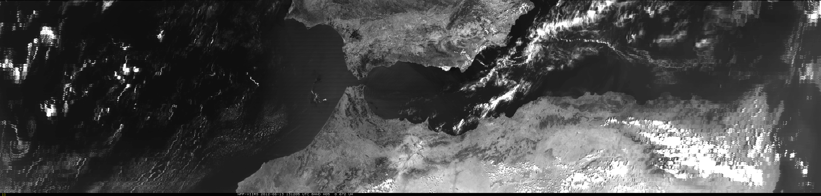
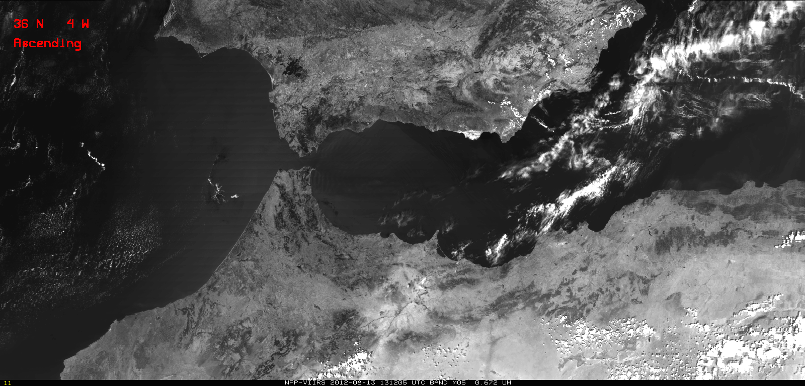
VIIRS granule display in McIDAS-X (band M5 example)
Full 90-second granule (768 x 3200)
(Bow-tie deletions at each end of SDR granule are filled)
Center half of granule (768 x 1600)
(Avoids filled-in bow-tie deletion areas at each end of SDR granule)
Notes:
Granules provided by Atmos PEATE via an ADDE server. Example is a M5 (visible/red band) SDR with bow-tie deletions (at ends of the granule) filled in.
(SDR = Sensor Data Record. Each granule is only ~90 seconds of VIIRS)

Slide 10
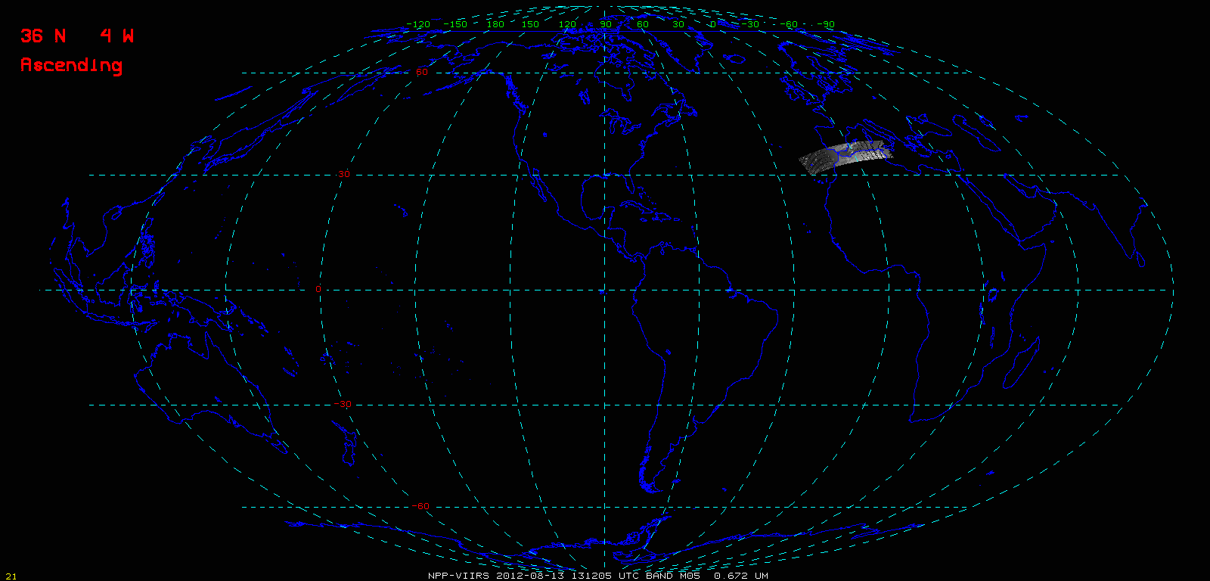
Full 90-second granule remapped to Mollweide projection (in McIDAS-X)

Slide 11
16 M-band detectors per scan
(red pixels are bowtie deletion pixels, first one then two lines.)
Should be a repeating pattern every 16 lines.
Right half
Left half

Slide 12
Bow Tie Line Deletions
Sequential lines missing (M-bands) | 2 | 1 | 0 | 1 | 2
Lines missing out of 16 lines/scan (M-bands) | 4 | 2 | 0 | 2 | 4
Elements (M-bands) | 1-640 | 641-1008 | 1009-2192 | 2193-2560 | 2561-3200
Number of elements (M-bands) | 640 | 368 | 1184 (2x592) | 368 | 640
Scan angle | 56°-44.7° | 44.7°-32° | 32°-0°-32° | 32°-44.7° | 44.7°-56°
Zenith angle | 69.4°-52.6° | 52.6°-36.7° | 36.7°-0°-36.7° | 36.7°-52.6° | 52.6°-69.4°

Slide 13
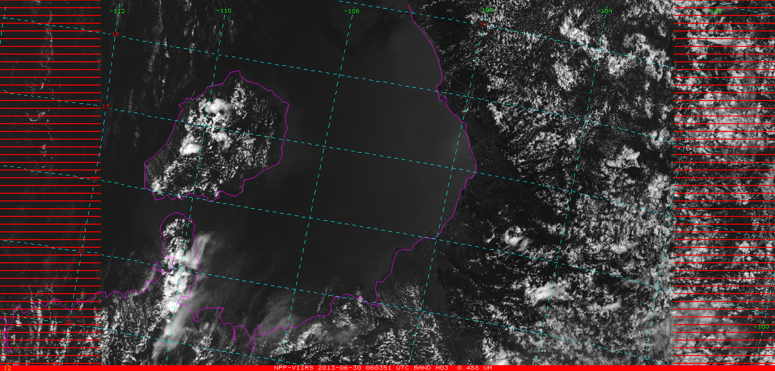
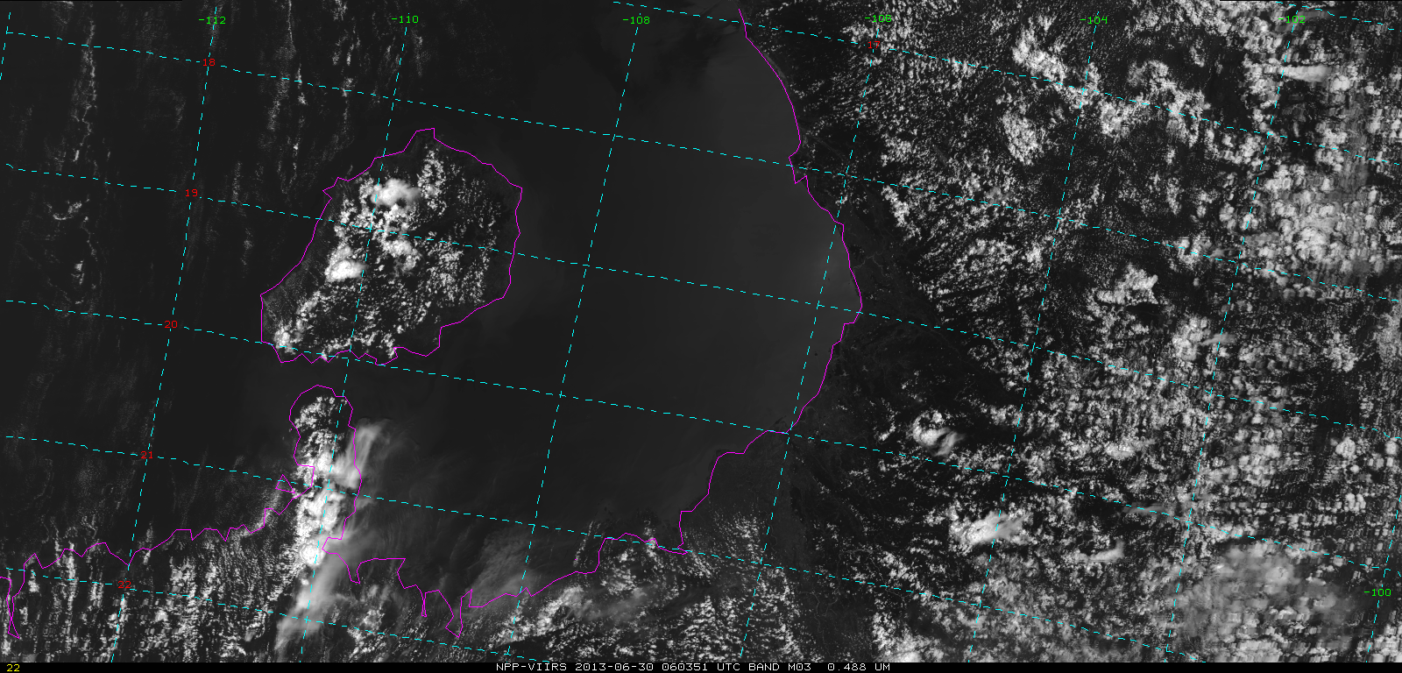
VIIRS M3 band
2013-06-30
06:03:51 UTC
VIIRS M3 band
2013-06-30
06:03:51 UTC
with bowtie deletions filled-in

Slide 14
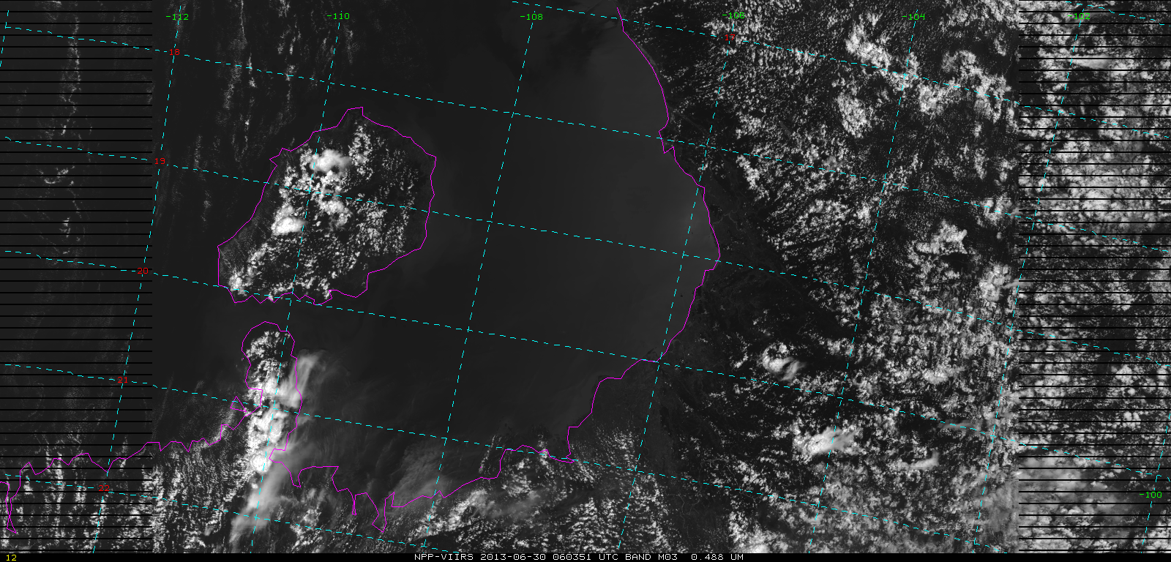
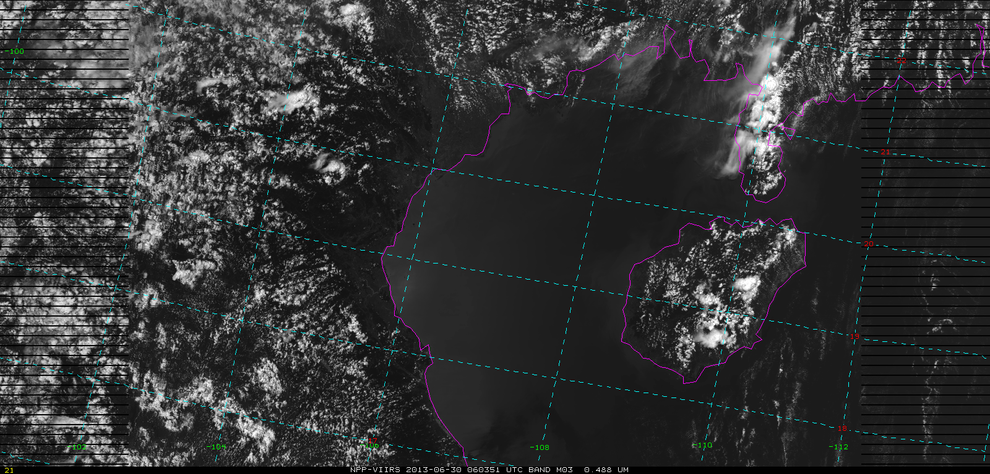
VIIRS M3 band
2013-06-30
06:03:51 UTC
VIIRS M3 band
2013-06-30
06:03:51 UTC
rotated so that north is to the top

Slide 15
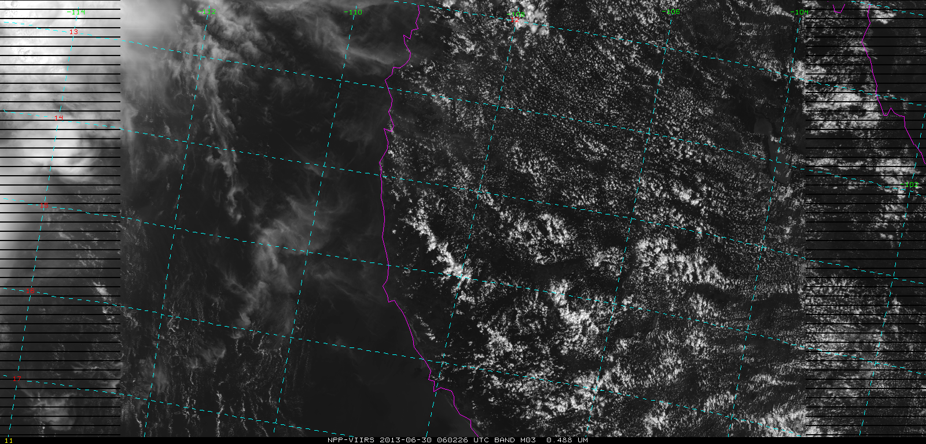
VIIRS M3 band
2013-06-30
06:02:26 UTC
Images of two adjacent granules
VIIRS M3 band
2013-06-30
06:03:51 UTC

Slide 16
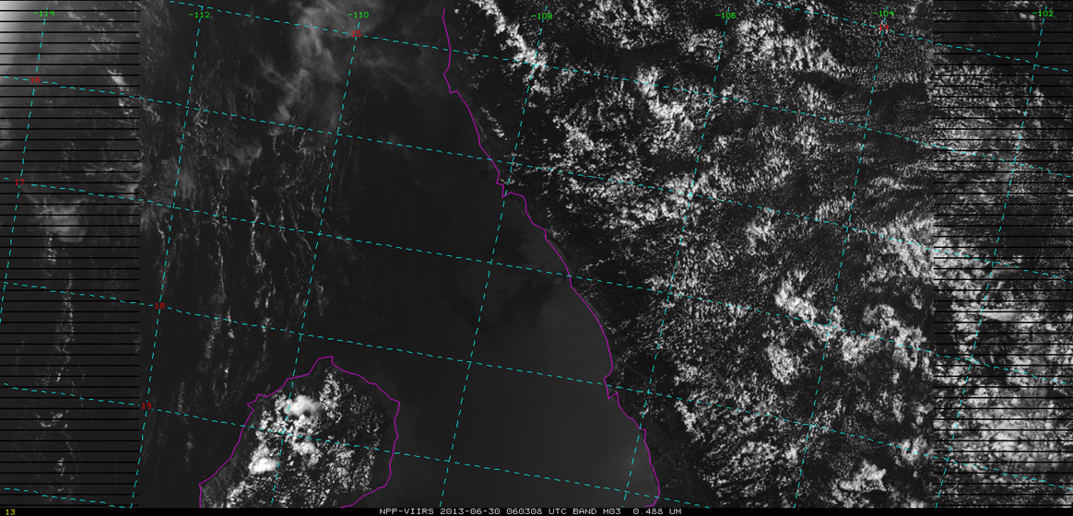
VIIRS M3 band
2013-06-30
06:03:08 UTC

Slide 17
VIIRS scientific units
(unlike GOES radiances in RAW counts)
VIIRS bands | Units available from HDF5 via ADDE server (only) |  | Other units in McIDAS
Visible / Reflective | Radiances | Reflectances | Brightness counts
Thermal / Emissive | Radiances | Brightness Temperatures | Brightness counts
Day/Night Band | Radiances | Reflectances | Brightness counts
Best to copy the VIIRS images from the server in the units needed, since once separated from the server, other unit scalings are not automatic, but need to be done manually.

Slide 18
Commonly used three-color (RGB) combinations of VIIRS bands.
Three-color (RGB) Product | Red | Green | Blue
True color | M5 (0.672 µm) | M4 (0.555 µm) | M3 (0.488 µm)
Natural color | M10 (1.61 µm) | M7 (0.865 µm) | M5 (0.672 µm)
 | I3 (1.61 µm) | I2 (0.865 µm) | I1 (0.64 µm)

Slide 19
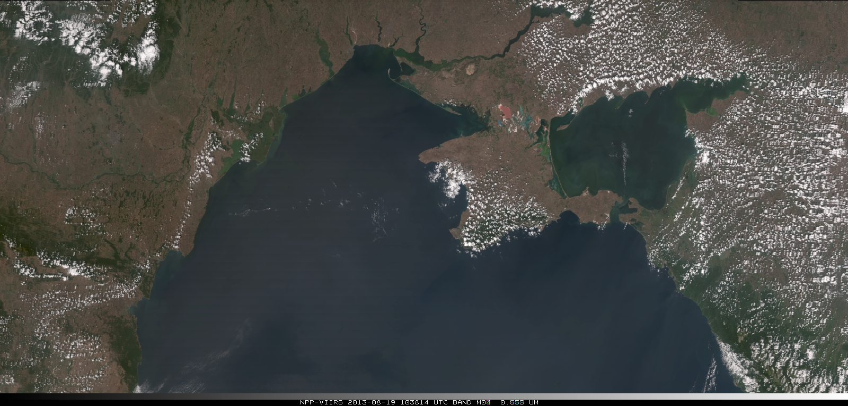
VIIRS true-color RGB combination

Slide 20
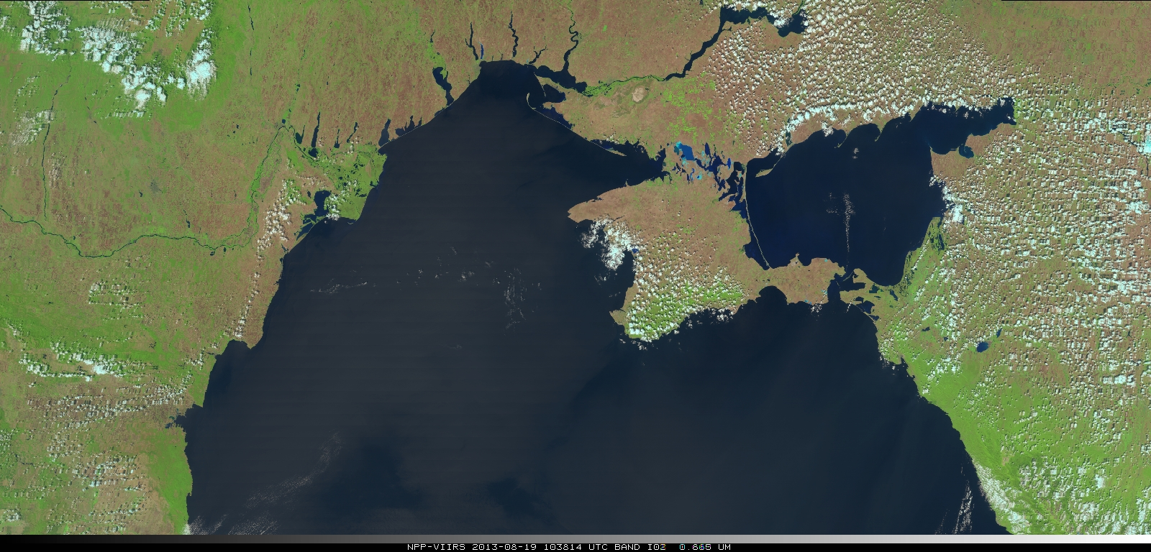
VIIRS natural-color RGB combination
North shore of Black Sea (Odessa)

Slide 21
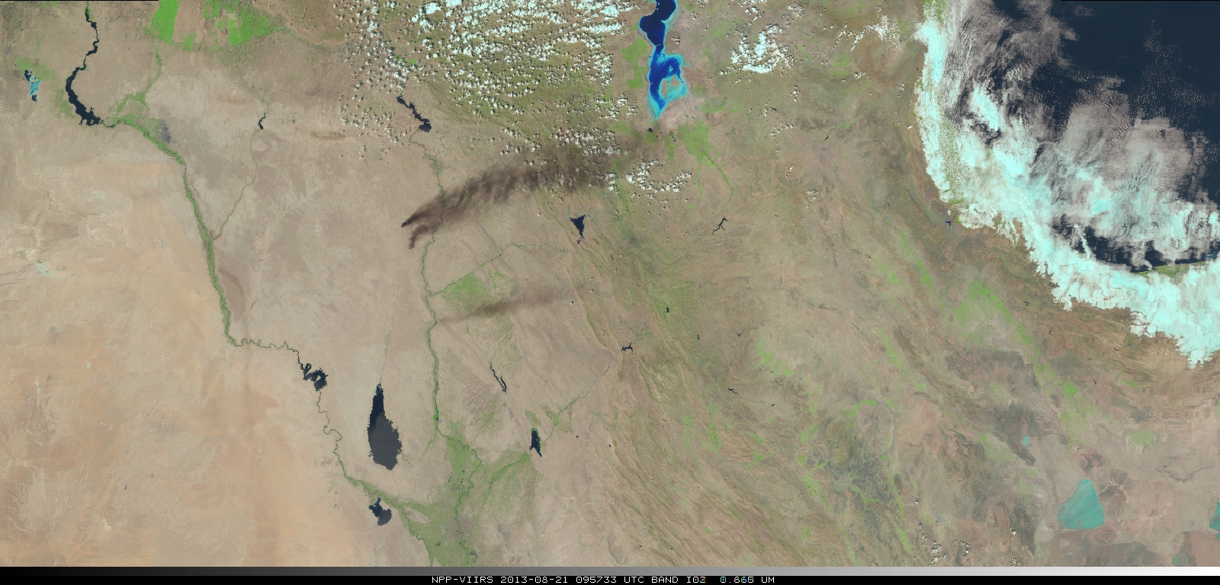
VIIRS natural-color image from 24-bit RGB combination (JPG) using COMBINE command

Slide 22
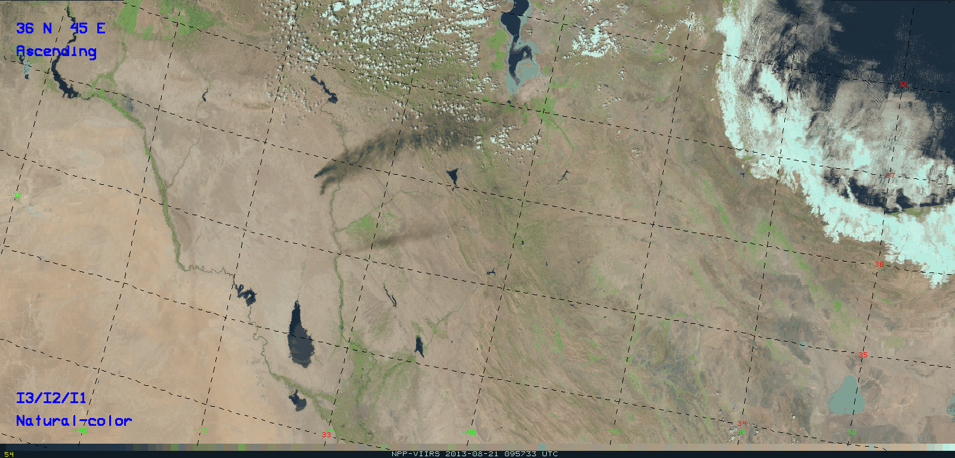
VIIRS natural-color image from 8-bit RGB combination (GIF) using AREACOLOR program
Northeastern Iraq fires

Slide 23
Sensor Data Record (SDR) to Environmental Data Record (EDR)
Ground Track Mercator (GTM) remapping software.
  GTM is a remapping of the data, but the same radiances/reflectances/temperatures for Non-NCC bands only.
For NCC imagery, which is derived from the Day Night Band (DNB), there is additional radiance (reflectance) processing
Environmental Data Record (EDR)
Sensor Data Record (SDR)
GTM software
GTM software
plus
DNB (SDR)
radiance
NCC (EDR) pseudo-albedo

Slide 24

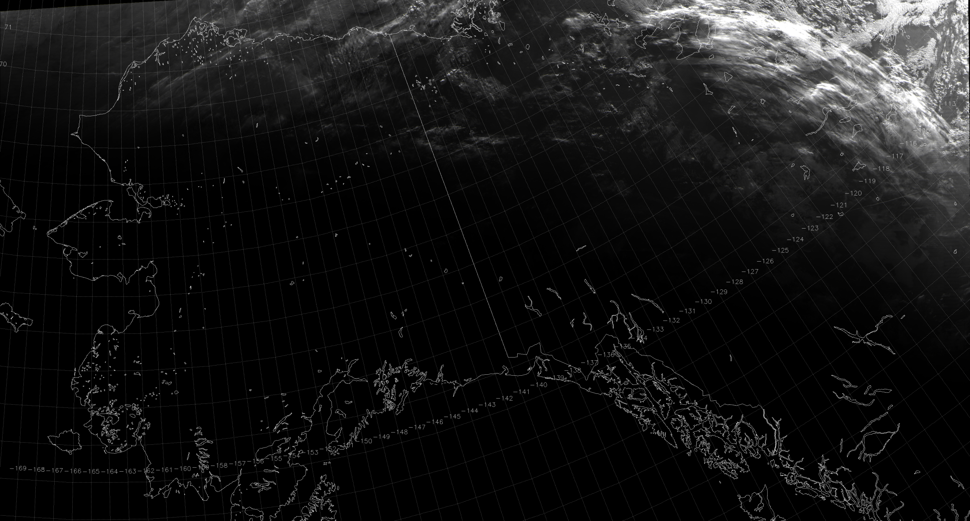
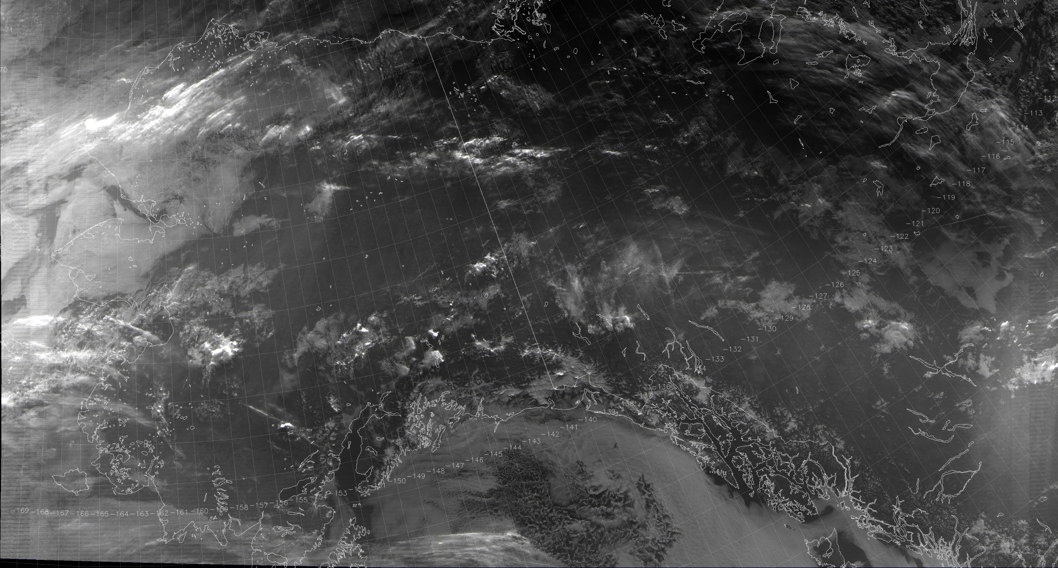
At the Day/Night Terminator
SDR
NCC EDR
11:53 UTC 31 July 2013

Slide 25
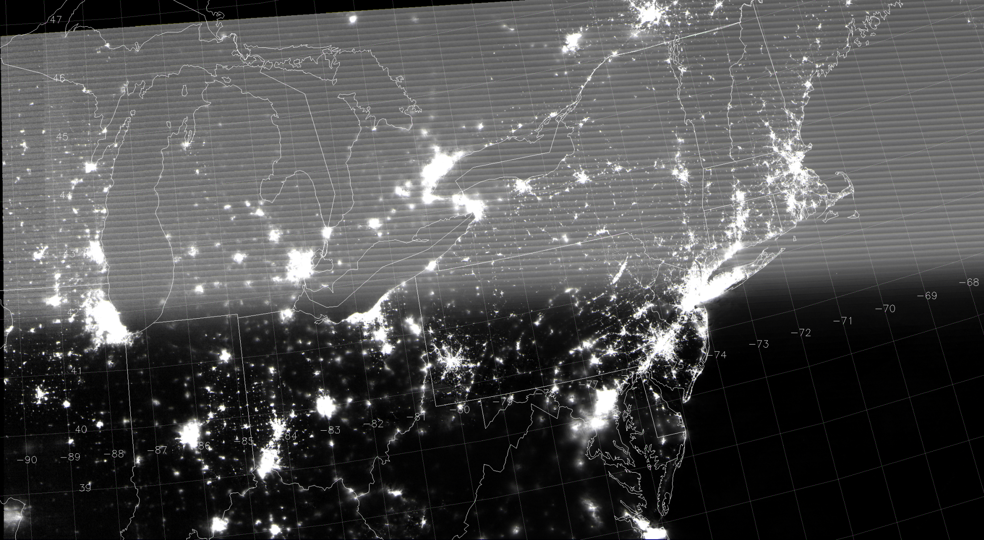
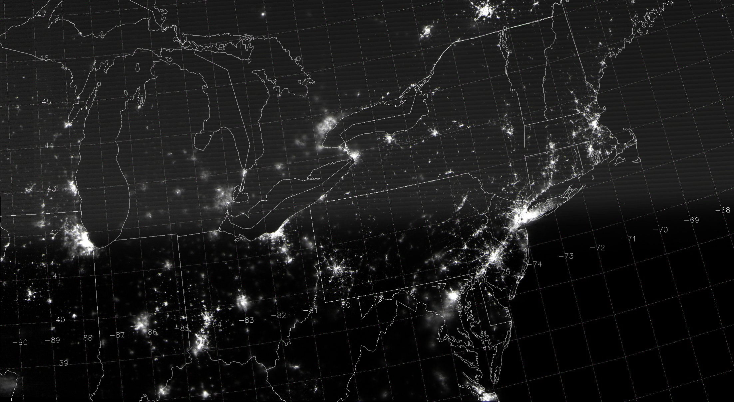

During a New Moon
SDR
NCC EDR
Stray light
Stray light
06:43 UTC 6 August 2013

Slide 26
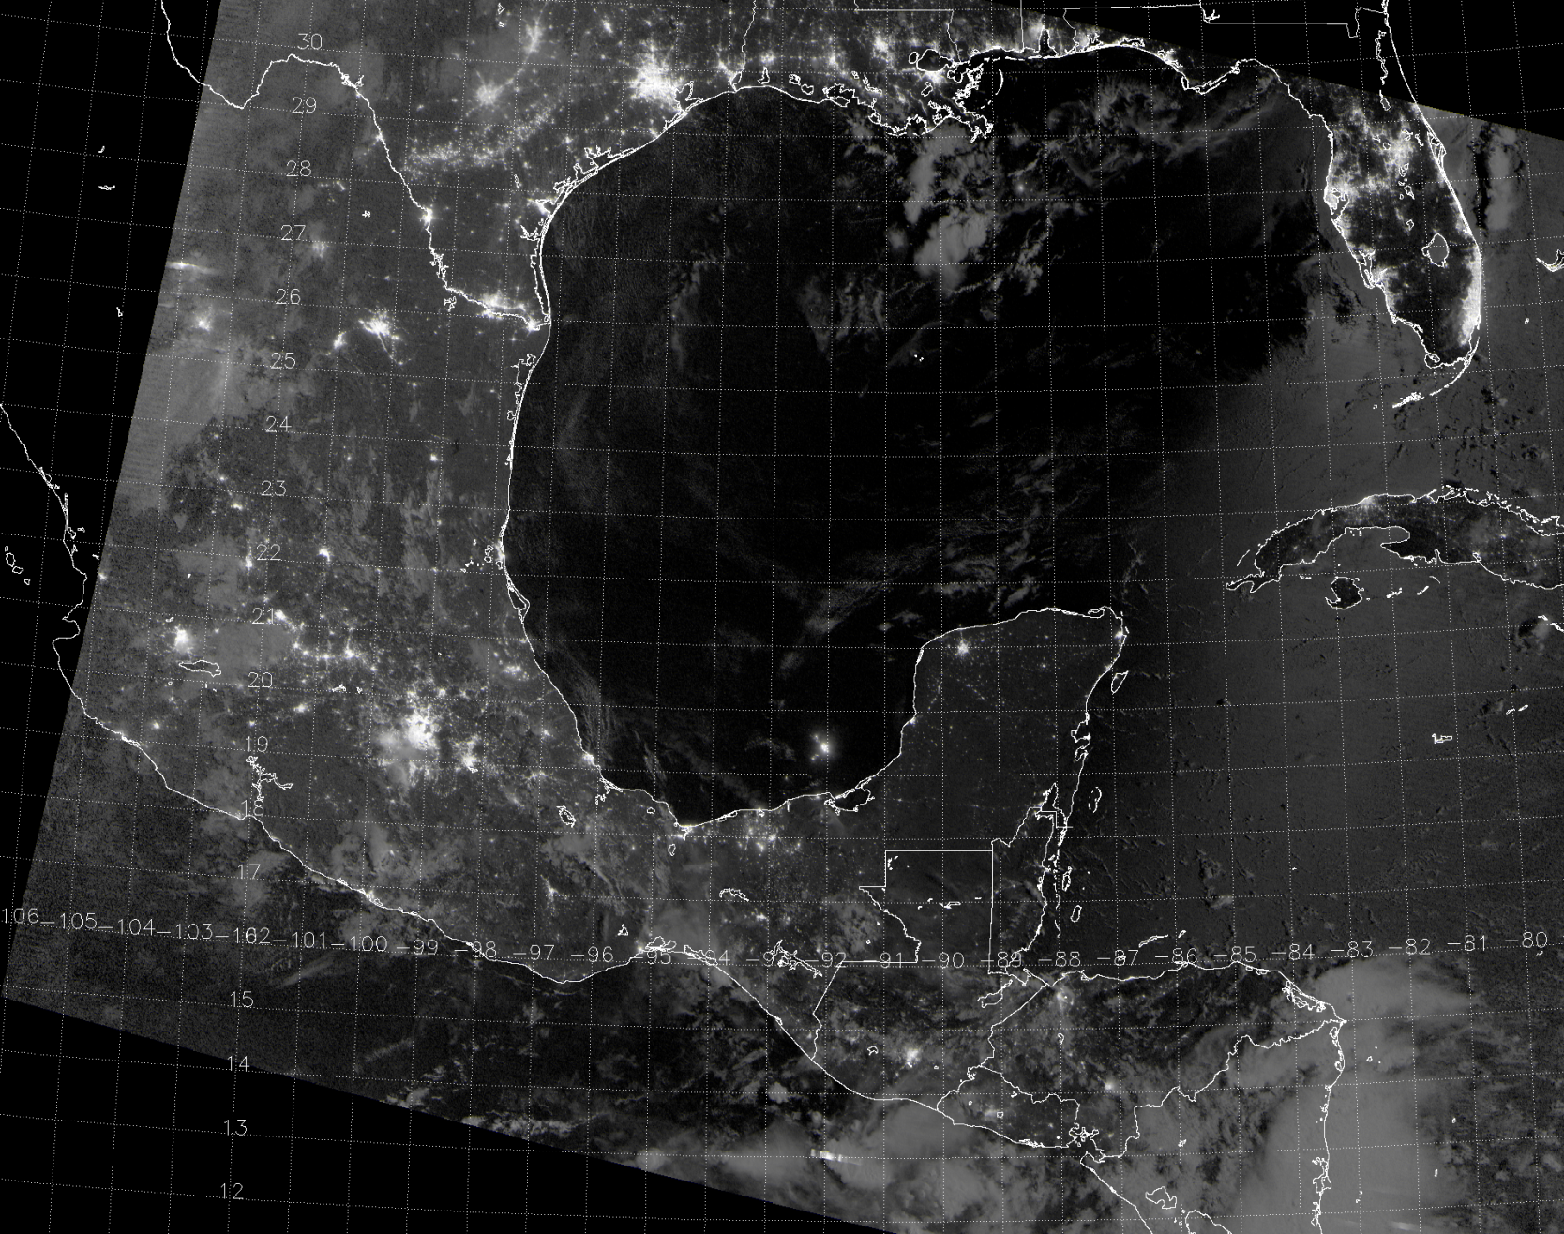
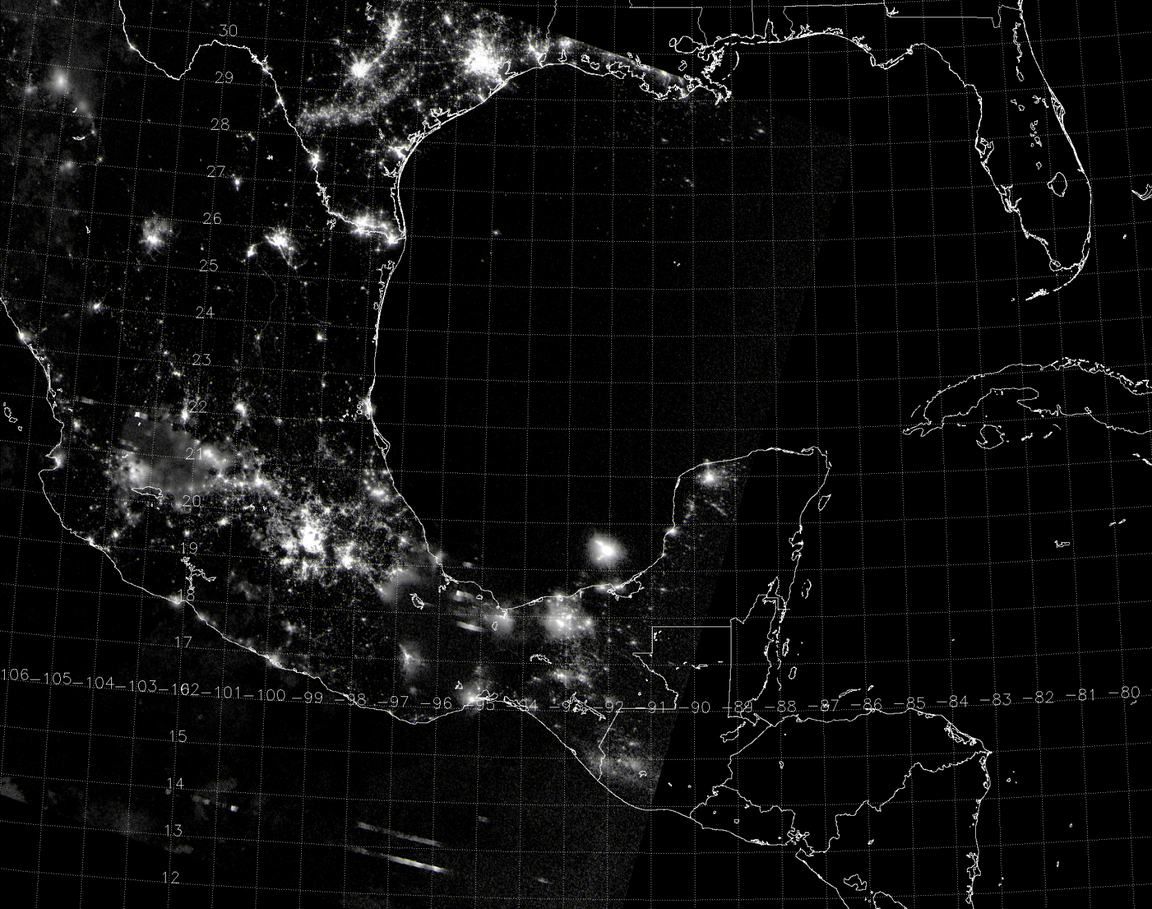
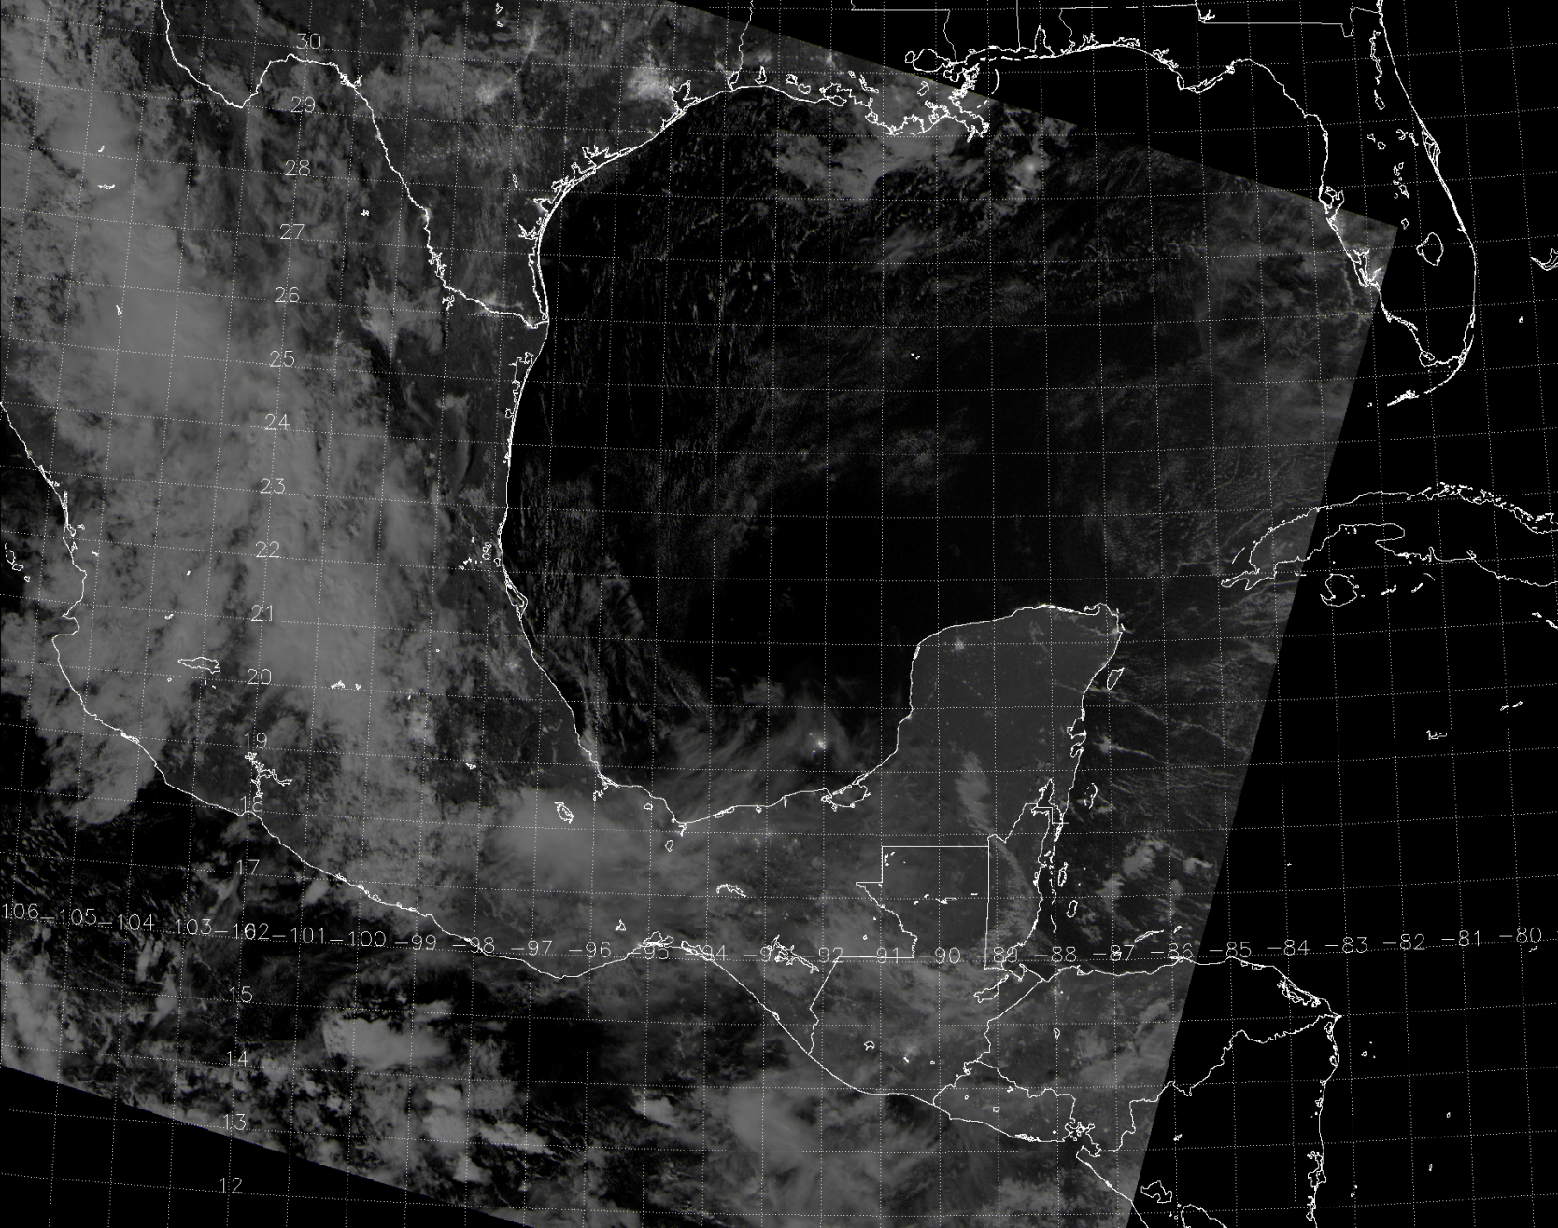
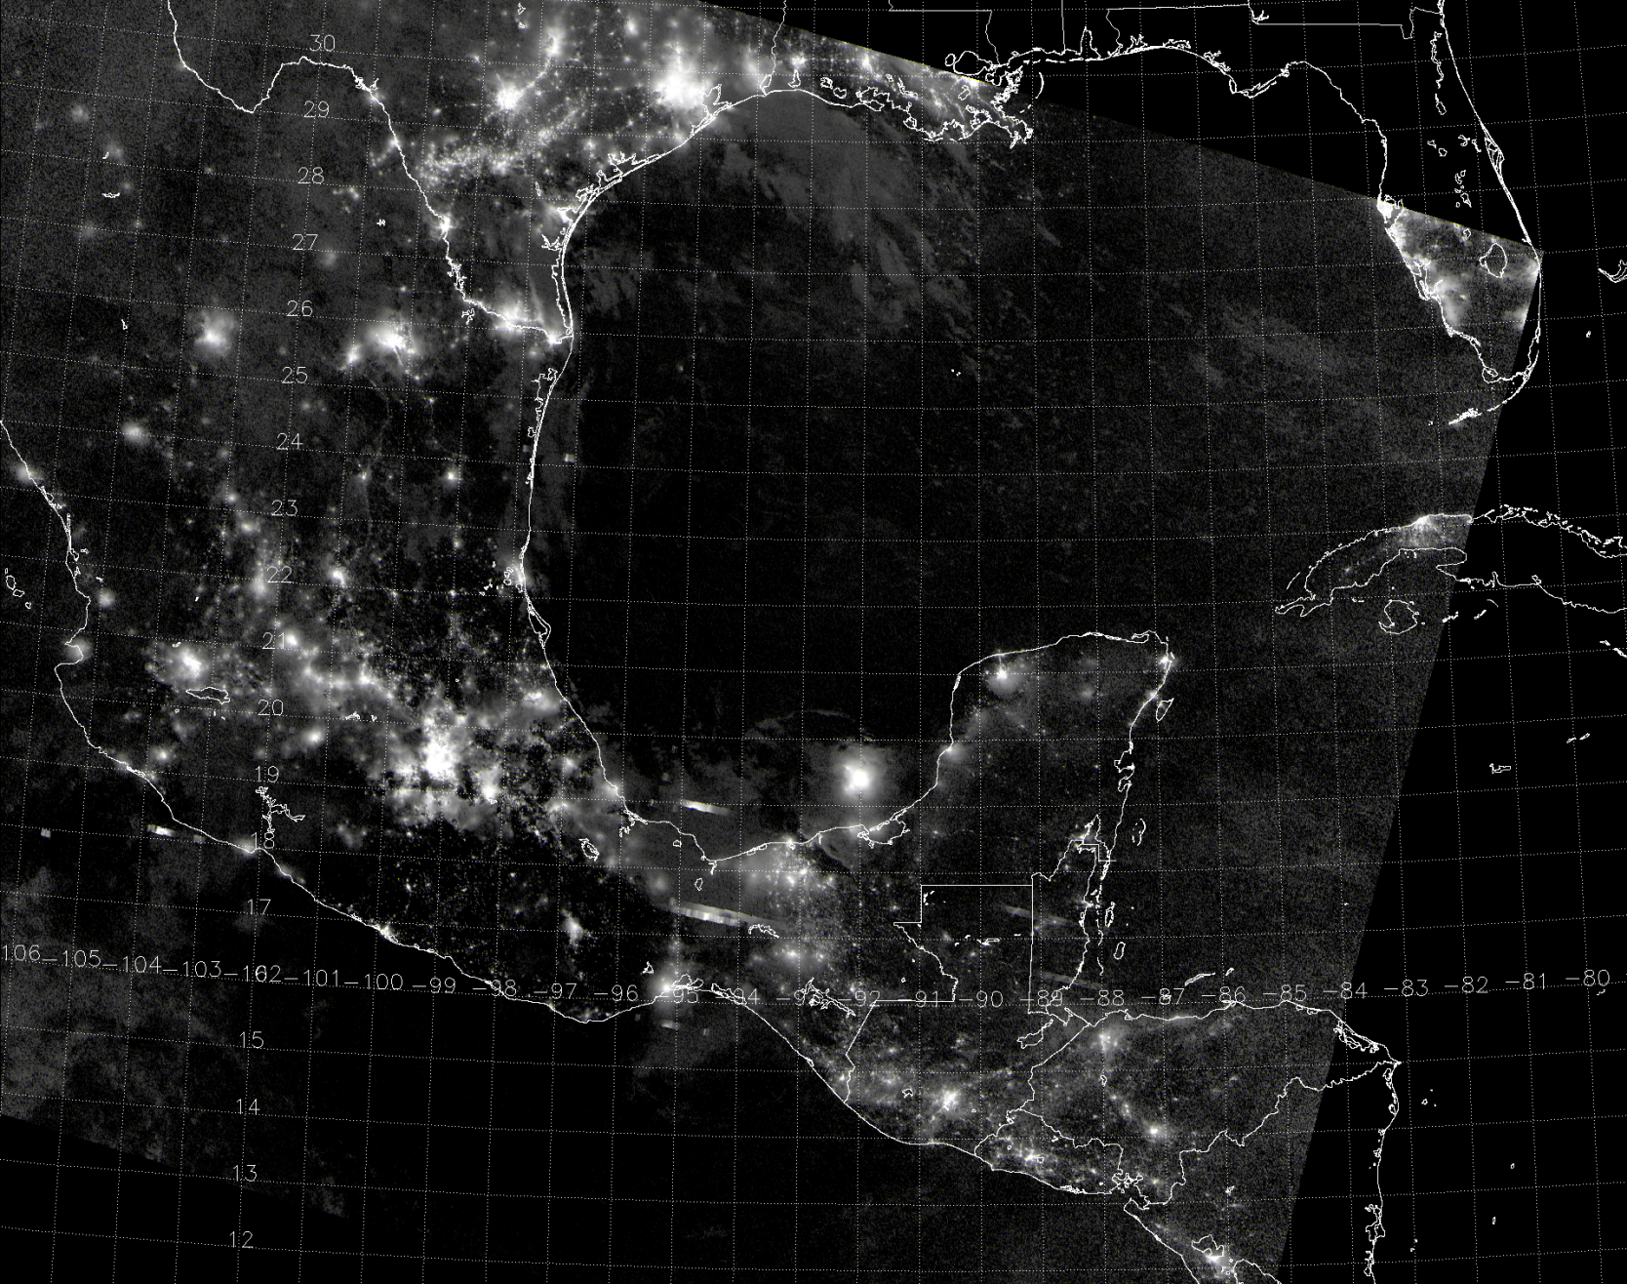



NCC Over a Full Lunar Cycle
Oil rigs
Moon glint
Lightning
08:09 UTC 22 July 2013
07:43 UTC 29 July 2013
08:28 UTC 6 August 2013
08:02 UTC 17 July 2013

Slide 27
Summary
We’ve made excellent progress with VIIRS Imagery after 18 months!
  Various RGB imager products are impressive.
  DNB/NCC Imagery is a great addition to heritage MODIS-type imagery.
McIDAS-X is VIIRS-capable from the server only.
  Offline, VIIRS needs special handling.
  VIIRS geo-locations are inexact for large granule-size images. (not explained here)
McIDAS-V for VIIRS will be addressed by the Mc-V Team.

Slide 28
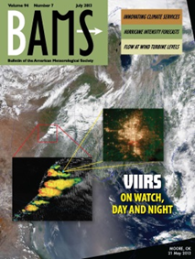
BAMS article from the Imagery Team
Hillger, D., T. Kopp, T. Lee, D. Lindsey, C. Seaman, S. Miller, J. Solbrig, S. Kidder, S. Bachmeier, T. Jasmin, and T. Rink, 2013: First-Light Imagery from Suomi NPP VIIRS. Bull. Amer. Meteor. Soc., 94(7), 1019-1029, plus cover images. doi:10.1175/BAMS-D-12-00097.1

