Slide 1
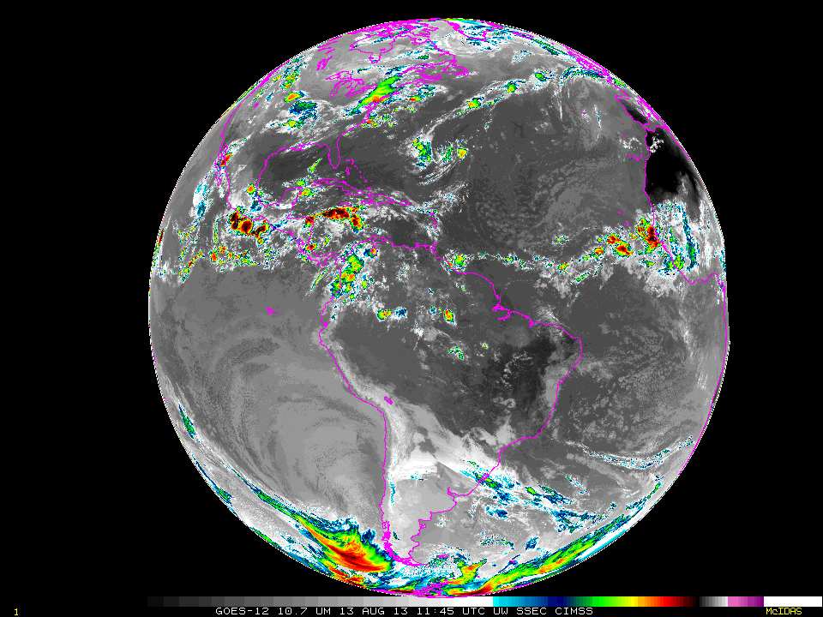
Status of
NOAA Satellite Operations
& McIDAS in ESPC
Matthew Seybold
Final 2 days of GOES-12
10.7 um Longwave IR
August 13-15, 2013
http://cimss.ssec.wisc.edu/goes/blog/
MUG Meeting
Madison, WI
September 9-12, 2013

Slide 2
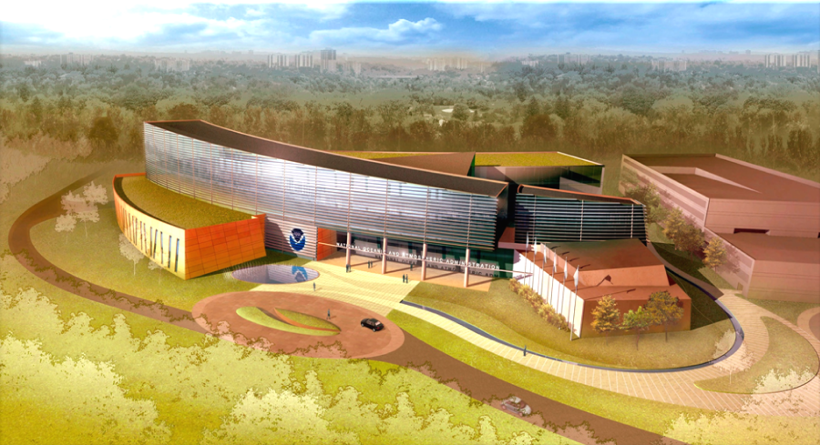
ESPC Coordination for MUG Talk
NESDIS / OSPO / SPSD @ NCWCP
Jessica Braun, Senior Product Programmer
Tom Renkevens, Deputy Director SDSD
Natalia Donoho, User Services Coordinator
Bob Potash, Senior Product Programmer
Steve Ambrose, GOES-R Data Ops Manager
NESDIS / OSPO / SPSD / SAB @ NCWCP
Tony Salemi, Ash, Fire, Oil, Tropical Desks
Mark Ruminski, Fire Team Lead & All Desks
Gregg Gallina, COOP Team Lead & All Desks
Davida Street, Branch Chief
NESDIS / OSPO / MOD @ NSOF
Bonnie Morgan, GOES Product Area Lead
Russ Lancaster, Senior Systems Analyst
Donna McNamara, Data Access Manager
NESDIS / GOES-R @ NASA Goddard
Ananth Rao
Maurice McHugh
NSOF
NCWCP
Notes:
Collaborative effort here.
All individuals reviewed entire slide deck.
All individuals provided thoughtful and thorough feedback.
Will cover Satellite status in 10 minutes.
Will cover McIDAS Use in ESPC in remaining 20 minutes.
Format is a bit unconventional with many questions being posed, which will understandably be addressed outside of this talk during discussions, feedback sessions, or offline.

Slide 3
NESDIS Office of Satellite and Product Operations (OSPO)
Operates the Nation’s 15 environmental satellites
3 Geostationary (GOES) by NOAA
4 Polar-Orbiting (POES) by NOAA
6 Defense Meteorological Satellite Program (DMSP) operated by NOAA
1 OSTM Jason-2 (Ocean Surface Topography Mission) Joint NOAA, NASA, CNES, EUMETSAT effort
1 Suomi National Polar-orbiting Partnership (NPP) by NOAA & NASA
Locations at four facilities housing 700 people
NOAA Satellite Operations Facility (NSOF) in Suitland, MD - $5B facility operating $5B of satellites
NOAA Center for Weather & Climate Prediction (NCWCP), College Park, MD
Command and Data Acquisition Stations at Fairbanks, AK and Wallops, VA
NSOF
NCWCP

Slide 4
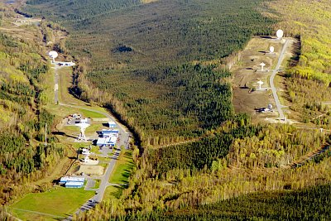
OSPO Key Roles
Ground System Command & Control, Ingest, Generation, and Distribution
Pre-Launch and Post-Launch Testing
Operational Testing, Validation, and Verification
User Readiness for Broadcast Services and Product Delivery
Long-Term Continuity of Products and Services
Fairbanks CDA
Wallops CDA

Slide 5
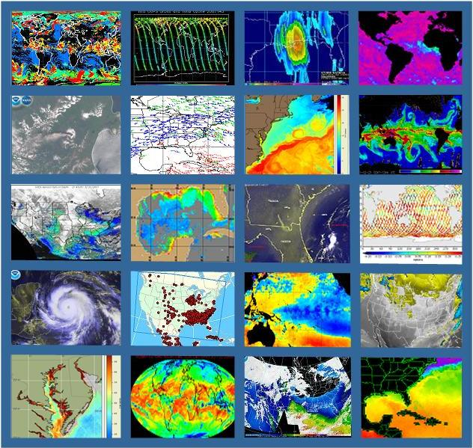
Products (Derived & Interpretive)
Atmospheric Chemistry
Atmospheric Temperature
Fire and Smoke
Hurricane Intensity and Position
Imagery (e.g. Visible, IR, WV)
Land Cover – Ice, Snow, Vegetation
Ocean Color
Satellite Derived Winds (WS,WD,H)
Sea Surface Height & Temperature
Sounder Profiles and Imagery
Space Weather
Volcanic Ash and many more…

Slide 6
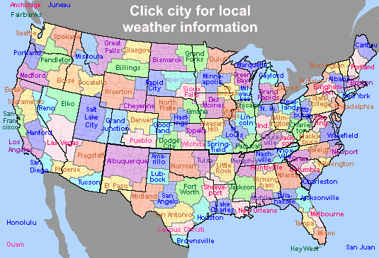
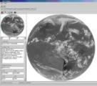
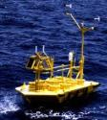
Direct Service Operations
Emergency Managers Weather Information Network (EMWIN):
NOAA satellites relay critical information to users across the country.
http://www.weather.gov/emwin/index.htm
Low Resolution Image Transmission (LRIT):
NOAA satellites are used to relay satellite and weather products to users in remote
locations, that do not have landlines or internet connections.
http://www.noaasis.noaa.gov/LRIT/
Data Collection:
NOAA satellites are used to collect and relay scientific data from around the globe.
http://www.noaasis.noaa.gov/DCS/ http://www.noaasis.noaa.gov/ARGOS/
Search and Rescue:
NOAA satellites are used to relay distress alerts from aviators, mariners and
land-based users
http://www.sarsat.noaa.gov/
Geonetcast Americas:
Data from NOAA for diverse societal benefits - agriculture, energy, health, climate,
weather, disaster mitigation, biodiversity, water resources, and ecosystems.
http://www.geonetcastamericas.noaa.gov/index.html
Notes:
OSPO also manages NOAA’s Satellite Services including Search and Rescue, Data Collection, Low Rate Information Transmission, and data/product rebroadcast including GVAR, HRPT/APT, and GeoNETCAST. We partner with NWS to provide data and products through the Emergency Managers’ Weather Information Network.

Slide 7
GOES Status (August 30, 2013) http://www.oso.noaa.gov/goesstatus
Payload Instrument | GOES-15 (West) Launch: Mar 10 Activation: Dec 11 | GOES-14 (Standby) Launch: Jun 09 Activation: N/A | GOES-13 (East) Launch: May 06 Activation: Apr 10
Imager | G | G | G
Sounder | Y (11) | G | Y (15)
Energetic Particle Sensor (EPS) | G | G | G
Magnetometers | G | G | G
High Energy Proton and Alpha Detector (HEPAD) | G | G | G
X-Ray Sensor (XRS) | G | G | R (8)
Solar X-Ray Imager (SXI) | S/C (12) | G | Y (9)
Spacecraft Subsystems
Telemetry, Command & Control | G | G | G
Attitude and Orbit Control | G | G | G
Inclination Control | G | G | G
Propulsion | G | G | S/C (10)
Mechanisms | G | G | G
Electrical Power | G | G | G
Thermal Control | G | G | G
Communications Payloads | S/C (13) | G | G
Key
Operational
Spacecraft Issues, but No User Impacts
Operational with Limitations
Non-Operational
G
S/C
Y
R
Notes:
1
Not surprisingly, the newest satellites in the constellation are enjoying the best health at this stage.
I will break down the issues with each satellite, drawing particular attention to ways in which users may be impacted.
------------------
All IR channels on GOES-14 & GOES-15 have 4km resolution at nadir and an 8th IR detector.

Slide 8
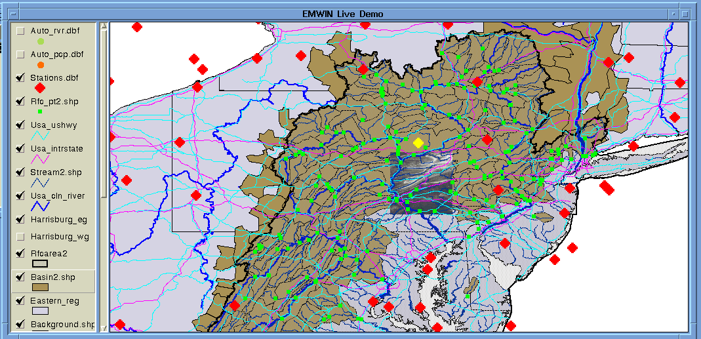
GOES Status (August 30, 2013)
Service | GOES-15 (West) | GOES-14 (Standby) | GOES-13 (East)
LRIT | Operational | Standby | Operational
EMWIN | Operational | Standby | Operational
SARSAT | Operational | Standby | Operational
DCS | Operational | Standby | Operational
GVAR | Operational | Standby | Operational
See summary of GVAR Instrument Factory Coefficients and Detector Offsets by Block:
http://www.osd.noaa.gov/GVAR_Downloads/gvar_downloads.html
Notes:
8
No issue, except for loss of redundancy with a GOES-15 EMWIN S-band receivers.
Preservation of Life and Property
SARSAT (Search and Rescue Satellite Aided Tracking)
GOES DCS (Data Collection System)
Broadcast Services
EMWIN (Emergency Managers Weather Information Network)
GVAR (GOES VARiable data transmission format)
GOES LRIT (Low Rate Information Transmission)
SARSAT Search and Rescue:
NOAA satellites are used to relay distress alerts from aviators, mariners and
land-based users
http://www.sarsat.noaa.gov/
GOES Data Collection Systems:
NOAA satellites are used to collect and relay scientific data from around the globe.
http://www.noaasis.noaa.gov/DCS/
Emergency Managers Weather Information Network (EMWIN):
NOAA satellites relay critical information to users across the country.
http://www.weather.gov/emwin/index.htm
Low Rate Information Transmission (LRIT):
NOAA geostationary satellites are used to relay satellite and weather products to users in remote
locations, that do not have landlines or internet connections.
http://www.noaasis.noaa.gov/LRIT/

Slide 9
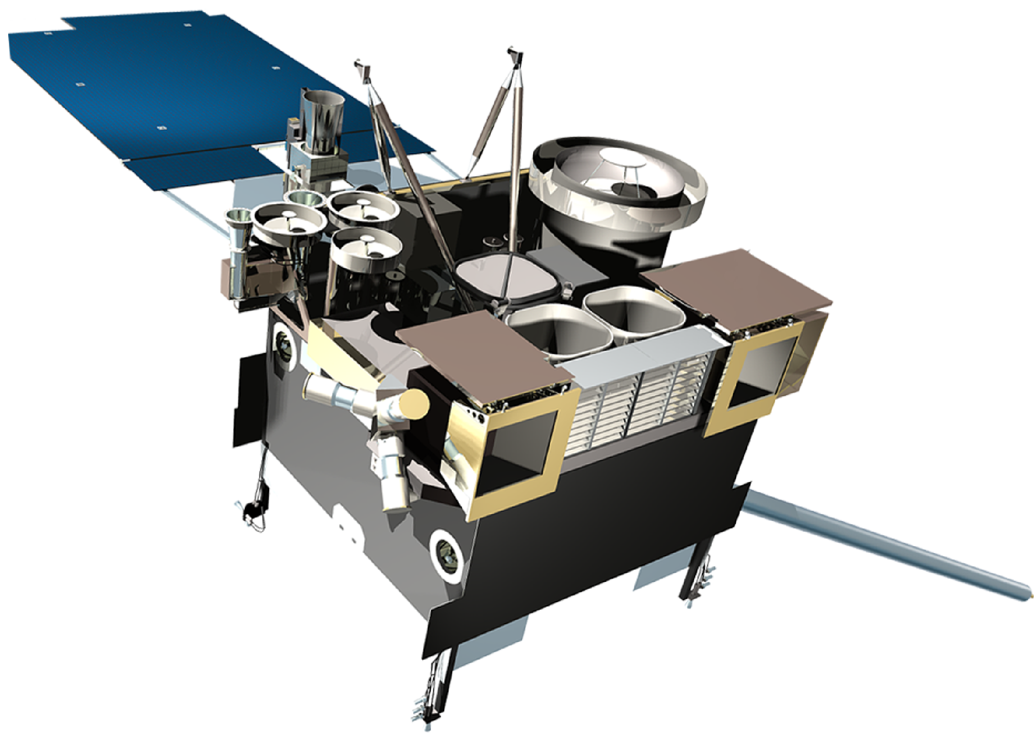
GOES-15 (West) Launch: March 2010 | Operational: Dec 2011
GOES-15 Sounder temperature control blanket is raised. To maintain patch temperature control, a yaw flip at Equinox to keep Sun angle below cooler plane.
Impact: 1 hour data outage and degraded products during each yaw flip maneuver and 28 hours of INR (Image Navigation & Registration) recovery period.
Notes:
-------------------
Solar X-Ray Imager (SXI)
SSPA (Solid State Power Amplifiers)
EMWIN (Emergency Managers Weather Information Network)

Slide 10
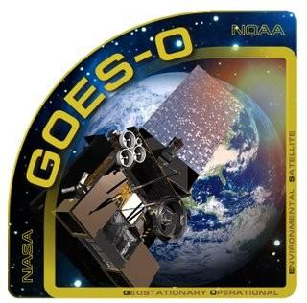
GOES-14 (Standby) Launch: June 2009 | Operational: N/A
No Spacecraft or Instrument Issues

Slide 11
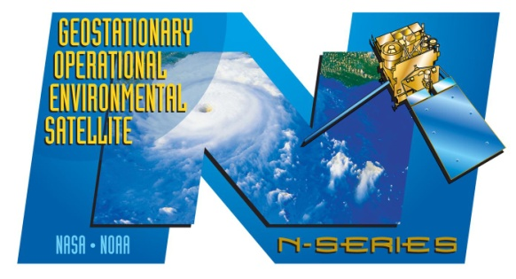
GOES-13 (East) Launch: May 2006 | Operational: April 2010
Sounder short-wave channel noise. Operating with both windings on. Sounder out-gassing in October, 2012 improved noise levels.
Notes:
XRS
- Most of the time it works, but it cannot be relied on it when there are flares because signal inversion occurs when the x-ray count goes above a threshold. It then provides negative values and trips itself.
- Performed tests on GOES-14 & 15 sensors to ensure failures will not be repeated
- Thanks to the redundancy in the GOES constellation, we can use GOES-15 spacecraft to receive solar x-ray data

Slide 12
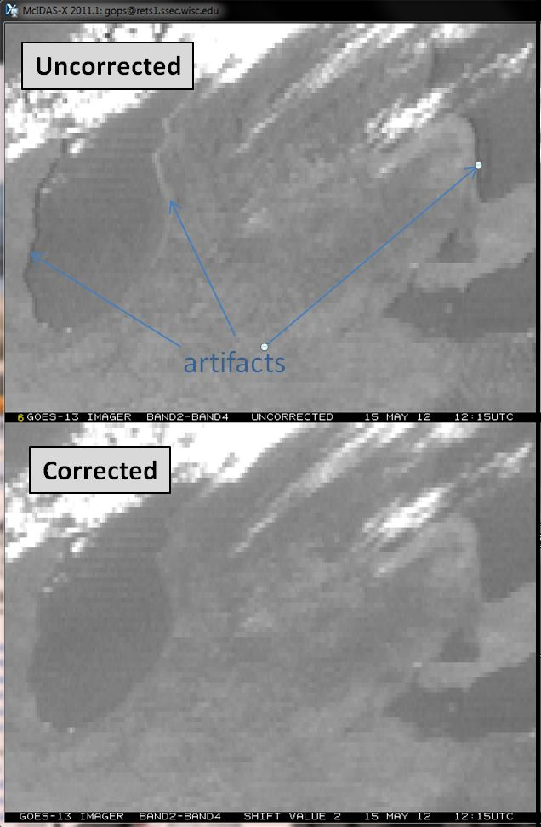
GOES-13 (East) Imager IR Co-Registration Error Correction
Improved data quality for weather products that rely on the combination of images in the IR channels (e.g. fog products that use difference between channel 2 and 4 – see figure)
This GOES Ground System fix will be indicated by the status word "re-sampling" in GVAR Block 0
Applied to future data only.
Expected in SPS release 10.4 by mid-October, 2013 (originally Summer 2013, but had to resolve false detects of fire points)
GOES-13 Imager band difference (band 2 – band 4) for the uncorrected (top panel) and corrected images (lower panel).
Notes:
Unique to GOES-13, other GOES are within specification
Two components
1) Characterization of co-registration errors
2) Then re-sampling the images to correct co-registration errors

Slide 13
GOES Flyout Schedule April 10, 2013
-
Look forward to engagement of users RE GOES-R activation: E/W, storage, operate
http://www.nesdis.noaa.gov/flyout_schedules.html http://www.goes-r.gov
Notes:
In order to maintain continuous coverage, nominally two are operational and there is an on-orbit spare at all times in case there is an unanticipated anomaly or failure.
Operations concept requires that a replacement spare be launched, checked out, and ready to assume role as spare NLT the time at which existing on-orbit spare will be required as replacement for the planned end-of-life of an operational satellite.
GOES-R is the next generation of GOES satellites that will provide a major improvement in quality, quantity, and timeliness of data collected.
Expect no more “GOES South America” going forward.
What about GOES-13? It is expected to remain GOES-East until the imager fails, so at that point it would not serve much purpose for South America.
What about GOES-14? It will remain in standby, until needed to fill the operational GOES-East or West position.
What about GOES-15? Similar to 13... It is expected to remain GOES-West until the imager fails, so at that point it would not serve much purpose for South America.
What about GOES-R? Once the GOES-R and S satellites are in operations we will no longer need a separate satellite that provides coverage of South America. Unlike the current imager that scans a full disk every 3 hours, ABI will scan a full disk every 15 minutes. Presently, RSOs drastically reduce the coverage for South America, but there will be no reduction in coverage due to RSOs with the GOES-R and S ABI.
There will still be a gap for SA if GOES-R is positioned as GOES-West, which is currently planned, because most of South America cannot be seen from the GOES-West perspective.
------------------------
New and improved capabilities for:
decreased lead times for severe weather warnings
better storm tracking capabilities
solar, space weather, and climate analyses
advanced products for aviation, transportation, commerce

Slide 14
POES Status (Sept 1, 2013) http://www.oso.noaa.gov/poesstatus/index.asp
Operational | G
Spacecraft Issue but no User Impact | S/C
Operational with Limitation | Y
Non-Operational | R
Not Applicable | N/A
Spacecraft Subsystems | METOP-A | METOP-B | NOAA-19 | NOAA-18 | NOAA-16 | NOAA-15
Launch Date | Oct 2006 | Sep 2012 | Feb 2009 | May 2005 | Sep 2000 | May 1998
Operational Date | May 2007 | April 2013 | Jun 2009 | Aug 2005 | Mar 2001 | Dec 1998
Mission Data Category | Secondary (AM) | Primary (AM) | Primary (PM) | Secondary (PM) | Secondary (PM) | Secondary (AM)
Payload Instruments
AVHRR | G | G | G | G | Y(13) | Y(20)
HIRS | G | Y (33) | Y (32) | Y (3) | Y(14) | R (6)
AMSU-A1 | Y(26) | G | G | G | Y(15) | Y(21)
AMSU-A2 | G | G | G | G | G
AMSU-B | N/A | N/A | N/A | N/A | G | R (12)
MHS | G | G | Y (8) | G | N/A | N/A
SEM | G | G | G | G | G | G
SBUV | N/A | N/A | S/C (9) | R (29) | Y(16) | N/A
Spacecraft Subsystems
Telemetry, Command & Control | G | G | G | G | G | G
ADACS | G | G | G | Y (7) | Y(17) | Y(10)
EPS | G | G | G | G | G | G
Thermal Control | G | G | G | G | G | Y(22)
Communications | Y (1) | G | G | G | Y(30) | Y(23)
APT/LRPT | R (2) | G | G | G | R(18) | G
DCS | N/A | N/A | N/A | G | G | G
ADCS | G | Y (31) | G | N/A | N/A | N/A
SAR | G | G | G | G | Y(19) | Y(24)
Notes:
LRPT: Low Rate Picture Transmission
HIRS: High-resolution Infrared Radiation Sounder

Slide 15
POES Status (Sept 1, 2013) http://www.oso.noaa.gov/poesstatus/index.asp
Operational | G
Spacecraft Issue but no User Impact | S/C
Operational with Limitation | Y
Non-Operational | R
Not Applicable | N/A
Spacecraft Subsystems | METOP-A | METOP-B | NOAA-19 | NOAA-18 | NOAA-16 | NOAA-15
Launch Date | Oct 2006 | Sep 2012 | Feb 2009 | May 2005 | Sep 2000 | May 1998
Operational Date | May 2007 | April 2013 | Jun 2009 | Aug 2005 | Mar 2001 | Dec 1998
Mission Data Category | Secondary (AM) | Primary (AM) | Primary (PM) | Secondary (PM) | Secondary (PM) | Secondary (AM)
Payload Instruments
AVHRR | G | G | G | G | Y(13) | Y(20)
HIRS | G | Y (33) | Y (32) | Y (3) | Y(14) | R (6)
AMSU-A1 | Y(26) | G | G | G | Y(15) | Y(21)
AMSU-A2 | G | G | G | G | G
AMSU-B | N/A | N/A | N/A | N/A | G | R (12)
MHS | G | G | Y (8) | G | N/A | N/A
SEM | G | G | G | G | G | G
SBUV | N/A | N/A | S/C (9) | R (29) | Y(16) | N/A
Spacecraft Subsystems
Telemetry, Command & Control | G | G | G | G | G | G
ADACS | G | G | G | Y (7) | Y(17) | Y(10)
EPS | G | G | G | G | G | G
Thermal Control | G | G | G | G | G | Y(22)
Communications | Y (1) | G | G | G | Y(30) | Y(23)
APT/LRPT | R (2) | G | G | G | R(18) | G
DCS | N/A | N/A | N/A | G | G | G
ADCS | G | Y (31) | G | N/A | N/A | N/A
SAR | G | G | G | G | Y(19) | Y(24)
Longwave ch 5,6 soon to be out of spec. Ch 10 out of spec.
HIRS Longwave channel noise
Longwave channel noise. Filter wheel motor in high mode. No NCEP or ECMWF assimilation.
*New - Chopper Motor Stalled. No usable data generated
Out of spec.
RF loss of ~10 dB, 25% less availability for data collection.
Notes:
LRPT: Low Rate Picture Transmission
HIRS: High-resolution Infrared Radiation Sounder

Slide 16
Suomi NPP – Mission Status
Launched in October, 2011
Date | Activity
2 / 2012 | ATMS radiances added to ECMWF & NOAA GFS models
8 / 2013 | NCEP added CrIS radiances to operational model
9 / 2013 | ORR (Operational Readiness Review) for moving NDE system to ESPC including prod, dist, mon, and notif
9 / 2013 | Ozone BUFR to NCEP Central Operations (NCO)
10 / 2013 | Temperature/humidity soundings delivered to AWIPS2
10 / 2013 | ACSPO SST to Coastwatch Servers MiRS to CLASS NUCAPS (CrIS & ATMS) Soundings to CLASS
11 / 2013 | VIIRS Imagery to NCO ACSPO SST to CLASS
12 / 2013 | VIIRS Polar Winds to NCO & CLASS Green Vegetation Fraction to NCO & CLASS
Notes:
All instruments remain in nominal operations mode with full science data production (VIIRS, CrIS, ATMS, OMPS, CERES)
OSD is providing 8 x 5 (and best effort) monitoring & notifications

Slide 17
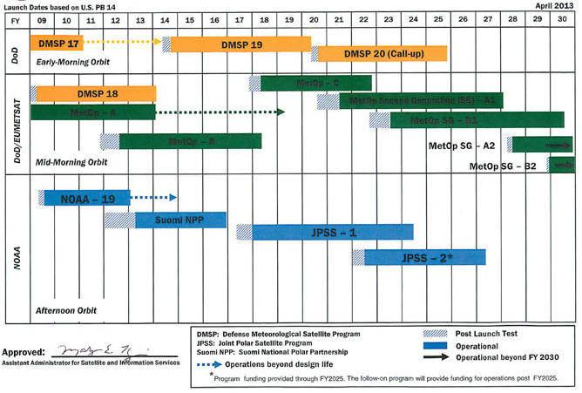
LEO Flyout Schedule - April 10, 2013
Free Flyers
1 approved,
1 canceled.
Carry Argos-DCS,
SARSAT, TSIS
(Total Solar
Irradiance Sensor)
Possible SARSAT &
A-DCS Gap (Not present on NPP)
Free Flyer
http://www.nesdis.noaa.gov/flyout_schedules.html http://www.jpss.noaa.gov
Notes:
NOAA responsibility for the JPSS satellites and ground systems operations after the launch, early orbit and activation phase, nominally 90 days after each launch.
What this means for OSPO:
Includes Operations at NOAA/NSOF by OSPO of JPSS and NPP satellites
Continue operations of DMSP
Capacity and flexibility to operate future DOD polar-orbiting satellites in morning orbit(s) on a cost reimbursement basis
Includes all hardware and software to process and disseminate NPP and JPSS data and products to NOAA and DOD Centrals, to NOAA’s Archives and to NASA’s SDS (for NPP)
NOAA will assume sustainment of the JPSS ground system one year after the launch of JPSS-1.

Slide 18
Data Access Services
Current Access Services (in addition to Direct Broadcast)
Data Distribution Service (DDS) – (s)FTP push/pull from secure accounts *
NWS Telecommunications Gateway
GINI (GOES Ingest and NOAAPORT Interface) / NOAAPORT for Advanced Weather Interactive Processing System (AWIPS) display
SATEPSDIST – GOES, POES, and Derived Products; McIDAS *
Shared Processing DAPE Gateway – for military partners *
MODIS server – subset of products made by NASA *
Websites - http://www.ospo.noaa.gov/
* Require Data Access Request
Archival
NODC, NGDC, and NCDC archive data products using CLASS
Notes:
Note photo of customer antennas from one of the local companies – SSEC at U. of Wisconson-Madison.
The NOAAPORT broadcast system provides a one-way broadcast communication of NOAA environmental data and information in near-real time to NOAA and external users. This broadcast service is implemented by a commercial provider of satellite communications utilizing C-band.
Customer Use of Servers…
GINI: NOAAPort/AWIPS, NWS, Unidata
Satepsdist: NWS/NCEP, DOD, STAR, SAB, Universities, Private Industry
DDS: NWS/NCEP/EMC, ECMWF, UKMET, STAR, DOD

Slide 19
McIDAS Data Delivery Summary
SATEPSDIST –
Geostationary satellite data is ingested on a SSEC Data Ingestor (SDI), converted to McIDAS format and placed on a server.
In addition, some foreign geostationary data, polar data, model data and derived products are converted into McIDAS.
This data is served via McIDAS ADDE:
Data NSOF Server ADDE Name
Derived Products SATEPSDIST1e DPD
GOES-E SATEPSDIST2e GER
GOES-W SATEPSDIST3e GWR
Polar SATEPSDIST4e PLR
Model data SATEPSDIST5 MOD
Global Mosaic 5 Sat. Comp. SATEPSDIST6 MOS
MSG/MET SATEPSDIST6e MSG / MET
MTSAT SATEPSDIST7e MTS
Select requested data SATEPSANONE PUB (not operational)
Surface/Ship Buoy/RAOBs FOS2 FOS (Family of Services)
No more FY Chinese data, but may obtain via CIMSS

Slide 20
GINI Role in AWIPS Products
GINI
Created and distributed through GINI
Imagery (E/W Conus, PR, SuperN, Nhemi, AK, HW)
Sounder images (E/W Conus, ECari, NAtl, HW, Npac)
Created outside GINI, but distributed through GINI
Five geostationary satellite composite files (VIS, IR, WV)
GOES Sounder Derived Products (TPW, LI, CTP, ECA, Skin-T)
GOES Imager Derived Products (LCB)
GOES / Polar Blended (POES and DMSP) TPW,
% of TPW Normal, Blended RR products
Created outside GINI, distributed outside GINI
Precipitation Autoestimator (PG on satepsdist1, PD from DDS to AWIPS)
GOES BUFR and POES BUFR Soundings
High Density Winds
ASCAT
Text Messages: SPENES, VAA, Tropical Bulletins,
Help Desk messages
ASOS Satellite Cloud Products
Autosnow GRIB Files
AWIPS
else
GINI
AWIPS
else
GINI
AWIPS
else
Notes:
Some of these data are not well known by AWIPS community because they are buried in layered drop-down menus.
Sounder “images” EConus, ECarib, Natlantic, WConus, Hawaii, Npacific.

Slide 21
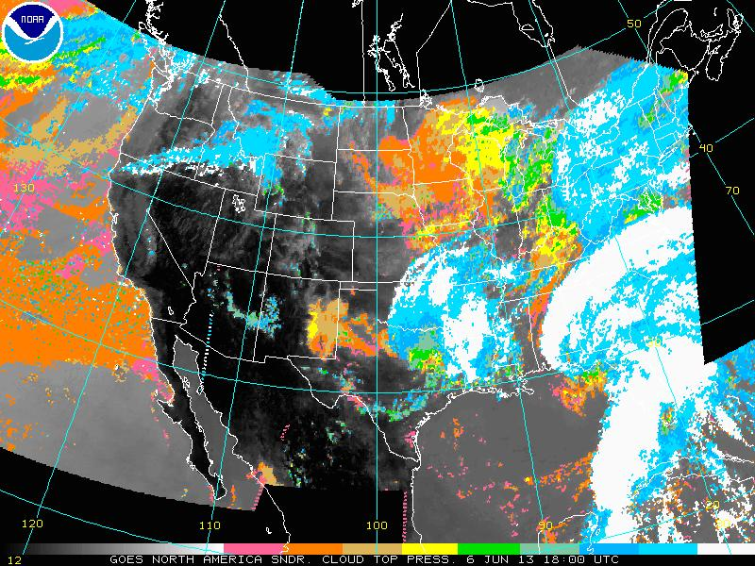
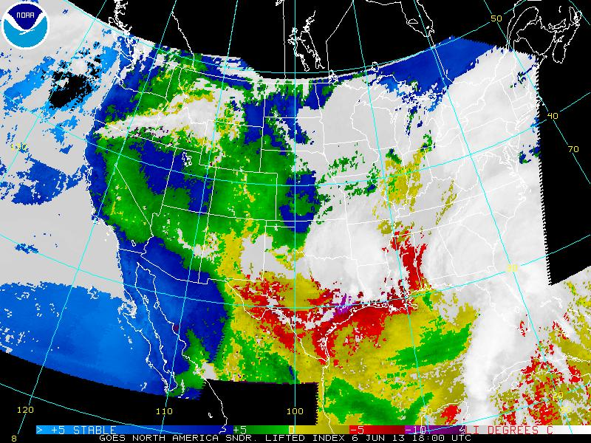
Data Access & Distribution Policy
Full policy and forms at http://www.ospo.noaa.gov/Organization/About/access.html
Security requirement to know and document all users accessing operational data servers and what products they are receiving
Users request data using a Data Access Request (DAR) form.
Ever increasing data volume requires prioritization of users to effectively manage distribution resources and ensure effective system performance
Higher priority access will be given to organizations with:
Mission and statutory authority
Signed NESDIS cooperative agreements or legislative authorities
A demonstrated timeliness requirement for near-real time data to support operational user applications
If available and sufficient, users will be directed to sources of data external to NESDIS (e.g. CIMSS). Also recommend alternatives for denied users
Cloud Top
Pressure
Lifted
Index

Slide 22
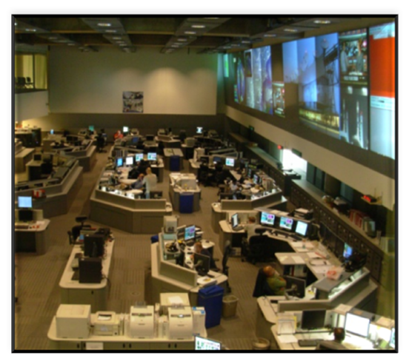
Data Access & Distribution
DDS Re-Validation was accomplished in 2012
Migration to new DDS was completed
There was a 17% reduction in the number of approved accounts
SATEPSDIST Re-Validation was accomplished in 2013
Part of migration to new GEODIST servers
GEODIST will likely host ONLY McIDAS ADDE access
McIDAS GROUP access restrictions will be enacted for external users
It very important users identify all datasets they need
All non-McIDAS files will be served via DDS
Satepsanone is not part of the sateps re-validation and migration
Contact information for SATEPSDIST users were not well maintained, so if you are a current user who has not been contacted, let us know ASAP to get a DAR form.
GEODIST scheduled to be operational in January, 2014 (originally Aug, 2013)
-- Planning for 30 days parallel test period prior to becoming operational
-- Planning to have SATEPSDIST run with 8x5 support for 2 weeks after cut-over date.
Command & Control at NSOF

Slide 23
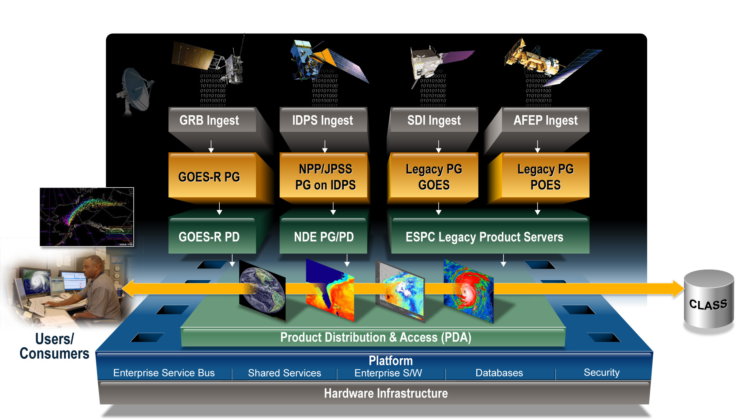
Future Data Access & Distribution
New enterprise system Product Distribution and Access (PDA) is coming
Will be used for legacy GOES/POES, NPP, IJPS and GOES-R data access
Operational for legacy and NPP planned for Oct 2014
McIDAS ADDE access will remain on GEODIST
The only planned backup for PDA is to serve NPP/JPSS at CBU (Fairmont, WV). GOES-R & Legacy are not yet planned.

Slide 24
ESPC Notifications, Status, and Contacts
24/7 Help Desk | ESPCOperations@noaa.gov
ESPC Messages | http://www.ssd.noaa.gov/PS/SATS/messages.html
WMO GTS Bulletins | Urgent: http://www.weather.gov/view/validProds.php?prod=ADM&node=KNES Routine: http://www.weather.gov/view/validProds.php?prod=ADA&node=KNES
User Services | SPSD.UserServices@noaa.gov
Data Access | NESDIS.Data.Access@noaa.gov
Webmaster | SSDWebmaster@noaa.gov
Facebook | www.facebook.com/NOAANESDIS
Twitter | www.twitter.com/noaasatellites
Satellite Ops Status | http://www.oso.noaa.gov/daily-news/index.asp
Press releases | http://www.nesdis.noaa.gov/news_archives/
Web | www.ospo.noaa.gov
Notes:
See new GOES web page and web page for mobile devices:
- The new GOES page -> http://www.goes.noaa.gov/
- Animated GIF imagery for mobile devices -> http://www.ospo.noaa.gov/Products/imagery/m/index.html

Slide 25
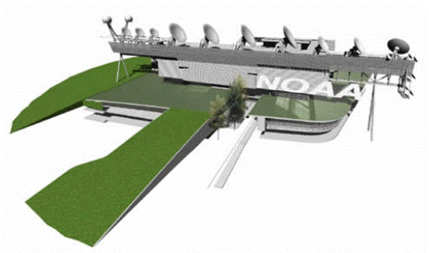
McIDAS at ESPC
ESPC has a standing, annual contract with SSEC for McIDAS Support and ongoing development
ESPC has two representatives on the McIDAS Advisory Committee (MAC) (How determined?)
Gregg Gallina (NESDIS/OSPO/SPSD/SAB)
Jessica Braun (SSAI in NESDIS/OSPO/SPSD)
Typically greater representation at MUG
OSPO/MOD - Bonnie Morgan, Russ Lancaster
OSPO/SPSD - Tom Renkevens, SAB Personnel

Slide 26
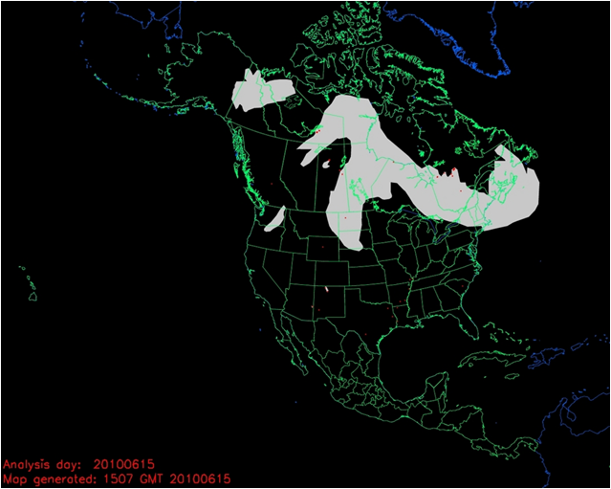
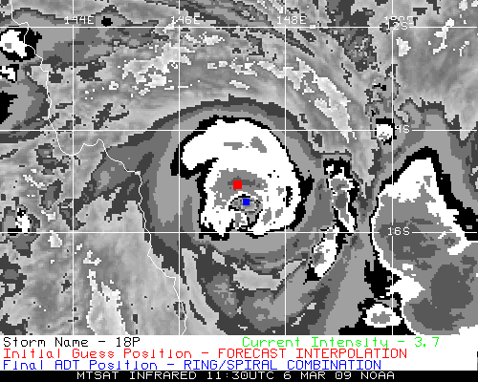
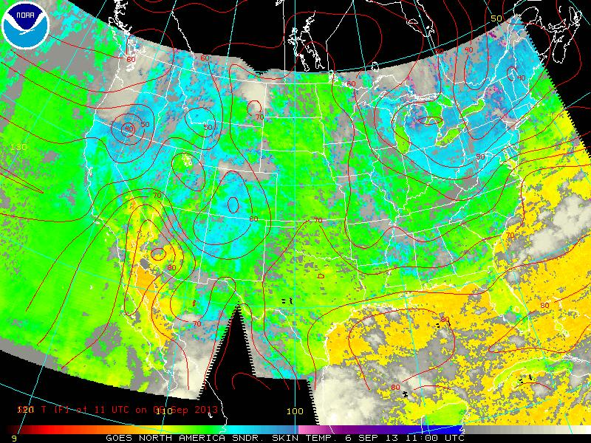
McIDAS & ESPC Applications
Over 50 applications in ESPC use McIDAS, McIDAS libraries, input & serve McIDAS AREA Files, MD point files, GRID (McIDAS GRID Format), and Text via ADDE
ADT, ABBA, CSBT, HMS, others…

Slide 27
Ad hoc McIDAS Usage at ESPC
Heavy usage of the local GINI server in McIDAS format for validation checks (image previews) for conversion of GOES-13 and GOES-15 data to NWS AWIPS
Great reliance on GINIs during GOES-13 anomalies to confirm the output images quickly and efficiently (Generated mock AWIPS files to confirm changes to use GOES-14).
GINIs, remappers, and Level 2 products that utilize McIDAS were all used for
The new GOES-13 rapid schedule (to compensate for GOES-12 decom)
The new GOES-13 optimized routine schedule (TBD)

Slide 28
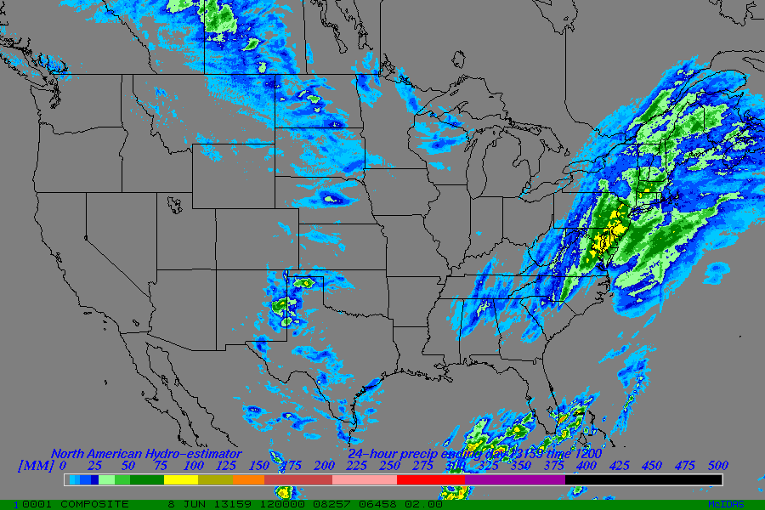
McIDAS Systems at ESPC
Over 20 SDIs at NSOF and Wallops OBF
Several are dedicated...
GOES-East, -West, -14, Remappers
MTSAT Remapper
GOES Ingest and NOAAPORT Interface (GINI)
Over 20 Workstations in SAB
-X for realtime analysis, product generation, and QA/QC
RHEL 5 Linux on Intel x86
Many “home grown” programs in Fortran, .PGM, BATCH
Advantage - The ADDE protocol allows for many users accessing single systems with one port (112)
Global Hydro-Estimator 1 Day Total
ESPC Product Generation/Distribution
IBM P6 Series with Linux Partitions
Many other Linux systems (gp*)
GINI running on Linux
Con – Lack of AIX support (GOES-East, GOES-West, and the ESPC Product server are all on AIX)
As of last week, ESPC ported the last GINI system (nport5) from SGI to Linux

Slide 29
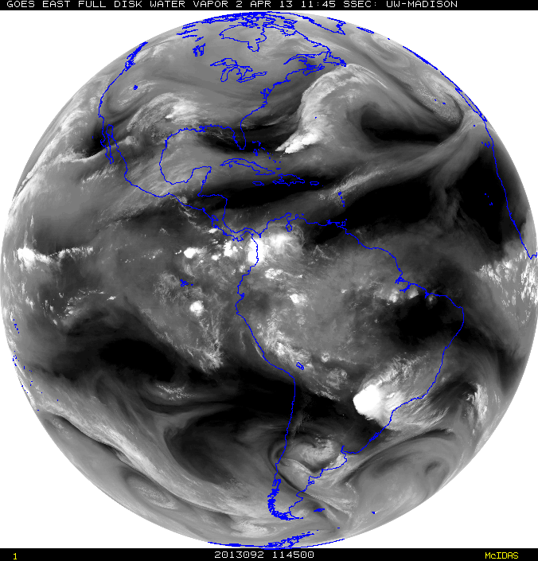
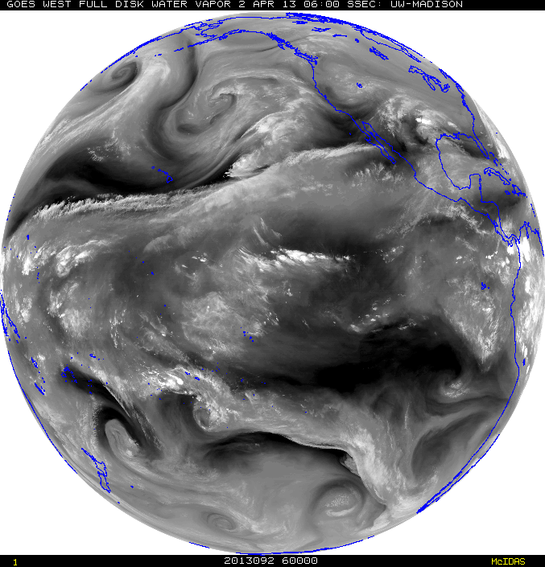
McIDAS Advantages in SAB
Institutional knowledge - SAB Analysts have great familiarity with McIDAS
Ability to have near-global coverage at multiple domain scales and resolution (~980 frames) of quickly and routinely loaded (SPIDER) imagery at the tap of a button (TU Hotkeys) to perform interrogation, manipulation and value-added analysis when every second counts for time sensitive and rapidly evolving natural and man-made hazards; such as volcanic eruptions, flash flooding, fires, etc.
This cannot be done presently with NAWIPS or HMS. In fact, depending on the area of concern up to 20 minutes is lost waiting for imagery to show up on these other systems vs McIDAS
HOWEVER, since the NWS is the primary user of many SAB products (e.g. volcanic ash and heavy precipitation), there are benefits for SAB to conduct PG on NAWIPS like, quick overlays and seamless in-tool distribution. Fire uses HMS for analysis.

Slide 30
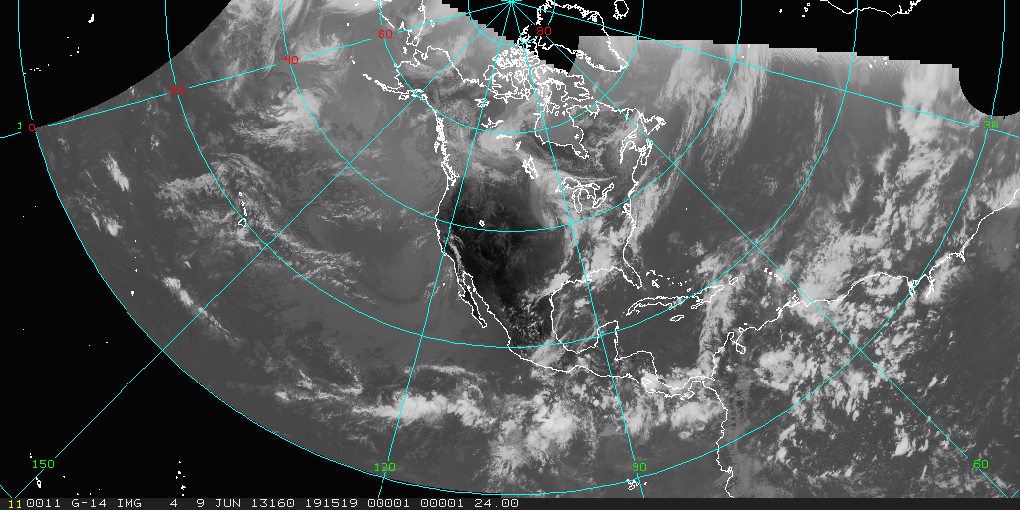
McIDAS Challenges in SAB
Maintaining efficient access to servers for operations (SPIDER is in-house stop-gap measure). Any interest in taking on support for SPIDER?
Additional customer requirements for advanced data formats (GIS, KMZ)… writing own local code for NPP VIIRS, Windsat, others to convert them to AREA files as there are no local servers
Learning Curve with commands
Color Tables – only 8 bit – challenge with upcoming GOES-R
North Hemi Composite - IR

Slide 31
SAB Use of McIDAS
SAB is 24x7 operation of 5 disaster mitigation desks (Heavy Precipitation, Volcanic Ash, Fire/Smoke/Dust, Marine Pollution, Tropical Cyclones) All desk use Mc-X in some capacity, except Marine which is ArcGIS
McIDAS-X Usage: ~10 operational Linux systems with 24 GB RAM each and multiple monitor visualization setup
A persistent daemon (image loop refresh) “SPIDER” uses ADDE protocol to display ~100 imagery loops
Use Fnc keys to switch loops and pan entire globe through SPIDER loaded frames (e.g. NW Pacific IR, Shift+F1 - NW Pacific Vis, F2 - Central US IR) and still use command line (grudgingly)
Lots of batch commands and everything is scripted by business work flow
Uses McIDAS AREA files for web site as do NWS offices across country, namely NHC, AWC, NWS Western Region
Notes:
15-30 full disk images with overlays are needed and this is what is needed from Mc-V! (Dave Santek saw this at the NCWCP in April, 2013).

Slide 32
Format Conversion Challenge GRIB1 to GRIB2
NCEP will decommission GRIB1 in Nov 2013
Many ESPC applications are set up to ingest NCEP data in McIDAS GRID format
We are working on our Model Server to decode the NCO data from GRIB2 format and generate GRID format by using the McIDAS GRIB Server
This may require using the MATH or the UNITS for the McIDAS GRDCOPY commands
Conversations with ESPC & SSEC technical POCs are underway

Slide 33
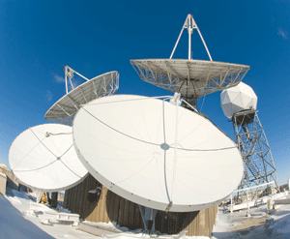
McIDAS AREA files for GOES-R
GOES-R files will come in NetCDF, which is not currently readable by McIDAS-X
No migration path has been proposed to ensure SAB operational needs will be met
Legacy AREA files for other satellite’s data will still be available in PDA
Need SSEC to translate (provide cal/nav blocks) from GOES-R NetCDF files to McIDAS AREA files for use in McIDAS-X
Would these “on the fly” translations sacrifice timelines?
Presumably this server would reside in ESPC
Does standing OSPO contract with SSEC cover the translation?
Is SSEC looking to GOES-R or PDA to fund translation? PDA has a requirement due in 9/2013 to provide the McIDAS AREA files. This will be deferred. Are you asking GOES-R to fund SSEC in early 2014?
Estimated date for when the translation may be provided?
SAB is also looking at ArcGIS (brand new enterprise license), IDL, AWIPS
We understand (via GOES-R folks) there is already some existing Mc-V support to read NetCDF files, so is ESPC covered?
Question – Other users migrating from Mc-X to Mc-V? Experiences?

Slide 34
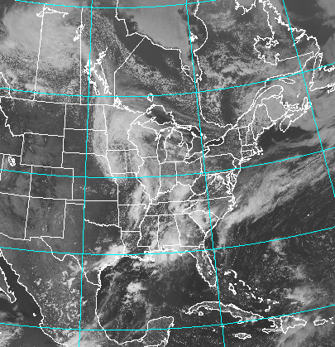
Ingestor for GOES-R?
Is an ingestor (SDI) planned for GOES-R?
If so, what is output format? AREA format, like present SDIs?
If so, then the NetCDF conversion to AREA format is unnecessary, correct? Sunset of McIDAS AREA files would occur as legacy satellites retire

Slide 35
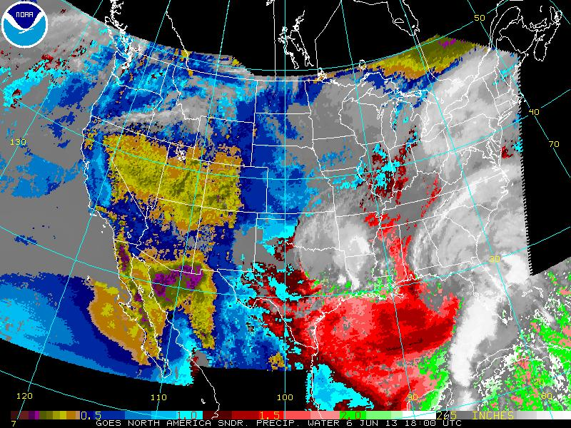
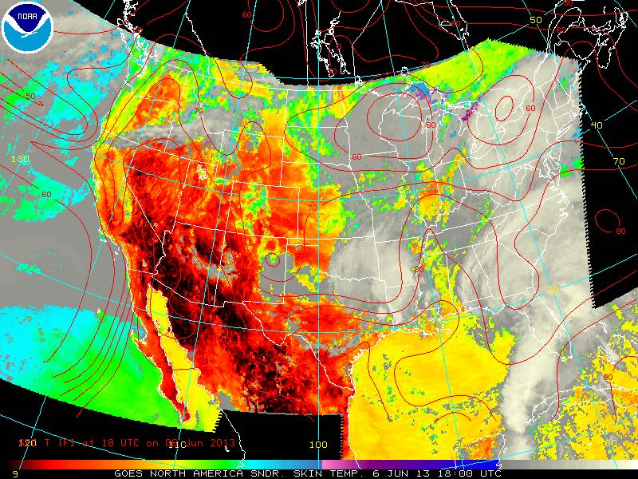
Will Mc-X be upgraded to handle...
Increased temporal resolution of GOES-R
Otherwise, SAB will have to develop and re-write SPIDER
Perhaps get a better SKU (Skedular command)
Increased spatial resolution of VIIRS/GOES-R while preserving 1 to 1 pixel ratio
Overlay of multiple files à la AWIPS2 (e.g. imagery and other obs files)
Time reference overlays to match imagery timestamps (read image time and align overlays).
Mc-V has this functionality, but not Mc-X. Impacts all SAB desks, but especially Precipitation.
Total Precipitable Water
Surface Skin Temperature
Notes:
Currently, ESPC uses SPIDER to process imagery fast enough and load it, because Mc-X Skedular command doesn't do this sufficiently. Ideally, we would have the scheduler provide this functionality now or in whatever McIDAS tool SAB uses in the future. Without it we are looking at modifying SPIDER to adapt to the GOES-R temporal (1 min) resolution.
Mc-X currently handles 8 bit color depth. The full resolution of GOES-R color gradients will be 12 VIS & 14 for IR. Will the bit depth for Mc-X be increased to handle the increased bit depth of GOES-R? 24 might be best approach to prepare for future capability purposes.
4) Automatic synchronization of imagery against obs files. Read image time and correlate against. Mc-V has this capability we know, but how about Mc-X which is what SAB is stuck with. Impacts precip predominantly, also... ash, smoke, tropical... all desks.

Slide 36
Will Mc-X be upgraded to handle...
How often is Mc-X maps database updated? Missing Pacific Islands currently... :(
Can Mc-V maps be supplied to Mc-X? There are currently better maps in V than X.
Are there plans to improve the resolution/quality of the maps in McIDAS-X or McIDAS-V
Can SAB update station database on their own?
OMI Tropics SO2 Composite
(OMI_ME_SO2_DDC2.GIF)

Slide 37
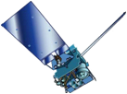
Will Mc-V be upgraded?
Does not meet SAB needs at present
Too slow and too prone to crash while handling imagery loops
Fine for a small set of images, but for a loop of many images or many loops of a small set of images, it becomes too slow or crashes
What is the status with the memory leak?
How much faster/more data can be loaded before crashing?
SAB has 48 hot keys with 10 image loops constantly loaded on each workstation... currently these will not load in Mc-V
Can the 3D and Hydra displays be turned off entirely (not just hidden). Perhaps this could improve response and stability?

Slide 38
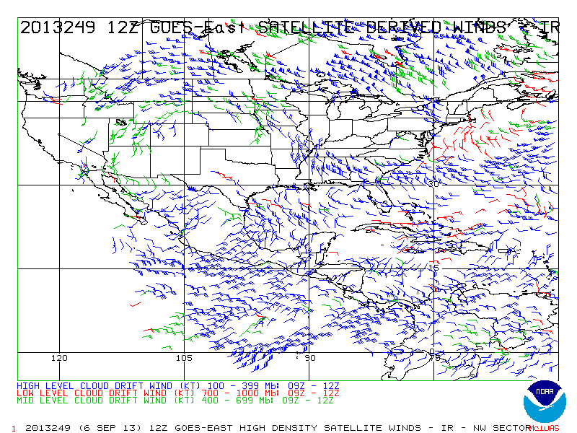
Will Mc-V be upgraded?
SAB is not looking to have a one-to-one replacement of their current McIDAS-X method of 48 loops and 1000+ frames. A 10 frame loop will not be sufficient for GOES-R’s routine high temporal resolution.
The ability to load high resolution data quickly and efficiently without reduction of bit depth within each pixel is extremely important, and this is not limited to just one type of data nor one set of images.
HD Winds image
(Point Data (MD File))
c812nwir.gif

Slide 39
ADDE access to S-NPP imagery?
Are there plans to provide ADDE access to SNPP image data (raw, native satellite projection data, NOT remapped)?
Currently, SAB has ADDE access to imagery, composites, and products and ftp access to HDF files of the raw, native projection data
Interested for the sake of Hazard Mapping System (Fire & Smoke)
Since the fires are often single pixel events, the typical remapping that occurs in the other products may mask the fire signature
The native resolution/projection is also important for emissions modeling if the user makes use of the fire’s radiative power
Does the PEATE ADDE server @ SSEC provide these data?
NOAA S-NPP VIIRS day-night band imagery.
Composite assembled by Jesse Allen and Robert Simmon.
Notes:
I was told that they were planning on making this available via ADDE but in my last correspondence with Dave Santek he indicated that the project was contingent on NOAA funding, which was turned down.
My interest in this is from the HMS perspective, although it has obvious other applications. Since the fires are often single pixel events, the typical remapping that occurs in the other products may mask the fire signature. Having the native resolution/projection is also important for emission modeling if the user makes use of the fire radiative power.

Slide 40
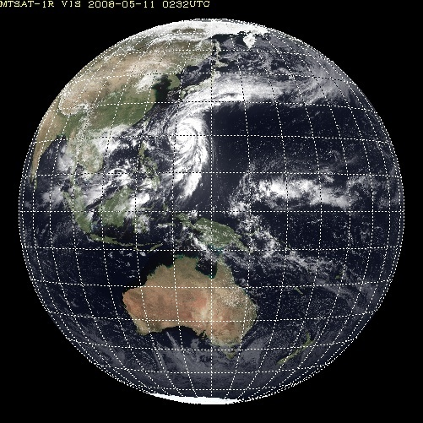
ADDE Server for Himawari-8?
Launch in summer, 2014
Late 2014 – test data available via FTP
Operational in summer, 2015 replacing MTSAT-2
Equivalent spectral channels to GOES-R ABI (16 channels) and similar specifications
No DRO transmissions, so either JMA will provide a commercial satellite relay or use NREN internet2
NWS reqs: Imagery, Radiances, AMVs (NetCDF4)
New SDI ingestors will be required to process H-8 data for McIDAS display
Any plans for an ADDE server for Himawari-8?
Notes:
National Research and Education Network – offeres high bandwidth connectivity

Slide 41
Summary of Questions
What is SSEC's plan for McIDAS-V to enhance performance for visualization? Could ESPC’s needs eventually be met? Is there an ideal solution?
Will McIDAS-X eventually have a "module" to read NetCDF4 files?
Will SSEC develop an ADDE (or ADDE-like) data server for GOES-R?
If so, what file format will these data be in? AREA? NetCF4? Other?
What is SSEC's plan to build an SDI to receive GRB data?
If there is a plan to receive the data via GRB, what format will the data be put in once received?
Are MUG funds "applied" to be used towards such step function transitions from one satellite generation to another, or is a "plus up" needed?
Outside of ESPC, what is the SSEC / MUG plan for "user transition" of the other 40-50 MUG members for GOES-R data? (e.g. AREA file format, ADDE, McIDAS-X vs V)
Basically, the bottom line question for SSEC/MUG - what are you plans for GOES-R? From an ingest of GRB, all the way to a distribution perspective.
GRB Industry Day is October 25, 2013 in Silver Spring, MD FedBizOps: https://www.fbo.gov/index?s=opportunity&mode=form&id=bd2a1dcc059a14c83a692b946342b25d&tab=core&_cview=0

Slide 42
Thank You!

