Slide 1
EUMETSAT Satellite Programmes
Use of McIDAS at EUMETSAT
Sauli Joro – Remote Sensing Expert
Peter Miu – Data Services Operations Engineer

Slide 2
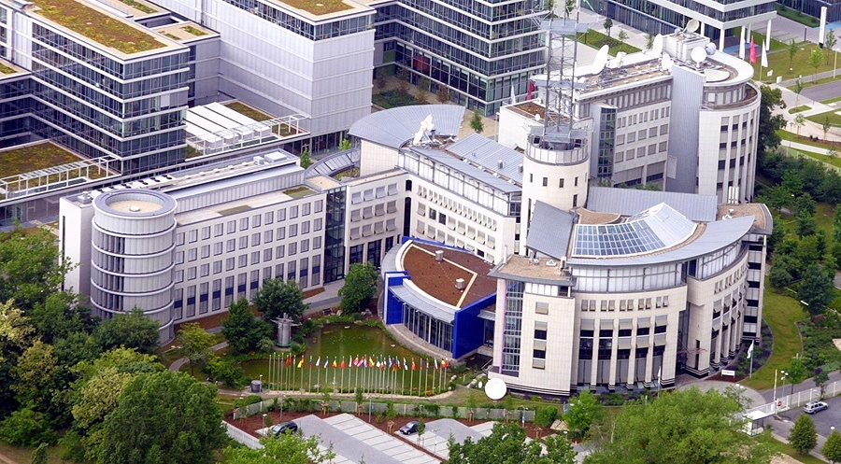
EUMETSAT Headquarters – Darmstadt

Slide 3
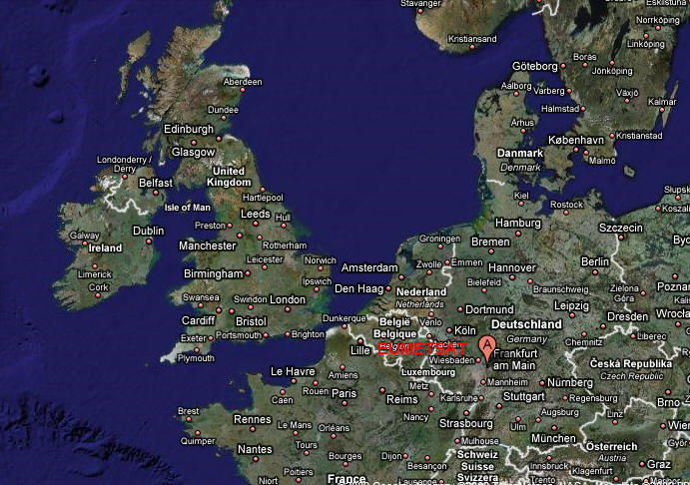
Location of EUMETSAT - Germany

Slide 4
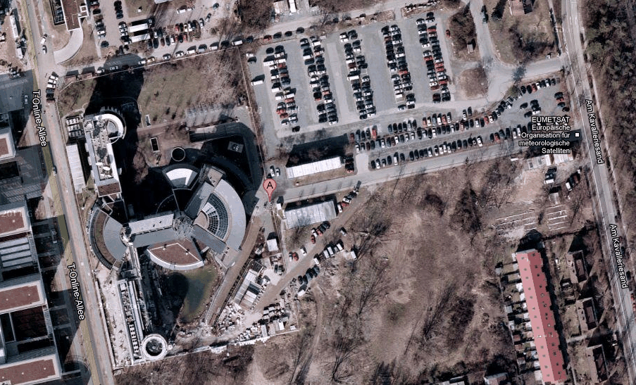
Google Map View

Slide 5

27 Member States & 4 Cooperating States
Member States
AUSTRIA
BELGIUM
CROATIA
CZECH REPUBLIC
DENMARK
FINLAND
FRANCE
GERMANY
Cooperating States
GREECE
HUNGARY
IRELAND
ITALY
BULGARIA
ICELAND
LATVIA
LUXEMBOURG
NETHERLANDS
NORWAY
LITHUANIA
SERBIA
POLAND
PORTUGAL
ROMANIA
SLOVAK REPUBLIC
SLOVENIA
SPAIN
SWEDEN
SWITZERLAND
TURKEY
UNITED KINGDOM
ESTONIA
Notes:
Wer sind wir

Slide 6


EUMETSAT Geostationary Satellites’ Coverage
60 N
Meteosat-10 (0°)
Meteosat-9 (9.5° E)
Meteosat-8 (3.5° E)
0
Meteosat-7 (57.5° E)
80
60 S
160
140
120
100
80
60
40
20
0
20
40
60
100
120
140
160
180

Slide 7
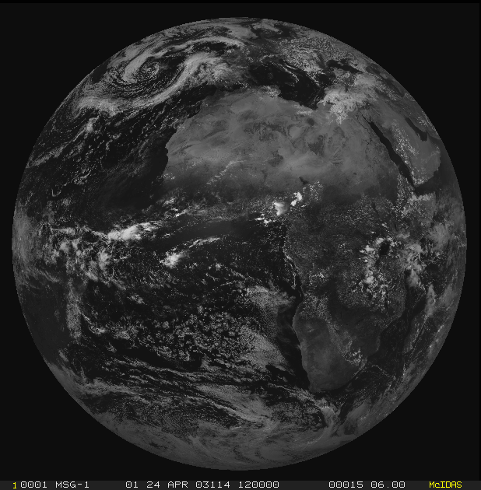
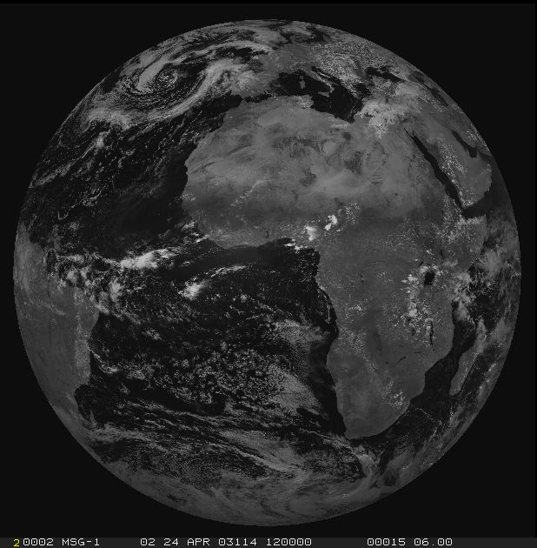
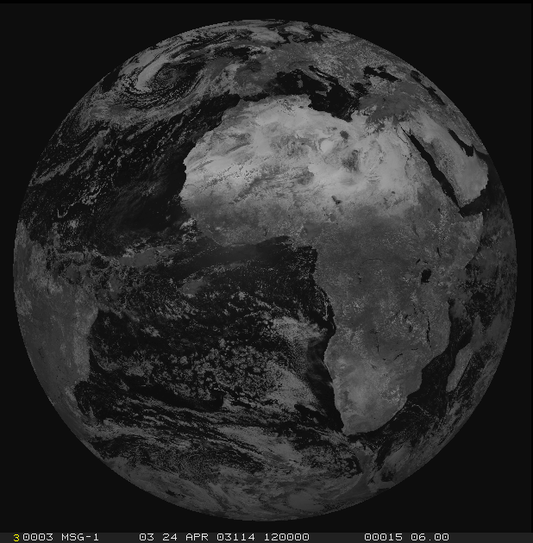
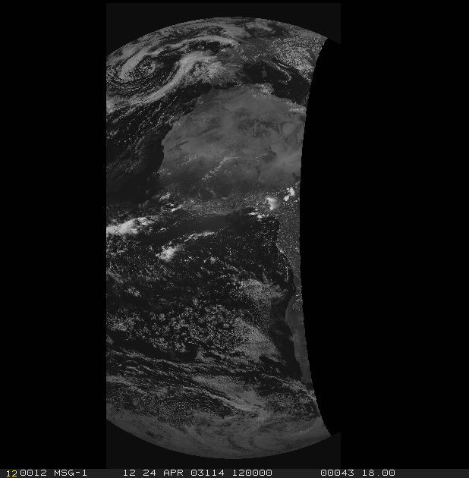
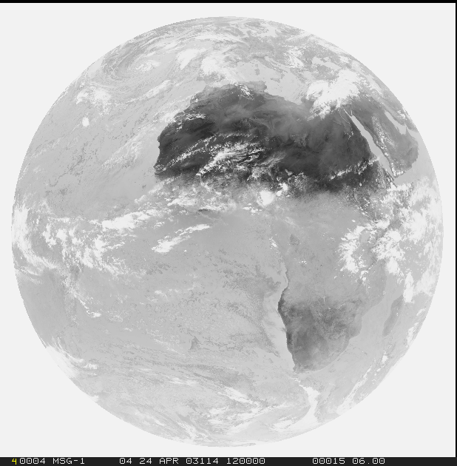
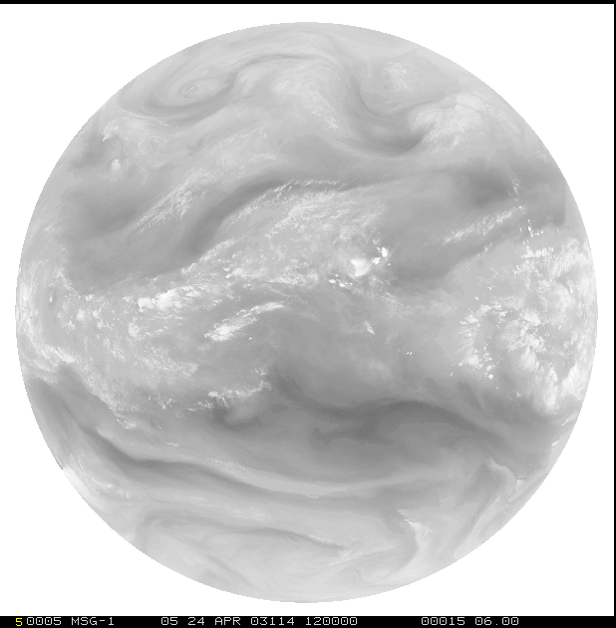
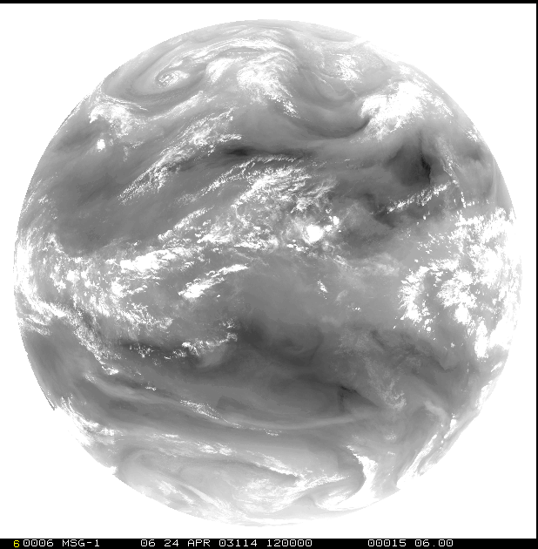
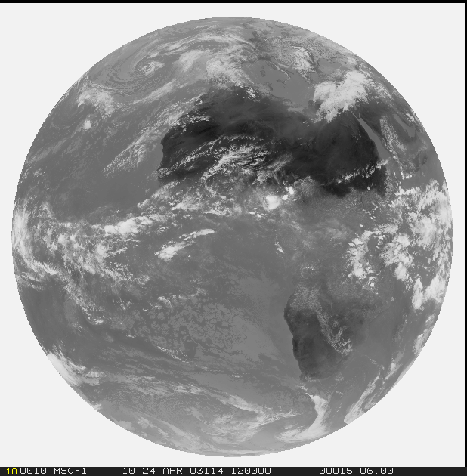
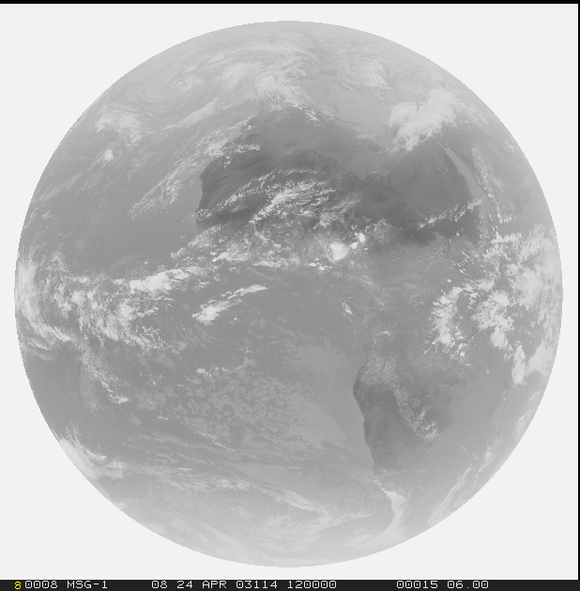
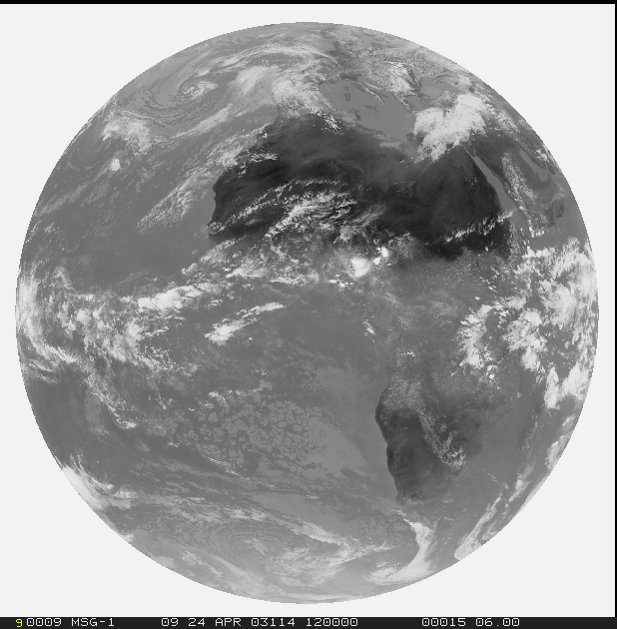
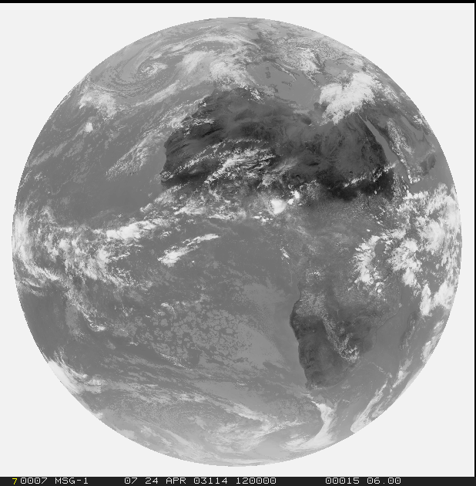
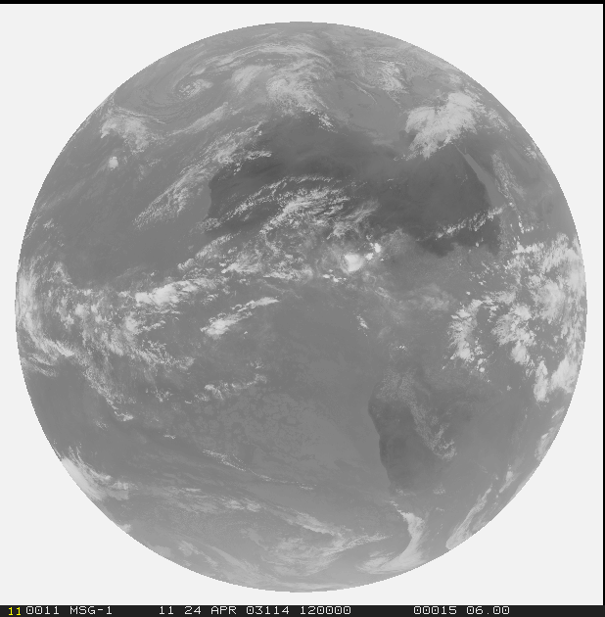
MSG: Meteosat Second Generation
MSG SEVIRI*:
12 Channels
3 km pixel size, 1 km HRV
15 min repeat cycle, 5 min “rapid scan
service”
1 = VIS0.6
2=VIS0.8
3=NIR1.6
12=HRV
4=IR3.9
5=WV6.2
6=WV7.3
7=IR8.7
*: SEVIRI :
Spinning Enhanced Visible and InfraRed Imager
8=IR9.7
9=IR10.8
10=IR12.0
11=IR13.4

Slide 8
MSG News
Launch of MSG-3 on 19 June 2012
Operational since 12 Dec 2012 -> Meteosat-10
Recent events on Meteosat-8: Loss of onboard sun sensors due to a solar panel damage, i.e. compromised image quality
MSG-4 launch foreseen late 2015, in orbit storage

Slide 9

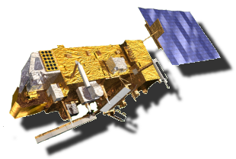
Metop News
Launch of Metop-B in in July 2012
Operational since 24 April 2013
09:30 orbit maintained,
however with a 90 deg
difference to Metop-A orbit
Two global dumps, data delivery via
EUMETCast
Svalbard
McMurdo

Slide 10
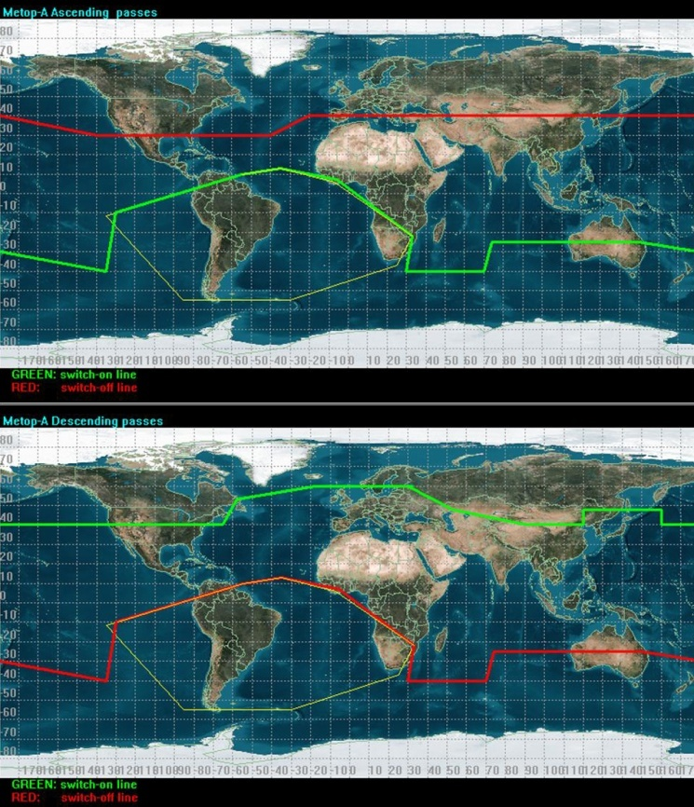
Metop HRPT direct dissemination
Metop-A: HRPT dissemination affected by heavy ion radiation
Metop-B: full, global Direct Readout Service
http://www.eumetsat.int/website/home/Satellites/CurrentSatellites/Metop/DirectReadoutService/index.html?lang=EN

Slide 11
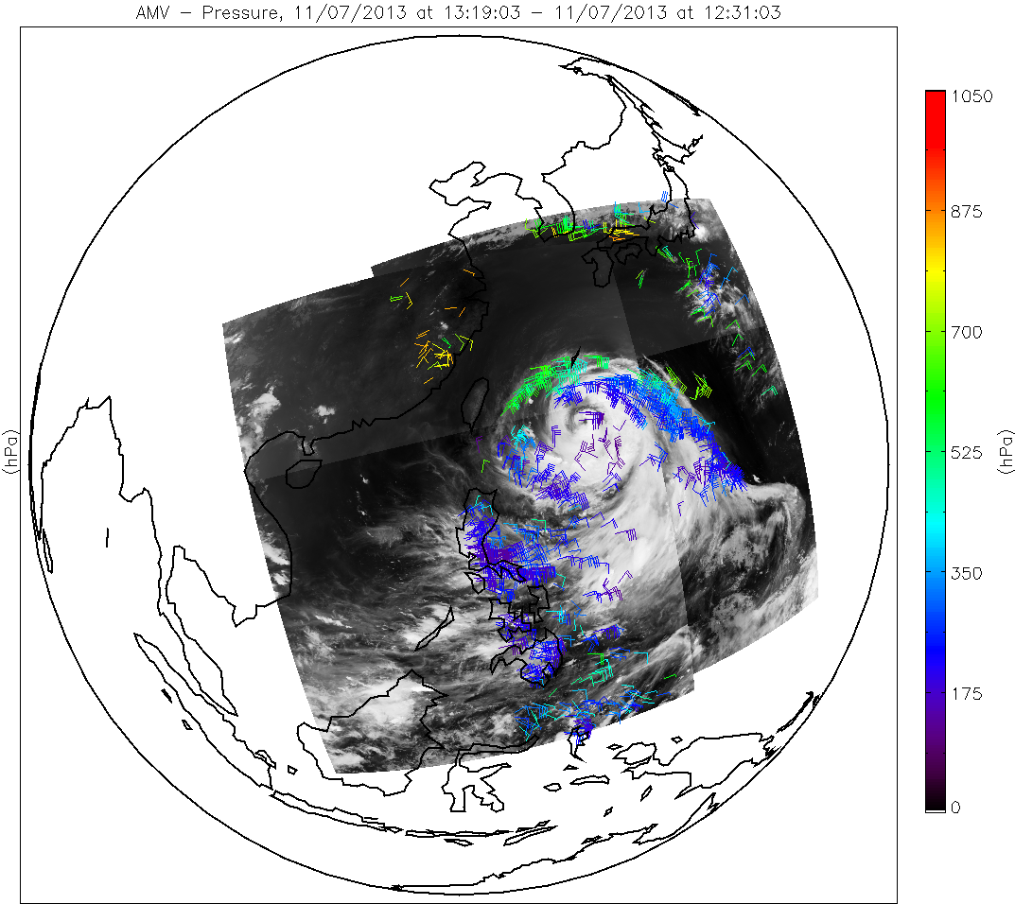
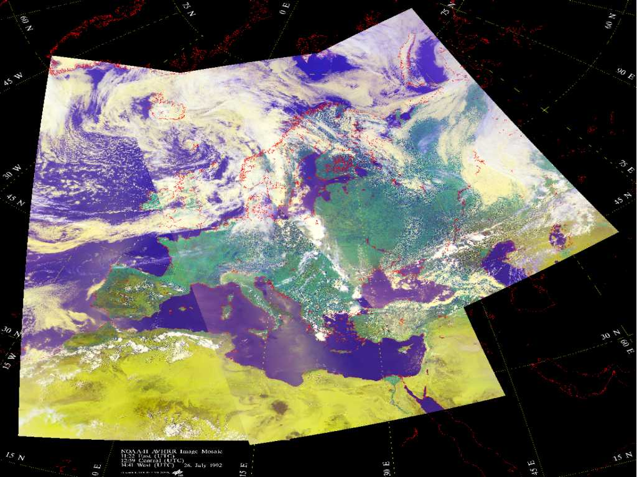
Reasons for Specific Metop Orbit Configuration
Technical reasons (ground station, data communication)
NWP requirements

Slide 12
GOME-2 on Metop-A & Metop-B Tandem Operations #7
Recommendation:
Special GSAG + O3MSAF Project Team convened on 25th April 2013
Recommendation to operate GOME-2 on Metop-A with a swath of 960km and GOME-2 on Metop-B with a swath of 1920km
To be re-evaluated in autumn.
Total ozone coverage pattern for GOME-2 Metop-A and Metop-B with GOME-2 on Metop-A in simulated 960km and GOME-2 on Metop-B the other in nominal 1920km swath mode using data from the current wide swath observations (no spatial resolution increase) taken on the 20th of January 2013 (courtesy of O3MSAF/DLR).

Slide 13
Future EUMETSAT Satellite Programmes
Eumetsat is preparing/developing the following satellites programmes:
Sentinel-3 (2013): Low Earth Orbiting mission to support services relating to the marine and global land environment, with capability to serve further atmospheric- and cryospheric-based application areas.
  http://www.eumetsat.int/website/home/Satellites/FutureSatellites/Sentinel3/index.html
MTG: Meteosat Third Generation (2018), EUMETSAT is preparing for the next European operational geostationary meteorological satellite system. MTG will revolutionise weather forecasting and environmental monitoring by providing significant improvement over the capabilities of the current Meteosat generation.
  http://www.eumetsat.int/website/home/Satellites/FutureSatellites/MeteosatThirdGeneration/index.html
EPS-SG: EUMETSAT Polar System – Second Generation (2020), The EPS follow-on system to EPS will provide continuity of polar orbiting observations for the user community.
  http://www.eumetsat.int/website/home/Satellites/FutureSatellites/EUMETSATPolarSystemSecondGeneration/index.html

Slide 14
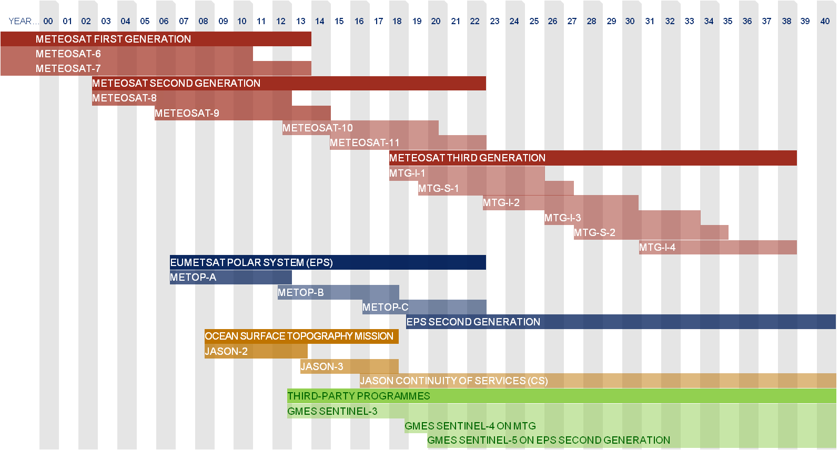
EUMETSAT Programmes Timeline

Slide 15
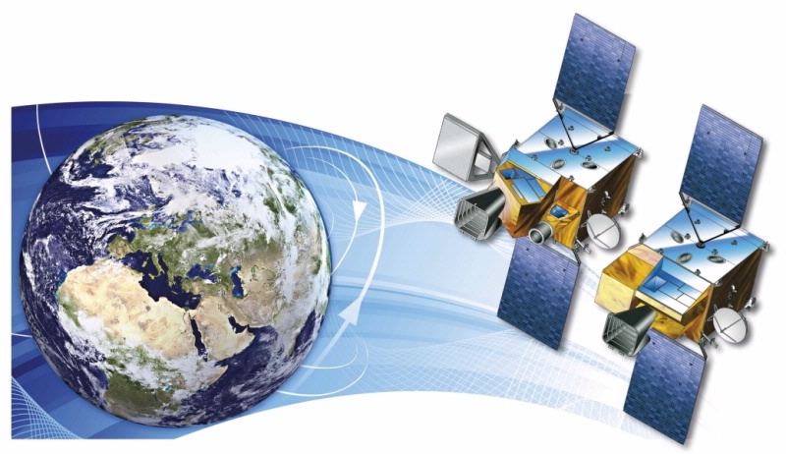

MTG Space Segment – Twin Satellite Concept
MTG-I; 4 satellites
MTG-S; 2 satellites
Courtesy of

Slide 16
MTG Space Segment Configuration
Twin Satellite Concept, based on 3-axis platforms
  4 Imaging Satellites (MTG-I) (20 years of operational services)
  2 Sounding Satellites (MTG-S) (15.5 years of operational services)
Payload complement of the MTG-I satellites
  • The Flexible Combined Imager (FCI)
  • The Lightning Imager (LI)
  • The Data Collection System (DCS) and Search and Rescue (GEOSAR)
Payload complement of the MTG-S satellites
  • The Infrared Sounder (IRS)
  • The Ultra-violet, Visible and Near-infrared Sounder (UVN)

Slide 17
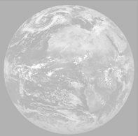
Meteosat Evolution: 1977 – 2002 - 2019
1=VIS0.4
2=VIS0.5
3=VIS0.6
4=VIS0.8
5=NIR0.9
6=NIR1.3
FCI-FDSS:
8 solar channels at 1km
8 thermal channels at 2km
7=NIR1.6
8=NIR2.2
FCI-RSS:
2 solar/thermal
channels
at
0.5 km/1.0 km
9=IR3.8
10=WV6.2
11=WV7.3
12=IR8.7
13=IR9.7
14=IR10.5
15=IR12.3
16=IR13.3

Slide 18
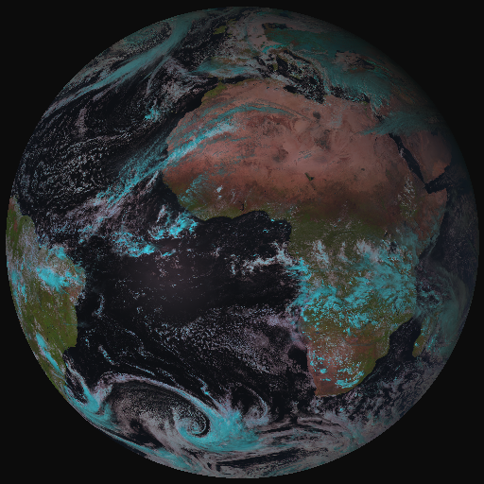
From MSG-SEVIRI to MTG-FCI
MTG FCI outbids MSG SEVIRI observations on cloud, aerosol, moisture and fire:
by adding new channels
by improving temporal-,
spatial-, and radiometric
resolution
a Full-Disk High-Spectral-resolution
Imagery (FDHSI)
High-Resolution Fast Imagery
Coverage Repeat cycle FDHSI mission 18ºx18º 10 min
HRFI mission 1/4 FD 2.5 min

Slide 19
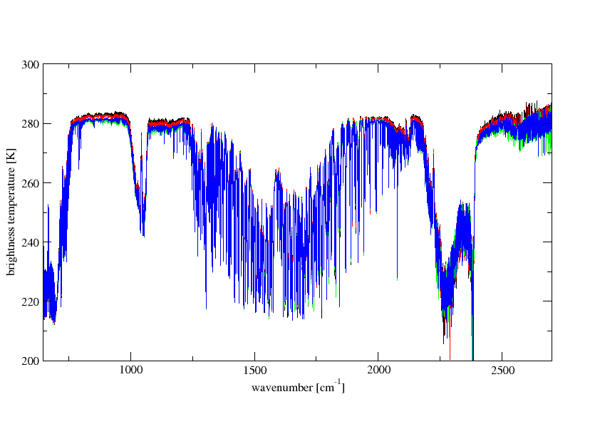
MTG-IRS: High Spectral/Spatial/Temporal Sampling
MTG-IRS will deliver unprecedented information on horizontal and vertical gradients of moisture, wind and temperature.
T(p) Sfc O₃ Sfc
H₂O(p) CO
700 – 1210 cm⁻¹
1600 – 2175 cm⁻¹
Temp (CO2)
Surface, Clouds
Surface,
Clouds
Surface,
Clouds
CO
O3
N2O,
Temp (CO2)
Temp (CO2)
H2O, CH4, N2O

Slide 20
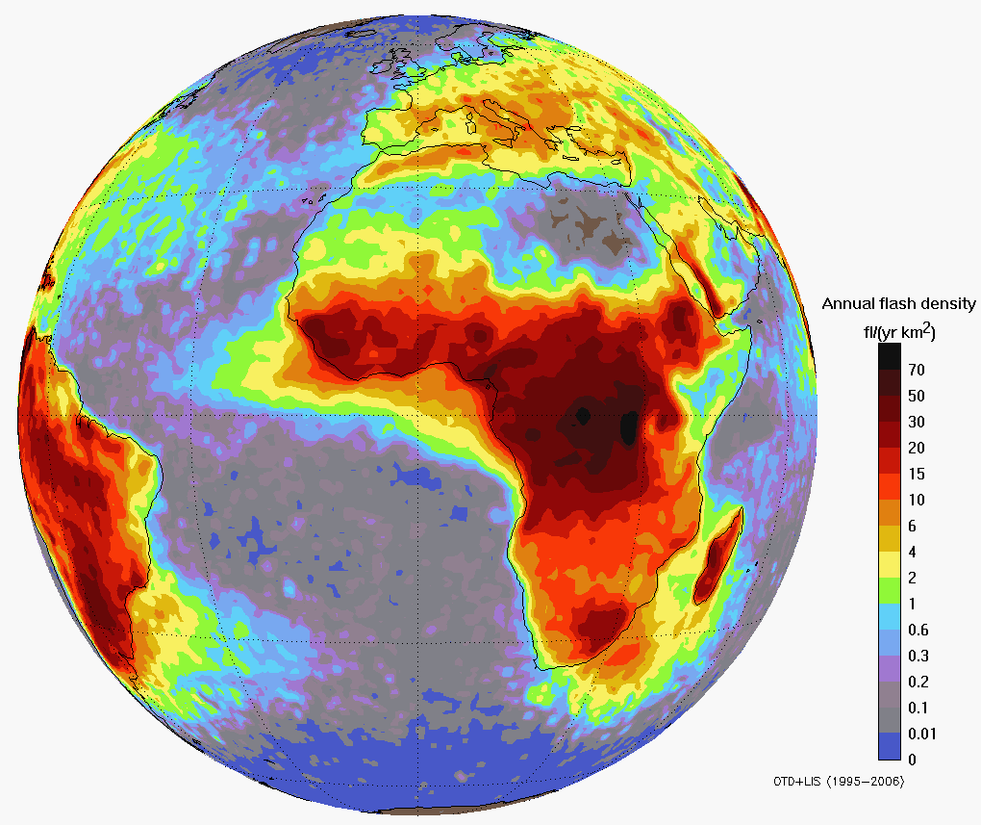
MTG Lightning Imager Requirements
The LI on MTG measures Total Lightning:
Cloud-to-Cloud Lightning (IC) and Cloud-to-Ground Lightning (CG)
Main benefit from GEO observations:
homogeneous and continuous observations delivering information on location and strength of lightning flashes to the users with high timeliness of 30 seconds
detect, monitor, track, and extrapolate in time occurrence of strokes:
Warnings
Development (Intensity/Movement) of active convective areas
Lifecycle of storms
As well as...
Lightning climatology
Chemistry (NOx production)
LIS/OTD flash density in
the MTG LI field of view

Slide 21
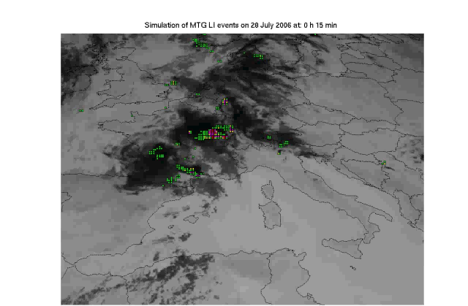
Proxy Data Development – Example
Based on LINET
ground-based
data over Europe
Colour code indicates the
MTG-LI “event” density

Slide 22
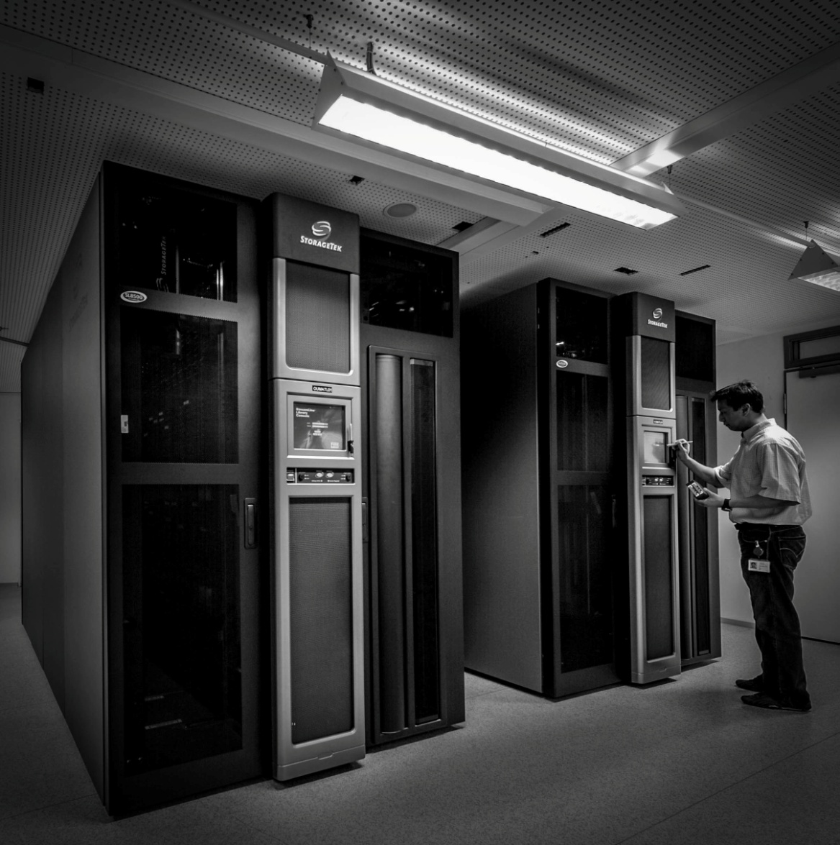
The EUMETSAT Data Centre

Slide 23
The EUMETSAT Data Centre
The Data Centre aims to:
Guarantee a long-term preservation of data and generated products from EUMETSAT’s meteorological satellites.
Enable users to browse, make automated orders, and retrieve data from EUMETSAT's catalogue of products.
Set up in 1995, the Data Centre has developed to become a state-of-the-art archive serving all EUMETSAT satellite programmes. With more than 150 meteorological satellite products available — in the case of Meteosat spanning a record of more than 30 years — the Data Centre offers one of Europe’s largest and most comprehensive collections in this field.

Slide 24
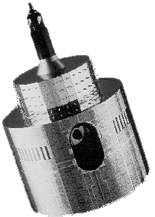
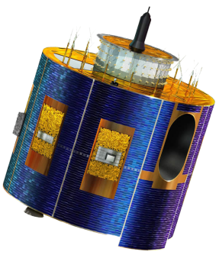

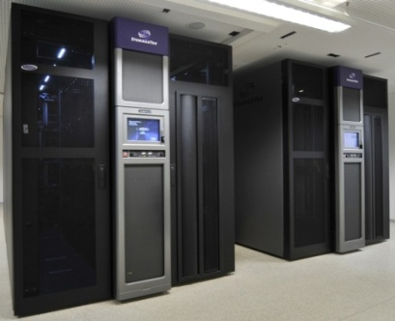

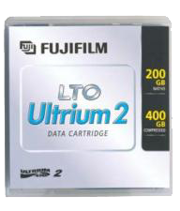
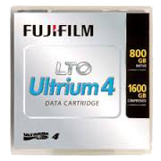

The EUMETSAT Data Centre
EUMETSAT Geostationary Systems
Meteosat satellites
EUMETSAT Polar System
Metop satellites
Jason-2
Optional Programme
for Ocean Altimetry
Satellite Application Facilities – Specialised Dept in EUMETSAT’s MET services
MFG facilities
MSG facilities
EPS facilities
Jason-2 facilities
SAF Ingestion IF
Planned Data Centre Developments
Data Centre Archive
Rolling
Archive
Mcidas
User
Media delivery
Online delivery
HTTP
Other Data Centre Data Servers
Records back to 1982
TDS
Mcidas
Training
EO Portal
USERS

Slide 25
How to find EUMETSAT Products: use the EUMETSAT Product Navigator
The Product Navigator is the central online access to all of EUMETSAT’s products’ information.
New users should use this web application to find out what EUMETSAT products are available.
The Navigator complies with ISO 19115/19139 meta-data standards and conforms to the EU INSPIRE directive.
EUMETSAT products can be ordered either in ‘real time’ or from the Data Centre Archive.
The ‘real time’ ordering service is called EUMETCAST and this service requires the installation of a EUMETCAST reception station and service subscription license. Costs are incurred by the subscriber for the hardware and the license.
The Data Centre Archive does not offer ‘real time’ data and there is no guaranteed delivery times...but the ordering of data is free.

Slide 26
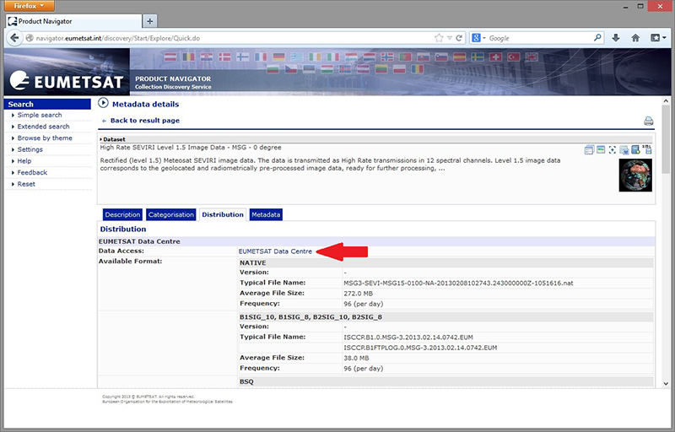
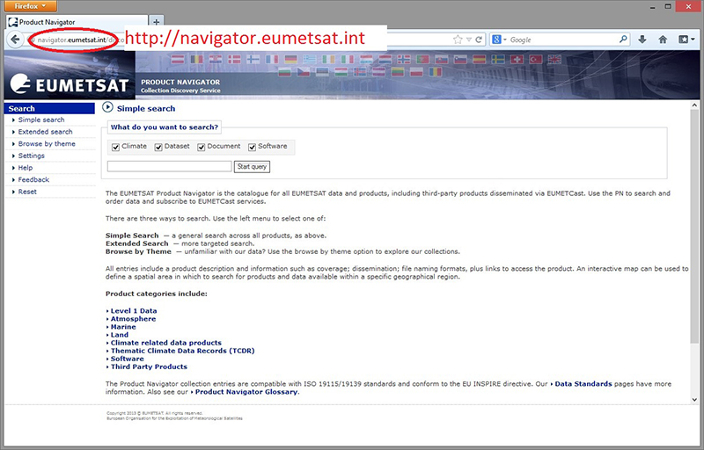
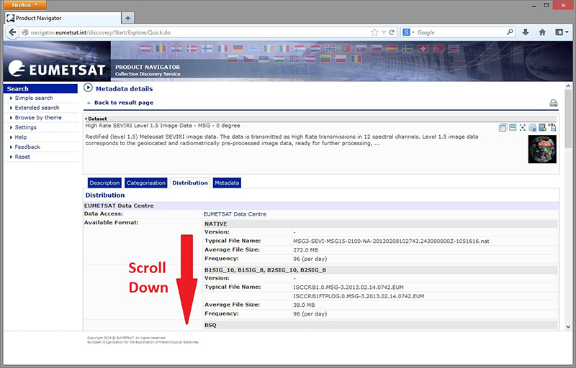
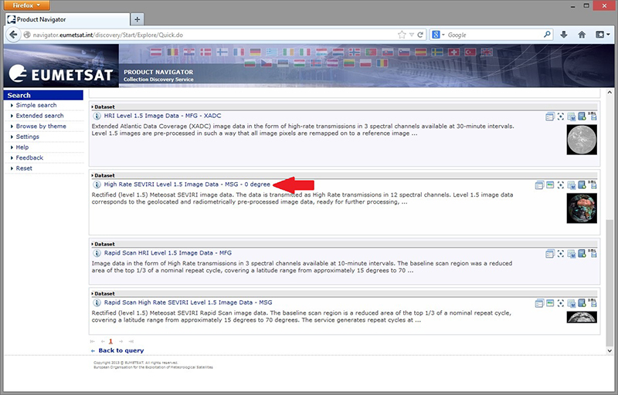
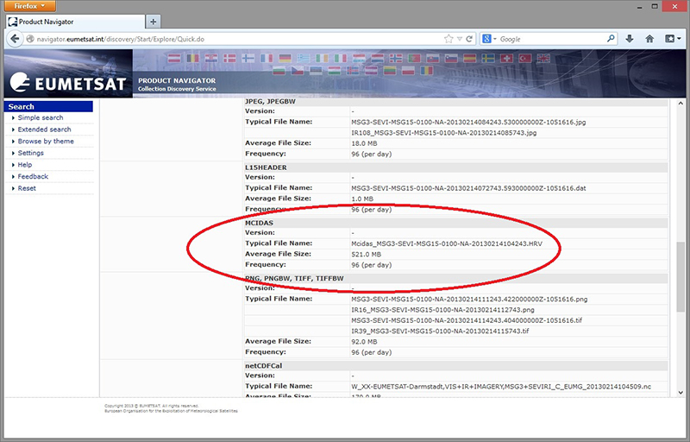
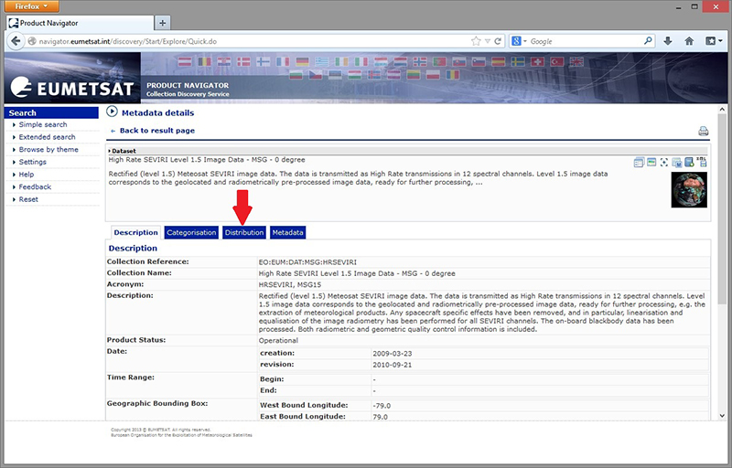
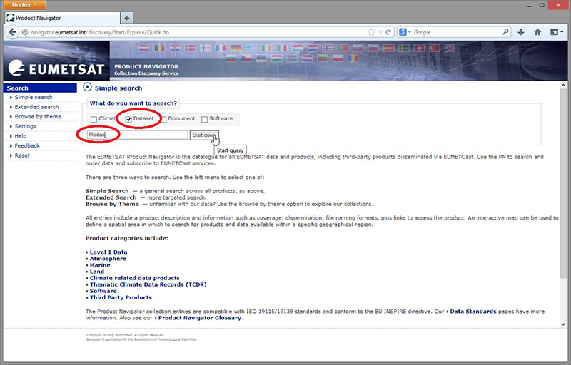
Using the Product Navigator

Slide 27
How to Order EUMETSAT Products: Use the EO Portal
Anyone can register using the EO Portal to become a Data Centre user.
EO Portal URL - http://eoportal.eumetsat.int into your browser.
User should subscribe to the Data Centre Service subscription.
This service offers an Online Ordering Application were EUMETSAT data can be queried and ordered.
The Data is free but there is no guarantee on delivery times.
User guides, training slides and general information about the Data Centre can be founded under:
http://www.eumetsat.int/website/home/Data/DataDelivery/EUMETSATDataCentre/index.html

Slide 28
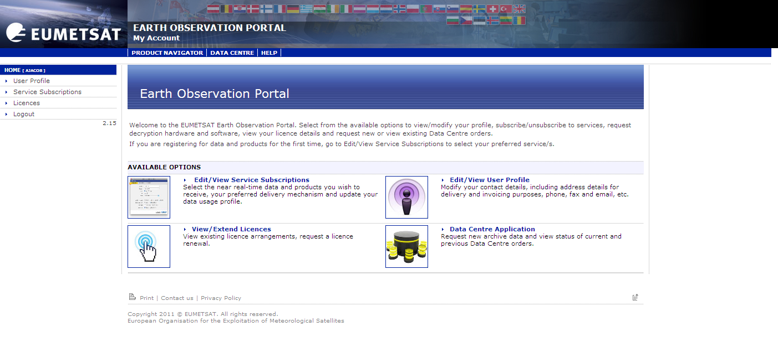
EO Portal: User Registration and Subscription
The Data Centre Ordering Application can be found here:

Slide 29
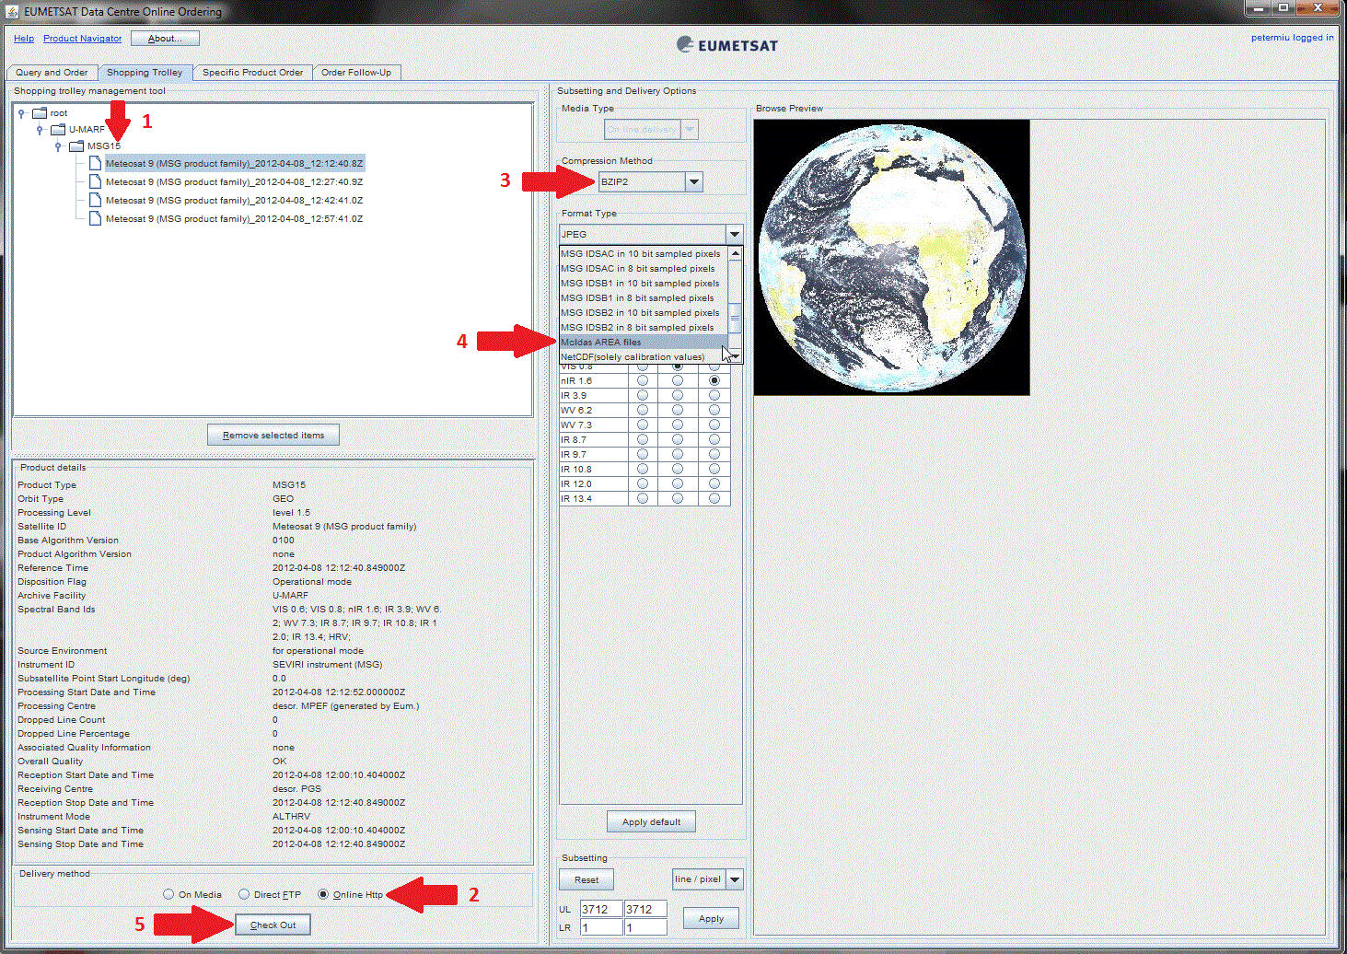
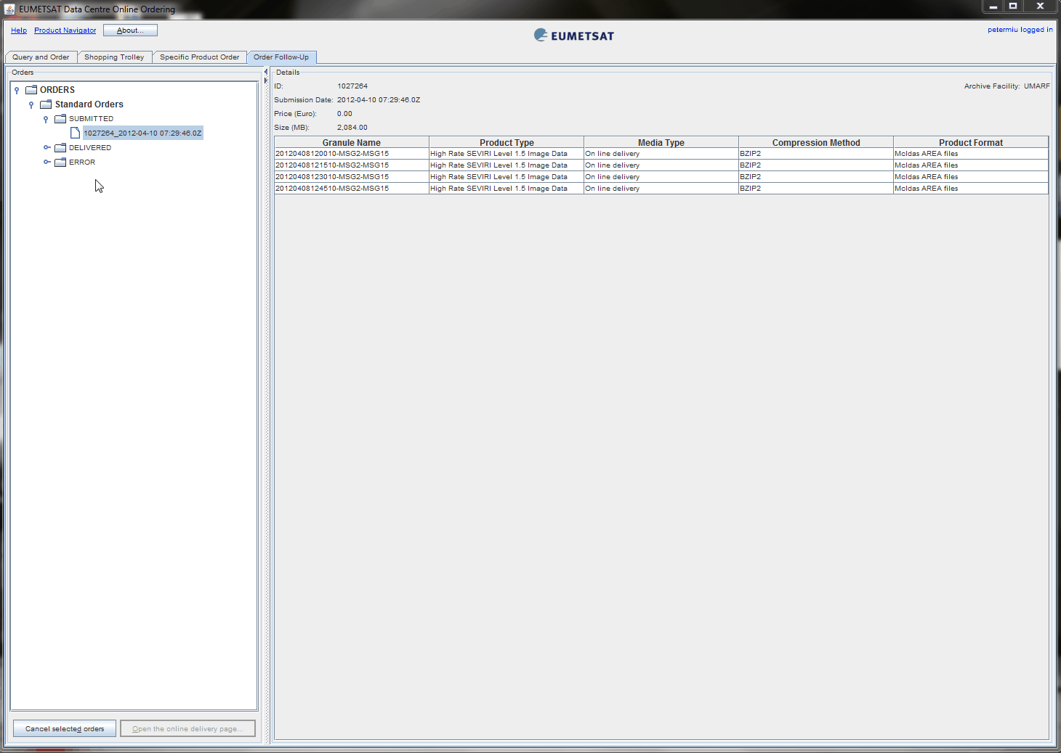
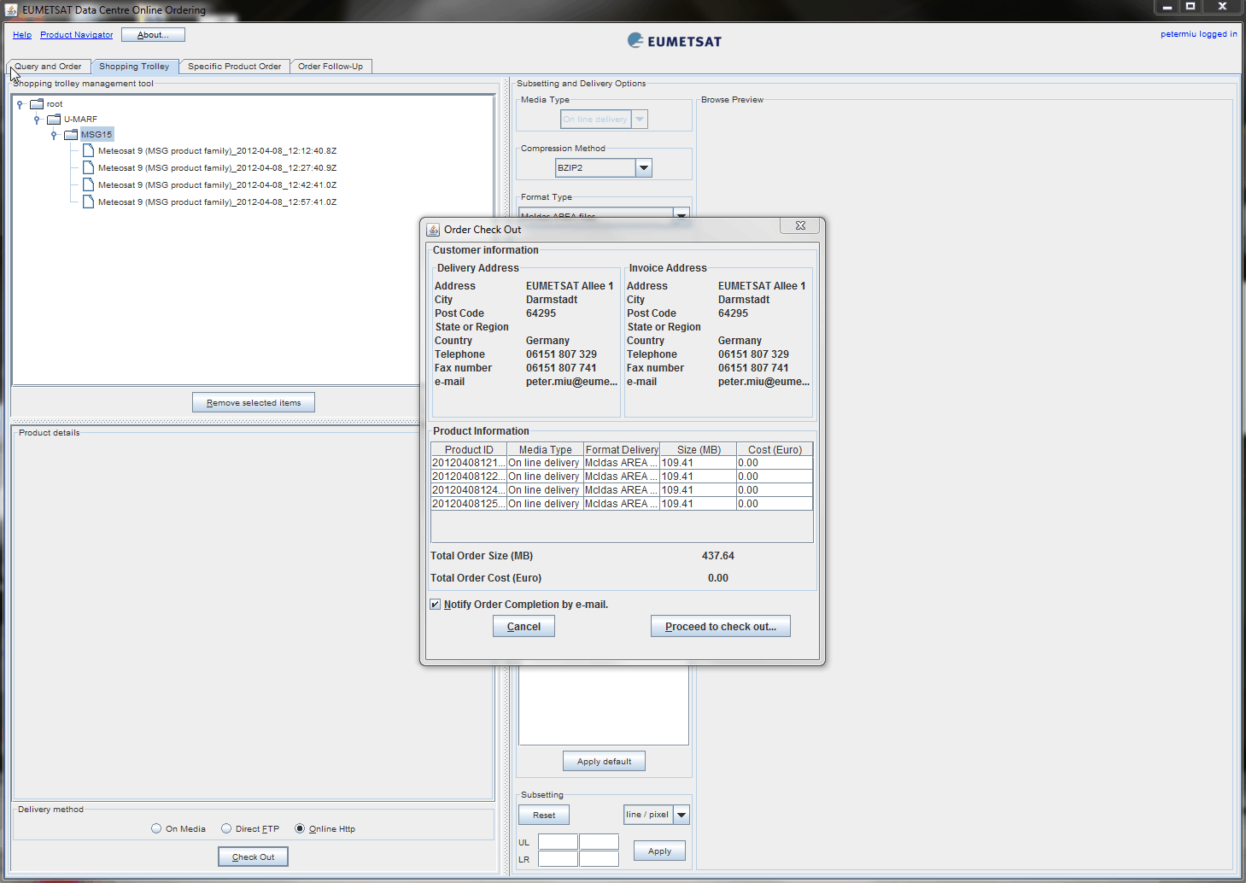
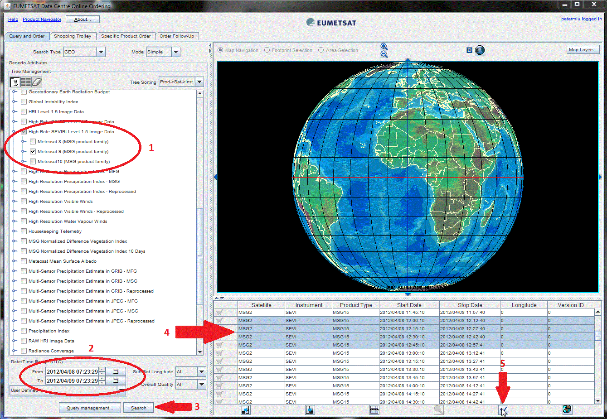
Ordering McIDAS Data Sets from the Data Centre Archive

Slide 30
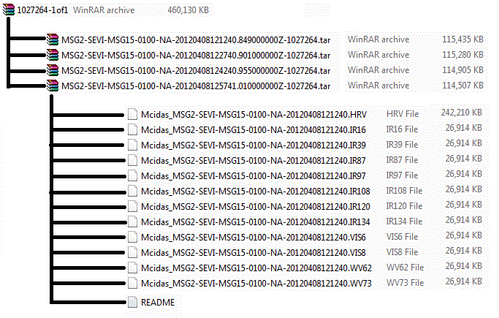
Ordering McIDAS Data Sets from EUMETSAT

Slide 31
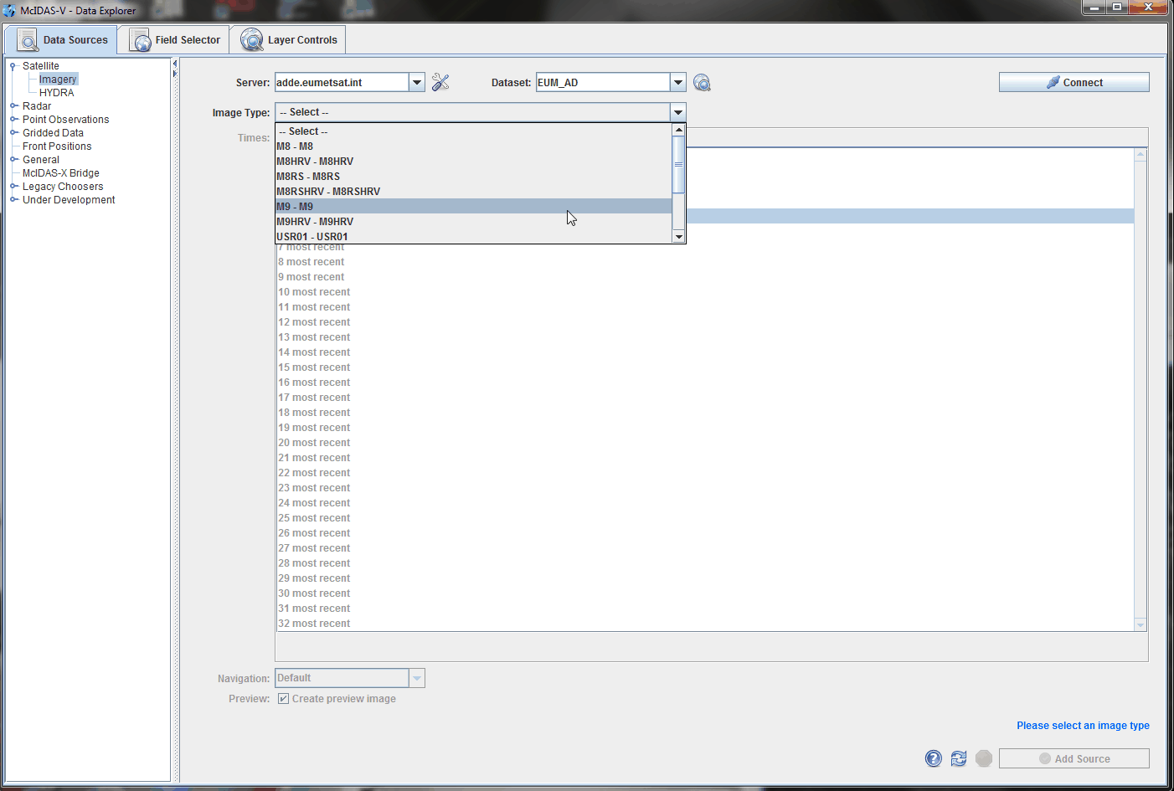
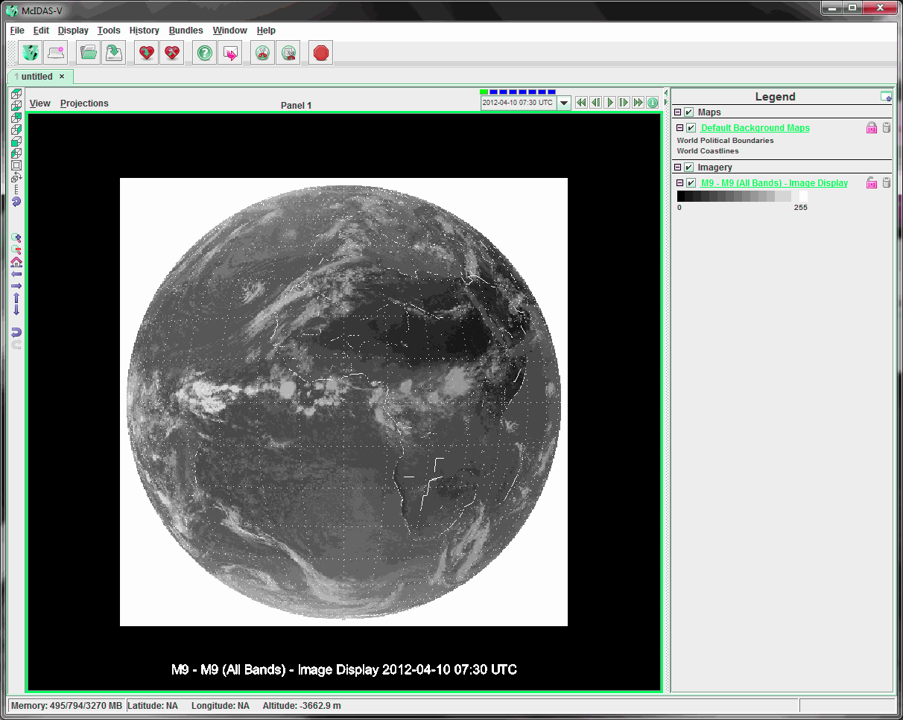
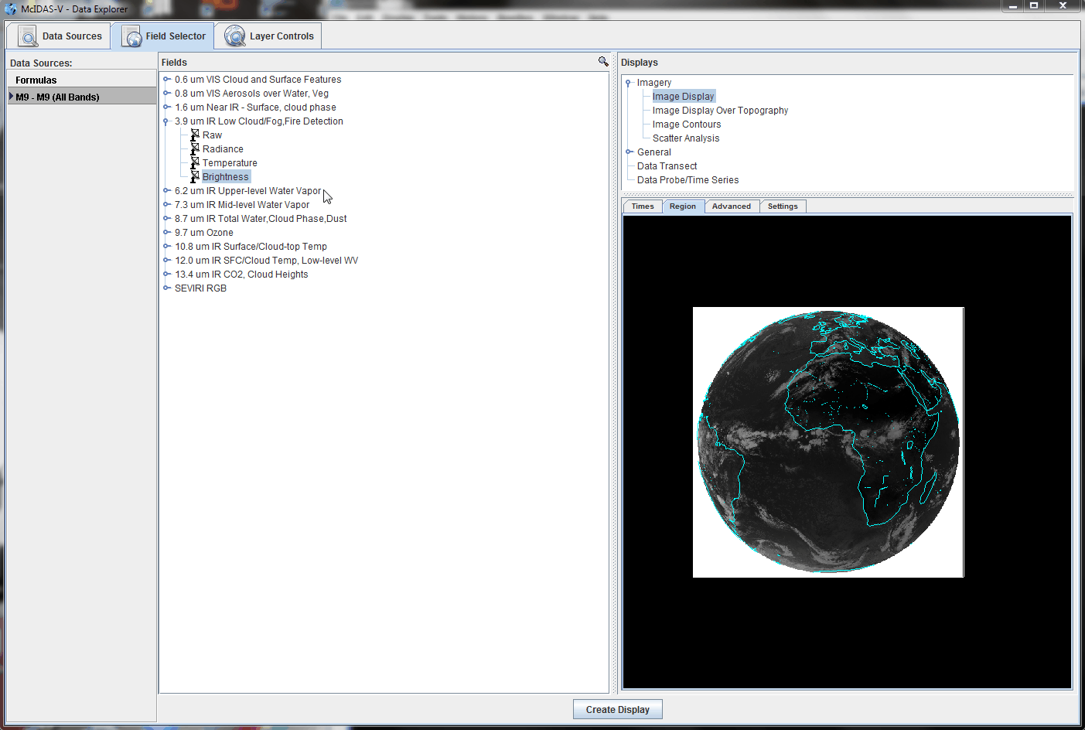
The EUMETSAT McIDAS ADDE Server (used for training)

Slide 32
Planned Future EUMETSAT Developments related to McIDAS
Implement new secondary ADDE servers to support more EUMETSAT products.
Develop the EUMETSAT ADDE Service for use by the wider user community (currently, this is limited for training).
EUMETSAT has implemented NetCDF as a common delivery format for nearly all the polar orbiting products. These formats following CF conventions and Unidata guideline to support visualisation of the products. Investigate the possibility of developing a ‘Generic’ secondary ADDE server to serve these types of products.

Slide 33
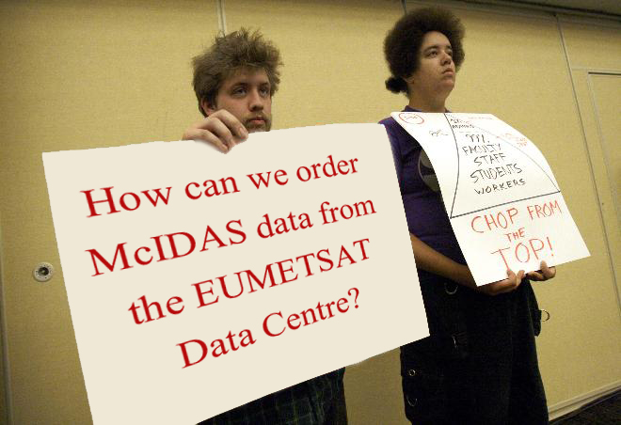


EUMETSAT User Service Helpdesk: first point of contract for all enquires.
Email: ops@eumetsat.int

Slide 34
End of Presentation
Thank you for your Attention, questions ?
EUMETSAT URLs:
http://www.eumetsat.int
http://eoportal.eumetsat.int
http://navigator.eumetsat.int
http://adde.eumetsat.int

