Slide 1
McIDAS at Johnson Space Center – a 25-Year Evolution or How We Rebuilt the Engine While Driving 60mph
This presentation has been reviewed for Proprietary, SBU, and Export Control (ITAR/EAR) and has been determined to be nonsensitive. It has been released to the public via the NASA Scientific and Technical Information (STI) Process DAA 29507.

Slide 2
McIDAS History at JSC
1984 – Site survey for JSC MIDDS by UW SSEC
1985 – remote McIDAS workstation at JSC to CCAFS
1986 – Challenger accident (Rogers Commission recommends increased weather support)
1987 – Installation of JSC MIDDS – development of custom applications for Shuttle operations on McIDAS foundation
1988 – STS-26 Return to Flight – first operational release of JSC MIDDS (two weeks before launch!)
1995 – First Evolution – rehost from IBM 4381 mainframe to distributed HPUX workstations
2007 – Second Evolution – rehost from HPUX to RedHat Linux on HP ‘PC’
2011 – End of the Shuttle Era – JSC MIDDS?
2013 – NEXT Evolution – RHEL 6 and a new network architecture

Slide 4
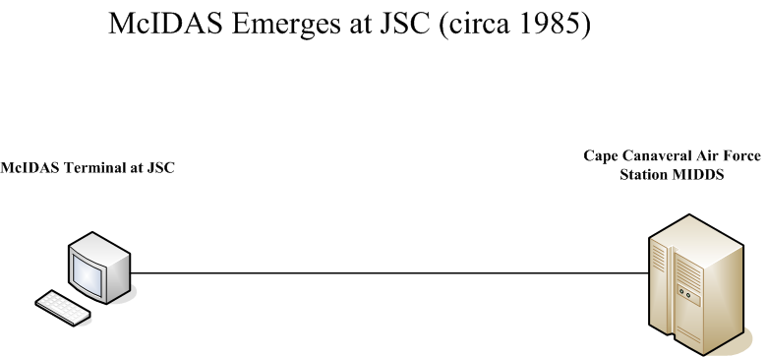

Slide 5
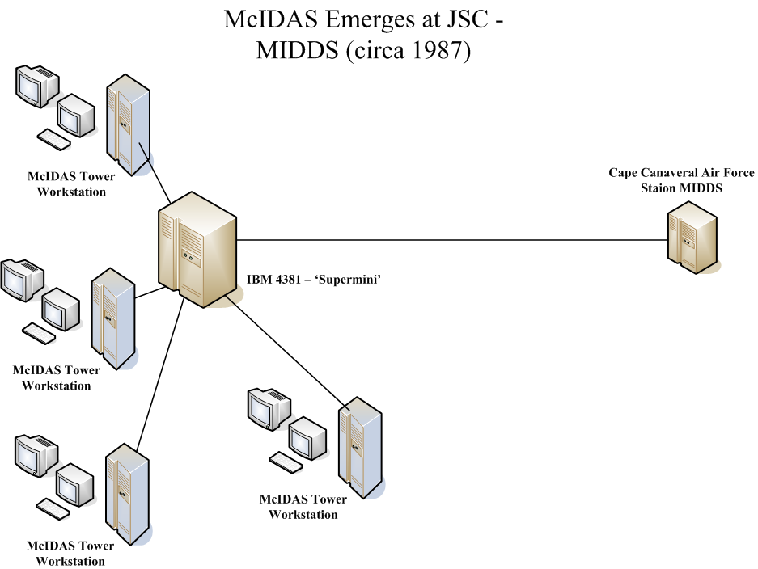

Slide 8
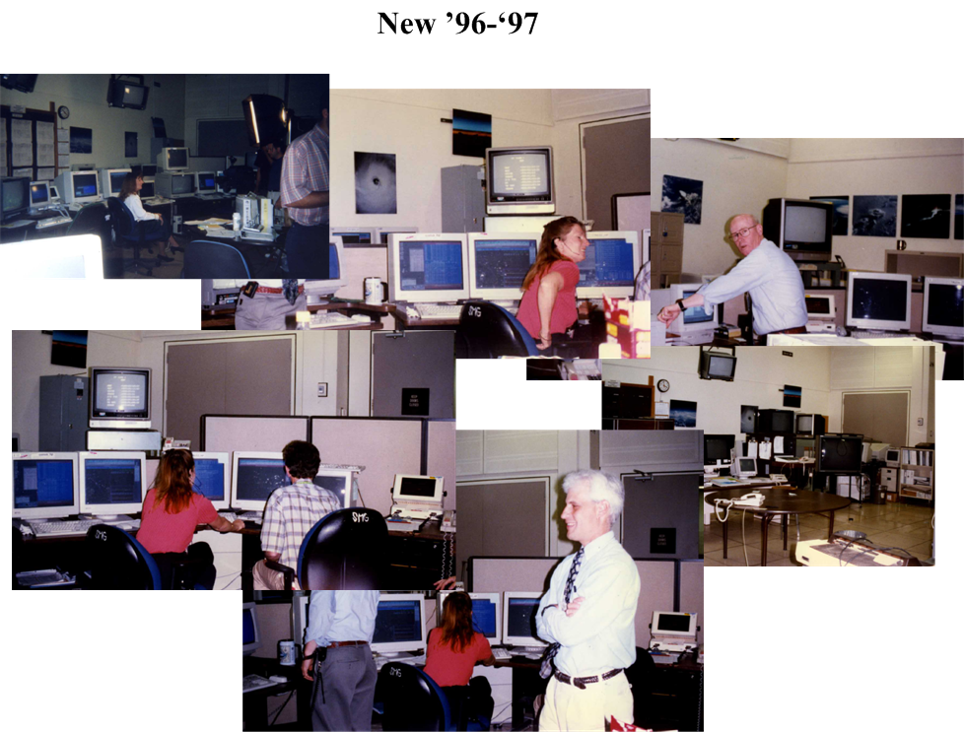

Slide 9
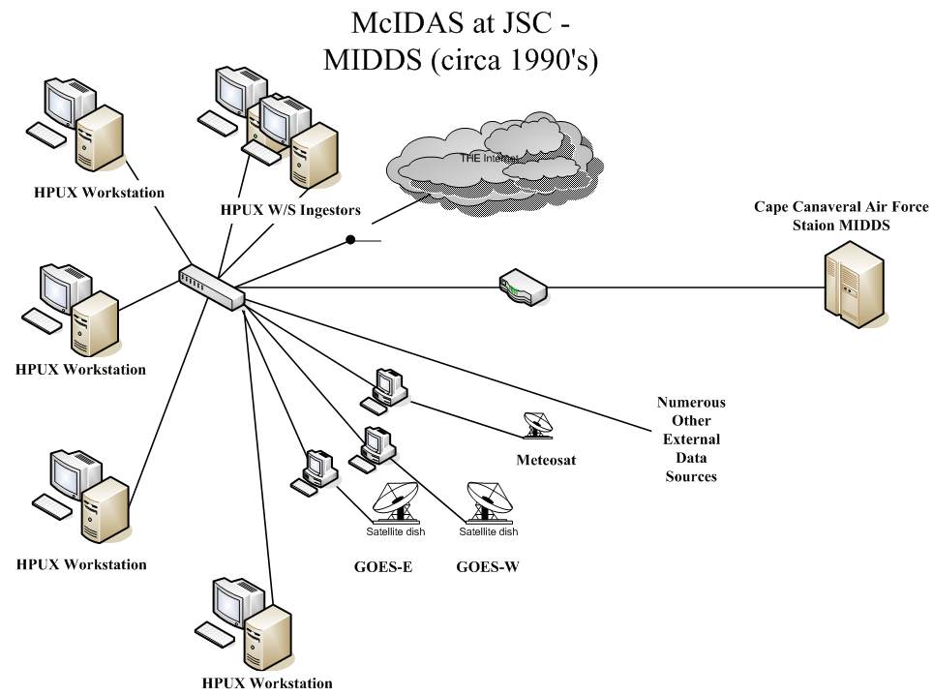

Slide 11
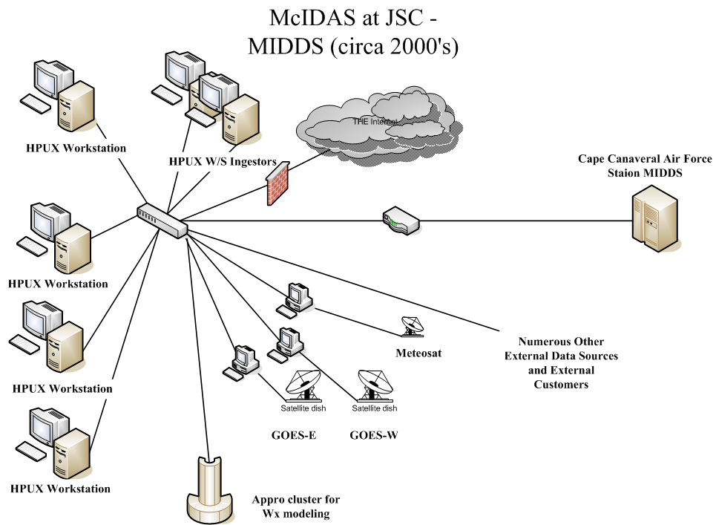

Slide 12
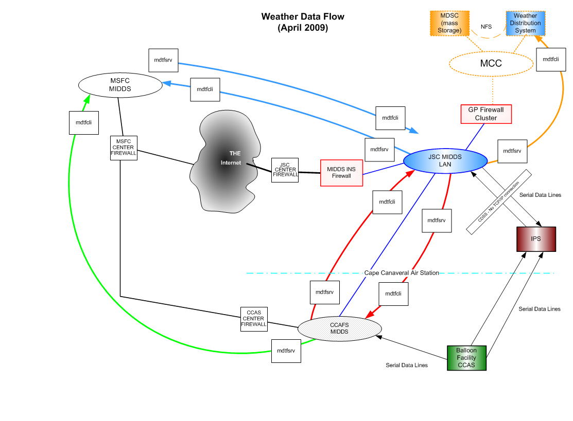

Slide 15
McIDAS at JSC – What did we accomplish?
Supported 109 Space Shuttle missions with 100% availability
Supported numerous Soyuz landings from ISS and other NASA programs as requested (MSFC GRIP, UAV lightning, Dryden flight tests, etc)
Two major ‘evolutions’ – IBM mainframe to distributed HPUX-based network, HPUX to Linux
Evolved while maintaining continuous flight support – “rebuilding the engine while driving 60 mph” (and sometimes much faster)
MANY McIDAS updates – including evolution to McIDAS-X and –XCD
Supplied McIDAS custom code to all three NASA centers

Slide 16
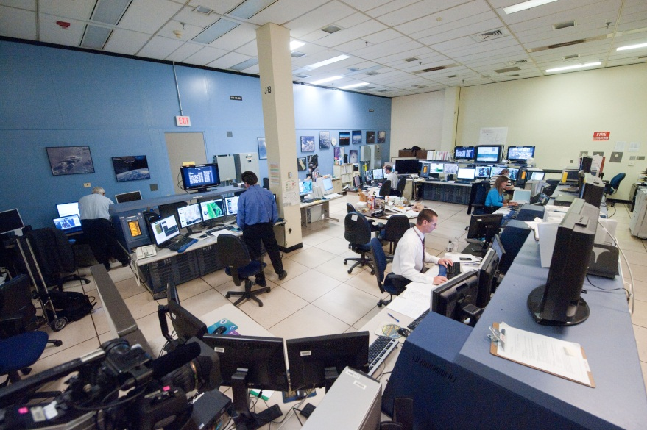
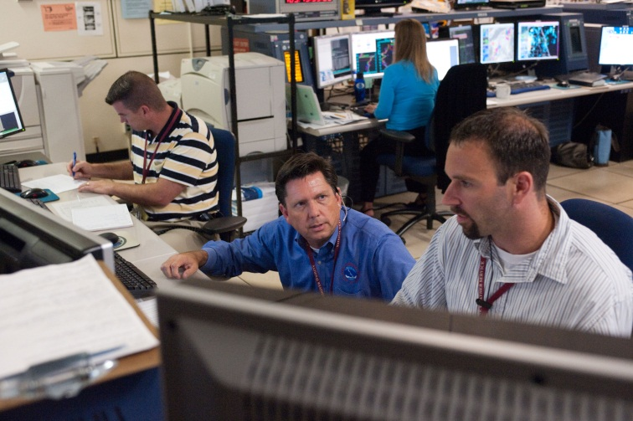
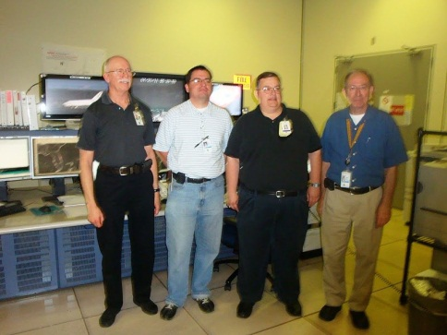
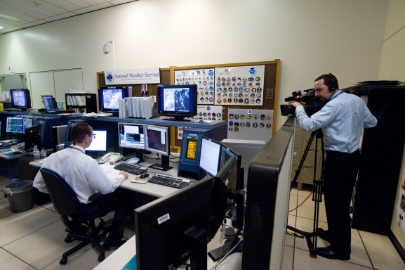
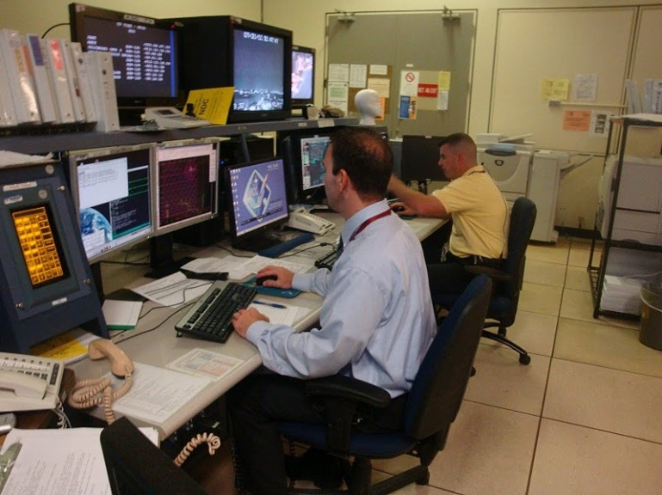
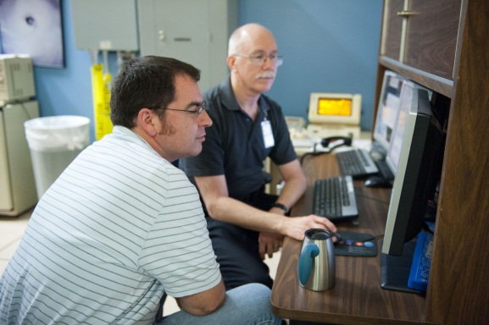
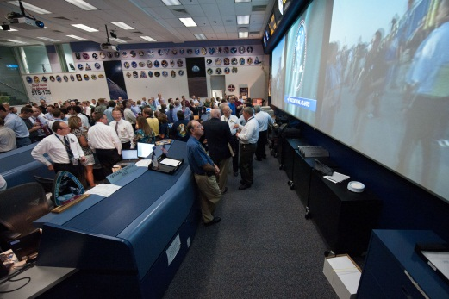
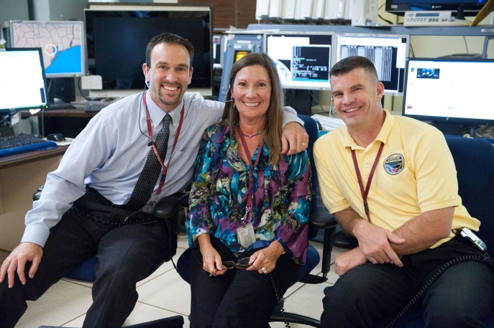
The End of an ERA

Slide 17
McIDAS at JSC – What’s Next?
MIDDS into the next generation control center – the MCC21 Project
EFT-1/EM-1 support
Commercial Crew support
Continued support to MSFC and CCAFS MIDDS

Slide 18
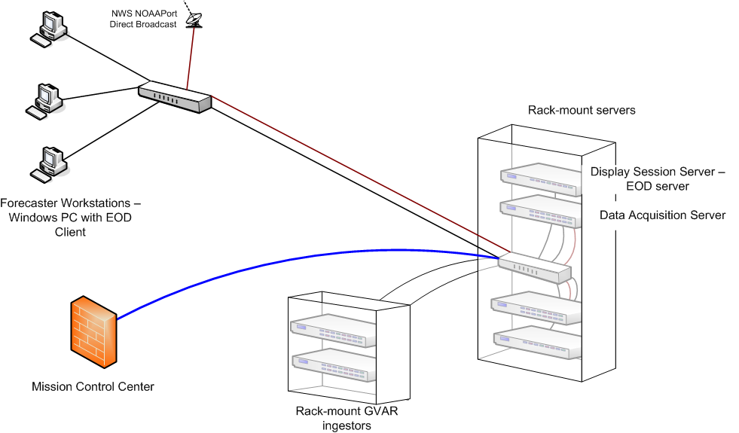
JSC MIDDS in the 21st Century Control Center

Slide 19
Last, but not least ! Our thanks to SSEC. Without your support the engine would have dropped out a long time ago…

