Slide 1
Using McIDAS-X to Support the NASA SEAC4RS Field Experiment
Douglas Spangenberg, SSAI, Hampton, VA
Rabi Palikonda, SSAI, Hampton, VA
Louis Nguyen, NASA LaRC, Hampton VA

Slide 2
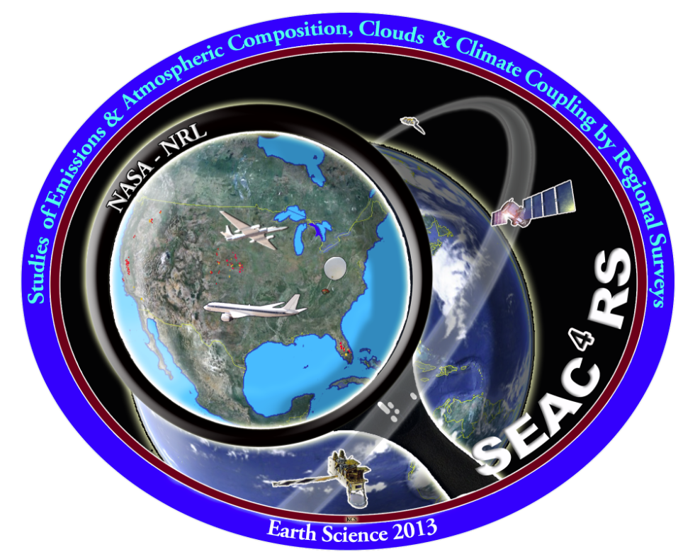
Introduction
SEAC4RS: Studies of Emissions and Atmospheric Composition, Clouds, and Climate Coupling by Regional Surveys (Aug-Sep 2013)
*Interest in pollution, smoke, atmospheric chemistry, North American monsoon, convective cloud microphysics.
*NASA LaRC personnel on site at Ellington Field in Houston, TX running McIDAS-X on 2 Mac OS X computers.
ER2
DC-8

Slide 3
McIDAS-X Tasks
GUI configured for 156-166 frames with specific frame sequences for each satellite channel and domain.
Scheduler run to ingest GOES data and display imagery in loop sequences; runs BATCH files.
Make and display virtual graphics of plane positions, tracks, and altitudes (ZA, PATH, AIRPLANE,VIRT=, SHOWVG).
Make polar orbiting satellite track maps (NAVDISP) and data (NAVCALC).
Overlay lightning, radar (SATOVERLAY2), overshooting tops on imagery.
Use DIST command to find distance to points of interest.
Obtain LAT/LON of points of interest to have the planes fly toward.
Provide cloud-top height (IMGDISPCP, BARCP).

Slide 4
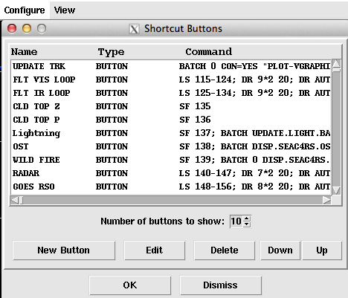
GUI with GOES-13 Enhanced Channel 4 Image with Plane Tracks
*PATH, AIRPLANE
*BAR
*PC T, ZA
*SHOWVG
17:02 GMT Aug 23, 2013

Slide 5
GUI Showing 1-km VIS from GOES-14 SRSO with Plane Tracks
17:15 GMT Aug 23, 2013
*PATH, AIRPLANE
*SHOWVG
*ZA

Slide 6
GUI Showing 4km WV from GOES-13 with Plane Tracks
17:02 GMT Aug 23, 2013
*PATH, AIRPLANE
*SHOWVG
*ZA

Slide 7
GUI Showing 4-km IR from GOES-13, 15 with NEXRAD Overlay
*IMGREMAP
*SATOVERLAY2
(plot function)
*BAR
*PC T, ZA – BAR labels
*MERGE_GEO
Satellite: 20:02 GMT Aug 23, 2013
Radar: 20:03 GMT Aug 23, 2013

Slide 8
GUI Showing 4-km IR from GOES-13 with Lightning Overlay
*IMGREMAP
*PC E
* ZLM FILL
*SHOWVG
Satellite: 21:32 GMT Aug 23, 2013
Lightning: 21:45-21:50 GMT Aug 23, 2013

Slide 9
GUI Showing 4-km VIS from GOES-13 with Overshooting Tops
*FRMLIST
*PTLIST
*PTDISP
21:45 GMT Aug 23, 2013

Slide 10
GUI Showing 4-km Cloud Top from GOES-13
*IMGDISPCP
*BARCP
14:15 GMT Aug 24, 2013

Slide 11
GOES-13 Image with Flight Plan for Aug 30, 2013
19:02 GMT Aug 30, 2013
CALIPSO
*PATH
*NAVDISP
with TLE files
ER2
DC8

Slide 12
GOES-13 5km Remapped RGB Image
16:45 GMT Aug 23, 2013
*IMGREMAP
*COMBINE
RED: CH1
Green: CH2-4
Blue: CH4

Slide 13
Orbital Predict for Aug 27, 2013
*NAVDISP with
TLE files
*PC T, ZLM – Squares in
frame’s label
AQUA
AURA
CALIPSO
NPP
TERRA

Slide 14
DC-8 Flight Track on GOES-13 VIS Image
*IMGREMAP
*plot routine
*ZA
Image time: 19:10 GMT Aug 21

Slide 15
Flight Tracks on GOES-15 Optical Depth Image
Image time:
22:00 GMT Aug 06, 2013
*IMGREMAP
*plot routine
*ZA
*IMGDISPCP
*BARCP

Slide 16
Summary
NASA LaRC cloud group in Houston, TX using McIDAS-X on 2 Mac OS X laptop computers to support SEAC4RS field experiment (Aug-Sep 2013) .
Real-time flight positions and past 20-60 min of aircraft tracks shown on GOES VIS, IR, WV image loops.
Image loops with current and projected airplane positions used to make course adjustments for studying convective clouds, smoke.
Polar orbiting satellite tracks shown to mission planning for aircraft coordination with overpass.
For takeoff and landing at Ellington Field, McIDAS IR image with NEXRAD and lightning overlay used.
McIDAS-X helped NASA-Langley support previous field missions: ATTREX, MACPEX, TC4, CCVEX, AIRS-2, CRYSTAL-FACE.
Need similar capabilities in McIDAS-V to support future field missions.

