Slide 1
McIDAS History and McIDAS-V Status
David Santek
9 September 2013

Slide 2
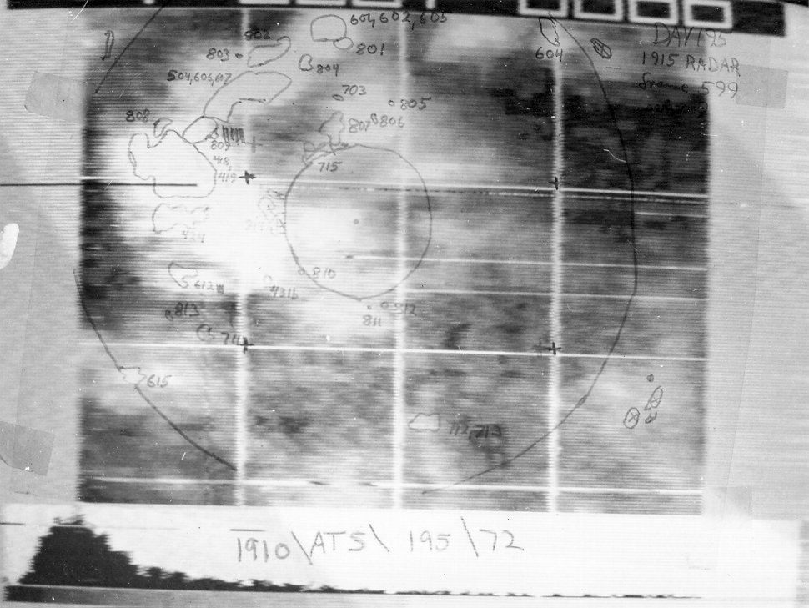
McIDAS History
1960s: Prof. Vern Suomi was striving to exploit the geostationary satellites for time domain information
McIDAS was initially developed with the goal to mass produce the cloud drift winds
For the last 40 years, McIDAS has evolved through 5 generations of hardware/software as an internationally renowned system

Slide 3
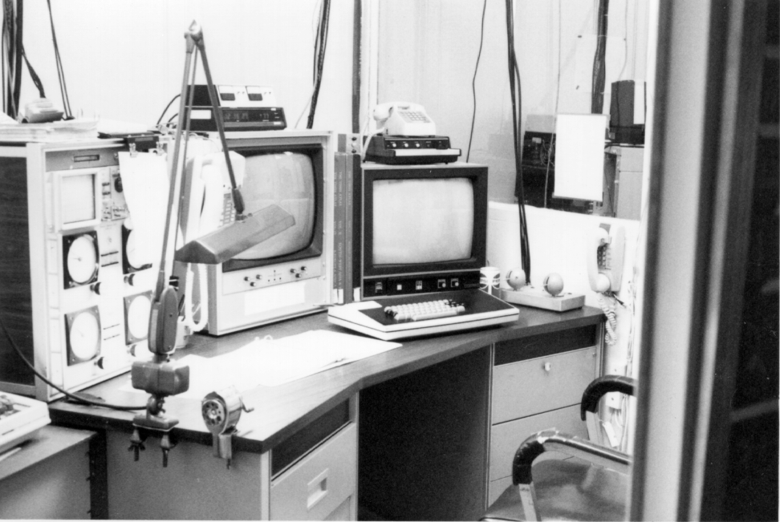
McIDAS Significant Milestones
12 October 1973: McIDAS was first used in a research project by Dave Martin
1977: McIDAS installed at WTVT in Tampa, FL; continues as an active McIDAS site today
1978: Cloud-drift winds were manually generated from five geostationary satellites for a year as part of the First GARP Global Experiment (FGGE)

Slide 4
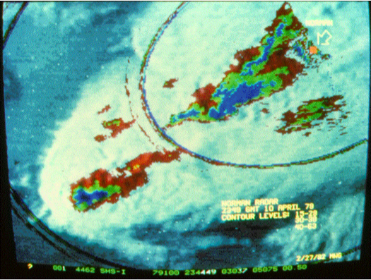
McIDAS Significant Milestones
1979: Congressional delegation visited SSEC to learn about advances in severe storm forecasting in wake of tornadoes in Wichita Falls, TX
1982: McIDAS installed at NSSFC to aid in severe weather forecasting.
Mesoscale Discussions began in 1986, partly in response to the availability of timely analyses
1982: Port to mainframe; funded by People’s Republic of China

Slide 5
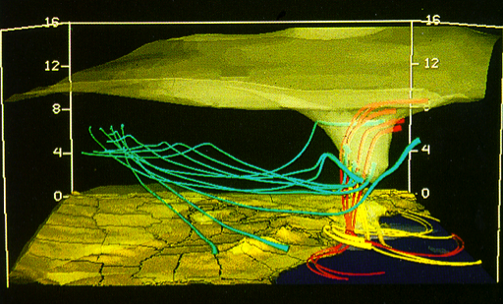
McIDAS Significant Milestones
1982: Interactive Flash Flood Analyzer (IFFA) based on McIDAS installed at NOAA
1989: McIDAS Users’ Group formed
mid-1980s: McIDAS installed at Cape Canaveral and Johnson Space Center in support of the space shuttle
late-1980s: Installed at NHC

Slide 6
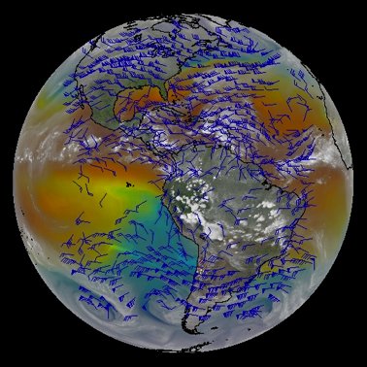
McIDAS Significant Milestones
1992: McIDAS-X, Unix-based system
1994: CIRA RAMSDIS – GOES satellite data into NWS
mid-1990s: Abstract Data Distribution Environment (ADDE)

Slide 7
McIDAS-X Current Chapter

Slide 8
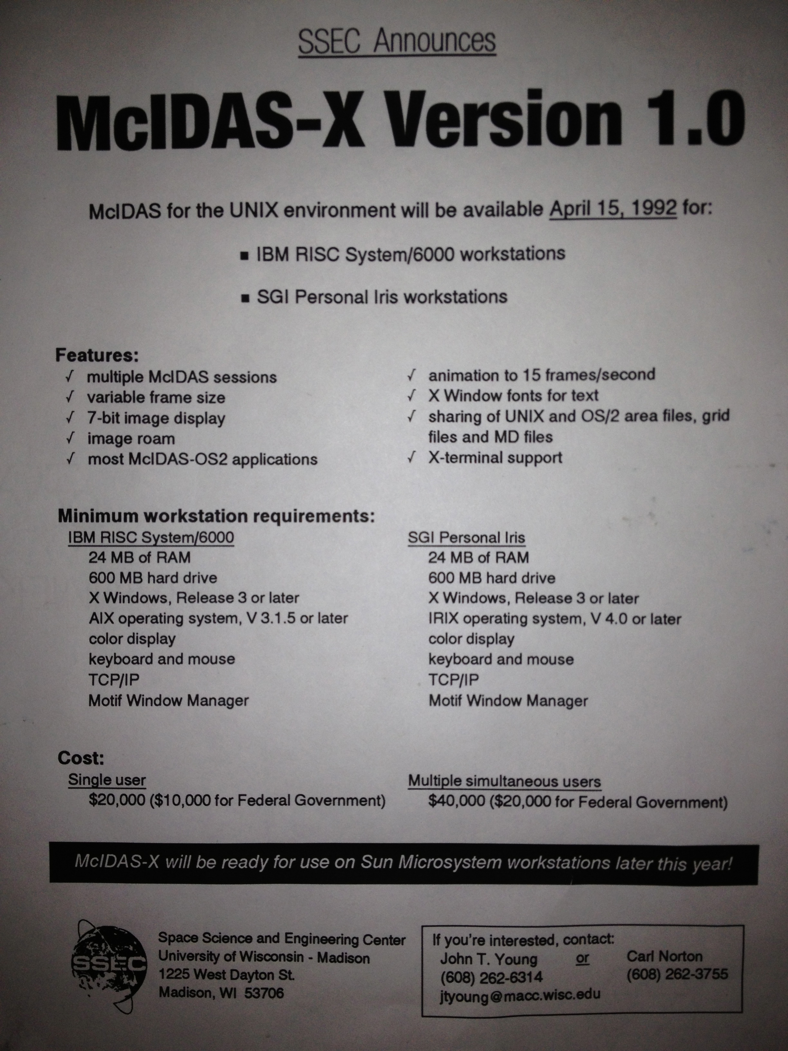
McIDAS-X Introduction
Ported code from mainframe and DOS- and OS/2-based computers to IBM AIX workstations
Released April 1992
A distributed system as opposed to previous mainframe

Slide 9
McIDAS-X Keys to Success
Port to Unix
ADDE (Abstract Data Distribution Environment)
McIDAS-X Reglue
Resulted in the longevity of McIDAS-X
Reliability, Stability
Solid infrastructure

Slide 10
McIDAS-X Future
McIDAS-X is expected to be supported until about 2020 for current GOES satellites
NOAA/NESDIS has a million lines of product generation code
MUG bug fixes, adaptive maintenance (changes to and new satellites)
Enhancements continue to be funded and/or code contributed by internal projects and external sites

Slide 12
McIDAS-V Motivation
McIDAS-X software (currently written in Fortran 77 and C) has a 40-year heritage resulting in limited extensibility potential
New visualization concepts cannot be incorporated
Forthcoming environmental satellite data cannot be utilized efficiently (GOES-R & JPSS operational systems)

Slide 13
McIDAS-V Goals
McIDAS-V shall be a powerful and versatile software system for environmental data processing, analysis and visualization
McIDAS-V shall support existing and evolving needs of scientific research and algorithm/applications development for new programs, such as NPOESS and GOES-R as well as for retrospective data, such as that from GOES and POES
McIDAS-V shall support data fusion and algorithm interoperability from existing and future sources
The McIDAS team shall continue to fully support the MUG and McIDAS-X functionality as users transition to McIDAS-V
McIDAS-V shall support operational users by providing tools and interfaces that enable a natural transition path for research results into operations
McIDAS-V shall be used to educate students in remote sensing and physical sciences, and students must be integrally involved in its development, evolution and use

Slide 14
McIDAS-V Innovative
Develop new capability in visualization and data analysis: Move beyond 2D to 3D

Slide 15
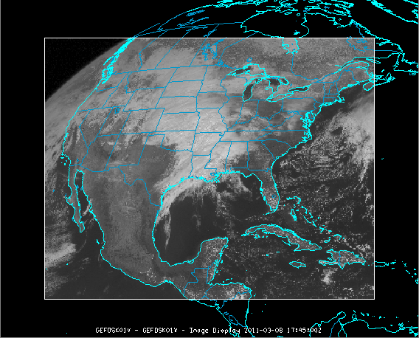
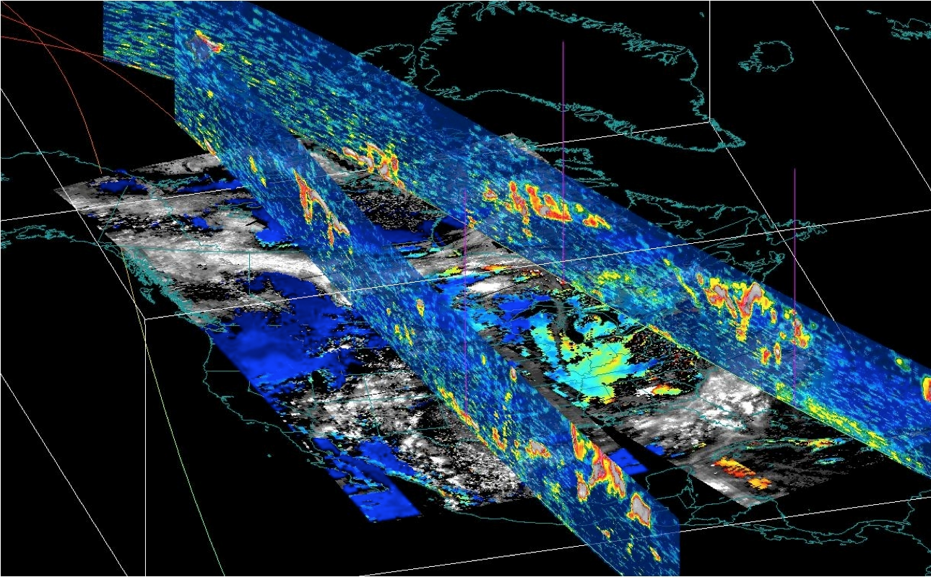
McIDAS-V Innovative

Slide 16
McIDAS-V Milestones
2003: Whittaker and Santek present a McIDAS-V plan to the Directors
2006: Investigations of a “new approach” to data analysis and visualization
2007: Collaboration with Unidata to advance VisAD and IDV as the basis of McIDAS-V
2008: McIDAS-V becomes an “alpha”
January 2009: beta 1
January 2010: beta 5
September 2010: V1.0

Slide 17
McIDAS-V Current Users
In 2012:
McIDAS-V was downloaded by 4600 unique IP addresses
McIDAS-V was launched 340,000 times (lifetime total of over 1,000,000)
Education (AOS, Texas A&M, MissState, etc.)
Real-time: EUMETCast users
Automated: Mexico weather service

Slide 18
McIDAS-V Survey
Fall 2012: A survey was created for users of McIDAS software.
December 2012: The survey was sent to:
Those on McIDAS email lists
A large group of scientists where it was uncertain if they ever used McIDAS
There were 69 responses to the McIDAS-V portion of the survey; about a 10% response.

Slide 19
McIDAS-V Survey
Usage
41% used McIDAS-V and not McIDAS-X
59% used both
41% used the software at least once a week
67% responders were in research; 30% in operations
89% used satellite data (88% geo; 44% polar)
Important attributes
89% wide variety of data types
74% imaging and animation tools
74% overlay multiple data types
70% ease of use
59% analysis tools

Slide 20
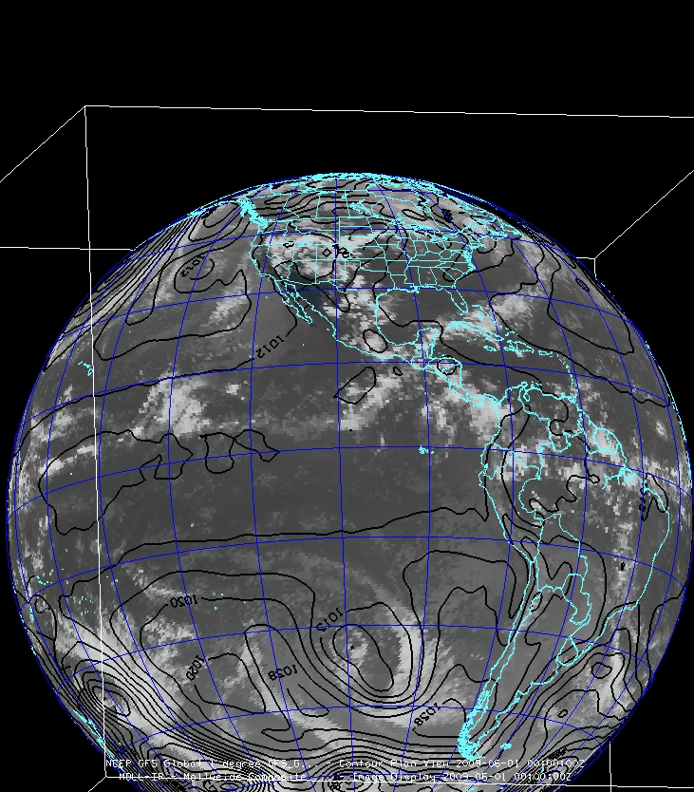
McIDAS-V Software Status
Four main components:
VisAD
IDV
HYDRA
Additional development

Slide 21
McIDAS-V Software Status: VisAD
VisAD is an open-source, Java library for building interactive and collaborative visualization and analysis tools:
Mathematical data model that embraces any numerical data set
General display model that supports 2- and 3-D displays, multiple data views, direct manipulation
Adapters for multiple data formats and access to remote data servers

Slide 22
McIDAS-V Software Status: IDV
IDV built on VisAD (User Interface, etc.)
The IDV is maintained by Unidata, with input and suggestions from SSEC
Monthly telecons between Unidata and SSEC
Shared programmer forums
Common source control
Includes the netCDF Java library for reading many different data formats (netCDF, HDF, GRIB, BUFR, etc.)

Slide 23
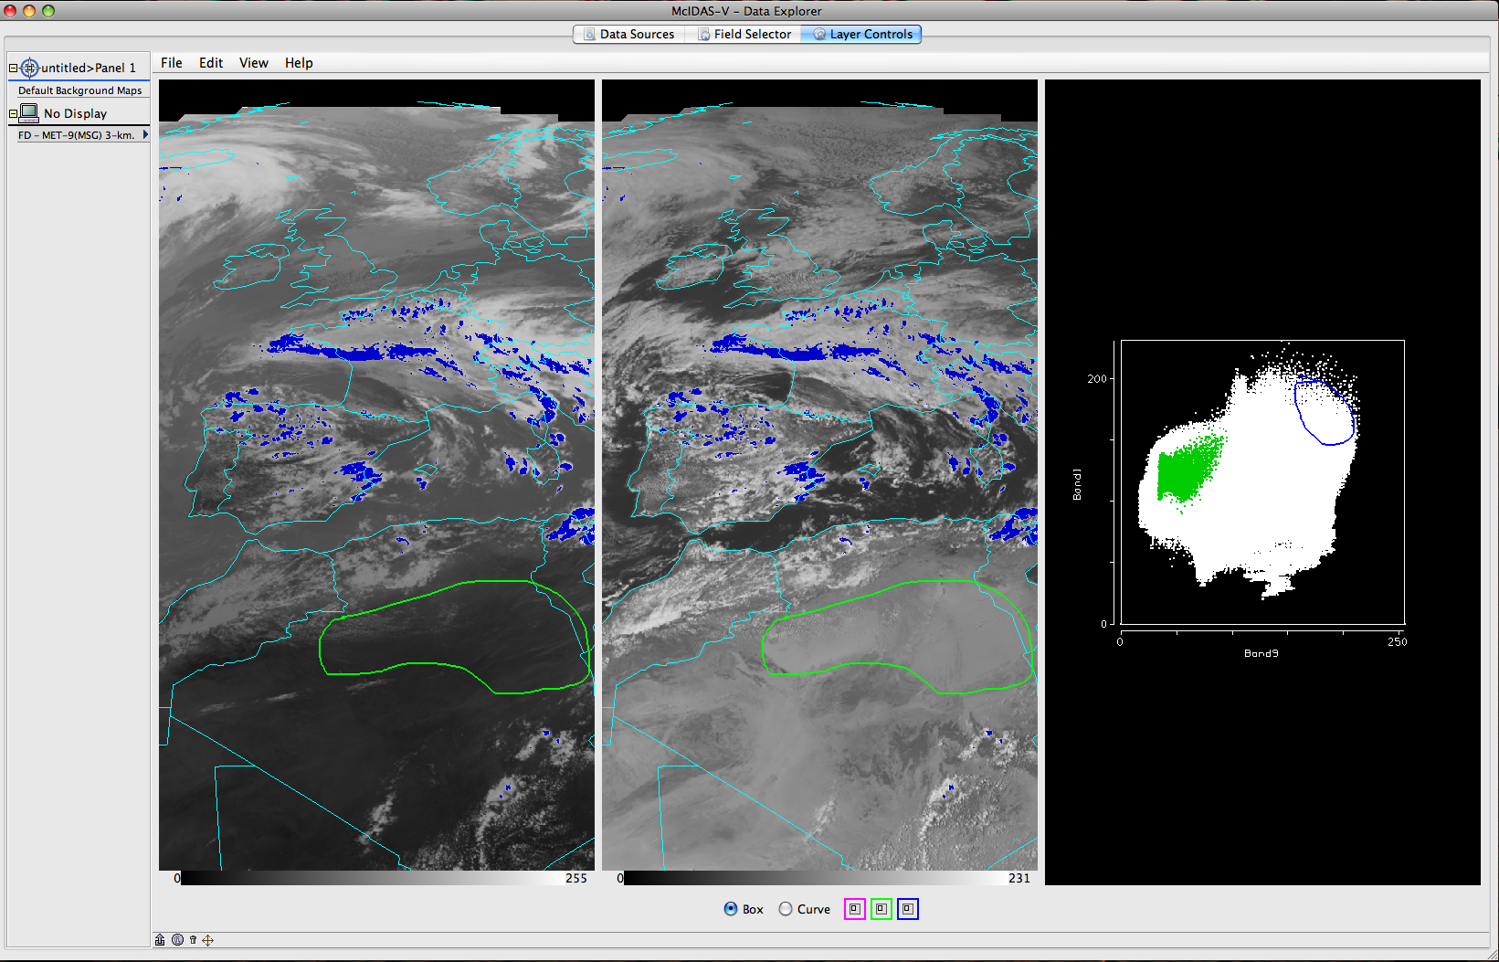
McIDAS-V Software Status: HYDRA
HYDRA: HYperspectral viewer for Development of Research Applications
Multi- and hyper-spectral data viewer and analysis package
Not yet fully integrated with McIDAS-V
Does not work with all data types
User Interface is different

Slide 24
McIDAS-V Software Status
New User Interface built on VisAD and IDV
The top-level McIDAS-V software and interface is maintained by the MUG programmers and others.
A new scripting capability was developed, replacing that in IDV
Current version: 1.3

Slide 25
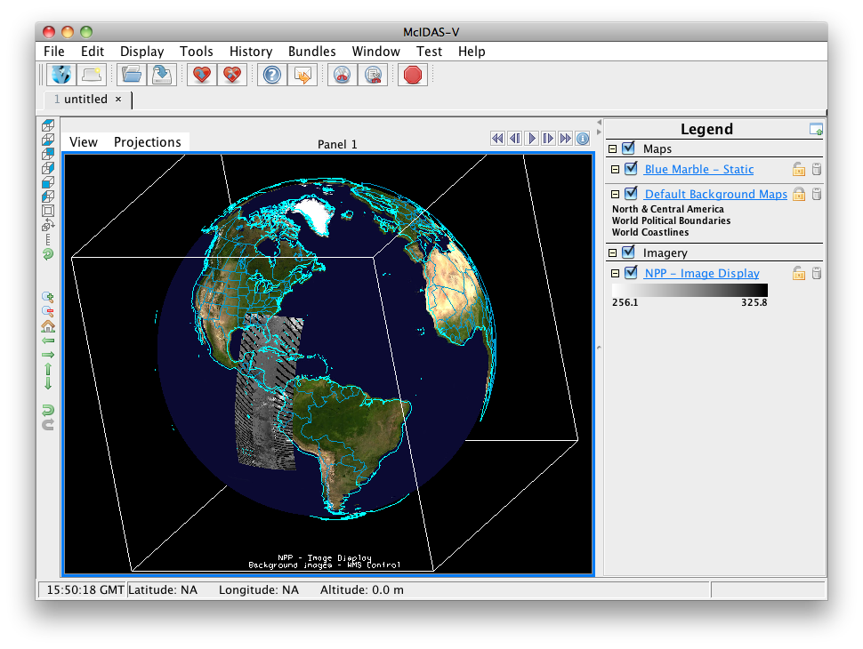
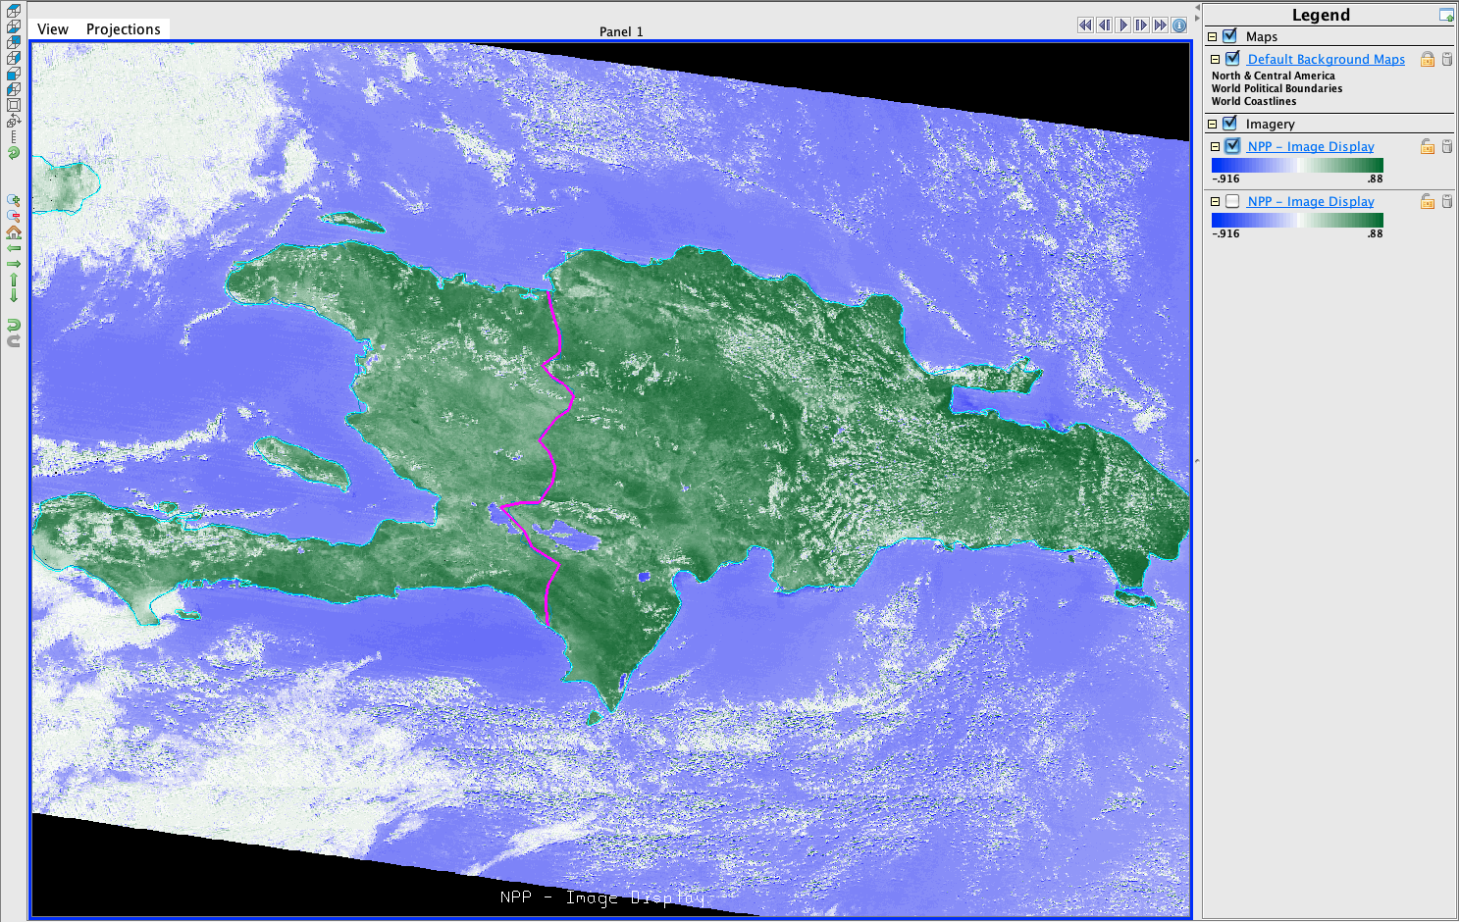
McIDAS-V Suomi NPP VIIRS

Slide 26
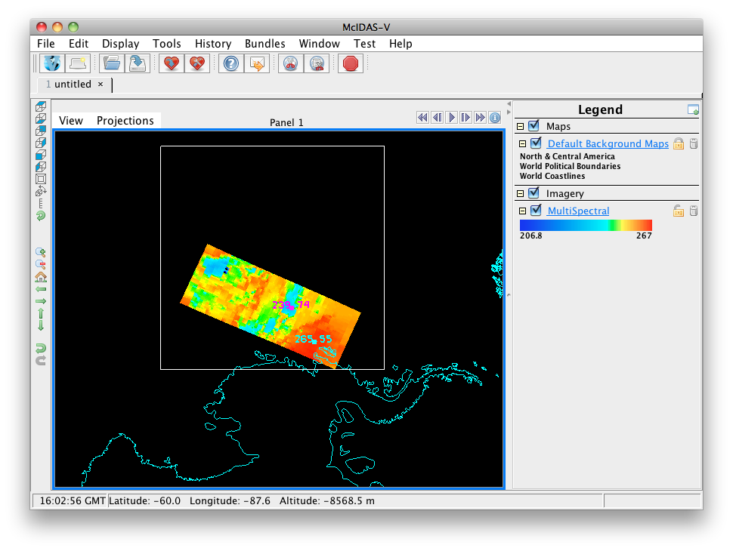
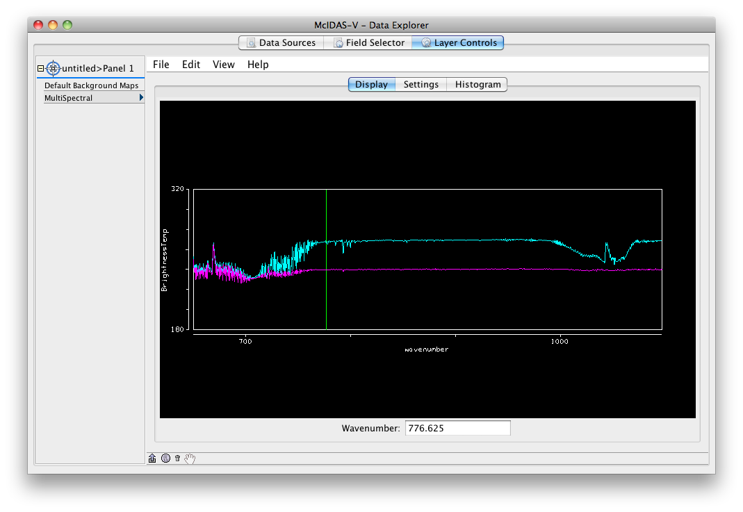
McIDAS-V Suomi NPP CrIS

Slide 27
McIDAS-V Future
Continue to engage younger generation:
Workshops and training
Classroom
Appeal to researchers:
More data fusion
Move beyond 2D world
Address technical and programmatic issues through a review process:
Engage additional SSEC developers and researchers
Evaluate current state and map a plan for future

Slide 28
McIDAS-V Review
Technical
Identify current technical issues
Anticipate future issues
Plan a technical direction
Programmatic
Coordinate internal funding sources
Mechanism for McIDAS-V infrastructure improvements

