Slide 1
Utilizing Python as a scripting language for the McIDAS-V visualization package
Mike Hiley
(and the McIDAS-V Team)
SSEC/CIMSS, University of Wisconsin-Madison
2013 McIDAS User’s Group Meeting
September 10, 2013
Madison, WI
Notes:
Introduction of myself … new to McIDAS-V team in January 2012, focused primarily on scripting, have also used McIDAS-V heavily as a teaching tool (TA, workshops). Background is atmospheric science

Slide 2
Quick Overview of McIDAS-V
Free, open-source 3D visualization package under active development at SSEC/CIMSS
Focused on meteorological data, but not limited to it
User support provided by the McIDAS User Group (MUG) – anyone can create an account on the forum and get help!
Java-based architecture; easy to install on Windows/OSX/Linux
Based on several components (details coming)

Slide 3
McIDAS-V Supported Data
Many supported data types:
Point data
Numerical weather model output in various formats (GRIB2, netCDF, GEMPAK, and more)
Satellite imagery, including hyperspectral via HYDRA
Radar (especially NEXRAD)
netCDF files that conform to CF conventions
Remote data access via ADDE, THREDDS
Lots more

Slide 4
McIDAS-V Functionality
Data choosers let the user put any combination of these data into a display, then manipulate the display interactively
Display is fully three-dimensional – especially useful for conventional radar as well as cross sections from e.g., CloudSat and CALIPSO
Notes:
i.e. instruments a 3rd dimension is the most natural way to view the data. Example coming.

Slide 5
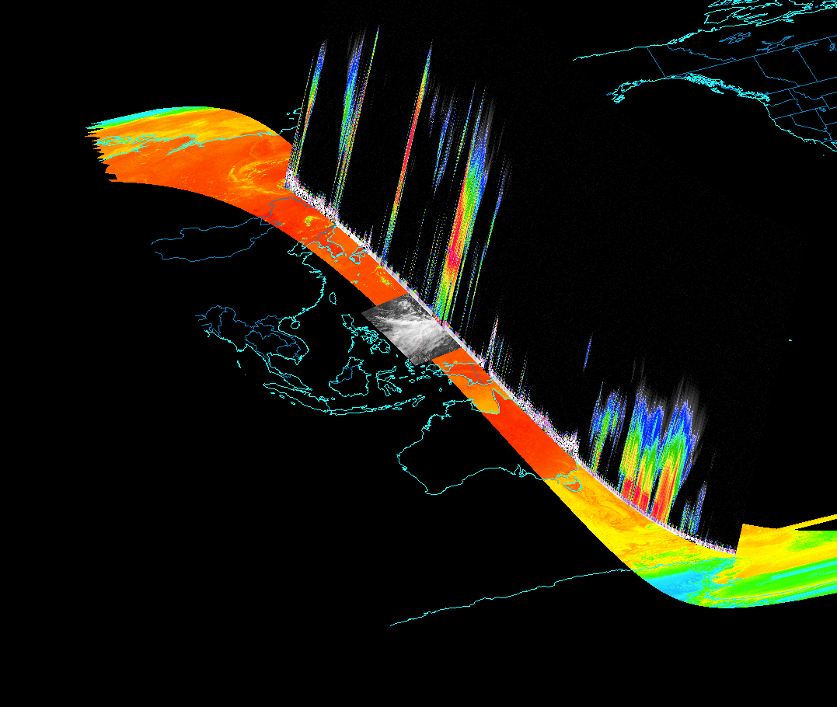
Example Image produced by McIDAS-V: putting the A-train in a single display!
CloudSat vertically pointing cloud radar
89GHz vertically polarized brightness temperatures from AMSR-E
0.65 um reflectance from MODIS
Thanks to Prof. Ralf Bennartz (Vanderbilt/SSEC) for help producing this image
Notes:
Careful to mention orientation of image; not clear what you are looking at especially if not familiar with CloudSat. Explain map outlines, mention Top-down geometry of cloudsat.
Make some mention of educational labs I’ve worked on.
Diverse A-train sensors all in one display.

Slide 6
Quick History of McIDAS-V
“Fifth-generation McIDAS” – the successor to McIDAS-X (though codebase is almost completely unrelated)
Based on several components:
VisAD: Java component library for visualization of virtually any numerical dataset, developed at SSEC
Integrated Data Viewer (IDV): Extension of VisAD providing support for meteorological data sources and adding a GUI interface, developed at Unidata
HYperspectral-viewer for Development of Research Applications (HYDRA): Extension of VisAD focused on visualization of hyperspectral satellite data, developed at SSEC
Notes:
Main point: what we call “McIDAS-V” is primarily a combination of several Java-based components/libraries. It is a CONGOLOMERATION of code that has been developed by many different people at different institutions, with different ideas about code design, application functionality, etc. This was and still is intimidating for me as a relatively new developer.

Slide 7
In a nutshell, McIDAS-V is an extension of the IDV and VisAD that incorporates HYDRA and adds other features like Suomi NPP support, a dedicated support team, and…
A new Jython scripting API !
Under active development at SSEC
McIDAS-V previously had some scripting capabilities, but:
limited functionality
“Un-Pythonic”
New API is designed from ground up to ease automation of common workflows in McIDAS-V via a user friendly and well documented API.
Notes:
Traditionally, IDV/McIDAS-V have had some limited scripting capabilities but users have had to deal with limited documentation and functionality.
“Un-Pythonic”… arguments were often long strings with confusing non-Python syntax, generally not object oriented… really just a wrapper around the XML-based “IDV Scripting Language”

Slide 8
Current status of scripting API
McIDAS-V version 1.2, released in April 2012, included the first version of this new scripting functionality.
So far we have focused primarily on access to satellite imagery via ADDE
Extensive tutorials and documentation available on McIDAS-V website
Scripting framework continues to be heavily developed. 1.3 and 1.4 releases include some new functionality:
listADDEImages (find out what is on the server without downloading images)
Jython Shell improvements (keyboard shortcuts, easier to run scripts that are on disk)
Numerous stability improvements

Slide 9
McIDAS-V scripting overview
Users write scripts in the Python programming language
Python scripts are interpreted in the Java-based McIDAS-V system via Jython, an implementation of the Python programming language in Java
In addition to our new API, advanced users can call any piece of Java code in the McV/IDV/VisAD library. (Without having to actually write Java code).
Notes:
McV/IDV/VisAD includes a huge number of utilities for grid interpolation, quantitative analysis, etc.
Lack of Java.. Scientists don’t want to learn multiple programming languages

Slide 10
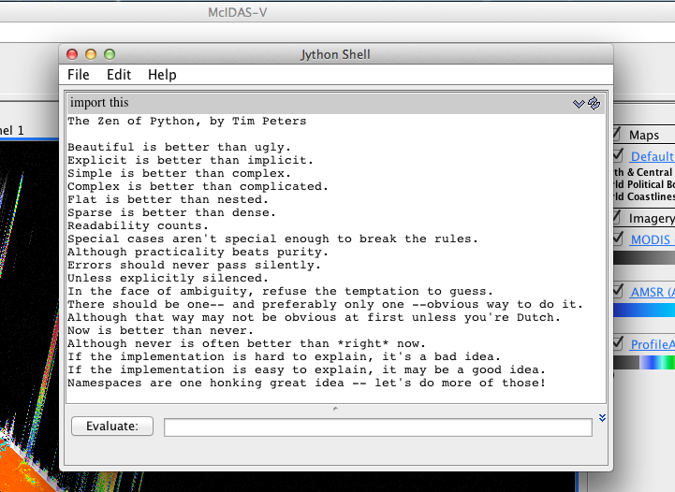
Users can run scripts in two modes:
Interactively: in a normal session of McIDAS-V by typing commands in the “Jython Shell”
In the “background”: from a terminal session. McIDAS-V boots, runs a script, and closes
Interactive mode

Slide 11
Simple example script
Use the “getADDEImage” function* to get some satellite imagery.
Put the data in a display.
Add a descriptive label using metadata from ADDE.
Change the map projection.
Write out the image as a PNG.
*(ADDE: Abstract Data Distribution Environment. Used heavily in McIDAS-X world. Main advantage: can get exactly the part of an image you need, nothing more.)
Notes:
Think of ADDE like HTTP for meteorological data, especially satellite imagery

Slide 12
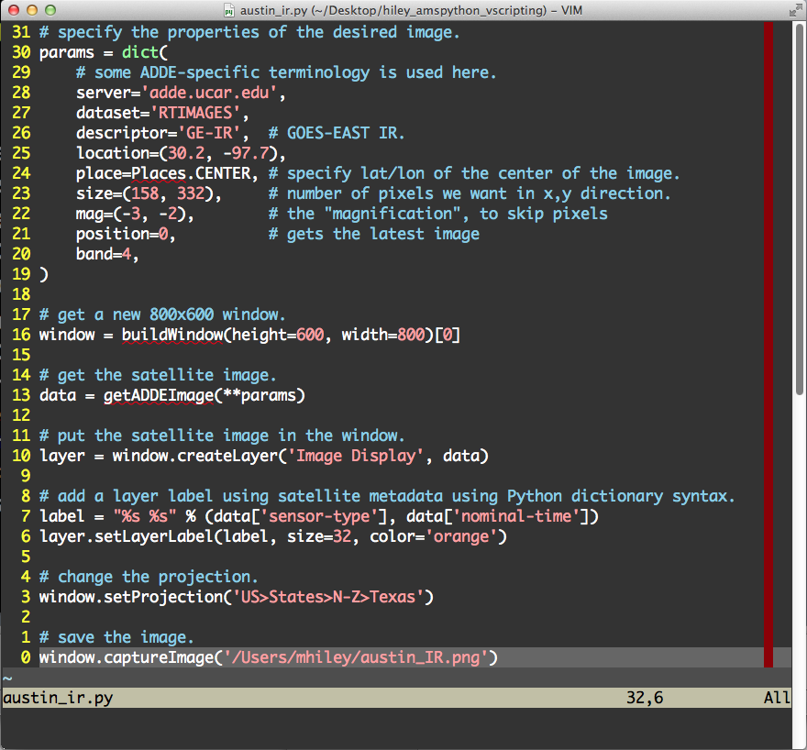
Example
script.
Notes:
Paste a vim screenshot here. Note that arbitrary strings are derived from existing GUI labels. Come back and note where the data, layer, display classes come into play. PNG automatically recognized.

Slide 13
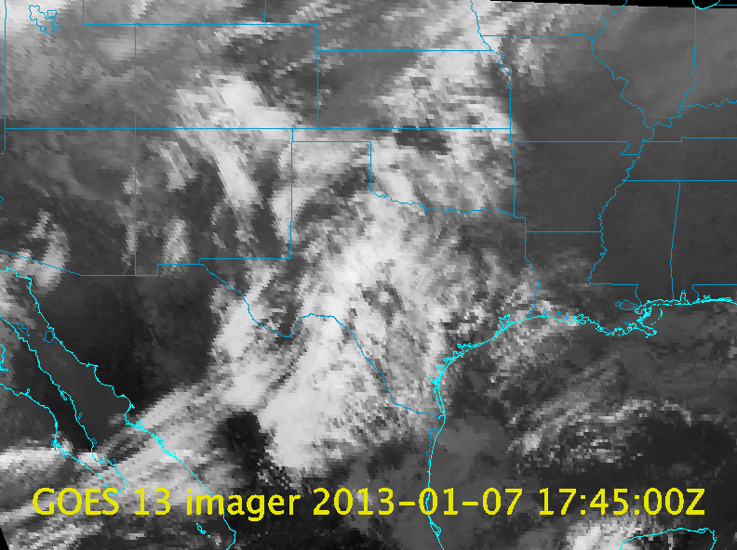
Notes:
Note Texas projection, layer label, low image resolution (on purpose)

Slide 14
API Design - principles
Functions and methods should be named well so they have a predictable result
Anywhere an arbitrary string is required - for example when specifying display type (image, contour, streamlines, etc.) – the user should be able to use the same strings found in the GUI labels
Pythonic syntax wherever feasible
Notes:
“A predictable result”… may seem obvious, but harder than it sounds, hasn’t been the case in previous scripting functionality in McV

Slide 15
API design – key classes
_Data: a piece of data, e.g. u and v model winds
Key metadata can be accessed via Python dictionary syntax
Can perform statistical analysis, do arithmetic operations, etc.
_Layer: A piece of data that has been displayed (e.g. a streamline display of the model winds)
Can change some key layer properties like enhancement table
_Window: A combination of multiple layers, e.g. wind streamlines plotted on top of a satellite image
Some key per-display properties you can set:
Display size
Lat/lon center point of image
Map projection
Can add text annotations and write image to disk
Notes:
Metadata: date/time, model name, satellite name, band, etc.
We wrap existing IDV behavior into these classes to make their behavior consistent in a scripting environment, and make the syntax friendly to the end-user

Slide 16
Example
script.
Notes:
Paste a vim screenshot here. Note that arbitrary strings are derived from existing GUI labels. Come back and note where the data, layer, display classes come into play. PNG automatically recognized.

Slide 17
Challenges – Implementation of new scripting API
The foundation of the McIDAS-V codebase, the IDV, was built primarily as a GUI-based system. For us developers, providing scripting-based access to IDV features can be challenging.
But – this is precisely why our work is important – to shield end users from these complications!
Notes:
GUI-based system… often GUI functionality intermingled with unrelated code

Slide 18
Challenges – Jython limitations
Current “final” release is only Jython 2.5.3; Jython 2.7 is under development and it is unclear if we will see a Jython 3. (Current stable CPython is version 3.3).
No NumPy!
Jython code significantly slower than native Java code.
Notes:
Expand on implications of no NumPy…

Slide 19
Challenges – facilitating data analysis
In McIDAS-V, all data is internally represented using the “VisAD Data Model”: a generic way of representing virtually any scientific dataset
We want scientists to do data analysis and algorithm development in McIDAS-V, but that means scientists need to learn this “VisAD Data Model”, which can be seen as a pro or a con:
PRO: VisAD provides a powerful way to manipulate/analyze a huge variety of data types in a uniform way.
CON: The VisAD learning curve can be steep (VisAD lingo can seem strange to scientists coming from a MATLAB/IDL world)
Part of our work will be to fill the gap between VisAD and traditional science code however we can… solid documentation, helper functions, boilerplate scripts, user forum support
Notes:
Skip to following slide showing VisAD simple case for satellite image… simple case not bad, but sometimes lingo takes getting used to.

Slide 20
Simple example of VisAD Data Model – a single-banded satellite image time series
(Time -> ((Line, Element) -> Band4 Brightness Temperature))
Function B: maps pixel locations to actual brightness temperatures
Function A: Maps time to satellite images
“Function” A maps the “DomainSet” (time steps) to the “Range” (in this case, another “Function” representing a single satellite image)
“Function” B maps the “DomainSet” (the Line/Element pixel locations) to a single “RangeComponent”: the actual brightness temperature values
Notes:
Similar diagrams could be drawn for any dataset you could imagine (eg non-physical dimensions like ensemble models)
Multi-banded image could just have additional RangeComponents
Flip back to previous slide when done

Slide 21
Conclusion
New McIDAS-V scripting API promises to provide consistent access to a wide variety of meteorological data sources using the Python programming language.
First edition of this scripting framework was introduced in version 1.2, and heavy development has continued since, and will continue for the foreseeable future.
McIDAS-V already has a wide variety of powerful tools available for both visualization and data analysis. Access to these tools via scripting will get better with every release.

Slide 22
Things you can do right now!!!
Install McIDAS-V; it’s easy and works on Windows/OSX/Linux; available for free at:
http://www.ssec.wisc.edu/mcidas/software/v/
Create an account on the McIDAS-V support forum to get help from the developers, support team, and other users!:
http://dcdbs.ssec.wisc.edu/mcidasv/forums/

Slide 23
Thanks for listening!
Acknowledgements:
McIDAS-V core “scripting team”
Becky Schaffer
Jonathan Beavers
Rick Kohrs
Bob Carp
The rest of the McIDAS team:
Tom Rink
Tom Whittaker
Tommy Jasmin
Dave Santek
Jay Heinzelman
Barry Roth
Users that keep pushing the boundaries of McV scripting:
Joleen Feltz
Hans-Peter Roesli (EUMETSAT)

