Slide 1
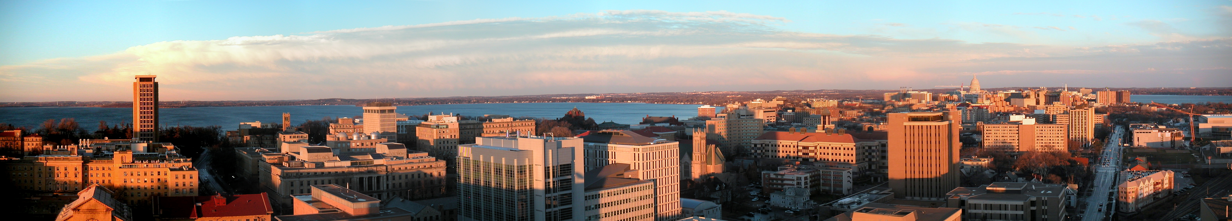


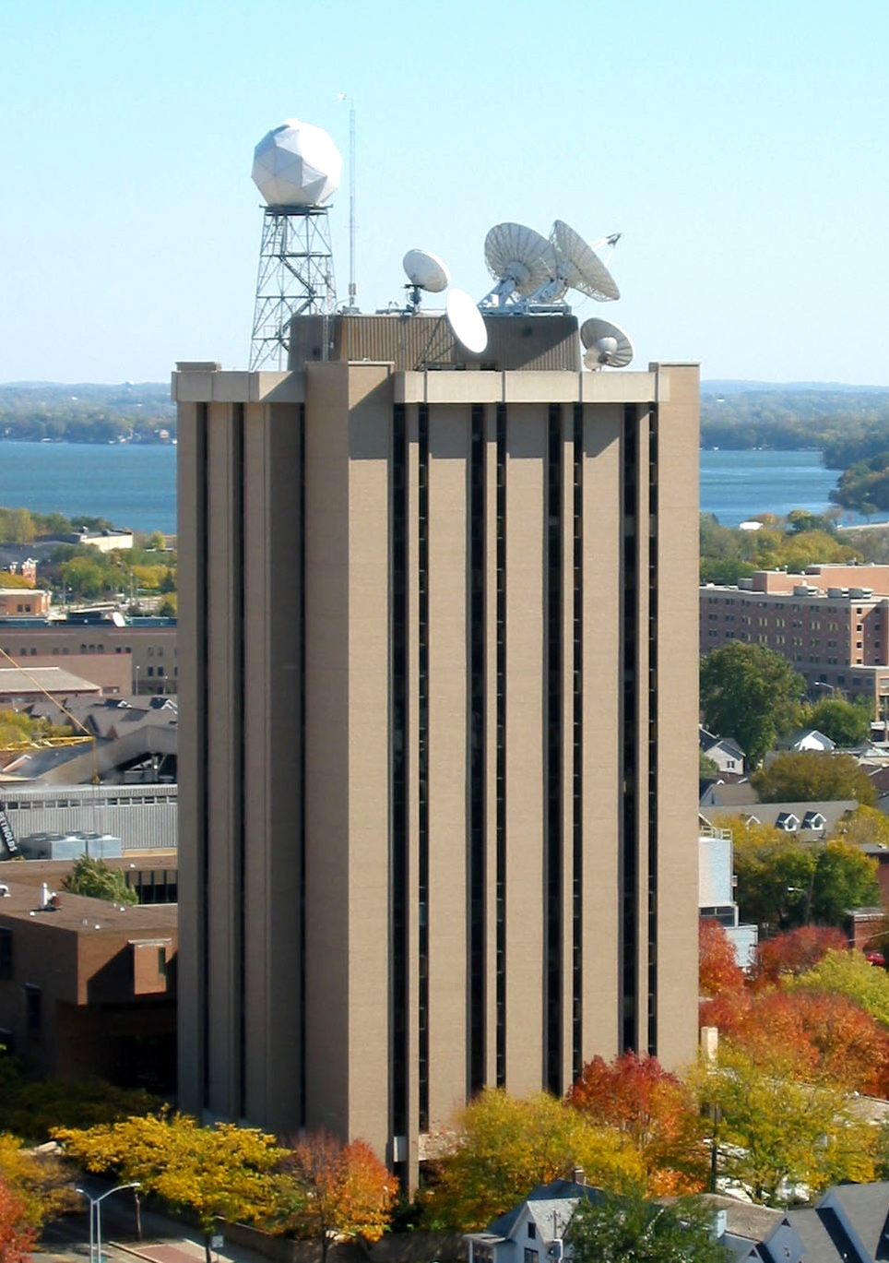
Executive Director – Science
Space Science and
Engineering Center (SSEC)
An Introduction UW-Madison SSEC/CIMSS Research and Facilities
Wayne Feltz
Associate Director
Cooperative Institute for Meteorological Satellite Studies (CIMSS)

Slide 2
CIMSS/SSEC/AOS/NOAA
ASPB
NCDC
Symbiotic relationship between CIMSS, SSEC, AOS, and NOAA/NESDIS

Slide 3
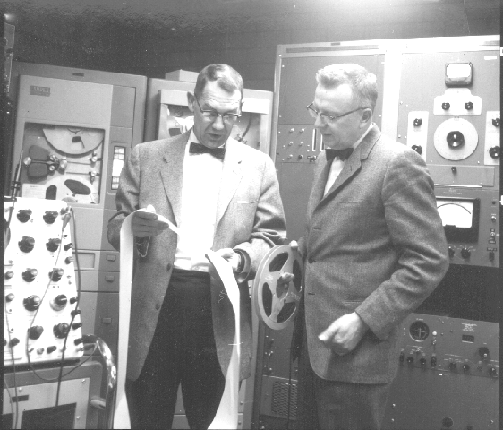
Verner E. Suomi (1915-1995)
“Father of Satellite Meteorology”
1959: 1st Meteorological
Satellite Experiment
  Earth Radiation Balance Observations on Explorer VII
  1966: 1st Earth Imaging
  from GEO
  Spin-scan Camera on 1st
  Advanced Technology Satellite (ATS 1)
with SSEC cofounder, Bob Parent (L)

Slide 4
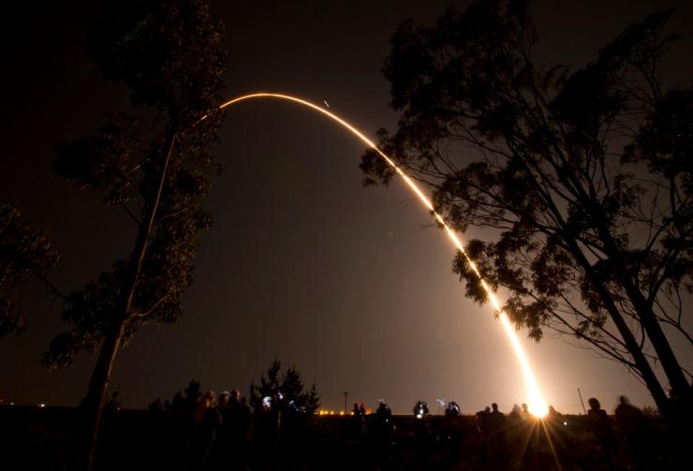
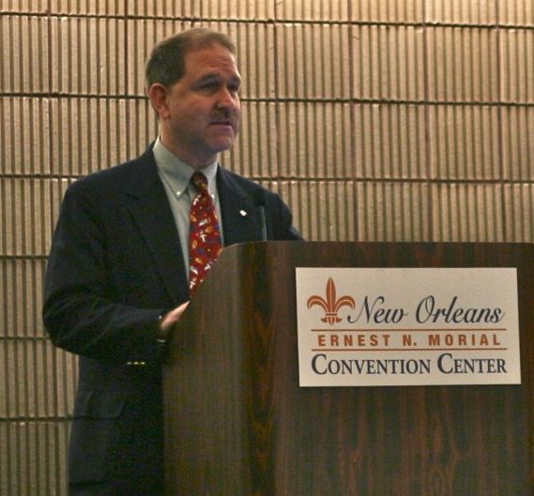
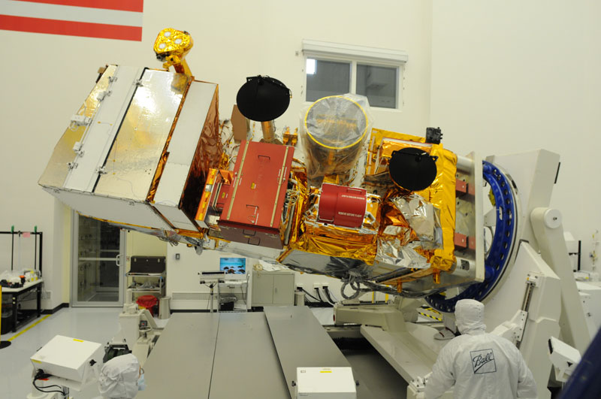
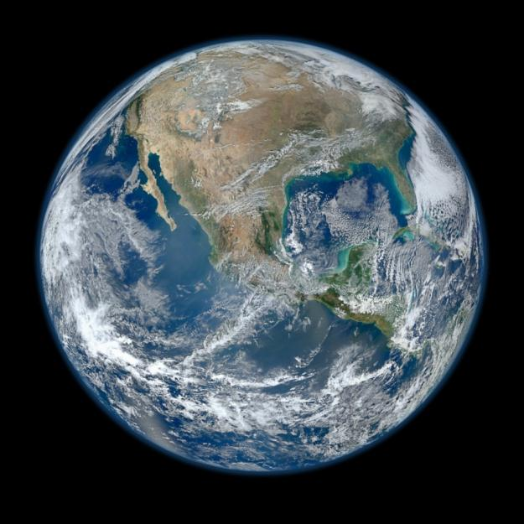
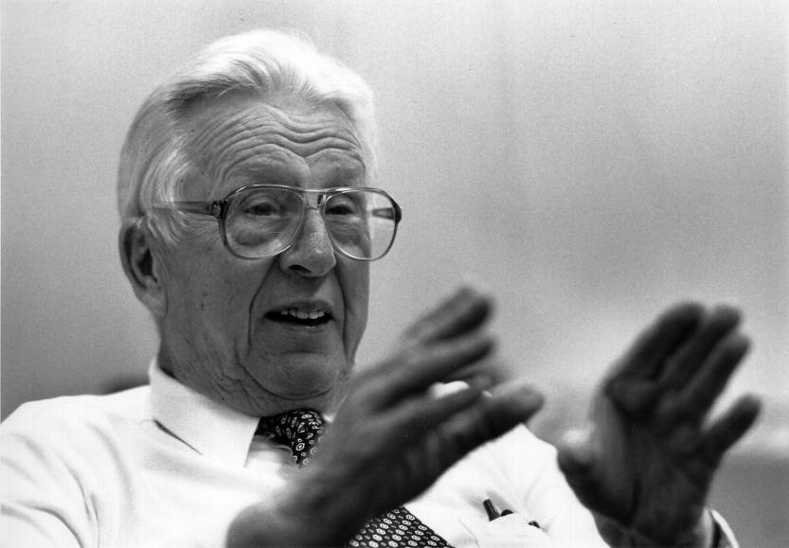
28 October 2011
“Suomi NPP!”
Announced at AMS
CERES
VIIRS
NASA’s Grunsfeld at AMS
CrIS
ATMS
OMPS
Verner E. Suomi
1915-1995
NPP VIIRS Image, GSFC
4

Slide 5
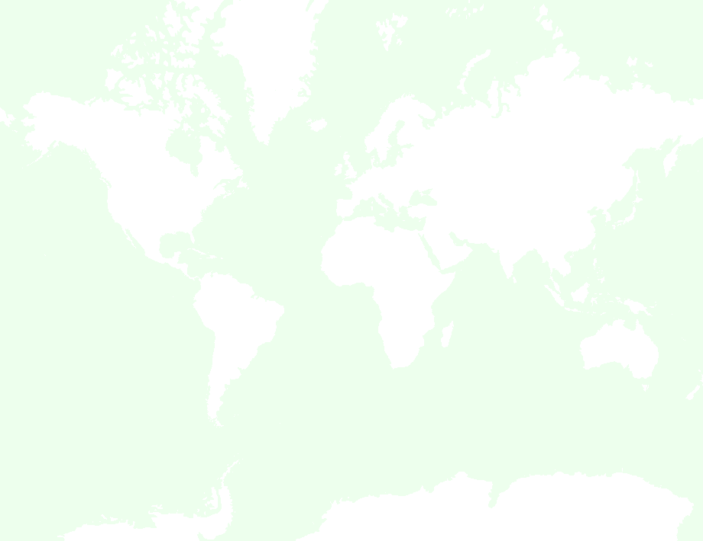
SSEC areas of technical expertise
Observational Science (spacecraft system/mission design, instrumentation, field programs, spaceflight instrument fabrication,
Computational & Visualization Science (hardware and software systems for information generation, data management, and communication)
Analytical Science & Applications (satellite & conventional data analysis, technical development & analysis)

Slide 6
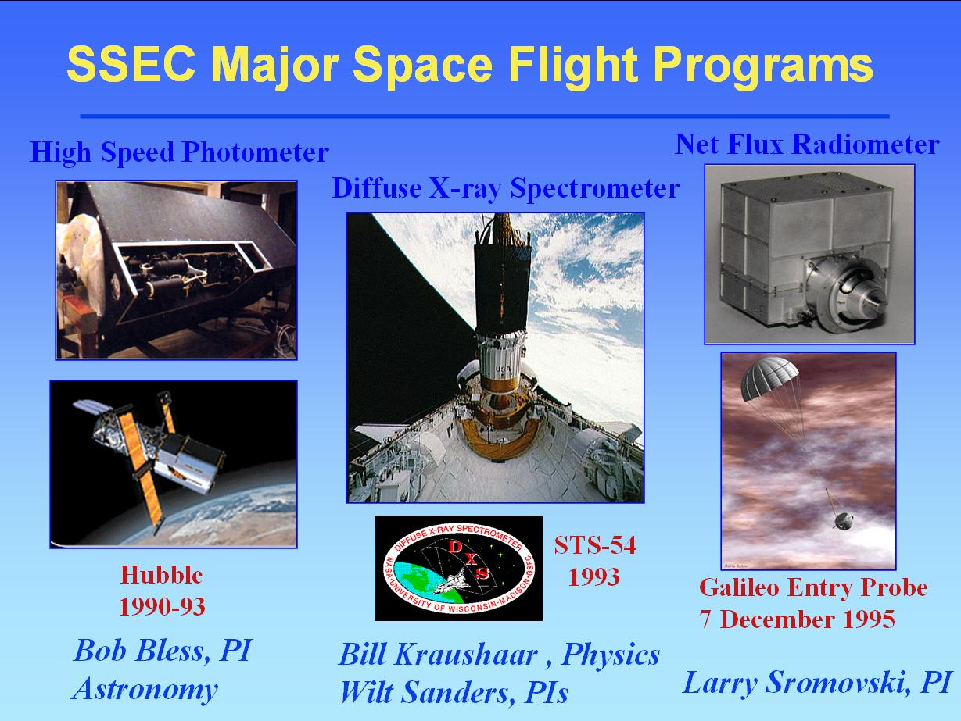

Slide 7
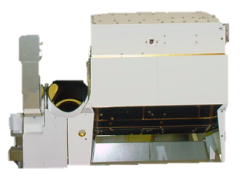
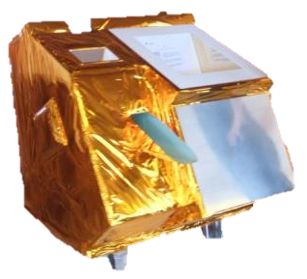
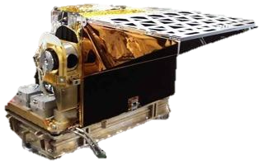
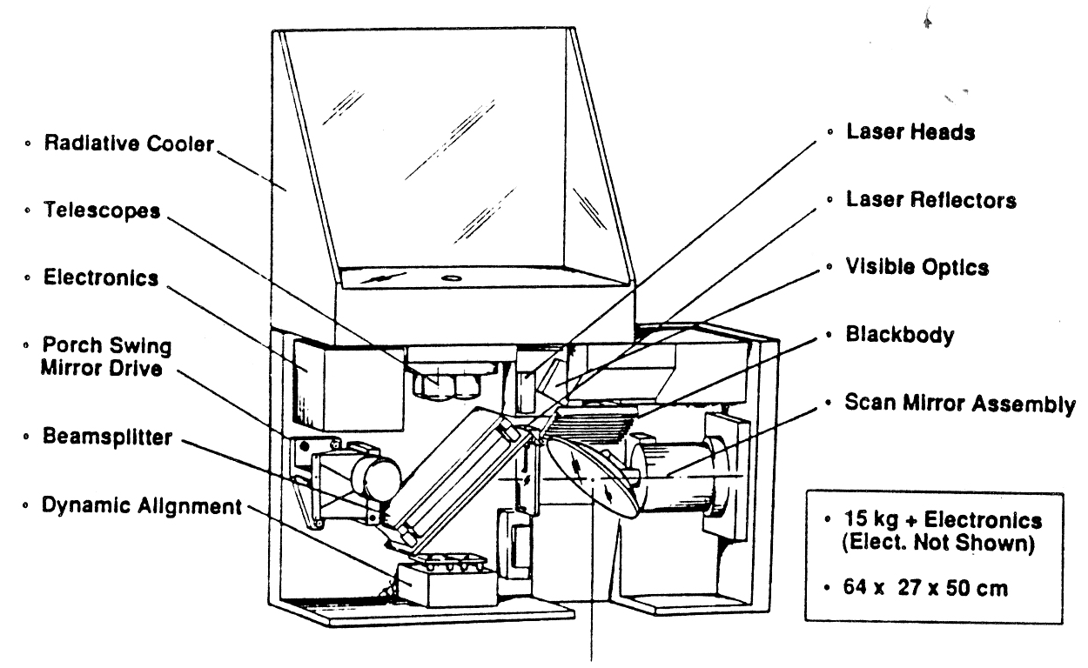
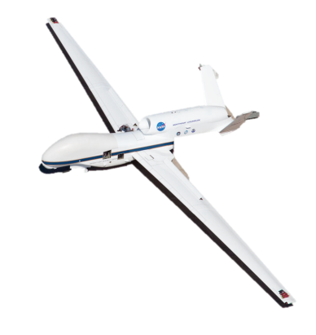
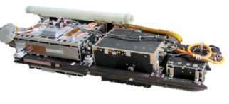
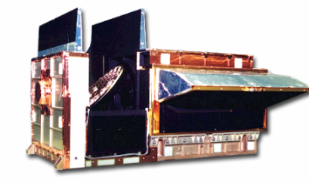
Cross-track IR Sounder
(CrIS) Heritage
2011-
CrIS
(2211 ch)
1330 Suomi-NPP
2006-
IASI
(8461 ch)
0930 METOP
2002-
AIRS
(2378 ch)
1330 Aqua
ITS
(~CrIS)
Design Study
1990/91
HIS,
S-HIS, NAST-I
1986-
It took a while!
HIRS
(20 ch)
1978-

Slide 8
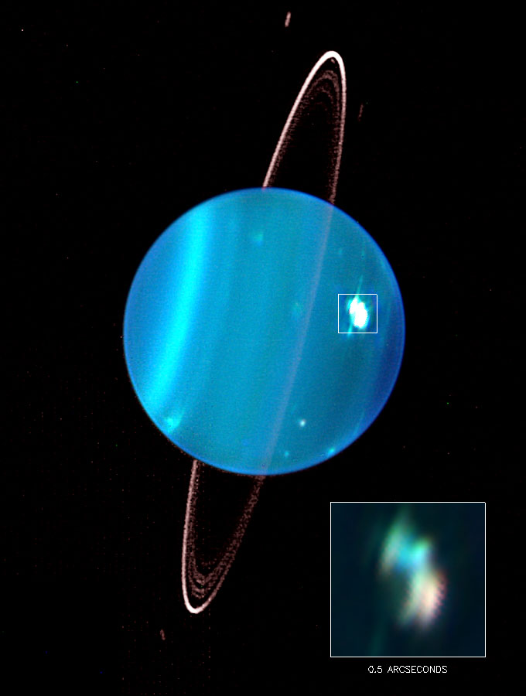
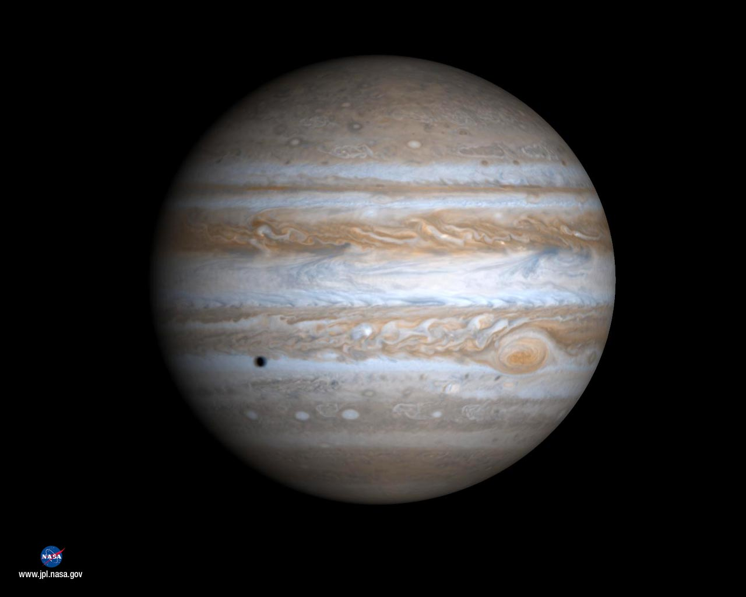
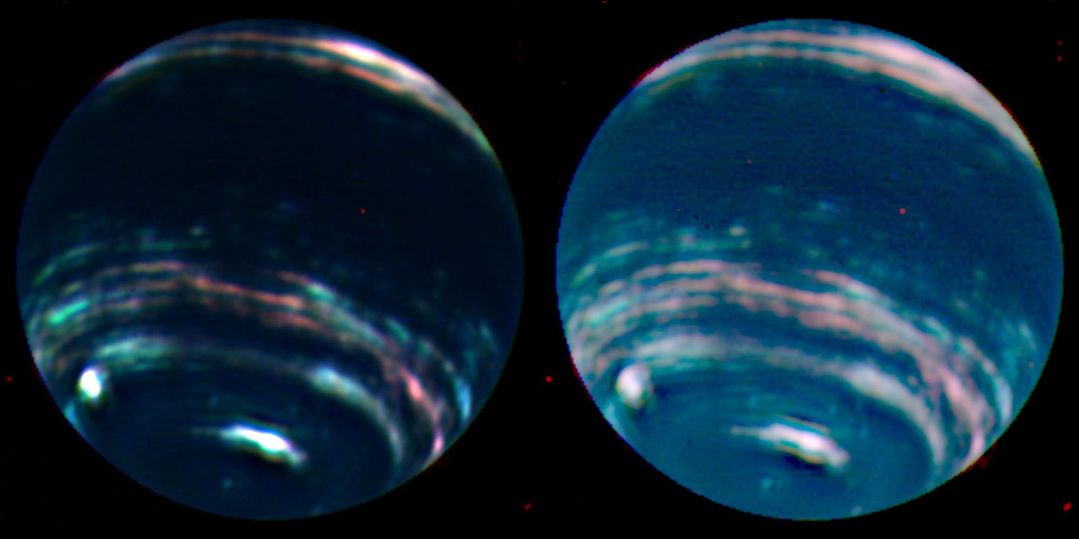
Research on Outer-Planet Atmospheres at SSEC
Science Team:
Larry Sromovsky and Pat Fry
Planets:
Jupiter, Neptune, Uranus
Research:
Atmospheric circulation
Seasonal response
Dynamics of circulation features
Vertical cloud structure and composition
Techniques:
Spectroscopy, Imaging, in situ observations, cloud tracking, radiation transfer modeling
Data Sources:
Hubble Space Telescope, Cassini, New Horizons
Ground based telescopes (Keck and IRTF).
Archived data from Voyager & Galileo missions.
8
Notes:
8

Slide 9
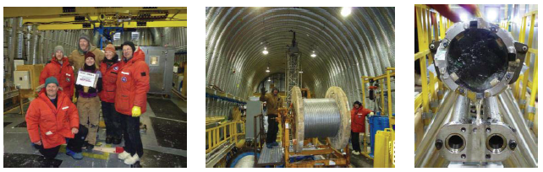
IDDO Ice Drilling & Operations
Charlie Bentley, Don Lebar, and their large, impressively talented team
WAIS Divide Ice Main Core Competed 12/31/11, Culmination of 10 yr effort
Excellent quality core over 3,405 m depth, even in technically challenging warm ice
1st high-resolution southern hemisphere record of greenhouse gases and climate comparable to the Greenland records
Will contribute significantly to improved understanding of climate variability over the last ~ 65,000 years
Drilling team Spooling on the new 4,200 m cable Ice core in DISC Drill
9
Notes:
This significant achievement was the culmination of over a decade of work including the design and construction of the DISC Drill by IDDO and its predecessor ICDS.

Slide 10
SSEC areas of technical expertise
Observational Science (spacecraft system/mission design, instrumentation, field programs, spaceflight instrument fabrication, including CAMPUS SCIENCE SUPPORT to
PHYSICS, ASTRONOMY, BOTANY, GEOLOGY)
Computational & Visualization Science (hardware and software systems for information generation, data management, and communication)
Analytical Science & Applications (satellite & conventional data analysis, technical development & analysis)

Slide 11
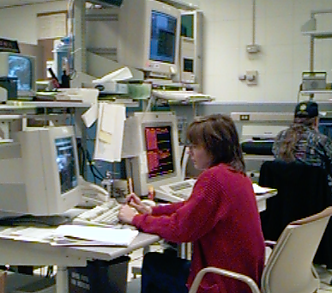
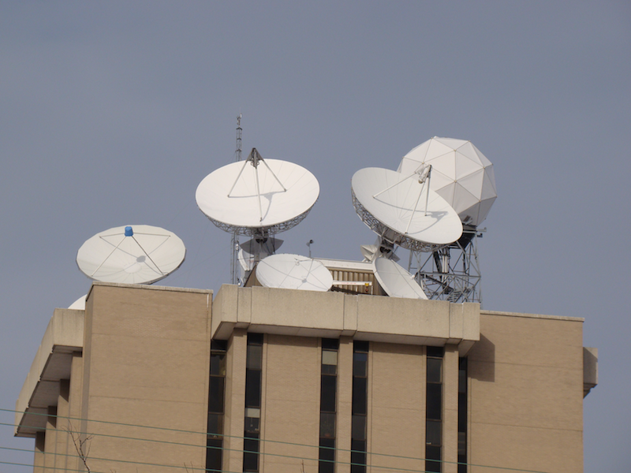
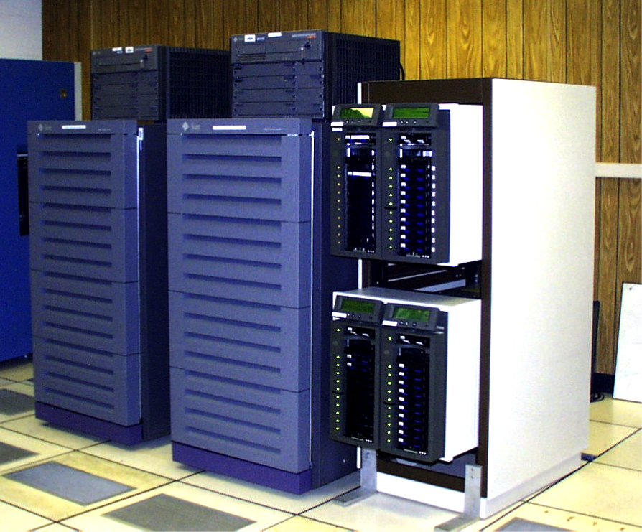
SSEC
Satellite / Meteorological Data Access
SSEC Data Center
Facilities
National GOES Archive
1978-2003
Now have >1 PB of raid storage for "online archive" of all GOES data, giving rapid access to ~ 30 years of satellite data!

Slide 12
SSEC Data Center - Activities
Assist Satellite Operations Control Center and other agencies in satellite checkout and troubleshooting of related problems
Support to field experiments
  Special archiving
  Extended staffing, either on-call or on-site
Provide large dataset backups for users
  Read, write, and copy tapes
  Provide specialized archives of user data
Provide Help Desk support to users of the SSEC SDI, and assist in the generation of SDI user documentation
Assist McIDAS User Services team with McIDAS testing for system upgrades
Provide archive data to in-house and external users

Slide 13
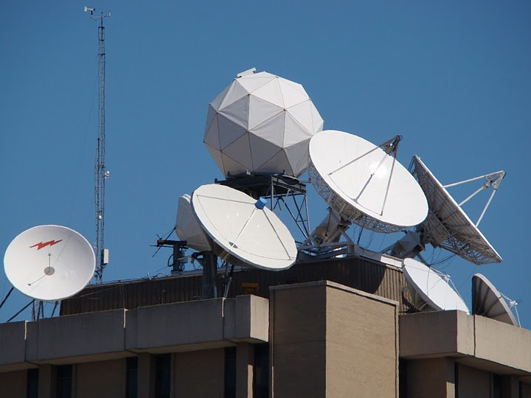
Data Center Antennas
C-Band
  11 meter heated (87° West – SES-2, POES Wallops Relay, MSG)
  7.3 meter (101° West – SES-1, POES Fairbanks Relay, MTSAT, Noaaport)
  6.3 meter heated backup (101° West – SES-1, POES Fairbanks Relay, MTSAT, Noaaport)
L-Band
  7.3 meter (75° West –GOES-East Primary)
  4.6 meter (135° West –GOES-West Primary)
  4.5 meter (60° West –GOES-SA auto tracking)
  4.5 meter (90° West –GOES-test/spare)
  3.7 meter (offline spare)
X-Band
  4.4 meter (Tracking – EOS)
X/L Band
  2.4 meter (Tracking – Suomi NPP, EOS, metop, FY1 and FY3)

Slide 14
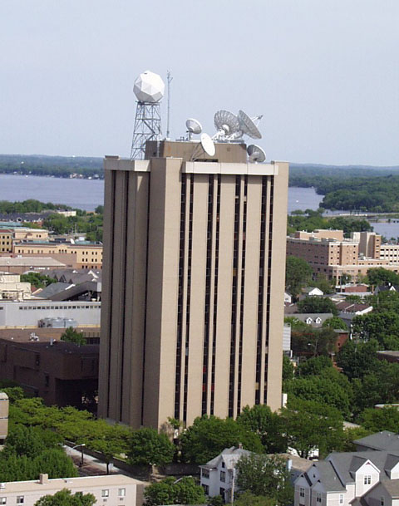
SSEC Data Center Incoming Data
170+ GB/day
via Satellite
(C-band. L-band, X-band)
GOES satellites ~96 GB/day
International Geo Satellites ~60 GB/day
NOAA Polar ~27 GB/day
Landsat-8 ~ 50 GB/day
Miscellaneous Polar and Non satellite ~85 GB/day
MODIS polar from NASA archive ~150 GB/day
NPP (VIIRS CrIS ATMS) ~1,800 GB/day
2,000+ GB/day
via Internet
(ftp, LDM, ADDE, http)

Slide 15
SSEC Data Center Outgoing Data
Four primary methods of Data delivery
ADDE
HTTP
FTP
LDM (Unidata local data manager)
HTTP
ADDE
LDM
FTP

Slide 16
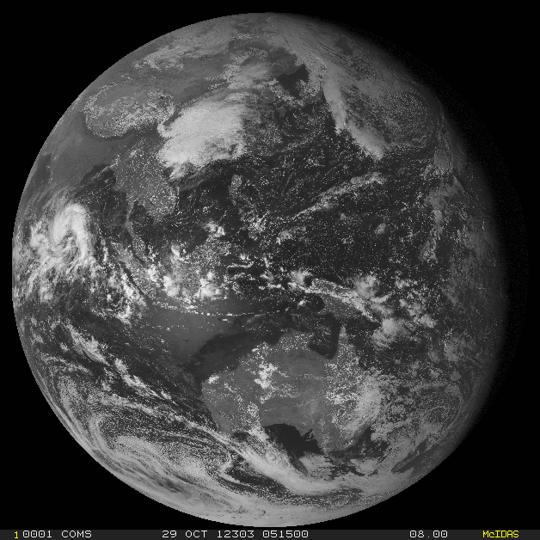
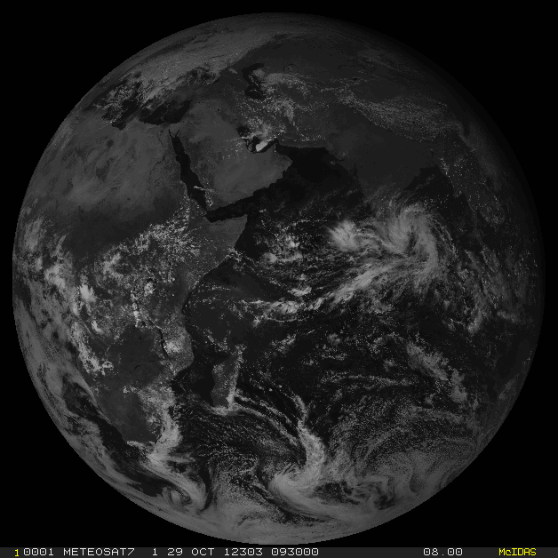
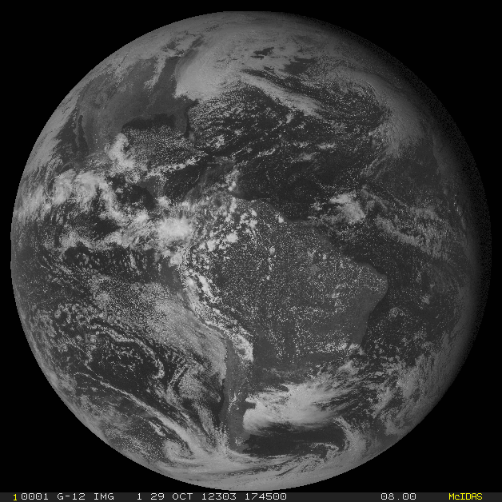
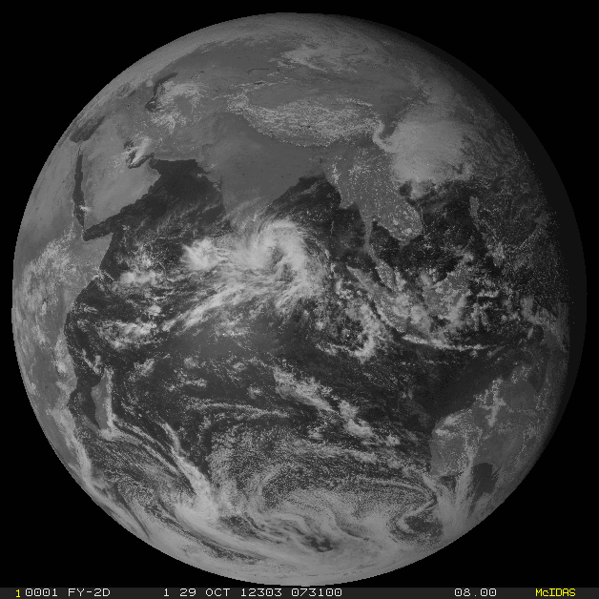
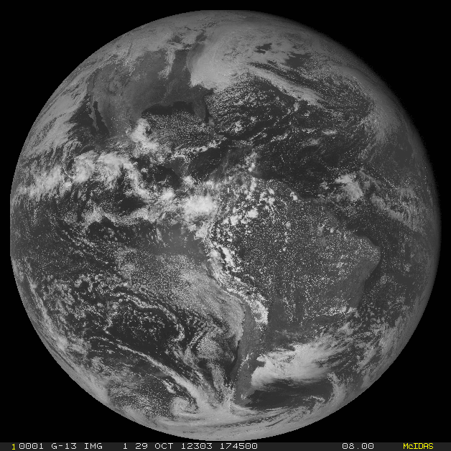
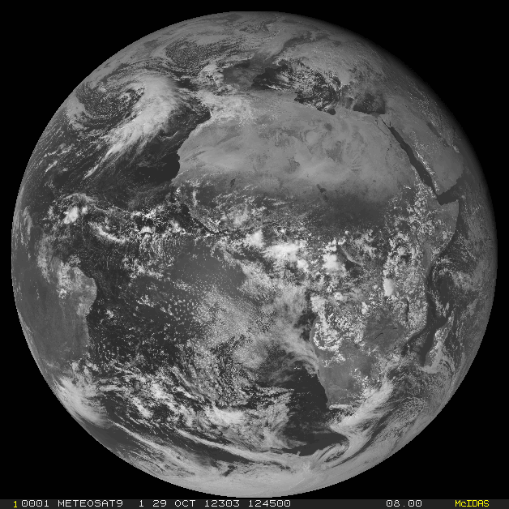
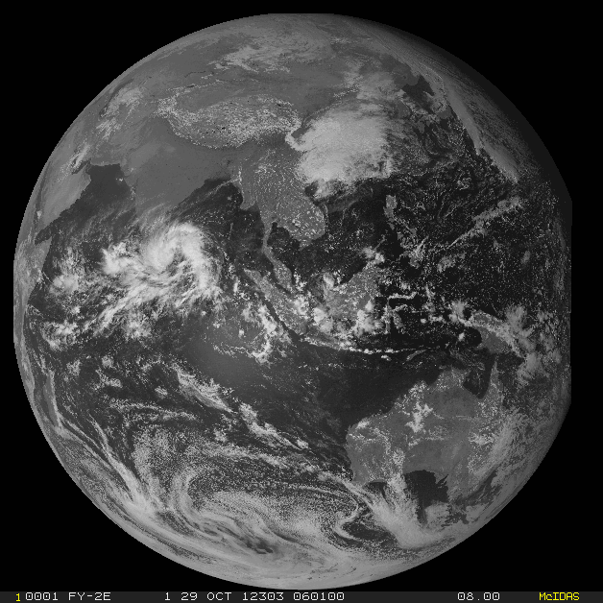
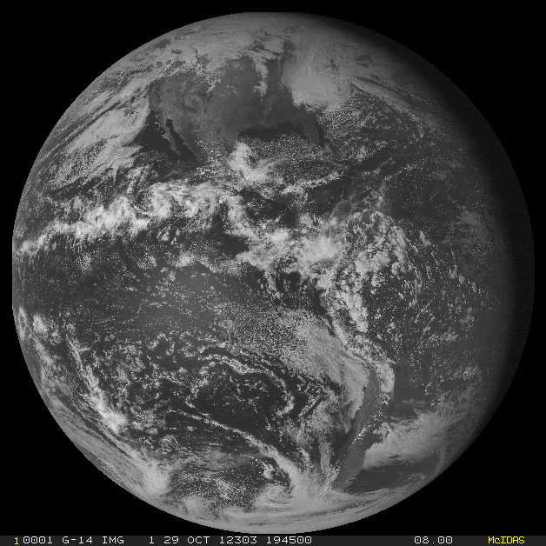
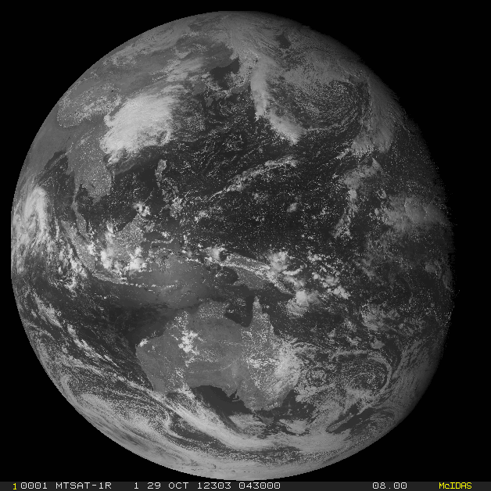
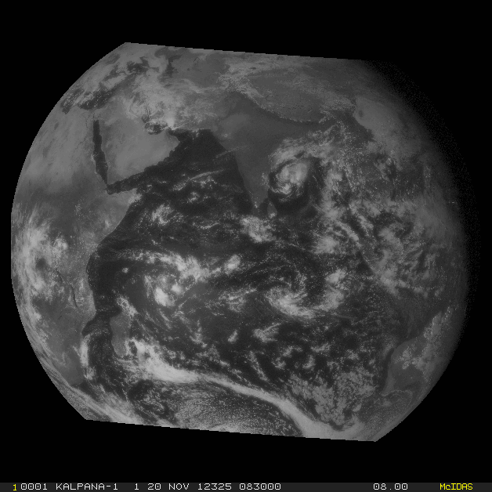
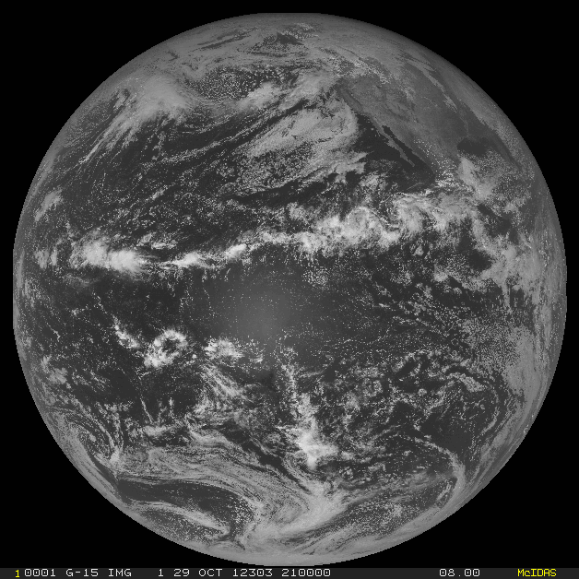
11 simultaneous GEO satellites!
A first: received, served ∼real time & archived
COMS
(S. Korea)
Meteosat-7
(Europe)
GOES-12
AFY2D
(China)
GOES-13
Meteosat-9
(Europe)
AFY2E
(China)
GOES-14
MTSAT-1R
(Japan)
Kalpana
(India)
GOES-15
Notes:
This was the first time that SSEC brought in Geostationary satellite data from 11 geostationary satellites simultaneously. All data was served in real-time or near realtime. All data was also archived.

Slide 17

Archive Data
As of March 2013, over 740 TBs online.
Grows approximately about 55 TB/year
US Geostationary Satellites
GOES-8 through GOES-15 (1994-Present) (East, West , South America and test)
GOES-1 through GOES-7 (1978-1996)
SMS-1&2 (1978-1981)

Slide 18

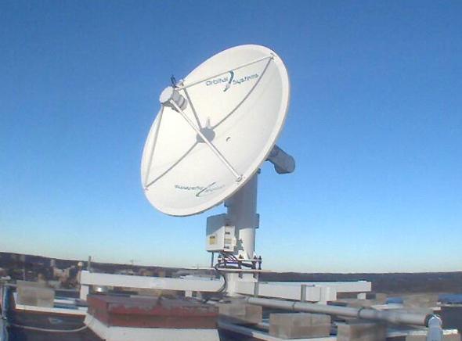
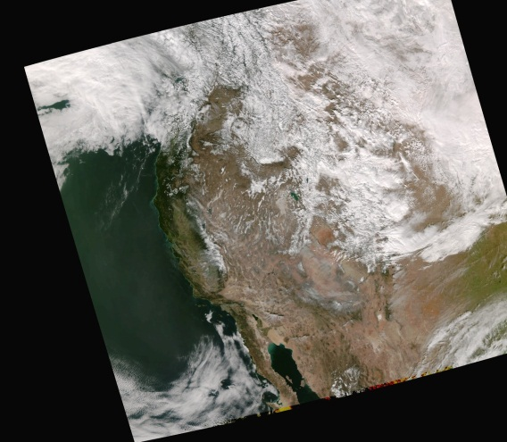
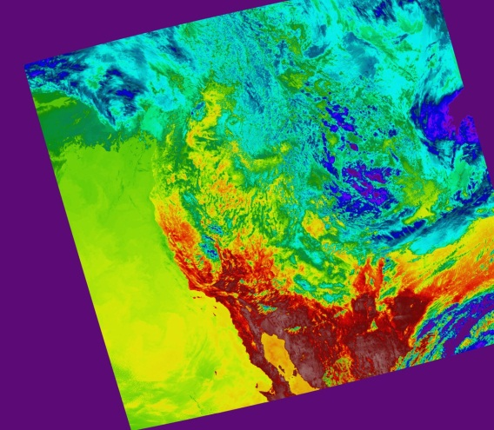
Community Satellite Processing Package offers World-wide Access
A software package for processing Suomi NPP, JPSS, POES, Metop, and FY-3 direct broadcast data.
Have released multiple versions of the VIIRS, CrIS, and ATMS SDR software.
CSPP is now used operationally by EUMETSAT, UK Met Office, MeteoFrance, and national agencies in Sweden, Norway, Mexico, South Africa, Australia, Japan, China, Russia…
SSEC DB Antenna
First Suomi NPP DB received data on 2012/02/23

Slide 19
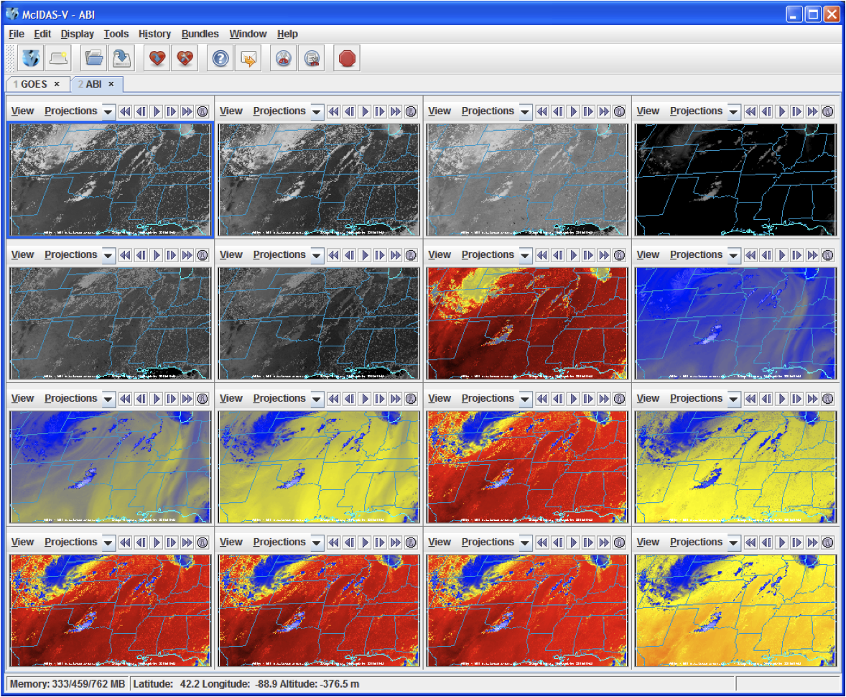
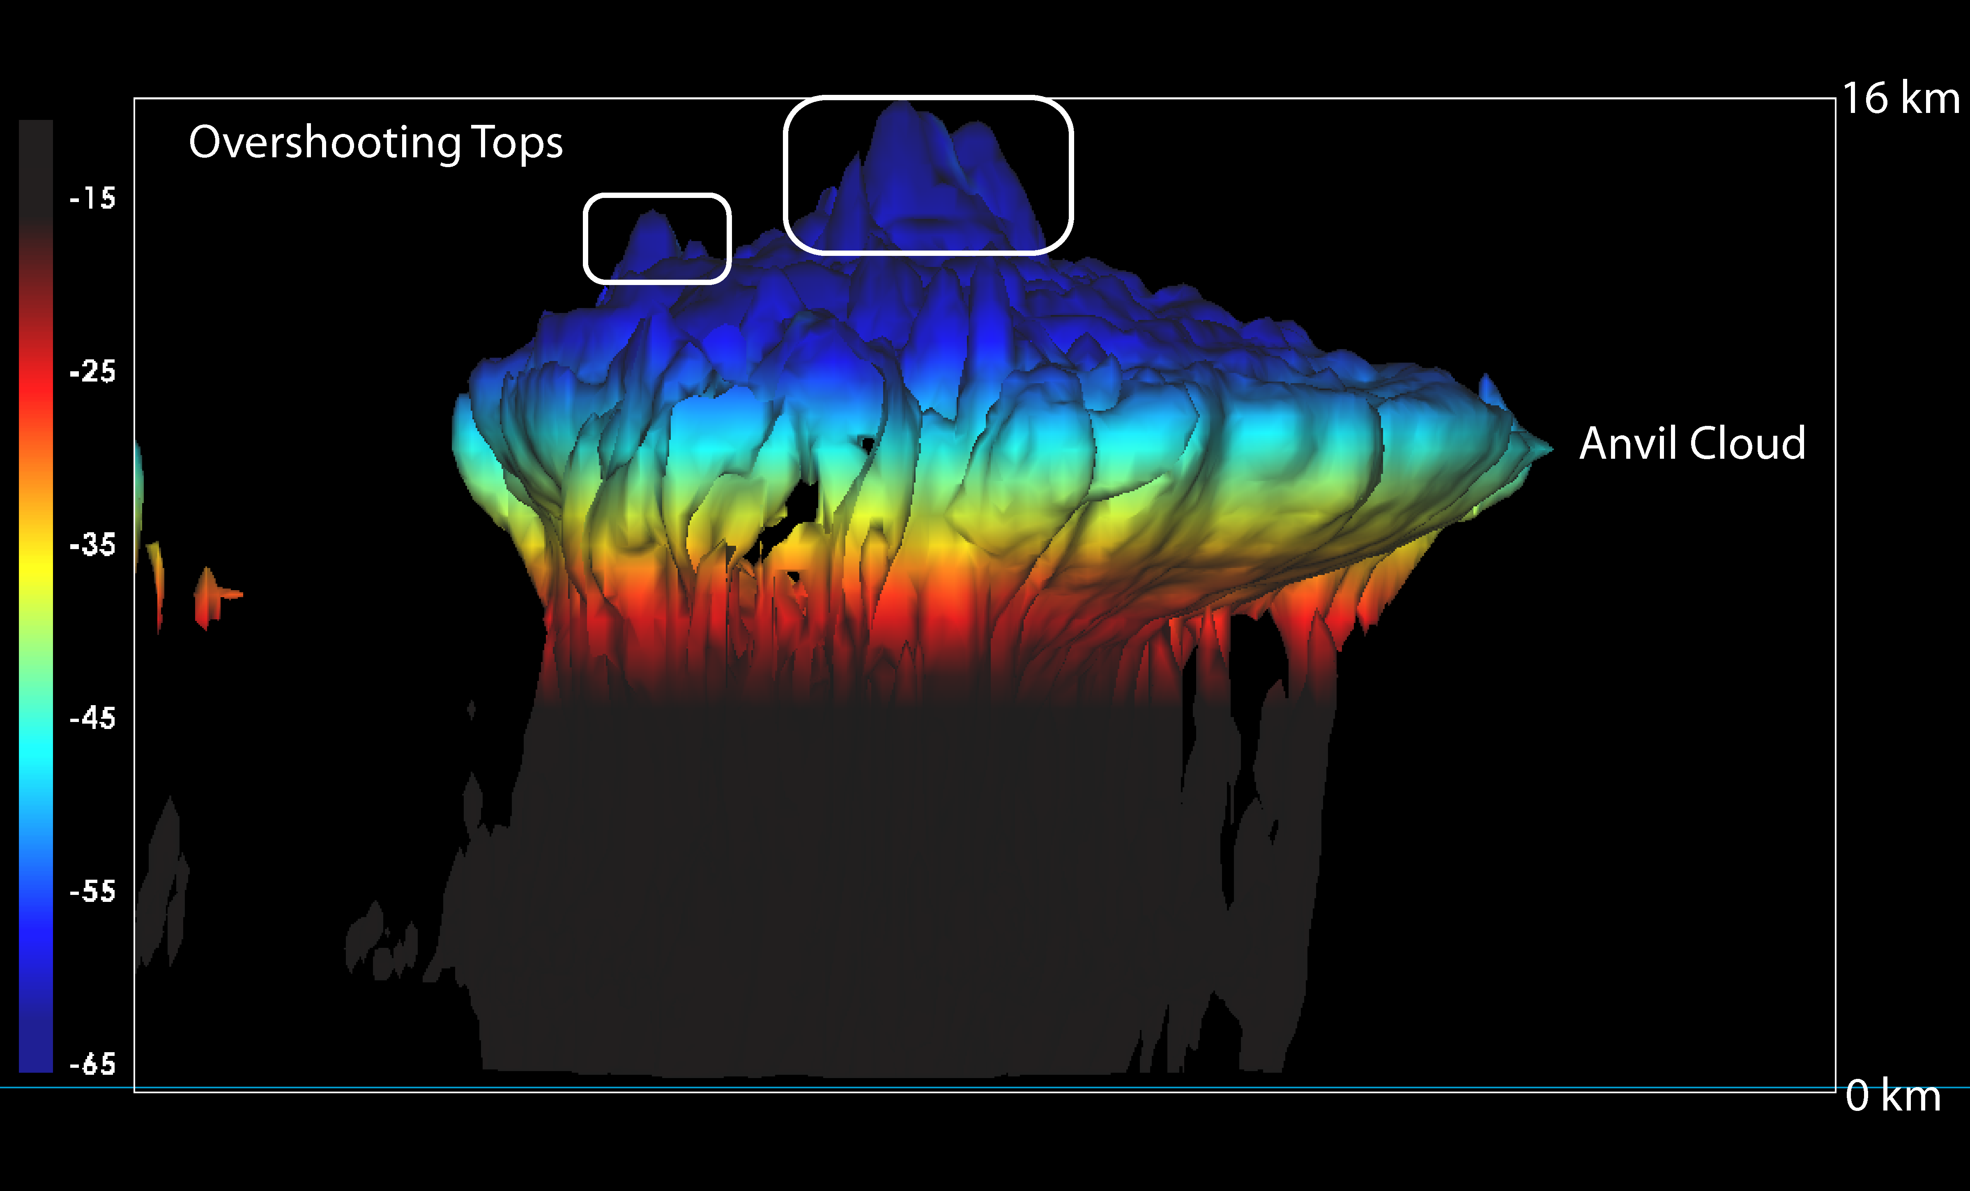

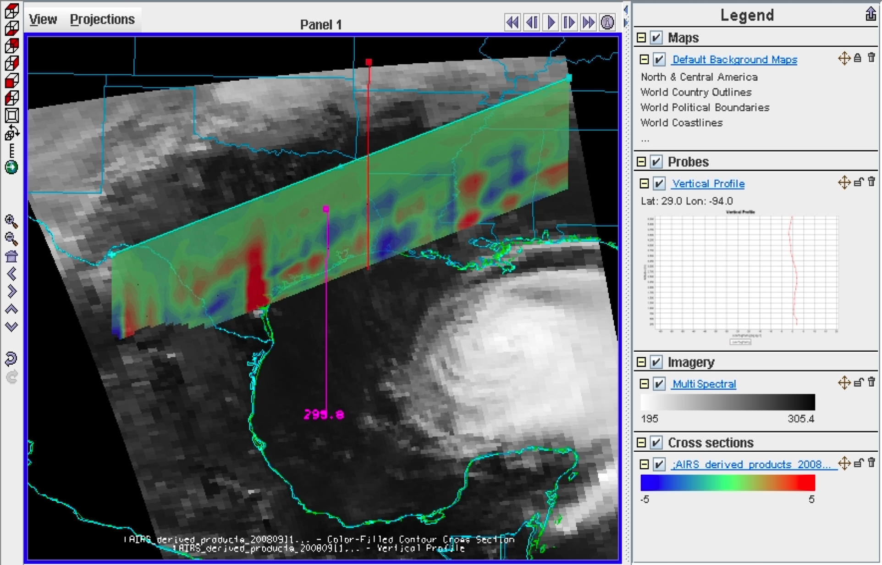
McIDAS-V
ABI simulated image with transect showing
3-D difference field of AIRS retrieval minus
ECMWF model forecast
Simulation of the 16 bands of ABI
ABI simulation of overshooting tops,
rotated to 3-D view from the side
Powerful new data analysis and 3-D visualization tool from SSEC
Fifth generation of Man-computer Interactive Data Access System
Java-based, open-source, and freely available
Incorporates functionality of VisAD, IDV, McIDAS-X, and HYDRA, for viewing data, developing algorithms, and validating results
Includes tools for research and operational users of observational, model, and satellite data, including data from multi- and hyper-spectral sensors on both current (GOES, POES, MSG, MTSAT, MODIS, METOP) and future (GOES-R, NPP/NPOESS) satellites
Includes a “bridge” to McIDAS-X, allowing –X users to continue using legacy code in -X, while visualizing in McIDAS-V
http://www.ssec.wisc.edu/mcidas/software/v/

Slide 20
SSEC areas of technical expertise
Observational Science (spacecraft system/mission design, instrumentation, field programs, spaceflight instrument fabrication, including CAMPUS SCIENCE SUPPORT to
PHYSICS, ASTRONOMY, BOTANY, GEOLOGY)
Computational & Visualization Science (hardware and software systems for information generation, data management, and communication)
Analytical Science & Applications (satellite & conventional data analysis, technical development & analysis)

Slide 21
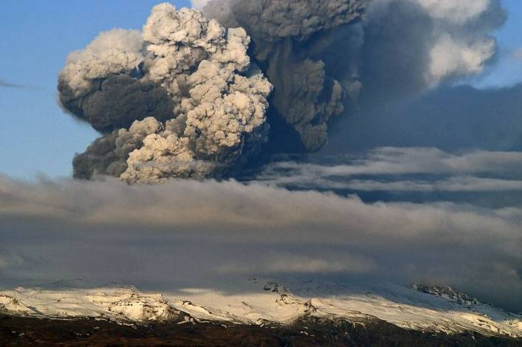
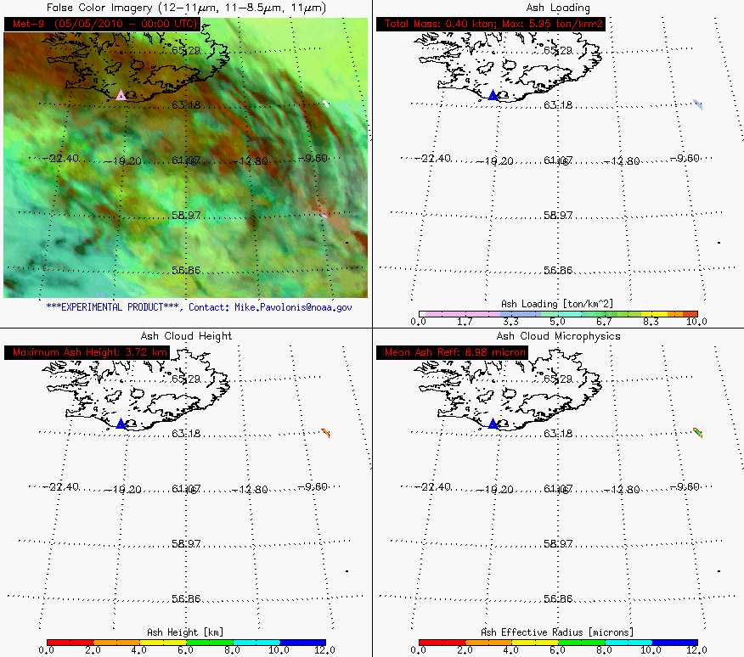
Tracking Iceland’s Eyjafjallajökull Volcanic Ash
Iceland
The GOES-R volcanic ash products were provided to the UK Met Office in real-time to assist with decision making
Detection
Loading
Height
Particle Size
Pavolonis and Sieglaff
21

Slide 22
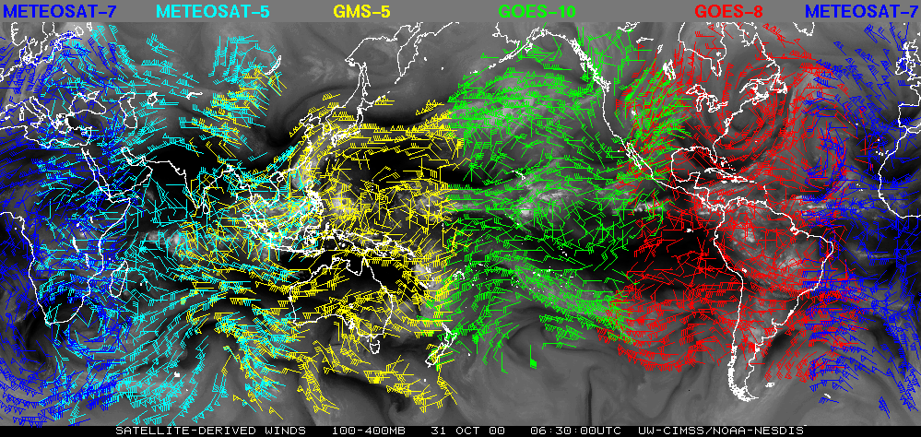
Multiple Geostationary Satellite Wind Data
Automatically Produced
Notes:
Thinned 100-400 mb wind vectors are displayed using different color scheme. METEOSAT-7 in Blue
METEOSAT-5 in Cyan
GMS-5 in yellow
GOES-10 in green
GOES-8 in red
Data sets are from 31 of October 2000 around 06:30 UTC
8 times a day these wind data sets are automatically ftp to CWB NWP center. CWB NPW center is using these wind data in their global, regional and typhoon models to improve their forecast.
Some of their preliminary study show some positive impacts are achieved and details study of the wind data sets impact is underway.

Slide 23
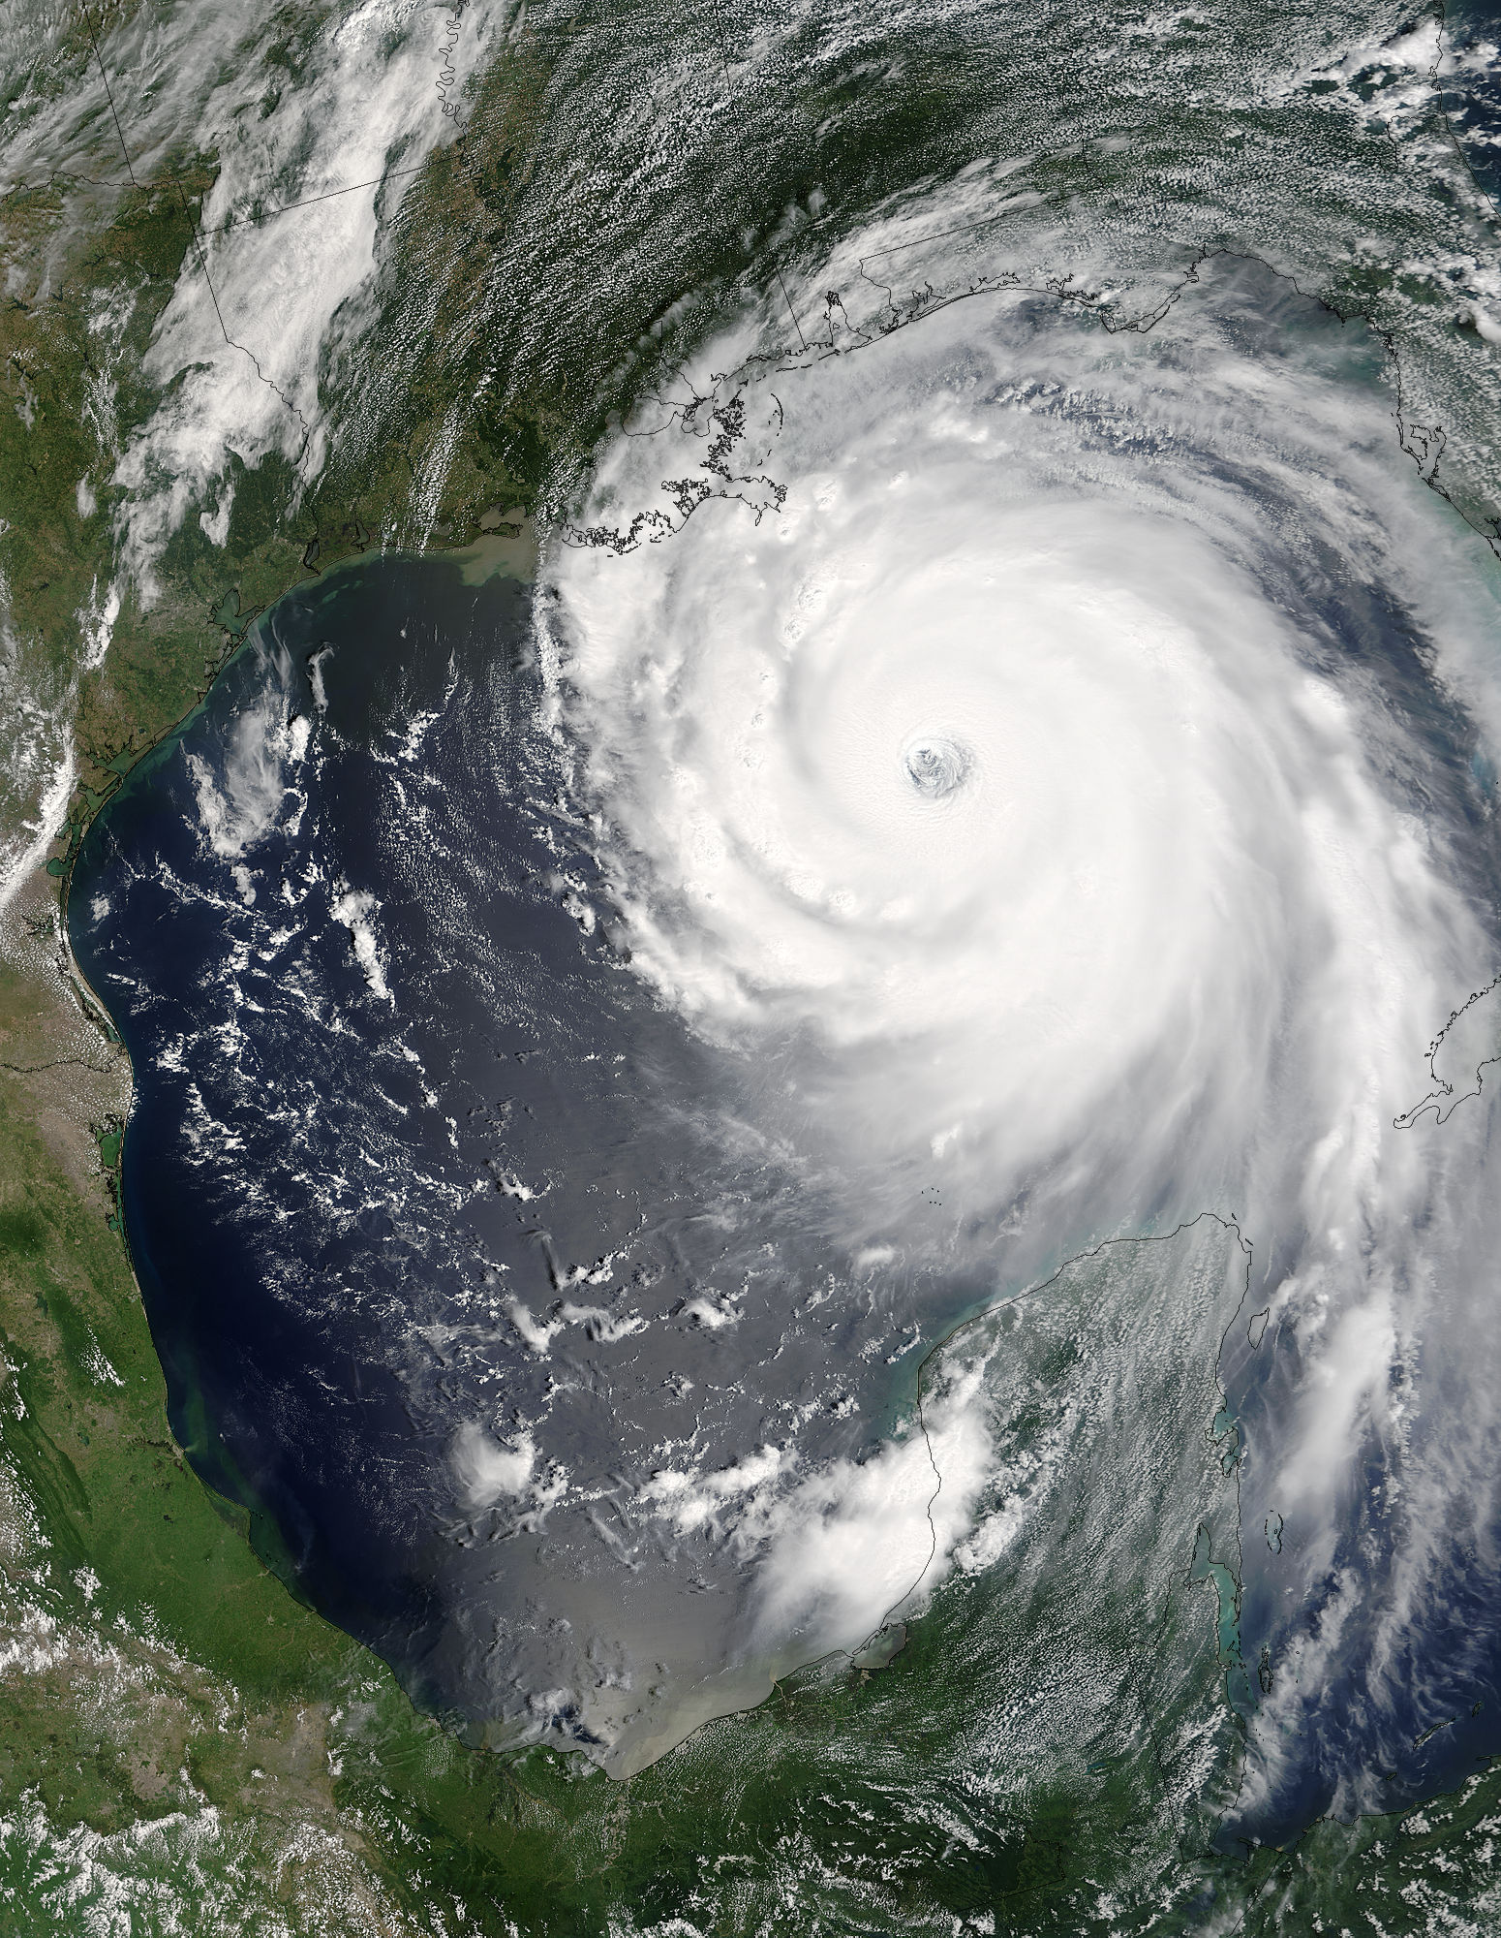
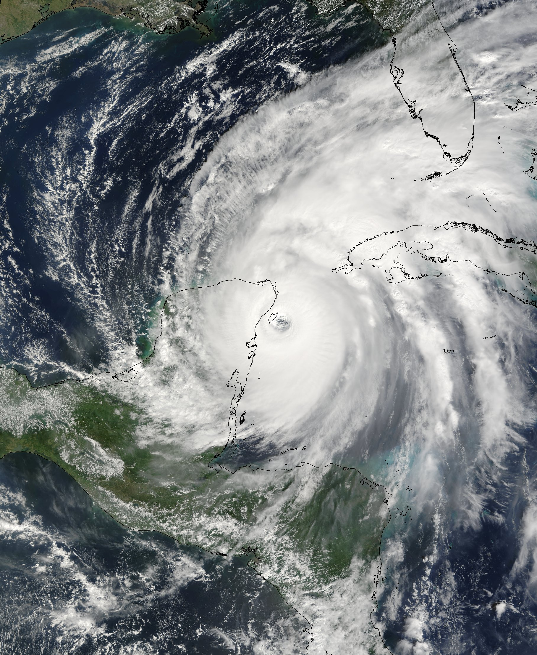
Tropical Cyclones
Katrina, 28 August 2005
Wilma, 21 October 2005

Slide 24
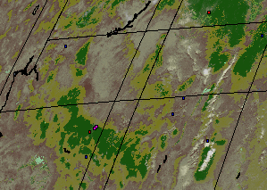
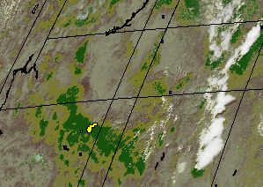



GOES WFABBA - Rapid Intensification of Wildfires
Arizona
Smoke
Chediski
Rodeo
Chediski
Rodeo
20 June 2002 16:15 UTC
18:15 UTC
21:15 UTC
Quebec
ONTARIO
QUEBEC
ONTARIO
QUEBEC
6 July 2002 11:45 UTC
17:45 UTC
Notes:
One of the primary advantages of using geostationary data for fire monitoring is the ability to detect and monitor rapidly growing fires. Two examples are shown in this slide.
On 20 June 2002, the GOES Wildfire ABBA monitored the Chedeski and Rodeo fires in Arizona. The rapid intensification of the Rodeo/Chediski complex was one of the most extreme examples ever documented with the GOES WF_ABBA.
On 6 July 2002, the GOES Wildfire ABBA monitored the rapid growth and intensification of numerous fires in Quebec. UW-Madison CIMSS is collaborating with M. Moreau (Environment Canada/Meteorological Services/Quebec Region) to evaluate the capability of the WF_ABBA for detecting and monitoring wildfires in remote regions at northerly latitudes in the province of Quebec, Canada. During the recent outbreak of wildfires in Quebec, M. Moreau indicated that the GOES WF_ABBA served as an excellent tool for monitoring fires in real-time especially in the restricted protection zone in Northern Quebec where conventional fire monitoring is limited. He indicated that the latest version of WF_ABBA has significantly fewer false alarms with good agreement with ground truth verification.

Slide 25

Hurricane Sandy Environment from VIIRS Day/Night Band, 29 Oct

Slide 26

London Lights from VIIRS Day/Night Band

Slide 27
CIMSS/SSEC/AOS/NOAA
ASPB
NCDC
Symbiotic relationship between CIMSS, SSEC, AOS, and NOAA/NESDIS

Slide 28



Cooperative Institute for Meteorological Satellite Studies (CIMSS)
Steve Ackerman Director
Foster collaborative research among NOAA, NASA, and the University in those aspects of atmospheric and earth system science which exploit the use of satellite technology
Serve as a center at which scientists and engineers working on problems of mutual interest may focus on satellite related research in atmospheric studies and earth system science.
Stimulate the training of scientists and engineers in the disciplines involved in the atmospheric and earth sciences.

Slide 29

CIMSS Staff

Slide 30
Graduation History of CIMSS Supported Graduate students
Graduated: 93 M.S and 37 Ph.D.
Currently Supporting 23 students

Slide 31
New Satellites: GOES-R+/JPSS Programs
Algorithm Development Group (AWG)
  CIMSS and ASPB scientists are involved in 2/3 of the 64 operational algorithms under development
  15 funded tasks for AWG at CIMSS
Risk Reduction
  10 funded tasks for Risk Reduction at CIMSS, investigating novel ideas and approaches
Proving Ground
  Evaluating baseline products, testing advanced products, and training future users of the data
High Impact Weather
  Investigating the impact of a high spatial and spectral resolution sounder in geo orbit

Slide 32
Welcome to Madison, WI
and the
University of Wisconsin-Madison
While you are here…

Slide 33



Slide 34


capitol

Slide 35


capitol

Slide 36



Not brats……

Slide 37

Babcock ice cream – yummmm
Available in the Union

Slide 38




Try em fried too!!

Slide 39




Slide 40




WI BEER

Slide 41







Slide 42


Lutefisk: literally means “lye fish",
This is a picture of traditional Norwegian lutefisk with extras (potato, bacon and mashed peas). It was taken in December 2005.

Slide 43


Staying longer
Farmer’s Market

Slide 44

Come back and visit again…

Slide 45
Go forth and enjoy it!

Slide 46
Executive Director – Science
Space Science and
Engineering Center (SSEC)
An Introduction UW-Madison SSEC/CIMSS Research and Facilities
Wayne Feltz
Associate Director
Cooperative Institute for Meteorological Satellite Studies (CIMSS)

