Slide 1
McIDAS in the Classroom: Tales of a Wayward McIDAS Site Coordinator
Matthew A. Lazzara, PhD
Amy A. Limberg-Dzekute
Department of Physical Sciences
School of Arts and Sciences
Madison Area Technical College
Madison, WI

Slide 2
Outline
Introduction
McIDAS in the classroom
From the IPP to Routine use
Real time display
Community outreach
Issues and challenges
McIDAS
Non-McIDAS
Future

Slide 3
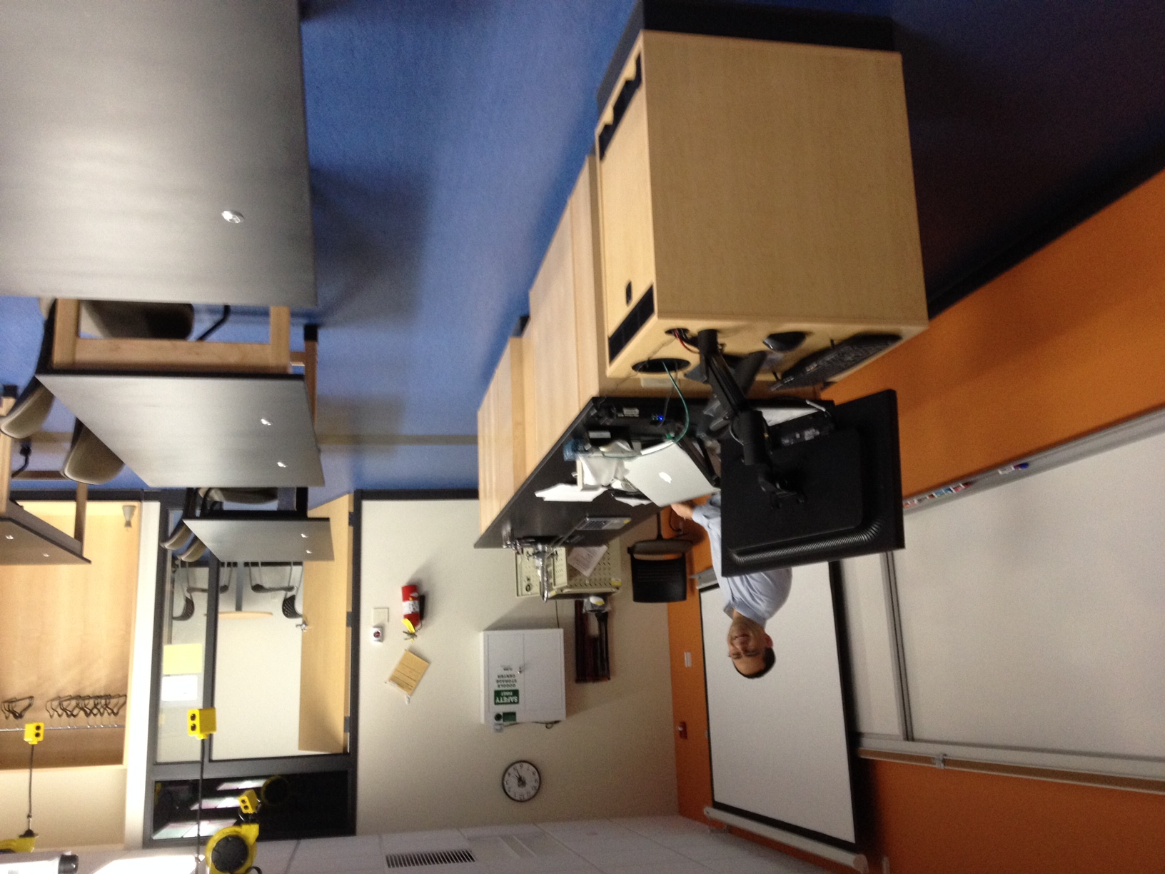
Introduction
Background about Madison College (aka MATC)
~40,000 students
9 campus locations
12 county district
+3200 graduates per year
Prior to August 2014:
Adjunct Faculty at MATC
Full time UW Associate Scientist
Post August 2014:
Full time Faculty
Part time UW Associate Scientist

Slide 4
From MATC IPP to Routine use: McIDAS in the classroom
2010: Madison Area Technical College Interactive (MATC) Processing Project (IPP) (See MUG Meeting 2010 presentation)
Unidata Equipment grant for:
Servers (ADDE and LDM)
Instructor and to seed student use (McIDAS-X & some McIDAS-V)
Displays (McIDAS-X)
Rollout of classroom laptops (60+) (McIDAS-X)
Applications:
Student Real-time Weather Scavenger Hunts
Satellite Meteorology:
e.g. Clouds top vs. Clear sky compared with Surface observations
Precipitation/radar
Paperless Weather Forecasting

Slide 5
Real time display
Display in the classroom laptops:

Slide 6
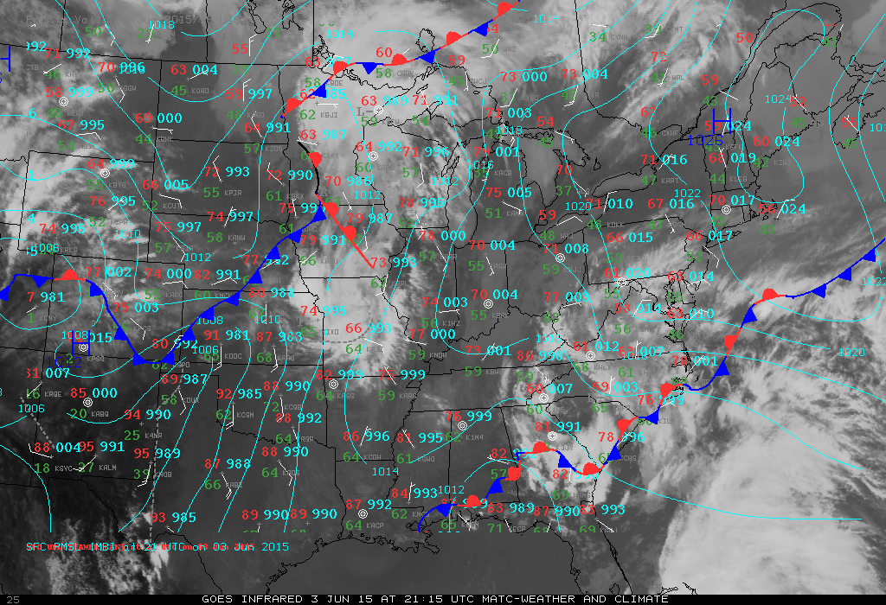

Slide 7
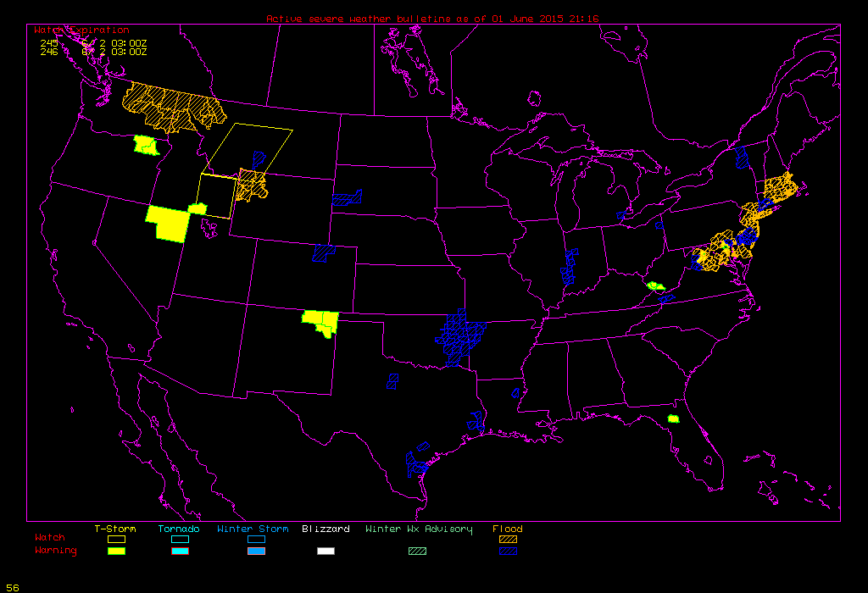

Slide 8
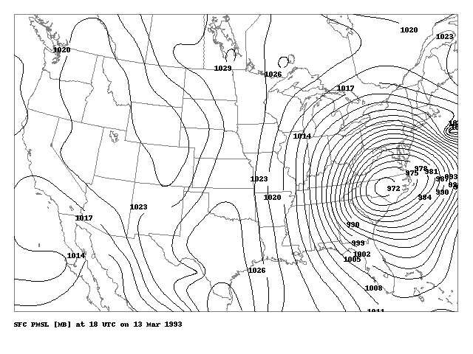

Slide 9
Community Outreach
MidWest Severe Storms Tracking/Response Center
Satellite support:
McIDAS-V
Via ADDE
Mini Severe Weather Seminar: Dark Skies
Science Olympiad
Hamilton Middle School

Slide 10
Issues and Challenges
Limited IT support
Nearly no Unix/Linux on campus
Primarily Windows
Mac/Apple nearly exclusively used in Art Department and Physical Sciences Department
Wireless Networking issues with a mobile classroom
(Minor issue: Wired network connection stability for servers)
Computer “Image” - rollout and stability
OS support level mismatch
Restrictions on administrative access (security concerns) to "fix" issues as they are noticed – remotely or even in house. Must rely on IT to fix and if lab that day, may be facing a time crunch.
Lack of computer refresh.

Slide 11
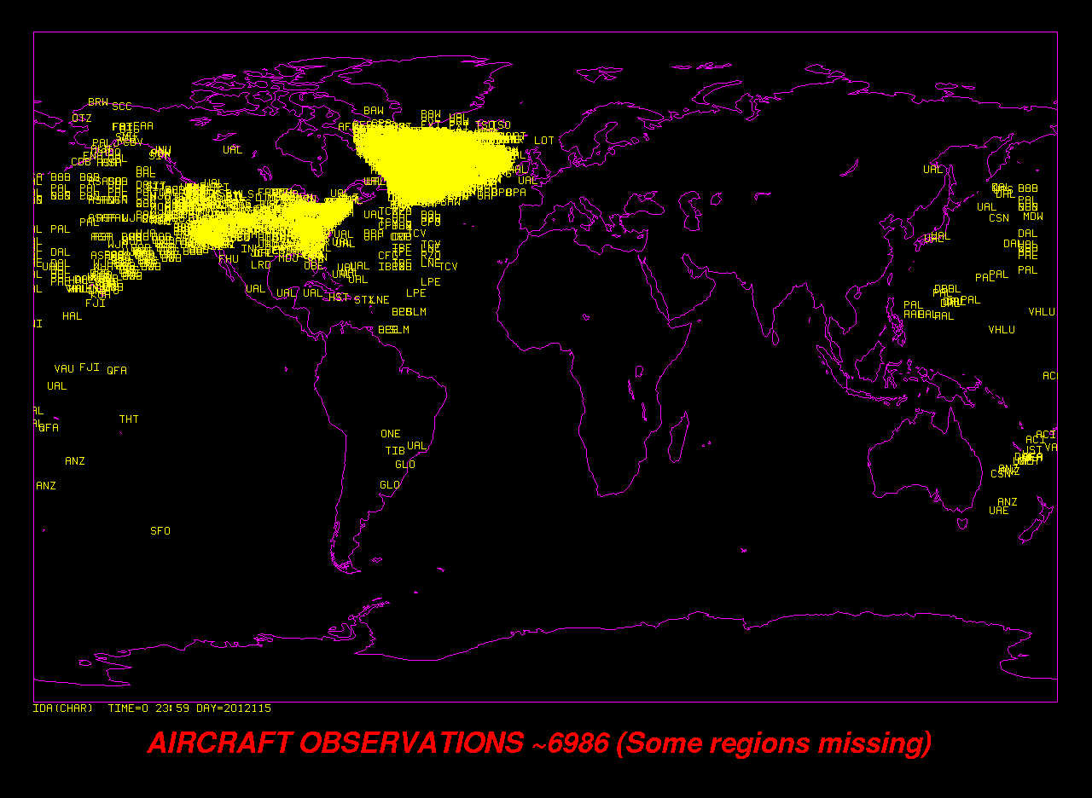
Issues and Challenges
McIDAS related issues:
Reliance on Unidata community ADDE servers
AIREPs/PIREPs
Missing sectors
GFSMOS
SFCPLOT
Station model: clouds
WWDISP/WWLIST
Have more watch/warnings
McIDAS-V/IDV adoption
LDM and ADDE expansion

Slide 12
Future
Support future course development
Individual student research
Honors program
Possibility of additional grant work involving students analyzing the data
McIDAS will be one of the tools in the tool box!
New equipment
Servers
Tablet environment?

Slide 13
Thank you! Questions?
Thank you to the Unidata, the Unidata community, UW- AOS, the McIDAS User Services Group, SSEC Data Center, and Madison College!
Dr. Matthew A. Lazzara - Faculty - Weather and Climate
Department of Physical Sciences - School of Arts & Sciences
Madison Area Technical College, Office B3223-J
1701 Wright Street (Mailbox #597), Madison, WI 53704
Telephone: (608) 616-3382
E-mail MLazzara@madisoncollege.edu
Web: http://faculty.madisoncollege.edu/mlazzara

