Slide 1
Antarctic Meteorological research center’s mCidas usage and future cyberinfrastructure
Carol Costanza, Dave Mikolajczyk, and Matthew Lazzara
AMRC – SSEC
University of Wisconsin-Madison
McIDAS User Group Meeting 2015

Slide 2
History
Funded by the Division of Polar Programs, Geoscience Directorate of the National Science Foundation
AMRC began in 1992
A “marriage” between the SSEC McIDAS group and the Antarctic Automatic Weather Station project (AWS started in 1980 with currently ~58)
Included:
Satellite composite creation
Meteorological data archive
Forecasting (the “AMFC” – ended ~1998)
Group vs. the Grant…
The AMRC as a grant is ending…
Transition: Cyberinfrastructure…

Slide 3
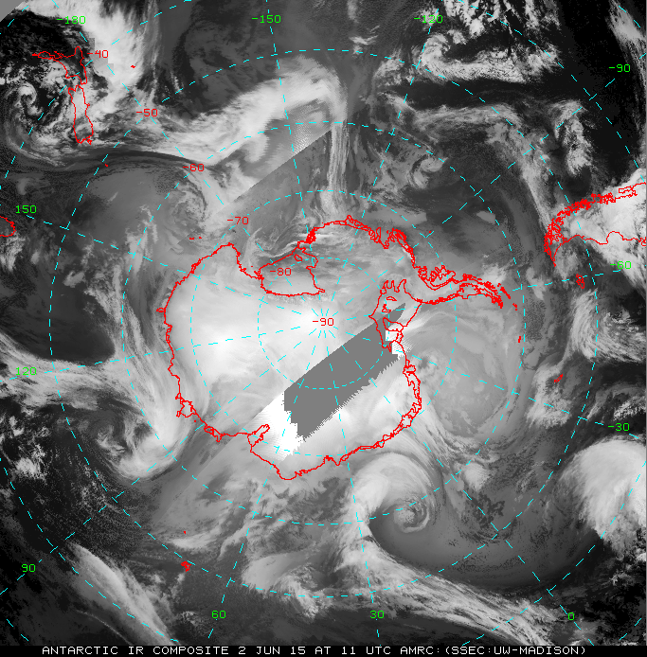
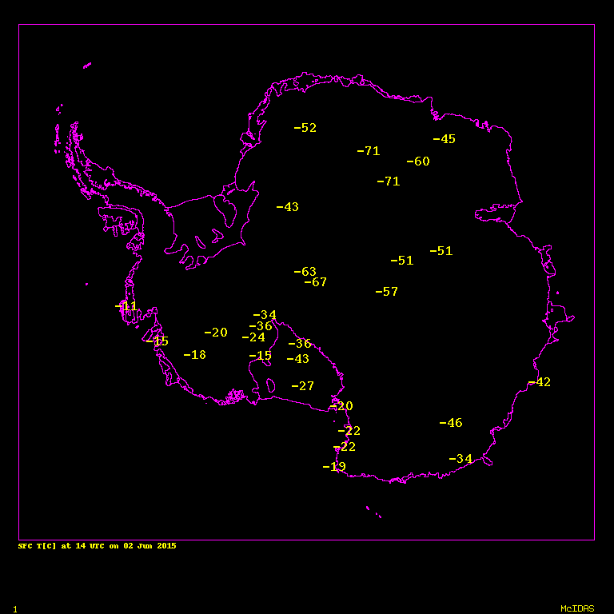
AMRC Introduction
Study & display the weather in Antarctica in multiple ways using McIDAS in the toolbox
AMRC project contributes to McIDAS-XRD

Slide 4
AMRC Historic SDI Usage
AMRC Automatic Weather Station - Real-time
Original SDI (running under Solaris 10)
2 - McMurdo Station, Antarctica
1 - Palmer Station, Antarctica
Software to breakout NOAA DCS (Argos)
Hexidecimal AWS data via ADDE text server
Only working through NOAA-18
Running on SDI-104 in SSEC Data Center
AMRC future usage pending with NSF

Slide 5
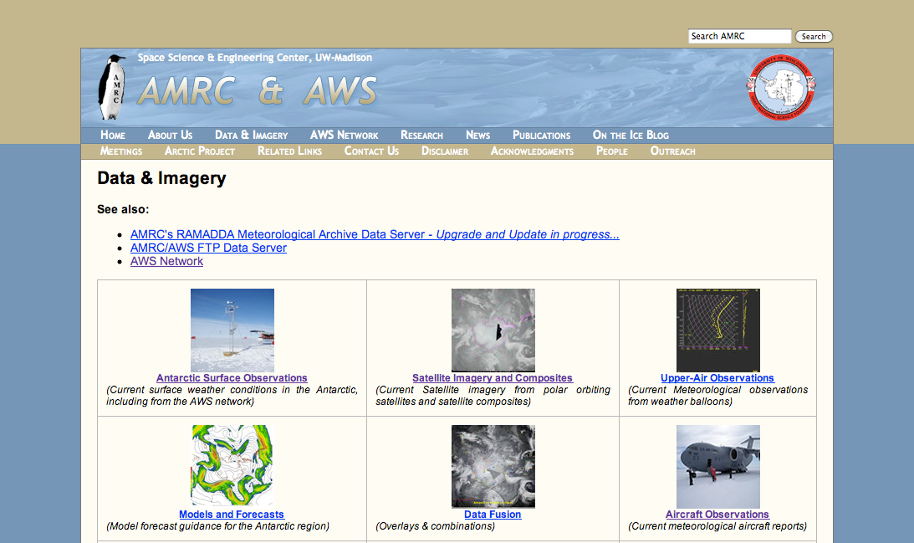
AMRC Website
McIDAS is utilized to create AWS meteorograms, AWS hex and text listings, AWS obs plots, satellite composites, hodographs, skew-t, synoptic model data displays, aircraft obs, etc.

Slide 6
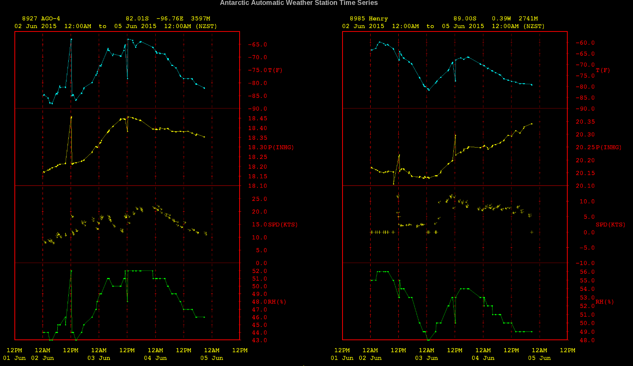
OWL: SSEC’s On-line Weather Looper!

Slide 7
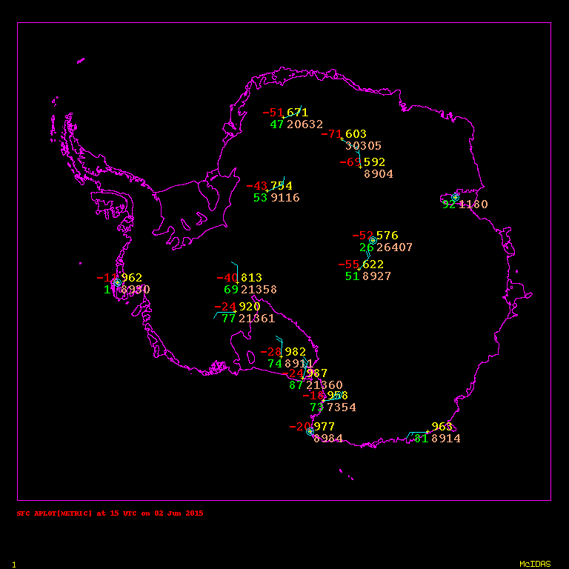
AWS Map Displays

Slide 8
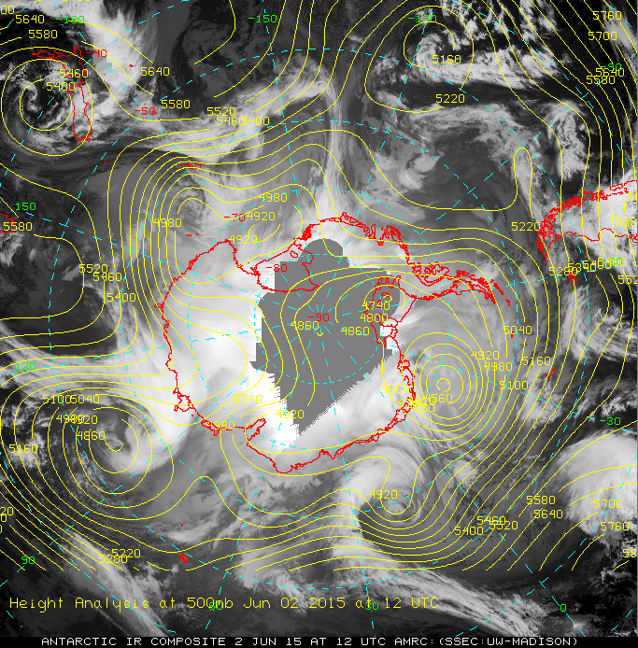
Model Data Fusion

Slide 9
Antarctic and Arctic Composites
Infrared, Longwave, Shortwave, Water Vapor, Visible, and Pseudo-Color (only Antarctic)
Published Kohrs et al., 2014
Composites created hourly at a 4km resolution using polar orbiting and geostationary satellites data that is available within the hour
Use McIDAS to create area files, multiple sized gif images, and animations

Slide 10
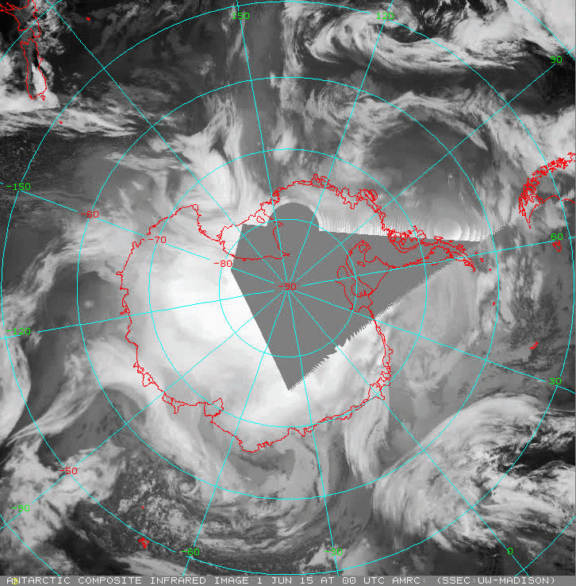
Antarctic Infrared Animation

Slide 11
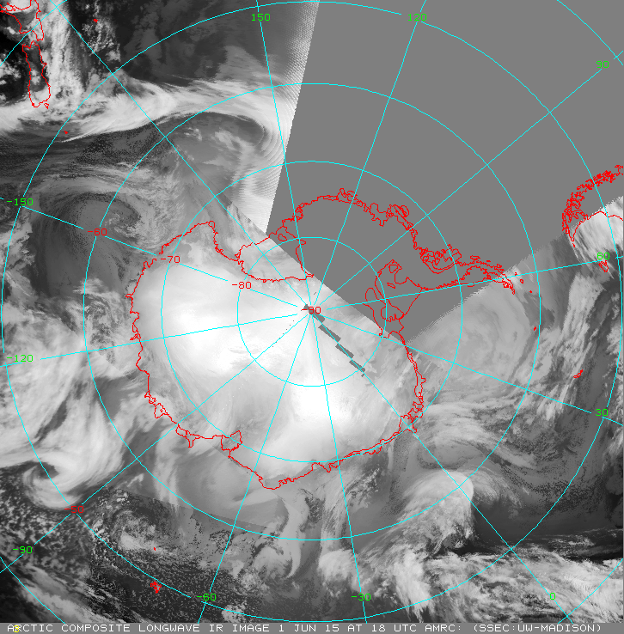
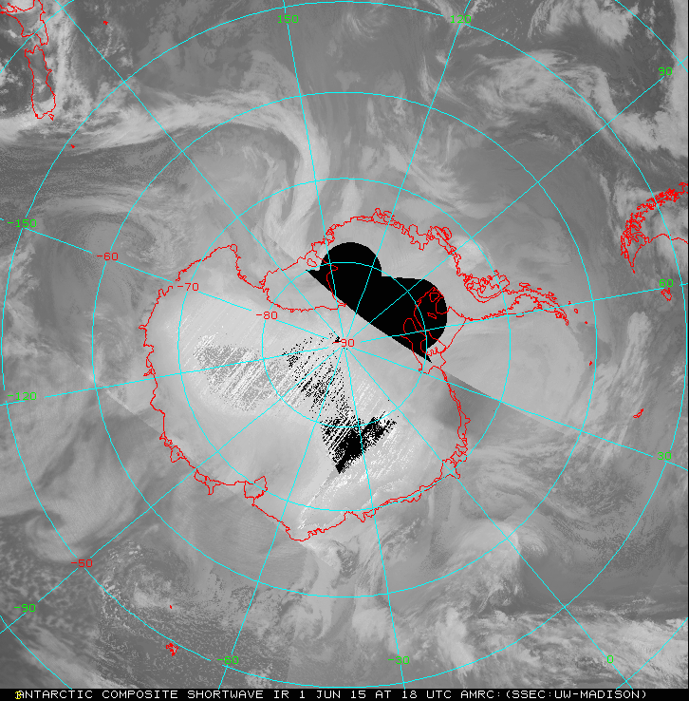
Antarctic Longwave and Shortwave

Slide 12
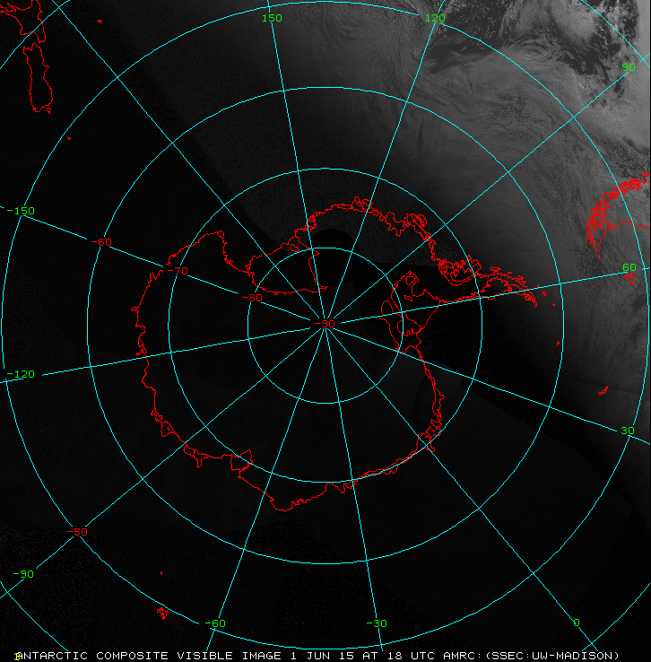
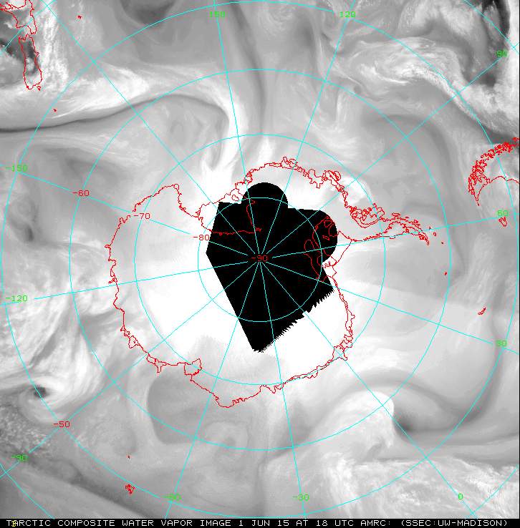
Antarctic Visible and Water Vapor

Slide 13
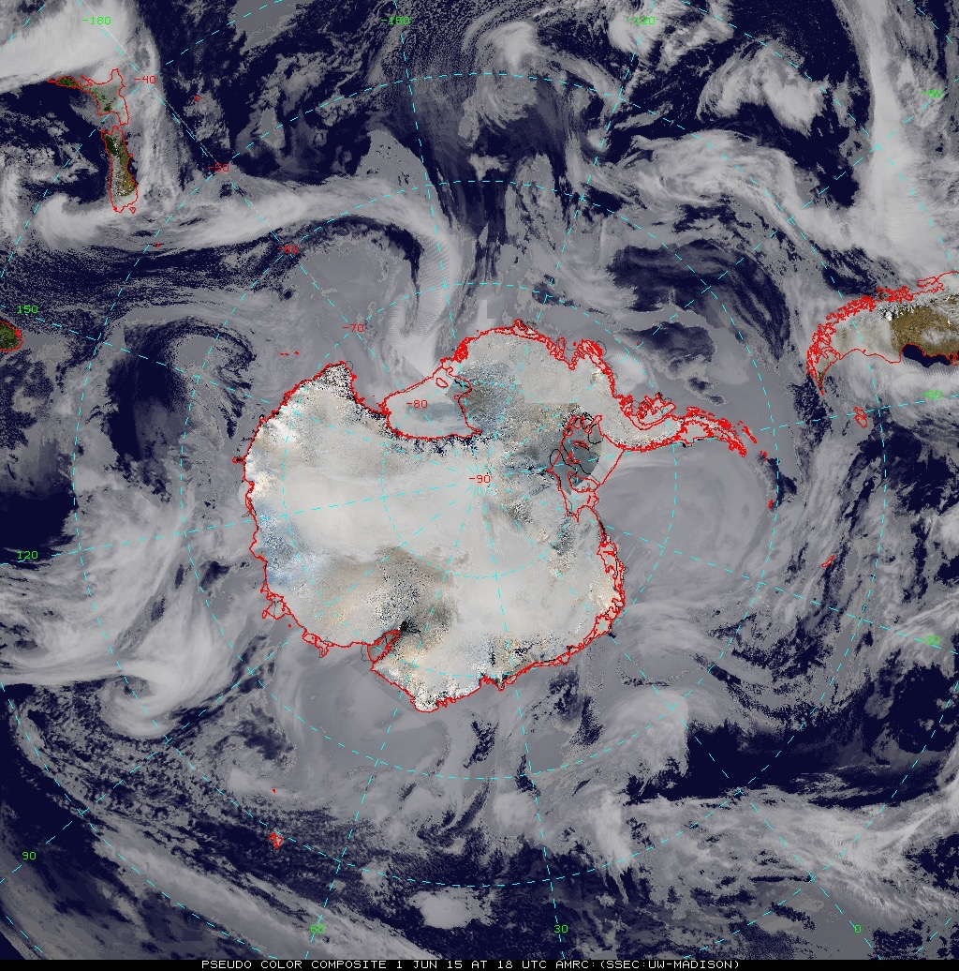
Antarctic Pseudo-Color

Slide 14
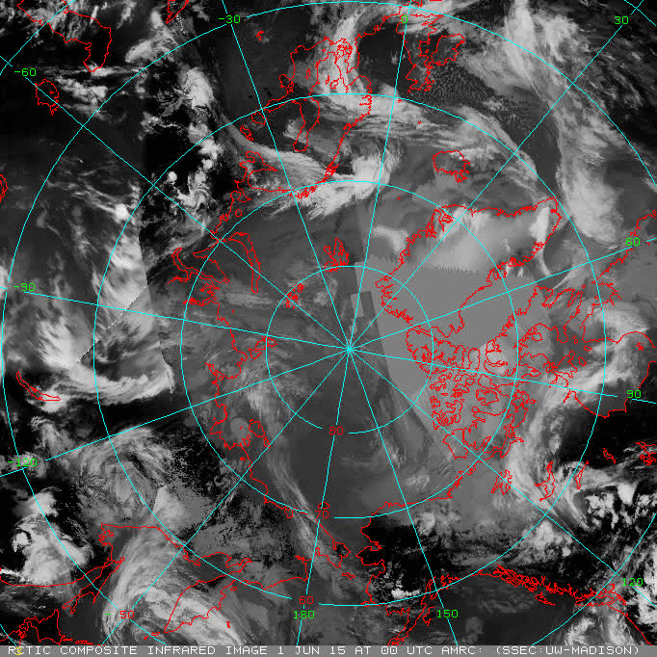
Arctic Infrared Animations

Slide 15
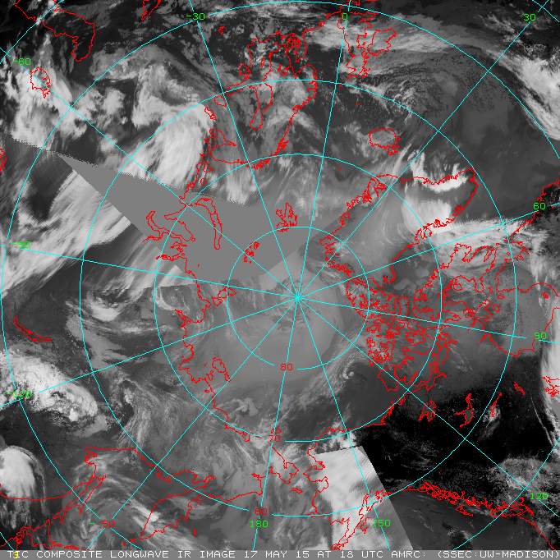
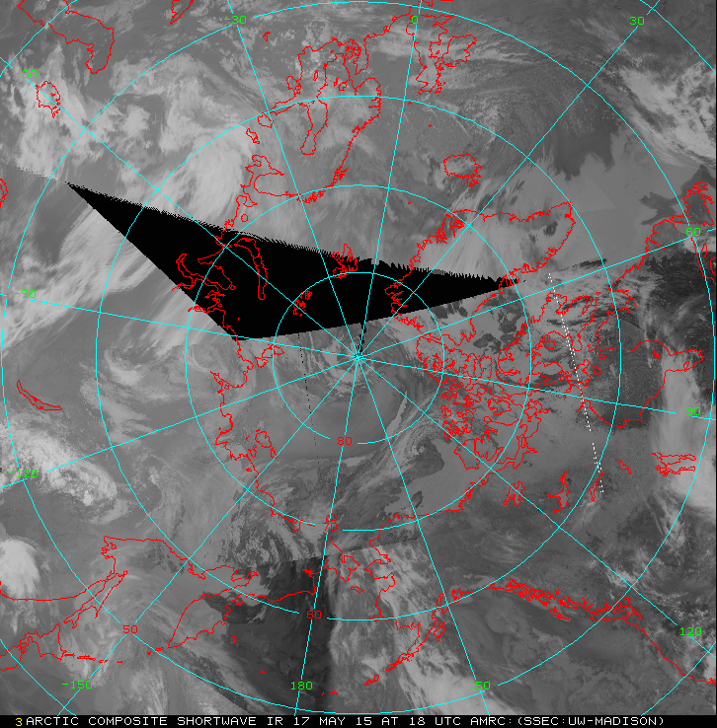
Arctic Longwave and Shortwave

Slide 16
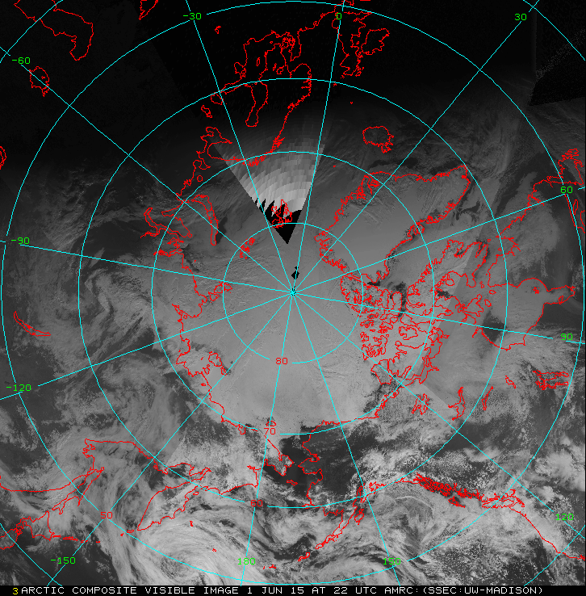
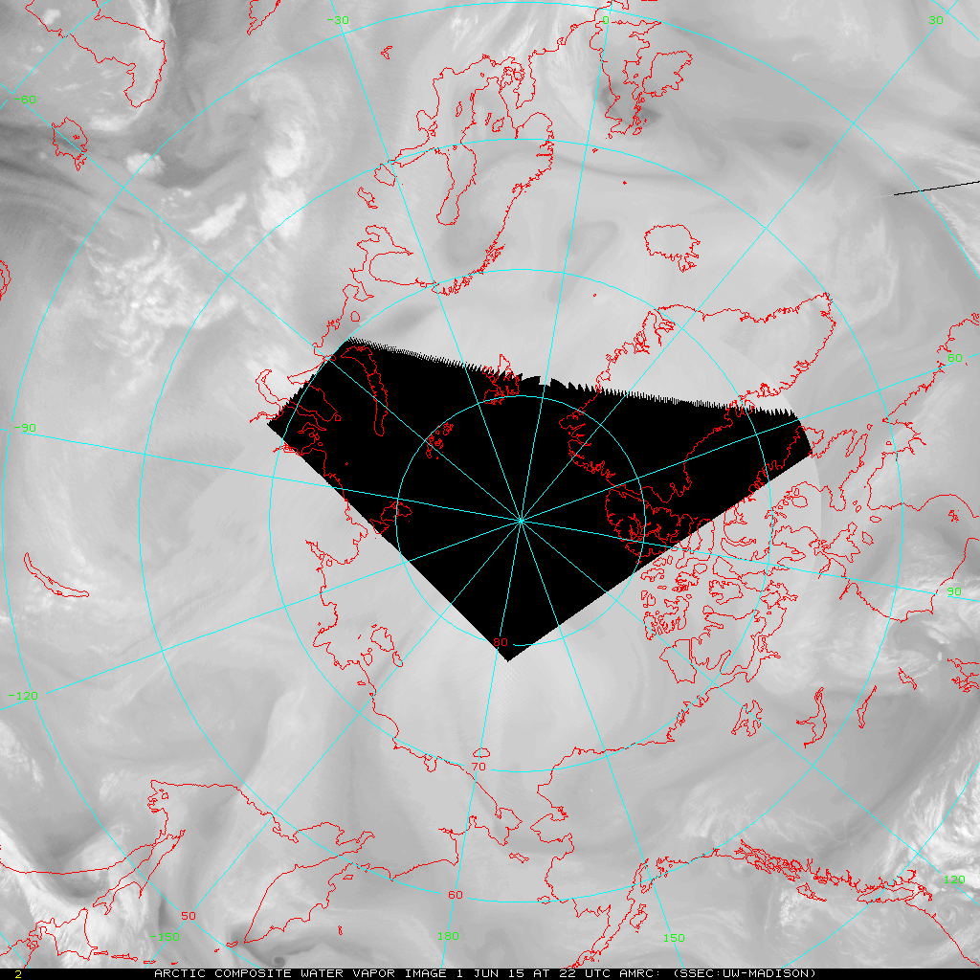
Arctic Visible and Water Vapor

Slide 17
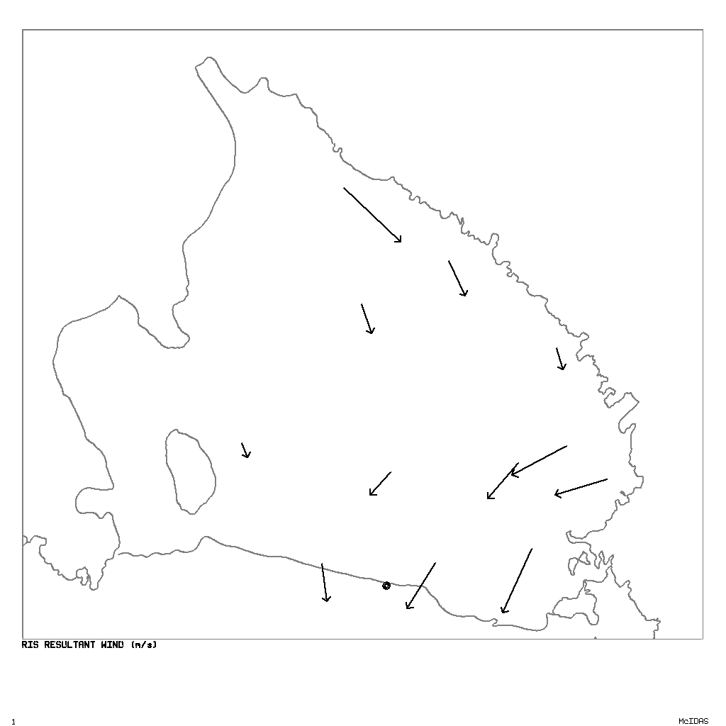
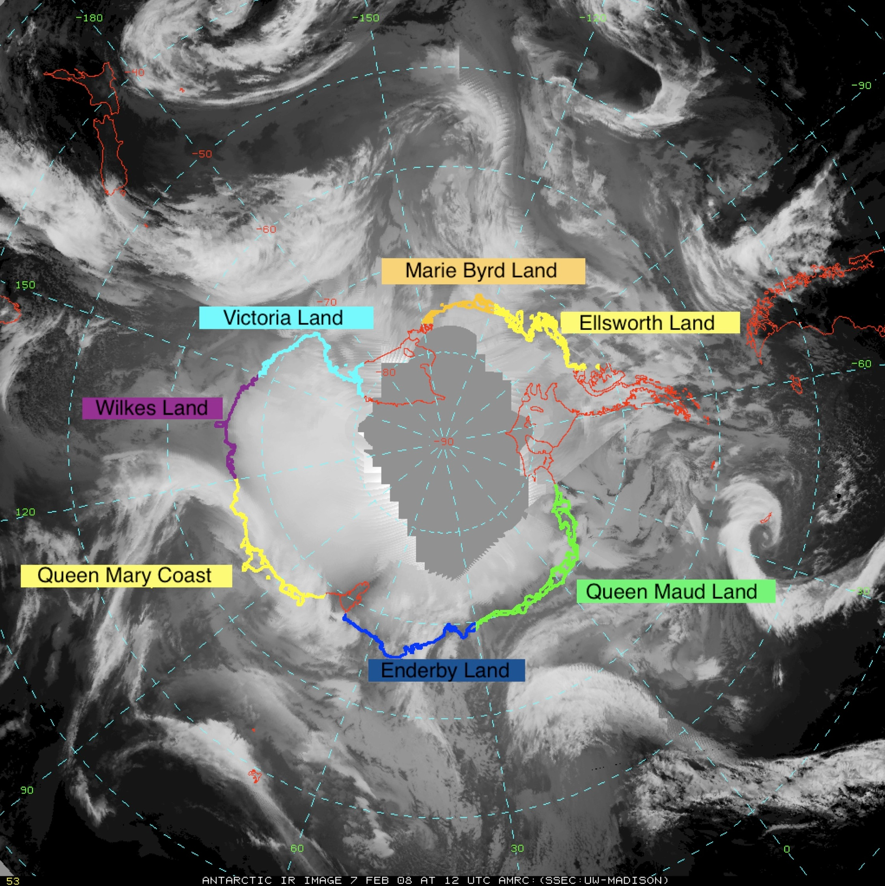
Using McIDAS for Research AWS and Satellite Composites
Climatology by C. Costanza
Cloud Mass Transport by J. Nettesheim

Slide 18
Cyber-Infrastructure
Archive of nearly 35 years of data could use an update of better cyber infrastructure
Need to create a database for both internal and external users
About to be funded to engage a task force for advice on best ways to continue the creation and management of Antarctic meteorological datasets – Sustainability!!

Slide 19
Future
Future tasks are unclear and still taking shape:
Real time AWS, displays, and composites future is pending with NSF’s Antarctic Infrastructure and Logistics section
Cyberinfrastructure will maintain some essential elements for approximately 2 years
Beyond that will be task force recommendation dependent
McIDAS-V
More routine implementation
Improved displays ?

Slide 20
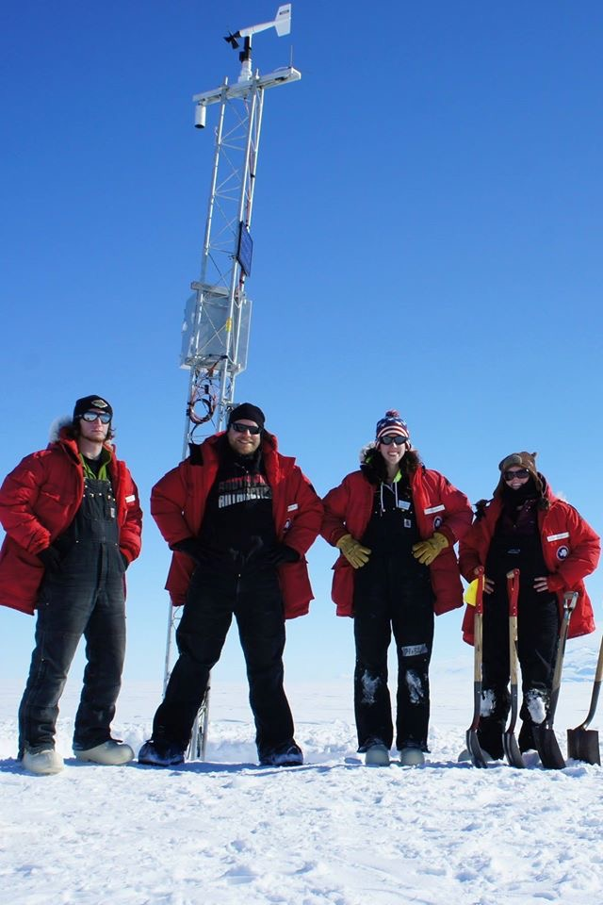
Thank You! Questions?
The authors appreciate the support of the University of Wisconsin-Madison Antarctic Meteorological Research Center for the data set, data display, & information, NSF grant number ANT-1141908.
http://amrc.ssec.wisc.edu

