Slide 1
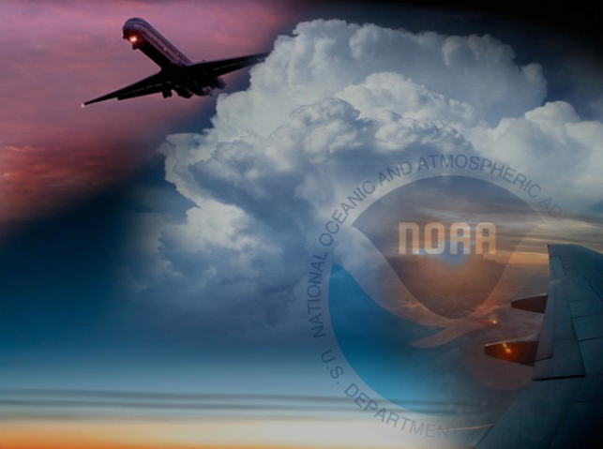
McIDAS-X Applications at the Aviation Weather Center
Amanda Terborg
UW CIMSS – Aviation Weather Center
McIDAS Users Group meeting
8 – 10 June 2015

Slide 2
Why McIDAS-X?
3. Unique domains
From terminal to global
2. Challenging forecasts
Many hazards, little time
1. Extensive responsibilities
From takeoff to touchdown, globally

Slide 3
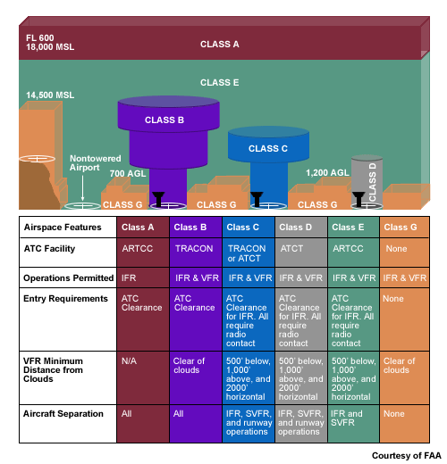
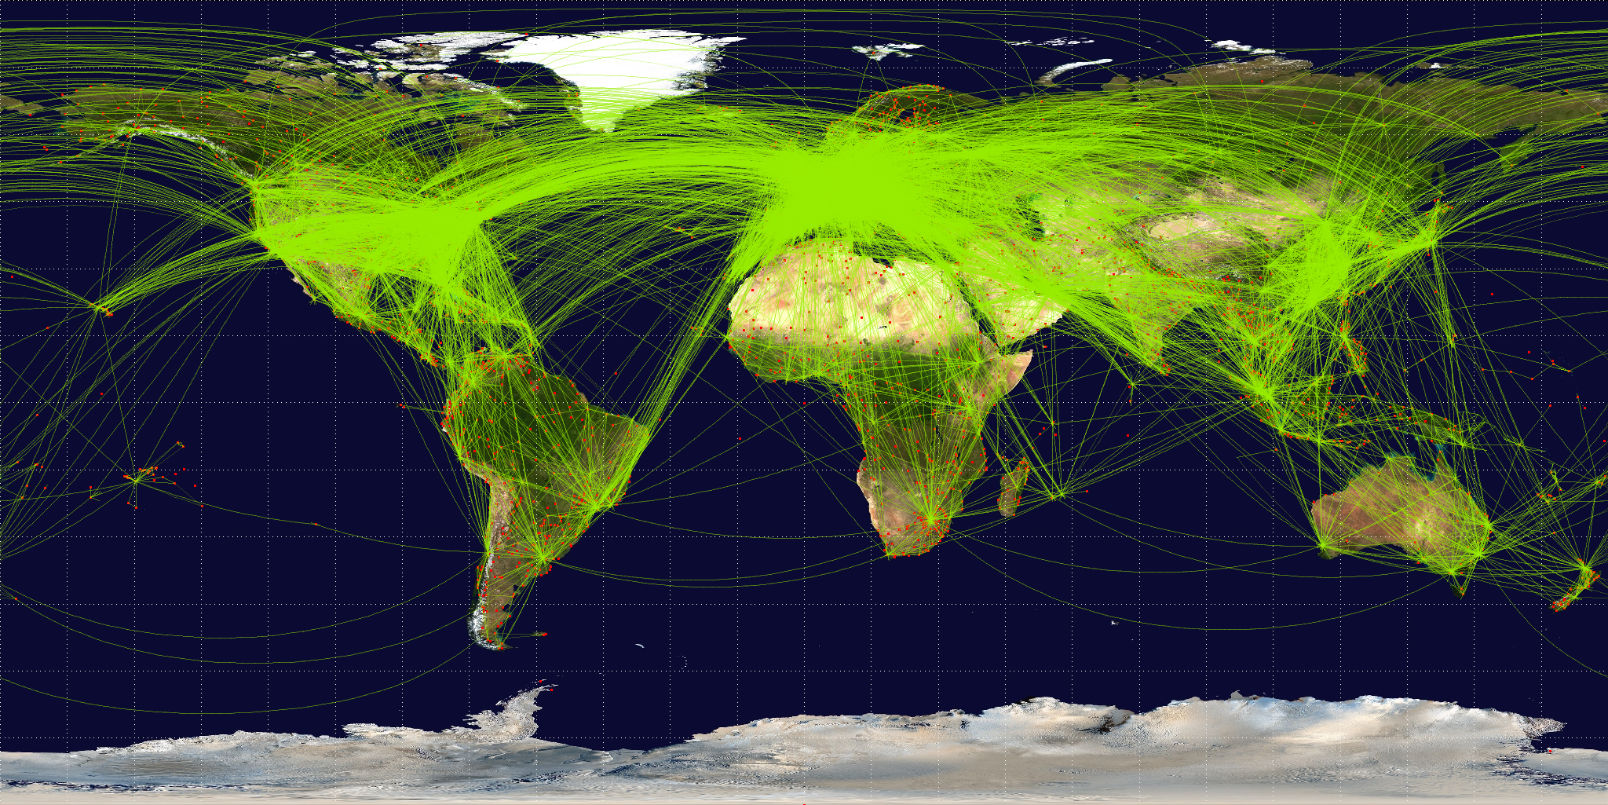
Why McIDAS-X?

Slide 4
McIDAS concepts
VIS/IR combo for ceiling and visibility
Continuous images day/night
Global mosaics – GEO/LEO combo
global
north/south pole
VIS/IR/WV
Satellite/model derivations – convective imagery
Other sectors…

Slide 5
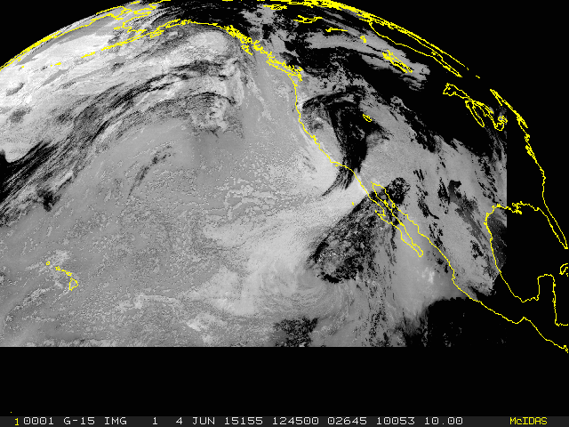
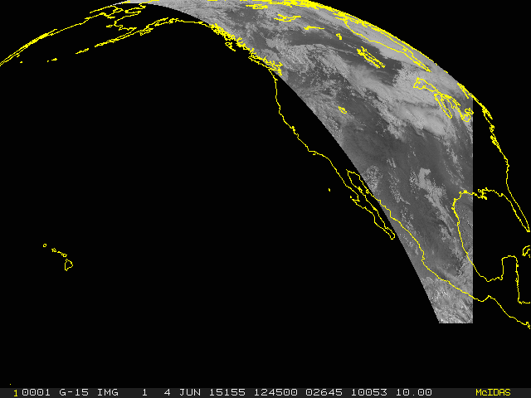
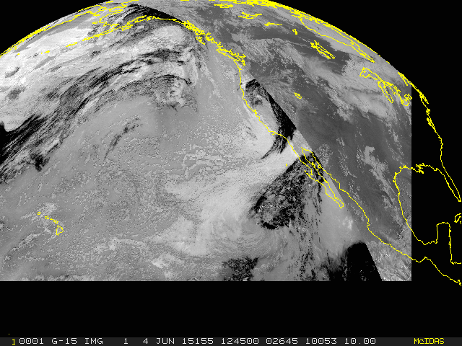
Visible/Infrared Mosaic For continuous day/night coverage

Slide 6
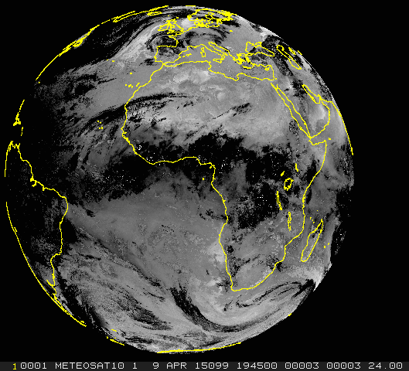
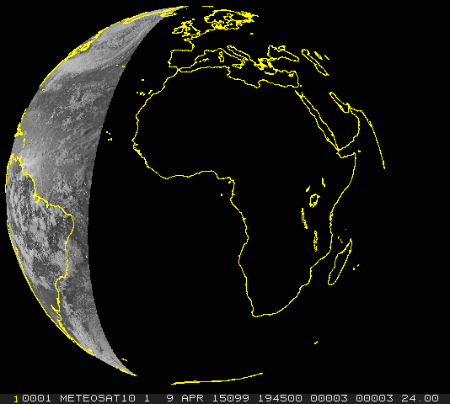
Visible/Infrared Mosaic For continuous day/night coverage

Slide 7
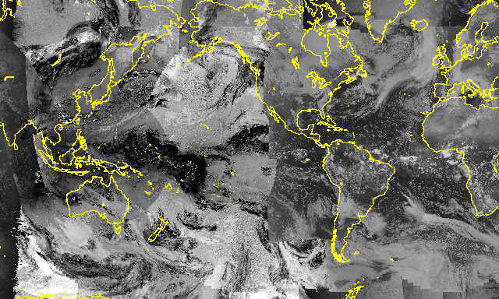
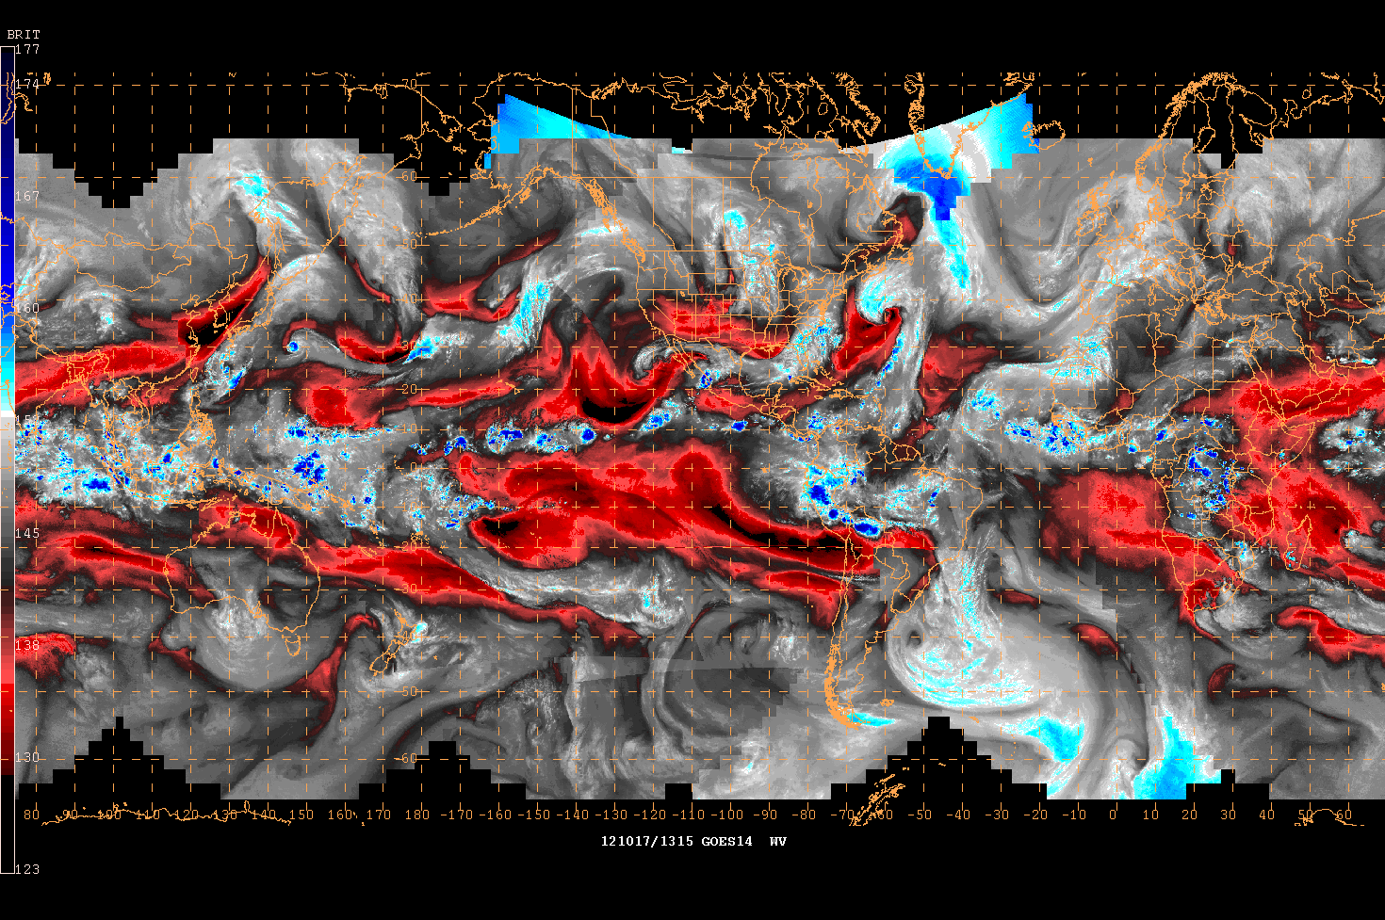
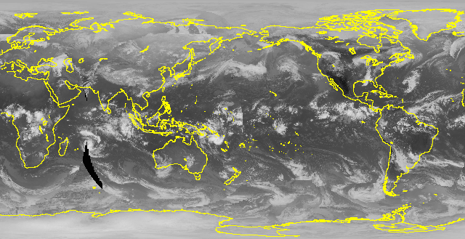
Global Mosaics For the International Operations Branch

Slide 8
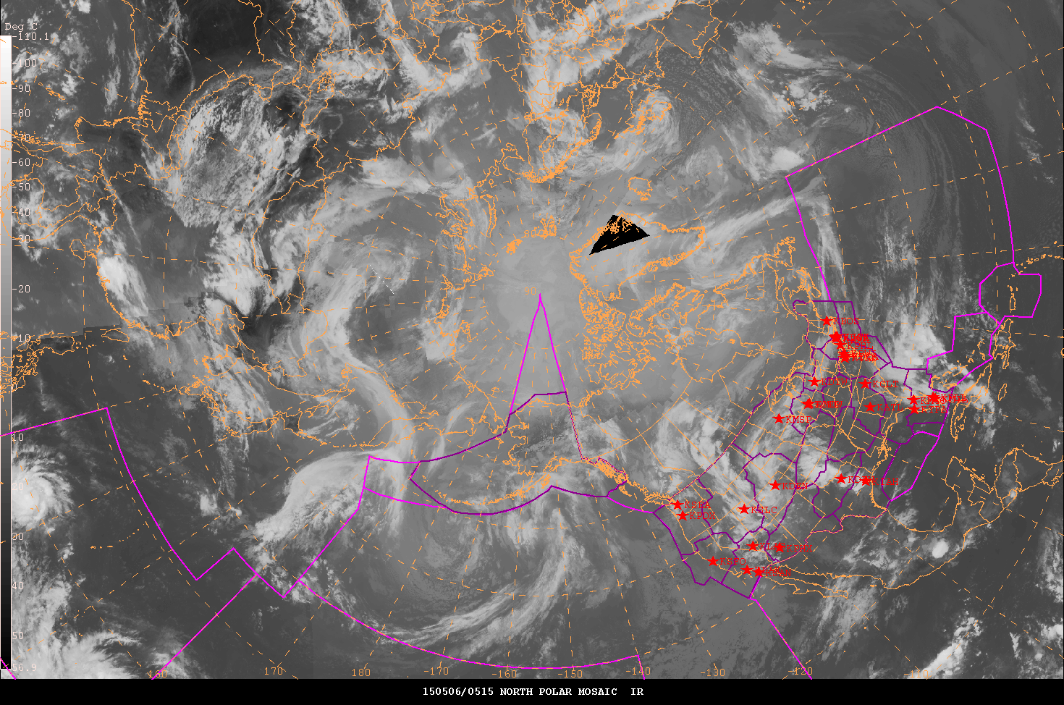
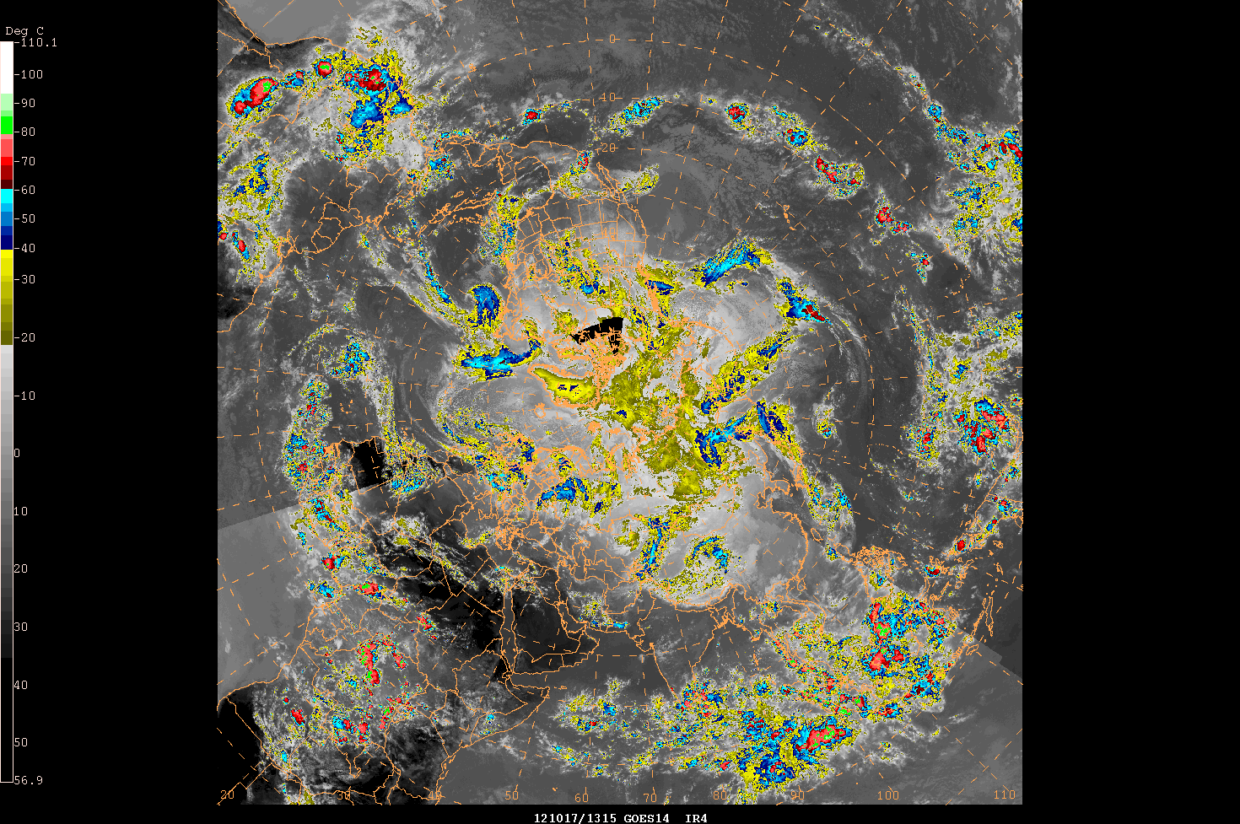
Polar Mosaics For the International Operations Branch

Slide 9
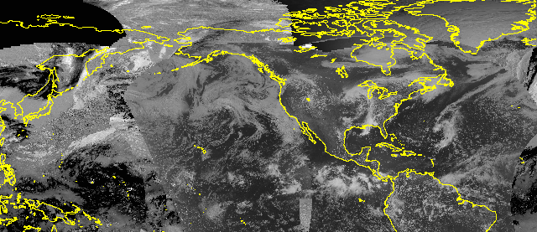
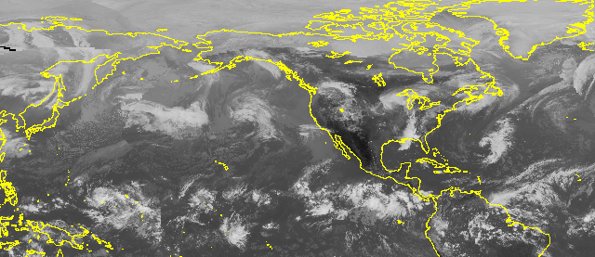
Hemispheric Mosaics For the International Operations Branch

Slide 10
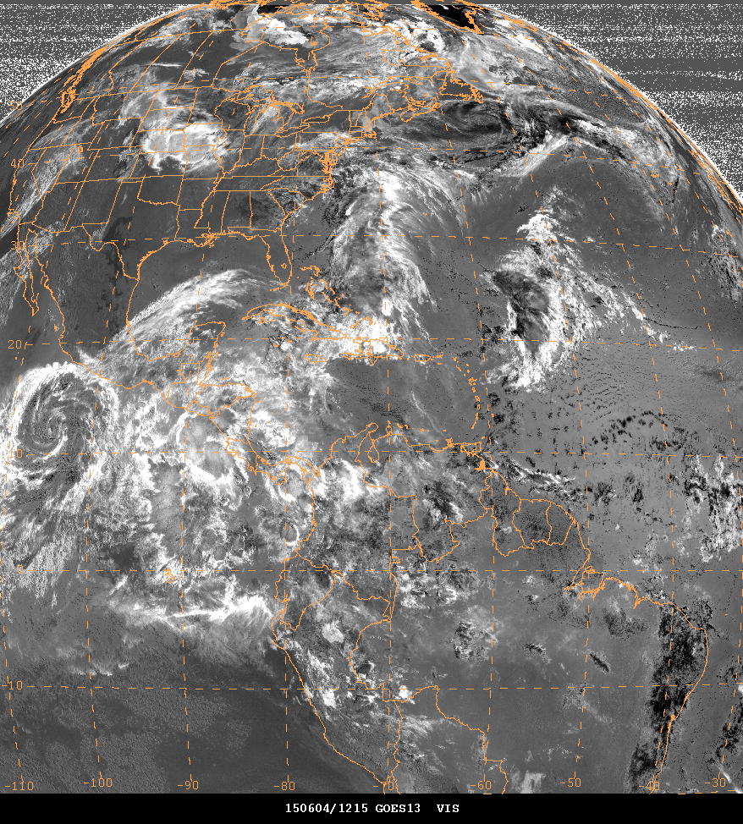
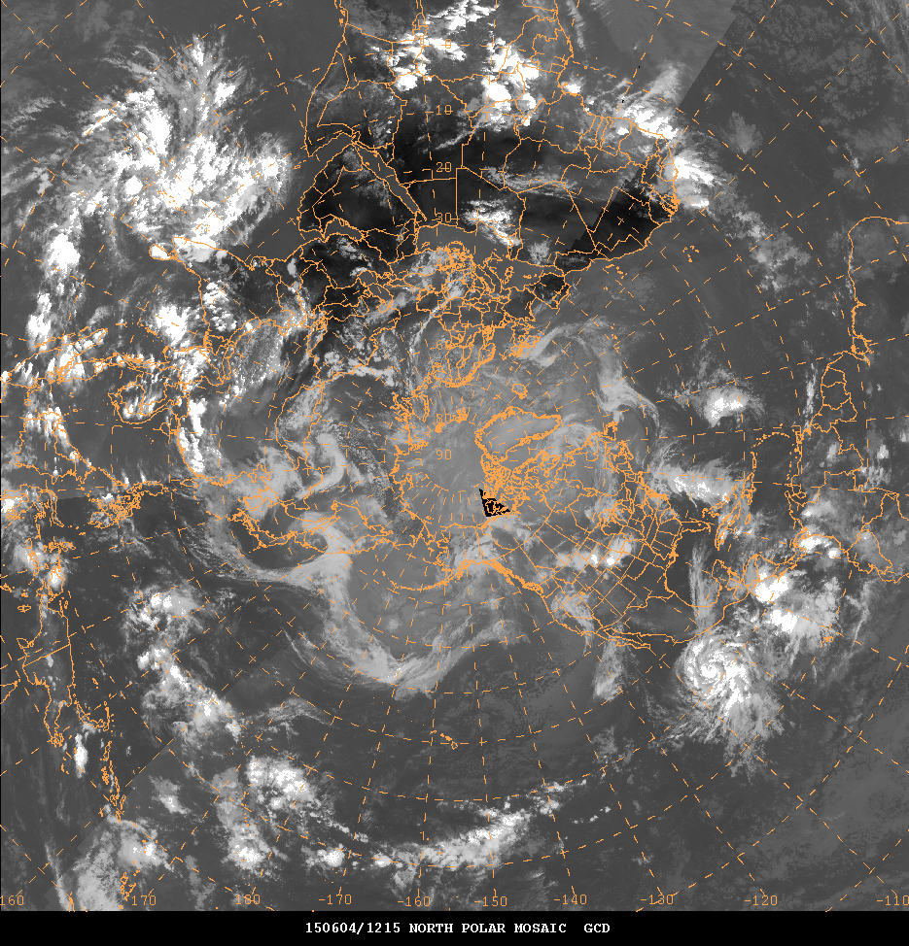
Derived Imagery Convective model/satellite products and ash products

Slide 11
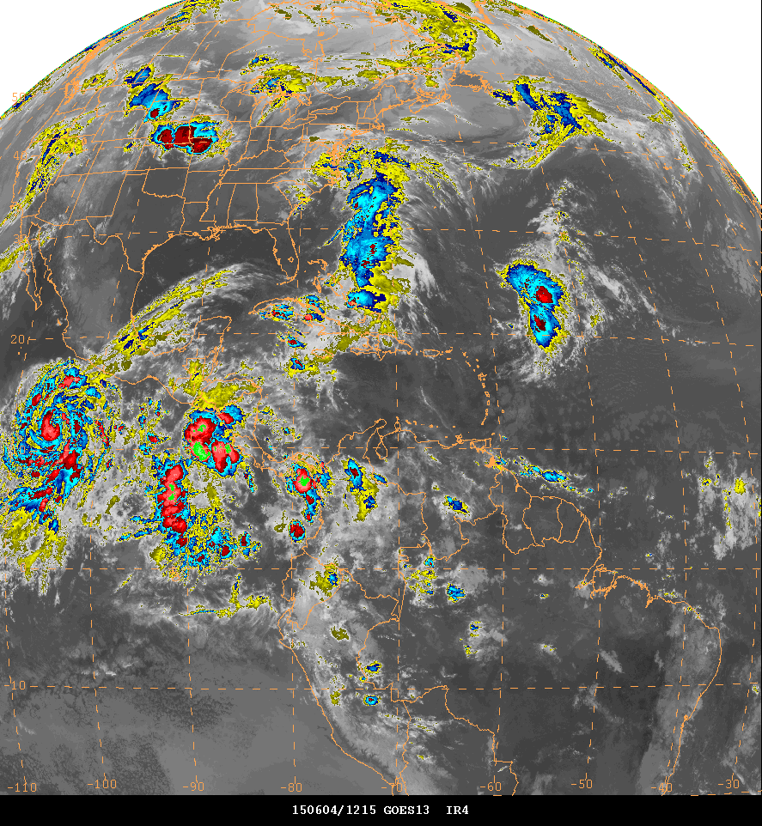
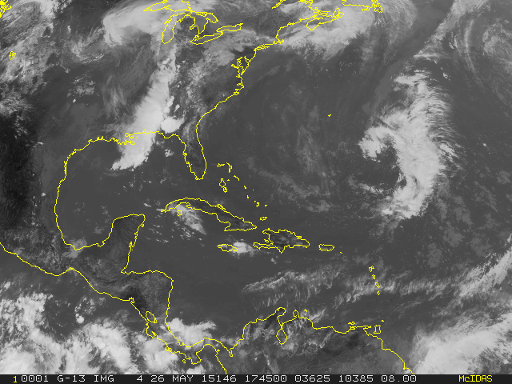
Other sectors Tropical and extended GE/GW coverage

Slide 12
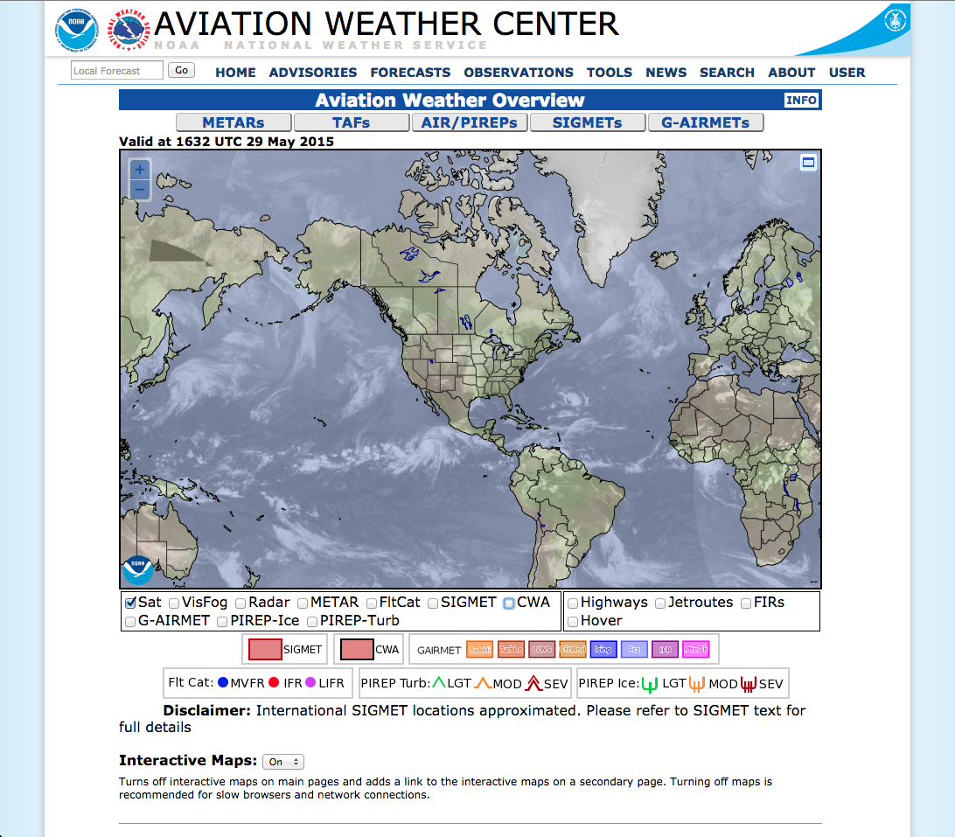
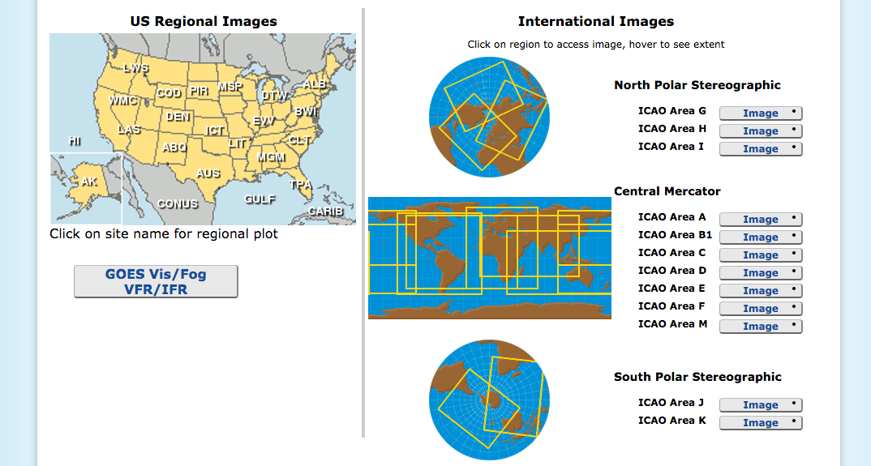
Other sectors Web mosaic imagery

Slide 13
Questions?

