Slide 1
Using McIDAS To Prepare Users For The ABI
Mat Gunshor¹
With help from:
Tim Schmit²
Joleen Feltz¹
Kaba Bah¹
Tom Whittaker³
CIMSS/SSEC
NOAA/NESDIS/ASPB
Retired! Formerly CIMSS/SSEC

Slide 2
Overview
GOES-R ABI represents a major shift in geostationary environmental satellite capability.
We have developed some ABI “Webapps” - tools that anyone can use to educate users and students on a host of topics.
  Spatial, Spectral, & Temporal Improvements of ABI.
  RGB Generation
  Uses of GOES data and Products.
    Fires, hurricanes, convection, fog, winds, etc.
We are prolific McIDAS users both “operationally” but also for image generation going into educational applications and as a hands-on tool.

Slide 3
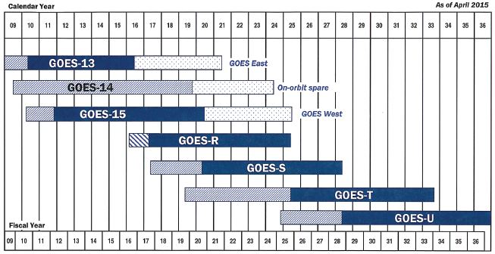
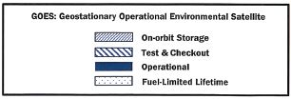

GOES Flyout Chart

Slide 4

Validation and Availability for GOES-R Baseline Products
GOES-R Launch
to 89.5° West
Operations Handover
(includes Products)
On-Orbit East/West
Operations
Milestone:
Program Phase:
Extended Validation
Pre-Launch | PLT (6 months) | Post-Handover
L1b Product Activities
L1b Validation - Products recertified against pre-launch instrument performance
‘First Light’ Data captures shared from Instruments
Insertion of L1b products into GRB service is controlled by ground system and will occur as products are certified
(Figure from Matt Seybold from NOAA Satellite Conference)
Notes:
More precisely: L1b Validation – On-orbit product performance recertified against pre-launch analytically-predicted product performance.

Slide 5
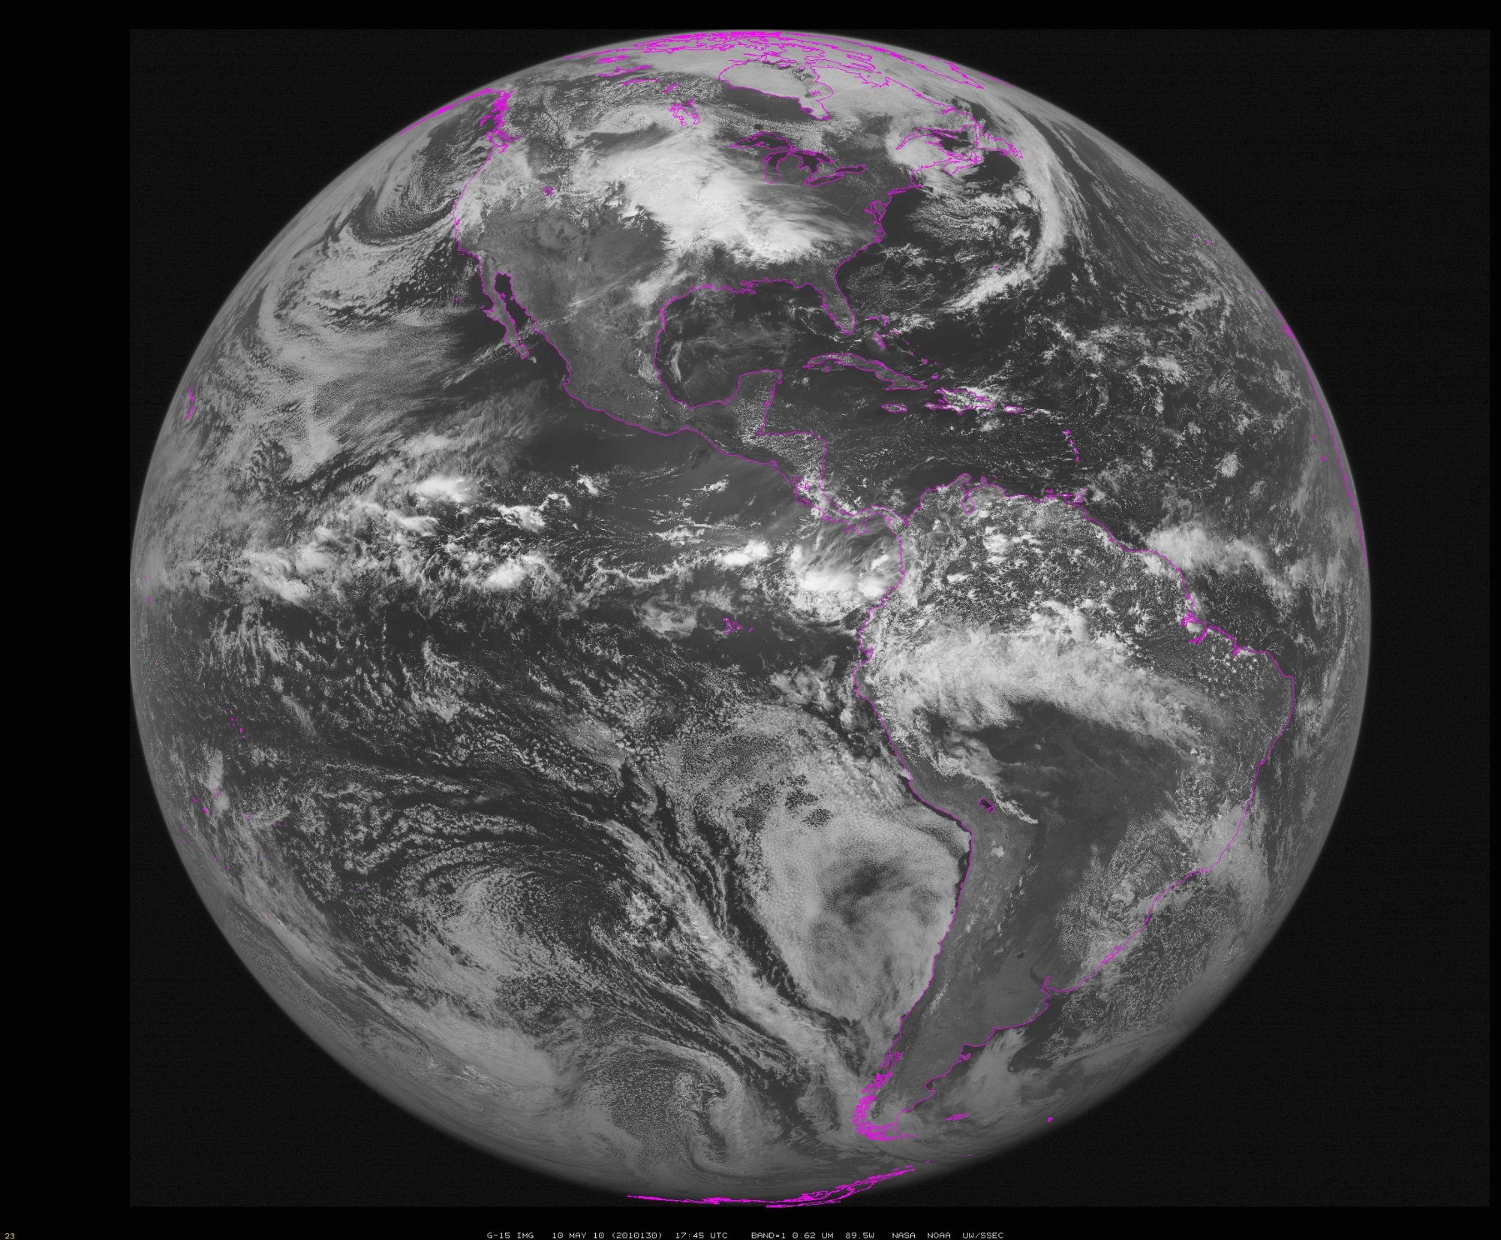
~90W (Approximate location of GOES-R during check-out)
Notes:
Data from SSEC Data Center

Slide 6
The Advanced Baseline Imager:
ABI Current
Spectral Coverage
16 bands 5 bands
6 VIS/NIR & 10 IR 1 VIS & 4 IR
Spatial Resolution
0.64 μm Visible 0.5 km Approx. 1 km
Other Visible/near-IR 1.0 km n/a
Bands (>2 μm) 2 km Approx. 4 km
Spatial/Temporal Coverage
Full disk Every 15 min Scheduled (3 hrly)
CONUS Every 5 min ~4 per hour
Mesoscale Every 30 sec n/a
Visible (reflective bands)
On-orbit calibration Yes No
Notes:
The ABI allows more bands, finer spatial resolution, faster refresh rates and on-orbit calibration of all bands!

Slide 7
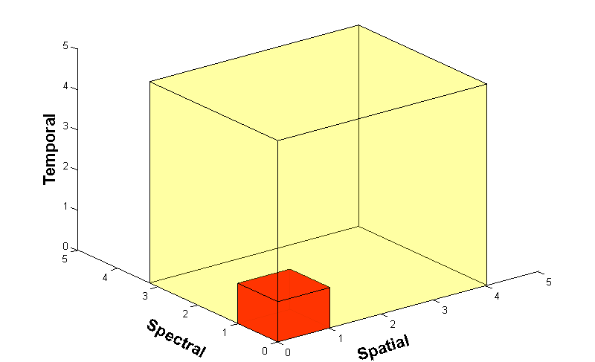
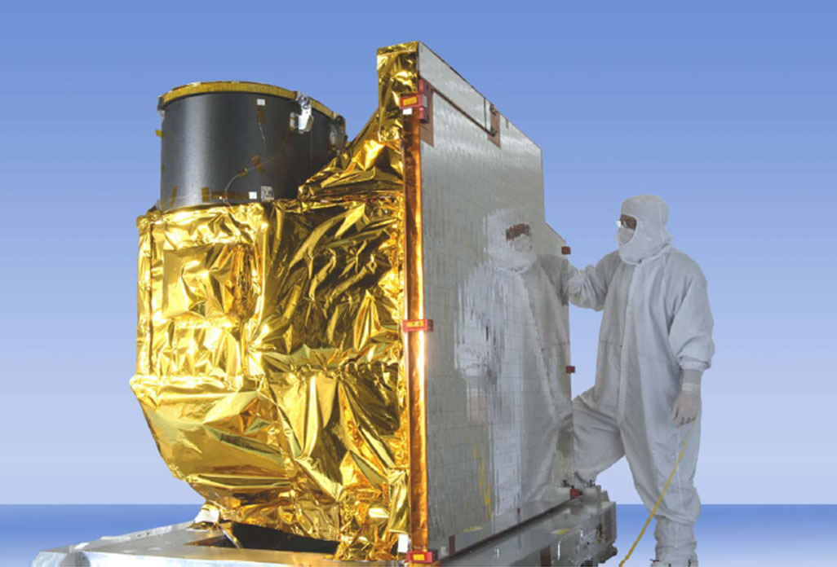
Advanced Baseline Imager
5
4
3
X
Faster coverage
(5-minute full disk vs. 25-minute)
X
Improved spatial
resolution
(2 km IR vs. 4 km)
X
More spectral bands (16 on ABI vs. 5 on the current imager)
Notes:
Slide from J. Gerth, CIMSS.

Slide 8
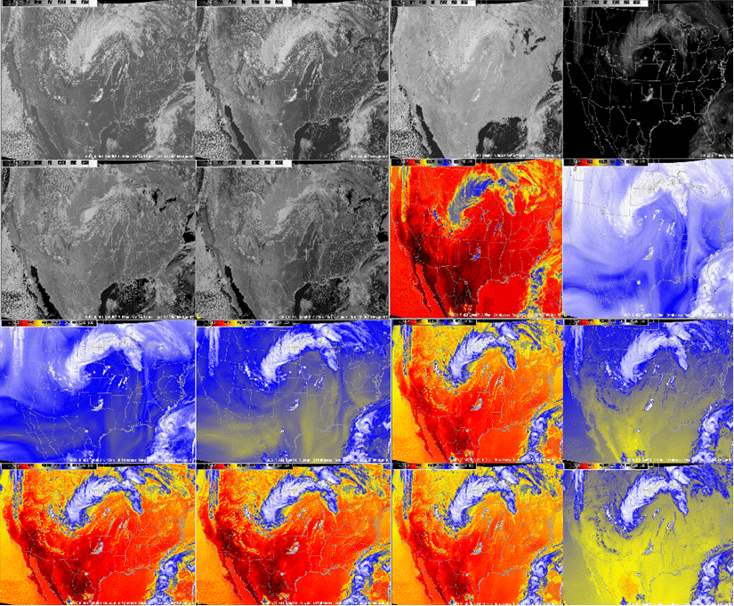
Simulated ABI bands (as shown in AWIPS)
0.47 μm
0.64 μm
0.86 μm
1.38 μm
1.61 μm
2.26 μm
3.9 μm
6.19 μm
6.95 μm
7.34 μm
8.5 μm
9.61 μm
10.35 μm
11.2 μm
12.3 μm
13.3 μm

Slide 9
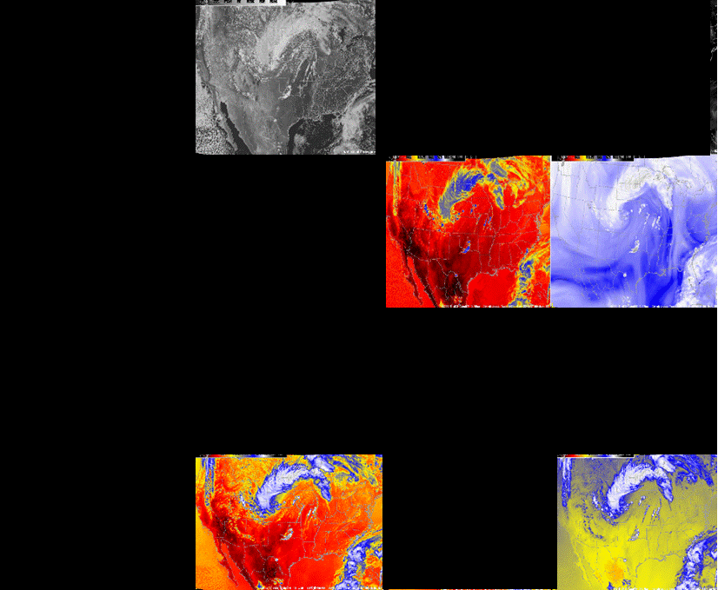
Current GOES Imager band selection

Slide 10
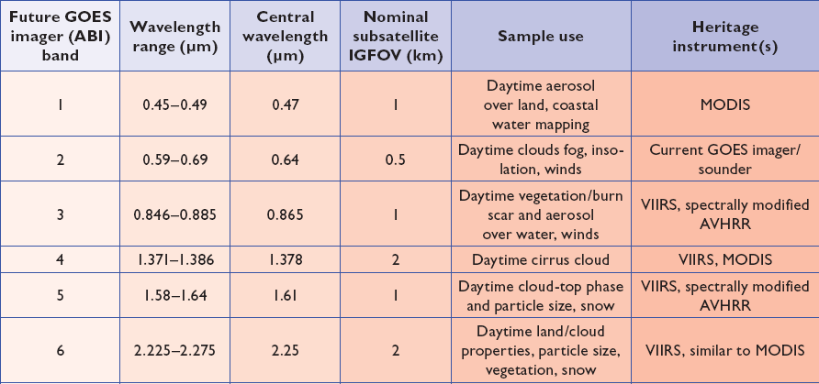
ABI bands 1-6
Approximate:
2 visible bands and 4 near infrared bands on the ABI, compared to only one on today’s imager
Notes:
Final column added: heritage. The ABI band 1 was suggested by Dr. Fred Mosher at a GOES Users' Conference.
The ABI band 3 was suggested by the late Dr. C. Rao (of the then ORA).
Some of these bands have been shifted to more closely match those on the VIIRS.

Slide 11
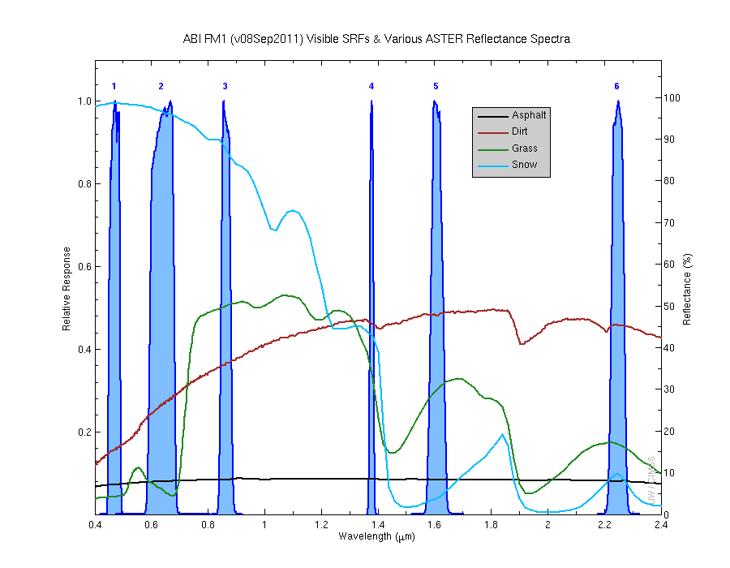
Visible and near-IR channels on the ABI
Aerosols, Insolation
Clouds, Snow
Vegetation, Imagery
Cloud mask, Suspended matter
Snow, Phase
Cloud Particle size
Sample use only, many other uses
The ABI visible and near-IR bands have many uses.
Notes:
Schmit, T. J., M. M. Gunshor, W. P. Menzel, J. J. Gurka, J. Li, and A. S. Bachmeier, 2005: Introducing the next-generation Advanced Baseline Imager on GOES-R. Bull. Amer. Meteor. Soc., 86, 1079-1096.

Slide 12
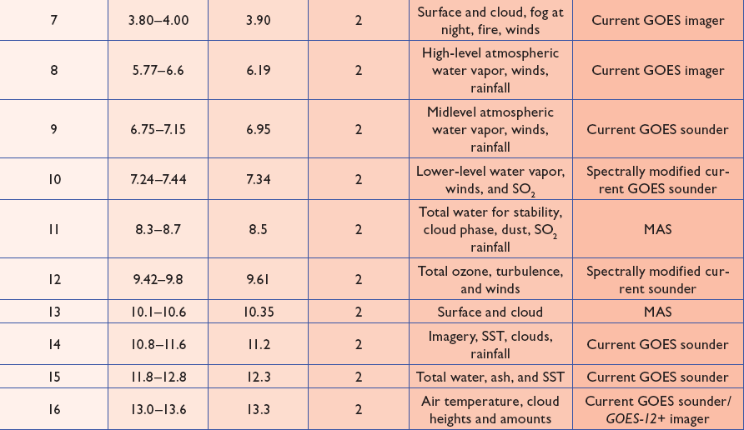
ABI bands 7-16
Approximate:
10 infrared bands on the ABI, compared to four on today’s imager
Notes:
The ABI band 10 was modified to better depict upper-level SO2. (G. Ellrod and others)
The ABI band 11 was suggested by Steve Ackerman (CIMSS), based on HIRS experience.
The ABI band 13 was suggested by W. P. Menzel (then NOAA NESDIS).

Slide 13
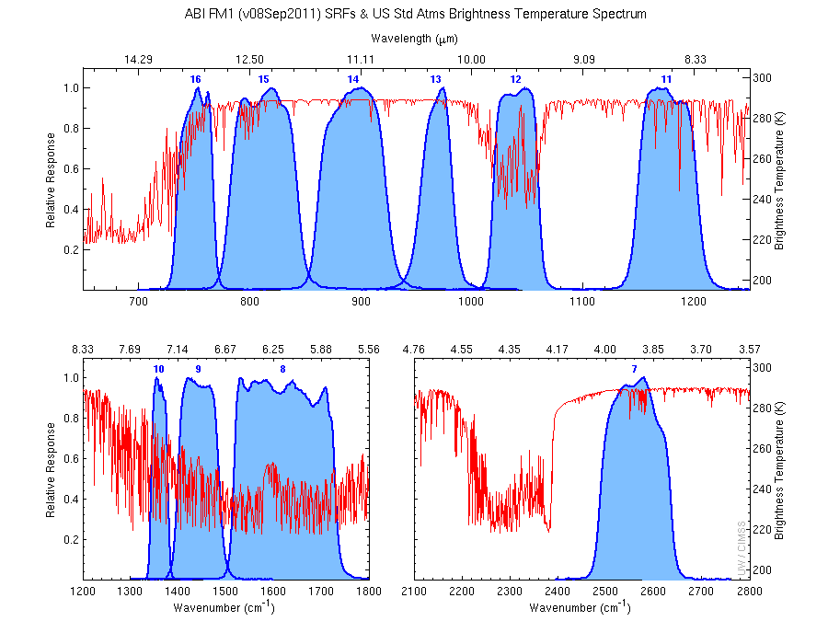
The IR channels on the ABI
Clouds, Stability Indices
Cloud Phase, SO2, dust
Fires, Radiances
Ozone, Downward Radiation
Rainfall, Aerosol
Hurricane, Imagery
Sample use only, many other uses
SO2, Radiances
Winds, WV profiling
TPW, Rainfall rate
Fires, Fog
ABI has many more bands than the current operational GOES imagers.
Notes:
Schmit, T. J., M. M. Gunshor, W. P. Menzel, J. J. Gurka, J. Li, and A. S. Bachmeier, 2005: Introducing the next-generation Advanced Baseline Imager on GOES-R. Bull. Amer. Meteor. Soc., 86, 1079-1096.

Slide 14
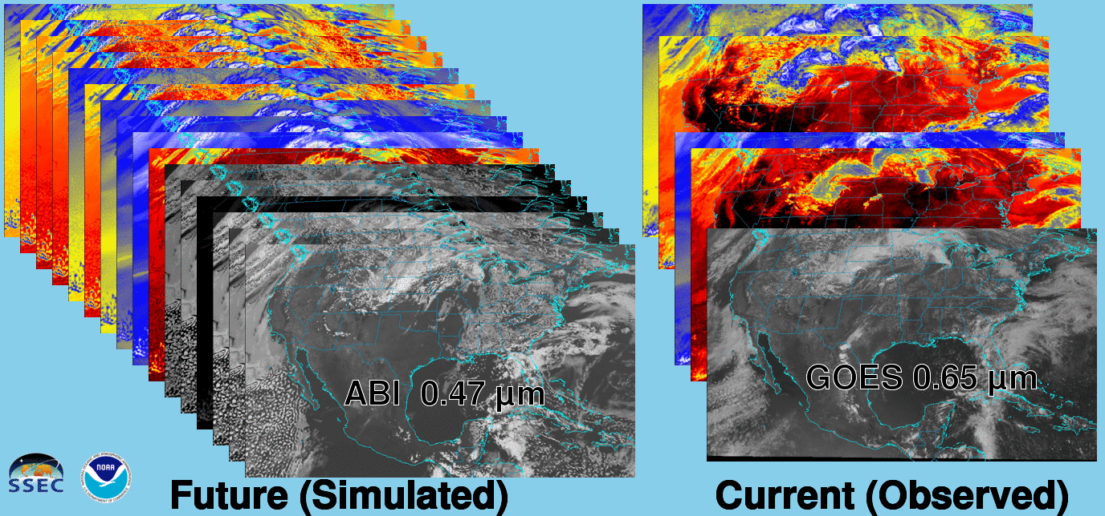
Future vs. Current Spectral Bands
The current GOES (right) has 5 spectral bands, while the GOES-R series ABI (left) will have 16 spectral bands.

Slide 15
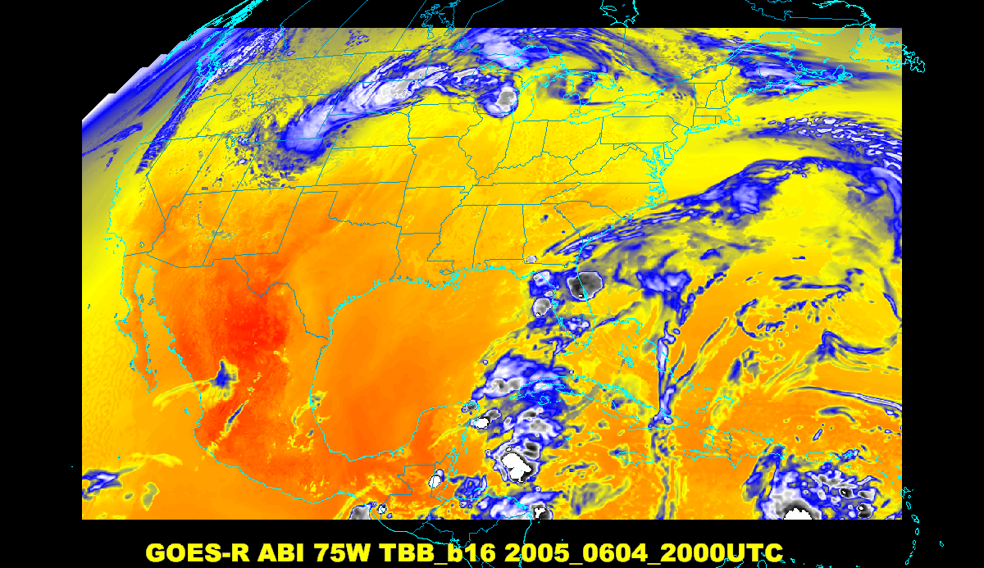
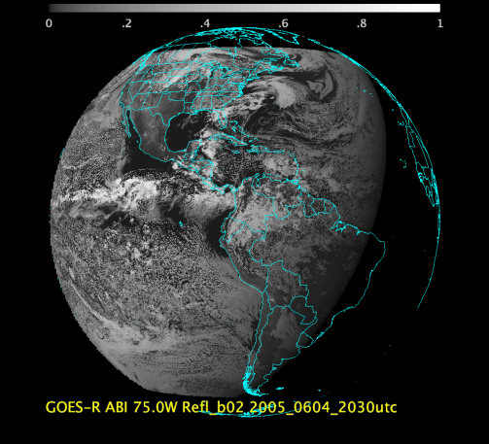
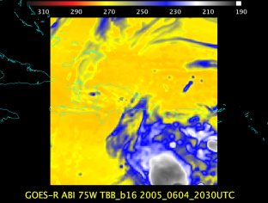
Baseline ABI Scan Modes
Scan mode (3) or ‘flex mode’ for the ABI:
- Full disk every 15 minutes + 5 min CONUS
+ 1-min mesoscales (2 locations).
[Scan mode (4) or ‘Continuous Full Disk’ (CFD) is a full disk every 5 min]
Notes:
CONUS image is the shifted center point.

Slide 16
Recent Mode 3 (Flex mode)
“Time-Time” chart
Note the ‘white’ space is instrument idle time.
Draft
Notes:
Copy and pasted from excel. Pasted as a picture. Resized to 44% by 44% of original. Arrange -> Align -> Align Center & Align Middle

Slide 17
Baseline Time-Time Mode 4
(Continuous Full Disk)
This is the Continuous Full Disk (every 5 min) mode
This is the highest data rate.

Slide 18
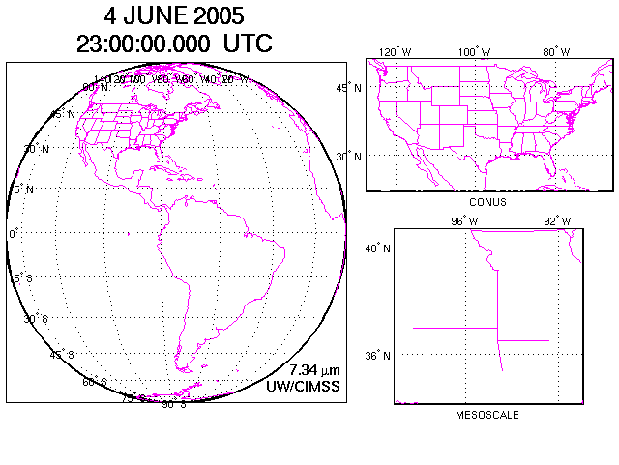
Figure courtesy of J. Li, CIMSS
Concept of flex mode scanning animation

Slide 19
Draft Scan Mode ”6” with 10-min FD
In 10-min:
  1 Full Disk +
  2 CONUS +
  20 Meso-scale
The 10-min Full Disk would offer synergy with other geos and improved AMVs outside of CONUS, plus still allow for meso-scale observations.
This draft mode 6 ideally could be tested during PLPT (Post Launch Products Test).
This mode should be easier to implement at the Ground System, sense the scan sectors are the same size/locations as in mode 3.
DRAFT!

Slide 20
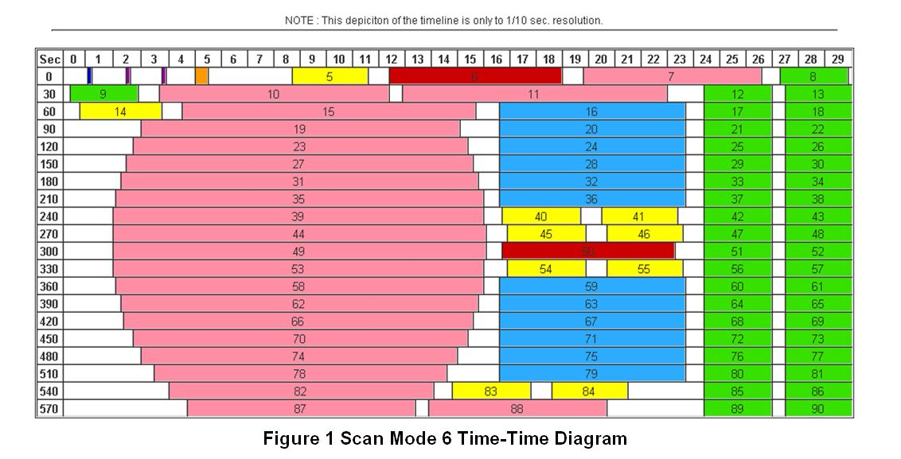
Draft Scan Mode ”6” with 10-min FD
Note less ‘white space’ than scan mode 3 (flex mode)
Matches EUMETSAT, JMA, and others for full disk cadence
Time-time diagram from Exelis
Notes:
Copy and pasted from excel. Pasted as a picture. Resized to 44% by 44% of original. Arrange -> Align -> Align Center & Align Middle

Slide 21
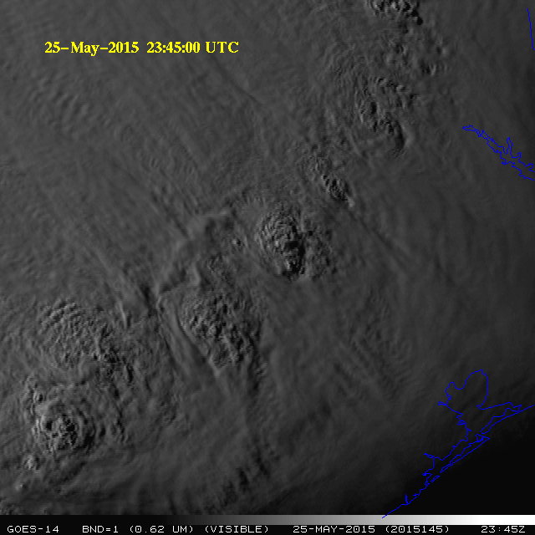
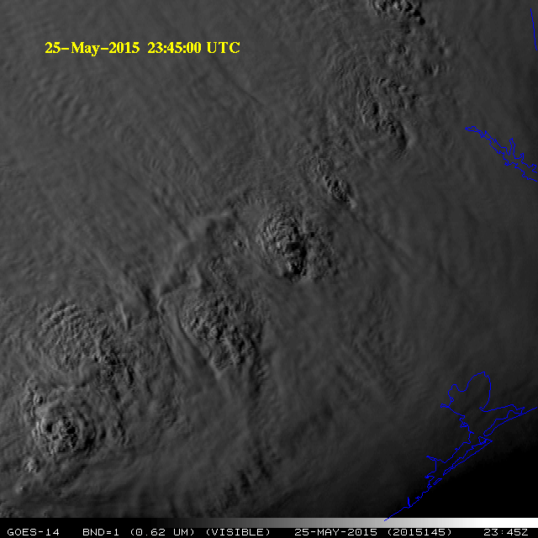
GOES-14 Super Rapid Scan Operations to Prepare for GOES-R (SRSOR)
SRSOR for 2015 include May 18-June 12, and August 10-22:
  http://cimss.ssec.wisc.edu/goes/srsor2015/GOES-14_SRSOR.html
  Data during parts of 2012 (Hurricane Sandy, convection), 2013 (CA Rim Fire, convection) and 2014 (Hurricane Marie, convection):
  http://cimss.ssec.wisc.edu/goes/srsor/GOES-14_SRSOR.html
  http://cimss.ssec.wisc.edu/goes/srsor2013/GOES-14_SRSOR.html
  http://cimss.ssec.wisc.edu/goes/srsor2014/GOES-14_SRSOR.html
GOES-14 provided very unique data and offered a glimpse into the possibilities that will be provided by the ABI on GOES-R in one minute mesoscale imagery
GOES-14 visible image showing rapid convection
(loops over just half an hour)
Notes:
http://cimss.ssec.wisc.edu/goes/srsor2015/GOES-14_SRSOR.html

Slide 22
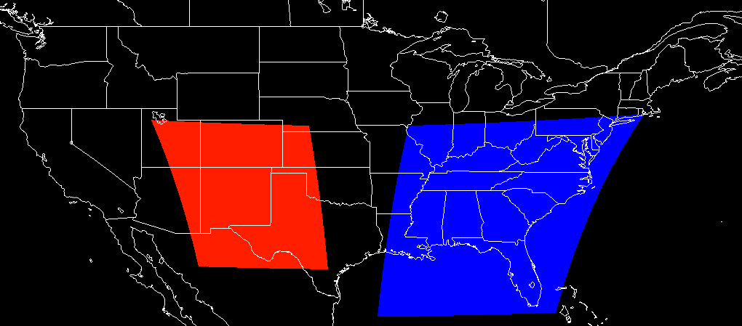
SRSOR vs Meso
GOES-R ABI (Meso)
1 per minute for 2 locations
Operational
(with FD + CONUS)
GOES (SRSOR)
~1 per minute
Experimental
(no other imagery)

Slide 23
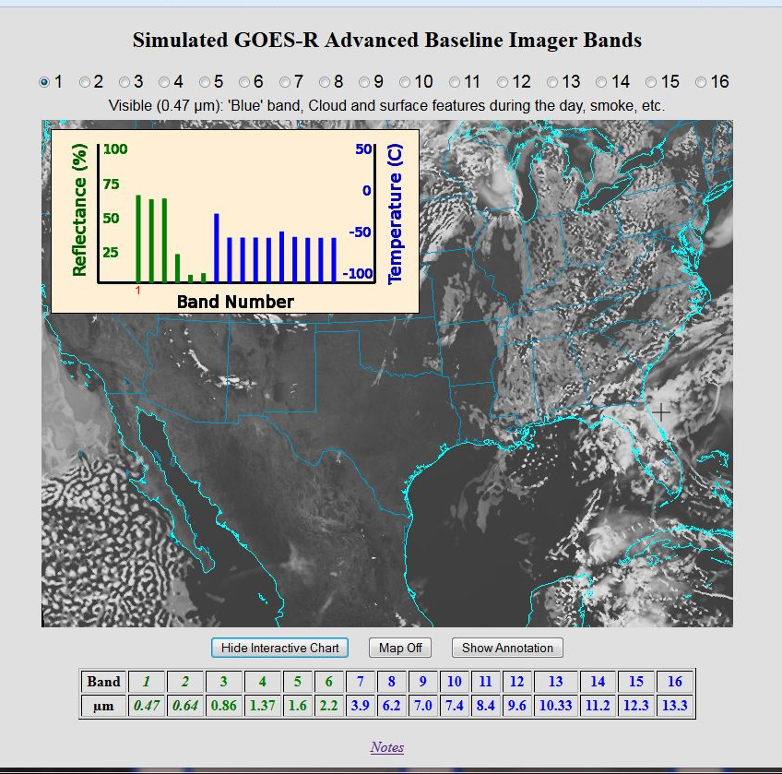
Educational Webapps Developed
NOAA NESDIS ASPB teamed up with CIMSS researchers to develop three educational WebApps to explore space, time and spectral resolutions of satellite imagery.
Part of the GOES-R Educational Proving Ground at CIMSS:
http://cimss.ssec.wisc.edu/education/goesr
Teacher feedback:
“…. Wow!! This is awesome!!
This is impressive. Thank you for sharing. This is great. Thanks for all your hard work and help!!!!
We are honored and will use it next week … Earth SySTEM Teacher Academy”
Sample interactive “Bandapp” educational webapp using simulated ABI images:
http://cimss.ssec.wisc.edu/goes/webapps/bandapp/
Notes:
Tim Schmit, ASPB
https://ams.confex.com/ams/95Annual/webprogram/Paper265203.html ABI = Advanced Baseline Imager
Other new webapps: one to change both the spatial and temporal sampling and the other only the pixel sampling

Slide 24
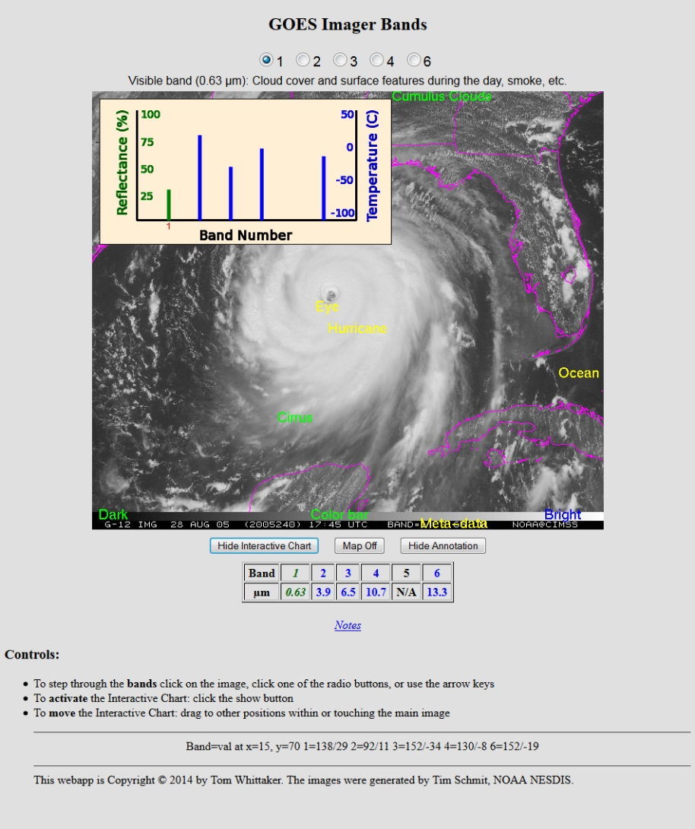
There are also several case studies using current GOES imagery (5 spectral bands)
with the option to add descriptive annotations,
or add map outlines.

Slide 25
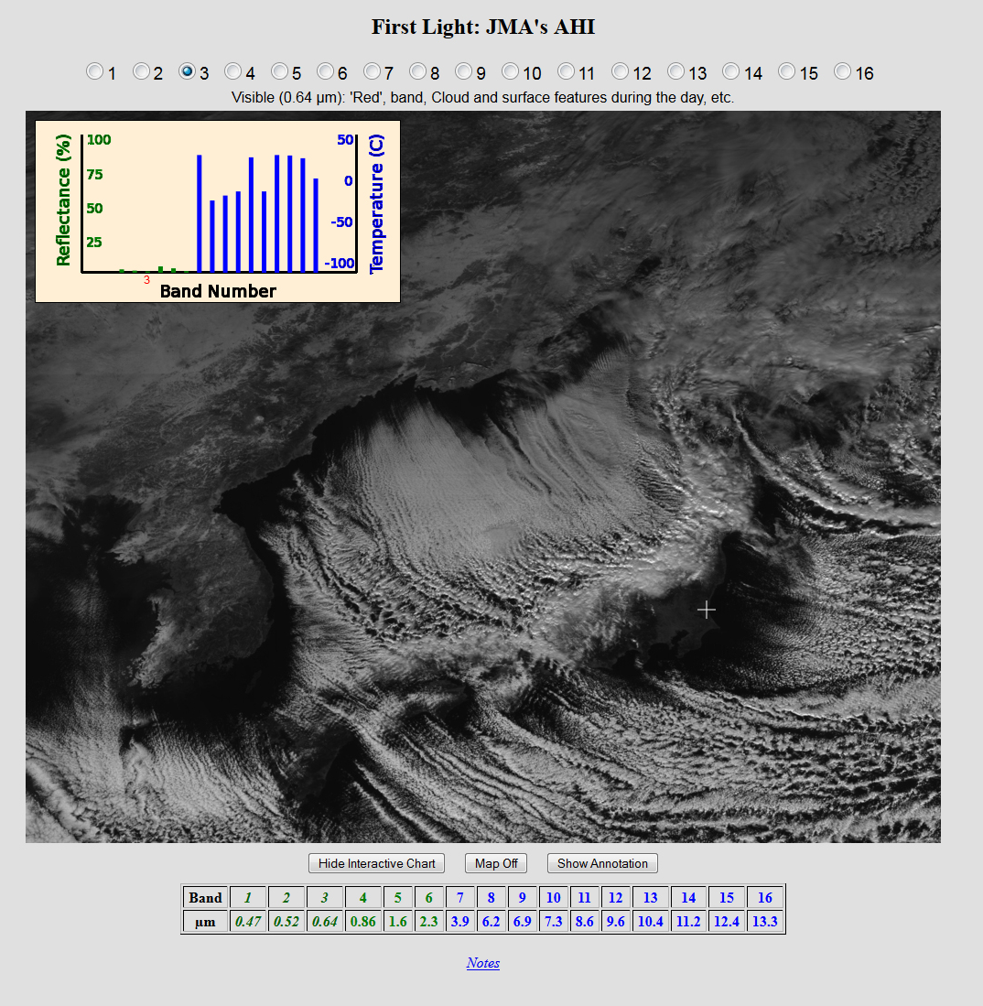
Mouse over anywhere in the image to get an interactive pop-up chart that provides data (reflectance
& temperature)
for each band at that location.

Slide 26
Hands-on…Spectral
Step through the ABI spectral bands (and turn on the interactive chart)
  One of the simulated cases
  http://cimss.ssec.wisc.edu/education/apps/bandapp/overview_goes-r.html
  or
  http://cimss.ssec.wisc.edu/goes/webapps/bandapp/
Or step through the AHI spectral bands (and turn on the interactive chart)
  One of the observed cases
  http://cimss.ssec.wisc.edu/education/apps/bandapp/overview_ahi_first_images.html
  or
  http://cimss.ssec.wisc.edu/goes/webapps/bandapp/overview_ahi_first_images.html

Slide 27
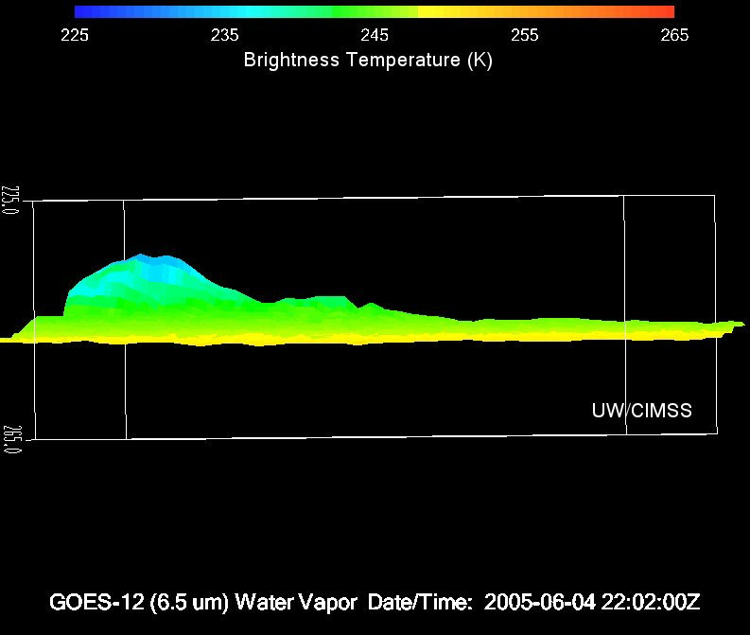
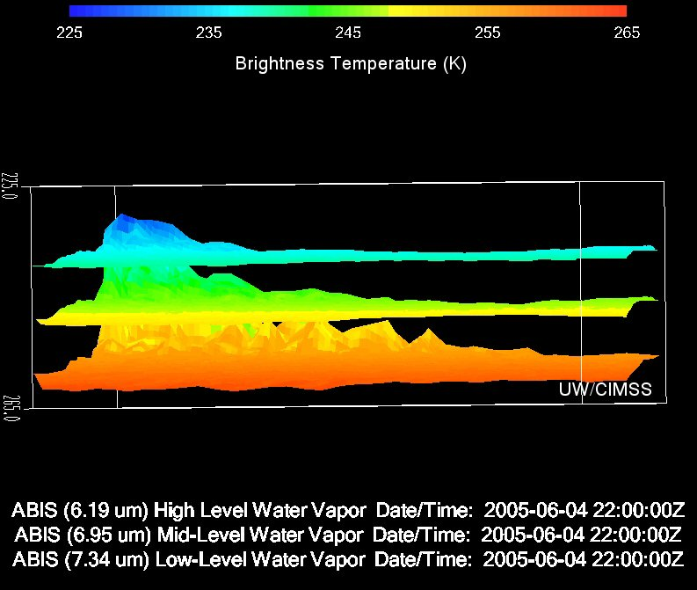

Three ABI water vapor bands
Current GOES
Future GOES
Images from J. Feltz
Notes:
Note the 3 layers of information possible from the ABI (right panel).
http://www.ssec.wisc.edu/mcidas/software/v/

Slide 28
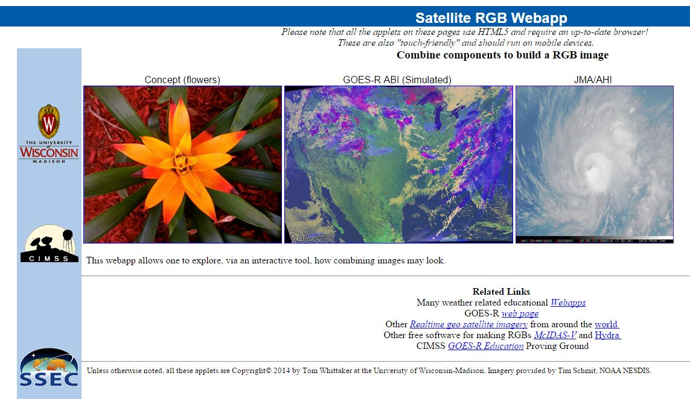
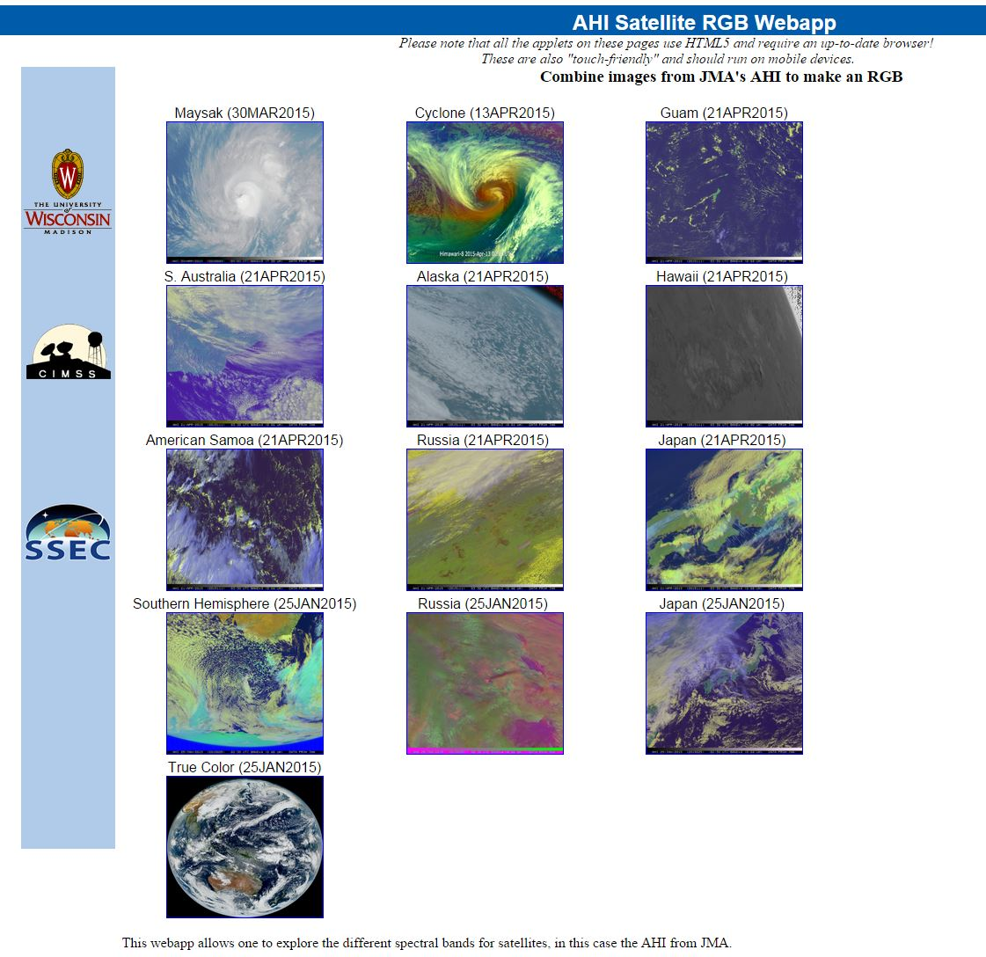
RGB Web App

Slide 29
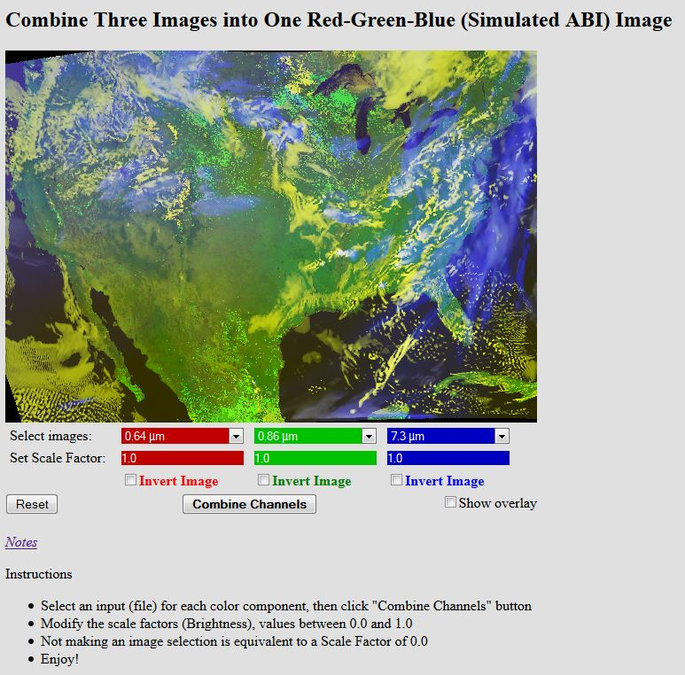
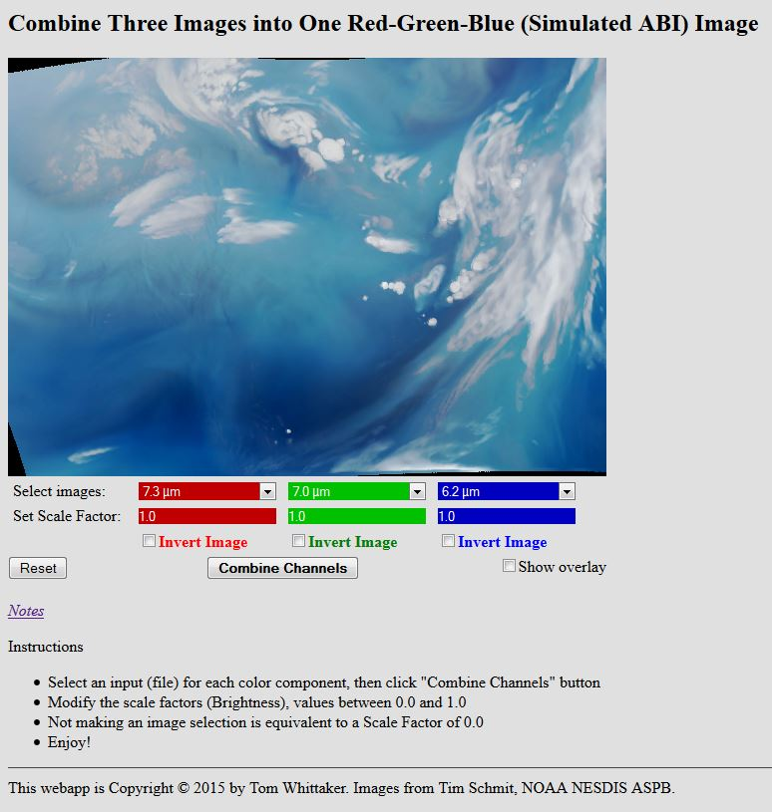
Sat RGB
Select an input for each band
Click “Combine Channels”

Slide 30
Hands-on….Red-Green-Blue
Combine the bands to bring out a feature of interest
  http://cimss.ssec.wisc.edu/goes/webapps/satrgb/overview.html
  One of the simulated ABI cases
  http://cimss.ssec.wisc.edu/education/apps/bandapp/overview_goes-r.html
  One of the observed AHI cases
  http://cimss.ssec.wisc.edu/goes/webapps/satrgb/overview_ahi.html

Slide 31
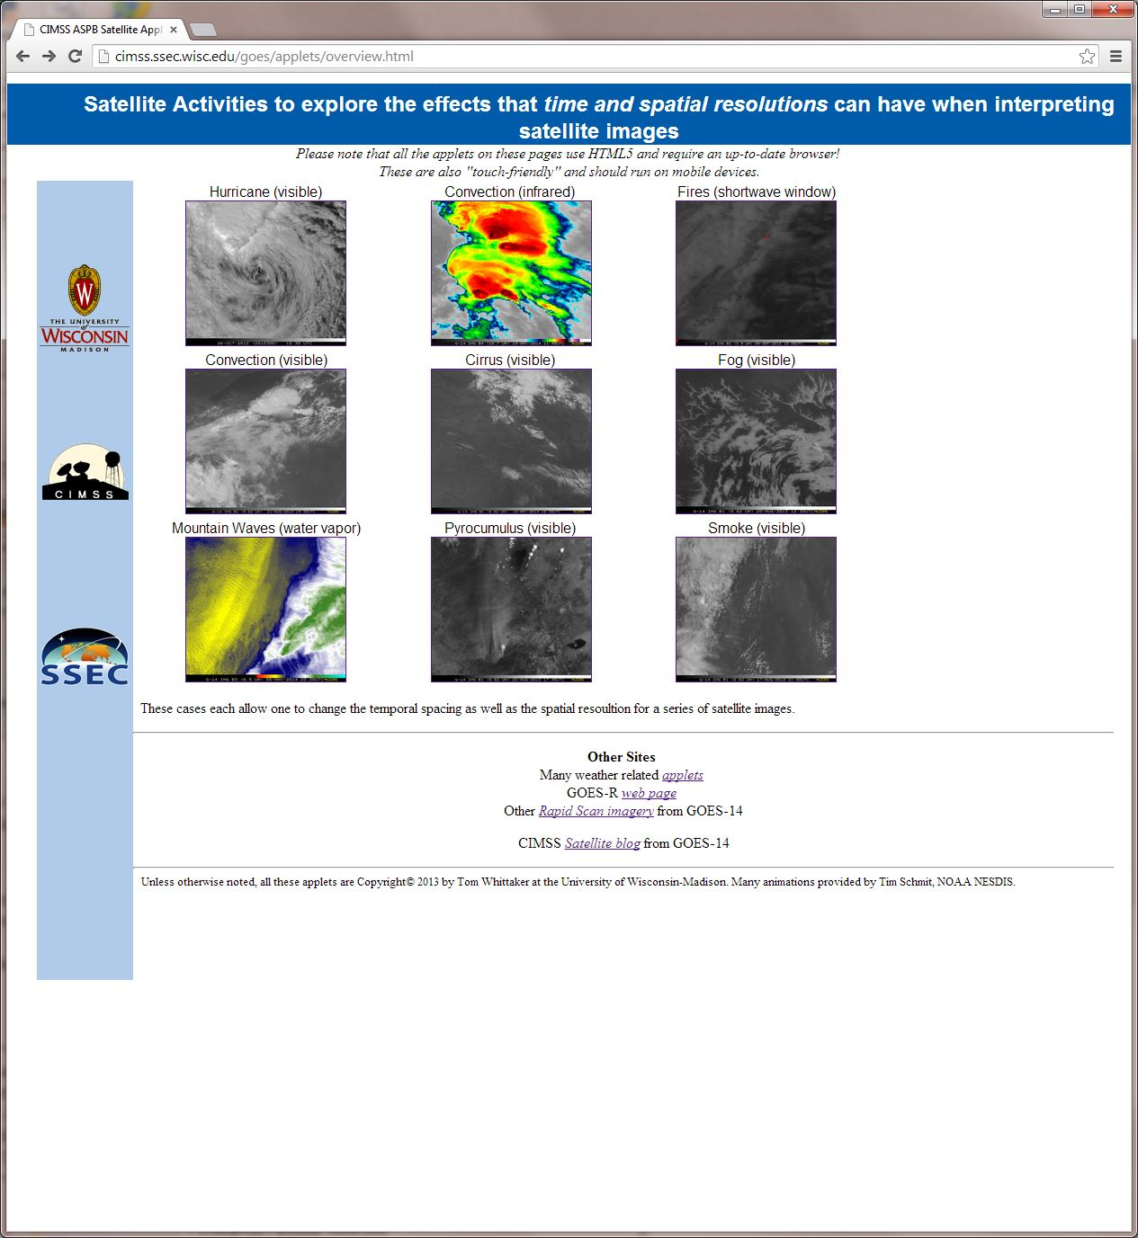
http://cimss.ssec.wisc.edu/goes/applets/overview.html

Slide 32
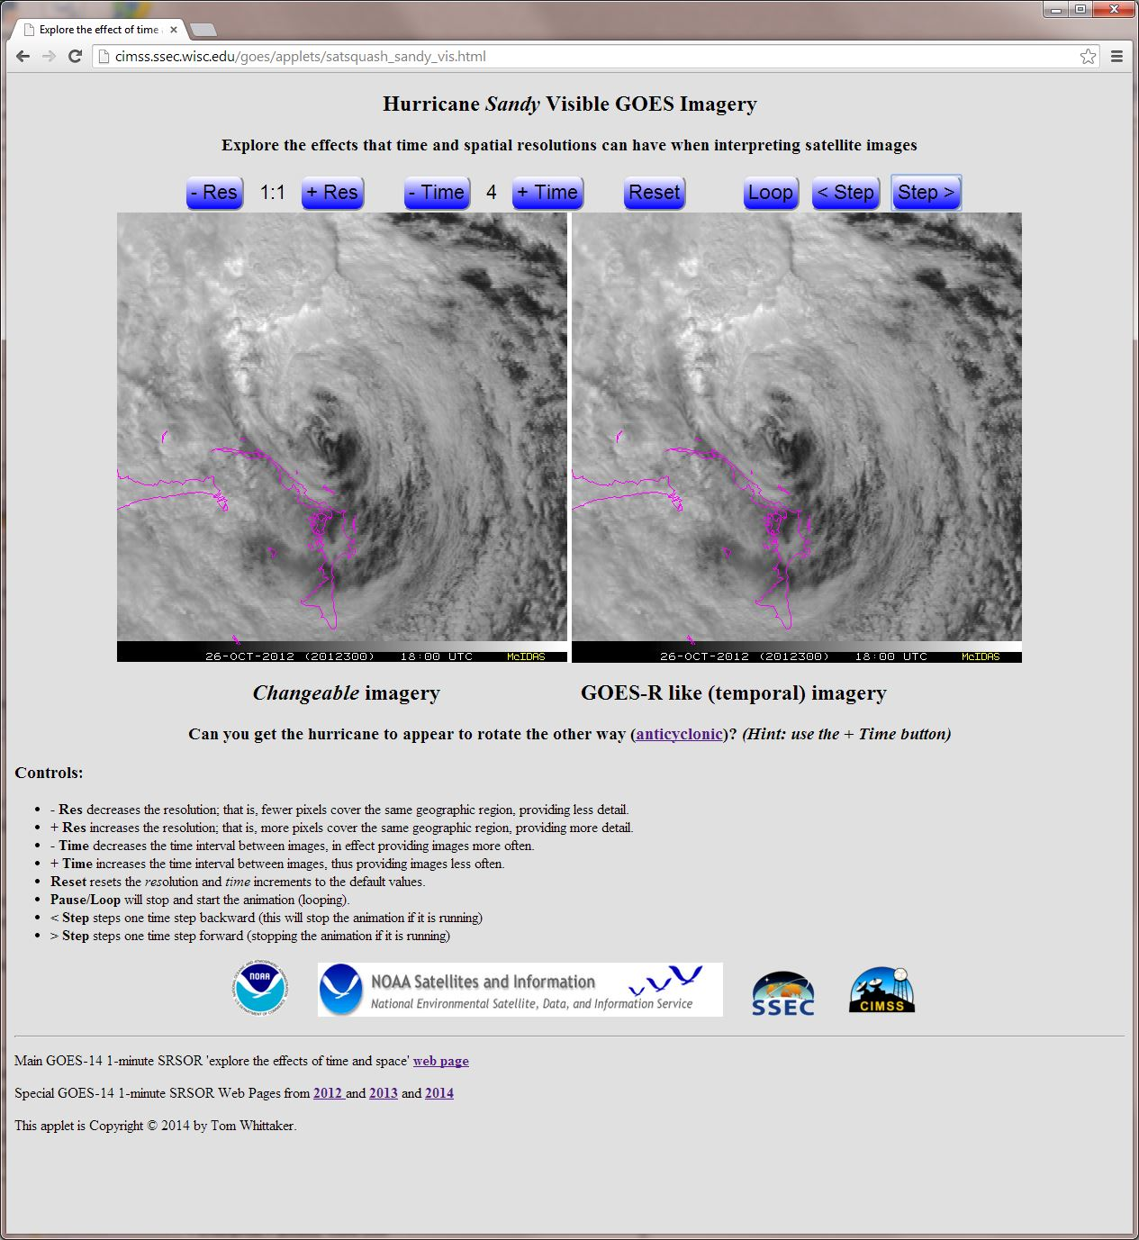

Slide 33
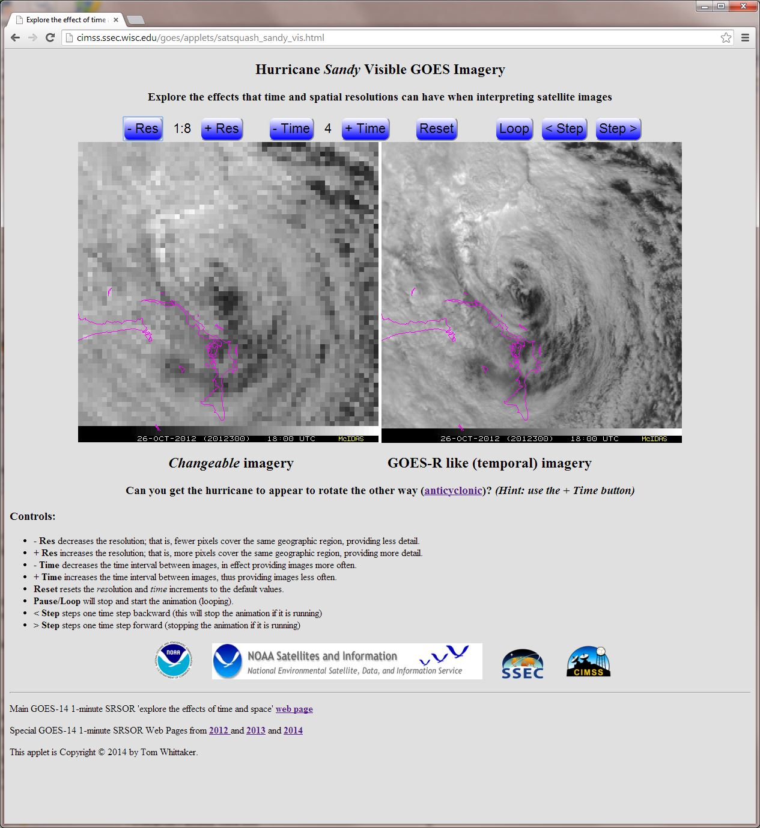

Slide 34
Hands-on….Temporal/Spatial
Choose a case to example the temporal and/or spatial resolutions:
  http://cimss.ssec.wisc.edu/goes/applets/overview.html
  or
  http://cimss.ssec.wisc.edu/education/apps/abi/
Via temporal sampling, can you get Hurricane Sandy to appear to rotate backwards?
Can you observe an enhanced v signature in the IR case over MN?

Slide 35
Summary
GOES-R ABI represents a major shift in capability that users need to be preparing for.
  Currently focused on Broadcast Meteorologists
  Tim Schmit, Scott Lindstrom, Chris Schmidt and others are in Raleigh, NC at the AMS Broadcaster’s Conference giving an all-day Short Course.
ABI “Webapps” are terrific “hands-on” tools that anyone can use to educate users and students on a host of topics.
  Spatial, Spectral, & Temporal Improvements of ABI.
  RGB
  Uses of GOES data and Products.
    Fires, hurricanes, convection, fog, winds, etc.
  Educational imagery produced with McIDAS-X and –V.

