Slide 1
Using the McIDAS-V Scripting API for Daily Research Tasks
Presenter: Joleen Feltz*
Mark Kulie*, Mike Hiley*, Tim Schmit**, Mat Gunshor*
*Cooperative Institute for Meteorological Satellite Studies/ Space Science and Engineering Center (SSEC/CIMSS) University of Wisconsin-Madison
**NOAA/NESDIS/Satellite Applications and Research Advanced Satellite Products Branch (ASPB)
Including work of
Kris Bedka (NASA Langley Research Center)
Martin Setvák (Czech Hydormeteorlogical Institute)
8-11 June 2015: McIDAS User’s Group Meeting

Slide 2
McIDAS-V Scripting API
McIDAS-V Scripting API uses the jython programming language. Core python commands are available (Great help on web!)
McIDAS-V Scripting API provides the ability to access ADDE data, load netCDF/hdf files, control display layers, capture movies/images
McIDAS-V Scripting API is under active development. Added capabilities are expected

Slide 3
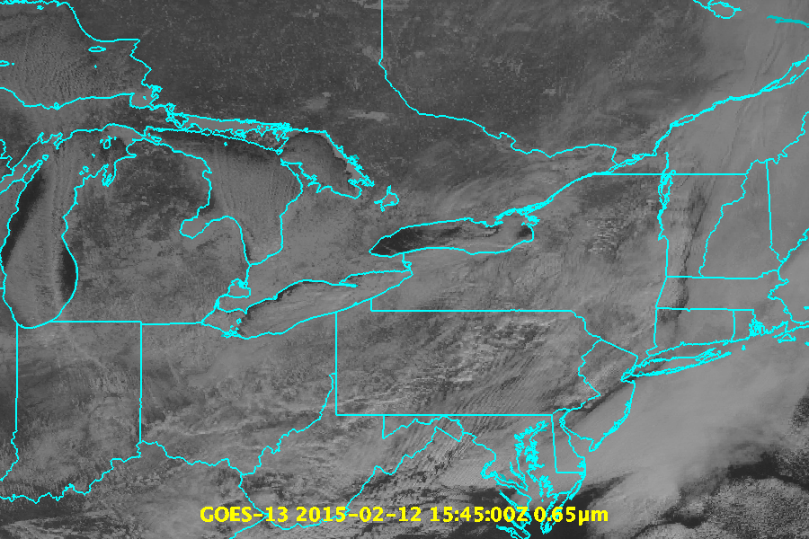
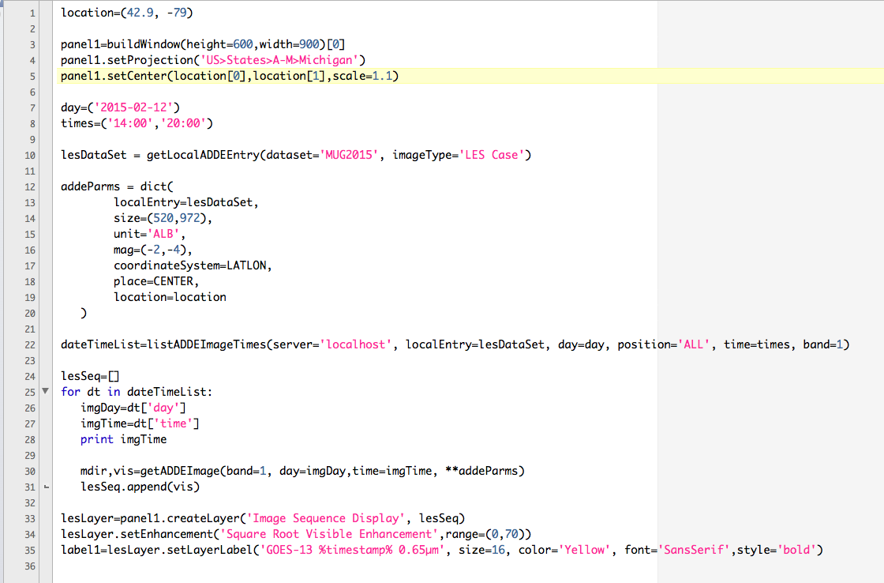
Notes:
One of the projects I work on at SSEC/CIMSS is the satellite derived Lake Effect Snow Project. For that project, I perform a task that is pretty common in McIDAS-X. I display a series of images, set an enhancement and layer label and view the image sequence. (Integrated total cloud water over whole column)

Slide 4
Possible Applications for McIDAS-V in Lake Effect Snow Project
Currently create scatter plots/density plots in IDL
These plots compare radar snowfall rate observations to satellite derived observations over many cases
Employ the geospatial aspect of the HYDRA scatter analysis, and select points either geographically or on the scatter analysis and accumulate those points over time.

Slide 5
Possible Applications for McIDAS-V in Lake Effect Snow Project (continued)
Keep the selected points of lat/lon time, value for the satellite point, and value for the radar point in a data object which can be written to a netCDF file when complete.
Generate statistics on the fly with multiple fields. Use ground data as a first order evaluation, radar and satellite. Use McIDAS-V to view all the data as a whole before creating/altering satellite derived LES algorithm.
Radar data can be extremely hard to read into software such as IDL. The user has to know the data structure well. McIDAS makes displaying radar data easier.

Slide 6
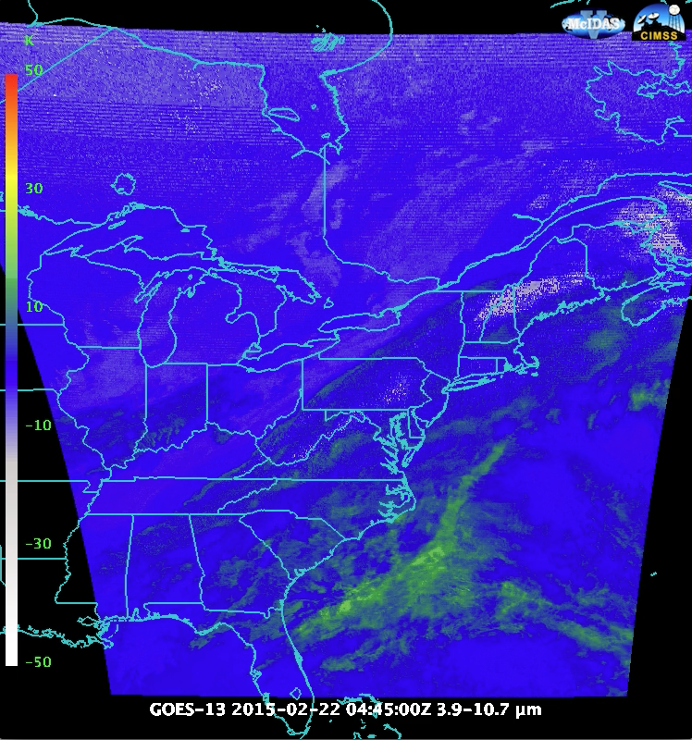
Stray light Contamination

Slide 7
Stray light contamination is
Easy to see in shortwave (swir) – longwave (lwir) IR animations
Easy to see in (swir – lwir) histograms
Difficult to identify by mean, percentage of swir-lwir pixels which fall in the extreme < -15 K or larger bin, or skewness alone.
Detection in a time series analysis?

Slide 8
Visualization Examples
Sandwich Product
Blends Thermal and Visible Channels
Sandwich Product by Martin Setvák (Czech Hydormeteorlogical Institute)
Convection Working Group: http://essl.org/cwg/?p=417
Notes:
Usually this done by blending satellite layers in an image editing package.

Slide 9
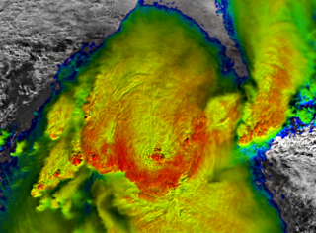
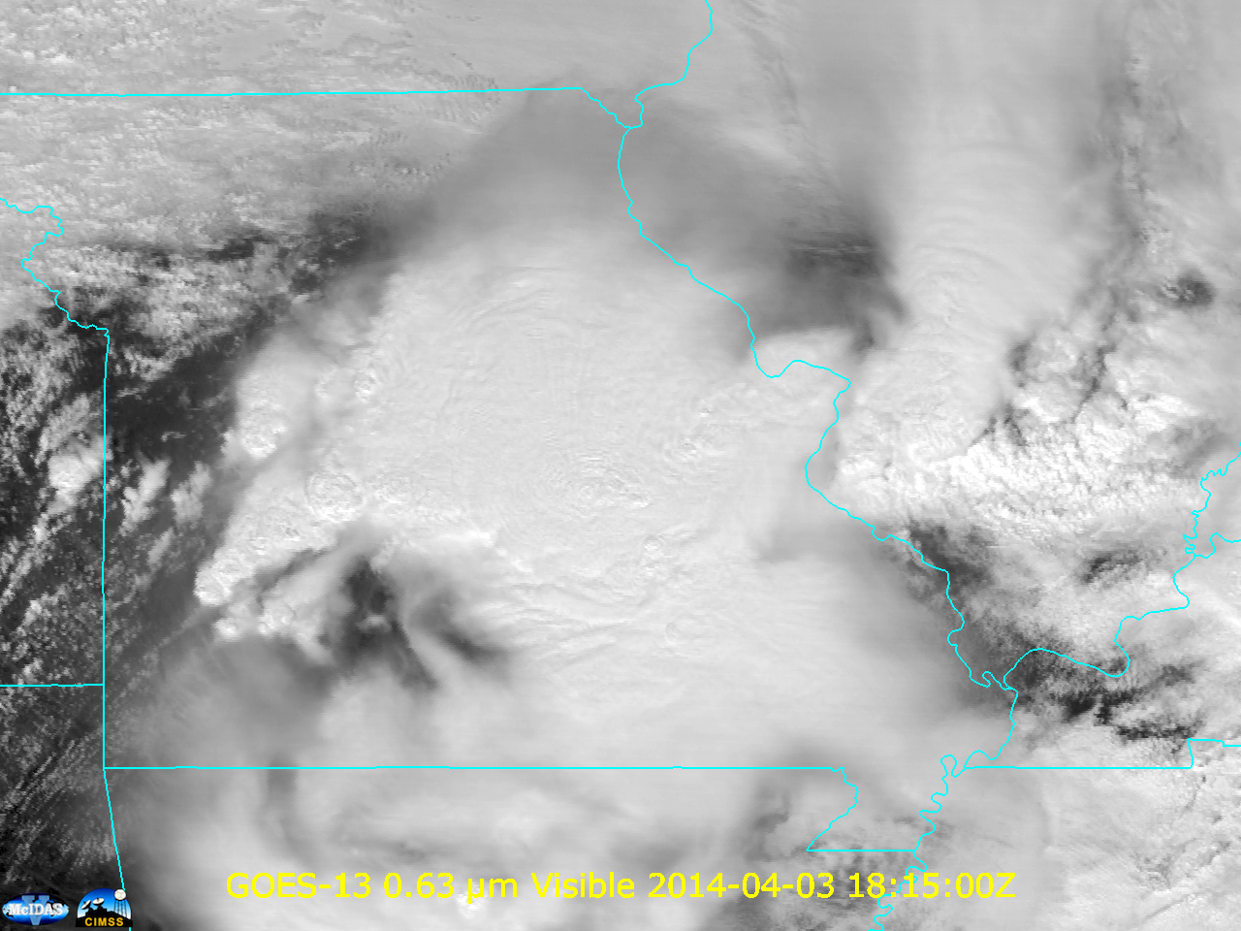
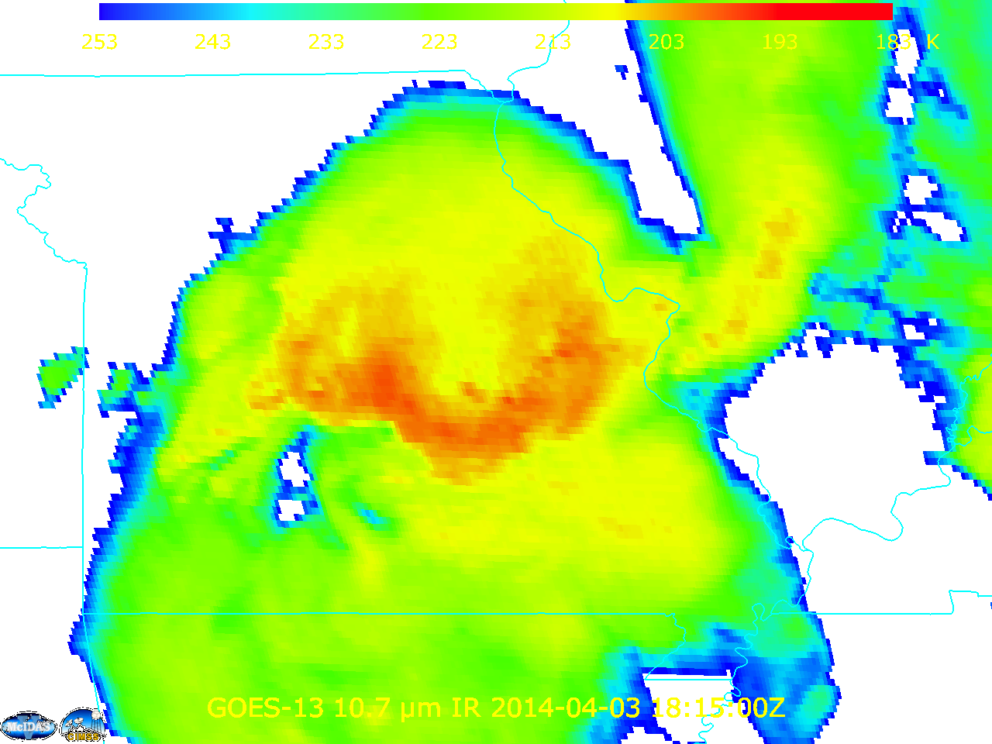
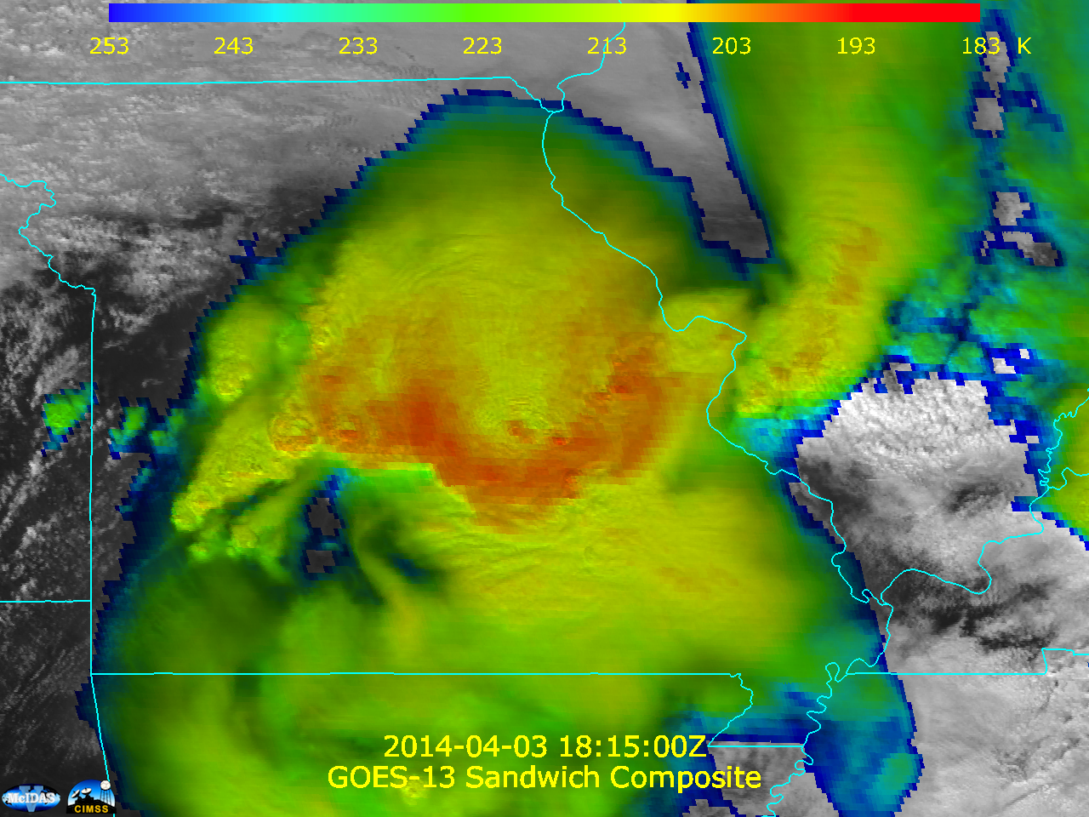
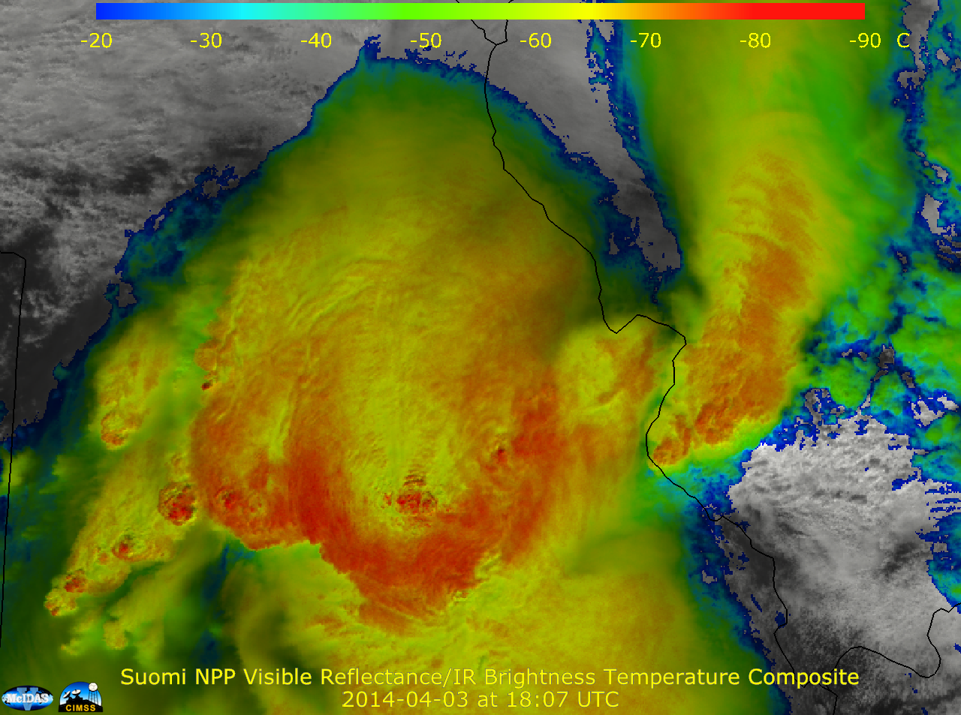
Visualization Examples
Notes:
Usually this done by blending satellite layers in an image editing package.

Slide 10
Better Sandwich Product in McIDAS-V
Look forward to GOES-R that promises higher spatial resolution in the longwave IR window.
In an ideal case, the thermal sensor spatial resolution matches the visible sensor.

Slide 11
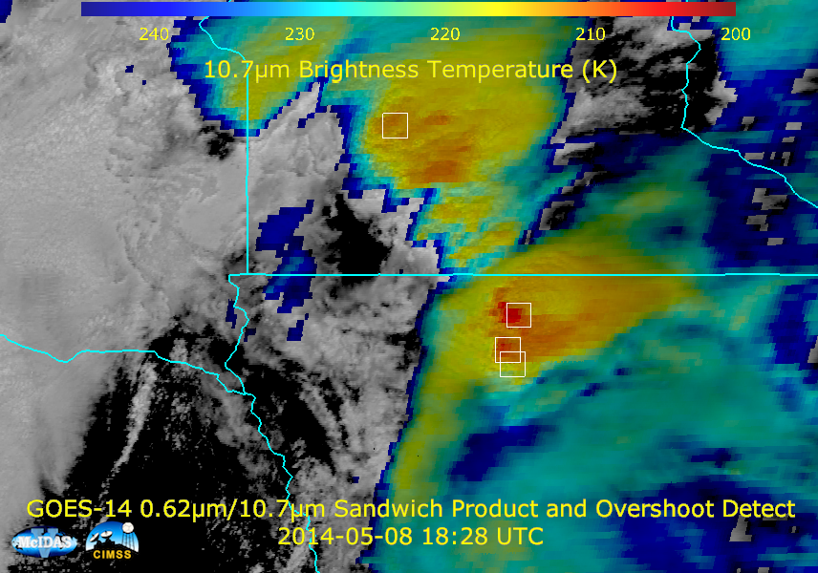
Why script this?
Notes:
Did I do this with a script? Yes, I did, it is a longer script and I had to monitor the run of the script. Why would I write a script? This is an SRSO, it is just easier to run a script multiple times than it is to create a series of loops in the foreground. (This is memory issue. It is not possible to process everything at once). It is repeatable and faster if I need to make a small adjustment. Labels still seem to display better from a script.

Slide 12
Notes:
Did I do this with a script? Yes, I did, it is a longer script and I had to monitor the run of the script. Why would I write a script? This is an SRSO, it is just easier to run a script multiple times than it is to create a series of loops in the foreground. (This is memory issue. It is not possible to process everything at once). It is repeatable and faster if I need to make a small adjustment. Labels still seem to display better from a script.

Slide 13
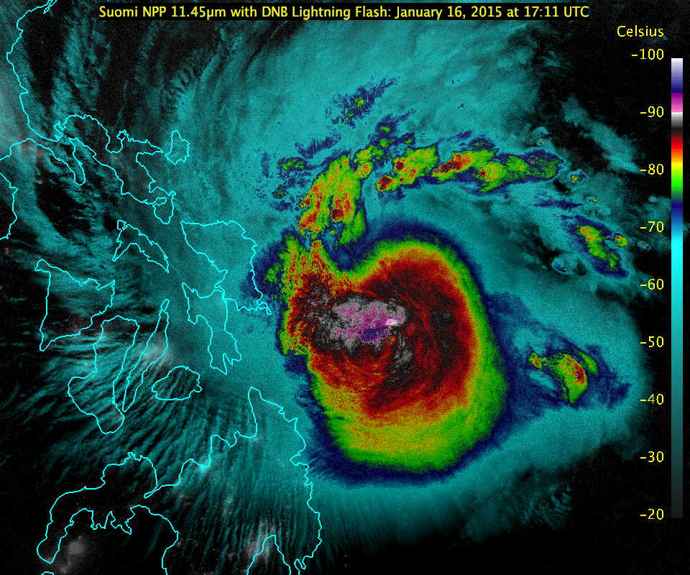

Slide 14
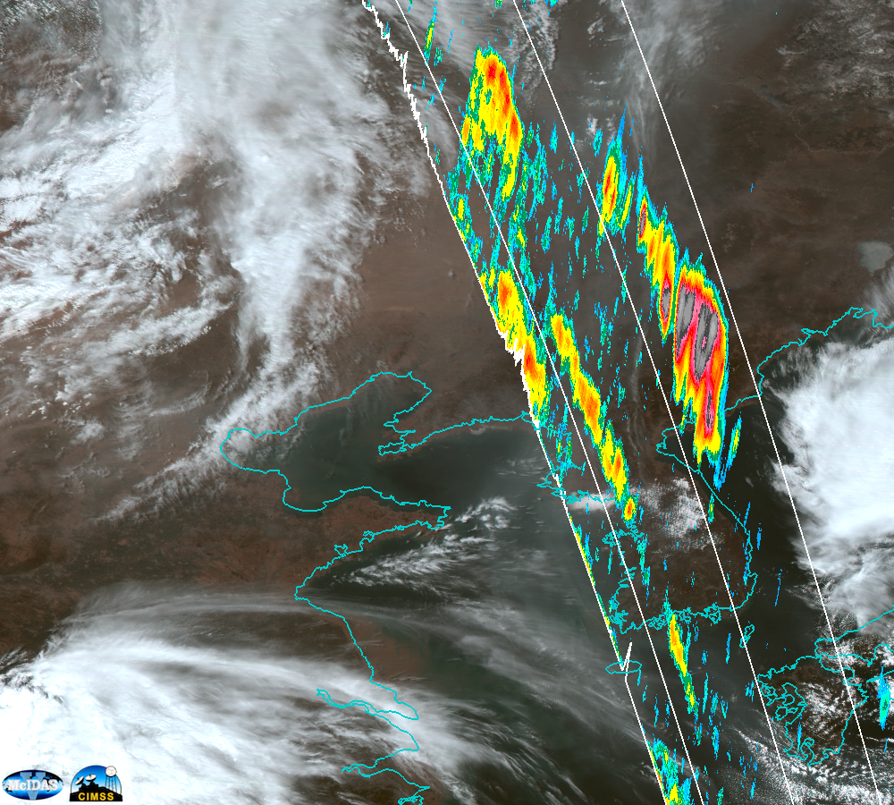
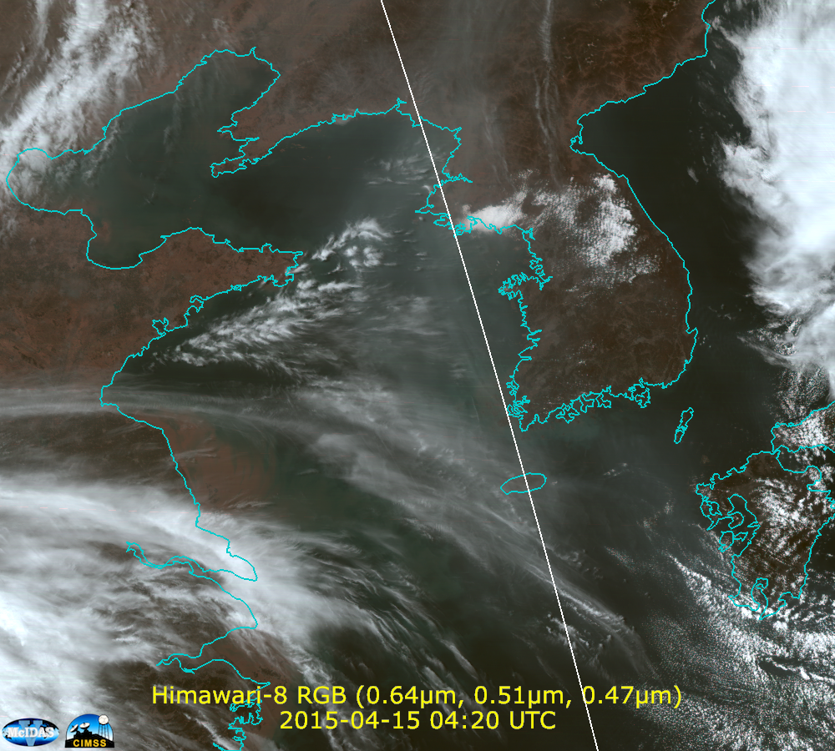
Himawari-8
(0.64, 0.51, 0.47 µm) RGB on April 15, 2015
4:20 UTC/4:26 UTC CALIPSO Overpass

Slide 15
Profile-Along Track Display for CALIPSO Data
Useful for diagnosing proper height assignment to set particle trajectories (trajectories could also be visualized in McIDAS-V)
Best practice for aligning the data probe with features of interest?
More control over height labeling, and placement of the major and minor increments for the height lines

Slide 16
Conclusion
Stability, repeatability and speed has significantly improved. Even more improvement might be necessary for the many McIDAS-X users who are accustomed to running multiple processes with minimal bugs or down-time.
Scripting API has made some tasks as easy in McIDAS-V as they are in McIDAS-X
Using a jython interface provides a very readable language. Since jython is the java implementation of python, there are multiple resources for reference on the web.

Slide 17
Conclusion
The 3-D capabilities, layering, and advance sensor support, geospatial flexibility make McIDAS-V a nice tool for meteorological data visualization.
Try it! Ask questions on the forum. Complain/Search for answers/Request additional capabilities on the forum. This drives development!

