Slide 1
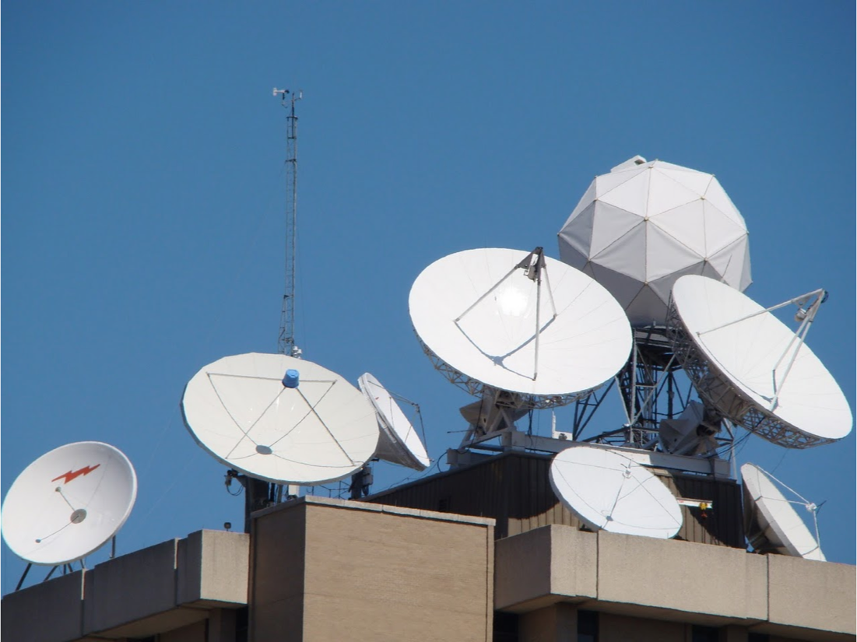
University of Wisconsin SSEC Datacenter
2015 McIDAS Users Group Meeting
June 8, 2015

Slide 2
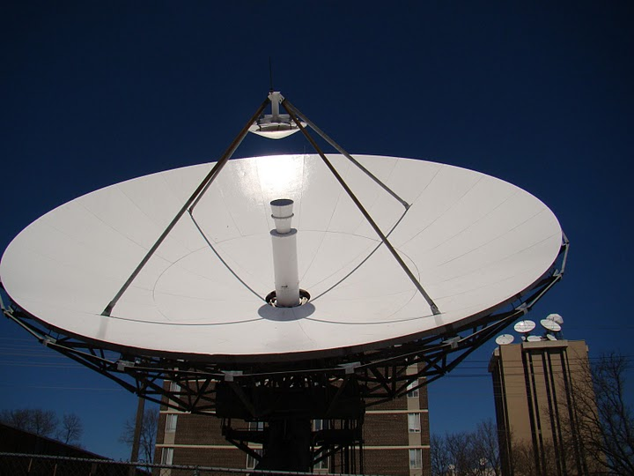
SSEC Data Center Mission Statement
The SSEC Data Center mission is to create and maintain the facilities, human expertise and technology necessary to provide SSEC scientists and collaborators with the highest quality geophysical data in a timely fashion and to provide real-time data access, archive and retrieval services as necessary to support SSEC’s scientific programs.

Slide 3
SSEC Data Center
Provide timely, high quality real-time and archive data, reliably to SSEC scientists and collaborators.

Slide 4
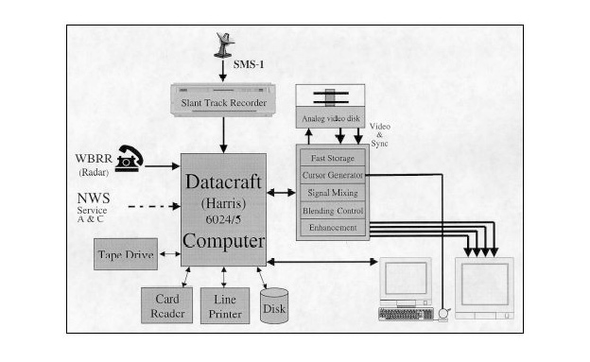
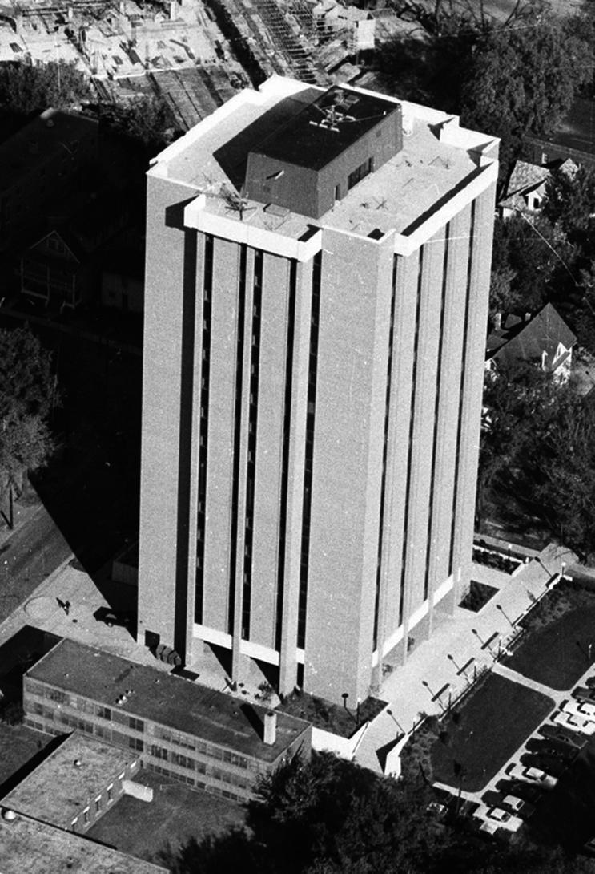
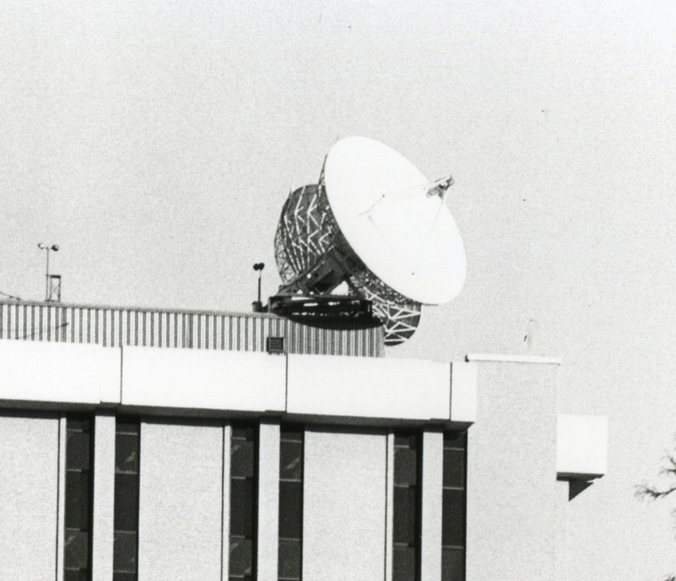
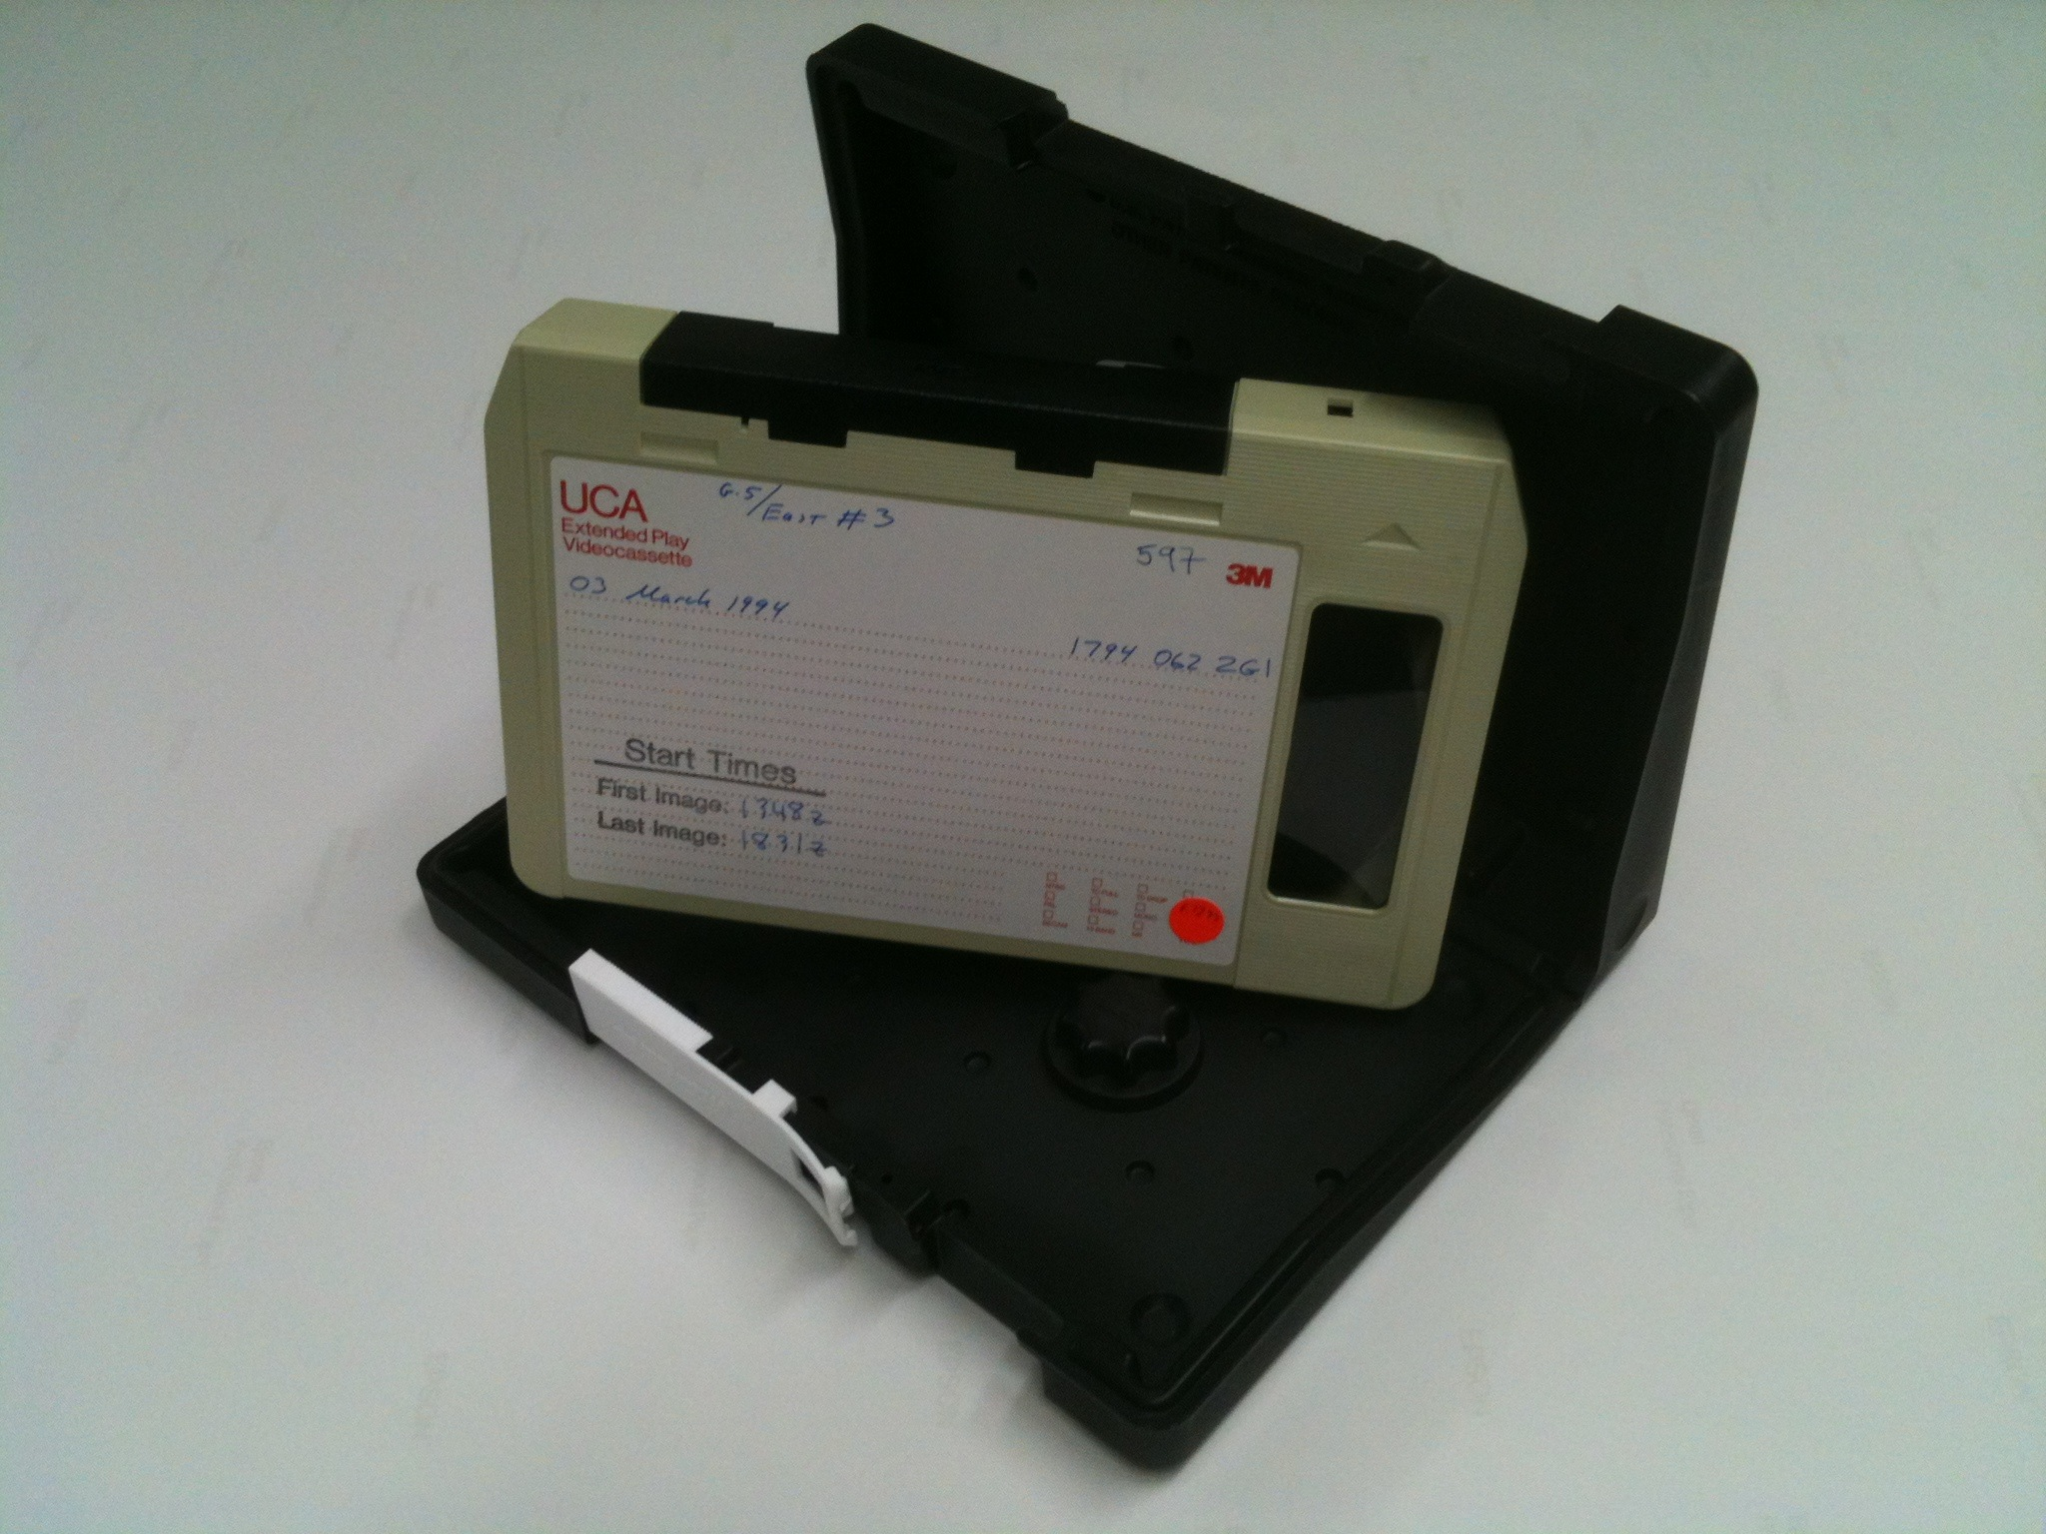
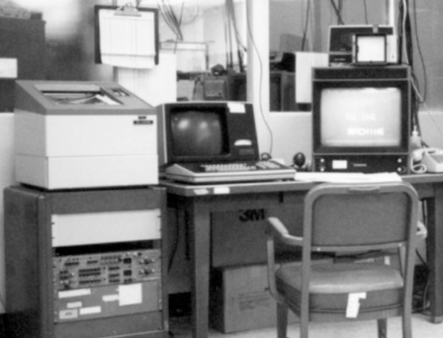
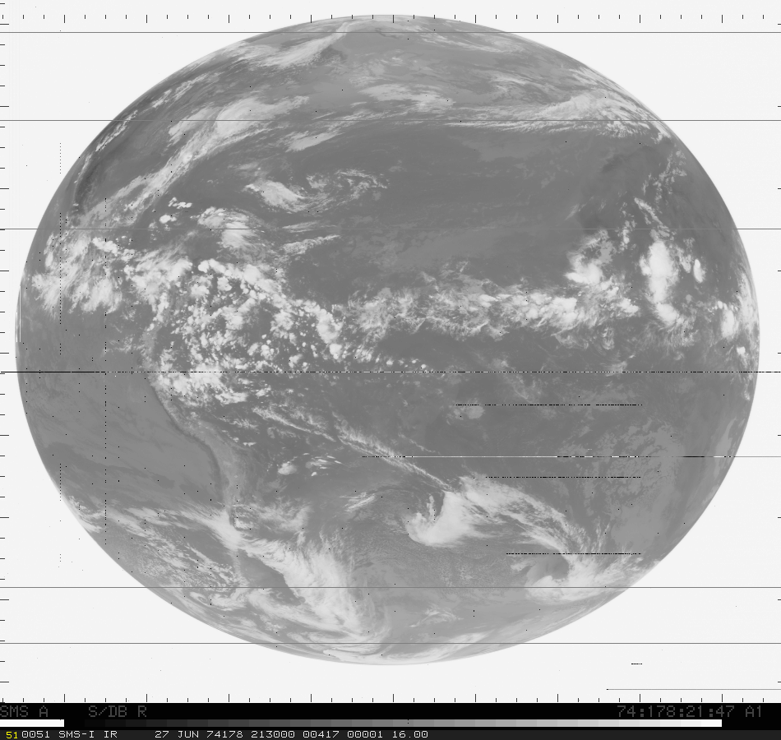
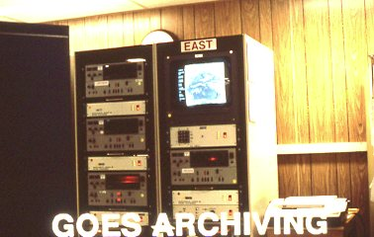
Data Center History
New building
at 1225 W Dayton
Official National
Archive
First 7.3 meter
antennas installed
1969
Jan 1974
1979
1970
1973
May 1974
1980
1978
1990
2000
2010
McIDAS first used
in Data Center
Routine Archiving
began
First SMS-1
data received

Slide 5
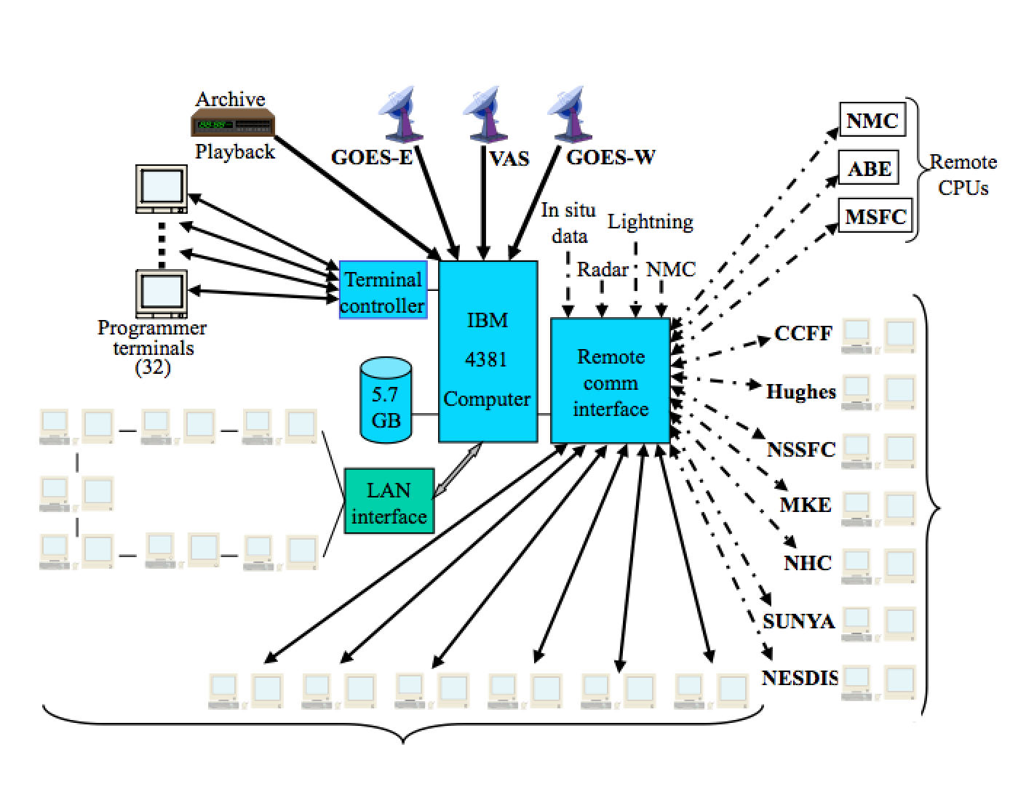
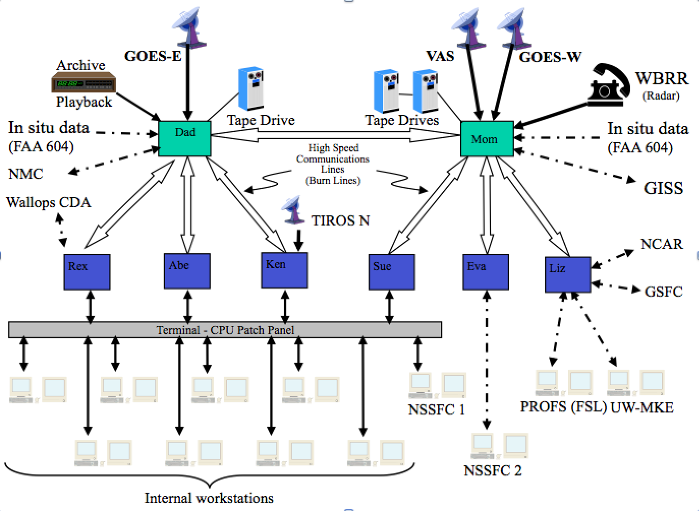
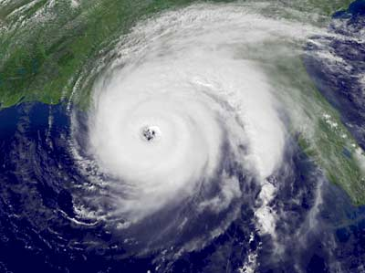
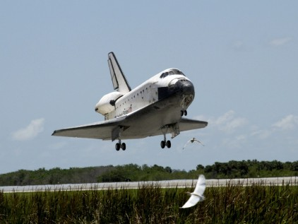
Data Center History
2nd Generation
3rd Generation
1978 - 1983
1983 - 1996
1970
1980
1990
2000
2010
1982
1985
1987
National Hurricane Center
Cape Canaveral
Johnson Space Center

Slide 6
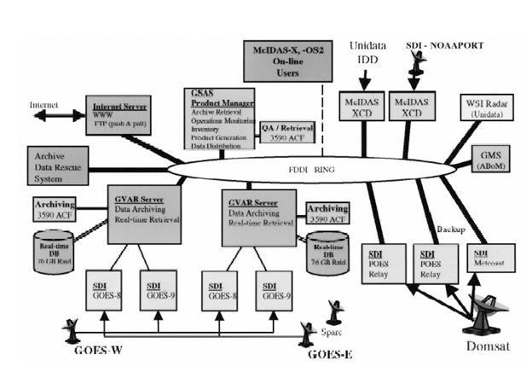
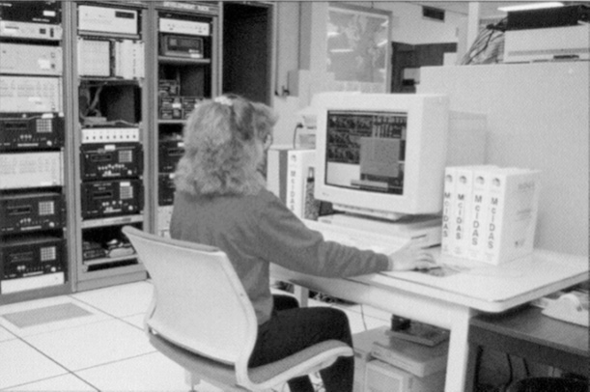
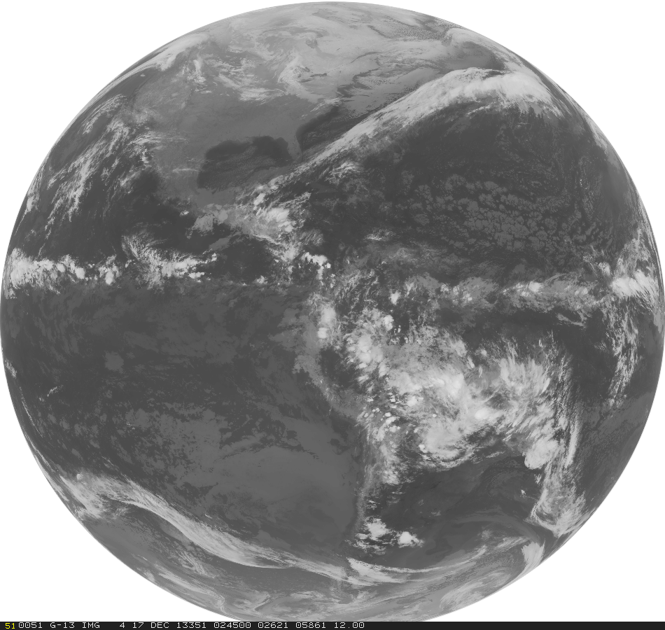
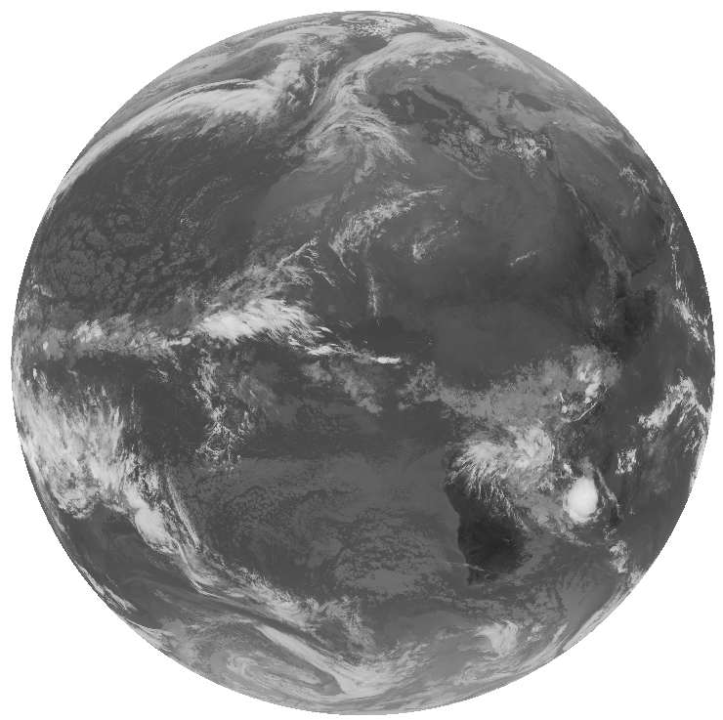
Data Center History
4th Generation
NCDC takes over GOES
S4 Supecomputer
installed
1996
2004
2011
1970
1980
1990
1994
1998
2000
2005
2010
Online archive begins
GVAR
Era begins
International Geostationary
Archive begins

Slide 7
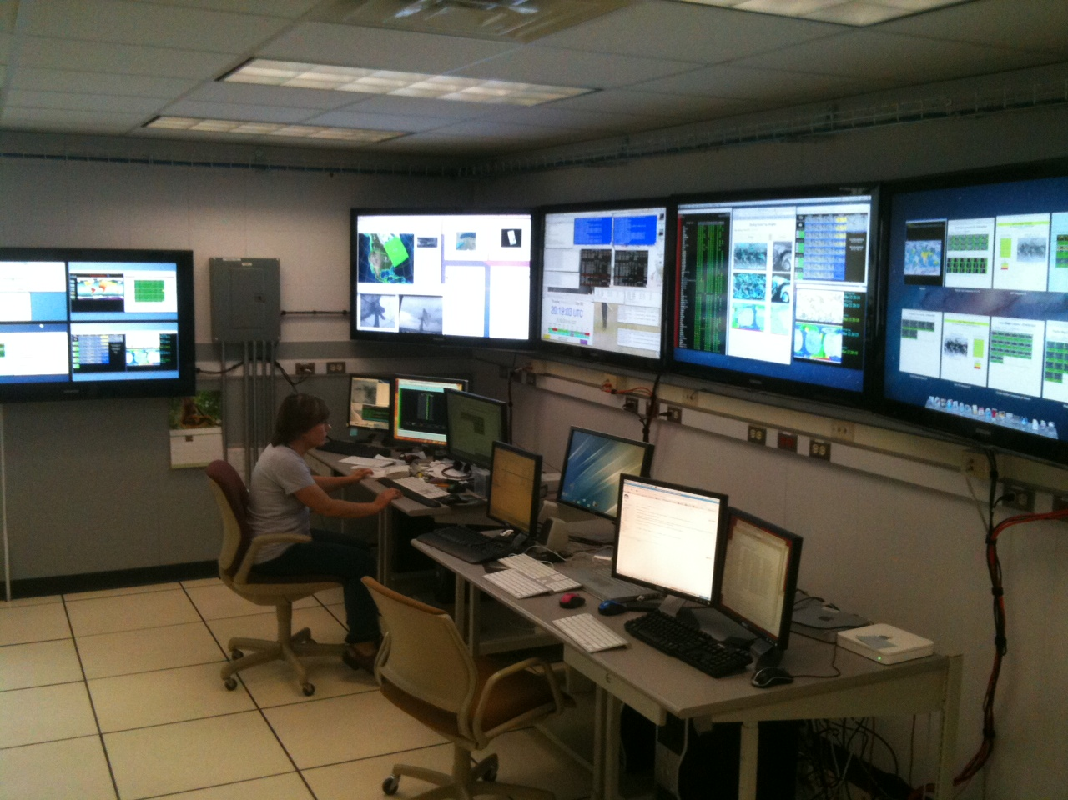
Current Satellite Real-time Ingest & Distribution
GOES-East
GOES-East*
Metadata inventory
GOES-West
GOES-West*
External Sites
GOES-Test
ADDE Client
server Requests
GOES-Test*
MTSAT
http/ftp/WMS server
MTSAT*
POES-Wallops
University Community
SCP to Archive
ldm
POES-Gilmore
MSG
MSG*
ADDE Client
server Requests
FY2, Kalpana, COMS
FY2, Kalpana, COMS
DDS Polar
NFS mount direct
access
*Live back up
Monitoring and
Data QC
Internal Individuals
(Interactive and automated product generation)
Landsat-8

Slide 8
SSEC Data Center
Staffed M-F , 7:30 AM - 11:00 pm Central time.
2 Student programmers
2 student QC assistants (2nd shift)
3 FTE ~100% time
Computer Operator (1st shift)
Computer Operator (1st shift)
Research Intern
5 FTE ~portions of their time
Program Manager
System Programmer
Data Base Programmer
Research Specialist (PM assistant)
Antenna/Communication technician

Slide 9
Data Center Facilities
Over 2100 ft.
Currently the Data Center has 44 racks representing over 1840 rack units of space.
The Data Center’s disk storage exceed 8 PBs.
The entire room is on three 72 KW UPSs, of which, about 155 KW are in use. Non UPS power usage is ~17 KW. An additional 72 KW UPS for a smaller 5 th floor computer room
Cooling provided by campus chilled water and outside air in the winter. Racks are cooled by 16 in row APC coolers.
Gigabit and 10 Gigabit network (also 100 MB admin network, 40 Gigabit InfiniBand).

Slide 10
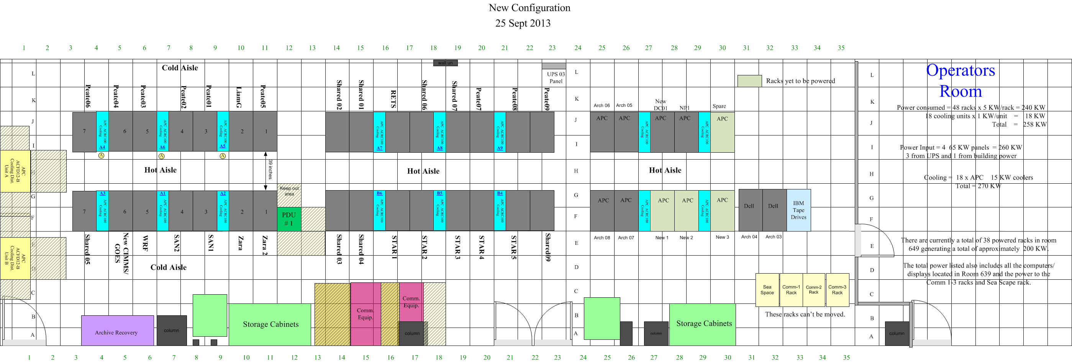
Server room layout
SIPS System
Research Clusters Shared Systems
Real-time ingest, process, and distribution
Research Clusters
Shared Systems
S4 Compute cluster

Slide 11
S4 Supercomputing Cluster
Total compute: 3072 cores, 8TB memory
Total storage: 456 TB
40 Gigabit/s InfiniBand Network Interconnect
Funded by the NOAA & used by NOAA and UW researchers to run data assimilation experiments
The system was designed, installed, and is maintained by the UW SSEC Technical Computing Group.
S4 expansion complete. Additional 1600 cores, 10 TB memory and 1 PB storage.

Slide 12
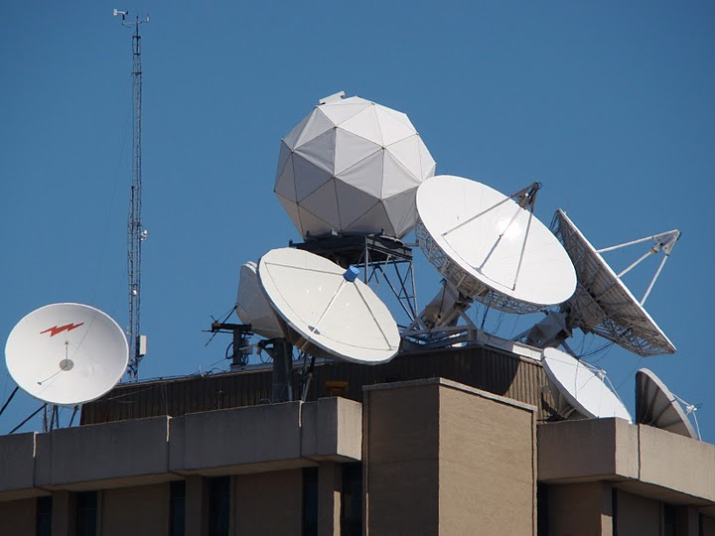
Data Center Antennas
C-Band
11 meter heated (87° West – SES-2, POES Wallops Relay, MSG)
7.3 meter backup (101° West – SES-1, POES Fairbanks Relay, MTSAT, Noaaport)
6.3 meter heated (101° West – SES-1, POES Fairbanks Relay, MTSAT, Noaaport)
L-Band
7.3 meter (75° West –GOES-East Primary)
4.6 meter (135° West –GOES-West Primary)
4.5 meter (60° West –GOES-SA auto tracking)
4.5 meter (90° West –GOES-test/spare)
3.7 meter (offline spare)
X-Band
4.4 meter (Tracking – EOS)
X/L Band
2.4 meter (Tracking – Suomi NPP, EOS, Metop A&B, NOAA-18, 19 and FY3)

Slide 13
SSEC Data Center Incoming Data May, 2015
170+ GB/day
via Satellite
(C-band. L-band, X-band)
GOES satellites ~96 GB/day
International Geo Satellites ~360 GB/day
NOAA Polar ~27 GB/day
Landsat-8 ~50 GB/day
Miscellaneous Polar and Non satellite ~85 GB/day
MODIS polar from NASA archive ~150 GB/day
NPP (VIIRS CrIS ATMS) ~1,800 GB/day
2,300+ GB/day
via Internet
(ftp, LDM, ADDE, http)

Slide 14
SSEC Data Center Outgoing Data
Four primary methods of Data delivery
ADDE
HTTP
FTP
LDM (Unidata local data manager)
HTTP
ADDE
LDM
FTP

Slide 15
Outgoing Data May 2015
On average over 890,000 ADDE transactions per day
Over 2.2 TB data distributed per day via ADDE
In addition over 1 TB data distributed via ftp, http, and ldm

Slide 16
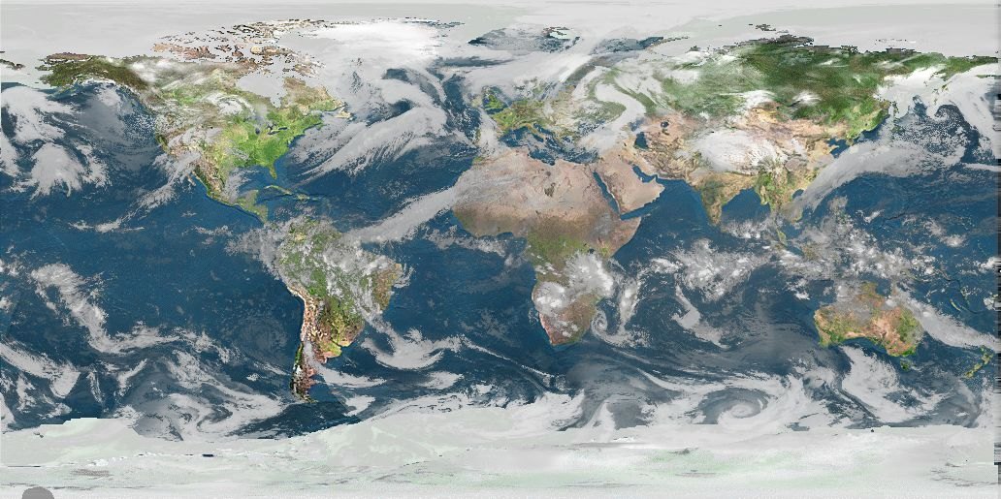
Real-time Data
The SSEC Data Center receives data from 12 different geostationary satellites and 11 different polar orbiting satellites. Most data are available in near real-time via ADDE. Other methods of data access are available upon request.

Slide 17
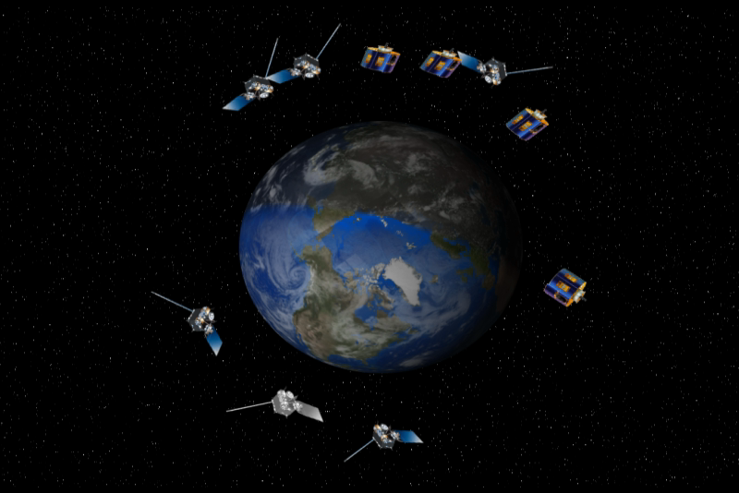
Geostationary Satellites received
GOES-13 -East (75°W)
GOES-15 -West(135°W)
GOES-14 -Test (105°W)
Meteosat-10 (0°E)
Meteosat-7 (57°E)
COMS (128° E)
FY-2D (86°E)
FY-2G (105° E)
MTSAT-2 (145° E)
Himawari-8 (140° E)
Kalpana(74° E)
INSAT-3D(83° E)

Slide 18
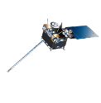

Slide 19
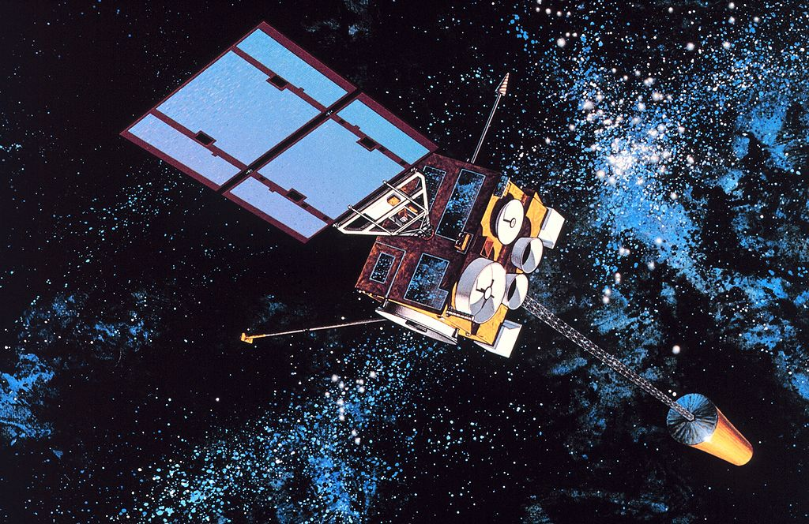
Geostationary Satellites Received at UW SSEC in 2015
 | Sub-Point | Reception Method | Source | Latency | Daily Volume
GOES-13 | 75° West | L-Band | DB | <2 minutes | 23 GB
GOES-14 | 105° West | L-Band | DB | <2 minutes | 23 GB
GOES-15 | 135° West | L-Band | DB | <2 minutes | 23 GB
Meteosat-10 | 0° East | C-Band Relay | DB Relay | <15 minutes | 24 GB
Meteosat-7 | 57° East | Network Relay | NESDIS | ~30 minutes | 2 GB
Himawari-8 | 140° East | Network Relay | NOAA STAR | ~ 10 minutes | 300 GB
MTSAT-2 | 145° East | C-Band Relay | DB Relay | ~ 6 minutes | 12GB
Kalpana | 74° East | Network Relay | ISRO | 45-120 minutes | 1.4 GB
Insat-3D | 83° East | Network Relay | ISRO | 45-180 min | 19 GB
FY2D | 86° East | Network Relay | ABOM | 15-30 minutes | 4.7 GB
FY2G | 105° East | Network Relay | ABOM | 15-30 minutes | 4.7 GB
COMS | 128° East | Network Relay | KMA | 9-24 minutes | 11 GB

Slide 20
Himawari-8

Slide 21
Himawari-8
Started receiving it routinely in March, 2015 via NOAA STAR
HSF format data
Archive on line March 2015 – Present (~ 300 GB/day)
Data are available via ADDE ~10 minutes after end of Image
Receiving 10 minute Full Disks and 2.5 minute Target Sectors
Operational after July 7, 2015

Slide 22
Insat-3D

Slide 23
Insat-3D
Started receiving it routinely in April, 2014
HDF5 format data
Archive on line April 2014 – Present
Data are available via ADDE 30 minutes to several hours after end of Image
NASA LaRC funded ADDE server work. Should be in the first fasttrack release after Himawari fasttrack

Slide 24
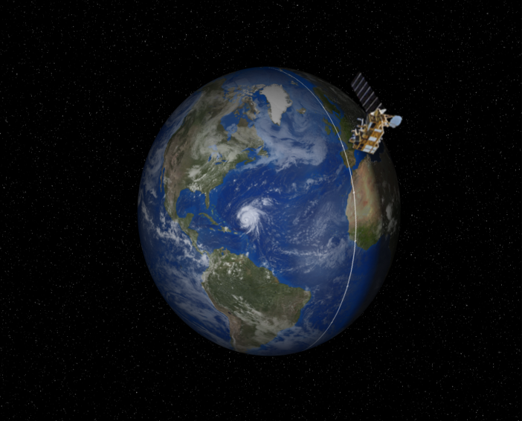
Polar Satellites received
NOAA-15
NOAA-18
NOAA-19
METOP-A
METOP-B
Aqua
Terra
Suomi-NPP
Landsat-8
FY-3B
GCOM-W1
24

Slide 25
Polar Satellites Received at UW SSEC in 2015
 | Reception Method | Domain | ADDE Latency | Instruments | External Access
NOAA-15 | C-Band relay, DDS | DB CONUS Global | DB <1 minutes after pass | AVHRR, AMSU, DCS->level-1 | ADDE
 |  |  |  | All other instruments Level-0 | NA
NOAA-18 | DB L-Band, C-Band relay, DDS | DB CONUS Global | DB <1 minutes after pass | AVHRR->level-1 | ADDE
 |  |  |  | All other instruments Level-0 | NA
NOAA-19 | DB L-Band, C-Band relay, DDS | DB CONUS Global | DB <1 minutes after pass | AVHRR->level-1 | ADDE
 |  |  |  | All other instruments Level-0 | NA
Metop-A | DB L-Band, NOAA DDS | DB CONUS Global | CONUS <15 minutes after pass | AVHRR ->level-1 | ADDE
 |  |  |  | AVHRR, IASI | DB ftp (sips)
Metop-B | DB L-Band, NOAA DDS | DB CONUS Global | CONUS <15 minutes after pass | AVHRR ->level-1 | ADDE
 |  |  |  | AVHRR,IASI | DB ftp (sips)
Suomi-NPP | DB X/L Band, NASA Relay | DB CONUS Global | CONUS <15 minutes after pass | VIIRS | ADDE
 |  |  |  | VIIRS,ATMS, CrIS | DB ftp (sips)
Aqua | DB X-Band, NASA Relay | DB CONUS Global | DB <15 minutes after pass | AIRS, MODIS -> Level-1 | ADDE
 |  |  |  | AIRS, MODIS | DB ftp (sips)
Terra | DB X-Band, NASA Relay | DB CONUS Global | DB <15 minutes after pass | MODIS -> Level-1 | ADDE
 |  |  |  | MODIS | DB ftp (sips)
Landsat-8 | Network Relay (USGS) | CONUS | 22-24 hours | Level-1 | ADDE, WMS
Shizuku GCOM-W1 | DB X-Band | CONUS | DB <1 min after pass | Level-0 | SSEC ftp
FY-3C | DB X/L Band | CONUS | DB <1 min after pass | Level-0 | SSEC ftp

Slide 26
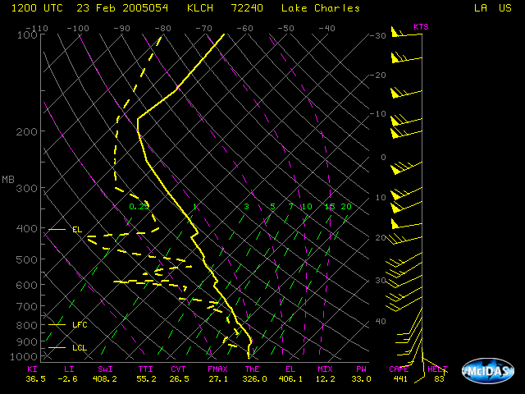
NOAAPORT/Conventional Data
Model Output (GFS, RAP, etc)
NEXRAD
NWS Text output

Slide 27
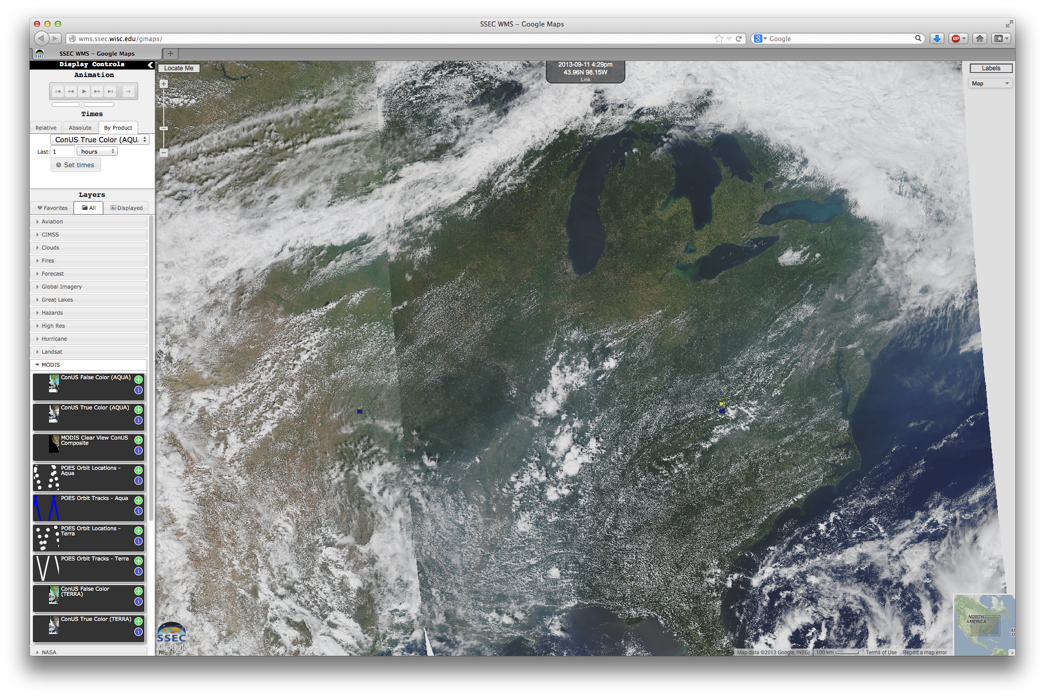
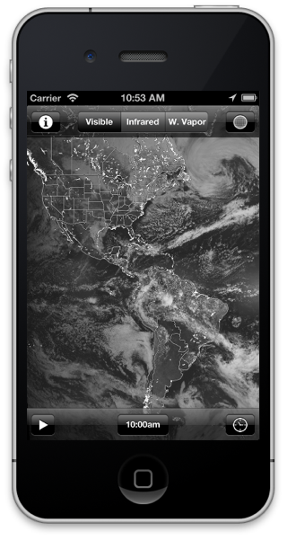
Real-time Data Custom Products
SSEC RealEarth
via WMS

Slide 28
Archive Data
As of May 2015, over 1,450 TBs online. (much of this is redundant)
Grows approximately about ~150 TB/year
US Geostationary Satellites
GOES-8 through GOES-15 (1994-Present) (East, West , South America and test)
GOES-1 through GOES-7 (1978-1996)
SMS-1&2 (1978-1981)

Slide 29
Archive Data
International Geostationary Satellites
GMS/MTSAT (1998-Present)
Meteosat/Meteosat IODC (1998-Present)
FY2 (2004-Present)
Kalpana (2005-Present)
Insat-3D (June 2014-Present)
COMS (June 2012 – Present)
Himawari-8 (March 2015 – Present)

Slide 30
Archive Data
NOAAPORT/Conventional Data
Model Output (1996-Present)*
In situ Point Observations (1976-Present)

Slide 31
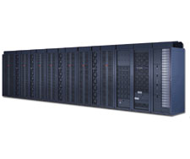
Current Satellite Archive Distribution
GEOARC02
GEOARC03
External Sites
ftp/http/WMS server
GEOARC04
GEOARC05
GEOARC
LTO-5
backup
NFS
mounts
ADDE Client
server Requests
GEOARC06
GEOARC
GEOARC07
GEOARC08
Internal Individuals
GEOARC09
GEOARC10
9 servers with ~1.2 pb disk
Dell MD1200s, MD1000s
Internal Cluster
(300 core)
Notes:
Older systems are PowerEdge 2970s and PowerEdge 6950s (with md1000s)
Newer systems are R510s with md1200s

Slide 32
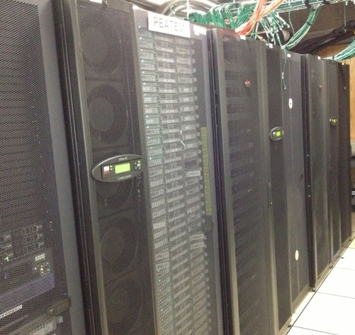
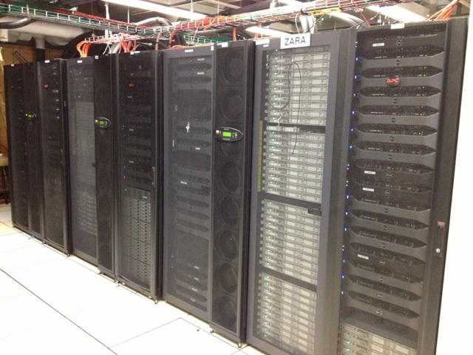
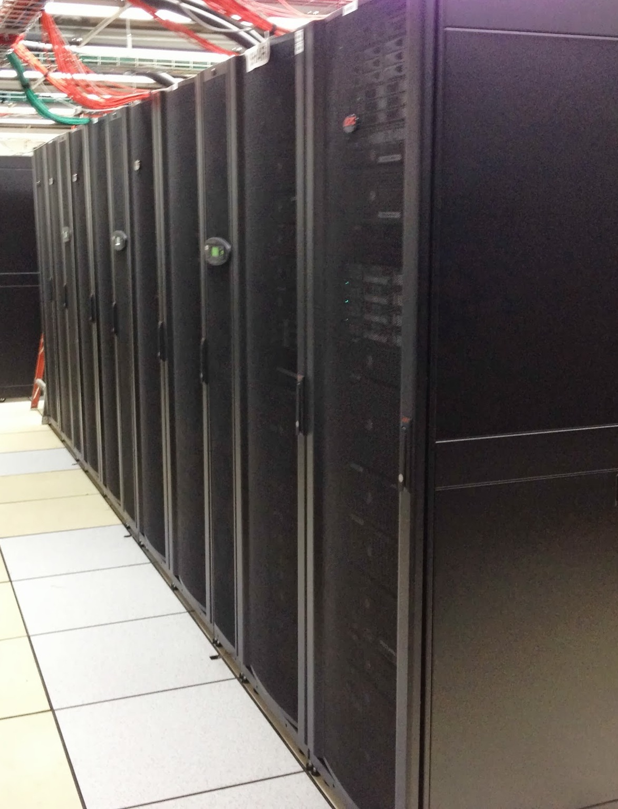
New Satellite Archive Distribution
Lustre mount
over Infiniband
PEATE
(1000 cores)
Lustre
Satellite Archive
External Sites
Lustre mount
over Infiniband
and local ADDE
GEOARC
NFS mounts
ADDE Client
server Requests
ftp/http/WMS server(s)
Zara Cluster
(300 cores)
Lustre mount
over Infiniband
GEOARC
Lustre 2.4 on ZFS
30 DELL MD1200s (4 TB disks)
12 DELL R720s OSS
2 DELL R720s MDS
(Designed by Scott Nolin, Jesse Stroik, and John Lalande)
FUSE mount
dawgfs server
NFS mount
s4 Cluster & S4 expansion
(4,672 cores)
Internal Individuals
(5000+ cores)

Slide 33
New Stuff

Slide 34
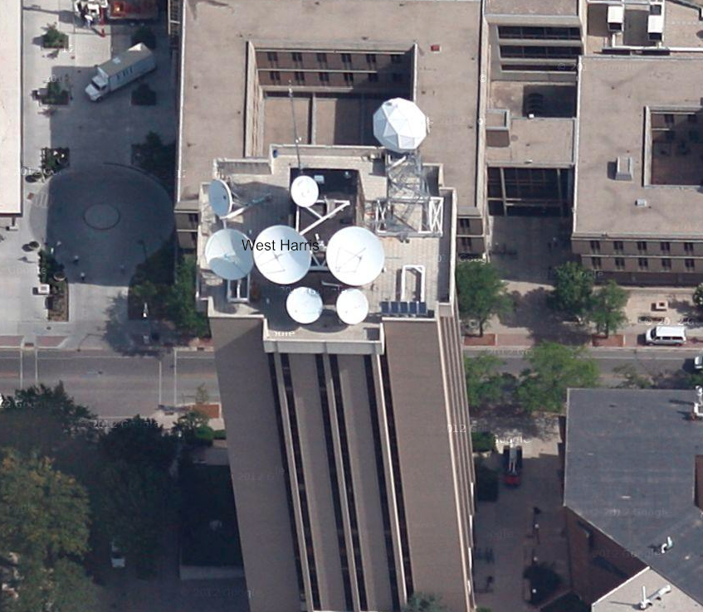
GOES-R
Antenna Upgrade Summer 2015
New Feed
DVB-S2 demodulator
7.3 meter diameter

Slide 35
GOES-R
ADDE access to ABI (with tracking)
Level-2 products via CSPP GEO (ADDE access when available)
Archive CADU CCSDS and level-1 netcdf

Slide 36
GOES-R
Archive level 0
No ADDE service

Slide 37
GOES-R
Testing with GRB simulator now
Developing new SDI for Ingest and serving

Slide 38
Event Handler
Satellite Imagery Event Handler
Provides users with notification of data availability
Users will be able to subscribe and trigger processing based on event attributes
Internal testing now. External access in 2016
Utilizes RabbitMQ

Slide 39
More methods of data access
ADDE interface that returns netCDF
McIDAS-X scripts in Python
WMS server direct access to ADDE archive

Slide 40
Opening up the archive
Starting in 2011, active McIDAS-X sites have access to archive data older than the previous month (limit of 5 GB/month) per site.
Beginning in 2016, any user will have access to ADDE data older than 6 months in our satellite archive up to 5 GB/day.

Slide 41
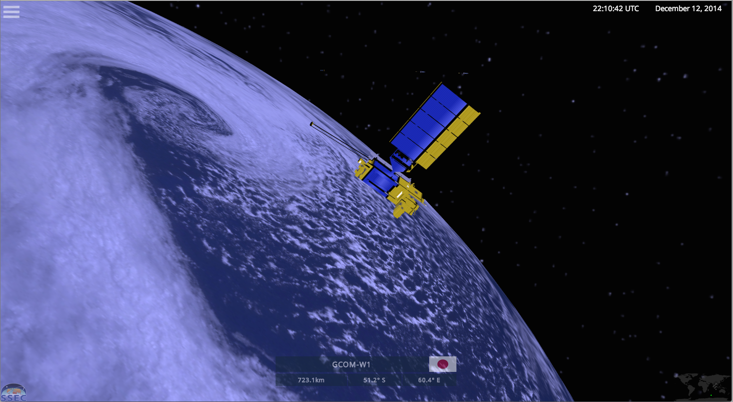
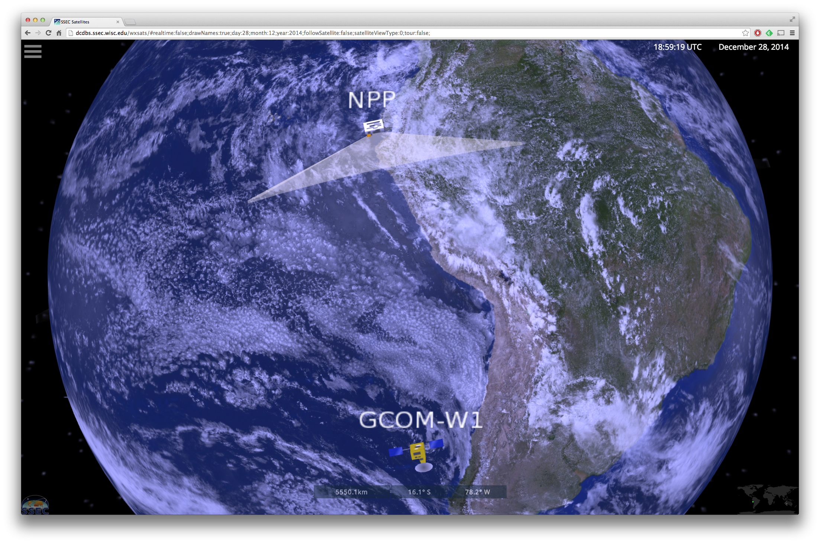
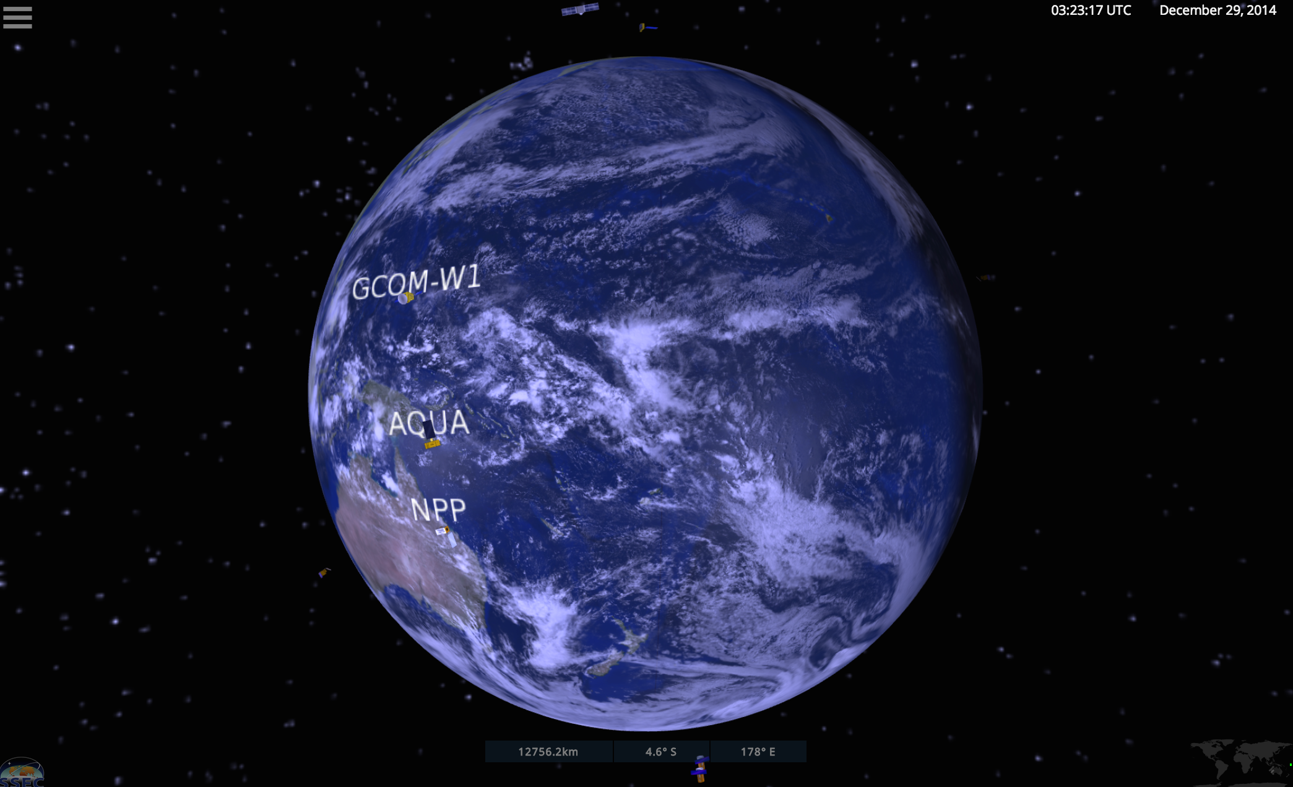
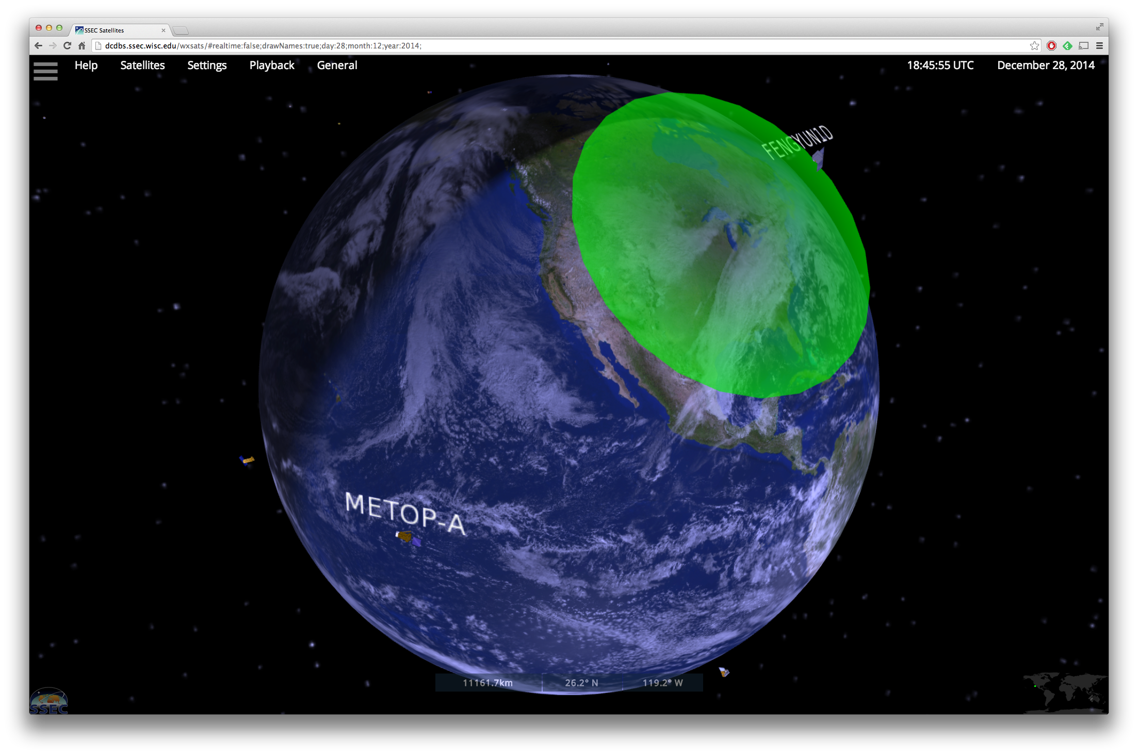
Visualizing Operational Leo and Geo Satellites in Real-time Utilizing WebGL
http://www.ssec.wisc.edu/datacenter/wxsats

Slide 42
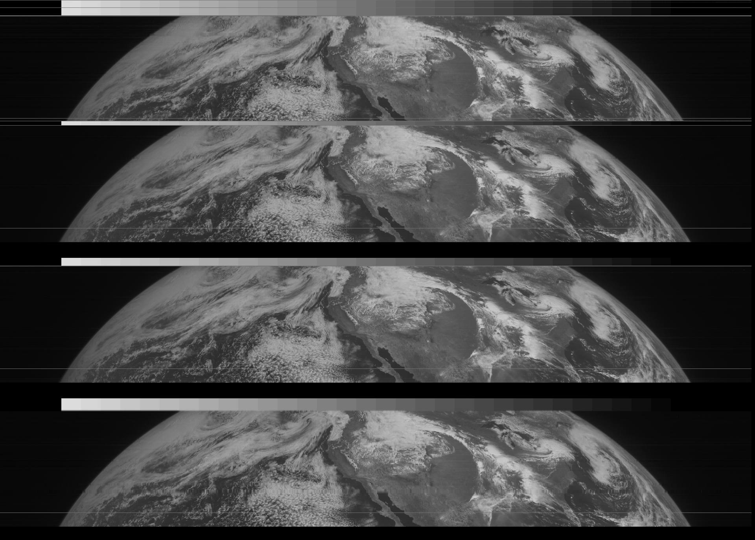
SMS 1 & 2 Rescue
SMS-1 &2 data for May 1974 – July 1981
1480 tapes
Joint effort with NASA GSFC

Slide 43
End

