Slide 1
McIDAS Program Status
David Santek
8 June 2015

Slide 2
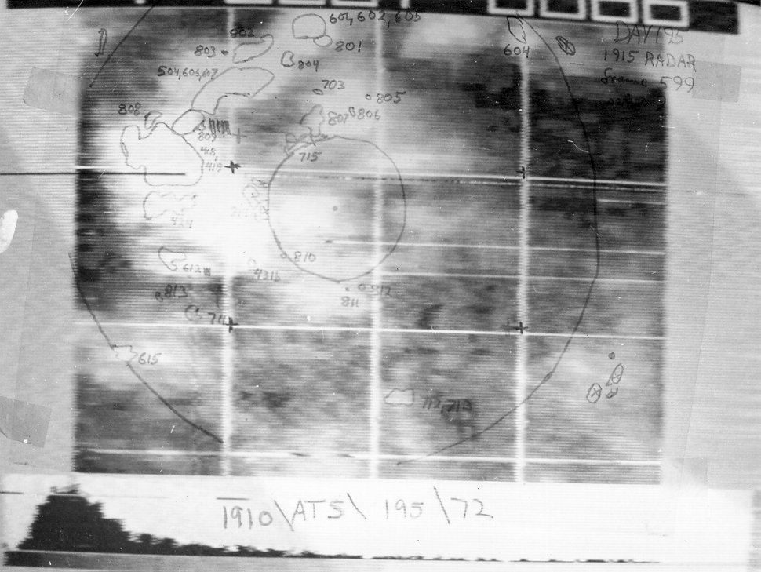
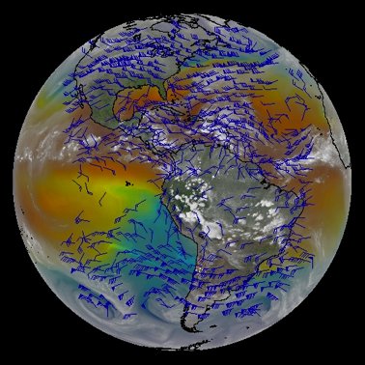
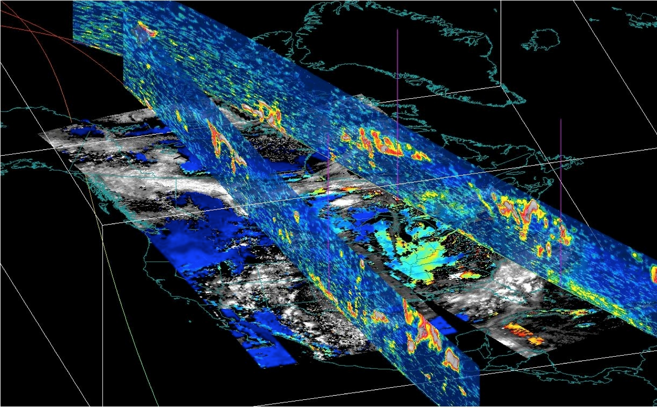
McIDAS Status
McIDAS-X
McIDAS-XCD
McIDAS-XRD
SDI
McIDAS-V

Slide 3
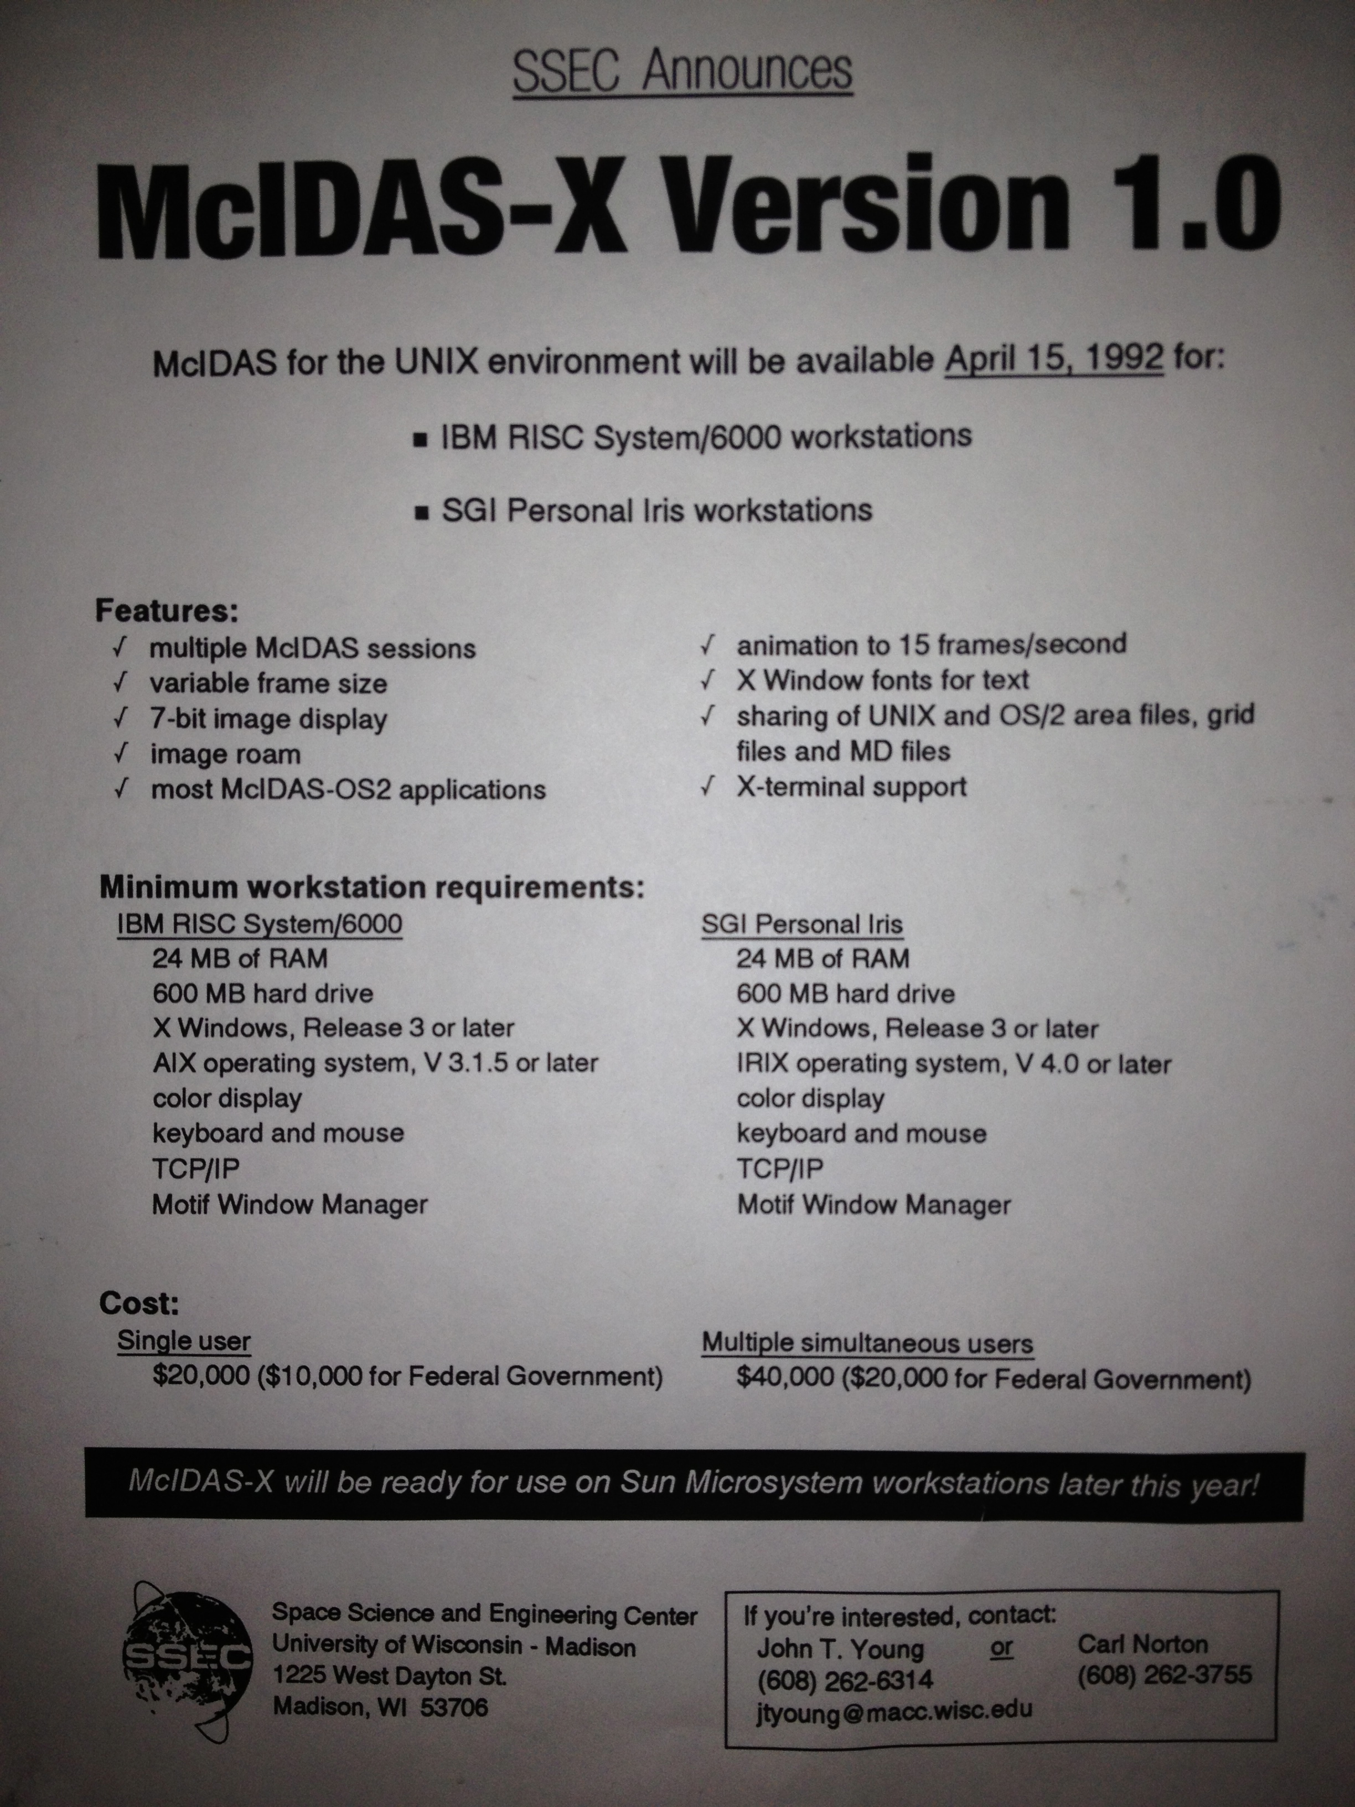
McIDAS-X Introduction
Ported code from mainframe and DOS- and OS/2-based computers to IBM AIX workstations
Released April 1992
A distributed system as opposed to previous mainframe

Slide 4
McIDAS-X Keys to Success
Port to Unix
ADDE (Abstract Data Distribution Environment)
Infrastructure: Reglue effort (better integration with Unix and independence of X Window System)
Resulted in the longevity of McIDAS-X
Reliability, Stability
Solid infrastructure

Slide 5
McIDAS-X Current
Periodically updates (1-2 times per year)
Number of supported platforms reduced over last several years
Capability with newest and future satellites:
Himawari-8 AHI (coming soon!)
GOES-R ABI (in development)
S-NPP VIIRS (prototype ADDE server, not expected to be released unless additional funding is acquired)

Slide 6
McIDAS-X Future
MUG bug fixes, adaptive maintenance (updates for current and new satellites), and OS and external library updates
Enhancements continue to be funded outside the MUG and code contributed by internal projects and external sites
McIDAS-X is expected to be supported beyond 2020 for current GOES GVAR and upcoming GOES-R series satellites. No end date in sight.

Slide 7
McIDAS-XCD Conventional Data
Ingest conventional weather data from NOAAPORT
Current version to be supported for at least two more years
New version beta will be introduced later in 2015
More information in McIDAS-XCD Replacement

Slide 8
McIDAS-XRD Research and Development
A collection of R&D code that is not formally tested by McIDAS User Services:
Over 100 McIDAS commands
Over 15 ADDE servers
Testing is limited to ensuring code builds on supported platforms
Status: Current support level continues
Future: Coincides with McIDAS-X future

Slide 9
OpenADDE
Open source version of the McIDAS ADDE servers
Source code of many of the ADDE servers, including required McIDAS-X library routines
Example data files: Area, AVHRR L1B, AIRS, GINI, MODIS L1B and products, NEXRAD
Last updated in 2006
Status: Not supported nor maintained
Future: Web page with links to code and data files will remain indefinitely. No updates planned, however we may revisit this in the future.

Slide 10
SDI
SDI (SSEC Desktop Ingestor) 1997 - 2005
SDI-104 (SSEC Data Ingestor) 1995 – present
SDI-SE (Server Edition) 2015 - ?
Status: SDI-104 supported; SDI-SE in development
Future:
SDI-104: supported as long as GOES GVAR satellites are operational or backup
SDI-SE: throughout the GOES-R era
More details in McIDAS SDI Status Update

Slide 12
McIDAS-V Motivation
McIDAS-X software (currently written in Fortran 77 and C) has a 40-year heritage resulting in limited extensibility potential
New visualization concepts cannot be incorporated
Forthcoming environmental satellite data cannot be utilized efficiently (GOES-R & JPSS operational systems)

Slide 13
McIDAS-V Goals
McIDAS-V shall be a powerful and versatile software system for environmental data processing, analysis and visualization
McIDAS-V shall support existing and evolving needs of scientific research and algorithm/applications development for new programs, such as NPOESS and GOES-R as well as for retrospective data, such as that from GOES and POES
McIDAS-V shall support data fusion and algorithm interoperability from existing and future sources
The McIDAS team shall continue to fully support the MUG and McIDAS-X functionality as users transition to McIDAS-V
McIDAS-V shall support operational users by providing tools and interfaces that enable a natural transition path for research results into operations
McIDAS-V shall be used to educate students in remote sensing and physical sciences, and students must be integrally involved in its development, evolution and use

Slide 14
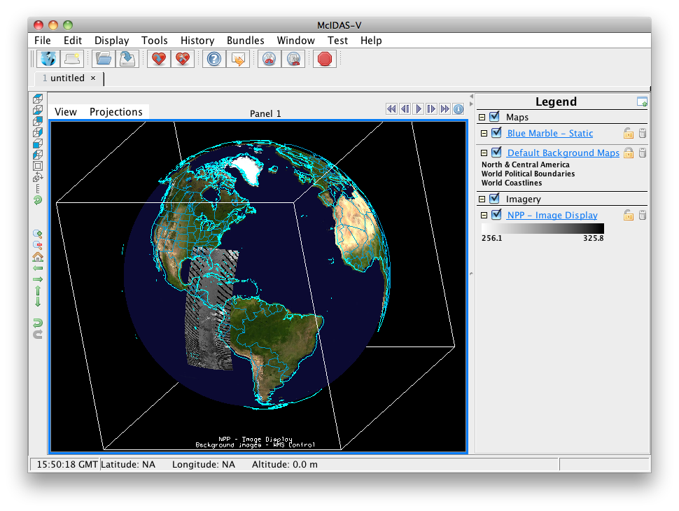
Are we meeting the goals?
Overall, the work is progressing toward most of the goals, however, there are limiting factors:
Funding sources
Enhancements vs. improving Infrastructure
Hardware performance
User expectations

Slide 15
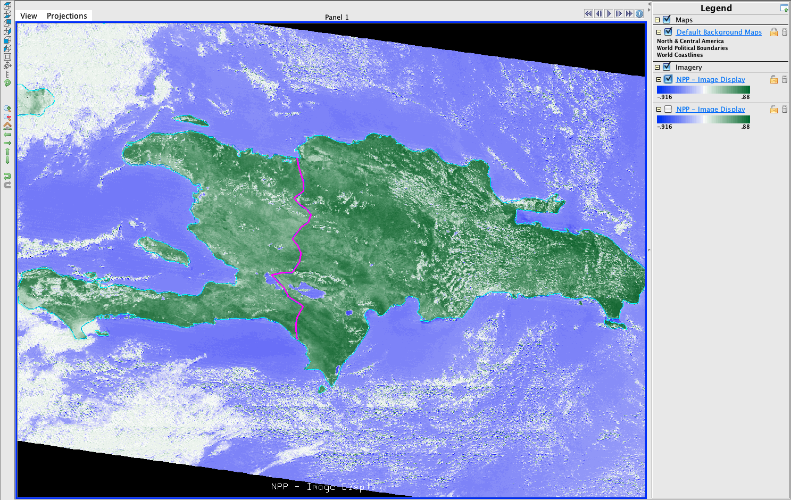
McIDAS-V Internal Review
Science
Who are the users?
What functionality is important?
Technical
Identify current technical issues
Anticipate future issues
Plan a technical direction
Programmatic
Coordinate internal funding sources
Mechanism for McIDAS-V infrastructure improvements

Slide 16
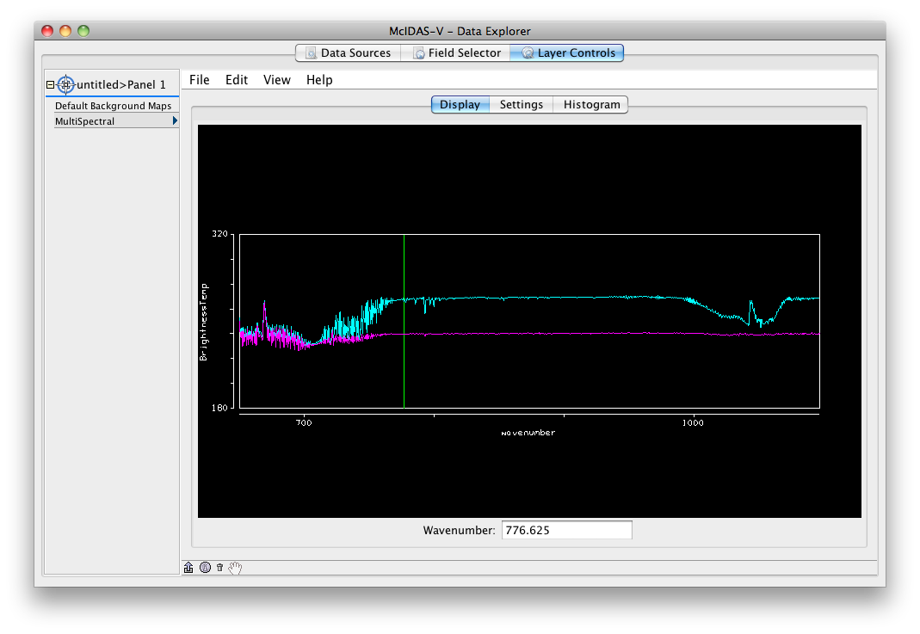
Who are the users? New Survey
Fall 2014: A new survey was created for users of McIDAS software.
November 2014: The survey was sent to:
All of SSEC
Those on McIDAS email lists
A large group of scientists where it was uncertain if they ever used McIDAS

Slide 17
Usage: November 2014 Survey
 | polled | respondents | Do you use computer vis software? |  | If yes, do you use Mc-V? |  | If yes, how often?
 |  |  | yes | no | yes | no | Daily | Weekly | Monthly | Rarely
SSEC | 257 | 182 (71%) | 119 | 62 | 80 | 40 | 9 | 7 | 14 | 49
Non-SSEC | 3845 | 283 (7%) | 273 | 10 | 135 | 138 | 15 | 28 | 20 | 72

Slide 18
Functionality
Most popular is GUI driven access and display of geo and polar data in near real time
About ¼ use 3-D data display and hyperspectral data display
Additional feedback:
Provides a quick way to load and inspect new data types
Works with netCDF files (which McIDAS-X does not)
Provides free access to many real-time data sources
Used in various trainings and classes.

Slide 19
Distinctive Features
From the survey and expert input, the key features of McIDAS-V are:
Freely available
Read a variety of file formats (netCDF, HDF-4, HDF-5, GRIB, BUFR, ASCII text)
Time-match and integrate into single 3D display, with animation
Display 2D fields as point observations and contours
Display 3D grids as volumes and transects
Data access of local and remote (ADDE, THREDDS, OPeNDAP) datasets. Also, local access through ADDE
GUI driven (both a plus and somewhat a minus). Easy for new users to learn due to GUI design, as opposed to scripting or command line programs

Slide 20
Technical Review Components of McIDAS-V
Jython: Bridges McIDAS-V internals to Python language for extension and scripting
McIDAS-V: extends IDV to provide additional Satellite Meteorology functionality
IDV: Application architecture and UI base
VisAD: Core data model, math and scientific graphics
Java JDK: Runtime, GUI, and compilation ecosystem
Java3D / JOGL: Permit Java to drive graphics hardware
OS & graphics driver: Implement OpenGL graphics
Notes:
get rid of attribution, change order
*Hardware OpenGL to varying success in Linux, even 15 years later
Extra capabilities provided on top of IDV include RAOBs, TLE satellite tracks, additional choosers (Hydra, HRIT, SNPP,

Slide 21
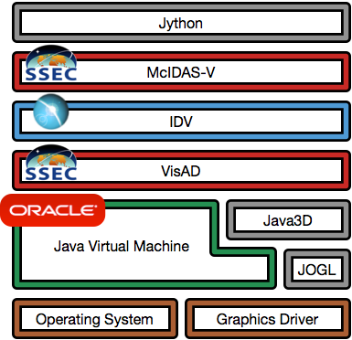
Dependency “Layer Cake”
Major components by Unidata, SSEC, Oracle, open source community
Additional components include file format libraries, math libraries, packaging and build utilities; all open source
OS vendors Linux,Windows, Mac
Hardware drivers from manufacturers
Notes:
who maintains VisAD?primarily Rink, Whittaker, Don Murray
https://github.com/visad/visad/graphs/contributors

Slide 22
Technical Summary
Software layers make use of high-performance drivers, open-source and commercial software, collaborator & SSEC code
Software components are adequately maintained, however, future of external packages needs monitoring (e.g., Java3D)
Process is reasonably well executed (better than most SSEC software projects)
Much feedback (bugs and enhancement requests) have resulted in a lagging in bug fixes
Some potential infrastructure (architectural) issues need investigation
Notes:
Opinion: Java and the JVM languages have become a bit of a Madagascar situation
Opinion: Falling behind as a “2005” application in a “2020” world
Of note that McIDAS-X had to go through a refactoring to function as a background “headless” processor
JVM runtime languages, system runtime “object code” languages

Slide 23
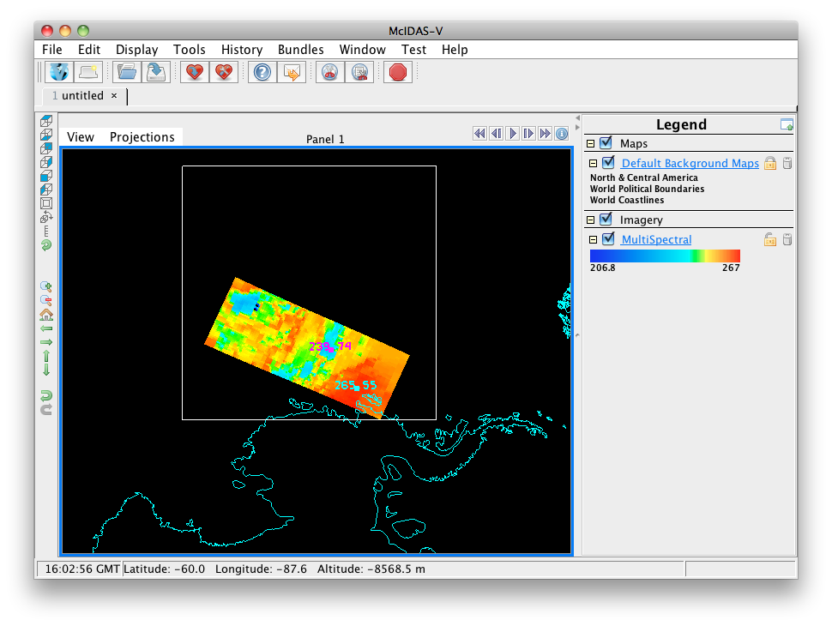
McIDAS-V Funding
MUG
Several CIMSS grants for S-NPP/JPSS and GOES-R
NASA ROSES proposals

Slide 24
MUG Support
User-level Infrastructure: User Interface, Scripting
Bug fixes: Prioritize, coordinate internally and with Unidata
Testing
Documentation: Includes maintaining tutorials
Help Desk: Includes maintaining forums

Slide 25
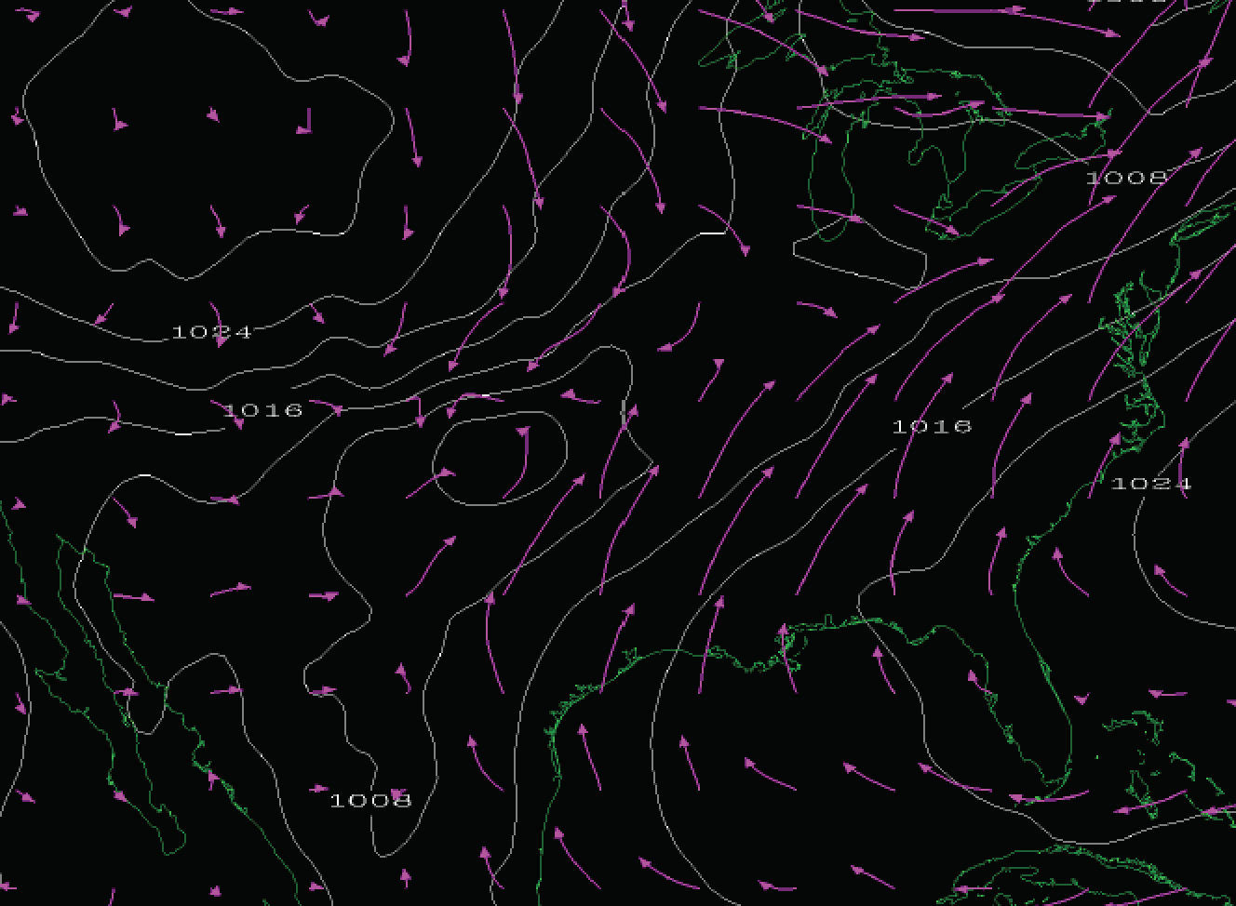
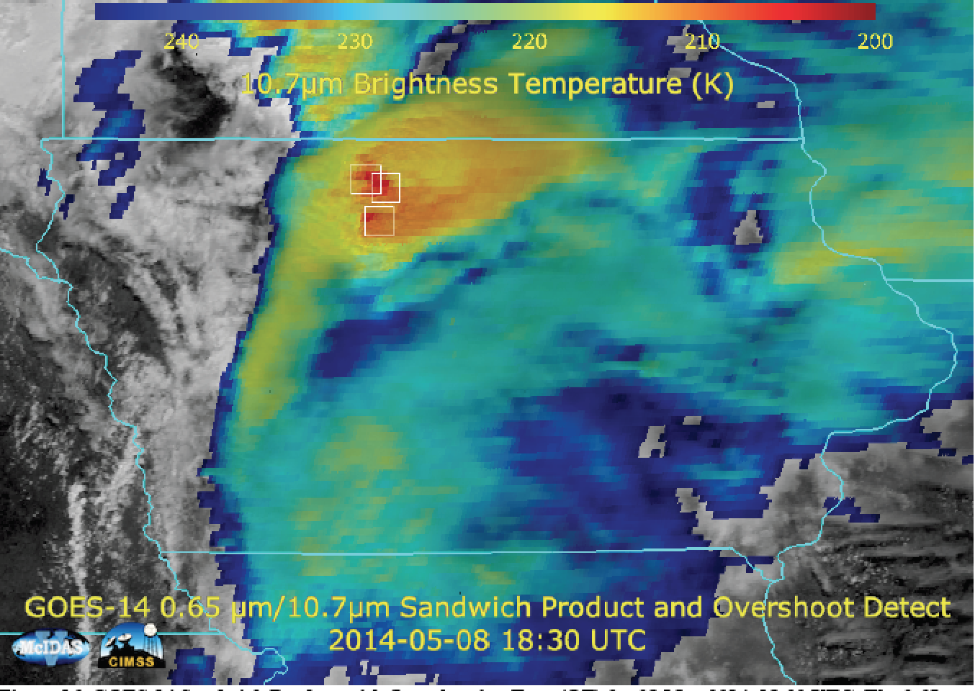
CIMSS Grants GOES-R
Several CIMSS grants for GOES-R
Improvements to scripting
Preparation for GOES-R
‘Sandwich product’
Trajectories

Slide 26
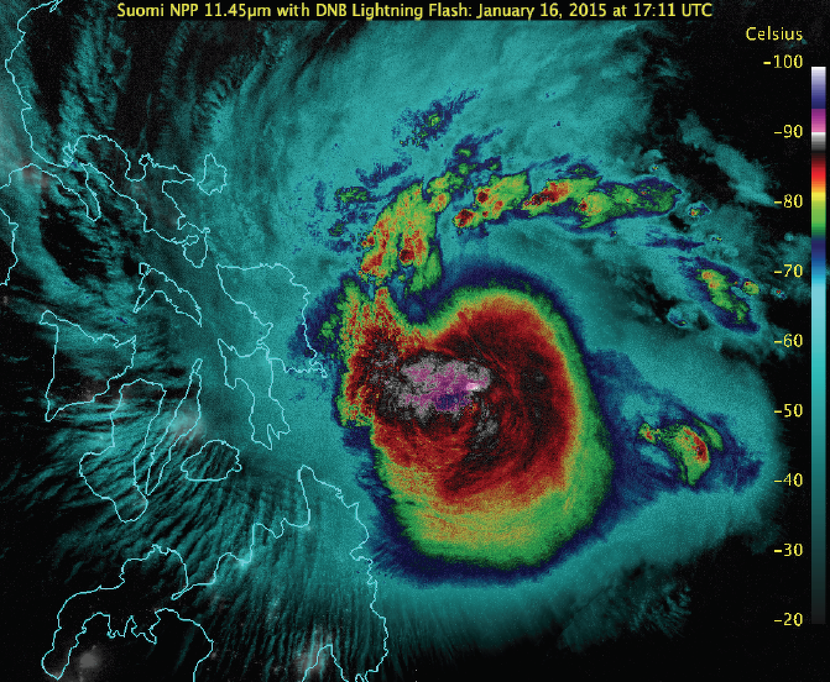
CIMSS Grants Suomi NPP
CIMSS grant for S-NPP data in collaboration with CIRA
Improvements for visualization of VIIRS, CrIS, ATMS
Updates to Time Matching
Enhancements for Layer Labels

Slide 27
Other Proposals
NASA ROSES (Research Opportunities in Space and Earth Sciences)
Santek and Kulie (SSEC), and Ramamurthy (Unidata)
2014 (not selected): “The Network is the Lab: Effecting Collaborative Research through Innovative Data Access and Shared Visualization”
2015 (to be submitted July 2015): “Interactive Algorithm Development and Product Validation through Innovative Data Access and Visualization Methods”

Slide 28
McIDAS-V Priorities
Fix Critical bugs (MUG, Unidata)
Incorporate enhancements from CIMSS projects, especially those that are not possible in McIDAS-X (CIMSS, MUG)
Trajectories, VIIRS, CrIS, ATMS
Ensure new data sources are usable (MUG, CIMSS)
Himawari-8 AHI, GOES-R ABI
Maintain compatibility with Unidata’s IDV (Unidata, MUG)
Major underlying infrastructure changes are still needed

Slide 29
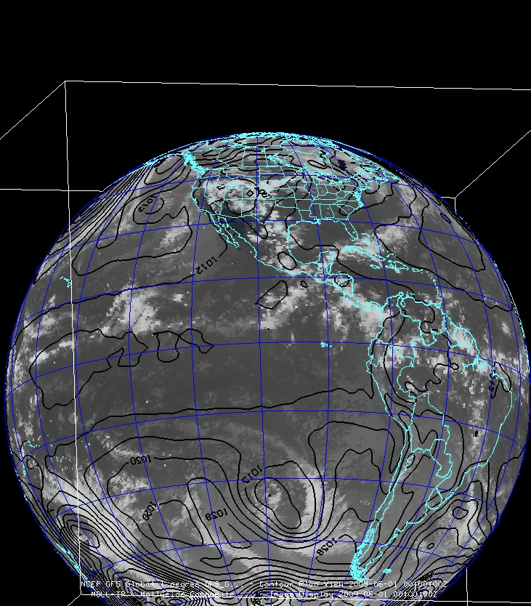
McIDAS-V Future
Continue to engage younger generation:
Workshops and training
Classroom
Appeal to researchers:
Input/output data formats
Scripting
More data fusion
With GOES-R in McIDAS-X, re-evaluate operational requirements:
Who is the user?
What functionality is needed?

Slide 30
McIDAS-X and –V Summary
No immediate plans for support fee structure changes
MUG members will continue to receive priority support for –X and –V
Until –V can fully function as a replacement for –X (several years), not much will change.
New development likely done in –V rather than –X, however:
We’re still updating –X for OS upgrades
We’re still creating ADDE servers for new satellites
If –X works for you, then stay with –X. When new features or data types come along in –V, then do your new development in –V.
If you need help with the new development, contact the McIDAS Help Desk
McIDAS-X is expected to be supported beyond 2020 for current GOES GVAR and upcoming GOES-R series satellites. No end date in sight.

