Slide 1
SDI (Satellite Data Ingestor)
2015 McIDAS Users Group Meeting
June 8, 2015

Slide 2
Overview
SDI 104
Hardware configuration
Software configuration
Satellites signals
Next generation SDI
Hardware Configuration
Software configuration
Satellites signals

Slide 3
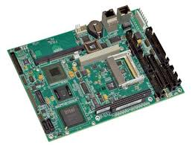
SDI 104
Hardware Configuration
PC/104-Plus
LittleBoard 735
1 GHz CPU
Disk: 160 Gbyte IDE
Boot from compact flash
Ethernet: Up to 1G/s
Connectors for monitor and keyboard
Mounted in 2U rack box

Slide 4
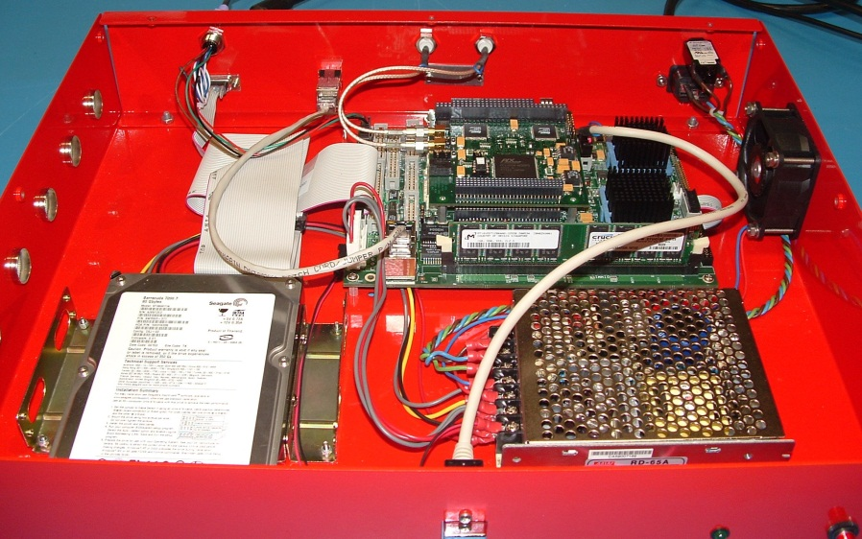
Hardware Configuration
Data rates tested up to 40 Mbits/s
Connectors:
D15P
BNC
Configuration:
Single ended (TTL)
RS422 (differential)
Data types
NRZ-L, NRZ-M, NRZ-S
Jumper configurable

Slide 5
Software Configuration
Knoppix 6.7.1 (Linux 3.0.41)
Up-to-date security
Compatible with old binaries
Upgrade to Knoppix for older SDI-104 systems running DSL as needed
Can be configured as a standalone ingestor/server, or write data to an external disk (via NFS, for example)

Slide 6
Event Notification
Notifications are dependent on signal type:
Image start (not for POES)
Image end (not for GVAR Imager)
Three types of notifications:
Send an email
Write notification to a file (log messages)
Run a program or script

Slide 7
SDI-104 Status for Current Satellites
GVAR: up-to-date for entire series
MTSAT: up-to-date for both satellites
May want to add swap space if running DSL (noisy data)
POES AVHRR:
Up-to-date for all satellites
Unable to test direct reception, although a system is running at NWS Honolulu

Slide 8
(Original) SDI Sunset
The Original SSEC SDI was sunset on 31 December 2013
We are not able to provide nor recommend hardware components if these would fail
The operating system used is an unsupported version of Solaris, which has been lacking security updates for several years.

Slide 9
SDI … the next generation

Slide 10
Introducing the SDI-SE

Slide 11
SDI-SE Hardware Configuration*
Dell PowerEdge R430 servers
12 core, 2.5 GHz Intel Xeon Processor
64 GB Ram
6 1-TB disks in RAID-6
10 Gb Ethernet and 1 GB Ethernet
No more clock and data
Everything over ethernet
(no SSEC designed hardware components)
*preliminary

Slide 12
SDI-SE Software Configuration*
CentOS 6.x
Software and security updates via yum
Repository at UW SSEC
McIDAS-X ADDE servers
CSPP-GEO ingest software
RabbitMQ event notification
*preliminary

Slide 13
SDI-SE Data Access*
ADDE
FTP
*preliminary

Slide 14
SDI-SE Event Notification*
RabbitMQ
Built in exchange server
Start and End Events
No more email events
Remote workstations will be able to connect to the Exchange server and receive desired events
May update SDI-104 to use RabbitMQ in the future
*preliminary

Slide 15
SDI-SE Supported Satellites *
GOES-R series
Ingest handled by CSPP GEO
Instruments
ABI (Advanced Baseline Imager)
Follow/tracking
GLM (Geostationary Lightning Mapper)
MAG (Magnetometer)
SEISS (Space Environment In-Situ Suite)
SUVI (Solar Ultraviolet Imager)
EXIS (Extreme Ultraviolet and X-ray Irradiance Sensors)
No Level-2 processing on the SDI-SE
HimawariCast (under consideration)
GVAR (under consideration)
*preliminary

Slide 16
What is CSPP – GEO?
Community Satellite Processing Package for Geostationary Data
NOAA sponsored project being developed at UW SSEC
The software will be capable of processing GOES Rebroadcast (GRB) data received from the next-generation GOES-R satellite. Level 2 Advanced Baseline Imager (ABI) products will be generated by state-of-the-art science algorithms developed under the GOES-R Algorithm Working Group project.
Software is freely available and is distributed as self-contained binary packages built for 64-bit Linux systems.

Slide 17
CSPP – GEO initial product suite
Cloud mask
Cloud phase
Cloud type
Cloud top height
Cloud top temperature
Cloud top pressure
Cloud 11 µm emissivity
Cloud visible optical depth
Cloud effective radius
Cloud liquid water path
Cloud ice water path
Probability of Marginal Visual Flight Rules (MVFR)
Probability of Instrument Flight Rules (IFR)
Probability of Low Instrument Flight Rules (LIFR)
Low cloud geometric thickness

Slide 18
End

