Slide 1
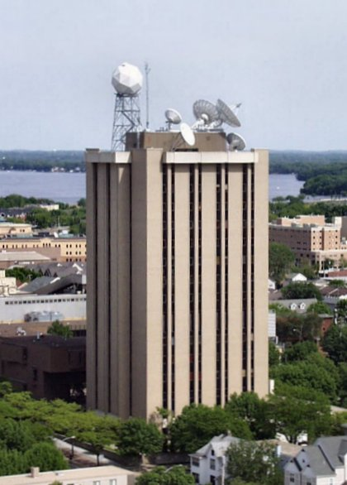
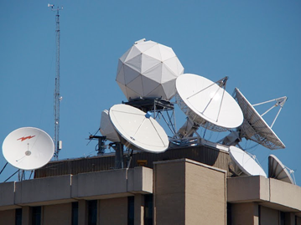
Welcome to Madison, WI and the
University of Wisconsin-Madison
Steve Ackerman

Slide 2
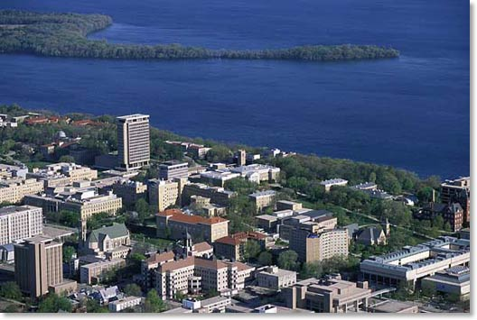
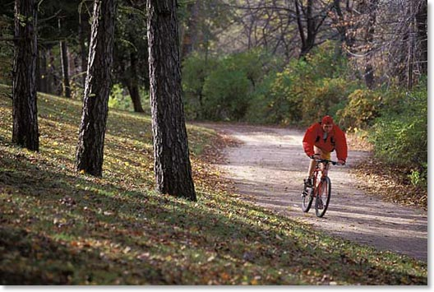

Slide 3
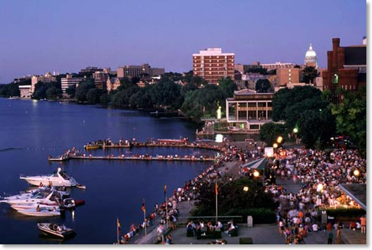
capitol

Slide 4
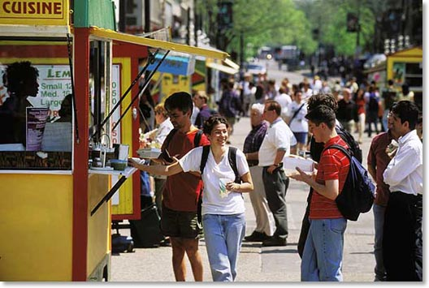
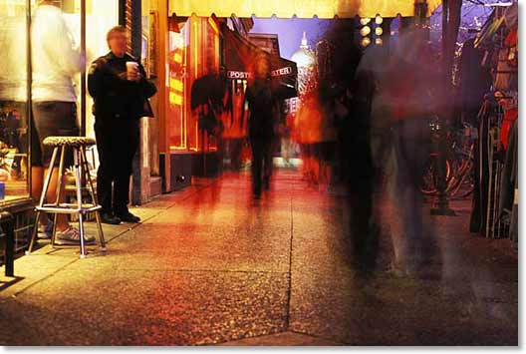
capitol

Slide 5
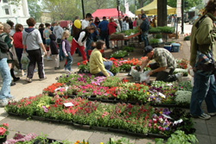
Staying longer….
The square….

Slide 6
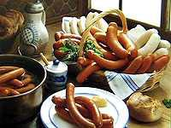
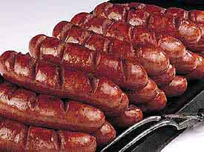
Finer Cuisine
Brats……

Slide 7
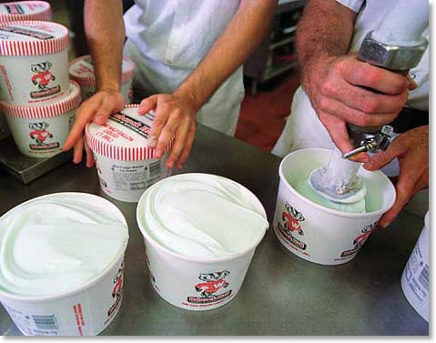
Babcock ice cream – yummmm
Available in the Union

Slide 8
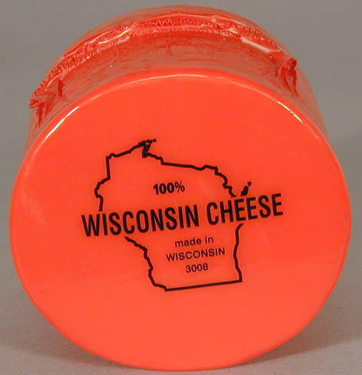
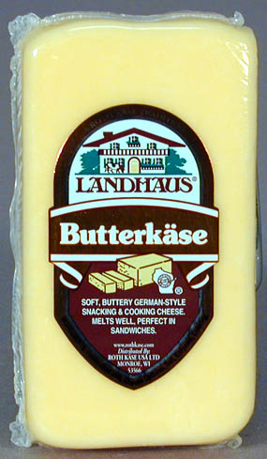
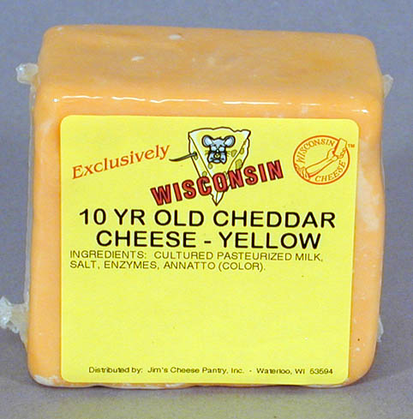
Try em fried too!!

Slide 9
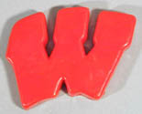
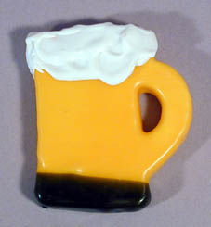
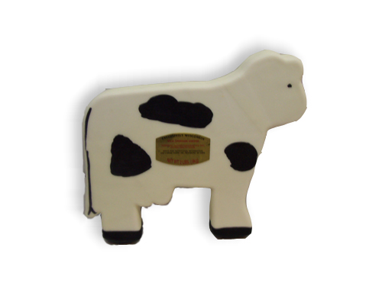

Slide 10
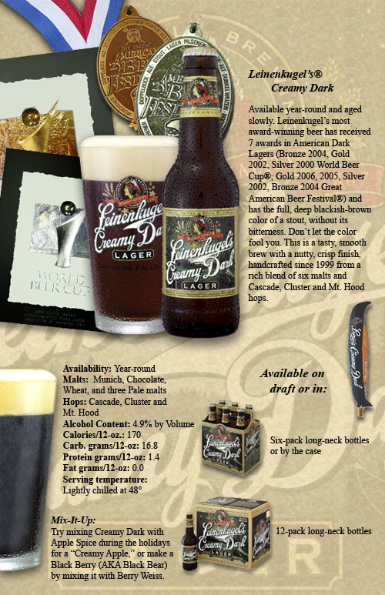
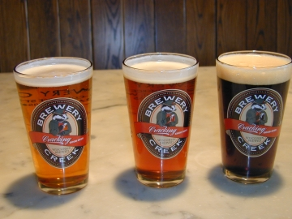
WI BEER

Slide 11
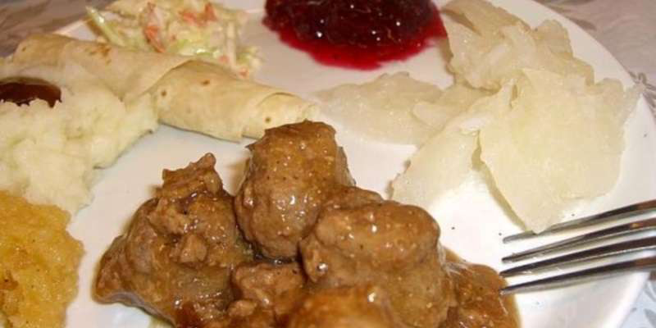
Lutefisk Supper, Norwegian dinners

Slide 12
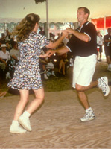
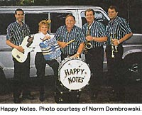
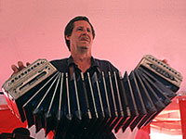
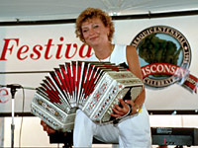
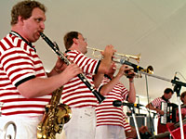

Slide 13
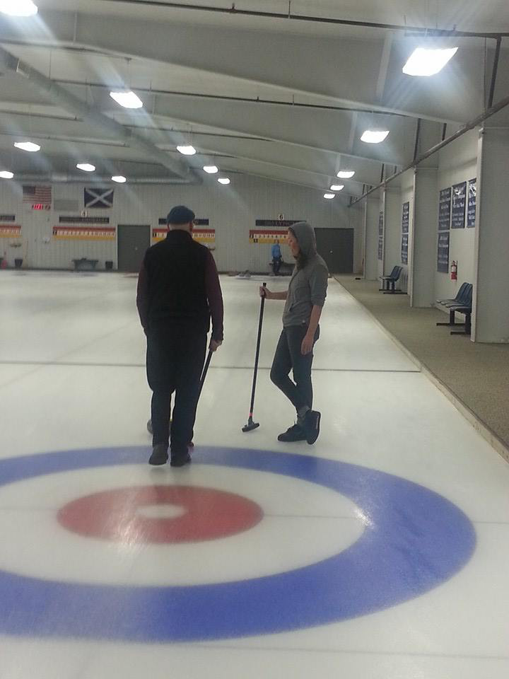
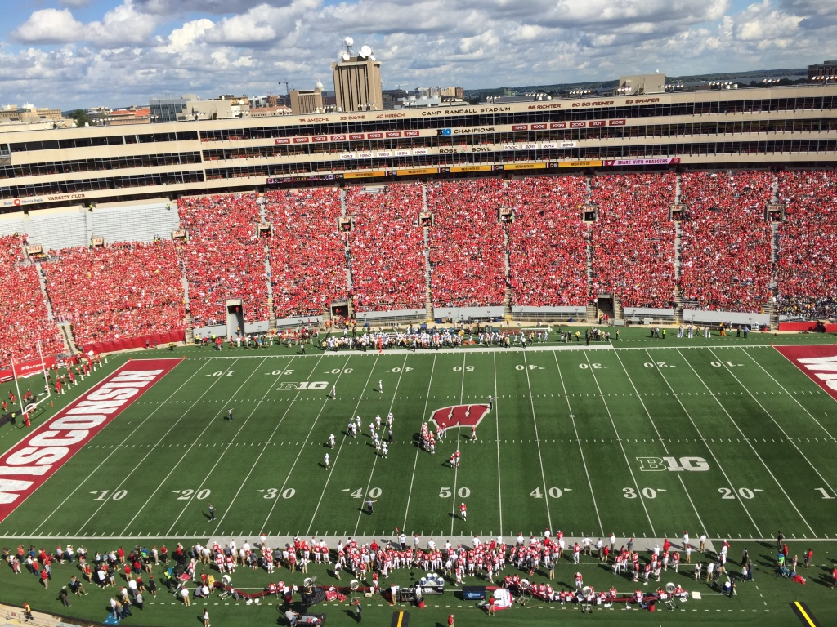
Sports…

Slide 14
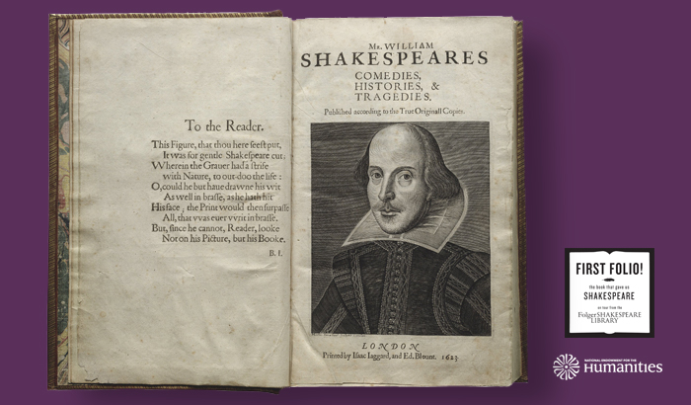
The Chazen Museum
The Book that Gave Us Shakespeare
on tour from the Folger Shakespeare Library

Slide 15
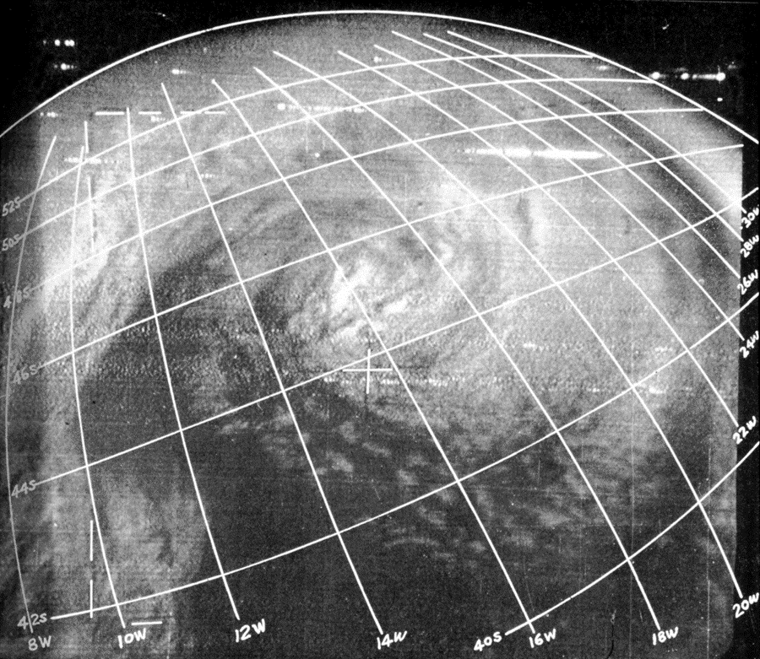
Our History….
Notes:
The first successful meteorological satellite instrument was designed by Profs. Verner Suomi & Robert Parent
13 Oct 1959 Explorer 7 measured the Earth Radiation Budget
On April first 1960 the USA launched its first meteorological satellite, TIROS 1.
TIROS 1 image of a mid-latitude cyclone, July 1961
TIROS = Television and Infrared Observation Satellite
Verner Suomi is referred to as the Father of Satellite Meteorology
He is the only person to have a Earth satellite named after him – the
Suomi National Polar Program satellite

Slide 16
McIDAS & McIDAS-V

Slide 17
Welcome! Enjoy!

