Slide 1
McIDAS – XCD Replacement Update
2016 McIDAS Users’ Group Meeting

Slide 2
Rewrite Team
Kevin Baggett, Jonathan Beavers, Dan Forrest, Jay Heinzelman, Dave Parker, Jerrold Robaidek, Becky Schaffer, Clayton Suplinski

Slide 3
McIDAS XCD
McIDAS X
Conventional Data
Decoder
McIDAS-XCD files, decodes and indexes the NOAAPORT data stream into formats that can be served by McIDAS-X ADDE servers.
Output formats include McIDAS MD files, Text files, McIDAS GRID files, GRIB
Version 1 and 2 files, NEXRAD files, and BUFR files.

Slide 4
NOAAPORT Data
The NOAAPORT broadcast system provides a one-way broadcast communication of NOAA environmental data and information in near-real time to NOAA and external users. This broadcast service is implemented by a commercial provider of satellite communications utilizing C-band.

Slide 5
NOAAPORT Channels
The following NOAAPORT channels supply data to be decoded by McIDAS-XCD:
NCEP/NWSTG Channel (NWS Telecommunications Gateway)
model output from the National Centers for Environmental Prediction (NCEP)
observations, forecasts, watches and warnings from NWS Forecast Offices
WSR-88D radar products
most observational data over North America
NCEP/NWSTG2 Channel
supplements the NWSTG channel

Slide 6
NOAAPORT Data flow into SSEC
Users generally get NOAAPORT data in two ways:
Directly from DOMSAT (101°W)
Over the Internet via LDM

Slide 7
Why Replace -XCD?
Installation is difficult
Upgrades are difficult
System is overly complex, large learning curve for operators, and very large learning curve for new programmer
System was written for a mainframe then ported to UNIX
A powerful system is needed to run -XCD, otherwise data can be lost
A data format change can mean bad data, and a fix can be difficult to implement, and is only effective for future data

Slide 8
Goals
Replace 4 parts of -XCD filing and decoding:
GRIB
NEXRAD
Text
POINT/MD serving
Utilize LDM direct filing
Reduce or eliminate compiled code
Remove legacy mainframe complexity
Utilize simple open-source database, SQLite
Match or exceed current filing and serving performance on existing hardware

Slide 9
-XCD Replacement: GRIB Data
LDM files GRIB messages to a temporary directory
A GRIB daemon written in Python watches for data, extracts information and files metadata into a SQLite database
SQLite databases are separated by model and date
Volume of GRIB data has increased greatly over the last several years increasing the challenge

Slide 10
-XCD Replacement: NEXRAD Data
LDM files NEXRAD files (WSR and TDWR) into a directory structure similar to the existing -XCD Decoder
Data served by NEXRAD server

Slide 11
-XCD Replacement: Text Data
LDM files data directly to disk
A bash script running as a daemon watches for new data and files data into a daily *.XCD file as data comes in
The bash script extracts metadata for insertion into a daily SQLite database
Text servers (wxtgserv and obtgserv) query SQLite databases to find data and return information to client
Commands: WXTLIST, WWLIST, WWDISP, *RPT

Slide 12
-XCD Replacement: Point Data
RTPTSRC datasets
Uses certain text data identified by WMO headers filed in the database (e.g. SA and SP for SFCHOURLY)
No MD files are created, but structure created on the fly when serving via ADDE
Commands such as PTLIST, PTDISP and PTCOPY get metadata from the SQLite database, then extract data from the *.XCD file created by the text filer
At the start of each UTC day, a Station Database table (equivalent to STNDB.CORE) is created
Station Database is retained for archived data

Slide 13
Point Data Improvements
Replacement –XCD captures more surface hourly data than existing –XCD
Existing –XCD: Hourly & 2 Specials
Replacement –XCD: Hourly & All Specials

Slide 14
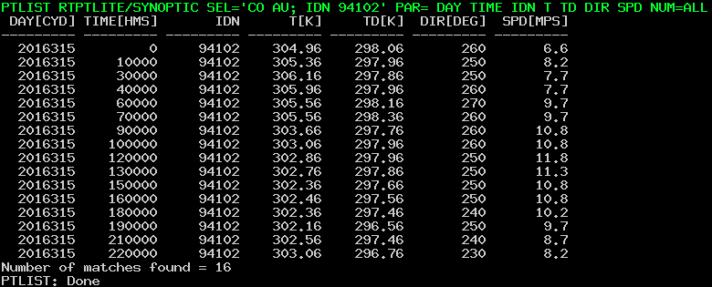
Point Data Improvements
Synoptic Data in current –XCD is stored every 3 hours
Replacement –XCD can store every hour

Slide 15
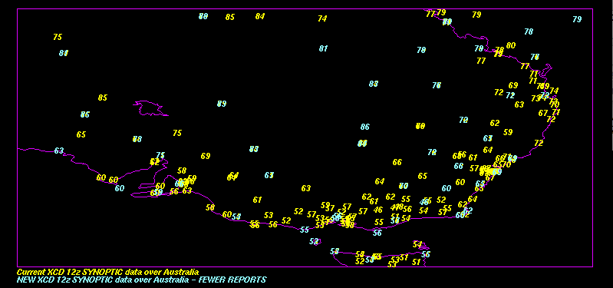
Point Data Case: Synoptic over Australia
PTDISP RTPTSRC/SYNOPTIC.ALL PAR=T[F] FORMAT=I2 SEL='TIME 12;DAY 2016316' DEC=NO PTDISP RTPTLITE/SYNOPTIC.ALL PAR=T[F] FORMAT=I2 SEL='TIME 12;DAY 2016316' DEC=NO COL=2

Slide 16
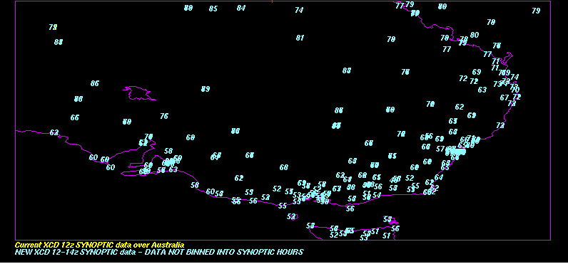
Point Data Case: Synoptic Over Australia
PTDISP RTPTSRC/SYNOPTIC.ALL PAR=T[F] FORMAT=I2 SEL='TIME 12;DAY 2016316' DEC=NO PTDISP RTPTLITE/SYNOPTIC.ALL PAR=T[F] FORMAT=I2 SEL='TIME 12 14;DAY 2016316' DEC=NO COL=2

Slide 17
Point Data Issues
Number of hourly records of PTCOPY for SFCHOURLY data needs to be increased
Up to 10 specials per hour?
Number of possible records of PTCOPY for SYNOPTIC data needs to account for the hourly availability

Slide 18
BUFR Data (Binary Universal FoRmat)
Filed directly using LDM
No operational McIDAS-X server exists
A prototype server was created but has not been updated in several years
Individual files can be loaded into McIDAS-V if they follow the standard BUFR tables
We aim to be ready as BUFR implementation proceeds

Slide 19
Local Data
A couple -XCD sites have local (non-NOAAport) feeds of data
We have contacted those sites in the past
So far, no core -XCD decoder dependencies are known i.e. sites have written their own decoders
If there is local data that do depend on -XCD libraries, sites will be able to continue to use -XCD libraries, or may link to McIDAS-X libraries as needed. Contact Jerry Robaidek or Becky Schaffer if you have concerns.

Slide 20
Hardware Specs
Development hardware (~$4K in 2013)
2- AMD Opteron 4180 CPUs - 6 core each
32 GB ram
7.2k rpm SAS disks
Briefly tested GRIB on a sub $1K desktop
Intel i5-3570 3.4 GHz (quad core)
16 GB memory
7.2k rpm SATA drives (6 Gb/s)

Slide 21
Serving performance (Text)
TEXT lists
WXTLIST (no parameters)
Current -XCD: fastest=.092 s slowest=.105 s
New -XCD : fastest=.014 s slowest=.35 s
WXTLIST WMO=SA
Current -XCD : fastest=.019 s slowest=.259 s
New -XCD : fastest= 1.654 s slowest= 1.890 s

Slide 22
Serving performance (SFCRPT)
SFCRPT
SFCRPT KGRB 9 (Current –XCD)
Fastest : ~.021 s
Slowest : ~.419 s
SFCRPT KGRB 9 (New –XCD)
Fastest : ~.017 s
Slowest : ~.122 s

Slide 23
Serving performance (PTLIST)
PTLIST
PTLIST RTPTSRC/SFCHOURLY SEL=“DAY 2016312; TIME 12; ID KMSN”
Current –XCD: fastest=.022 s slowest=.074 s
New –XCD: fastest=.023 s slowest=.167 s
Remove ID: PTLIST RTPTSRC/SFCHOURLY SEL=“DAY 2016312; TIME 12”
New –XCD slows to : ~0.3 s
Remove ID and Time: PTLIST RTPTSRC/SFCHOURLY SEL=“DAY 2016312”
New –XCD slows to : ~3.8 s

Slide 24
Server performance (GRID)
GRID lists (GRDLIST)
RTGRIDS/GFS-USLC DAY=2016312 TIME=6:00 PAR=U NUM=10
Current -XCD : ~.45 s
New -XCD : ~.07 s
GRID display (GRDDISP)
RTGRIDS/GFS-USLC DAY=2016312 TIME=6:00 PAR=U FHOUR=12 LEV=500
Current -XCD: ~.185 s
New -XCD : ~.105 s
GRID copy (GRDCOPY)
RTGRIDS/NAM-USPS G/G.5700 DAY=2016312 TIME=0:00 PAR=T FHOUR=9 LEV=500
Current -XCD: ~.125 s
New -XCD: ~.052 s

Slide 25
Monitoring
Command line
ldmadmin watch
gribadmin
Graphical
HTML based
Does not require apache to be installed

Slide 26
Monitoring

Slide 27
Point Monitoring

Slide 28
GRIB Monitoring

Slide 29
Radar Monitoring

Slide 30
Packaging and installation
Existing servers and decoders (compiled code) will be migrated into McIDAS-X
We plan to have -XCD replacement beta GRIB software (Python) and text software (bash) packaged as Linux containers using Docker
Docker will simplify the process of building, running, and upgrading the containers
Docker is a relatively new platform and we are working through issues
Goal is to simplify the installation process for system administrators

Slide 31
Schedule
All ingest and serving components are in testing
Monitoring development and testing in progress
Operations testing in progress
Beta release early 2017
Version 1.0 of the -XCD replacement will be packaged with McIDAS-XCD 2017.1

