Slide 1
Preparing for GOES-R: Imagery and Validation
Participants at MUG Meeting: Joleen Feltz and James P. Nelson*
Tim Schmit**, Mat Gunshor*, Kaba Bah*, Hong Zhang*
*Cooperative Institute for Meteorological Satellite Studies/ Space Science and Engineering Center (SSEC/CIMSS) University of Wisconsin-Madison
**NOAA/NESDIS/Satellite Applications and Research Advanced Satellite Products Branch (ASPB)

Slide 2
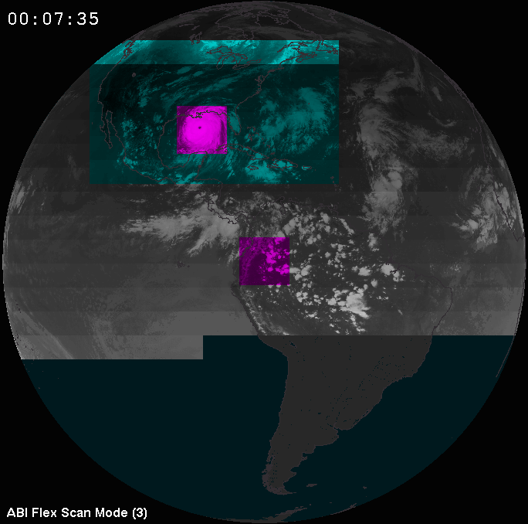
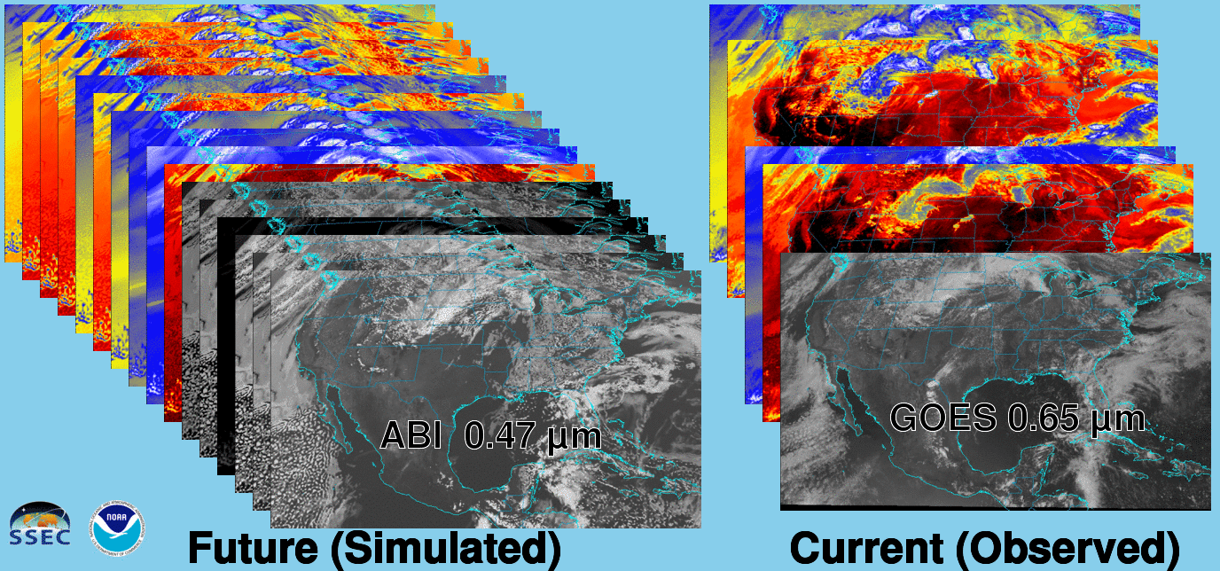
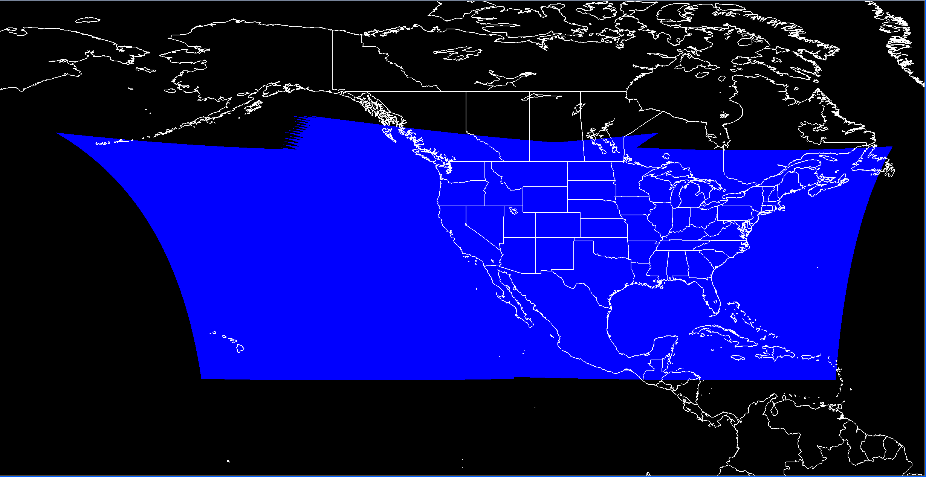
Preparing for More with GOES-R!
16 bands = 3x(current 5-band imager)
Higher Spatial Resolution
Full disk imagery (2200x2200) every 15 minutes
5 minute conus scans
1 minute mesoscales at 2 locations
Data from Geostationary Lighting Mapper (GLM)
Image Courtesy: Rick Kohrs
CONUS from East and West GOES ABI
Image Courtesy: Kaba Bah
Notes:
As a group, the GOES imagery team is preparing to display and interrogate significantly more data than the current era of GOES satellites. There will be double the spectral bands over the current five band imager. GOES-R will have higher spatial resolution over all 16 bands than the current imager. Full disk imagery will be at 4 times the repeat rate of the current series. Conus scans will be at three times the repeat rate. In addition, 1 minute mesoscale scans will be conducted at two different locations. Finally, the Geostationary Lightening Mapper will be onboard as well. On the left there is a visual diagram of the mesoscale, full disk, conus scans for mode 3. On the lower left is a coverage map from the combined CONUS for GOES ABI. Finally, on the right is a animation of current versus future spectral band capabilities.

Slide 3
Preparing for Higher Time Resolution: GOES-14 1 minute rapid scans (SRSOR)
Notes:
In preparation for GOES-R, in particular the mesoscale scans, scientists at CIMSS as well as other cooperative institutes and Proving Ground Partners, have been visualizing 1-min SRSOR data. This practice not only helps to prepare us for handling imagery at a higher rate, it also reveals more interesting features in satellite imagery in a more timely manner for forecasting. In this image, we have Martin Setvak’s Sandwich RGB product overlaid on a visible image. This RGB, along with other RGBs, is popular in Europe for forecasting severe storms. Use of the sandwich product is increasing here as well. The advantage of this method is that rapid cooling of IR brightness temperatures can be viewed simultaneously with the texture from the visible image. This brings the eye to rapidly developing storms which tend to cool rapidly and exhibit a dynamic texture.
HWT Testbed: http://goesrhwt.blogspot.com/2015_05_31_archive.html
“SRSOR
- Must have it
- Big tool for radar sparse areas.”
(AMS Paper Reference – Mention a Day in the Life and a good resource for what can be seen in the eyes of an operational meteorologist)
There are a number of features which appear between the scan times of the current imager
1.) This feature develops behind a bigger storm and while it develops of the entire one and one half hour period, major development occurs between the traditional time lapse of the data being collected by the current operational schedule.
2.) At this location, we catch a rapidly cooling cloud just as it appears, but miss much of the other development of the storm.
Around the entire image, the life of the storms are far more evident in the 1-minute imagery

Slide 4
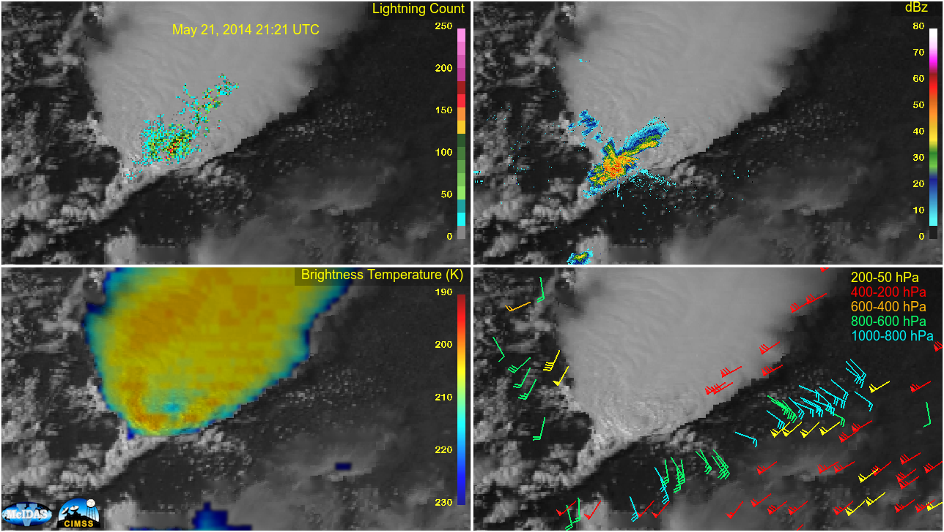
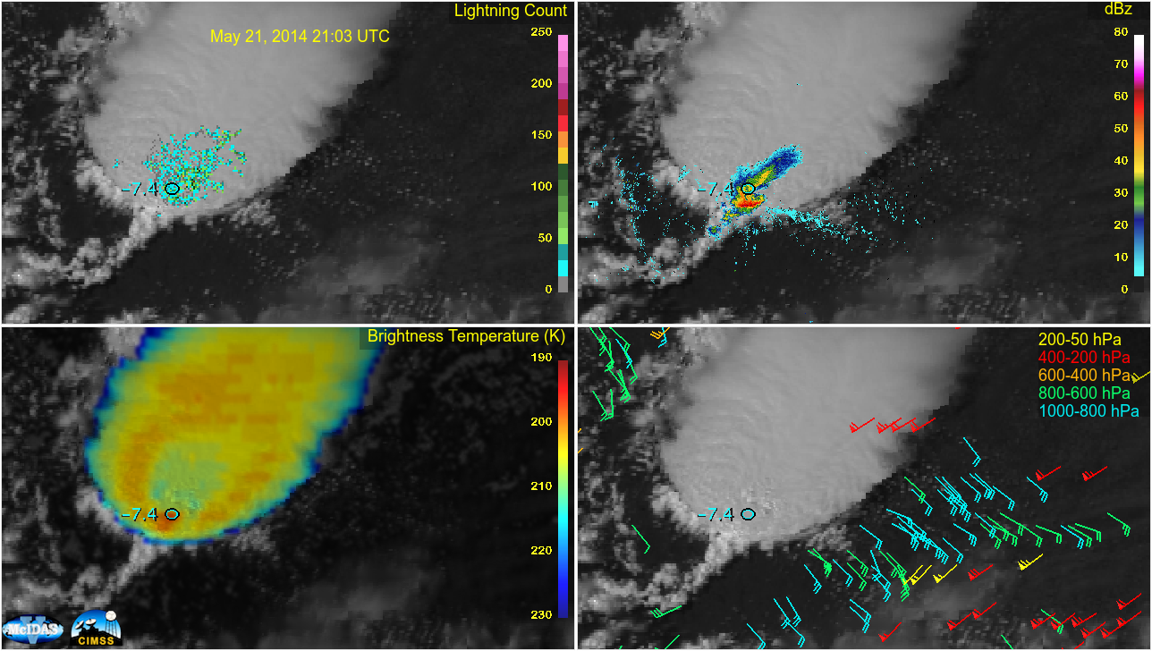
Combining Current Products to Prepare for Future Data
Notes:
As a team, we are looking at ways to combine current satellite products and other instruments to prepare for the GLM and imagery which lives in the same or similar time space as other data such as radar. I won’t get into much meteorological detail here, but Kristopher Bedka (see reference slide) gave an outstanding presentation at the AMS satellite conference which combines knowledge of his satellite research products and techniques with other metrological observations in a similar visual comparison as this. In this image, the Colorado lightening detection array is being use as a proxy for the Geostationary Lightening Mapper, overlaid on visible imagery. TDWR radar data is in the upper left frame. On the lower left is the sandwich product (visible/thermal infrared) and on the right are satellite derived winds. In addition, the magnitude of satellite derived cloud top cooling from the previous time is plotted on top of all frames.

Slide 5
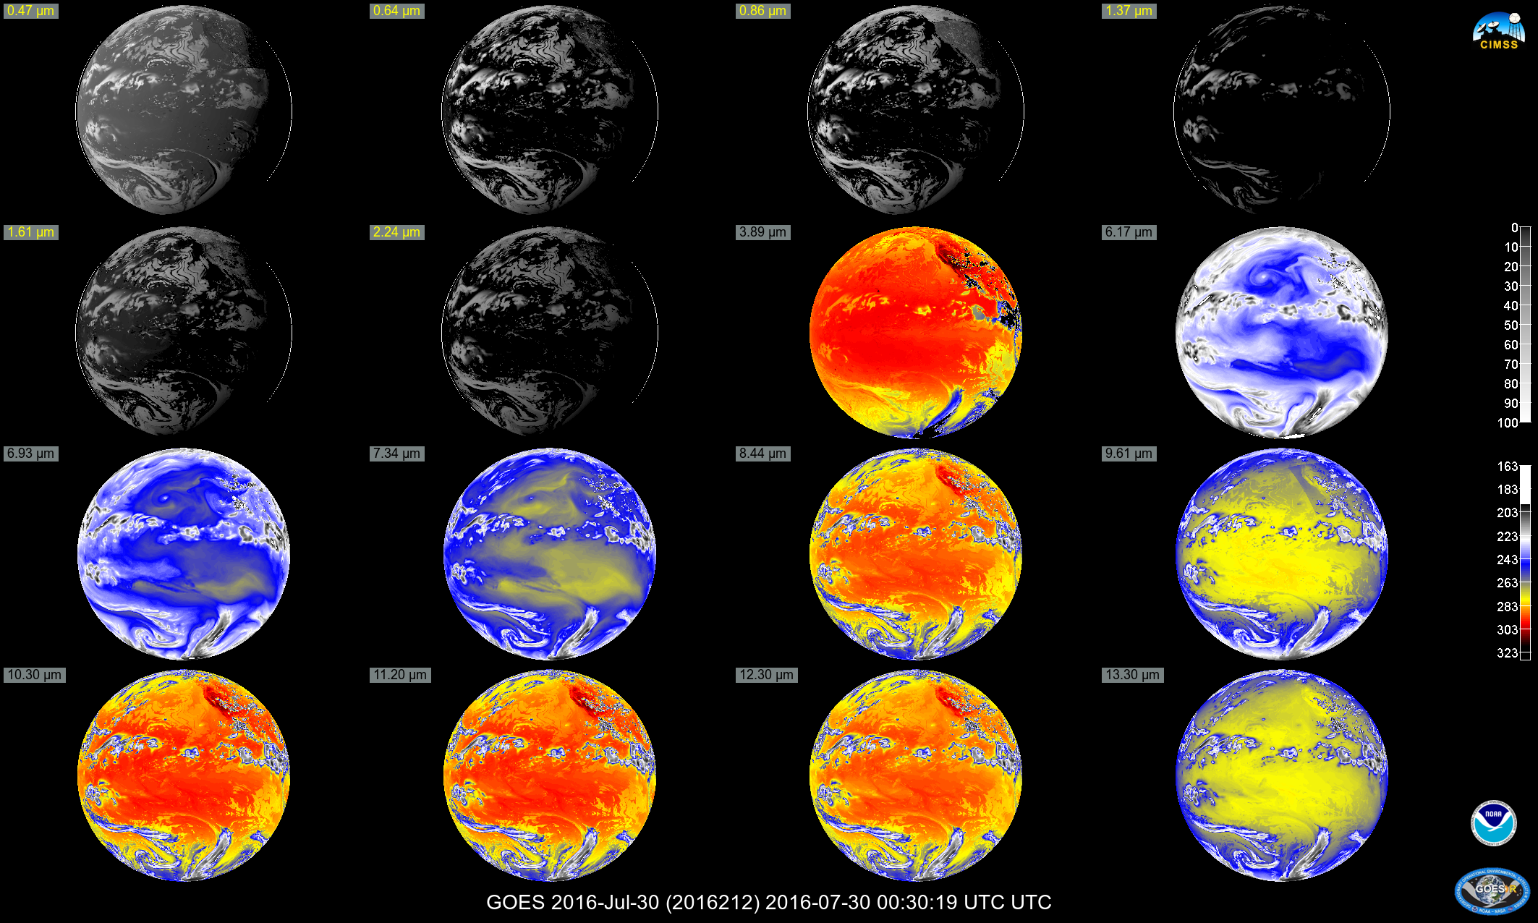
First Light Mock-Up Images
Notes:
As a team, we are testing and building our tools for first light imagery of GOES-R. Using ground system test data, we have built tools in both McIDAS-X and McIDAS-V

Slide 6
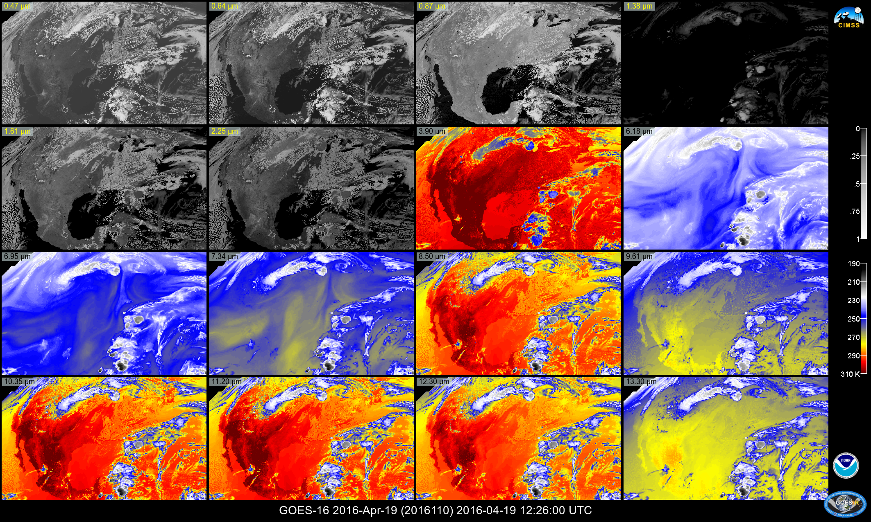
First Light Images: Prepare for Multiple Scenarios
Full Disk Single Band Images
16 panel Full Disk Images
16 panel CONUS Images at various zoom levels
16 panel FD as CONUS
Run in either McIDAS-X or McIDAS-V
Level 1b Radiance served via McIDAS-X
Level 2 Cloud and Moisture Imagery in McIDAS-V
Create Imagery either from Grid or ADDE formats
Run on multiple platforms by multiple members of the team
Notes:
In an effort to be ready, the team has set a number of goals tested the capability to create
Full Disk Single Band Images
16 panel Full Disk Images
16 panel CONUS Images at various zoom levels
16 panel FD as CONUS
Run in either McIDAS-X or McIDAS-V
Level 1b Radiance served via McIDAS-X
Level 2 Cloud and Moisture Imagery in McIDAS-V
Create Imagery either from Grid or ADDE formats
Run on multiple platforms by multiple members of the team

Slide 7
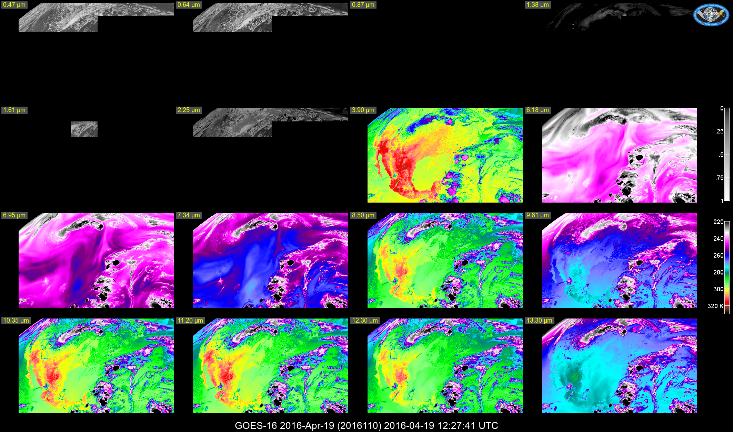
Why 16 Panels: “Quick Check” of Image Quality
Notes:
16 panels show quite a bit of imagery. I have been asked why create 16 panels?
1.) A quick visual check of image quality across the bands
(This is test data that is incomplete)

Slide 8
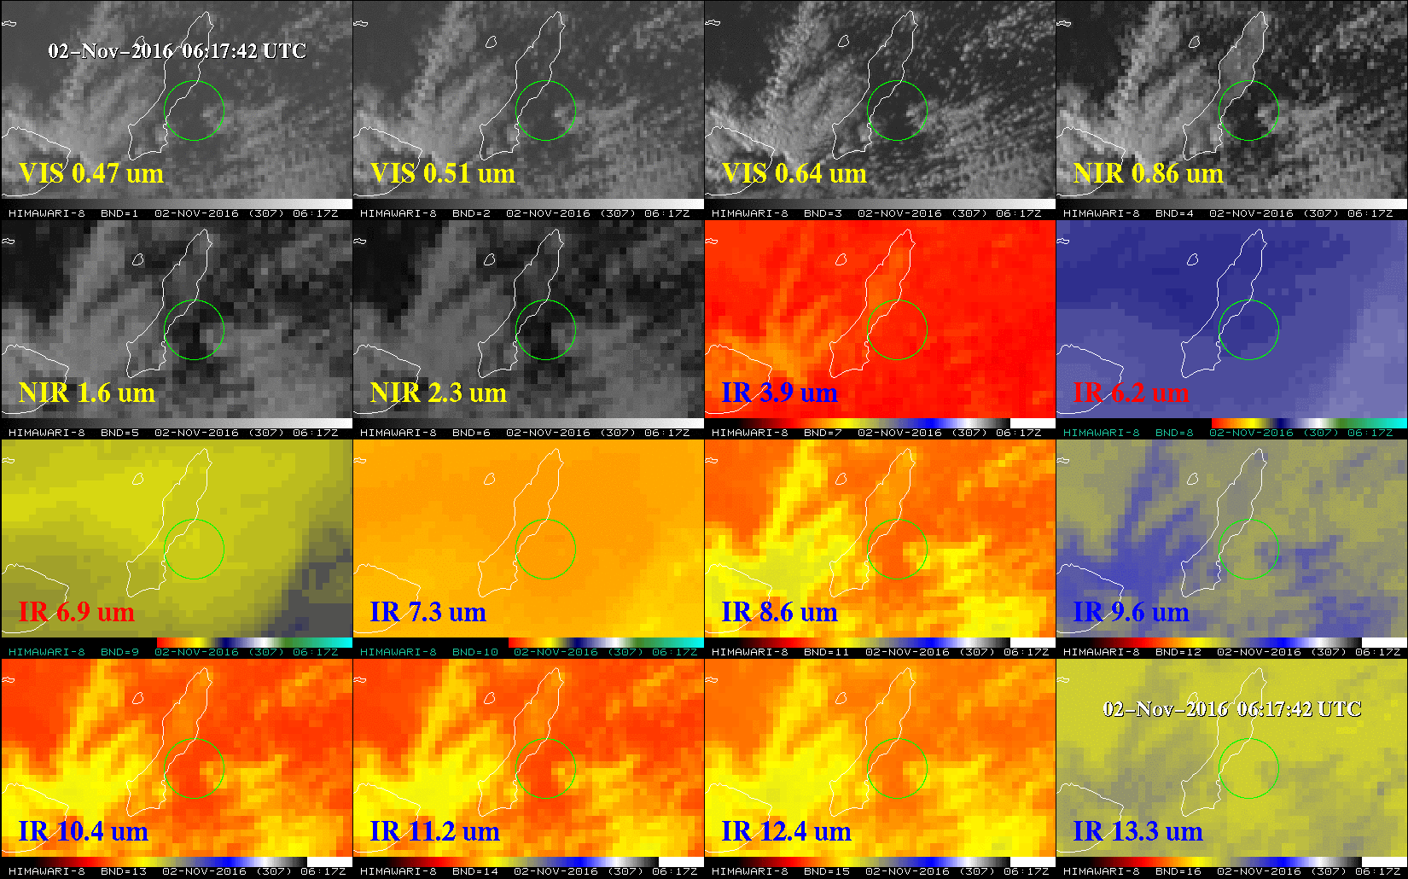
16 Panels: Himawari-9 Launches/Himawari-8 Observes
From Tim Schmit, NOAA/ASPB
Notes:
Reason #2 – Verify the existence of features consistent with a theory.
The H-9 satellite was launched in November. Just looking at the visible band (0.64 um), it might be argued that the brief cloud is a wish-observation of the exhaust plume from the H-9 launch. However, looking at all the 16 bands for a short time-series, the plume and the thermal signature are seen giving the observation more credence.

Slide 9
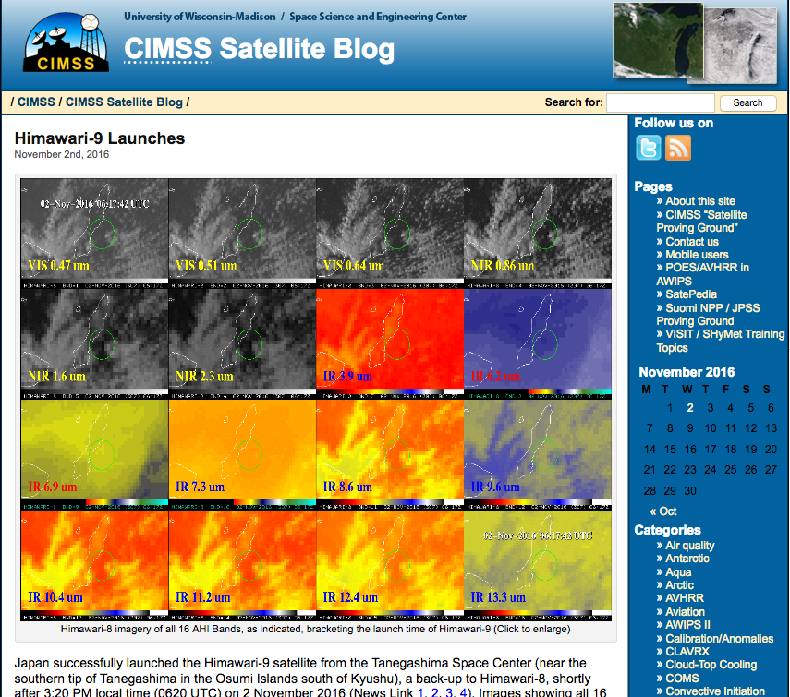
Read More at the CIMSS Satellite Blog!
http://cimss.ssec.wisc.edu/goes/blog/archives/22519
Notes:
The H-9 satellite was launched in November. If we had just looked at the visilble band (0.64 um), we might argue the brief cloud is a figment of an active imagination. However, looking at all the 16 bands for a short time-series, the plume and the thermal signature are easily seen lending much more credence to the idea that we did observe the rocket launch with the H-8 satellite.

Slide 10
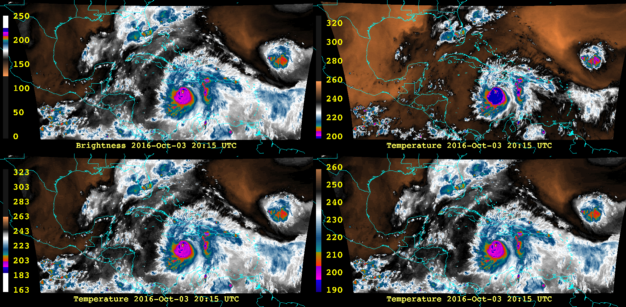
Brightness Value (0-255) displayed with WVJL2.ET imported into McIDAS-V
Brightness Temperature with WVJL2.ET inverted and stretching/squeezing done to try to replicate panel 1.
WVJL2.ET converted using BiLinear Stretch Equation and applied to Brightness Temperatures from 163-330K
Instead of squeezing a color table from 163-330K to 180-310K, select the colors at each temperature in the range from 190-260K.
Notes:
When creating the 16 panels for McIDAS-X and McIDAS-V, we explored the question of why McIDAS-X color tables look different between McIDAS-X and McIDAS-V when displayed on a brightness temperature image.
The top left image is the original McIDAS-X WVJL2.ET color table displayed on pixel brightness levels from 0-255. This means that for every point in the color table, there is a linear relationship between the color choice in the table and the pixel on the screen.
On the top right, we have taken that table and applied it directly to a image of brightness temperature values in degrees Kelvin. We might realize that we need to invert the table and attempt to stretch the colors to match the top left image. However, this generally does not work. Why?
The reason is that in McIDAS-X, a bi-linear stretch was applied to most color tables meaning that below a certain temperature, there was a linear relationship between the color level in the table and the temperature. Above a certain temperature, the relationship is two to one. In the lower left panel, I have used McIDAS-V’s jython shell to recreate the bi-linear stretch color table which was always stretched arbitrarily from 163-330 K.
if (temp < 242):
BV = 418 - temp
else:
BV = 660 - (2*temp)
Yet, this is still not quite what is needed. The last step is to go back into the color table and select the color levels out of the color table that corresponds to each temperature in the actual range of the data.

Slide 11
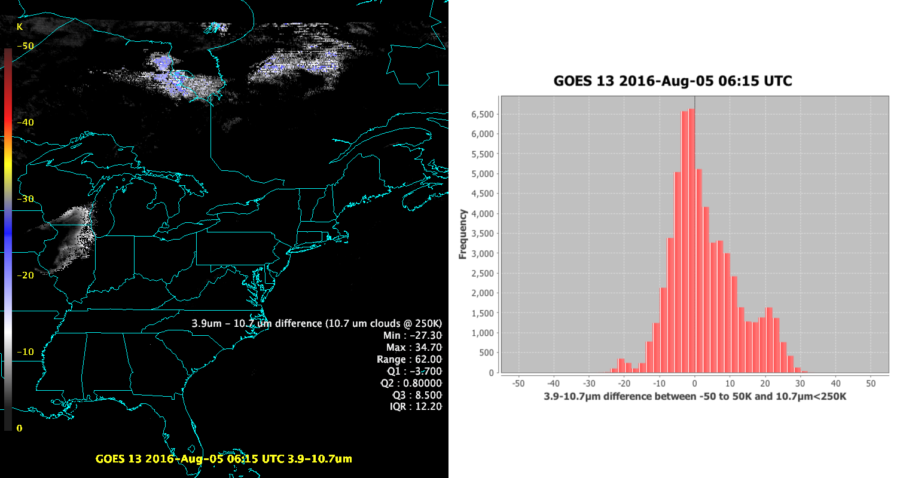
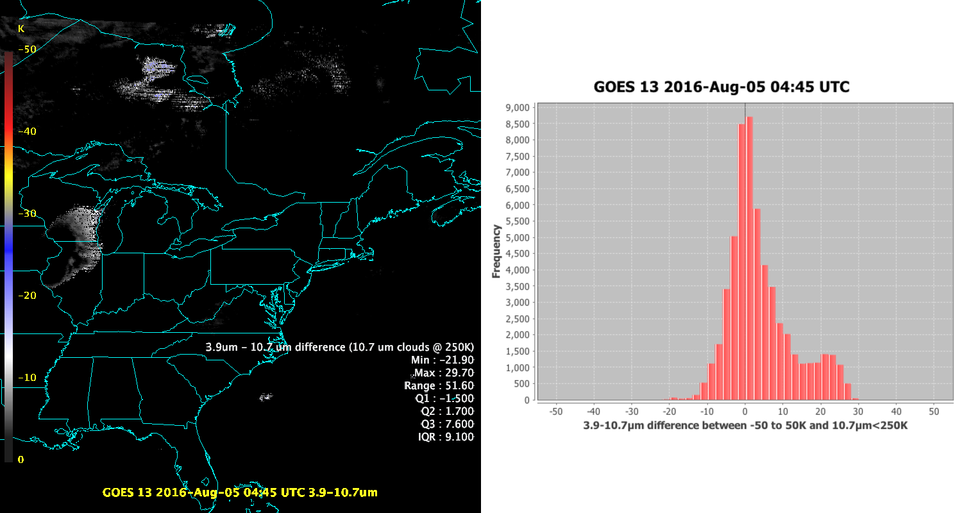
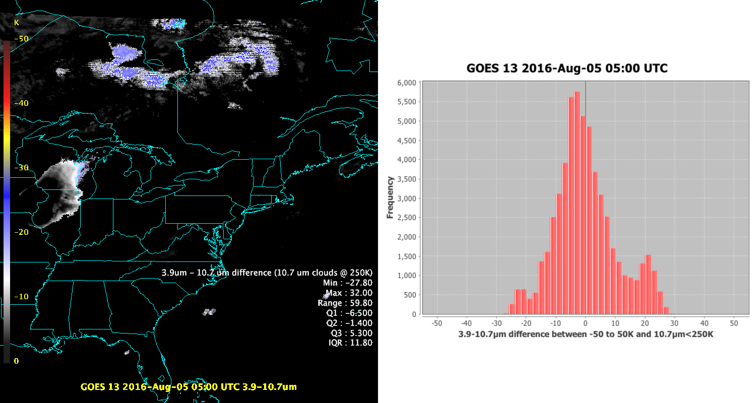
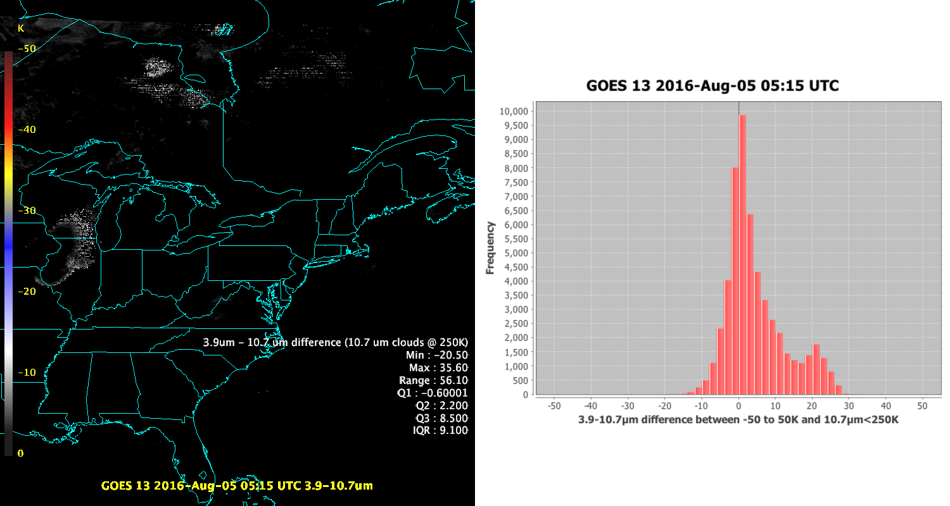
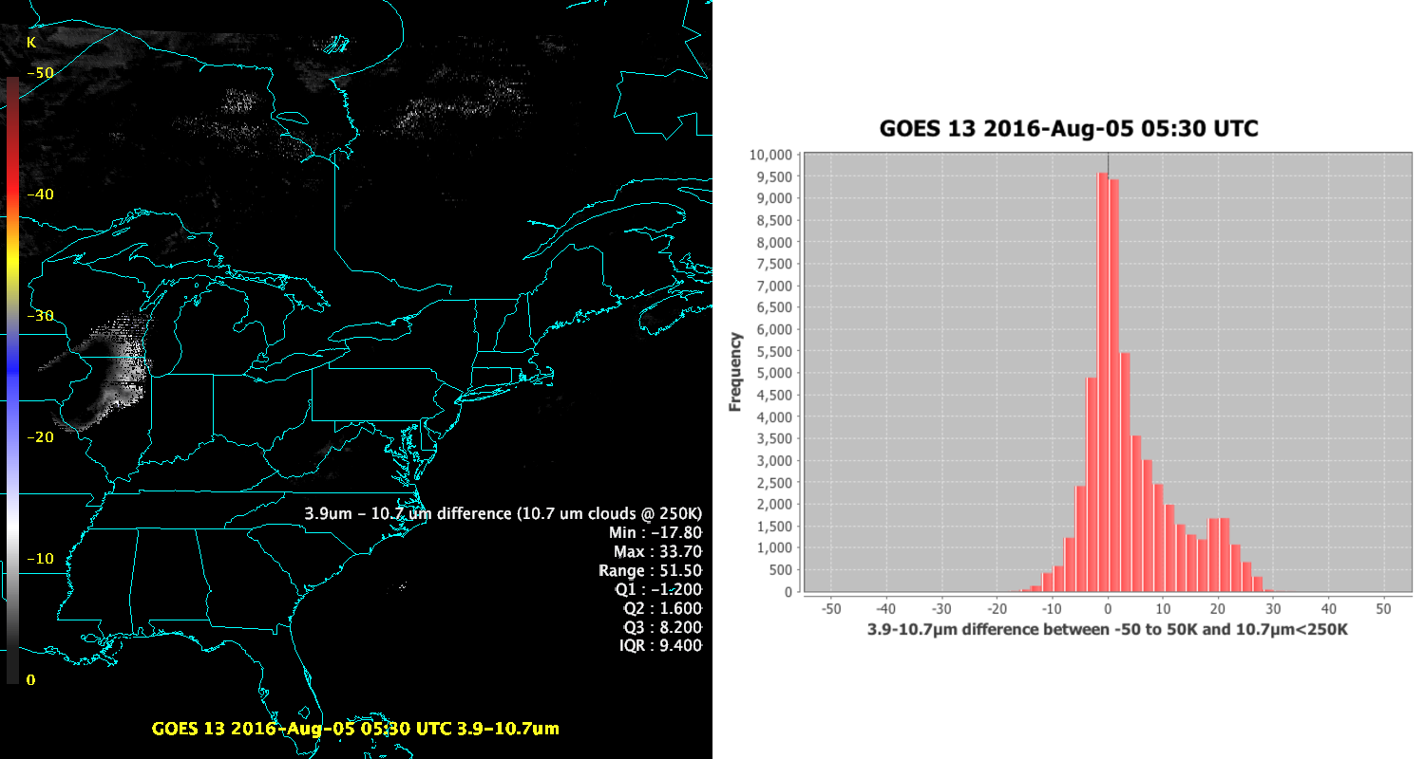
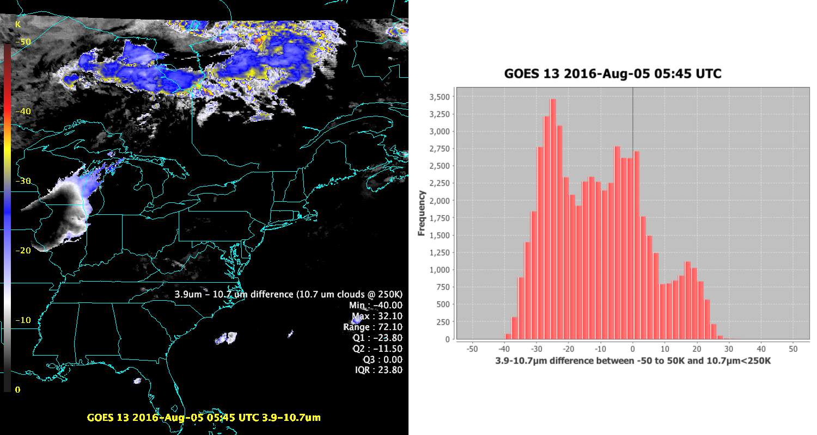
Image Quality Checks
Notes:
Over the course of a few years, the team has been developing skills in detecting improper calibration during a space look of the satellite instrument. “Stray light” calibration problems occur when the satellite scans space, which should be cool but has extra, unpredicted warming from the sun. The calibration of the image is affected so that cold radiative features will not appear much colder due to a poorly calibrated space look. Tim S. had noted a leftward shift in the sw-lw band difference over clouds (where LW < 250K). This can be seen in this set of images. Starting with a relatively well calibrated image, the histogram centers closer to zero with few points below zero in the early morning hours. As we continue, we see a shift of the histogram and in this case a spreading of the values. The large negative first quartile feature is a hallmark of images highly affected by stray light calibration shifts, but the goal is to have a quick look web page for image quality and histograms are a poor way of looking at the data in time-series.

Slide 12
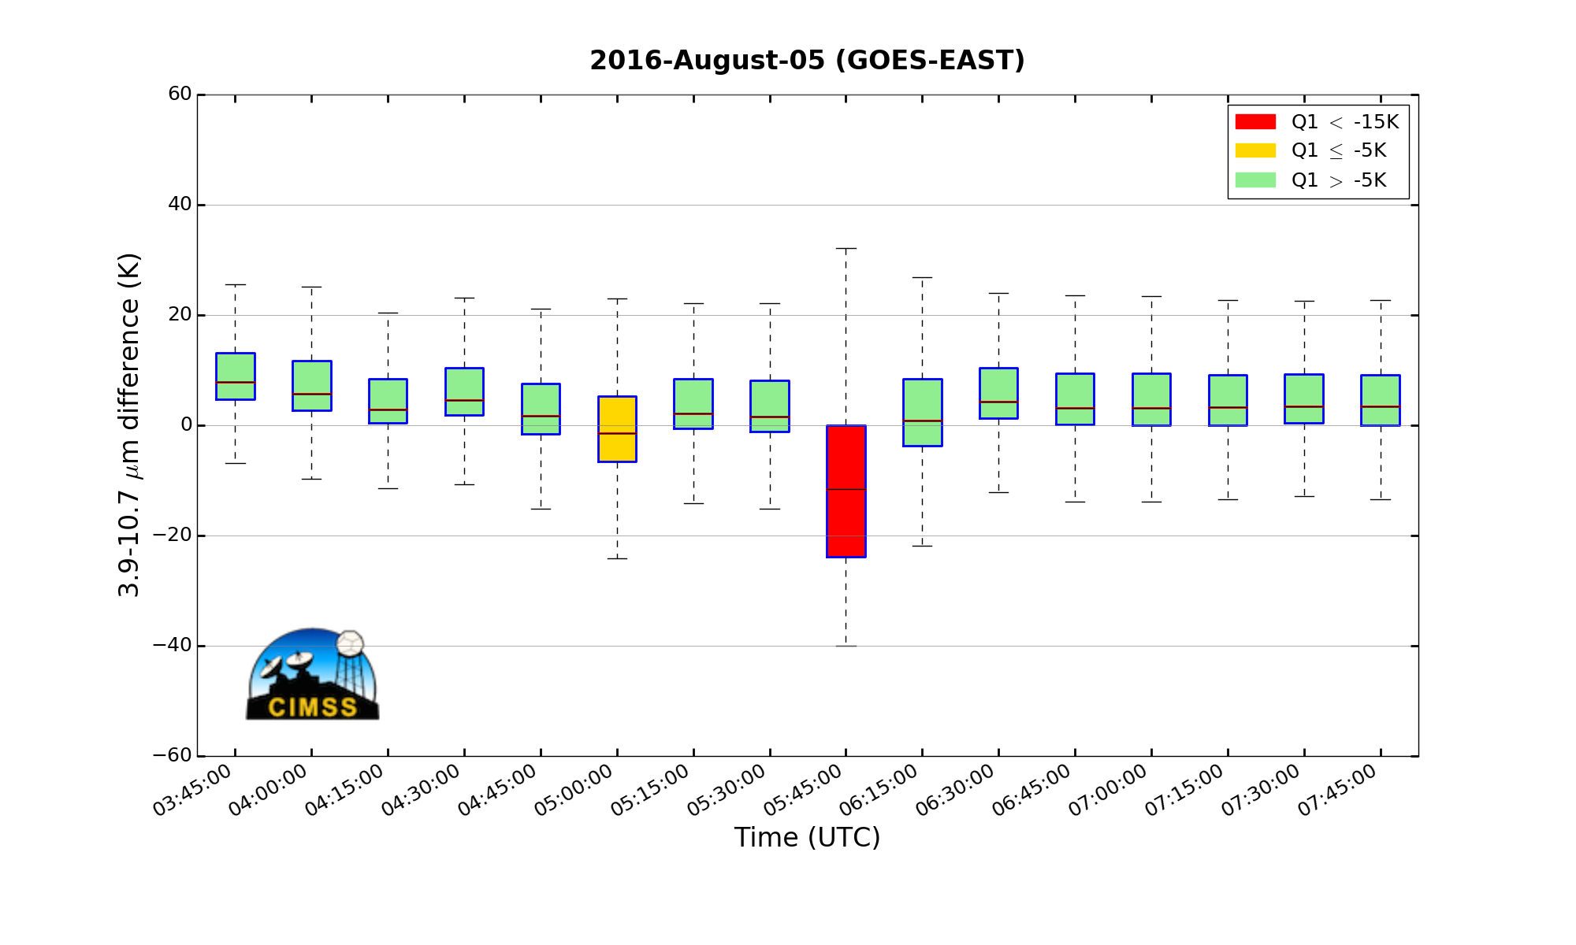
Straylight Calibration Image Quality Quick Looks
Statistics calculated in McIDAS-V Scripting API, plotted in matplotlib
Notes:
The statistics are currently being generated for GOES-East, and have also been tested on Data Operations Exercise (DOE)-4 data. We plan to have a web page that will display time series such as these, that will be flexible in how these series are displayed. In this instance, we have chosen to mark any image with the first quartile below -15 K as severely affected (red) by stray light calibration issues. These cases appear clearly in a time-series.
Some definitions:
The lines in the center of the boxes are the median. This represents the position where equal portions of the data lie above and below the line.
The first quartile (Q1, 25%) is the location in the data which is located halfway between the median and the lower extreme of the data. (bottom line of box)
The third quartile (Q3, 75%) is the location in the data which is located halfway between the median and the upper extreme of the data. (top line of box)
The Inter-Quartile Range (IQR or spread) encompasses the entire box from top to bottom (Q3-Q1), and describes the range of the center 50% of the data.

Slide 13
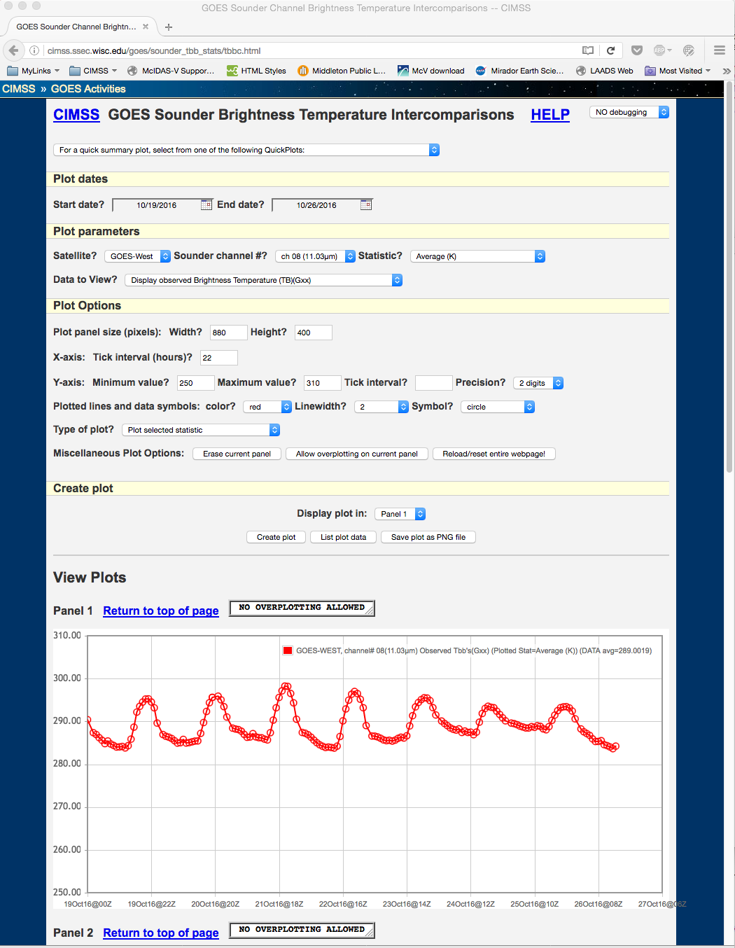
GOES Sounder Brightness Temperature Intercomparison Webpage:
http://cimss.ssec.wisc.edu/goes/sounder_tbb_stats/tbbc.html
Notes:
A web page along the above lines of the GOES Sounder Brightness Temperature Intercomparison page will be established, that will summarize GOES-R ABI image quality. The goal is to display plots based on statistic and user-selected time range. If possible, it would be nice to create a page with a live update of the box plots.

Slide 14
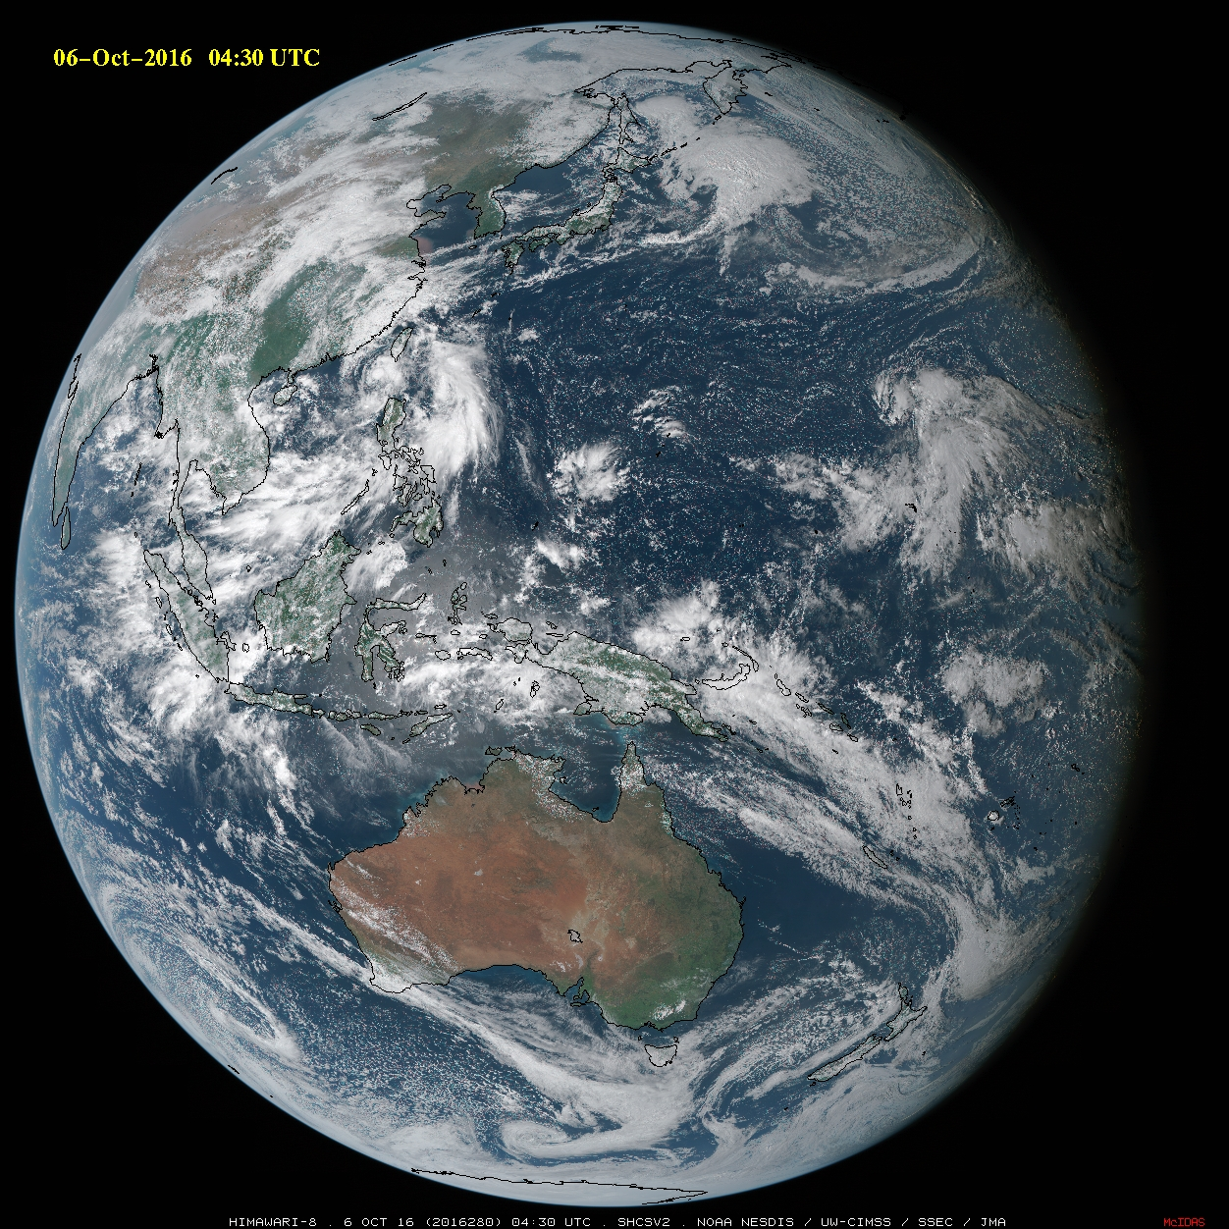
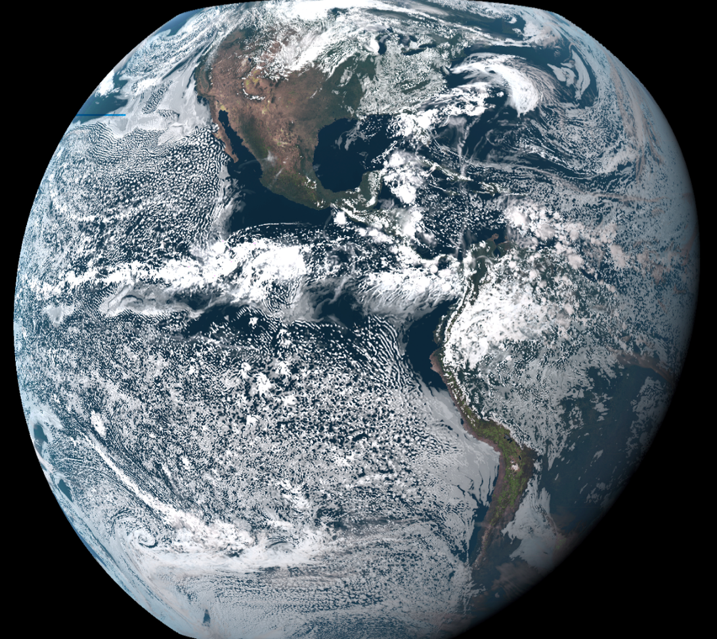
True Color RGB Approaches
McIDAS-X Script
From Tim Schmit, NOAA/ASPB
Calculations IDL/RGB Display in McIDAS-V
From Kaba Bah, CIMSS
ABI Green Band Creation
Notes:
Working together with CIRA, CIMSS has been working on variations of algorithms to produce a RGB which replicates MODIS True Color. Also being created via McIDAS-X is a Simple Hybrid Contrast Stretch RGBs(SHCS), an approach which approximately replicates the MODIS True Color Imagery. The SHCS for an Advanced Himawari Imager image is on the left. This is done in part by using a boosted green channel which is a combination of two visible channels. Then, the R,G,B components are scaled such that the middle part of the 0-255 color range is stretched, and the ends of the range are compressed, before the r,g,b, components are combined. It should not be difficult to replicate the SHCS in McIDAS-V.
On the right is a modified approach to creating the RGB for the Advanced Baseline Imager. In this case, a green band needs to be created via a look-up table. Then, an inverse hyperbolic sine function is applied to the three red, green blue channels. After the function is applied, the RGB is created.

Slide 15
Mentioned in this Presentation:
Getting Ready for the Advanced Baseline Imager (ABI) on the GOES-R series (Timothy J. Schmit, NOAA/NESDIS/Center for Satellite Applications and Research, Madison, WI; and M. M. Gunshor, R. B. Pierce, J. J. Gerth, S. S. Lindstrom, J. M. Daniels, and S. J. Goodman)
A Day in the Life Using 1-Minute Satellite Imagery: An Operational Forecaster Perspective (Daniel Nietfeld, NOAA/NWS, Valley, NE; and C. M. Gravelle and J. M. Laflin at AMS 96th Annual Meeting)
Analysis Of Severe Convective Storms Using Super-Rapid Scan Satellite Imager, Dual-Polarization Radar, And Total Lightning Observations In Preparation For GOES-R (Kristopher Bedka, LRC, Hampton, VA; and C. R. Homeyer, J. R. Mecikalski, B. Scarino, T. Sandmael, J. Apke, and C. P. Jewett at AMS 21st Conference on Satellite Meteorology)
Notes:
These are the talks mentioned in this presentation. Please view these three talks for a detailed explanation of the 1.) ABI instrument 2.) What can be deduced from 1-minute satellite imagery in an analysis from a convective forecaster working with the Satellite Proving Ground Testbed experiments and 3.) Techniques for combining observations of satellite data and other detection devices in severe storm analysis.

Slide 16
Links in plain text:
Getting Ready for the Advanced Baseline Imager (ABI) on the GOES-R series - https://ams.confex.com/ams/21SATMET20ASI/webprogram/Paper297113.html
A Day in the Life Using 1-Minute Satellite Imagery: An Operational Forecaster Perspective -
https://ams.confex.com/ams/96Annual/webprogram/Paper291108.html
Analysis Of Severe Convective Storms Using Super-Rapid Scan Satellite Imager, Dual-Polarization Radar, And Total Lightning Observations In Preparation For GOES-R –
https://ams.confex.com/ams/21SATMET20ASI/webprogram/Paper297042.html

Slide 17
Finally:
Bulletin of American Meteorological Society Early Online Release of A Closer Look at the ABI on the GOES-R Series, Timothy J. Schmit, Paul Griffith, Mathew M. Gunshor, Jaime M. Daniels, Steven J. Goodman, and William J. Lebair
http://journals.ametsoc.org/doi/pdf/10.1175/BAMS-D-15-00230.1
Notes:
Finally, a little pre-launch post-launch celebratory reading. There is an early online release of “A Closer Look at the ABI on GOES-R Series” which will appear in April 2017 of the Bulletin of the American Meteorological Society.

Slide 18
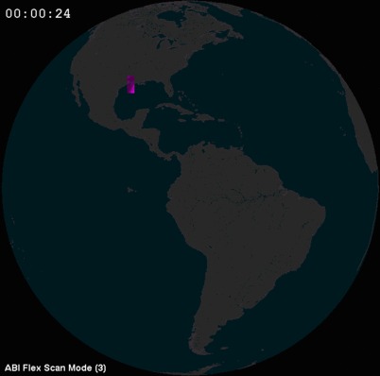
Flex Mode Concept (Tim Schmit)
Notes:
animation

