Slide 1
Use of McIDAS at EUMETSAT Data Centre
Peter Miu – Data Centre Operations Team Leader
16 November, 2016

Slide 2
Presentation Overview
What is the EUMETSAT Data Centre
EUMETSAT Data Access Services
McIDAS and the Data Centre
Future Developments
Questions

Slide 3
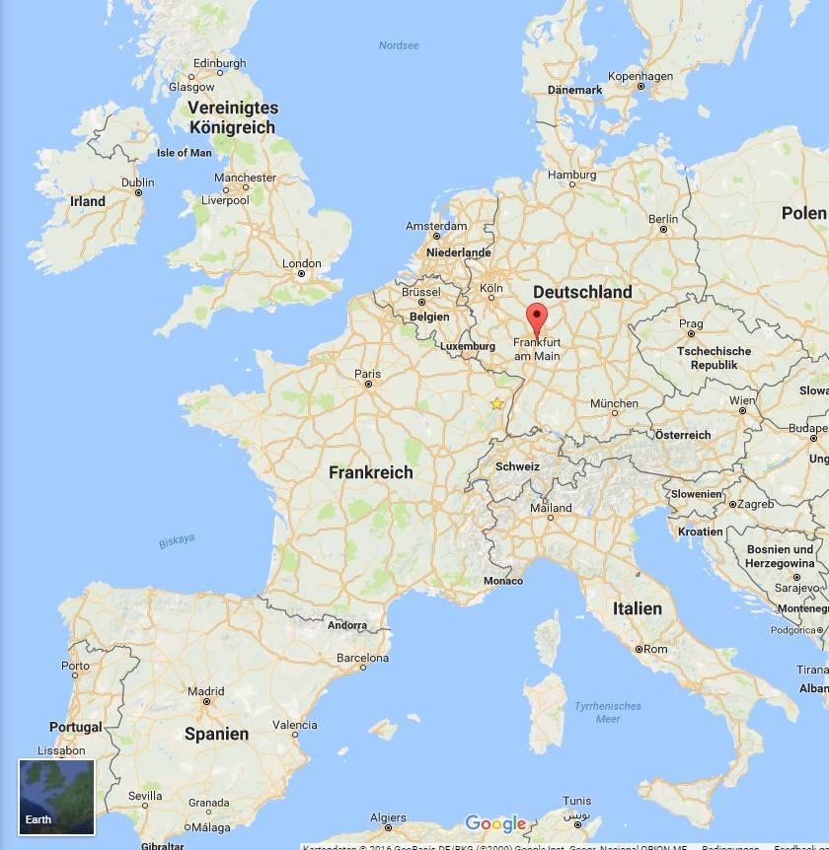
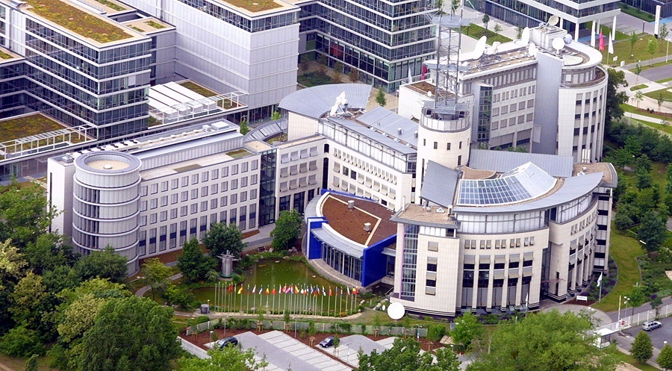
EUMETSAT Data Centre; Location

Slide 4
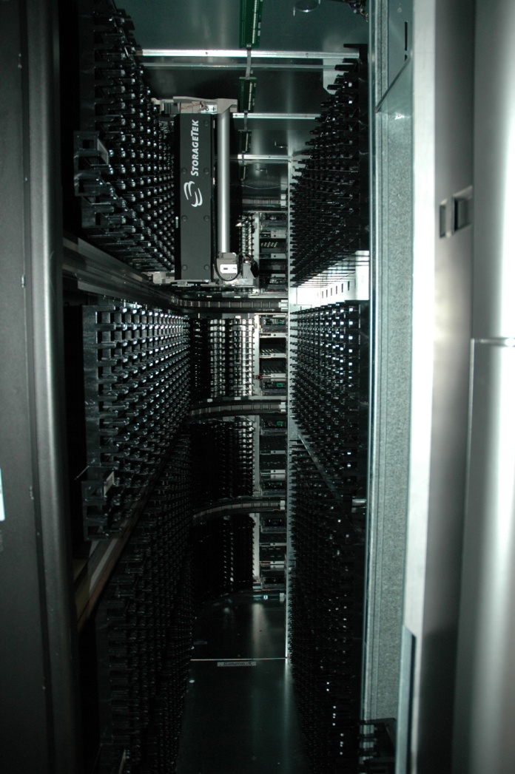
Data Centre – Overview
The EUMETSAT Data Centre consists of an Archive and Data Access Services:
The Data Centre Archive:
long-term preservation of data; up to 3 copies (Disaster Recovery)
Raw and meteorological products
EUMETSAT's catalogue of products and Ordering System
State of the art Archive
Operational in 1995
Over 30 years of Meteosat Data
200 types of Products; GEO & LEO
One of Europe’s largest and most comprehensive collections in this field.
Notes:
The Data Centre Archive: guarantee a long-term preservation of data and generated products from EUMETSAT’s meteorological satellites; there are upto 3 copies of each product, 1 copy of each product is kept off-site to ensure that the archive can be rebuilt in the event of a disaster.
Enable users to browse, make automated orders, and retrieve data from EUMETSAT's catalogue of products.
Set up in 1995, the Data Centre Archive has developed to become a state-of-the-art archive serving all EUMETSAT satellite programmes. With more than 200 meteorological satellite products available — in the case of Meteosat spanning a record of more than 30 years — the Data Centre offers one of Europe’s largest and most comprehensive collections in this field.

Slide 5
Data Centre Archive – Facts and Figures
The Archive contains approx 72 million products/
The size of the Archive is approx 1.5 Pbytes.
In 2016, the average retrieval volume per month ca. 1,000,000 files or 40 TB delivery.
Products can be ordered in various formats; JPEG, GIF, netCDF, GRIB, BUFR, McIDAS, many more...
Sub-area or partial orbits can be specified for a product and ordered. This reduces the amount of data delivered, and for the users to store and process.
There are currently 4,220 Users registered with the Data Centre.
Users orders can be delivered online to a EUMETSAT web server for download or on various media types which are delivered to the user by post.
Data Centre Archive Data is free to the user community.

Slide 6
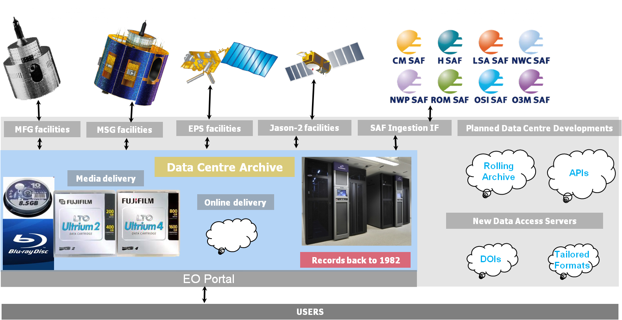
Data Centre Archive - Operations Overview
Ingestion – Products from EUMETSAT’s Satellites and from the Satellite Application Facilities (SAFs) are stored into the Data Centre Archive and made available for discovery in its Online Catalogue.
Ordering – Products in the Data Centre Online Catalogue can be ordered by users via its Online Ordering system (see next slide).
Notes:
Planned Developments and New Data Access Servers are discuss in a later slide.

Slide 7
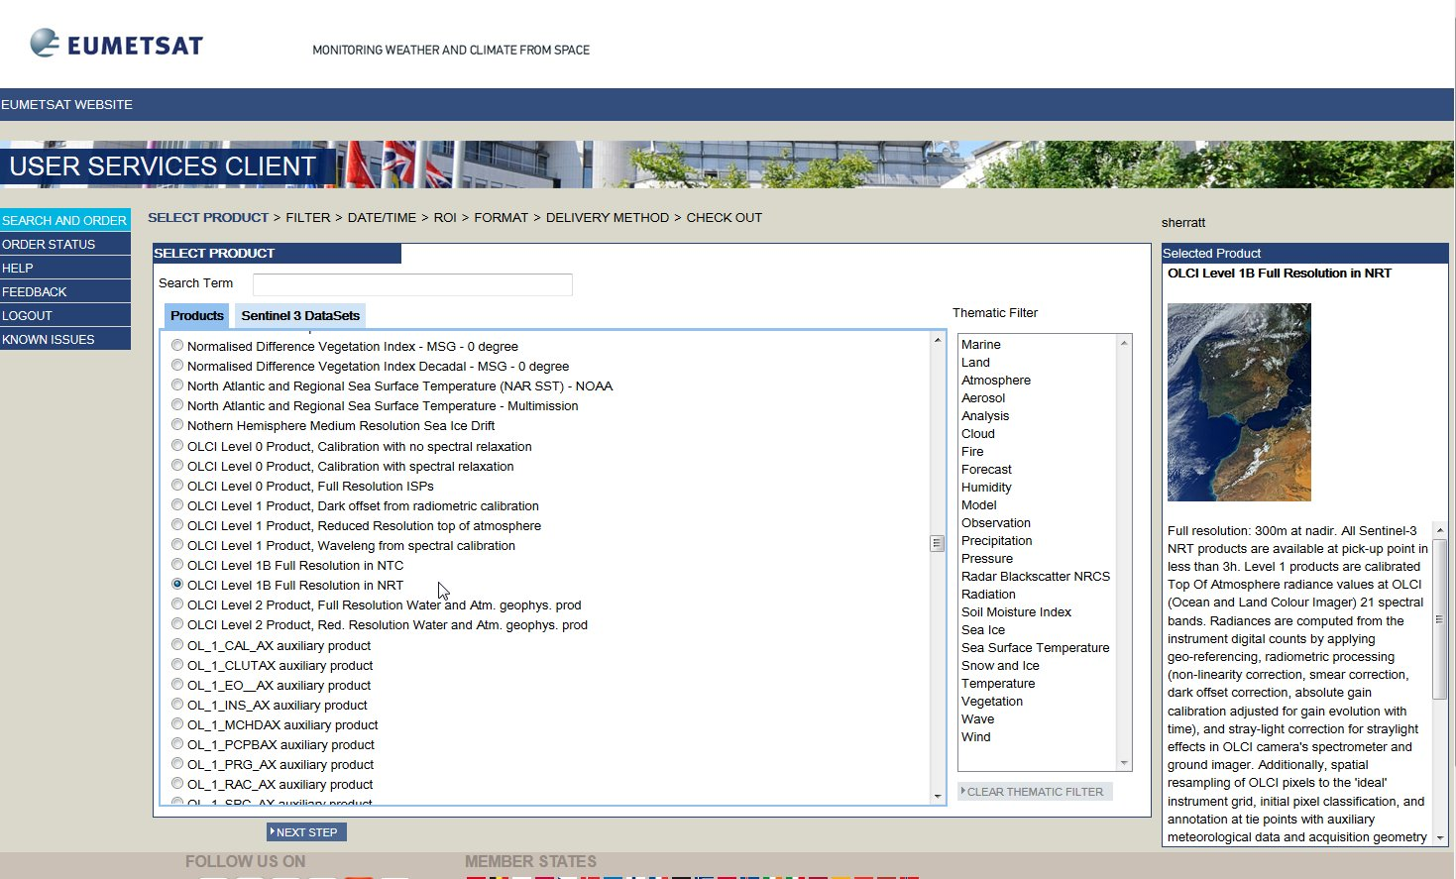
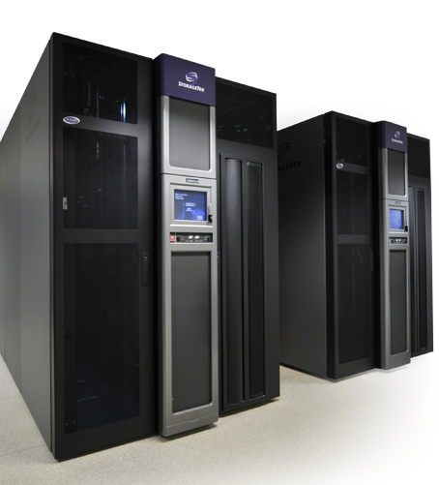
Data Centre – How to use the Data Access Services
Users can discover EUMETSAT product information from the Product Navigator.
Users should register an account in the Earth Observation (EO) Portal and this will provide access to the Data Centre Service.
Using this service will invoke the Data Centre Ordering Client, the client has been designed to intuitively guide users in ordering their products from the Data Centre Archive.
Users can seek Data Access services support via the EUMETSAT website, YouTube videos or by contacting the User Service Helpdesk.
Data Centre URL: (http://archive.eumetsat.int)
http://www.eumetsat.int/website/home/Data/DataDelivery/EUMETSATDataCentre/index.html
Video on
Ordering Process
YouTube: Access Data from EUMETSAT Data Centre
Notes:
Navigator and EO Portal are described in earlier slides.

Slide 8
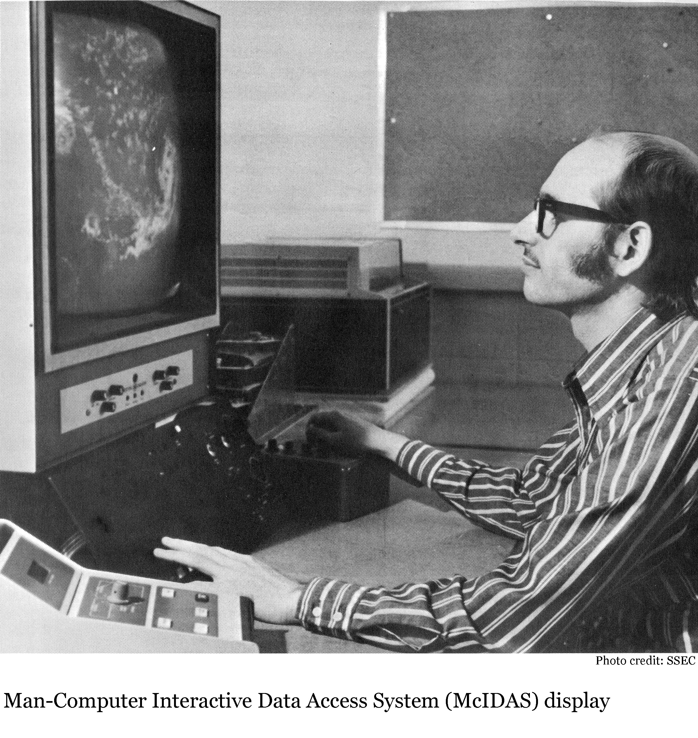
McIDAS and the EUMETSAT Data Centre
McIDAS: Delivery Format
McIDAS: ADDE Server
McIDAS: Users
McIDAS: Development
McIDAS: Future

Slide 9
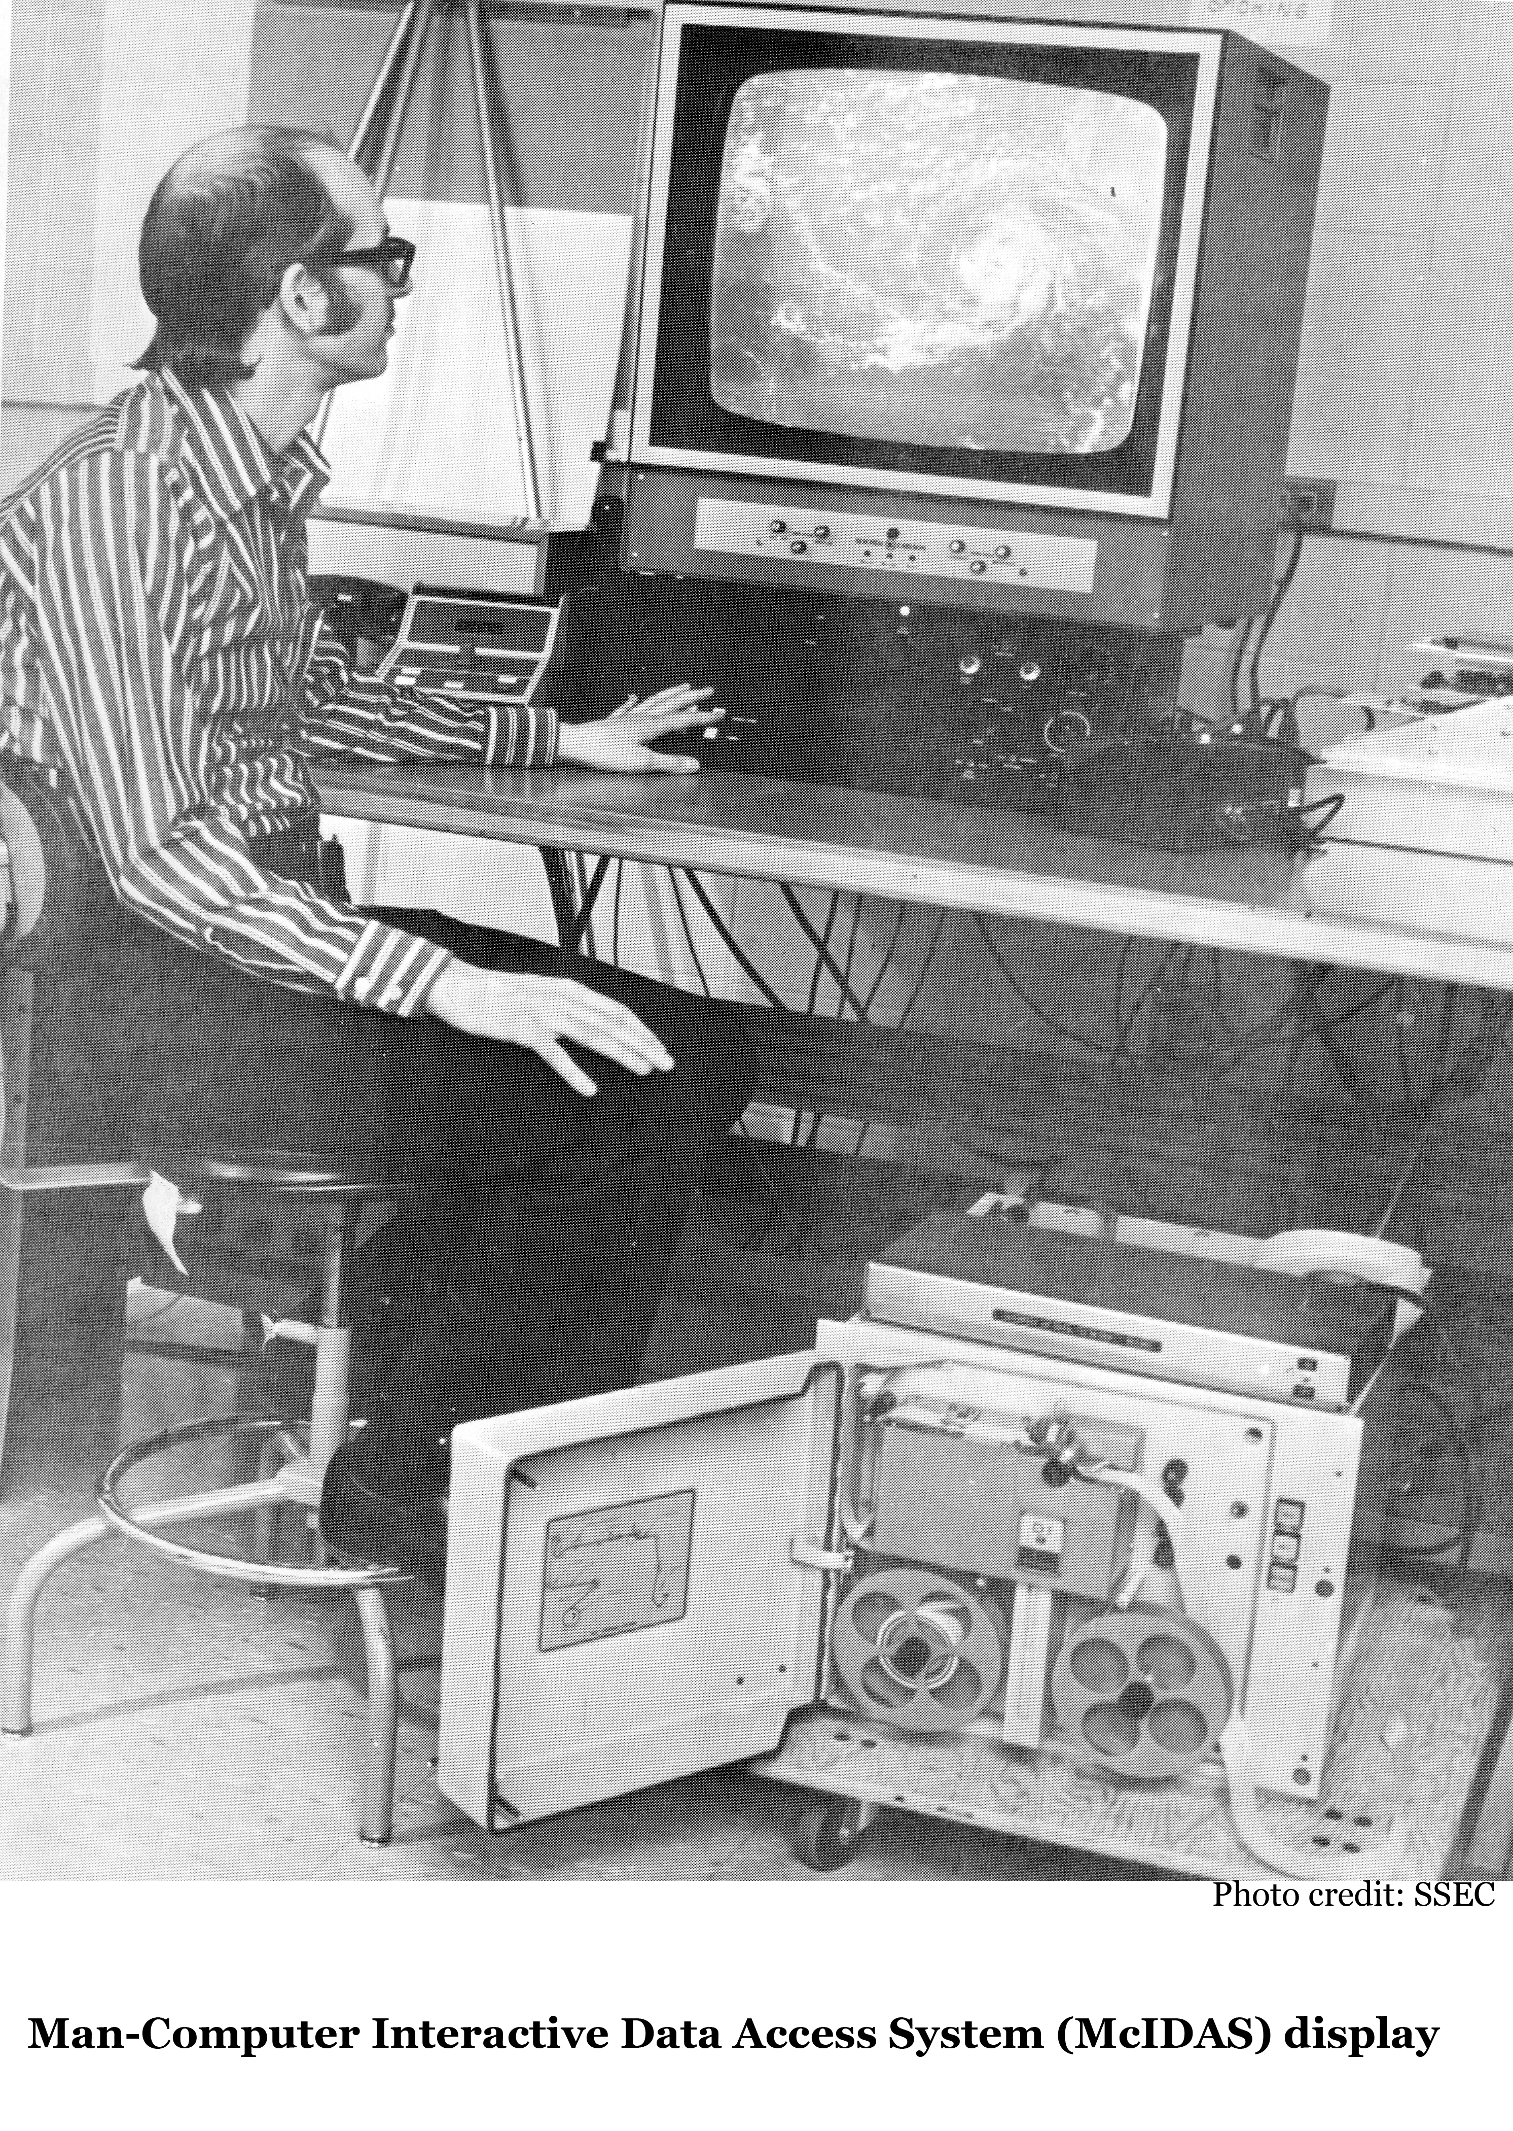
McIDAS Development in the Data Centre
McIDAS – netCDF Secondary Server
More Products – Generic EPS netCDF product secondary ADDE Server
McIDAS – Operational ADDE Server
Currently training use only, operational server intended to provide full access to the wider user community

Slide 10
McIDAS Future
McIDAS – new Programme Products; MTG, EPS-SG, …
McIDAS new products Integration into Data Centre Ordering System
McIDAS – Visualisation using IDV (?)

Slide 11
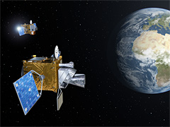
Meteosat Third Generation: MTG
Twin Satellite Concept, based on 3-axis platforms.
Four Imaging Satellites (MTG-I) (20 years of operational services expected)
Two Sounding Satellites (MTG-S) (15.5 years of operational services expected)
Payload complement of the MTG-I satellites:
The Flexible Combined Imager (FCI)
The Lightning Imager (LI)
The Data Collection System (DCS) and Search and Rescue (GEOSAR)
Payload complement of the MTG-S satellites:
The Infrared Sounder (IRS)
The Ultra-violet, Visible and Near-infrared Sounder (UVN)
The sounder will be one of the key innovations in the new programme, for the first time allowing Meteosat satellites to image weather systems and analyse the atmosphere layer-by-layer, therefore, performing far more detailed chemical composition studies.

Slide 12
EUMETSAT Polar System - Second Generation: EPS-SG
The EPS follow-on system (EPS-SG) will provide continuity of observations and respond to the needs of the users in the 2020–2040 time frame.
EPS-SG represents Europe's contribution to the future Joint Polar System (JPS), which is planned to be established together with the National Oceanic and Atmospheric Administration (NOAA) of the United States, following on from the Initial Joint Polar System (IJPS).
Polar orbiting satellites, due to their global coverage and of the variety of passive and active sensors that can be deployed from Low Earth Orbits, have the most significant positive impact on Numerical Weather Prediction (NWP). The Initial Joint Polar System (IJPS), shared by EUMETSAT and NOAA, currently accounts for around 45% of the total error reduction on Day 1 forecasts achieved by all types of observation ingested in real-time by NWP models.
Polar orbiting satellites also deliver unique infrared and microwave imagery inputs to critical nowcasting of high impact weather at high latitudes. These are vital for the National Meteorological Services of all EUMETSAT Member and Cooperating States.
The EPS-SG Programme is expected to be one of the most important sources of satellite observations for all forecasts based on NWP in the 2020–2040 time frame. It is expected to increase direct socio-economic benefits to Member States and leverage additional benefits through its integration into the JPS and cooperation in the context of CGMS and WMO.

Slide 13
End of Presentation: Thank you for your Attention
Product Navigator
Registration Portal
Data Discovery / Registration
User Helpdesk
Data Centre
Copernicus
ODA
Satellite Direct Readout
EUMETCast
User Enquiries
Any questions?
Contact the User Helpdesk:
ops@eumetsat.int

