Slide 1
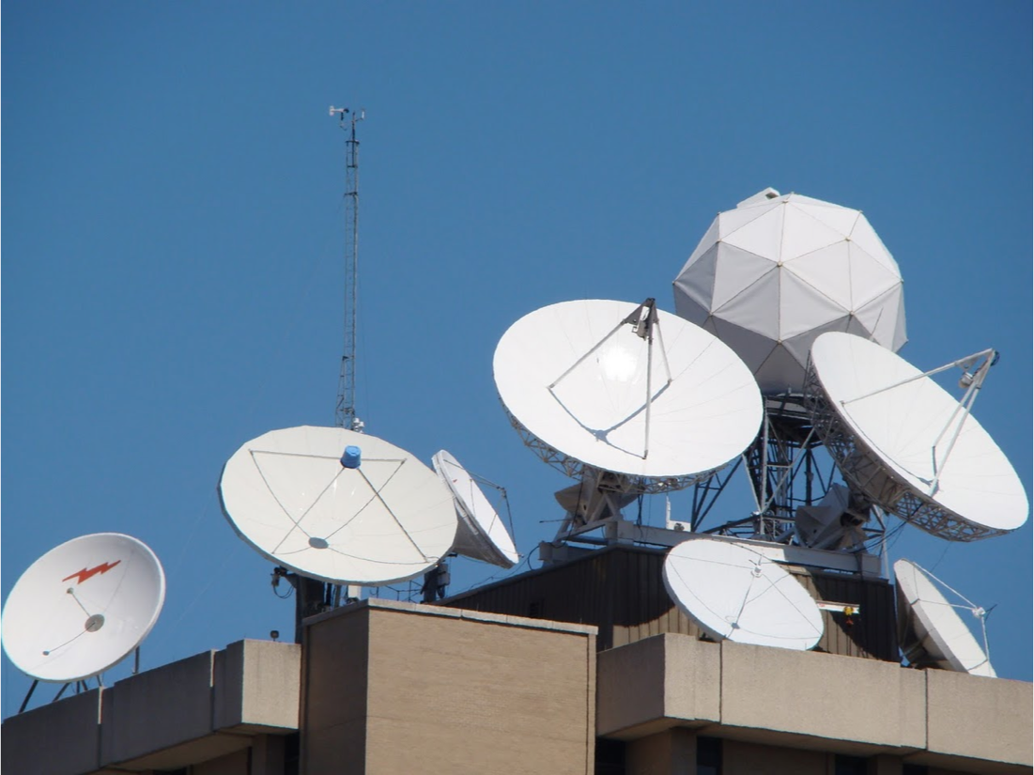
University of Wisconsin SSEC
Datacenter
Satellite Data Services
2016 McIDAS Users Meeting
November 16, 2016

Slide 2
Satellite Data Services Overview
GOES-R at SSEC
Other Satellite Data Services Projects

Slide 3
Satellite Data Services Team
Dan Forrest
Rosie Spangler
Nancy Troxel-Hoehn
Douglas Ratcliff
Rick Kohrs
Clayton Suplinski
Istvan Bocsi

Slide 4
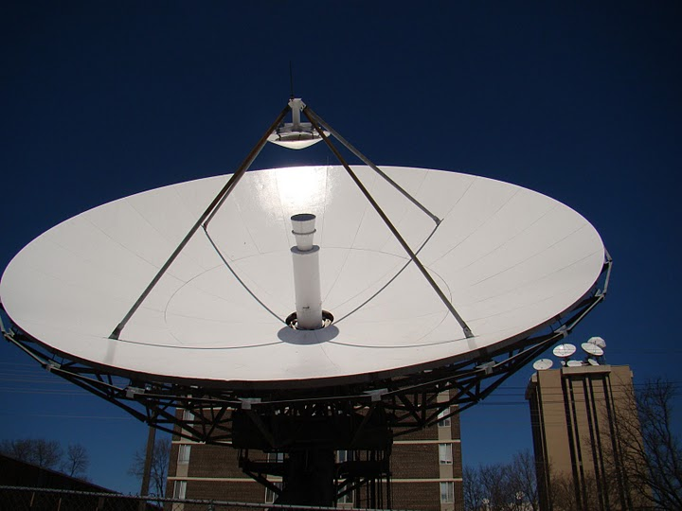
SSEC Satellite Data Services Mission Statement
The SSEC Data Center mission is to create and maintain the facilities, human expertise and technology necessary to provide SSEC scientists and collaborators with the highest quality geophysical data in a timely fashion and to provide real-time data access, archive and retrieval services as necessary to support SSEC’s scientific programs.

Slide 5
SSEC Satellite Data Services Mission Statement
Provide timely, high quality real-time and archive data, reliably to SSEC scientists and collaborators.

Slide 6
SSEC SDS
Staffed M-F , 7:30 AM - 11:00 pm Central time.
2 Student programmers
2 student QC assistants (2nd shift)
2 FTE ~100% time
Computer Operator (1st shift)
Computer Operator (1st shift)
5 FTE ~portions of their time
Program Manager
System Programmer
DataBase/Web Programmer
Research Specialist (PM assistant)
Antenna/Communication technician

Slide 7
Data Center Facilities
Over 2100 ft.
Currently the Data Center has 44 racks representing over 1,840 rack units of space.
The Data Center’s disk storage exceed 12 PBs.
The entire room is on three 72 KW UPSs, of which, about 155 KW are in use. Non UPS power usage is ~17 KW. An additional 72 KW UPS for a smaller 5th floor computer room
Cooling provided by campus chilled water and outside air in the winter. Racks are cooled by 16 in row APC coolers.
Gigabit and 10 Gigabit network (also 100 MB admin network, 40 Gigabit InfiniBand).

Slide 8
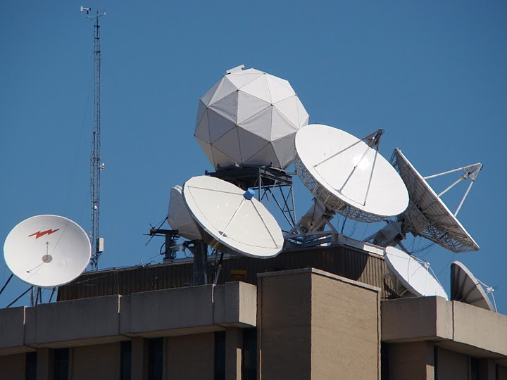
Antennas @ SSEC
C-Band
11 meter heated (87° West – SES-2, POES Wallops Relay, MSG)
6.3 meter heated (101° West – SES-1, POES Fairbanks Relay, MTSAT, Noaaport)
4.5 meter (101° West – SES-1, POES Fairbanks Relay, MTSAT, Noaaport)
L-Band
7.3 meter (75° West –GOES-East Primary/GOES-R/S ready)
7.3 meter (135° West –GOES-West Primary/GOES-R testing)
4.6 meter (135° West –GOES-West Primary)
4.5 meter (60° West –GOES-East auto tracking)
3.7 meter (offline spare)
X-Band
4.4 meter (Tracking – EOS)
X/L Band
2.4 meter (Tracking – Suomi NPP, EOS, Metop A&B, NOAA-18, 19 and FY3)

Slide 9
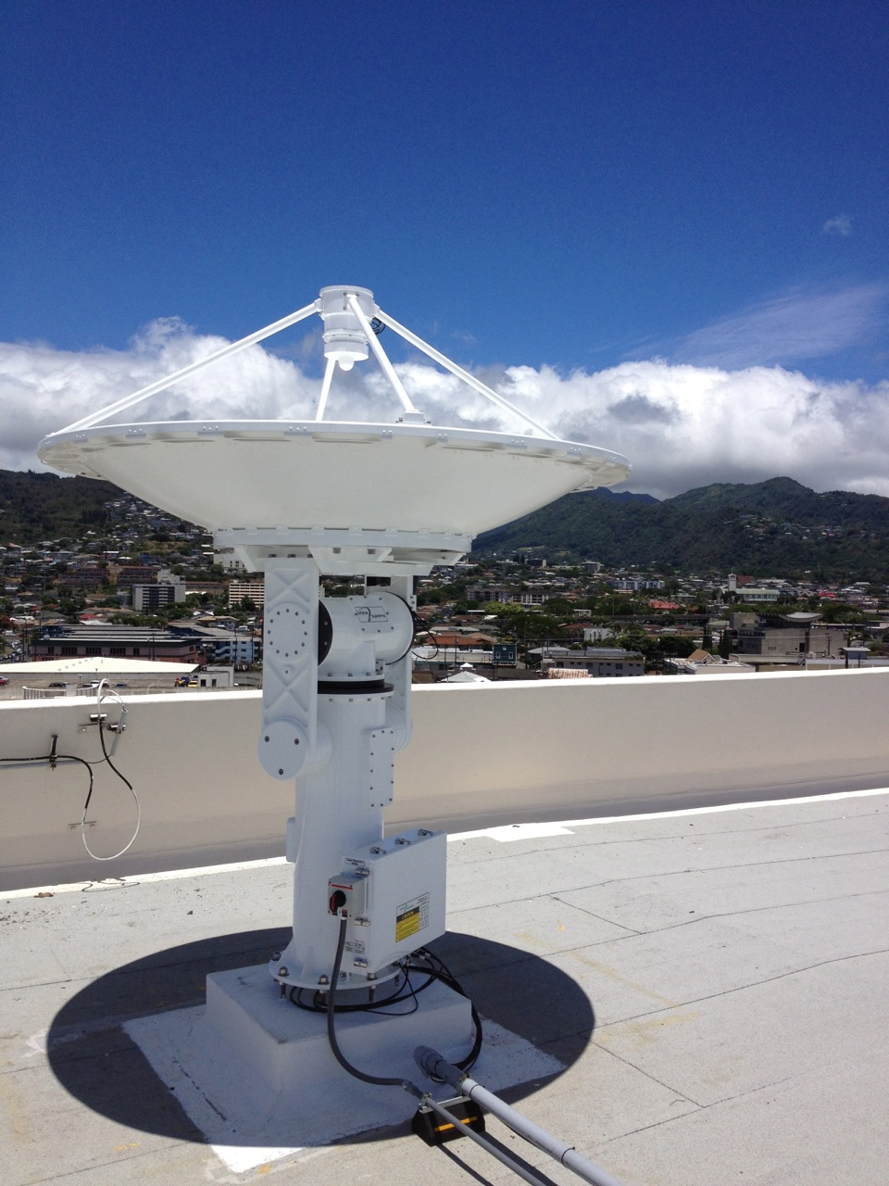
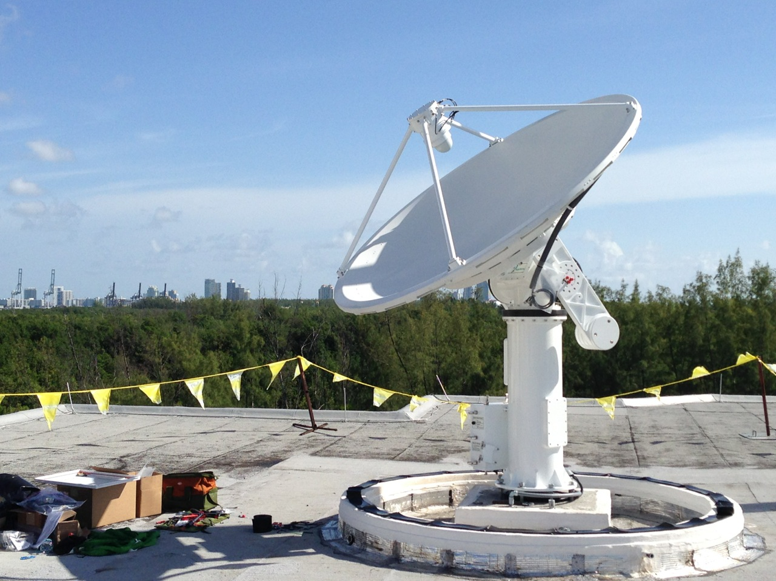
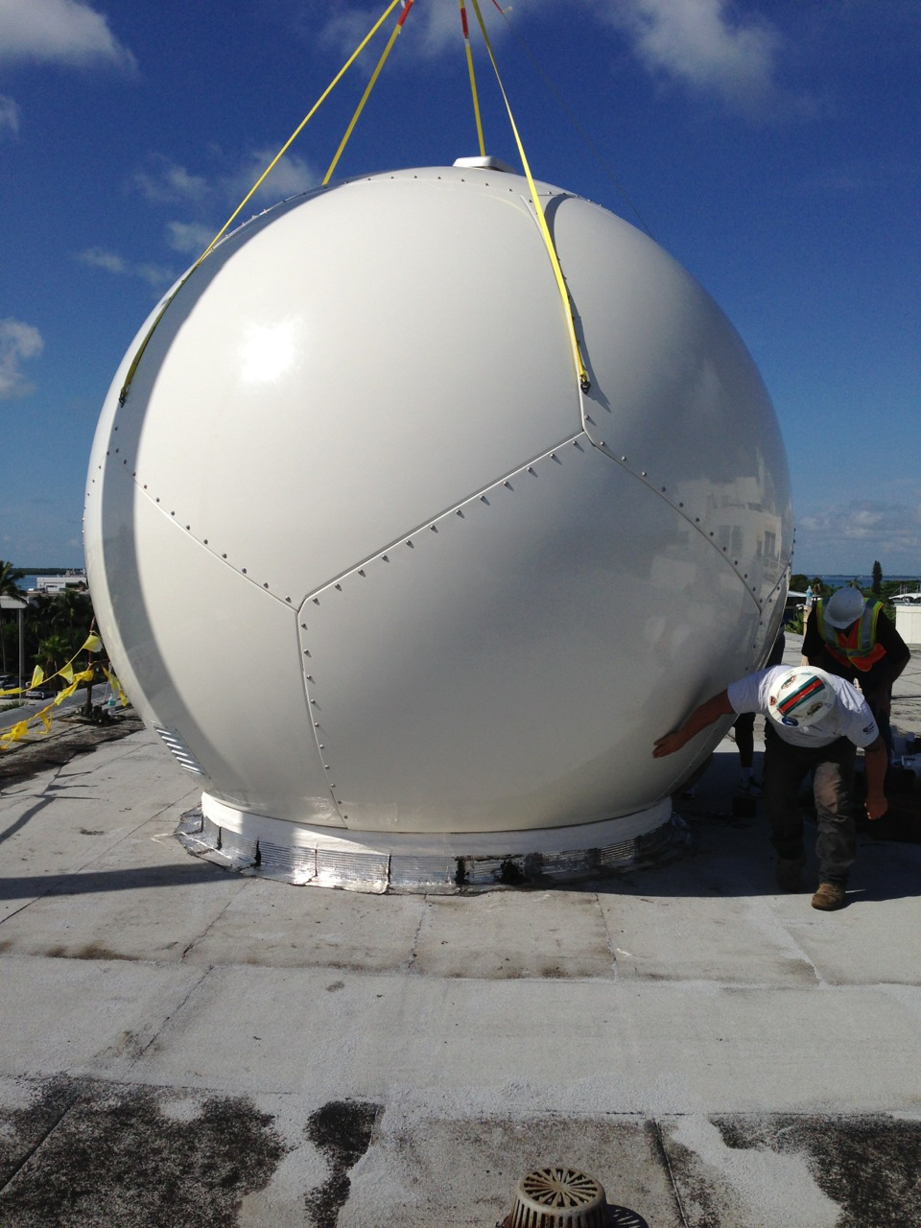
UW SSEC SDS Antennas Remotely Managed
X/L Band
Honolulu Community College
Atlantic Oceanographic & Met Lab , Miami, FL
University of Puerto Rico
All are 2.4 m used for Tracking – Suomi NPP, EOS, Metop A&B, NOAA-18, 19 and FY3

Slide 10
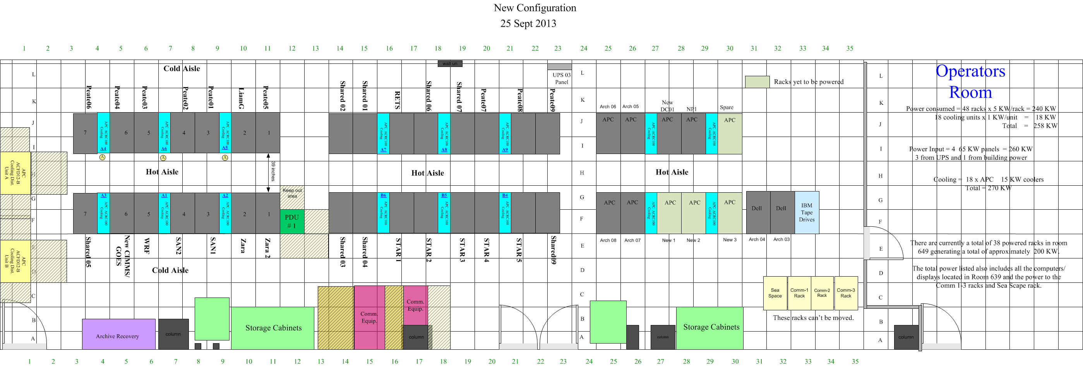
Server room layout
SIPS System
Research Clusters Shared Systems
Real-time ingest, process, and distribution
Research Clusters
Shared Systems
S4 Compute cluster

Slide 11
SSEC SDS Incoming Data January, 2016
420+ GB/day
via Satellite
(C-band. L-band, X-band)
GOES satellites ~72 GB/day
International Geo Satellites ~360 GB/day
NOAA Polar ~27 GB/day
Landsat-8 ~50 GB/day
Miscellaneous Polar ~35 GB/day
MODIS polar from NASA archive ~150 GB/day
NPP (VIIRS CrIS ATMS) ~1,800 GB/day
Noaaport ~300+ GB/day
2,600+ GB/day
via Internet
(ftp, LDM, ADDE, http)

Slide 12
SSEC SDS Incoming Data May, 2015
170+ GB/day
via Satellite
(C-band. L-band, X-band)
GOES satellites ~96 GB/day
International Geo Satellites ~360 GB/day
NOAA Polar ~27 GB/day
Landsat-8 ~50 GB/day
Miscellaneous Polar and Non satellite ~85 GB/day
MODIS polar from NASA archive ~150 GB/day
NPP (VIIRS CrIS ATMS) ~1,800 GB/day
2,300+ GB/day
via Internet
(ftp, LDM, ADDE, http)

Slide 13
SSEC SDS Outgoing Data
Four primary methods of Data delivery
ADDE
HTTP
FTP
LDM (Unidata local data manager)
HTTP
ADDE
LDM
FTP

Slide 14
Outgoing Data As of November 1, 2016
On average over 875,000 ADDE transactions per day
Over 4.1 TB data distributed per day via ADDE
In addition over 1 TB data distributed via ftp, http, and ldm

Slide 15
Data Distribution
Realtime
McIDAS ADDE (Abstract Data Distribution Environment)
ftp
http
Ldm
Direct access via mount
WMS (Web map service)
Archive
ADDE
Direct Access
WMS
McFETCH

Slide 16
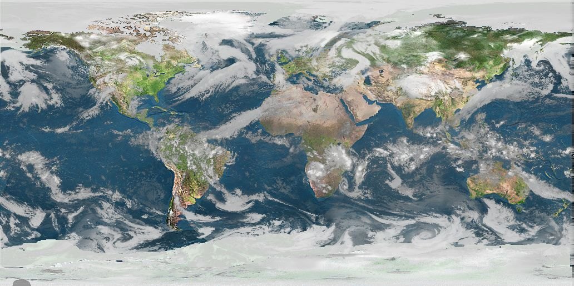
Real-time Data
The SSEC Data Center receives data from 11 different geostationary satellites and 11 different polar orbiting satellites. Most data are available in near real-time via ADDE. Other methods of data access are available upon request.

Slide 17
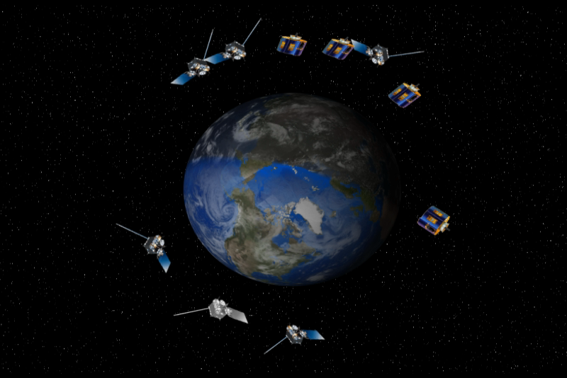
Geostationary Satellites received
GOES-13 -East (75°W)
GOES-15 -West(135°W)
GOES-14 -Test (105°W)
Meteosat-10 (0°E)
Meteosat-7 (57°E)
Meteosat-8(near 57°E)
COMS (128° E)
FY-2E (86°E)
FY-2G (105° E)
Himawari-8 (140° E)
Kalpana(74° E)
INSAT-3D(83° E)

Slide 18
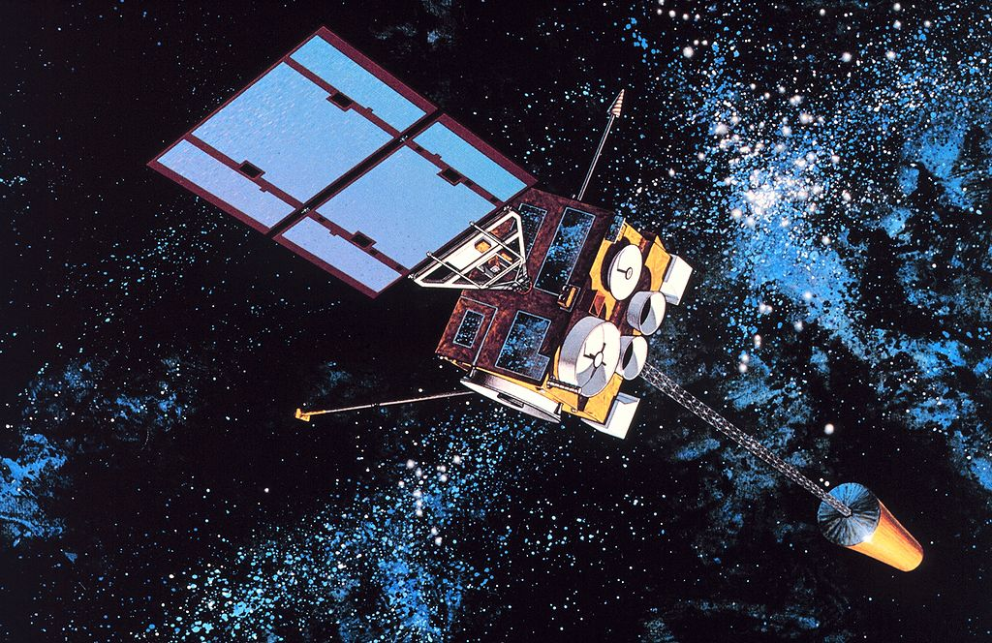
Geostationary Satellites Received at UW SSEC in 2016
 | Sub-Point | Reception Method | Source | Latency | Daily Volume
GOES-13 | 75° West | L-Band | DB | <2 minutes | 23 GB
GOES-14 | 105° West | L-Band | DB | <2 minutes | 23 GB
GOES-15 | 135° West | L-Band | DB | <2 minutes | 23 GB
Meteosat-10 | 0° East | C-Band Relay | DB Relay | <15 minutes | 24 GB
Meteosat-7 | 57° East | Network Relay | NESDIS | ~30 minutes | 2 GB
Meteosat-8 | 57° East | Network Relay | NOAA STAR | ~30 minutes | 24 GB
Himawari-8 | 140° East | Network Relay | NOAA STAR | ~ 10 minutes | 300 GB
Himawari-8 | 140° East | Himawari Cast Network Relay | Hawaii NWS | ~ 10 minutes | 62 GB
Kalpana | 74° East | Network Relay | ISRO | 45-120 minutes | 1.4 GB
Insat-3D | 83° East | Network Relay | ISRO | 45-180 min | 19 GB
FY2E | 86° East | Network Relay | ABOM | 15-30 minutes | 4.7 GB
FY2G | 105° East | Network Relay | ABOM | 15-30 minutes | 4.7 GB
COMS | 128° East | Network Relay | KMA | 9-24 minutes | 11 GB

Slide 19
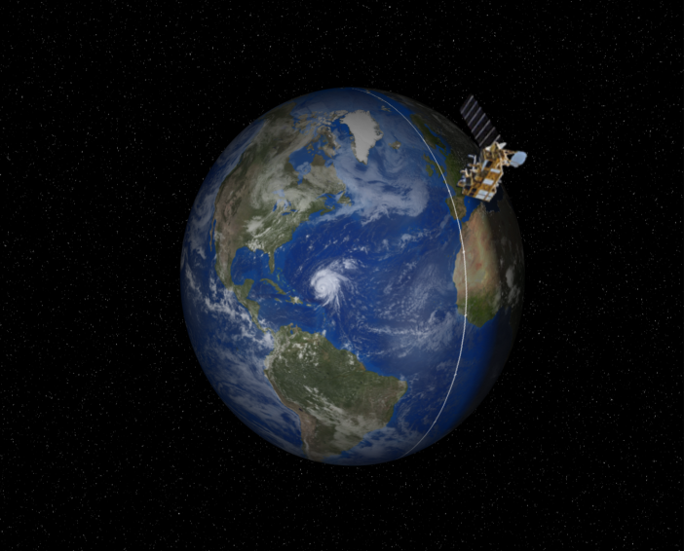
Polar Satellites received
NOAA-15
NOAA-18
NOAA-19
METOP-A
METOP-B
Aqua
Terra
Suomi-NPP
Landsat-8
FY-3B
GCOM-W1
19

Slide 20
Polar Satellites Received at UW SSEC in 2016
 | Reception Method | Domain | ADDE Latency | Instruments | External Access
NOAA-15 | C-Band relay, DDS | DB CONUS Global | DB <1 minutes after pass | AVHRR, AMSU, DCS->level-1 | ADDE
 |  |  |  | All other instruments Level-0 | NA
NOAA-18 | DB L-Band, C-Band relay, DDS | DB CONUS Global | DB <1 minutes after pass | AVHRR->level-1 | ADDE
 |  |  |  | All other instruments Level-0 | NA
NOAA-19 | DB L-Band, C-Band relay, DDS | DB CONUS Global | DB <1 minutes after pass | AVHRR->level-1 | ADDE
 |  |  |  | All other instruments Level-0 | NA
Metop-A | DB L-Band, NOAA DDS | DB CONUS Global | CONUS <15 minutes after pass | AVHRR ->level-1 | ADDE
 |  |  |  | AVHRR, IASI | DB ftp (sips)
Metop-B | DB L-Band, NOAA DDS | DB CONUS Global | CONUS <15 minutes after pass | AVHRR ->level-1 | ADDE
 |  |  |  | AVHRR,IASI | DB ftp (sips)
Suomi-NPP | DB X/L Band, NASA Relay | DB CONUS Global | CONUS <15 minutes after pass | VIIRS | ADDE
 |  |  |  | VIIRS,ATMS, CrIS | DB ftp (sips)
Aqua | DB X-Band, NASA Relay | DB CONUS Global | DB <15 minutes after pass | AIRS, MODIS -> Level-1 | ADDE
 |  |  |  | AIRS, MODIS | DB ftp (sips)
Terra | DB X-Band, NASA Relay | DB CONUS Global | DB <15 minutes after pass | MODIS -> Level-1 | ADDE
 |  |  |  | MODIS | DB ftp (sips)
Landsat-8 | Network Relay (USGS) | CONUS | 22-24 hours | Level-1 | ADDE, WMS
Shizuku GCOM-W1 | DB X-Band | CONUS | DB <1 min after pass | Level-0 | SSEC ftp
FY-3B/C | DB X/L Band | CONUS | DB <1 min after pass | Level-0 | SSEC ftp

Slide 21
Non-Satellite data
NOAAport
Text/Point
Model Grids
Radar

Slide 22
Archive Data
As of Dec 2015, over 975 TBs online.
(closer to 1.5 PB when redundant data are included)
Grows approximately about ~150 TB/year
US Geostationary Satellites
GOES-8 through GOES-15 (1994-Present) (East, West , South America and test)
GOES-1 through GOES-7 (1978-1996)
SMS-1&2 (1978-1981)

Slide 23
Archive Data
International Geostationary Satellites
GMS/MTSAT (1998-2015)
Meteosat/Meteosat IODC (1998-Present)
Meteosat-1 FGGE (1978-1979)
FY2 (2004-Present)
Kalpana (2005-Present)
Insat-3D (June 2014-Present)
COMS (June 2012 – Present)
Himawari-8 (March 2015 – Present)

Slide 24
Archive Data
NOAAPORT/Conventional Data
Model Output (1996-Present)*
In situ Point Observations (1976-Present)

Slide 25
Plans for GOES-R
Ingest
Distribution
Archive

Slide 26
GOES-R Antenna Upgrade

Slide 27
GOES-R Antenna Upgrade

Slide 28
GOES-R Antenna Upgrade

Slide 29
SDI-GRB Appliance

Slide 30
SDI- GRB Appliance
CSPP GEO
GOES-R Rebroadcast
GRB
CADU
(Channel Access Data Unit)
Partial CCSDS packets
RT-CSPP
Community Satellite Processing Package for Geostationary Data
Assembles and Aggregates packets
GRB-R
GRB Reconstuctor
Writes/Fills NetCDF4 files and logs
rabbitMQ events
NetCDF4
ABI (Advanced Baseline Imager)
GLM (Geostationary Lightning Mapper)
MAG (Magnetometer)
SEISS (Space Environment In-Situ Suite)
SUVI (Solar Ultraviolet Imager)
EXIS (Extreme Ultraviolet and X-ray Irradiance Sensors)
ADDE servers
SFTP servers
SDI
Archive
Processing
Users

Slide 31
SSEC Datacenter Distribution
GOES-R Rebroadcast
GRB
CADU
(Channel Access Data Unit)
Partial CCSDS packets
SDI GRB Appliance (events via rabbitMQ)
NOAA Star
(PDA)
dcserve
(rabbitMQ)
sftp
ftps
rsync
Commercial
Cloud Provider
CCSDS Packets
sftp
NOAA Star
rsync
(push)
dcserve
(rabbitMQ)
SATBUFF
(non-realtime)
rabbitMQ
Level 1&2 Products
nfs
arcwrite
rsync/ scp
ADDE Users
(optional rabbitMQ listener)
arcdata
Cluster Users
nfs
nfs
arcserve
nfs
cspp-geo
GEOCAT/AIT
Level 2+ Products
nfs

Slide 32
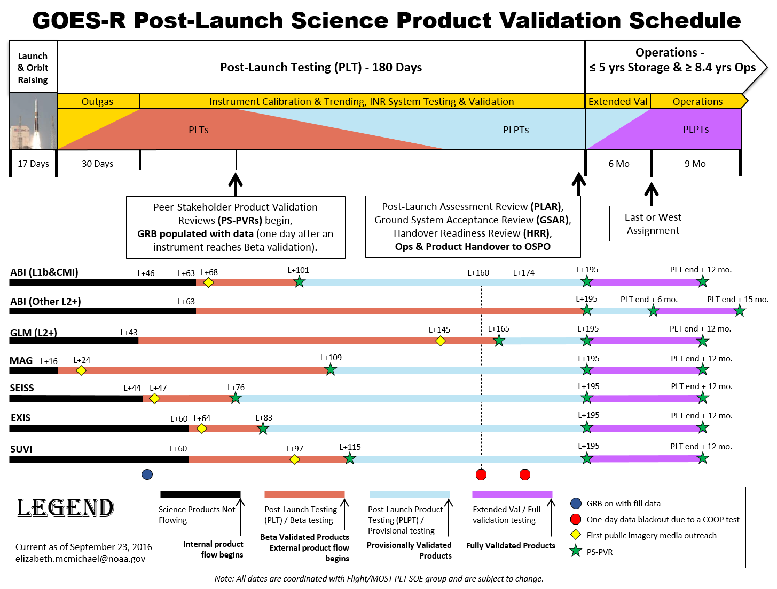
Science Product Validation Schedule
Assignment to GOES-East or GOES-West in November, 2017
ABI Imagery Distribution starts in Late February, 2017
First ABI image in
Early January, 2017
Notes:
The important point on this slide is to note when data flow occurs. The green stars mean a Peer Stakeholder – Product Validation Review (PS-PVR) will be held which appraises the status of product quality with respect to Program definitions. The PS-PVR Panel has the authority to declare products have achieved a product maturity level and provides guidance on work expected to achieve the next maturity level. The chair of the PS-PVR Panel is the GOES-R Chief Scientist. Once each instrument reaches Beta Maturity, data from that instrument will populate the GRB stream and thus all downstream users including PDA
NWS determines when to release data to WFOs
Ground Segment internal flow of instrument data: Commences upon completion of each instrument’s outgassing
Data will flow for path integrity test purposes to PDA and AWIPS
Data will flow for instrument vendor and CWG Cal/Val purposes to LZSS
Data will not be released from LZSS, PDA, AWIPS to any other downstream consumers other than instrument vendors, CWG, and CLASS. The Unique Payload Services (GRB, HRIT/EMWIN, DCS) will also not yet distribute data.
First media image(s) for ABI will be released after Orbit Raising and initial image navigation and radiometric assessment

Slide 33
GOES-R Archive
~500 GB/day netCDF
Archive ABI, GLM netCDF (no level-2 products)
Parallel “archive” of GRB packets (first 6 months/TBD)
Level-0 archive

Slide 34
Plans for GOES-R
External and Internal Data users will have ADDE access to:
ABI
GLM
L2 products from PDA
Special subscriptions to cloud based data feeds will be provided on request.
Archiving ABI, GLM, netCDF indefinitely

Slide 35
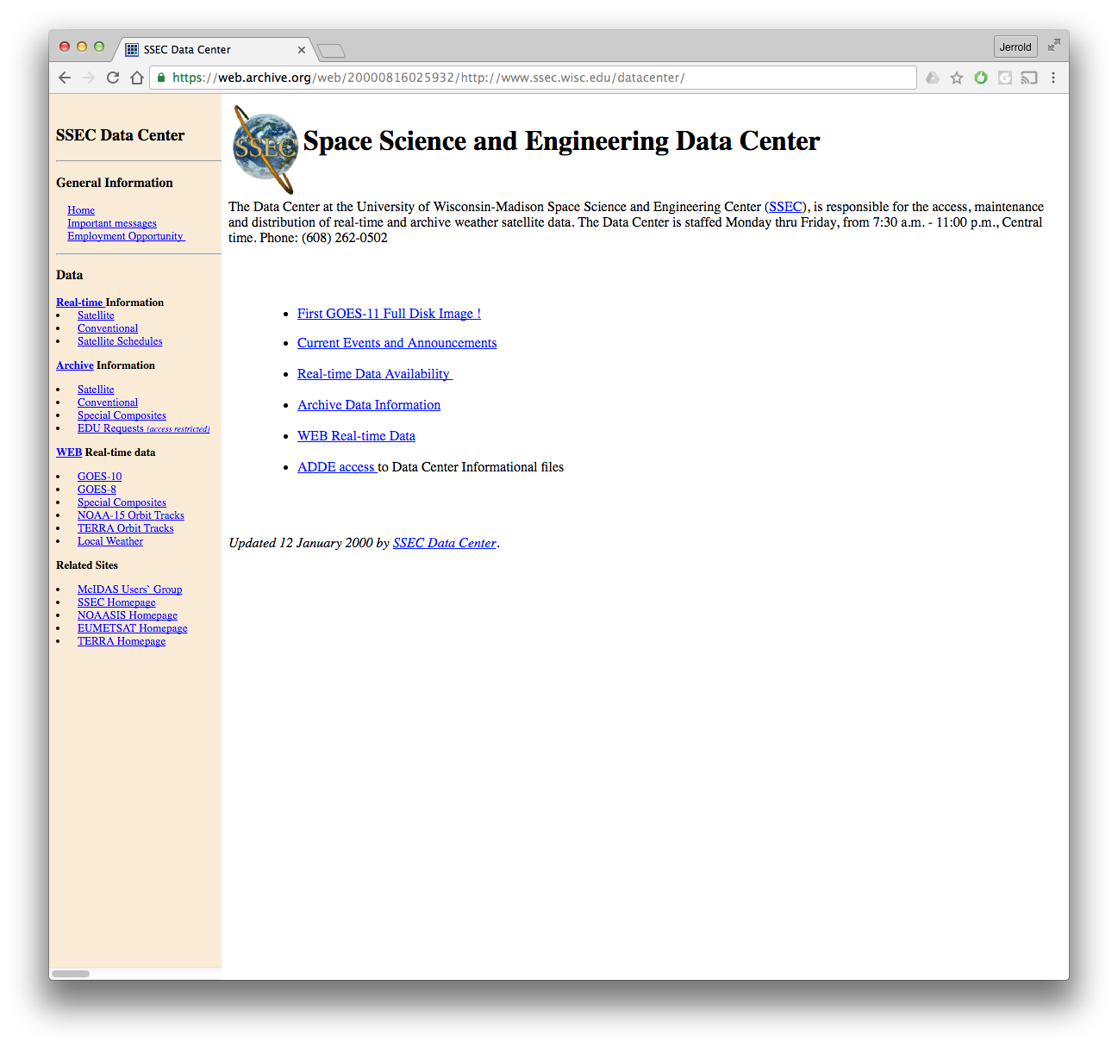
Satellite Data Services Web Site
January 2000

Slide 36
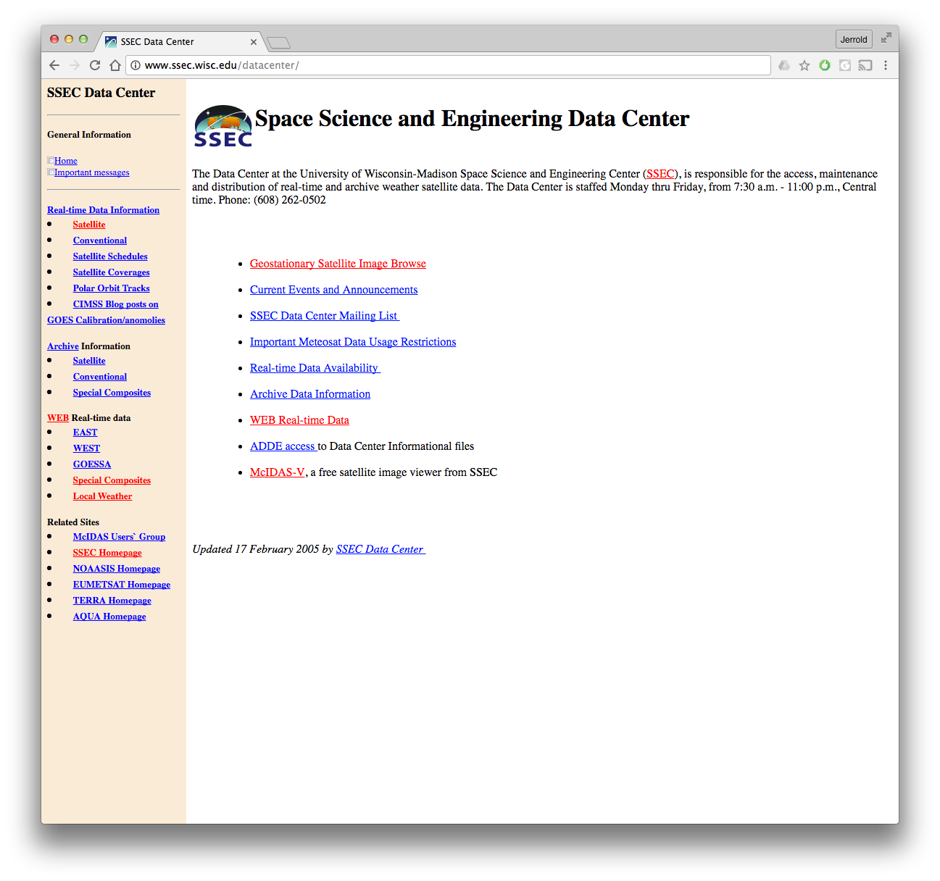
Satellite Data Services Web Site
October 2016

Slide 37
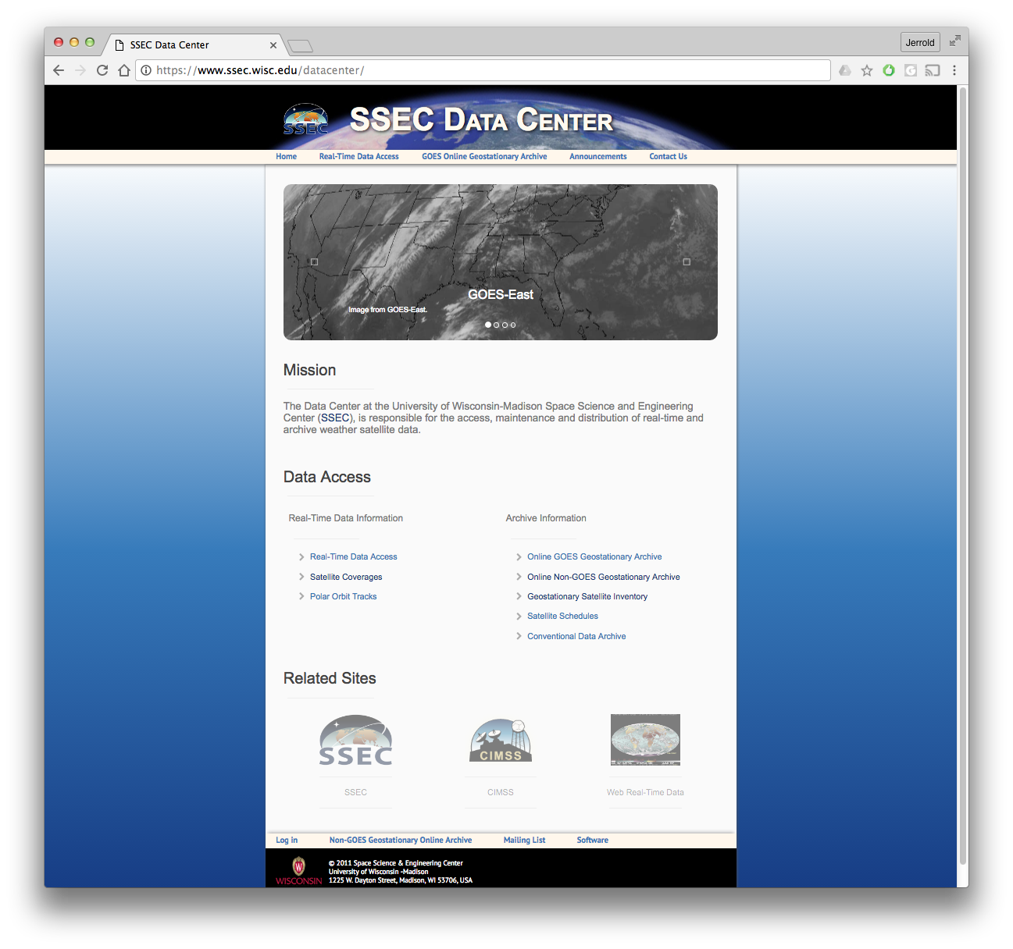
Satellite Data Services Web Site
November 2016

Slide 38
Other SDS Projects

Slide 39
McFETCH Satellite Data Server
Dave Parker, Dave Santek, Bill Bellon, Clayton Suplinski, Rick Kohrs, Jerry Robaidek

Slide 40
McFETCH Satellite Data Server
This is not new!
McWEB …. Ken Bywaters in 1995.

Slide 41
McFETCH Satellite Data Server
Multi-format client-agnostic File Extraction Through Contextual HTTP
Allows access to ADDE archive servers
Heavily dependent on McIDAS-X
Outputs all formats McIDAS-X can plus others

Slide 42
McFETCH Satellite Data Server
Access via HTTPS
Any client that can request a URL, can access, subset, and remap satellite data from an ADDE server
Will eventually be integrated with inventory and RealEarth
Rolling out now

Slide 43
McFETCH Satellite Data Server
Output formats:
AREA | Flat Binary
NetCDF | Gif
Geotiff | JPEG
Flat text | PNG

Slide 44
McFETCH Satellite Data Server
Must register for a unique data key
1 GB daily limit
1000 transaction per day daily limit
Data must be 180 days or older

Slide 45
McFETCH Satellite Data Server

Slide 46
McFETCH Satellite Data Server
To get a data access key:
Go to http://www.ssec.wisc.edu/mcfetch

Slide 47
WxSatS
Clayton Suplinski, Rick Kohrs, Jerry Robaidek

Slide 48
WxSatS
Interactive educational tool for visualizing SDS satellite data resources
Uses WebGL, and can be viewed in a browser.
Mobile and VR options are possible in the future

Slide 49
WxSatS

Slide 50
WxSatS

Slide 51
WxSatS
Go to:
http://www.ssec.wisc.edu/datacenter/wxsats/
To try it out.

Slide 52
End

