Slide 1
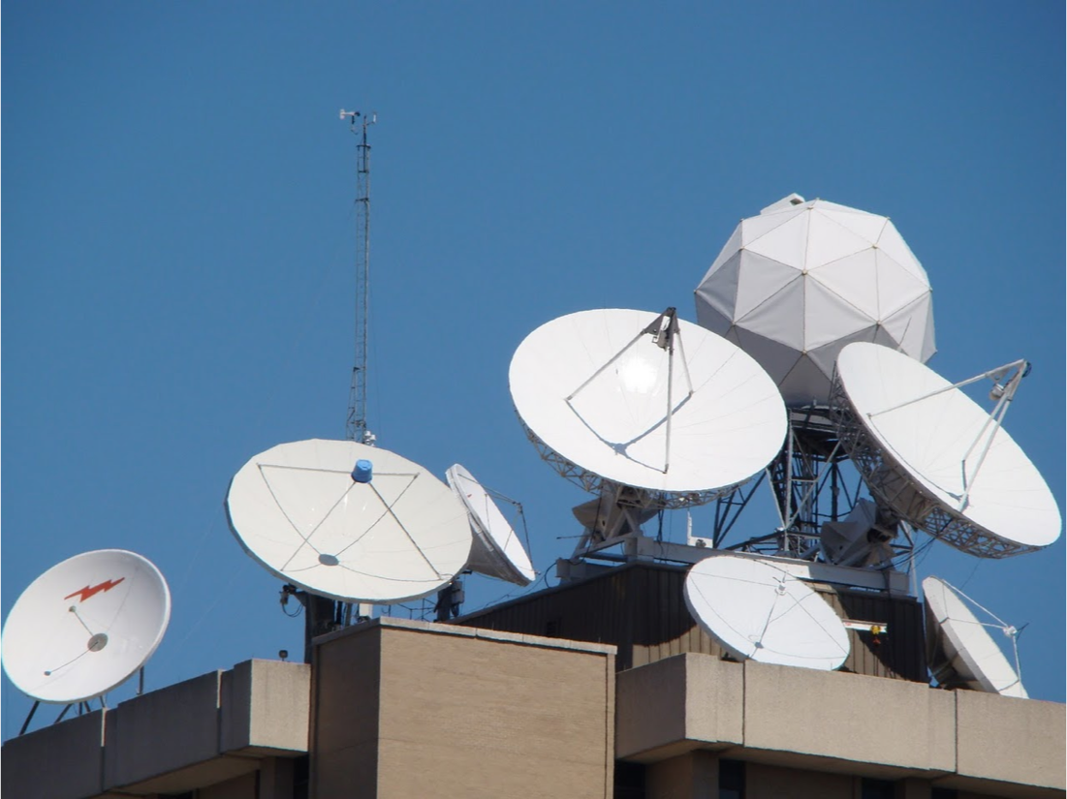
University of Wisconsin SSEC
Satellite Data Services
Archive
2016 McIDAS Users Meeting
November 17, 2016

Slide 2
History

Slide 3
First antennas 1974

Slide 4
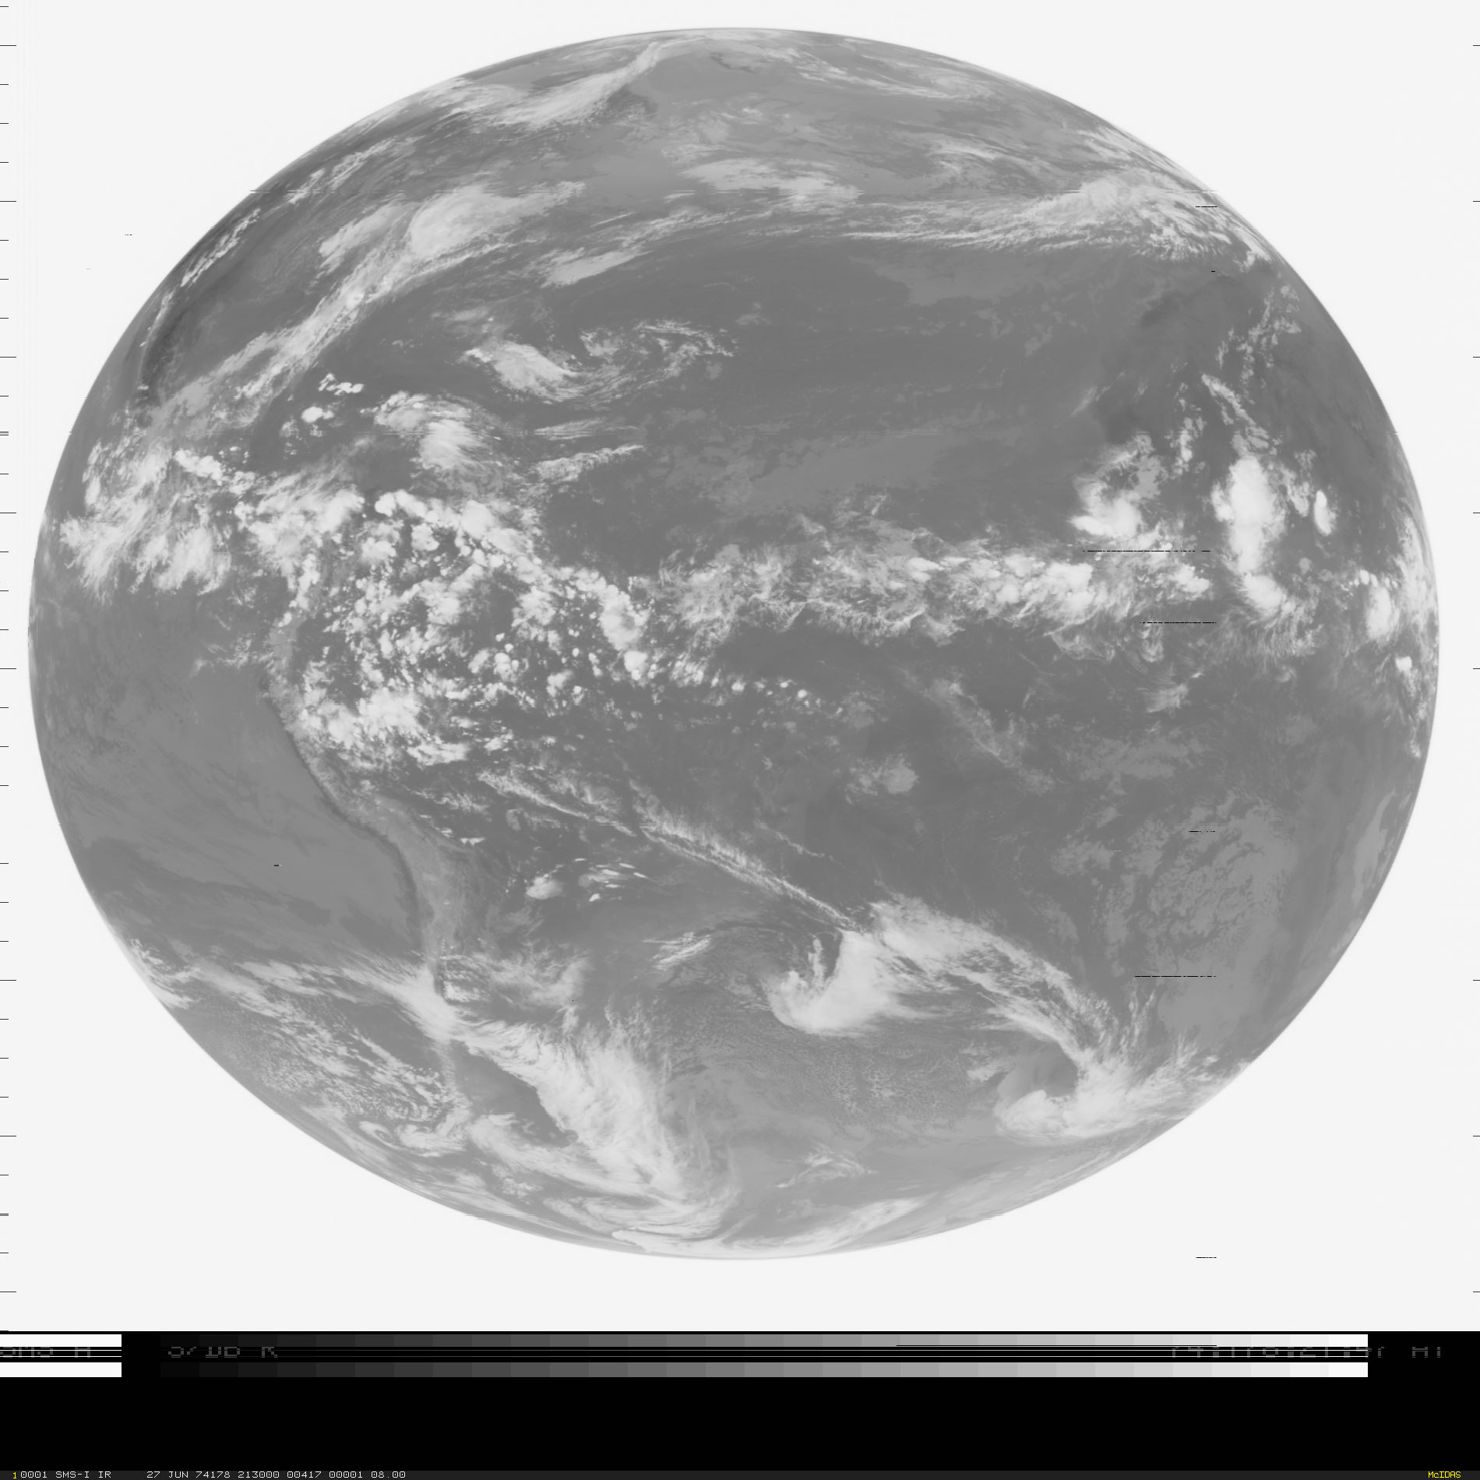
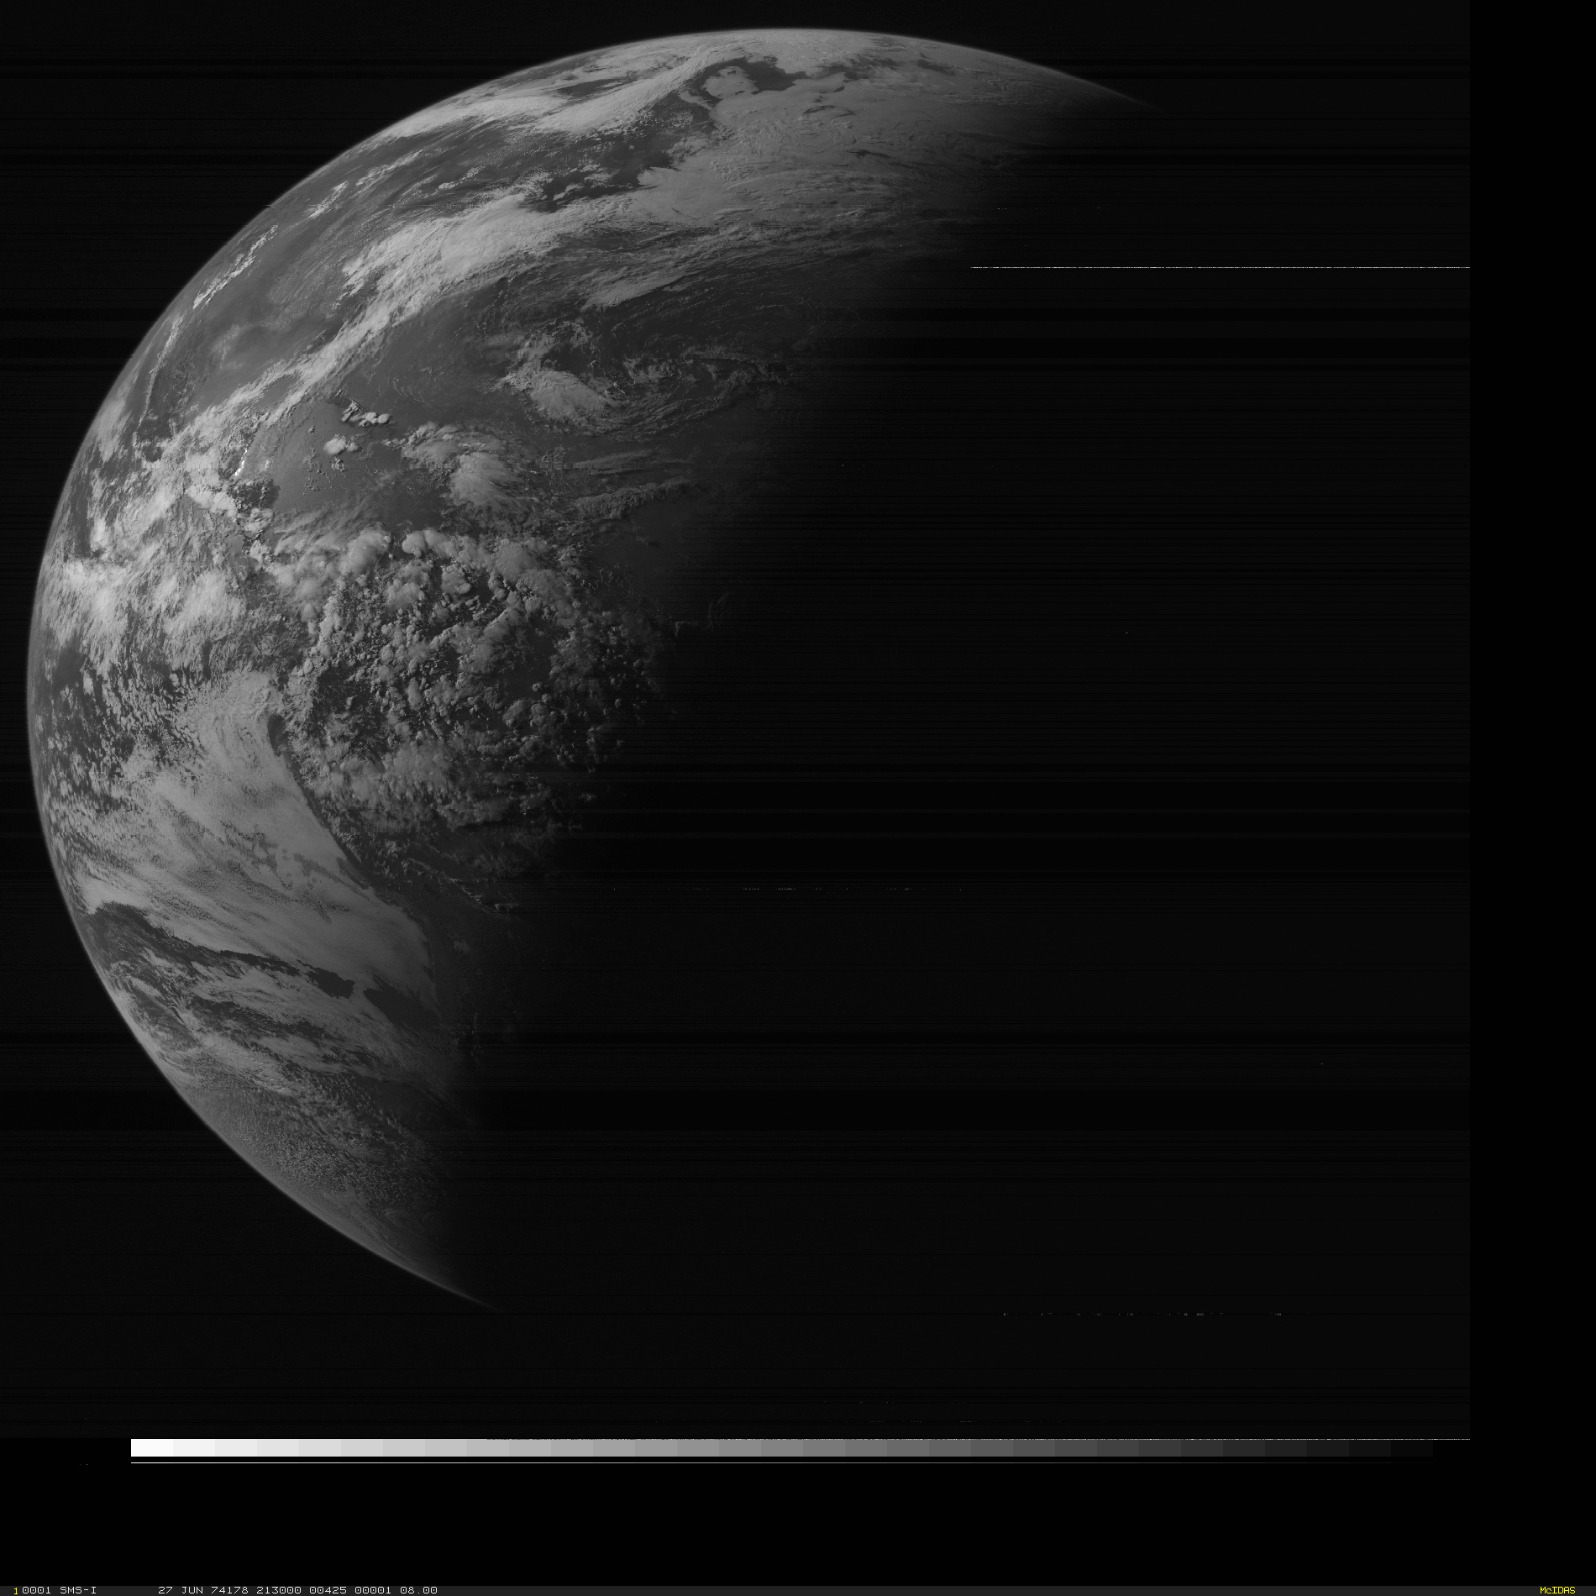
First Satellite Imagery in the online archive
1974 day 178

Slide 5
9-Track tapes

Slide 6
Dr. Verner Suomi

Slide 7
U-matic (1978-1996)

Slide 8
U-matic (1978-1996)

Slide 9
National Archive (1979-2004)
SSEC became the National Archive of GOES data in 1979
Tried to send the archiving activity to NOAA over the next 25 years
Finally Moved to NCDC in 2004 (Now called NCEI)

Slide 10
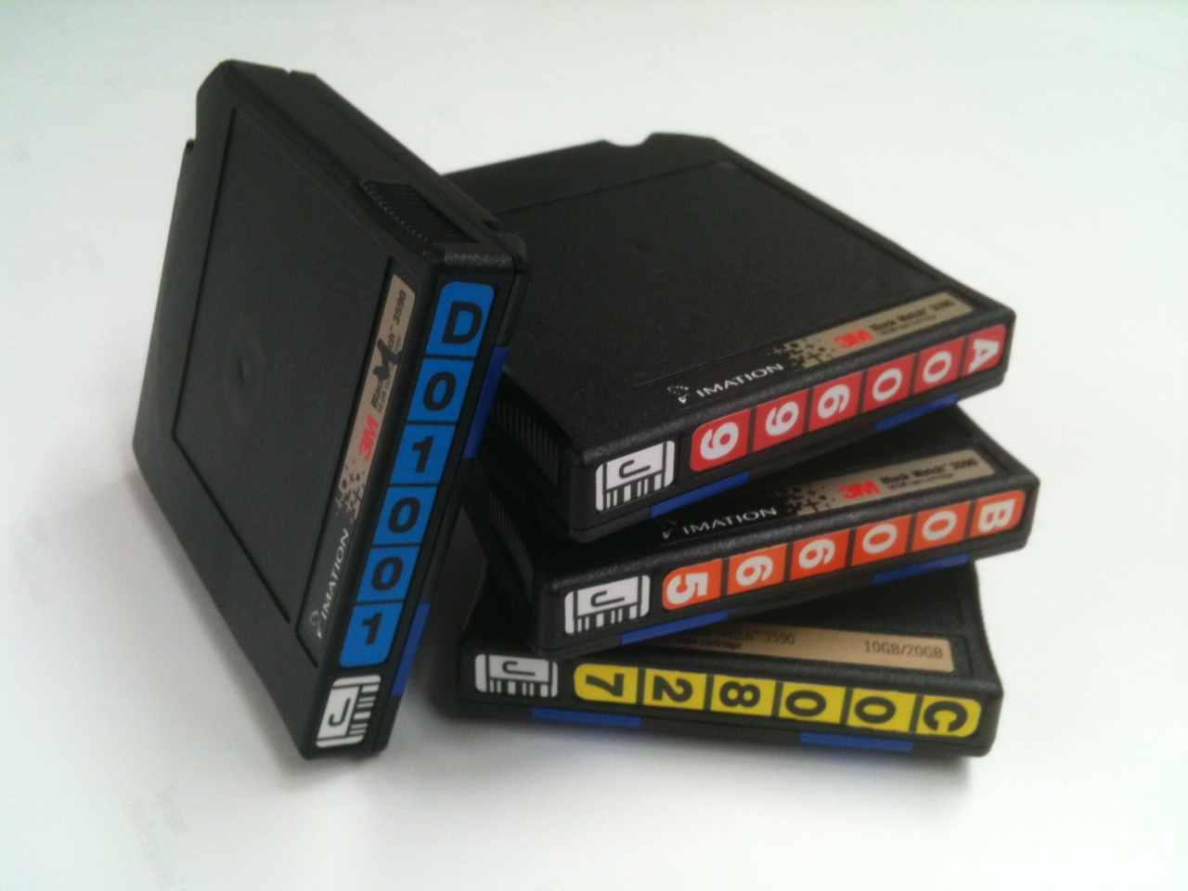
3590 tapes (1996-2005)

Slide 11
Online Archive (2005- Present)

Slide 12
LTO-5

Slide 13
Source | Satellites | Years | sensors | Formats | Servers
US Geo | SMS1&2 GOES1-7 | 1974, 1978-1996 | imager and sounder | Mode A,AA,AAA AREA | ADDE
US Geo | GOES8-15 | 1993-Present | imager and sounder | GVAR and AREA for sounder | ADDE
Eumetsat | Met-1, Met-3, Met5-7 | 1978-1979 1992-1995 1998-Present | imager | Native, AREA OMTP pdus | ADDE
Eumetsat | Met8-11 | 2004-Present | SEVERI | HRIT | ADDE
Japan (JMA) | GMS-1 GMS-5 | 1978-1979 1998-Present | Imager | AREA | ADDE
Japan (JMA) | MTSAT1R,2 | 2005-Present | Imager | HiRID,HRIT | ADDE
Japan (JMA) | Himawari-8 | 2015-Present | Imager | HSD | ADDE
China | FY2,C,D,E,G | 2005-Present | Imager | AREA | ADDE
India (ISRO) | Kalpana Insat-3D | 2004-Present 2014-Present | VHRR Imager, Sounder | HDF4,5 | ADDE
South Korea (KMA) | COMS | 2012-Present | CMOS | HRIT | ADDE

Slide 14
Misc Data Archive
Source | Years | Formats | Servers
Insitu Point | 1976-Present | McIDAS MD | ADDE
Noaaport Model Output | 1996-Present | McIDAS GRID, GRIB1, GRIB2 | ADDE, THREDDS
Noaaport Text | 1996-Present | Original text, concatenated binary file | ADDE
Global Satellite Composite | 2001-Present | AREA | ADDE
Cloud top height global composites | 2003-Present | AREA | ADDE
Lots of others misc, sst composites,SSMI, modis winds | Early 2000-Present | AREA, l1b, | ADDE, THREDDS

Slide 15
Statistics
210 TB of data via ADDE in first 10 months of 2016
12 million transaction in 2016
Averaged 2.5 TB transferred via ADDE per day in October 2016
As of Dec 2015, over 975 TBs online.
(closer to 1.5 PB when redundant data are included)
Grows approximately about ~150 TB/year

Slide 16
Backend Hardware
6-Dell PowerEdge R430 servers
2 Dell PowerEdge R730 servers
3 Dell PowerVault MD3460 storage arrays
2 Dell PowerVault MD3060e storage arrays
Lustre 2 on zfs

Slide 17
Recent Performance Enhancements
Modifications to Lustre server data prefetch:
Himawari-8 entire Day List
Before enhancements 200+ seconds
After Enhancements ~13 seconds
COMS
Before enhancements ~17 seconds
After Enhancements ~2.5 seconds

Slide 18
Meteosat-1

Slide 19
Meteosat-1
Originally pulled from 9-track tape in early 2000s, but not decoded.
Covers time period of December 1, 1978 – November 24, 1979
Rediscovered in summer 2016 due to an inquiry by Paul Menzel
Decoded, Navigated, and Calibrated by Dan Forrest and Dave Santek
Provided to Eumetsat in November 2016

Slide 20
Eumetsat article

Slide 21
One Day in 1979

Slide 22
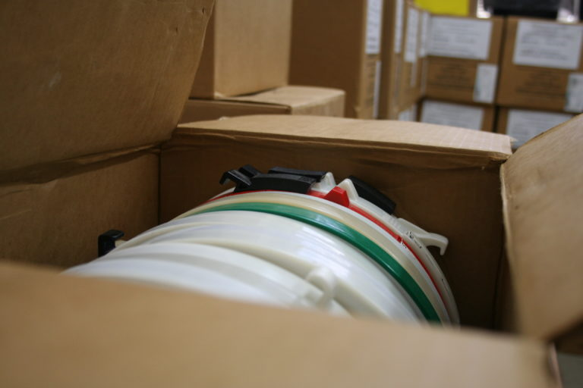
SMS 1974-1980
Doug Ratcliff, Dan Forrest, Nancy Troxel-Hoehn, Jerrold Robaidek

Slide 23
SMS 1974-1980
~1,300 9-track tapes scheduled for destruction by NASA Goddard
Reading was complete in the past week
Processing and decoding now
Tapes covered a period of 1974 – 1980, but most were from July 1974 and Fall 1975 time period

Slide 24
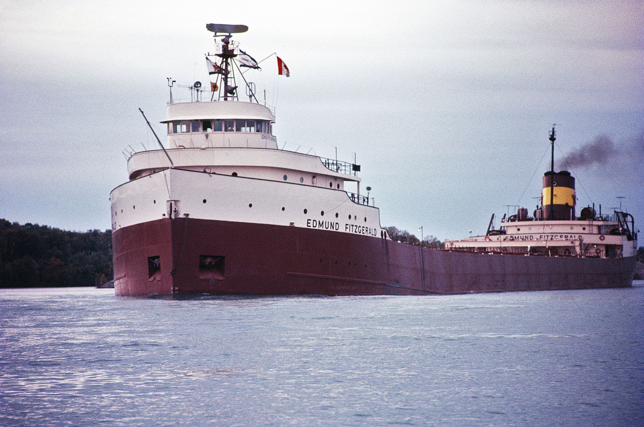
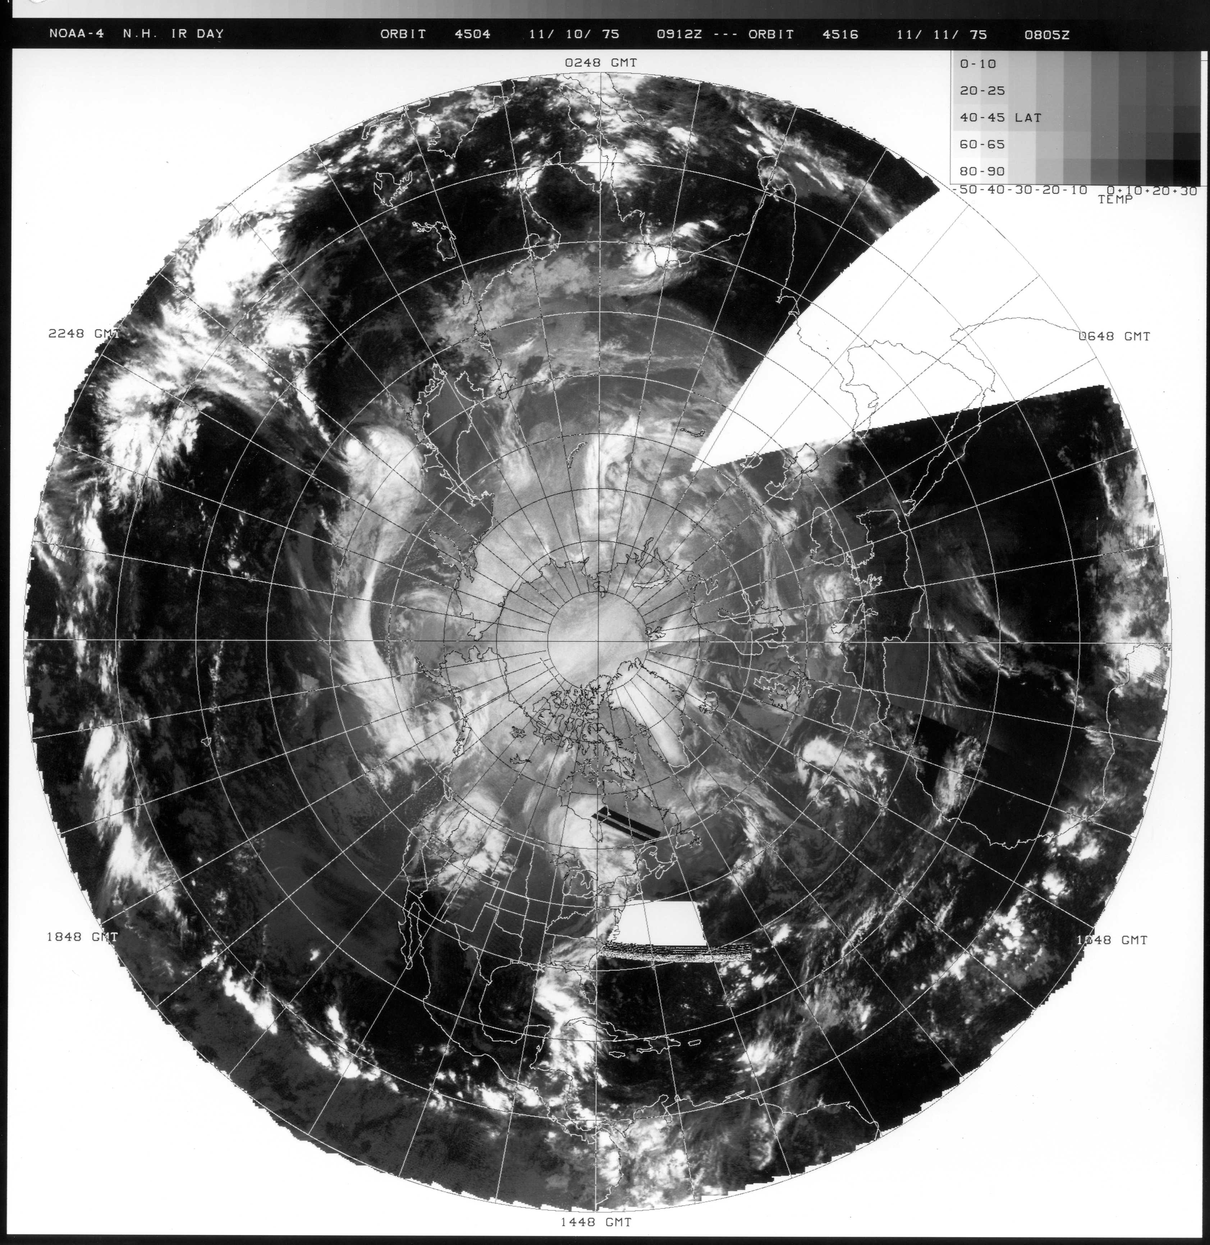
Edmund Fitzgerald
November 10, 1975

Slide 25
Edmund Fitzgerald
“Superior, they said, never gives up her dead”
The tapes did not contain this data.
But almost an entire year of GOES data has now recovered that had previously been lost.

Slide 26
SMS 1974-1980
An interesting case:
Major tornado outbreak swept across Omaha, Nebraska, killing three people and injuring more than 100
Five-minute imagery created from 6 May 1975

Slide 27
SMS-1 1974-1975 +

Slide 29
GMS IR (1981-1998)

Slide 30
Inventory http://inventory.ssec.wisc.edu/inventory

Slide 31
Fact Check

Slide 32
Total Eclipse of February 26, 1979

Slide 33
McFETCH
http://mcfetch.ssec.wisc.edu/cgi-bin/mcfetch?dkey=***********&output=gif&GROUP=AGOES03&DESCRIPTOR=A-VIS&SERVER=geoarc.SSEC.WISC.EDU&date=February+26,+1979&band=1&mag=1+-1&map=yes&lat=48+100&USER=****&PROJ=****&TIME=16:15&size=2000+2000
http://mcfetch.ssec.wisc.edu/cgi-bin/mcfetch?dkey=***********&output=gif&GROUP=AGOES03&DESCRIPTOR=A-VIS&SERVER=geoarc.SSEC.WISC.EDU&date=February+26,+1979&band=1&mag=1+-1&map=yes&lat=48+100&USER=****&PROJ=****&TIME=16:45&size=2000+2000

Slide 34
February 26, 1979

Slide 35
February 26, 1979

Slide 36
February 26, 1979

Slide 37
February 26, 1979
Story checks out!

Slide 38
End

