Slide 1



SDI (Satellite Data Ingestor)
David Santek, Scott Mindock, Jerrold Robaidek
2016 McIDAS Users’ Group Meeting
16 November 2016

Slide 2
Overview
SDI-104
  Hardware configuration
  Software configuration
  Satellites signals
Next generation SDI
  Hardware Configuration
  Software configuration
  Satellites signals

Slide 3
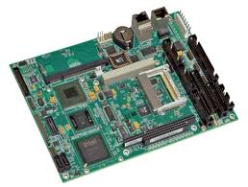
SDI-104
Hardware Configuration
PC/104-Plus
LittleBoard 735
1 GHz CPU
Disk: 160 Gbyte IDE
Boot from compact flash
Ethernet: Up to 1G/s
Connectors for monitor and keyboard
Mounted in 2U rack box

Slide 4
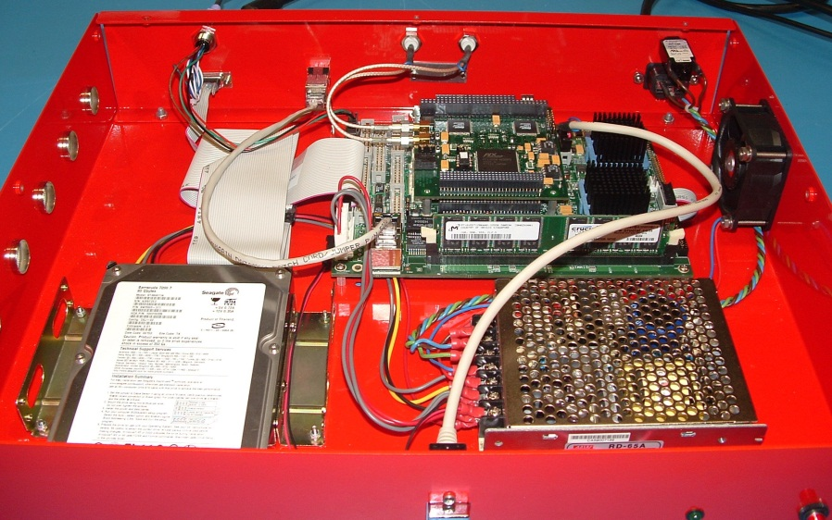
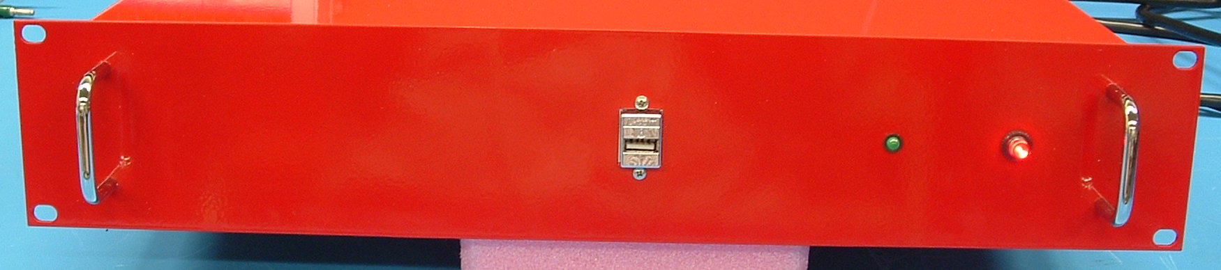

Hardware Configuration
Data rates tested up to 40 Mbits/s
Connectors:
  D15P
  BNC
Configuration:
  Single ended (TTL)
  RS422 (differential)
Data types
  NRZ-L, NRZ-M, NRZ-S
  Jumper configurable

Slide 5
Software Configuration
Knoppix 6.7.1 (Linux 3.0.41)
  Up-to-date security
  Compatible with old binaries
  Can be configured as a standalone ingestor/server, or write data to an external disk (via NFS, for example)

Slide 6
Event Notification
Notifications:
  Image start
  Image end (not for GVAR Imager)
Three types of notifications:
  Send an email
  Write notification to a file (log messages)
  Run a program or script

Slide 7
SDI-104 Status for Current Satellites
GVAR: up-to-date for entire series
POES AVHRR:
  Up-to-date for all satellites
  Unable to test direct reception, although a system is running at NWS Honolulu

Slide 8
SDI … the next generation

Slide 9
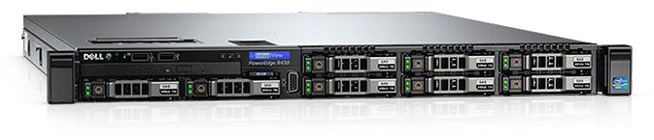
Introducing the SDI-GRB Appliance

Slide 10
SDI-GRB Hardware Configuration
Dell PowerEdge R430 servers
12 core, 2.5 GHz Intel Xeon Processor
64 GB Ram
6 1-TB disks in RAID-6
10 Gb Ethernet and 1 GB Ethernet
  No more clock and data
  Everything over Ethernet
No SSEC-designed hardware components

Slide 11
SDI-GRB Software Configuration
CentOS 6.x
Software and security updates via yum
  Repository at UW SSEC
McIDAS-X ADDE servers
CSPP Geo ingest software
RabbitMQ event notification

Slide 12
SDI-GRB Data Access
ADDE
SFTP
Considering NFS

Slide 13
SDI-GRB Event Notification
RabbitMQ Server
  Start and End Events
  No more email events
  Remote workstations will be able to connect to the exchange server and receive desired events

Slide 14
SDI-GRB Appliance
CSPP GEO
GOES-R Rebroadcast
GRB
CADU
(Channel Access Data Unit)
Partial CCSDS packets
RT-CSPP
Based on NASA RT-STPS
Assembles and aggregates packets
GRB-R
GRB Reconstuctor
Writes NetCDF4 files and logs
Publish AMQP messages –>
RabbitMQ broker
    NetCDF4
    ABI (Advanced Baseline Imager)
    GLM (Geostationary Lightning Mapper)
    MAG (Magnetometer)
    SEISS (Space Environment In-Situ Suite)
    SUVI (Solar Ultraviolet Imager)
    EXIS (Extreme Ultraviolet and X-ray Irradiance Sensors)
ADDE servers
SFTP servers
SDI
Archive
Processing
Users

Slide 15
SDI-GRB Supported Satellites
GOES-R series
  Ingest handled by CSPP Geo
  Instruments
    ABI (Advanced Baseline Imager)
      Follow/tracking
    GLM (Geostationary Lightning Mapper)
    MAG (Magnetometer)
    SEISS (Space Environment In-Situ Suite)
    SUVI (Solar Ultraviolet Imager)
    EXIS (Extreme Ultraviolet and X-ray Irradiance Sensors)
    No Level-2 processing on the SDI-GRB
GVAR (under consideration)

Slide 16
What is CSPP Geo?
Community Satellite Processing Package for Geostationary Data
NOAA-sponsored project at UW SSEC
The software will be capable of processing
GOES-R Rebroadcast (GRB) data
Level 2 ABI products will be generated by algorithms developed by the GOES-R Algorithm Working Group
Software is freely available; distributed as self-contained 64-bit Linux binary packages

Slide 17
CSPP Geo initial product suite
Cloud mask
Cloud phase
Cloud type
Cloud top height
Cloud top temperature
Cloud top pressure
Cloud 11 µm emissivity
Cloud visible optical depth
Cloud effective radius
Cloud liquid water path
Cloud ice water path
Probability of Marginal Visual Flight Rules (MVFR)
Probability of Instrument Flight Rules (IFR)
Probability of Low Instrument Flight Rules (LIFR)
Low cloud geometric thickness

Slide 18
Questions?

