Slide 1


McIDAS Users’ Group
MUG Update
Becky Schaffer
Program Manager
McIDAS User Services
2016 MUG Meeting – Madison WI – Nov 16-17

Slide 2
MUG Update
MUG Personnel
What’s New in 2016
Who uses McIDAS-X and McIDAS-V?
McIDAS Support Requests
How long will McIDAS-X be supported?

Slide 3
MUG Personnel –
Current MUG Staff
  Kevin Baggett: -XCD programming
  Jon Beavers: -V programming
  Bob Carp: Help Desk, testing & doc
  Jay Heinzelman: Help Desk & testing
  Dave Parker: Systems programming
  Barry Roth: Help Desk & documentation
  2 new students – Sammy VanDyke & Matt Lane

Slide 4
MUG Personnel –
Programmers
McIDAS-X Russ Dengel Dan Forrest Tommy Jasmin Rick Kohrs Scott Lindstrom Dave Santek Tom Yoksas (Unidata) | McIDAS-V and VisAD Tommy Jasmin Tom Rink Yuan Ho (Unidata)

Slide 5
MUG Personnel –
Unidata Collaboration
Working Together on VisAD, IDV, -V
Combined –V / IDV Developers Meeting in Madison, November 2011
Monthly Teleconferences
Merged our developer tools (git, redmine)
MUG testers helping to test new functionality coming from IDV

Slide 6
MUG Personnel –
Training and Outreach
Demonstrations & Talks
  AGU Conference
  San Francisco CA (2015)
  AMS Annual Meeting
  New Orleans LA (2016)
  EUMETSAT Meteorological Satellite Conference
  Toulouse (2015), Darmstadt (2016)
  NWA Annual Meeting
  Norfolk VA (2015), Oklahoma City OK (2016)

Slide 7
What’s New in 2016 –
McIDAS–X Releases
2016.1 – February 2016
- Preliminary release of GOES-R ABI servers, calibration and navigation
- Added HimawariCast HRIT servers
2016.2 – October 2016
- Updates to the preliminary release of the GOES-R ABI servers for bug fixes, performance improvements, and support of Level 2 products
Next release – early 2017
- More GOES-R updates planned, including multi-band IMGCOPY and GLM servers

Slide 8
What’s New in 2016 –
OS Support for –X
-X Version | Vendor | Operating Systems | Compilers Supported
2016.1 | Apple -Mac Intel | OS X 10.9.5 OS X 10.10.5 | gfortran/gcc 4.9.2
2016.2 | Apple -Mac Intel | OS X 10.10.5 OS X 10.11.5 | gfortran/gcc 4.9.2 gfortran/gcc 5.3.0
beyond | We’ll evaluate 10.12 when it's supported at the University of Wisconsin SSEC, and then support only 10.11 and 10.12.

Slide 9
What’s New in 2016 –
OS Support for -X
Vendor | Operating System | Compilers Supported
Microsoft | Windows 7 Enterprise with SUA | g77 3.3 gcc 3.3 (packaged with SUA)
We have no plans to support Windows 8. We’ll evaluate Windows 10 and beyond when they’re supported at the University of Wisconsin SSEC.

Slide 10
What’s New in 2016 –
OS Support for -X
Vendor | Operating System | Compilers Supported
Red Hat | Enterprise Linux WS
 | 6.7 Intel | gfortran 4.4.7 gcc 4.4.7
 | 7.2 Intel | gfortran 4.8.5 gcc 4.8.5
We will evaluate 8.0 when it's supported at the University of Wisconsin SSEC.
We no longer support Linux PPC. ESPC funded the additional hardware for PPC support, and they no longer use that hardware.

Slide 11
What’s New in 2016 –
OS Support for -X
Vendor | Operating System | Compilers Supported
SUN | Solaris 10 OS SPARC | gfortran/gcc 4.9.2
 | Solaris 10 OS x86 | sunset support with 2015.2
The Solaris operating system is now maintained by Oracle. SSEC tests on Sun Solaris 10, which was purchased before Oracle acquired Sun Microsystems.
In order to use the hdf5 and netcdf4 libraries for the new INSAT-3D, GOES-R, and Kalpana servers, we switched to gcc and gfortran, and removed support for x86.

Slide 12
What’s New in 2016 –
OS Usage for -X
A survey was conducted in September 2015 with 100% McIDAS sites reporting. Thank you!
Only one question -- What operating system(s) are you using on your machines running McIDAS-X?
Operating System | # of Sites | Version(s) In Use
Apple Mac OS X | 4 | 10.4 - 10.10
Linux | 34 | 4.x – 7.x RHEL (24), CentOS (11), Ubuntu (7), SUSE (3)
Microsoft Windows | 4 | Win7 and Win10
Sun/Oracle Solaris | 2 | 10 OS SPARC

Slide 13
What’s New in 2016 –
2017 MUG Fees Announced
2017 MUG Fees
McIDAS (increased 5% over 2016)
SX (1-2 workstations) $ 9,840
DX (3-5 workstations) $19,680
MX (6+ workstations) $39,360
XCD (increased 5% over 2016) $14,340
SDI (decreased from $8,340 in 2016 to
better match actual support costs) $ 5,100

Slide 14
What’s New in 2016 –
New MUG Members
  AccuWeather
  - State College, Pennsylvania
  Pat King (private contractor)
  - Toronto, Canada
  Masdar Institute of Science & Technology
  - Abu Dhabi, United Arab Emirates
The total number of MUG Sites has stayed at ~40 sites for ~20 years.

Slide 15
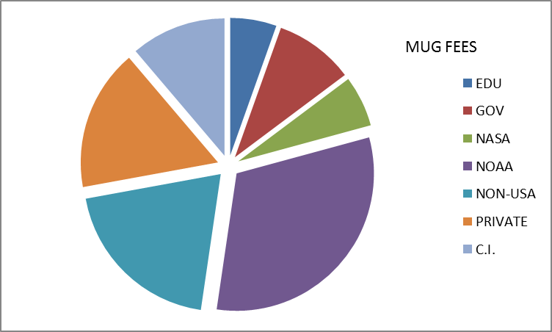
Who uses McIDAS-X?
38 Current MUG Members
NOAA (10) AWC, CLASS, ESPC, NCO, NHC, NWS-JSC,PACIFIC, and WESTERN, STAR, SPC NOAA CI (2) CIMSS/SSEC,CIRA EDUCATION (1) Unidata NASA (2) Langley, MSFC Other Gov’t (3) FAA, NTSB, Patrick AFB
 |  | Non-US (11) AEMET, ABoM, CONAE, EUMETSAT, Green Power Labs, HKO, Masdar, Mexico NWC, Pat King, Solargis, VTI
 | PRIVATE (9) AccuWeather, ATSC, Boeing, Iteris, StormGeo, TelventDTN, Universal Weather, the Weather Company, Weather Decision Technologies

Slide 16
Who uses McIDAS-V?
McIDAS-V is now used in…
  numerous research projects
  CIMSS High School Summer Workshop
  the NOAA Environmental Visualization Lab
  Satellite Meteorology classes
  (Miss State, Texas A&M, Wisconsin)
  EUMETSAT/CIMSS International Summer School
  visualizing data from the EUMETCast data stream
  at EUMETSAT and in EUMETSAT training courses

Slide 17
Who uses McIDAS-V? from the usage statistics
 | 2014
Total Uses | 370 K
.edu/.gov | 20 K
All others | 350 K
2015
600 K
20 K
580 K
2016
880 K so far | -V Forums ~1100 users
20 K | ~3400 unique IPs
860 K
Mostly private and non-US IP addresses
Windows7 | 66% | 47% | 20%
Linux | 31% | 51% | 79%
Mac OS X | 3% | 2% | 1%

Slide 18
McIDAS Support –
User Support Requests
With so many new non-paying users, how do we prioritize our support?
McIDAS-X, –XCD and SDI questions from
MUG members to the McIDAS Help Desk
McIDAS-V questions from MUG members
to the Help Desk and Support Forums
McIDAS-V questions from non-MUG users
to the Support Forums
ALL bug reports are put into the
McIDAS Inquiry System

Slide 19
McIDAS Support –
User Support Requests
McIDAS-X, XCD, and SDI users receive their answers from the McIDAS Help Desk.
  McIDAS-V users receive their answers from the Help Desk or from other forum users. Users of McIDAS-V are encouraged to answer the forum questions of other users and to share their knowledge and expertise.
2015 Inquiries & Forums | New | Resolved
McIDAS-X Inquiries | 222 | 240
McIDAS-V Inquiries | 331 | 255
McIDAS-V Forum Topics | 112 | 112

Slide 20
How long will –X be supported?
SSEC plans to support McIDAS–X through the current GOES-R Satellite Series, which is currently listed as 2036
➔ NO END DATE IN SIGHT!!!
No plans for support fee structure changes
  MUG members will continue to receive priority support for –X and –V
Continue to release –X as needed for bugs, updates, and new OS & data/satellite changes (~2 times per year)

Slide 21
How long will –X be supported?
SSEC plans to support McIDAS–X through the current GOES-R Satellite Series, which is currently listed as 2036
➔ NO END DATE IN SIGHT!!!
Important Issues
  ADDE written in Fortran and C → Python?
  XCD becoming brittle → beta coming in 2017
  Larger datasets mean larger images, grids, maps than currently allowed in McIDAS-X
  The McIDAS-X GUI is written in tcl/tk and becomes more fragile with each OS upgrade

Slide 22
Looking for more user input!
Use the McIDAS-V Support Forums or contact the McIDAS Help Desk
Join the McIDAS Advisory Committee
Fill out the MUG Meeting Survey at the end of the meeting on Thursday
    Do you have suggestions for improving the MUG Meeting?
    What data types do you need to read/write with McIDAS?
    On what platform(s) do you currently run McIDAS? Also, be sure to answer the new 2017 OS Survey.
If you have specific development needs, contact me about helping to fund development.

Slide 23
In Summary…
McIDAS Users’ Group is still going strong!
  MUG Membership staying steady for
  –X, -XCD, and SDI → still our #1 Priority
  McIDAS-X will be fully supported through the GOES-R Program
  McIDAS-V usage and forum membership growing every day
  If –X works for you, then stay with –X. When new features or data types are added in –V, then do your new development in –V.

Slide 24
We need input from you to make all of McIDAS better for everyone!
  THANK YOU!!!

