Slide 1
McIDAS support of Suomi-NPP /JPSS and GOES-R L2
William Straka III¹
Tommy Jasmin¹, Bob Carp¹
¹Cooperative Institute for Meteorological Satellite Studies, Space Science and Engineering Center, University of Wisconsin-Madison
1

Slide 2
Outline
Suomi-NPP/JPSS Overview and McIDAS-V Examples
McIDAS-X and -V Support of GOES-R ABI Level 1b and 2 Products
2

Slide 3
Suomi-NPP/JPSS Overview and McIDAS-V Examples

Slide 4
Suomi NPP
S-NPP observes the Earth’s surface twice every 24-hour day, once in daylight and once at night.
It has 5 instruments which retrieve data regarding the atmosphere, land and ocean
VIIRS
CERES
CrIS
ATMS
OMPS
4

Slide 5
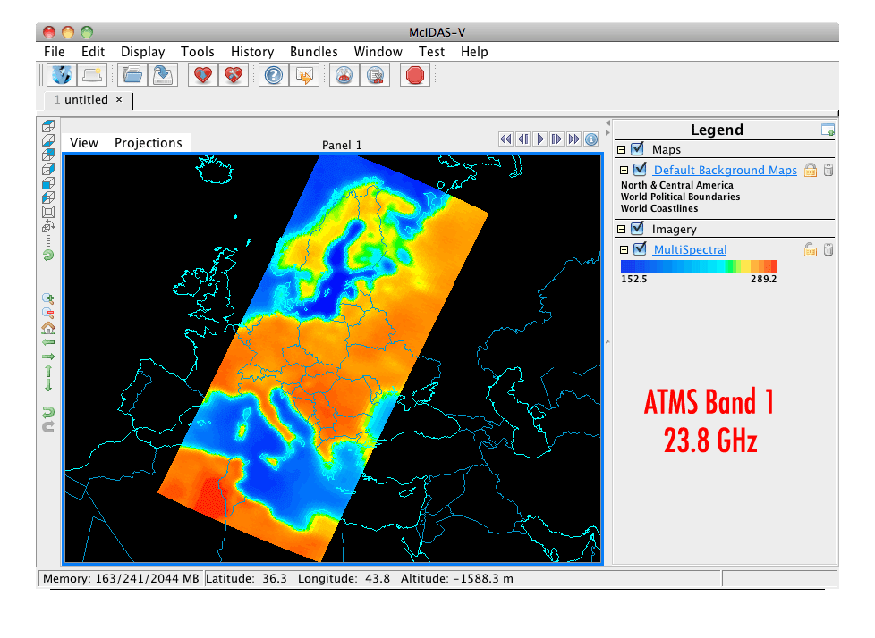
Advanced Technology Microwave Sounder (ATMS)
22 microwave channels, combining all the channels of the preceding AMSU-A1, AMSU-A2, and AMSU-B sensors into a single package
Provides sounding observations needed to retrieve profiles of atmospheric temperature and moisture for forecasting models and continuity for climate monitoring purposes.
5

Slide 6
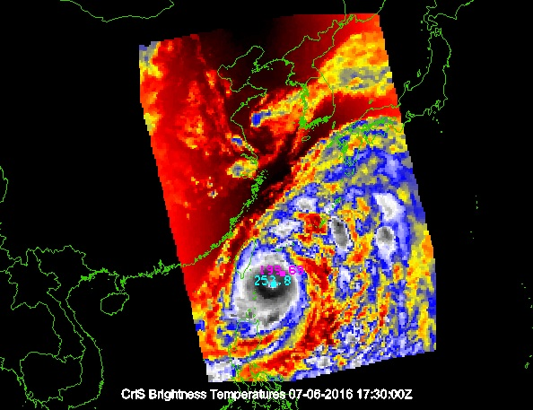
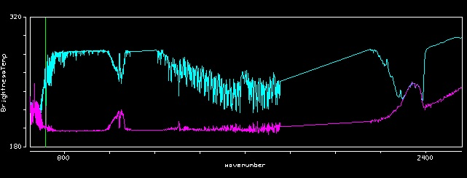
Cross-track Infrared Sounder (CrIS)
1,305 infrared spectral channels
Designed to provide high vertical resolution information on the atmosphere's structure of temperature and water vapor.
6

Slide 7
Visible Infrared Imaging Radiometer Suite (VIIRS)
Has 22 channels at three different resolutions
16 Moderate Band (M-Band) channels (~750 m at nadir)
5 high resolution (I-Band) channels (~375 m at nadir)
Day Night Band (~750 m at nadir)
M and I band data encompass data from 412 nm to 12 μm
Used to produce Level 2 products
7

Slide 8
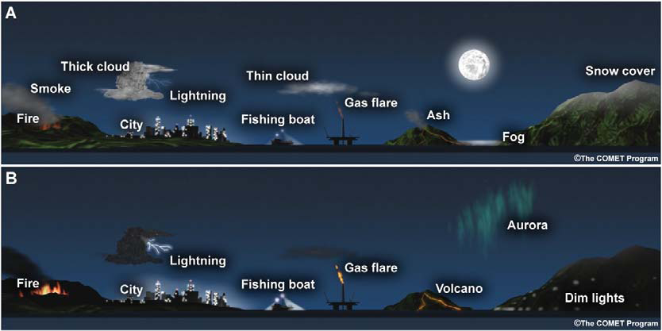
Day Night Band
The DNB measures visible radiances from both the Earth and atmosphere
Wavelength of 0.7 μm, 742m x 742m pixel size
Receives visible data from via reflection and emission sources (natural and anthropogenic )
Stray light fix implemented August 21, 2013
Figure 1 from Lee et al (2005)
8
2016 McIDAS Users’ Group Meeting

Slide 9
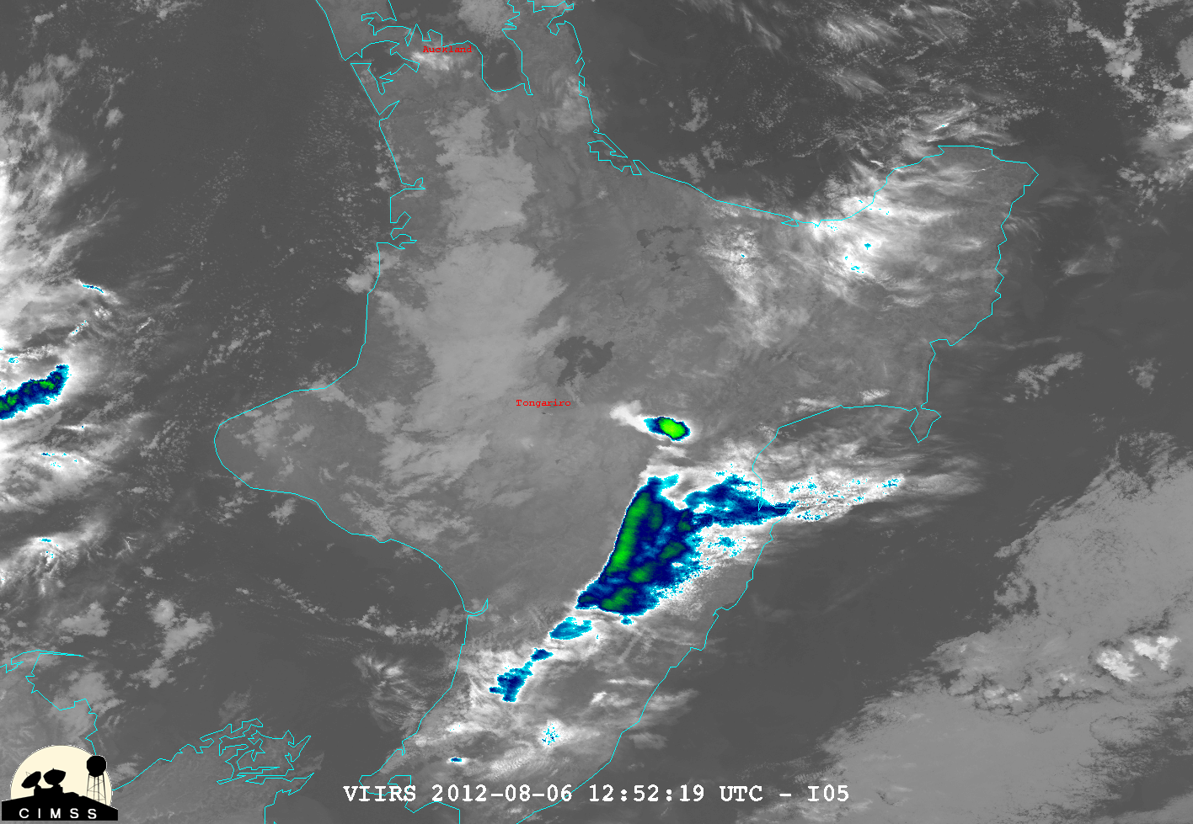
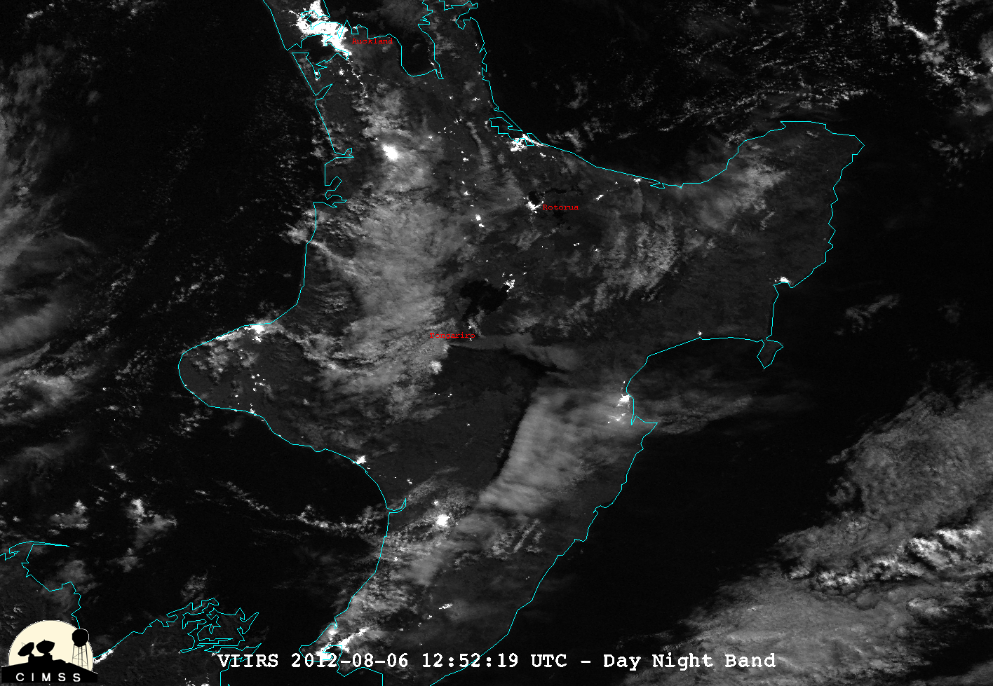
Tongariro (New Zealand) August 6, 2012 – 1252Z
Ash
9
NASA Image of the Day
http://earthobservatory.nasa.gov/NaturalHazards/view.php?id=78791

Slide 10
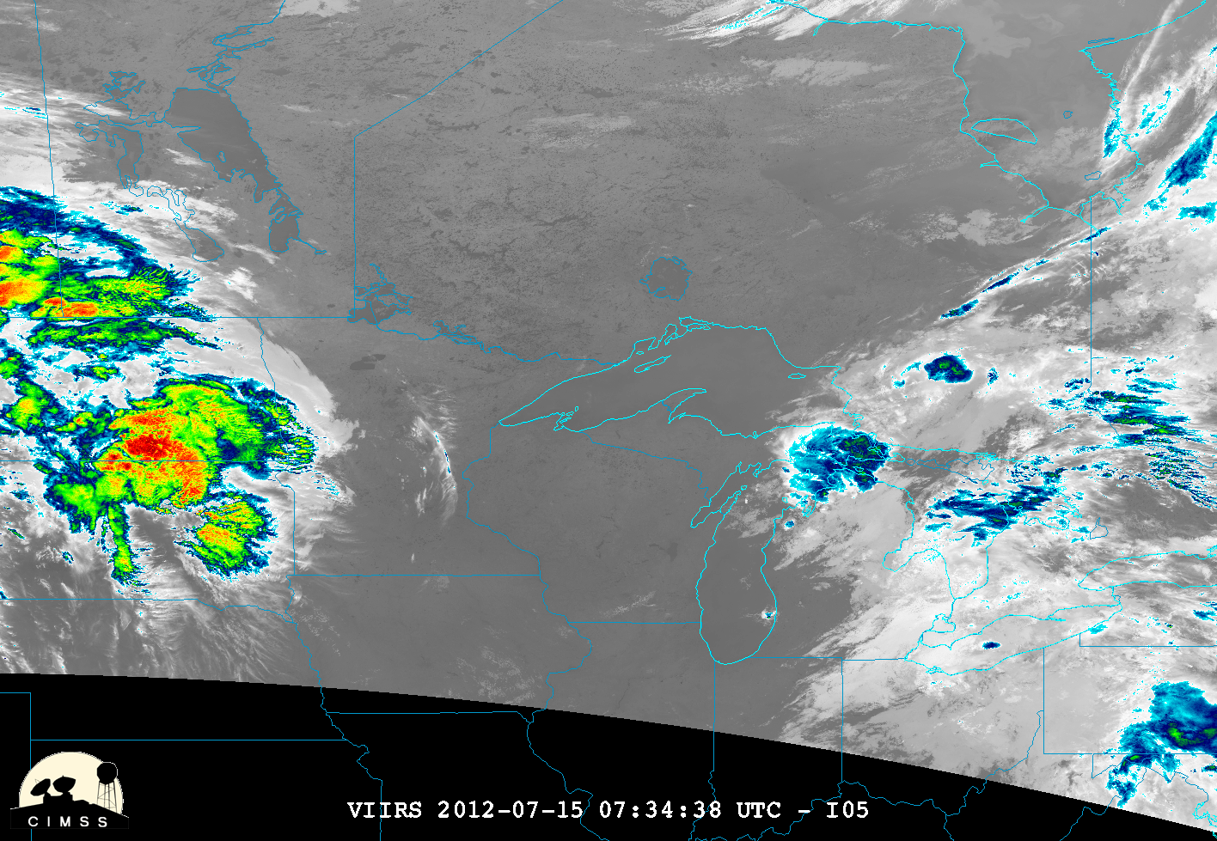
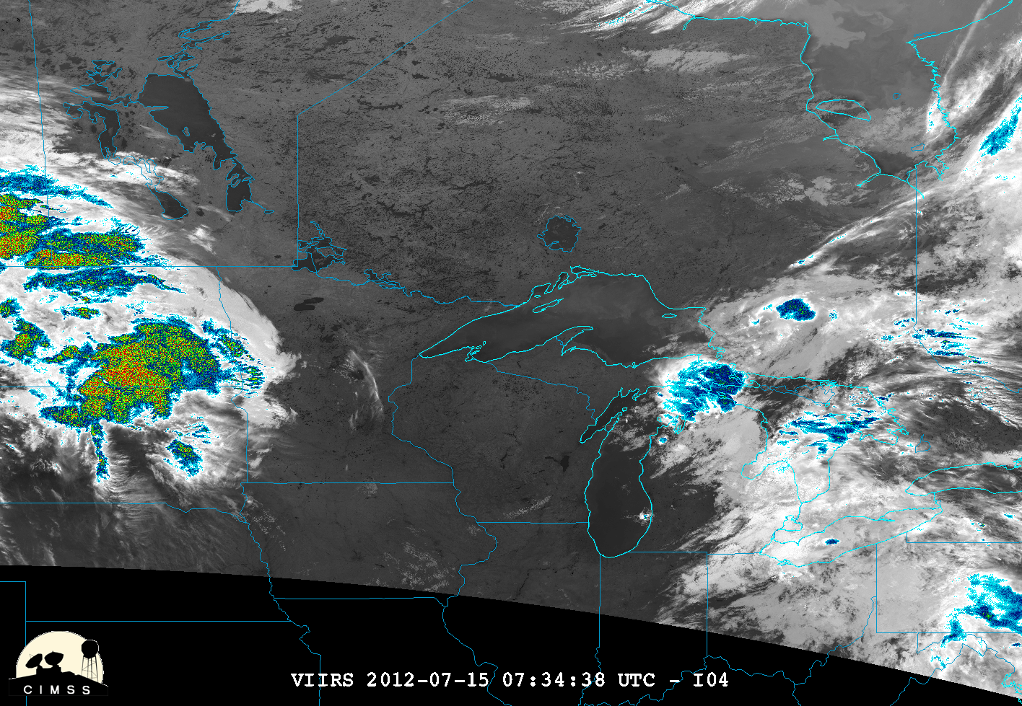
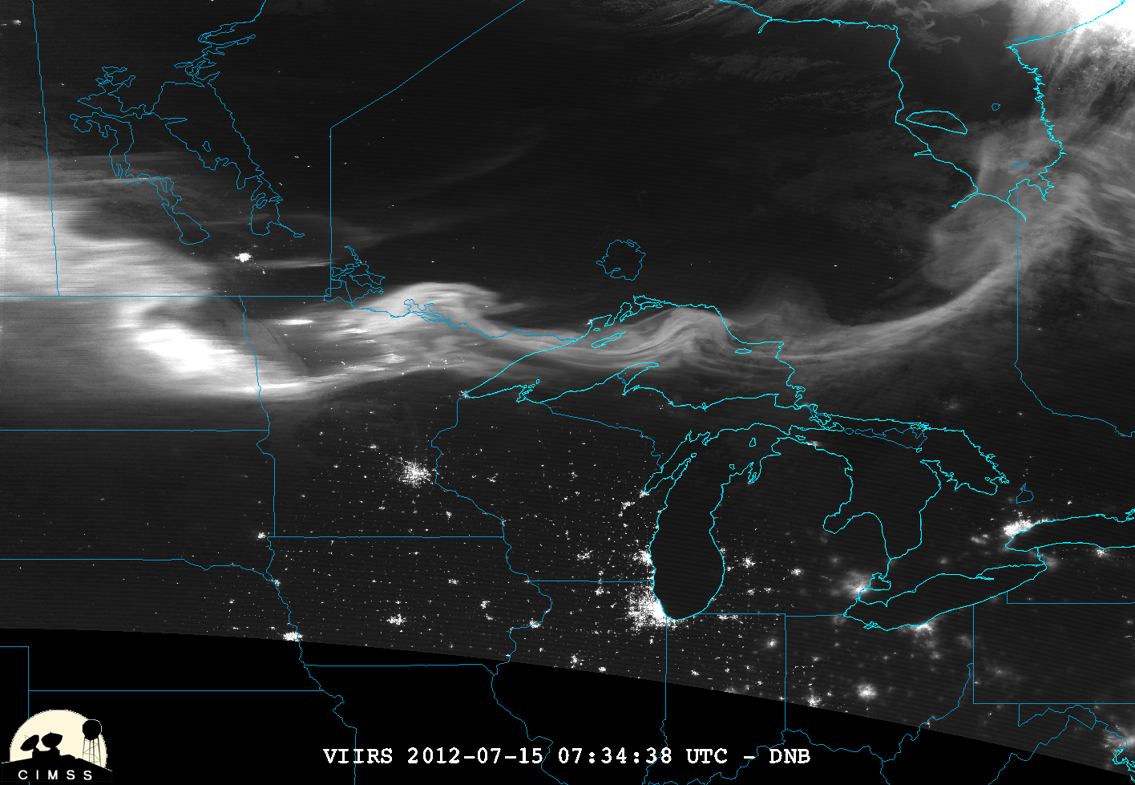
VIIRS (11, 3.9μm and DNB) 0733Z, July 15, 2012
Fires
Winnipeg
Aurora
Chicago
10

Slide 11
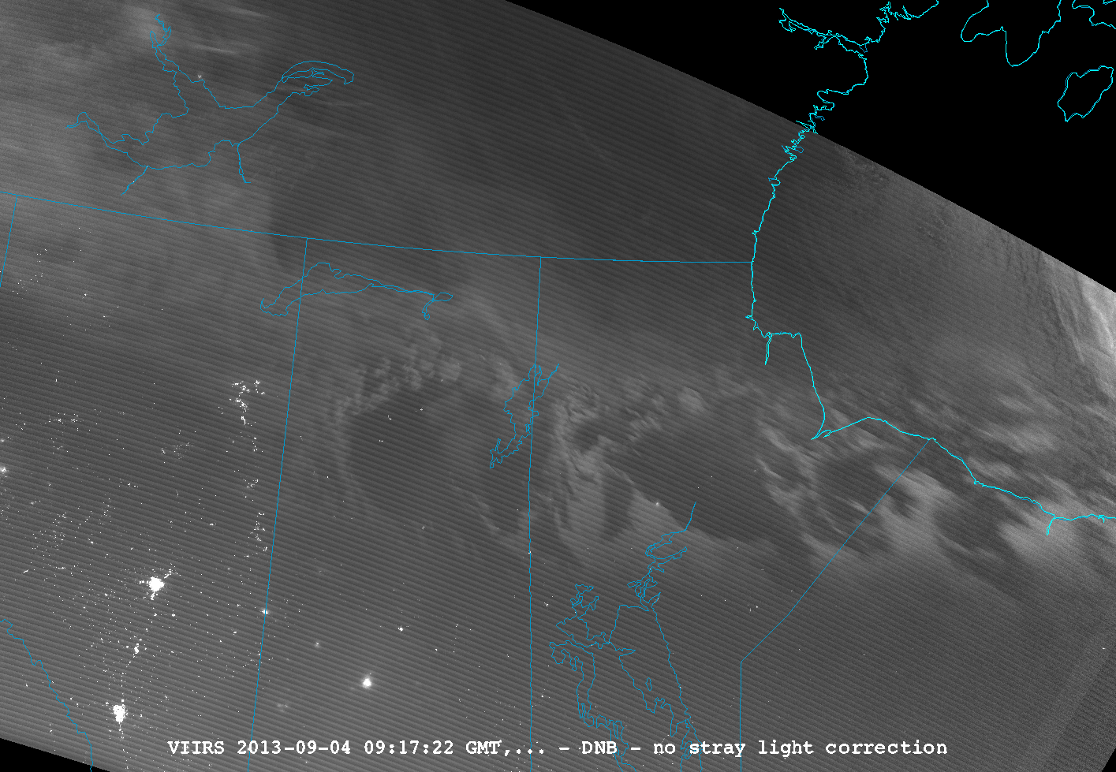
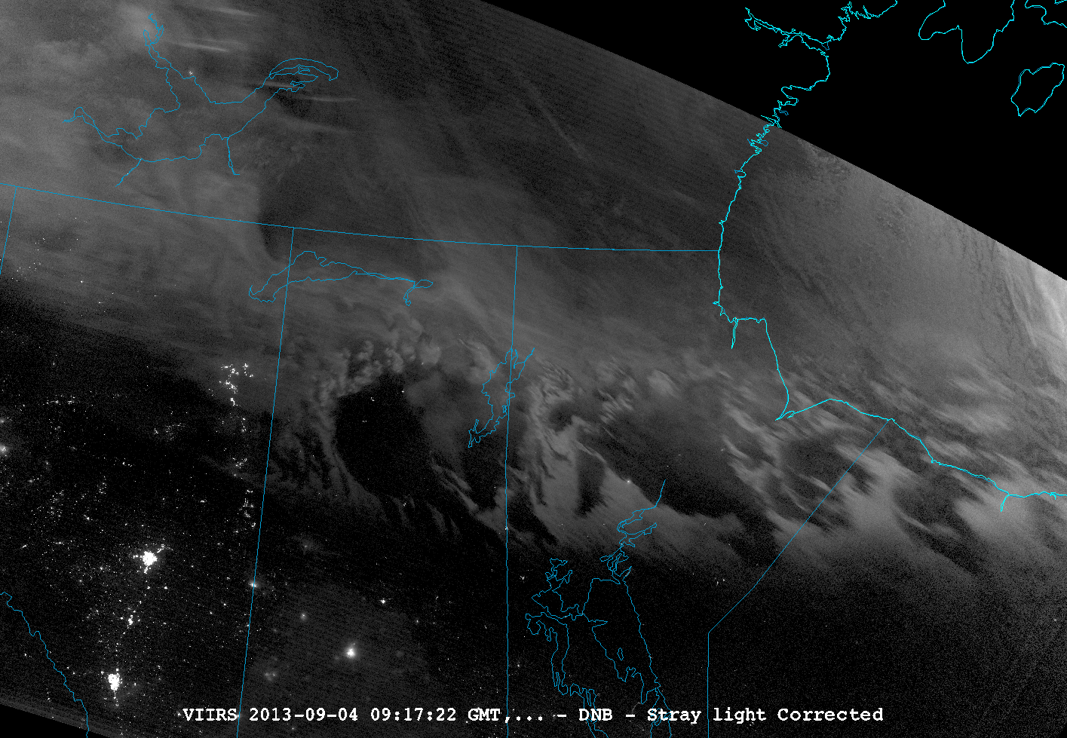
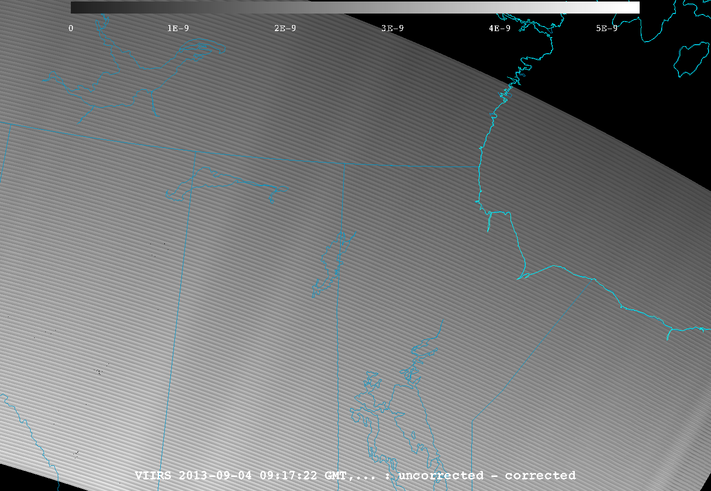
VIIRS Channel Differencing DNB Stray light example
11

Slide 12
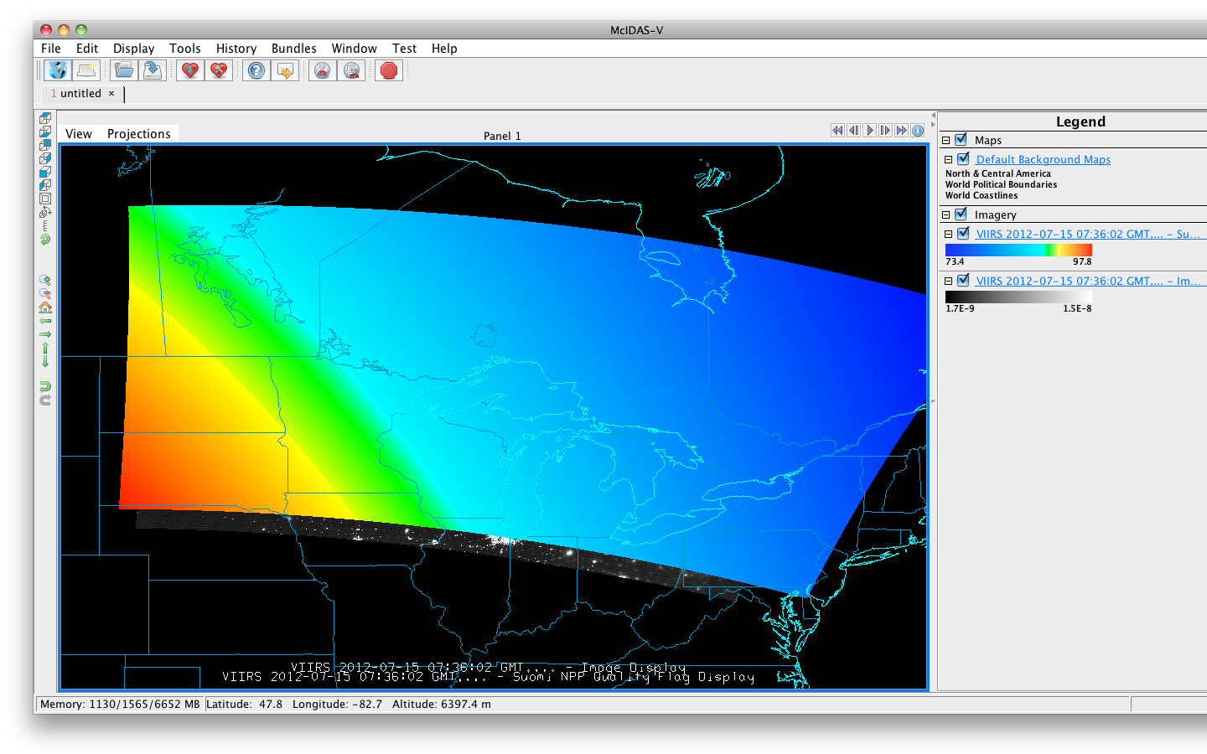
VIIRS SDR Ancillary data
12

Slide 13
Visible Infrared Imaging Radiometer Suite (VIIRS) EDR
There are a series of 20 Environmental Data Records (EDRs) produced from VIIRS
McIDAS-V has been able to successfully ingest all EDRs including NDE Enterprise output
McIDAS-V can unpack and display bit level data.
Ex. Displaying VCM test results
13

Slide 14
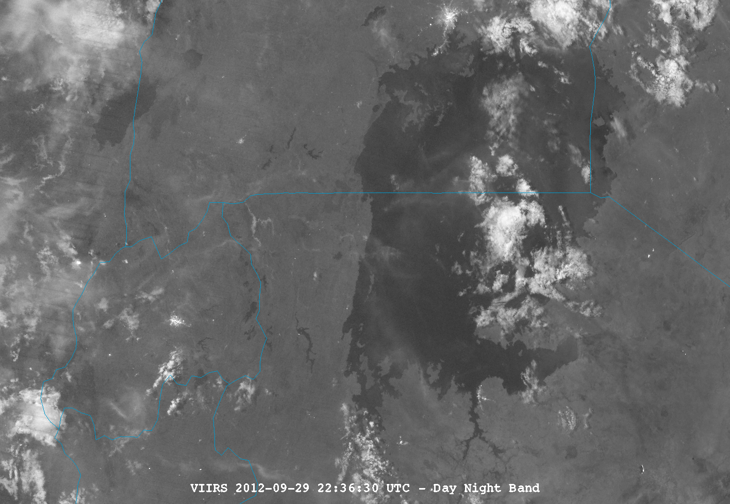
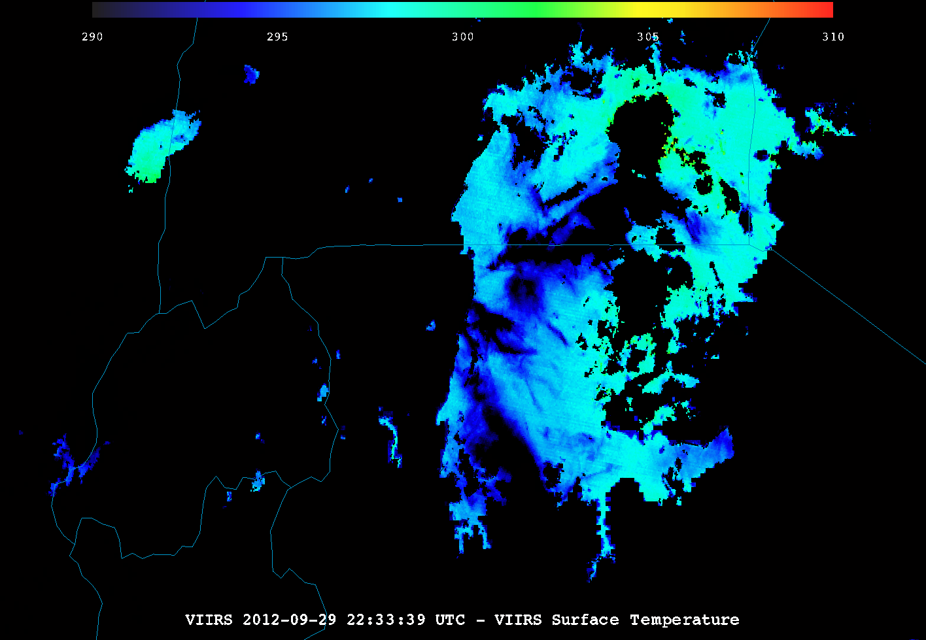
VIIRS DNB and Surface temperature EDR 2236Z, 09/29/2012
Kampala
Lake Albert
Fog
Kigali
Mwanza
Lake Victoria
14

Slide 15
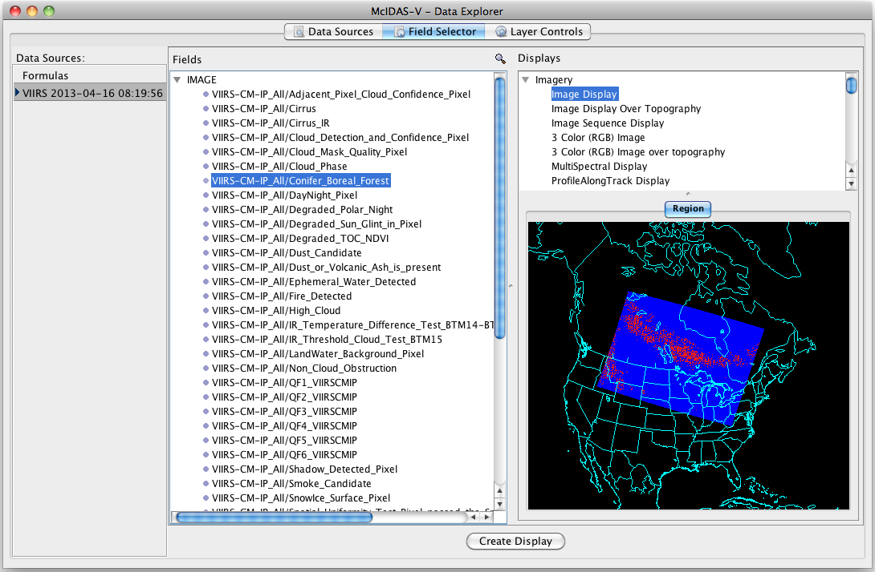
Product EDR Variable selection
Notes:
May want to mention the image is for an expanded and appropriately masked bit-level variable.

Slide 16
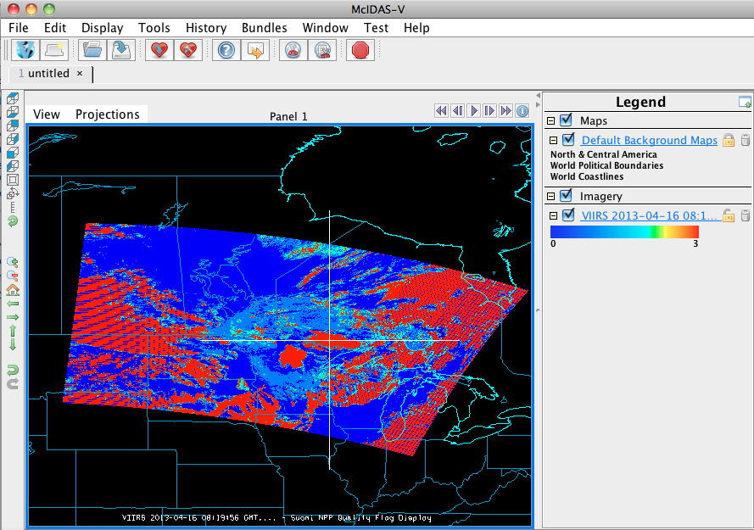
Product EDR Data Probe

Slide 17
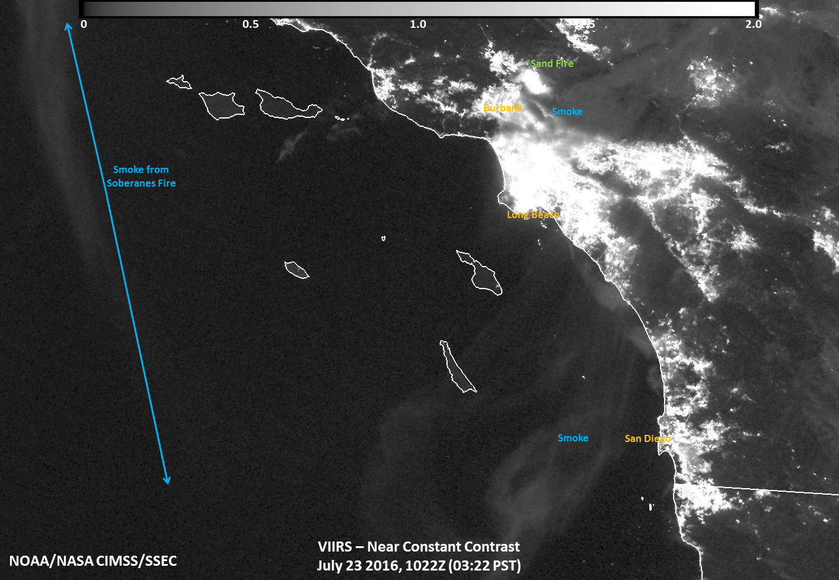
Imagery EDR example

Slide 18
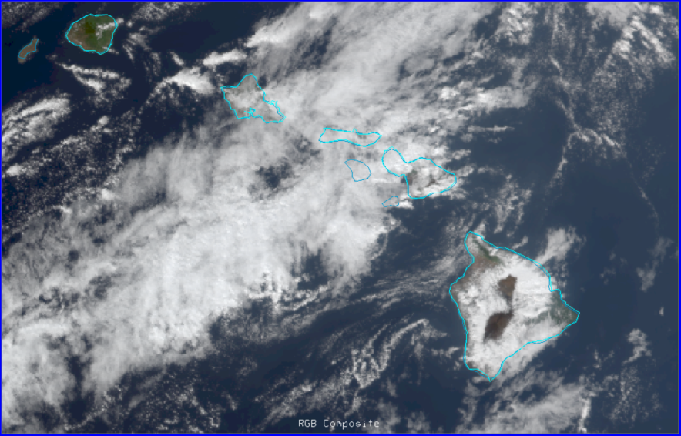
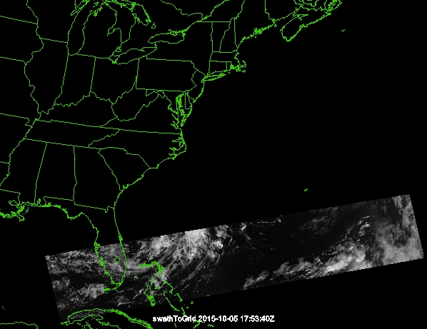
S-NPP/JPSS specific McIDAS-V Status
Expanded granule concatenation for SDRs and EDRs
Support for both NASA and NOAA L1b formats
Needed due to the move of the APEATE to NASA SIPS
Works with Is able to easily load and manipulate Suomi NPP (Block 1 and 2) and JPSS-1 simulated Block 2 data without any special readers
RGB Composite from NASA SIPS L1b
18

Slide 19
Other CIMSS SDR/EDR support

Slide 20
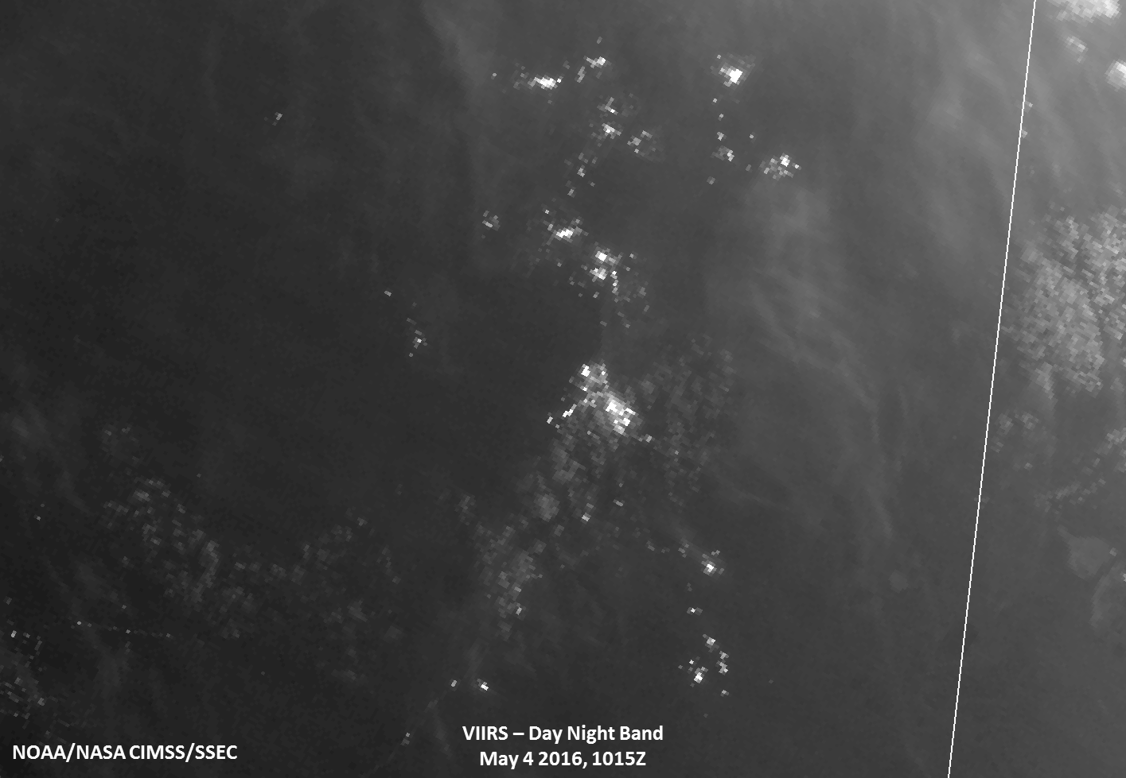
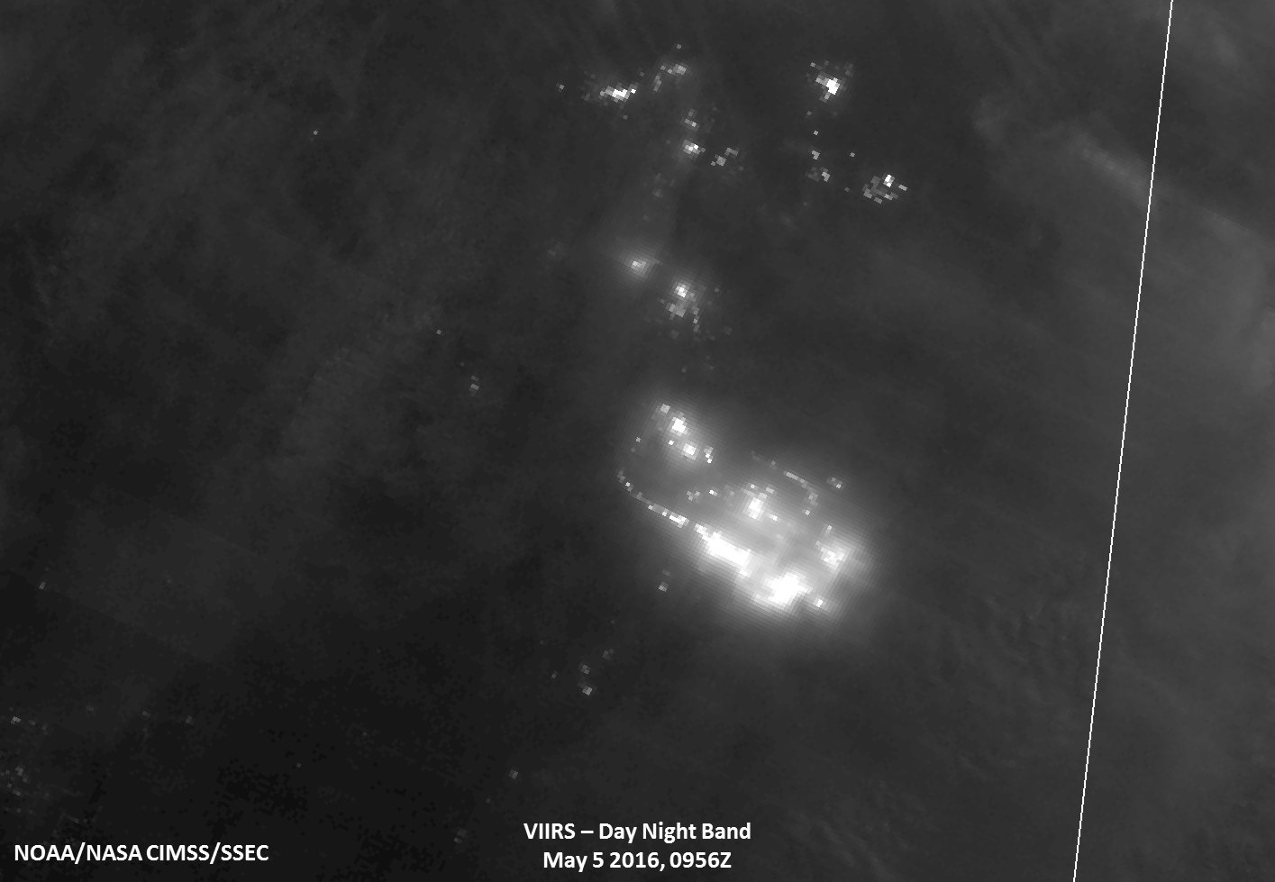
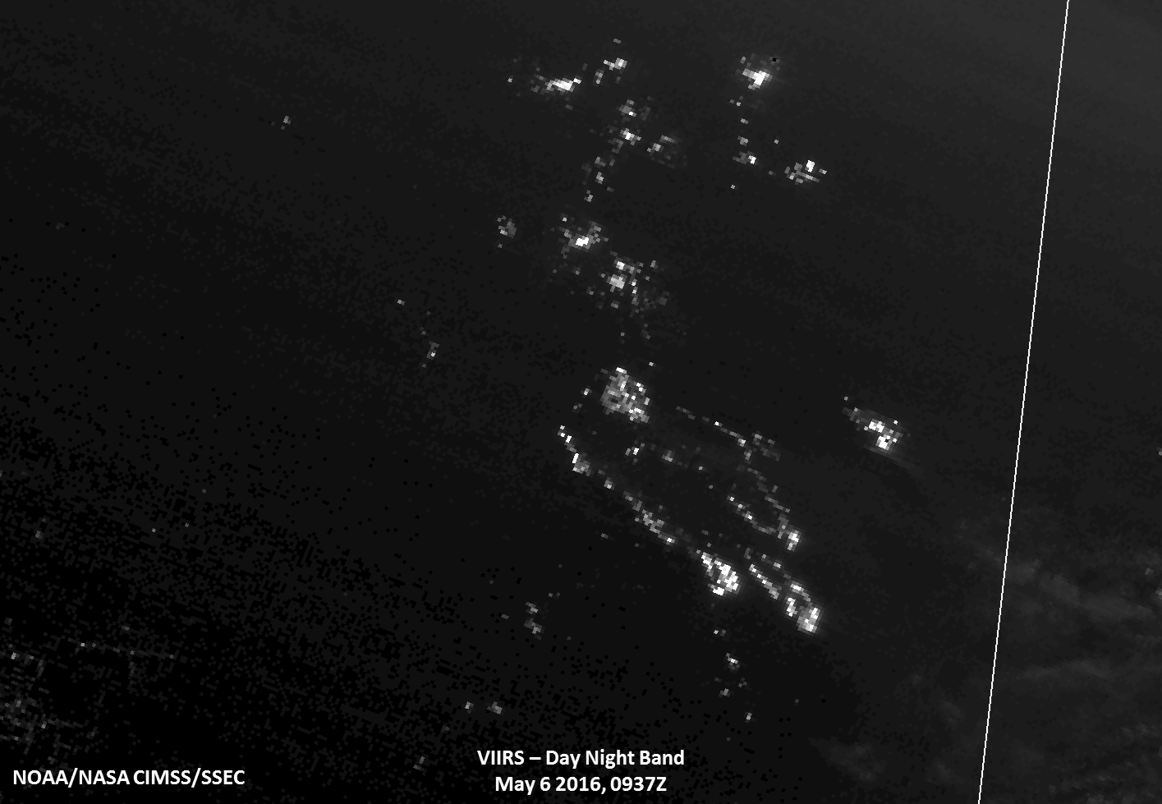
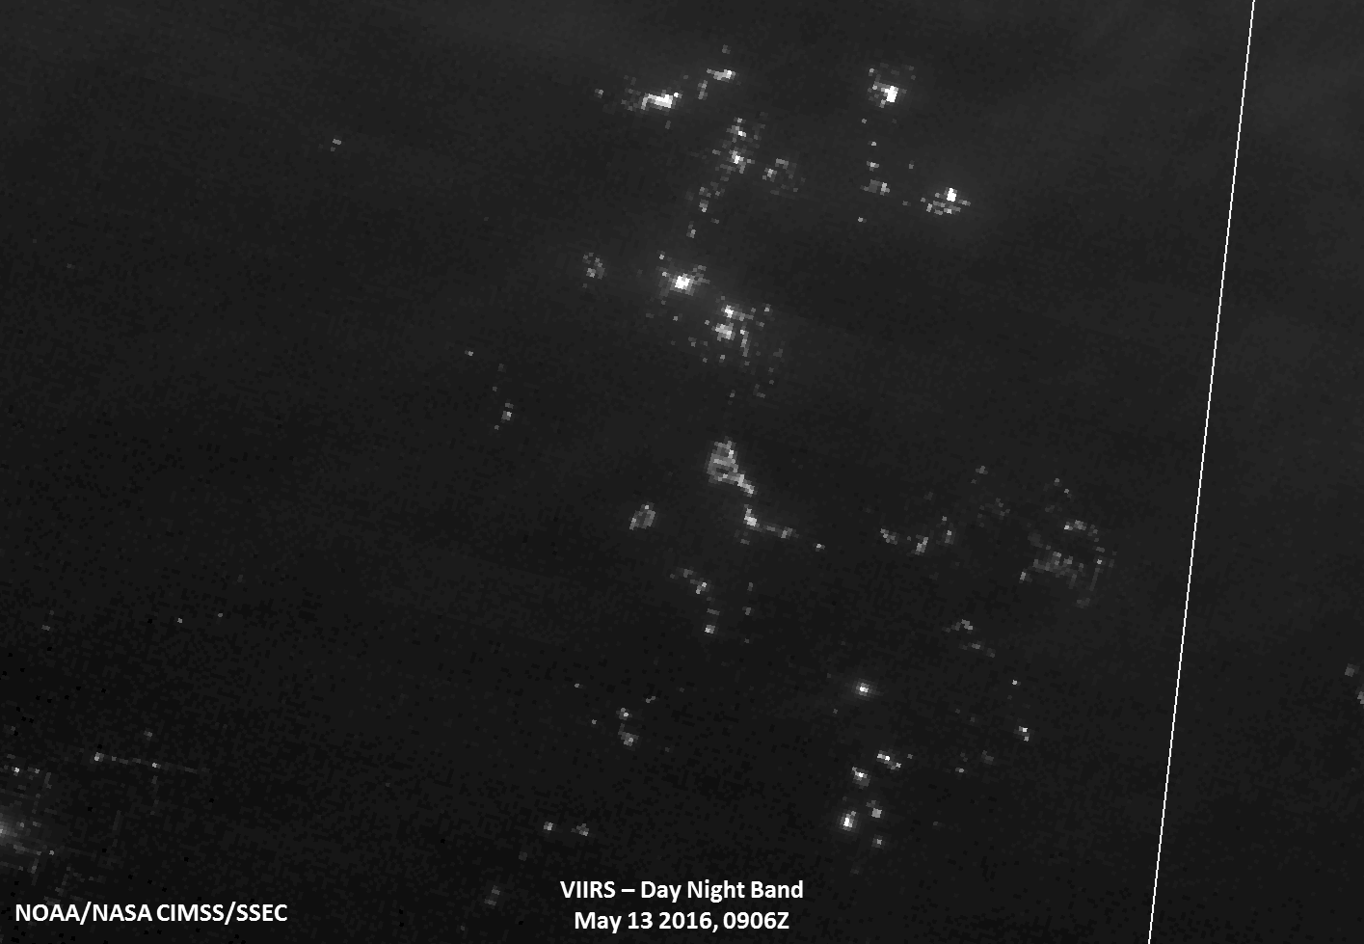
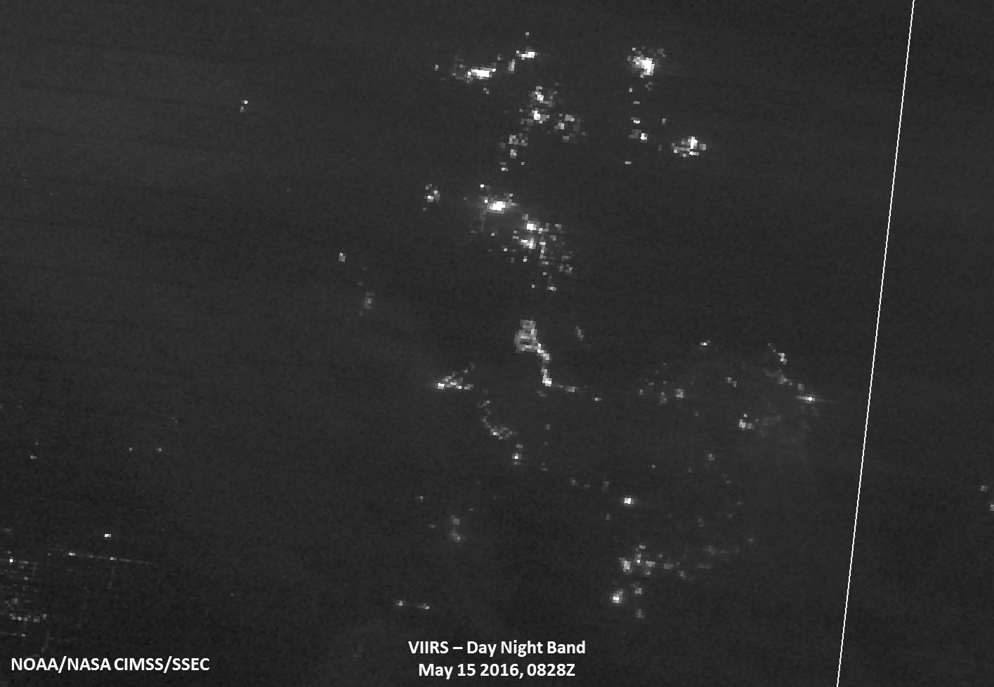
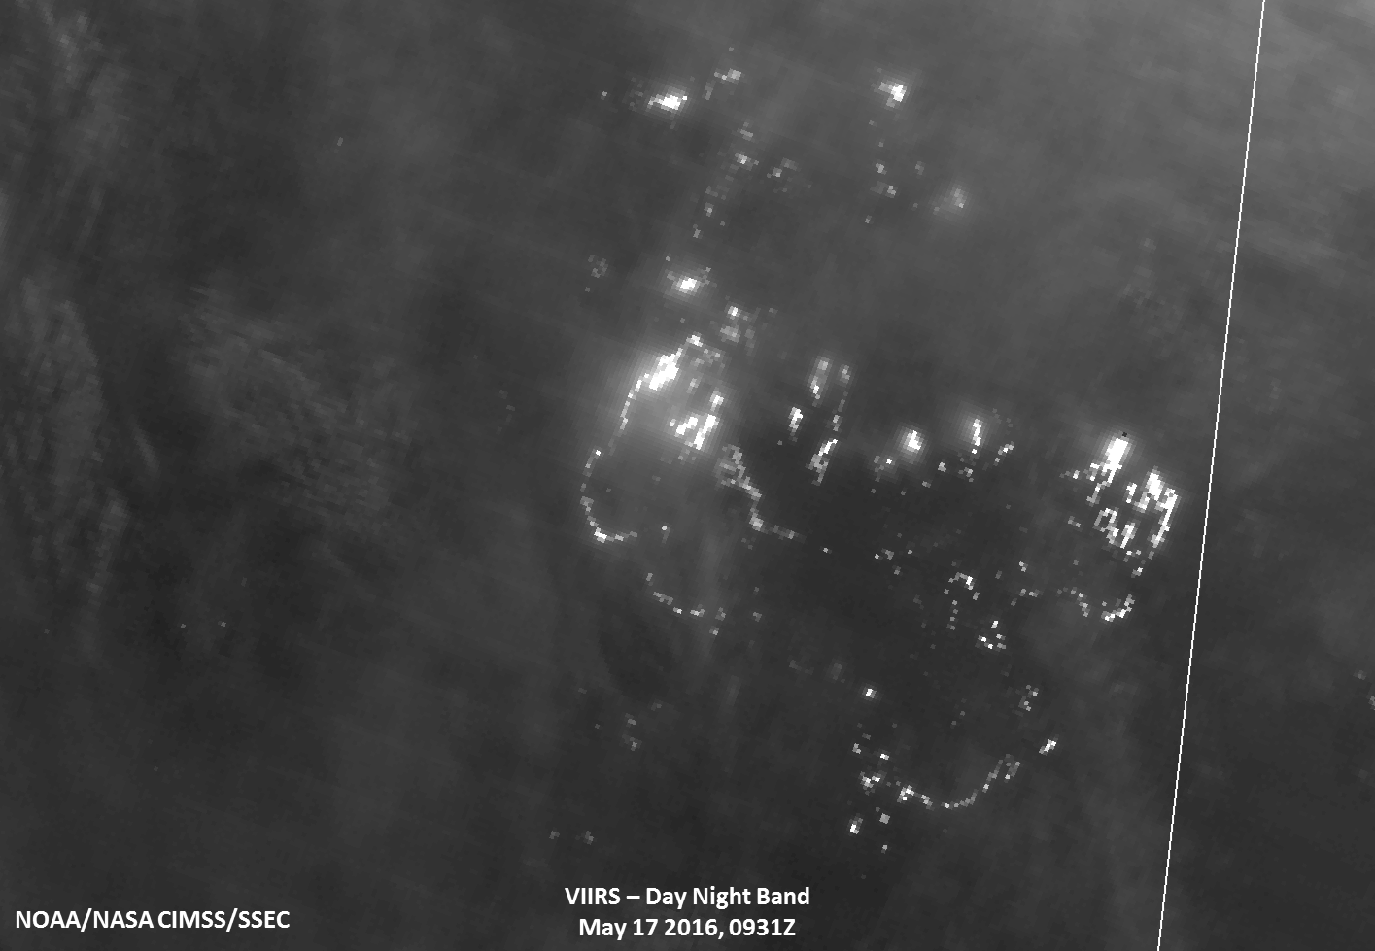
Disaster monitoring
Fires and Smoke support
Oil sands
Oil sands
Fort McMurray

Slide 21
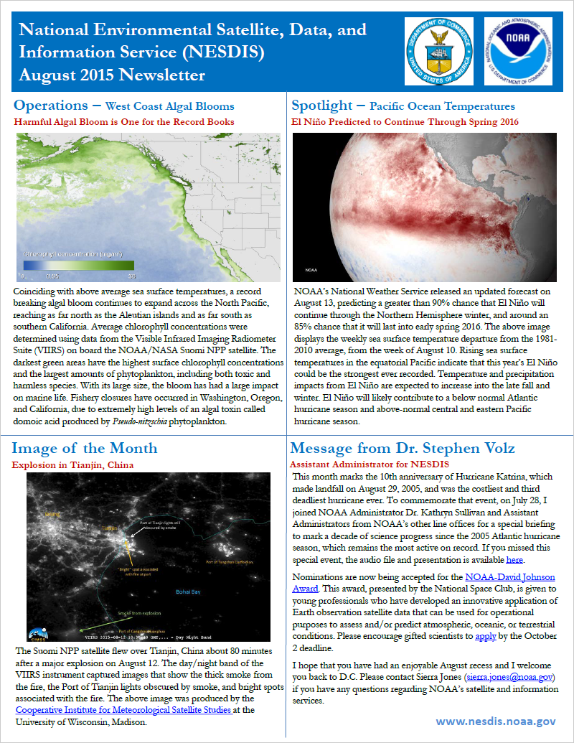
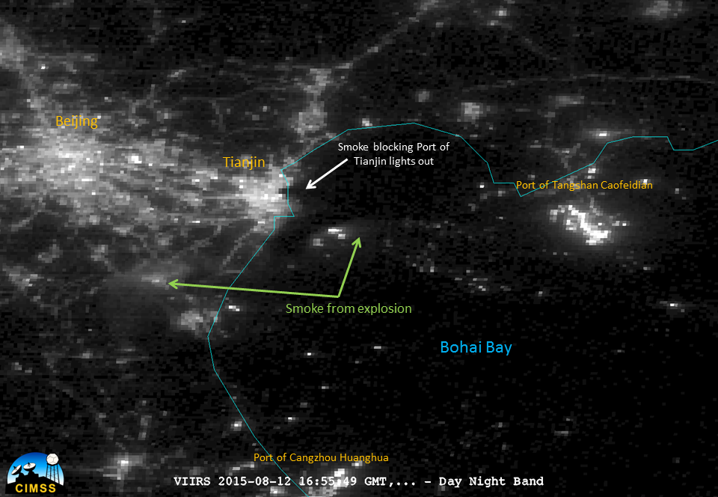
Disaster monitoring Tianjin, China Port explosion

Slide 22
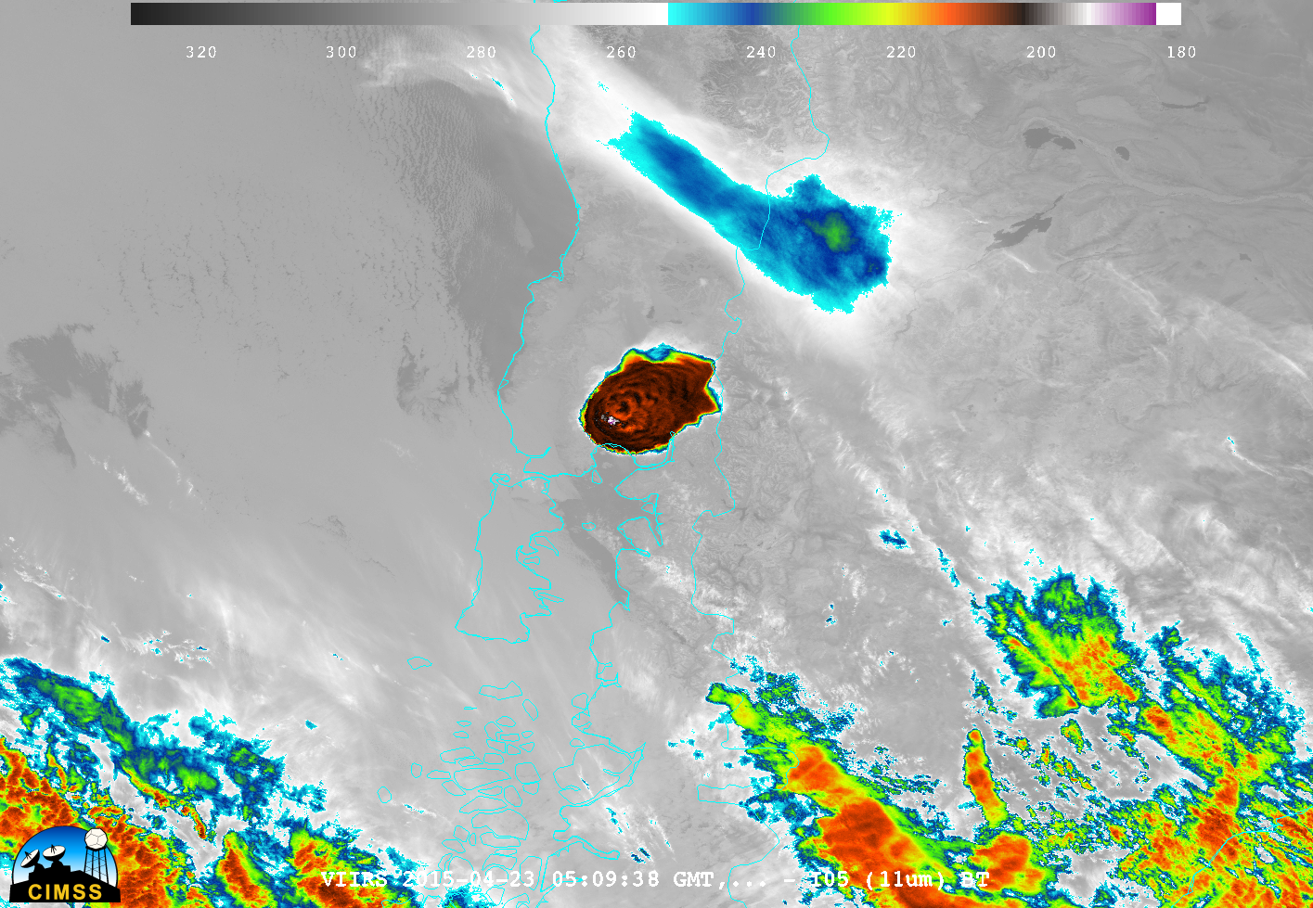
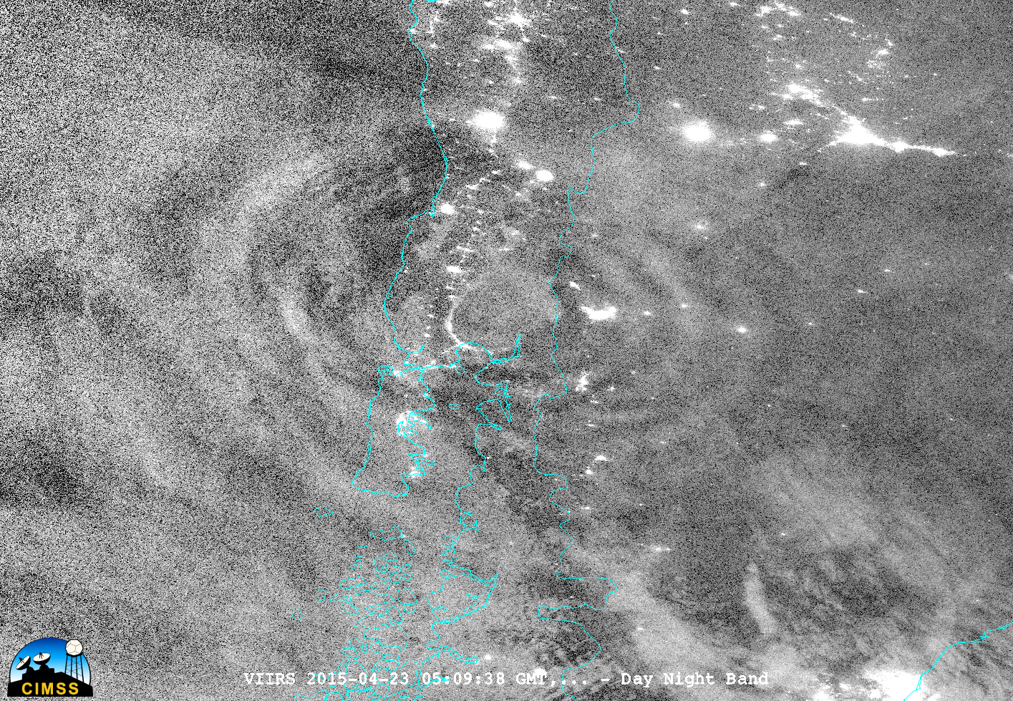
Mesospheric Gravity Wave monitoring

Slide 23
McIDAS-X and -V Support of GOES-R ABI Level 1b and 2 Products

Slide 24
GOES-R Products
Baseline Products
Future Capabilities
Advanced Baseline Imager (ABI)
Aerosol Detection (Including Smoke and Dust) Aerosol Optical Depth (AOD) Clear Sky Masks Cloud and Moisture Imagery Cloud Optical Depth Cloud Particle Size Distribution Cloud Top Height Cloud Top Phase Cloud Top Pressure Cloud Top Temperature Derived Motion Winds Derived Stability Indices Downward Shortwave Radiation: Surface Fire/Hot Spot Characterization Hurricane Intensity Estimation Land Surface Temperature (Skin) Legacy Vertical Moisture Profile Legacy Vertical Temperature Profile #Radiances Rainfall Rate/QPE Reflected Shortwave Radiation: TOA Sea Surface Temperature (Skin) Snow Cover Total Precipitable Water Volcanic Ash: Detection and Height
Advanced Baseline Imager (ABI)
Aerosol Detection (Including Smoke and Dust) Aerosol Optical Depth (AOD) Clear Sky Masks Cloud and Moisture Imagery Cloud Optical Depth Cloud Particle Size Distribution Cloud Top Height Cloud Top Phase Cloud Top Pressure Cloud Top Temperature Derived Motion Winds Derived Stability Indices Downward Shortwave Radiation: Surface Fire/Hot Spot Characterization Hurricane Intensity Estimation Land Surface Temperature (Skin) Legacy Vertical Moisture Profile Legacy Vertical Temperature Profile Radiances (ABI L1B) Rainfall Rate/QPE Reflected Shortwave Radiation: TOA Sea Surface Temperature (Skin) Snow Cover Total Precipitable Water Volcanic Ash: Detection and Height
Geostationary Lightning Mapper (GLM)
#Lightning Detection: Events, Groups & Flashes
Space Environment In-Situ Suite (SEISS)
Energetic Heavy Ions Magnetospheric Electrons & Protons: Low Energy Magnetospheric Electrons: Med & High Energy Magnetospheric Protons: Med & High Energy Solar and Galactic Protons
Magnetometer (MAG)
Geomagnetic Field
Extreme Ultraviolet and X-ray Irradiance Suite (EXIS)
Solar Flux: EUV Solar Flux: X-ray Irradiance
Solar Ultraviolet Imager (SUVI)
Solar EUV Imagery
Geostationary Lightning Mapper (GLM)
Lightning Detection: Events, Groups & Flashes (L2+)
Space Environment In-Situ Suite (SEISS)
Energetic Heavy Ions Magnetospheric Electrons & Protons: Low Energy Magnetospheric Electrons: Med & High Energy Magnetospheric Protons: Med & High Energy Solar and Galactic Protons
Magnetometer (MAG)
Geomagnetic Field
Extreme Ultraviolet and X-ray Irradiance Suite (EXIS)
Solar Flux: EUV Solar Flux: X-ray Irradiance
Solar Ultraviolet Imager (SUVI)
Solar EUV Imagery
Advanced Baseline Imager (ABI)
Absorbed Shortwave Radiation: Surface Aerosol Particle Size Aircraft Icing Threat Cloud Ice Water Path Cloud Layers/Heights Cloud Liquid Water Cloud Type Convective Initiation Currents Currents: Offshore Downward Longwave Radiation: Surface Enhanced “V”/Overshooting Top Detection Flood/Standing Water Ice Cover Low Cloud and Fog Ozone Total Probability of Rainfall Rainfall Potential Sea and Lake Ice: Age Sea and Lake Ice: Concentration Sea and Lake Ice: Motion Snow Depth (Over Plains) SO₂ Detection Surface Albedo Surface Emissivity Tropopause Folding Turbulence Prediction Upward Longwave Radiation: Surface Upward Longwave Radiation: TOA Vegetation Fraction: Green Vegetation Index Visibility
Advanced Baseline Imager (ABI)
Absorbed Shortwave Radiation: Surface Aerosol Particle Size Aircraft Icing Threat Cloud Ice Water Path Cloud Layers/Heights Cloud Liquid Water Cloud Type Convective Initiation Currents Currents: Offshore Downward Longwave Radiation: Surface Enhanced “V”/Overshooting Top Detection Flood/Standing Water Ice Cover Low Cloud and Fog Ozone Total Probability of Rainfall Rainfall Potential Sea and Lake Ice: Age Sea and Lake Ice: Concentration Sea and Lake Ice: Motion Snow Depth (Over Plains) SO₂ Detection Surface Albedo Surface Emissivity Tropopause Folding Turbulence Prediction Upward Longwave Radiation: Surface Upward Longwave Radiation: TOA Vegetation Fraction: Green Vegetation Index Visibility
24
Notes:
Baseline Products implemented operationally, Future/New Capabilities potential new products

Slide 25
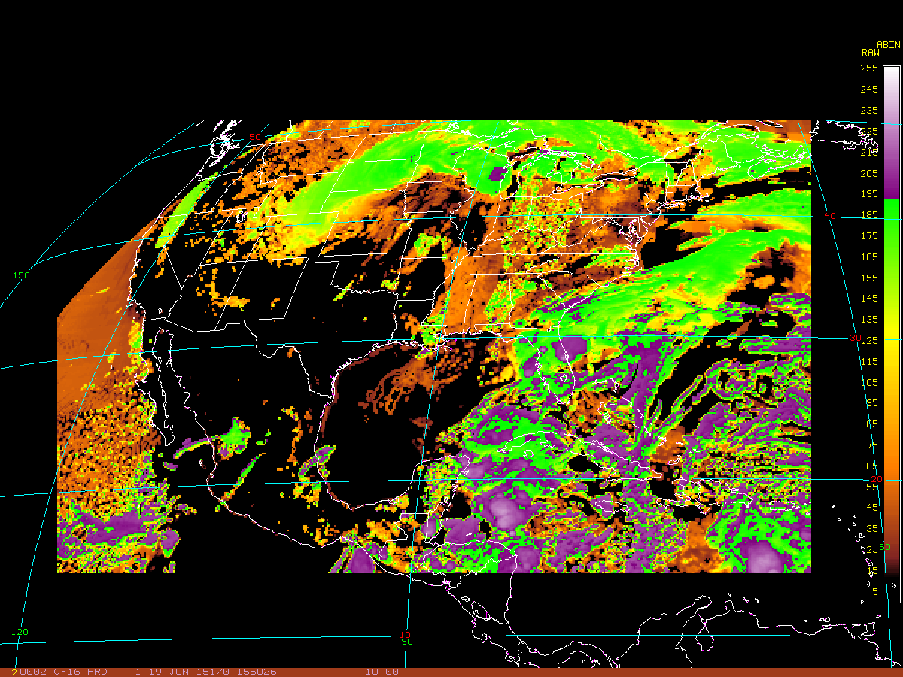
McIDAS-X: Level 2 ABI Products
McIDAS-X ADDE server in development for Level 2 ABI products is available in McIDAS-X 2016.2 (released Oct 2016)
McIDAS-X display of Cloud Top Height

Slide 26
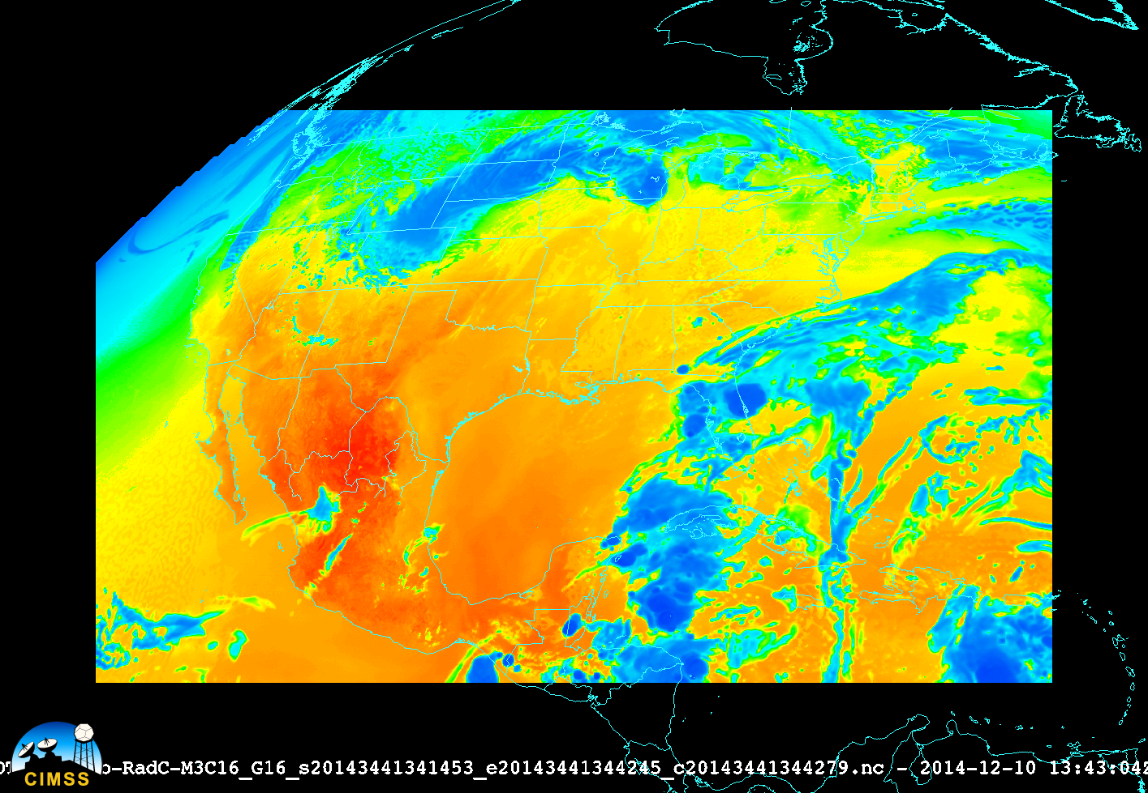
McIDAS-V: ABI Level 1B and L2+
McIDAS-V version 1.6
Both L1b and L2+ products can be read in directly using General file chooser
Local L2+ ADDE file access will be added later
Note : Linux and OSX versions of 1.6 have preliminary (limited) ABI L1b local ADDE server integrated in.
McIDAS-V display Band 16

Slide 27
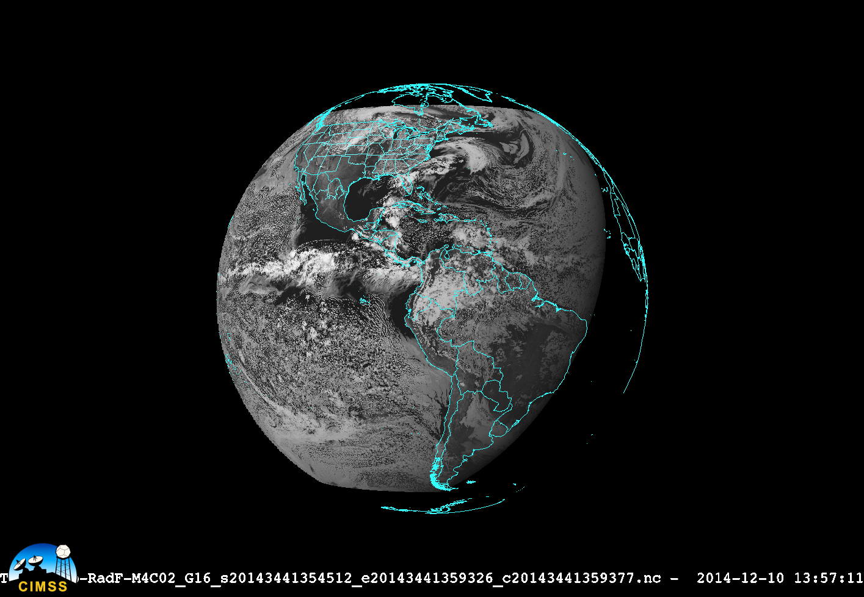
McIDAS-V: ABI Level 1B
McIDAS-V display Band 2

Slide 28
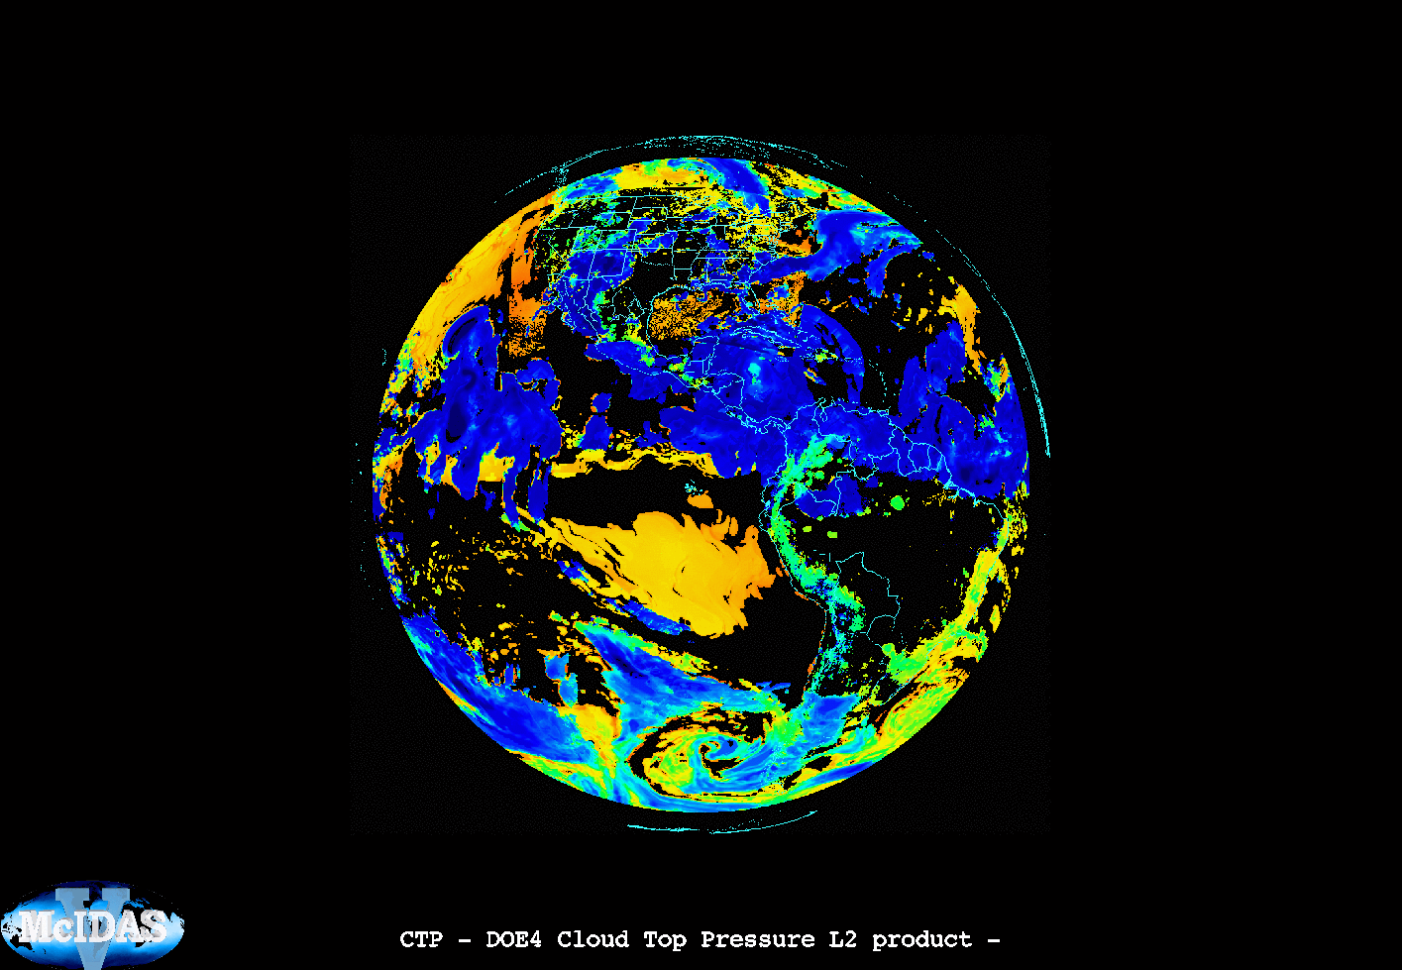
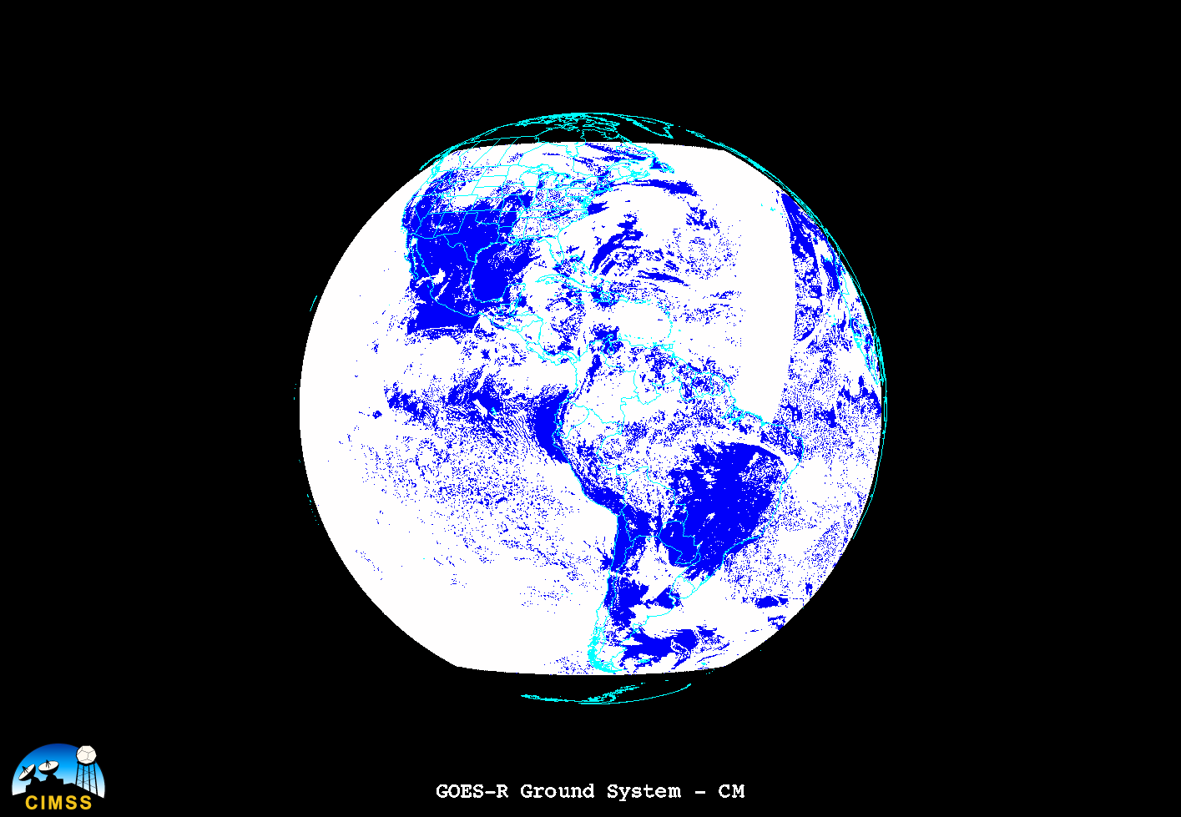
McIDAS-V: Level 2 Products

Slide 29
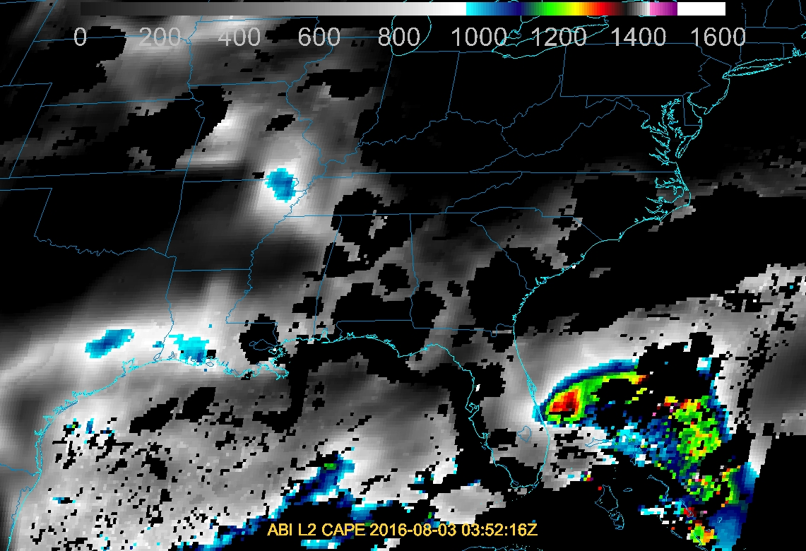
McIDAS-V: DOE-4 Level 2 CAPE

Slide 30
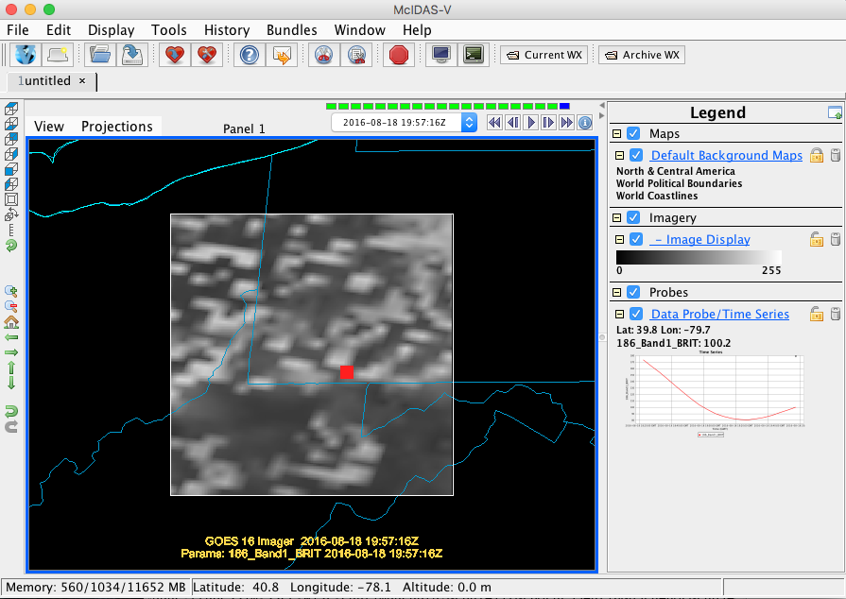
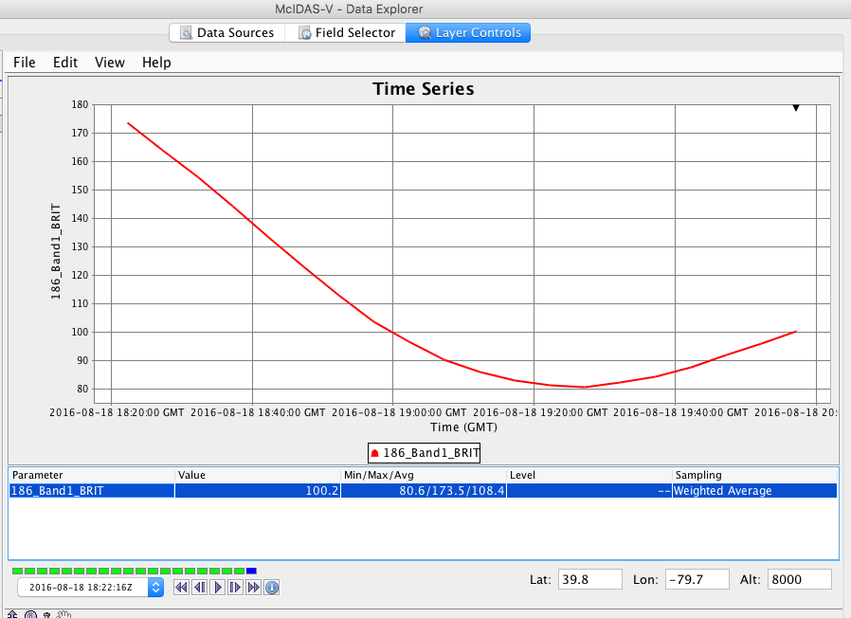
Analysis tools McIDAS-V Time Series

Slide 31
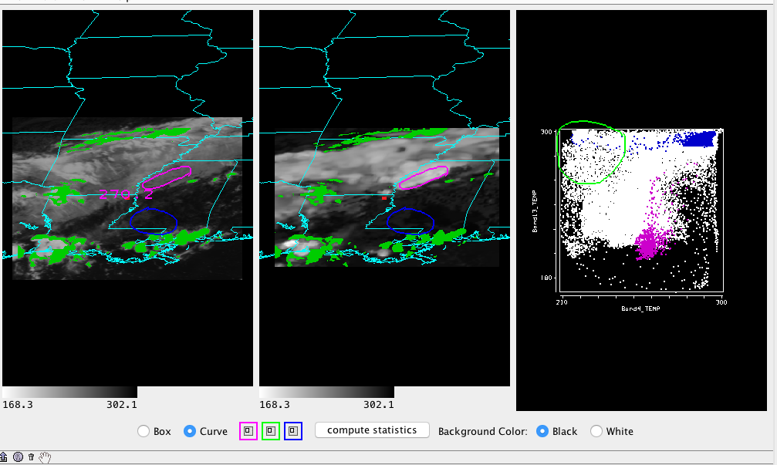
Analysis tools McIDAS-V: Scatter Plot

Slide 32
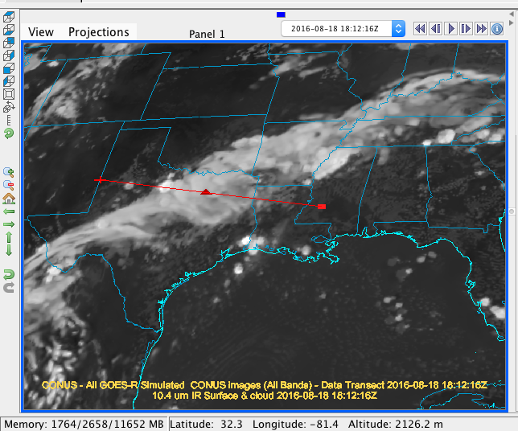
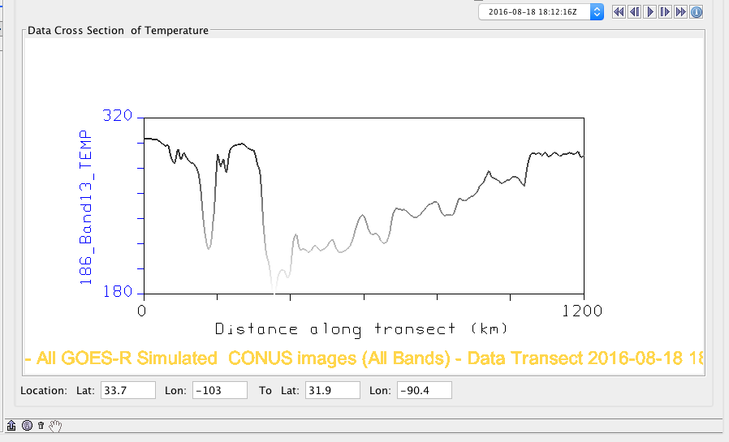
Analysis tools McIDAS-V: Data Transect

Slide 33
McIDAS GOES-R Status
Initial development complete:
ABI Level 1B and limited L2 ADDE server available as part of 2016.2 release (Oct 2016)
All servers are for GOES-R mission standard format netCDF files only. SCMI files are not supported.
In development:
GLM ADDE server (modifications are needed due to format change)
Continued testing by teams (ex. Imagery team) of various servers

Slide 34
Uses of McIDAS for L2+ Products Post Launch
Ability to quickly visualize the L2+ (ABI and GLM) Products (McX and McV) and produce images for presentations
Note: McIDAS-X servers do not currently read in DQFs
McIDAS-V has the ability to provide data analysis tools for teams (transects, simple scatter plots, time series) via ADDE servers

Slide 35
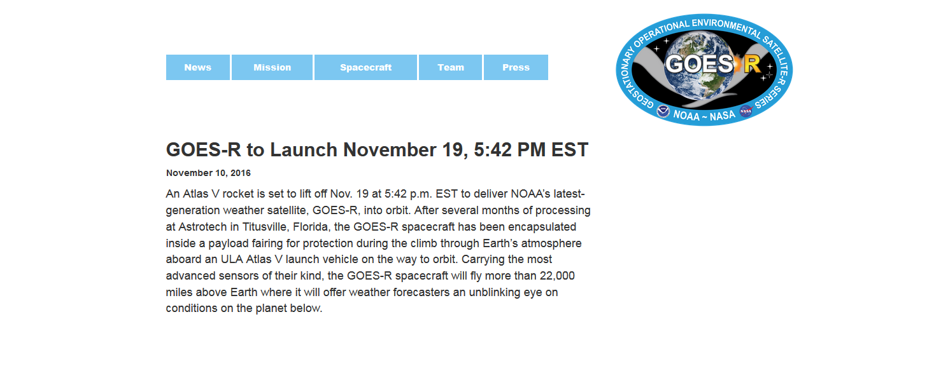
Launch time!
Official L1b and L2+ Products available publically sometime 2017

