Slide 1
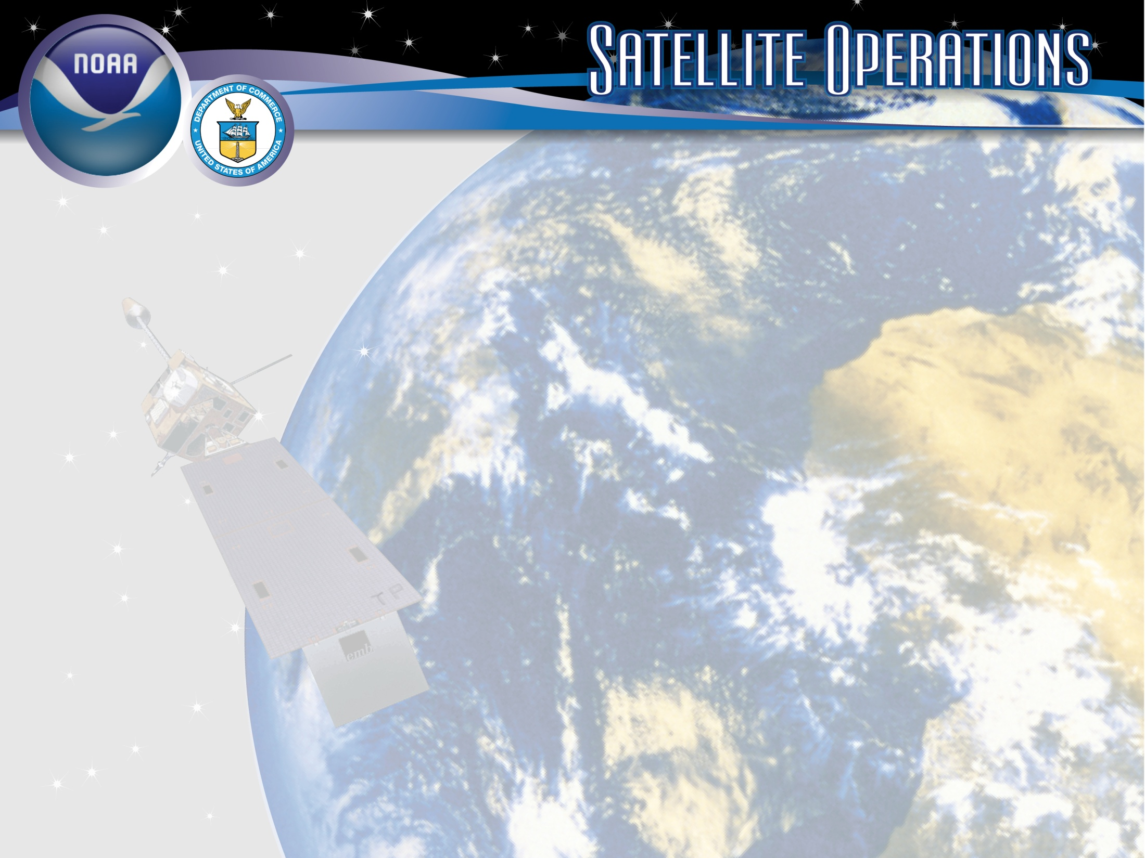
Status of NOAA Satellite Operations & McIDAS at ESPC
Jason Taylor – User Services Coordinator
Bonnie Morgan – IT Specialist
NESDIS/Office of Satellite and Product Operations (OSPO)
2016 McIDAS Users’ Group Meeting
November 16-17, 2016
Madison, WI
Notes:
Images
Satellite Image - GOES-13/14/15 (GOES-N/O/P)
Derived and Interpretive Products Image - Infrared Imagery with overlay of Heavy Precipitation (Rain & Snow) Interpretive Analysis from SAB (Satellite Analysis Branch)
Antennas at OSPO Wallops CDA (Command and Data Acquisition Station), symbolic of Direct Broadcast Services.
Title Slide Background and Banner were designed by TeddyPavlis@gmail.com

Slide 2
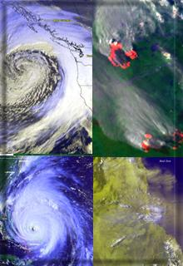
Presentation Outline
Overview of the Office of Satellite and Product Operations (OSPO)
Status of Satellite Operations
Status of McIDAS at ESPC
Updates on Data Access and Distribution
Q&A

Slide 3
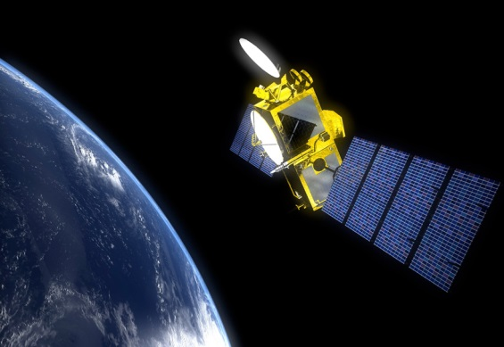
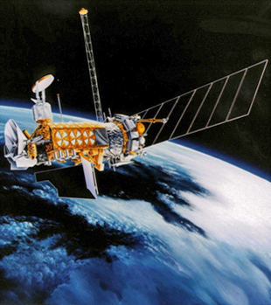
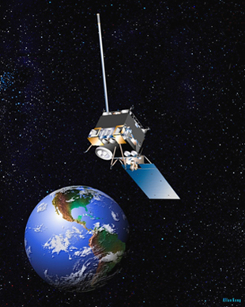
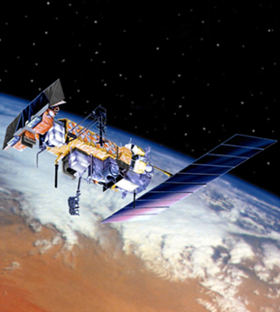
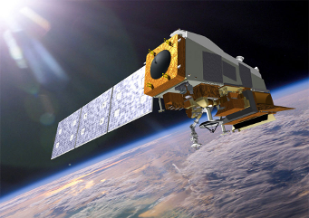
NESDIS Office of Satellite and Product Operations (OSPO)
Operates the Nation’s 16 environmental satellites:
  3 Geostationary (GOES) by NOAA
  3 Polar-Orbiting (POES) by NOAA
  6 Defense Meteorological Satellite program (DMSP) operated by NOAA
  2 OSTM Jason-2 & Jason-3 (Ocean Surface Topography Mission) - Joint NOAA, NASA, CNES, EUMETSAT effort
  1 Suomi National Polar-orbiting Partnership (NPP) by NOAA & NASA
  1 DSCOVR (Deep Space Climate Observatory) by NOAA
  *GOES-R scheduled to launch this Saturday, November 19, 2016.
  *JPSS-1 will launch no earlier than mid-March 2017.
Notes:
The NESDIS Office of Satellite and Product Operations (OSPO) currently commands and controls nations 16 environmental satellites (listed are various types).

Slide 4

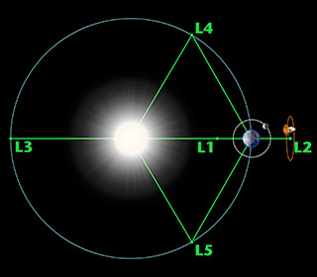
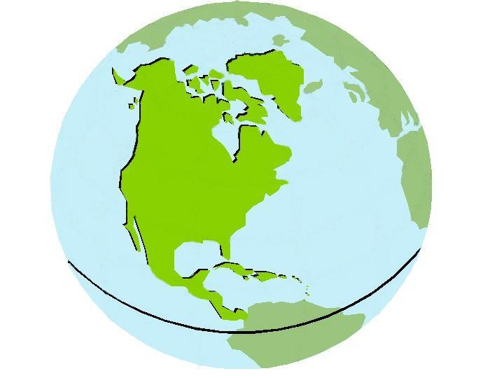



Three Observation Vantage Points
Polar-orbiting Operational
Environmental Satellites
Geostationary Operational
Environmental Satellites
Deep Space
at Lagrange 1 Point
22,300 Miles
540 Miles
Each satellite covers the Earth
twice per day
  Pole-to-pole orbit is 101 minutes and views each location at the same time of day; capability for ½ orbit dumps with JPSS-1
  Global coverage every 12 hours with one satellite
  EUMETSAT - mid-morning orbit
  NOAA - early afternoon orbit
Continuous monitoring
of the Americas
  Coverage over the same geographic location
  Constant monitoring for nowcast purposes and for forecast applications (NWP, etc.)
Continuous monitoring
of the Sun
  Uninterrupted view of the sun
  Information is used for solar winds monitoring for Space Weather warnings
Notes:
The satellites provide three observational vantage points for coverage of Earth.
Polar-orbiting satellites orbit the globe twice per day (pole to pole) for morning and afternoon coverage.
Geostationary satellites provide coverage over the same geographic location for constant nowcast monitoring.
Deep Space satellite (DSCOVR) provides an uninterrupted view of the sun.

Slide 5

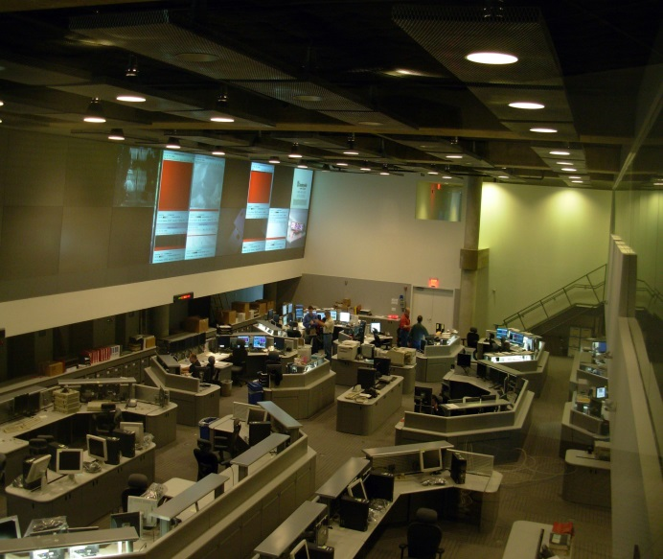
OSPO’s Key Roles
Ground System Command & Control, Ingest, Generation, and Distribution
Pre-Launch and Post-Launch Testing
Operational Testing, Validation, and Verification
User Readiness for Broadcast Services and Product Delivery
Long-Term Continuity of Products and Services
Notes:
OSPO manages and directs the operation of the central ground facilities which ingest, process, and distribute environmental satellite data and derived products to domestic and foreign users.
Responsible for:
Ground System Command and Control,
Pre-Launch and Post-Launch Testing,
Operational Testing, Validation, and Verification
User Readiness for Broadcast Services and Product Delivery
Long-Term Continuity of Products and Services

Slide 6

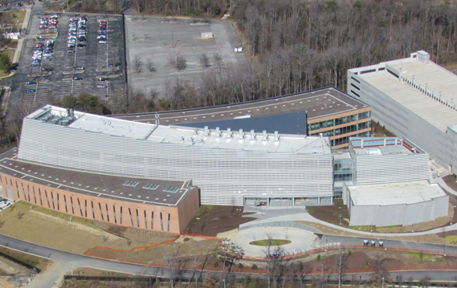
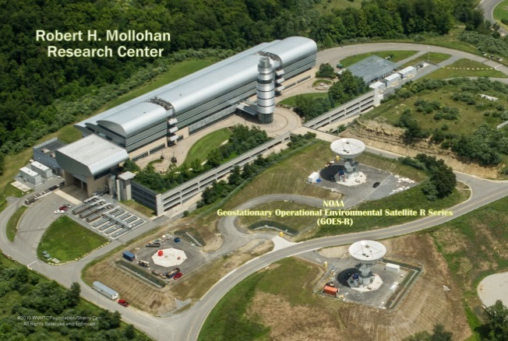
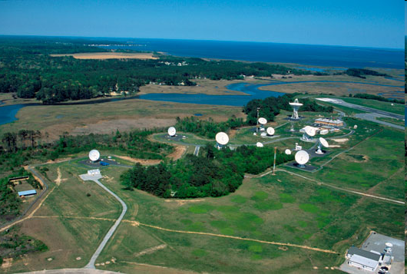
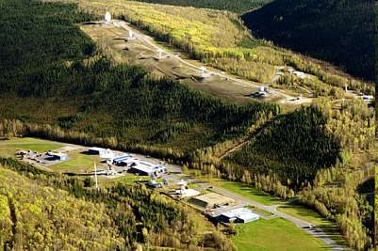
OSPO Operational Facilities
Over 500 staff supporting or operating the satellites, receptors, and processing systems
Suitland, MD
College Park, MD
Fairmont, WV*
Wallops, VA
Fairbanks, AK
* GOES-R and JPSS (New) Backup Facility
Notes:
OSPO has locations at four major facilities housing over 500 people.
NOAA Satellite Operations Facility (NSOF) in Suitland, Maryland
Mission Operations Division (MOD)
NOAA Center for Weather & Climate Prediction (NCWCP) in College Park, Maryland.
Satellite Product and Services Division (SPSD)
OSPO has Command and Data Acquisition Stations in Fairbanks, Alaska and Wallops, Virginia.

Slide 7
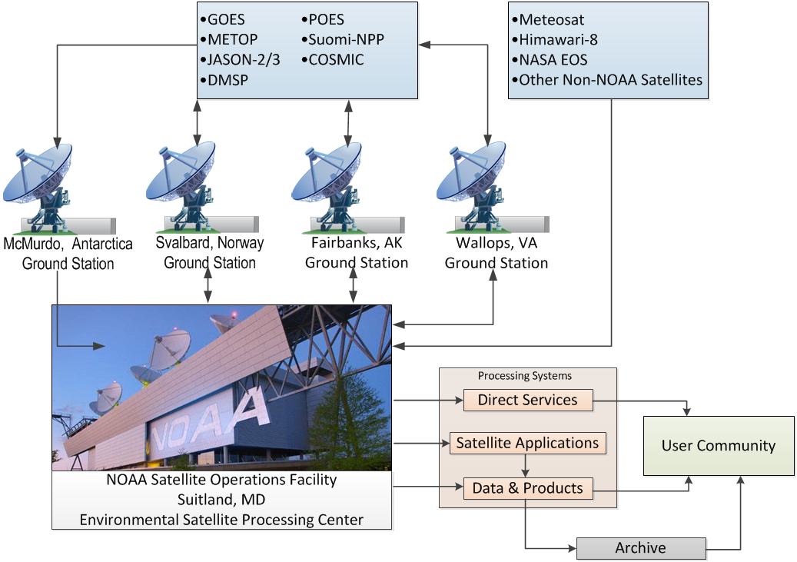
Nominal Satellite Data Flow
Notes:
Here’s a depiction of the nominal satellite data flow as data from the satellites is ingested and processed by ESPC.
Processing systems provide the data to the user community and archive (NCEI).

Slide 8
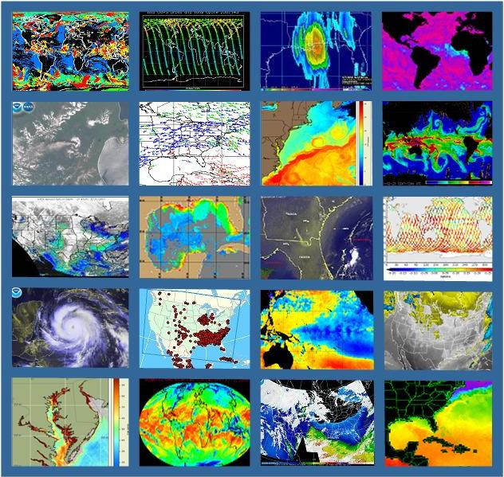
OSPO’s Satellite Products and Services Division
Provides 24x7 interpretive analyses of satellite data
  Atmospheric temp/moisture
  Hurricane intensity & position
  Volcanic Ash
  Fire and Smoke
  Oil Spills
  Significant Precipitation (20x7)
Manages automated environmental products
Collaborates with partners to support transition of research products into operations
Notes:
OSPO’s Satellite Products and Services Division leads production, adaptive maintenance, and monitoring activities for a variety of derived and interpretive environmental products.
Satellite Analysis Branch (SAB) provides operational 24X7 interpretive analyses of satellite data.
Satellite Products Branch (SPB) collaborates with STAR - Satellite Products and Services Review Board (SPSRB) to effectively manage the product life cycle process from product development, transition into operations, enhancements, and retirement.

Slide 9
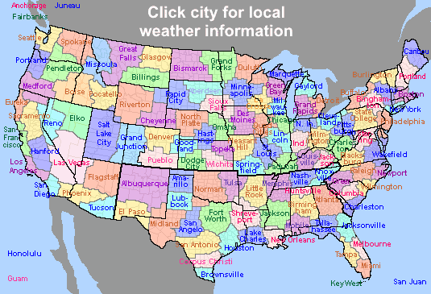
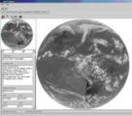
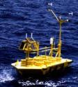


Direct Service Operations
Emergency Managers Weather Information Network (EMWIN):
NOAA satellites relay critical information to users across the country.
  http://www.weather.gov/emwin/index.htm
Low Resolution Image Transmission (LRIT):
NOAA satellites are used to relay satellite and weather products to users in remote
locations, that do not have landlines or internet connections.
  http://www.noaasis.noaa.gov/LRIT/
Data Collection:
NOAA satellites are used to collect and relay scientific data from around the globe.
  http://www.noaasis.noaa.gov/DCS/ http://www.noaasis.noaa.gov/ARGOS/
Search and Rescue Satellite Aid Tracking (SARSAT):
NOAA satellites are used to relay distress alerts from aviators, mariners and
land-based users (http://www.sarsat.noaa.gov/
Geonetcast Americas:
Data from NOAA for diverse societal benefits - agriculture, energy, health, climate,
weather, disaster mitigation, biodiversity, water resources, and ecosystems.
  http://www.geonetcastamericas.noaa.gov/index.html
Notes:
OSPO partners with NWS to provide data and products through the Emergency Managers’ Weather Information Network (EMWIN).
OSPO also manages GOES Data Collection Services (*more than 21,000 active Argos platforms collecting data for over 1,900 distinct projects in 100+ countries).
Though the assistance of OPSO’s Search and Rescue Satellite Aid Tracking (SARSAT) program – (*250 individuals were rescued in calendar year of 2015 alone).
Since 1982, there have been a total of 7,740 SARSAT saves in the US, and more than 39,000 worldwide (as of December 31st, 2015)

Slide 10
GEO Status

Slide 11
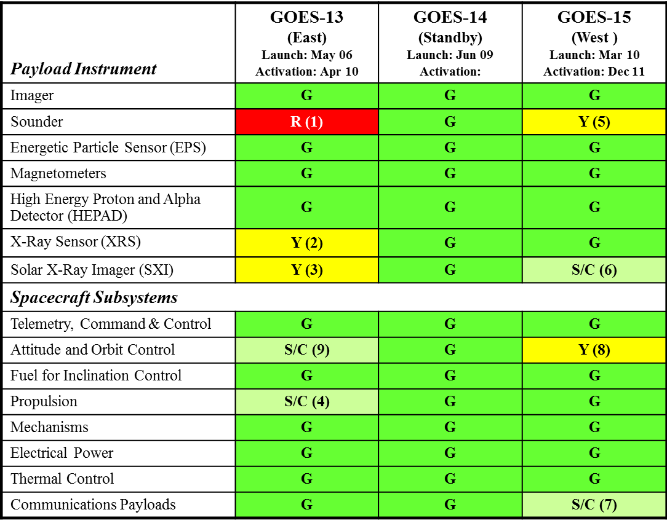

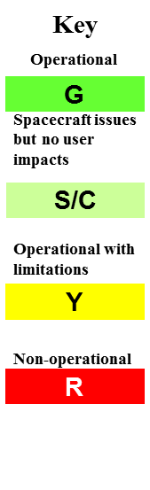
GOES Status (November 2016) http://www.oso.noaa.gov/goesstatus
Notes:
1
Here’s the most recent version of the famous stoplight chart showing the status of instruments and subsystems for the GOES satellites. There are a few issues that I want to highlight.
GOES-13 remains as GOES-East and GOES-13 Imager is fully functional.
However, On November 20, 2015, the GOES-13 rotating sounder filter wheel stalled resulting in a complete loss of IR sounder data.
The loss of GOES-13 Sounder data resulted in mitigation with GOES-15 Sounder data and other observations.
OSPO/SPSD aided in the mitigation efforts on December 29, 2015 by replacing GOES-East Sounder ASOS SCP products with GOES-East Imager ASOS SCP products.
For GEOS-13 (East), a Star Tracker 3 (ST3) anomaly occurred on August 30, 2016 and engineers determined ST3 to be non-recoverable. Therefore, the backup Star Tracker 2 (ST2) was powered on to return to two star tracker attitude control configuration (ST1-ST2) on September 26, 2016
For GOES-15 (West), past Star Tracker 1 & 2 failures have resulted in degraded Image Navigation and Registration (INR) with operations functional for ST3 only (single star tracker operations).
Scheduled maneuvers and Yaw flips used to correct issues with INR.

Slide 12
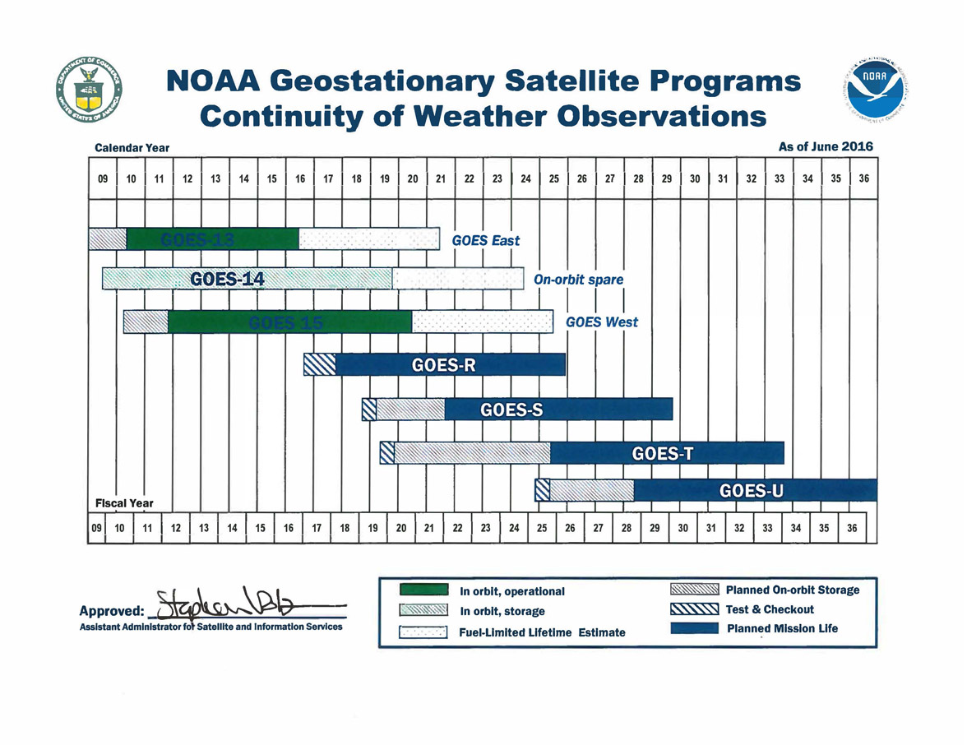
GOES Flyout Schedule
http://www.nesdis.noaa.gov/FlyoutSchedules.html http://www.goes-r.gov
Notes:
Here is the Flyout Schedule showing the continuity of the GOES Mission.
GOES-R is the next generation of GOES satellites that will provide a major improvement in quality, quantity, and timeliness of data collected.

Slide 13
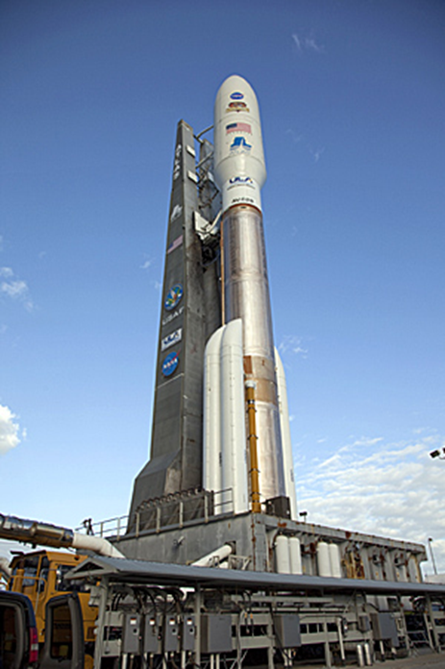
GOES-R Update
- GOES-R Launch: Nov 19, 2016 at 5:42 p.m. ET to 89.5deg West
  - GOES-16 Post-Launch Testing: Nov 2016 – Apr 2017 at 89.5deg West
  - GOES-16 Extended Validation: Apr 2017 – Nov 2017 at 89.5deg West
- First public images for GOES-16 data: ~Jan 2017
- GOES-16 Positioned at GOES-East or GOES-West: ~Nov 2017
Future Launch Dates:
- GOES-S Launch: Feb 2018
- GOES-T Launch: 2019
- GOES-U Launch: 2024
Notes:
GOES-R, scheduled to launch (this Saturday) November 19, 2016 (previous Nov 4th date was pushed back due to impacts from Hurricane Matthew).
First public images for GOES-16 data: ~Jan 2017
GOES-16 Positioned at GOES-East or GOES-West: Nov 2017
GOES-S launch, was pushed to 2018 due to the 6-month push of the GOES-R launch.

Slide 14
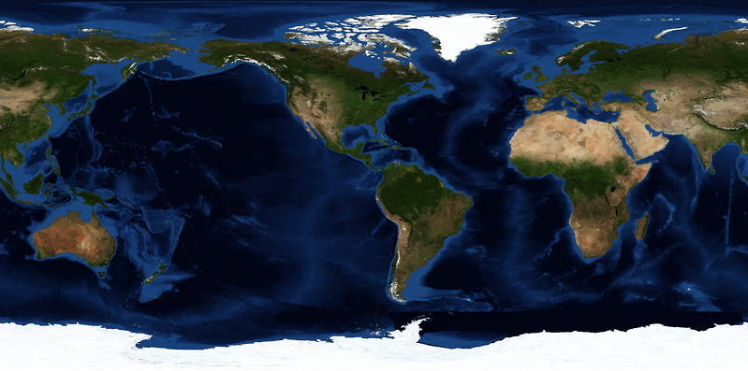
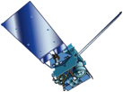
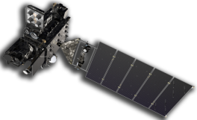
GOES Constellation
GOES-West
GOES-15
135° West
GOES-East
GOES-13
75° West
Standby
GOES-14
105° West
GOES-R
Checkout
89.5° West
  Primary source of data for short term forecasting, especially of severe weather such as tropical storms
Continuity of Operations since 1974
Notes:
After launch, the plan is to maintain the current GOES constellation until a decision is made regarding GOES-R positioning.
OSPO will continue to keep a standby satellite at 105w as backup to GOES-East and GOES-West.
GOES-R (after settling in at 89.5 degrees West position) will have a no effect on GOES-13/15 operations.
GOES Maintenance schedules will remain intact for legacy satellites.
The decision on positioning of GOES-R will depend on a number of factors:
The overall health of the entire GOES constellation and the needs of the user community.
Keep in mind, GOES-13 turned 10 years old this year and has existing issues (i.e. Sounder issue).
GOES-15 has only one healthy Star Tracker (ST1 & ST2 out). This and other considerations will factor into any decision.
Various other scenarios could come into play to influence GOES-R positioning and the fate of one of the spare satellites.

Slide 15
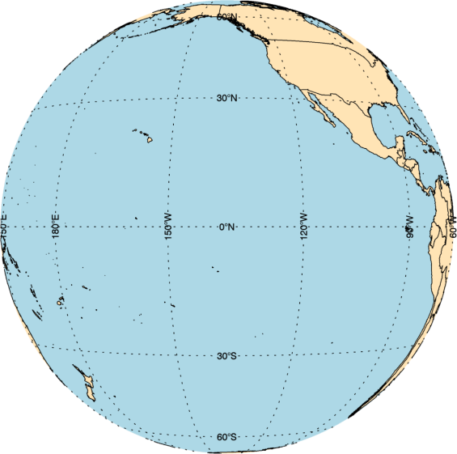
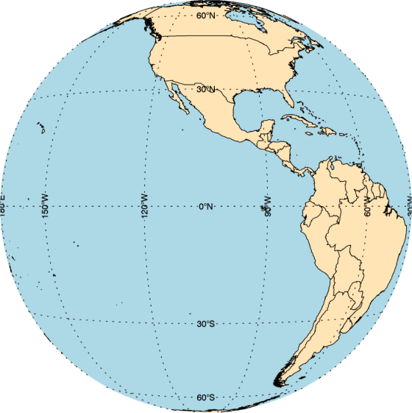
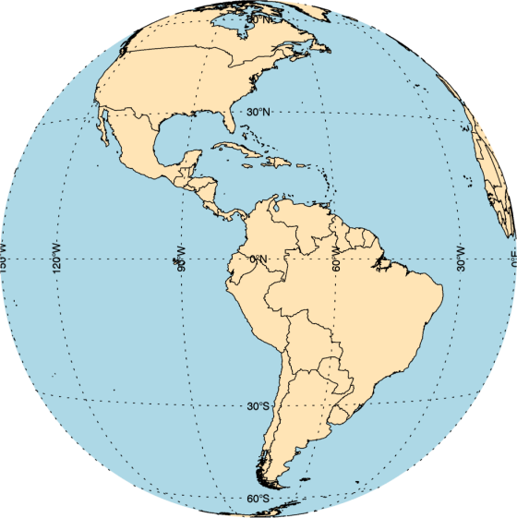
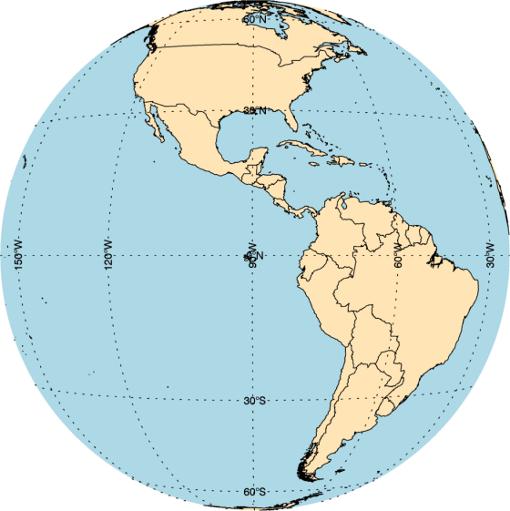
GOES Constellation
GOES-West
GOES-15
135° West
Standby
GOES-14
105° West
GOES-East
GOES-13
75° West
GOES-R
Checkout
89.5° West
  Primary source of data for short term forecasting, especially of severe weather such as tropical storms
Continuity of Operations since 1974
Notes:
Here’s another depiction of the GOES Constellation coverage.
GOES is the primary source of data for short term forecasting, especially of severe weather such as tropical storms.
The GOES-R checkout location at 89.5 degrees West provides coverage of the entire Atlantic Ocean and even the fringe of the Western edge of the African continent.
The Atlantic Ocean is fully covered for tropical monitoring purposes.

Slide 16
POES Status

Slide 17
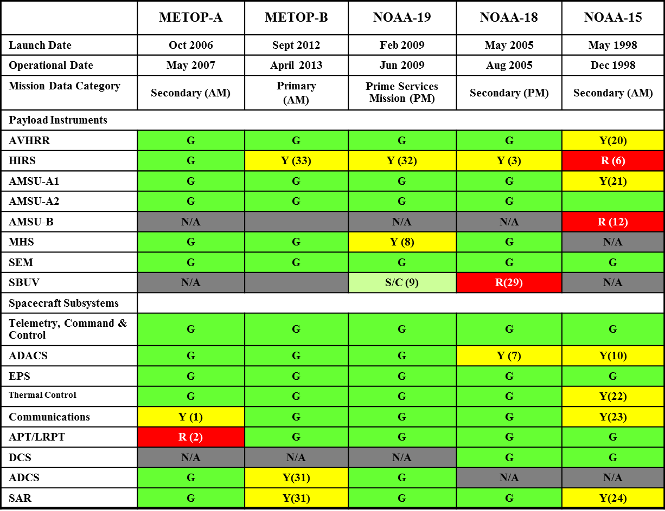
POES Status (Nov 2016)
http://www.ospo.noaa.gov/Operations/POES/status.html
Operational | G
Spacecraft Issue but no User Impact | S/C
Operational with Limitation | Y
Non-Operational | R
Not Applicable | N/A
Notes:
Here’s a depiction of POES stoplight chart showing the status of payload instruments and spacecraft subsystems.
OSPO still flies legacy POES. Not only does POES support the weather mission, but POES also supports SARSAT (rescue) and ARGOS (data collection) missions.
Some issues affecting certain POES satellites are mitigated though use of fellow POES satellites.
For time’s sake, I won’t go through all the specific issues (please reference the web link).
(4/26/2016), the instrument group announced that channel-8 on Metop-A AMSU-A1 has gone red. Recall; Channels 7 and 8 have been bad for a long time back (December 2014?) and since then we (NOAA) have taken out channels 7 and 8 from ATOVS application for Metop-A. After substituting these channels ATOVS products are fine in terms of quality.
Metop-B AMSU-A channel 15 became unusable starting with sensing time at 00:53:00 UTC, October 17, 2016. The anomaly causes degradation to the MIRS (Microwave Integrated Retrieval System) Metop-B products. Users were notified about the degradation while OSPO was working with STAR to develop a possible mitigation for the anomaly. On October 21, a solution was tested and implemented to mitigate the impact of the AMSU-A channel-15 anomaly. The MHS (Microwave Humidity Sounder) channel-1, which has the same frequency (89GHz) as AMSU-A channel-15, is now used to replace AMSU-A channel-15 in the MIRS Metop-B retrievals. The impact assessment indicates that the mitigation solution has restored the MIRS retrieval quality.

Slide 18
POES AVHRR Channel Switching
Background: AVHRR Channel 3A/3B
  Support hydrology community needs for snow/ice data mapping (channel 3A).
  Support hazard community needs for fire detection and monitoring (channel 3B).
Traditional configuration:
  POES AVHRR using 3B, NOAA-15, NOAA-18 and NOAA-19
  Metop AVHRR 3A/3B configuration: both A and B swapping at day/night terminator crossing
Origin of initial request for switching and justification came from Geographic Information Network of Alaska (GINA).
NESDIS formally granted NWS request for the activation of 3A/3B switching of NOAA-15 and NOAA-19 satellites to Channel 3A over the Alaska region for the period excluding May 15th to Sept. 15th.
Notes:
NESDIS received a formal request from NWS for the activation of switching of NOAA-15 and NOAA-19 satellites to Channel 3A over the Alaska Region to support snow/ice data mapping operations.
The request was granted by OSPO director Vanessa Griffin.
NOAA-15 switching activation began over the Alaska region on March 2nd and NOAA-19 began on April 12th.
Switching is deactivated (remains 3B) between the period of May 15th through September 15th on both N-15 and N19 to support seasonal fire detection and monitoring.
Switch activation will resume outside that time frame.

Slide 19


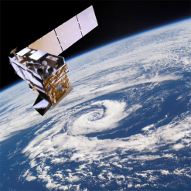
S-NPP Status (Nov 2016)
Spacecraft | S-NPP
Launch Date | Oct 28, 2011
Mission Category | LTAN 1330 (PM) +/- 10 mins
Payload Instruments | Status
ATMS | G
CERES | G
CrIS | G
OMPS – Nadir | G
OMPS – Limb | G
VIIRS | G
Spacecraft Subsystem | Status
TLM, Command & Control | G
ADCS | G
EPS | G
Thermal Control | G
Communications | G
CDP | G
SCC | G
GPS | G
1553 | G
1394 | G
Operational (or capable of)
Operational with limitations (or in standby)
Operational with degraded performance
Functional but turned off
Not functional
No status reported
Notes:
S-NPP currently has no issues to report as all subsystems and payload instruments enjoy healthy operational status.
The ATMS instrument is being closely monitored and procedures are in place to maximize the instrument life.

Slide 20
Key Points: Suomi-NPP and JPSS-1
Main mission objective is to provide KPPs (Key Performance Parameters):
  Sounder data (ATMS/CrIS) for NWP data assimilation purposes
  Imagery for high latitudes (VIIRS) for nowcasting purposes where geostationary satellite coverage is not present - Alaska
Data volume outputs from these satellites are large (1.5 - 4 TB/day).
Activities to extend critical life expectancy of key instruments (ATMS microwave sounder) have been implemented.
Collision avoidance with space debris remains a challenge that is mitigated with risk mitigation maneuvers performed by the satellite.
JPSS-1 launch expected no earlier than mid-March 2017.
A significant ground system update is expected to take place in 2017.
Notes:
Main goals is to provide KPPs (Key Performance Parameters):
Sounder data (ATMS/CrIS) is important for NWP data assimilation purposes.
Imagery for high latitudes (VIIRS) to aid in nowcasting where geostationary satellite coverage is not present - Alaska
Activities to extend critical life expectancy of key instruments (ATMS microwave sounder) have been implemented.
Collision avoidance with space debris remains a challenge that is mitigated with risk mitigation maneuvers performed by the satellite.
JPSS-1 launch expected no earlier than mid-March 2017, which will accompany a major ground system update in 2017.

Slide 21
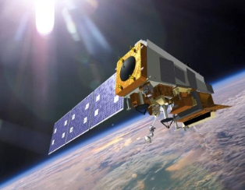
SNPP & JPSS-1 Concurrent Operations at OSPO
The JPSS-1 mission profile is substantially similar to S-NPP as JPSS-1 will lead S-NPP by ½ orbit (i.e. ~51 min.)
With the launch of JPSS-1, NOAA will operate two satellites within the same environment.
S-NPP northern contact will often coincide with JPSS-1 southern contact.
  JPSS1- SMD playback data latency significantly improved vs. S-NPP( 140 to 80 min.)
The Community Satellite Processing Package (CSPP) supports direct readout users in making the transition from POES to SNPP and subsequently to JPSS.
Notes:
NOAA will operate two satellites within the same environment.
The JPSS-1 mission profile is substantially similar to S-NPP as JPSS-1 will lead S-NPP by ½ orbit (i.e. ~51 min.)
S-NPP northern contact will often coincide with JPSS-1 southern contact.
Once JPSS-1 is launched scheduling or commanding for the POES satellites will not change as
Dedicated antennas at SVL (north pole) and MCM (south pole). POES antennas are at FBK and WAL.

Slide 22
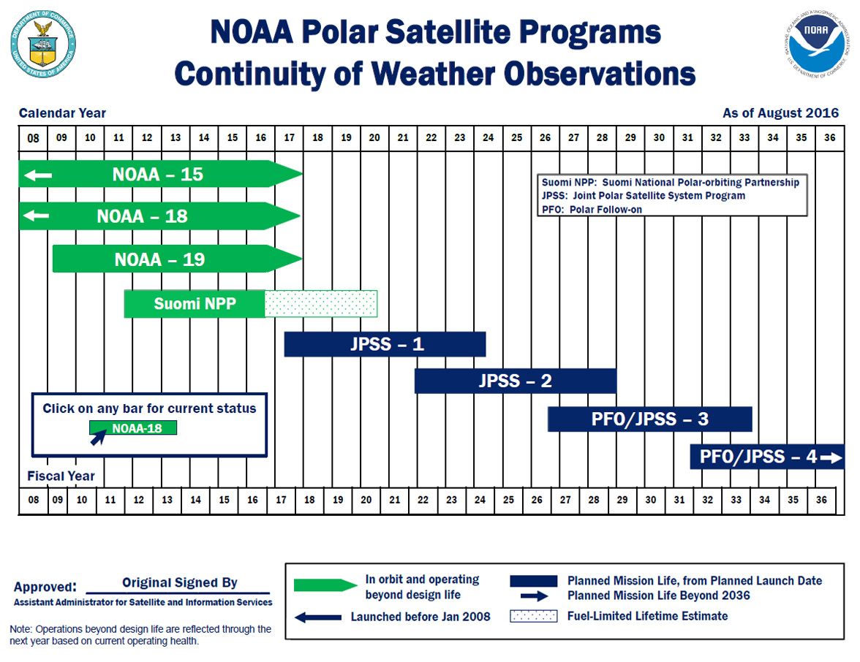
LEO Flyout Schedule
http://www.nesdis.noaa.gov/FlyoutSchedules.html http://www.jpss.noaa.gov
Notes:
Here is a depiction of the Low Earth Orbit Flyout Schedule.
S-NPP is a risk reduction mission for JPSS-1 and provides data continuity for NASA EOS Missions.
Highest priority is to launch the follow-on polar satellite Joint Polar Satellite System (JPSS-1/NOAA-20) with launch expected Mid-March 2017 while JPSS-2 launch readiness is planned for 4th quarter FY 2021
The JPSS will succeed NOAA's POES satellites and ground systems by leveraging investments made in NOAA POES, NASA's Earth Observing System (EOS), and the SNPP to maintain continuity of global, operational, space-based observations.

Slide 23
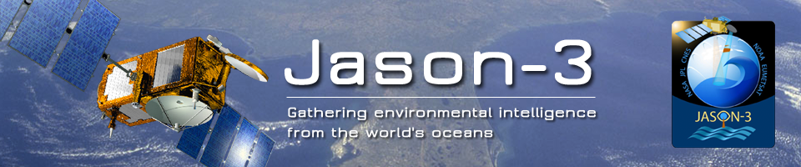
Launched January 17, 2016
February 12, 2016 - Began sending Operational Geophysical Data Records (OGDRs) to Ocean Prediction Center for evaluation.
Full public release of Jason-3 products commenced this summer.
Jason-2 successfully transferred to interleaved orbit on October 13, 2016
  First Intermediate Geophysical Data Records (IGDRs) distributed to users on October 17, 2016
Notes:
The Jason-3 satellite is continuing the long term climate data record on the primary ground track previously occupied by Topex, Jason-1, and Jason-2.
The new Jason-2 interleaved orbit is the same interleaved orbit used by Topex from 2002-2005 and Jason-1 from 2009-2012.

Slide 24
Space Weather Observations
Deep Space Climate Observatory (DSCOVR)
Launched 11 February 2015, at L1 on 8 June
NOAA took command on October 28, 2015
DSCOVR will work together with GOES-R to locate and measure size of solar flares; provide earlier warning detection for geomagnetic storms.
Notes:
DSCOVR and GOES-R will work together to help better predict and monitor geomagnetic storms.
GOES-R Solar Ultraviolet Imager (SUVI) telescope will monitor the sun in the extreme ultraviolet wavelength range
GOES-R X-Ray Spectrometer will locate and measure the size of solar flares.

Slide 25
Indian Ocean Data Coverage (IODC) - Mission Update

Slide 26
Meteosat-7 Transition Plans
Meteosat-8 moves MSG-1/M-8) to 41.5° East longitude
Drift period from July 1, 2016 to ~Sep 15, 2016 (TBC)
Parallel operations of M-8 and M-7 (57.5° E) planned to run from Oct 2016– Jan 2017 (TBC)
M-8 IODC service – Jan 2017 (TBC) – 2019 (TBC)
Re-orbiting / Decommission of Meteosat-7 – April 2017 (TBC)
Notes:
Met-8 has moved to 41.5E in preparation to replace Meteosat-7.
Parallel operations will run through Jan 2017.
Meteosat-7 will be decommissioned in April 2017.

Slide 27
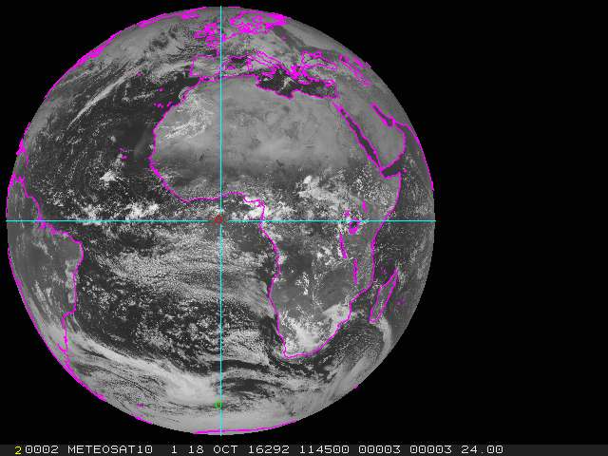
Meteosat-8 Transition
Metosat-10 Active
Notes:
Here’s a depiction of the Met-8 drift location to 41.5E that was captured on September 5, 2016.
Also shown (alternating images) Meteosat-10 location at 0 degrees on October 18, 2016 (Meteosat-9 is the backup).

Slide 28
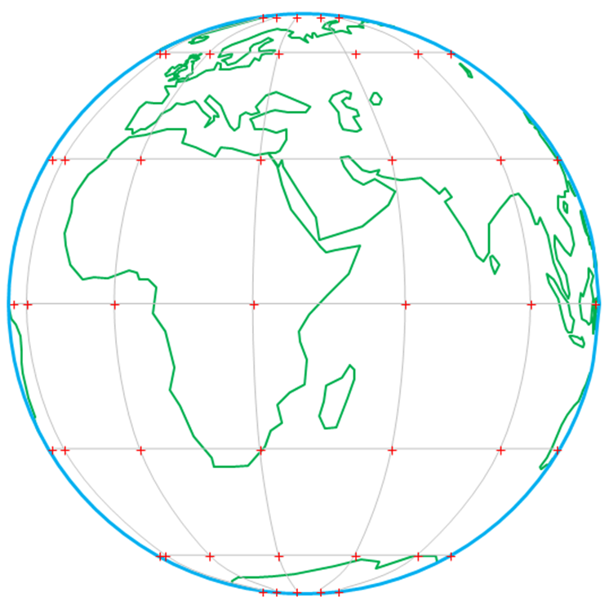
Proposed Meteosat-8 IODC Services – Image Data
Full Earth scan -
12 channels/15 Minutes
Covering
~40°West to ~120°East
Imager Resolution:
                1 km VIS (HRV) and 2 km channels 1-11, VIS, IR and WV
                Image frequency – every 15 mins
View from 41.5 deg
Notes:
Coverage provided by Meteosat-8 will be from ~40 deg. West to 120 East.
M-8 will provide 1 km VIS and 2KM IR resolution with 15 minute frequency.

Slide 29
Planned Meteosat-8 IODC Data
Dissemination Strategy
To NOAA using EUMETCast terrestrial-based multicast service via approved terrestrial point-to-point protocols
EUMETSAT and NOAA are currently working toward using high speed trans-Atlantic links (GEANT & I2, and N-WAVE); this initiative is underway
OSPO examining resources required to process M-8 HRIT data to McIDAS format at the ESPC for user distribution
  If resources are available, imagery would be provided, possibly level 2 products
Notes:
OSPO’s short-term dissemination strategy is to receive M-8 data from STAR.
OSPO is exploring possibility of processing M-8 data HRIT (High Rate Information Transmission) if resources are available for user distribution.

Slide 30
Himawari-8 Update
NESDIS/STAR, College Park, is pulling full resolution Himawari-8 AHI level 1b data from the HimawariCloud server
  NOAA has one account for data access to the JMA server. On a best effort basis, full res H-8 AHI data are further distributed from STAR’s server to:
    NWS NCEP (includes AMVs and radiances in BUFR to EMC/JCSDA)
    DoD
    SSEC/CIMSS
    NSOF/ESPC
NSOF/ESPC is making H-8 imagery and derived level 2 products in McIDAS available from GEODIST
    Sub-sampled H-8 data reflecting the H-8 specifications of the five channels having a spatial resolution of 4 km in the IR, and 1 km in the Visible are being used to produce imagery and derived level 2 products (product listing next slide)
Notes:
JMA transitioned to Himawari-8 as the primary operational satellite on July 7, 2015.
Parallel ops for MTSAT-2 and Himawari-8 was run until Dec 4, 2015 (then MTSAT-2 was turned off)
OSPO successfully mitigated the coverage gap for MTSAT-2 data users with sub-sampled H-8 data in McIDAS format.
Data access to H-8 imagery made available through the GEODIST system.

Slide 31
Specific Products Generated at NESDIS/ESPC from Himawari-8 Data
NESDIS H-8 Product | Data Format(s)
Visible and IR Imagery | McIDAS Area
Tropical Cyclone Formation Probability | McIDAS Area
Wildfire Automated Biomass Burning Algorithm | McIDAS Area
Global Hydro-Estimator Satellite Rainfall Estimates | McIDAS Area, GRIB2, NetCDF4, PNG
Advanced Dvorak Technique | McIDAS Area
Volcano Multi-Spectral Imagery | McIDAS Area
Volcano Principle Component Imagery | McIDAS Area
Snow Cover, Ice Cover, Snow Depth, and Ice Concentration | McIDAS Area, GRIB2, ASCII
One-hourly NH Composite for AWIPS | AWIPS/GINI
Three-hourly Global Geostationary Mosaic | McIDAS Area, NetCDF4
Arctic Composite Imagery | McIDAS Area
Geostationary Satellite (Web) Server | JPEG, GIF
Notes:
Transfer of data from STAR to the ESPC PDA will begin sometime in mid 2017.

Slide 32
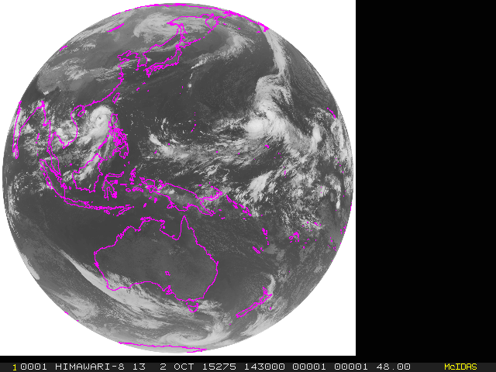
Himawari-8 Full Disk IR
Notes:
Here is a depiction H-8 IR full disk which replaced MTSAT-2 (5 Himawari-8 bands provided replacement)
“Dumb down“ version of the Himawari-8 data made to look like MTSAT-2, same bands, same spatial resolution.
When STAR is unavailable, we get the data from SSEC / HCAST (Himawari CAST link) which is already at half resolution (internal use only).

Slide 33
Additional Updates
Transfer of HimawariCloud data distribution from STAR to the ESPC PDA will begin sometime in mid 2017
  Operational 24x7 support
Himawari-9 launched successfully on Nov 2, 2016
Notes:
Transfer of data from STAR to the ESPC PDA will begin sometime in mid 2017.
Himawari-9 launched successfully on Nov 2, 2016.
The Himawari-8/9 AHI instrument is nearly identical to the ABI instrument on GOES-R — so similar imagery will be routinely available once GOES-R becomes operational in 2017.
After initial function test, it will be put on standby until it will succeed the observation from H-8 ~ 2022

Slide 34
McIDAS at ESPC

Slide 35

McIDAS Data Delivery Summary
GEODIST –
Geostationary satellite data is ingested on a SSEC Data Ingestor (SDI), converted to McIDAS format and placed on a server.
In addition, some foreign geostationary data, polar data, model data and derived products are converted into McIDAS.
This data is served via McIDAS ADDE:
  Data NSOF Server ADDE Name
  Derived Products GEODIST1e DPD
  GOES-E GEODIST2e GER
  GOES-W GEODIST3e GWR
  Polar GEODIST4e PLR
  Model data GEODIST5 MOD
  Global Mosaic 5 Sat. Comp. GEODIST6 MOS
  MSG/MET/ GEODIST6e MSG / MET / IND
  Himawari GEODIST7e HIM
  Select requested data SATEPSANONE PUB (not operational)
  Surface/Ship Buoy/RAOBs FOS2 FOS (Family of Services)
Notes:
Here a summary of McIDAS Data Delivery at ESPC.
GEODIST is used to serve most data.
Satespone is a non operational server that also stores selected data that is publically accessible.
Family of Services provides surface, ship, and RAOB data.

Slide 36
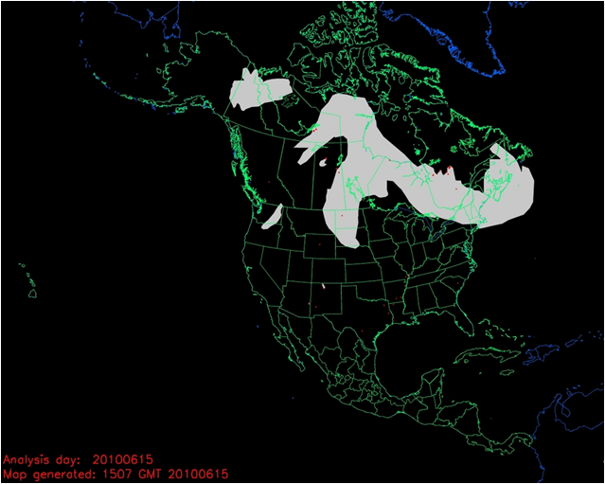
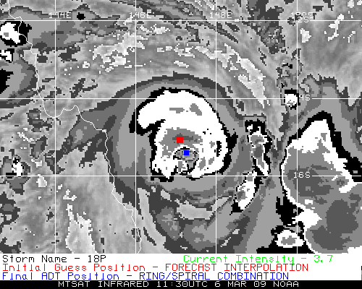
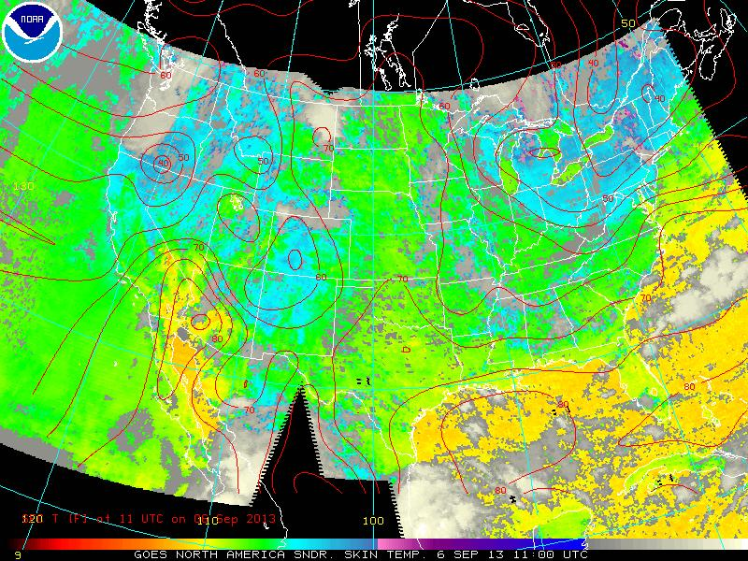
McIDAS & ESPC Applications
Over 50 applications in ESPC use McIDAS, McIDAS libraries, input & serve McIDAS AREA Files, MD point files, GRID (McIDAS GRID Format), and Text via ADDE
ADT, ABBA, CSBT, HMS, others…
Notes:
ESPC has over 50 applications that use some form of McIDAS.

Slide 37
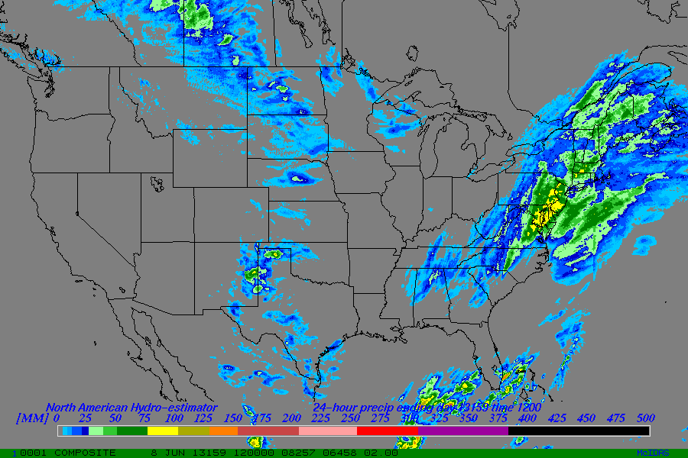
McIDAS Systems at ESPC
Over 20 SDIs at NSOF and Wallops OBF
  Several are dedicated...
  GOES-East, -West, -14, Remappers
  MTSAT Remapper
  GOES Ingest and NOAAPORT Interface (GINI)
Over 20 Workstations in SAB
  -X for realtime analysis, product generation, and QA/QC
  RHEL 6 Linux on Intel x86_64
  Many “home grown” programs in Fortran, .PGM, BATCH
Advantage - The ADDE protocol allows for many users accessing single systems with one port (112)
Global Hydro-Estimator 1 Day Total
ESPC Product Generation/Distribution
  IBM P6 & P7 Series with Linux Partitions, GEO Boxes
  Many other Linux systems (gp*)
  GINI running on Linux
Notes:
Overall there are more than 20 SSEC Data Ingestors (SDIs) are located at NSOF and Wallops.
OPSO’s Satellite Analysis Branch uses McIDAS-X for real-time analysis and incorporates many “home grown” batch programs.

Slide 38
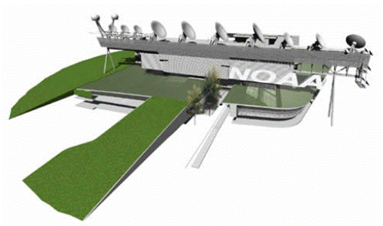
McIDAS at ESPC
ESPC has a standing, annual contract with SSEC for McIDAS Support and ongoing development
ESPC representatives on the McIDAS Advisory Committee (MAC)
  Jason Taylor and Bonnie Morgan
  Kathryn Mozer (Alternate)
Notes:
ESPC has a standing, annual contract with SSEC for McIDAS Support and ongoing development
ESPC representatives on the McIDAS Advisory Committee (MAC) are Jason Taylor and Bonnie Morgan with Kathryn Mozer (Alternate)

Slide 39
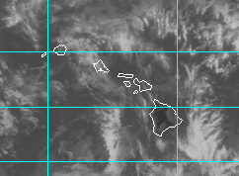
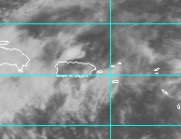
SAB Use of McIDAS
SAB is 24x7 operation of 5 disaster mitigation desks (Heavy Precipitation, Volcanic Ash, Fire/Smoke/Dust, Marine Pollution, Tropical Cyclones) All desk use Mc-X in some capacity, except Marine which is ArcGIS
McIDAS-X Usage: ~10 operational Linux systems with 24 GB RAM each and multiple monitor visualization setup
A persistent daemon (image loop refresh) “SPIDER” uses ADDE protocol to display ~100 imagery loops
Use Fnc keys to switch loops and pan entire globe through SPIDER loaded frames (e.g. NW Pacific IR, Shift+F1 - NW Pacific Vis, F2 - Central US IR) and still use command line (grudgingly)
Lots of batch commands and everything is scripted by business work flow
Uses McIDAS AREA files for web site as do NWS offices across country, namely NHC, AWC, NWS Western Region
Notes:
SAB uses McIDAS-X operational to monitor Heavy Precipitation, Volcanic Ash, Fire/Smoke/Dust, Marine Pollution, Tropical Cyclones.
ADDE protocol used to display ~100 imagery loops in support of operations.
McIDAS AREA files support OSPO website imagery displaying functionality.

Slide 40
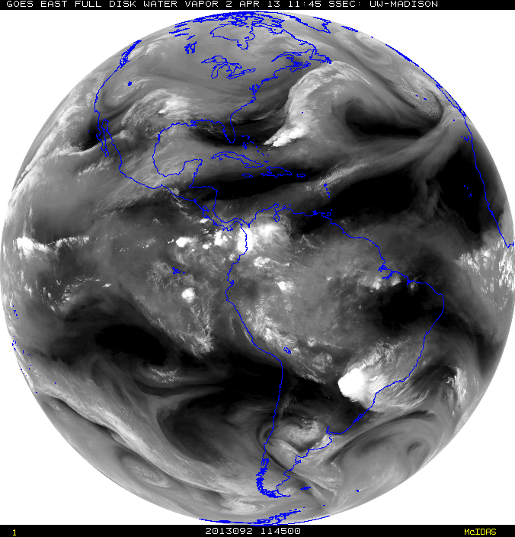
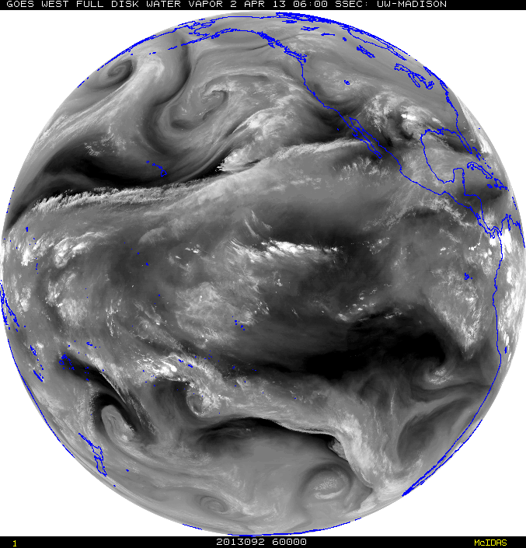
McIDAS Advantages in SAB
Institutional knowledge - SAB Analysts have great familiarity with McIDAS
Ability to have near-global coverage at multiple domain scales and resolution (~980 frames) of quickly and routinely loaded (SPIDER) imagery at the tap of a button (TU Hotkeys) to perform interrogation, manipulation and value-added analysis when every second counts for time sensitive and rapidly evolving natural and man-made hazards; such as volcanic eruptions, flash flooding, fires, etc.
  This cannot be done presently with NAWIPS or HMS. In fact, depending on the area of concern up to 20 minutes is lost waiting for imagery to show up on these other systems vs McIDAS
  HOWEVER, since the NWS is the primary user of many SAB products (e.g. volcanic ash and heavy precipitation), there are benefits for SAB to conduct PG on NAWIPS like, quick overlays and seamless in-tool distribution. Fire uses HMS for analysis.
Notes:
There are several advantages for SAB in using McIDAS.
Some advantages are existing institutional knowledge, near global coverage ability, data manipulation functions, and faster image loading compared to other applications.
SAB analyst also like the advantage of using McIDAS vs other systems for its ability of toggle quickly between VIS and IR.

Slide 41
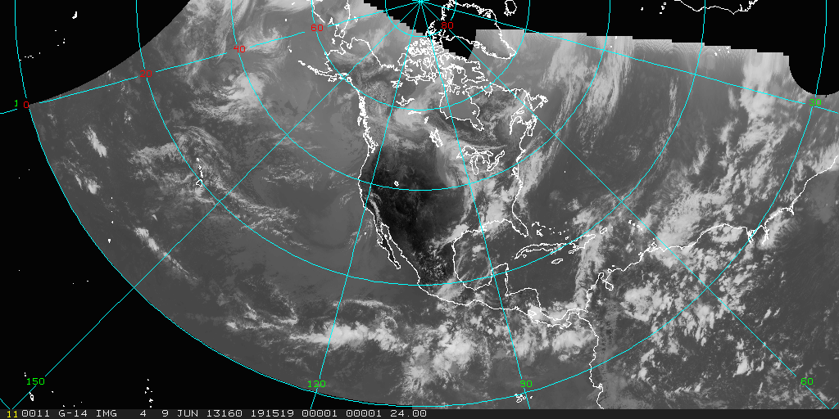
McIDAS Challenges in SAB
Maintaining efficient access to servers for operations (SPIDER is in-house stop-gap measure).
Additional customer requirements for advanced data formats (GIS, KMZ)… writing own local code for NPP VIIRS, Windsat, others to convert them to AREA files as there are no local servers
Learning Curve with commands
Color Tables – 8 bit (default) – challenge with upcoming GOES-R
North Hemi Composite - IR
Notes:
There are a couple of challenges: efficient access to servers for operations (in-house methods fill gap), file conversion difficulty, learning curve for new analysts.

Slide 42
SPider
Satellite Product Information Distribution EnviRonment
Expands on concepts of Core Mcidas commands concepts
  ADDE, DATALOC, DSSERVE, PT/GRD/IMGLIST, PT/GRD/IMGDISP, PT/GRD/IMGCOPY, SKL, etc.
Consists of two programs: Spider Server (SPS) and Spider Client (SPC)
Benefits:
  -- Automatic loading without duplication of images
  -- Reduces task loading of server/workstations
    Numerous pings to server but fewer downloads
  -- Run from command line environment (typically SKL) on all platforms
    Leads to distribution system effectiveness
  -- Timely, based on user needed requirements (set to any refresh rate)
Notes:
ESPC uses SPIDER (in-house stop-gap measure) to help maintain efficient access to ADDE servers.
Running Spider from SKL, allows for the updating of loops.
Spider can also be used to do routine copying of files, and in this context is usually run from cron.
Spider is used to copy GE and GW data to satepsanone.
Current problem with SPIDER loading imager fast enough when RSO in place.
Loops can get out of sync between VIS/IR and or images don’t get loaded.

Slide 43
Two Types of SPider
Spider Client (SPC)
Spider Server (SPS)
User
  Resides on Workstation
  Keeps Request File of user defined loop(s) specifications and polls it against the Server Availability File
  Pulls “area” files from server and loads it into predetermined frame
Host
  Resides on Server
  Integrated into “Area generator” that creates products on the server
  Keeps and up to date Availability List of these products
SPS
SPC
Notes:
There are two types of SPIDER:
(User) Client pull the AREA files from the server
(Host) Server keeps up to date list of available products
Remap Spider Loops
Predefined loops available on the Spider SERVER
The user request data in the Spider Client
McIDAS Frames update automatically

Slide 44
Other Ad hoc McIDAS Usage at ESPC
Heavy usage of the local GINI server in McIDAS format for validation checks (image previews) for conversion of GOES-13 and GOES-15 data to NWS AWIPS
Great reliance on GINIs during GOES-13 anomalies to confirm the output images quickly and efficiently (Generated mock AWIPS files to confirm changes to use GOES-14).
GINIs, remappers, and Level 2 products that utilize McIDAS were all used for:
  The GOES-13 rapid schedule
  The GOES-13 optimized routine schedule
McIDAS-X client-side software to create all of the imagery on the OSPO web page.
OSPO web servers are currently being upgraded with the newest McIDAS-X as well as the prerequisite Redhat update.
Notes:
There is heavy ad hoc McIDAS usage for image format validation.
Also McIDADS is used to confirm anomalies/outages.
McIDAS-X client-side software is used to create all of the imagery on the OSPO web page.

Slide 45
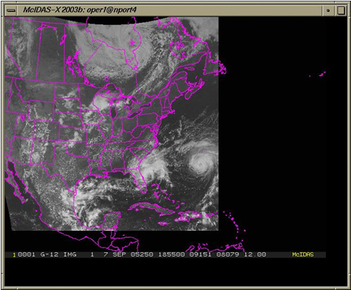
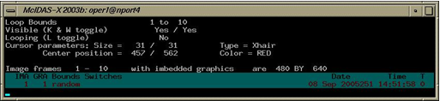

AWIPS Composite Using McIDAS
Notes:
OSPO uses its local GINI server for conversion of GOES-13 and GOES-15 data to NWS AWIPS.
Here is an example of an AWIPS Composite, using the McIDAS software package to display with the MCIDAS-X GINI Server.
The AWIPS Products are generated from the McIDAS AREA files, the MCIDAS is stripped off and an AWIPS header/trailer is placed to make it an AWIPS product.
At the bottom, screen capture of buttons allowing for the toggling between EAST and WEST operations.

Slide 46








AWIPS EAST Products
CONUS, Super National, North Hemisphere, Puerto Rico National, Puerto Rico Regional
Atlantic Sounder, Carribean Sounder, Gulf of Mexico Sounder
Notes:
East Conus Sounder missing

Slide 47






AWIPS WEST Products
Conus, Super National, North Hemisphere, Alaska Regional,
Alaska National, Hawaii Regional, Hawaii National, Conus Sounder
Notes:
Pacific, Hawaii, Mexico Sounders are missing

Slide 48


Future SAB Use of McIDAS
SSEC McIDAS-X support to end 2020? (answered- Thank you!)
NAWIPS, AWIPS2, McIDAS-X, & ENVI/IDL currently used in operations
Increased use of AWIPS2 for some operations being explored.
Spider will use netCDF files to display routine GOES-R imagery.
Imagery file formats needed (HDF, geoTIFF, netCDF).
McIDAS-V could be used for intense image interrogation, manipulation and value-added analysis.
Notes:
What does the future hold for McIDAS use at ESPC and SAB?
Will McIDAS-X support really end in 2020?
Will need to plan to replace functionality that it provides in operations.
NAWIPS, AWIPS2, McIDAS-X, & ENVI/IDL are currently used in operations.
Increased use of AWIPS2 being explored.
Spider will use netCDF files to display routine GOES-R imagery.
Operations will continue to need (HDF, geoTIFF, netCDF) file formats.
McIDAS-V could be used for intense image interrogation, manipulation and value-added analysis.

Slide 49
Data Distribution Update:
Near real-time data access
Product Distribution & Access (PDA)

Slide 50

Data Access Services
Current Access Services (in addition to Direct Broadcast)
  Data Distribution Service (DDS) – (s)FTP push/pull from secure accounts *
  NWS Telecommunications Gateway
  GINI (GOES Ingest and NOAAPORT Interface) / NOAAPORT for Advanced Weather Interactive Processing System (AWIPS) display
  GEODIST – GOES, POES, and Derived Products; McIDAS *
  Shared Processing DAPE Gateway – for military partners *
  MODIS server – subset of products made by NASA *
  Websites - http://www.ospo.noaa.gov/
  * Require Data Access Request
Archival
  NCEI archive data products using CLASS
Notes:
Current data assess services for customers include: DDS, NWS Telecommunications Gateway, GINI for AWIPS, GEODIST, DAPE, MODSI, Websites, and Achieve.
Customer Use of Servers…
GINI: NOAAPort/AWIPS, NWS, Unidata
GEODIST: NWS/NCEP, DOD, STAR, SAB, Universities, Private Industry
DDS: NWS/NCEP/EMC, ECMWF, UKMET, STAR, DOD

Slide 51


Data Access & Distribution Policy
Full policy and forms at http://www.ospo.noaa.gov/Organization/About/access.html
Security requirement to know and document all users accessing operational data servers and what products they are receiving
  Users request data using a Data Access Request (DAR) form.
Ever increasing data volume requires prioritization of users to effectively manage distribution resources and ensure effective system performance
Higher priority access will be given to organizations with:
  Mission and statutory authority
  Signed NESDIS cooperative agreements or legislative authorities
  A demonstrated timeliness requirement for near-real time data to support operational user applications
If available and sufficient, users will be directed to sources of data external to NESDIS (e.g. CIMSS). Also recommend alternatives for denied users
Cloud Top
Pressure
Lifted
Index
Notes:
ESPC’s current data access policy is available on the OSPO website.
Priority given to organizations that support operations.
Users are directed to other sources of data (CIMSS, NOAA CLASS archieve)

Slide 52
Near Future Distribution with PDA
The purpose of the Production Distribution and Access (PDA) is to serve as the NESDIS enterprise distribution system for our near real-time users.
PDA Distribution Service Improvements:
Enhanced security controls / transfer protocols
Provide our organization with far greater management control and system insight over data distribution.
Ability to handle large data volumes
In deference to NOAA security policies, PDA will set subscriptions for international and non-US government partners, as is done now on the DDS. (PDA User Interface requires a government CAC or PIV card.)
Notes:
Near future distribution will be through the Production Distribution Access (PDA).
PDA will serve as the NESDIS enterprise distribution system for our near real-time users.
Some PDA benefits include: Enhanced security controls / transfer protocols, ability to handle large data volumes, user subscriptions.

Slide 53
ESPC PDA Operations –
User Prioritization
PDA supports near real-time users – prioritized according to most critical mission need first.
PDA operators can perform load shedding of the lowest priority users – this is a system management feature that guarantees resources for the highest priority users if so needed.
The new ESPC network infrastructure is a high performance, horizontally scalable network; however, distribution time is governed by the slowest link speed between source and destination.
Operational Prioritization Approach
1 | Life & Property / National Interest Missions
2 | Int'l Agreement Missions / NRT NOAA-NASA Environmental Missions/ Launch Support-Cal Val
3 | External Mission Support (i.e. AR) / Data Preservation/Archive
4 | Operations Test Support
5 | Mission (Development ) Test Support / Long term Approved RT Request
6 | Prototype dataflow / temporary dataflows or tests – research to operations
Notes:
The Prioritization approach, table in slide, allows ESPC to manage user return to service expectations during significant anomalies/outages.
Highest priority is protection of life, property, and national interests mission.

Slide 54


Data Access & Distribution in PDA Era
Legacy GOES data in GVAR format will be on PDA.
McIDAS AREA files will remain on GeoDist servers for GOES 13 & 15.
Users will need to obtain GOES-R data via PDA.
GOES-R data will not be on GeoDist servers and will not be in McIDAS AREA file format nor served on ADDE via ESPC
Newer versions of McIDAS will allow users to read GOES-R data.
S-NPP/JPSS products will be generated by NDE 2.0 and provided via PDA.
All distribution will use FTPS or SFTP protocols.
Notes:
Data access and distribution during the PDA Era will look very different but some things will remain the same.
Legacy GOES data in GVAR format will be available on PDA.
McIDAS AREA files will remain on GeoDist servers for GOES 13 & 15.
GOES-R data will not be on GeoDist servers and will not be in McIDAS AREA file format nor served on ADDE via ESPC.
Instead users will need to obtain GOES-R data via PDA.
Newer versions of McIDAS will allow users to display GOES-R data.
S-NPP/JPSS products will be generated by NDE and provided via PDA.
All distribution will use FTPS or SFTP protocols.

Slide 55

Future ESPC Data Operations (To-Be State)
Notes:
Here is a depiction of the near future flow of data at ESPC for GOES-R and JPSS to the PDA.

Slide 56
User Subscription Revalidation
All users have been notified to revalidate their subscriptions before the switch to PDA occurs.
    Data Access Request (DAR) Form is available at http://www.ospo.noaa.gov/Organization/About/access.html
Users must complete and submit the new Data Access Request (DAR) form (Apr. 2016 version 15).
  Exception for users involved with Solers integration activities.
Subscribers who fail to revalidate will not be automatically moved over to PDA or removed from DDS.
  As data gets moved off DDS and the DDS is subsequently turned off, users who do not revalidate will be without data.
Notes:
All users were asked to revalidate their subscriptions before the switch from DDS to PDA occurs.
Notifications went out in June and August to remind users to complete revalidation.
To revalidate users will need to complete and submit the new DAR (version 15 created in April 2016).
Subscription revalidation must occur for all users with the exception of those already working with our Solers (contractor) on integration efforts.
Subscribers who fail to revalidate will not be automatically moved over to PDA nor will they be immediately removed from DDS.
What will happen? As data gets moved off DDS and the DDS is subsequently turned off, users who do not revalidate will be without data.
User training will be provided to re-validated users this fall.

Slide 57
PDA Schedule
Internal readiness reviews:
  Operational Readiness Review (ORR) held Nov 15, 2016
  JPSS Block 2.0 transition NET Jan 23, 2017
  Actual near real-time data flow is dependent upon the new JPSS ground system upgrade (TBD)
Existing users of S-NPP NDE system are being scheduled for integration.
Existing users with questions should contact:
  Donna McNamara (Data Access Manager) donna.mcnamara@noaa.gov
  Chris Sisko (JPSS Data Operations Manager) chris.a.sisko@noaa.gov
  Matt Seybold (GOES-R Data Operations Manager) matthew.seybold@noaa.gov
New users with questions should contact NESDIS Satellite User Services NESDIS.Data.Access@noaa.gov
Notes:
Here is the PDA schedule and contact information for questions - general, GOES-R questions, JPSS-1 questions)

Slide 58
PDA User Training
PDA user training will be made available to re-validated users in Dec 2016.
A PDA external User’s Guide will be available as well.
Training will be done locally in the Washington area as well as remotely via Webinar.
Notes:
PDA user training will be made available to re-validated users in Dec 2016.
A PDA external User’s Guide will be available as well.
Training will be done locally in the Washington area as well as remotely via Webinar.

Slide 59
ESPC Notifications, Status, and Contacts
24/7 Help Desk | ESPCOperations@noaa.gov
ESPC Messages | http://www.ssd.noaa.gov/PS/SATS/messages.html
WMO GTS Bulletins | Urgent: http://www.weather.gov/view/validProds.php?prod=ADM&node=KNES Routine: http://www.weather.gov/view/validProds.php?prod=ADA&node=KNES
User Services | SPSD.UserServices@noaa.gov
Data Access | NESDIS.Data.Access@noaa.gov
Webmaster | SSDWebmaster@noaa.gov
Facebook | www.facebook.com/NOAANESDIS
Twitter | www.twitter.com/noaasatellites
Satellite Ops Status | http://www.oso.noaa.gov/daily-news/index.asp
Press releases | http://www.nesdis.noaa.gov/news_archives/
Web | www.ospo.noaa.gov
Notes:
Please reference the OSPO contact information listed for a variety of resources.

Slide 60

NOAA Satellite Conference
July 17-21, 2017
New York City, New York

Slide 61
Thank you!
Questions?

