Slide 1
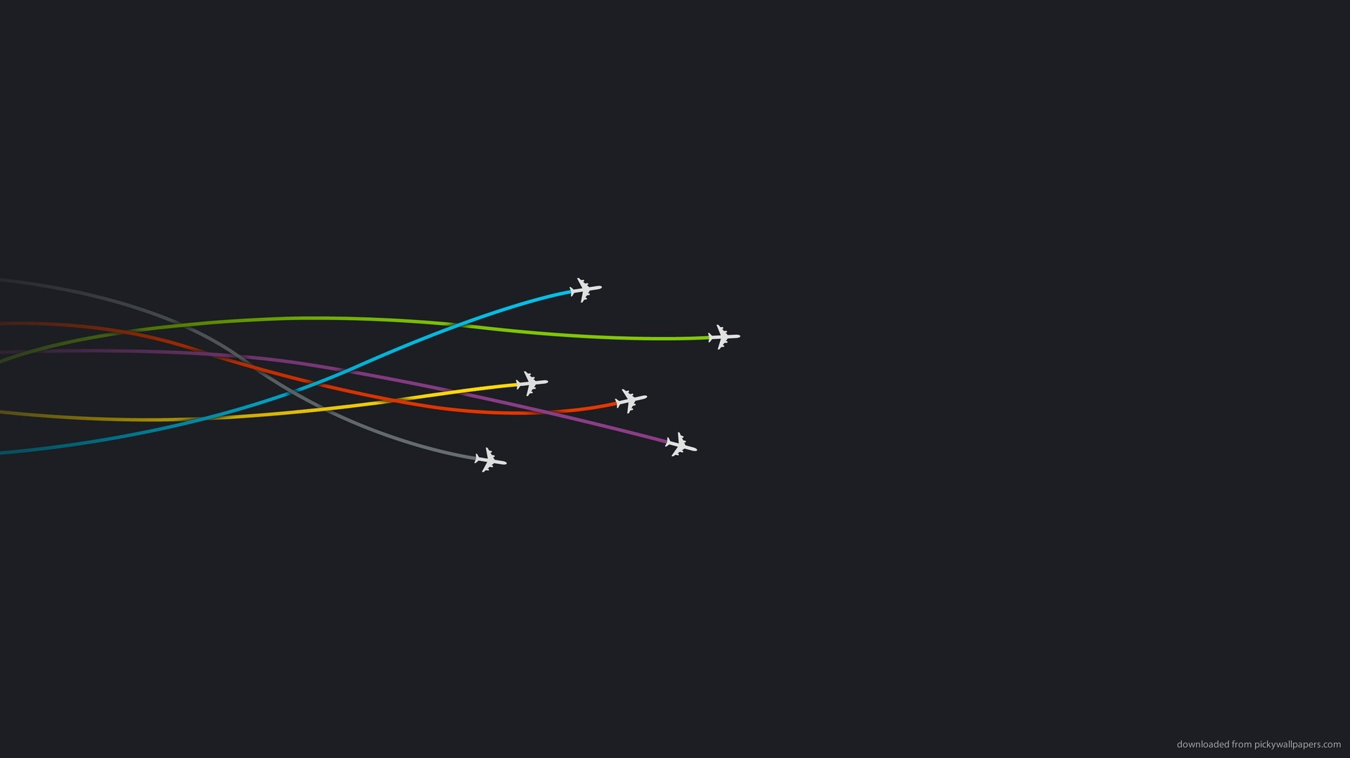
MCIDAS AND THE AVIATION WEATHER CENTER
Amanda Terborg
UW CIMSS/Aviation Weather Center
2016 MUG Meeting – Madison, WI
15-16 November 2016

Slide 2
McIDAS-X concepts at the AWC
From the 2015 meeting:
VIS/IR combination for ceiling and visibility → continuous day/night image
Global mosaics → GEO/LEO composites
Issue with the change to the imgremap command in 2015.1…
Other band differences/derived products → Convective, volcanic ash, SSTs, etc.
New items/concepts:
Converting areas to AWIPS-2 compliant netcdfs → awipaput utility in XRD (CIRA)
GOES-R data visualization → ABI and derived imagery
From PDA and GRB
“ABIN” navigation and N-AWIPS

Slide 3
mosaics
AWC concepts and noted issues with imgremap in 2015

Slide 4
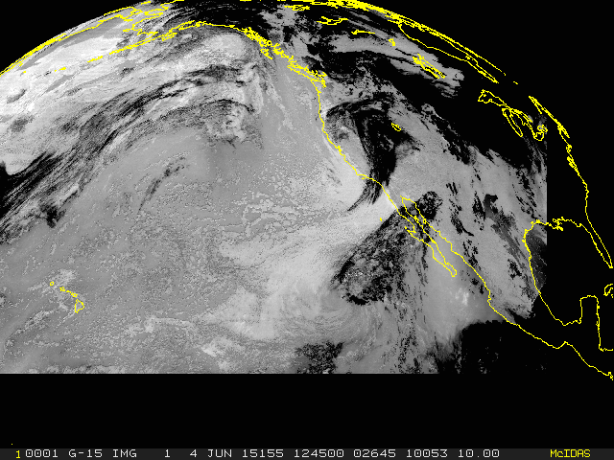
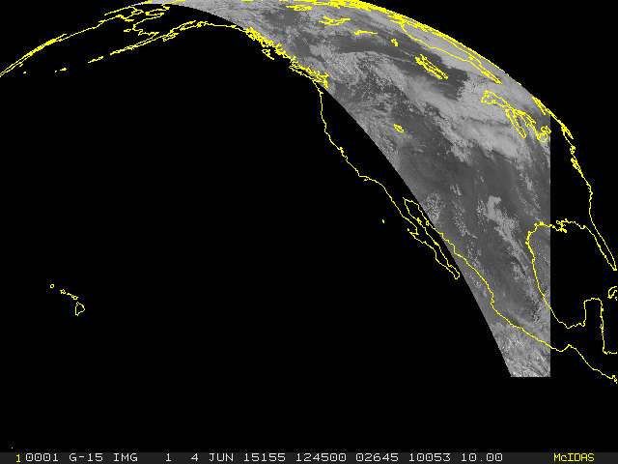
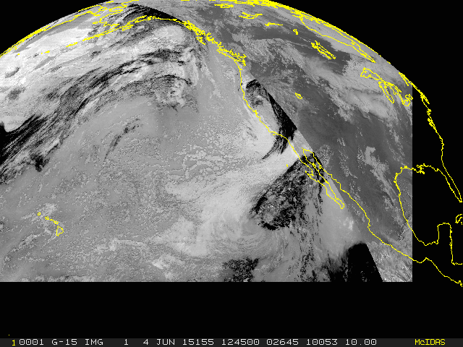
Visible/infrared mosaic – continuous coverage from day to night, locally

Slide 5
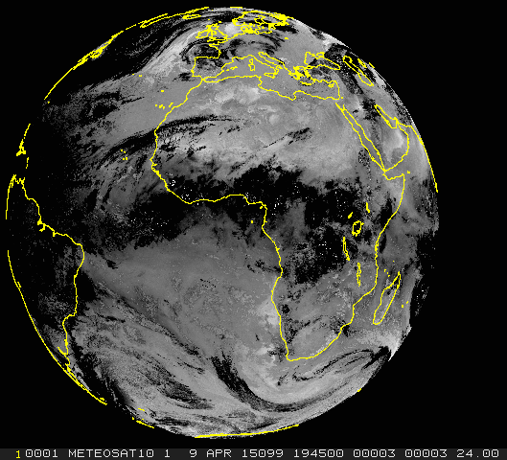
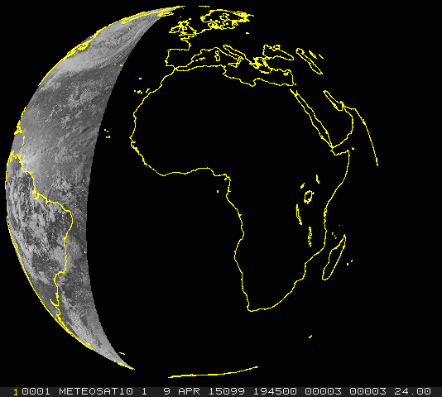
Visible/infrared mosaic – continuous coverage from day to night, globally

Slide 6
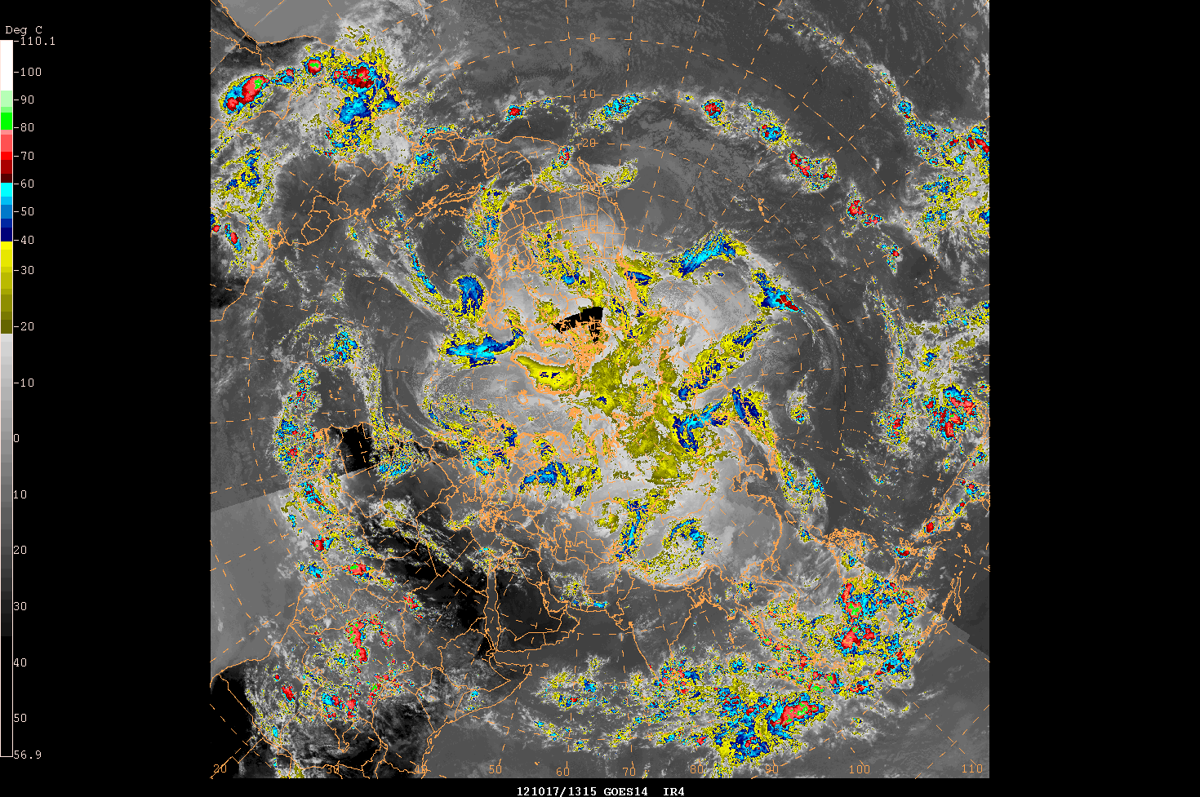
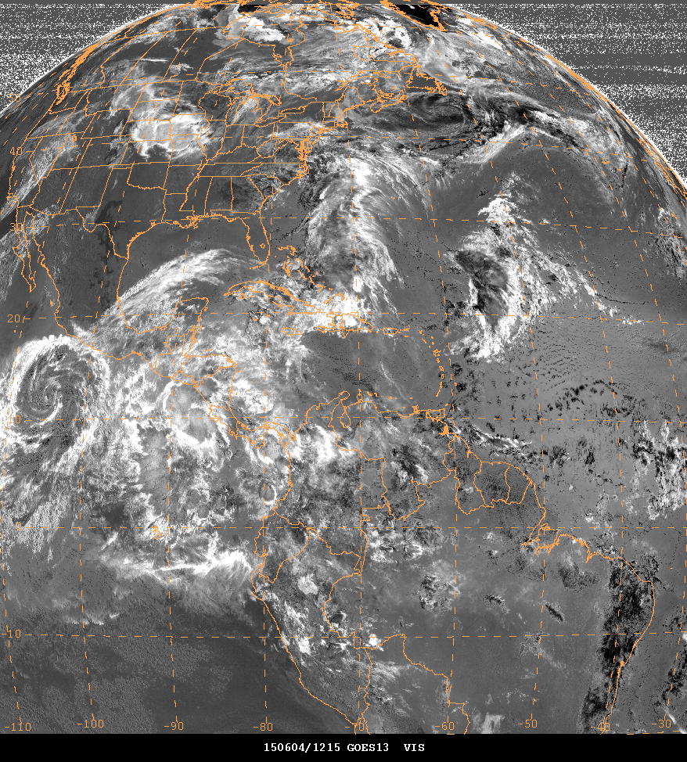
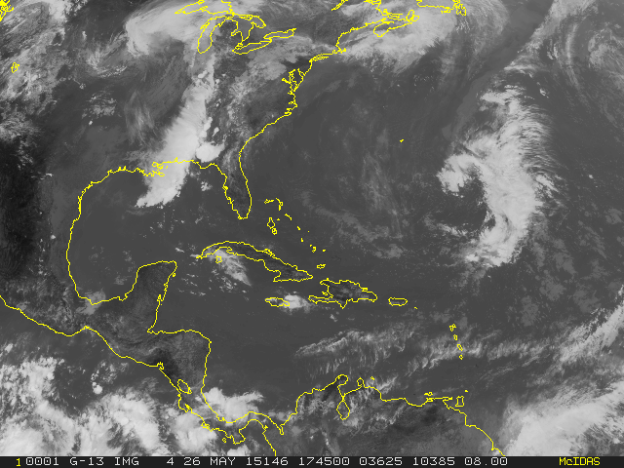
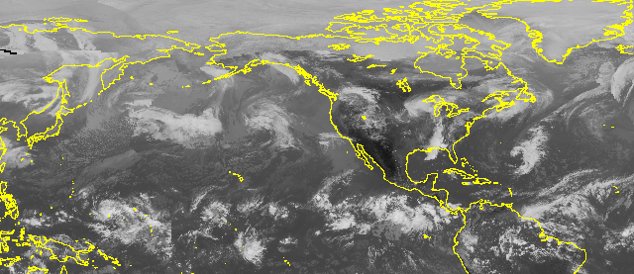
Other mosaics – north hemi, polar views, derived products, etc

Slide 7
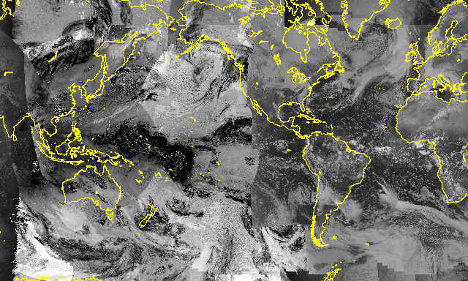
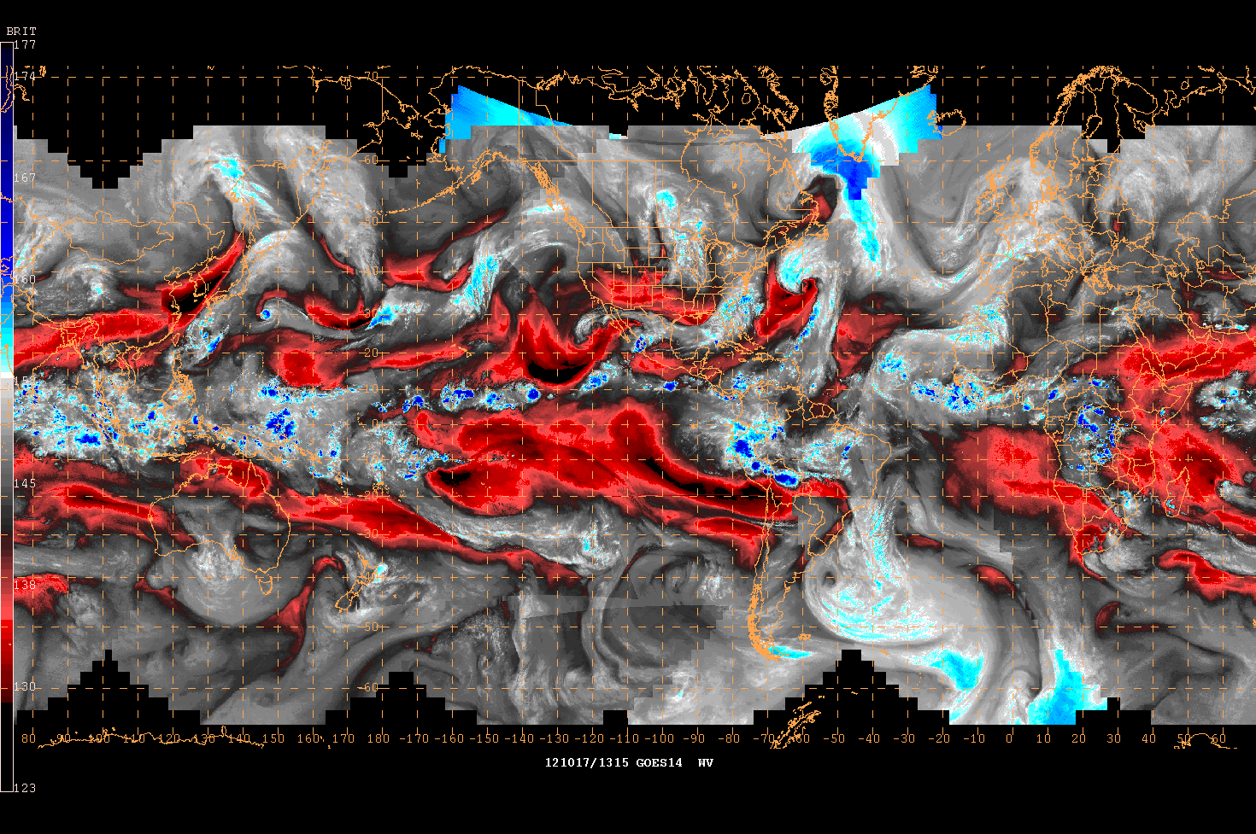
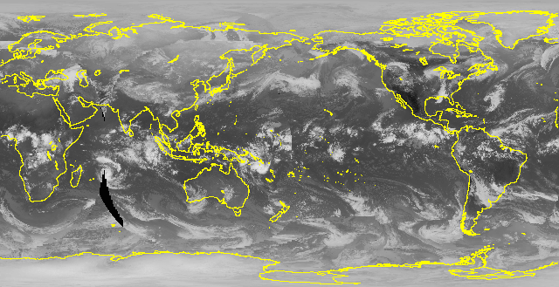
Global mosaics – for international forecasting

Slide 8
Global mosaics – for international forecasting
Two issues noted with 2014 to 2015 version and imgremap command. First, to generate mosaics, AWC uses this command to remap a base image:
.TIMEOUT 10 IMGREMAP (C2) (C6A) PRO=RECT LATLON=0 180 RES=05 -
SIZE=4001 8008 DEV=NNN
Where C2 is a GE north hemisphere image and C6 is the base mosaic. Then this command is looped to remap all other international satellites on top:
.TIMEOUT 10 IMGREMAP (CIN1) (C6A) MER=YES HTS=10. (DTEST) DEV=NNN
Where CIN1 is each satellite name and C6A is the basemap. DTEST is a limb cutoff value (we use 1.5 for GEOs). In this case it is a edge cutoff of 1.5 or a 70 degree cuttoff using the HTS keyword the imgremap command.
With the new imgremap command, HTS works but leaves lots of white space…

Slide 9
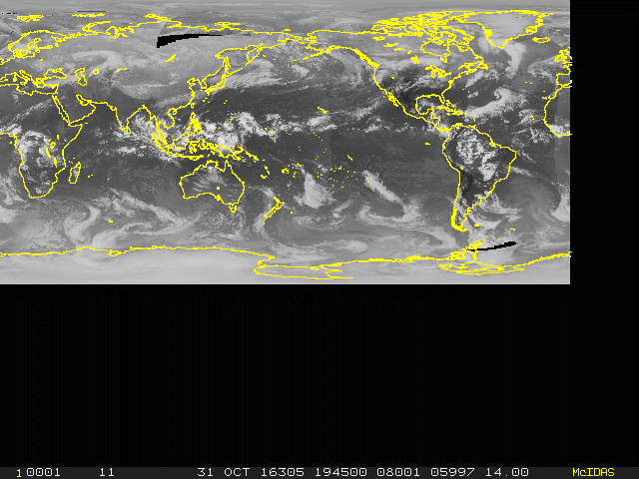
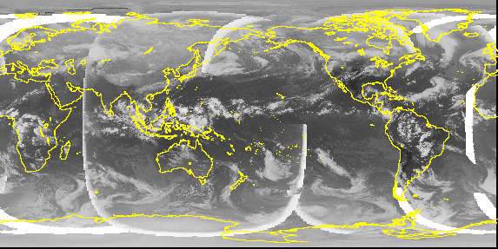

Slide 10
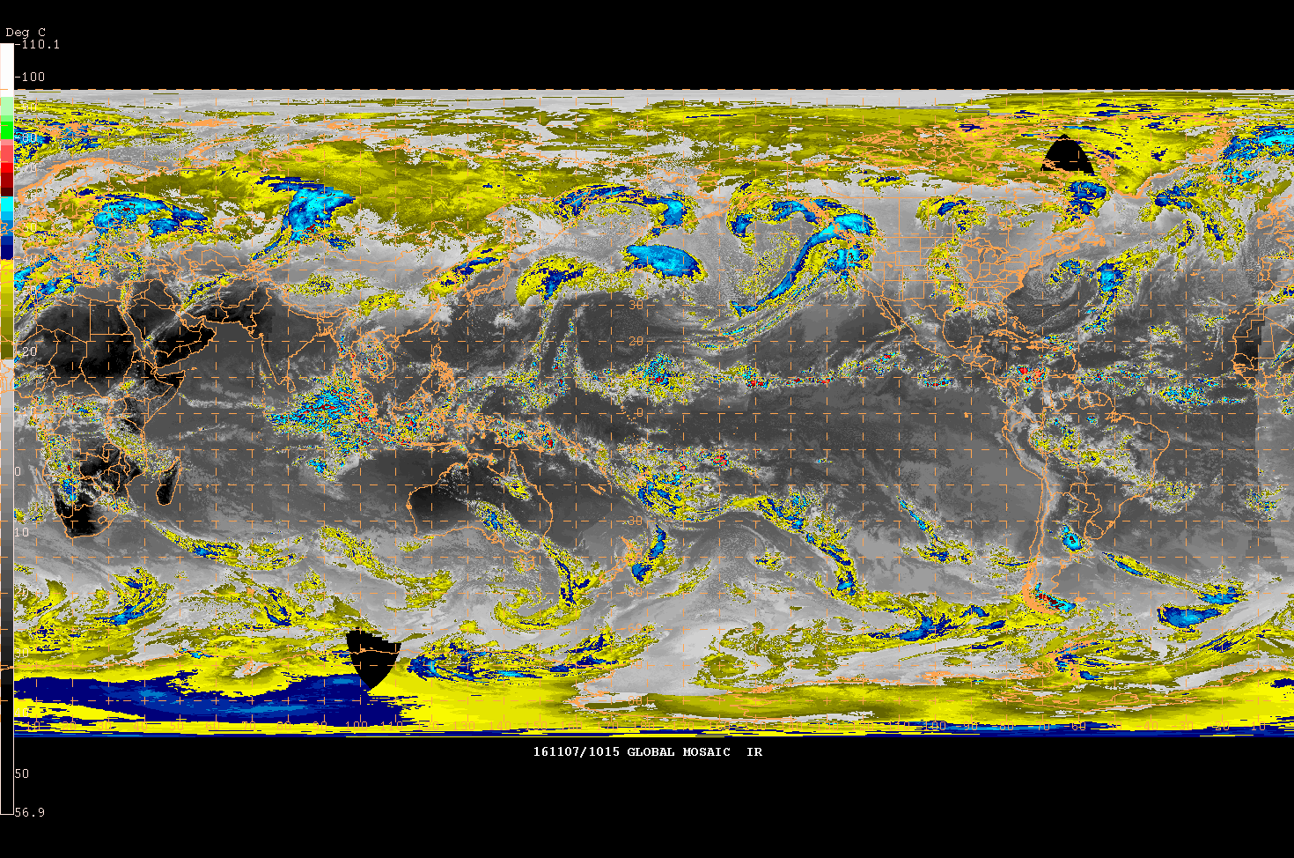
So, use DIST instead:
.TIMEOUT 10 IMGREMAP (CIN1) (C6A) MER=YES DIST=7500 DEV=NNN
That works fine for the most part, but…

Slide 11
Global mosaics – for international forecasting
The second issue seems to involve reprojecting a global mosaic. AWC remaps from a 10km rectilinear to a 14km mercator:
.IMGREMAP (C1) (C2A) PRO=MERC RES=14 LATLON=5 110 -
SIZE=1550 2852 DEV=NNN
Where C1 is the rectilinear and C2 is the mercator. In the old imgremap command this seemed to work fine. With the updated version there is a gap…

Slide 12
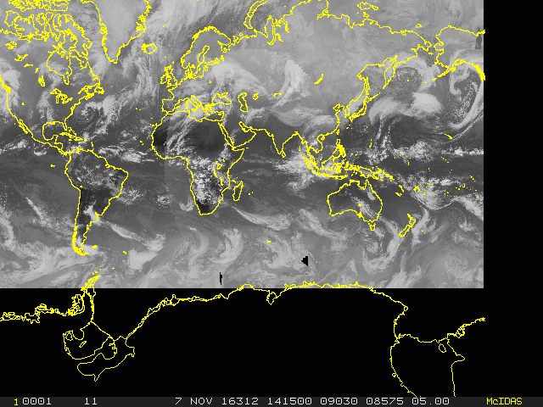
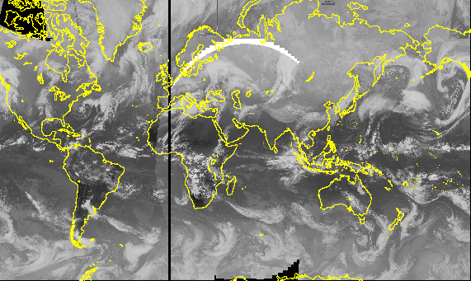

Slide 13
AWIPS-2 and N-AWIPS
AWC mosaic imagery and GOES-R data visualization

Slide 14
AWIPS-2 and N-AWIPS visualization
Worked with SPoRT to use awipaput function in XRD for AWIPS-2
As AWC transitions to AWIPS-2, we need netcdfs
Using awipaput with ncatted allows addition of needed variables for AWIPS-2 compliant netcdfs… depictorName, channel, & satelliteName
GOES-R data visualization → N-AWIPS
With 2016.2, simulated GOES-R netcdfs can be converted to area files
These areas can then be visualized in N-AWIPS…
…with one issue → N-AWIPS/gempak cannot read the *ABIN* navigation so files need to be remapped into another projection/navigation

Slide 15
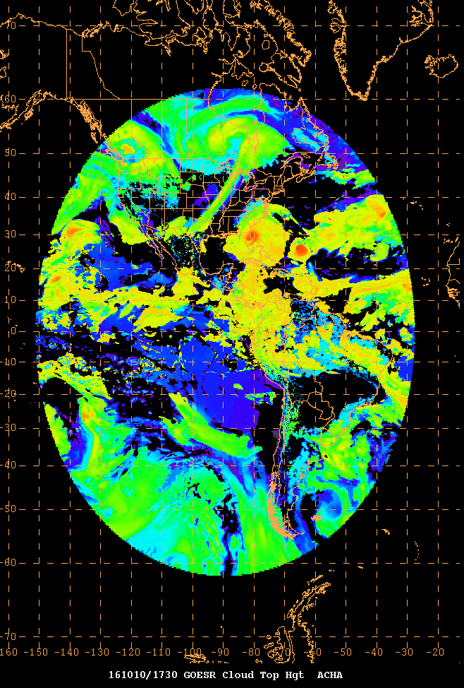
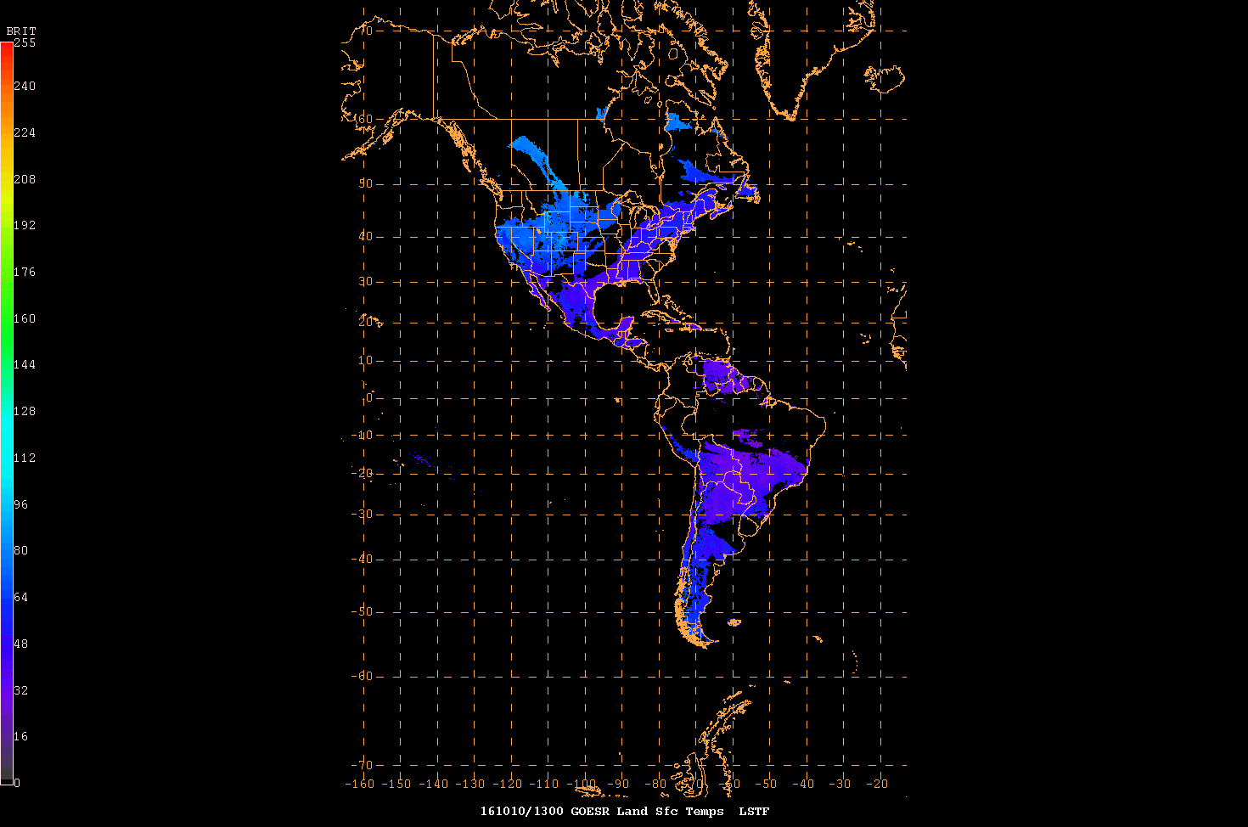
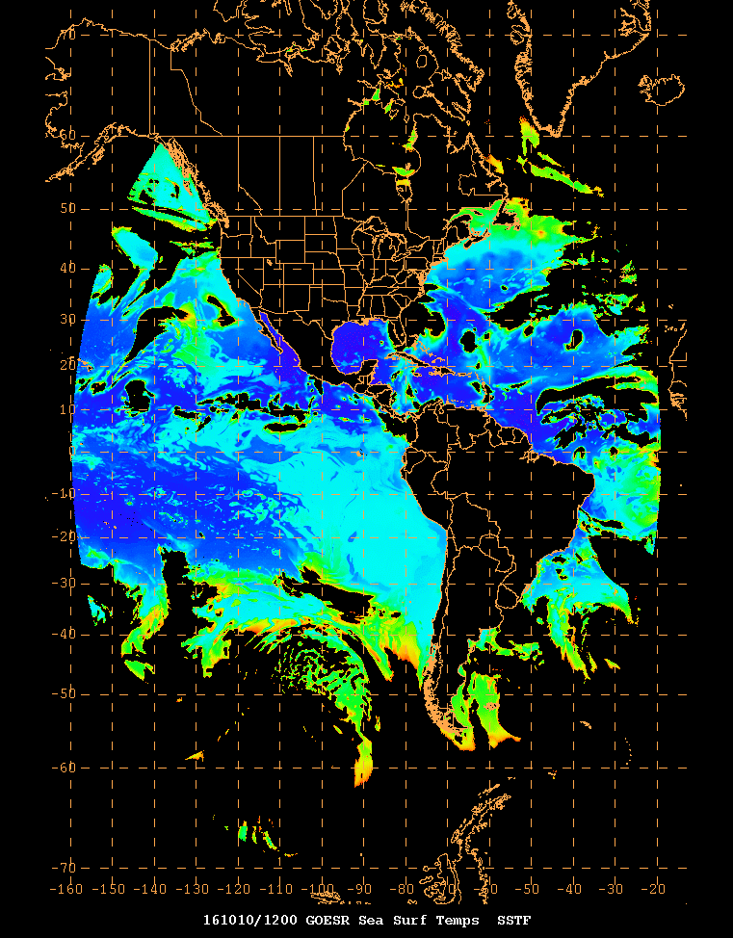
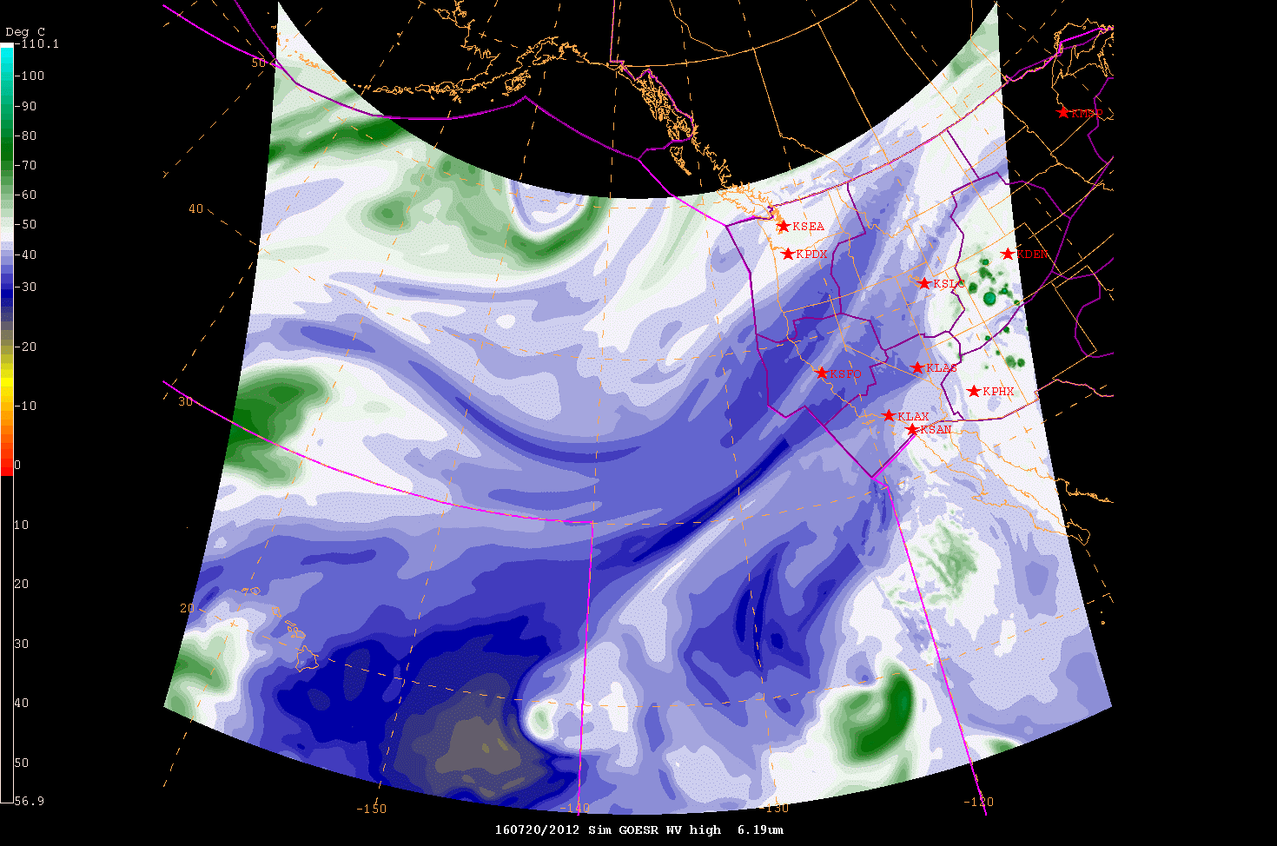
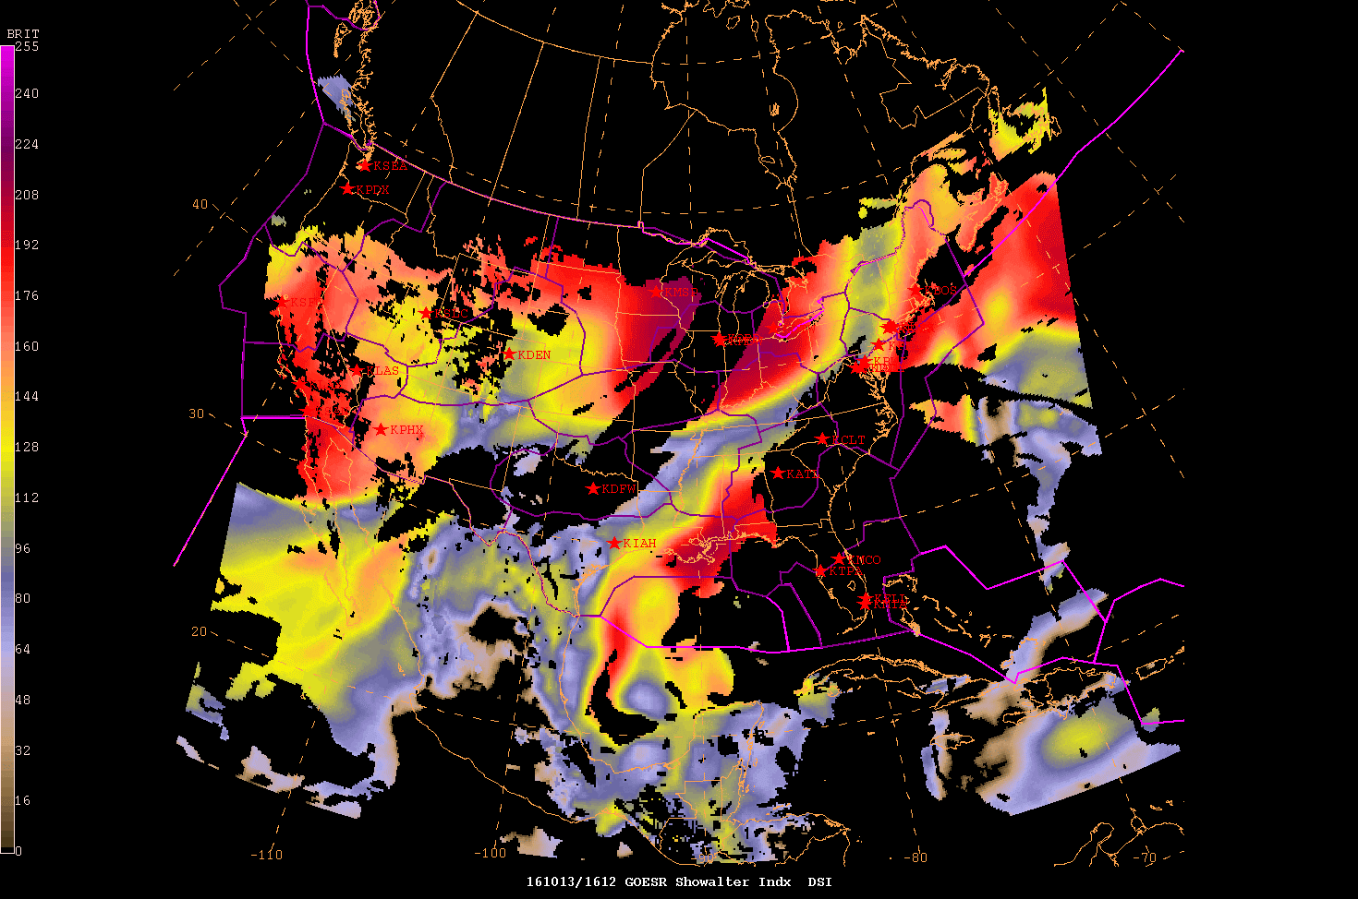
GOES-R data visualization
N-AWIPS style…

Slide 16
McIDAS-V concepts at the AWC
Not the primary processing system (utilize McIDAS-X), but still has been useful
GOES-R data visualization → color bars
Squashing an AWIPS-2 1024+ color scale into 96 colors for N-AWIPS → great color scale editing tool in McIDAS-V
Used to build colorbars for other future capability GOES-R data
Recommended as a training tool for data visualization to WMO training group
WMO in Curacao → South American and Caribbean countries are using it
Plug in built for Geonetcast-A data visualization

Slide 17
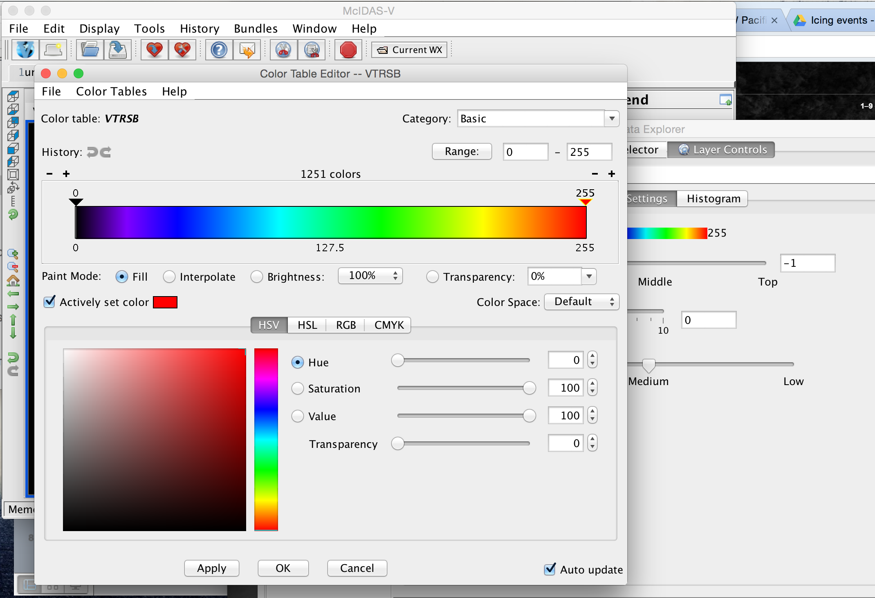
McIDAS-V concepts at the AWC

Slide 18
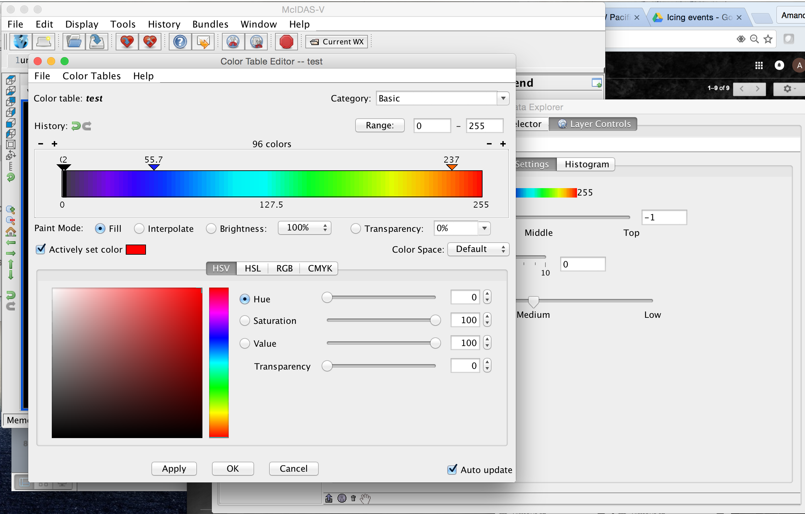
McIDAS-V concepts at the AWC

Slide 19
Questions?
Thanks for listening!

