Slide 1
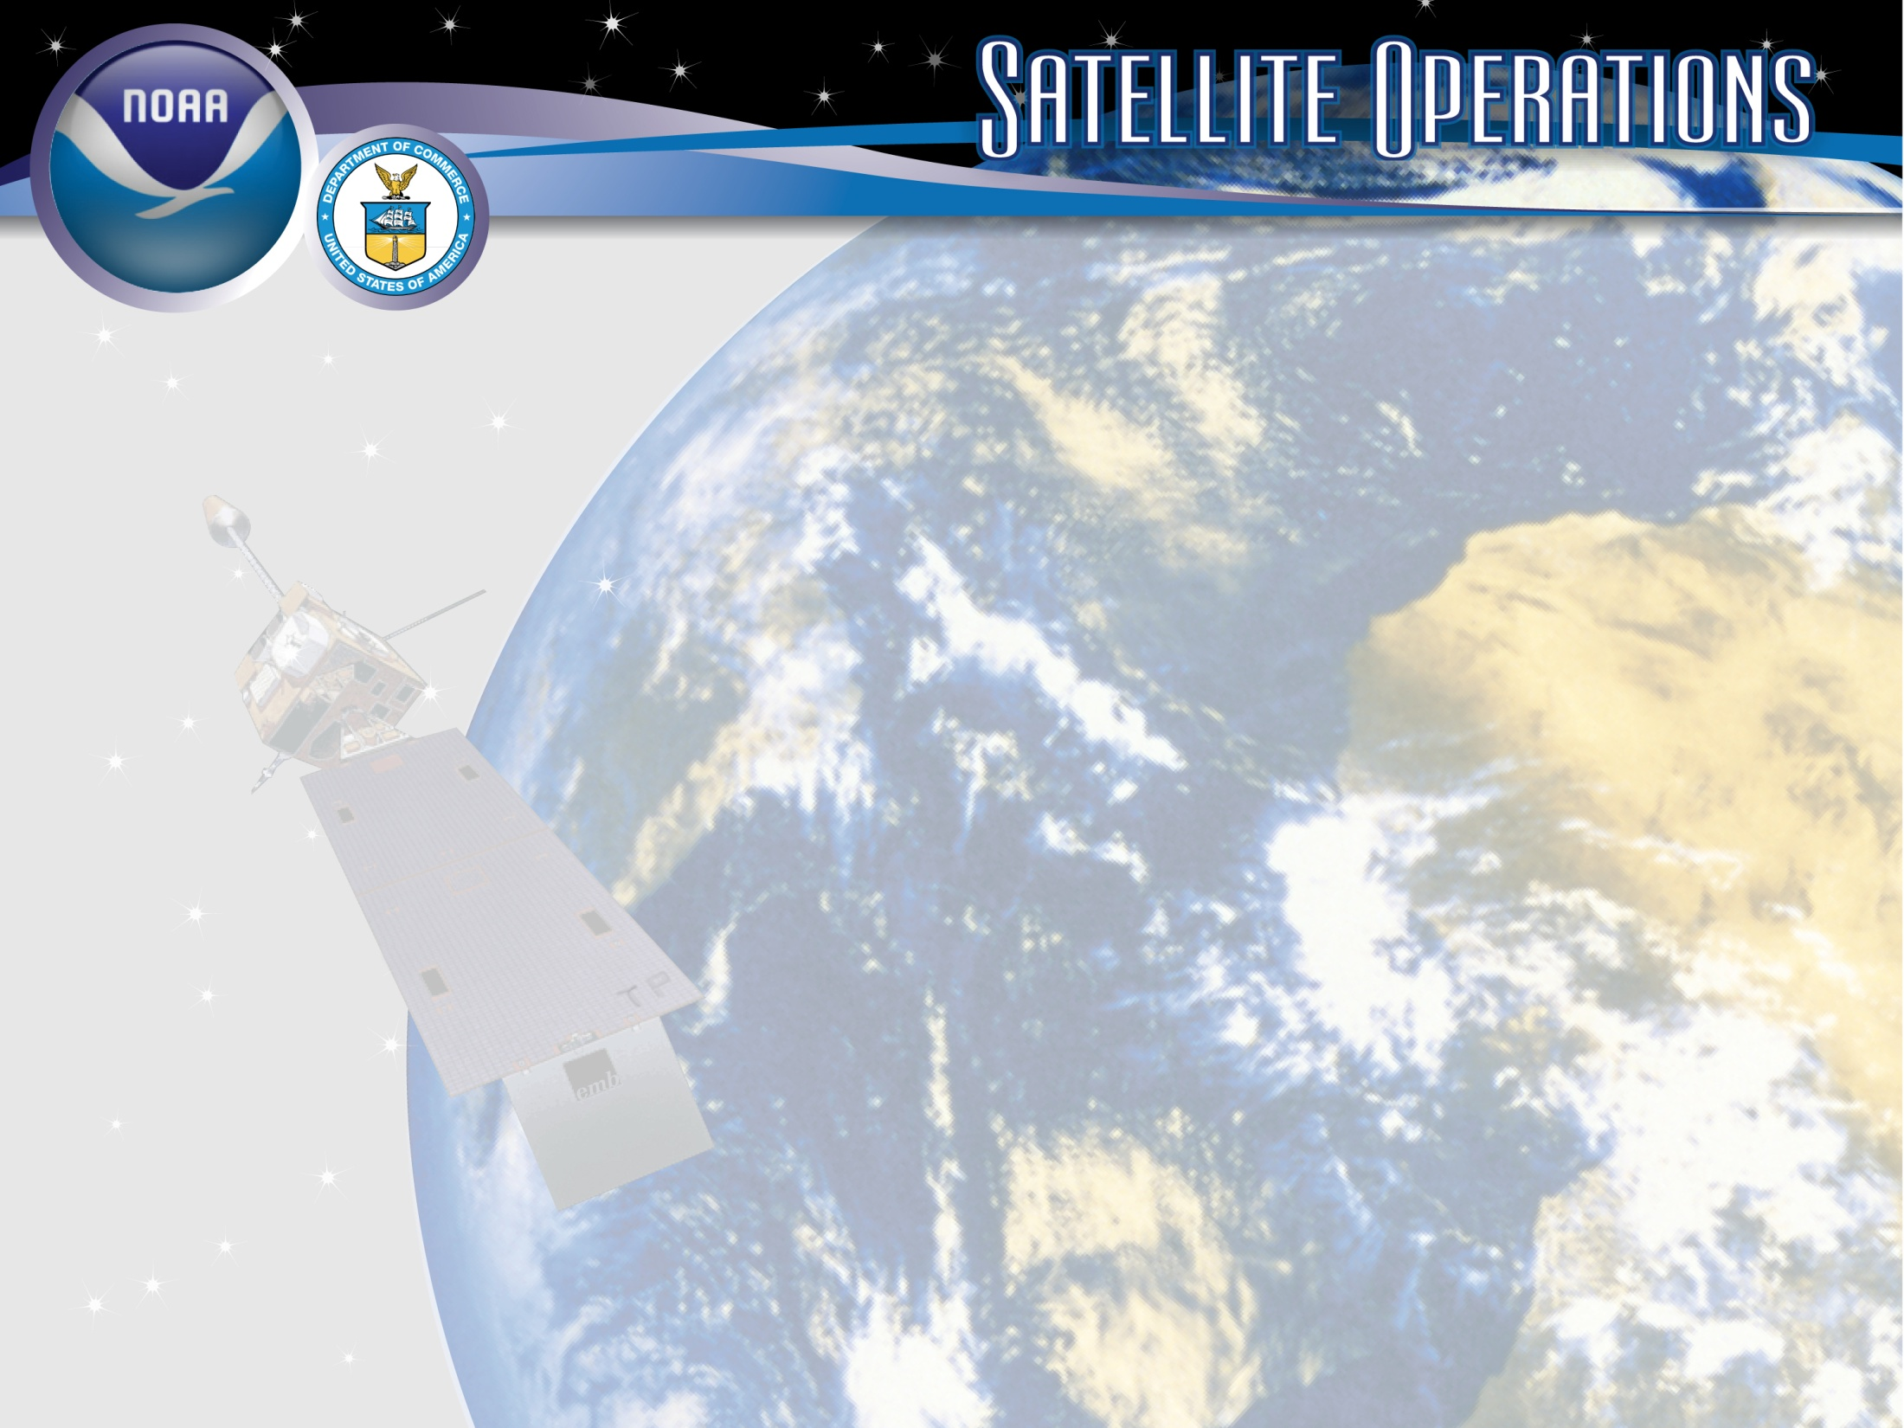
Status of NOAA Satellite Operations & McIDAS at ESPC
Clay Davenport – Chief Programmer
NESDIS/Office of Satellite and Product Operations (OSPO)
2018 McIDAS Users’ Group Meeting
May 22-23, 2018
Madison, WI
Notes:
Title Slide Background and Banner were designed by TeddyPavlis@gmail.com

Slide 2
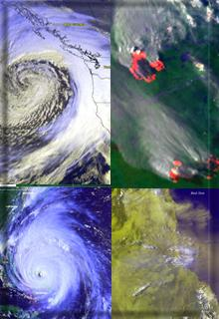
Presentation Outline
Overview of the Office of Satellite and Product Operations (OSPO)
Status of Satellite Operations
Status of McIDAS at ESPC
Updates on Data Access and Distribution
Q&A

Slide 3
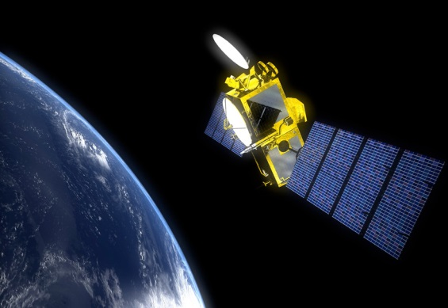
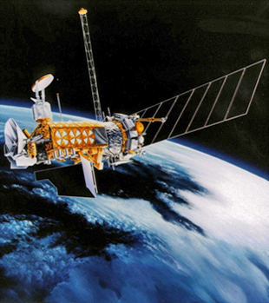
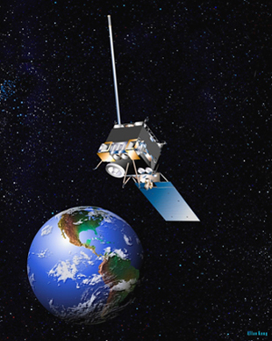
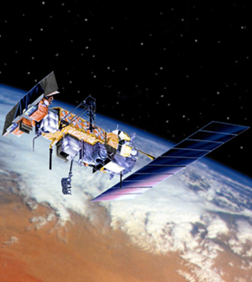
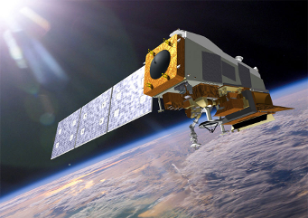
NESDIS Office of Satellite and Product Operations (OSPO)
Operates the Nation’s 18 environmental satellites:
  5 Geostationary (GOES) by NOAA
  2 Joint Polar Satellite Systems by NOAA + NASA (NOAA-20, Suomi-NPP)
  3 Polar-Orbiting (POES) by NOAA
  5 Defense Meteorological Satellite program (DMSP) operated by NOAA
  2 OSTM Jason-2 & Jason-3 (Ocean Surface Topography Mission) - Joint NOAA, NASA, CNES, EUMETSAT effort
  1 DSCOVR (Deep Space Climate Observatory) by NOAA
Notes:
The NESDIS Office of Satellite and Product Operations (OSPO) currently commands and controls nations 18 environmental satellites (listed are various types).

Slide 4

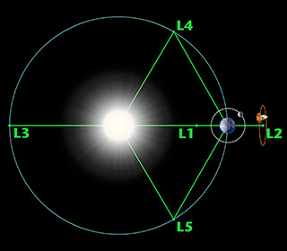

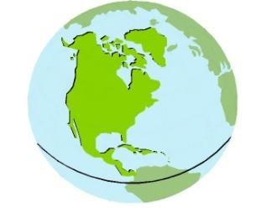


Three Observation Vantage Points
Polar-orbiting Operational
Environmental Satellites
Geostationary Operational
Environmental Satellites
Deep Space
at Lagrange 1 Point
22,300 Miles
540 Miles
Each satellite covers the Earth
twice per day
  Pole-to-pole orbit is 101 minutes and views each location at the same time of day; capability for ½ orbit dumps with JPSS-1
  Global coverage every 12 hours with one satellite
  EUMETSAT - mid-morning orbit
  NOAA - early afternoon orbit
Continuous monitoring
of the Americas
  Coverage over the same geographic location
  Constant monitoring for nowcast purposes and for forecast applications (NWP, etc.)
Continuous monitoring
of the Sun
  Uninterrupted view of the sun
  Information is used for solar winds monitoring for Space Weather warnings
Notes:
The satellites provide three observational vantage points for coverage of Earth.
Polar-orbiting satellites orbit the globe twice per day (pole to pole) for morning and afternoon coverage.
Geostationary satellites provide coverage over the same geographic location for constant nowcast monitoring.
Deep Space satellite (DSCOVR) provides an uninterrupted view of the sun.

Slide 5

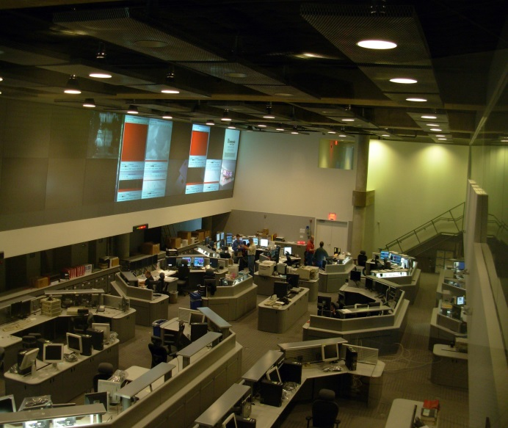
OSPO’s Key Roles
Ground System Command & Control, Ingest, Generation, and Distribution
Pre-Launch and Post-Launch Testing
Operational Testing, Validation, and Verification
User Readiness for Broadcast Services and Product Delivery
Long-Term Continuity of Products and Services
Notes:
OSPO manages and directs the operation of the central ground facilities which ingest, process, and distribute environmental satellite data and derived products to domestic and foreign users.
Responsible for:
Ground System Command and Control,
Pre-Launch and Post-Launch Testing,
Operational Testing, Validation, and Verification
User Readiness for Broadcast Services and Product Delivery
Long-Term Continuity of Products and Services

Slide 6

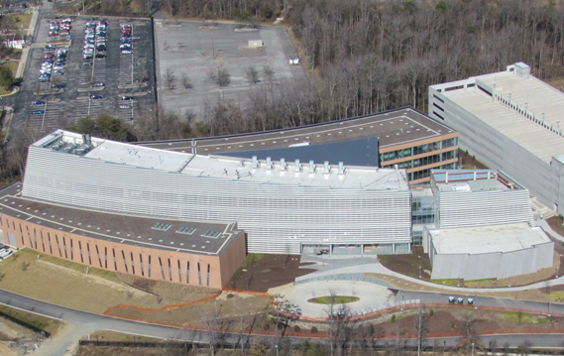
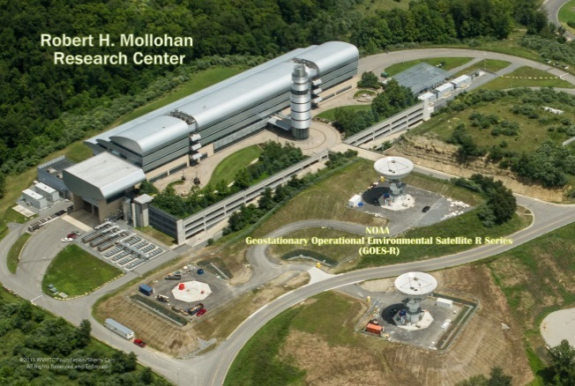
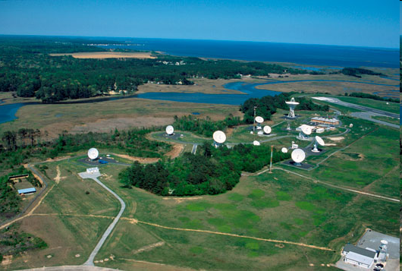
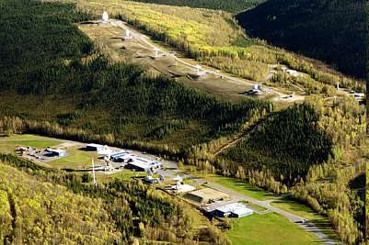
OSPO Operational Facilities
Over 500 staff supporting or operating the satellites, receptors, and processing systems
Suitland, MD
College Park, MD
Fairmont, WV*
Wallops, VA
Fairbanks, AK
* GOES-R and JPSS (New) Backup Facility
Notes:
OSPO has locations at four major facilities housing over 500 people.
NOAA Satellite Operations Facility (NSOF) in Suitland, Maryland
Mission Operations Division (MOD)
NOAA Center for Weather & Climate Prediction (NCWCP) in College Park, Maryland.
Satellite Product and Services Division (SPSD)
OSPO has Command and Data Acquisition Stations in Fairbanks, Alaska and Wallops, Virginia.

Slide 7
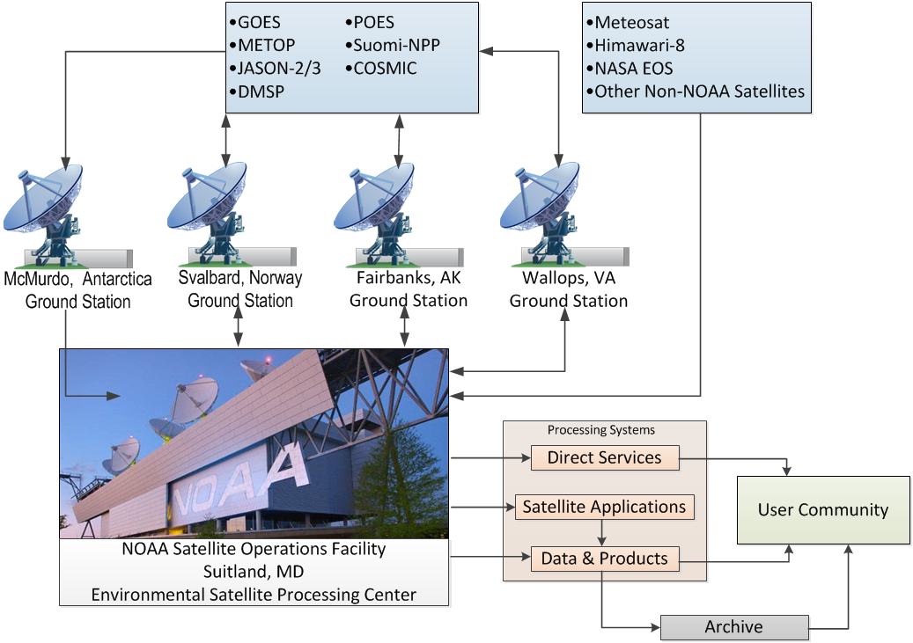
Nominal Satellite Data Flow
Notes:
Here’s a depiction of the nominal satellite data flow as data from the satellites is ingested and processed by ESPC.
Processing systems provide the data to the user community and archive (NCEI).

Slide 8
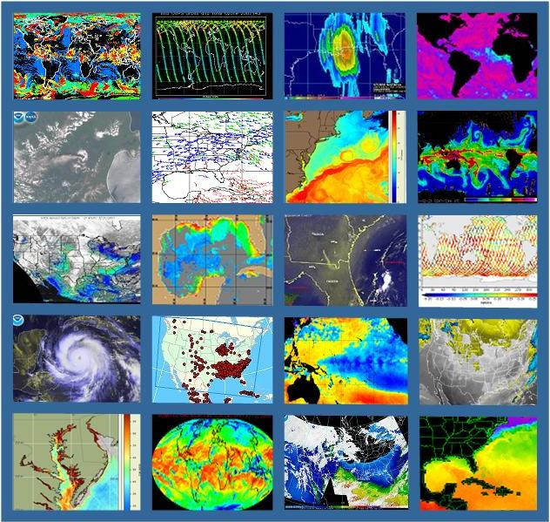
OSPO’s Satellite Products and Services Division
Provides 24x7 interpretive analyses of satellite data
  Atmospheric temp/moisture
  Hurricane intensity & position
  Volcanic Ash
  Fire and Smoke
  Oil Spills
  Significant Precipitation (20x7)
Manages automated environmental products
Collaborates with partners to support transition of research products into operations
Notes:
OSPO’s Satellite Products and Services Division leads production, adaptive maintenance, and monitoring activities for a variety of derived and interpretive environmental products.
Satellite Analysis Branch (SAB) provides operational 24X7 interpretive analyses of satellite data.
Satellite Products Branch (SPB) collaborates with STAR - Satellite Products and Services Review Board (SPSRB) to effectively manage the product life cycle process from product development, transition into operations, enhancements, and retirement.

Slide 9
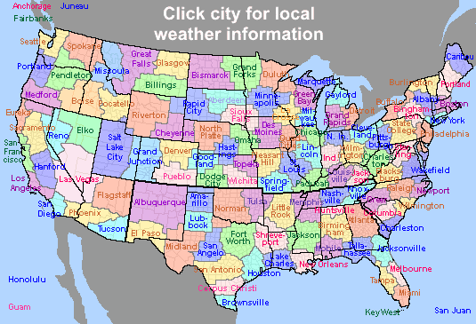
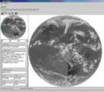
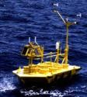


Direct Service Operations
Emergency Managers Weather Information Network (EMWIN):
NOAA satellites relay critical information to users across the country.
  http://www.weather.gov/emwin/index.htm
Low Resolution Image Transmission (LRIT):
NOAA satellites are used to relay satellite and weather products to users in remote
locations, that do not have landlines or internet connections.
  http://www.noaasis.noaa.gov/LRIT/
Data Collection:
NOAA satellites are used to collect and relay scientific data from around the globe.
  http://www.noaasis.noaa.gov/DCS/ http://www.noaasis.noaa.gov/ARGOS/
Search and Rescue Satellite Aid Tracking (SARSAT):
NOAA satellites are used to relay distress alerts from aviators, mariners and
land-based users (http://www.sarsat.noaa.gov/
Geonetcast Americas:
Data from NOAA for diverse societal benefits - agriculture, energy, health, climate,
weather, disaster mitigation, biodiversity, water resources, and ecosystems.
  http://www.geonetcastamericas.noaa.gov/index.html
Notes:
OSPO partners with NWS to provide data and products through the Emergency Managers’ Weather Information Network (EMWIN).
OSPO also manages GOES Data Collection Services (*more than 21,000 active Argos platforms collecting data for over 1,900 distinct projects in 100+ countries).
Though the assistance of OPSO’s Search and Rescue Satellite Aid Tracking (SARSAT) program – (*250 individuals were rescued in calendar year of 2015 alone).
Since 1982, there have been a total of 7,740 SARSAT saves in the US, and more than 39,000 worldwide (as of December 31st, 2015)

Slide 10
GEO Status

Slide 11
Geostationary Operational Environmental Satellite (GOES-NOP)
Performance Status – March 2018
Payload Instrument | GOES-13 (Storage) Launch: May 06 Activation: Apr 10 Legacy: Jan 18 | GOES-14 (Standby) Launch: Jun 09 Activation: | GOES-15 (West) Launch: Mar 10 Activation: Dec 11
Imager | G | G | G
Sounder | R (4) | G | Y (3)
Energetic Particle Sensor (EPS) | G | G | G
Magnetometers | G | G | G
High Energy Proton and Alpha Detector (HEPAD) | G | G | G
X-Ray Sensor (XRS) | Y (1) | G | G
Solar X-Ray Imager (SXI) | Y (2) | G | G
Spacecraft Subsystems
Telemetry, Command & Control | G | G | G
Attitude and Orbit Control | G | G | G
Fuel for Inclination Control | G | G | G
Propulsion | G | G | G
Mechanisms | G | G | G
Electrical Power | G | G | G
Thermal Control | G | G | G
Communications Payloads | G | G | G
Key
Operational
Operational with limitations
Non-operational
G
Y
R
Notes:
1

Slide 12
Geostationary Operational Environmental Satellite (GOES-16)
Performance Status – March 2018
Payload Instrument | GOES-16 (EAST) Launch: Nov 2016 Activation: Dec 2017
Advanced Baseline Imager (ABI) | G
Space Environment I-Situ Suite (SEISS) | G
Solar Ultraviolet Imager (SUVI) | G
EUV and X-ray Irradiance Sensors (EXIS) | G
Magnetometer | Y
Geostationary Lighting Mapper (GLM) | G
Spacecraft Subsystems
Command Data & Handling (CD&H) | G
Guidance Navigation Control (GNC) | G
Electrical Power Subsystem (EPS) | G
Propulsion | G
Mechanisms | G
Electrical Power | G
Thermal Control | G
Communications Payloads | G
Key
Operational
Operational with limitations
Non-operational
G
Y
R
Notes:
1

Slide 13
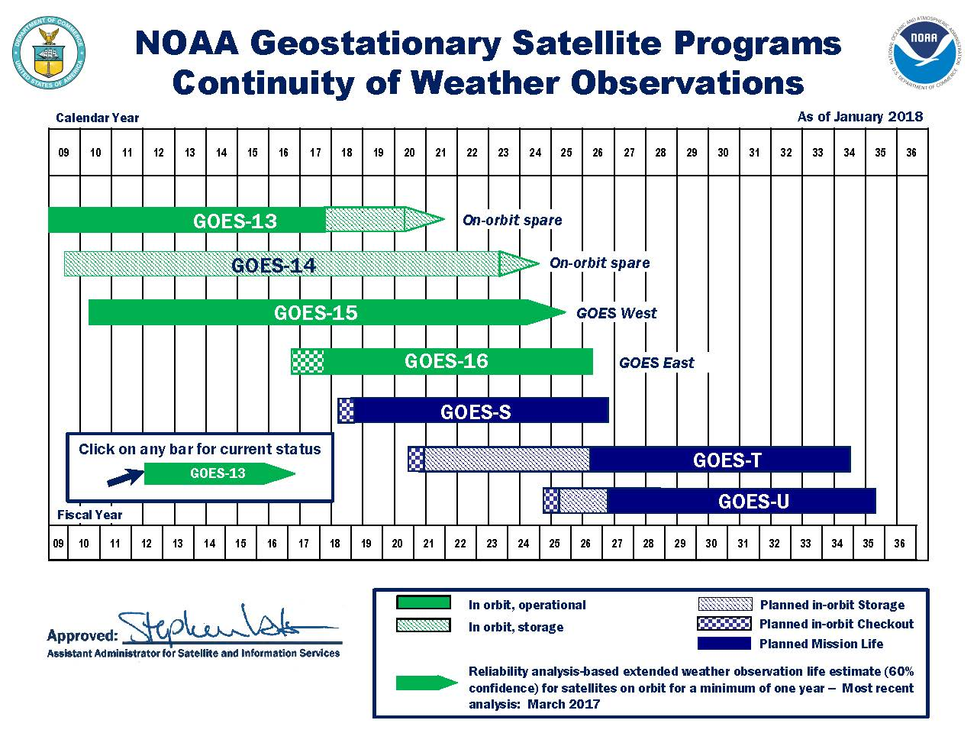
GOES Flyout Schedule
http://www.nesdis.noaa.gov/FlyoutSchedules.html http://www.goes-r.gov
Notes:
Here is the Flyout Schedule showing the continuity of the GOES Mission.
GOES-R is the next generation of GOES satellites that will provide a major improvement in quality, quantity, and timeliness of data collected.

Slide 14
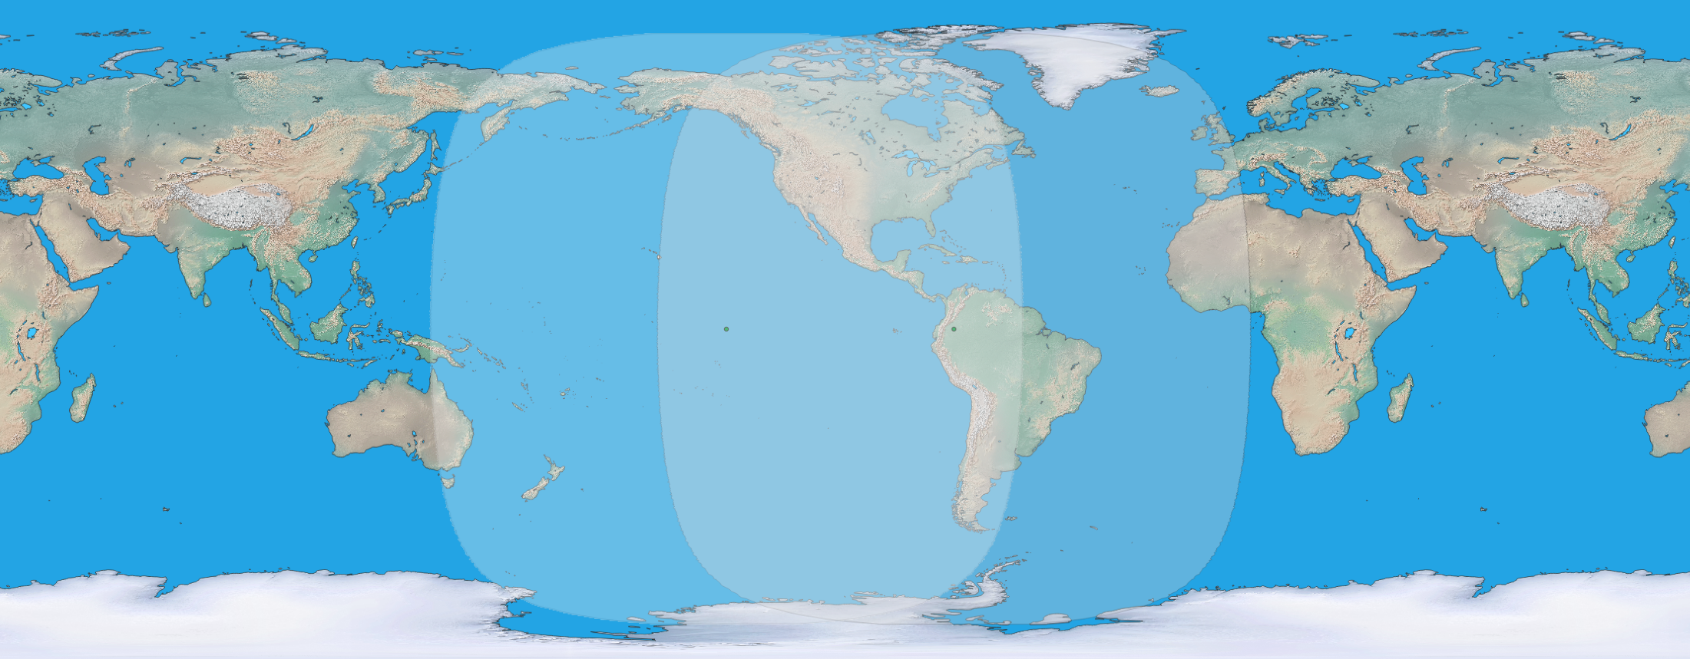

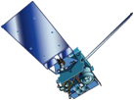
GOES Constellation
GOES-West
GOES-15
135° West
GOES-East
GOES-13
75° West
GOES-West
Standby
GOES-East
  Primary source of data for short term forecasting, especially of severe weather such as tropical storms
Continuity of Operations since 1974
Notes:
After launch, the plan is to maintain the current GOES constellation until a decision is made regarding GOES-R positioning.
OSPO will continue to keep a standby satellite at 105w as backup to GOES-East and GOES-West.
GOES-R (after settling in at 89.5 degrees West position) will have a no effect on GOES-13/15 operations.
GOES Maintenance schedules will remain intact for legacy satellites.
The decision on positioning of GOES-R will depend on a number of factors:
The overall health of the entire GOES constellation and the needs of the user community.
Keep in mind, GOES-13 turned 10 years old this year and has existing issues (i.e. Sounder issue).
GOES-15 has only one healthy Star Tracker (ST1 & ST2 out). This and other considerations will factor into any decision.
Various other scenarios could come into play to influence GOES-R positioning and the fate of one of the spare satellites.

Slide 15
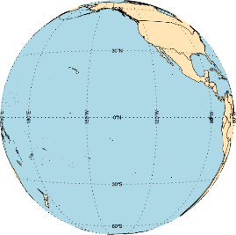
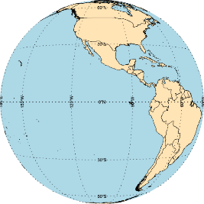
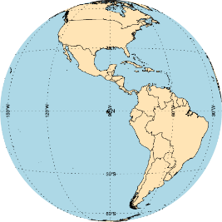

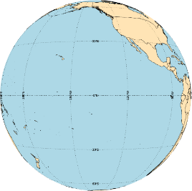
GOES Constellation
Current Constellation as of May 22, 2018
GOES-West
GOES-15
135° West
Standby
GOES-14
105° West
Checkout
GOES-17
89.5° West
GOES-East
GOES-16
75.2° West
Storage
GOES-13
60° West
Future Constellation Plans as of May 22, 2018
GOES-West
GOES-17
137° West
Storage
GOES-15
105° West
Standby
GOES-14
105° West
Checkout
GOES-T/U
89.5° West
GOES-East
GOES-16
75.2° West
Storage
GOES-13
60° West
Drifting to
137° West in
October, 2018;
Operational at
137° West in
Nov/Dec, 2018
Drifting to
105° West
for storage in
Nov/Dec, 2018
GOES-T Launching in
June, 2020;
GOES-U Launching in
2024
Notes:
Here’s another depiction of the GOES Constellation coverage.
GOES is the primary source of data for short term forecasting, especially of severe weather such as tropical storms.
The GOES-R checkout location at 89.5 degrees West provides coverage of the entire Atlantic Ocean and even the fringe of the Western edge of the African continent.
The Atlantic Ocean is fully covered for tropical monitoring purposes.

Slide 16
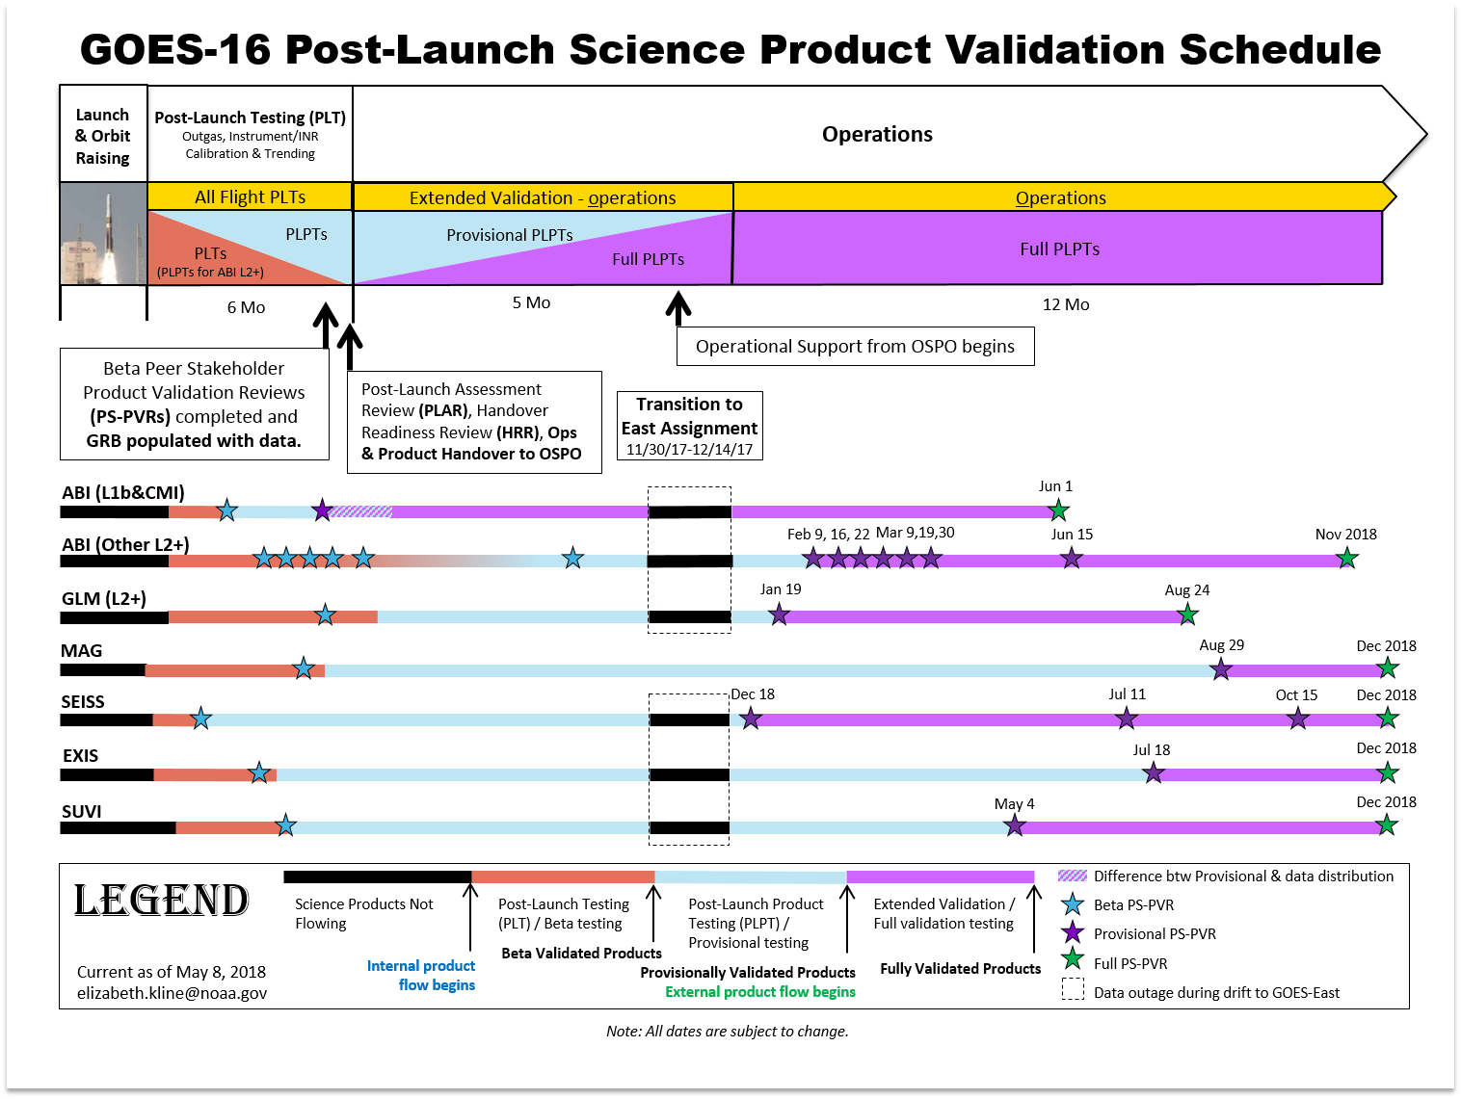
GOES Constellation
Notes:
Vertical blue line is today
No products have received full maturity qual yet

Slide 17
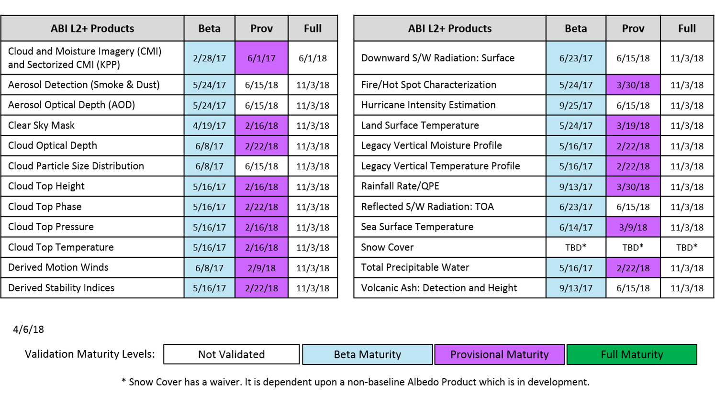
GOES-16 L2+ Science Product Validation Status
Notes:
CMIs expected to reach full maturity on 6/1
All remaining level 2s are provisional by 6/15, full in November (except snow)

Slide 18
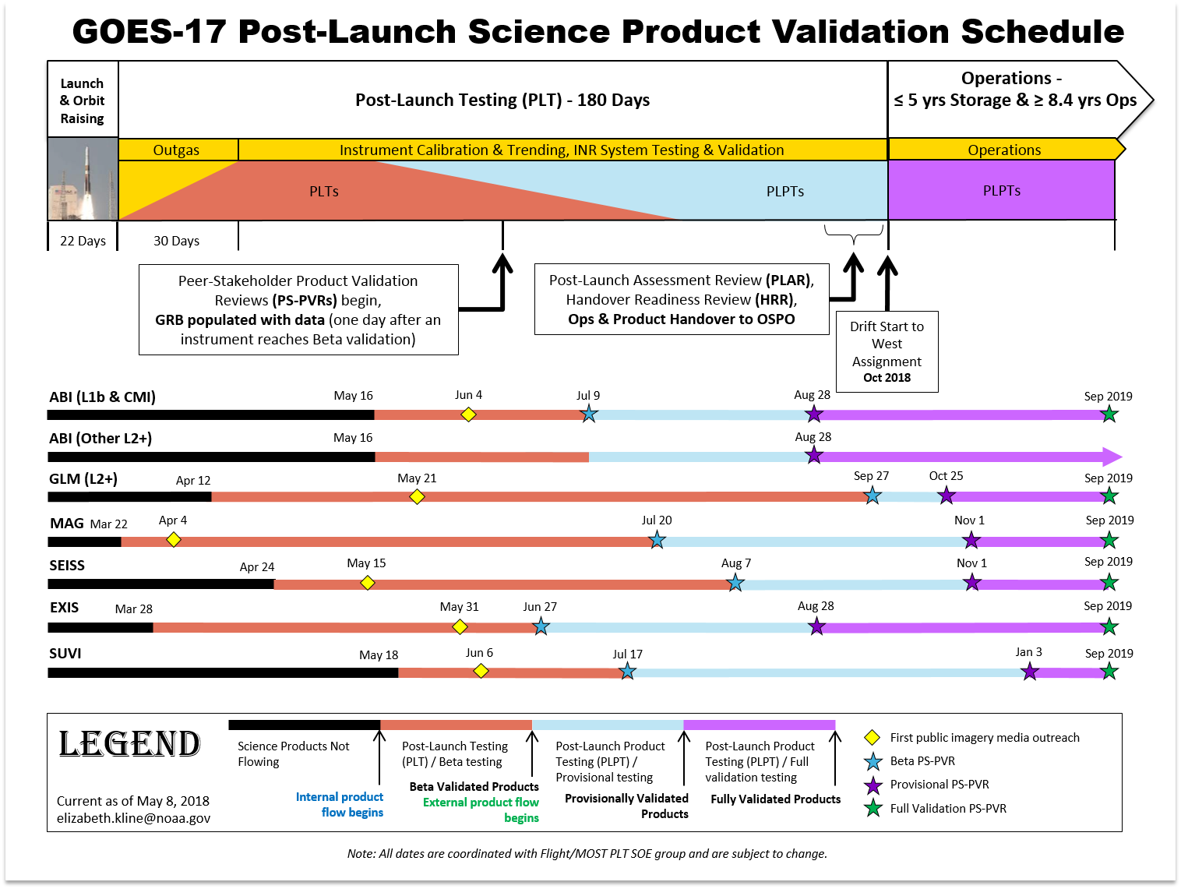
GOES-17 First Public Images & Plots
First public images/plots will be released after orbit raising and initial image navigation and radiometric assessment
CWG POCs are established for creation of First Drafts of Public Image/Data Mock-Ups
PRO Lead, Program Chief of Staff and NESDIS Communications facilitate and provide copy-edits for story-board layouts and captions

Slide 19
GOES-West Transition Plan for Replacement of GOES-15 with GOES-17
Date | GOES-17 | GOES-15
Sep, 2018 | Post Launch Acceptance Review
Sep, 2018 | Handover Readiness Review
Oct, 2018 | Drift Start from 105 deg West (data stops)
Oct, 2018 |  | GVAR Re-Routed through GOES-14
Nov, 2018 | Drift Stop at 137 deg West
Nov, 2018 | Data Distribution Resumes
Nov, 2018 | Operations Transition Readiness Review
Nov/Dec, 2018 | Becomes GOES-West
Nov/Dec, 2018 |  | Data Distribution Disabled (some Space Wx may continue)
Dec, 2018 |  | Data Re-Routing via GOES-14 Disabled
Dec, 2018 |  | Instruments Placed in Safe Mode (some Space Wx may continue). Consider drift options.
Notes:
Current plans have ~3 week overlap between g15 and g17 in final position
DoD/NWS pushing for ~3 months…if accommodated, would delay the turnoff of g15 into Jan/Feb 19

Slide 20
POES Status

Slide 21
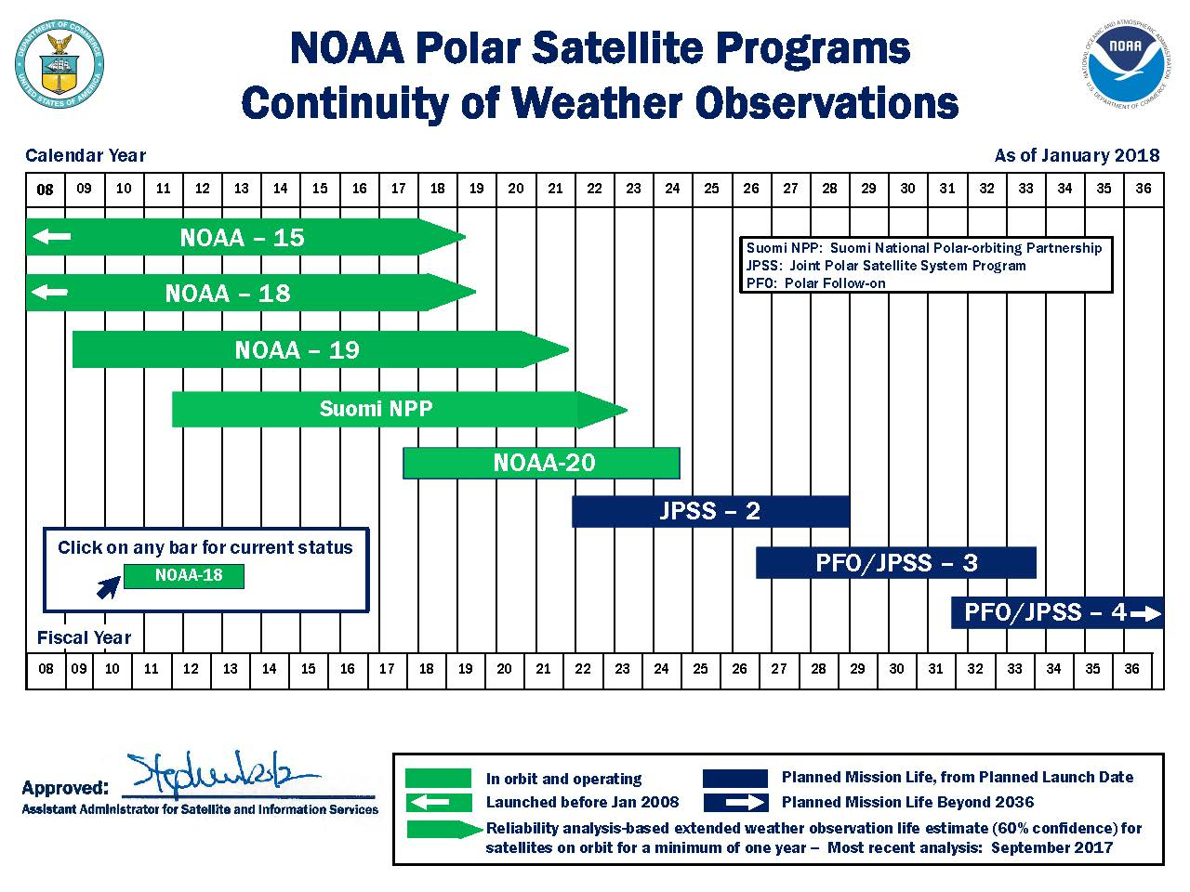
LEO Flyout Schedule
http://www.nesdis.noaa.gov/FlyoutSchedules.html http://www.jpss.noaa.gov
Notes:
Here is a depiction of the Low Earth Orbit Flyout Schedule.
S-NPP is a risk reduction mission for JPSS-1 and provides data continuity for NASA EOS Missions.
Highest priority is to launch the follow-on polar satellite Joint Polar Satellite System (JPSS-1/NOAA-20) with launch expected Mid-March 2017 while JPSS-2 launch readiness is planned for 4th quarter FY 2021
The JPSS will succeed NOAA's POES satellites and ground systems by leveraging investments made in NOAA POES, NASA's Earth Observing System (EOS), and the SNPP to maintain continuity of global, operational, space-based observations.

Slide 22
POES Status (Apr 2018)
http://www.ospo.noaa.gov/Operations/POES/status.html
Operational | G
Spacecraft Issue but no User Impact | S/C
Operational with Limitation | Y
Non-Operational | R
Not Applicable | N/A
 | METOP-B | NOAA-19 | S-NPP* | GOES-16 | GOES-15
Launch Date | Sept 2012 | Feb 2009 | Oct 2011 | Nov 2016 | March 2010
Operational Date | April 2013 | Jun 2009 | Sept 2013 (NDE) | Dec 2017 | December 2011
Mission Data Category | Primary (AM) | Secondary (PM) | Primary (PM) | GOES-East | GOES-West
Product Areas
Imagery | G | G | G | G | G
Radiances | G | G | G (CrIS/ATMS) | G | G
RadBud/Emissivity | G | G | G (Emissivity) | G | G
Soundings | G | G | G (CrIS/ATMS Moist and Temp Profiles) | G | G
Winds | G | G | G (VIIRS PW) | G | G
Sea Surface Temp | G | G | G (VIIRS SST) | G | G
Precipitation | G | G | G (MIRS RR+TPW) | G | G
Volcanic Ash | G | G | Future | G | G
Tropical Products | G | G | G(NTCP) | 6/15/2018 | G
Ozone | G | G | G (OMPS TC/Profile + CrIS Ozone) | N/A | N/A
Fire and Smoke | G | G | G(Active fires and AOT) | 3/30/2018 | G
Snow and Ice | G | G | G (Binary Snow Cover) | TBD | G
Vegetation | G | G | G (VIIRS Green Vegetation Fraction) | N/A | N/A
Broadcast Services | G | G | G | G | G
Notes:
Here’s a depiction of POES stoplight chart showing the status of payload instruments and spacecraft subsystems.
OSPO still flies legacy POES. Not only does POES support the weather mission, but POES also supports SARSAT (rescue) and ARGOS (data collection) missions.
Some issues affecting certain POES satellites are mitigated though use of fellow POES satellites.
For time’s sake, I won’t go through all the specific issues (please reference the web link).
(4/26/2016), the instrument group announced that channel-8 on Metop-A AMSU-A1 has gone red. Recall; Channels 7 and 8 have been bad for a long time back (December 2014?) and since then we (NOAA) have taken out channels 7 and 8 from ATOVS application for Metop-A. After substituting these channels ATOVS products are fine in terms of quality.
Metop-B AMSU-A channel 15 became unusable starting with sensing time at 00:53:00 UTC, October 17, 2016. The anomaly causes degradation to the MIRS (Microwave Integrated Retrieval System) Metop-B products. Users were notified about the degradation while OSPO was working with STAR to develop a possible mitigation for the anomaly. On October 21, a solution was tested and implemented to mitigate the impact of the AMSU-A channel-15 anomaly. The MHS (Microwave Humidity Sounder) channel-1, which has the same frequency (89GHz) as AMSU-A channel-15, is now used to replace AMSU-A channel-15 in the MIRS Metop-B retrievals. The impact assessment indicates that the mitigation solution has restored the MIRS retrieval quality.

Slide 23
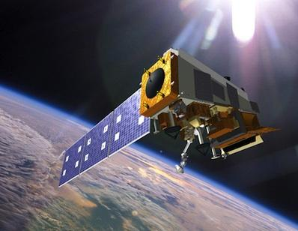
Suomi National Polar-orbiting Partnership (S-NPP)
Performance Status – March 2018
Payload Instruments | Status
ATMS | G
CERES | G
CrIS | G
OMPS – Nadir | G
OMPS – Limb | G
VIIRS | G
Spacecraft Subsystem | Status
TLM, Command & Control | G
ADCS | G
EPS | G
Thermal Control | G
Communications | G
CDP | G
SCC | G
GPS | G
1553 | G
1394 | G
Spacecraft | S-NPP
Launch Date | Oct 28, 2011
Mission Category | LTAN 1330 (PM) +/- 10 mins
Operational (or capable of)
Operational with limitations (or in standby)
Operational with degraded performance
Not functional
Functional but turned off
No status reported
Additional Notes:
29-Mar-2018: All instruments operating normally and are meeting/exceeding their established performance specifications Additional instrument/system notes: Extensive monitoring of the ATMS scan drive motor current loads and temperatures is ongoing. All data processing and distribution is being performed on Block JPSS 2.0 systems and on the new ground segment (NDE 2.0/PDA) ATMS Instrument - Routine execution of twice an orbit ATMS scan drive motor reversal activities been ongoing since 18 Aug 2016 – this activity will continue indefinitely. These reversal activations are performed near high latitudes (70N, 70S, 75N, 75S, 80N, 80S) in order to provide for a more consistent placement of the reversal-induced data gaps. Note - The purpose of the ATMS scan driver motor reversal is to extend the bearing life. During each reversal activity, expect up to a one minute ATMS data outage. ATMS data resumes normally after each scan drive motor reversal activity is completed.

Slide 24
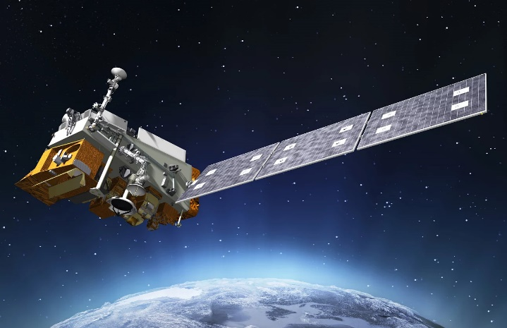
NOAA-20 (Joint Polar Satellite System-1)
Performance Status – March 2018
Payload Instruments | Status
ATMS | On/Cal
CERES | On/Cal
CrIS | On/Cal
OMPS – Nadir | On/Cal
OMPS – Limb | On/Cal
VIIRS | On/Cal
Spacecraft Subsystem | Status
TLM, Command & Control | G
ADCS | G
EPS | G
Thermal Control | G
Communications | G
CDP | G
SCC | G
GPS | G
1553 | G
SpaceWire | ON
Spacecraft | NOAA-20/JPSS-1
Launch Date | Nov 18, 2017
Mission Category | Transitioning to Operational Orbit
Operational (or capable of)
Operational with limitations (or in standby)
Operational with degraded performance
Not functional
Functional but turned off
No status reported
Additional Notes:
Spacecraft is nominal at this time VIIRS: VIIRS Outgassing has improved the performance of the VIIRS instrument back to near-nominal levels. Engineering is monitoring instrument performance for 200 orbits (the initial time it took for the degradation to appear) before closing out anomaly.

Slide 25
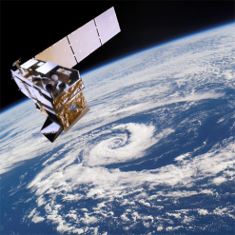
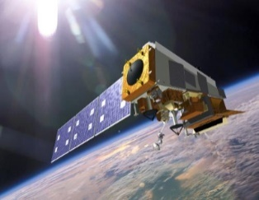
SNPP & NOAA-20 Concurrent Operations at OSPO
The NOAA-20 mission profile is substantially similar to S-NPP as NOAA-20 leads S-NPP by ½ orbit (i.e. ~51 min.)
With the launch of NOAA-20, NOAA will operate two satellites within the same environment.
S-NPP northern contact will often coincide with NOAA-20 southern contact.
  NOAA-20 SMD playback data latency significantly improved vs. S-NPP( 140 to 80 min.)
The Community Satellite Processing Package (CSPP) supports direct readout users in making the transition from POES to SNPP and subsequently to JPSS.
Notes:
NOAA will operate two satellites within the same environment.
The JPSS-1 mission profile is substantially similar to S-NPP as JPSS-1 will lead S-NPP by ½ orbit (i.e. ~51 min.)
S-NPP northern contact will often coincide with JPSS-1 southern contact.
Once JPSS-1 is launched scheduling or commanding for the POES satellites will not change as
Dedicated antennas at SVL (north pole) and MCM (south pole). POES antennas are at FBK and WAL.

Slide 26
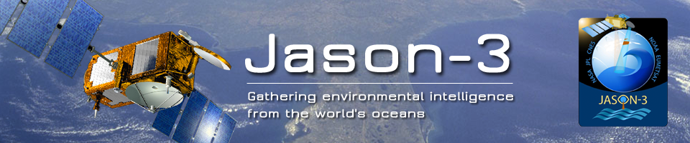
Launched January 17, 2016
February 12, 2016 - Began sending Operational Geophysical Data Records (OGDRs) to Ocean Prediction Center for evaluation.
Full public release of Jason-3 products commenced this summer.
Jason-2 transferred to interleaved orbit on October 13, 2016; transferred to separate orbit December 2017 to enhance coverage
Notes:
The Jason-3 satellite is continuing the long term climate data record on the primary ground track previously occupied by Topex, Jason-1, and Jason-2.
The new Jason-2 interleaved orbit is the same interleaved orbit used by Topex from 2002-2005 and Jason-1 from 2009-2012.

Slide 27
Space Weather Observations
Deep Space Climate Observatory (DSCOVR)
Launched 11 February 2015, at L1 on 8 June
NOAA took command on October 28, 2015
DSCOVR will work together with GOES-R to locate and measure size of solar flares; provide earlier warning detection for geomagnetic storms.
Notes:
DSCOVR and GOES-R will work together to help better predict and monitor geomagnetic storms.
GOES-R Solar Ultraviolet Imager (SUVI) telescope will monitor the sun in the extreme ultraviolet wavelength range
GOES-R X-Ray Spectrometer will locate and measure the size of solar flares.

Slide 28
Meteosat and Himawari

Slide 29
Specific Products Generated at NESDIS/ESPC from Himawari or Meteosat Data
NESDIS H-8 Product | Data Format(s)
Visible and IR Imagery | McIDAS Area
Tropical Cyclone Formation Probability | McIDAS Area
Wildfire Automated Biomass Burning Algorithm | McIDAS Area
Global Hydro-Estimator Satellite Rainfall Estimates | McIDAS Area, GRIB2, NetCDF4, PNG
Advanced Dvorak Technique | McIDAS Area
Volcano Multi-Spectral Imagery | McIDAS Area
Volcano Principle Component Imagery | McIDAS Area
Snow Cover, Ice Cover, Snow Depth, and Ice Concentration | McIDAS Area, GRIB2, ASCII
One-hourly NH Composite for AWIPS | AWIPS/GINI
Three-hourly Global Geostationary Mosaic | McIDAS Area, NetCDF4
Arctic Composite Imagery | McIDAS Area
Geostationary Satellite (Web) Server | JPEG, GIF
Notes:
Transfer of data from STAR to the ESPC PDA will begin sometime in mid 2017.

Slide 30
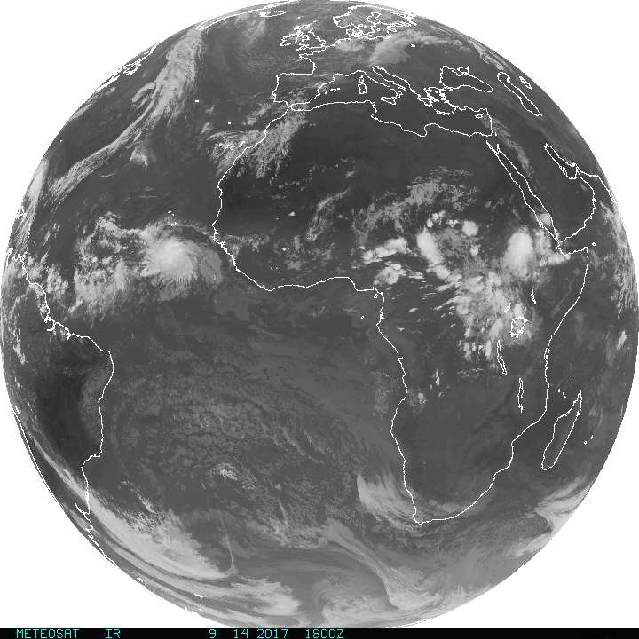
Current MSG Constellation
SATELLITE | LIFETIME | POSITION | SERVICES
Meteosat-11 | 15/07/2015 – TBC | 0° | 0º SEVIRI Image Data. Real-time Imagery.
Meteosat-9 | 22/12/2005–Fuel lifetime is until 2024 | 3.5° E | Rapid Scan Service gap filling spacecraft and back-up to prime Met-11 spacecraft
Meteosat-10 | 05/07/2012–TBC | 9.5° E | Rapid Scan Service Real-time Imagery.
Meteosat-8 | 28/08/2002 – Fuel lifetime is until 2020 | 41.5° E | Full IODC service

Slide 31
Current Issue/Risk for MSG
OSPO receives Meteosat data several ways
  DOMSAT has been our primary link, BUT…
    Routes through Wallops Island facility (remote from OSPO)
    Expensive
    Low capacity (cannot handle 2 meteosats simultaneously)
    Has EOL components that could fail at any time and not be replaced
    Circuit infrastructure being phased out NLT Dec 2018

Slide 32
Current Issue/Risk for MSG
OSPO receives Meteosat data several ways
  JEUNO is the newer network architecture
    Higher capacity (5 Gb/sec vs 1)
    Delivers to PDA at NSOF
    Able to deliver both met-11 and met-8
    Downside – extra processing steps (PDA initiates pull, security scans, PDA distribution) create 2-6 minute latencies, compared to DOMSAT

Slide 33
Current Issue/Risk for MSG
OSPO receives Meteosat data several ways
  Via NOAA/STAR
    Maintains ftp server receiving data from EUMETCAST broadcast service
    Used by OSPO as backup data source to DOMSAT (now) and PDA (future)
    Not operational – STAR support only 8x5

Slide 34
Himawari Update
NESDIS/STAR, College Park, is pulling full resolution Himawari (8/9) AHI level 1b data from the HimawariCloud server
  NOAA has one account for data access to the JMA server. On a best effort basis, full res H-8 AHI data are further distributed from STAR’s server to:
    NWS NCEP (includes AMVs and radiances in BUFR to EMC/JCSDA)
    DoD
    SSEC/CIMSS
    NSOF/ESPC
NSOF/ESPC is making H-8 imagery and derived level 2 products in McIDAS available from GEODIST7
    Sub-sampled H-8 data reflecting the H-8 specifications of the five channels having a spatial resolution of 4 km in the IR, and 1 km in the Visible are being used to produce imagery and derived level 2 products (product listing next slide)
Notes:
JMA transitioned to Himawari-8 as the primary operational satellite on July 7, 2015.
Parallel ops for MTSAT-2 and Himawari-8 was run until Dec 4, 2015 (then MTSAT-2 was turned off)
OSPO successfully mitigated the coverage gap for MTSAT-2 data users with sub-sampled H-8 data in McIDAS format.
Data access to H-8 imagery made available through the GEODIST system.

Slide 35
Additional Updates
Expected transfer of HimawariCloud data distribution from PDA did not happen
Still rely on STAR, only supported 8x5
Imagery backup (for SAB visual use) from SSEC/HCAST data
Products/external users have no backup source
  Attempt underway to extend HCAST distribution
Notes:
Transfer of data from STAR to the ESPC PDA will begin sometime in mid 2017.
Himawari-9 launched successfully on Nov 2, 2016.
The Himawari-8/9 AHI instrument is nearly identical to the ABI instrument on GOES-R — so similar imagery will be routinely available once GOES-R becomes operational in 2017.
After initial function test, it will be put on standby until it will succeed the observation from H-8 ~ 2022

Slide 36
McIDAS at ESPC

Slide 37

McIDAS Data Delivery Summary
GEODIST –
Geostationary satellite data is ingested on a SSEC Data Ingestor (SDI), converted to McIDAS format and placed on a server.
In addition, some foreign geostationary data, polar data, model data and derived products are converted into McIDAS.
This data is served via McIDAS ADDE:
  Data NSOF Server ADDE Name
  Derived Products GEODIST1e DPD
  GOES-E GEODIST2e GER PDA/NCDF Only
  GOES-W GEODIST3e GWR
  Polar GEODIST4e PLR
  Model data GEODIST5 MOD
  Global Mosaic 5 Sat. Comp. GEODIST6 MOS
  MSG/MIO GEODIST6e MSG / MIO
  Himawari GEODIST7e HIM
  Select requested data SATEPSANONE PUB (not operational)
  Surface/Ship Buoy/RAOBs FOS2 FOS (Family of Services)
Notes:
Here a summary of McIDAS Data Delivery at ESPC.
GEODIST is used to serve most data.
Satespone is a non operational server that also stores selected data that is publically accessible.
Family of Services provides surface, ship, and RAOB data.

Slide 38
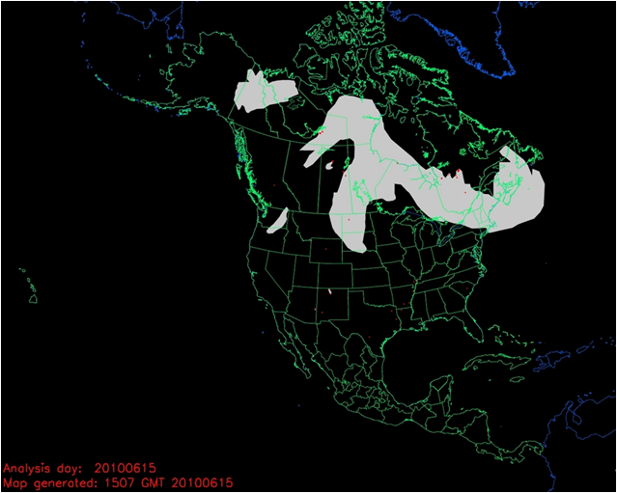
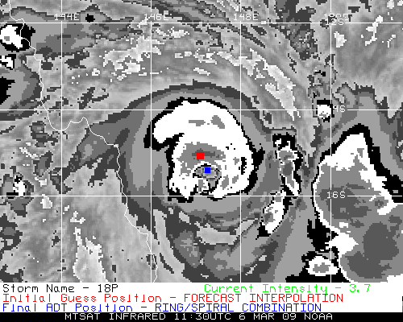
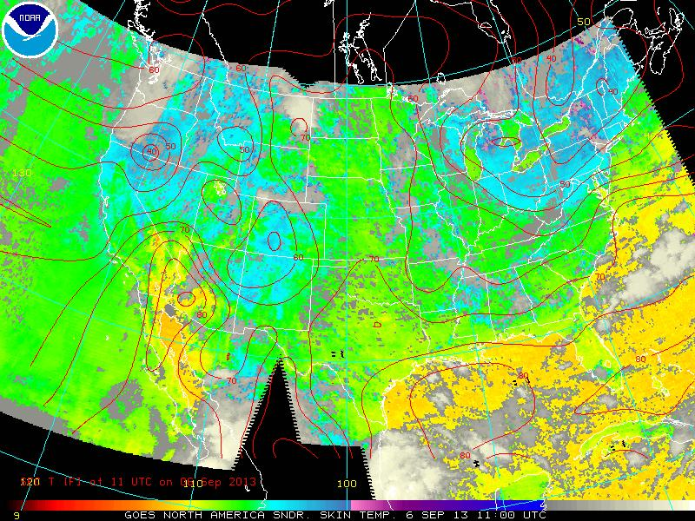
McIDAS & ESPC Applications
Over 50 applications in ESPC use McIDAS, McIDAS libraries, input & serve McIDAS AREA Files, MD point files, GRID (McIDAS GRID Format), and Text via ADDE
ADT, ABBA, CSBT, HMS, others…
Notes:
ESPC has over 50 applications that use some form of McIDAS.

Slide 39
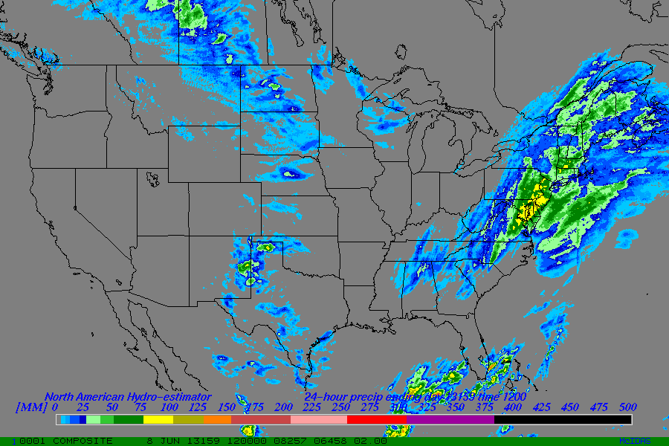
McIDAS Systems at ESPC
Over 20 SDIs at NSOF and Wallops OBF
  Several are dedicated...
  GOES-West, -14, Remappers
  GOES Ingest and NOAAPORT Interface (GINI)
Over 20 Workstations in SAB
  -X for realtime analysis, product generation, and QA/QC
  RHEL 7 Linux on Intel x86_64
  Many “home grown” programs in Fortran, .PGM, BATCH
Advantage - The ADDE protocol allows for many users accessing single systems with one port (112)
Global Hydro-Estimator 1 Day Total
ESPC Product Generation/Distribution
  IBM P6 & P7 Series with Linux Partitions, GEO Boxes
  Many other Linux systems (gp*)
  GINI running on Linux
Notes:
Overall there are more than 20 SSEC Data Ingestors (SDIs) are located at NSOF and Wallops.
OPSO’s Satellite Analysis Branch uses McIDAS-X for real-time analysis and incorporates many “home grown” batch programs.

Slide 40
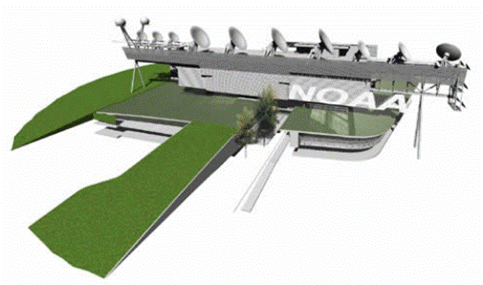
McIDAS at ESPC
ESPC has a standing, annual contract with SSEC for McIDAS Support and ongoing development
ESPC representatives on the McIDAS Advisory Committee (MAC)
  Jason Taylor and Clay Davenport
  Kathryn Mozer (Alternate)
Notes:
ESPC has a standing, annual contract with SSEC for McIDAS Support and ongoing development
ESPC representatives on the McIDAS Advisory Committee (MAC) are Jason Taylor and Bonnie Morgan with Kathryn Mozer (Alternate)

Slide 41
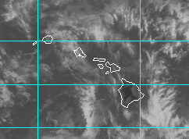
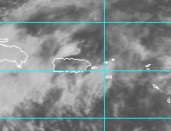
SAB Use of McIDAS
SAB is 24x7 operation of 5 disaster mitigation desks (Heavy Precipitation, Volcanic Ash, Fire/Smoke/Dust, Marine Pollution, Tropical Cyclones) All desk use Mc-X in some capacity, except Marine which is ArcGIS
McIDAS-X Usage: ~10 operational Linux systems with 24 GB RAM each and multiple monitor visualization setup
A persistent daemon (image loop refresh) “SPIDER” uses ADDE protocol to display ~100 imagery loops
Use Fnc keys to switch loops and pan entire globe through SPIDER loaded frames (e.g. NW Pacific IR, Shift+F1 - NW Pacific Vis, F2 - Central US IR) and still use command line (grudgingly)
Lots of batch commands and everything is scripted by business work flow
Uses McIDAS AREA files for web site as do NWS offices across country, namely NHC, AWC, NWS Western Region
Notes:
SAB uses McIDAS-X operational to monitor Heavy Precipitation, Volcanic Ash, Fire/Smoke/Dust, Marine Pollution, Tropical Cyclones.
ADDE protocol used to display ~100 imagery loops in support of operations.
McIDAS AREA files support OSPO website imagery displaying functionality.

Slide 42
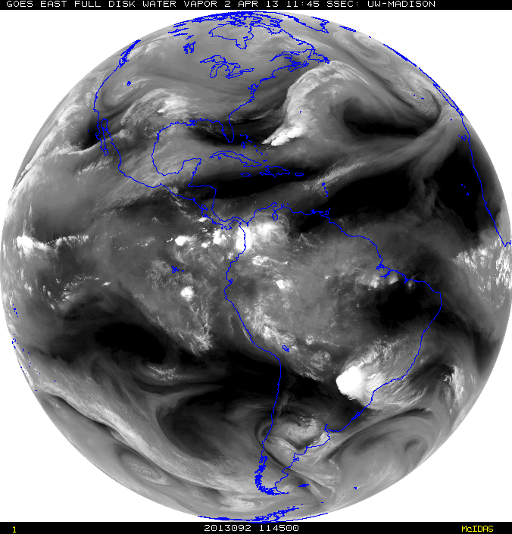
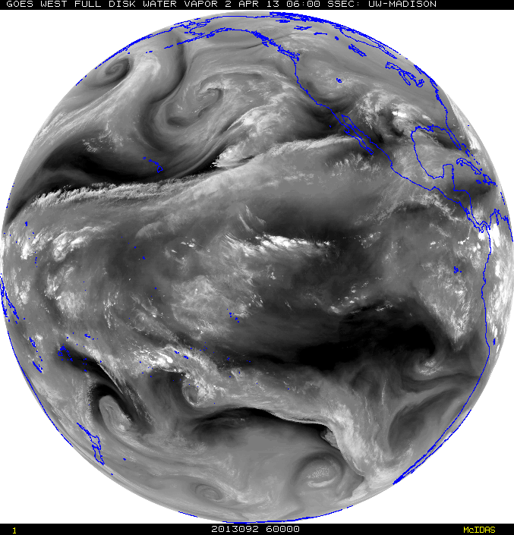
McIDAS Advantages in SAB
Institutional knowledge - SAB Analysts have great familiarity with McIDAS
Ability to have near-global coverage at multiple domain scales and resolution (~1800 frames) of quickly and routinely loaded (SPIDER) imagery at the tap of a button (TU Hotkeys) to perform interrogation, manipulation and value-added analysis when every second counts for time sensitive and rapidly evolving natural and man-made hazards, such as volcanic eruptions, flash flooding, fires, etc.
  This cannot be done presently with NAWIPS or HMS. In fact, depending on the area of concern up to 20 minutes is lost waiting for imagery to show up on these other systems vs McIDAS
  HOWEVER, since the NWS is the primary user of many SAB products (e.g. volcanic ash and heavy precipitation), there are benefits for SAB to conduct PG on NAWIPS like, quick overlays and seamless in-tool distribution. Fire uses HMS for analysis.
Notes:
There are several advantages for SAB in using McIDAS.
Some advantages are existing institutional knowledge, near global coverage ability, data manipulation functions, and faster image loading compared to other applications.
SAB analyst also like the advantage of using McIDAS vs other systems for its ability of toggle quickly between VIS and IR.

Slide 43
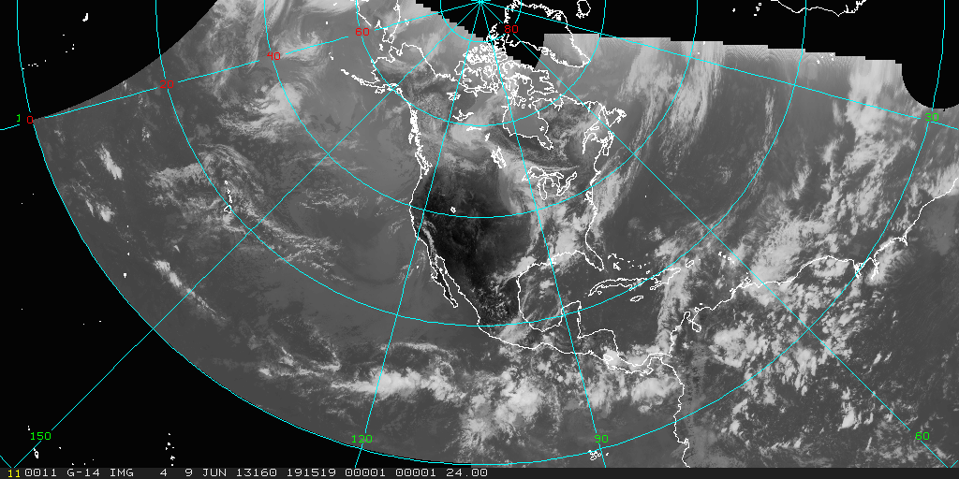
McIDAS Challenges in SAB
Maintaining efficient access to servers for operations (SPIDER is in-house stop-gap measure).
Additional customer requirements for advanced data formats (GIS, KMZ)… writing own local code for NPP VIIRS, Windsat, others to convert them to AREA files as there are no local servers
Learning Curve with commands
Color Tables – 8 bit (default) – challenge with GOES-R series
North Hemi Composite - IR
Notes:
There are a couple of challenges: efficient access to servers for operations (in-house methods fill gap), file conversion difficulty, learning curve for new analysts.

Slide 44
SPider
Satellite Product Information Distribution EnviRonment
Expands on concepts of Core Mcidas commands concepts
  ADDE, DATALOC, DSSERVE, PT/GRD/IMGLIST, PT/GRD/IMGDISP, PT/GRD/IMGCOPY, SKL, etc.
Consists of two programs: Spider Server (SPS) and Spider Client (SPC)
Benefits:
  -- Automatic loading without duplication of images
  -- Reduces task loading of server/workstations
    Numerous pings to server but fewer downloads
  -- Run from command line environment (typically SKL) on all platforms
    Leads to distribution system effectiveness
  -- Timely, based on user needed requirements (set to any refresh rate)
  -- Upgrades for Goes-R series have improved monitoring capability and broken the 10K file limit
Notes:
ESPC uses SPIDER (in-house stop-gap measure) to help maintain efficient access to ADDE servers.
Running Spider from SKL, allows for the updating of loops.
Spider can also be used to do routine copying of files, and in this context is usually run from cron.
Spider is used to copy GE and GW data to satepsanone.
Current problem with SPIDER loading imager fast enough when RSO in place.
Loops can get out of sync between VIS/IR and or images don’t get loaded.

Slide 45
Two Types of SPider
Spider Client (SPC)
Spider Server (SPS)
User
  Resides on Workstation
  Keeps Request File of user defined loop(s) specifications and polls it against the Server Availability File
  Pulls “area” files from server and loads it into predetermined frame
Host
  Resides on Server
  Integrated into “Area generator” that creates products on the server
  Keeps and up to date Availability List of these products
SPS
SPC
Notes:
There are two types of SPIDER:
(User) Client pull the AREA files from the server
(Host) Server keeps up to date list of available products
Remap Spider Loops
Predefined loops available on the Spider SERVER
The user request data in the Spider Client
McIDAS Frames update automatically

Slide 46
Other Ad hoc McIDAS Usage at ESPC
Heavy usage of the local GINI server in McIDAS format for validation checks (image previews) for conversion of GOES-15 data to NWS AWIPS
Great reliance on GINIs during GOES anomalies to confirm the output images quickly and efficiently (Generated mock AWIPS files to confirm changes to use GOES-14).
Deliver GOES-16 data to select legacy applications
  Spoofs GOES-13 AREA file appearance with IMGREMAP
  No or minimal changes required in legacy code to process
  Usable by older (pre-GOES-R) McIDAS versions
Imagery on OSPO web page generated by McIDAS-X client-side software.
OSPO web servers are currently being upgraded with 2018.1 McIDAS-X
Notes:
There is heavy ad hoc McIDAS usage for image format validation.
Also McIDADS is used to confirm anomalies/outages.
McIDAS-X client-side software is used to create all of the imagery on the OSPO web page.

Slide 47
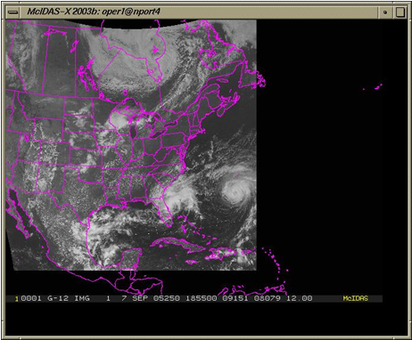
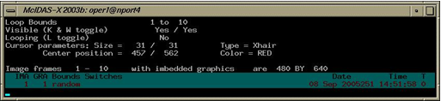

AWIPS Composite Using McIDAS
Notes:
OSPO uses its local GINI server for conversion of GOES-13 and GOES-15 data to NWS AWIPS.
Here is an example of an AWIPS Composite, using the McIDAS software package to display with the MCIDAS-X GINI Server.
The AWIPS Products are generated from the McIDAS AREA files, the MCIDAS is stripped off and an AWIPS header/trailer is placed to make it an AWIPS product.
At the bottom, screen capture of buttons allowing for the toggling between EAST and WEST operations.

Slide 48
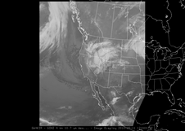
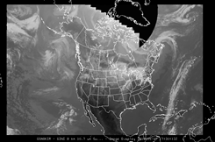






AWIPS WEST Products
Conus, Super National, North Hemisphere, Alaska Regional,
Alaska National, Hawaii Regional, Hawaii National, Conus Sounder
OSPO uses its local GINI server to convert GOES-15 data to NWS AWIPS.
The AWIPS Products are generated from McIDAS AREA files; MCIDAS headers are exchanged with AWIPS header/trailers to make it an AWIPS product.
Notes:
Pacific, Hawaii, Mexico Sounders are missing

Slide 49

SO2 Plume /OMI (Aqua)
Notes:
OMI data from Aqua/Modis processed in McIDAS

Slide 50

Global HydroEstimator

Slide 51

Arctic Composite Imagery

Slide 52

E-TRaP

Slide 53

Fire Products

Slide 54


SAB Use of McIDAS for GOES-16/17
Dedicated servers to ingest GOES-R series data – hold seven days
Redundant data feeds from GRB antenna (NCEP, College Park, via LDM) and by PDA (local curl scripts)
Soft links between old AREAnnnn names and netcdf files allow Spider to continue its distribution role
Numeric limit extended to 10K per directory, from 10K total
Setting up to have most RGB components pre-generated
Notes:
What does the future hold for McIDAS use at ESPC and SAB?
Will McIDAS-X support really end in 2020?
Will need to plan to replace functionality that it provides in operations.
NAWIPS, AWIPS2, McIDAS-X, & ENVI/IDL are currently used in operations.
Increased use of AWIPS2 being explored.
Spider will use netCDF files to display routine GOES-R imagery.
Operations will continue to need (HDF, geoTIFF, netCDF) file formats.
McIDAS-V could be used for intense image interrogation, manipulation and value-added analysis.

Slide 55
Data Distribution Update:
Near real-time data access
Product Distribution & Access (PDA)

Slide 56

Data Access Services
Current Access Services (in addition to Direct Broadcast)
  Data Distribution Service (DDS) – (s)FTP push/pull from secure accounts – SERVICE ENDING IN JUNE*
  Product Distribution and Access (PDA) – Operational*
  NWS Telecommunications Gateway
  GINI (GOES Ingest and NOAAPORT Interface) / NOAAPORT for Advanced Weather Interactive Processing System (AWIPS) display
  GEODIST – GOES, POES, and Derived Products; McIDAS *
  Shared Processing DAPE Gateway – for military partners *
  MODIS server – subset of products made by NASA *
  Websites - http://www.ospo.noaa.gov/
  * Require Data Access Request (Government)
Archival
  NCEI archive data products using CLASS
Notes:
Current data assess services for customers include: DDS, NWS Telecommunications Gateway, GINI for AWIPS, GEODIST, DAPE, MODSI, Websites, and Achieve.
Customer Use of Servers…
GINI: NOAAPort/AWIPS, NWS, Unidata
GEODIST: NWS/NCEP, DOD, STAR, SAB, Universities, Private Industry
DDS: NWS/NCEP/EMC, ECMWF, UKMET, STAR, DOD

Slide 57
ESPC Notifications, Status, and Contacts
24/7 Help Desk | ESPCOperations@noaa.gov
ESPC Messages | http://www.ssd.noaa.gov/PS/SATS/messages.html
WMO GTS Bulletins | Urgent: http://www.weather.gov/view/validProds.php?prod=ADM&node=KNES Routine: http://www.weather.gov/view/validProds.php?prod=ADA&node=KNES
User Services | SPSD.UserServices@noaa.gov
Data Access | NESDIS.Data.Access@noaa.gov
Webmaster | SSDWebmaster@noaa.gov
Facebook | www.facebook.com/NOAANESDIS
Twitter | www.twitter.com/noaasatellites
Satellite Ops Status | http://noaasis.noaa.gov/NOAASIS/ml/status.html
Press releases | http://www.nesdis.noaa.gov/news_archives/
Web | www.ospo.noaa.gov
Notes:
Please reference the OSPO contact information listed for a variety of resources.

Slide 58
Thank you!
Questions?

