Slide 1
SSEC Satellite Data Services
RabbitMQ Messaging System
Rick Kohrs
Satellite Data Services
Space Science & Engineering Center
University of Wisconsin – Madison
2018 McIDAS Users’ Group Meeting
22-23 May 2018
Madison, WI

Slide 2
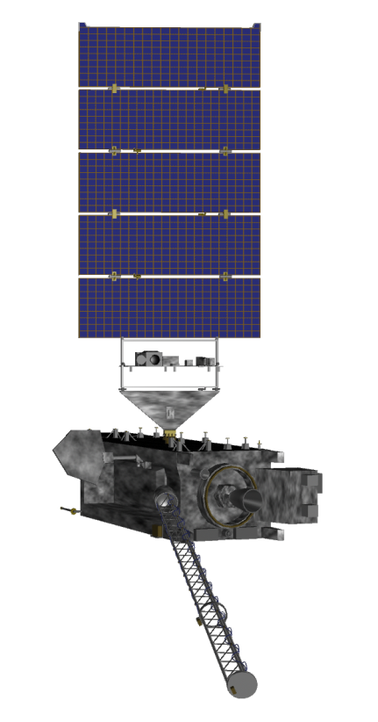
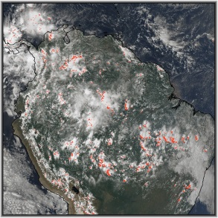
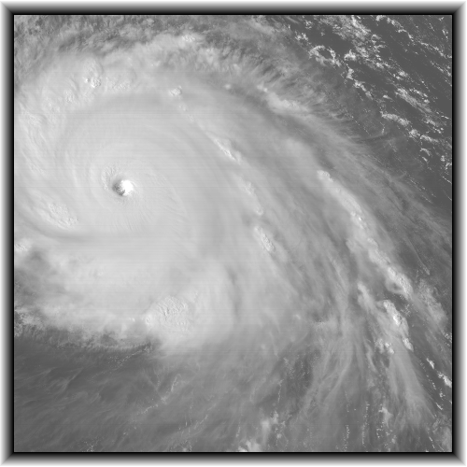
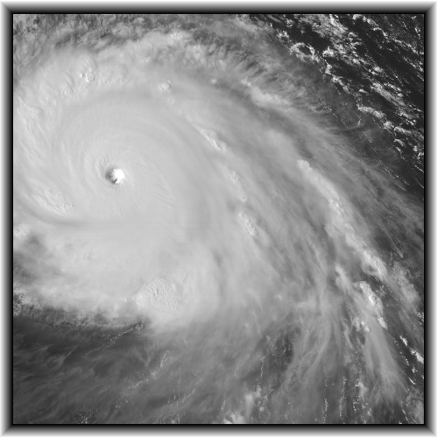
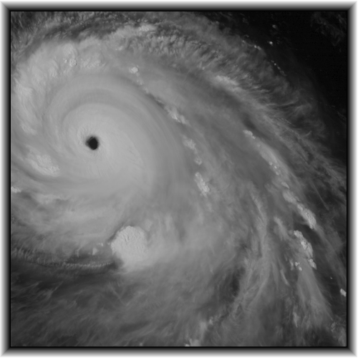
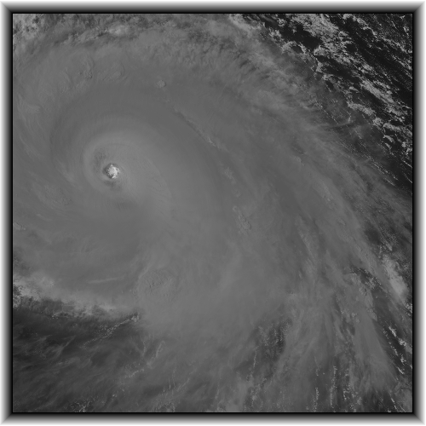
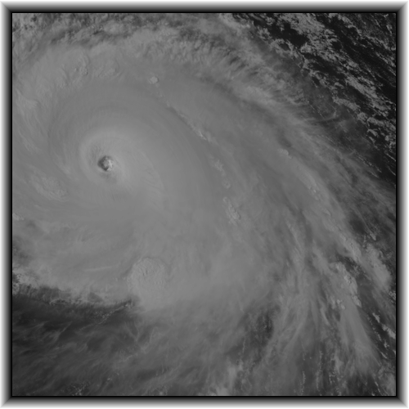
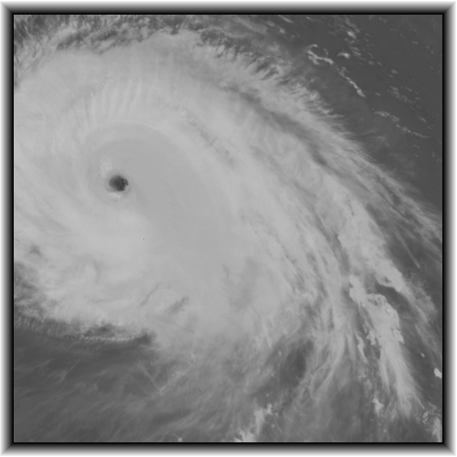
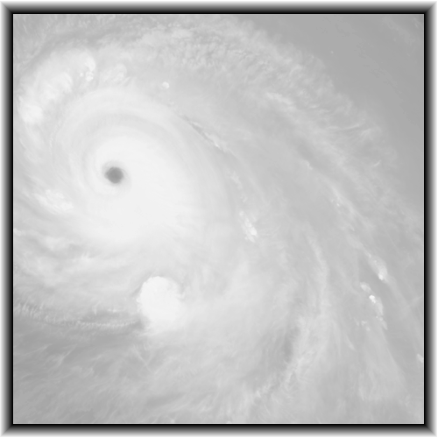
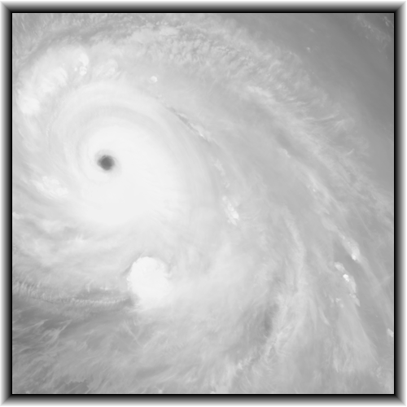
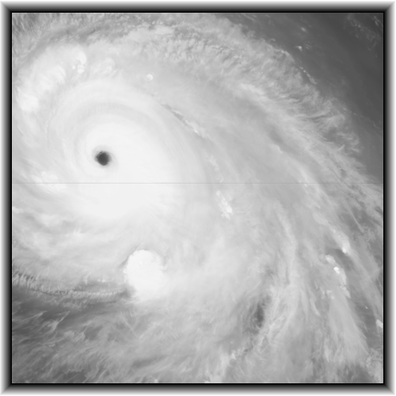
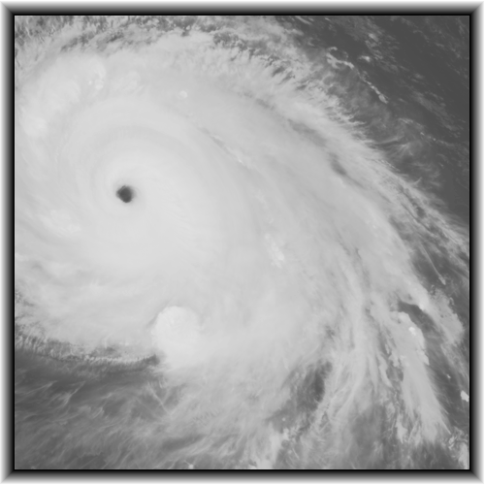
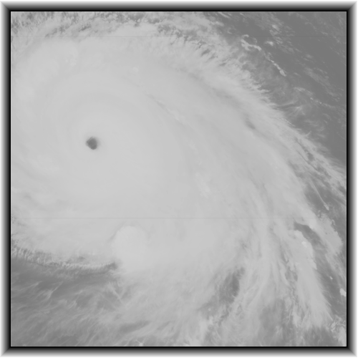
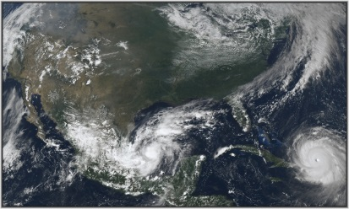
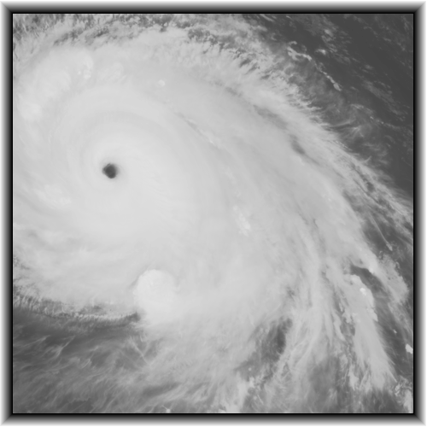
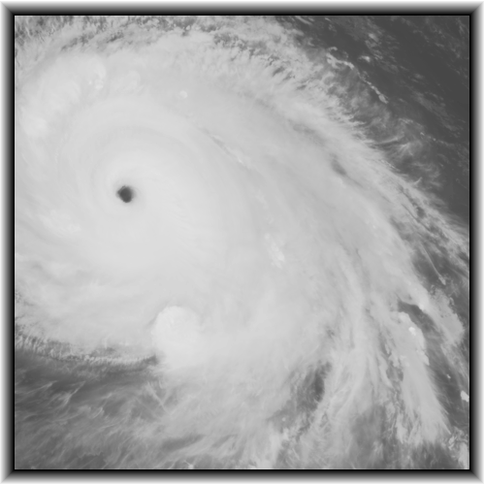
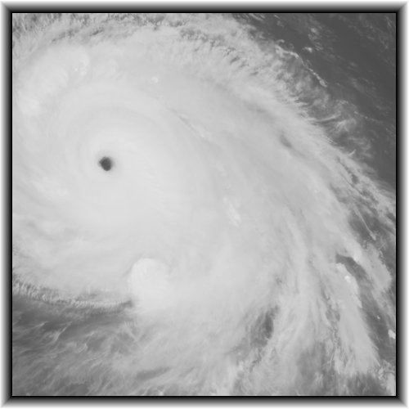
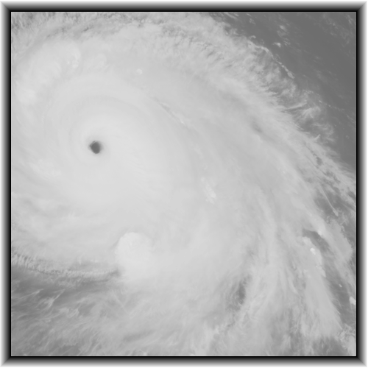
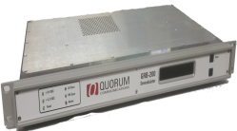
GOES-R Rebroadcast
(GRB)
NFS
ADDE
SFTP/LDM
Server
Ground
Station
Antenna Electronics
Ingest System

Slide 3
What is RabbitMQ
Benefits
Satellite Data Services Paradigm
Use Case

Slide 4
What is RabbitMQ
Publisher
Publisher
Satellite Ingestor
ADDE Server
Archive Server
Product Generator

Slide 5
What is RabbitMQ
Publisher (currently ~200 msgs/minute)
Broker Message Queue
Messaging
Queue
Publisher
Satellite Ingestor
ADDE Server
Archive Server
Product Generator

Slide 6
What is RabbitMQ
Publisher (currently ~200 msgs/minute)
Message Queue – 'The Broker'
Client/Consumer
Messaging
Queue
Publisher
Client
Satellite Ingestor
ADDE Server
Archive Server
Product Generator

Slide 7
What is RabbitMQ
Publisher (currently ~200 msgs/minute)
Message Queue
Client/Consumer
image start
band end
image complete
image complete
image start
Messaging
Queue
band end
Publisher
Client
Satellite Ingestor
ADDE Server
Archive Server
Product Generator

Slide 8
What is RabbitMQ
Publisher (currently ~200 msgs/minute)
Message Queue
Client/Consumer
image start
band end
image complete
Advanced Message Queueing Protocol (AMQP)
Pika – python implementation of AMQP
image complete
image start
Messaging
Queue
pika
AMQP
band end
pika
AMQP
Publisher
Client
Satellite Ingestor
ADDE Server
Archive Server
Product Generator

Slide 9
What is RabbitMQ
Publisher (currently ~200 msgs/minute)
Exchange / Topic
satellite
Topic Keys
sat_type.sat_family.sat_ID.sat_instrument.medium.server_type.format.classification.status
image complete
image start
Messaging
Queue
pika
AMQP
band end
pika
AMQP
Publisher
Client
Satellite Ingestor
ADDE Server
Archive Server
Product Generator

Slide 10
What is RabbitMQ
Publisher
Exchange / Topic
satellite
Topic Keys
sat_type.sat_family.sat_ID.sat_instrument.medium.server_type.format.classification.status
geo
leo
image complete
image start
Messaging
Queue
pika
AMQP
band end
pika
AMQP
Publisher
Client
Satellite Ingestor
ADDE Server
Archive Server
Product Generator

Slide 11
What is RabbitMQ
Publisher
Exchange / Topic
satellite
Topic Keys
sat_type.sat_family.sat_ID.sat_instrument.medium.server_type.format.classification.status
geo
leo
goes
himawari
image complete
image start
Messaging
Queue
pika
AMQP
band end
pika
AMQP
Publisher
Client
Satellite Ingestor
ADDE Server
Archive Server
Product Generator

Slide 12
What is RabbitMQ
Publisher
Exchange / Topic
satellite
Topic Keys
sat_type.sat_family.sat_ID.sat_instrument.medium.server_type.format.classification.status
geo
leo
goes
himawari
g16
g17
h8
image complete
image start
Messaging
Queue
pika
AMQP
band end
pika
AMQP
Publisher
Client
Satellite Ingestor
ADDE Server
Archive Server
Product Generator

Slide 13
What is RabbitMQ
Publisher
Exchange / Topic
satellite
Topic Keys
sat_type.sat_family.sat_ID.sat_instrument.medium.server_type.format.classification.status
geo
leo
goes
himawari
g16
g17
h8
abi
glm
exis
magnetometer
seiss
suvi
ahi
image complete
image start
Messaging
Queue
pika
AMQP
band end
pika
AMQP
Publisher
Client
Satellite Ingestor
ADDE Server
Archive Server
Product Generator

Slide 14
What is RabbitMQ
Publisher
Exchange / Topic
satellite
Topic Keys
sat_type.sat_family.sat_ID.sat_instrument.medium.server_type.format.classification.status
geo
leo
goes
himawari
g16
g17
h8
abi
glm
exis
magnetometer
seiss
suvi
ahi
adde
file
image complete
image start
Messaging
Queue
pika
AMQP
band end
pika
AMQP
Publisher
Client
Satellite Ingestor
ADDE Server
Archive Server
Product Generator

Slide 15
What is RabbitMQ
Publisher
Exchange / Topic
satellite
Topic Keys
sat_type.sat_family.sat_ID.sat_instrument.medium.server_type.format.classification.status
geo
leo
goes
himawari
g16
g17
h8
abi
glm
exis
magnetometer
seiss
suvi
ahi
adde
file
sdi
adde
image complete
image start
Messaging
Queue
pika
AMQP
band end
pika
AMQP
Publisher
Client
Satellite Ingestor
ADDE Server
Archive Server
Product Generator

Slide 16
What is RabbitMQ
Publisher
Exchange / Topic
satellite
Topic Keys
sat_type.sat_family.sat_ID.sat_instrument.medium.server_type.format.classification.status
geo
leo
goes
himawari
g16
g17
h8
abi
glm
exis
magnetometer
seiss
suvi
ahi
adde
file
sdi
adde
ncdf
hsf
image complete
image start
Messaging
Queue
pika
AMQP
band end
pika
AMQP
Publisher
Client
Satellite Ingestor
ADDE Server
Archive Server
Product Generator

Slide 17
What is RabbitMQ
Publisher
Exchange / Topic
satellite
Topic Keys
sat_type.sat_family.sat_ID.sat_instrument.medium.server_type.format.classification.status
geo
leo
goes
himawari
g16
g17
h8
abi
glm
exis
magnetometer
seiss
suvi
ahi
adde
file
sdi
adde
ncdf
hsf
band
image
product
granule
image complete
image start
Messaging
Queue
pika
AMQP
band end
pika
AMQP
Publisher
Client
Satellite Ingestor
ADDE Server
Archive Server
Product Generator

Slide 18
What is RabbitMQ
Publisher
Exchange / Topic
satellite
Topic Keys
sat_type.sat_family.sat_ID.sat_instrument.medium.server_type.format.classification.status
geo
leo
goes
himawari
g16
g17
h8
abi
glm
exis
magnetometer
seiss
suvi
ahi
adde
file
sdi
adde
ncdf
hsf
band
image
product
granule
start
end
complete
image complete
image start
Messaging
Queue
pika
AMQP
band end
pika
AMQP
Publisher
Client
Satellite Ingestor
ADDE Server
Archive Server
Product Generator

Slide 19
What is RabbitMQ
Publisher
Exchange / Topic
satellite
Topic Keys
Body/Payload
satellite_family: GOES satellite_location: GOES-East coverage: Mesoscale-1
satellite_ID: G16 start_time: 2018-04-30 19:52:29.2 mode: 3
instrument: ABI end_time: 2018-04-30 19:52:35.0 signal_type: grb
medium: adde create_time: 2018-04-30 19:52:39.3 data_type: RadM1
server_type: sdi server_ip: satbuf1.ssec.wisc.edu title: ABI L1b Radiances
message_type: band adde_dataset: EASTA/M1
status: end band: 3
path: /data/goes/grb/goes16/2018/2018_04_30_120/abi/L1b/RadM1/ OR_ABI-L1b-RadM1-M3C03_G16_s20181201952292_e20181201952350_c20181201952393.nc
image complete
image start
Messaging
Queue
pika
AMQP
band end
pika
AMQP
Publisher
Client
Satellite Ingestor
ADDE Server
Archive Server
Product Generator

Slide 20
What is RabbitMQ
Client
Exchange / Topic
Subscribe to Keys
amqpfind http://www.ssec.wisc.edu/datacenter/amqpfind/
sat_type.sat_family.sat_ID.sat_instrument.medium.server_type.format.classification.status
geo.goes.g16.abi.adde.sdi.ncdf.band.end
image complete
image start
Messaging
Queue
pika
AMQP
band end
pika
AMQP
Publisher
Client
Satellite Ingestor
ADDE Server
Archive Server
Product Generator

Slide 21
RabbitMQ Benefits
Avoid multiple data request
cron
Immediate Access to data
adde
https
No need for e-mail messages
Client
00
18
06
12
new data available
wait
Server adde
no

Slide 22
RabbitMQ Benefits
Avoid multiple data request
cron
Immediate Access to data
adde
https
No need for e-mail messages
Client
00
18
06
12
new data available
wait
Server adde
no

Slide 23
RabbitMQ Benefits
Avoid multiple data request
cron
Immediate Access to data
adde
https
No need for e-mail messages
Client
00
process
data
18
06
12
new data available
wait
Server adde
no
yes

Slide 24
RabbitMQ Benefits
Avoid multiple data request
cron
Immediate Access to data
adde
https
No need for e-mail messages
Client
process
data
00
18
06
12
you've got data
Broker
Server adde

Slide 25
Satellite Data Service
GOES-16 Data Flow
GRB RF
demod
CADU
fanout 1

Slide 26
Satellite Data Services
GOES-16 Data Flow
GRB RF
demod
CADU
fanout 1
cspp-geo
SDI
rsync
SATBUF1

Slide 27
Satellite Data Services
GOES-16 Data Flow
GRB RF
demod
CADU
fanout 1
cspp-geo
publish
messages
SDI
rsync
rsync
SATBUF1
mq1
RabbitMQ server
publish
messages
arcwrite1
Lustre
arcdata

Slide 28
Satellite Data Services
GOES-16 Data Flow
GRB RF
demod
CADU
fanout 1
cspp-geo
publish
messages
SDI
rsync
rsync
SATBUF1
mq1
RabbitMQ server
publish
messages
amqpfind
In-House
Users
ADDE
arcwrite1
nfs
Outside
Users
https/ADDE/nfs
Lustre
arcdata
https/ADDE

Slide 29
Satellite Data Services
GOES-16 Data Flow
GRB RF
demod
demod
CADU
Amazon
CADU
fanout 1
fanout 2
rsync/nfs
rsync/nfs
GRBDELTA
GRBGAMMA
csppalpha
GEOCAT/AIT
Level 2+ Products
cspp-geo
dbINGE
cspp-geo
dbINGE
csppbeta
GEOCAT/AIT
Level 2+ Products
score
score
publish
messages
SDI
sdigrbbeta
rsync
Lustre
AWG
rsync
SDI
sdigrbbeta
publish
messages
rsync
rsync
rsync
rsync
SATBUF1
nfs
SATBUF2
mq1
RabbitMQ server
publish
messages
Lustre
Users
publish
messages
mq2
RabbitMQ server
amqpfind
In-House
Users
ADDE
arcwrite1
arcwrite2
In-House
Users
amqpfind
nfs
ADDE
nfs
Outside
Users
https/ADDE/nfs
Lustre
arcdata
Outside
Users
https/ADDE
https/ADDE

Slide 30
Satellite Data Services
GOES-16 Data Flow
GRB RF
demod
demod
CADU
Amazon
CADU
rsync (push)
hwcloudtop2
rsync (push)
hwcloudtop2
NOAA Star
NOAA Star
UNIDATA
fanout 1
fanout 2
NOAA PDA
NOAA PDA
rsync/nfs
rsync/nfs
GRBDELTA
GRBGAMMA
csppalpha
GEOCAT/AIT
Level 2+ Products
cspp-geo
dbINGE
cspp-geo
dbINGE
csppbeta
GEOCAT/AIT
Level 2+ Products
score
score
publish
messages
SDI
sdigrbbeta
rsync
Lustre
AWG
SDI
sdigrbbeta
publish
messages
publish
messages
rsync
rsync
rsync
rsync
rsync
SATBUF1
nfs
SATBUF2
mq1
RabbitMQ server
publish
messages
Lustre
Users
publish
messages
mq2
RabbitMQ server
amqpfind
In-House
Users
ADDE
arcwrite1
arcwrite2
In-House
Users
amqpfind
nfs
ADDE
nfs
Outside
Users
https/ADDE/nfs
Lustre
arcdata
Outside
Users
https/ADDE
https/ADDE

Slide 31
Satellite Data Services
GOES-16 Data Flow
GRB RF
demod
demod
CADU
Amazon
CADU
rsync (push)
hwcloudtop2
rsync (push)
hwcloudtop2
NOAA Star
NOAA Star
UNIDATA
fanout 1
fanout 2
NOAA PDA
NOAA PDA
rsync/nfs
rsync/nfs
GRBDELTA
GRBGAMMA
csppalpha
GEOCAT/AIT
Level 2+ Products
cspp-geo
dbINGE
cspp-geo
dbINGE
csppbeta
GEOCAT/AIT
Level 2+ Products
score
score
publish
messages
SDI
sdigrbbeta
rsync
Lustre
AWG
SDI
sdigrbbeta
publish
messages
publish
messages
rsync
rsync
rsync
rsync
rsync
SATBUF1
nfs
SATBUF2
mq1
RabbitMQ server
publish
messages
Lustre
Users
publish
messages
mq2
RabbitMQ server
amqpfind
In-House
Users
ADDE
arcwrite1
arcwrite2
In-House
Users
amqpfind
nfs
ADDE
nfs
Outside
Users
https/ADDE/nfs
Lustre
arcdata
Outside
Users
https/ADDE
https/ADDE

Slide 32
Single Server
./amqpfind -H mq2.ssec.wisc.edu -u sdsuser -p sdsmq \
-X satellite \
-C 'geo.goes.*.*.*.*.*.*.*' \
-j '{start_time} {coverage} {instrument} {message_type} {status}'
Multi-Server
./amqpfind -H mq2.ssec.wisc.edu -u sdsuser -p sdsmq \
-H mq1.ssec.wisc.edu -u sdsuser -p sdsmq \
-X satellite \
-w 60.0 \
-C 'geo.goes.*.*.*.*.*.*.*' \
-j '{start_time} {coverage} {instrument} {message_type} {status}'

Slide 33
Wrapper Script
$HOME/amqpfind/amqpfind -X satellite -C 'geo.goes.*.*.*.*.*.image.complete' \
-H mq1.ssec.wisc.edu -p sdsmq -u sdsuser \
-j '{start_time} {server_ip} {adde_dataset}'|\
grep --line-buffered -i CONUS| \
xargs -P1 –n4 python $HOME/bin/mc-example.py

Slide 34
mc-example.py
#! /usr/bin/python
def main(cmdArgs):
import mcidasx
import datetime
imageDate = cmdArgs[1]
imageTime = cmdArgs[2]
server = cmdArgs[3]
addeDataset = cmdArgs[4]
group = addeDataset.split('/')[0]
mcenv = mcidasx.mcenv(f=['3@750x1250'], i=228, g=8)
mccmdout = mcenv.dataloc('ADD ' + group + ' ' + server)
dateTimeStr = imageDate + ' ' + imageTime
dateTimeObj = datetime.datetime.strptime(dateTimeStr,'%Y-%m-%d %H:%M:%S.%f')
dateTimeKeyword = dateTimeObj.strftime(' DAY=%Y%j TIME=%H:%M:%S ')
mcCmd = ' USER 1234'
mcCmdOut = mcenv.logon(mcCmd)
mcCmd = addeDataset + dateTimeKeyword + ' BAND=13'
mcCmdOut = mcenv.imgdisp(mcCmd)
mcCmd = ' X current-G16-band13.gif'
mcCmdOut = mcenv.frmsave(mcCmd)
if __name__ == '__main__':
import sys
main(sys.argv)

Slide 35
Thank You!
Questions?

