Slide 1
Use of McIDAS-X at NASA SPoRT
Kevin McGrath Jacobs Technology Short-term Prediction Research and Transition Center (SPoRT) Marshall Space Flight Center Huntsville, Alabama McIDAS Users’ Group Meeting May 22, 2018

Slide 2
SPoRT Mission
Transition unique NASA and NOAA observations and research capabilities to the operational weather community to improve short-term weather forecasts on a regional and local scale
Prepares end users and mission scientists for next generation satellite missions and capabilities through an interactive R2O/O2R paradigm
Primary end users: NWS WFOs and National Centers

Slide 3
Typical Uses of McIDAS-X
ABI, AHI, MODIS, VIIRS, AVHRR, SEVIRI
Communicate with remote ADDE servers
Many NRT datasets that SPoRT disseminates to end users are delivered in Area format from university and government partners (NASA, NESDIS, UAH, CIRA)
Custom FORTRAN/C programs for manipulating data and outputting to Area
Application Support:
Most processing is scripted with mcenv and commonly use IMGREMAP, IMGCOPY, IMGOPER, and FRMSAVE
AWIPS II (netCDF3)
N-AWIPS (Area)
GIS (geoTIFFs)
Web Graphics

Slide 4
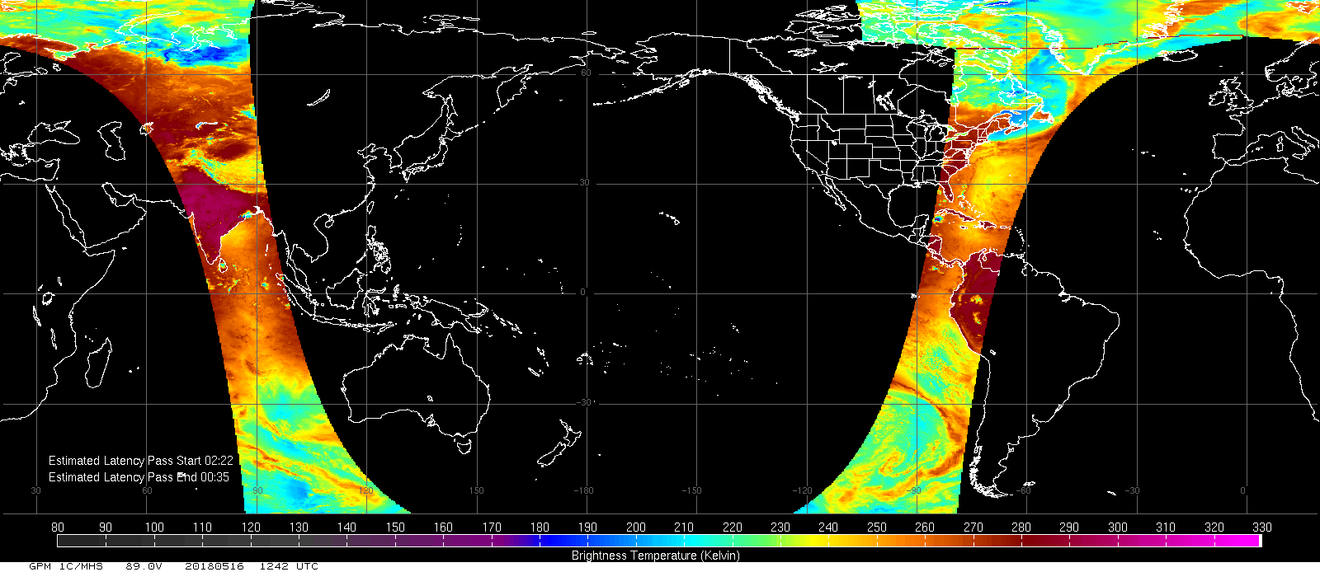
Custom Servers
Utilize custom *dir.c, *get.c, and *put.c servers to read data in non-standard formats, provide calibration, and generate Area files
Example datasets:
Global Precipitation Measurement Passive Microwave
AIRS, CrIS/ATMS, and IASI
MODIS
NESDIS Snowfall Rate
OMPS
VIIRS with bowtie correction

Slide 5
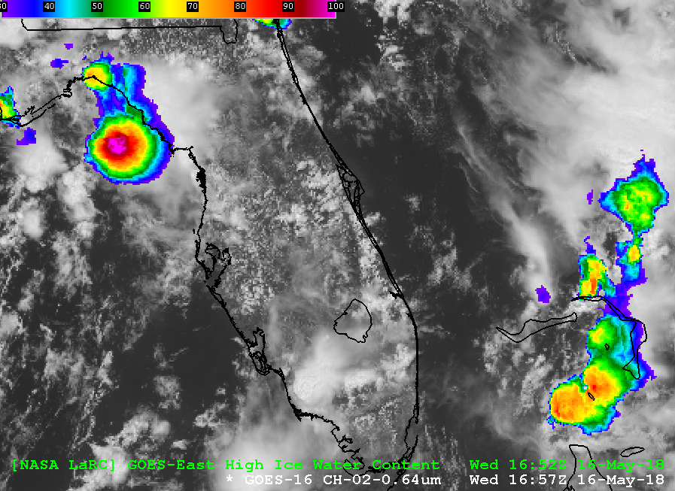
AWIPS II Support
The AWIPS II regionalSat plugin ingests 8-bit sat imagery in netCDF3
The awipaput -X server (XRD) generates nearly regionalSat-compatible netCDF3
Generated by IMGCOPY with K=AWIP in RESOLV.SRV
SPoRT has modified the 2015 version of awipaput:
Removed lat/lon values (not needed by regionalSat)
Negate centralLon values
Modified projName strings
Use ncatted (part of NCO Toolset) to add/modify netCDF global attributes

Slide 6
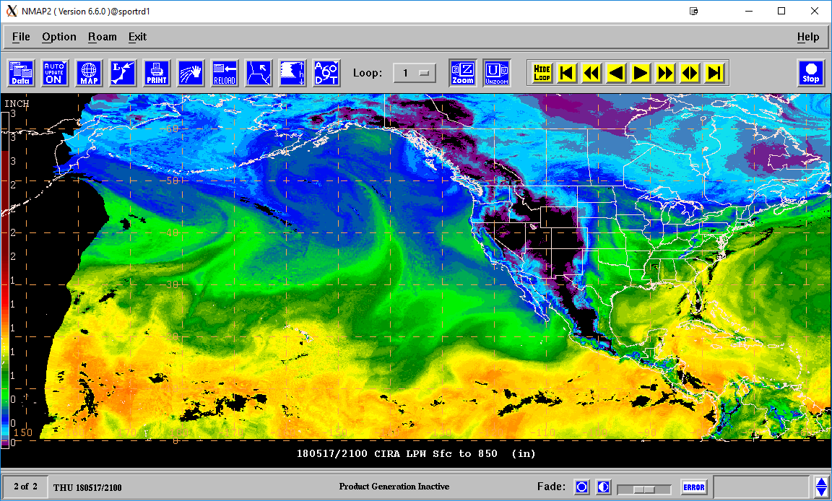
N-AWIPS Support
Still the primary decision support system used by NWS National Centers
Imagery is provided in Area format
Always use IMGREMAP due to corner point sensitivity
Only supports 96 colors
Quantitative data:
Sampling not supported by N-AWIPS
Embed calibration tables with the PRDUTIL command. Honored by Unidata version of Gempak/N-AWIPS, but not the NWS version.

Slide 7
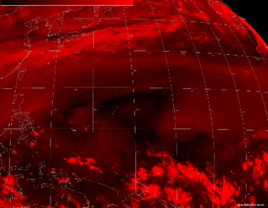
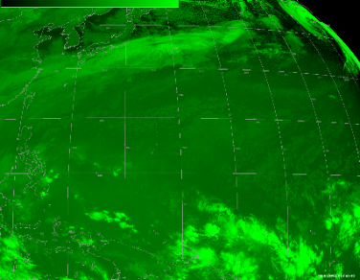
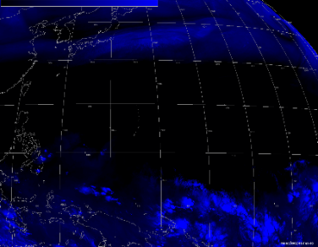
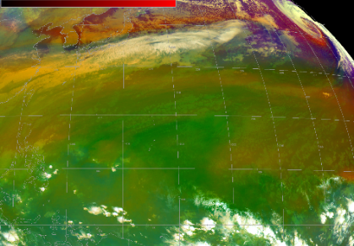
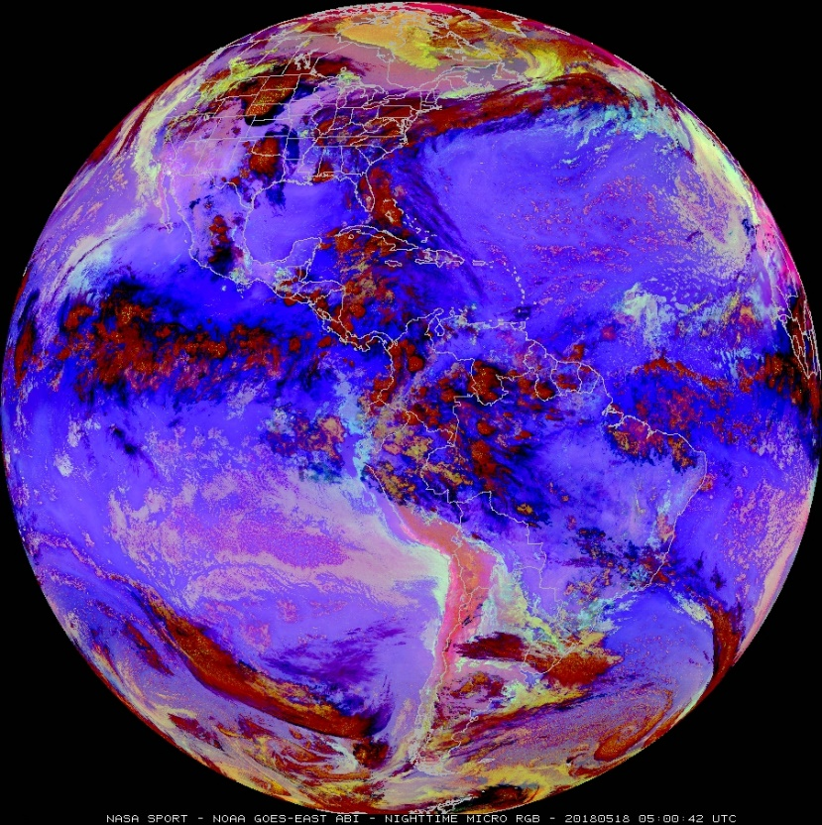
RGB Product Generation
RED
GREEN
BLUE
RGB Image
6.2 – 7.3 µm
9.6 – 10.3 µm
10.3 µm
Product-Specific C Code
IMGREMAP
Compress to 96 colors
Raw Data
IMGCOPY
Single Band Areas (2-byte)
Red-Green-Blue Areas
Distribution to National Centers (Area)

Slide 8
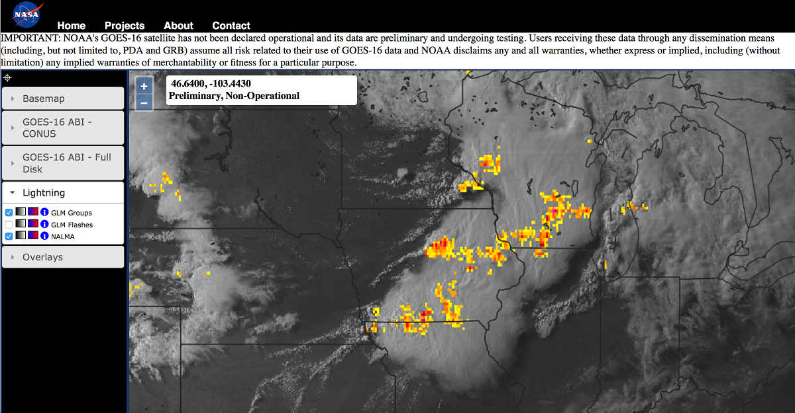
GeoTIFFs
IMGCOPY (K=GEOT) used to generate grayscale geoTIFFs
Convert merges R-G-B TIFFs into 24-bit TIFF
Gdalwarp converts to WGS84
Deliver via WMS and web viewer
Support:
EMAs
National Guard
IMGREMAP
IMGCOPY
Red Area
Red geoTIFF
imagemagick convert
Green Area
Green geoTIFF
24-bit geoTIFF
Blue Area
Blue geoTIFF
RGB GeoTIFF Product Flow
GLM 2-Minute Groups Overlaid on ABI 0.64µm in WMS Web Interface

Slide 9
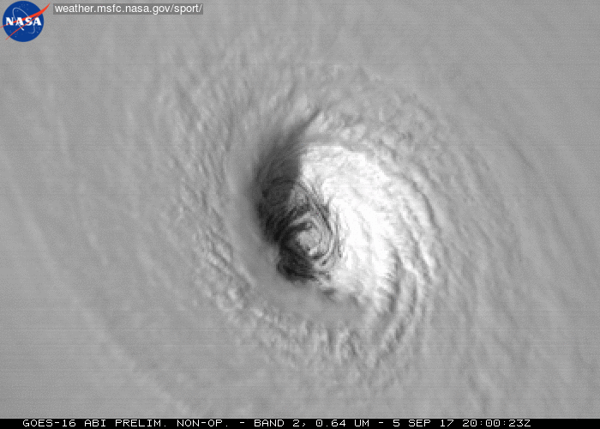
Social Media Animations
Developed scripts utilizing McIDAS-X to generate frames of single channel and RGB products
Generate animations with ffmpeg (MP4) and imagemagick (GIF)
Useful for those within SPoRT that lack McIDAS-X experience

Slide 10
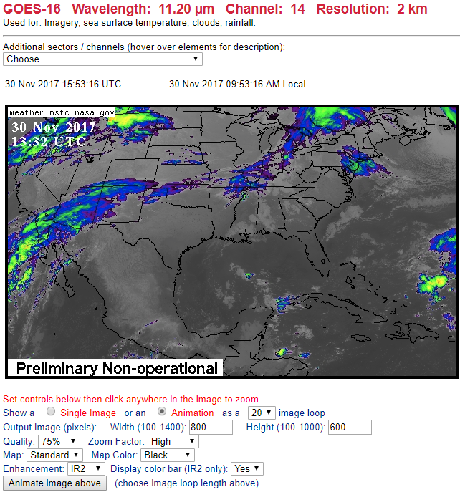
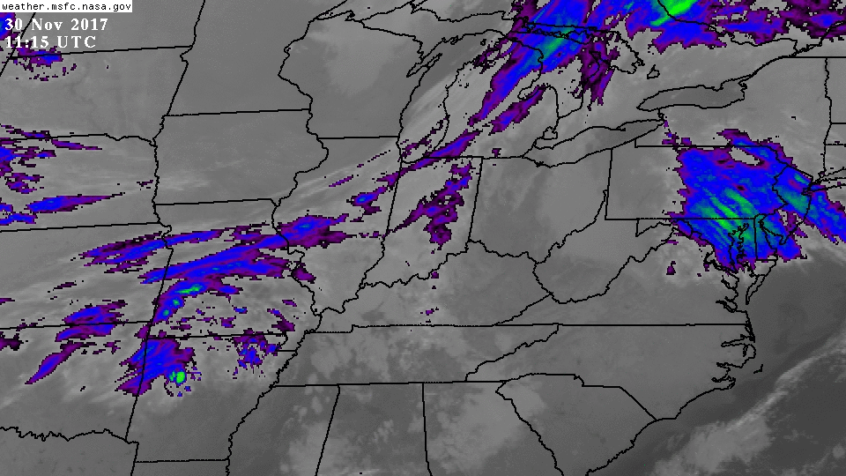
Interactive Online GOES Viewer
Developed in 1997; ~50M visits/month
Based upon Area files
Benefits: flexibility, speed, accessibility
Users define area of interest to display
Animations are very quick to load
Multiple options:
Scriptable with API
Color palettes
Map overlays
Quality
Resolution
Width/height
Static or animated
https://weather.msfc.nasa.gov/GOES/

Slide 11
Summary
McIDAS-X is still SPoRT’s tool-of-choice for reading and calibrating data from a wide range of sensors
Appreciate how easy it is to display and interrogate data
Utilize custom servers to accommodate non-standard datasets
Looking forward to trying new RGBDISP command
Wish item: Ability to embed enhancement tables into geoTIFFs

Slide 12
kevin.m.mcgrath@nasa.gov
@kevinmmcgrath
https://weather.msfc.nasa.gov/sport/
@NASA_SPoRT

